Slide 1
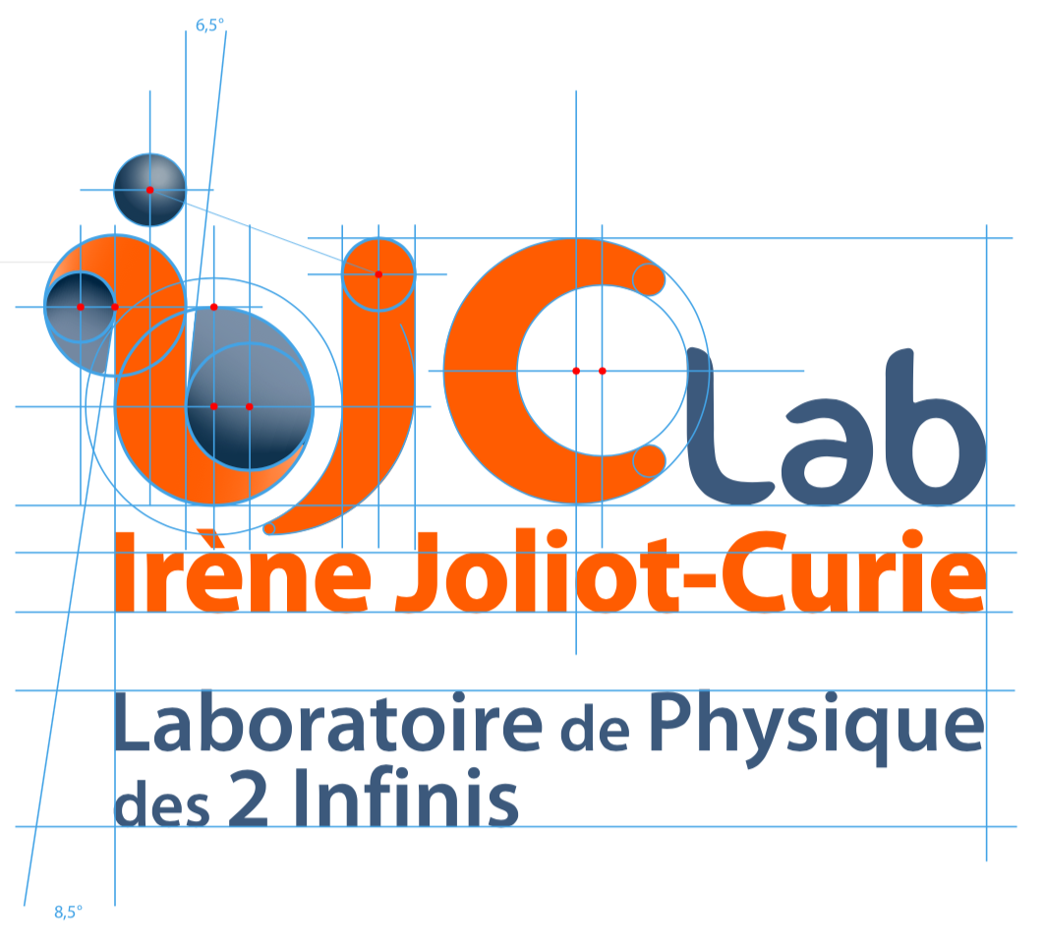

Journée Pole Théorie – 1st December 2021
Presentation of the Nuclear Theory team
The most important nuclear theory group in France
Permanent staff
Emeriti
Marcella Grasso (DR2)
Guillaume Hupin (CRCN)
Elias Khan (PRCE1)
Bira van Kolck (DR1)
Denis Lacroix (DR2 -> DR1)
Paolo Napolitani (CRCN)
Michael Urban (DR2)
Jaume Carbonell
Neil Rowley (emeritus)
Peter Schuck (emeritus)
Nguyen Van Giai (emeritus)

Slide 2
Who we are
Postdoc
12/21 Snapshot
Lorenzo Contessi, 09/21-09/23, IN2P3 [v. Kolck]
Yann Beaujeault-Taudiere, 01/21-11/23, P2IO [Lacroix, co-supervision LRR]
PhD students
Thomas Czuba, 09/19-09/22, UPSaclay [Lacroix]
Hung Viet Dinh, 10/19-10/22, PHENIICS + IJCLab [Napolitani]
Mingya Duan, 02/21-02/25, CSC grants [Urban]
Florian Mercier, 09/19-09/22, UPSaclay [Khan]
Edgar Andres Ruiz Guzman, 09/20-09/23, CNRS [Lacroix]
Jing Zhang, 11/21-10/25, CSC grants [Lacroix]
Osamah Yaghi, 12/21-11/24, [Hupin]
Geoffrey Zietek, 01/21-01/24, CEA [Grasso, co-supervision]
Viswanathan PL, 10/20-09/23, CEFIPRA [Urban, co-supervision IIT Madras]

Slide 3
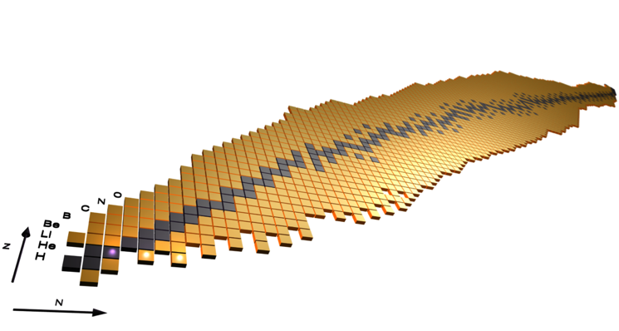
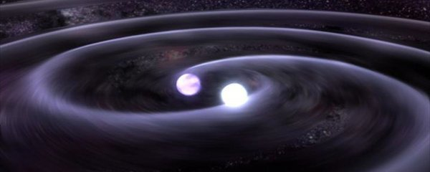
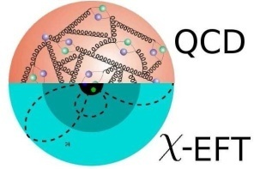
What we do?

Slide 4
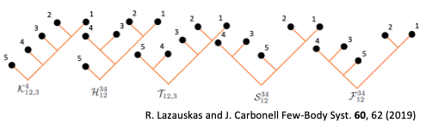
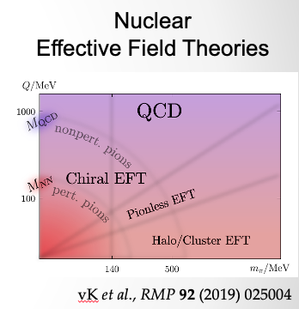
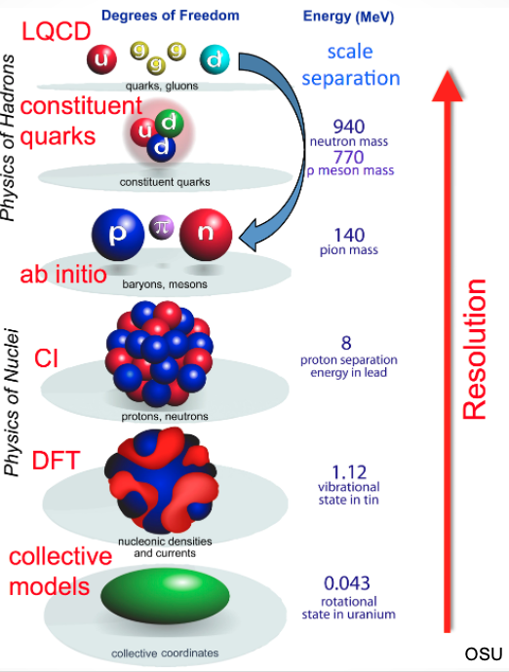
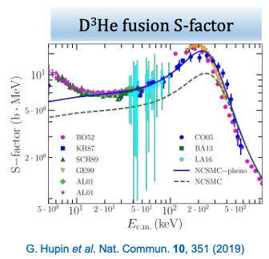
What we do?
Ab-initio methods
Few body sector
Nuclear interaction
Consistent theories for reactions

Slide 5
What we do?
Ab-initio methods
Some examples of current topics
Few body sector
Search for universal physics
(discrete Scale invariance, Efimov)
Nuclear interaction
Extension to antiprotonic probes
Consistent theories for reactions
beyond-the-Standard-Model
physics, 0ν2β decay
Impact of multi-body interactions
on nuclear structure and reactions
Description of the nuclear
resonances in light,
very neutron rich system

Slide 6
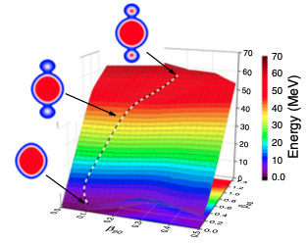
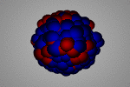
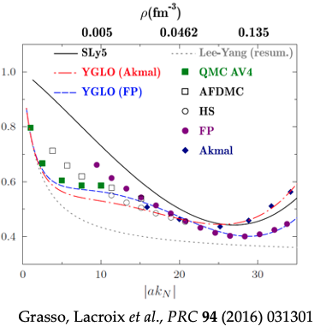
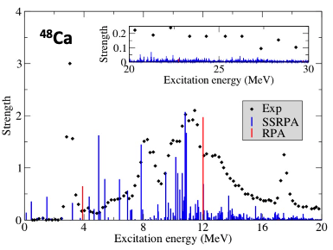
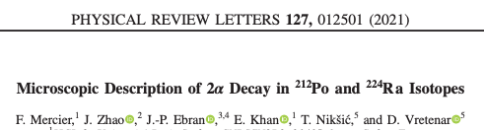
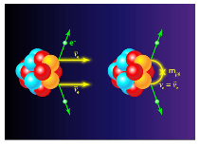
What we do?
Description of nuclear phenomena
a and Search of new physics
Development of innovative
Many-body approaches
New non-empirical
Density Functional Theory
Gambacurta, Grasso, Engel,
Phys. Rev. Lett. (2020)

Slide 7
What we do?
Some examples of current topics
Description of nuclear phenomena
a and Search of new physics
Brigding DFT with EFT (power
counting), ab-initio DFT
Development of innovative
Many-body approaches
New non-empirical
Density Functional Theory
Link with low density or unitary
gas
Description of quantum self-bound
Droplets, continuum effect, …
Search of new radioactivity
Beyond mean-field approaches:
Formal and practical aspects
Gambacurta, Grasso, Engel,
Phys. Rev. Lett. (2020)

Slide 8
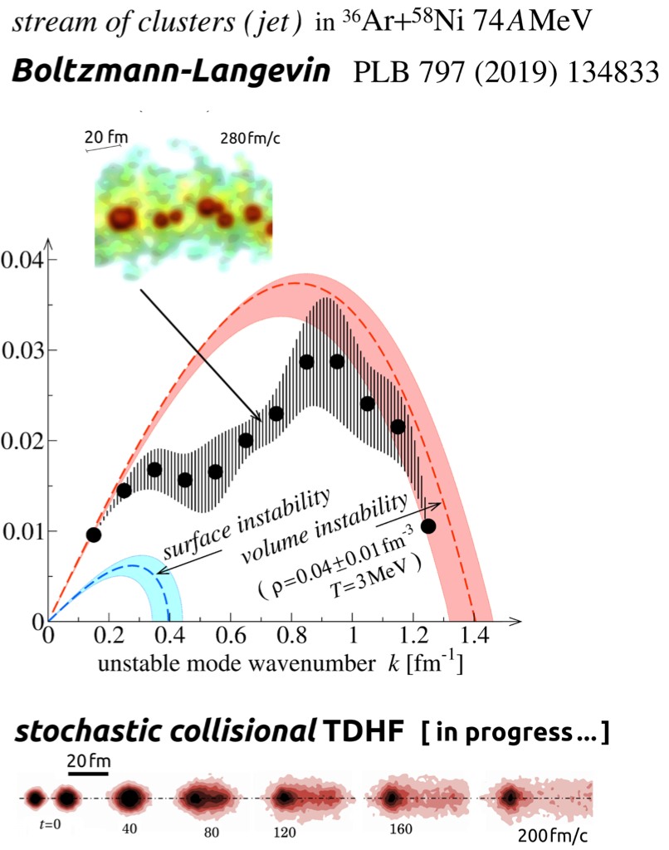
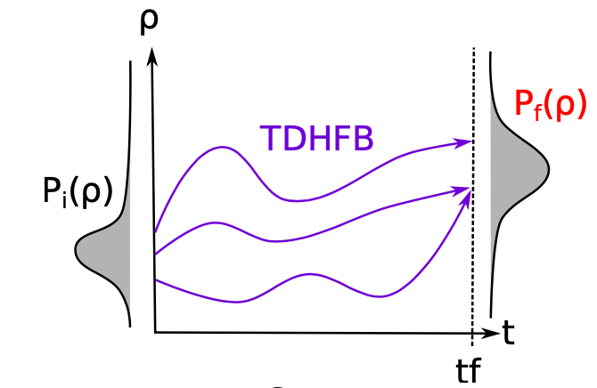
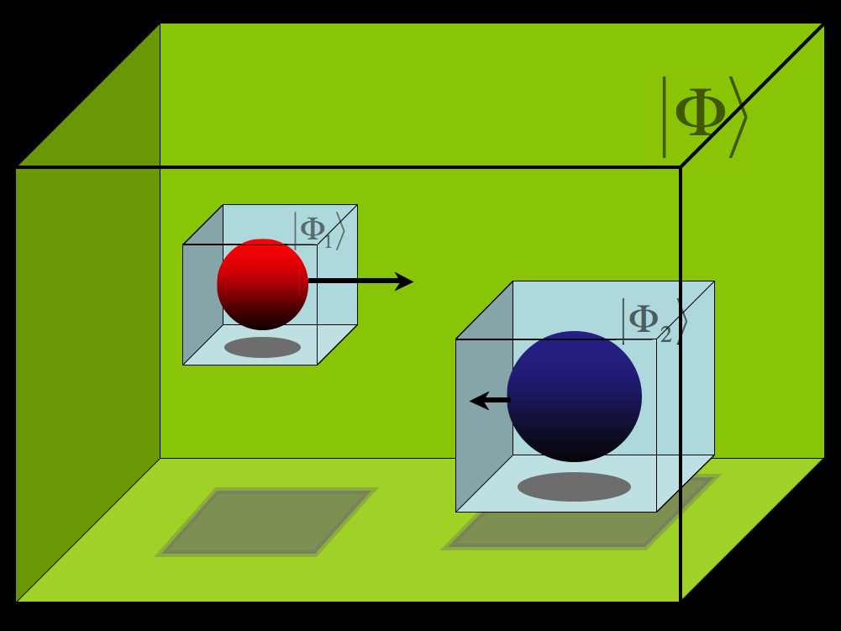
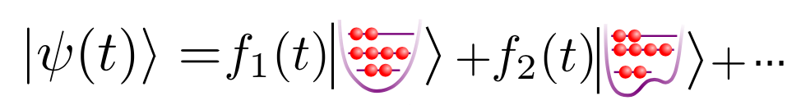
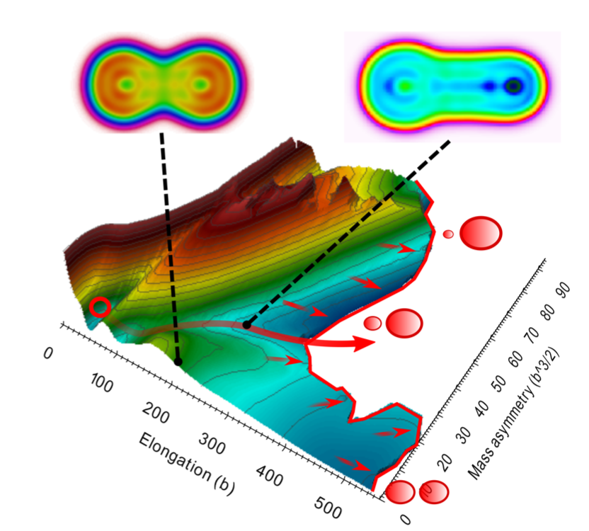
What we do?
Dynamical evolution of Complex systems
Beyond mean-field for
Fermi energy collisions
Stochastic methods,
phase-space and path integrals
Napolitani, Colonna,
PLB 797 (2019)
New evolution of quantum superfluid systems

Slide 9
What we do?
Dynamical evolution of Complex systems
Some examples of current topics
Beyond mean-field for
Fermi energy collisions
Quantization of mean-field
evolution
Stochastic methods,
phase-space and path integrals
Napolitani, Colonna,
PLB 797 (2019)
Role of spontaneous symmetry
breaking
New evolution of quantum superfluid systems
Inclusion of in-medium
Nucleon-nucleon collisions
Fluctuations and bifurcations
Description of some phenomena
(fission, multifragmentation, …)
Predictive models for heavy-ion
collisions
Structure, formation and
evolution of nuclear clusters

Slide 10
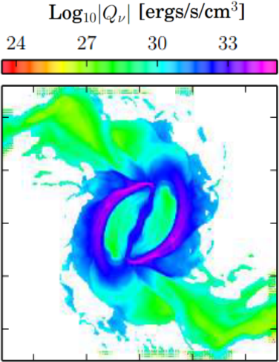
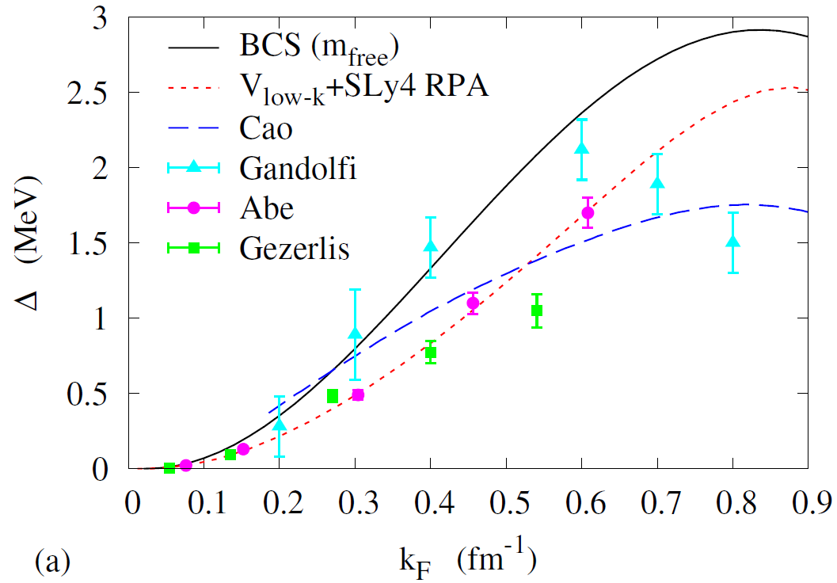
What we do?
constraint on symmetry energy from
gravitational waves and nuclear physics
neutrino emissivity in neutron-star merger
for dependence on density, temperature, and proton fraction
pairing gap in neutron matter
Khan et al., PRC 102 (2020) 015805
PRD 89 (2014) 104029
Urban et al., EPJ ST (2021)

Slide 11
What we do?
Some examples of current topics
Superfluidity at low density
constraint on symmetry energy from
gravitational waves and nuclear physics
neutrino emissivity in neutron-star merger
for dependence on density, temperature, and proton fraction
Role of Hypernuclei
pairing gap in neutron matter
what can we learn from
gravitionnal waves
neutrino emission from (hot)
asymmetric matter
Description of reaction for
nuclear astrophysics
Khan et al., PRC 102 (2020) 015805
PRD 89 (2014) 104029
Urban et al., EPJ ST (2021)

Slide 12
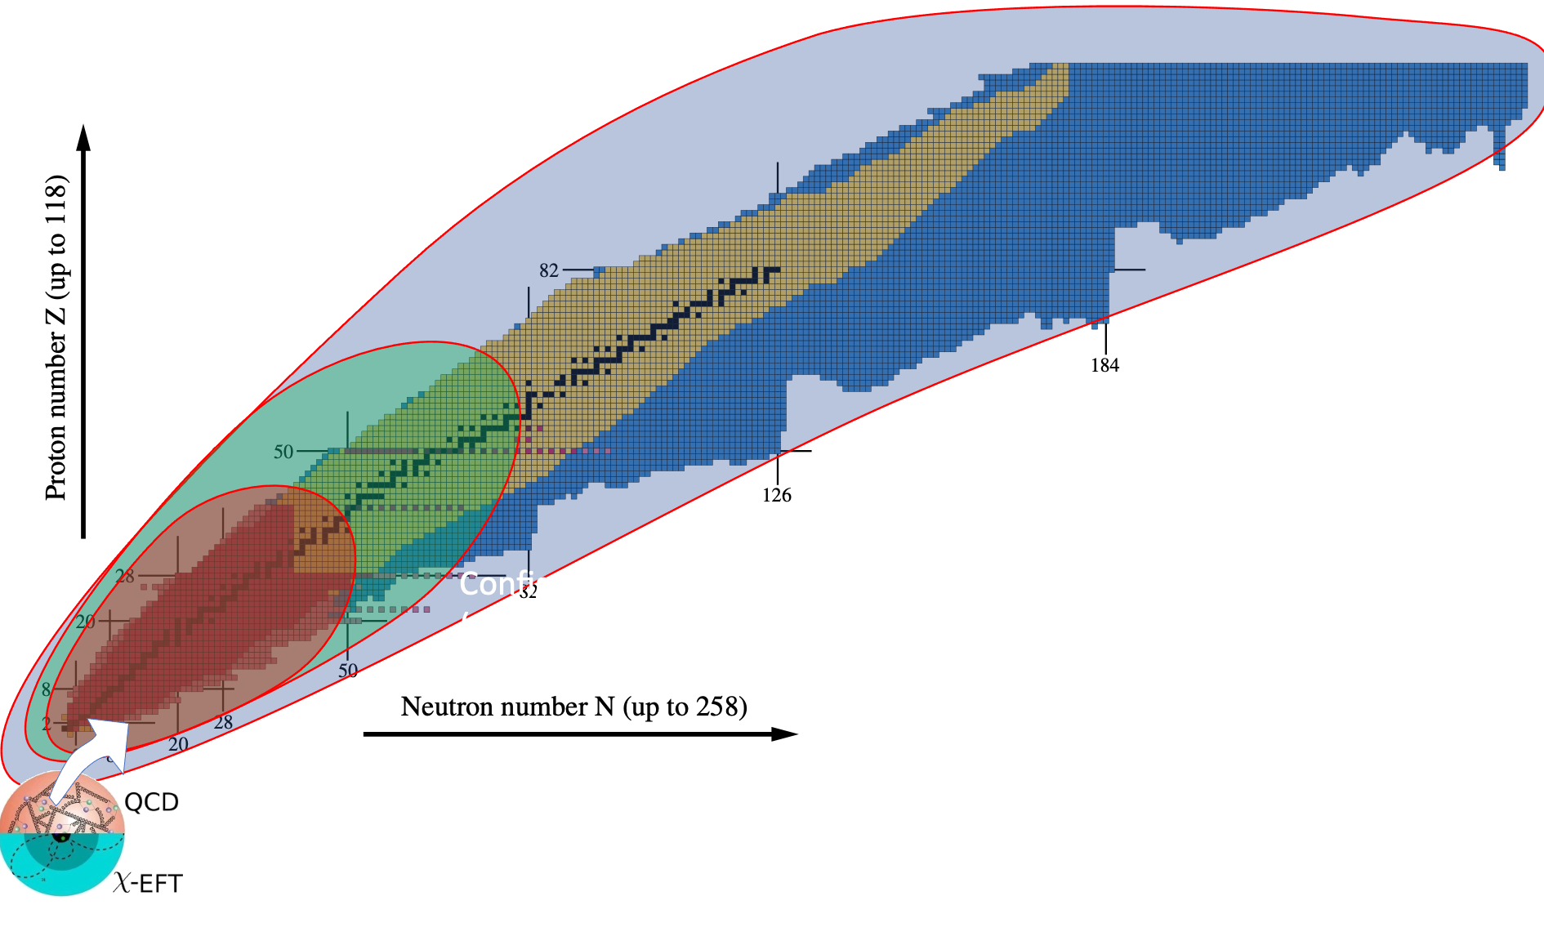

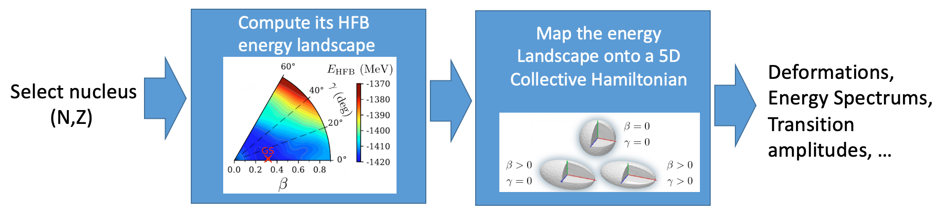
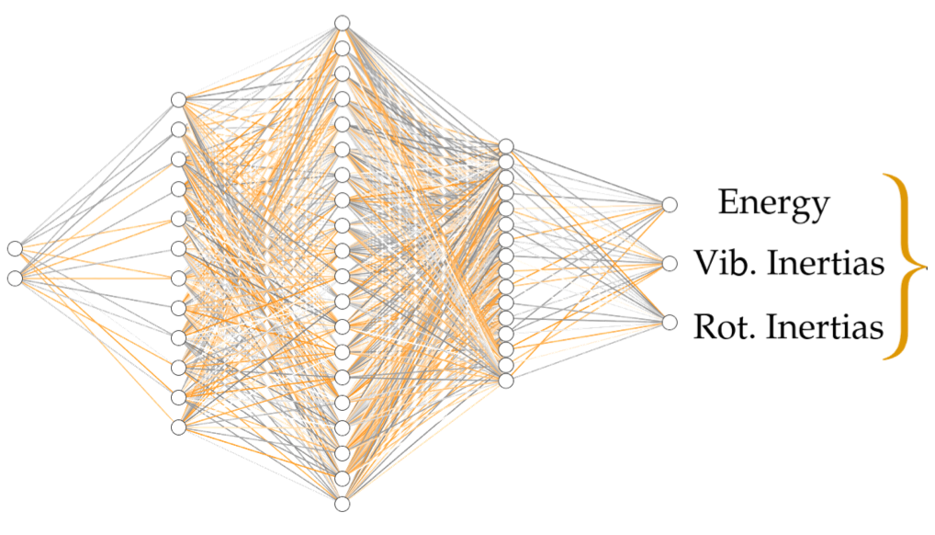
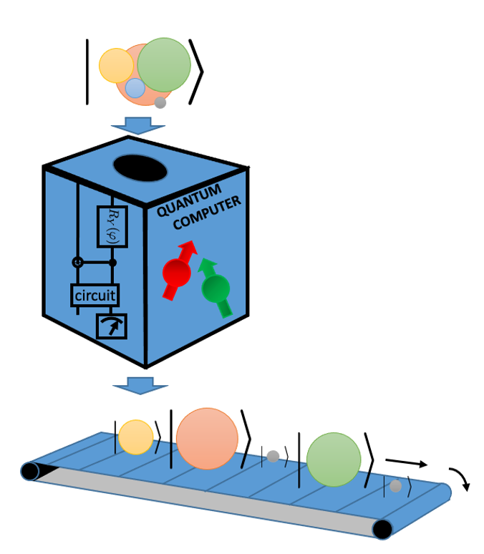
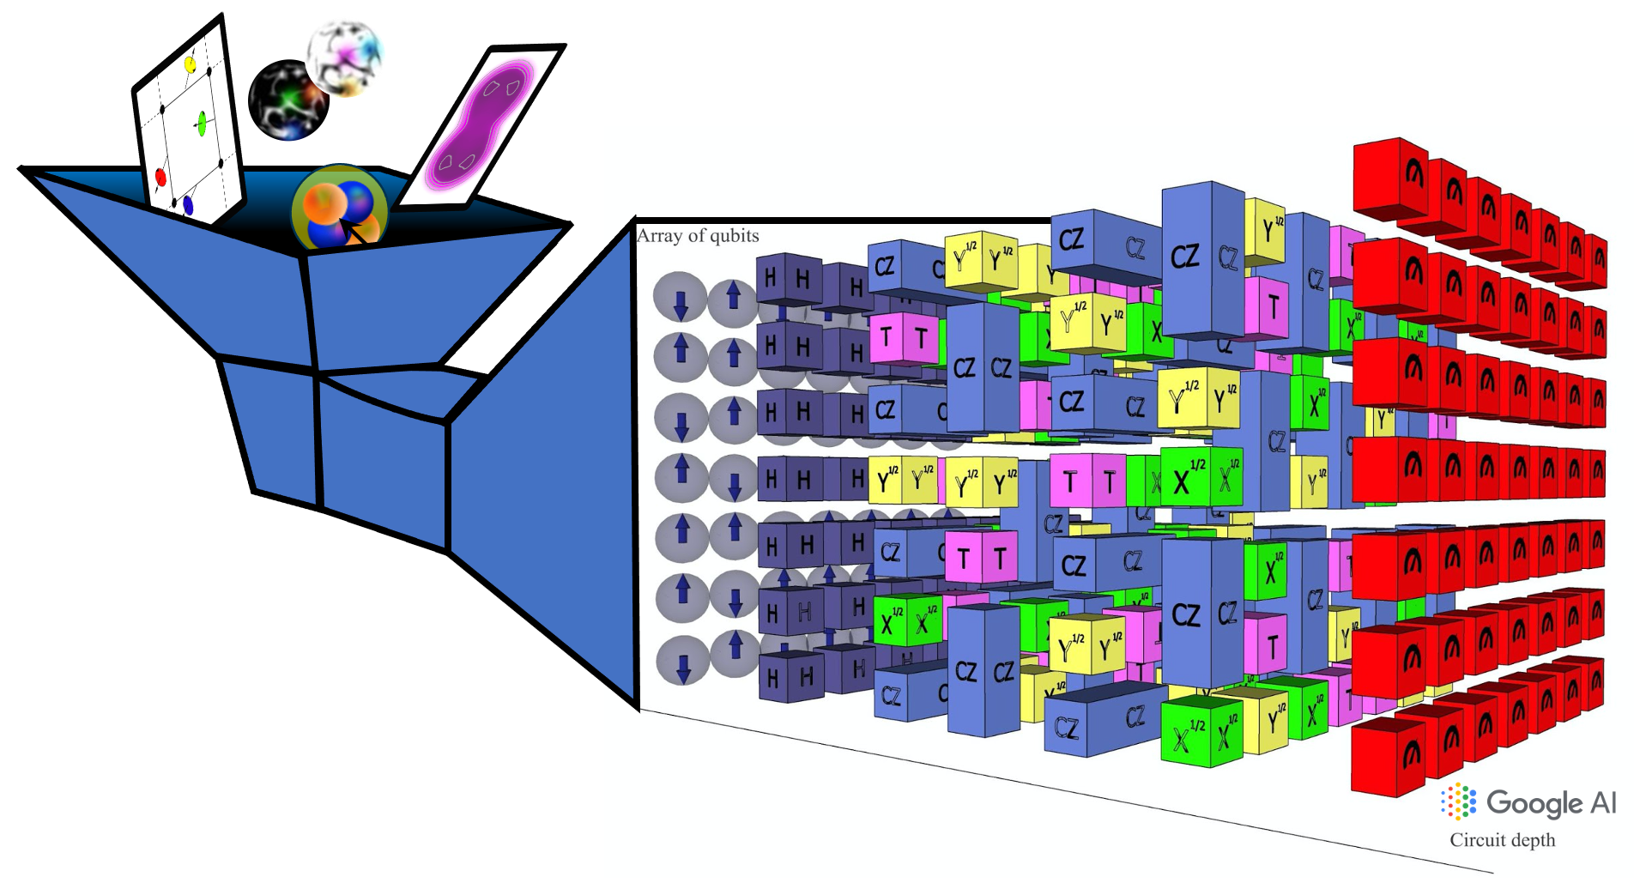
Some scientific highlights of nuclear physics theory @IN2P3
Using New technologies: quantum computing and machine learning
Machine learning
Lasseri et al, PRL 124, (2020).
Quantum computing
Lacroix, PRL 125, 230502 (2020).

Slide 13
Our grants, « official » projects, …
ANR Jeune chercheur NECTAR, 10/21-10/25 [Hupin, … ]
Masterproject BRIDGE-EDF, IN2P3, 01/19-12/21 [Grasso + Hupin, v. Kolck, Lacroix]
Masterproject New-MAC, IN2P3, 01/19-12/21 [Khan]
IRP France-Brésil, IN2P3, 01/19-12/23 [v. Kolck + Carbonell, … ]
CAPES-COFECUB collaboration project, Campus France, 01/20-12/22 [v. Kolck + … ]
80PRIME grant, CNRS, 01/20-12/21 [Lacroix + Carbonell, Grasso, Hupin]
Projet QC2I, IN2P3, 01/21-01/24 [Lacroix + Carbonell, Hupin]
Accord JINR/BLTP-IN2P3, 01/04-present [Lacroix]
Franco-Indian collaboration project, CEFIPRA, 10/20-09/23 [Urban]
Thank you !

Slide 14
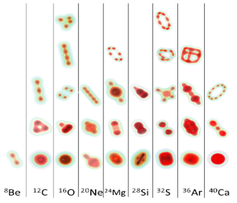
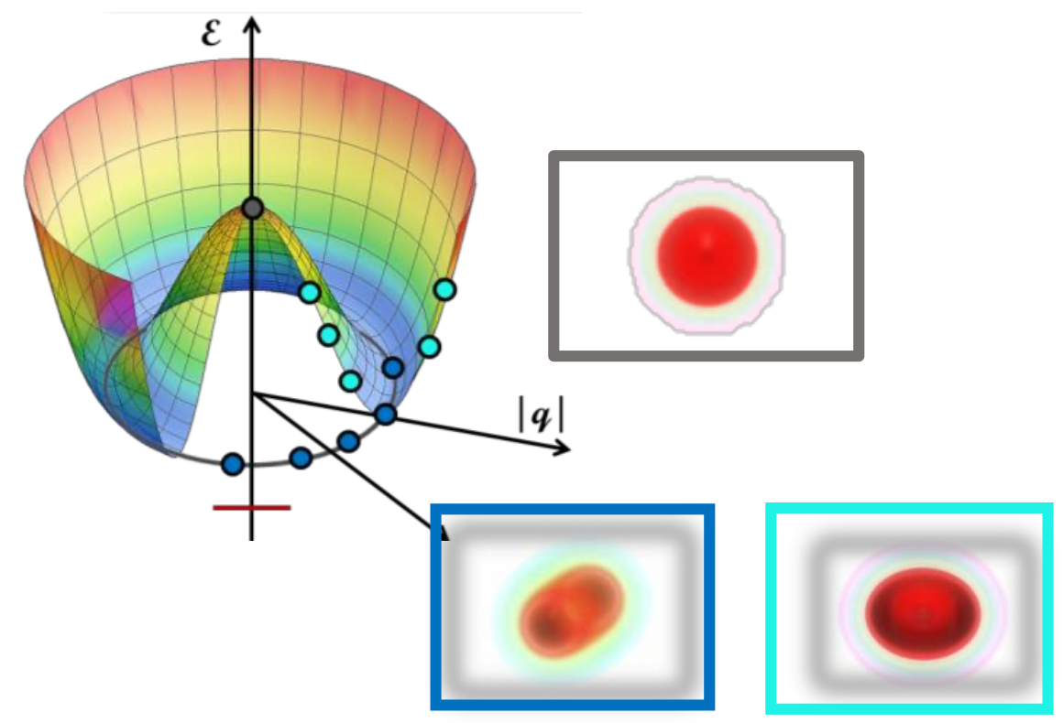
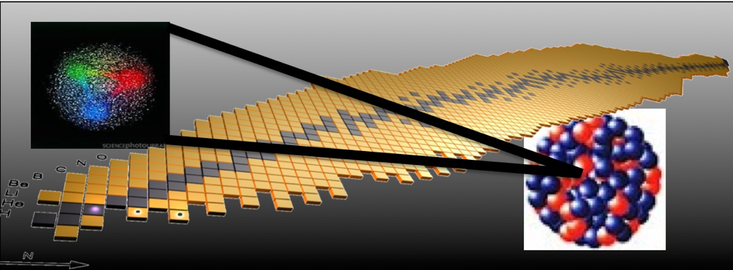
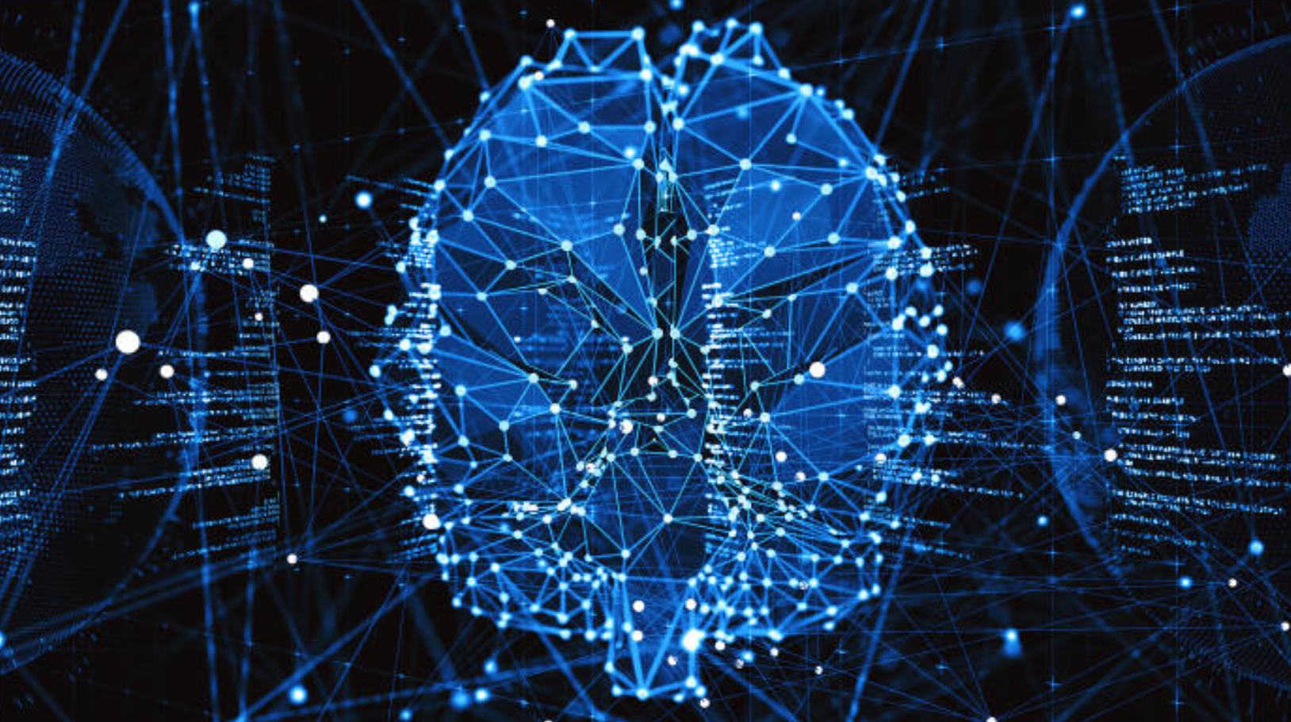
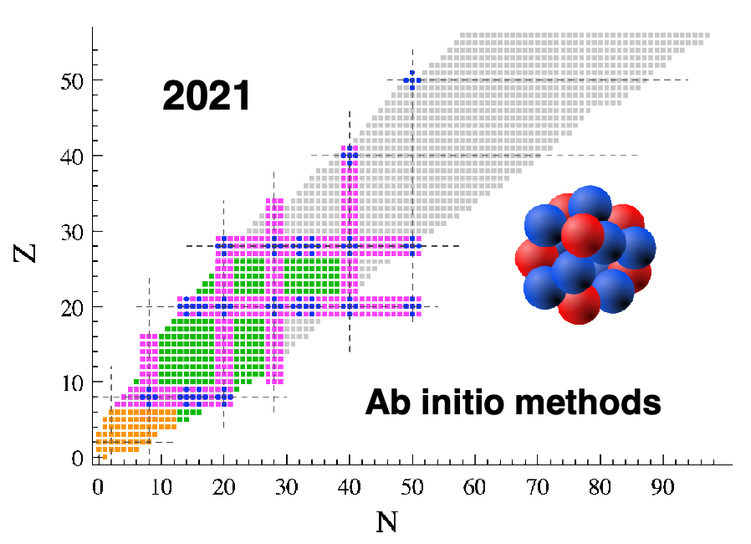
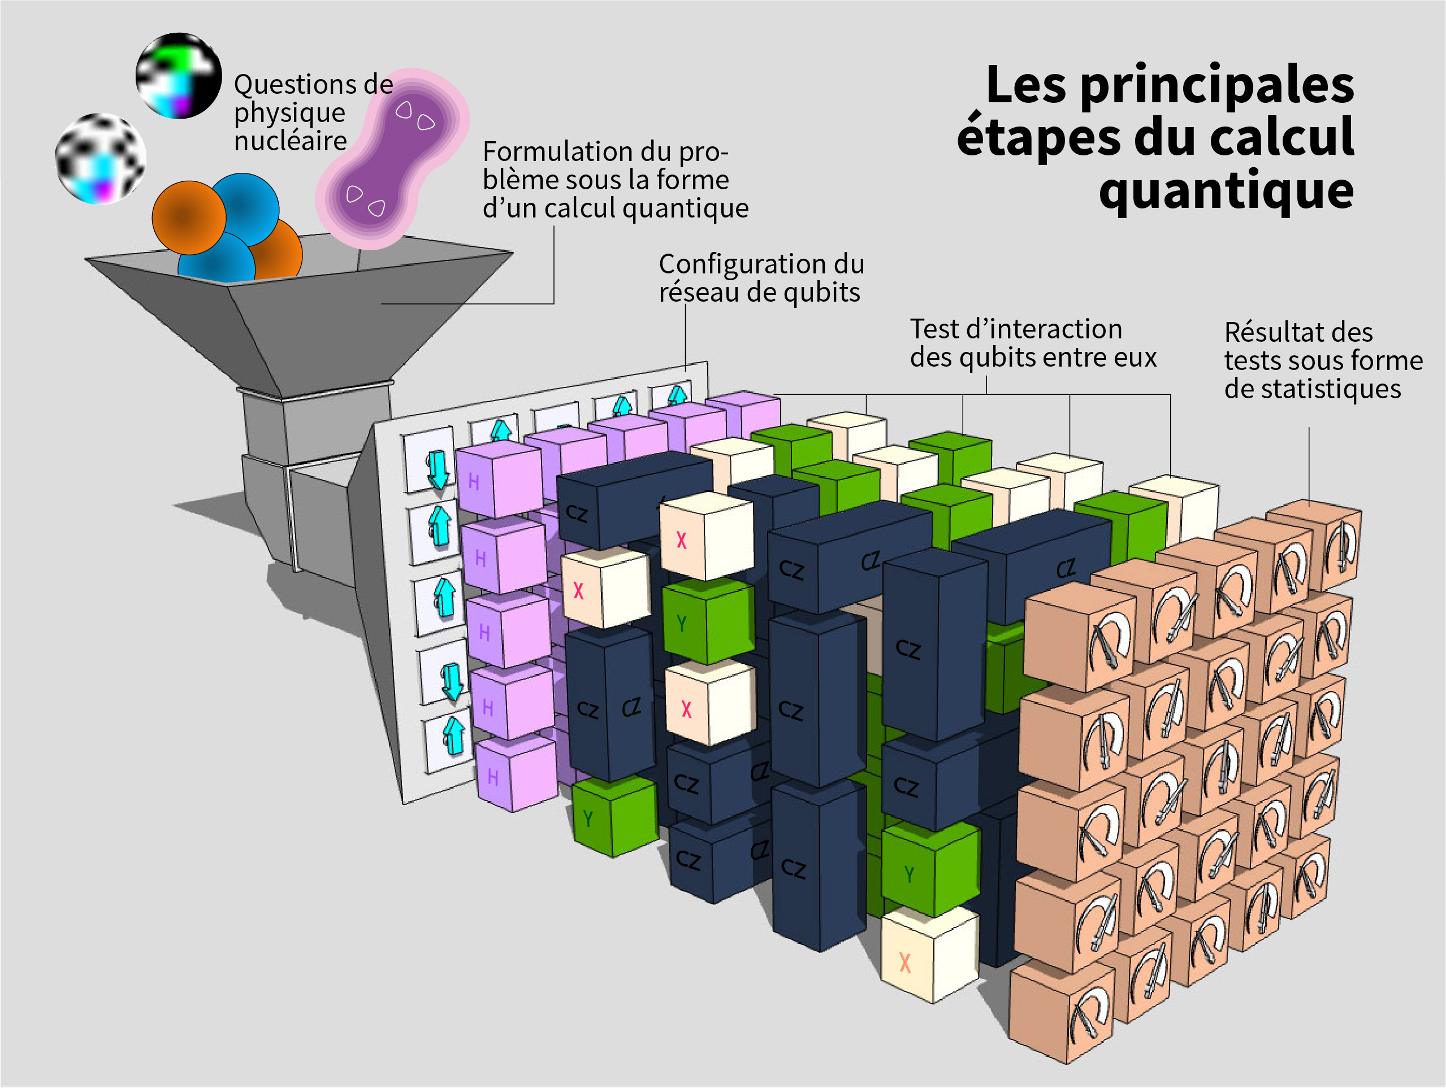
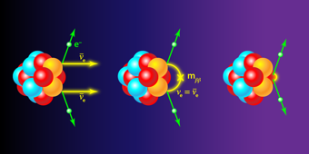
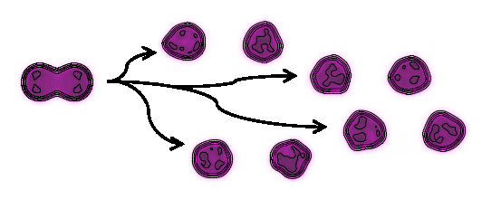
What we do?
Strong interaction and decays
Nuclear structure and shapes
Dynamics
New technologies

