Slide 1
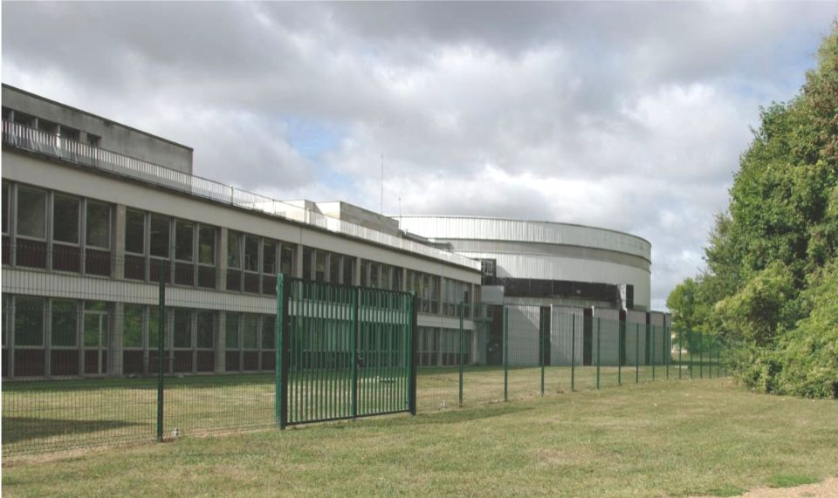
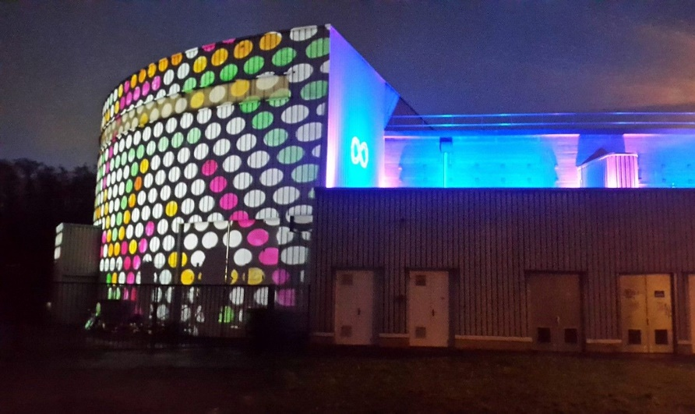
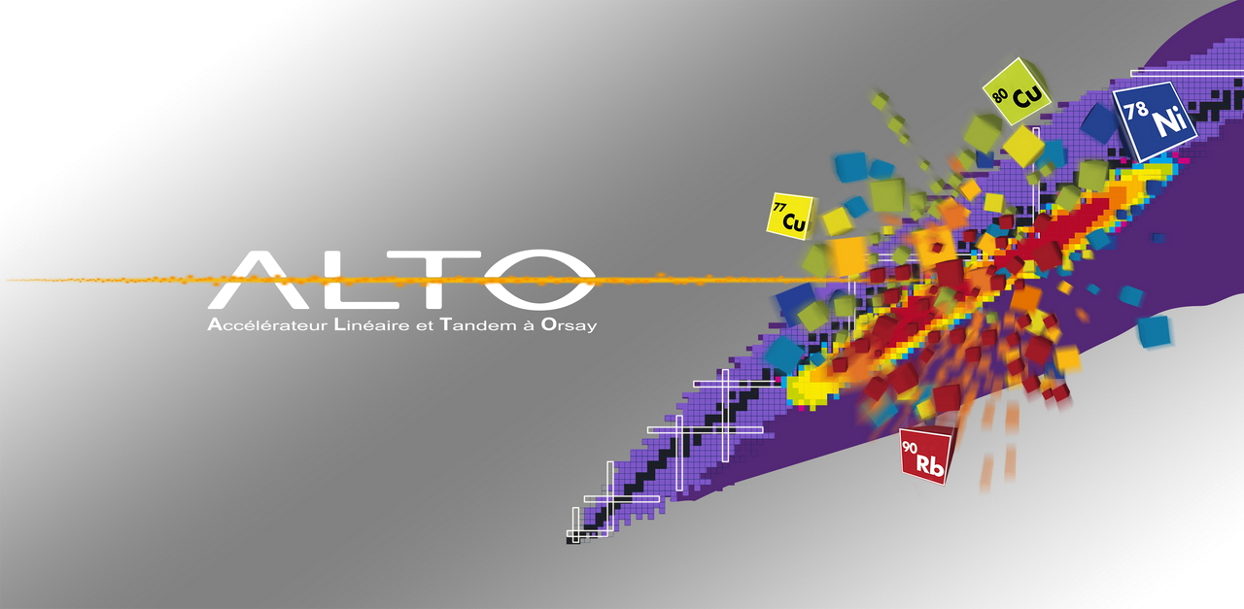
Introduction: Irradiations at ALTO
Journée Irradiations IJC Lab 17 novembre 2021
J.N. Wilson and A. Said

Slide 2
Bibliométrie ALTO: publications (2017-2020)

Slide 3
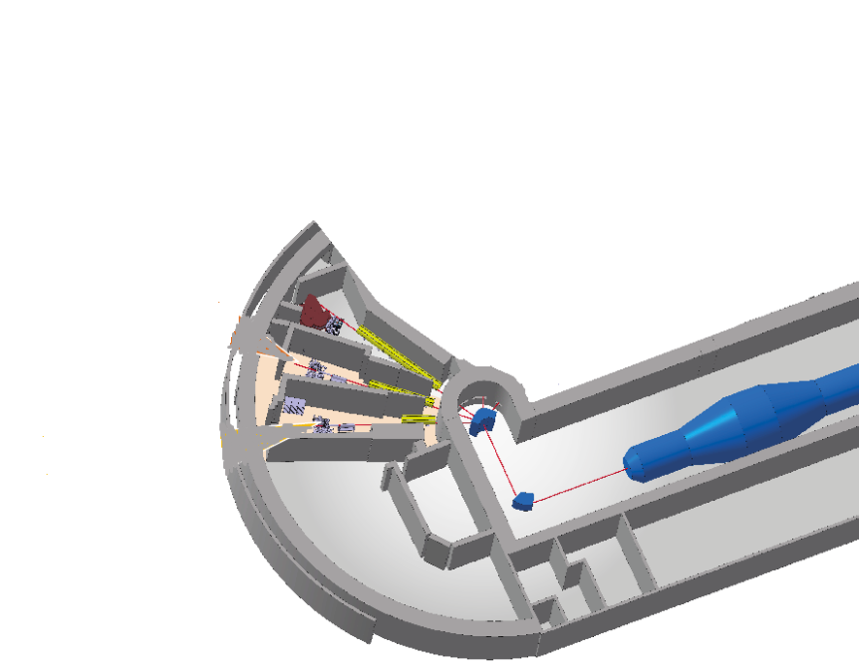
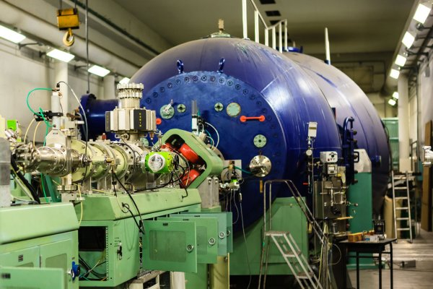
ALTO High Energy stable Beams (HEB)
Faisceaux standards du Tandem :
- H, ³He, ⁴He, ..., ¹⁴C, ... up to ¹²⁷I
- Tension au terminal entre < 1 MV et 14.5 MV
- Faisceaux pulsés : largeur d’impulsion 1 - 2 ns; taux de répétition : 100 ns - 100 μs
- Nouvelle source d’ion → intensité x5 → faisceaux difficiles (Mg, Ca)
ALTO - HEB
Tandem

Slide 4
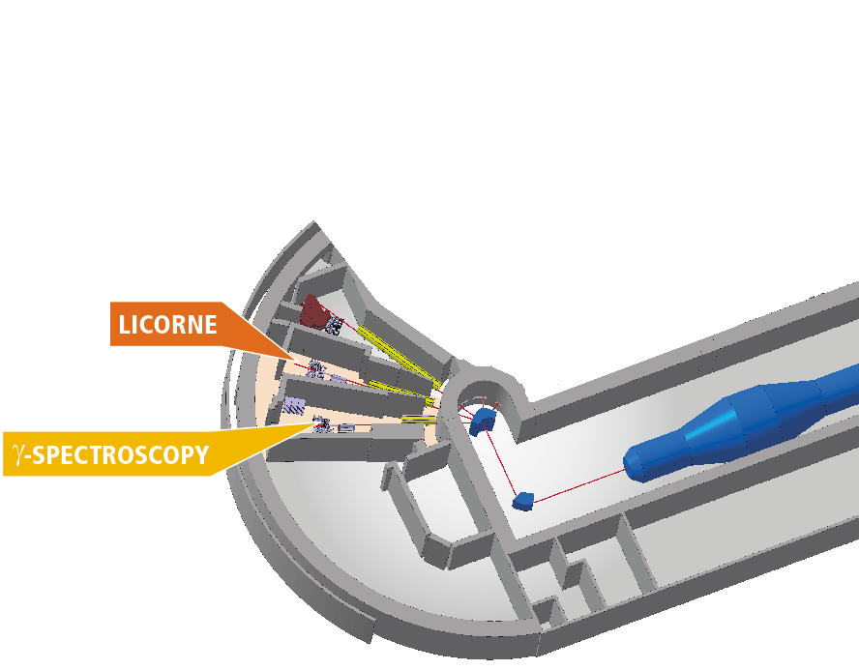

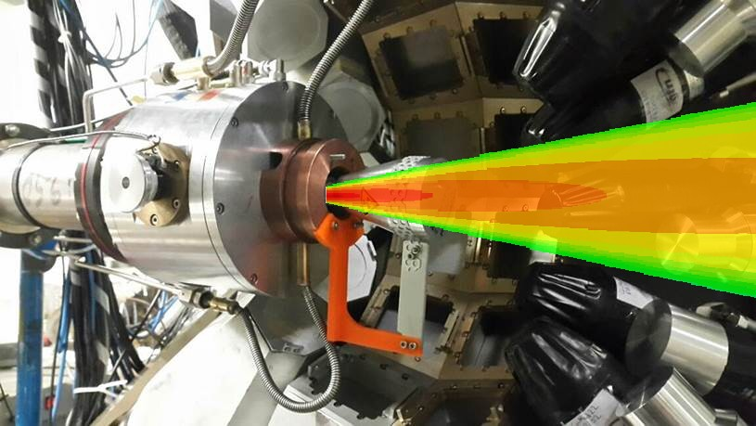
ALTO Neutron production/beams
H gas target
γ
ALTO - HEB
n
Permits participation in European TNA Network
n
n
0.5 µA ⁷Li
13-18 MeV
n
γ
Sample
High complementarity with NFS@GANIL
LICORNE: Unique, naturally directional quasi-monoenergetic neutron source neutron source:
Low background
High Flux: 10⁸ n/s/steradian
E_{n}=0.5 – 4 MeV
LICORNE

Slide 5
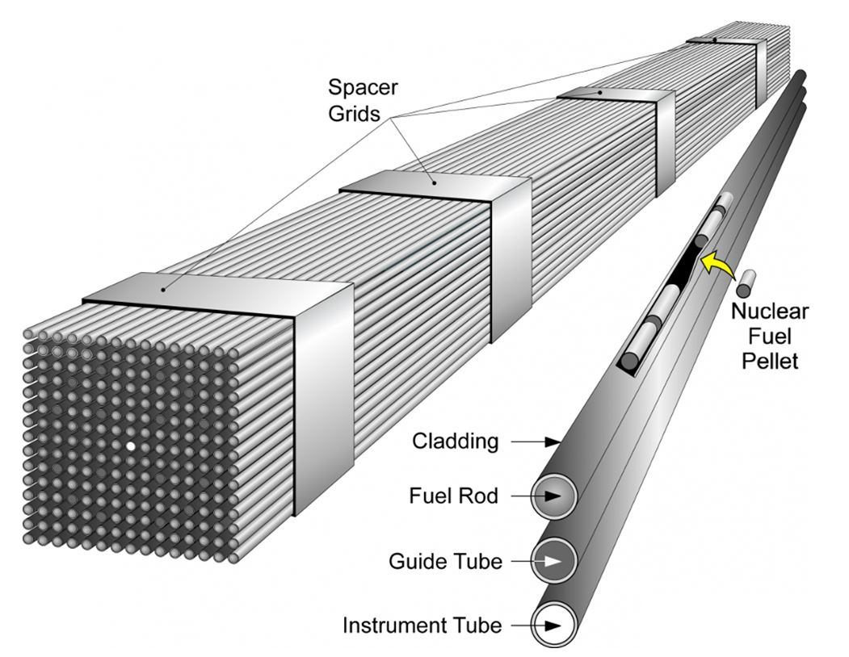
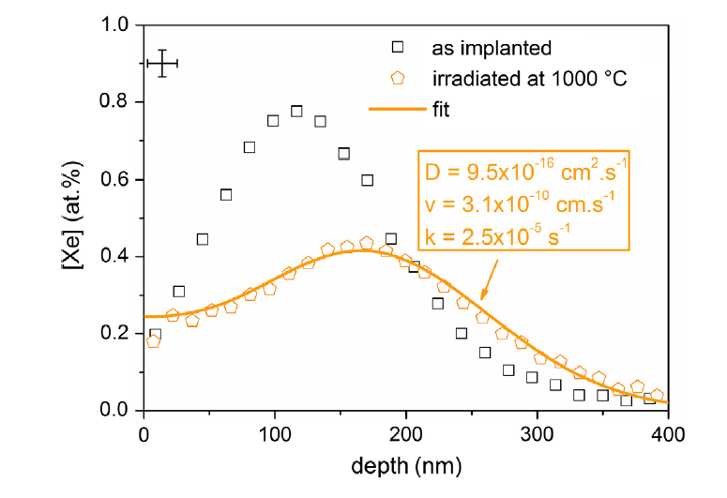
Energy Applications: Irradiations of nuclear materials
Xenon migration in UO2 under irradiation studied by SIMS profilometry
B.Marchand et al. Journal of Nuclear Materials 440, p562-567 (2013)
Xe and Kr represent 25% of total fission product yield. Gaseous fission products deform the fuel pellets and cladding. Limit the lifetime of fuel bundles in reactors
Understanding of the (implanted) Xe diffusion as a function of temperature and irradiation conditions

Slide 6
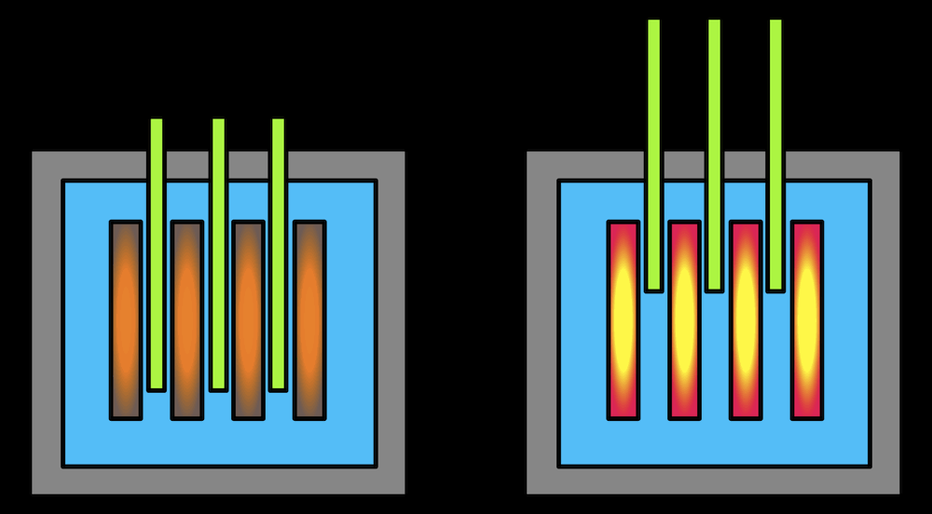
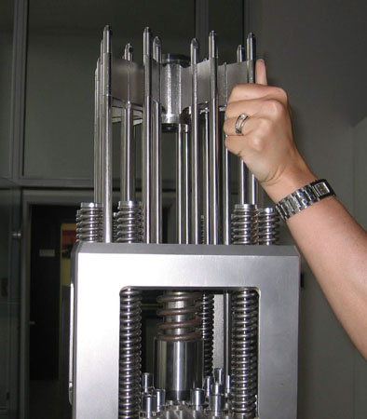
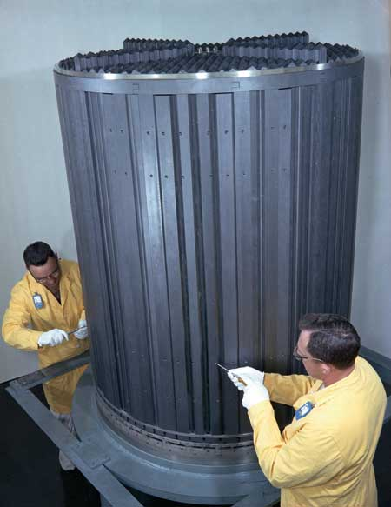
Energy Applications: Irradiations of nuclear materials
Structural modifications induced by ion irradiation and temperature in boron carbide B4C
G. Victor et al. Nucl. Instrum. Meth. B365 p30-34 (2015)
B4C control rods
Irradiations at ALTO with ¹²⁷I to induce accelerated material damage
Ion irradiation to simulate neutron irradiation in model graphites: Consequences for nuclear graphite N.Galy et al. Nucl. Instrum. and Meth. B: 409, p235-240 (2017)
Graphite is used as a core moderator material
(some reactor designs)
Ion irradiation of 37Cl implanted nuclear graphite: Effect of the energy deposition on the chlorine behavior and consequences for the mobility of 36Cl in irradiated graphite
N.Toulhoat et al. Journal of Nuclear Materials 464, 405-410 (2015)

Slide 7
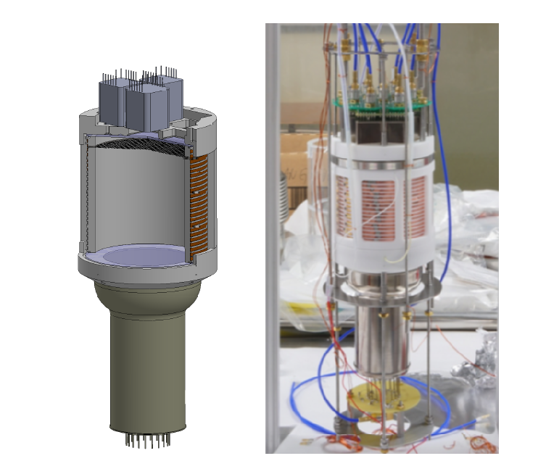
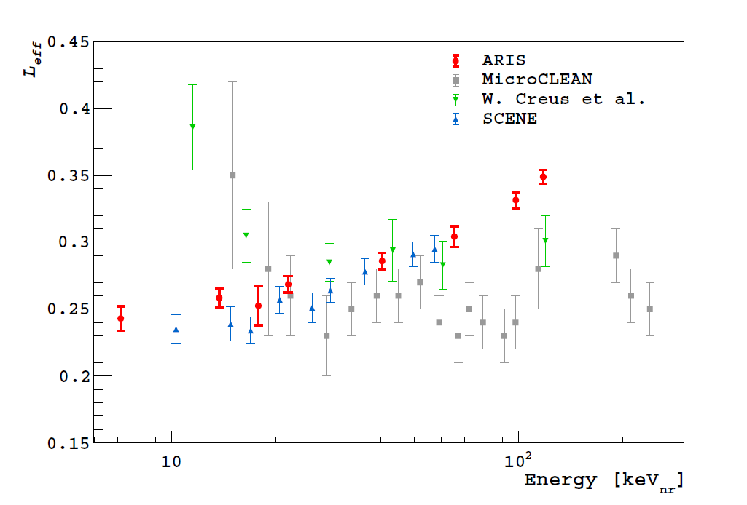
ARIS: Dark Matter Search, Liquid Argon TPC irradiation
Measurement of the liquid argon energy response to nuclear and electronic recoils
P. Agnes, et al. Phys. Rev. D 97, 112005 (2018)
Dark matter search liquid Argon detector prototype
Neutrons used as a proxy for WIMPS
Characterisation of the detection properties
via nuclear recoils and sensitivity limits

Slide 8
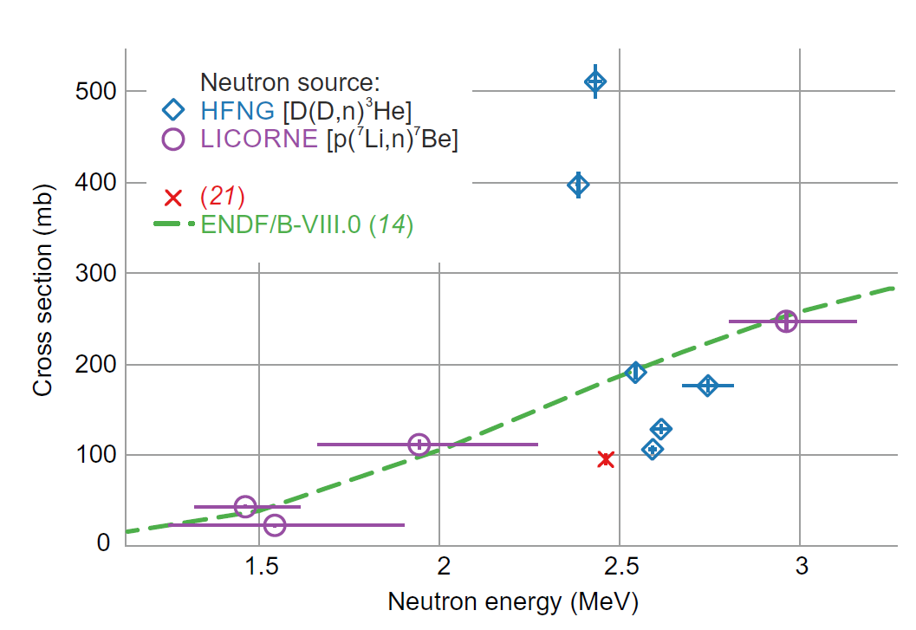
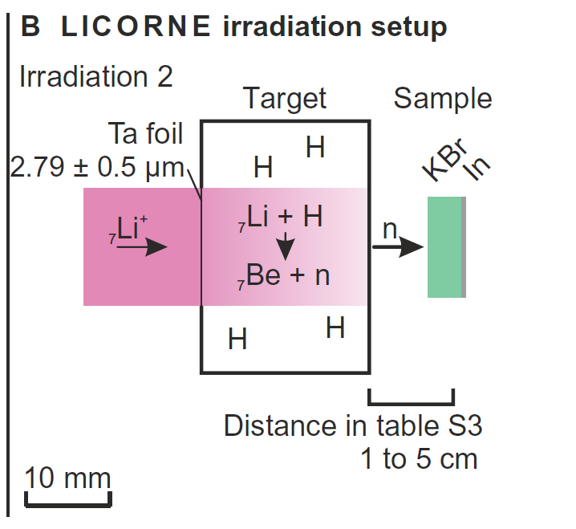
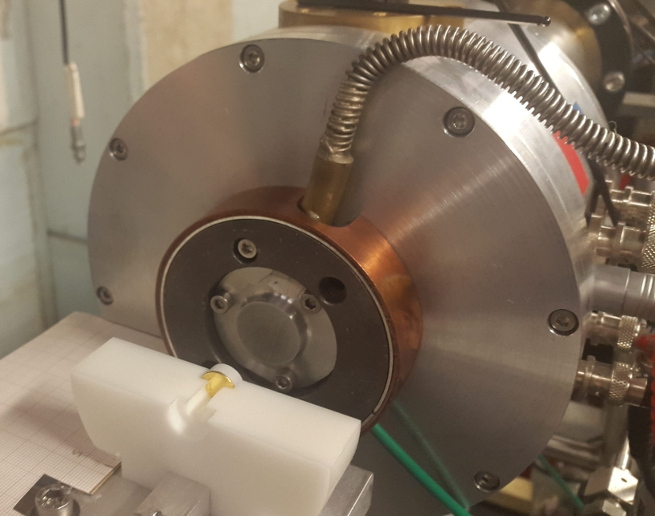
Geochronology: Measurement of ³⁹K(n,p)³⁹Ar cross section
Boutique neutrons advance 40Ar/39Ar geochronology D. Rutte et al. Science Advances, Vol5. No.9 (2019)
T_{1/2} (⁴⁰K) = 1.25 x 10⁹ years
Geochronological dating method for old rocks -> build up of ⁴⁰Ar daughter
Accelerator based neutron irradiations broaden the applicability of the dating method to fine-grained materials

