Slide 1
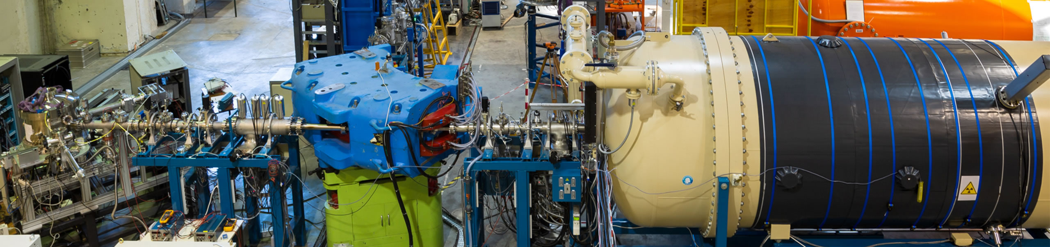

ANDROMEDE
S. Della Negra, I. Ribaud, D. Jacquet, T.T.H. Lai*, F. Daubisse
CNRS/IN2P3, IJCLab, Université Paris-Saclay, 91405 Orsay, France
*SATT Paris-Saclay, Université Paris-Saclay
ANDROMEDE research platform
Equipex( 2010 – 2020)

Slide 2
ANDROMEDE/ outline
Introduction to the Andromede facility
Accelerator and sources
Available beams
ToF Mass spectrometer EVE
Multitechnique approach
Specificities of the nanoparticle probe
Examples of analyses conducted with Andromede
Meteorite studies
First EMIR&A experiment
Interdisciplinary research platform open to the academic and industrial worlds in the fields of biology, biochemistry, astrophysics and astrochemistry, molecular chemistry, and chemistry and physics of materials.

Slide 3
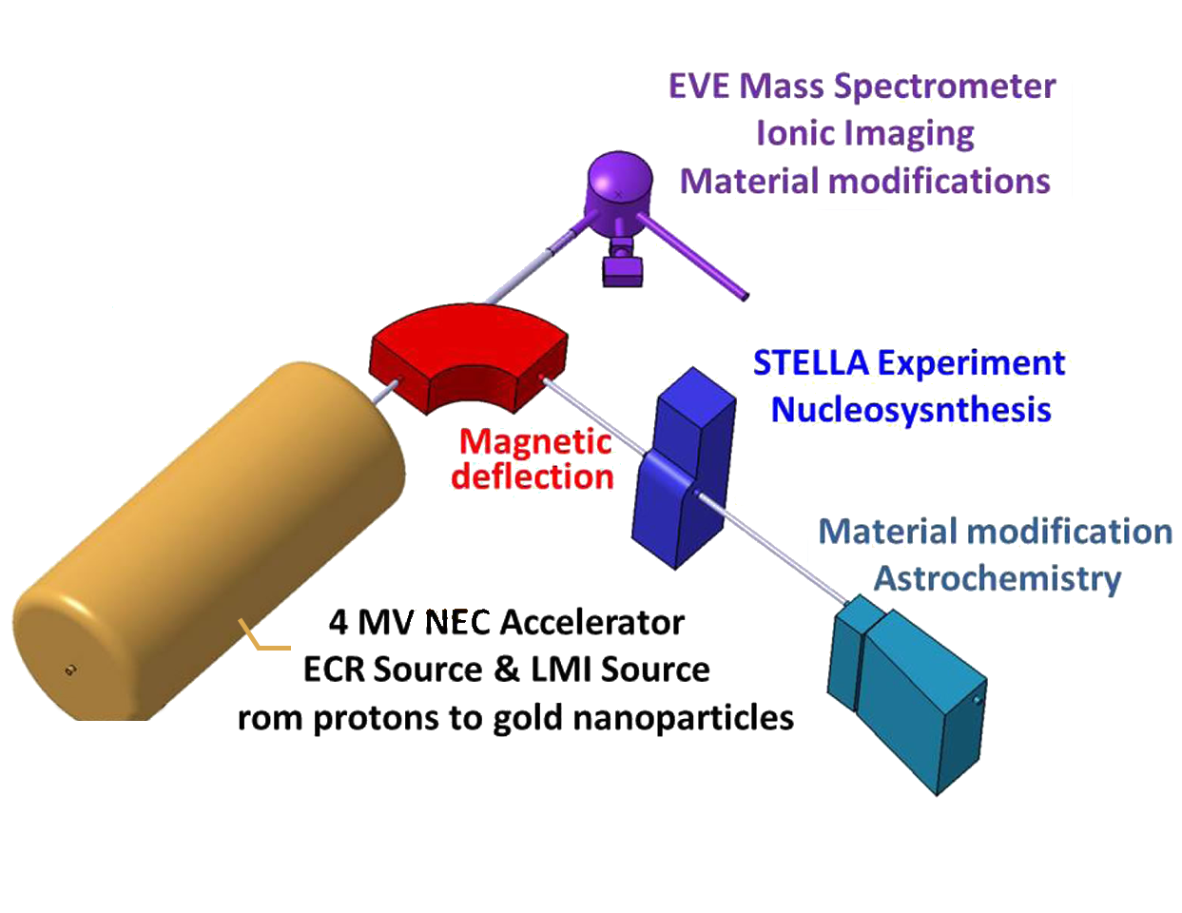
ANDROMEDE - Accelerator
Accelerator and ion source
The ion beams are accelerated at high energy by a 4 MV NEC Pelletron® accelerator. The terminal of this accelerator is designed to accommodate two types of ion sources, an Electron Cyclotron Resonance Source (ECR) and a Liquid Metal Ion Source (LMIS).
Beam line at 1°29
Dedicated mainly to molecular beams and metal clusters up to nanoparticles.
Beam line at 90 °
Muti-charged atomic and molecular ion beams from hydrogen to ions with a mass-to-charge ratio of less than 70.
Notes:
NOW Andromede
The main information is indicated in this slide
Today there are Two beam line and at the terminal of the accelerator it is possible to install two different sources

Slide 4
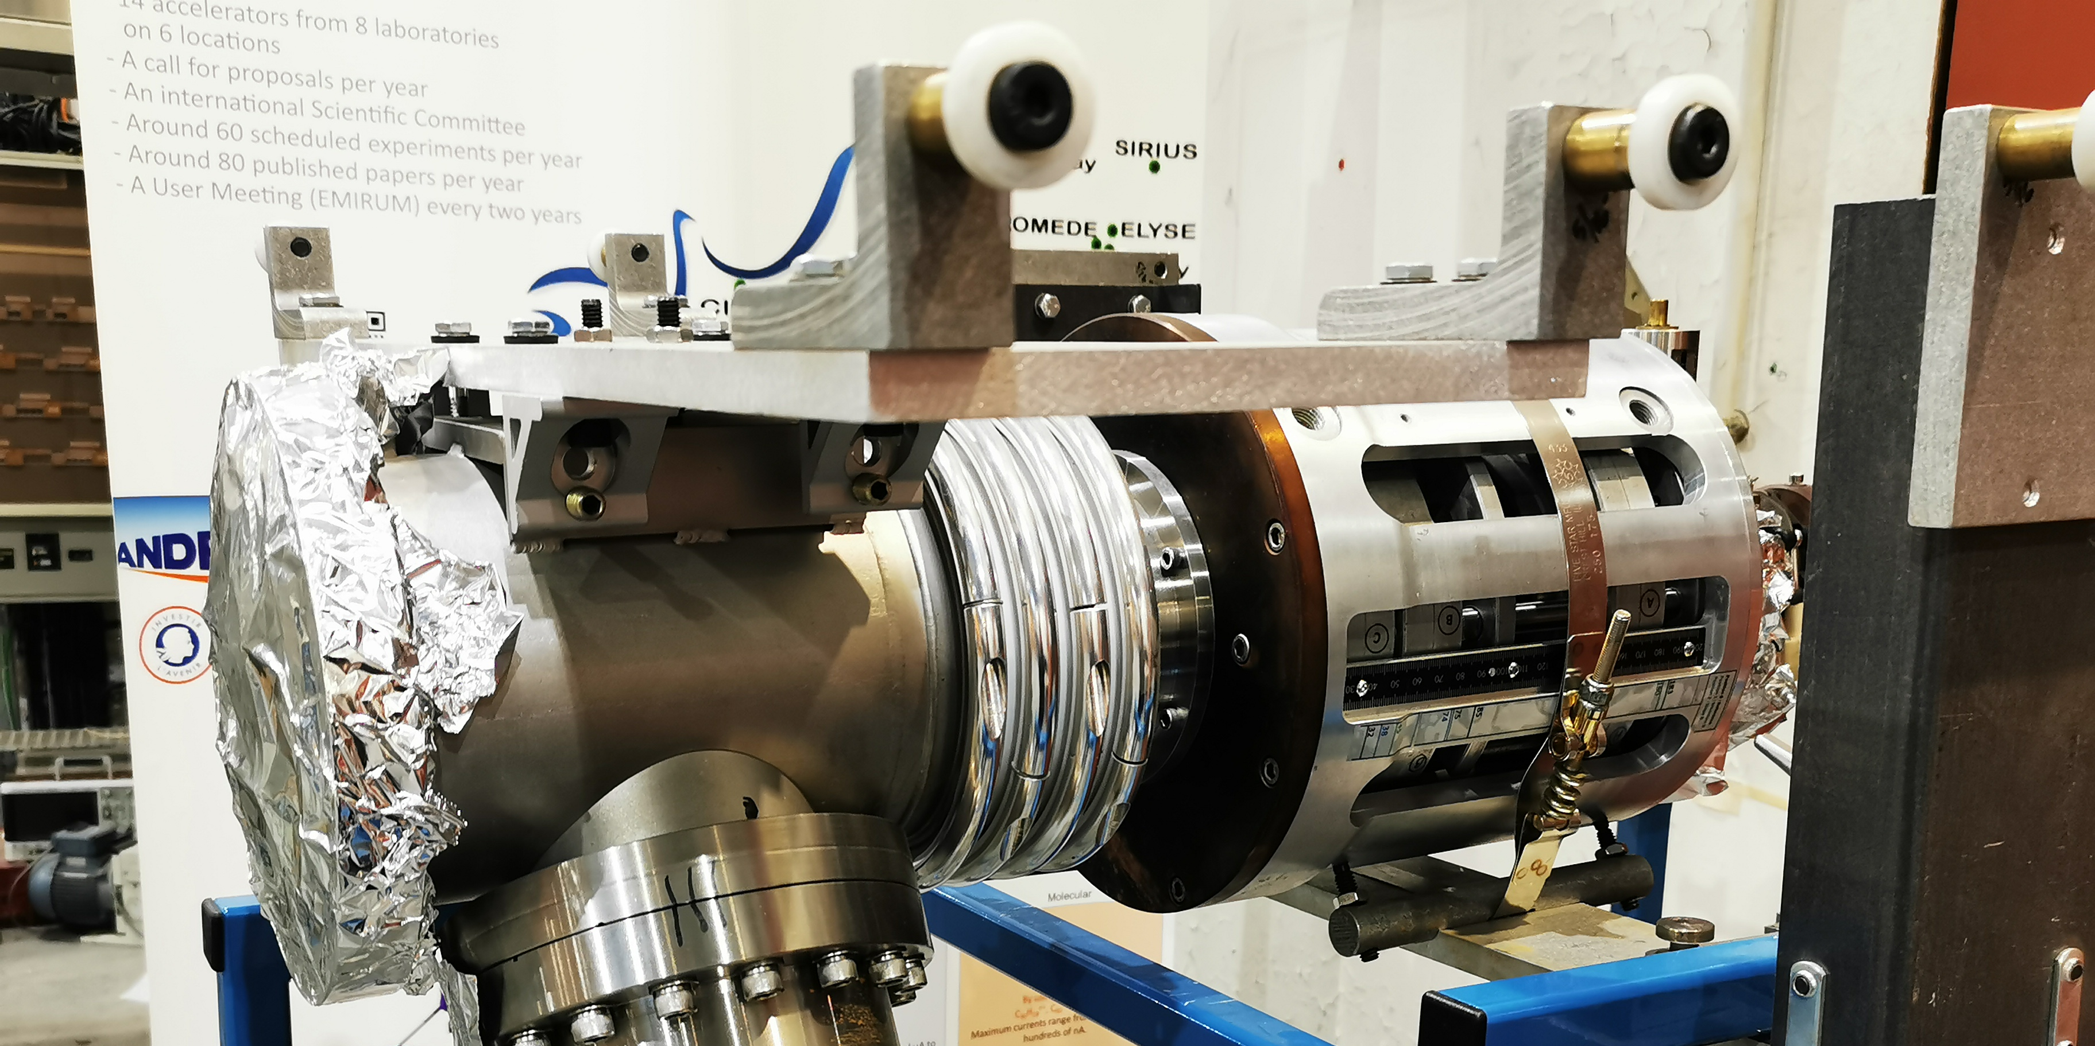
ECR Ion Source Microgan
Notes:
The first
The ECR source has two modes of operation, called with minimum B or without, with this source it is possible to adjust this specification by moving the magnets.
This specific arrangement permit to obtain multicharged atomic beams or molecular ions which can also be multicharged. Up to C60 1+2+3+

Slide 5
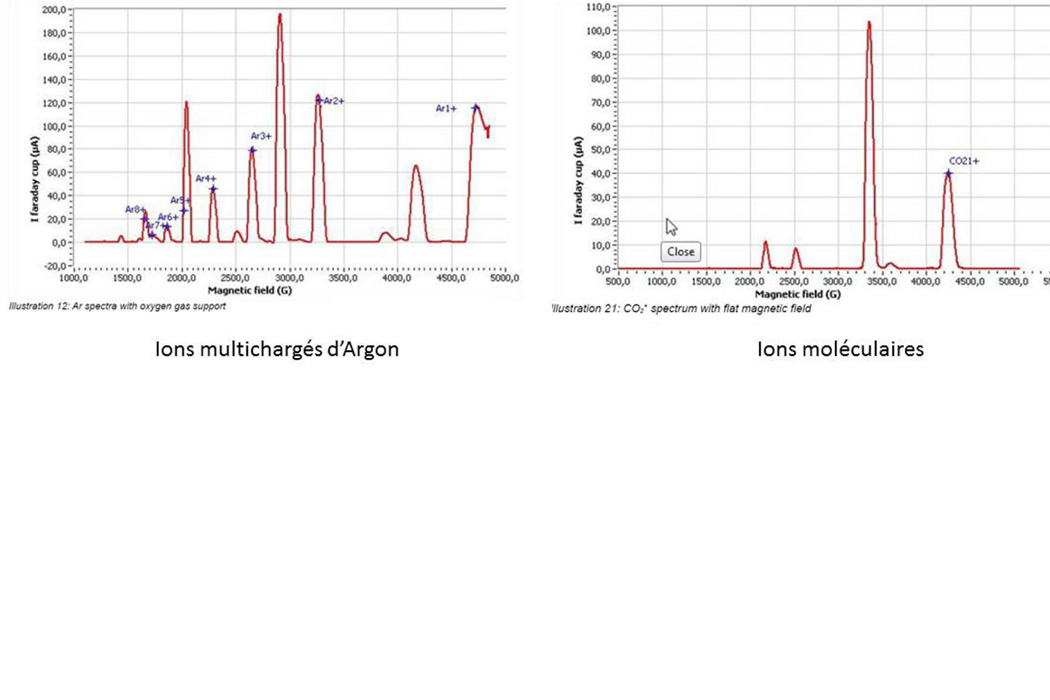
ECR Ion Source Microgan
The ions produced by this source are selected at the accelerator terminal by a Wien filter.
Atomic ions (Argon)
Molecular ions (CO₂)
H⁺
C, O, N ^{n+} n=1-4
F^{n+} n=1-4
Ne^{p+} p=1-4
S^{n+} n=1-4
Ar, Kr, Xe^{n+} n=1- 8 ou 10
The maximum currents are from several µA to tens of µA.
Millimetre size
CO, CO₂⁺
CH_{n}⁺ n=1-4
C₂H_{p}⁺ p=1-6
SF_{n}⁺ n=1-5
With oven
C₃₆H₁₈^{n+}, C₆₀ ^{n+} n=1-3
Maximum currents range from a few nA to hundreds of nA.
Dimensions from 100 µm to mm
Notes:
The first
The ECR source has two modes of operation, called with minimum B or without, with this source it is possible to adjust this specification by moving the magnets.
This specific arrangement permit to obtain multicharged atomic beams or molecular ions which can also be multicharged. Up to C60 1+2+3+

Slide 6
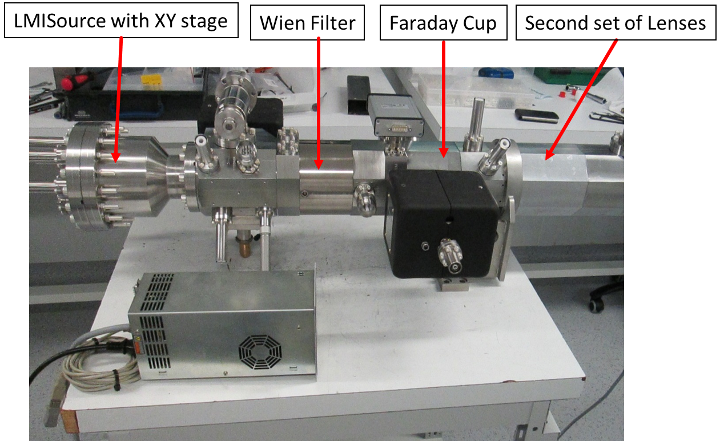
Sources : LMIS, Ionic column « NAPIS »
Notes:
The brightness of this source permits to obtain nm beam in the keV range the emittance is perfect and also allows to obtain parallel beam it is perfect for a accelerator and to focus this HE beams.
The different beams delivered by this source are shown on this table the mass range of the clusters is important up to 20000
Depending on the eutectic used, beams of germanium or silicon, mono- and double-charged, are available with several tens of nA.

Slide 7
Sources : LMIS, Ionic column « NAPIS »
The NAPIS column is equipped with a Liquid Metal Ion Source (LMIS) providing beams of atomic ions, clusters and gold nanoparticles.
 | EXIT ACCELERATOR |  | CENTER EVE CHAMBER
Ions | Energy (MeV) | Intensity (nA) | Beam size (µm) | Intensity (pA)
Au²⁺ | 1,2,3 | 10 |  | 100
Au⁺ | 1,2,3 | 40 | 10 | 1000
Au₂⁺ | 1,2,3 | 4 |  | 100
Au₃⁺ | 1,2,3 | 3 | 10 (200) | 150 (3000)
Au₅⁺ | 1,2,3 | 0.2 | 20 | 20
Au₄₀₀⁴⁺ | 4-16 | 0.5-1 | 100 (400-800) | 10
Beam separation on beamline at 1°29, size 10 µm-800µm
Notes:
The brightness of this source permits to obtain nm beam in the keV range the emittance is perfect and also allows to obtain parallel beam it is perfect for a accelerator and to focus this HE beams.
The different beams delivered by this source are shown on this table the mass range of the clusters is important up to 20000
Depending on the eutectic used, beams of germanium or silicon, mono- and double-charged, are available with several tens of nA.

Slide 8
Surface analysis / Mass spectrometer EVE, IONIC IMAGING
Vacuum: 10⁻⁸ and 10⁻⁷mbar
Continuous or pulsed beam
Sample holder 50x50 mm²
Scanning of the sample 500x500 µm².
XYZ motorised stage with 100 nm precision
2 x 2 mm² field of view cameras
Notes:
independently of ion beams the Andromeda facility has a UHV time-of-flight mass spectrometer, this slide present the set up.
In first here there is the injection of the beam. The size of the beam and the axis is determined by two sets of collimator the diameter of the holes is between 20 µm and 800 µm.
Between the two sets of collimator there are steerers and fast deflection plates which allow not more than one ion per pulse to pass through the second collimator.
There is One impact to analyse the surface. The surface analysis is performed impact per impact;
The target is fixed on a stage which moves in XYZ with a precision of a few tens of nm the total movement reaches 50 mm. It is possible to analyse a few samples
The ions emitted from the sample are accelerated by this electrode with 10 or 20 kV .there are two arms in black the TOF with lenses and very important a 64 multianode detector
which permits the 64 simultaneous TOF measurement with low dead time less 10 ns. This detector is very well adapted for angular distribution measurement and also high multiplicity emission.
The second arm in red is a electron and proton emission microscope Electron and Proton are deflected by a pulsed ESA and the detection is ensured by MCPs and a high-speed camera. In the near future this microscope will permit a localisation at the submicrometer level.
For fundamental research we use a direct TOF but time of flight with a reflectron is available to achieve mass resolutions of several thousand

Slide 9
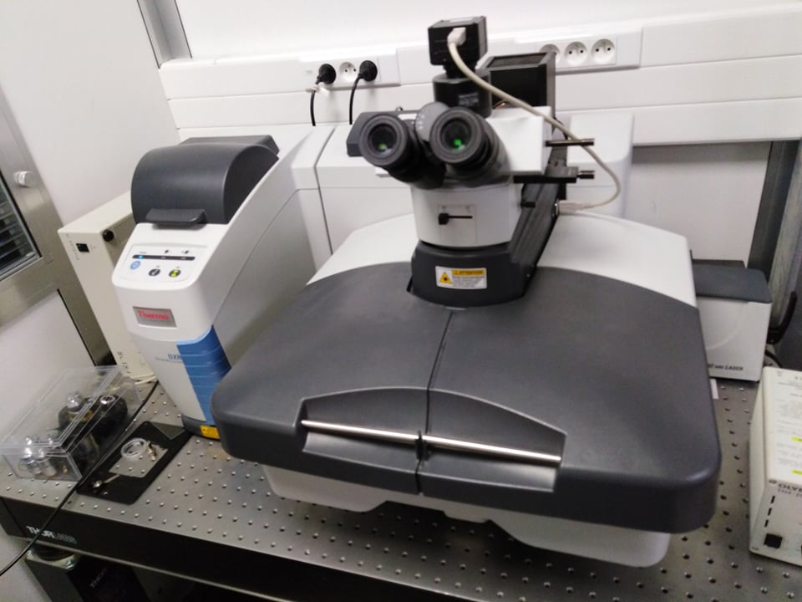
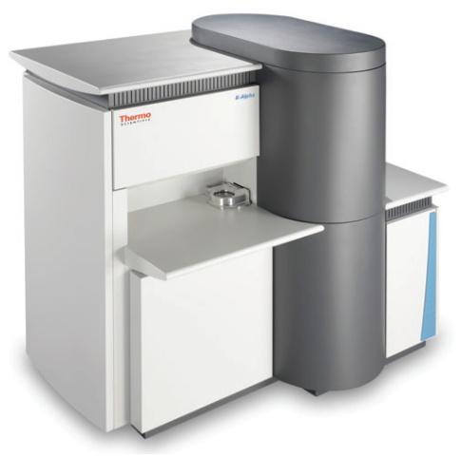
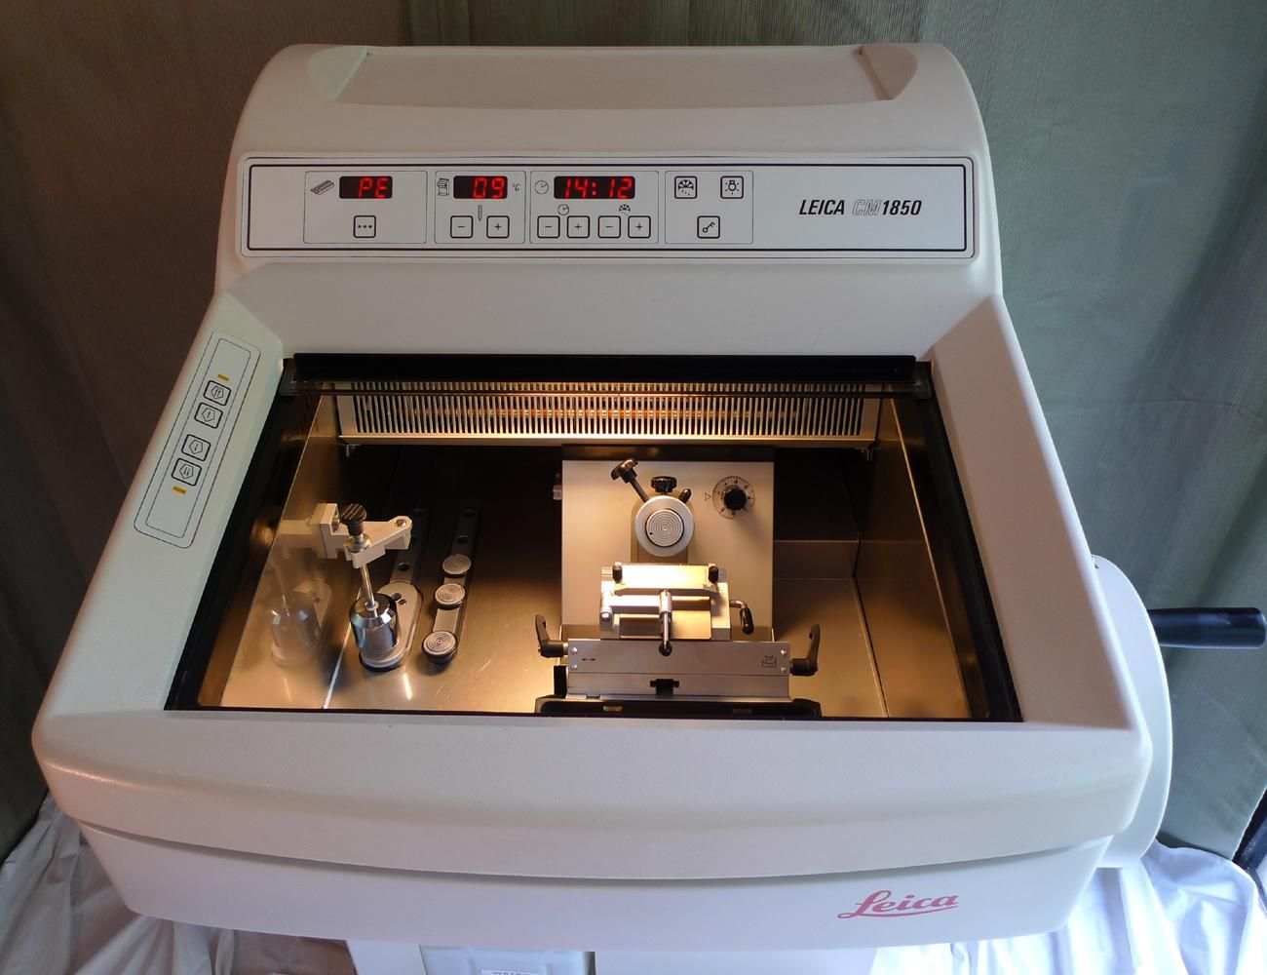
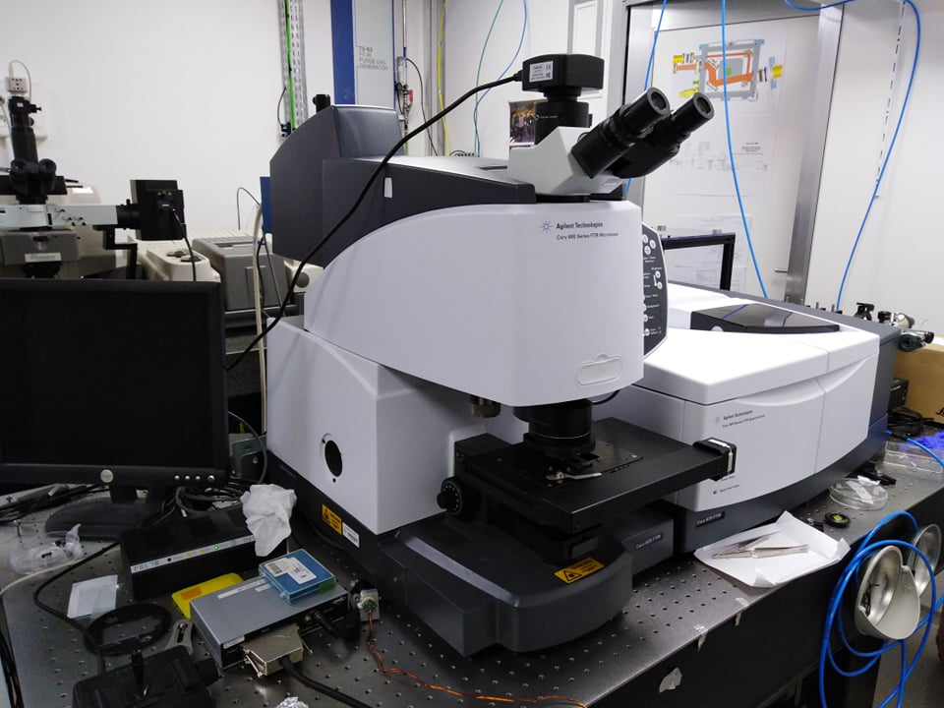
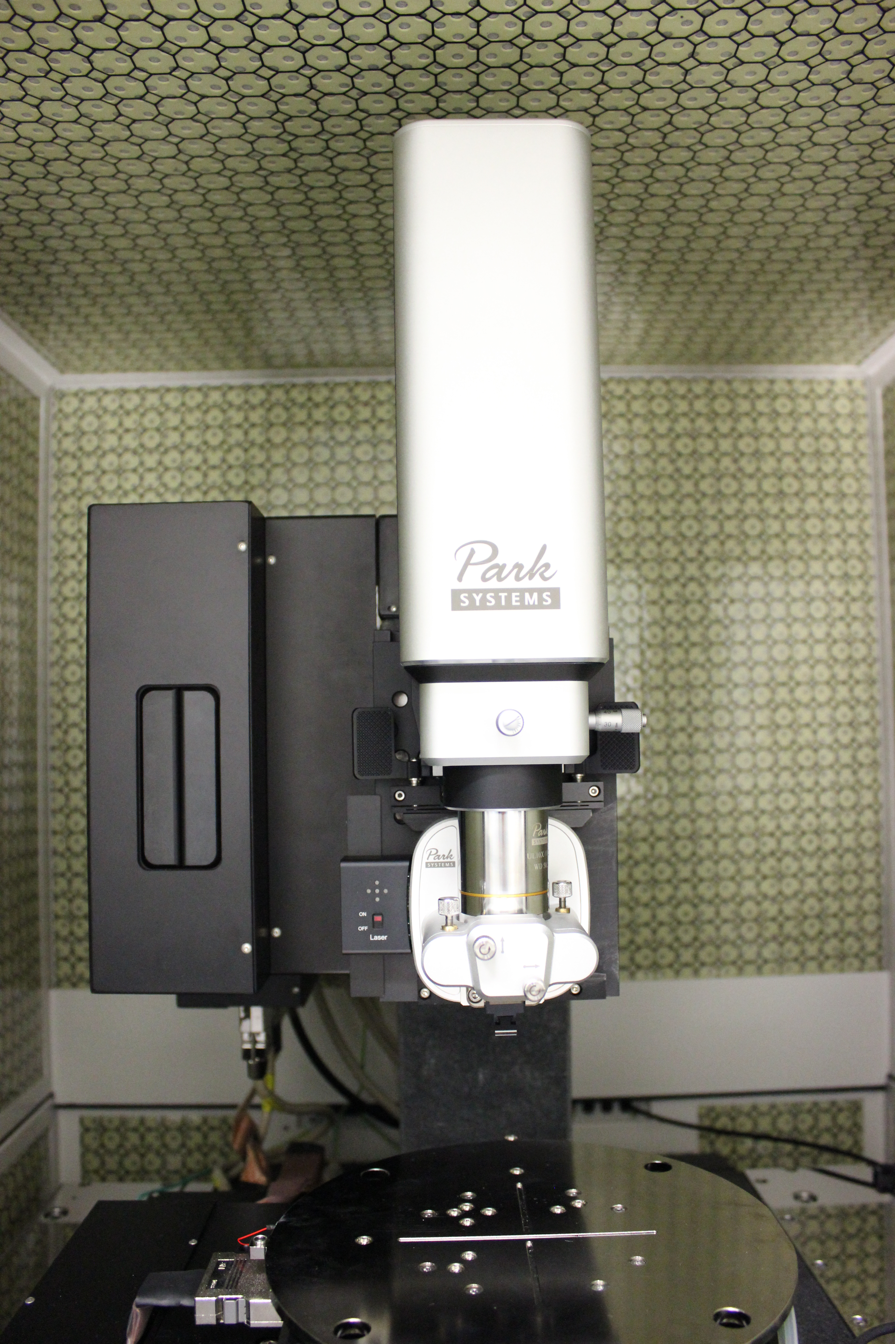
Multitechnique Approach…
Ionic Surface Analysis & Ionic imaging; (Andromede Facility)
Biological Sample preparation (Cryostat-cryosection) (Cellule de Biologie expérimentale)*Cryofixation knowledge!*
Topology >µm> Confocal microscope (plateforme vide & Surface/Panama)
Profilometer (Brucker Nanosurface division )
>nm> AFM (Scalp et Soleil)*
MEB-EDX (plateforme vide & Surface/Panama)
TEM-EELS (Nion UltraSTEM LPS Orsay)
XPS (ICMMO – projet Hibiscus-Polyions)*
Micro IR, IR Spectroscopy (Soleil-coll. IAS)*
Micro-Raman spectroscopy (soleil-Coll IAS)*

Slide 10
Surface Analysis
inter-disciplinary fields
Scientific activities
From 2018
Tagged protein Co-localisation
endotoxin research, bactéria / tissus
Basic research
Ions-Materials interaction, secondary emission mechanism
Interdisciplinary research
Surface analysis and ion imaging at Andromede, Au MeV's unique cluster probe,
Molecular identification at the nanometric scale, co-location, etc.
Instrumental research
R&D Ion sources, HIBISCUS ANR project
Biology
Search for organic and mineral phases / meteorites
Astrobiology
Accelerator
Science
Understanding of secondary emission processes disturbing acceleration fields (CERN)
Material
Modification
Understanding track creation processes
From 2021-2022
Ion Imaging and characterisation of wood (Prime80 ICSN)
MolyBee ( AAP IMI 2020) (ILV)
Study of the modification of archeo. organic materials under IBA (LAEC)
Chemistry
Notes:
Today there basic …
In fact these studies are performed in collaboration with a few group

Slide 11
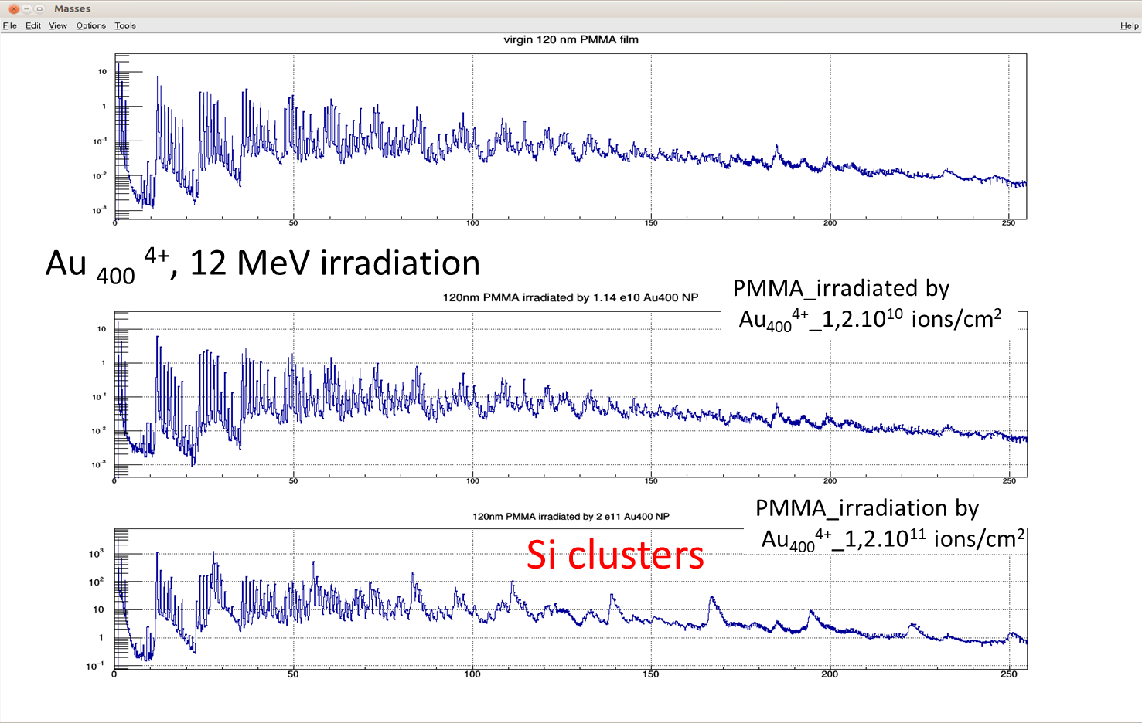
Advantages of nanoparticle beams
ANDROMEDE advantages of high energy nanoparticle
∅ Traces
Nion UltraSTEM
Graphene film
Hundreds of ions emitted by impact
100 to 1000 times more than current probes
Coincidences are possible IN the volume of emission
Structural studies at the nanometric scale
High sensitivity on all materials, from metals to biological samples
Analysis of « beam screens » from LHC-CERN
Suheyla Bilgen PhD (december 2020)
Track TEM images for impact of 12 MeV Au₄₀₀⁴⁺ projectiles on a 6 monolayer graphene foil.
Coll LPS UPSAclay
~100 nm
10 to 100 times more than the usual keV and MeV projectiles
Volume of organic matter ejected by impact : 10⁶ nm³ /impact
WITHOUT destruction of organic film
Confirmed by XPS
Dextrat XT A from Brucker Nanosurface division
Enhanced Sputter and Secondary Ion Yields using MeV Gold Nanoparticle beams delivered by the Andromede Facility
T-L. Lai, D. Jacquet, I. Ribaud, M. J. Eller, D. Verkhoturov , E.A. Schweikert, L.H.G. Tizei, F. Shao, S. Bilgen, B. Mercier, G. Sattonnay, S. Della Negra; published online, 07-13-2020, in JVST: B (Vol.38, Issue 4)
https://doi.org/10.1116/6.0000173
Notes:
I am going to give on this last transparency some advantages of the Nanoparticles that I will develop this evening.
First point the passage of 1 NP create a hole of 100 nm in a graphene foil, the second point the volume of emission reaches 106 nm3 but if you look at the emission from this film the response is surprising the film seems intact no damage !
Now the yields…..
As an illustration I present the analysis of a copper surface before and after conditioning of a beam screen maintained at ultra high vacuum 10-10 hPa at the LHC. The first thing we see with only 106 ions/cm2 is the evolution of the copper and thanks to the aggregates the change in the degree of ionisation the slight variation in shape indicates a deposit. And this deposit is a graphene film. Here is the carbon spectrum which is comparable to the graphene soectre obtained during the hole experiment. The interaction of the secondary ionic electron beams with the surfaces and.... the contamination of the initial surfaces because we have observed on these surfaces high mass polymer structures despite cleaning. Both spectra demonstrate the interest of these analyses.

Slide 12
Advantages of nanoparticle beams
MeV NP ions beams appear as a very powerful probe for surface analysis in a large field of applications.
The MeV NP projectiles induce very high emission yields whatever the surface (metals, semiconductors, organic films) whatever the type of ions: atomic, cluster and molecules
The huge emission yields per impact induced by these NPs allow a rapid information about the surface without destroying the organic material. Such this combination paves the way for profiling-type analysis of complex samples
Thanks to coincidences between the different ions emitted, impact by impact, it is possible to colocate the species and thus deduce the chemical environment, generating an imaging with a lateral scale of 100 nm.

Slide 13
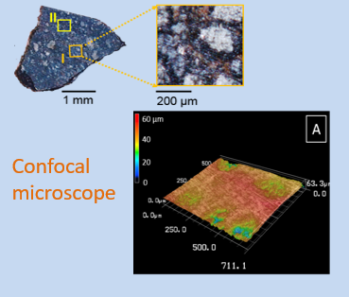
Mutitechnique analysis. Examples
Meteorite (coll. IAS, Arribard PhD thesis)
control of surface roughness

Slide 14
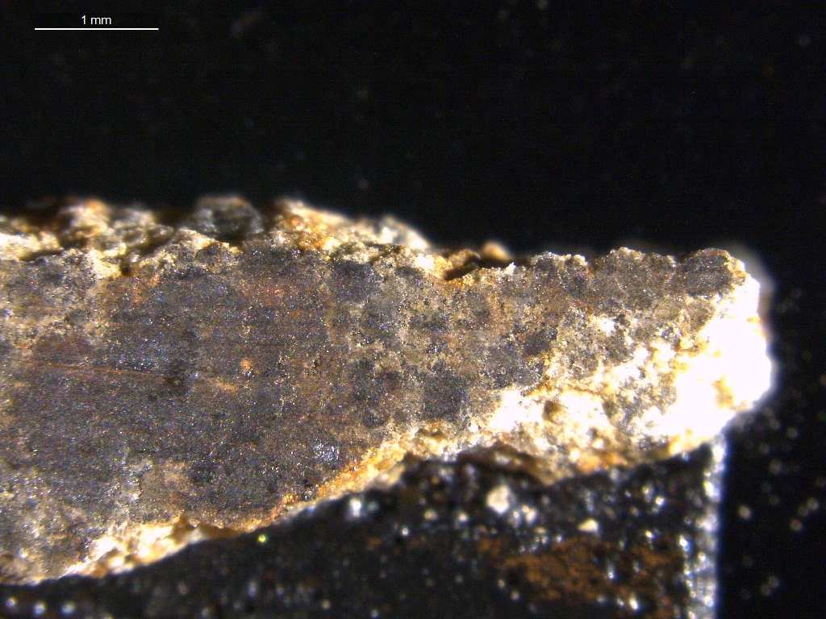
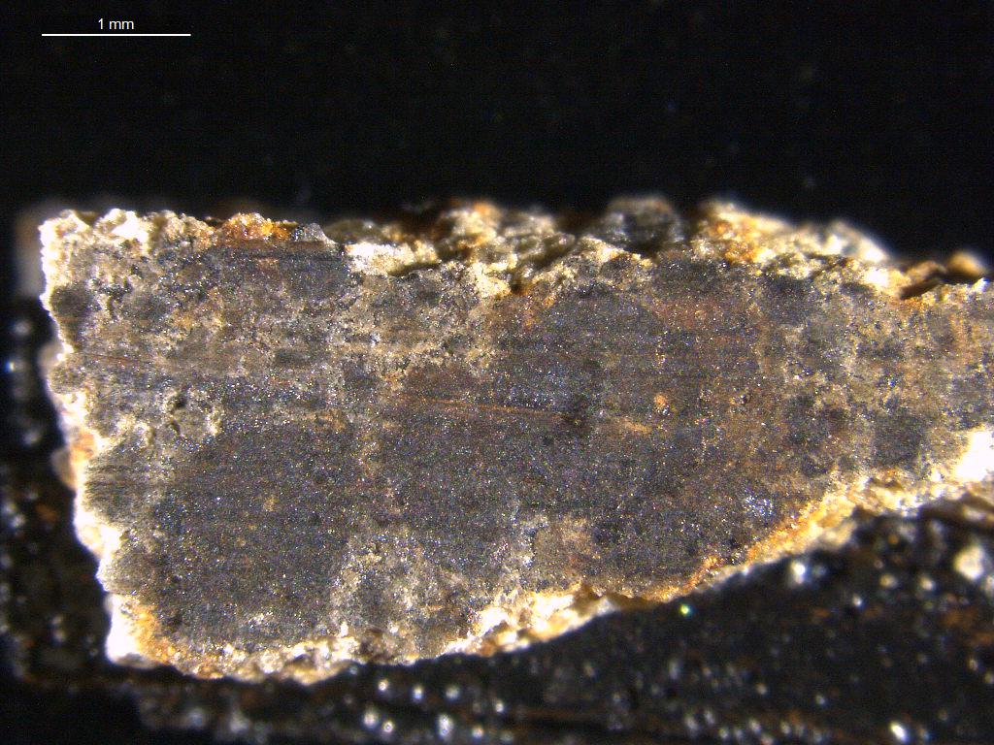
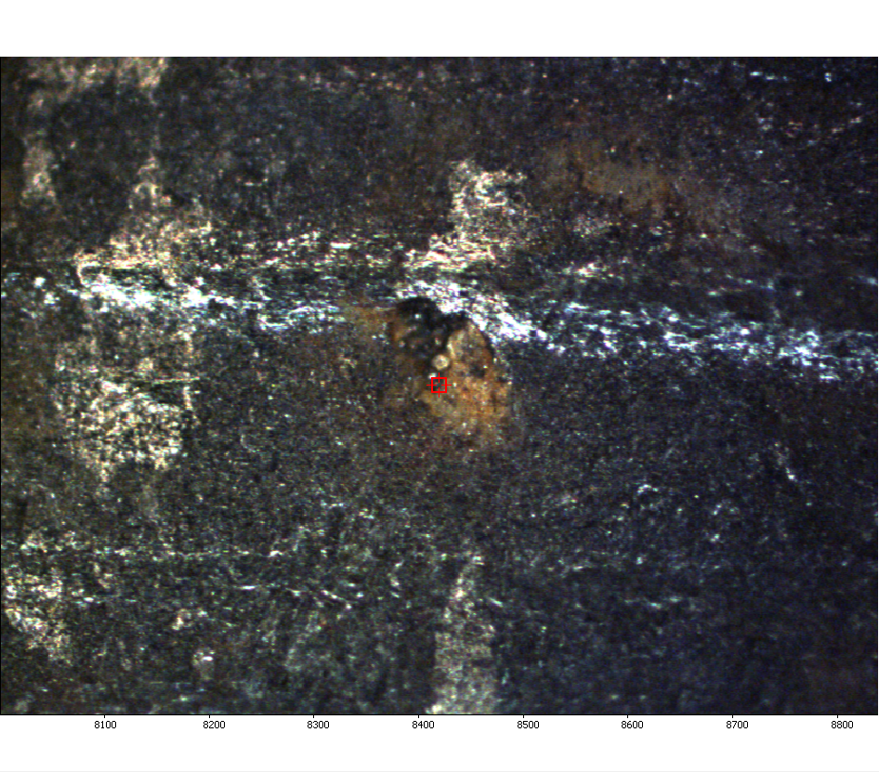
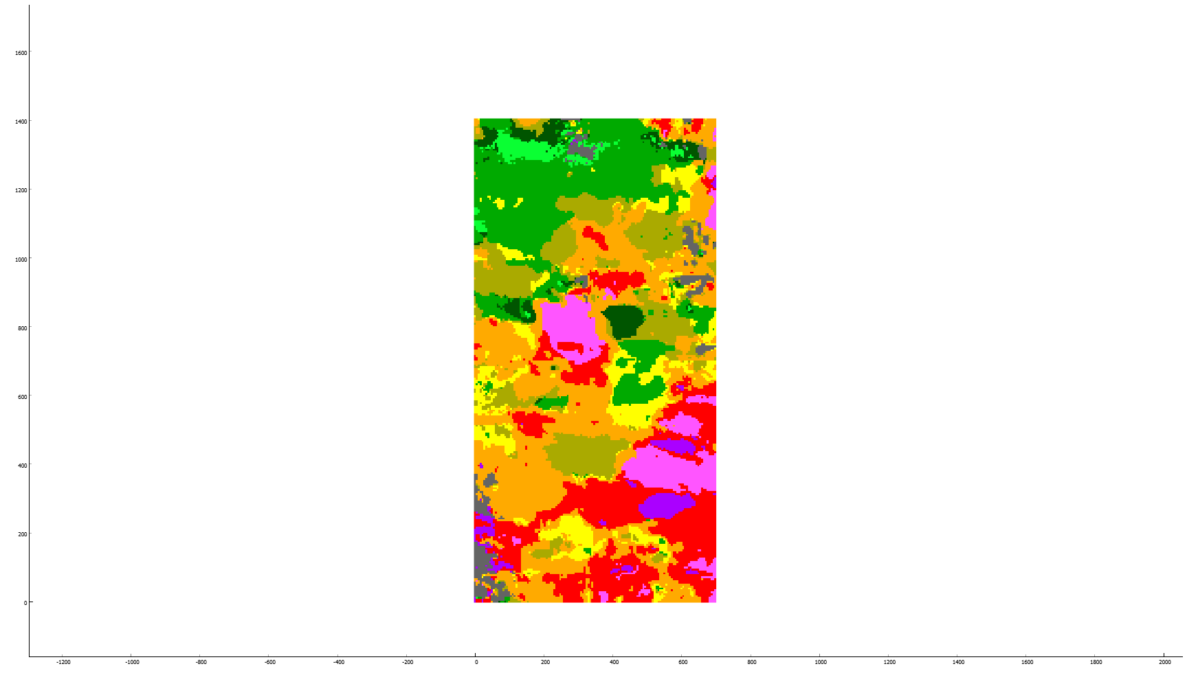
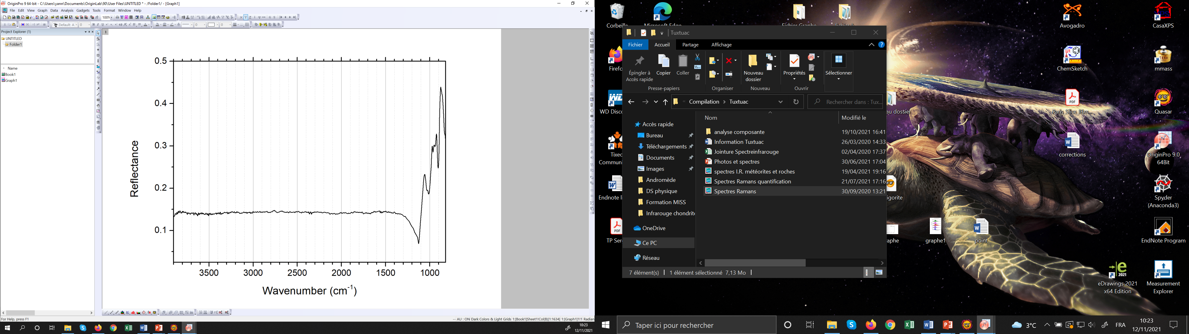
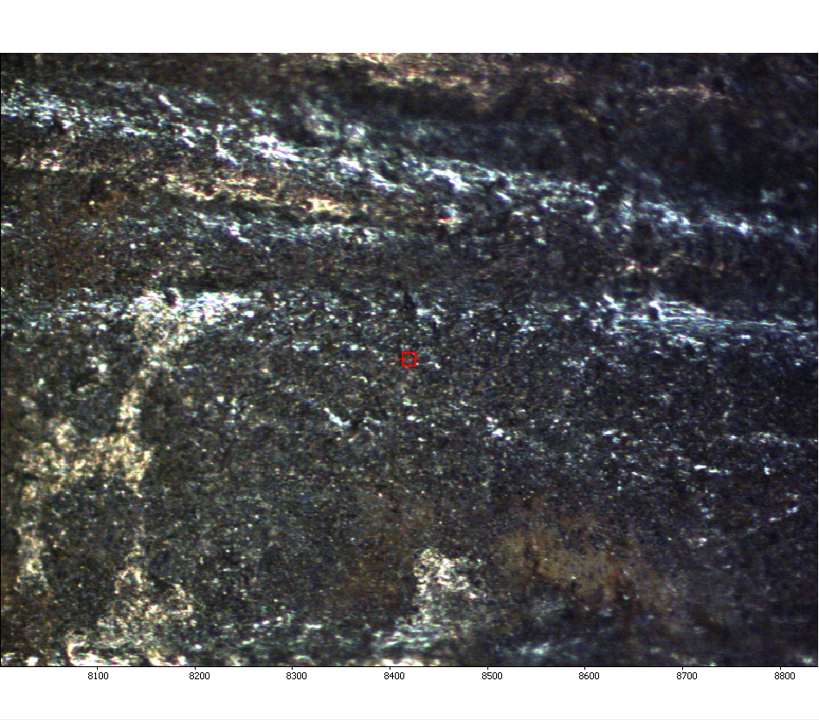
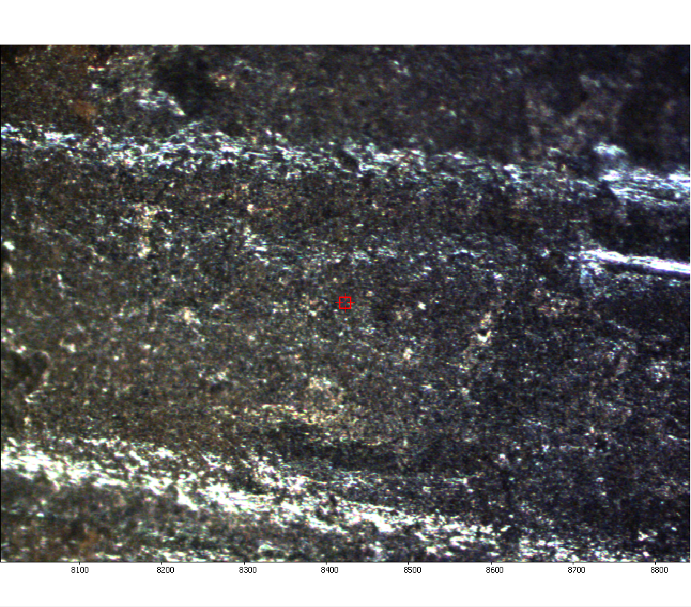
Mutitechnique analysis. Examples
Meteorite (coll. IAS, Arribard PhD thesis)
Tuxtuac
hyperspectral infrared spectroscopy by reflectance
f
Microscope (x15)
Spectromètre
(source globar + détecteur FPA)
1 mm
Elongation band Si-O :
Anhydrous silicates (enstatite)
Elongation band O-H :
hydration
1408 μm
Microscope IR Cary 670 (Agilent)
Measurement on a pixel matrix
Pixel size: 5.5 µm
Field of view: 704*704 µm²

Slide 15
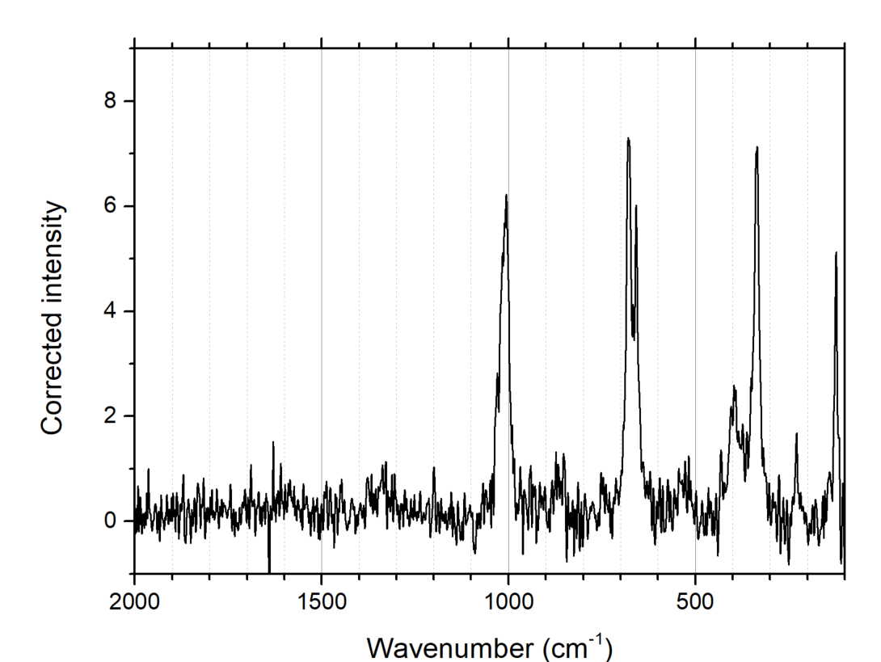
Mutitechnique analysis. Examples
Meteorites (coll. IAS, Arribard PhD thesis)
Tuxtuac
Micro-Raman spectrometry
f
1 mm
anhydrous silicate band: enstatite
No G and D band: no polyaromatic organic matter
1400 µm
Raman spectrometer
DRX (ThermoFischer)
Mesure ponctuelle
Diamètre de spot : < 1µm

Slide 16
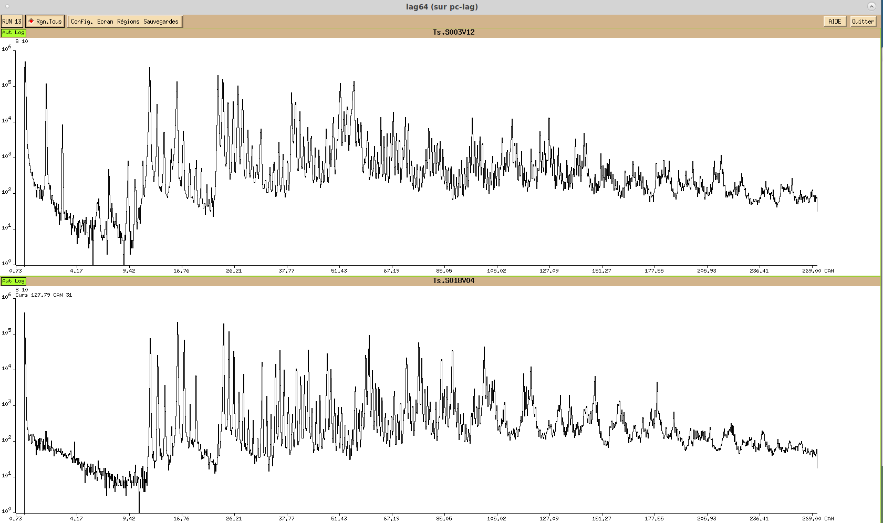
Mutitechnique analysis. Examples
Cr+, Fe+, Ni+
H⁺, H₂⁺, H₃⁺
Positive ions
Meteorites (coll. IAS, Arribard PhD thesis)
Tuxtuac
Calcium compounds
Mass Spectrometry and ion imaging (scanning)
K⁺
Ca⁺
Al⁺
Si⁺
Ca²⁺
Silicon oxide clusters
O+
C+
C_{n}⁻, C_{n}H⁻
Calcium compounds
Négative ions
H⁻
Silicon oxide clusters

Slide 17
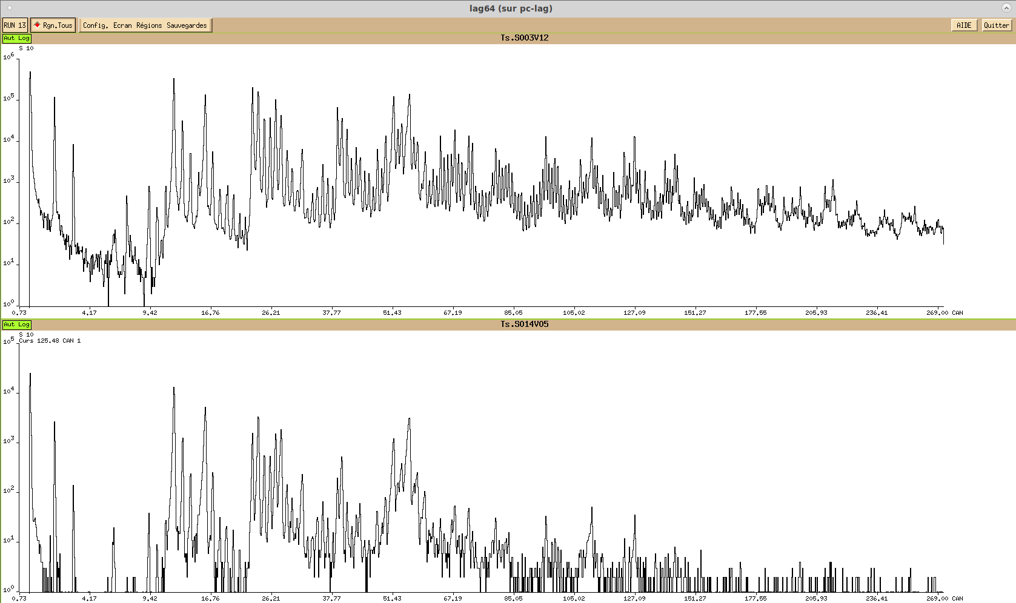
Mutitechnique analysis. Examples
Meteorites (coll. IAS, Arribard PhD thesis)
Tuxtuac
Mass Spectrometry and ion imaging (scanning)
Ca⁺

Slide 18
Mutitechnique analysis. Examples
Total Secondary Emission (Sabrina GOUASMIA BOUSSAHOUL, IRB)
EMIR&A
Crater shape measurement as a function of the metal deposit thickness
AFM
Secondary ion emission: cluster distribution and substrat ion emission
NP ToF SIMS-Andromede
Total sputtering measurement
Catcher technique and/or quartz-balance measurement

Slide 19
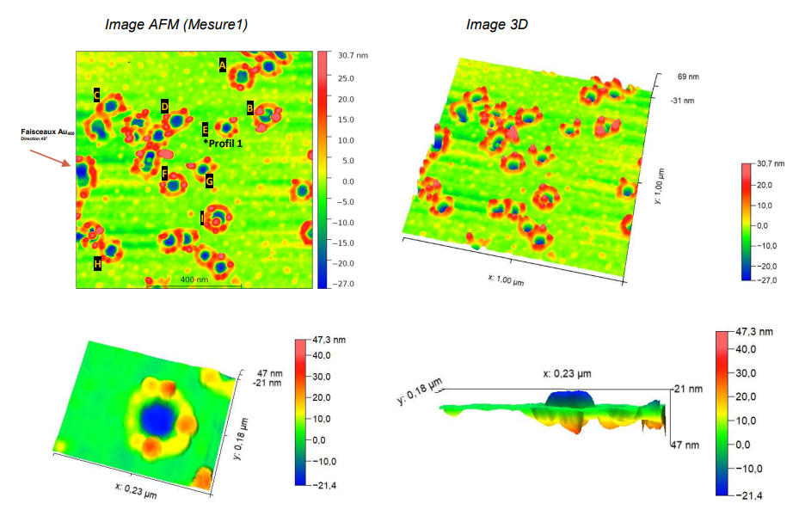
Mutitechnique analysis. Examples
Total Secondary Emission (Sabrina GOUASMIA BOUSSAHOUL, IRB)
AFM measurements
40 nm gold/Si « irradiated » by 12 MeV Au₄₀₀⁴⁺

Slide 20
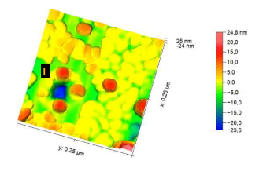
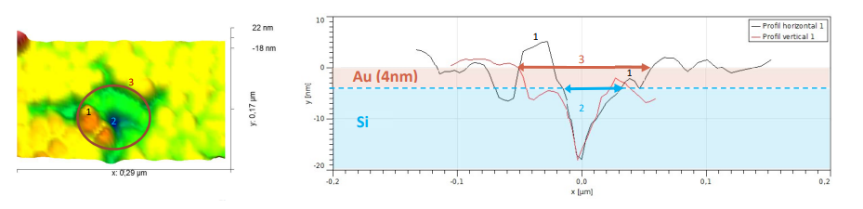
Mutitechnique analysis. Examples
Total Secondary Emission (Sabrina GOUASMIA BOUSSAHOUL, IRB)
AFM measurements
4 nm gold/Si

Slide 21
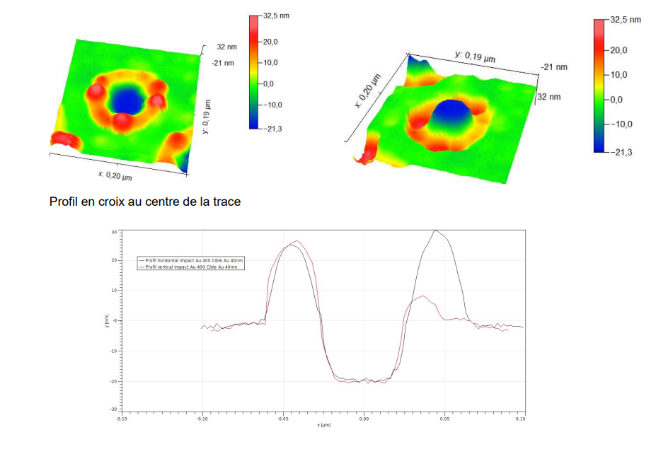
Mutitechnique analysis. Examples
Total Secondary Emission
Top view
Bottom view
Giant volume correlated to HUGE ion emission with several hundreds of secondary ions emitted per impact
12 MeV Au₄₀₀⁴⁺
50 nm
20 nm
Gold surface (40 nm/Si)*
Crater profil
* Samples provided by IRB(Croatia)
Notes:
Now Gold sample There is similar behaviour and conclusion The shape of the crater is cylindrical and we have an axial symetry. The rim around the crater indicates that a large amount of matter set in motion. This needs melting and high pressure. An indication the gold atomic projectil with 30 kev is stopped in the first 5 nm of gold !

Slide 22
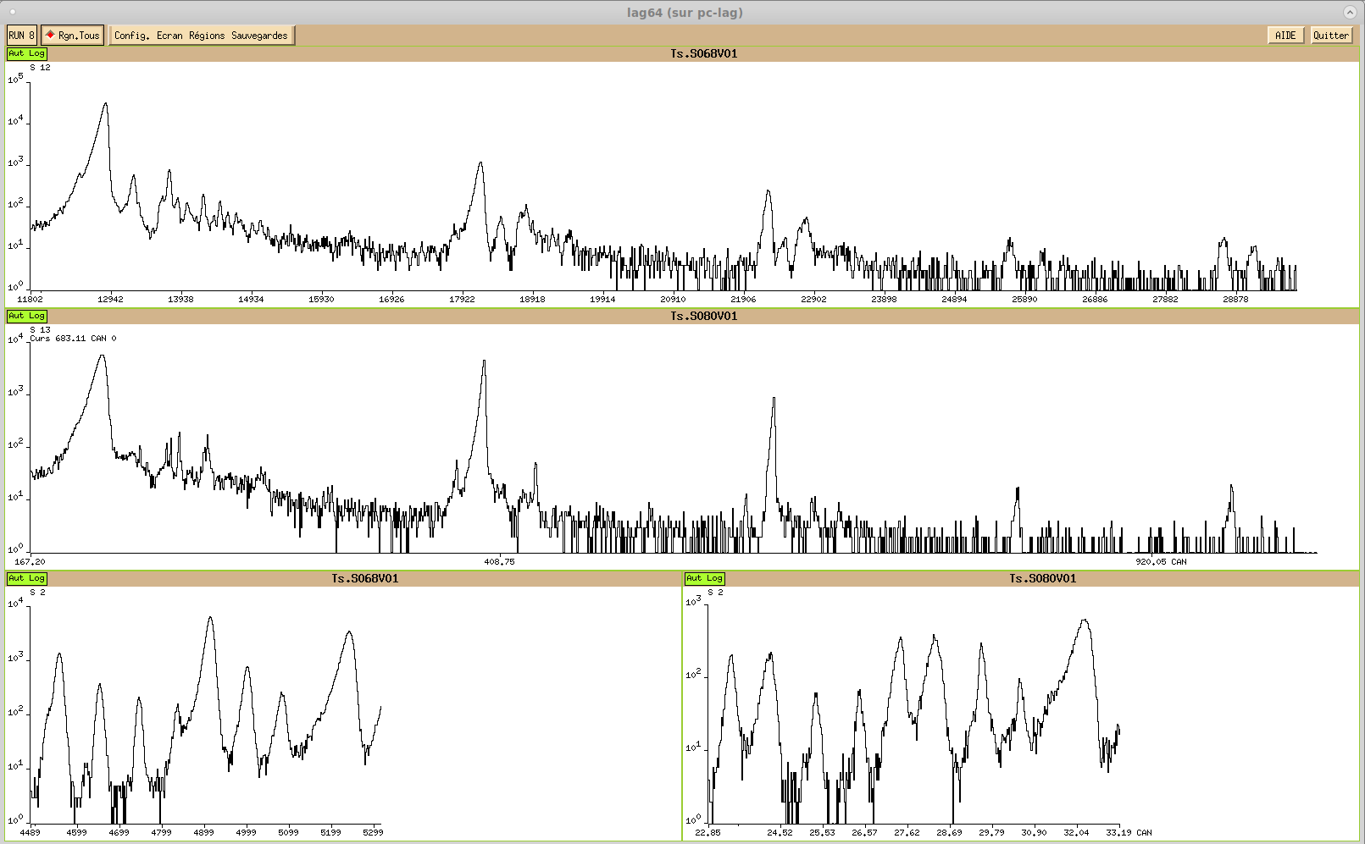
Mutitechnique analysis. Examples
Total Secondary Emission
12 MeV Au₄₀₀⁴⁺
Au⁺
Au₂⁺
4nm Gold target
Au₃⁺
Au₄⁺
Au⁺
Au₂⁺
Au₃⁺
20 nm Gold target
Au₄⁺
Au₅⁺
²⁸Si
4nm Gold target
²⁸Si
20 nm Gold target
Yield (²⁸Si)= 2.36
Yield (²⁸Si)= 0.09

Slide 23
Mutitechnique analysis. Examples
Total Secondary Emission
Gold cluster distributions as a function of the thickness of the gold target (12 MeV Au₄₀₀⁴⁺)

Slide 24
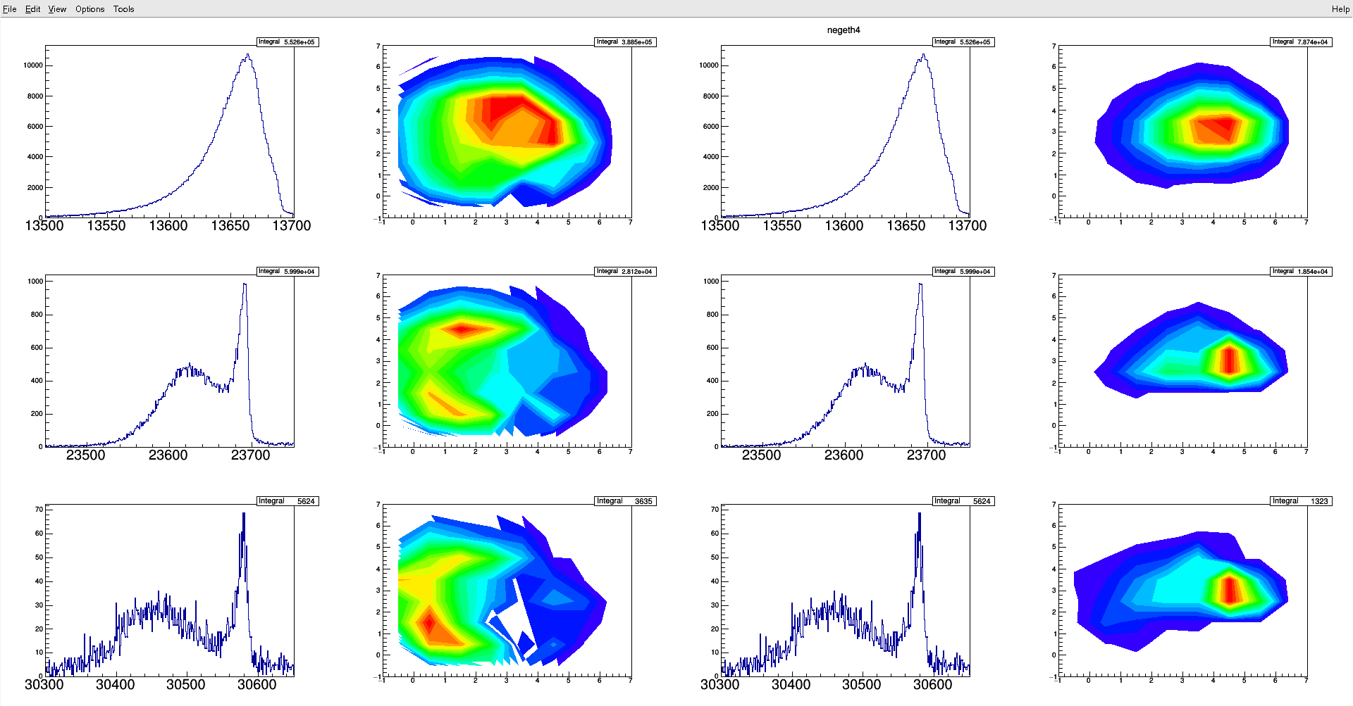
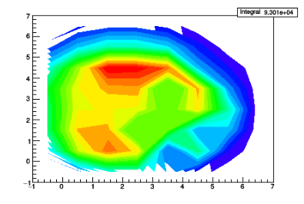
SECONDARY EMISSION MECHANISMS INDUCED BY MeV GOLD NANOPARTICLES
Gold nanoparticles on gold surface
Two coincidence windows
Au⁻
Two processes :
1- Curtain emission with high axial velocity but
Similar radial velocity ? Sound velocity Shockwave ?
2- rebound in the projectile direction
Au₃⁻
Beam
Au₅⁻
15/10/2021
Notes:
Organic samples are very intersting but complex What happens for simple sample as gold target. Gold on gold it is a very simple No
In fact is more complex.
I don’t talk abour the axial energy for molecular ion emission because the energy is small in the eV range. Just an information before description of the results the yiels are very large around 50 ions per impact and the detection efficiency is 36 % terfore a least hudred gold are emitted simultaneously.
Now results: For gold ion emission; the axial energy determined from the time of Flight presented here at the left of figure is very large a few hundreds eV the distribution seems maxwellian for Au but it is not so clear for cluster ions and we observe two distributions with a low energy and high energy. Time windows to select high energy give the urtain emission whatever the axial energy Bu if we select the low energy par or the low energy peak we otain another angular emission in the direction of the beam with a low radial and axial velocity

Slide 25
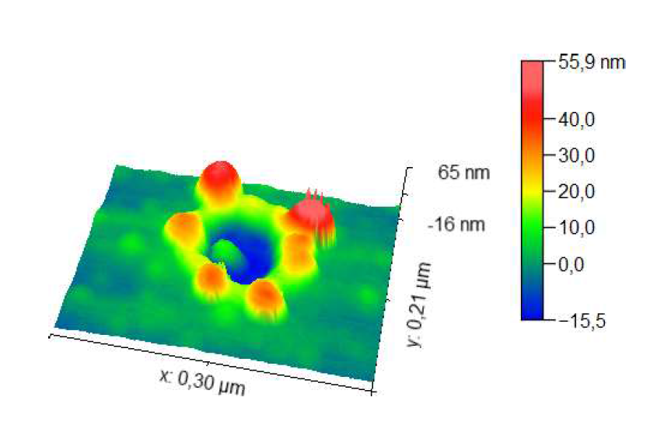
SECONDARY EMISSION MECHANISMS INDUCED BY MeV GOLD NANOPARTICLES
Au₇₀₀⁵+, 3 MV/ Au40 nm
Rebound !
Rim
There is not specific direction for these structures corresponding to the final frozen state of the solid. There is a variety of rim structures and « rebound »shapes.
BUT: the distribution of diameters and depths are monodisperse.
Signature of given pressure and temperature ?
Question: relationship between crater volume, amount of matter set in motion and ejected matter (ions and neutrals) ?
Notes:
In fact the crater are not simple with gold target. The diamter and depth are very similar for all but the topology of the rim and inside the crater present differences I show you an example which is common. The main conclusions are:

Slide 26
SECONDARY EMISSION MECHANISMS INDUCED BY MeV GOLD NANOPARTICLES
Conclusions
Andromède: De la pluridisciplinarité à l’interdisciplinarité *
Atouts d’IJCLAB: Instruments et compétences complémentaires
Vide & Surface/Panama, Scalp, Biologie expérimentale
Interactivité des collaborations scientifiques:
Ouverture vers de nouveaux instruments et compétences
* Pluridisciplinarité : co-présence et coordination de disciplines autour d’un objet d’étude .Interdisciplinarité : à la faveur de ladite co-présence, enrichissement mutuel des disciplines par échanges des connaissances, des analyses, des méthodes
15/10/2021
Notes:
The use of such massive clusters associated with multi-anode detectors, allowing the simultaneous detection of several ions of a given mass, permits correlation studies between the emitted ions within a single impact, shedding additional light on the chemical composition and structure of the analysed sample for various samples from metallic surfaces to biologic molecules deposits.

