Slide 1
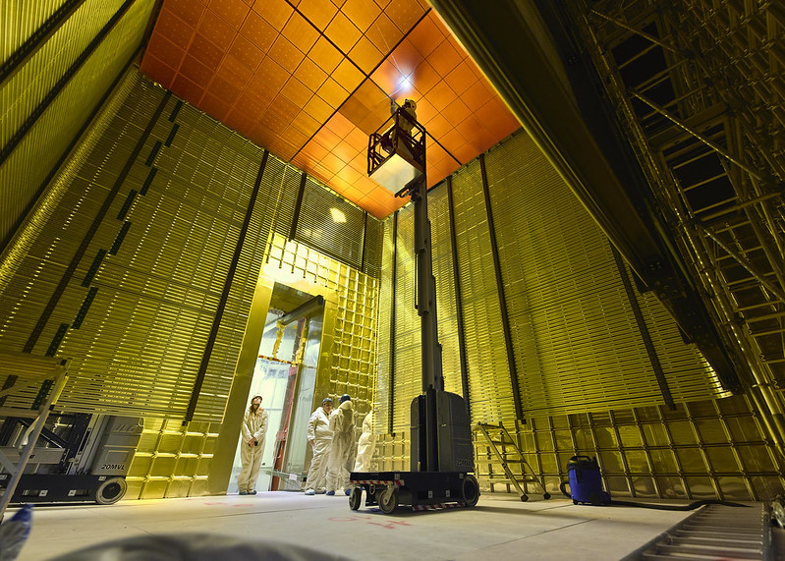

Outline
The DUNE Experiment
The Neutrino Oscillation in DUNE
The Vertical Drift Detector
DUNE@IJCLab
Fabien Cavalier
Flavor Day
27 Octobre 2021

Slide 2
Neutrino Oscillation Mechanism
Oscillation phenomena between two species (α and β) is possible if :
The mass spectrum is not degenerated (Δm² = m_{α}²-m_{β}²≠ 0) => oscillation frequency
The mass eigenstates are not the flavor eigenstate (θ ≠ 0) => oscillation amplitude
PMNS matrix connects the mass eigenstates (1,2 and 3) and the flavor eigenstates (e,μ and τ).
Similar to the CKM matrix in the quark sector.
Parametrized using 3 mixing angles θ₁₂ (“solar”), θ₂₃ (“atmospheric”) and θ₁₃ (“reactor”) and a phase δ_{CP}.
Oscillation mechanism sensitive to difference of squared masses, not to absolute mass.
Ordering of the masses is still unknown : Normal or Inverted ?

Slide 3
Schematic view of the DUNE Experiment
Muonic Neutrino/Antineutrino beam produced at Fermilab starting from a 60-120 GeV proton beam with P ~1.2 MW, upgraded to 2.4 MW
A Near Detector (580 meters after the target) to precisely measure composition, energy and flux of the beam and cross-sections => Mandatory to reduce systematics
A Far Detector (1300 km away) made of 4 independent modules based on LArTPC technology

Slide 4
Expected Spectrum in DUNE

Slide 5
Science Program
Key goals
Oscillation measurements
Search for proton decay in several modes
Detect and characterize the ν_{e} flux coming from a galactic core-collapse supernova
Ancillary program
Accelerator-based neutrino flavor transition measurements with sensitivity to beyond the standard model (BSM) physics
Non-standard interactions (NSIs),
Lorentz invariance violation
Charge, parity, and time reversal symmetry (CPT) violation
Sterile neutrinos
Large extra dimensions
Heavy neutral leptons
Tau neutrino appearance
Measurements of neutrino oscillation phenomena using atmospheric neutrinos
Dark matter
Neutron-antineutron oscillation
Measurements of neutrino cross sections and studies of nuclear effects using the Near Detector

Slide 6
Detection Principle
Detection of the tracks of charged particles produced by neutrinos interactions
Detection of the scintillation light from Argon at 126.8 nm (eventually from Xenon if doping is used)
Constraints on LAr purity for long drifts (lifetime from 3 to 5 ms)
=> Perform tracking, calorimetry and particle identification (dE/dx)
Anode Plane

Slide 7
Vertical Drift concept
Liquid Argon TPC
Internal dimensions
62 m long
15.1 m wide
14. m tall
17.4 kT of Liquid Argon
Fiducial mass ~15 kT

Slide 8
The Vertical Drift Concept
Single Phase Detector
Cathode at mid-height (-325 kV) leading to 2 drift volumes
Fiducial mass increased to 14.7 kt
Anode readout PCB-like
Modular Construction

Slide 9
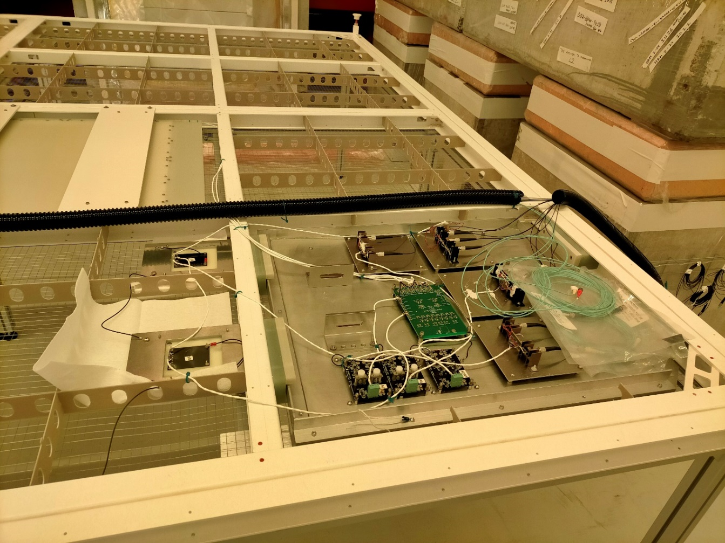
DUNE@IJCLab
4 permanent physicists : Yoann Kermaïdic, Thibaut Houdy, Laurent Simard and myself
Motivated by Mass Hierarchy and PMNS matrix (and beyond) studies => activity to be really develop in the coming years
Technical responsibilities for Vertical Drift detector (strong support for Mechanics service)
Cathode which delivers the drift field
Feedthrough for Top Electronics
Strong involvement in tests at the CERN neutrino Platform

Slide 10
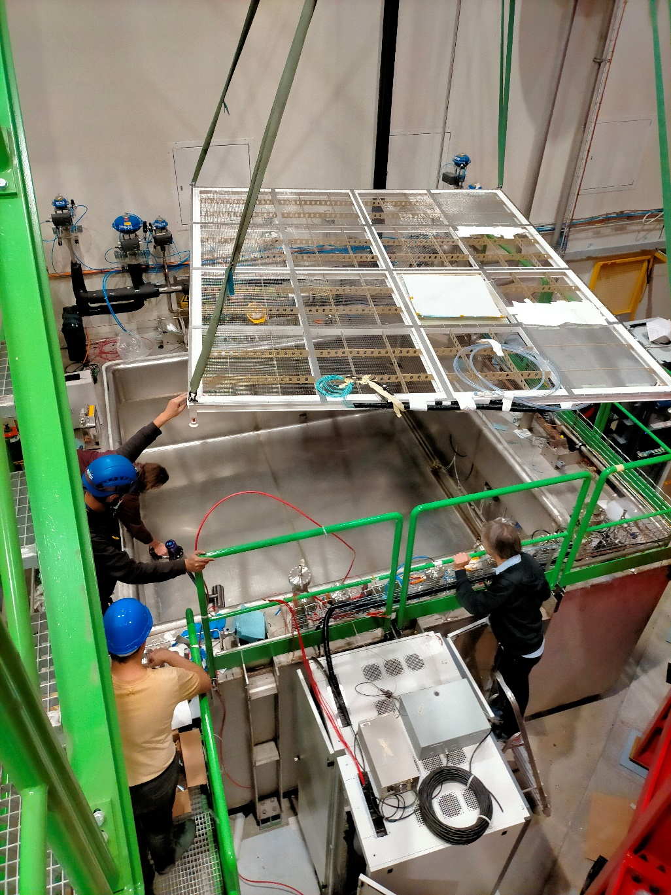
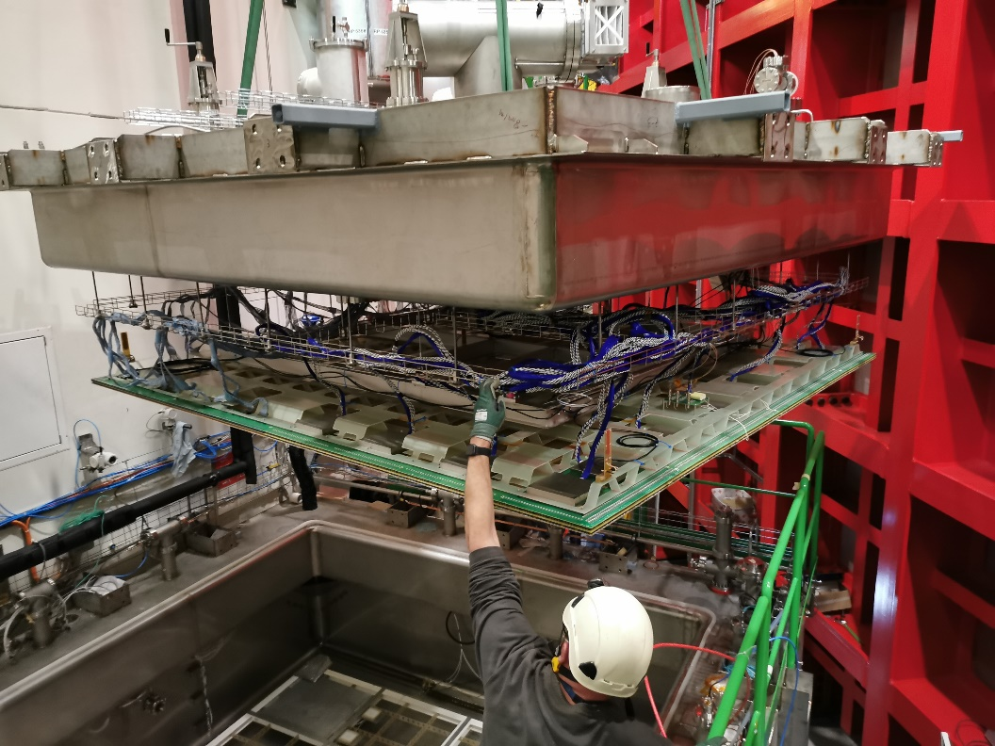
Cathode installed in ColdBox cryostat
CRP Insertion in the ColdBox
Start of commissioning this week in gas phase before LAr filling

Slide 11
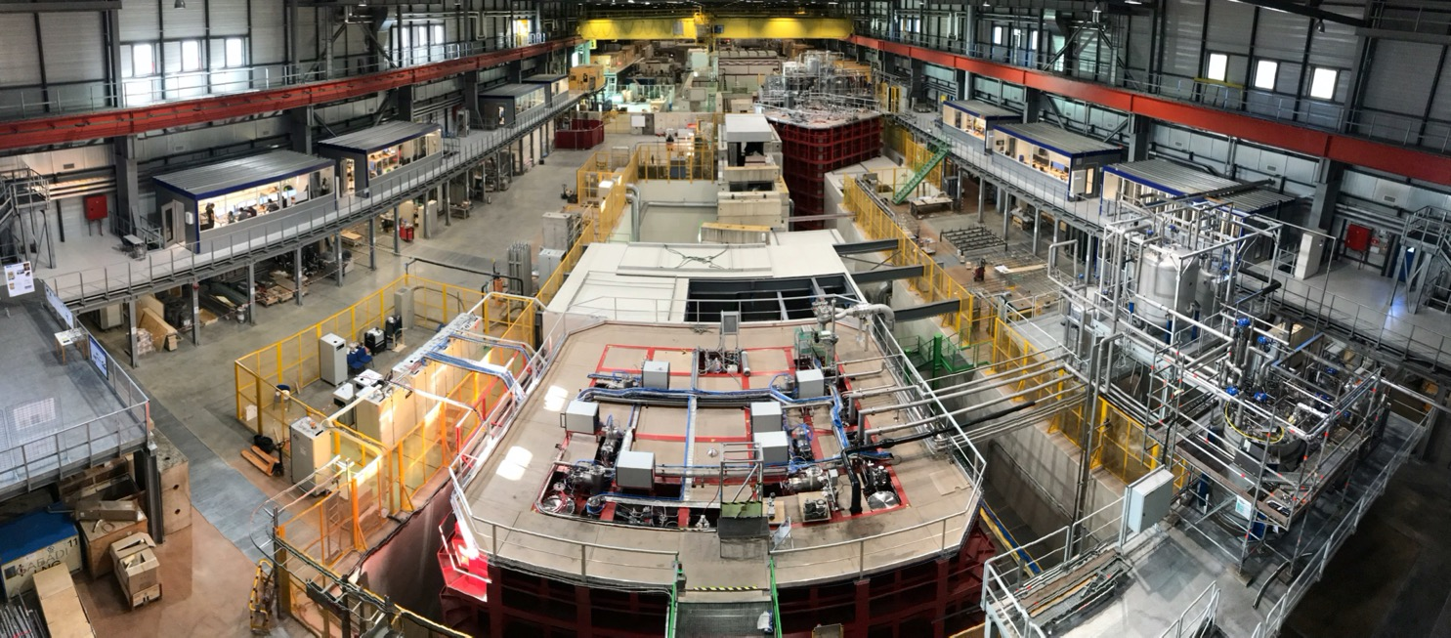
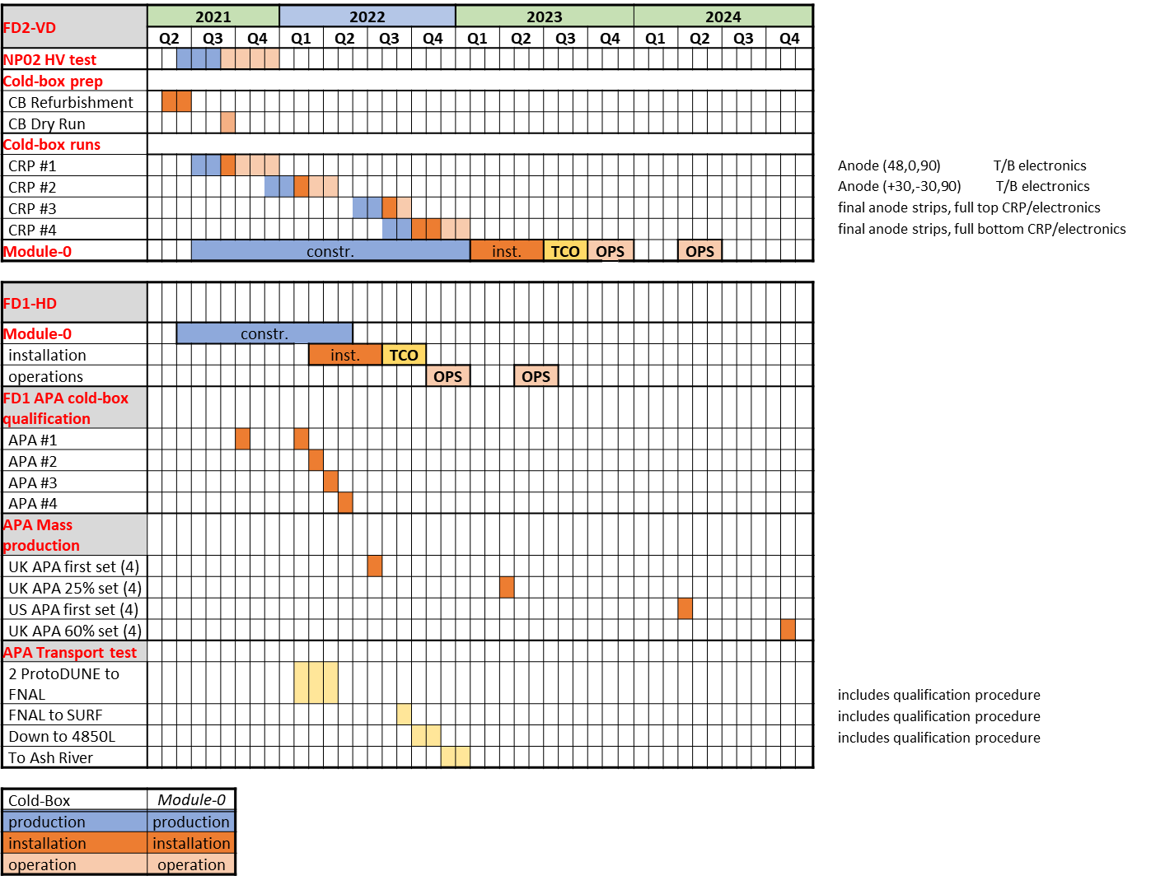
Vertical Drift Module-0 in NP02
Almost a scale 1:1 test
Mandatory step to validate integration of all elements before mass production
Production Readiness Review foreseen at the end of 2023

Slide 12
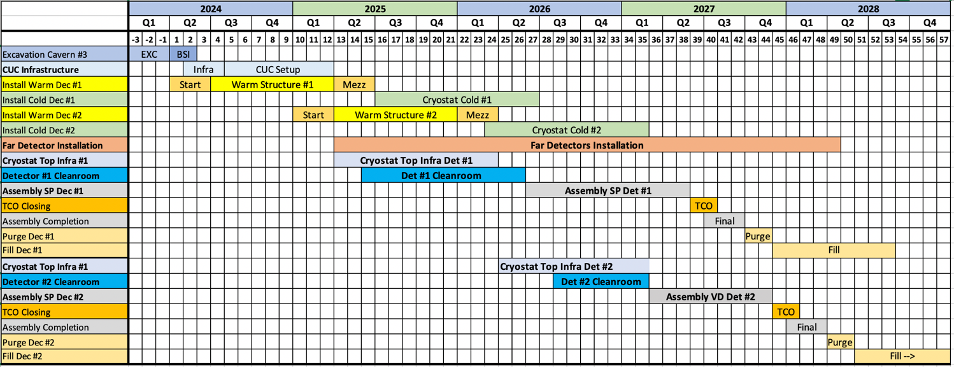
An aggressive planning
VD Module Production
VD Module Installation

Slide 13
Conclusion
DUNE will be one of the major neutrino experiments at the end of this decade
Mass hierarchy will be determined and large set of CP violating phase will be explored
Among all possible scientific topics, the Neutrino team wishes to contribute to the determination of the mass hierarchy and the measurements of the PMNS matrix.
From the technical point of view, the group is positioned on two contributions:
the chimneys for the electronics
the cathode which creates the electrical field needed for the drift. The group will be involved in the simulation (mechanics and electrical) of the cathode, estimating the impact of the design on the physics performances
The Vertical Drift concept is promising but has to be fully established and approved in 2022-23

