Slide 1
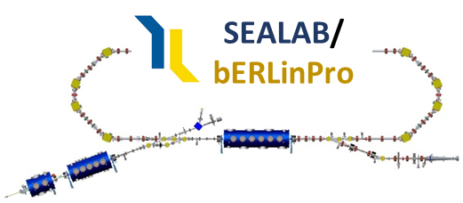

Status and Perspective
of the Energy Recovery Linac at Helmholtz Zentrum Berlin
12/10/21, A. Neumann
IJClab Accelerator Seminar
Today
online

Slide 2
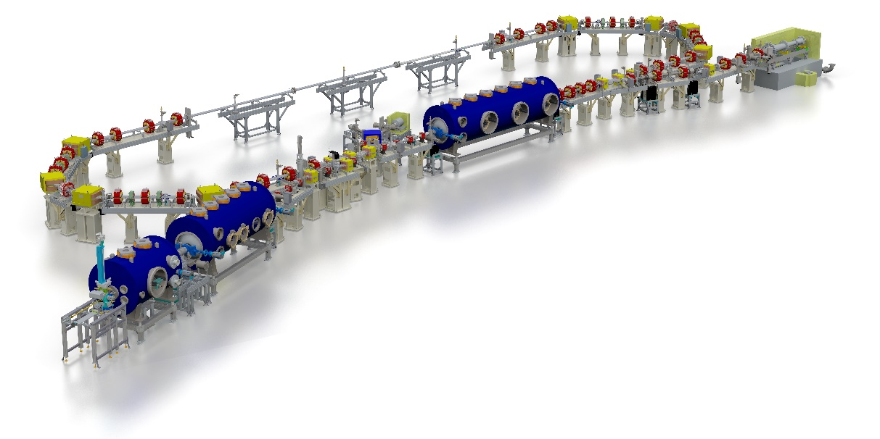
Outline of today’s presentation
outline
Introduction:
Why do we build an ERL?
Challenges for ERL design and operation
Achievements during the bERLinPro project phase
Mishaps and problems during the project phase
SRF Gun Cavity development and operation
Design studies for the main Linac
SRF Booster injector and high power coupler conditioning
Status of the warm machine and technical installations
Outlook: What are we doing next, applications for bERLinPro
Injector studies and UED driver
Test facility for HEP ERL studies
bERLinPro: An ERL demonstrator project
Artist view of bERLinPro Energy Recovery Linac Project at Helmholtz-Zentrum Berlin in Berlin Adlershof

Slide 3
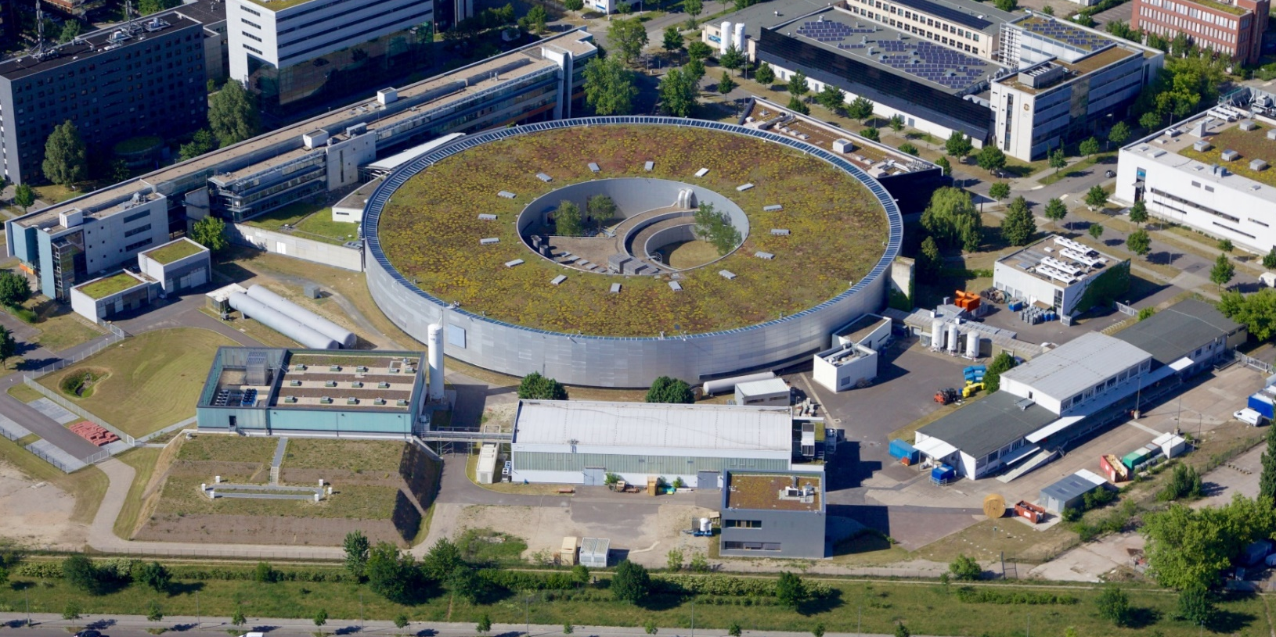

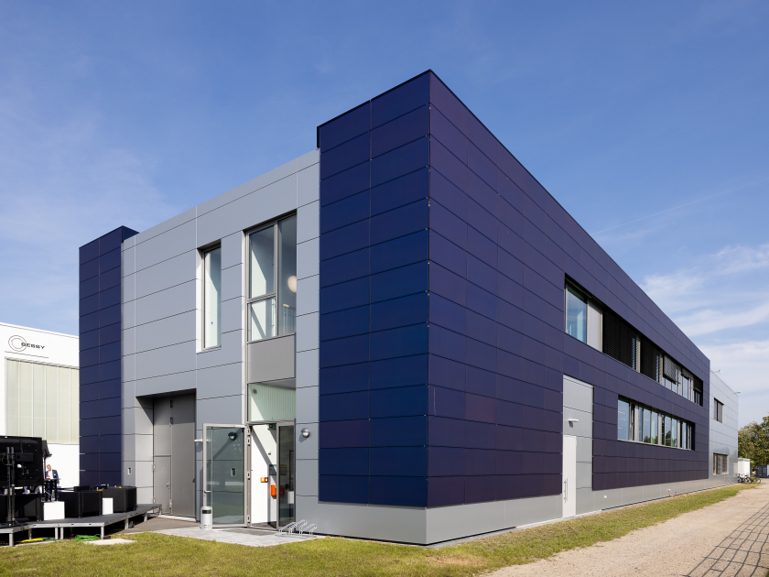
Where is bERLinPro?
Where are we?
Location
Fala-FEL Place
BESSY II
MLS
Berlin
897.5 km
Orsay
N
SLH
bERLinPro
TH2, TH1: Cleanrooms, SRF Teststands

Slide 4
Why bERLinPro, why ERLs?
Introduction
From next generation Lightsource to many applications, e.g. HEP
Next generation multi-user light source
(e.g XFEL oscillators, multi-ID facility as former ARC-en-ciel or 4GLS)
High energy electron cooling of bunched proton/ion beams
(e.g. hadron cooling of Electron-Ion-Collider EIC by BNL/JLAB)
Many applications bERLinPro would deliver important results or milestones for
Ultra high luminosity electron – ion collider (EIC, LHeC)
(ERL serving as high intensity electron factory for electron hadron collisions at LHeC (7TeV p, 50 GeV e-), similar as former HERA )
Compact radiation sources
(FEL, inverse Compton sources, next generation lithography, THz facility)
and more …: UED by injector
ERLs allow efficient operation at high average brightness/luminosity with Linac class beam quality
→ Reduces ecological footprint of large scale science, especially when combining with higher T_{C} SRF technology

Slide 5

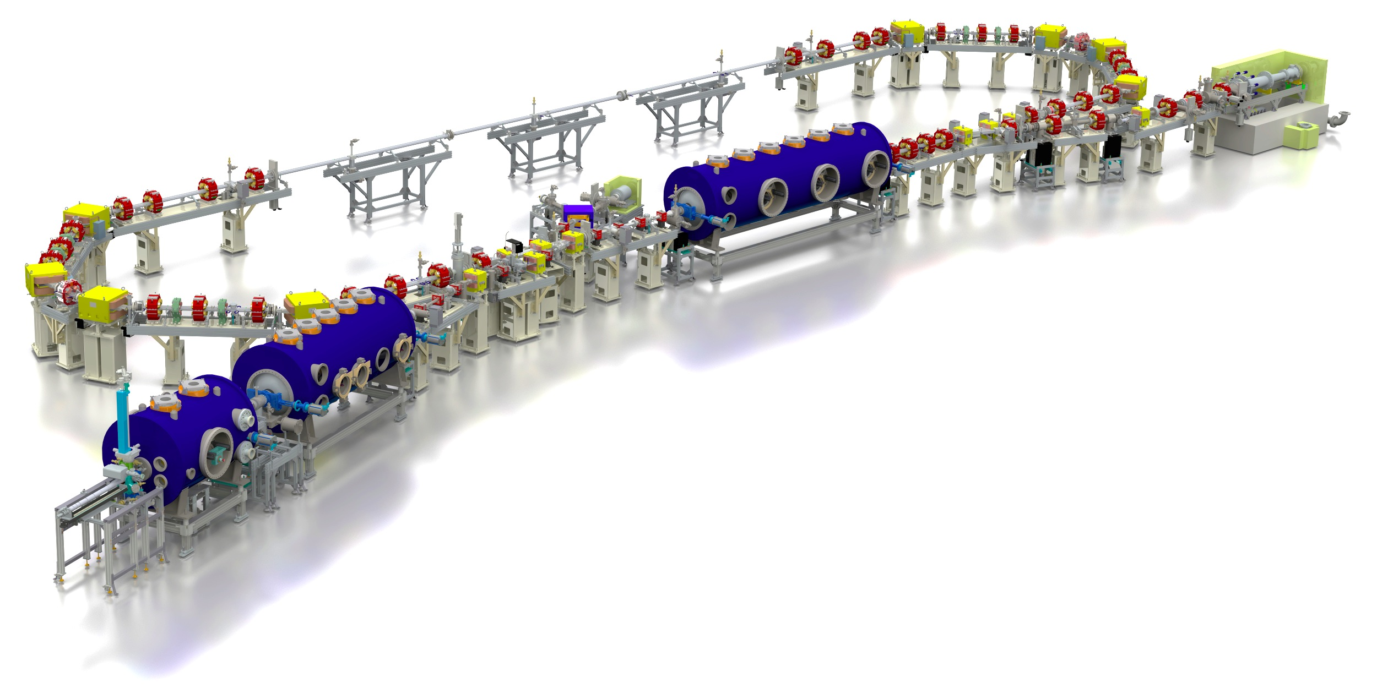
bERLinPro ERL after re-scoping in 2012
introduction
bERLinPro: A demonstration facility for ERL science and technology
New developments:
Beam dynamics and manipulation (merger, recirculator, study beam break-up)
SRF systems: Photo-injector, high power booster, HOM damped Linac
Electron source: High repetition laser system high QE cathode development
Control of beam losses and radiation protection
High power beam dump
High power CW RF
Few 100 kW class klystrons → Power couplers!
Some 10 kW solid state amplifier
Diagnostics, synchronization machine protection, beam loss monitoring
A stable Cryoplant
Recirculator
test and diagnostic line
beam dump
6.5 MeV, 100 mA
= 650 kW
linac module
3 x 7 cell SRF cavities
44 MeV
merger
dogleg
modified Cornell booster
3 x 2 cell SRF cavities
4.5 MeV
Parameter | bERLinPro
Beam energy recirculator (MeV) | 50
Beam current ERL mode (mA) | 100
Frequency RF and Laser (GHz) | 1.3
Normalized emittance (mm mrad) | 1 (< 0.6 in simulations)
Bunch length (ps) | < 2 (ERL mode), 100 fs @ 10 mA
Beam losses | << 10⁻⁵ @ 100 mA
srf-gun
1.4 cell SRF cavities
1.5-2.3 MeV, single SC solenoid,

Slide 6
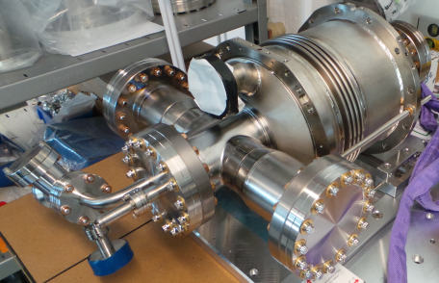
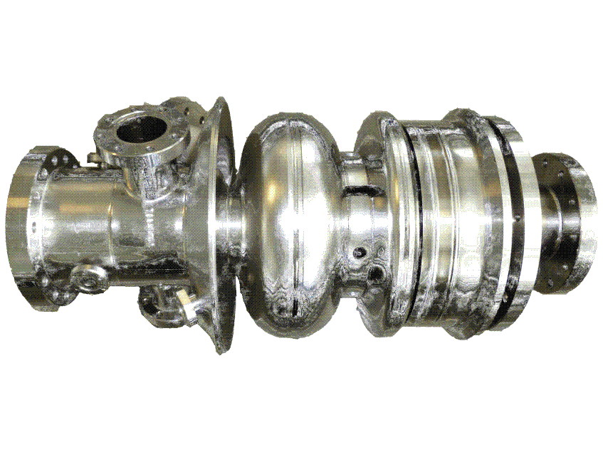
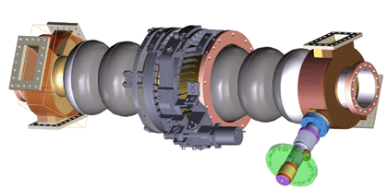
Challenges for the SRF systems
Introduction
+4.5 MeV (100mA)
Compact machine: All vacuum parts need to be treated within ISO 4-5 environment
SRF booster cavity (Cornell)
High beam power
High beam current
Intermediate field levels 10 MV/m
Low coupler kicks
Zero-crossing operation
+45 MeV (2x 100 mA, recovered)
Main linac cavity
2.3 MeV, 100 mA
SRF Gun:
Low emittance high brightness beam
Insertion of a thermally isolated high QE Cs-K-Sn cathode (particulate free)
Control of field emission to avoid dark current based losses and halo formation
High current, high beam power operation (HOM, FPCs)
High emission RF field → beam dynamics optimized shape
Avoid coupler kick based emittance dilution
Synchronization Laser ←→ RF, precise RF control
Low beam power
High beam current
Strong higher order mode damping
Higher field levels 19 MV/m
Multi-pass beam
Precise field control and tuning

Slide 7
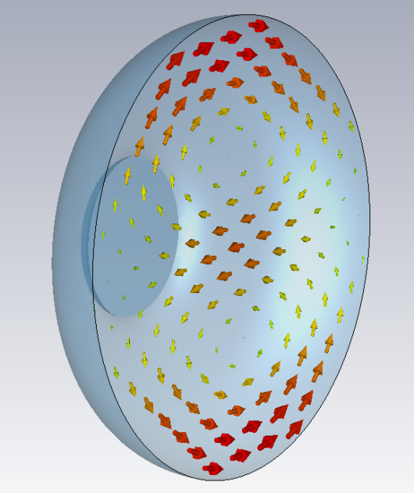
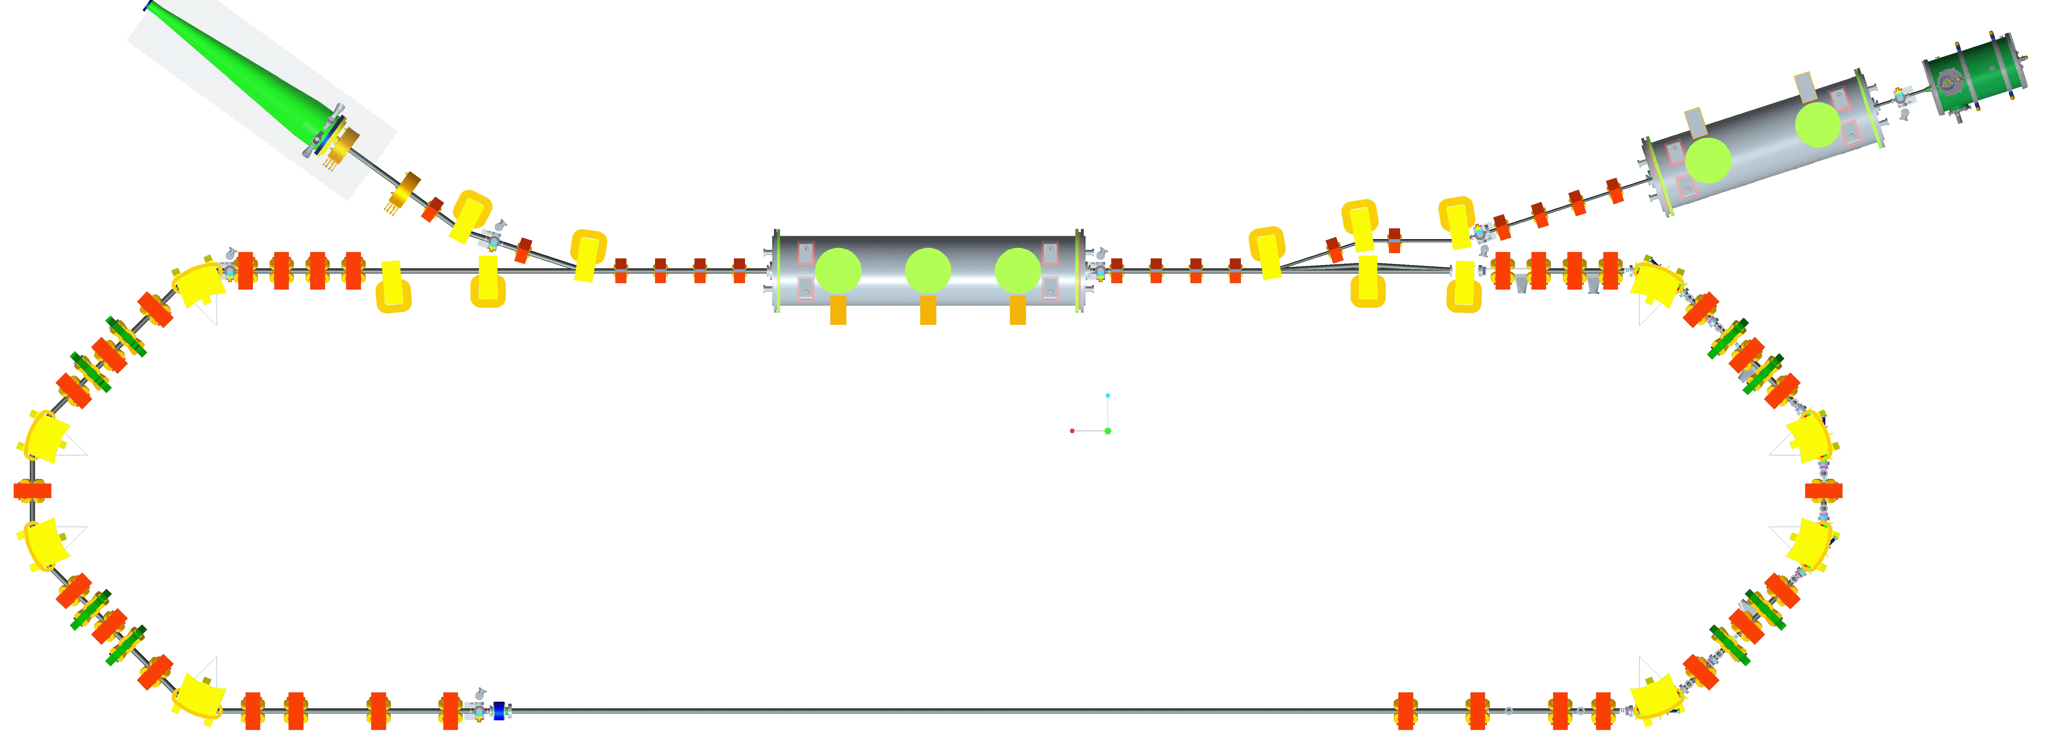
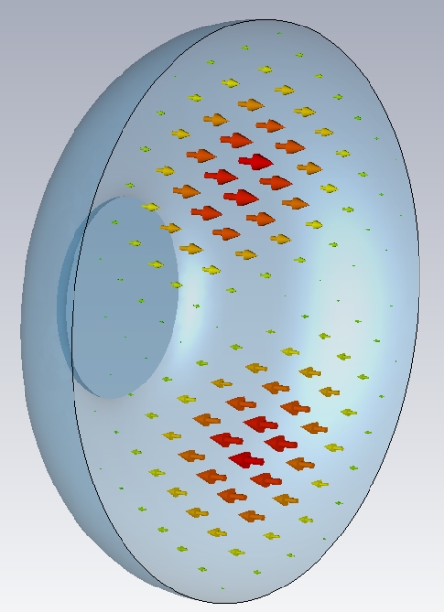
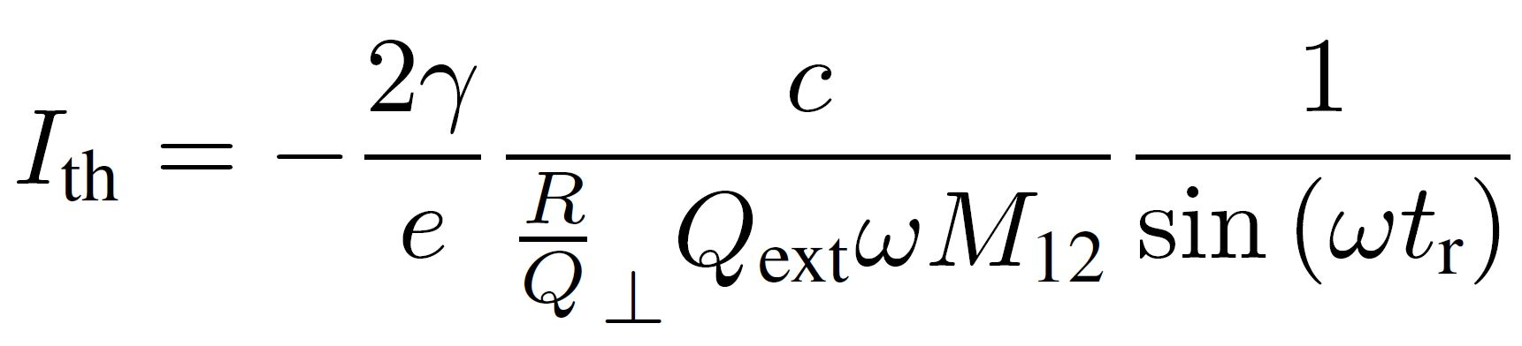
Beam break-up in ERLs by main Linac
Introduction
1st
TM₁₁₀ magnetic field
Multi-pass transverse beam breakup (BBU):
An injected beam receives an initial kick by a given dipole higher oder mode (HOM) or excites in first pass a dipole mode by its initial injection caused offset
Following beam is deflected by the dipole mode and receives more offset → stronger excitation of HOM if phase advance by optics allows positive feedback
Single mode BBU can be mitigated by proper setting of optics phase advance (while preserving recovery) or by RF feedback techniques within cavity or transverse optics manipulations
Multi-mode problem usually tackled by proper HOM damping techniques
2nd
TM₁₁₀ electric field
Single cavity, single HOM case!
Recirculation time
Sum and product of transport matrix, HOM polarization
Cavity figure of merits: R/Q, w determined by shape
HOM damping

Slide 8
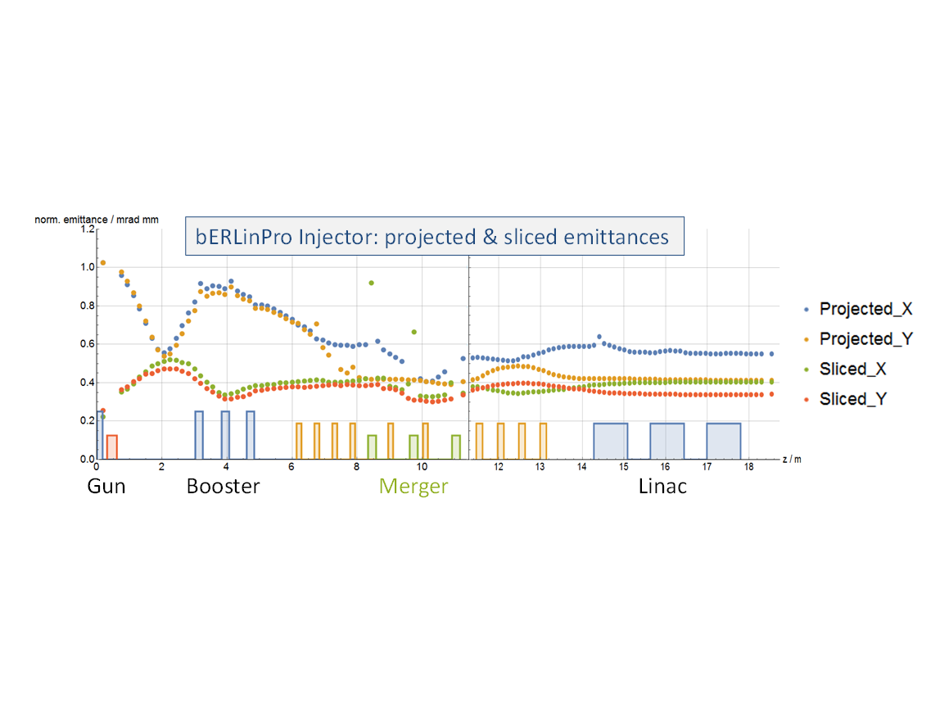
No machine without beam optics!
Achievements
Parameters at LINAC exit
Energy / MeV | 50.1
Bunch length / ps | 4.65
Emittance x,y / µm | 0.58/0.41
Energy spread / keV | 254
Injector and recirculator optics design, magnet layout, collimators
Wanted vs. unwanted beam studies, dark current, halo formation,
Beam break-up studies and countermeasures
Orientation of injector cavities optimized to:
Reduce coupler kick effects
Limit back travelling dark current towards cathode
Short pulse and low emittance modes
Booster field
emission
Dark current losses along
injector
M. Abo-Bakr, M. McAteer, J. Völker
B. Kuske, M. Matveenko, et al.

Slide 9
Complete impedance analysis of the machine
Achievements
Wake field calculations done up to 30 GHz
Results re-mapped to bERLinPro bunch pattern
Similar studies done for cavity string of Linac, Booster
See H.-W. Glock et al.,
IPAC 2015, Richmond, VA
Impedance analysis, optimization and final loss factor calculation of the complete bERLinPro ERL
Redesign of collimators, bellows, diagnostic sections, etc..
Basis for placement of temperature sensors along vacuum chamber

Slide 10
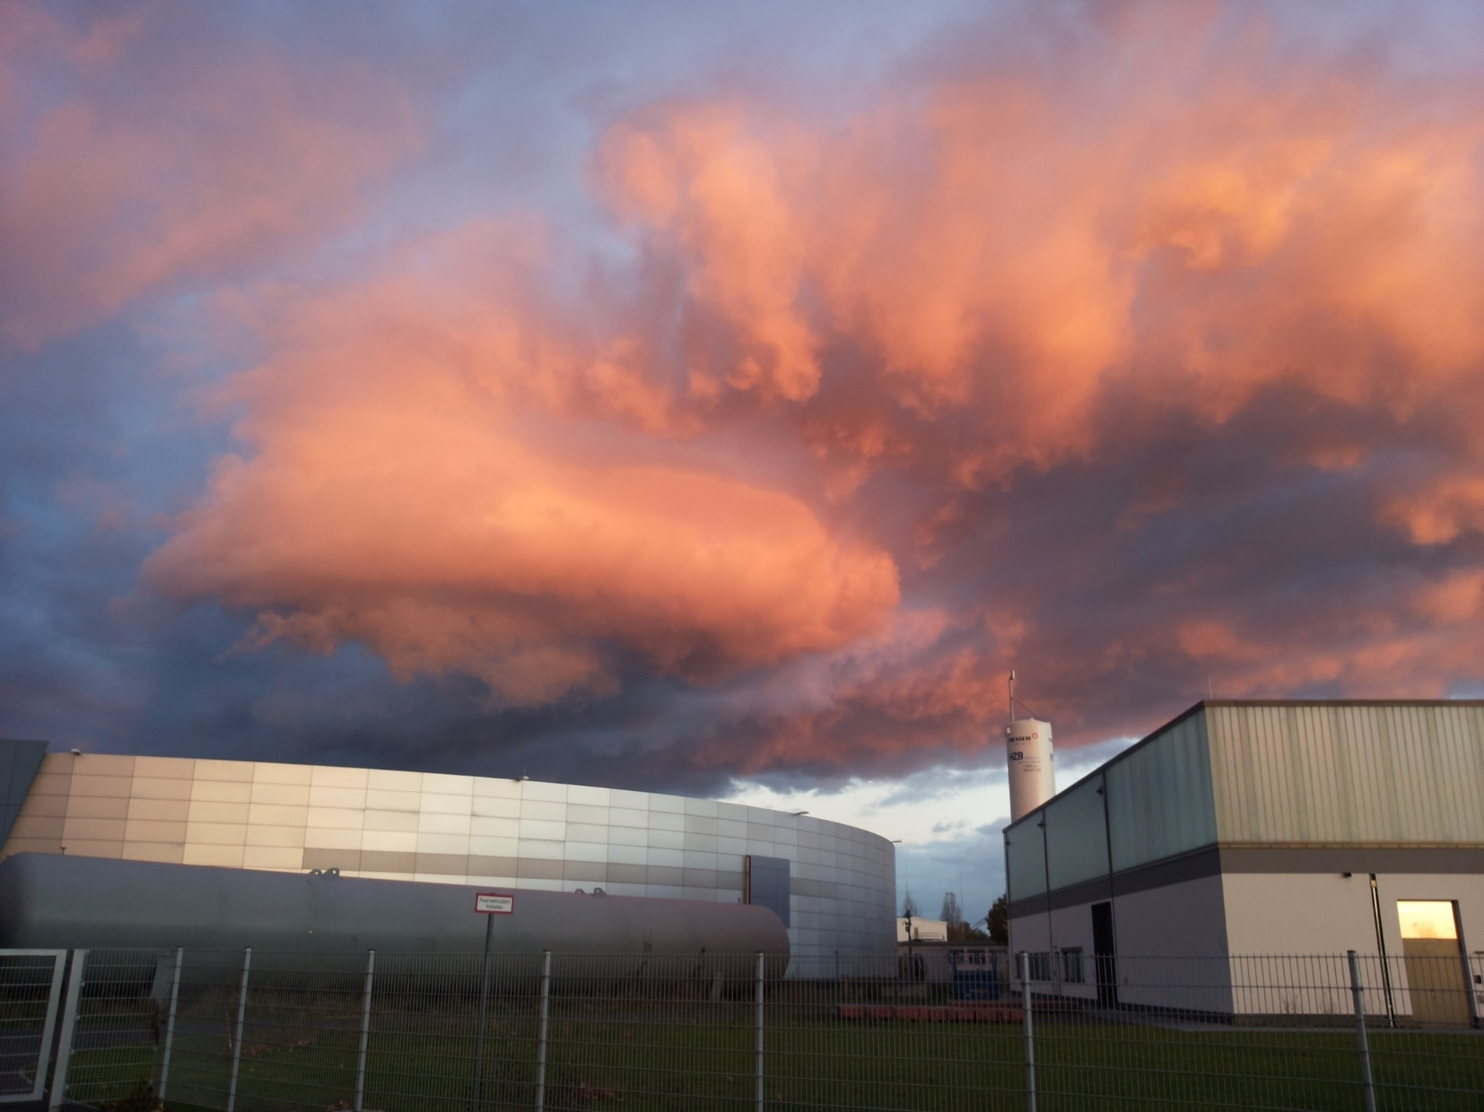
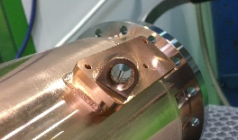
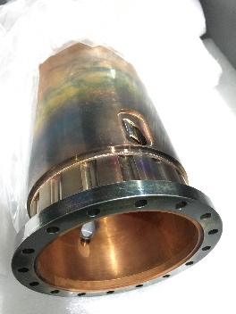
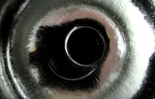
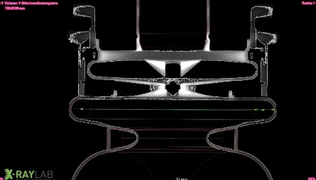
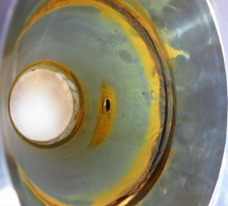
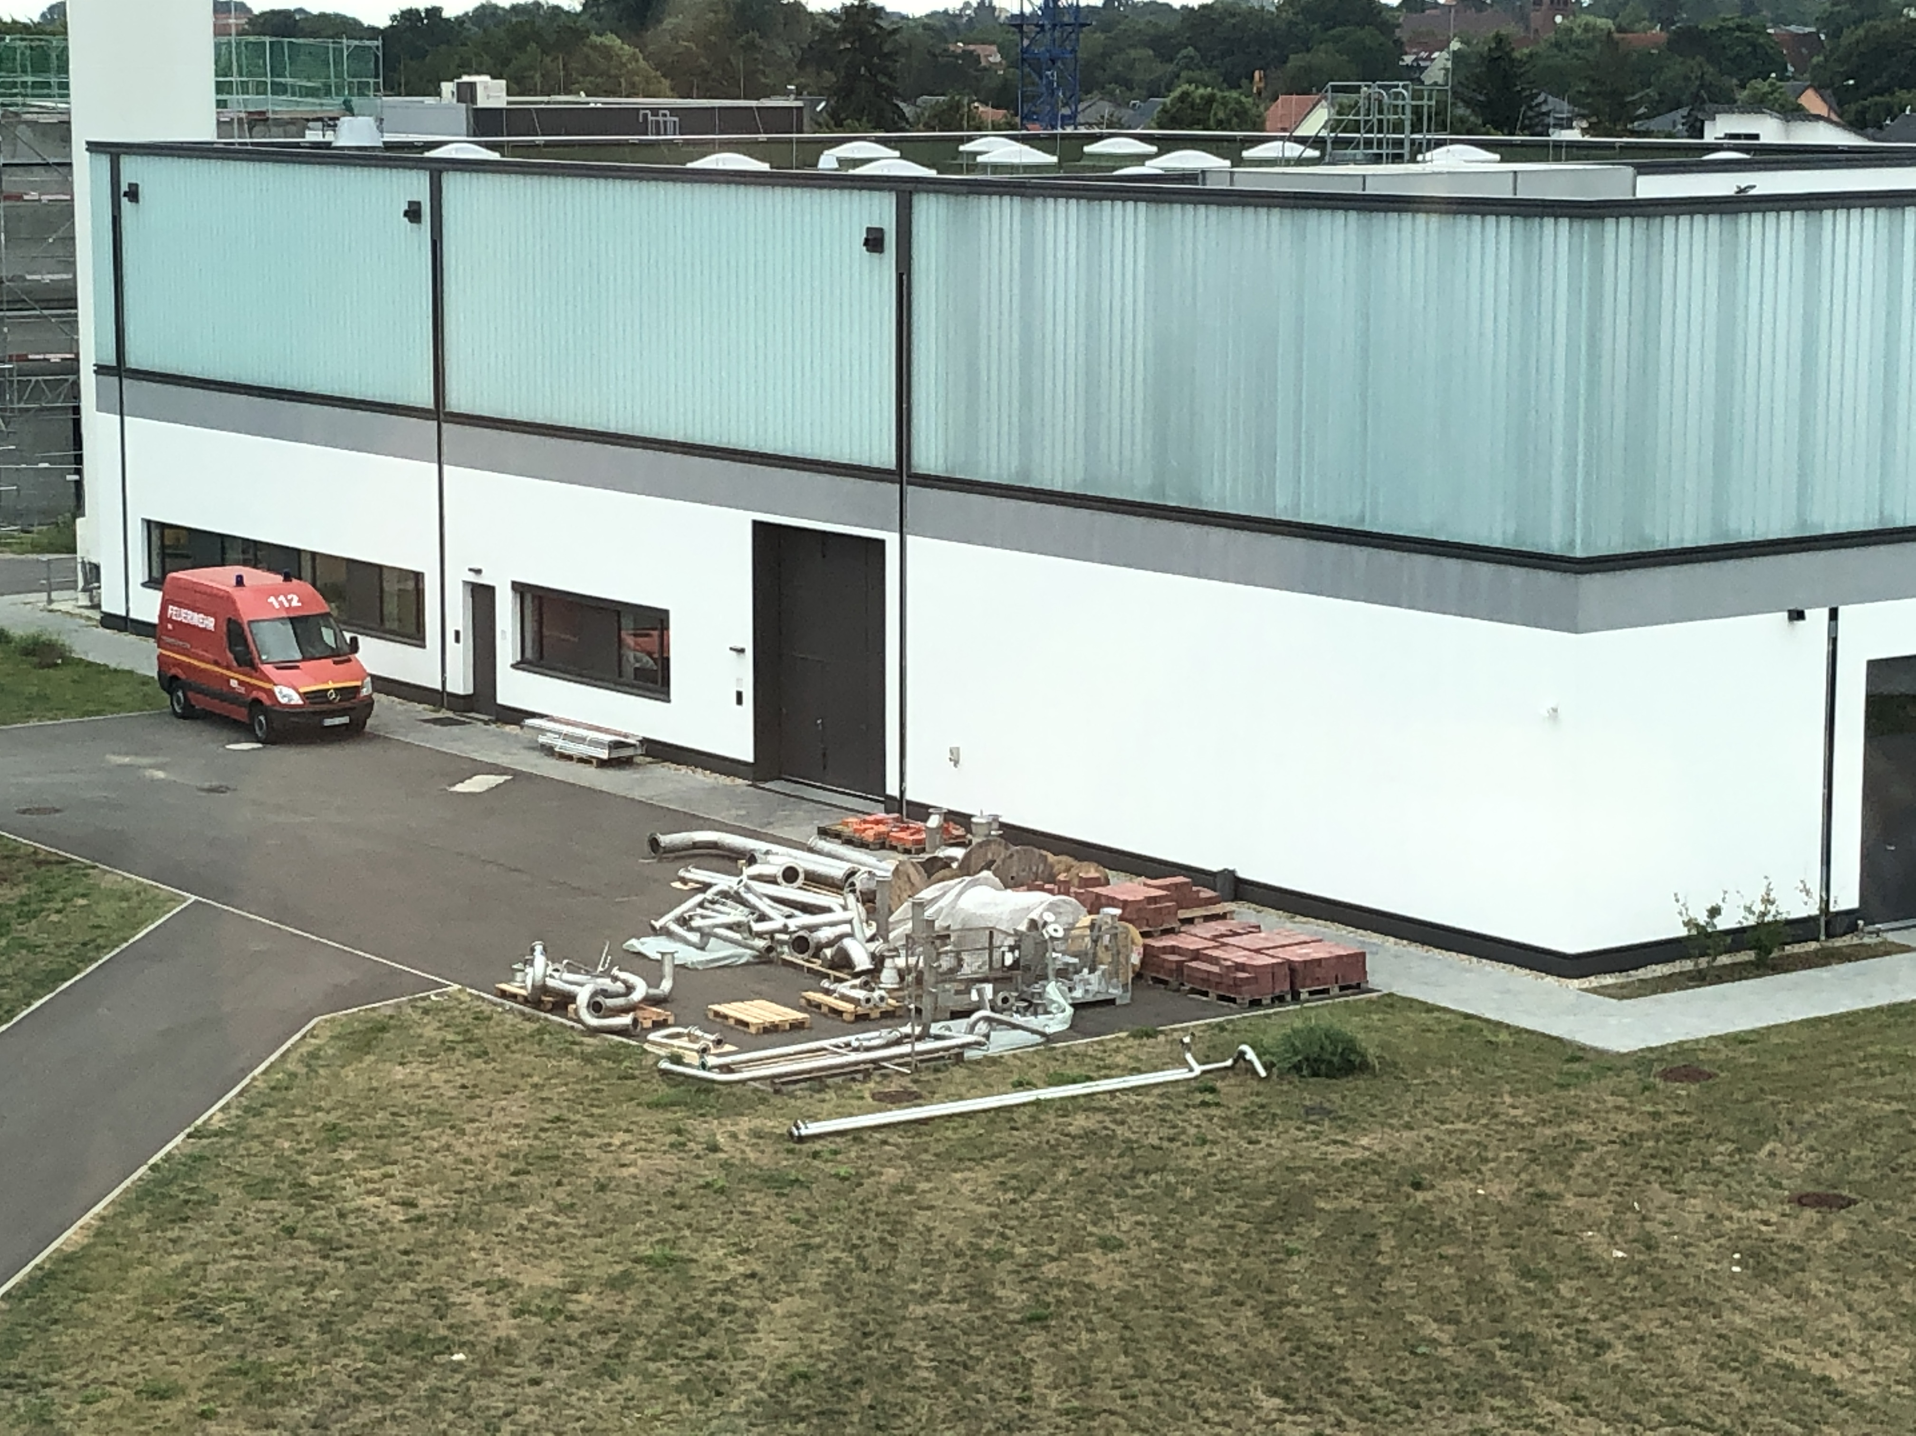
bERLinPro, a collection of experiences, successes and mishaps
Achievements
1st Gun cavity was built too “short” → shifted frequency and degraded RF performance → X-ray tomography
Build up of infrastructure and training of personnel was not accounted for → Damned for success
Number of personnel never fully matched requirements
2nd Gun got severely damaged by manufacturer at final treatment stage → Refurbishment program started
Building was delayed by some years before being ready for users
Booster power couplers needed remanufacturing of warm parts
Booster cavity helium tank required reworking
Redesign of Gun module required because of thermal short
BESSY VSR redirected large part of personnel to another project
Vacuum beamlines delayed by rewelding parts
Rust in de-ionized water cooling circuits required complete exchange
………….
The past, disaster or success?

Slide 11
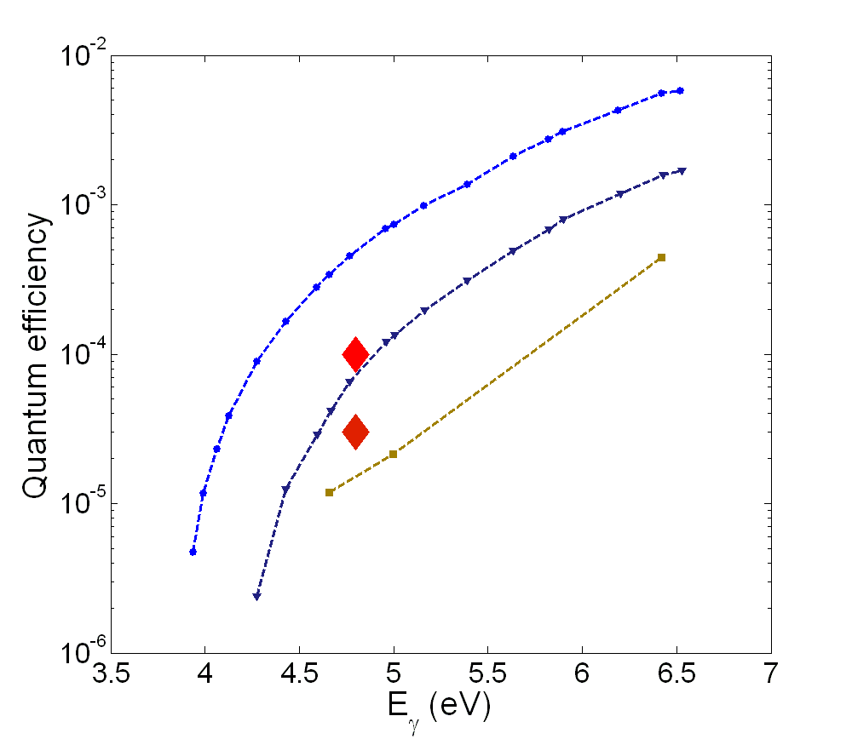
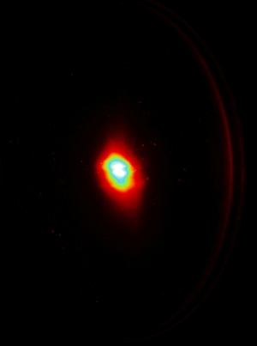
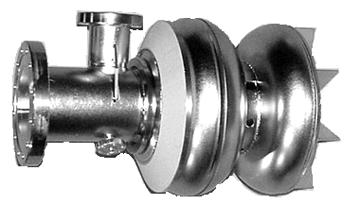
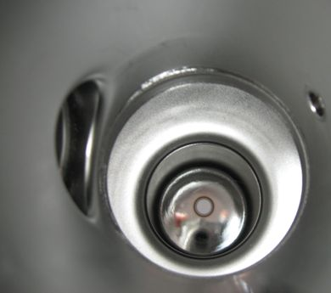
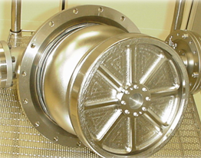
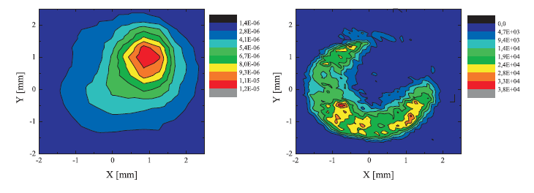
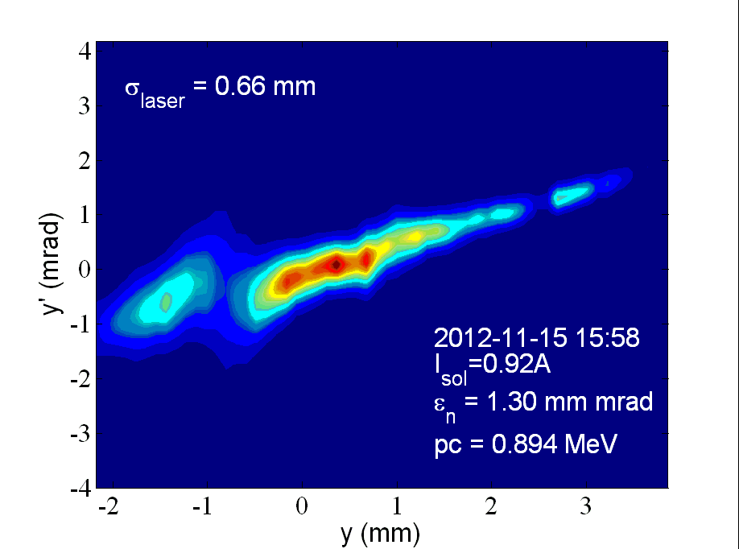
But progress was made: SRF photo-injector (2010-2012)
Achievements
First full SC photo-injector with first beam, QE studies, laser cleaning, etc → Contributes to E-XFEL and PolFEL still considered, studied and improved at DESY
First beam from
Lead cathode 04/2011
Arc deposited
lead BNL
Laser
Cleaning
0.1 mJ/mm²
1.1.10⁻⁴
Cavity 1
3.10⁻⁵
Cavity 2
Emittance studies, thermal emittance models of arc deposited lead cathodes

Slide 12


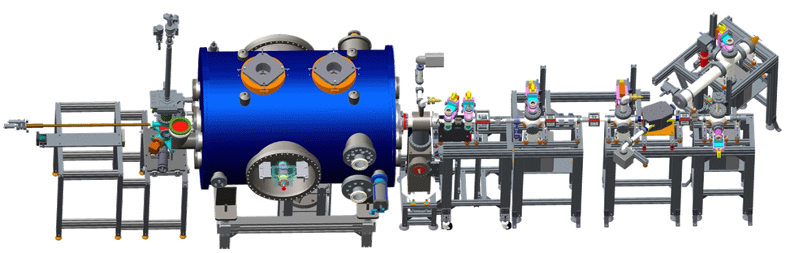
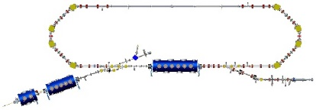
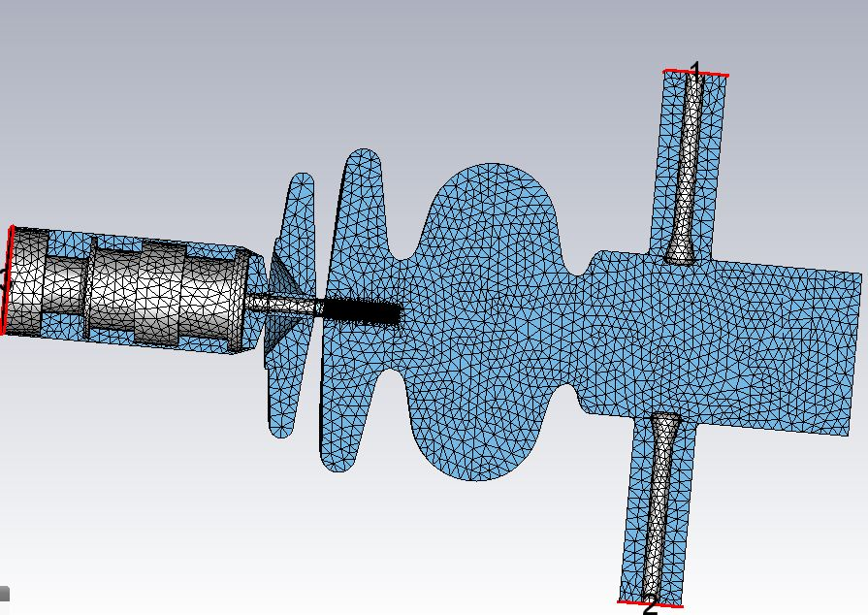
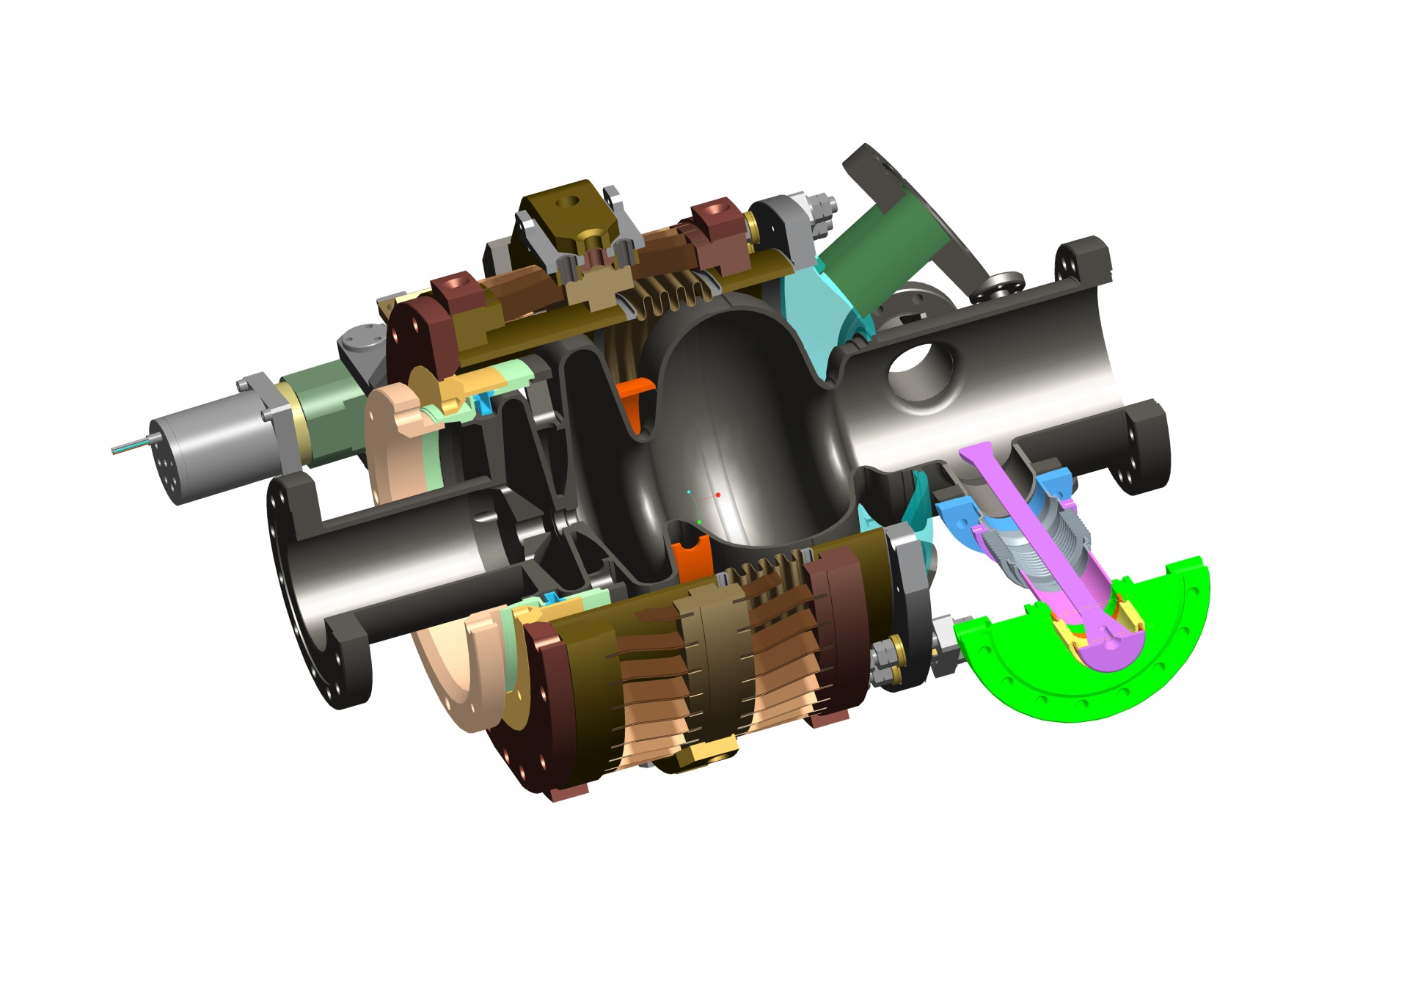
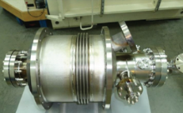
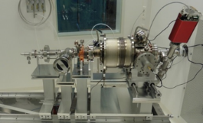
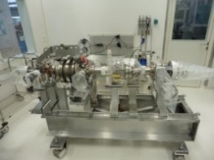
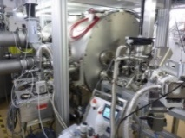
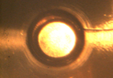
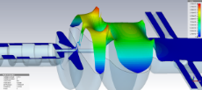

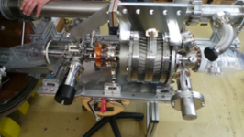
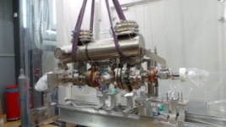
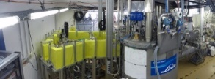
SRF Photo-injector (Gun)
Achievements
SRF photo-injector: From cradle to grave and resurrection
Fully in-house developed SRF photoinjector with strong partners
HZB
HZB
HZB
bERLinPro
PC
VTA
VTA/HTA
HTA
Gunlab
Decommissioning
Refurbish
Rebuild
Commissioning in 2022
1st Beam
Cathode transfer
Design
Manufacture
Test/Assembly
String test
String/Cold mass
Module assembly
Commissioning
2011-2012
2013
2014-2016
2016
2017/2018
2018-2021
Time
12

Slide 13
SRF Gun Cavity design
Achievements
0.4.λ cell + full cell:
Optimized
emission phase
Chimney 22 cm²~35 W at 1.8 K
about E_{peak}=45 MV/m at Q₀=3.5.10⁹
Stiffening ring:
Δf/ΔP minimized
106 mm beam tube:
Allows propagation of
lowest TM₁₁₀ mode:
HOM studies
HZDR cathode
insert and choke
cell design:
Proven system
Cathode exchange
with HZDR
Overview: Injector Cavity 1
3 pick-up antennas to measure HOM
polarization
2xCW modified TTF-III
Coupler: Q_{ext} 3.6.10⁶
for up to I_{avg}=6 mA,
10 kW each
Study 2 coupler operation
Blade tuner with
motor and 4x piezo tuner:
Microphonics compensation

Slide 14
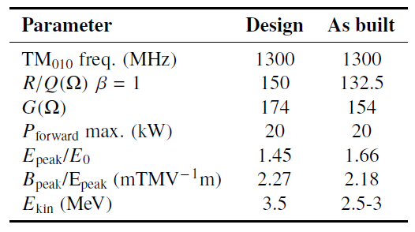
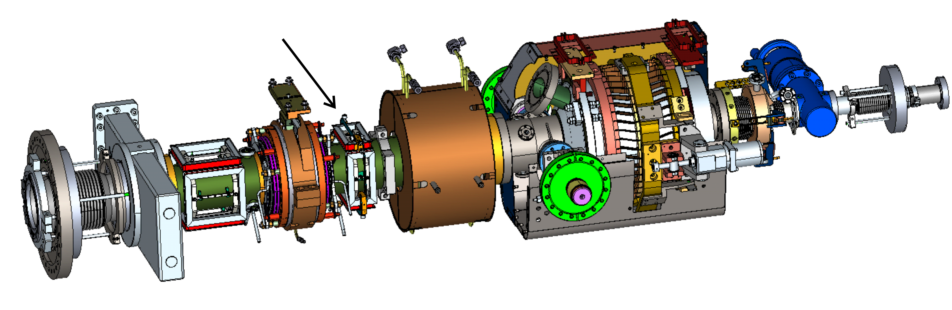
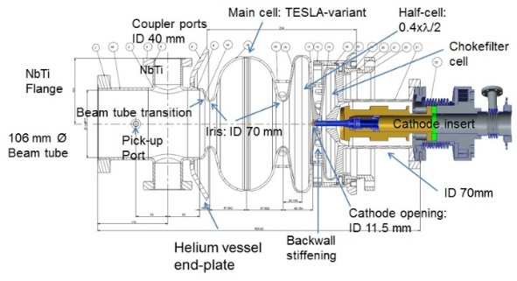
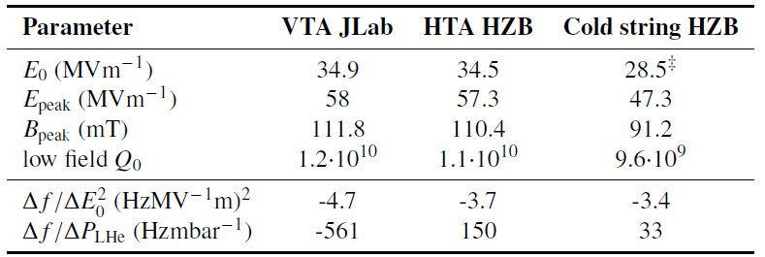
Cold String layout of bERLinPro SRF Gun
Achievements
Twin CW-modified
TTF-III coupler up to 20 kW
Support
structure
Gate valve
and transition
to 300K
Cathode tube with tuner (HZDR)
x, y steerer
4K
80K
80K
4K
1.8K
Cavity+LHe vessel (HZB, JLab),
Cornell-type blade tuner,
2 layer magnetic shielding
SiC HOM
absorber (Cornell)
SC solenoid
1.4xλ/2 cells + Choke cell
*
*
*
*15-20% higher
found by beam
energy measurements

Slide 15
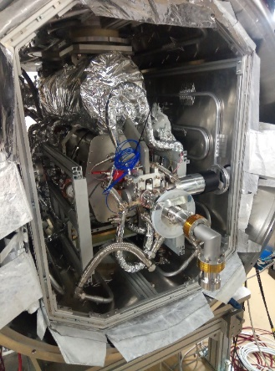
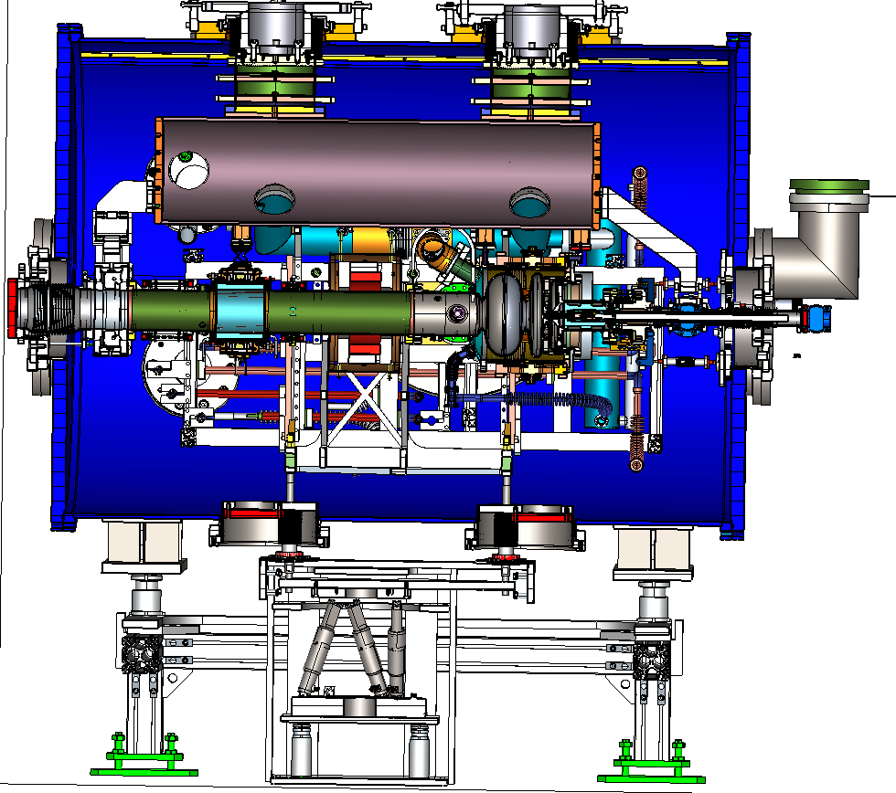
Module layout
Module layout of bERLinPro SRF Gun
Achievements
Holders and bellows for alignment
80K helium
shield
Both doors can be opened
HGRP
2nd magnetic
shield
Modified: Issue with thermal short
Beam
Cathode transfer system port
4K cooling:
Solenoid
HOM load
FPCs
4K filling line cavity
1.8 K JT line cavity
80K FPC and HOM
80 K shield and cathode
Solenoid shielding:
Cryoperm around solenoid might saturate
Replaced by Nb disc between Solenoid and cavity outer shield, efficiency factor 5-8 to be published by J. Völker et al.
External Solenoid hexapod mover with feedthroughs

Slide 16

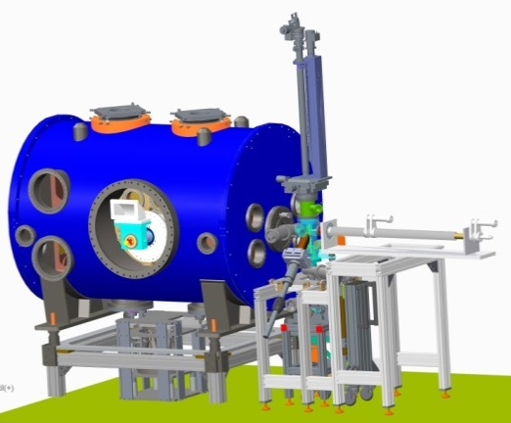
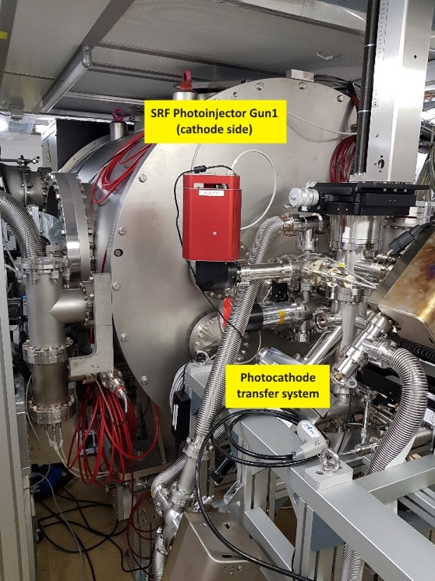
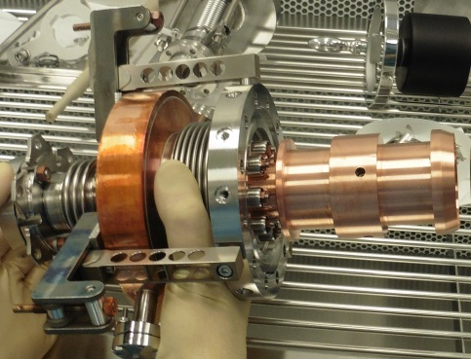
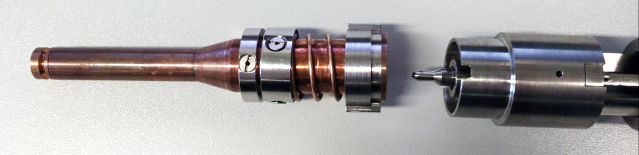


Transfer system and cathode carrier (HZDR modification)
Achievements
Module+transfer system
Transfer system behind module
Plug: Ø 10 mm
3(4) thermal transitions
Cathode insert with Plug
and transfer rod
Cathode cooler (80 K Helium) and Petrov filter holding the insert with tuner

Slide 17







Operation of first 1.4 cell SRF Gun with cathode exchange mechanism
Achievements
SRF Gun module
First beam 12/2017
QE map
01/2018 Operation with high QE cathode failed,
as cathode plug dropped into Gun cavity by malfunction of holder mechanism ☹

Slide 18







Development of high QE cathode and drive Laser
Achievements
Photocathode preparation and analysis laboratory up and running since 2015
- insight into growth process with material science studies in parallel
- achieved quantum efficiency of 16.8% at 515 nm (specs 1%)
- successful transfer from cathode lab to SRF gun
- demonstrated, that cooling of cathode to 120 K do not harm quantum efficiency (unlike prediction by other researchers!)
Last evidence of cathode being alive
We were close to
operate this record cathode in Gunlab…….
And learned from our
fails…..
doi:10.1103/PhysRevAccelBeams.21.113401
…cathode holder
heating and shock experiments

Slide 19





Recent Achievements → Refurbish SRF Gun
Recent activities
Both cavities were damaged: 1.0 Initial scratch after production → Dark current 1.1 got damaged at manufacturer
A repair and refurbishment program was set up between 06/2019 until 06/2021
Treatment by grinding, polishing, BCP and optimized HPR system, HF rinsing →
Gun 1.0
1.1
1.0
Y. Tamashevich, et al. published SRF21
1.1: HPR lance scratch
1.1 After grinding and polishing
Gun 1.0 is back on track
Gun 1.1 will be back-up
1.0: surface defects

Slide 20







Impressions of Gun cold string assembly
Recent activities
Completed cold string leak tight and evacuated, accomplished for Nikolaus!
Petrov+cooler positioning
Determine cathode position
Concentricity check with dummy cathode
Preassembled sub- components
Detailed, accurate preparation led to quick, but not imprecise assembly
Key was documentation of the past (2016) and a motivated and well working team
Thanks to: André, Michael, Henry, Jan, Frank and fast support from the workshop

Slide 21




Cold String Role out and preparation for cold string test in HTA
Recent activities
Role out
HoBiCaT with support
Table for cold string
Cold String test assembly
Prior to module assembly, a full cold string test is the final acceptance test in HoBiCaT:
Test if Q₀ and max. E-field is preserved after assembly
Did we activate any field emitters by improper handling?
Test of tuner system, coarse and piezo stacks
Characterization of parameters for LLRF control

Slide 22








Linac studies
Achievements
Design was ready for production, study performed with company
HOM prototype fabricated and tested by JLab
Module was optimized for high level beam break-up current and to preserve beam quality, BBU study of full 3 cavity string
Optimization of interconnecting structures w.r.t. localized modes
Minimization of coupler kicks studied
Heating derived by HOM
simulations
T-Map of succesful HOM test
T_{max} (50 W) = 64.9 C

Slide 23




High power Booster module + couplers
Achievements
Beam power 450-500 kW, 220 kW/cavity with twin coupler arrangement
Thus 120 kW travelling wave supplied by one 250 kW klystron per FPC
Design needs to avoid coupler kicks and emittance dilution
HOM damping by beam tube absorbers
Cavities outperform specs
Coupler are being conditioned
HOM arrival this winter → all parts for cold string in house

Slide 24





Recent Achievements → High Power Coupler Processing
Recent activities
3 out of 4 pairs conditioned, 4th pair in 2022
Parameter | Required Gun 1: 6 mA | Required Gun 2: 100 mA | Values reached so far
Traveling wave | 7 kW | 110 kW | 60 kW CW 120 kW 10% Duty Cycle
Standing wave | 1.75 kW | 54 kW | 15 kW

Slide 25






Warm beamline, magnets, diagnostics, power supplies
Achievements
All girders and magnets
Installed and
pre-aligned
Particulate-free
UHV vacuum system + 600 kW beam dump:
ISO 5
NEG coated
Under vacuum and waiting
Budker Institute
of Nuclear Physics

Slide 26



A glance at diagnostics and vacuum system
Achievements
Vacuum sectors
Beam
diagnostics
Beamloss
diagnostics
18x screen stations
24x Striplines, of which 8 with Ion clearing
2x button ion clearing
6x current monitors (ICT)
5x collimators
2x Faraday cups
3x Beam dumps
2 segmented Faraday cups
1 transverse defl. Cavity
Option: 6x THz/Sync. Rad.
+ Control system EPICS, visualization and data archiving
Jupyter Notebooks for
Python based data analysis and measurement programs

Slide 27





RF and cryogenics installation status
Achievements
1.3 GHz CW 270 kW Klystron Second test in dummy load
Waiting for final commissioning mainly cold compressor operation missing (1.8K)
Pics
courtesy
W. Anders
600 kW FuG power supply
3 Klystrons in house, 1 tested in SLH and at bERLinPro, currently in use for coupler conditioning
2 Klystrons will power Booster, 1 a high power gun at some point
15 kW solid state amplifiers for Linac Tcav and 1st Booster (zero-crossing)
Made by CPI
N₂ to cool L700
Booster+Gun coldbox

Slide 28



Recent Achievements → Completion of Recirculator vacuum
Recent activities
Recirculator vacuum is closed since summer 2021, final survey of the machine within the building
We just need a Linac module and would be a real Energy Recovery Linac
Pics: Courtesy J. Völker

Slide 29



View of the photo-cathode laser and its control
Recent activities
pulse compressor,
IR→ VIS conversion
tunable pulse stretcher for „green“
~40 W green
Bunch spacing and current options:
50 MHz Laser:
1-100 Hz macro-pulse: → I_{avg} = 77 pA – 7.7 µA
CW 3.8 mA
1.3 GHz Laser:
1 Hz – 1 kHz macro-pulse: → Iavg = 77 pA – 20 µA
CW 100 mA
All this with 77 pC bunch charge, laser power set up for QE of 1 %
pulse train oscillator (50 MHz)
2nd preamplifier
power amplifier
2nd pulse selector
pulse stretcher,
1st pulse selector
1st preamplifier
control
synchronization
diagnostic
50 MHz Laser Channel
currently stand-alone operation (no control system, no master clock from accelerator infrastructure)
1.3 GHz Laser Channel
to be placed on free space beneath 50 MHz-setup, amplifier stages will partly be shared
still under development at MBI:
A reliable solution for the pulse train oscillator has finally been found (main difficulty: tight space within optical cavity for 1.3 GHz rep. rate)
next steps:
adapt synchronization,
test concept for enhanced efficiency in IR→ to green-light conversion
adapting control
Courtesy
G. Klemz
Alignment beam in accelerator hall
29

Slide 30


bERLinPro, quo vadis?
outlook
New project heads?
ARD
HMS bERLinPro
bERLinPro?
Old project heads?
JEAN LOUIS THÉODORE GÉRICAULT - La Balsa de la Medusa (Museo del Louvre, 1818-19)
The project was completed in 2020
But only to continue as a research facility!
Let’s have anyway a glimpse into the future
John Tenniel - Punch, 29. März 1890, “Der Lotse geht von Bord”

Slide 31

What is coming next?
outlook
From bERLinPro to SEALAB (SRF Electron Accelerator LABoratory)
FRT, courtesy N. Shipman CERN
So far bERLinPro was conceived solely as an energy-recovery linac test facility: 100 mA average current, 50 MeV, ε_{n}<1 mm.mrad Now the scope was extended.
We want to open the machine up to internal and external applications:
Completion of the injector and linac/dump lines: Commissioning Injector with beam (up to 5 mA, up to few 100 pC, up to 6.5 MeV)
UED experiment → Aiming for shortest pulses, synchronization
Offer the injector as a testbed to test and commission AI/machine learning techniques, digital twins, as long as Linac gap is open: Test area for (S)RF cavities, modules (e.g. MESA)
Map the complete attainable injector phase space for many applications: From FEL, UED to HEP
Testing of new diagnostics, acceleration concepts and controls
Collaborate with external partners for a 100 mA compatible Linac module in most efficient design, e.g. fast reactive tuners, optional 4K operation of single cavity (ERL initiative for HEP)
Ultrafast Electron
Diffraction modifications
SRF Gun
FCUPZGAF
Aperture
SRF Booster
FOMZ1MAF at 7.64
UED Target & Viewscreen
FOMZ1ZAF at 12.69
UED Detector
Solenoid

Slide 32









Acknowledgements
Fin
We would like to acknowledge:
J. Teichert, A. Arnold, P. Murcek, R. Rimmer, A. Burrill, F. Marhauser, S. Belomestnykh, E. Zaplatin, E. Kako, R. Eichhorn, J. Sekutowicz, P. Kneisel, G. Ciovati, A. Matheisen, B. van-der-Horst, M. Schmökel, W.A. Clemens, C. Dreyfuss, D. Forehand, T. Harris, R.B. Overton, L. Turlington, M. Schalwat, S. Lederer, V. Volkov, I. Will, MAC members
+many more
HZB bERLinPro Team & friends
former colleagues
Budker Institute of Nuclear Physics
Thanks for your attention!

