Slide 1
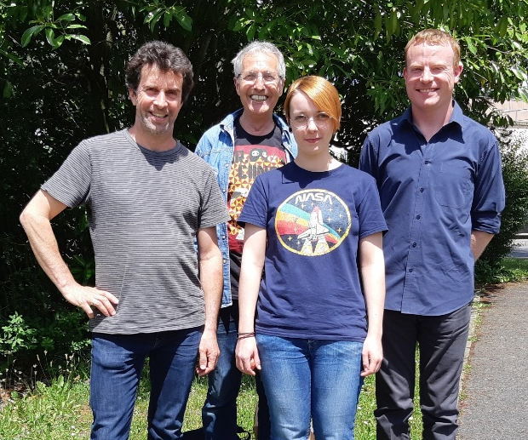
DeLLight
(Deflection of Light by Light)
with LASERIX @ IJCLab
Modification of the light velocity in vacuum with intense laser pulses
Core DeLLight group : F. Couchot, A. Klaych (upcoming postdoc Nov. 2021), A. Mailliet (PhD), S. Robertson (former postdoc until Aug. 2021), X. Sarazin
Laserix : E. Baynard, J. Demailly, M. Pittman,
Other members : A. DjannaL-Atai (APC, upcoming visitor), M. Urban (emerite)
DeLLight experiment to observe an optically induced change of the vacuum index,
Phys. Rev. A 103, 023524 (2021), arXiv:2011.13889
Project currently funded by ANR: Nov. 2018 → April 2022

Slide 2




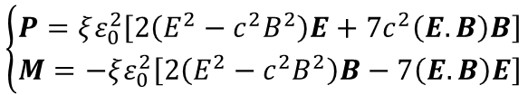



Is the vacuum optical index constant ?
Maxwell’s equations are linear in vacuum
$$\left\{\begin{aligned}D=ε_{0}E \\ B=μ_{0}H\end{aligned}\right.$$
$$c=\frac{1}{\sqrt{ε_{0}μ_{0}}}$$
ε₀ and μ₀ are CONSTANT
⇒ Speed of light (optical index) is constant
Maxwell’s equations are not linear in dielectric media
$$\left\{\begin{aligned}D=ε_{0}E+P\left(E,B\right)=ε\left(E,B\right).E \\ B=μ_{0}H+μ_{0}M\left(E,B\right)=μ\left(E,B\right).H\end{aligned}\right.$$
Optical index depends on external fields E,B
Nonlinear interaction between the e.m. fields through the medium
Nonlinear optical Kerr effect with intense laser:
$$n=n_{0}+n_{2}×I(\text{W}\text{/}{\text{cm}}^{2})$$
$$n_{2}\left(Air\right)≅{10}^{−19} {\text{cm}}^{2}/W$$
QED : nonlinearity in vacuum induced by the coupling of the fields with the e⁺/e⁻ virtual pairs
Heisenberg and Euler, Z. Phys. 98, 714 (1936)
$$\left\{\begin{aligned}P=ξε_{0}^{2}\left[2\left(E^{2}−c^{2}B^{2}\right)E+7c^{2}\left(E.B\right)B\right] \\ M=−ξε_{0}^{2}\left[2\left(E^{2}−c^{2}B^{2}\right)B−7\left(E.B\right)E\right]\end{aligned}\right.$$
$$ξ^{−1}=\frac{45m_{e}^{4}c^{5}}{4α^{2}ℏ^{3}}≈3 {10}^{29} \text{J}\text{/}{\text{m}}^{\text{3}}$$
Optical Kerr effect in vacuum ?
$n_{2}=1.6×{10}^{−33}$ W/cm²
S. Robertson et al. Phys. Rev. A 100, 063831 (2019)
arXiv:1908.00896

Slide 3
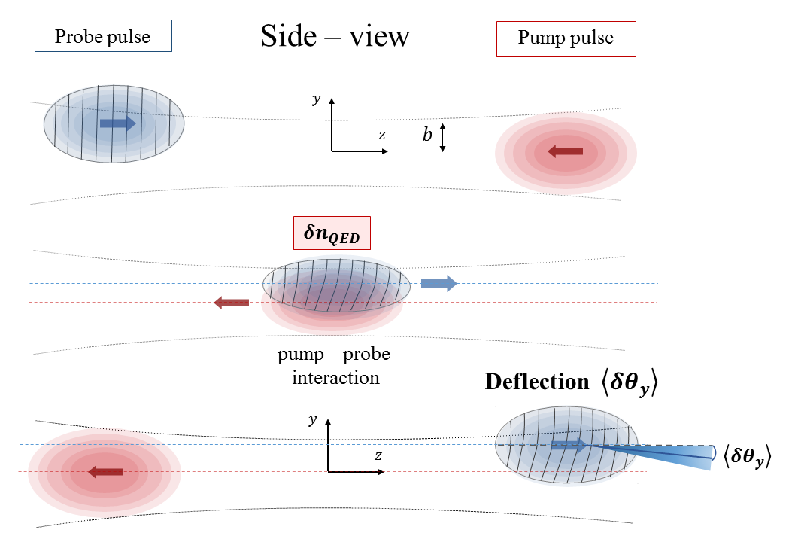
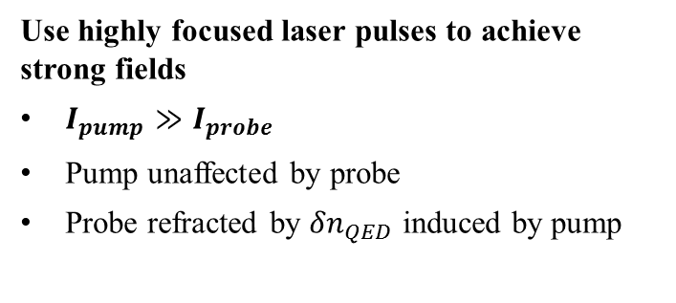
Pump-Probe interaction
Use highly focused laser pulses to achieve strong fields
$I_{pump}≫I_{probe}$
Pump unaffected by probe
Probe refracted by ${δn}_{QED}$ induced by pump
Pump specifications (with LASERIX)
Energy ≈ 2.5 Joules
Duration ≈ 30 fs
Waist @ focus ≈ 5 μm
⇒ I_{pump} ∼ 3 × 10²⁰ W/cm²
⇒ B ∼ 10⁵ T
⇒ δθ ∼ 10⁻¹³ rad

Slide 4
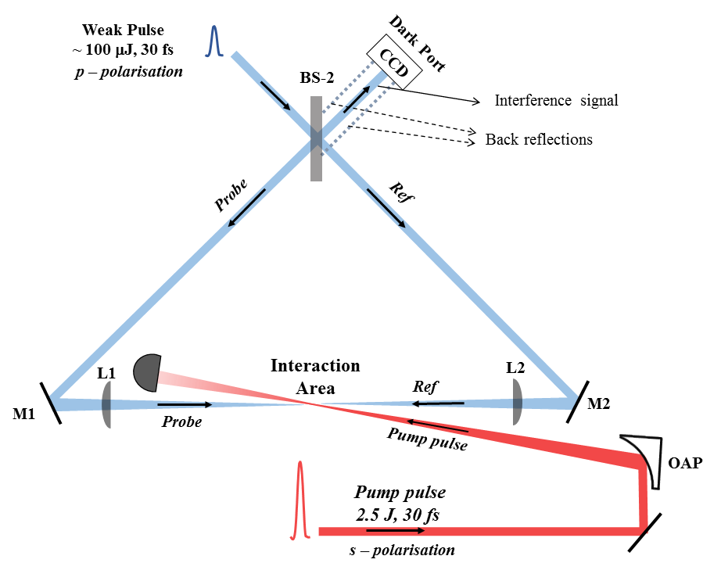

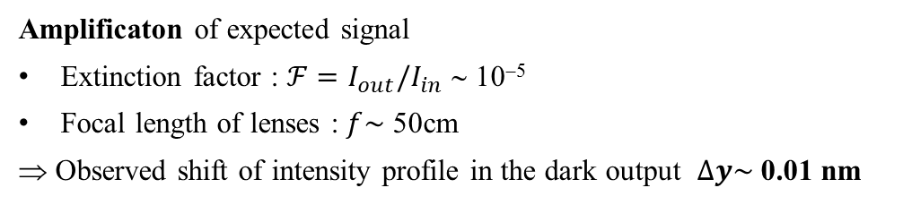


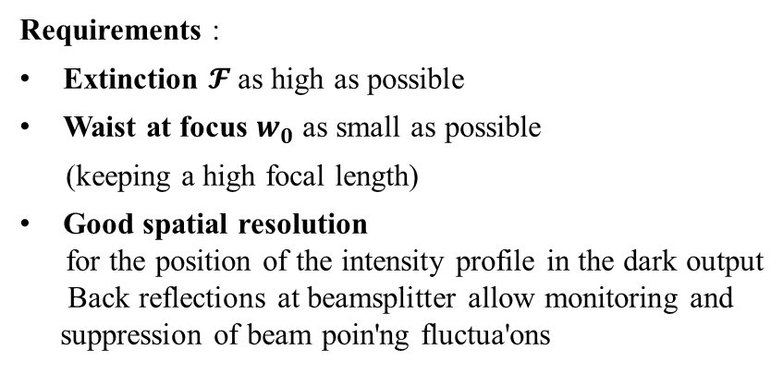
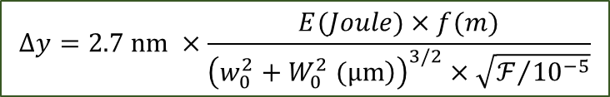

Refraction measured with a Sagnac Interferometer
Amplificaton of expected signal
Extinction factor : $ℱ=I_{out}/I_{in}$ ∼ 10⁻⁵
Focal length of lenses : $f\sim$ 50cm
⇒ Observed shift of intensity profile in the dark output $∆y\sim$0.01 nm
$$Δy=2.7 nm ×\frac{E(Joule)×f(m)}{{\left(\left.w_{0}^{2}+W_{0}^{2} (μm\right)\right)}^{3/2}×\sqrt{ℱ/{{10}^{−5}}}}$$
Requirements :
Extinction $𝓕$as high as possible
Waist at focus $w_{0}$ as small as possible
(keeping a high focal length)
Good spatial resolution
for the position of the intensity profile in the dark output
Back reflections at beamsplitter allow monitoring and suppression of beam poin'ng fluctua'ons
Target
$𝓕=$ 10⁻⁵
$w_{0}=$ 5 μm
$σ_{y}=$ 10 nm
QED signal : 1 sigma sensitivity per $\sqrt{T_{obs}\left(days\right)}$

Slide 5
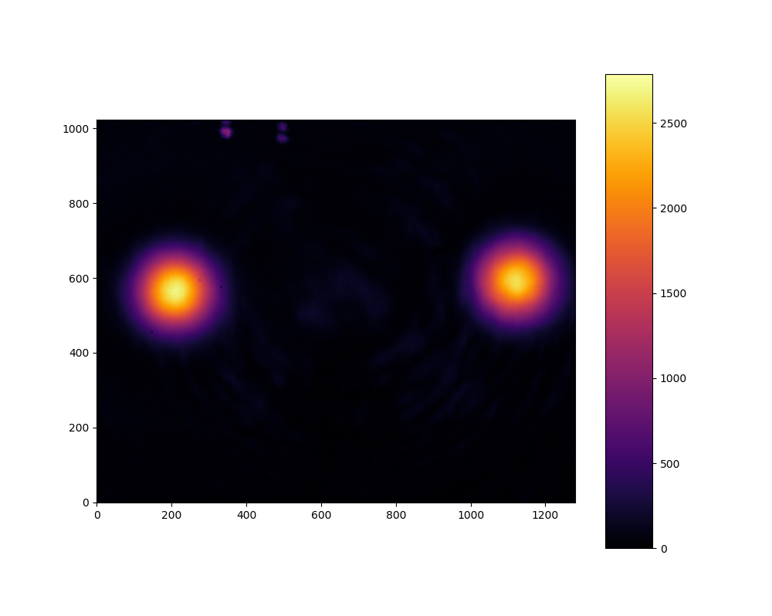
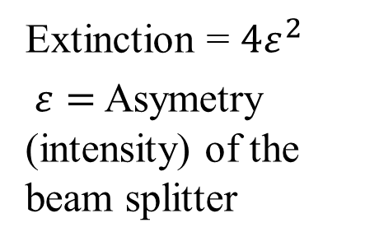
Extinction of the interferometer
Signal : Extinction ~ 3×10⁻⁵
Extinction = $4ε^{2}$
$ε=$ Asymetry (intensity) of the beam splitter
Back reflection at beamsplitter

Slide 6
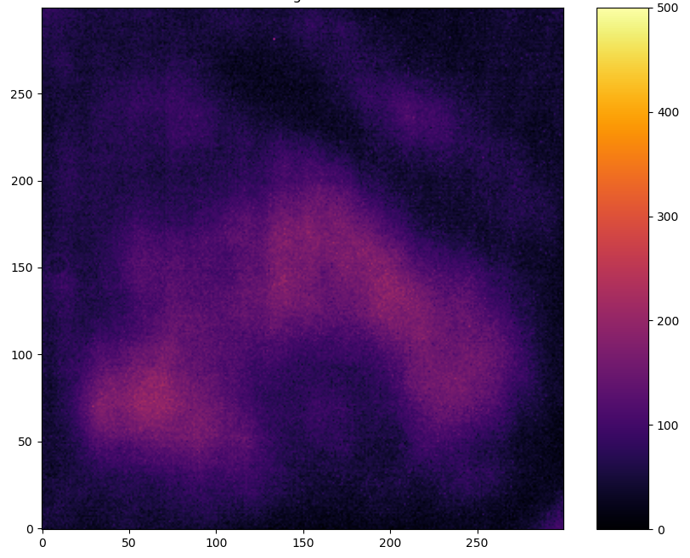
Extinction of the interferometer
Signal : Extinction ~ 3×10⁻⁵
Hot spots : Surface defects on mirrors, BS and lenses inside the Sagnac
Extinction = $4ε^{2}$
$ε=$ Asymetry (intensity) of the beam splitter

Slide 7
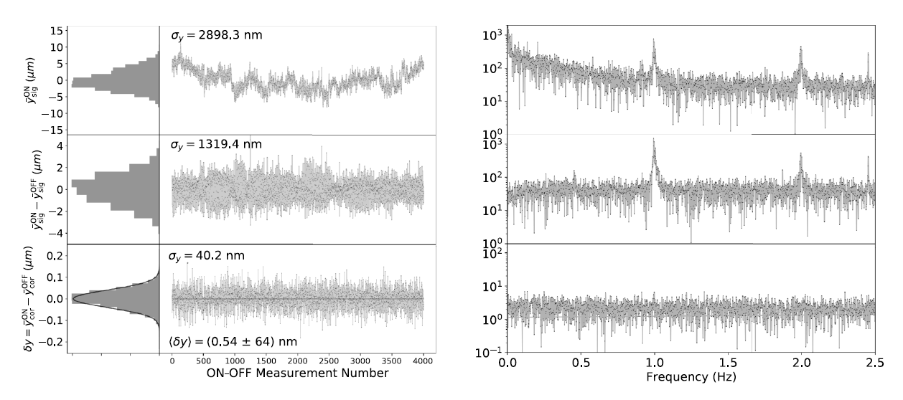
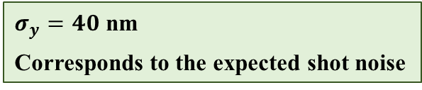

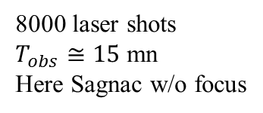
Spatial resolution
8000 laser shots
$T_{obs}≅15 \text{mn}$
Here Sagnac w/o focus
CCD Basler camera
Pixel size = 5.8×5.8 μm²
Saturation charge ∼ 10⁴ e⁻ per pixel
$σ_{y}=40$ nm
Corresponds to the expected shot noise
CCD Basler camera
Pixel size = 1.8×1.8 μm²
Saturation charge ∼ 10⁴ e⁻ per pixel
In the future
Expected shot noise : $σ_{y}\sim$ 13 nm

Slide 8
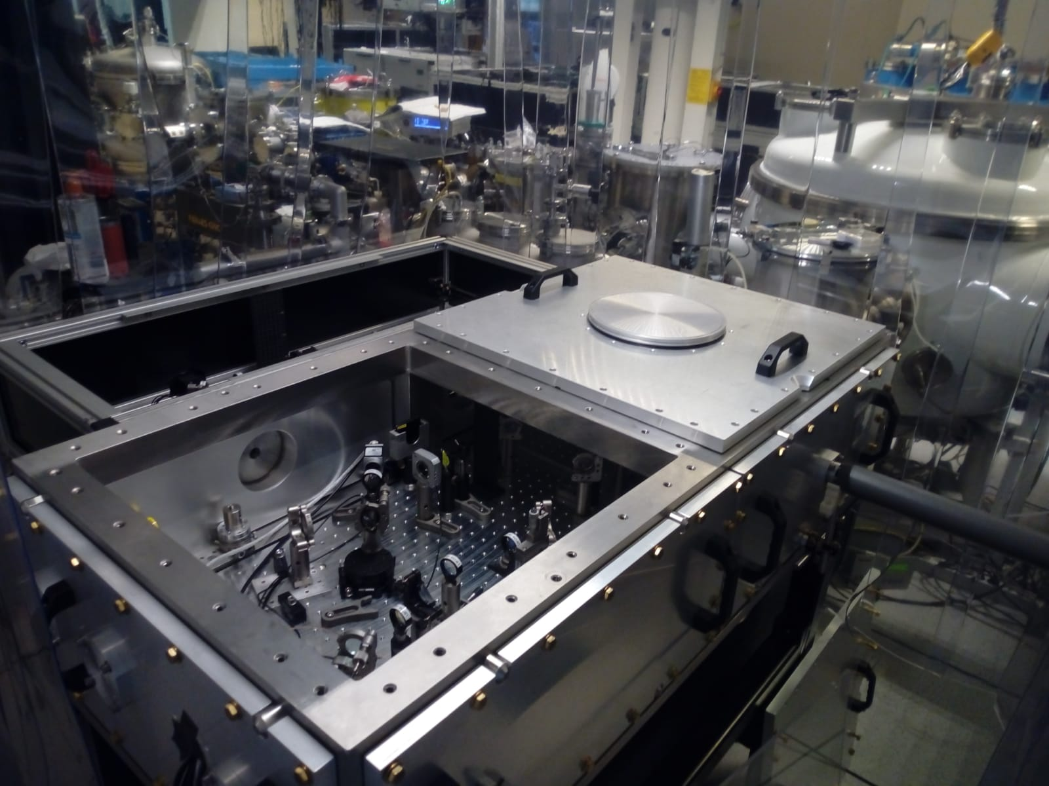
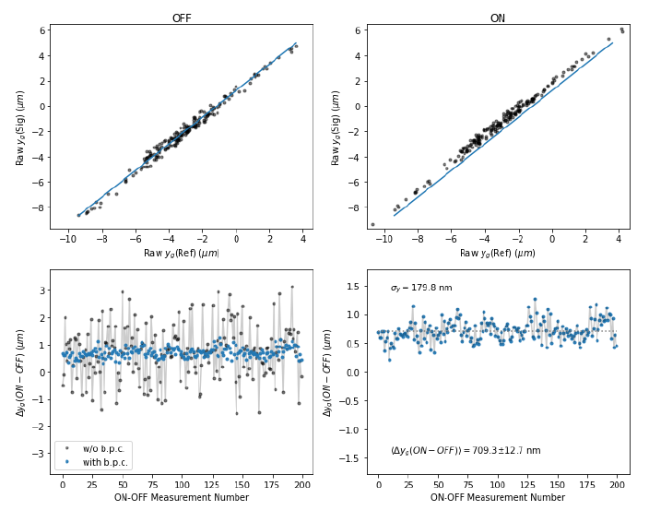
Current prototype
Measurement of the Kerr effect in air at low energy

Slide 9
Technical issue
Sagnac interferometer with intense femtosecondes laser pulses (~ 10¹¹ W/cm²)
Large spectrum
Nonlinear effect in the beamsplitter
Monitoring and feedback for the Sagnac alignment
Surface quality of lenses, mirrors and beamsplitter
Current development with LMA Lyon
Replace [Mirrors + Lenses ] by Off Axis Parabolic Mirrors ?
Stability of the transverse intensity profile of the femtosecond pulses at 10 Hz repetition rate
Work in progress…
High spatial resolution for the position of the intensity profile in the dark output
Today we use CCD camera which gives good resolution + imaging

