Slide 1
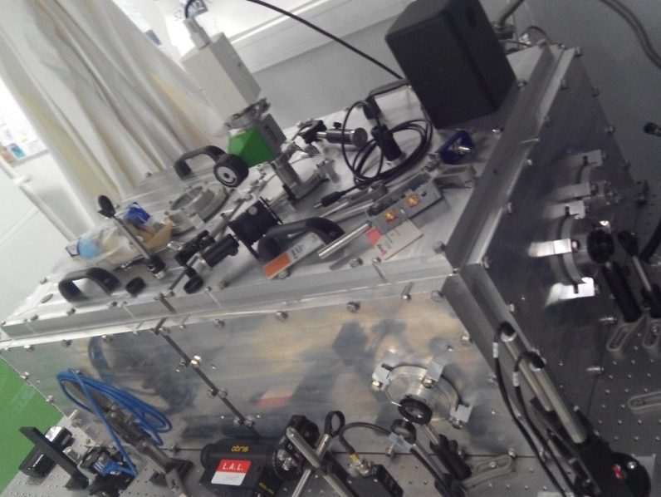
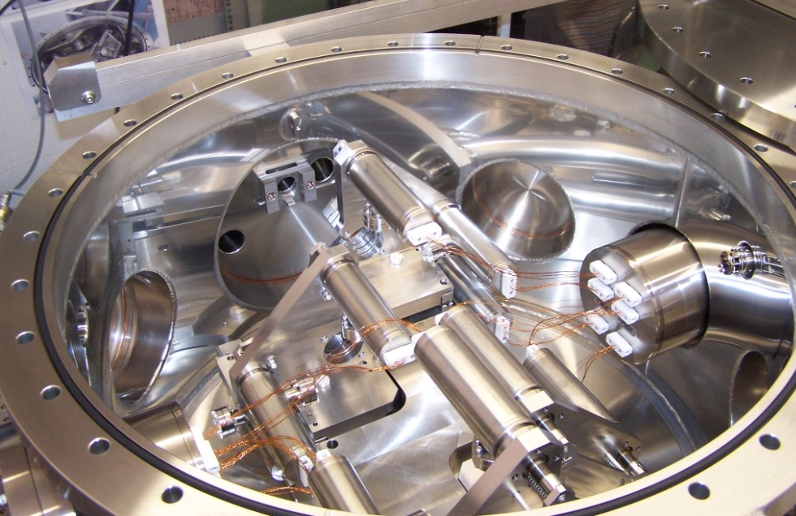
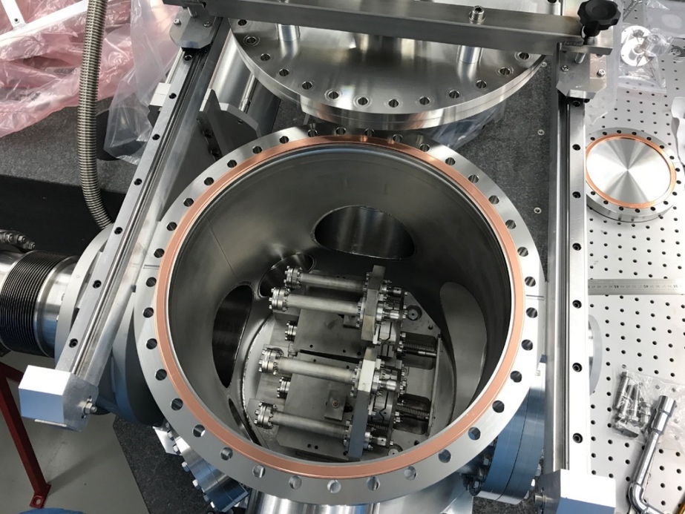
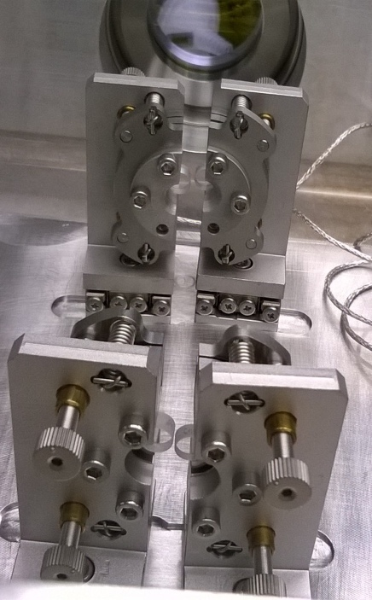
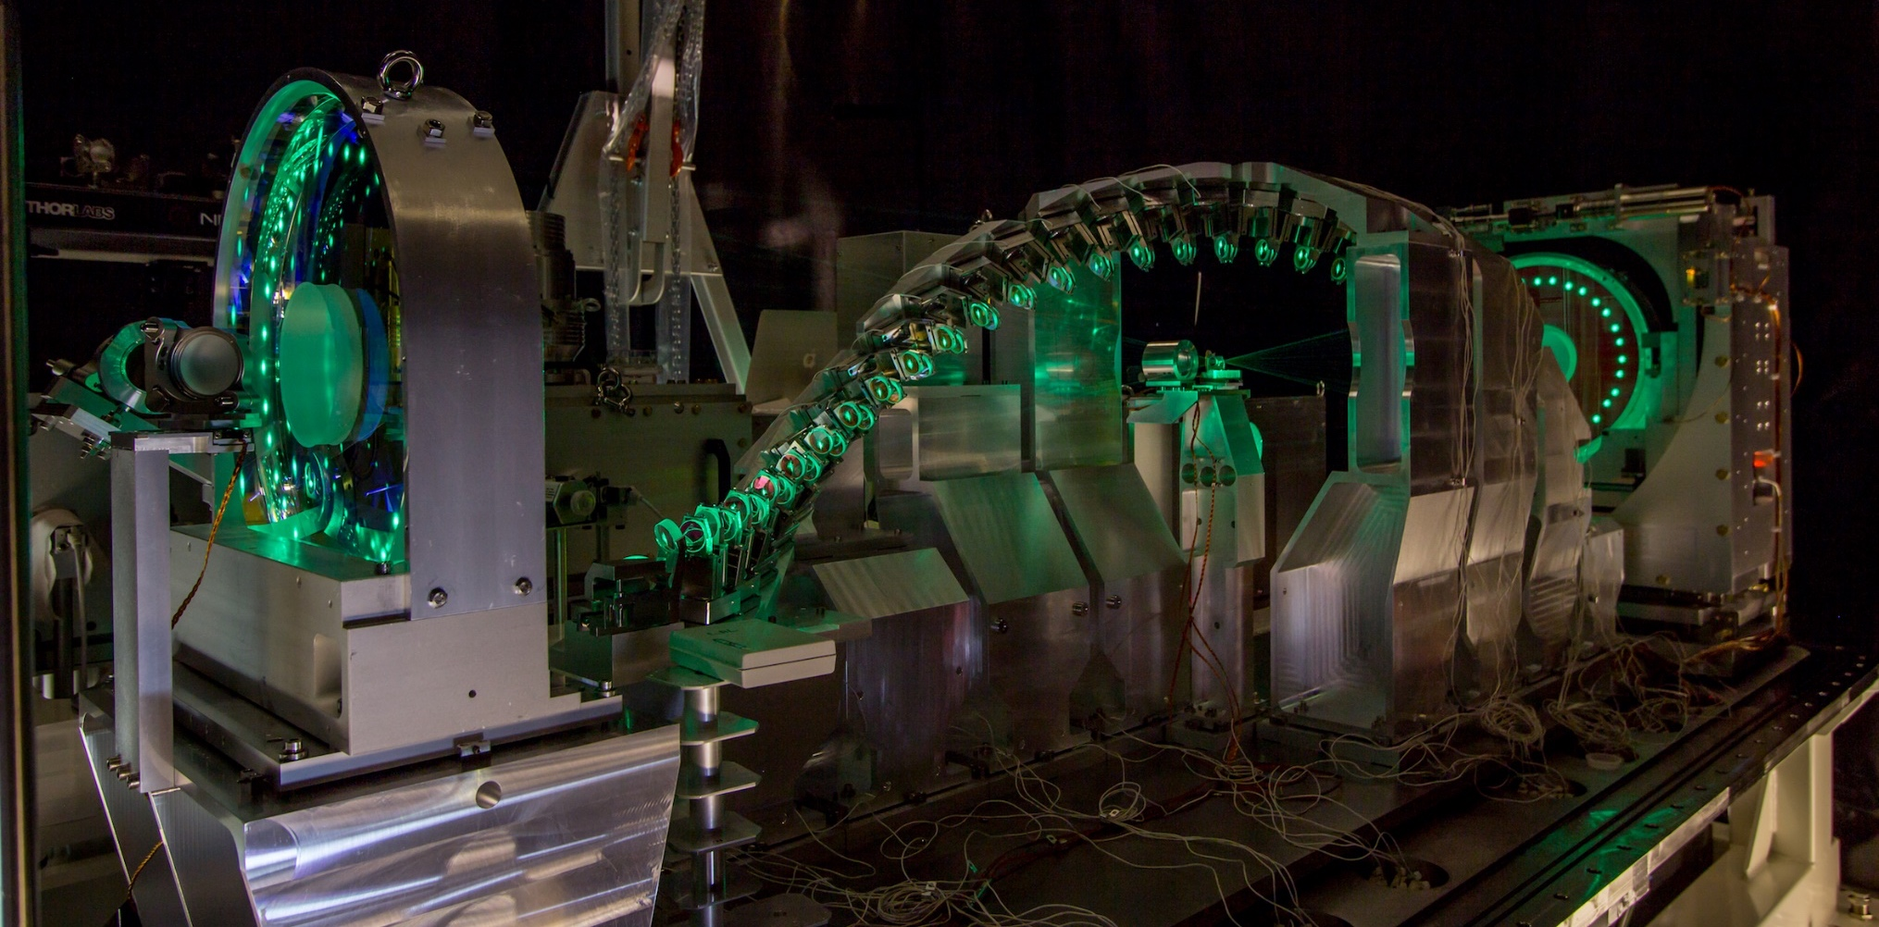
Cavités optiques et systèmes lasers pour l’interaction laser-faisceaux (dont ThomX)

Slide 2
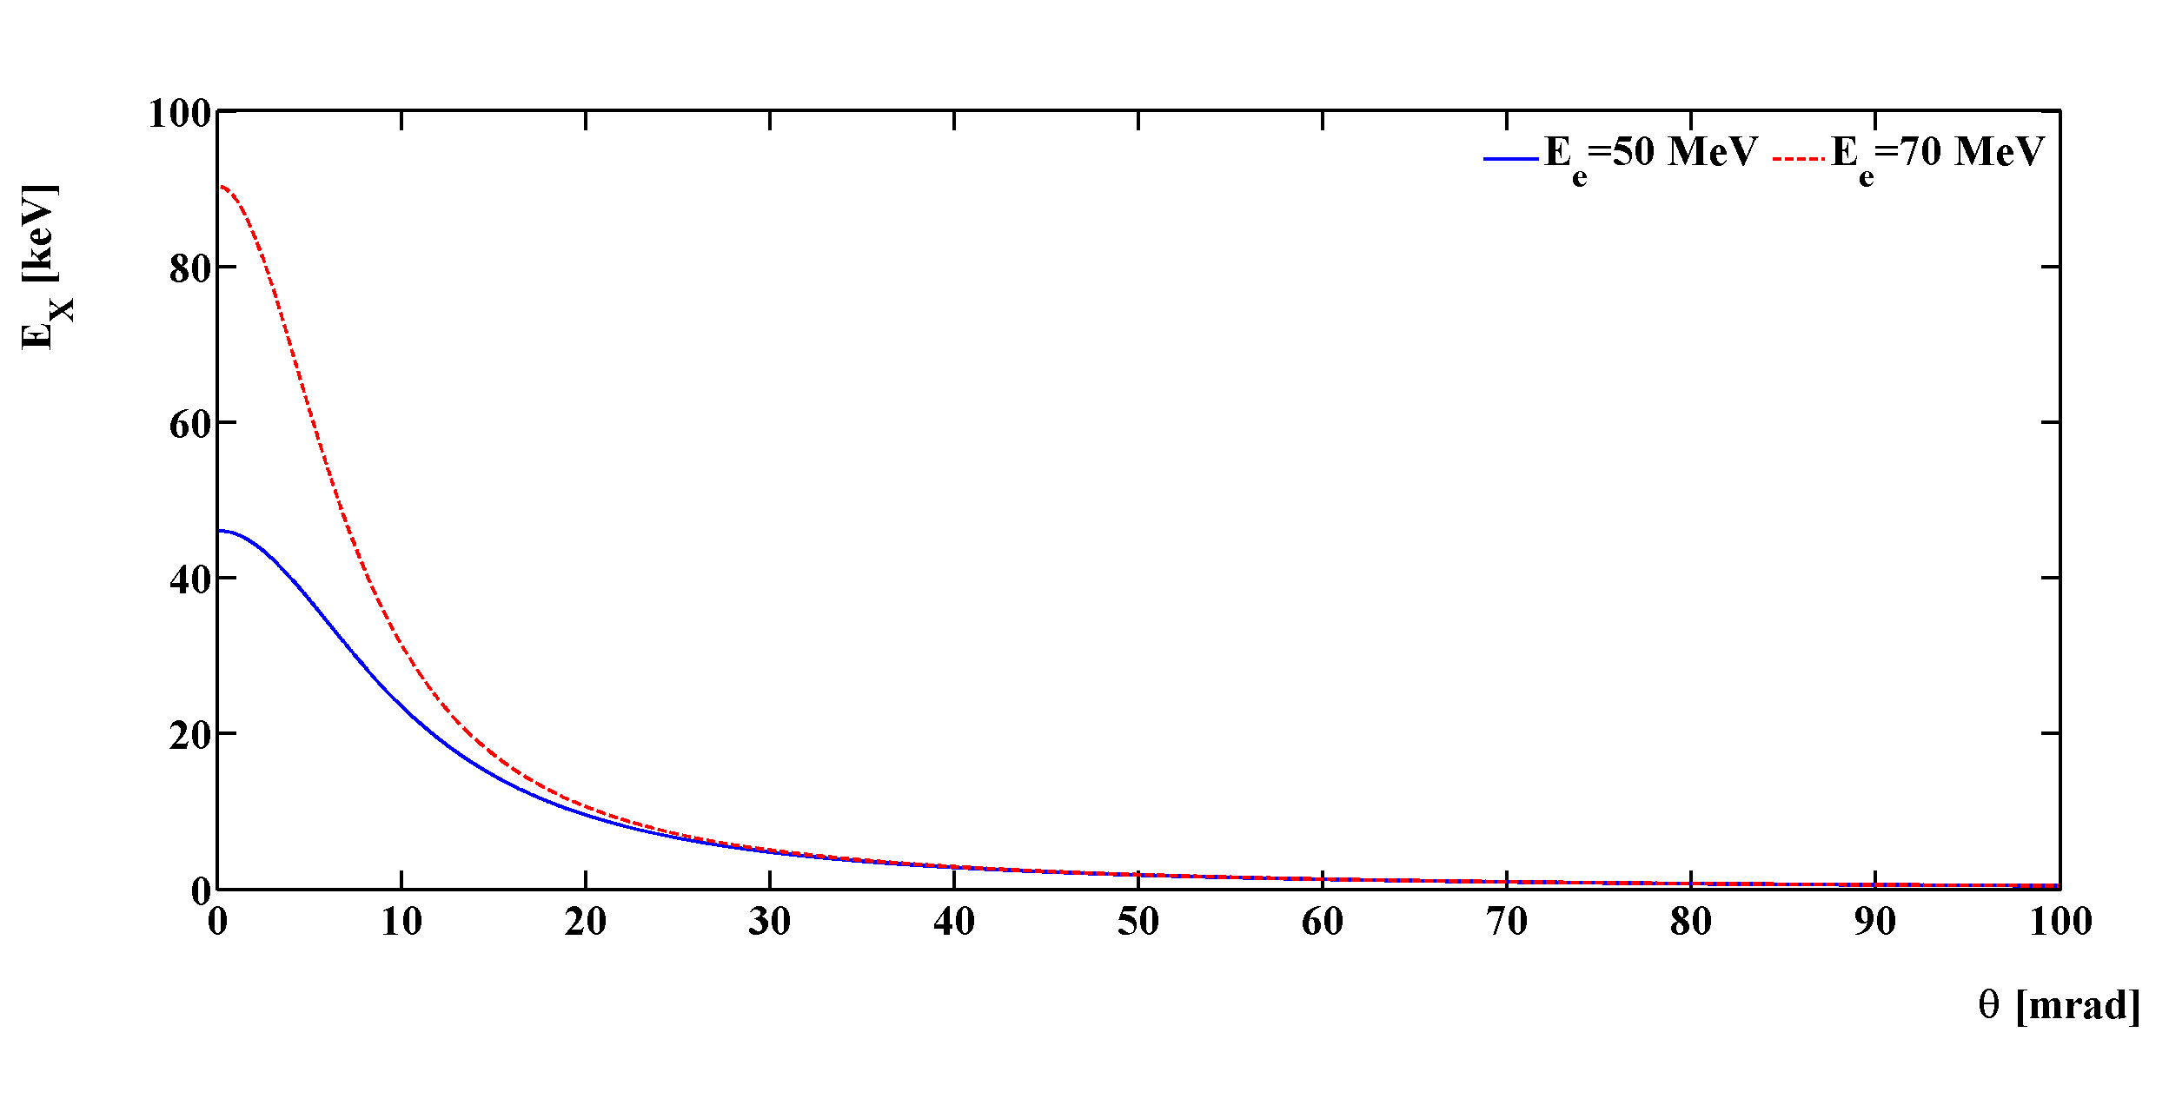
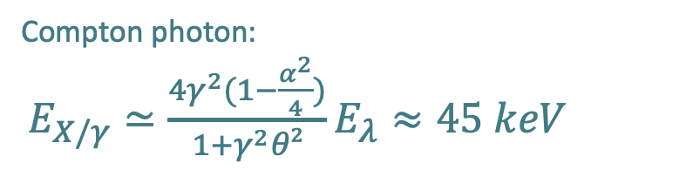
Compton interaction as a monochromatic source
laser (E_{λ}=hc/𝜆=1.2eV)
Compton photon:
$E_{X/γ}≃{\frac{4γ^{2}(1−\frac{α^{2}}{4})}{1+γ^{2}θ²}E}_{λ}≈45 keV$
α
θ
e⁻ beam $Ee=50 MeV$
Advantage:
Quasi monochromaticity obtained by use of collimator
Price to pay → Flux reduction

Slide 3
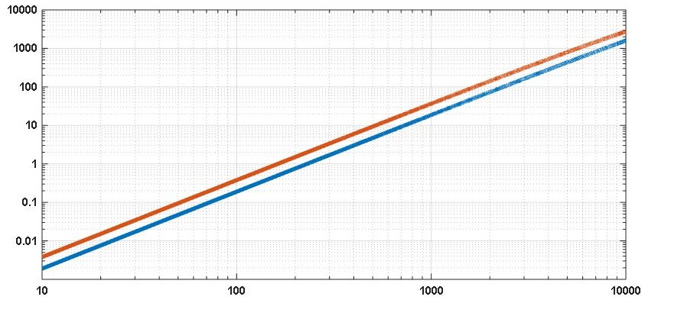
A wide range of applications
Compton energy threshold for λ_{laser} = 1µm, 0.5µm
ILC
SuperKEKB
Maximum Scattered photon energy [MeV]
ELI-NP-GS
MightyLaser
+ GammaFactory
Amplitude/Radiabeam
ThomX
electron energy [MeV]
Low energy: 10keV to 1 MeV
Radiography & Radiotherapy
Art history
Material science
Medium energy (1 to 100 MeV)
Nuclear fluorescence, GDR
Nuclear physics
Nuclear waste management
Medical isotopes production
High energy (>100 MeV)
Electron beam polarimetry
𝛾𝛾 collider
Secondary beam production (ex: polarized positrons)

Slide 4
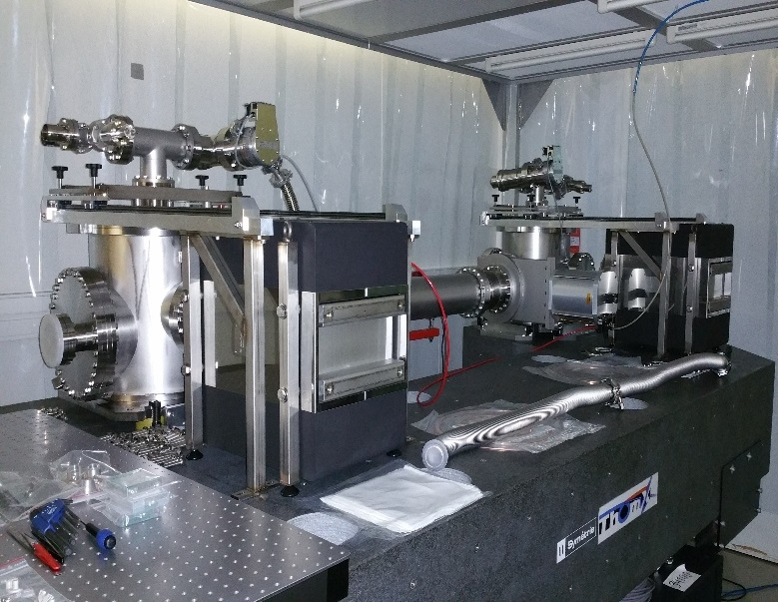
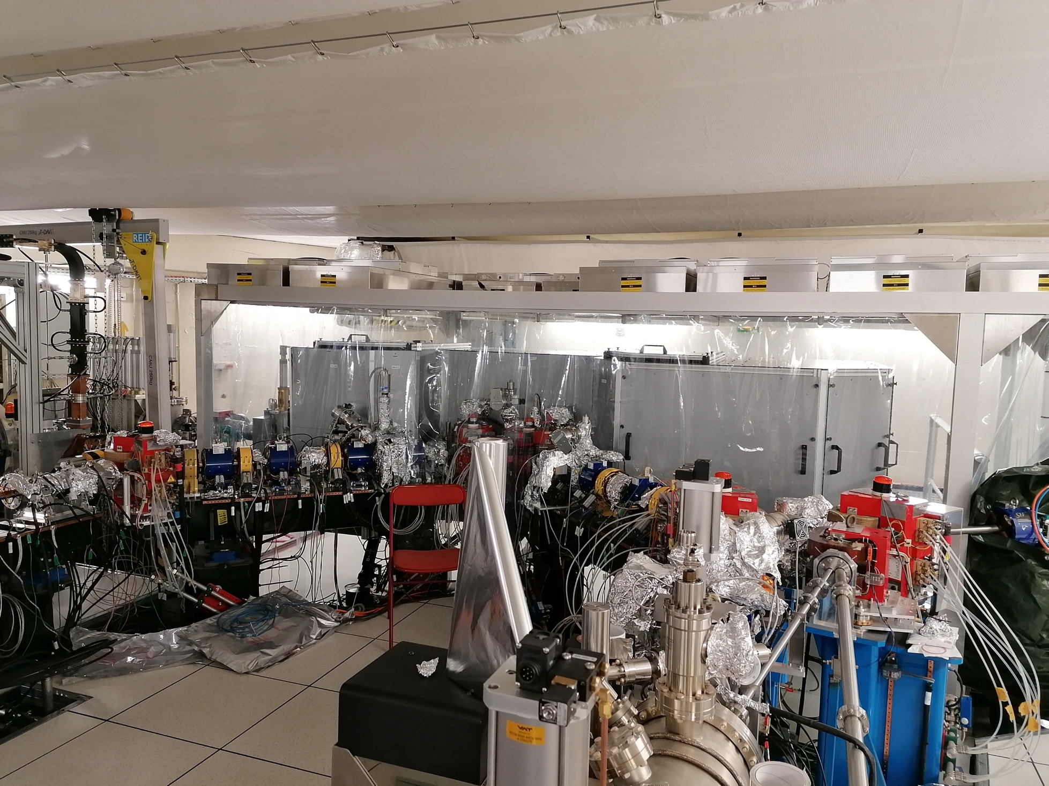

What ?

Slide 5
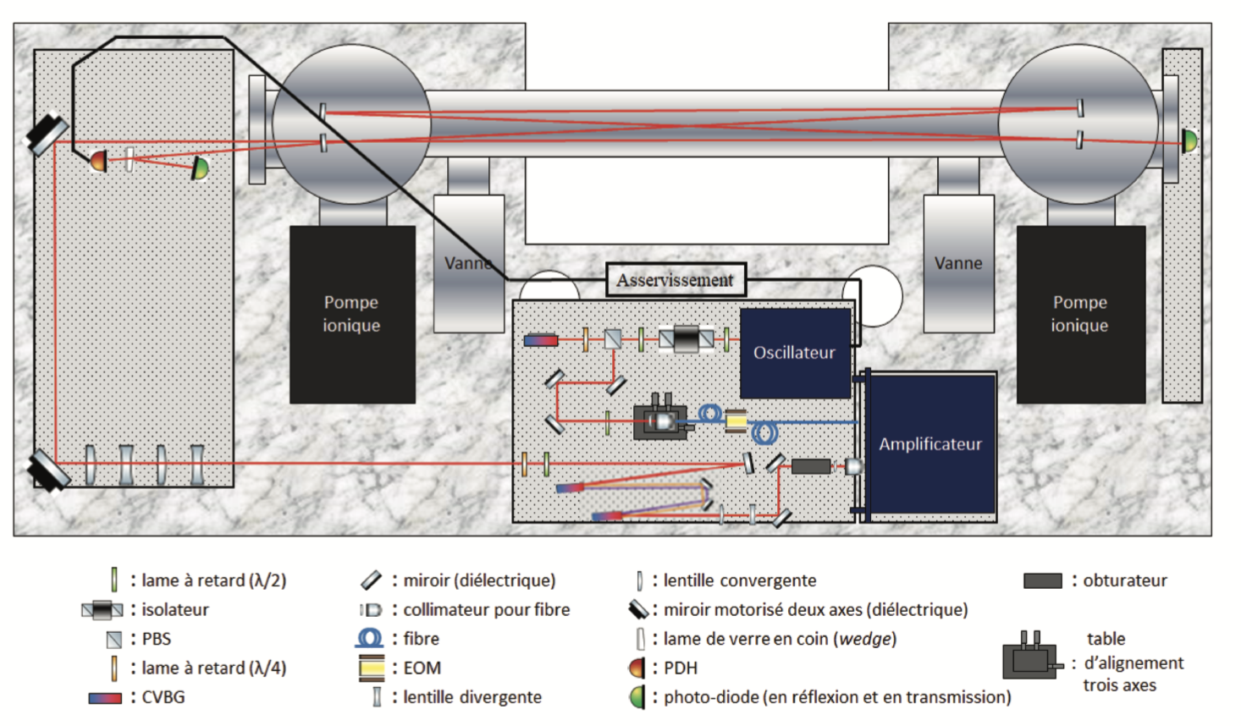
Ex: ThomX optical system
High quality factor (finesse) optical cavity

Slide 6
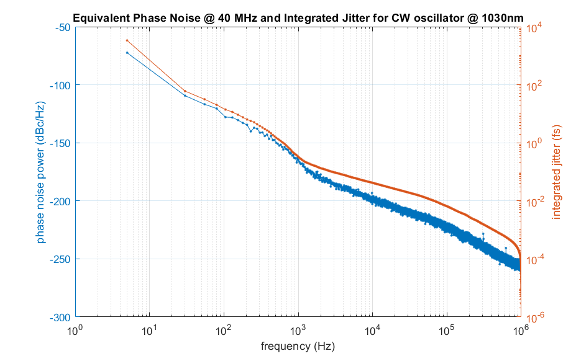
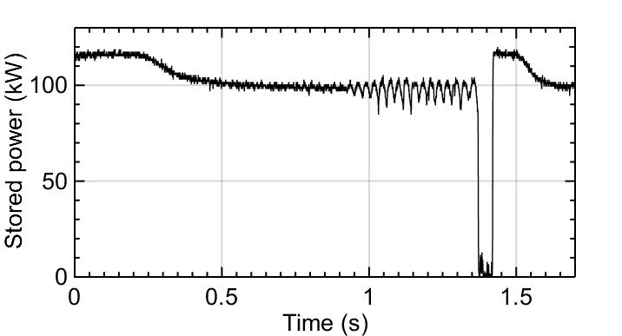
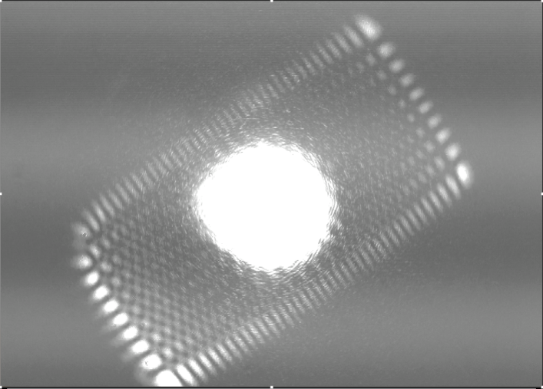
Technical challenges
Noise measurement
Optical beating RF technique
Metrology requirement on phase noise:
Unique provider now refuses to produce this type of laser
Look for alternatives…
Currently no R&D laser available (pulsed laser)
30as integrated time jitter
10kHz
Higher-order mode degenerescence:
Residual absorption in coatings
Residual losses by diffraction (surface roughness)
Mirrors provided by IP2I/LMA

Slide 7
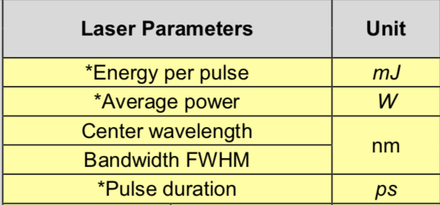
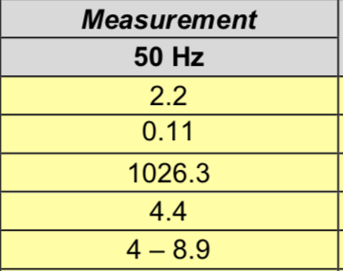
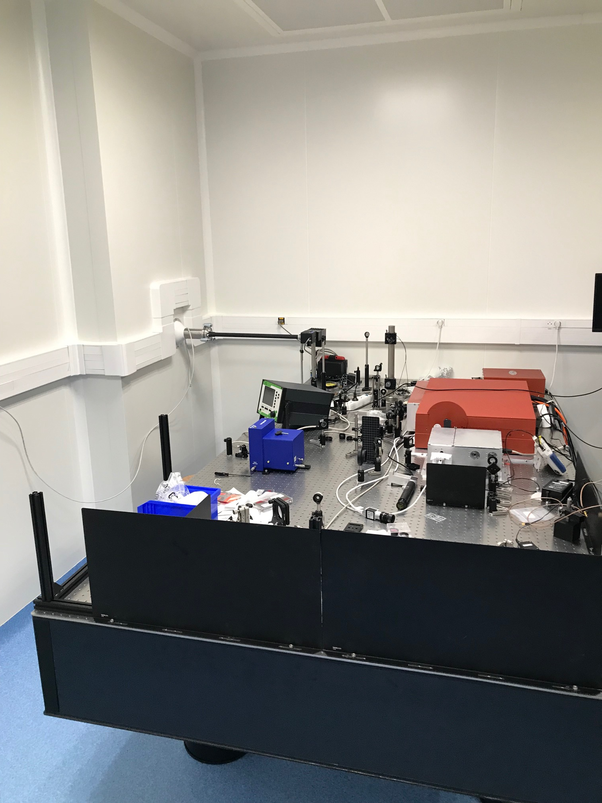
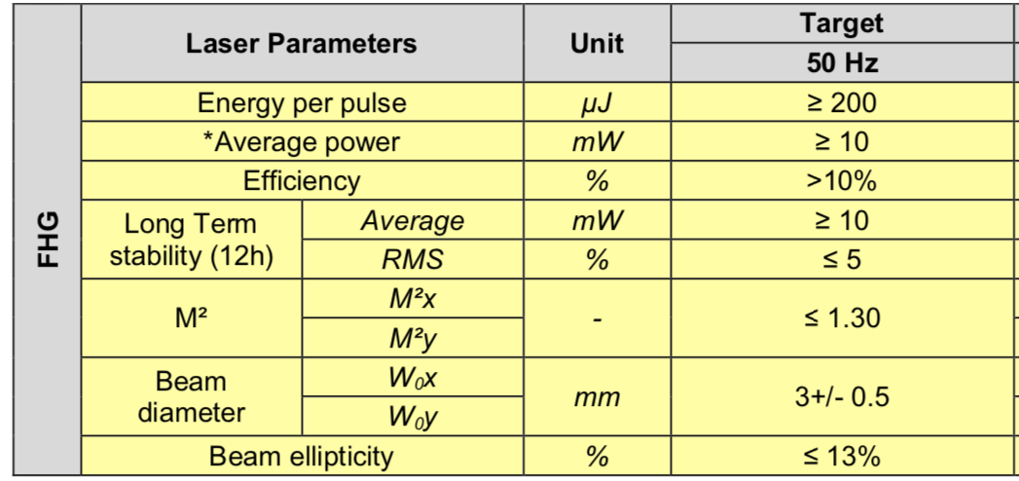
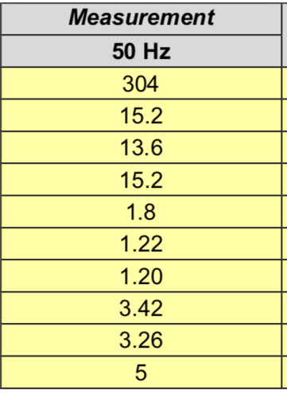
ThomX photocathode
Quadrupled Yb laser
Operated by V. SOSKOV → Retirement in 2022/2023

Slide 8
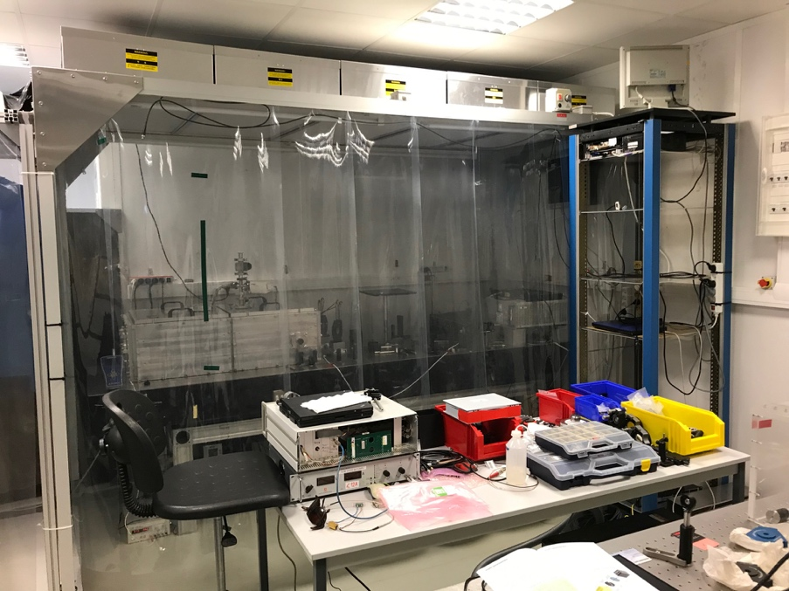
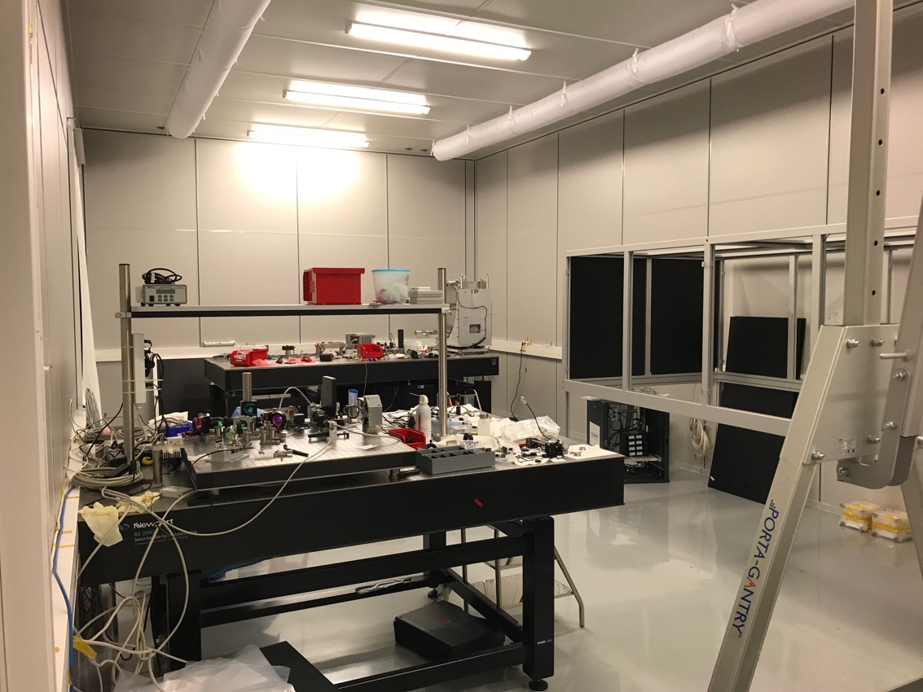
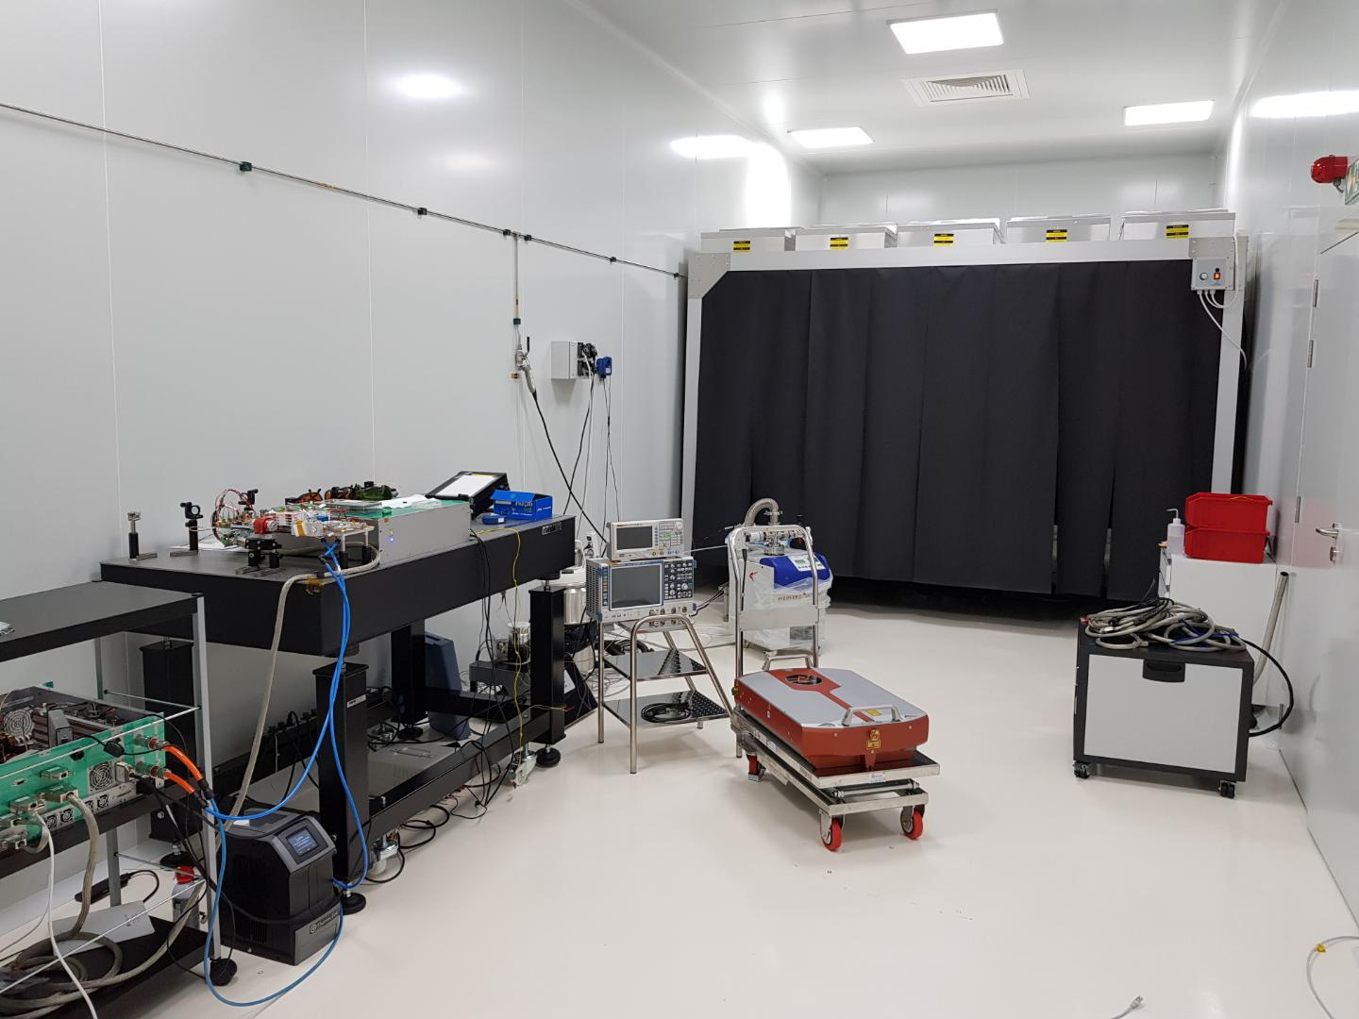
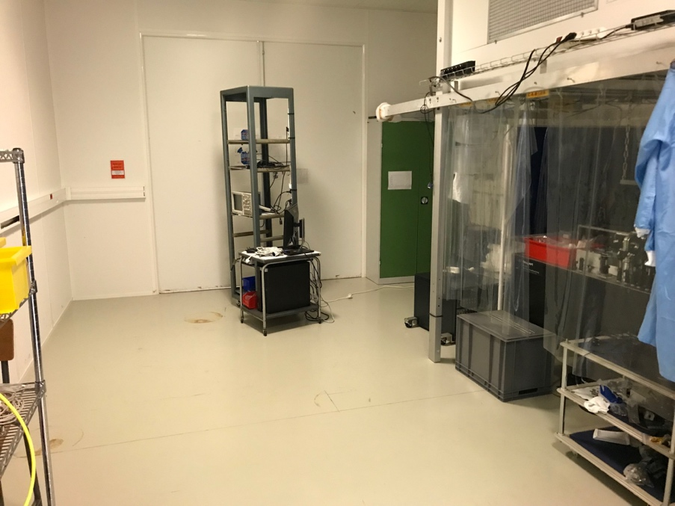
Material
Mode-lock frequency combs at about 1031nm
MENLO orange fibre 175MHz, old, difficult to use but not used anymore. Maintenance may be needed.
OneFive 62MHz. Maintenance required. Could be used for our R&D if can be repaired.
ThomX lasers: 33Mhz and 133MHz working (or currently under maintenance)
Two CW ultra-stable lasers, being used with ThomX and current projects
Two fibre amplifiers 10-30W (not in use these days, but expected to be in the coming months)
3 green alignment lasers, 1 HeNe
Fibre soldering machine (PM fibre)
Spin-coater (to clean mirrors)
Various optics at 1030nm (mostly in use), optics at 515nm (un-used) + some blanks
Two optical spectrometers, one autocorrelator, Wavefront sensors, polarimeter
Vacuum devices, dust meter
Optical modulators (acousto, electro), doubling crystals
RF phase noise meter, PID electronics (LaseLock)
Bat. 208, salle ISO7
Bat. 209, salle ISO7, loc. ISO5
Bat. 209/PLIC, salle « grise »

Slide 9
HR
*: convention: moyenne années passées → attendu années à venir
**: % de la part totale des activités
***: en phase de conception/installation
Statuts Chercheurs/Enseignants-chercheurs**
F. ZOMER (PdU, HDR, 50%→ 25%)
K. DUPRAZ (MCF, 25% → 25%)
D. NUTARELLI (MCF, 50% → 50%)
A. MARTENS (CRCNS, HDR, 100% → 80%)
Statuts Ingénieurs/Techniciens
R. CHICHE (IR elec, 80%→ 80%)
Y. PEINAUD (AI BE meca, 70% → 70%***)
K. CASSOU (IR opt., 80% → 0-5%)
V. SOSKOV (IR opt., 5-10% → RETRAITE 2022-23)
+ 2 to 3 students
RH: Points de vigilence et besoins pour les années à venir:
Expertise clé asservissement numériques et analogiques dédiés aux cavités optiques de R. CHICHE
Plus d’une décennie de savoir faire unique
Pérennisation sur le très long terme nécessaire si IJCLab veut continuer à contribuer
Idéalement: identification d’un jeune compétent volontaire à former en vue d’un remplacement à 10 ans
Savoir faire de (>10 ans) sur la conception mécanique de nos systèmes par Y. PEINAUD
Renforts nécessaires:
BE méca: gestion des effets thermomécaniques, en support au travail des doctorants
IE optique: permanent dédié pour le soutien aux nombreux projets et lien technique continu sur le long terme
AI/IE elec. analogique: manque depuis le départ de D. JEHANNO, profil difficile à trouver…
Air-conditionning contract:
Several past issues with DALKIA that di not maintain properly the system for one of the rooms. Apparently solved since a month.

Slide 10
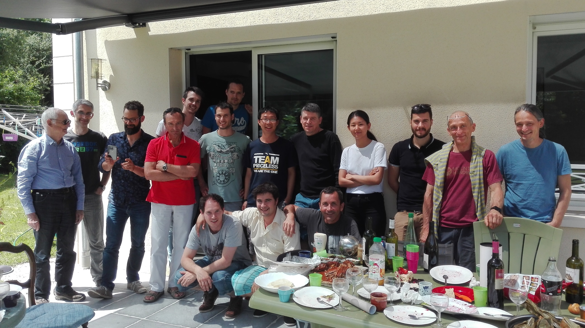


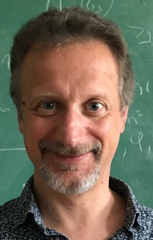
Un travail d’équipe réalisé par des doctorants
Themis
+ Manar
+ Frédéric
Cheikh
Loïc
Yann
Daniele
Ronic
Fabian
Huan
Titouan
Xing
Eric
Christian
Pierre
Daniel
Kevin
Viktor
Denis
Kevin

