Slide 1



Global interpretation of LHC indications within the Georgi-Machacek Higgs model
Cosmologie et Physique des Hautes Energies (cosPT)
F. Richard
IJCLaB
October 2021

Slide 2
Introduction
A key question for HEP is the following: can LHC exclude the presence of light objects with masses below 1 TeV which are of relevance for e+e- ?
In case the answer happens to be YES, a circular machine, including LEP3, seems an affordable choice satisfying our needs
Alternatively, one needs to make sure that the next machine can reach the energy needed to produce and measure these light objects
This talk is an attempt to provide some answers about light scalars which naturally occur in composite models (PGB)
I will briefly review the various LHC indications and will try to show that they make some sense within a GM phenomenology

Slide 3
1st indication : ZZ into four leptons
In 1806.04529 LHC data with 113.5 fb-1 CMS (2/3) and ATLAS (1/3) unofficial combination indicating a peak at ~660 GeV, ~4.3 s.d. local significance, Γt~100 GeV
With the 139 fb-1 ATLAS has observed a modest excess with enriched VBF ATLAS-CONF-2020-032 at the same mass
Not seen in WW which seems incompatible with WW/ZZ=2 predicted in SM & MSSM
Awaiting CMS results

Slide 4
2d indication : a resonance at 400 GeV seen in various modes
A ttbar paper from CMS claims a 3.5 s.d. at ~400 GeV
CMS took into account interference with the QCD background (major handicap of LHC)
Signals were observed by ATLAS in ττ, ττ+b and in hZ+b
Signals at ~3 s.d. local, but giving ~6 s.d. global when combined
Does not fit with MSSM which would predict ~zero for A->hZ 1802.09122
Requires full statistics and ATLAS-CMS mutual confirmation
Have a look to my two ArXiv preprints about anomalies:
https://arxiv.org/abs/2001.04770
https://arxiv.org/abs/2003.07112

Slide 5
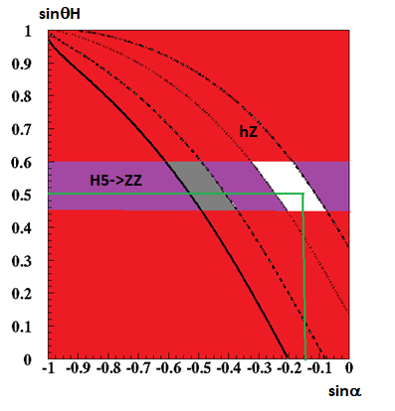
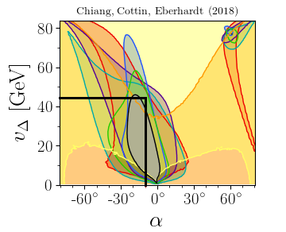
Giorgi-Machacek for pedestrians
Allows I>1/2 without violating Mzcosθw/Mw=1
Is achieved by combining 2 triplets with the same vacuum
Predicts 5-plet H++ H+ H0 H- H-- degenerate in mass
Fermiophobic, only produced by VBF
H5+ -> WZ is allowed, H5-> ZZ/WW with ZZ/WW~2 (instead ½ in MSSM)
+ 3-plet H3+ H0 (CP odd A->hZ) H3- degenerate in mass
+ 2 singlets h(125) and h’(?) mixing angle α
Present indications from LHC fix the masses except for h’
Couplings depend on 2 mixing angles constrained by LHC observations : sinα~-0.15 and sinθH~0.5
1807.10660

Slide 6
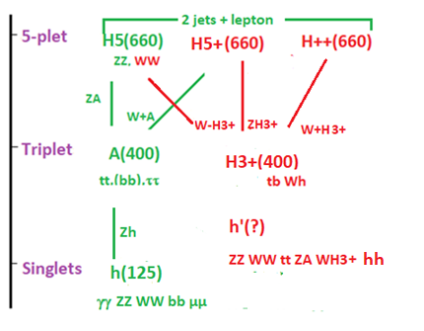
Cascades I
The picture suggest the presence of many cascades which allow various strategy of signature
ttW and ttZ seem the most promising channels
ttW shows a 50% excess in both experiments which can be attributed to these cascades
2011.03652

Slide 7
Predicted mass spectrum
Unitary bounds were derived by Aoki and Kanemura:
mA<400 GeV
mH5<650 GeV
mh’<700 GeV
Zbb suggests that mH5~√3mA, in striking agreement with LHC present indications
Mayumi Aoki (Tokyo U., ICRR), Shinya Kanemura (Toyama U.) (Dec 27, 2007)
Published in: Phys.Rev.D 77 (2008) 9, 095009, Phys.Rev.D 89 (2014) 5, 059902 (erratum)
e-Print: 0712.4053

Slide 8
Cascades II
Cascades could also explain the various anomalies recorded by Budenbrock et al 1901.05300 in ATLAS and CMS
They predict additional scalars H(270) S(150) which tend to cascade into each other H->SS* and H->Sh(125)
Evidence ~5 s.d. for S(151)-> γγ+Etmiss by comb. ATLAS & CMS 2109.02650
Both mechanisms at work ?
H5->ttW/Z ->bbWWW/Z
H5->(hW,tb)W/Z->bbW+W-/Z
H5++->(hW,tb)W+->bbW+W+

Slide 9
Need for an extended GM
Is GM satisfying the various observations ?
The answer is NO, in particular for what concerns the fermionic couplings of A(400) which tell us that Yt~SM while Yb,τ >> SM and GM
The remedy is to add an extra doublet and benefit from an enhancement of Yb,τ~tanβ∼25 as in MSSM. Too naïve since then Yt~1/tanβ
A solution is provided by the Aligned-Two-Higgs-Doublet-Scheme mechanism A2HDS, a more general scheme sufficient to suppress FCNC transitions, which assumes Y2f=ξfY1f where Y1f and Y2f are the Yukawa couplings to the two doublets φ1 and φ2, and where ξf is an arbitrary constant which can be complex and differ for top, bottom and lepton
Solves the problem ! 0908.1554

Slide 10
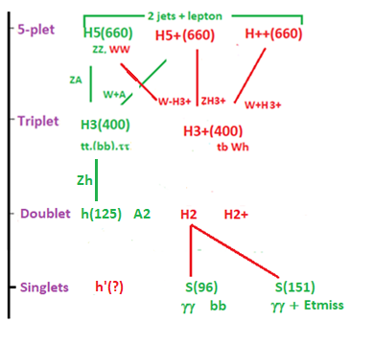
Extended GM model
Yukawa couplings

Slide 11
Conclusions
One is eagerly awaiting for solid confirmations by cross-checks between ATLAS & CMS + official data combinations between ATLAS and CMS e.g. for ZZ and γγ
An extended Giorgi-Machacek model seems to provide a valid interpretation for the various anomalies, both spectroscopic A(400), H(660), S(151), S(96)… and topologic multi-leptons + b jets, each at the ~8 s.d. level
Almost all ingredients are now available to test at LHC the predictions of this model on a large set of observables
Measuring precisely the parameters of these scalars should be possible at an e+e- collider reaching at least 1 TeV, preferably ~1.5 TeV (H++)
Complex final states have a critical impact on future LC detectors
Suggestions, criticisms welcome
Revised (EGM model) paper available 2103.12639

Slide 12
APPENDIX

Slide 13
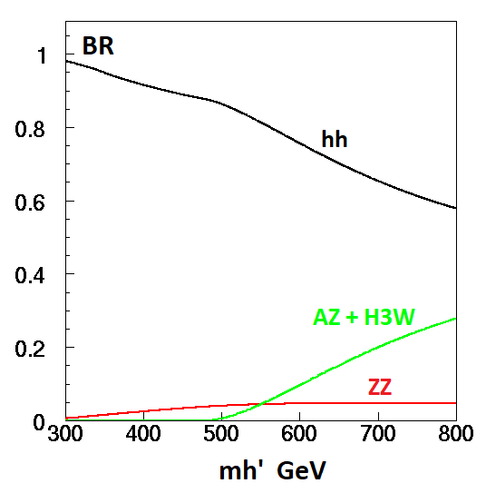
Prospects at HL-LHC
EGM is a gold mine for LHC with a very rich spectrum of scalars
Confirm H(660)->ZZ and A->tt,hZ,ττ
Search for the second singlet h’
Presumably heavy with h’->hh (2γ ?)
Search for H+->WZ in VBF
Select VBF and try to reconstruct complex final states from ttZ and ttW
…
F. Richard IJCLab October 2021
13

Slide 14
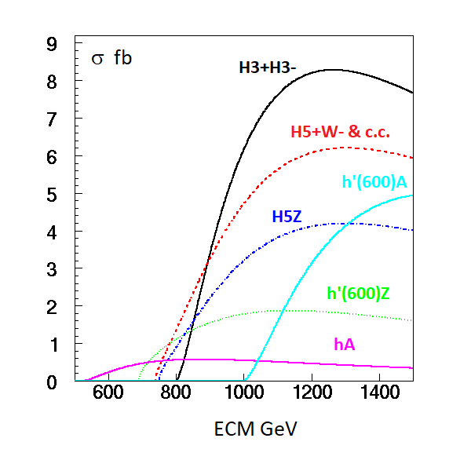
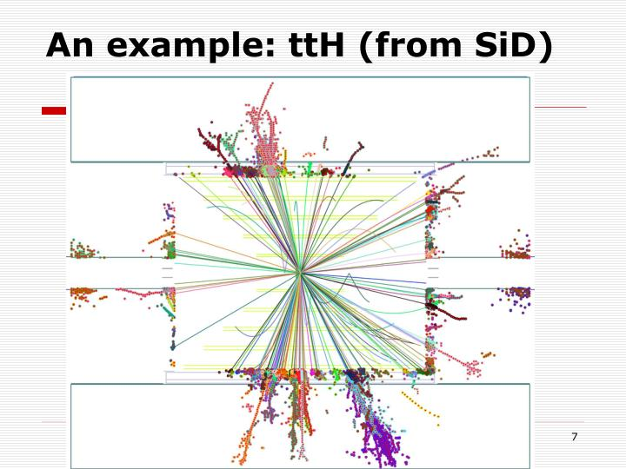
Prospects for a LC
ECM=1 TeV is needed to observe this spectrum
>1.5 TeV to pair produce H5++ H5 - -
Requires highest possible luminosity ~8000 fb-1 with ILC at 1 TeV 1903.01629
Excellent “hermeticity” for jet reconstruction and b tagging needed for these complex modes ε∼Ω^{n} n~8
Recoil mass techniques using Z/W/h with their hadronic decays (recoil mass is wide due to the resonance widths) to be tried
Backgrounds are small (Zhh ~0.5 fb at 1 TeV)

Slide 15
What about h(96) ?
h(96)->2γ by CMS, not by ATLAS which however does not reach the same sensitivity
Could it be the h’ ?
If so one would expect A->h’(96)Z ~30*A->h(125)Z, which is not the the case
Could be an additional isosinglet embedded in EGM or be the Radion expected within Randall Sundrum phenomenology 1712.06410
Difficult to observe at LHC in the fermionic modes given the contamination from ZZ
Ideal for an e+e- collider h(96)->bb ττ gg
CMS-PAS-HIG-19-010

Slide 16
Is there an h’ candidate in LHC data ?
Hint of mh’~1 TeV in hh in ATLAS & CMS
Seems inconsistent with GM which predict mh’<750 GeV
Hint of a narrow resonance in γγ in ATLAS
Reminder of the 750 GeV episode, with a 5 fb cross section inconsistent with GM 1601.06394
The present signal ~0.5 fb more easily accommodated
CMS-PAS-B2G-20-004
ATLAS-CONF-2021-030
2102.13405

Slide 17
Most recent candidates
S(151)->γγ +Etmiss+… ~5 s.d. Combination of ATLAS & CMS
H(125)->aa(52)->bbµµ 3.3 s.d. 10-4 BR ATLAS
2110.00313
Adding up S(96) this makes 3 candidates accessible at a Higgs factory operating at ~250 GeV
…

Slide 18
Georgi-Machacek Couplings

Slide 19
Problems with A(400)
A(400) is observed into ττ with a BR inconsistent with GM
While the Yukawa coupling is close to the SM in tt it is 20 times larger in ττ
This cannot be fixed as in MSSM by having a large tanβ since the tt coupling goes like 1/ tanβ
Additional issue: h(125)Z and ττ are reinforced by asking a spectator b jet which implies a large Abb coupling
In GM fermion couplings for A(400) all Yukawa couplings are affected by tanθ_{M}
A recent analysis from ATLAS does not confirm ggF->A->Zh but the channel A->Zh+bb has not me released yet

Slide 20
Top-down approach to GM
The GM model does not pronounce on the origin of symmetry breaking and is therefore incomplete
In a UV complete compositeness scenarios, one assumes a symmetry breaking mechanism from extended symmetries to a group containing the SM SU(2)XU(1), accompanied by pseudo Nambu-Goldstone bosons in addition to the SM Higgs doublet
A recent reference 1703. 06064 shows how this mechanism naturally generates Higgs triplets
These theories are strongly interacting and therefore constraints are extracted by lattice calculations
The Higgs potential depend on few parameters, therefore easily falsifiable

Slide 21
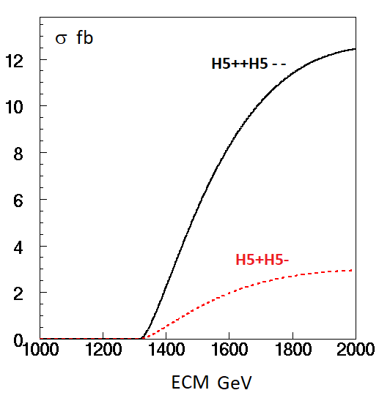
High energy cross-sections
Access to H++(660)
SM h(125) cross-sections
1710.00184

Slide 22
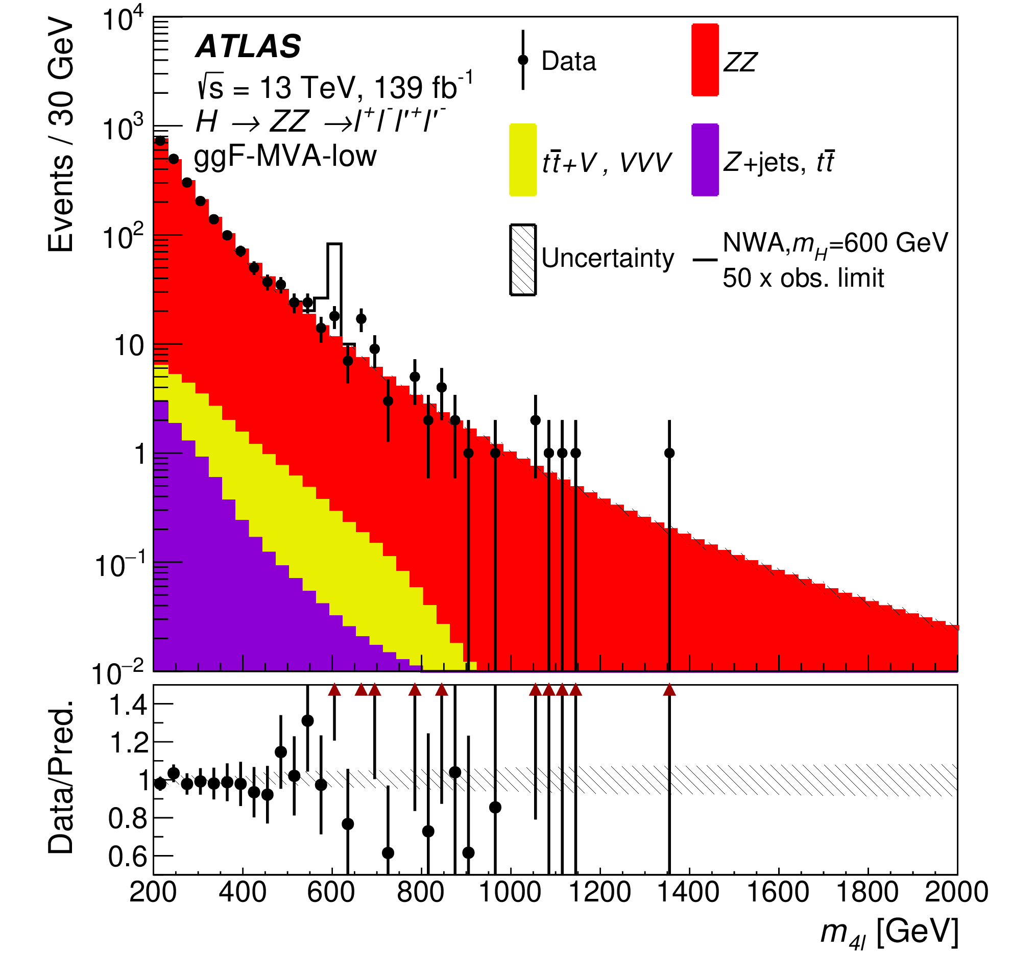
Update from ATLAS
2103.01918
14.2 events expected between 630 and 730 GeV with 42 events observed 1/3ATLAS + 2/3CMS

Slide 23
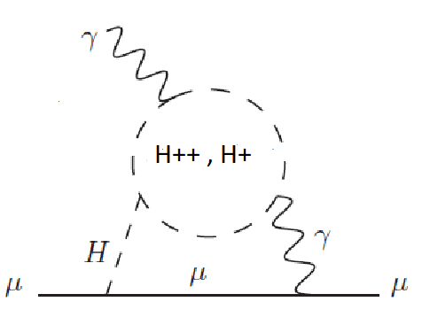
What about g-2 ?
Usual wisdom is that extra scalars need to be <100 GeV to influence g-2
Reference 2104.03275 states that it is possible that H.O. contributions contradict this provided that the H couplings to µµ and H++ are enhanced and that H is not too heavy
Seems possible to interpret a significant part of the effect in an EGM model

Slide 24
Precision measurements
Slow decoupling ~v²/Mnew² instead of ~v⁴/Mnew⁴ in MSSM
Mnew=400 GeV up to ~35% κv>0, κf<0
Should be seen at HL-LHC or even before
However very dispersed predictions
1404.2640

Slide 25
LUMINOSITY at 1 TeV
In reference 1903.01629 a running scenario of ILC at 1 TeV collecting 8000 fb-1 has been envisaged
Beneficial for Higgs self-coupling measurement
Discoveries at LHC would boost these studies at ILC and CLIC
Convert ILC into an ERL 2105.11015 ?

Slide 26
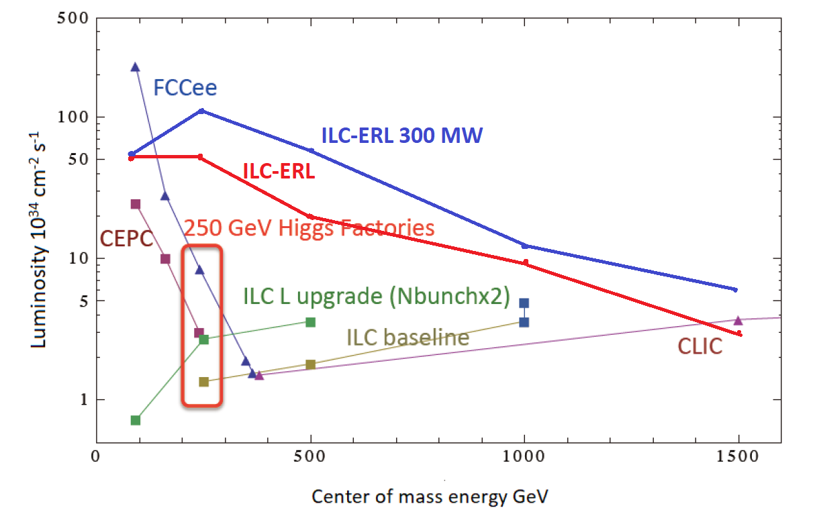
2105.11015

