Slide 1
History of Particle Astrophysics, multi messenger astronomy, past and present with a view to the Future and a Zoom on French contributions
Michel Spiro
President of IUPAP

Slide 2
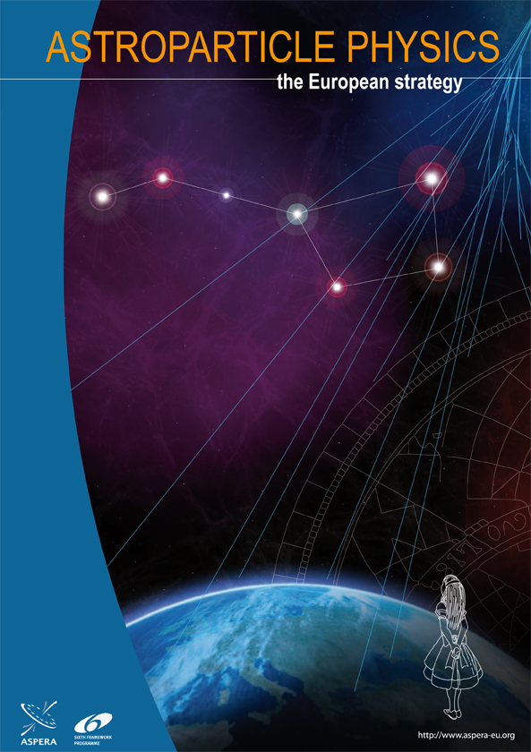
Particle
Physics
Astro
physics
Particle Astrophysics
Nuclear physics
Notes:
Based on apresentation at Auger symposium, 20 years of Auger observatory
Help of C. Spiering

Slide 3
WHAT IS PARTICLE ASTROPHYSICS
Observational Cosmology
  Big Bang Nucleosynthesis
  Cosmic Microwave Background
  Supernovae and cosmology
  Clustering of Galaxies (BAO…)
  Dark matter (Fritz Zwicky and Vera Rubin), dark energy
Neutrino Physics and Proton Decay
Neutrino cosmology
  Neutrinos and star evolution: Solar neutrinos, Supernova 1987
  Non accelerator Neutrino physics (mass, oscillations, nature: Dirac, Majorana, sterile)
  Proton decay.
High energy astrophysics (multimessenger approach)
high Energy Neutrinos (Moisej Markov)
high energy Gamma rays (Alexander Chudakov)
high enregy cosmic rays (Pierre Auger)
Gravitational waves (Albert Einstein)
coupled to astronomy from infra red to X-rays
With a Zoom
on France
Notes:
Concerning Astroparticle physics, this is too wide→I will focus on MMA.

Slide 4

Future of Multi Messengers Astronomy
Notes:
Past can be told (Alan and Paul) and cannot be changed. Future in your power, especially the young people and cannot really be predicted. Summary rather than future. Allow late comers to catch up

Slide 5

Charged
Cosmic
Rays
Gamma
Rays
Multimessenger approach to violent phenomena in the universe
Neutrinos
Gravitational
Waves

Slide 6
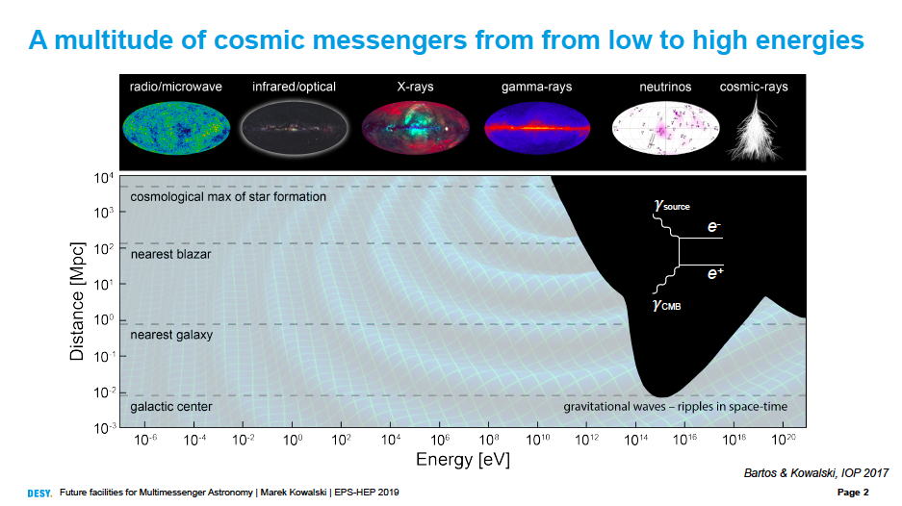

Slide 7
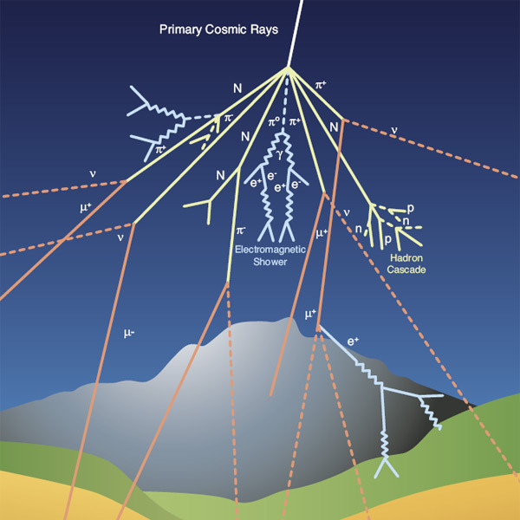
Primary cosmic ray showers:
detectors are on ground, on mountains, on balloons or in space, deep underwater

Slide 8
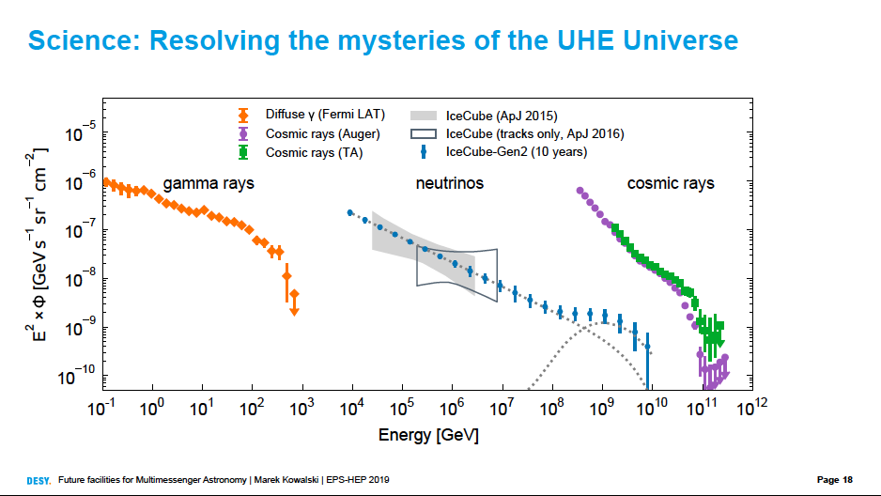
Notes:
Nice complementarity

Slide 9
Motivations
Spectra, composition and origins of cosmic rays (super/hypernovae, Active Galacitic Nuclei, coalescence..)
Learn about acceleration mecanisms in the Universe (jets)
Search for new physics beyond the reach of accelerators
Indirect detection of dark matter particles, through their annihilation into gamma rays or neutrinos, in the form of dark matter black holes through their gravitational coalescence
Started in the 80’s with proton decay detectors, gamma ray detectors, solar neutrino deficit and ultra high energy cosmic ray anomaly (events beyond the GZK cut-off)

Slide 10
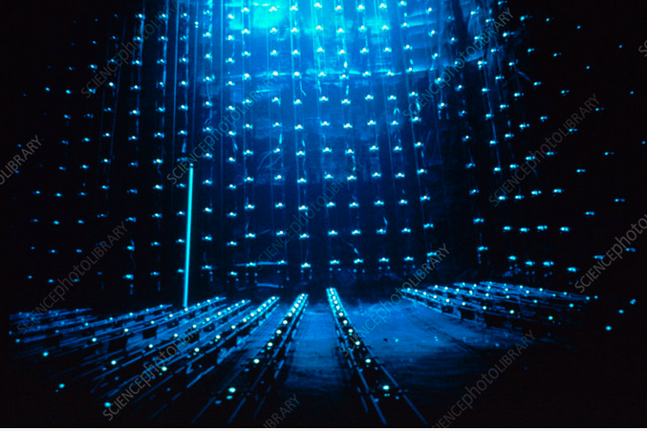
Proton lifetime experiments
IMB 1981 (Sulak..), Kamiokande (1983, Koshiba…): also good muon and neutrino detectors

Slide 11
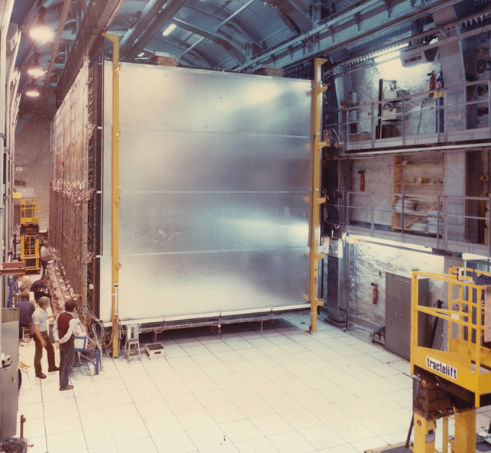
Expérience durée de vie du proton
LSM 1983 (Rousset, Barloutaud, Julian..)

Slide 12
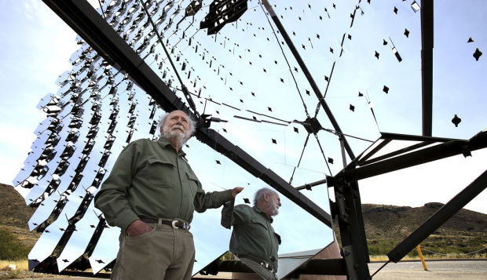
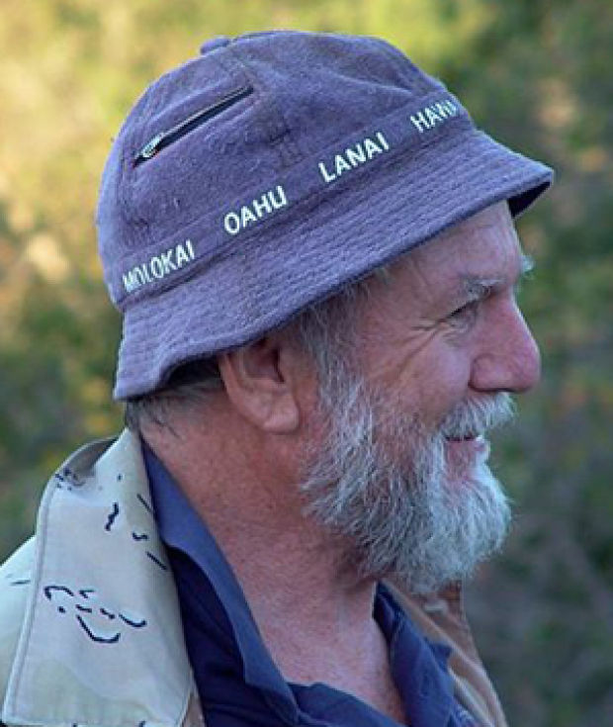
Trevor Weekes
1985
Whipple
Detection of the Crab nebula as TeV gamma-ray source
(WHIPPLE Telescope/Arizona)

Slide 13
Two important results in 1985
- The Soudan 1 experiment has obtained additional evidence for underground muons associated with the x‐ray pulsar Cygnus X‐3. We report the preliminary analysis of data recorded during the October 1985 radio outburst of Cygnus X‐3, which show a significant excess of muons for a narrow range of Cygnus X‐3 pulsar phases.
Trejor Weekes: After decades of fruitless search, astronomers have found a source (Cygnus X3) of high energy charged particles and TeV gamma rays bombarding the earth
Finally this turned out to be wrong (G. Chardin anticipated) , but one source of TeV gamma rays was discovered by Whipple (the crab nebula supernova remnant), which is by now the reference (brightest) source in this energy range

Slide 14
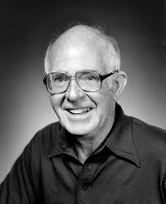
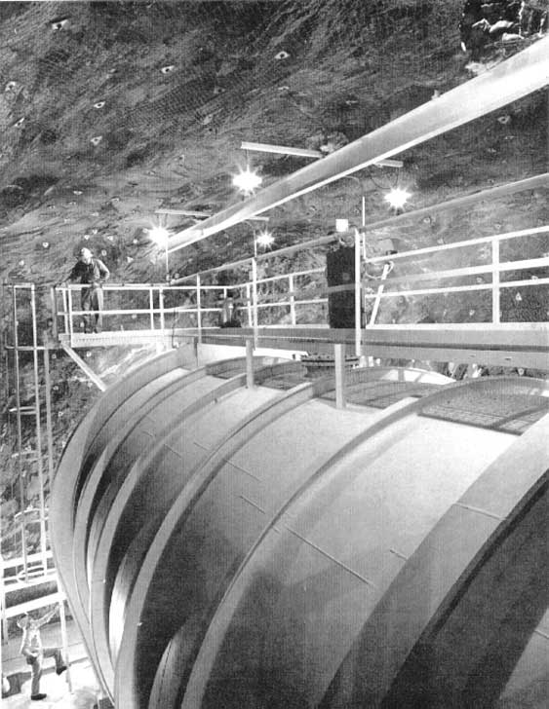
The solar neutrinos deficit enigma
Ray Davis
Homestake mine
600t C2Cl4

Slide 15
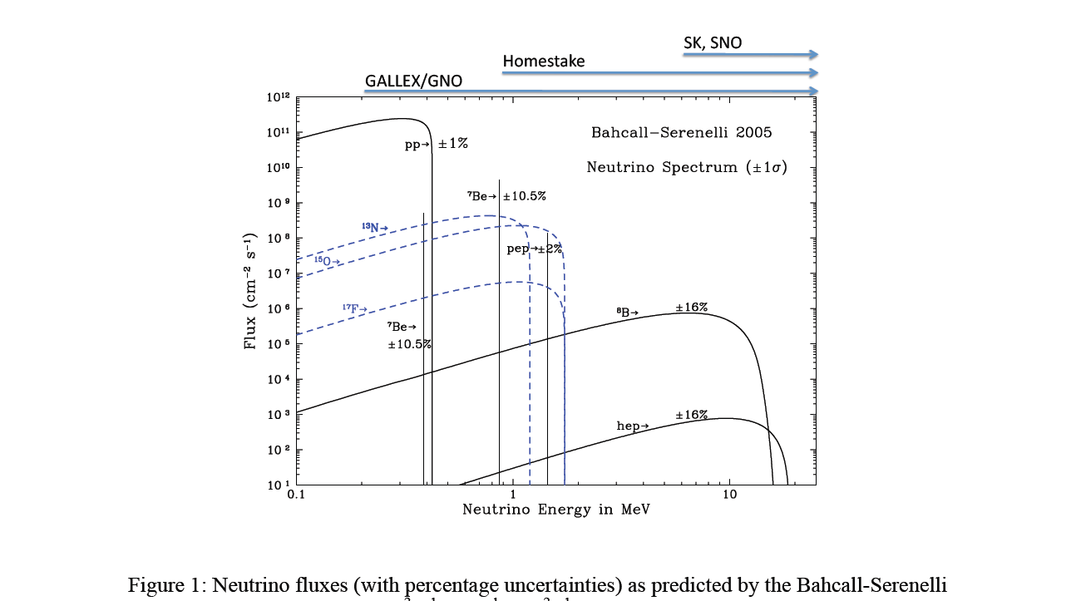
Expected Solar Neutrino Spectrum (J. Bahcall)

Slide 16
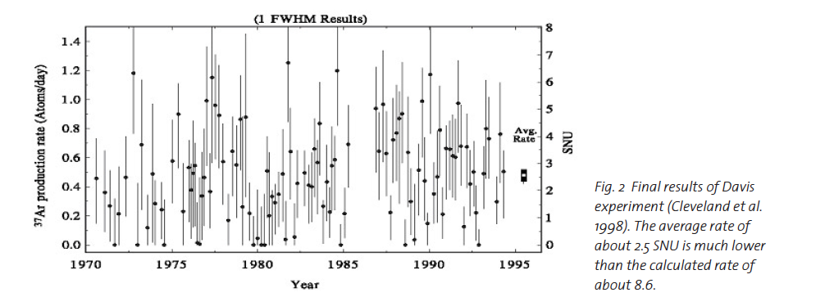
← Expected
Is he signal coming from solar neutrinos?
Is the detector fully efficient?
Is the discrepancy due to solar modeling (Turck-Chieze vs Bahcall)
or to new neutrino properties.

Slide 17
GALLEX (Italy, Germany, France..) in Gran Sasso 100t GaCl₃
⁷¹Ga(ν_{e},e)⁷¹Ge (E_{thr} = 233 keV)
EC τ = 16.5 d
⁷¹Ga
Reaction
pp + pep 73 SNU (55 %)
⁷Be 35 SNU (27 %)
CNO 8 SNU ( 8 %)
⁸B 13 SNU (10 %)
Tot 129 SNU ⁺⁹_{–7} 1σ
Source of the signal
1.2 ν int. per day, but due to decay during exposure + ineff., 9 ⁷¹Ge decay detected per extraction
(28 days exposure)
Expected Signal
(SSM)

Slide 18
Extraction
GeCl₄ volatile in acidic soluion
dans 100 t of GaCl₃ in sol. Flux d’Azote
Operation
See f.i. PL B490(2000)16
PL B314(1993)445
Extract
GeCl₄
12 h
Add 1 mg
of carrier
GeCl₄
In synthesis lab
10 h
t₀
In tank
GeH₄ + Xe
in counter V =1cc
Wait
21-28 d for SR
1 d for blanks
Counter in
shielding
Stop counting
Remove counter
6 months

Slide 19
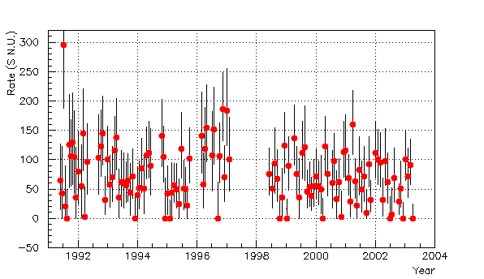
GALLEX - GNO
Davis plot
GALLEX
65 solar runs
GNO (Russia)
58 solar runs

Slide 20
⁵¹Cr Source
Strength | 63.4 PBq | 69.1 PBq
R (meas/expt) | 1.01 ±11.5% | 0.84 ±11.5%
500 keV
3/2⁻
175 keV
5/2⁻
1/ 2⁻
0.93 ± 0.08 [0.91 ± 0.08]
g.s. ⁷¹Ge
Energy (keV) | ⁵¹Cr | ⁷Be
862 | - | 90%
751 | 80.6% | -
746 | 9.5% | -
431 | 8.8% | -
426 | 1.1% | -
384 | - | 10%

Slide 21
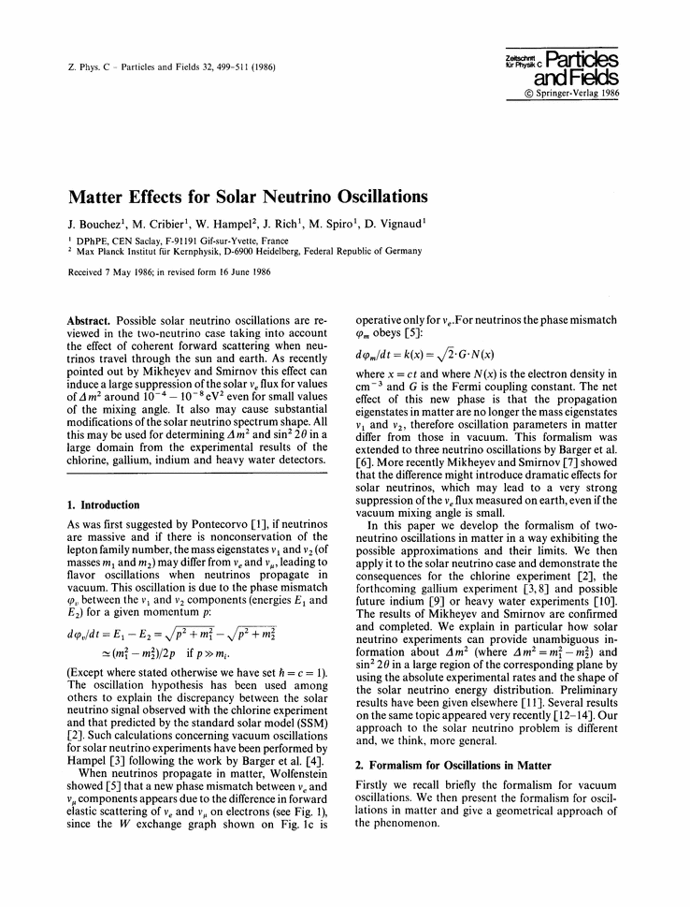

Slide 22
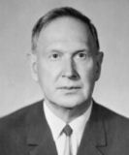
Moisej Markov
1960
Proposal to detect C-light from charged particles in open water

Slide 23
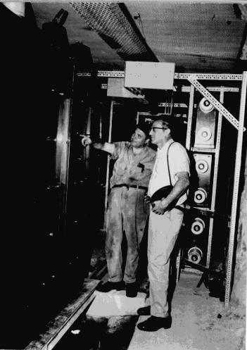
Fred Reines
1965
Detection of neutrinos with liquid scintillator

Slide 24


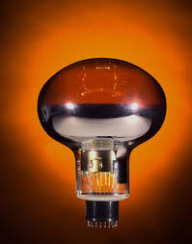
Are the neutrinos really coming from the sun ?
Masatoshi Koshiba
Water Cerenkov detector: Kamiokande
high energy (compared to rest mass)
produces cerenkov radiation when
traveling in water (can get direction
of neutrinos but not for antineutrinos)
_{x}
_{x}
neutral
current (NC)
Z
e⁻
e⁻
_{e}
_{e}
W⁻
charged
current (CC)
e⁻
e⁻

Slide 25
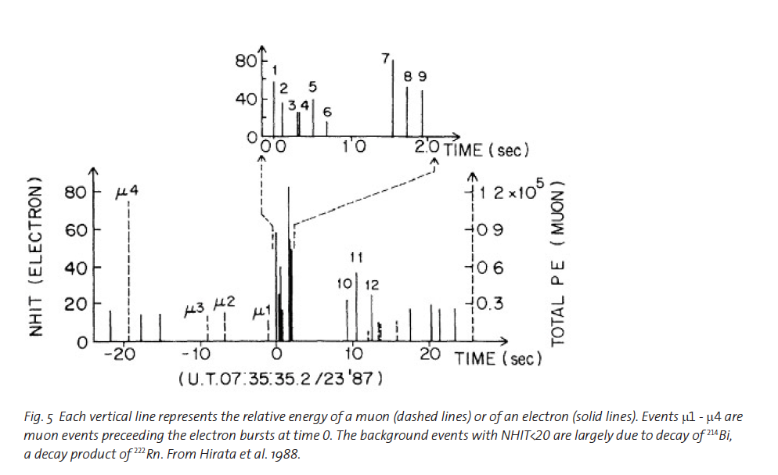

Slide 26
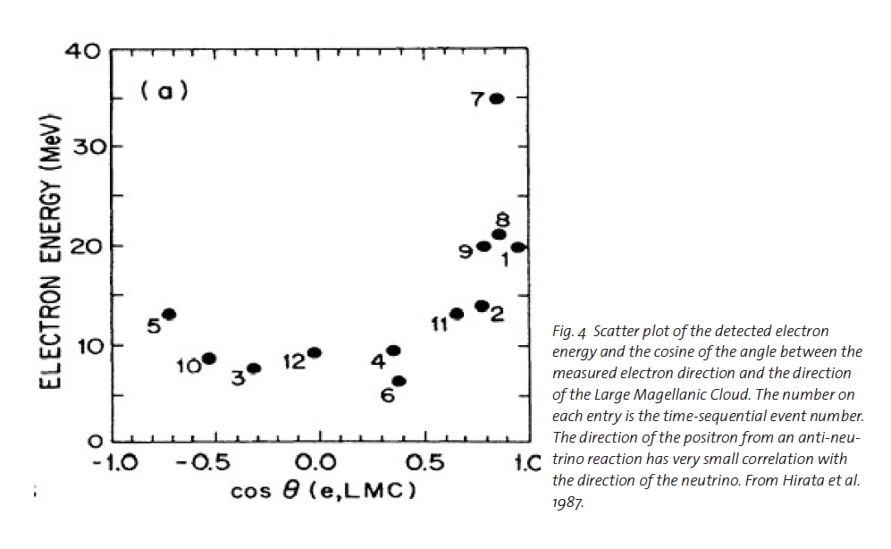

Slide 27
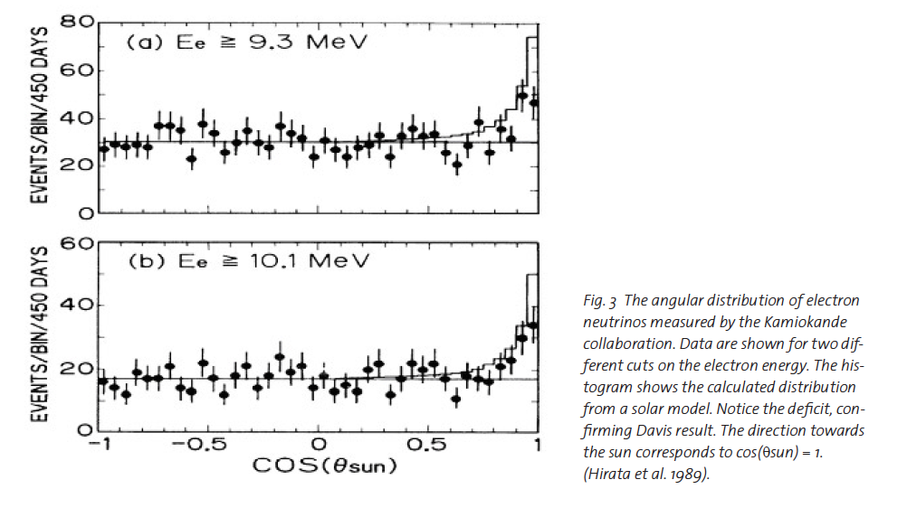

Slide 28
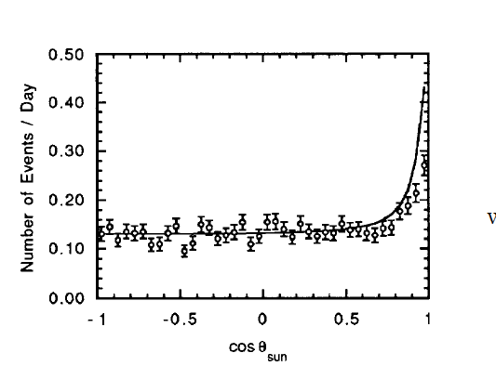


Slide 29
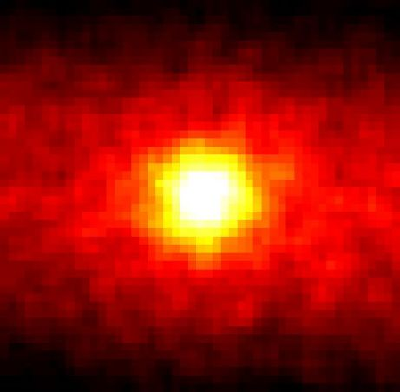
Astronomy Picture of the Day June 5, 1998
Neutrino image of the sun by Kamiokande – first step in neutrino astronomy

Slide 30

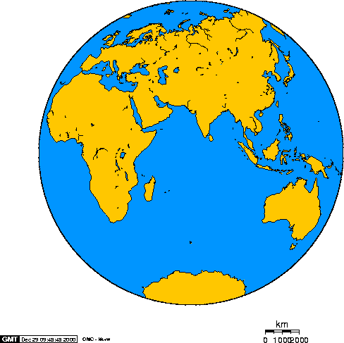
High energy neutrino detectors: neutrinos come from below and interact in the rock or in water/ice
Baikal
Antares
Jj Aubert -→
AMANDA
IceCube

Slide 31

Baikal, Mediterranean Sea, South Pole
GVD Baïkal
KM3NeT
(ARCA + ORCA)
GNN
IceCube Gen2
HEA +PINGU + ….

Slide 32
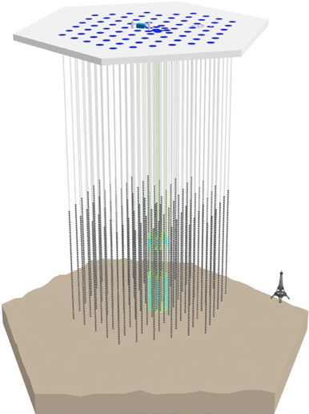
IceCube Neutrino Observatory
IceTop air shower detector
81 pairs of water Cherenkov tanks
IceCube
86 strings including 8 Deep Core strings
60 PMT per string
DeepCore
8 closely spaced strings
1450m
~220 neutrinos/day
Threshold
- IceCube ~ 100 GeV
- DeepCore ~10 GeV
2450m
2820m

Slide 33
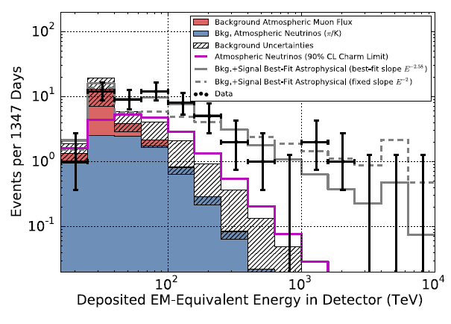
Follow-up Analysis: HESE (High Energy Starting Event)
First evidence for an extra-terrestrial h.e. neutrino flux
2 yrs data, 28 evts 4.1σ
Science 342 (2013)
3 yrs data, 37 evts 5.9σ
Phys.Rev.Lett. 113:101101 (2014)
4 yrs data, 54 evts ~ 7σ
Threshold ~ 30 TeV

Slide 34
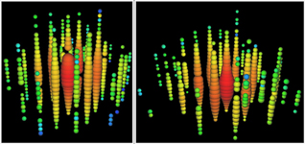
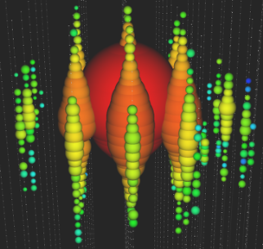


Follow-up Analysis: HESE (High Energy Starting Event)
First evidence for an extra-terrestrial h.e. neutrino flux
2 yrs data, 28 evts 4.1σ
Science 342 (2013)
3 yrs data, 37 evts 5.9σ
Phys.Rev.Lett. 113:101101 (2014)
4 yrs data, 54 evts ~ 7σ
”Bert”
1.04 PeV
Aug. 2011
”Ernie”
1.14 PeV
Jan. 2012
”Big Bird”
2 PeV
Dec. 2012

Slide 35
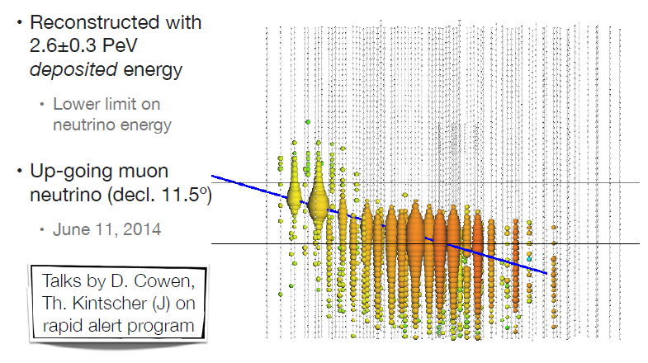
2.6 PeV !

Slide 36
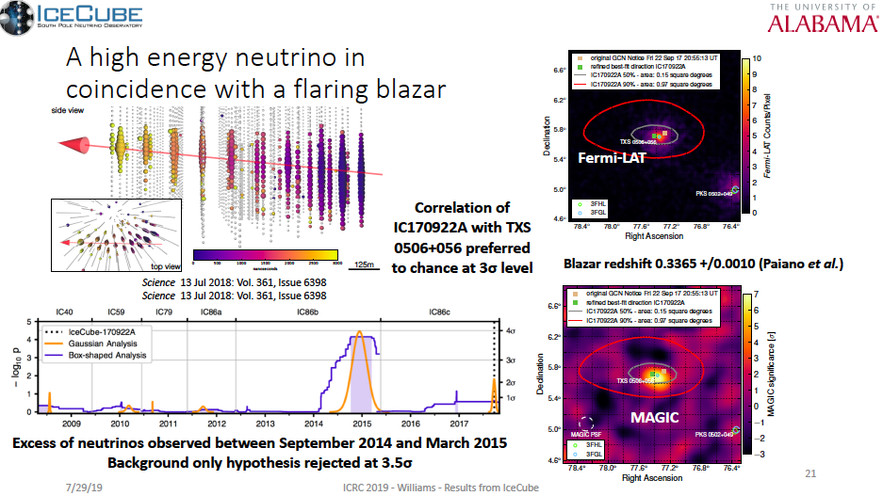
2 indications for point sources

Slide 37
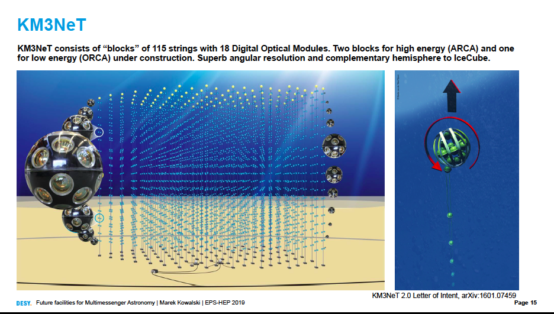

Slide 38
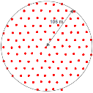
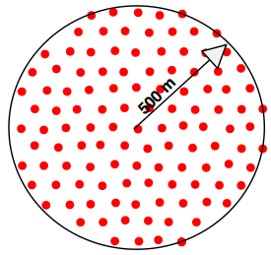
Phase 2.0: ORCA and ARCA (2022?)
France
ORCA
ARCA
Italy
ORCA: determination of the Neutrino Mass Hierarchy (NMH)
ARCA: IceCube physics, but with better angular resolution and
from the Northern hemisphere

Slide 39
Conclusions HE neutrinos
Cosmic high-energy neutrinos discovered !
Opened new window, but landscape not yet charted: one point source identified(3 sigmas) up to now
Remaining uncertainties on spectrum and flavor composition
First point source(s) seen. Many Point sources in reach!
Need larger detectors, also with different systematics and at the Northern hemisphere.
Next logical step: ARCA + GVDPhase1
Next logical step on NMH: ORCA (then PINGU)
~2028: A Global Neutrino Observatory (KM3NeT-GVD-IceCube-Gen2,) full sky with > 5 km³
Indirect search for dark matter (heavy particles trapped in the sun or in the center of the earth)

Slide 40
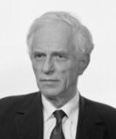
Alexander Chudakov
1965
First search for gamma-ray showers in the atmosphere

Slide 41
Trevor Weekes
1985
Whipple
Detection of the Crab nebula as TeV gamma-ray source
(WHIPPLE Telescope/Arizona)

Slide 42
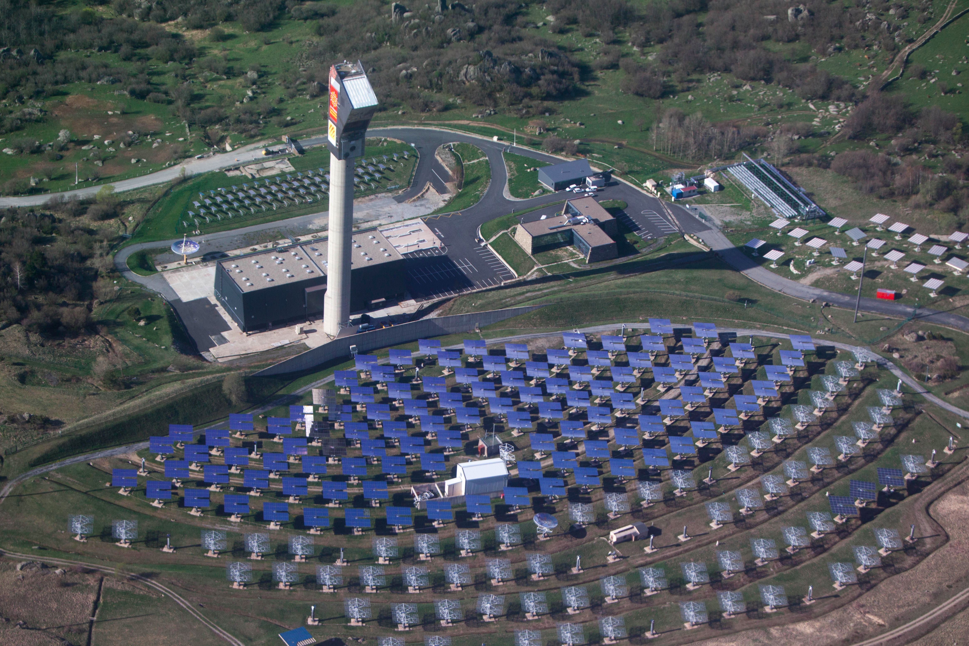
ASGAT 1988 , Themistocle 1988 CAT 1996, CELESTE 1997 → 2004: La France pionnière en astronomie gamma: P. Goret, G. Fontaine, B. Desgranges, E. Paré, P. Fleury, M. Urban

Slide 43
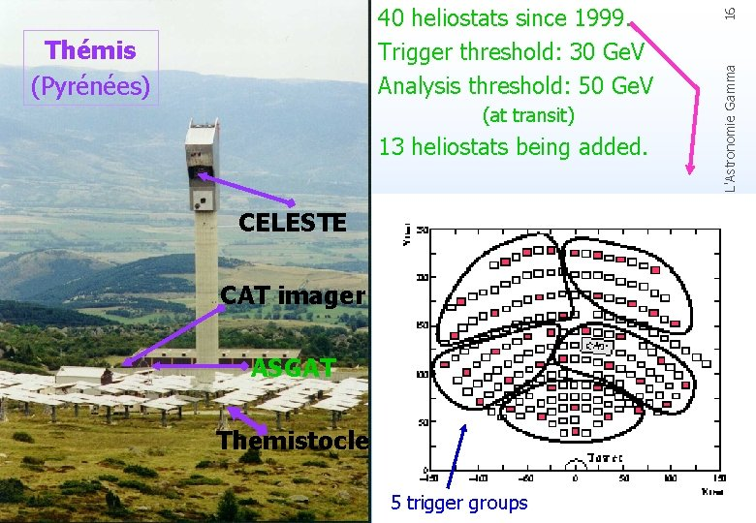
Themistocle and ASGAT: sampling techniques: many parabola with photomultipliers at the focus
CAT: imaging technique→ one large mirror with many photomultipliers at the focal plane to image the shower
CELESTE uses the full (40 heliostats) solar plant to focus the light at the top of the tower→ low threshold
3rd generation will use many CAT imager type mirrors plus focal plane imagers

Slide 44
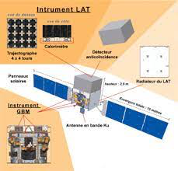
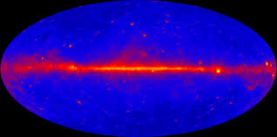
Reference map (20 MeV to 300 GeV) FERMI SATELLITE
(strong French contribution),
LAT instrument CMS/LHC inspired

Slide 45
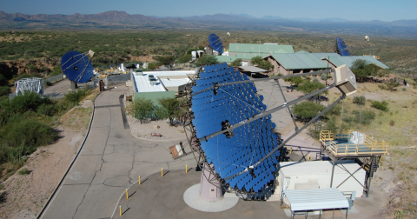
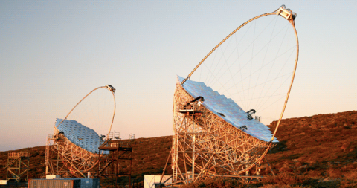
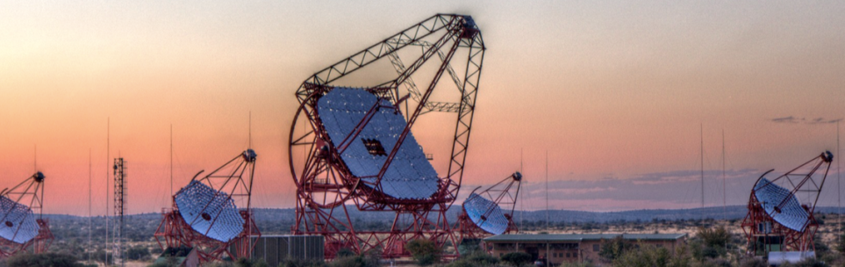
3rd generation Imaging Air Cherenkov telescopes
VERITAS, USA
MAGIC, La Palma
H.E.S.S., Namibia

Slide 46
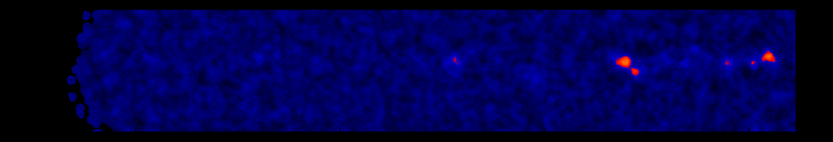
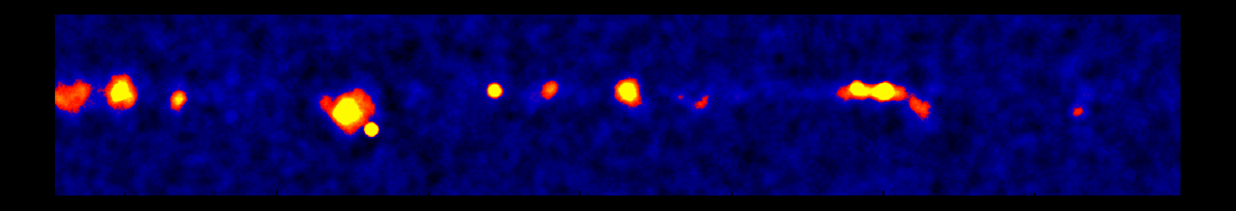
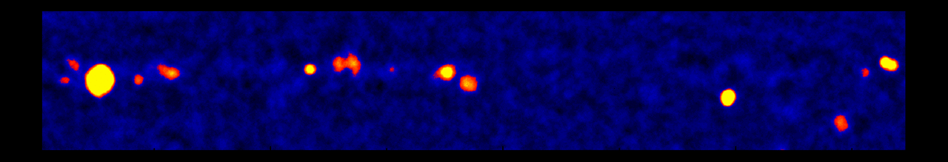
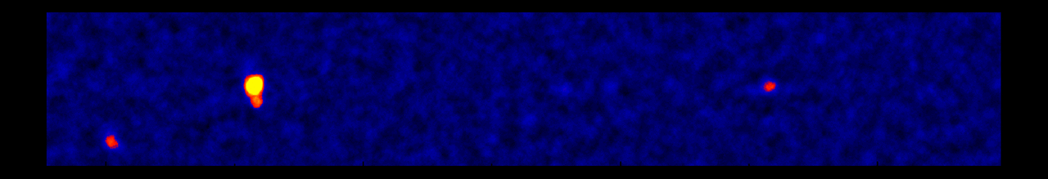
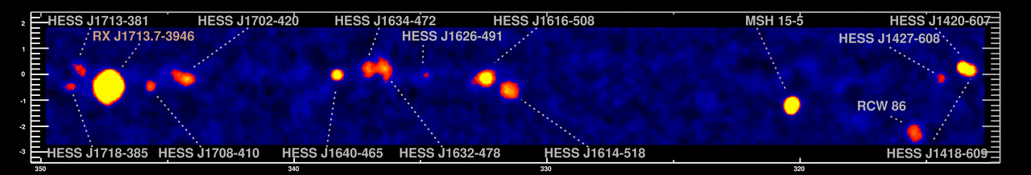
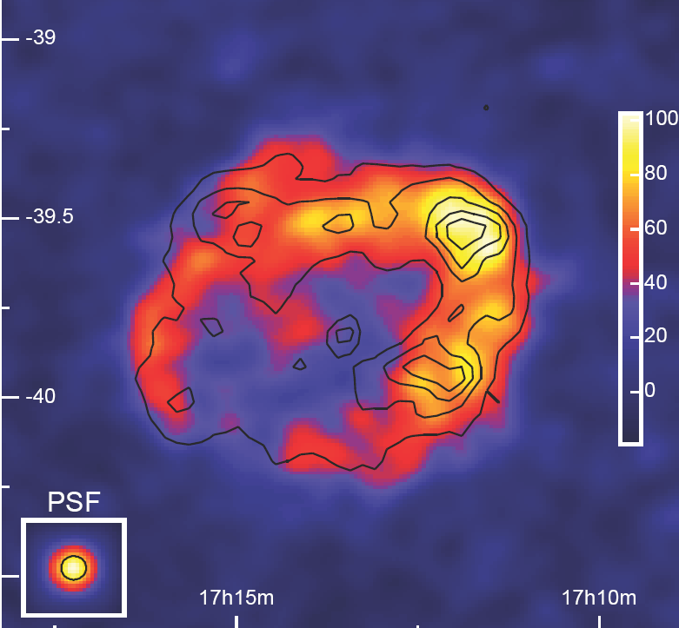
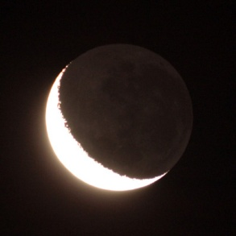
The Sky at TeV-Energies (Fermi satellite covering up to 300 GeV)
H.E.S.S.-Scan of the galactic plane
0.5°
RX J1713.7-3946
1989: 1 Source
1996: 3 Sources
2005: 80 Sources
2015: 150 Sources
Moon

Slide 47
It‘s going to be like classical astronomy !
Periodicities/Variability: from ms to years
Energy-coverage: over several decades
Source position: on the arc-second level
Morphology : few arc-min level (even energy-dependent!)
0.5°
RX J1713.7-3946
1989: 1 Source
1996: 3 Sources
2005: 80 Sources
2015: 150 Sources
Moon

Slide 48
It‘s going to be like classical astronomy !
PLUS:
Physics beyond the Standard Model
  Indirect Dark Matter Search
  Test of Lorenz Invariance
  …
Cosmology
  Measurement of Extragalactic Background ightL
  Indirect search for dark matter
  VHE Standard Candles → dark energy ?

Slide 49
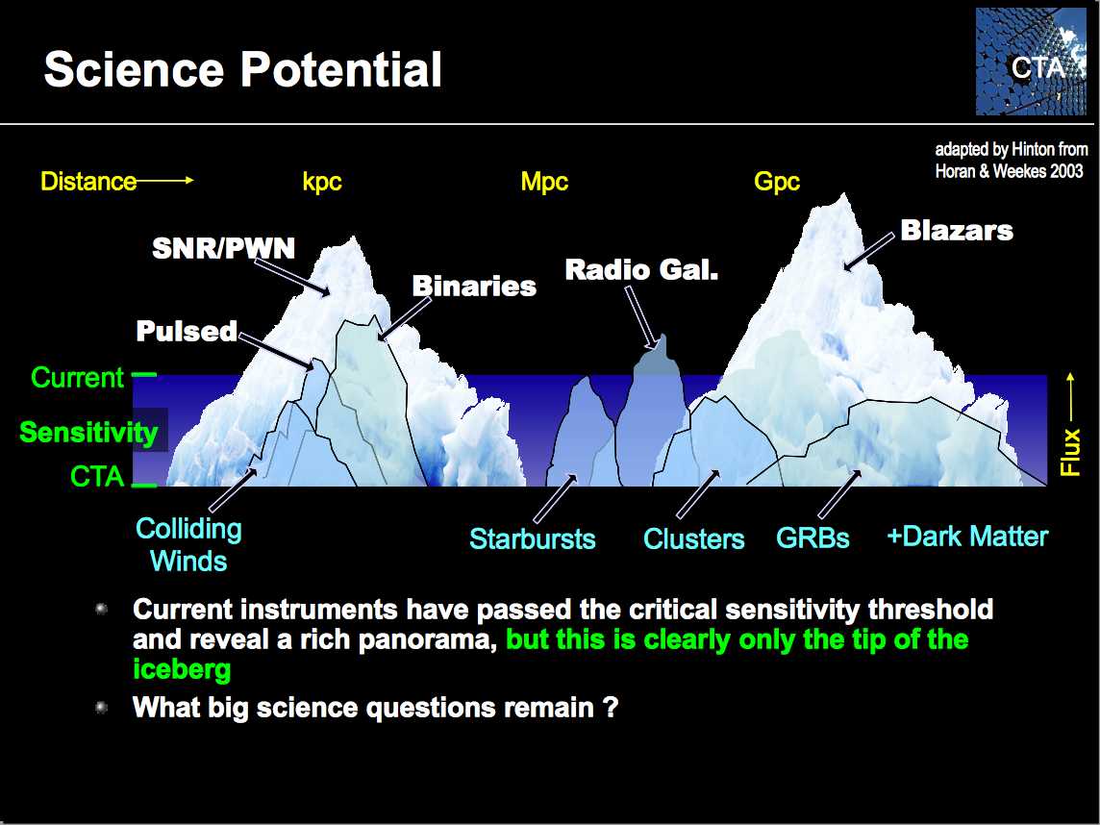

What‘s next?

Slide 50
Summary on Gamma Rays
CTA will open a new era in gamma-ray astronomy
It will be flanked by wide-angle arrays like HAWC (TeV range), SWGO? and LHAASO, TAIGA (reaching into PeV range)
Follow-up of Fermi satellite is still open

Slide 51
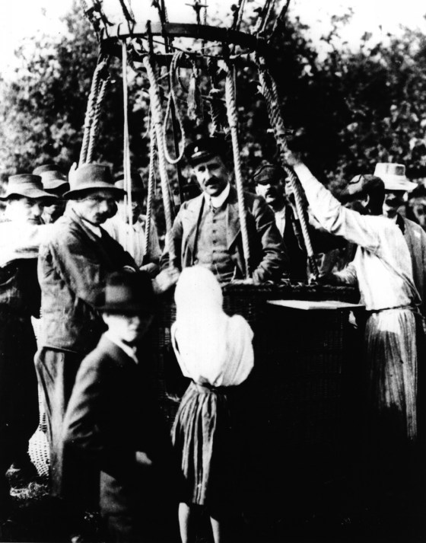
Viktor Hess
1912
Detection of cosmic rays

Slide 52
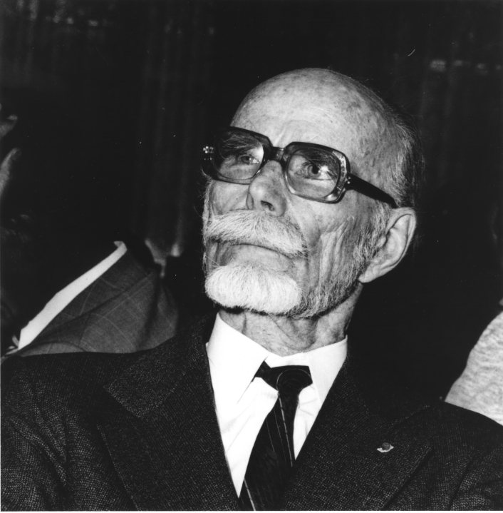
Pierre Auger
1939
Detection of cosmic air showers

Slide 53


James Cronin
Alan Watson
Murat Boratav
1989
Detection of cosmic highest energy air showers

Slide 54


Slide 55

Spectrum of Cosmic Rays

Slide 56
Spectrum of Cosmic Rays
accelerators
satellites,
balloons
air shower
arrays
Auger

Slide 57
Spectrum of Cosmic Rays
accelerators
satellites,
balloons
air shower
arrays
Auger
Current models
tuned here

Slide 58
Cosmic Rays and LHC
pp inel. cross section at sqrt(s)=57 TeV
Compare to QCD and Glauber model, tuning EAS simulations

Slide 59
Cosmic Rays and LHC
Cooperation of particle- and CR-physicists has been intensified over the last years.
Extremely useful for understanding CR nature
Accelerator data helped improving shower models. Tools of CR community will also help better understanding HE particle interactions: models sometimes better than HEP models
Need common approach to understand muon excess in HE CR showers
NA61/SHINE (SPS Heavy Ion and Neutrino Experiment): important input data for cosmic ray and neutrino experiments.

Slide 60

Cut-off at highest energies confirmed, but …
… is that the GZK cut-off?
… or do the sources just run out of power?
190 000 events

Slide 61
Cut-off: how to undestand ist nature
Need a better mass determination to check how the cut-off depends on particle mass
Need more statistics and first point sources to check how the cut-off depends on distance

Slide 62

Point Sources: Tantalizing hot spot at TA

Slide 63
What after results with upgraded arrays?
Ultrahigh-energy cosmic ray physics is at a turning point
High-energy cut-off has been clearly confirmed, but nature unclear
No point sources, but hot spot TA + “warm” spot Auger
Origin of the muon excess at high energies not understood
Detection and study of point sources was one of the two primary goals of Auger/TA. Would also be the primary motivation for any future EeV CR experiment – ground based arrays of the 30 000 – 90 000 km² class or the space based JEM-EUSO.
Key to move ahead in both directions: more precise mass assignment of individual events and the separation of a proton event sample which is minimally polluted by heavier nuclei.

Slide 64

Albert Einstein
1916
Prediction of gravitational waves

Slide 65

Joseph Weber
1958
Search for GW with a bar cylinder

Slide 66


Rapport du comité présidé par Patrick Fleury en 1990
aVirgo, Pisa 3 km

Slide 67








The current GW network of interferometers
GEO, Hannover, 600 m
LIGO Hanford, 4 km: aLigo, 4 km
TAMA, Tokyo 300 m
KAGRA 3km
being started
aVirgo, Pisa 3 km
LIGO Livingston, 4 km
Notes:
The first generation of GW detectors forms a world wide network that jointly takes data and analyzes them in a common effort.
Three detectors in the US: Washington 4km & 2km
Louisiana 4km. Negotiations to move one of the Washington ones to India. Decision next summer
three kilometer long one in Italy: Virgo
German British GEO600 Germany.
LCGT a 3km cryogenic interferometer is being constructed in Japan in the Kamioka mine.

Slide 68

The GW network in 4-5 years
GEO, Hannover, 600 m
LIGO Hanford, 4 km: aLigo, 4 km
LIGO India
KAGRA 3km
aVirgo, Pisa 3 km
LIGO Livingston, 4 km
GW Australia ?
Notes:
The first generation of GW detectors forms a world wide network that jointly takes data and analyzes them in a common effort.
Three detectors in the US: Washington 4km & 2km
Louisiana 4km. Negotiations to move one of the Washington ones to India. Decision next summer
three kilometer long one in Italy: Virgo
German British GEO600 Germany.
LCGT a 3km cryogenic interferometer is being constructed in Japan in the Kamioka mine.

Slide 69


Slide 70


Slide 71

Black holes as dark matter?
Most events seen by LIGO/VIRGO are coalescence of few tens solar masses black holes (excellent laboratory to test General Relativity)! Could these black holes be the dark matter in the universe?
Very recently the EROS collaboration, combining its data with MACHO, has shown that the dark matter in the halo of our galaxy cannot be made of compact objects of masses between 10⁻⁶ and 10³ solar masses
This is based on observations of millions of stars in the LMC, looking (during 10 years) at the occurrence of alignments between us, a dark compact object in the halo of our galaxy and a star in the LMC.
        Thèse 2021: Tristan Blaineau, directeur de thèse: Marc Moniez

Slide 72


Slide 73


Slide 74
High and ultra high energy multi-messenger astronomy
Gamma ray astronomy paved the way, gives the reference map of the high energy sky (Thousands of sources): CTA next very large infrastructure
Strong evidence for extraterrestrial TeV to PeV neutrinos. Probably pointing to a new class of blazars (mergers?).
Cut-off of the cosmic ray high energy spectrum seen: composition (p or Fe) and muon production near the cut-off debated. Origin unknown.
Gravitational waves is entering the game and open new questions: origin of 30 solar masses black holes, gamma ray bursts, hypernovae and neutron stars collapses …
Multi messenger approach crucial, including gravitational waves and conventional astronomy (open data policy, virtual observatories including these new messengers will help)
This is a new astronomy: the astronomy of the most violent phenomena in the Universe today!!

Slide 75
Features of Particle astrophysics
Collaborative
Innovative (creating new instruments)
Stimulating
“coopetition”
Search for Unity (explanations, class of objects, laws) within Diversity (objects in the sky): observational cosmology is a success in that direction
Guided by curiosity: serendipity plays a role

Slide 76
A fascinating field
Bold
Inclusive and participative (developing countries, gender balance,young people, local community)
Interdisciplinary
Incredible locations and instruments
Rich in discoveries
Sometimes disruptive

Slide 77
International Year of Basic Sciences for Sustainable Development in 2022
Long term curiosity driven sciences, source of knowledge, of disruptive discoveies and of applications for future generations (astroparticle physics is an example)
IUPAP (International Union of Pure and Applied Physics) is taking the lead for the proclamation of an International Year of Basic Sciences for Sustainable Development)
It was recommended by the UNESCO Executive Board and soon by the UNESCO General Conference. The proclamation should be by the UN GA end of November 2021

Slide 78
end

