Slide 1
Scientific cooperation between Ukraine and Paris-Saclay University within the framework of ICM Erasmus + projects
Represented by
Anne-Lise Braesch, ICM Manager and incoming mobility officer
Regional Seminar – April 27, 28 and 29, 2021

Slide 2






All about Paris-Saclay University
4
Component
institutions
2
Member-associated
universities
9
Academic faculties
7
National
research
bodies
FACULTY OF
MEDICINE
FACULTY OF
PHARMACY
FACULTY OF
SCIENCES
FACULTY OF
SPORTS SCIENCE
FACULTY OF LAW, ECONOMICS AND MANAGEMENT
IUT CACHAN
IUT SCEAUX
IUT ORSAY
OBSERVATORY
OF THE SCIENCES
OF THE UNIVERSE

Slide 3




Horizontal priorities
INCLUSIVE
GREEN
DIGITAL

Slide 4
Programme Actions (1): Education and Training
Policy development
Mobility
Cooperation
mobility of higher education students and staff
mobility of VET learners and staff
mobility of school pupils and staff
mobility of adult education learners and staff
language learning opportunities
partnerships for cooperation, including small-scale partnerships
partnerships for excellence, in particular European universities, Centres of Vocational Excellence, Erasmus Mundus Joint Master Degrees
partnerships for innovation
online platforms and tools for virtual cooperation
preparation and implementation of the EU general and sectoral policy agenda in education and training
quality, transparency and recognition of skills and competences
policy dialogue and cooperation with stakeholders
qualitative and inclusive implementation of the programme
cooperation with other EU instruments and support to other policy areas
dissemination and awareness-raising activities
Jean Monnet actions
  Jean Monnet in the field of higher education
  Jean Monnet in other fields of education and training

Slide 5
Programme Actions (2) : Youth
Cooperation
Policy development
Mobility
partnerships for cooperation, including small-scale partnerships
partnerships for innovation
online platforms and tools for virtual cooperation
preparation and implementation of the EU general and sectoral policy agenda in education and training
quality, transparency and recognition of skills and competences
policy dialogue and cooperation with stakeholders
qualitative and inclusive implementation of the programme
cooperation with other EU instruments and support to other policy areas
dissemination and awareness-raising activities
mobility of young people
Youth participation activities
DiscoverEU activities
mobility of youth workers

Slide 6
Programme Actions (3): Sport
Cooperation
Policy development
Mobility
mobility of sport staff
partnerships for cooperation, including small-scale partnerships
not-for-profit sport events
preparation and implementation of the EU policy agenda on sport and physical activity
policy dialogue and cooperation with relevant stakeholders
qualitative and inclusive implementation of the programme
cooperation with other EU instruments and support to other policy areas
dissemination and awareness-raising activities

Slide 7
ICM Projects at Paris-Saclay University
2018
2020
Areas of study
Algeria (1)
Cambodia (2)
Lebanon (1)
Palestine (1)
Ukraine (4)
Algeria (1)
Cambodia (2)
Cameroun (2)
Colombia (3)
Georgia (3)
Egypt (1)
Kenya (2)
Palestine (1)
Ukraine (4)
Nuclear Physics
Medical physics
Applied physics & measures
Pharmacy
Microbiology
Material Sciences (chemistry)
Automation
Engineering
2019
Ukraine (4)
Countris working in the field of Physics : Ukraine, Georgia, Palestine, Columbia

Slide 8

Ukraine and Paris-Saclay University
Partners
  V. N. Karazin Kharkiv National University (2018)
  Taras Shevchenko National University of Kiyv (2019)
  Kyiv Academic University (2019)
  Oles Honchar Dnipro National University (2019)
Notes:
Mise en œuvre : objectifs, activités, difficultés
Gestion du projet : implication des partenaires, changement des partenaires

Slide 9
Undertaken activities
Teaching activities during summer schools and winter shools in Ukraine
Training activities for teachers, researchers in Orsay
Training activities for administrative staff members of both countries
Intership placements for bachelor and master students in Orsay laboratories (IJClab, CNRS, CEA)
Study exchanges in selective master’s programmes
Results:
Strengthened cooperation through increased exchanges
Planning to expand our cooperation with Ukraine through further actions funded by the Erasmus programme

Slide 10
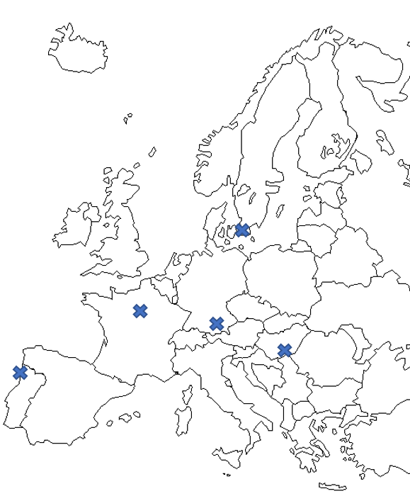





The European University Alliance for Global Health
EUGLOH as a pilot European university able to:
offer a European experience to 50% of its students at all levels
improve the competences and European practices of the teaching and administrative staff
build a European campus with a high level of integration sustained by joint procedures and structures
boost attractiveness and competitiveness of European higher education, research and innovation
be an internationally recognized observatory of best practices and expertise in Global Health
SWEDEN
FRANCE
2
HUNGARY
1
5
3
4
GERMANY
PORTUGAL

Slide 11
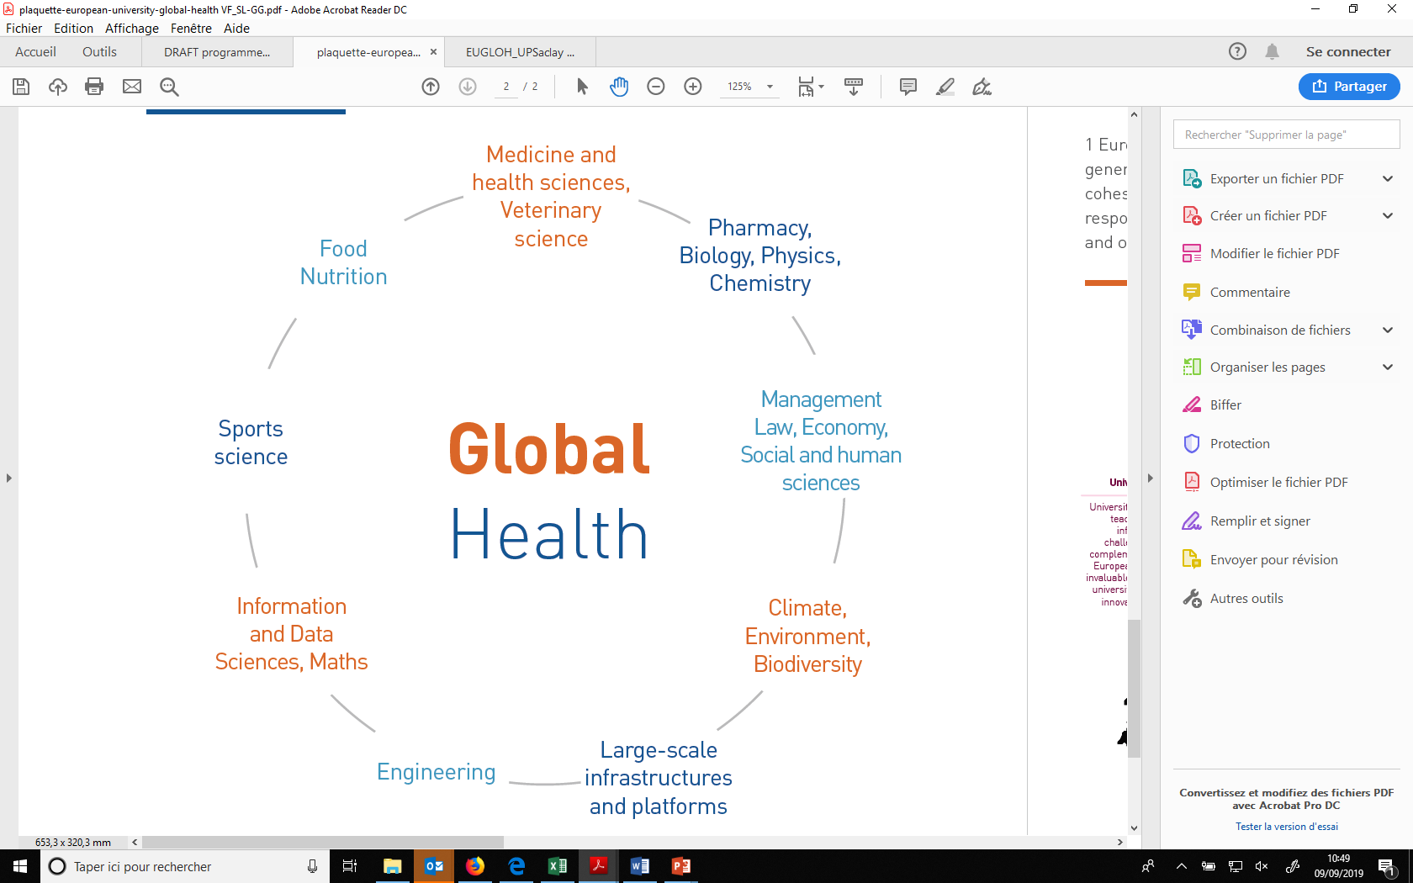
A unifying theme encompassing
various fields and challenges: Global Health

Slide 12
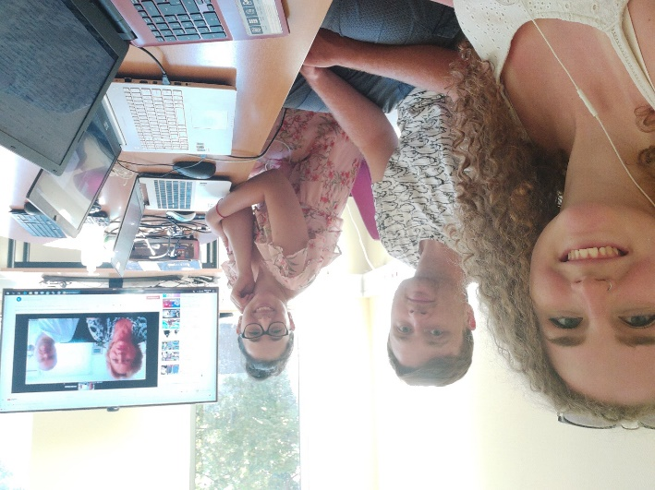
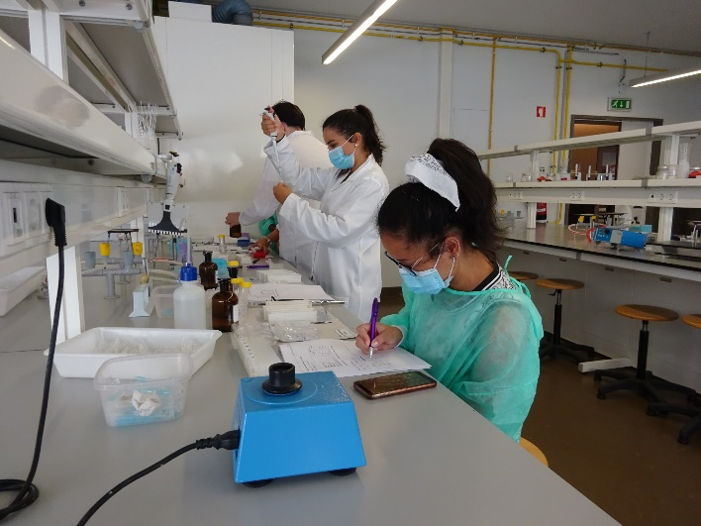
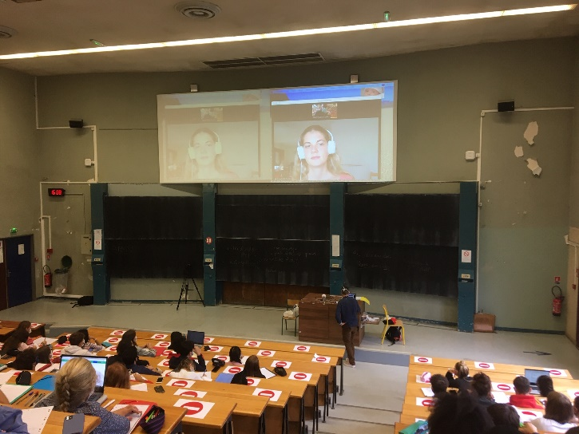
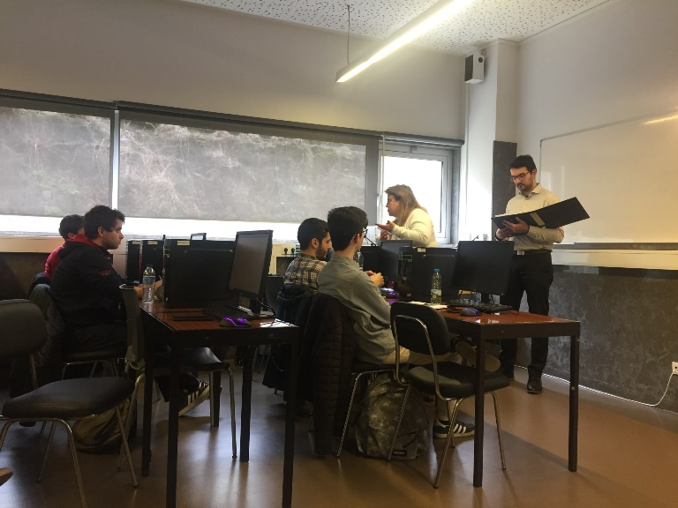
Examples of activities implemented:
Lifelong Learning Programme on
Medicinal Plan
EUGLOH Summer School
First EUGLOH introductory course in astrophysics
Rush Game in Pharmaceutical Marketing course

Slide 13
International Credits Mobility contacts: anne-lise.braesch@universite-paris-saclay.fr
Celia.fernandez1@universite-paris-saclay.fr
Cooperation contact: Sergei.shikalov@universite-paris-saclay.fr
Thank you for your attention !
ICM Information on our website:
https://www.universite-paris-saclay.fr/en/formation/partir-letranger/international-credit-mobility-erasmus-programme

