Slide 1
Irradiation capabilities for nuclear and high energy physics research at the LUE-40 linac
M.I. Ayzatsky, V.N. Boriskin, O.S. Deiev, V.M. Vereschaka, R.M. Dronov, V.F. Zhiglo, I.M. Zaitsev, K.Yu. Kramarenko, V.A. Kushnir, V.V. Mytrochenko, A.M. Opanasenko, S.N. Olejnik, S.O. Perezhogin, O.O. Repikhov, L.I. Selivanov, B.I. Shramenko, I.S. Timchenko, V.I. Tatanov, V.L. Uvarov, I.V. Khodak, V.O. Tsymbal, Yu.D. Tur
French-Ukrainian Workshop 29/10/2021 IJCLab

Slide 2
LUE-40 Linac
Initially the LUE-40 linac was build in early of 60^{s} of last century as test bench for 2GeV linac. Then, in 2004 it was reconstructed to carry out researches
employing photonuclear reactions on light nuclei.
Accelerating sections were replaced with high accelerating gradient sections as well as an injector part of the linac was replaced with an injector based on evanescent wave resonant system.
Linac distinctiveness are relatively low beam emittance and possibility to change beam energy smoothly that is limited just long-term beam energy stability.
Year | 2004
Energy, MeV | 30-100
Number of sections | 2
Current-pulse width, μs | 1.6
Repetition rate, pps | 50
Average current, μA | ≤5
ΔW/W (FWHM), % | <2
Pulsed beam current at 40 MeV, mA | 70
Pulsed beam current at 95 MeV, mA | 40
Normalized beam emittance, mm⋅mrad | 70
Experimental Nuclear Reaction Data (EXFOR)
At least 19 datasets in EXFOR are based on experiments carried out at LUE-40 within energy range from 35 to 90 MeV
French-Ukrainian Workshop 29/10/2021 IJCLab

Slide 3
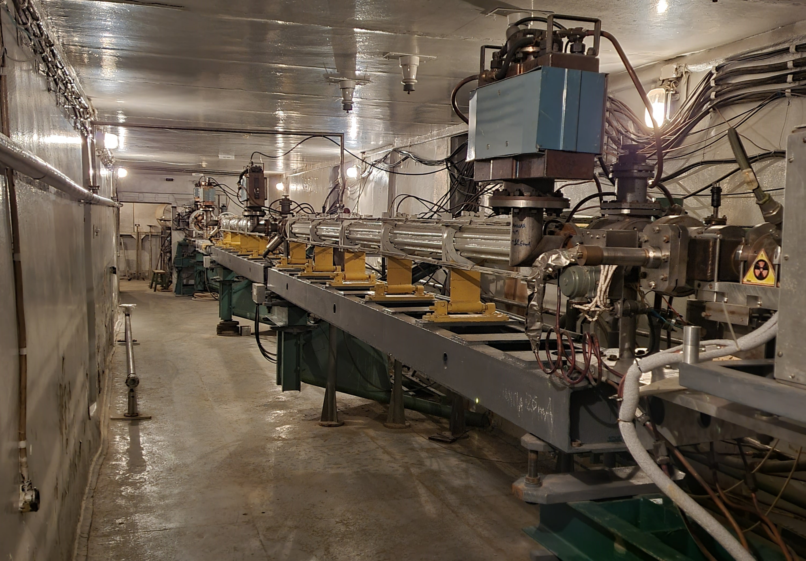
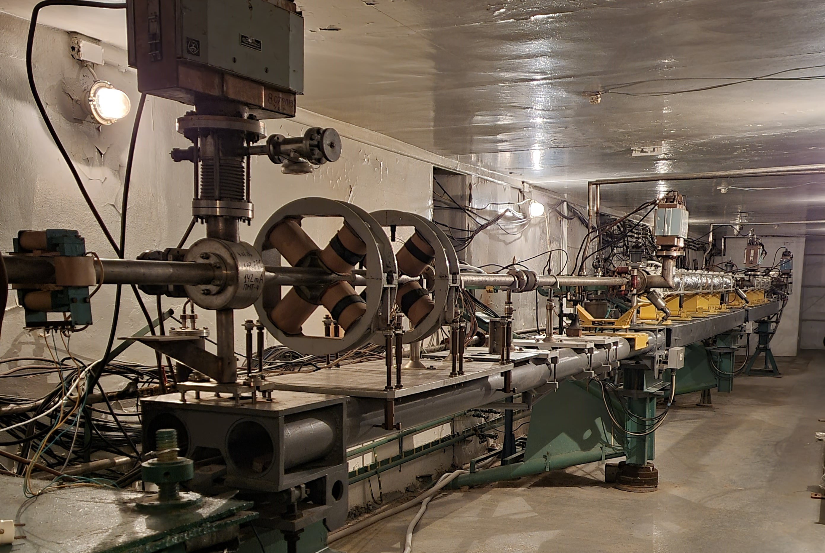
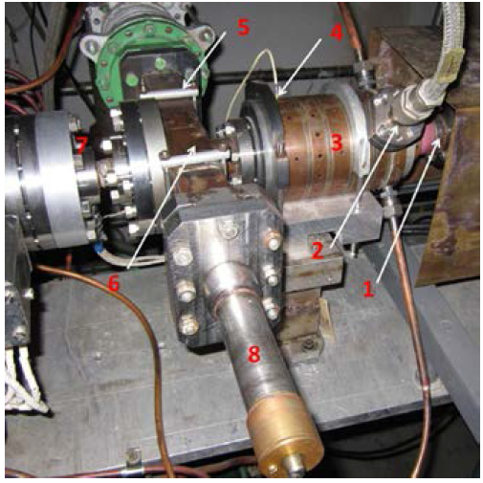
LUE-40 Linac
LUE-40 linac view from the injector
LUE-40 linac view from the exit
French-Ukrainian Workshop 29/10/2021 IJCLab

Slide 4
Research activity at the LUE-40 linac
  Studies of photonuclear reactions with multiple emission of nuclides
O.S. Deiev, I.S. Timchenko, S.N. Olejnik, et. Al. ISOMERIC RATIO OF THE 181Ta (γ, 3n) 178m, gTa REACTION PRODUCTS AT ENERGY E γmax UP TO 95 MeV, Chinese Physics C, Vol. 46, No. 1 (2022)
A.N. Vodin, O.S. Deiev, V.Yu. Korda, et. Al. Photoneutron reactions on 93Nb at Eγmax=33–93 MeV, Nuclear Physics A, Volume 1014, 2021, 122248.
O. Bezshyyko, O. Vodin, L. Golinka-Bezshyyko, et. Al. Isomer ratios for products of photonuclear reactions on Rh, EPJ Web of Conferences, 2020, 239, 01026
O. Vodin, O. Bezshyyko, L. Golinka-Bezshyyko, et. Al. Isomer ratios in photonuclear reactions with multiple neutron emission, Problems of Atomic Science and Technology, 2019, vol. 3, p. 38-46
French-Ukrainian Workshop 29/10/2021 IJCLab

Slide 5
Research activity at the LUE-40 linac
S.A. Perezhogin , E.V. Bulyak, V.A. Kushnir, et. Al. SOURCE OF POSITRONS ON THE BASE OF LINAC LUE-40, Problems of Atomic Science and Technology, 2020. Vol.3(127), p. 7 -10.
The source of slow (secondary) positrons for solid state physic research.
N.I. Aizatskyi, V.A. Bocharov, N.P. Dikiy et. Al. RESULTS OF STUDY THE INFLUENCE ELECTRON IRRADIATION ON THE HIGH-FREQUENCY DIELECTRIC PROPERTIES OF ZIRCONIA NANOCERAMICS, Problems of Atomic Science and Technology, 2015. Vol.6(100), p. 47 – 51.
Samples were irradiated with electron beam fluences from 2⋅10¹⁶ to 2⋅10¹⁸cm⁻²
V.A. Kushnir, K.Yu. Kramarenko, V.V. Mytrochenko et. Al. DIELECTRIC RF RESONATORS WITH OPEN BOUNDARIES FOR STUDYING RADIATION EFFECT ON ELECTRODYNAMIC CHARACTERISTICS OF SOLID DIELECTRICS, Problems of Atomic Science and Technology, 2020. Vol.3(127), p. 39-44.
To study the effect of radiation on the complex dielectric permittivity (ε and tgδ) of dielectrics with relative accuracy up to Δε/ε∼10⁻⁴ in situ.
M.І. Ayzatsky, K. Yu. Kramarenko, V.A. Kushnir, et. Al. ANALYSIS OF SHORT ELECTRON BUNCHES SHAPING IN A LINAC, Problems of Atomic Science and Technology, 2018. Vol.3(115), p. 81 -85.
The features of short electron bunch shaping via velocity bunching are explored. The basic possibility to obtain bunches with duration less than 1 ps at the LUE-40 linac is shown.
French-Ukrainian Workshop 29/10/2021 IJCLab

Slide 6
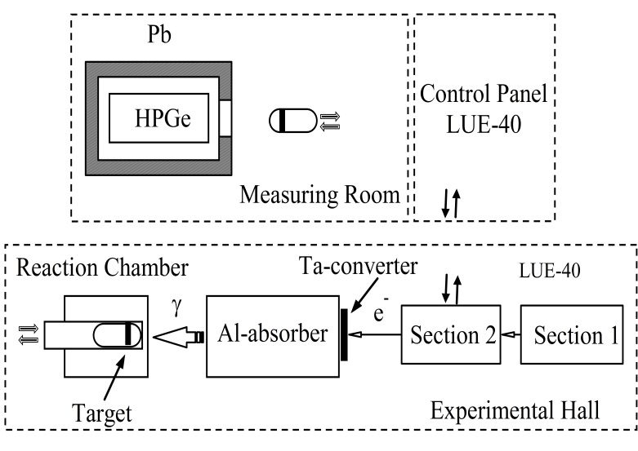
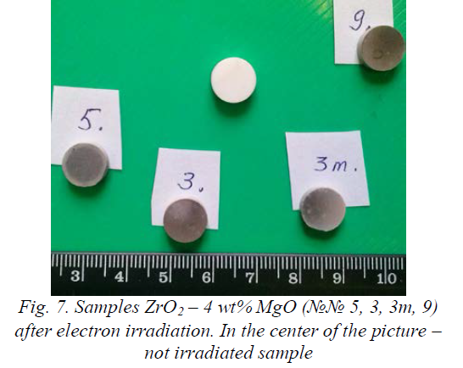
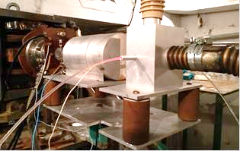
Setup for studies of photonuclear reactions with multiple emission of nuclides
Zirconia nanoceramic samples
Pneumatic tube transport
Electron beam fluence 10¹⁸cm⁻²
French-Ukrainian Workshop 29/10/2021 IJCLab

Slide 7
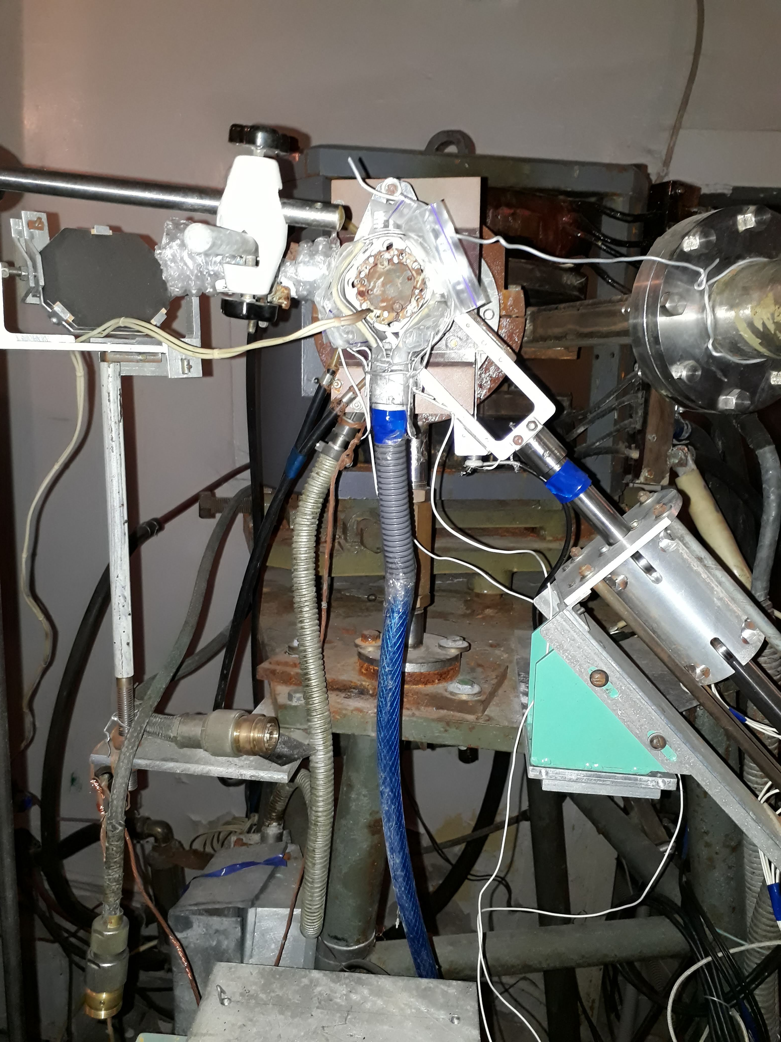
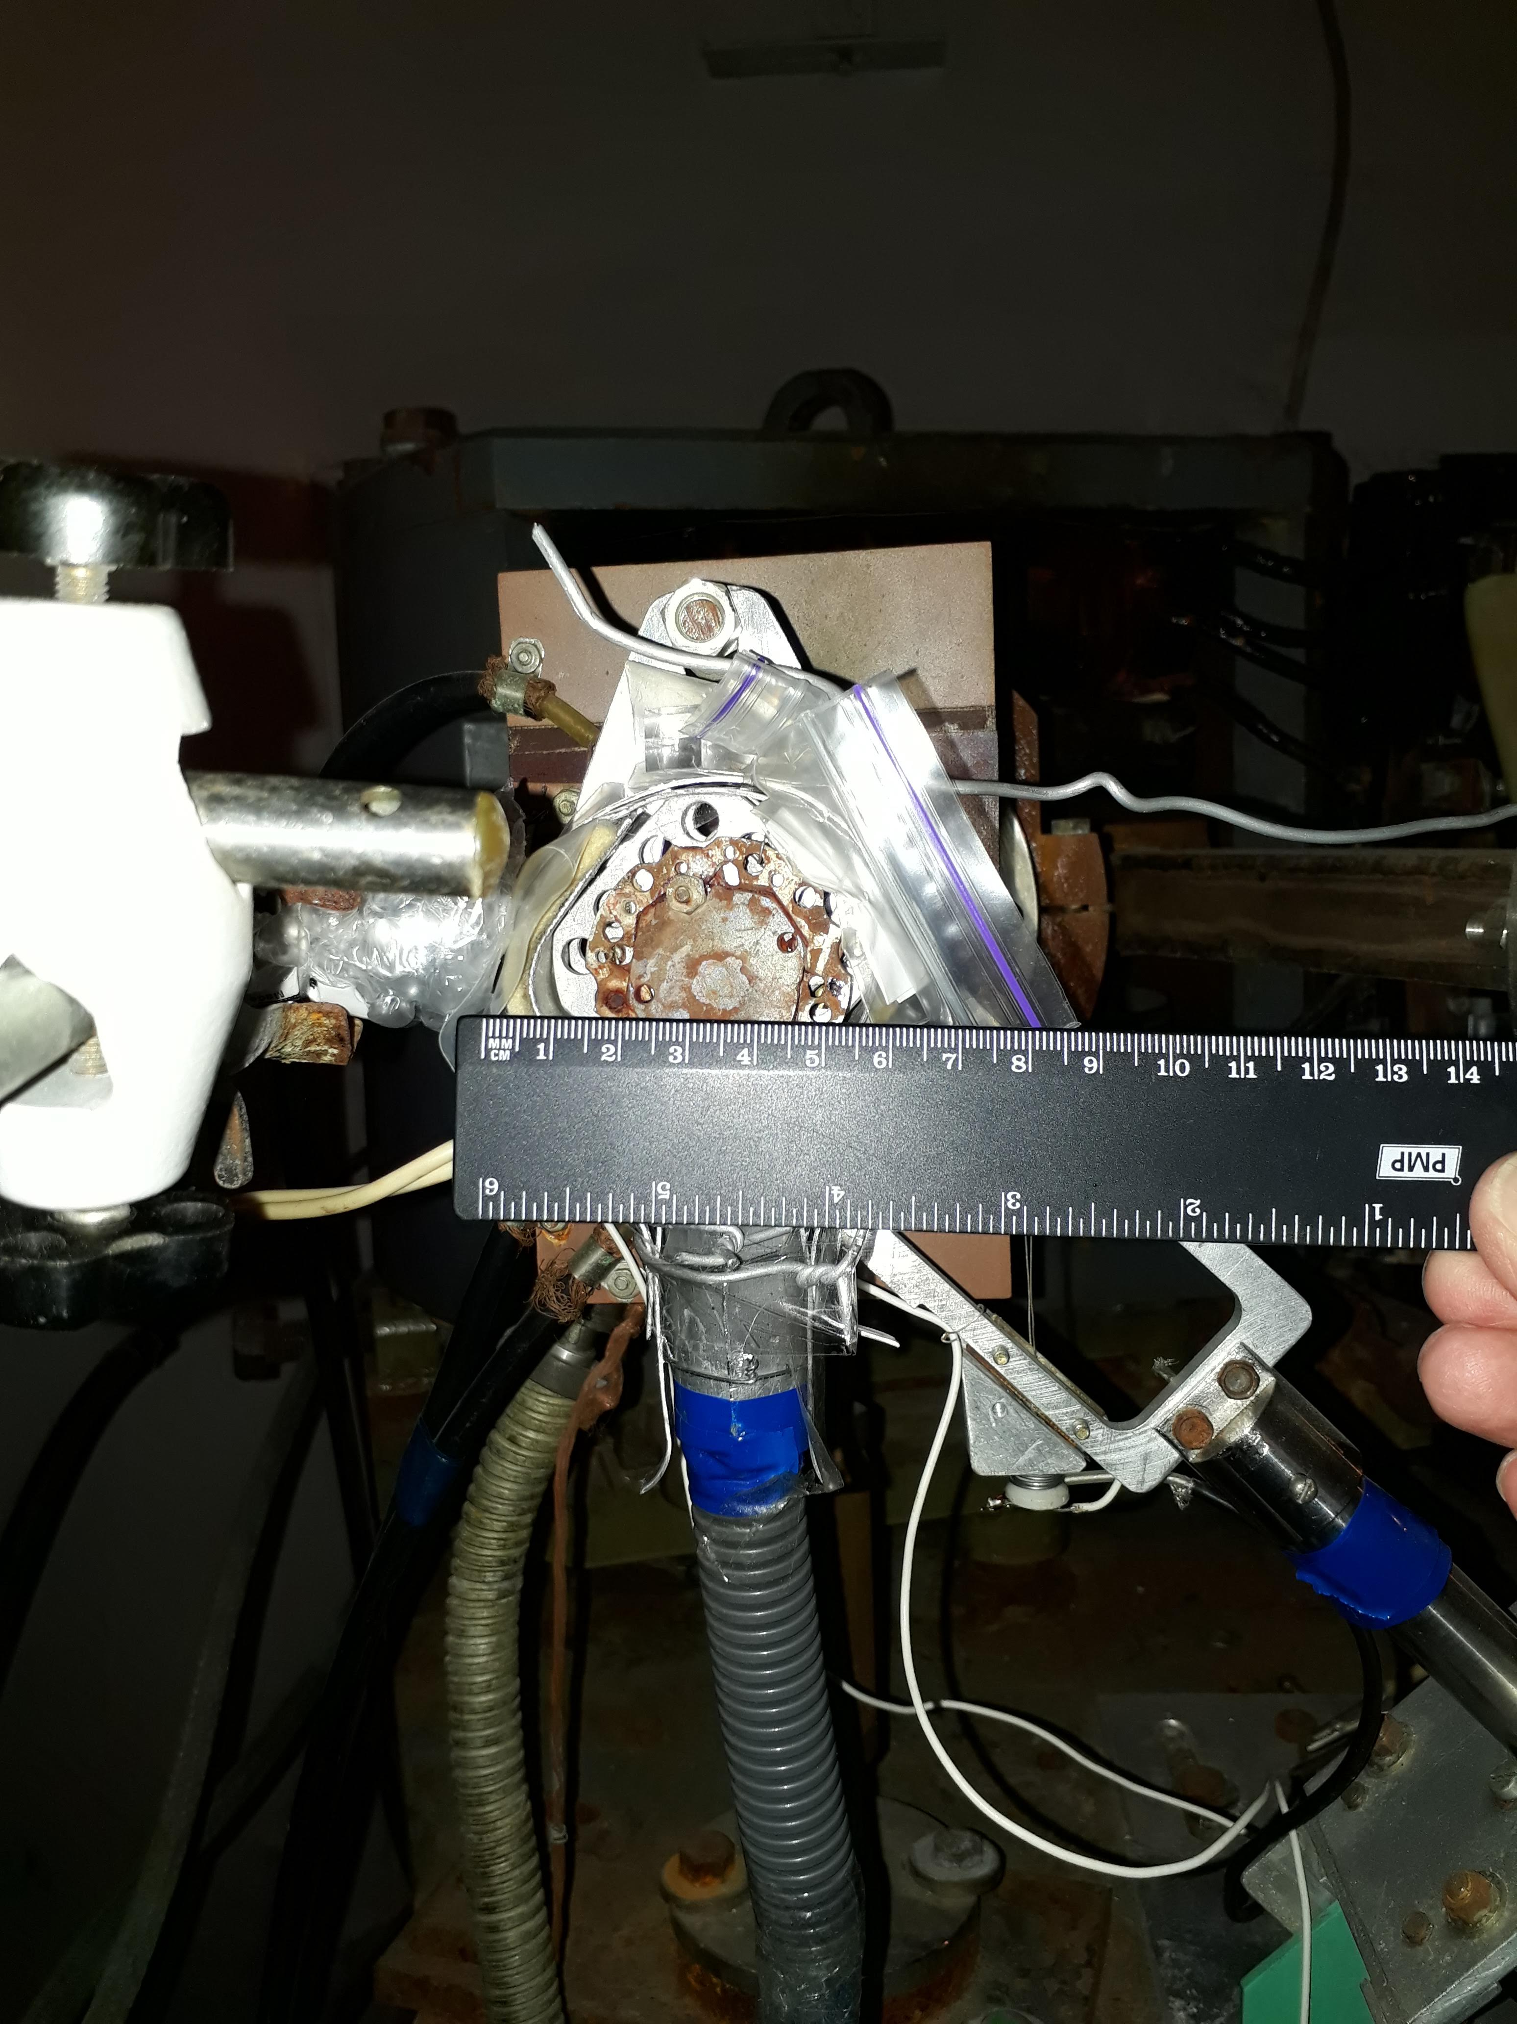
Recent activity to irradiate PLUME samples
Improvised converter for neutron generation
8x1 mm Ta plates. High pressure compressor was used to cool converter. Frame temperature was about 80°C. Neutron fluence 10¹⁴ n/cm²
French-Ukrainian Workshop 29/10/2021 IJCLab

Slide 8
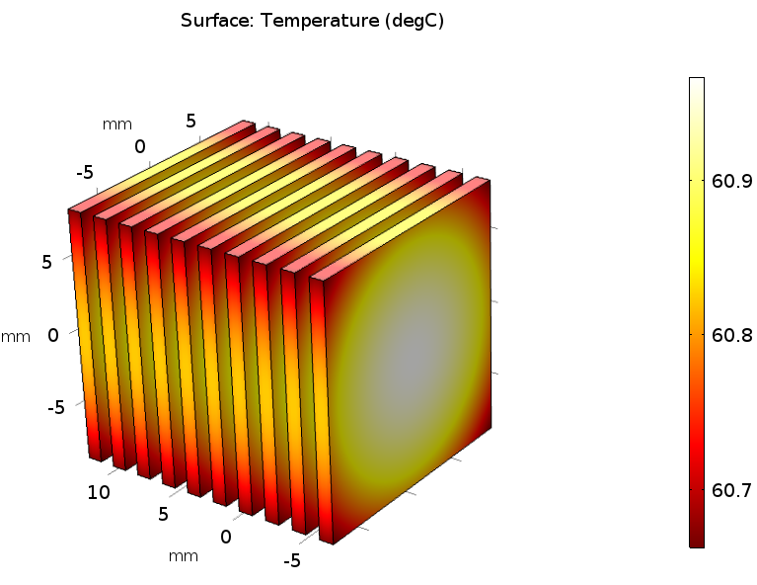
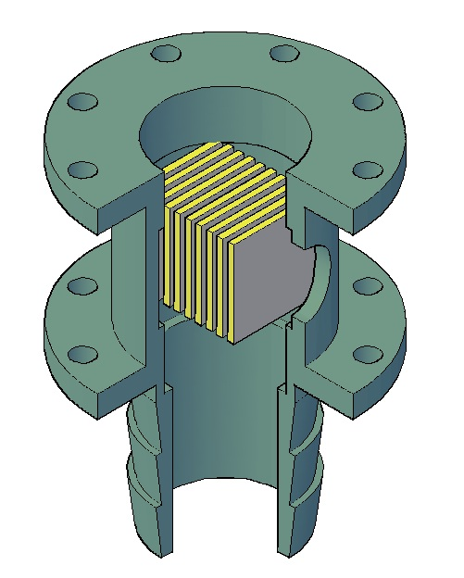
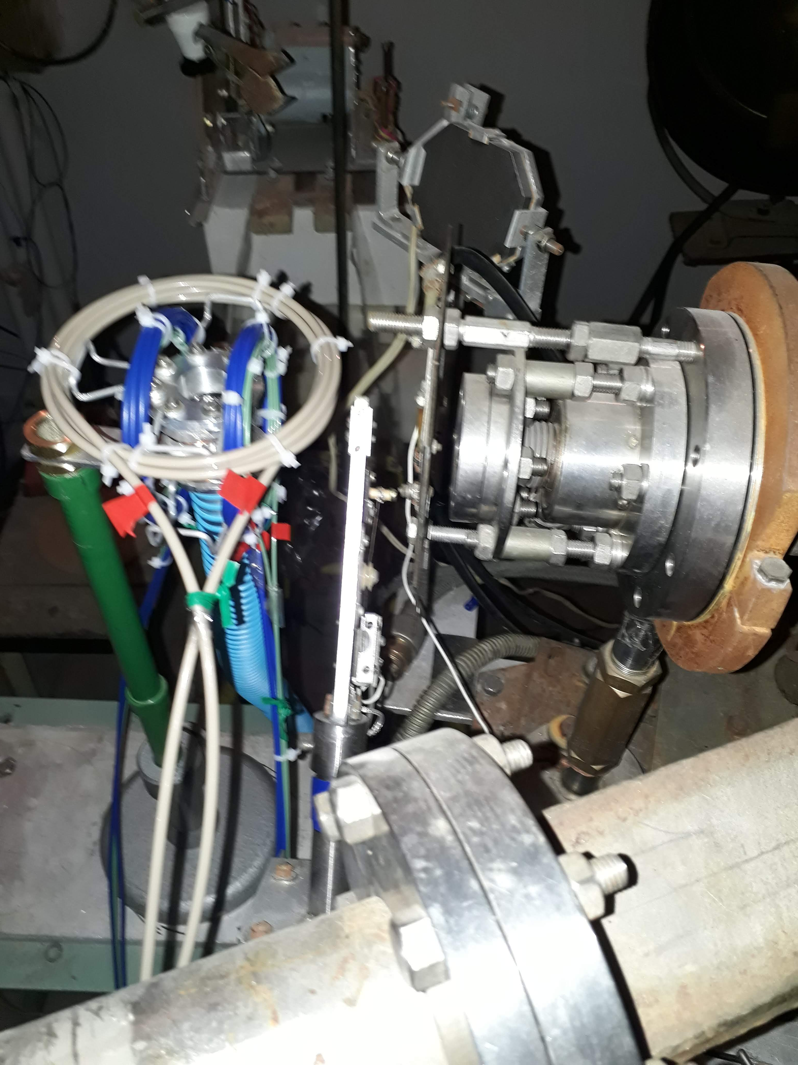
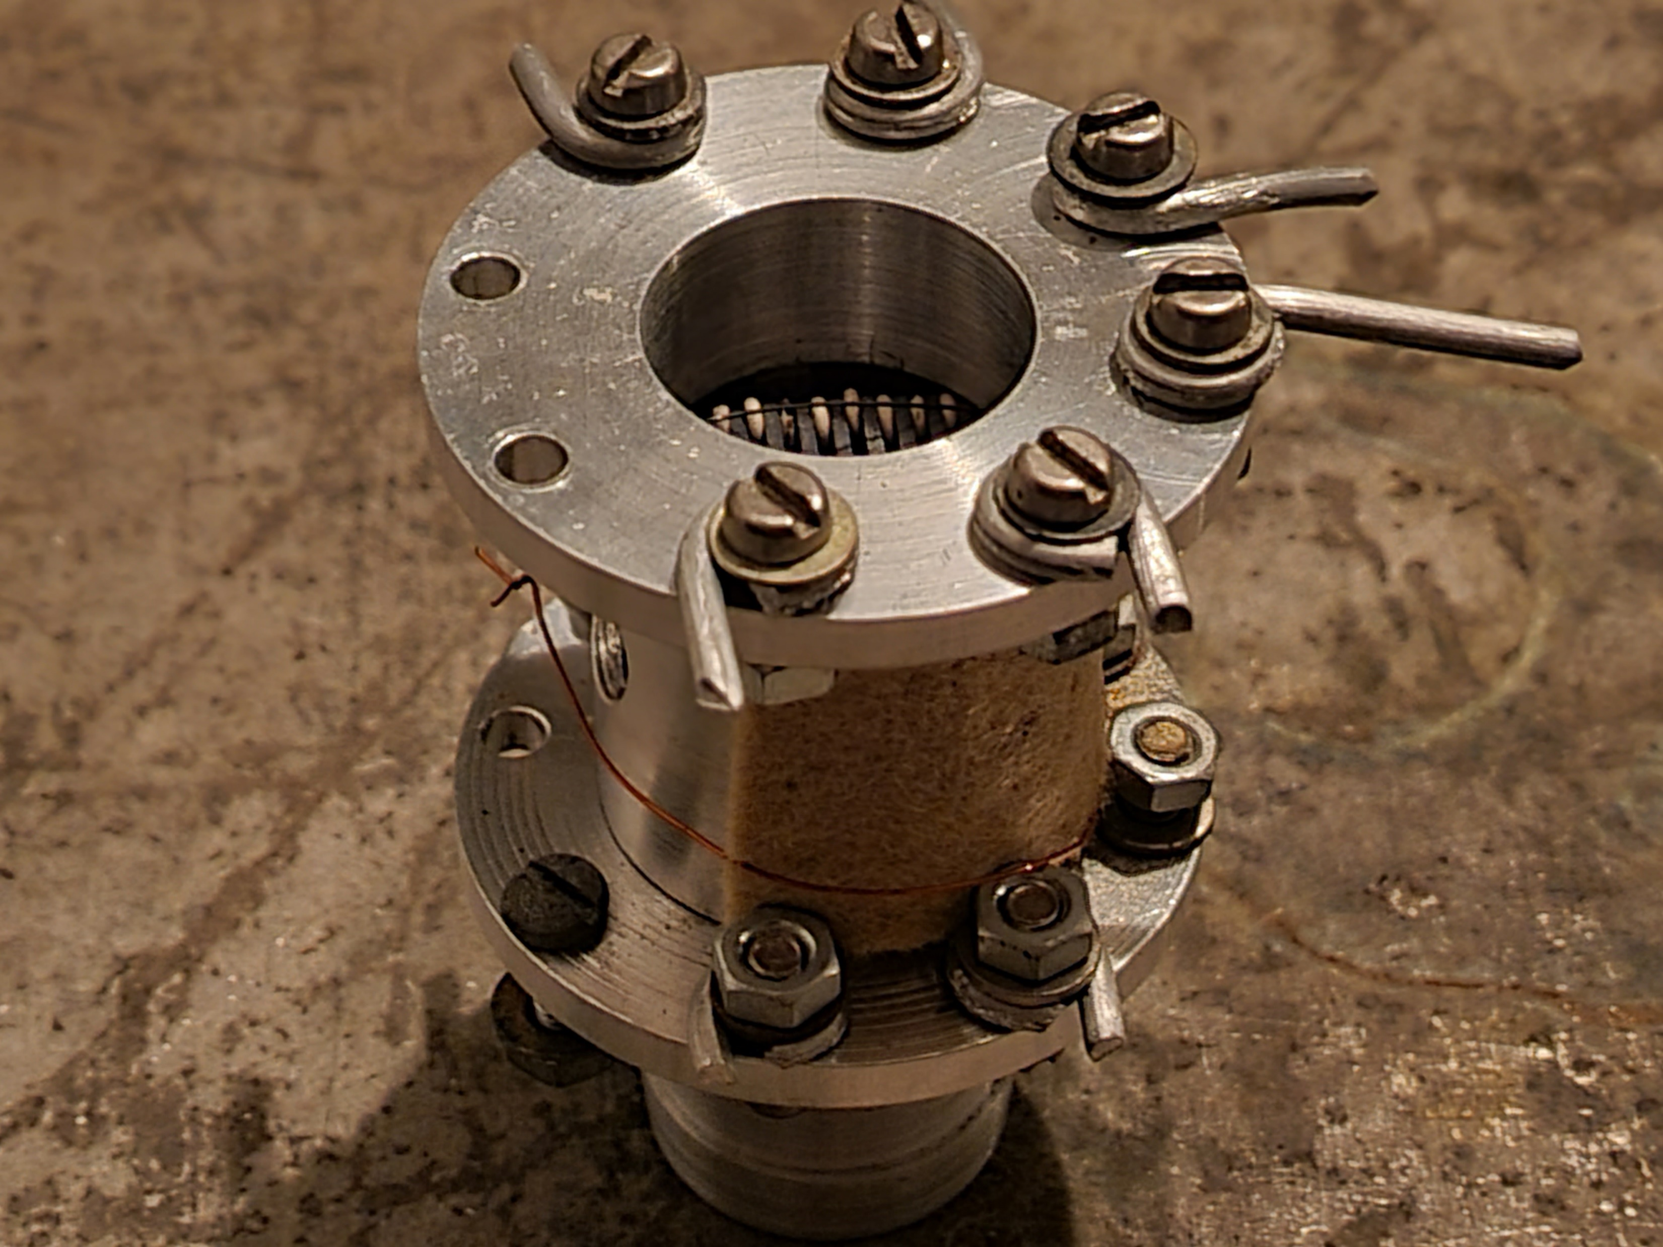
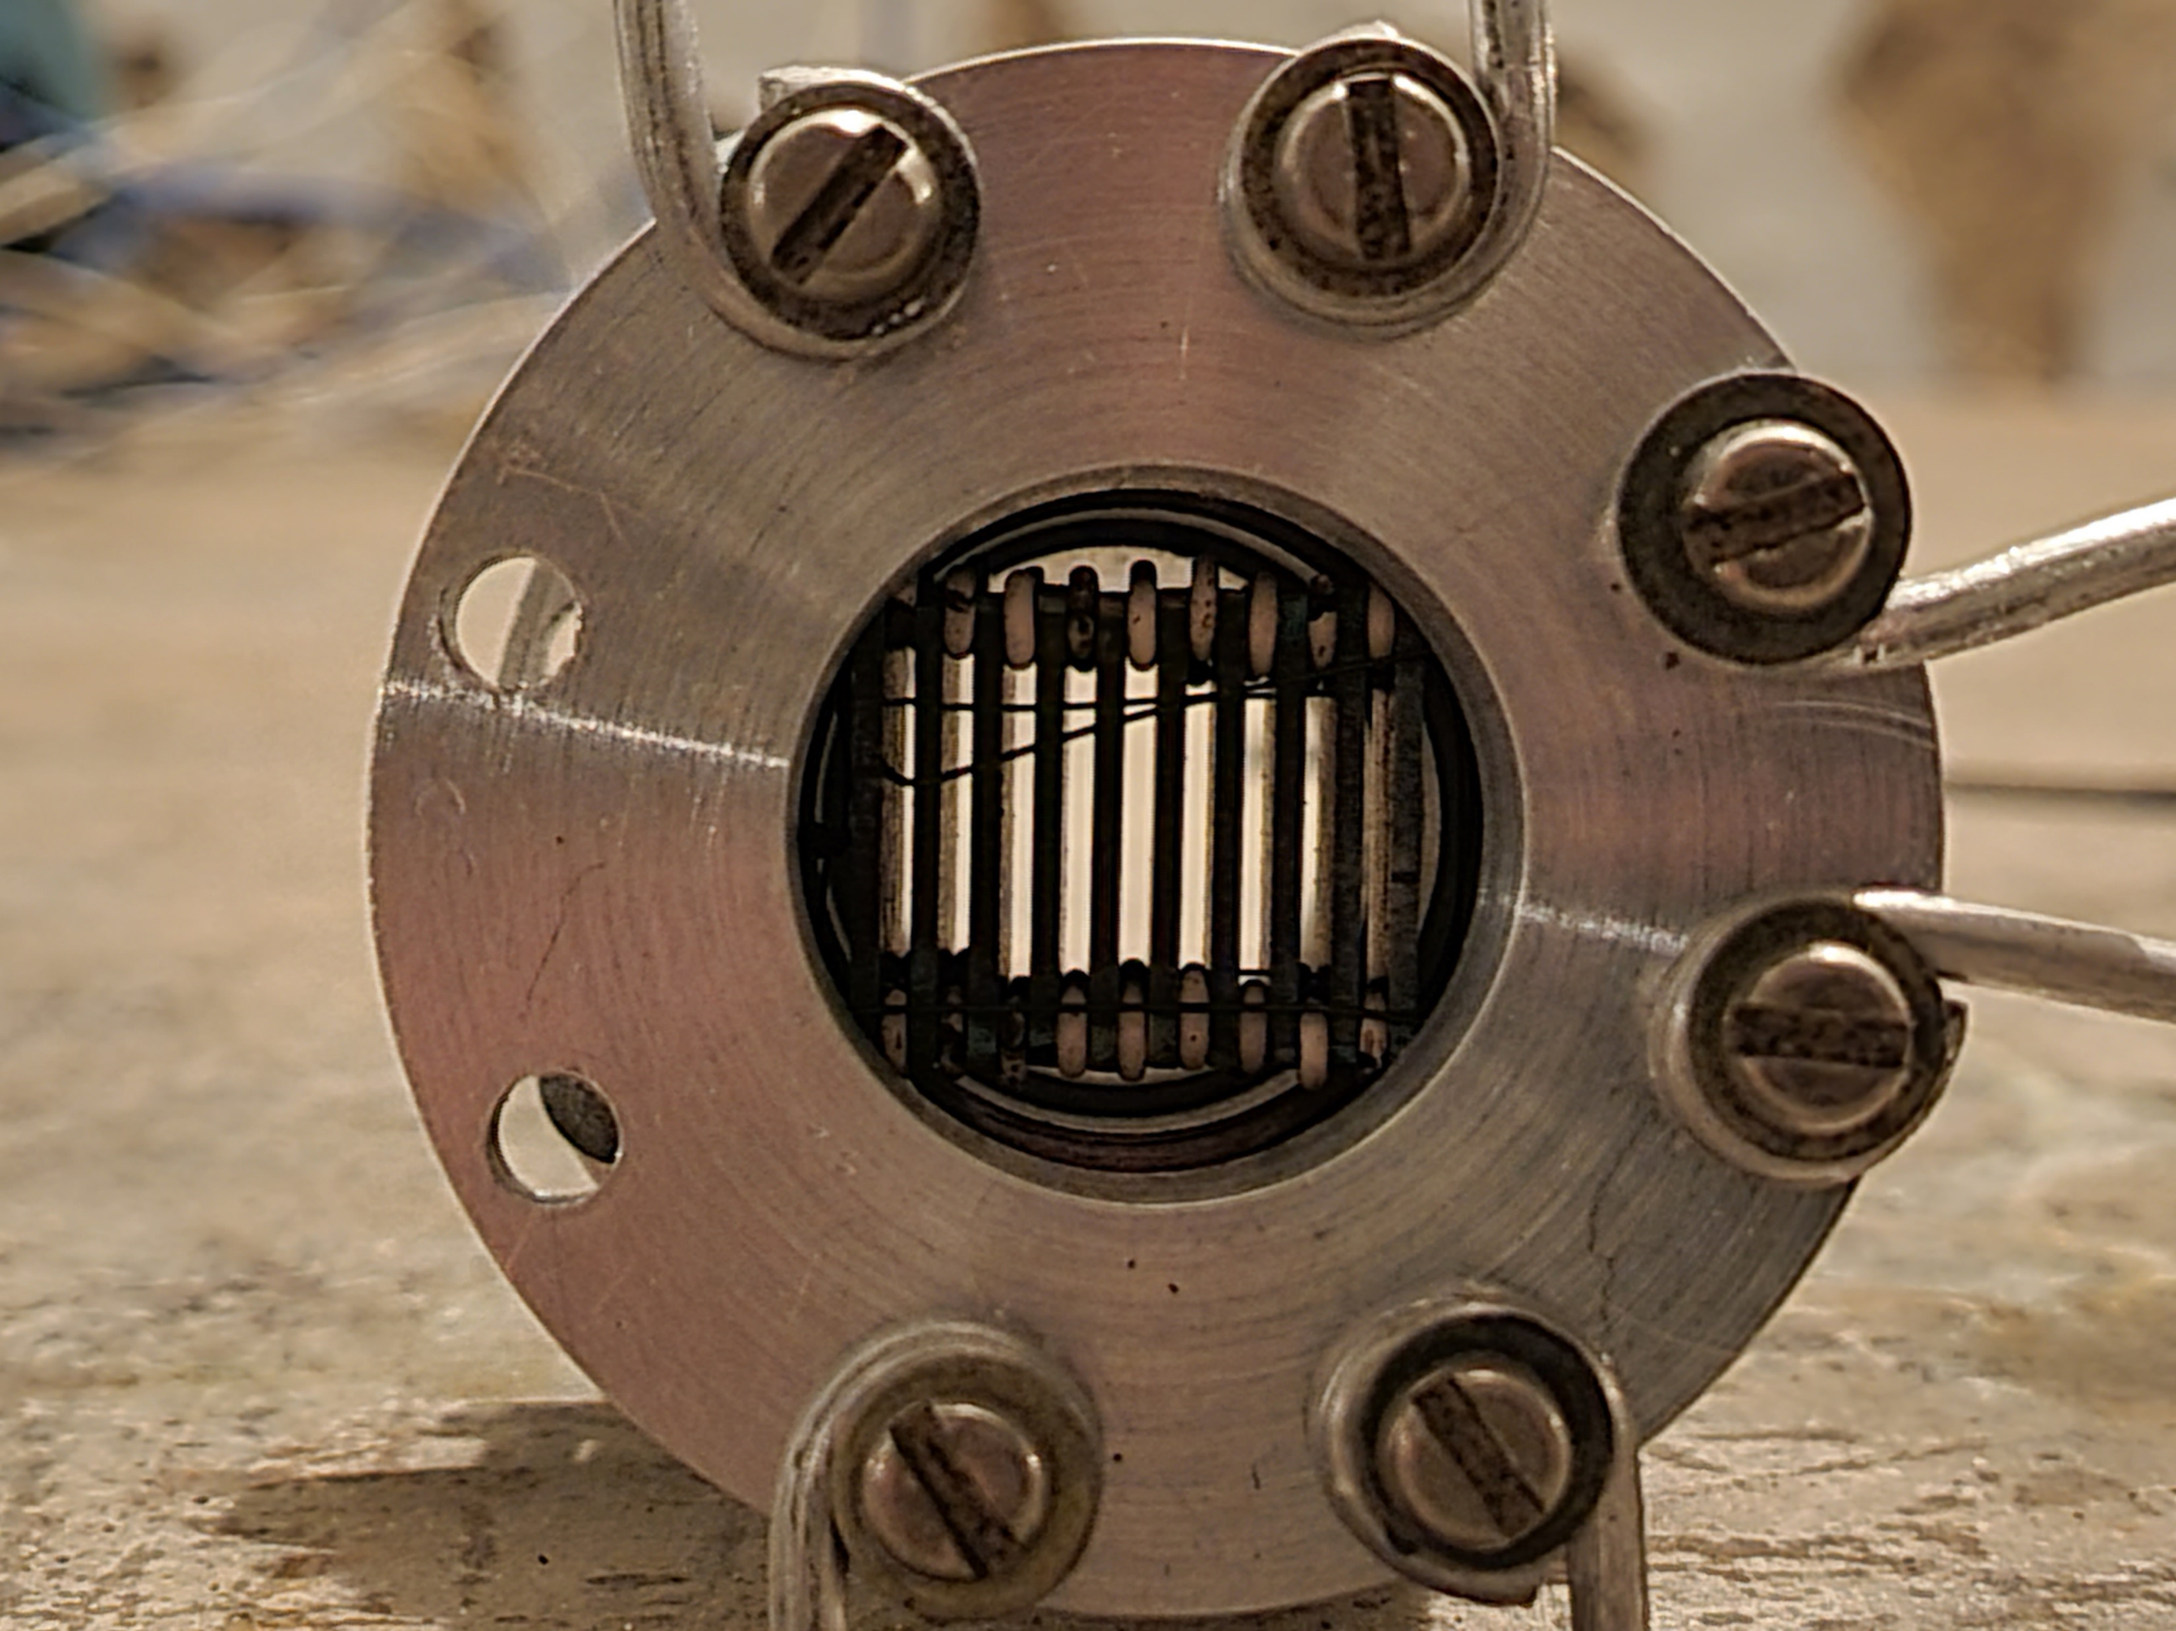
Improved converter
10 Tungsten plates. Plate dimension 16x16x1mm³. Simplifications at thermodynamic simulations: only collision stopping power was considered; uniform distribution of beam losses across plates; power dissipation in all plates are equal.
Neutron Flux 9x10¹⁴ n/cm²
Electron beam energy – 82 MeV
Power dissipation in one plate – 13.5 W
Cooling air velocity - 3 m/s
Air flow > 2 m³/hour
e⁻
Air
French-Ukrainian Workshop 29/10/2021 IJCLab

Slide 9
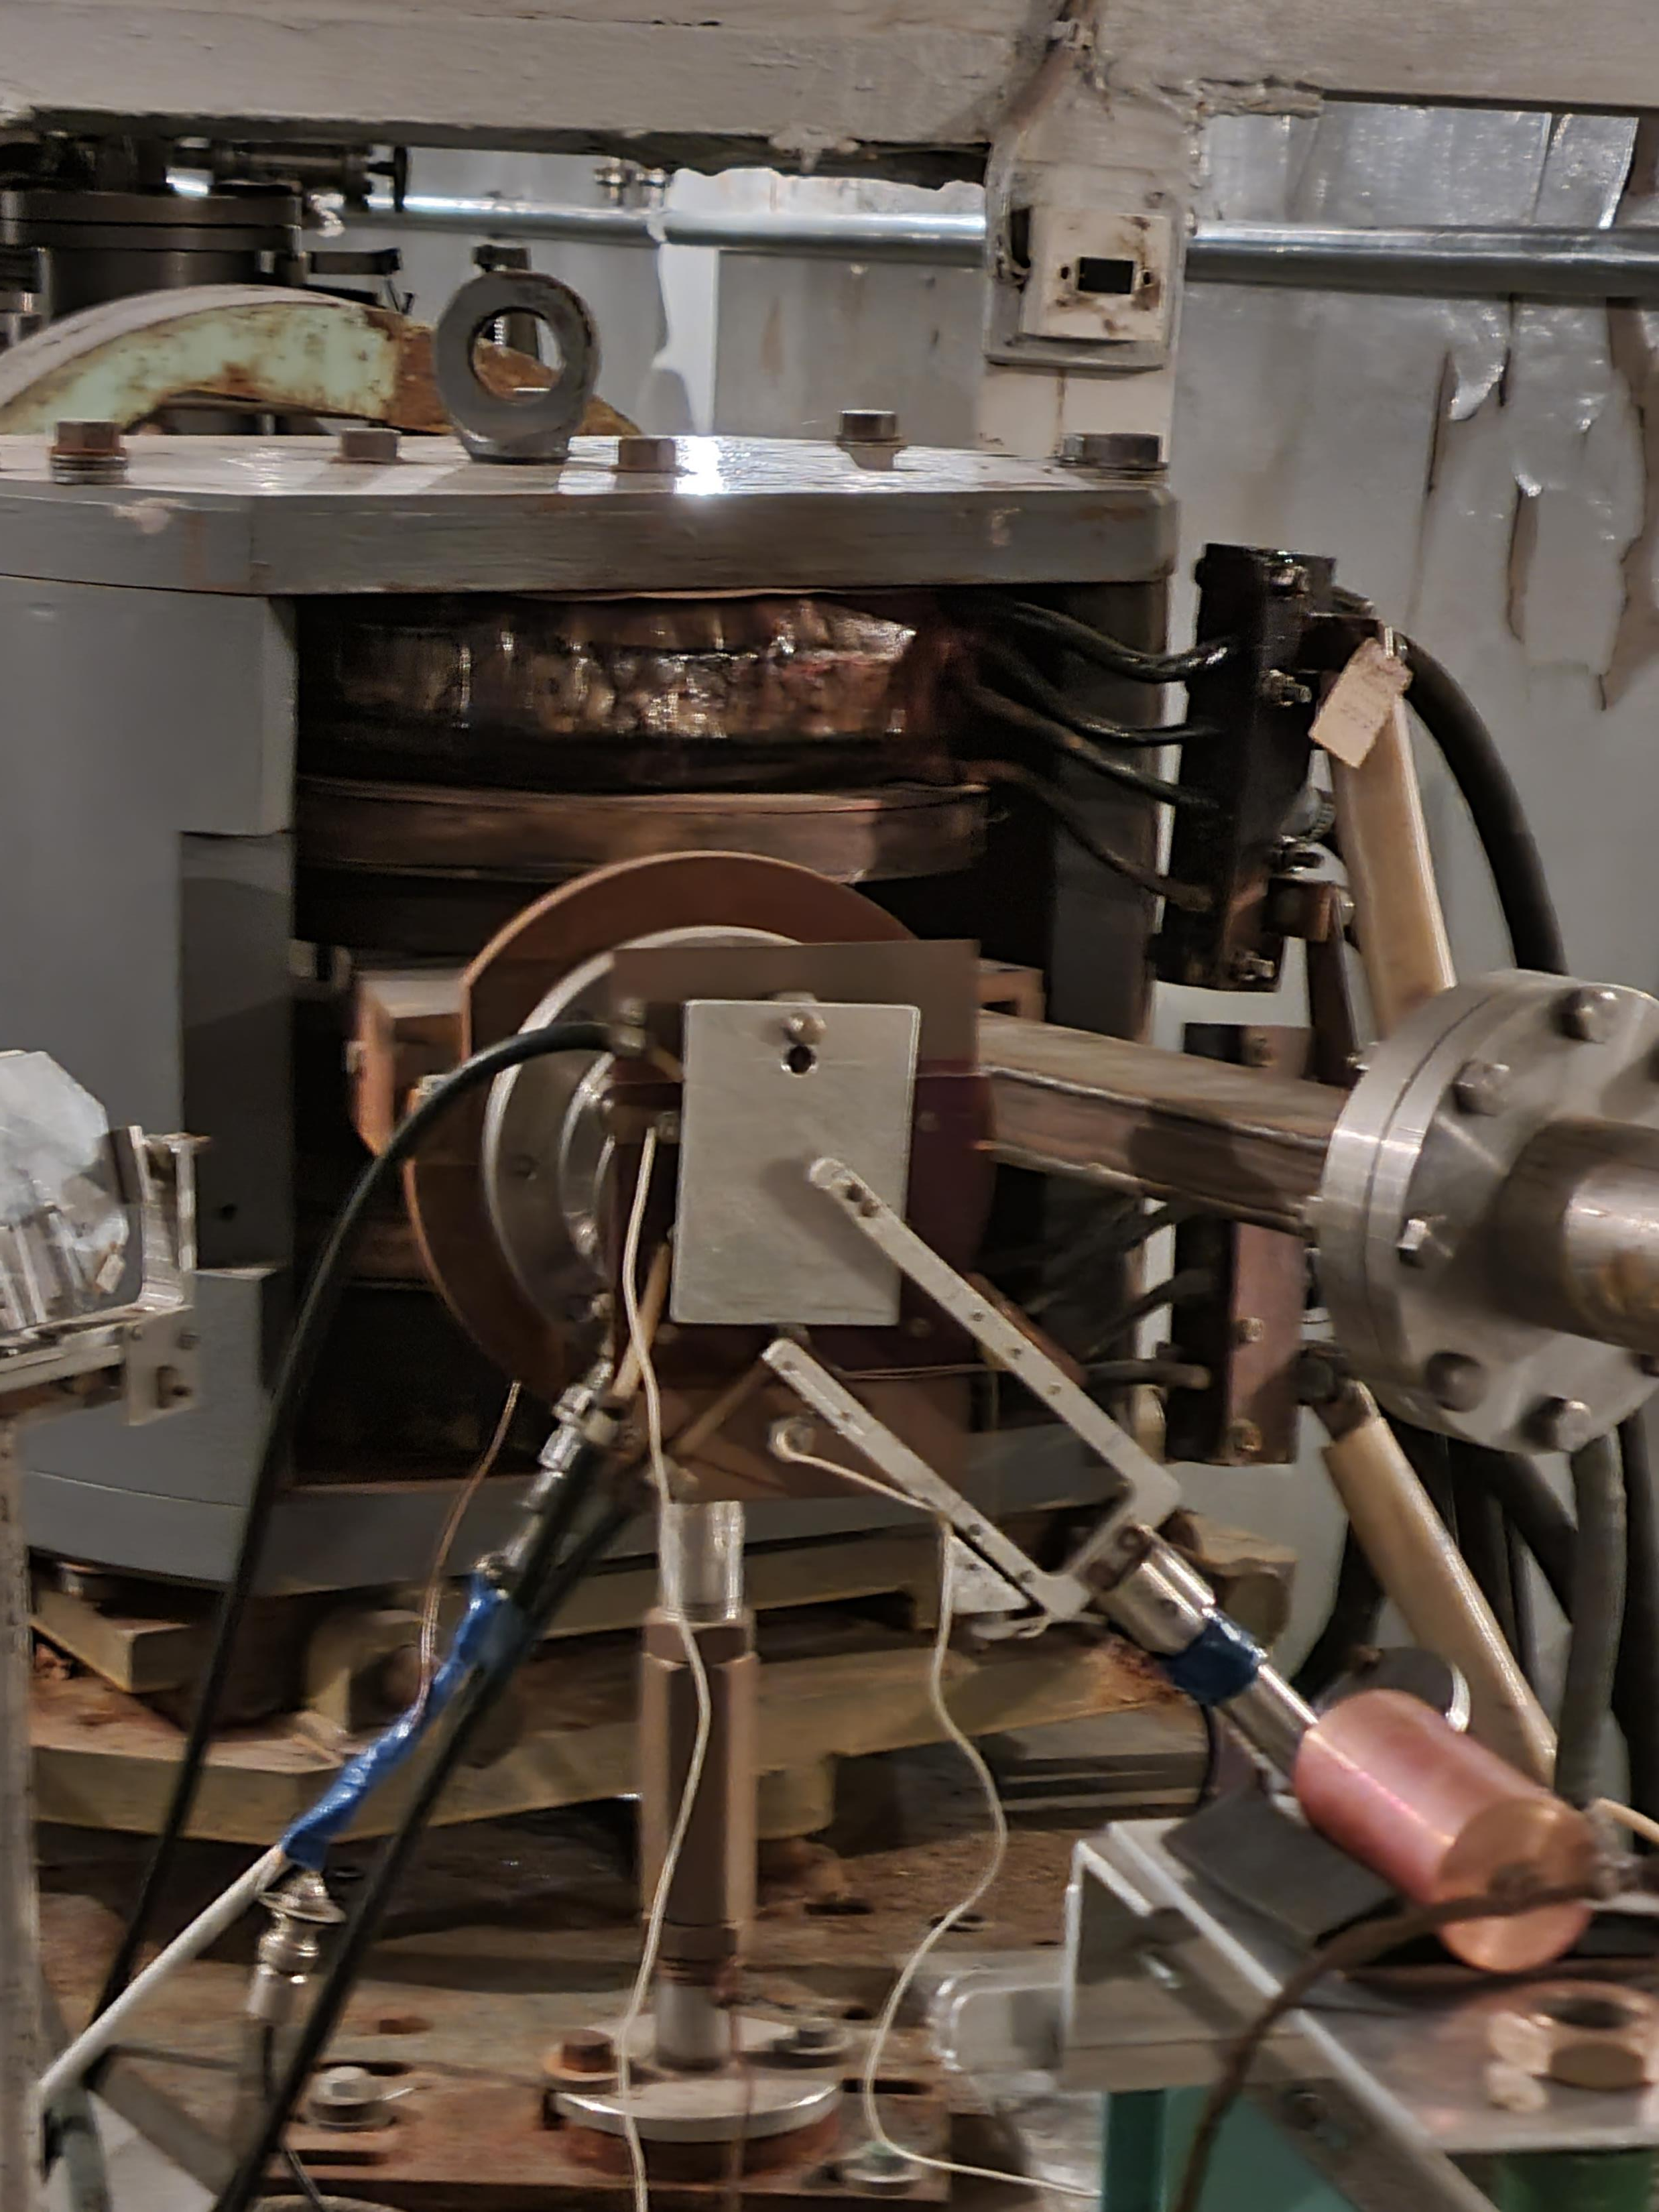
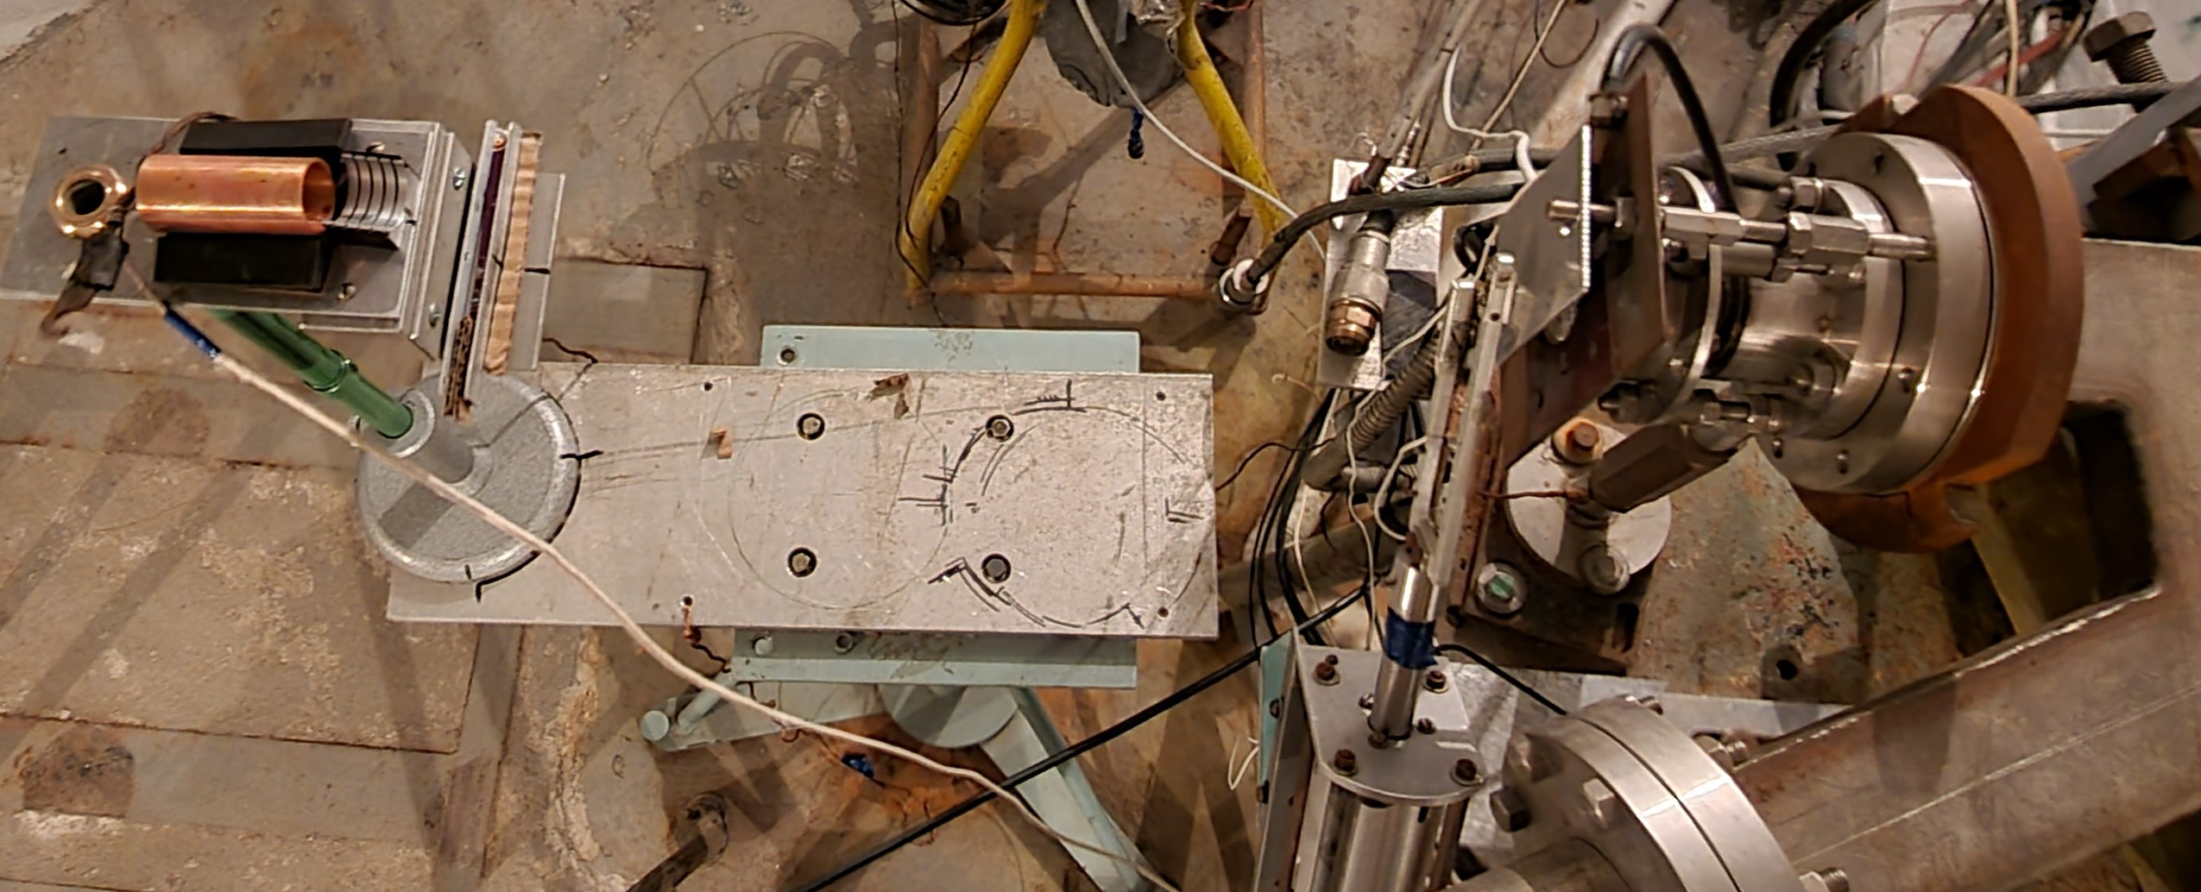
Setup for irradiation of siloxane rubber samples with electrons
Target beam current – 0.5 μA. Beam energy – 40 MeV.
Dose estimations: Estar (NIST, https://physics.nist.gov), Geant4, Riso B3 Film.
Doses: 0.25 MGy; 0.5 MGy; 0.75 MGy; 1 MGy;
French-Ukrainian Workshop 29/10/2021 IJCLab

Slide 10
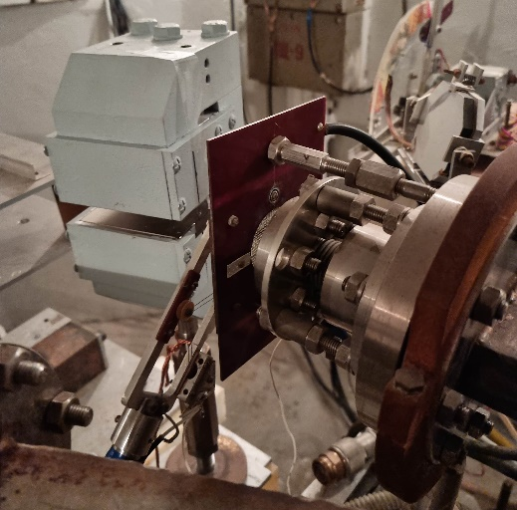
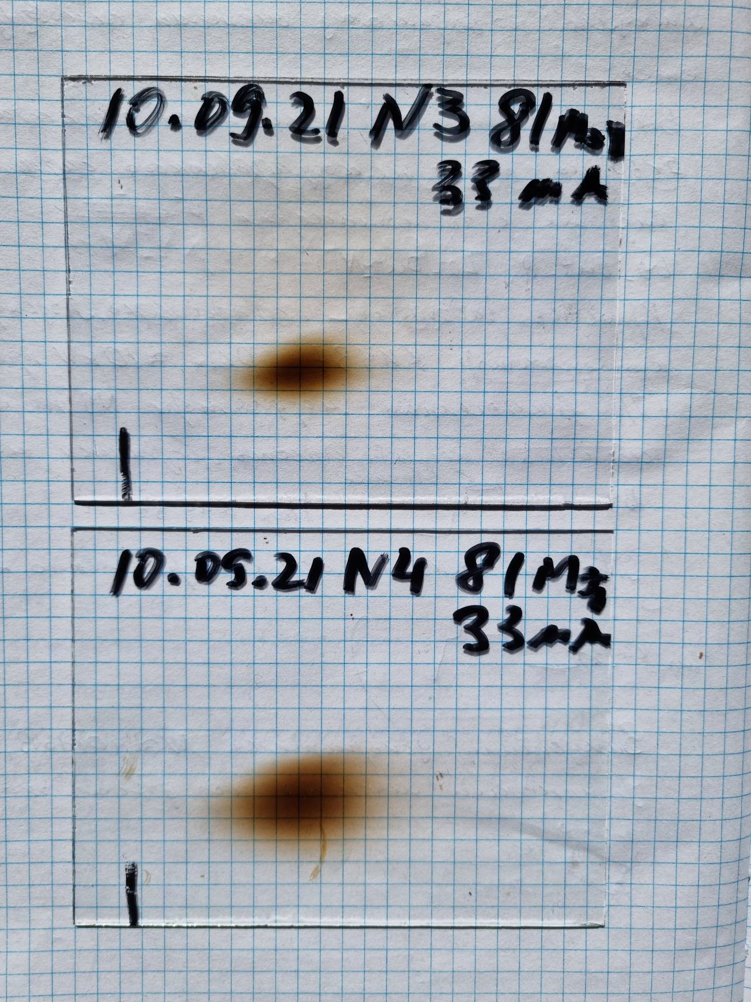
Permanent dipole magnet to obtain “pure” beam of bremsstrahlung quanta when studying the cross sections of multiparticle photonuclear reactions
B = 0.9 T
L= 83 mm
W=81 MeV
Convertor thickness 0.0 mm
Distance 90 mm
B = 0.9 T
L= 83 mm
W=81 MeV
Convertor thickness – 0.1 mm
Distance 90 mm
French-Ukrainian Workshop 29/10/2021 IJCLab

Slide 11
Horizontal profiles derived from scanned images
W=42 MeV. Blue curve corresponds to a case without converter; Green one corresponds to a case with 0.1 mm Ta converter
W=81 MeV. Blue curve corresponds to a case without converter; Green one corresponds to a case with 0.1 mm Ta converter
0.3 Ta converter.
Blue curve corresponds to 40 MeV; Green one corresponds to 84 MeV
French-Ukrainian Workshop 29/10/2021 IJCLab

Slide 12
Summary
The LUE-40 linac at NSC KIPT is in operational conditions providing electron beam with energy in the range of 35 - 90MeV at average beam current of 3.5 μA for 90 MeV and 5 μA for 35MeV that allows carrying out researches in different branches of nuclear and high energy physics.
Results of carried out experiments on radiation hardness of detector materials and equipment show an imminent importance of such a facility for the PLUME and calorimeter systems of LHC experiments.
A project of research program of the Ukraine National Academy of Sciences for 2021-2023 with a title of “Radiation tests of detectors and electronic equipment for upgrade of experiments at the LHC complex at CERN” is carrying out now by staff of NSC KIPT, Institute for scintillation materials of NAS of Ukraine and Taras Shevchenko National University of Kyiv.

