Slide 1
ISMA’s development of detectors
for HEP experiments
II. Pulse shape discrimination
for particles identification
A. Boyarintsev, B.Grinyov, A. Kolesnikov,
T. Sibileva, P. Zhmurin
Institute for Scintillation Materials,
Kharkov, Ukraine

Slide 2
ISMA’s development of detectors
for HEP experiments

Slide 3
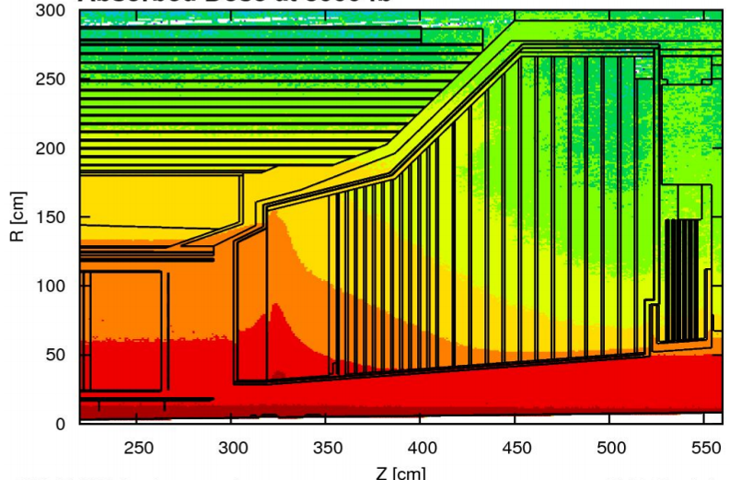
Motivation
New type of calorimeter - HGCAL
S₁
S₂
S₃
Scheme of radiation exposure zones
 | Silicon detector | Metamaterial scintillatiors
Radiation hardness | up to 100Mrad | up tо 100Мrad
Working temperature | - 30°С | + 25°С
Overlaping large area | yes | yes
Cost | high | Cost efficient
S₁ (70-100Мrad) ~ 10% (inorganic scintillator or Silicon sensors)
S₂ (5-70Мrad) ~ 65% (metamaterial scintillators)
S₃ (up to 5Мrad) ~ 25% (plasticscintillators)
?
Actual task: cost-efficient detectors free of technological limitations
on overlapping large areas

Slide 4
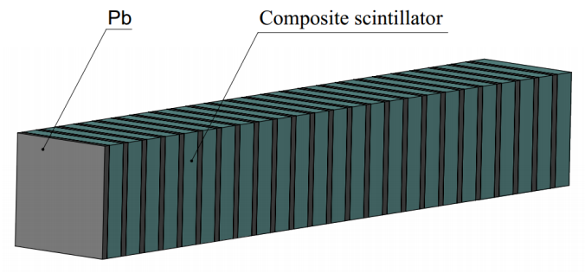
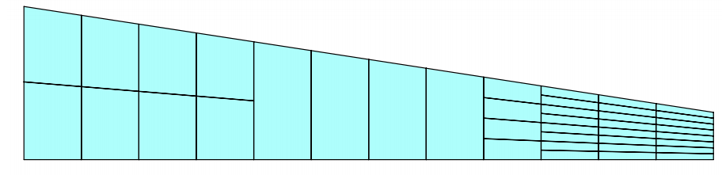
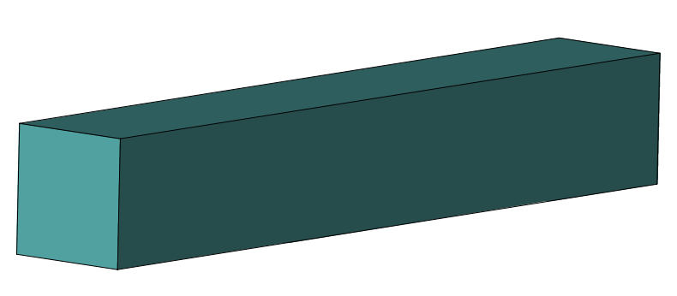
Requirements for scintillation materials for high energy physics
“Shashlik” design
Bulk scintillator
“Tile” design
The transition from bulk scintillators to thin layers with alternation of absorber and scintillator
  Physical and technical requirements
  Radiation hardness
  Short decay time
  Low activation
  Signal/noise ratio
  Ability to overlap large areas
Radiation-resistant components of the scintillation element are required:
- scintillator
- organic optical medium
- light guide
  Potential materials:
Al₂О₃
SiO₂

Slide 5
Scintillation crystal selection
Silicates -LYSO:Ce (Lu_{1.8}Y_{0.2}SiO₅:Ce) -YSO:Ce (Y₂SiO₅:Ce) -GSO:Ce (Gd₂SiO₅:Ce) -GPS:Ce (Gd₂Si₂O₇:Ce) | Garnets -YAG:Ce (Y₃Al₅O₁₂:Ce) -GGAG:Ce (Gd₃Al_{2.5}Ga_{2.5}O₁₂:Ce) -YAG:pure -YAGG:Ce (Y₃AlGa₄O₁₂:Ce) | Saphire - Al₂O₃:Ti
 | Activator concentration | Decay time, ns | Light yield, ph/MeV | Emission λ_{max}, nm
LYSO:Ce | 0.2% | 41 | 30000 | 397
YSO:Ce | 0.1% | 70 | 30000 | 420
GSO:Ce | 0.5% | 60 | 12500 | 430
GPS:Ce | 7.0% | 46 | 30000 | 372
YAG:Ce | 0.1% | 100 | 15000 | 550
GGAG:Ce | 0.2% | 50 | 50000 | 530
YAGG:Ce | 0.1% | 15 | 15000 | 500
Al2O3:Ti | 0.1% | 3400 | 18000 | 750

Slide 6
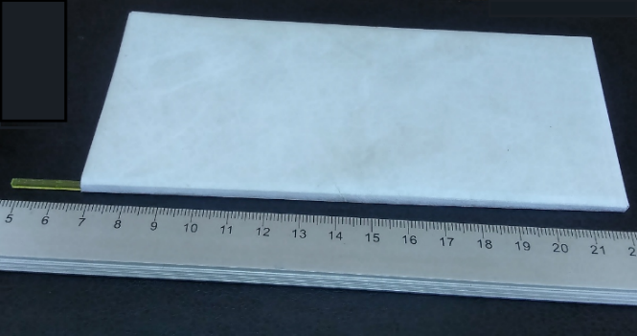
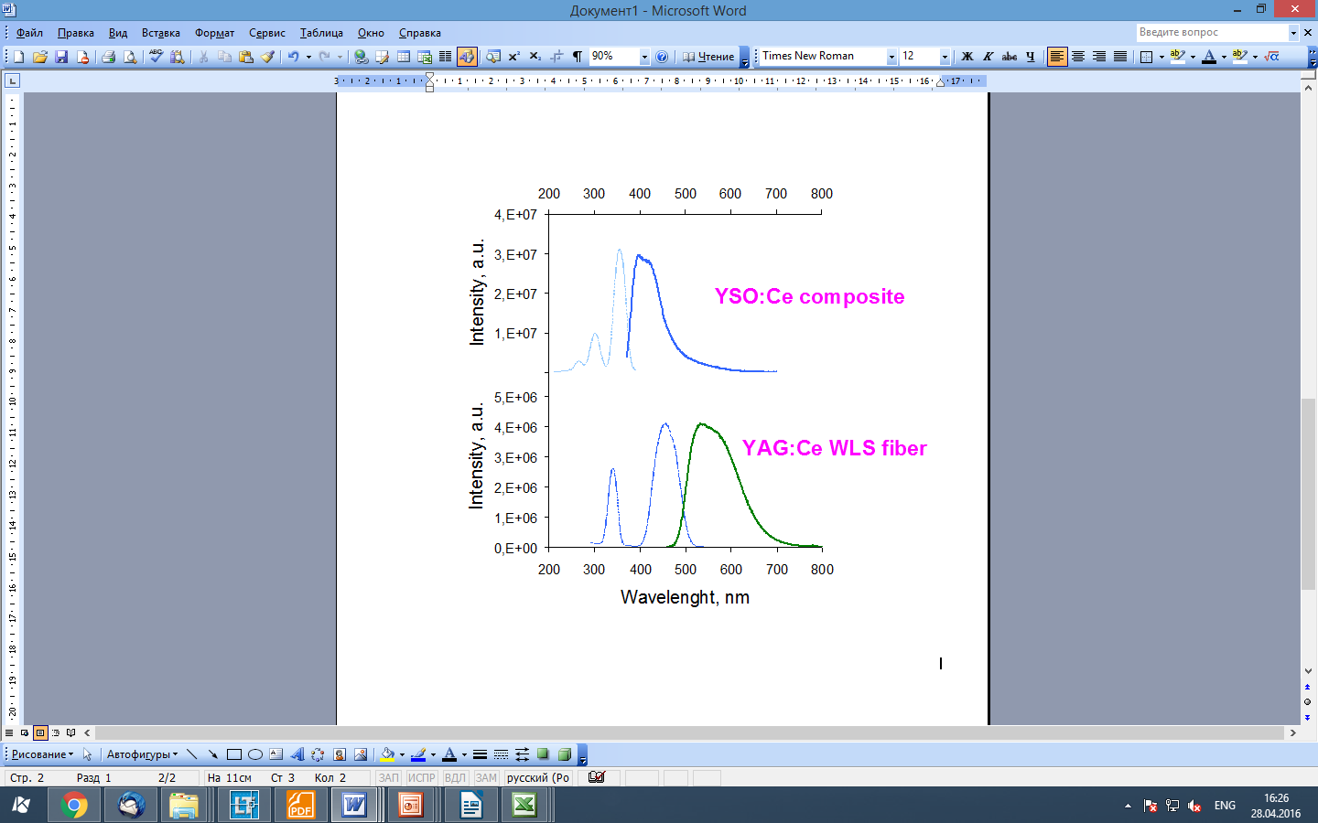
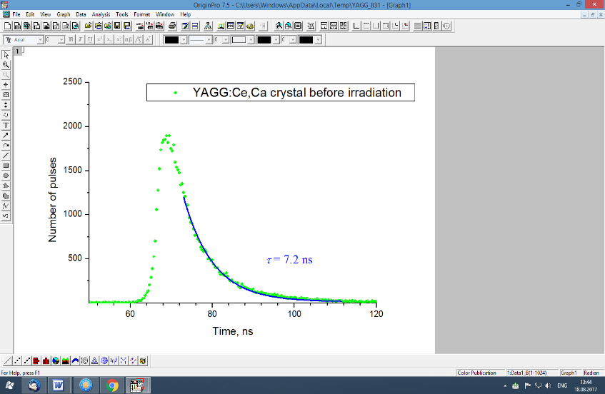
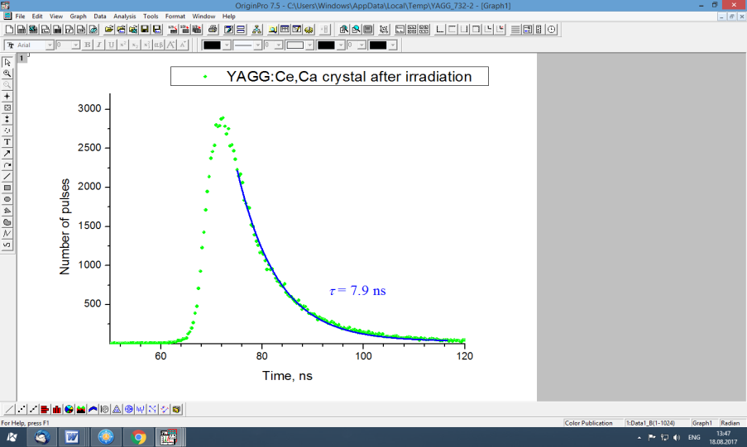
Radiation hard scintillation element
before irradiation
after irradiation
Essential overlapping
of YSO:Ce emission spectrum and YAG:Ce (or YAGG:Ce) absorption spectrum
Decay time YAGG:Ce, Ca fiber before and after irradiation with dose of 50 MRad

Slide 7
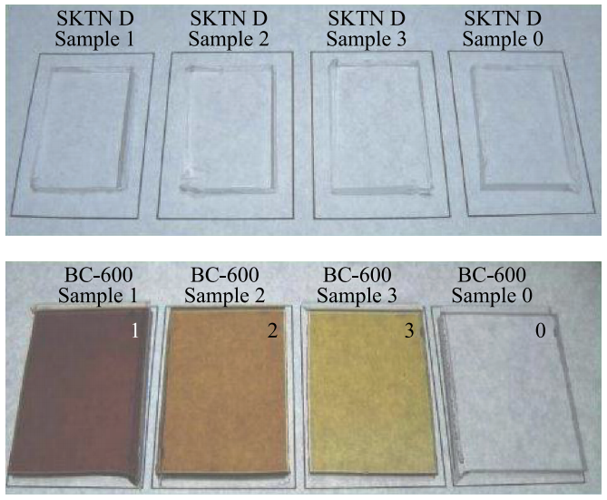
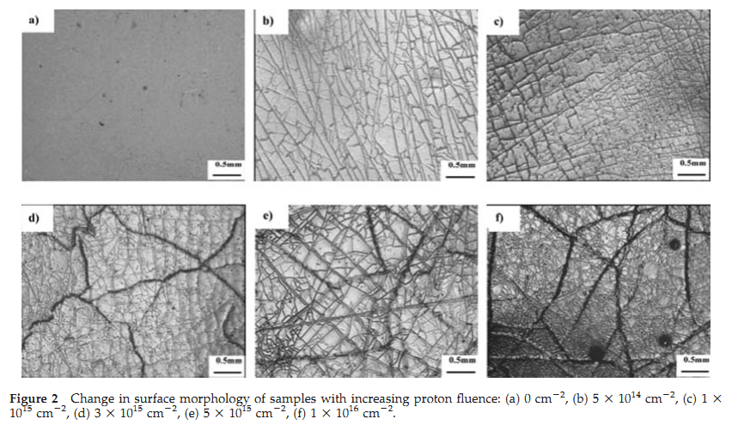
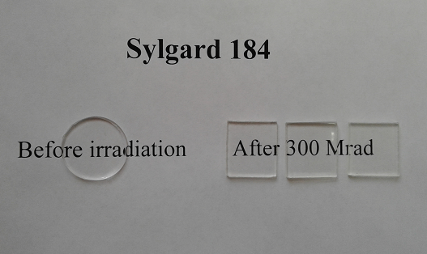
Radiation hardness of polysiloxanes
The tests were carried out in several scientific institutes of the world
Irradiation with electrons (E₀ = 8.3 MeV) up to 300 MRad dose
ISMA (Kharkov) tests
Irradiation with neutrons (E > 1 MeV)
JINR (Dubna) tests
a
Irradiation with protons (150 KeV)
Space Materials and Environment Engineering Laboratory, Harbin Institute of Technology (Harbin) tests
b
Plates made from SKTN (D) polymer resins (a) and Bicron-600 (b).
Irradiated by neutron with fluency 0 (#0), 16*10¹⁴ (#1), 3.8*10¹⁴ (#2) and 1.2*10¹⁴ сm⁻² (#3).
Haiying Xiao et al., Journal of Applied Polymer Science, ·2008

Slide 8
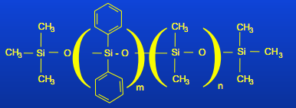
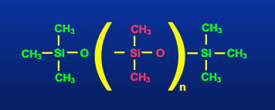
Two main types of Pt-cured Polysiloxanes
Polymethyl siloxane
Polyphenyl siloxane
Radiation hardness of Polysiloxanes vs. Scintillation plastic
Polysiloxane
- High strength Si–O bonds preserves transparency of polysiloxane up to high irradiation dose;
- Mechanical hardness is increased by the presence of phenyl groups absorbing part of radiation energy due to π-electrons in aromatic rings
Plastic scintillator
- Decrease in transparency because of the destruction of C–H and C–C bonds, production of free radicals and C=C bonds as absorbing centers

Slide 9
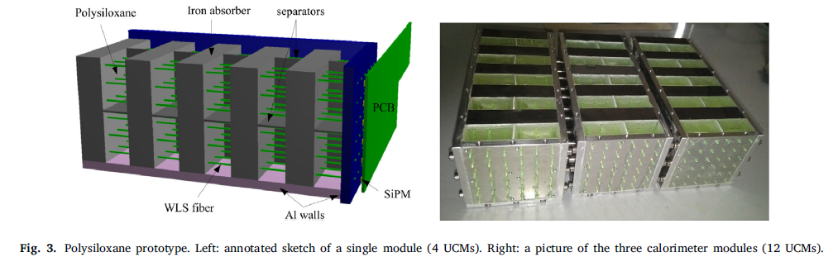
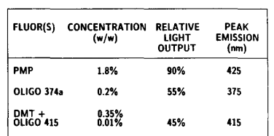
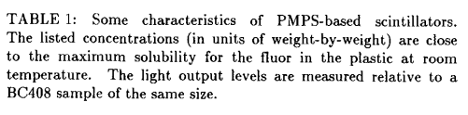
Polysiloxane-based scintillators for “shashlyk” calorimeters
The calorimeter provides particle identification capabilities and energy resolution for electrons
at the same level as for standard plastic scintillators
F. Acerbi et al., Nuclear Inst. and Methods in Physics Research, A 956 (2020)
no yellowing with doses up to 100 kGy
light outputs ranging from less than 5% to 90%
of a reference sample (BC-408)
Margaret Bowen et al., IEEE Transactions on Nuclear Science, 1989

Slide 10
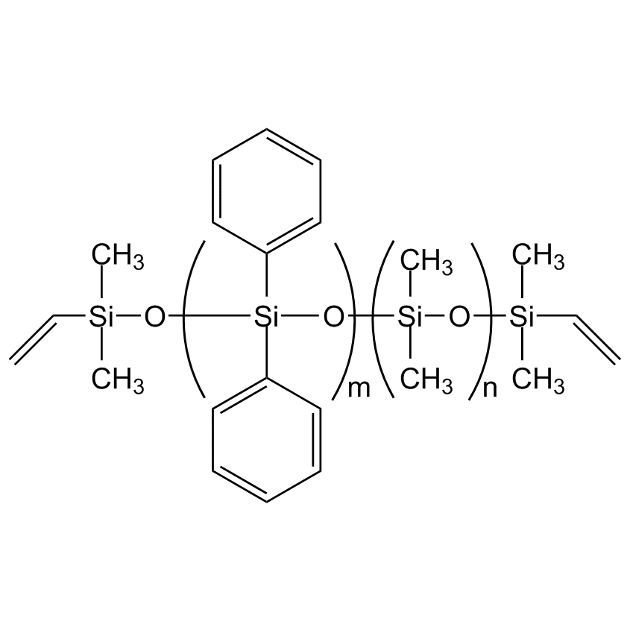
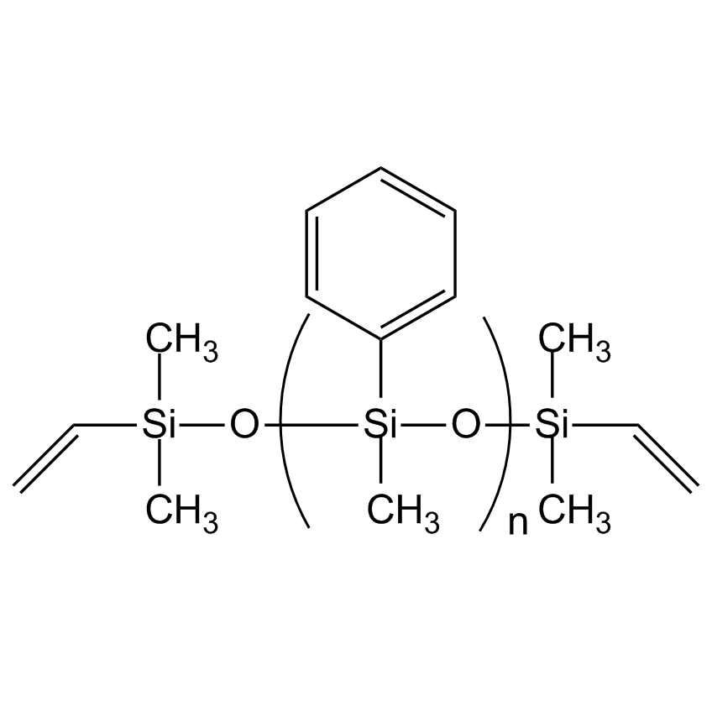
Polysiloxane based scintillator
# | L₀ (L) | L/L₀, % | D_{1/2}, МRad
1 | 2364 (1500) | 63,5% | 15,2
2 | 4228 (2450) | 58% | 12,7
DIPHENYLSILOXANE
# | L₀ (L) | L/L₀, % | D_{1/2}, МRad
3 | 3666 (2090) | 57% | 12,3
4 | 3821 (3029) | 79% | 29,8
POLYPHENYLMETHYLSILOXANE

Slide 11
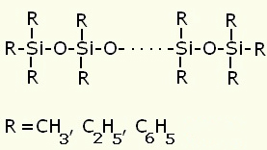
Radiation damage of polysiloxane based scintillator
Under ion beam irradiation the light emission of polymers decreases
Radiation damage:
The radiation hardness more than 20 MRad was reached due to the new activators
fluorescent dyes
polymer network
 | 1214 | 1280 | 1278 | 1272 | 1301 | 1309
D1/2 | 7,6 | 15,7 | 14,3 | 14,5 | 20,6 | 21,2

Slide 12
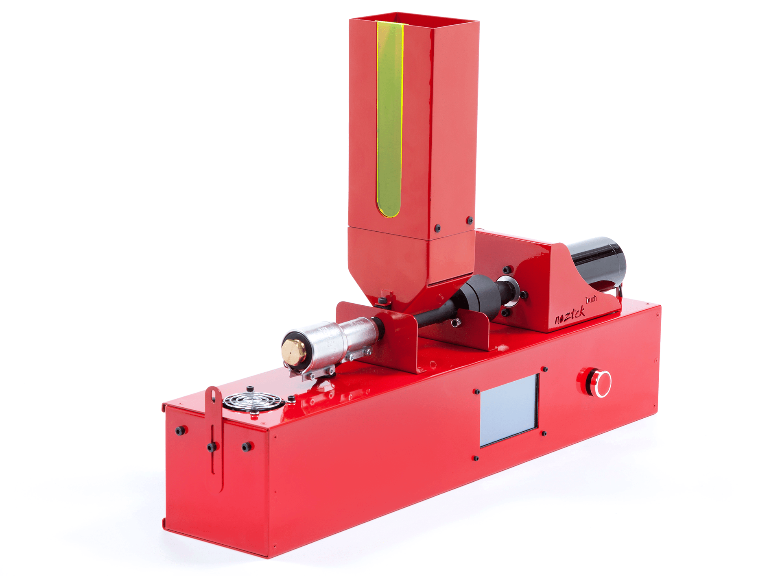
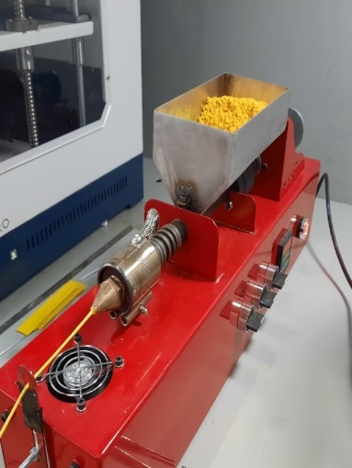
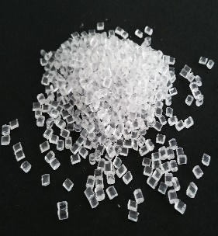
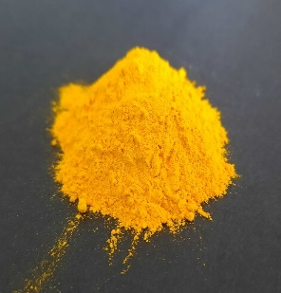
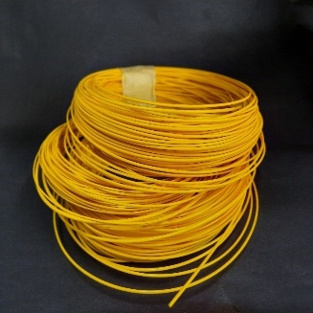
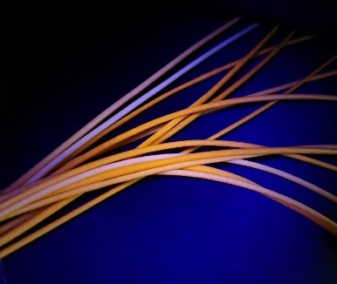
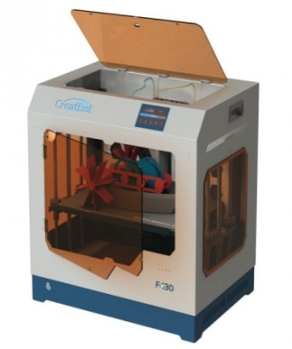
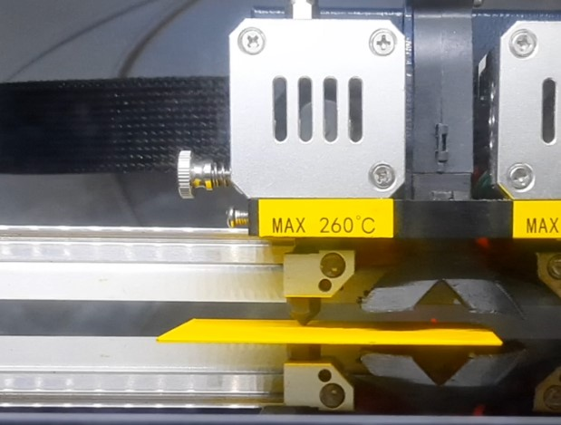
3D printing technology for metamaterial detectors
1
2
As scintillation powders were used ZnSe:Al, GOS:Pr, GaGG:Ce and CsI:Tl with weight content from 30 to 75%
+
Optically clear pellets
Inorganic scintillation powder
Filament Extruder
3
4
Scintillation filament
FDM 3d-printer
The modes for obtaining of filaments doped with inorganic powders have been determined

Slide 13
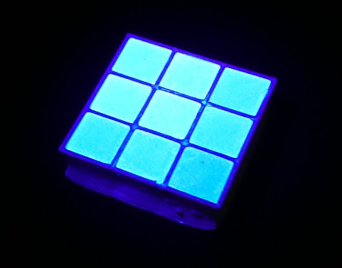
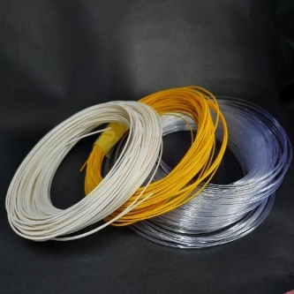
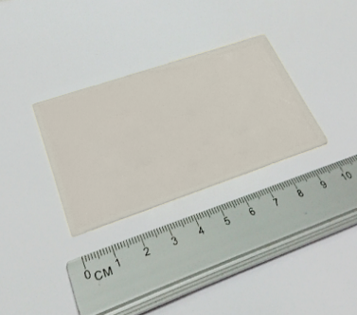
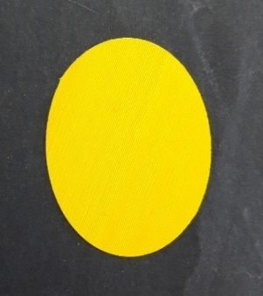
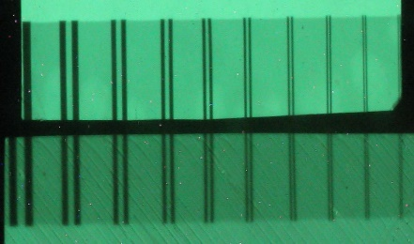
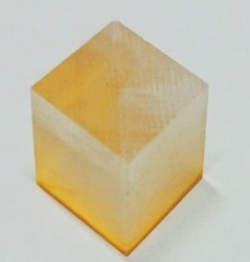
3D printing scintillator technology
1
2
3
Scintillation filaments with a weight content of inorganic powders up to 75% were obtained
Plastic scintillator with reflector
Thin layer scintillation films with spatial resolution up to 3.35 lp/mm were obtained
4
5
6
Scintillators for registration of alpha- and beta-particles and gamma-photons
Results obtained are in good correlation with the data for industrial samples
3D-printing technology has ample opportunities in the creation of scintillation detectors

Slide 14
II. Pulse shape discrimination for particles identification

Slide 15
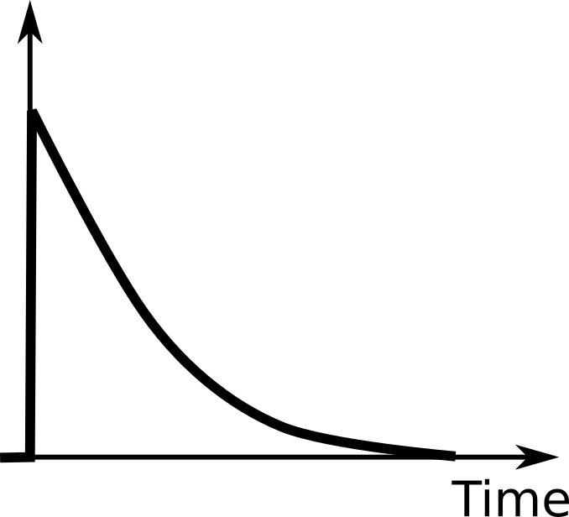
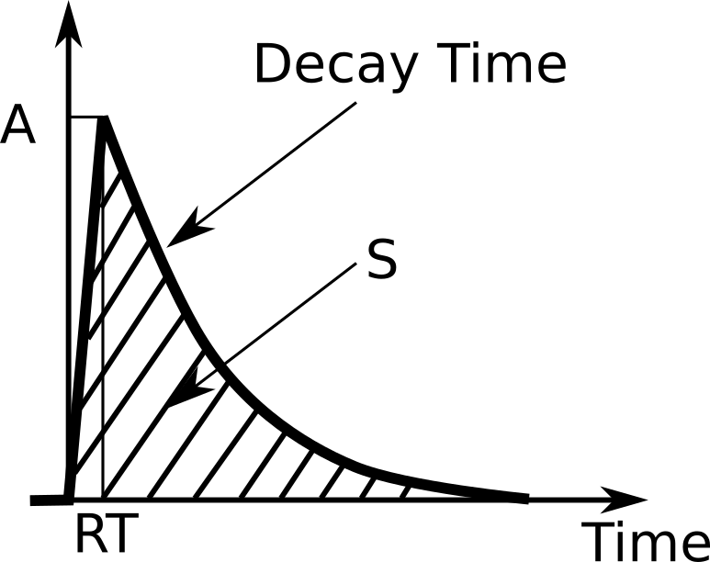
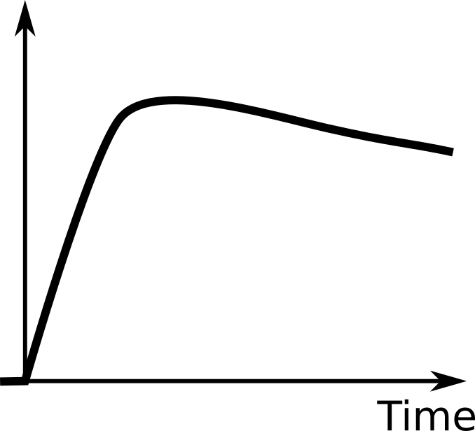
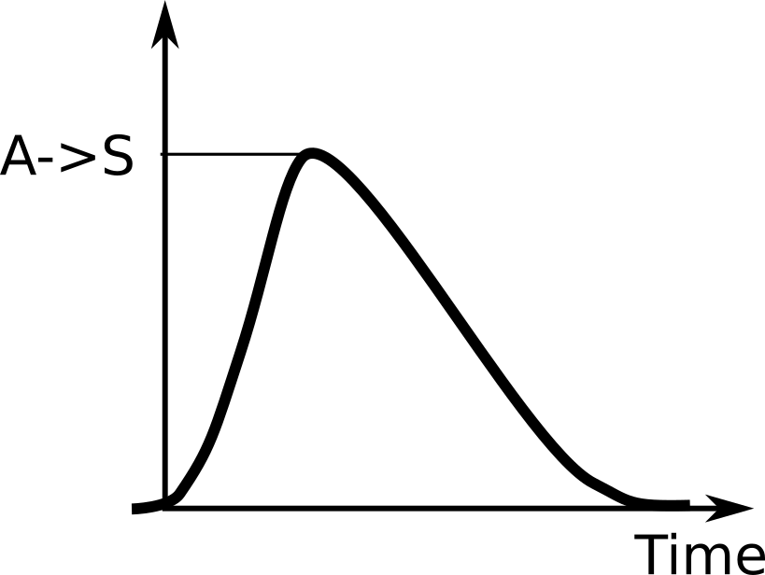
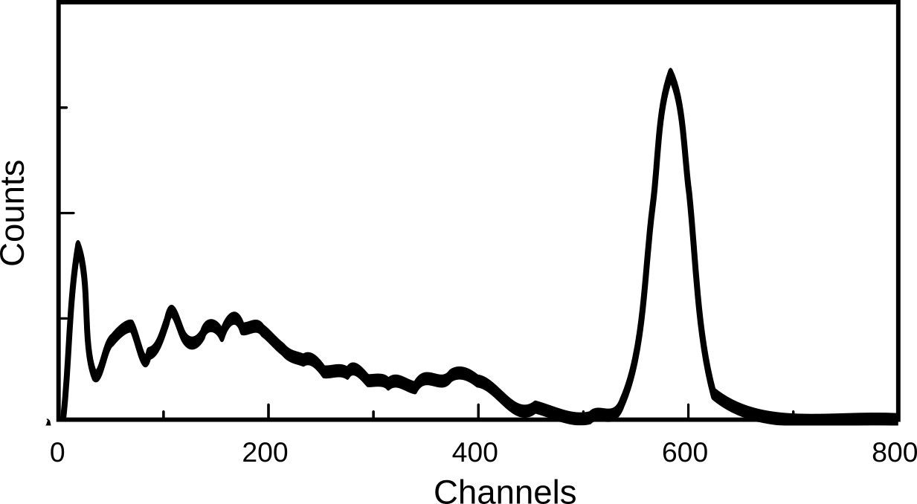
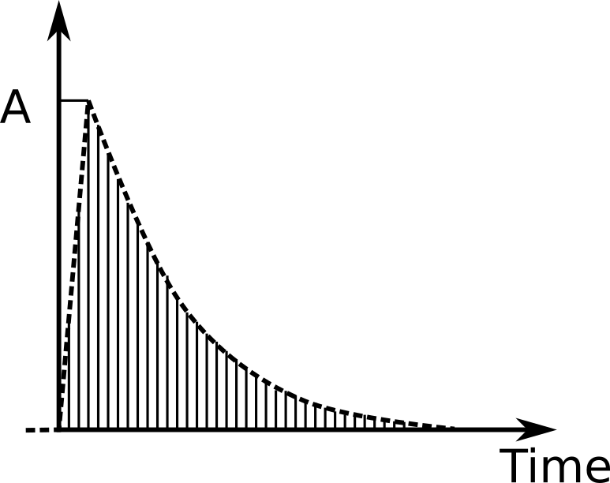
Classical spectrometer (scintillation pulse area analysis)
Photo detector
PreAmp
50 us
All events
Scintillator
Shaper
MCA
Digital spectrometer for pulse shape analysis
True shape pulses
Digitizer
Scintillator
Photo detector
PreAmp
Fast
ADC
FPGA
Soft 1
PC
Soft 2

Slide 16
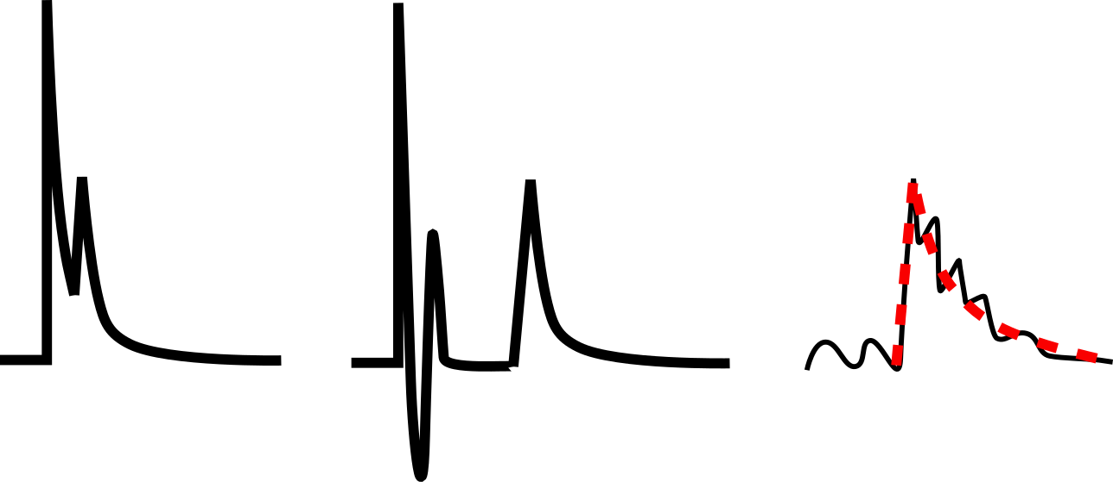
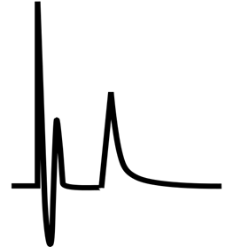
Comparison of classical and PSD spectrometry
Causes of pulse distortion
Normal pulse
Superposition
of two pulses
Noise as an pulse
Selection of a pulse with an amplitude close to noise
 | Advantages | Drawback
Classic MCA | -Cost-efficient -Standard PHR -Optimal technical resource | -PSD impossible
Pulse shape discrimination analyses | -The events discrimination by pulse shape -Analysis of pulse shape -Improve PHR | -Overlarge data file , preliminary filtering of data is required

Slide 17
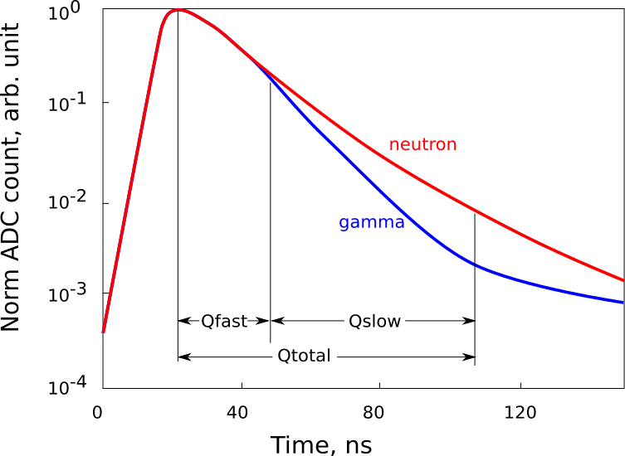
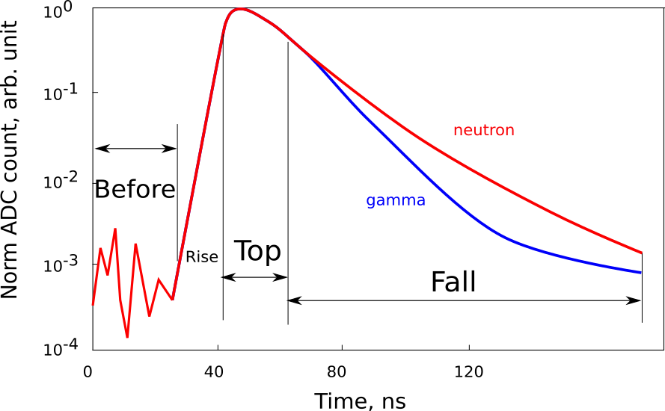
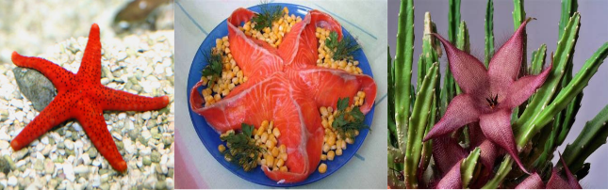
Pulse shape discrimination methods for neutron\gamma separation
Classic PSD method
FOM = Qslow / Q total
Digitizer
Scint.
Photo
detector
Pre Amp
Fast
FPGA
Soft 1
ADC
Image PSD
PSD by image (soft2)

Slide 18
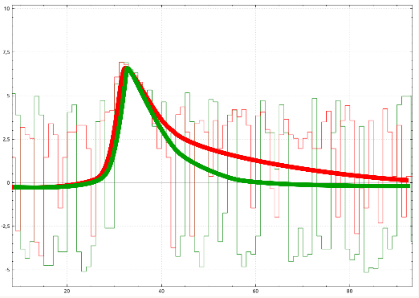
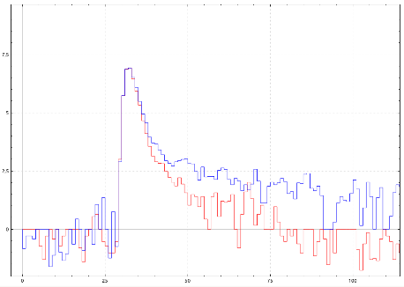
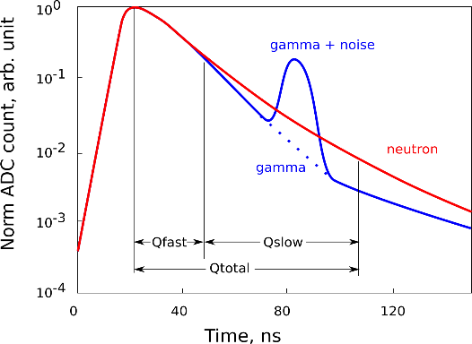
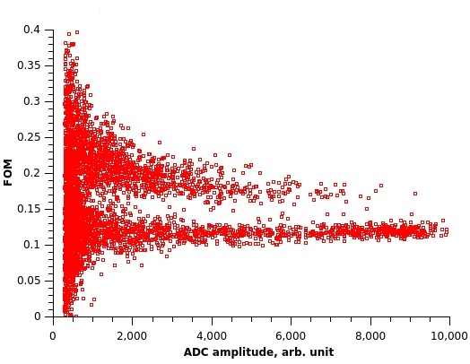
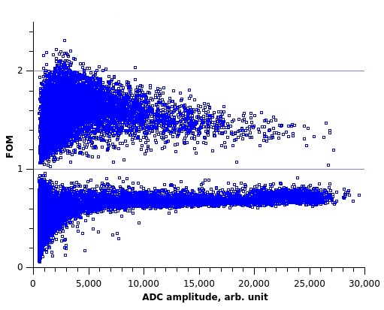
Neutron/gamma discrimination
Theory
In practice
Low amplitude pulse
High amplitude pulse
Noise under the signal
Conventional
PSD by image
The separation N/G low amplitude pulse it is a general task

Slide 19
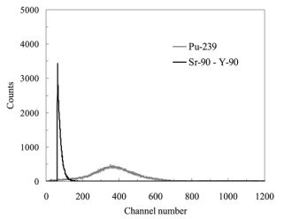





Аlpha/beta discrimination
Conventional
PSD image
The material selection with a specific pulse form
Alfa/betta separation by energy
Alfa/betta discrimination by pulse form due slow and fast scintillators (plastic and ZnS(Ag)
Alfa/betta PSD

Slide 20






Spectrometry for multimaterial detectors
Large area NaI + Plastic scintillator
PS – excellent sensitivity for energy high than 300 keV
NaI – excellent spectrometry
PS + NaI – high sensitivity and spectrometry available
- increased sensitivity to registration of back scattering gamma quantum
- image spectrometry
1 – Plastic scintillator
2 – NaI(Tl) or CsI(Tl) layer
3 – Reflector
4 – Housing
5 - PMT
Fig. 1. 50x250x1000 mm3 gamma detector
1 – Plastic scintillator
2 – NaI(Tl) or CsI(Tl) layer
3 – Reflector
4 – Housing
5 - PMT

Slide 21



Spectrometry for multimaterial detectors
We applied PSD for separation of “suitable for spectrometry” signals and filtered “impeding” signals from PS (it is actual for complex spectrum)
PS pulses
NaI pulses
PS pulses don’t provide information about peaks and aren’t used in spectrums
NaI pulses are suitable for spectrum creation and isotopes identification
NaI + PS pulses
(NaI + PS) pulses describes backscatter peaks

Slide 22


“Improved” spectrometry
4 peaks are resolved.
Peak 2614 keV isn’t resolved because of the small thickness of NaI(Tl).
Statistical methods are required “improved” spectrometry with PSD

Slide 23
Thank you for your attention!

