Slide 1
Fast luminosity measurements for SuperKEKB
Philip Bambade
IJC Lab
Acknowledgements:
S. Wallon (IJC Lab), L. Brunetti (LAPP), V. Vinnichenko (Kharkiv)
S. Di Carlo, D. El Khechen, D. Jehanno, V. Kubytskyi, C.-G. Pang, C. Rimbault (ex-LAL)
Y. Verechshaka (Kharkiv & Paris-Saclay), S. Vaiva (Paris-Saclay), T. Ottmann (Nantes), A. Bwembya (Moscow)
S. Uehara (Belle II ZDLM), R. Yang, Y. Funakoshi, M. Masuzawa (KEK ACCEL Department)
French-Ukrainian Workshop IJCLab - Orsay 27-29 October 2021

Slide 2
Exploring the luminosity frontier with SuperKEKB
1km diameter
ACO
KEKB
2.1×10³⁴/cm²/s
SuperKEKB
6.5×10³⁵/cm²/s
Nanobeam collision scheme (+ crab waist)*
- 1st trials at SuperKEKB
- planned at future e⁺e⁻ circular colliders (FCCee, CEPC)
Maximize luminosity ↔ mitigate beam induced detector & accelerator backgrounds
* P. Raimondi → Daφne + SuperB

Slide 3
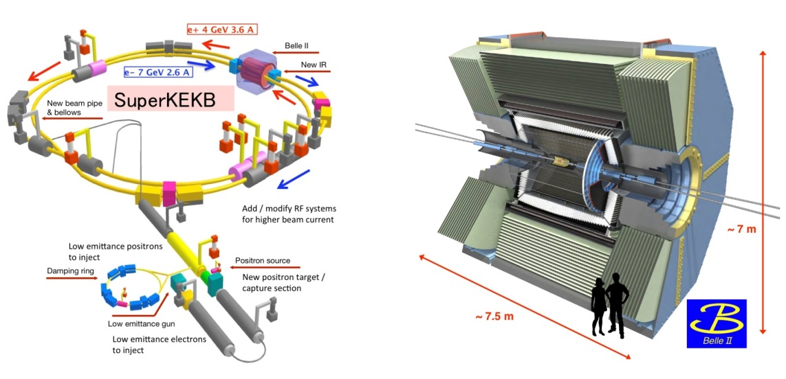
SuperKEKB & Belle-II projects
1) Phase 1 : February → June, 2016
- single beam commissioning
- vacuum scrubbing
- no luminosity (no final focus)
- no Belle II
2) Phase 2 : February → July 2018
- colliding beam commissioning
- Belle II w/o vertex detector
- first collisions + pilot run (0.5 fb⁻¹)
3) Phase 3 : 2019, 2020, 2021…
- physics run with full detector
- continued machine studies
- integrated luminosity : 213.5 fb⁻¹
- 2020-2021 in spite of COVID-19
→ luminosity record 2.4 10⁺³⁴ cm⁻²s⁻¹
- Resuming just now in October-December…

Slide 4
Belle-II @ SuperKEKB physics motivation
Discover new physics via precision searches for deviations from SM predictions induced by new particles appearing in higher order quantum corrections
Precision measurements of CKM matrix elements
Rare / forbidden B, D, τ decays
Dark sector searches
….
specification: × 40 peak luminosity of KEKB → 50 ab⁻¹
1st B-B like event during 1st physics run
1st Belle II publications:
“Measurement of the integrated luminosity of the Phase 2 data of the Belle II experiment”, Chin.Phys.C 44 (2020) 2, 021001
“Search for an invisibly decaying Z′ boson at Belle II in e+e−→μ+μ−(e±μ∓) plus missing energy final states”, Phys.Rev.Lett. 124 (2020) 14, 141801
“Search for Axion-Like Particles produced in e+e− collisions at Belle II”, Phys.Rev.Lett. 125 (2020) 16, 161806
“Search for B+→K+νν¯ decays using an inclusive tagging method at Belle II”, accepted for publication in PRL
“Precise measurement of the D0 and D+ lifetimes at Belle II”, accepted for publication in PRL
“Combined analysis of Belle and Belle II data to determine the CKM angle ϕ3 using B+→D(K0Sh+h−)h+ decays”, submitted to JHEP
…..
Talks at this workshop on Friday 29 October :
Status of Belle II – Karim TRABELSI 11:10
Beam polarization and tau-physics at Belle – Aurélien MARTENS 11:30

Slide 5
KEKB ↔ SuperKEKB parameters
× 1/20 β_{y}
σ_{y} ≈ 50-60 nm
(similar as ILC/ATF2)
× 2-3 beam currents
similar beam-beam strength
(tune-shift)
→ × 40 peak luminosity

Slide 6
Nanobeam collision scheme
Opportunities
Very small β_{y} avoids “hour-glass” limitation (effective bunch length ≈ depth of field of the optics)
Collide more charge @ tiny vertical beam size with similar beam-beam tune-shift strength parameter
1. Optical aberrations near IP must be cancelled to achieve / maintain tiny beam spots
2. Control beam-beam tune-shift with more complex IP beam-beam dynamics + optical aberrations
3. Continuously inject intense beams in strongly demagnified IP optics → backgrounds from tails…
Challenges
× 1/20 β_{y}
× 2-3 beam currents
× 1/20 σ_{y}

Slide 7
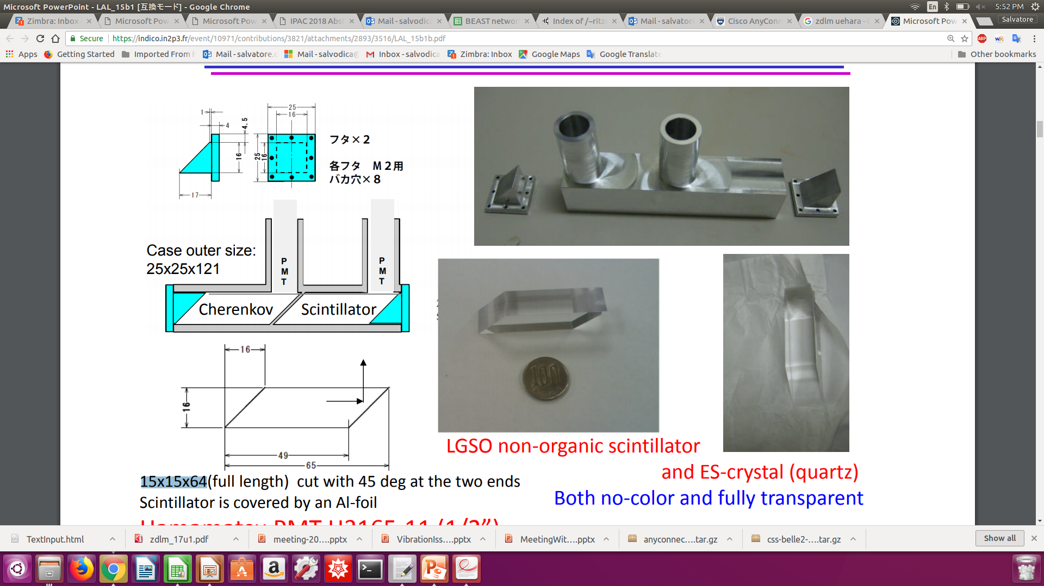

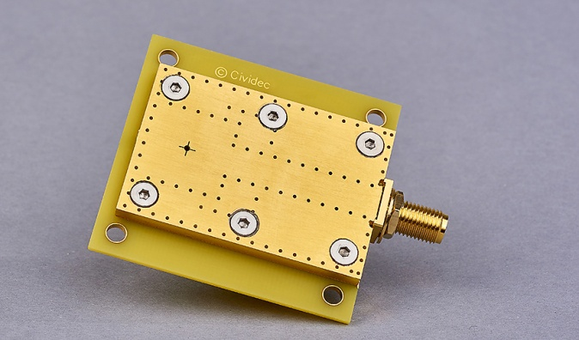
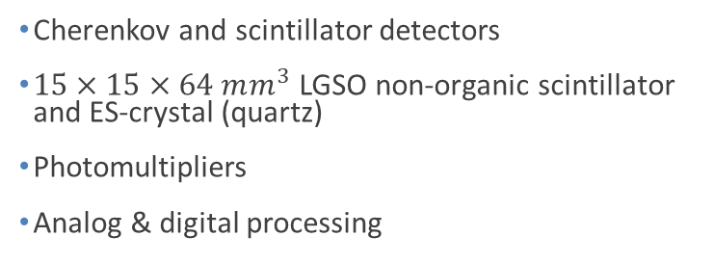

Two complementary techniques for fast luminosity measurements - compare / collaborate / mutually supporting - share simulation, mechanics, some data… - since 2012
LumiBelle2 / IJCLab
ZDLM (Zero Degree Luminosity Monitor) / KEK
single crystal CVD diamond sensors
$4×4×0.5/0.14 mm^{3}$
Fast charge/current amplifiers
Digital electronics and processing
Cherenkov and scintillator detectors
$15×15×64 mm^{3}$ LGSO non-organic scintillator and ES-crystal (quartz)
Photomultipliers
Analog & digital processing
Notes:
LGSO (Lu2-xGdxSiO5)

Slide 8
What for / specs ?
“Dithering” feedback
Correct for few Hz horizontal motion
79 Hz orbit “dithering” + luminosity sampling @ 1 kHz → reconstruct baseline freq. + 2nd harmonic
Efficient separation from other “slow” variations
1% relative precision @ 1 kHz sufficient (cf. C.-G. Pang et al., J.Phys.Conf.Ser. 1067 (2018) no.7, 072023)
Provide analog signal as input to lock-in amplifier
Notes:
LGSO (Lu2-xGdxSiO5)

Slide 9
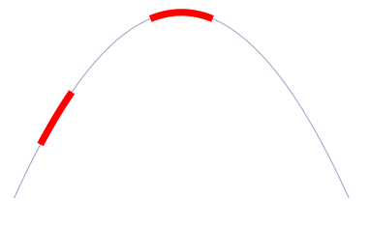
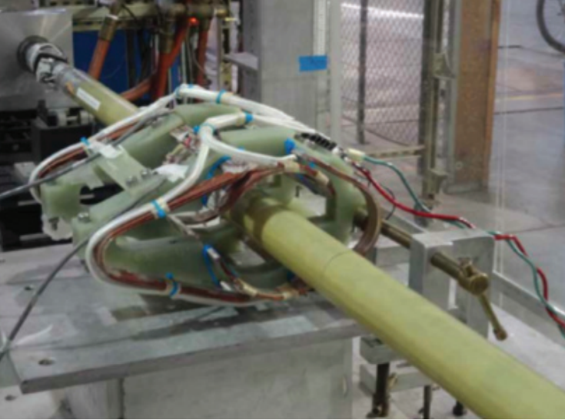
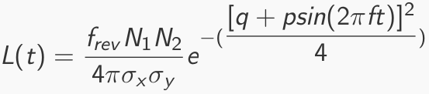
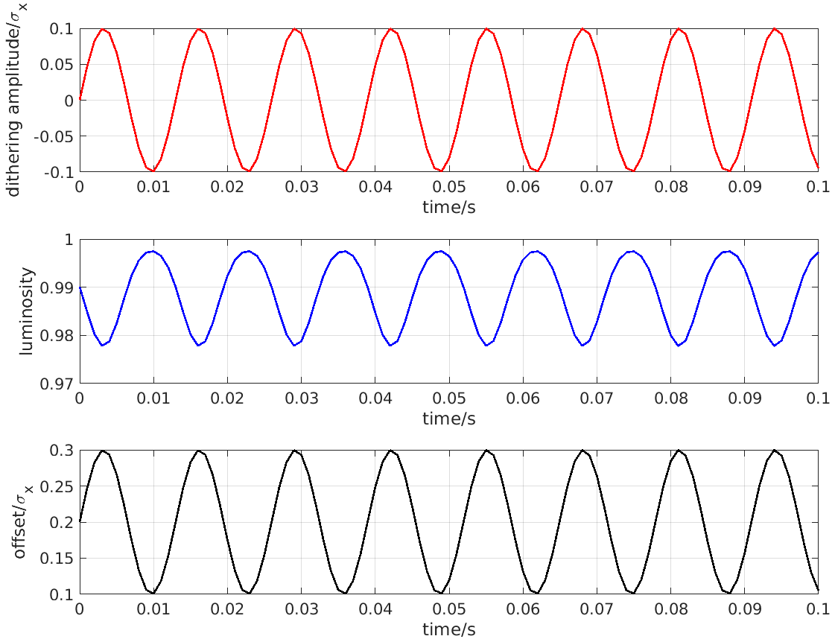
Fast & slow beam position variations at IP require feedback corrections
Beam-beam deflection for fast vertical motion
Luminosity feedback by “dithering” for slower horizontal motion
Δy at IP=
∼ 5nm ∼ 1/10σ_{y}*
BPM
Δy at BPM= ∼ 1.3μm
Vertical vibration ∼ 25-100 Hz
Sampling (BPMs) ∼ 32 kHz
IP
BPM
Cf. WEXBA04 by Yoshihiro Funakoshi, Wednesday, 11:20 am
Horizontal motion ∼ few Hz
Modulation freq. f₀ ∼ 79 Hz
Sampling (lumi. meas.) ∼ 1 kHz
- minimize f₀ output component
- dithering × lumi. signal → phase
↔
2×f₀
Luminosity
↔
f₀
x
Dithering coil x 12
DITHERING
LUMINOSITY

Slide 10
What for / specs ?
“Dithering” feedback
Correct for few Hz horizontal motion
79 Hz orbit “dithering” + luminosity sampling @ 1 kHz → reconstruct baseline freq. + 2nd harmonic
Efficient separation from other “slow” variations
1% relative precision @ 1 kHz sufficient (cf. C.-G. Pang et al., J.Phys.Conf.Ser. 1067 (2018) no.7, 072023)
Provide analog signal as input to lock-in amplifier
Bunch by bunch luminosity diagnostic
Nominally 4 ns bunch separation → need short signal pulses, ideally < 4 ns
1% or better relative precision @ 1 Hz
IP vertical beam size measurement + tuning at very low currents
Single beam orbit + optics corrections in two rings
Vertical e+ and e- beam size optical tuning → suppress local aberrations in nanobeam final focus
Control of beam-beam blowup → find best spot in tune diagram
Can avoid confusion from beam-beam induced blowup if done at very low currents !
Dynamic range L ≈ 10³² → 10³⁶ cm⁻² s⁻¹
Non luminosity scaling contamination < 1% (e.g. beam gas bremsstrahlung and Touschek losses)
Manage radiation damage at highest luminosity
Notes:
LGSO (Lu2-xGdxSiO5)

Slide 11
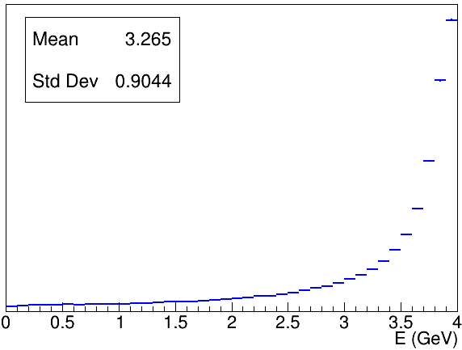
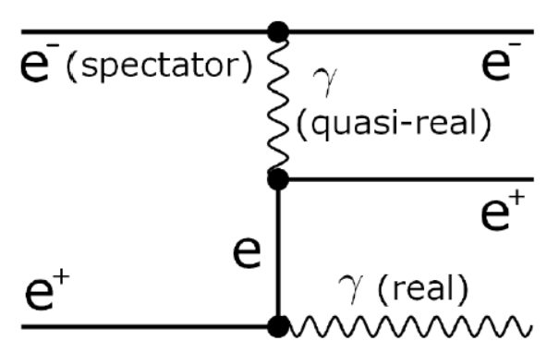
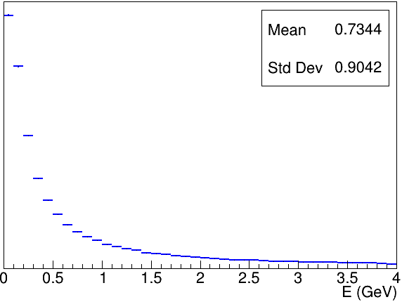
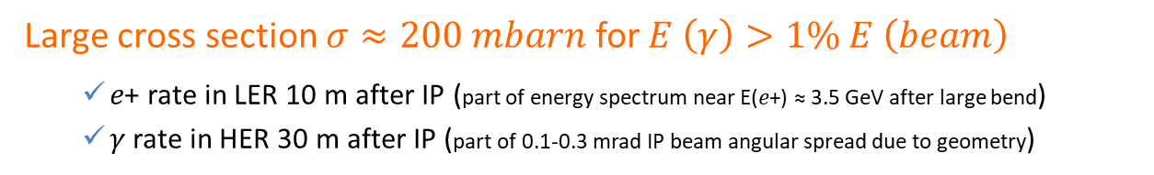






How ?
Bhabha process at vanishing scattering angle
Large cross section $σ≈200 mbarn$ for $E \left(γ\right)>1\% E \left(beam\right)$
𝑒+ rate in LER 10 m after IP (part of energy spectrum near E(𝑒+) ≈ 3.5 GeV after large bend)
𝛾 rate in HER 30 m after IP (part of 0.1-0.3 mrad IP beam angular spread due to geometry)
from GUINEA-PIG++
$$E (e^{−})=7GeV$$
$$E (e^{−})=7GeV$$
𝑒+
$$E (e^{+})$$
$$E (e^{+})=4GeV$$
$$E (γ)$$
$$L∝\frac{dN}{dt}$$
𝛾
Only relative luminosity → with certain conditions…
Acceptance depends on choice of sensor / location
Also some variation with beam parameters…
𝜎_{Bhabha@zero-degree} not precisely known from QED
➔ OK for usage on short enough time-scales
➔ special care for beam parameter dependence
Notes:
LGSO (Lu2-xGdxSiO5)

Slide 12
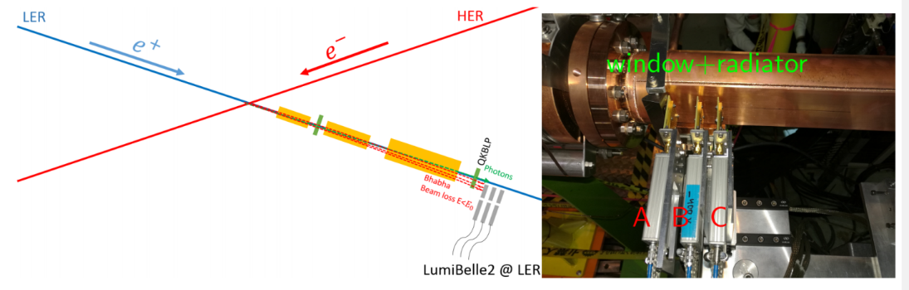
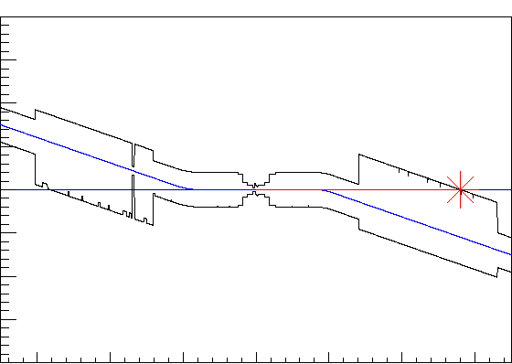
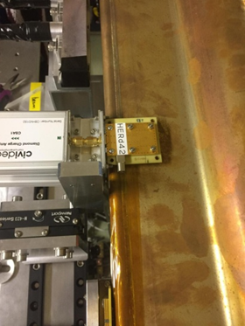
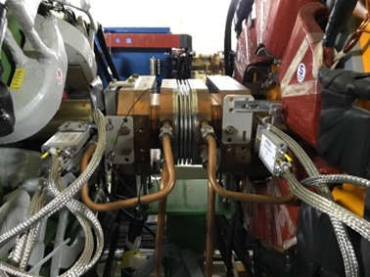
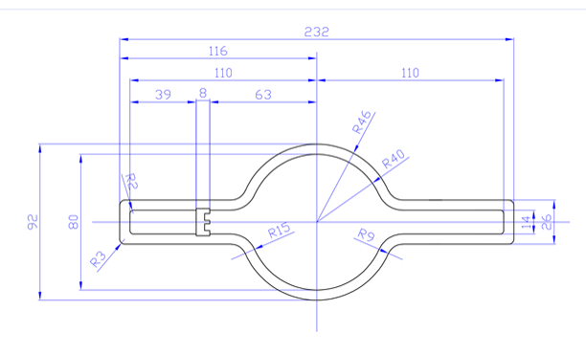

Where ?
POSITRON RING (measure e+)
Optimal position found at 10 m behind IP using SAD
Over-bent Bhabha positrons → vacuum chamber
Special beam pipe with window + Tungsten radiator
Start-to-end simulation (Guinea Pig ++, SAD, GEANT4)
IP
0.4
ELECTRON RING (measure $γ$)
e-
Photon ray-tracing in detailed vacuum chamber geometry + GEANT4
Original position at 30 m (2018)
In 2019, new optimal position found at 28 m with ≈ 10 times higher rate
IP
X(m)
0
0
28
Z(m)
Notes:
Radiation length of Tungsten is 0.3504 cm

Slide 13
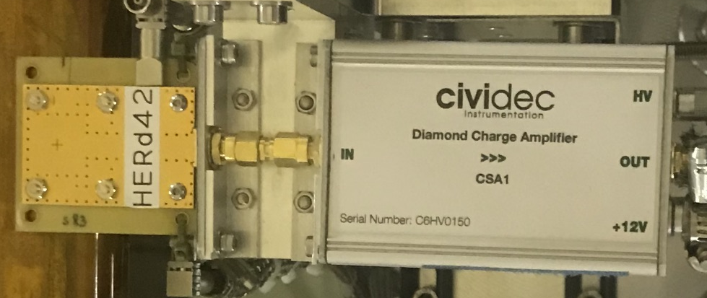
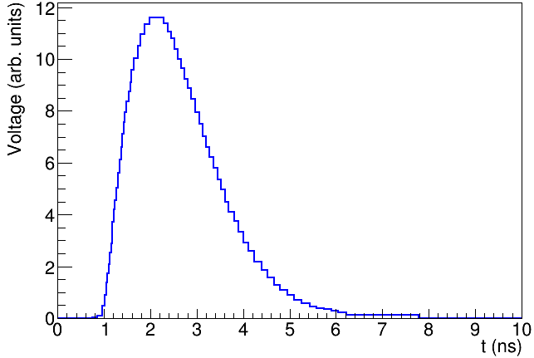
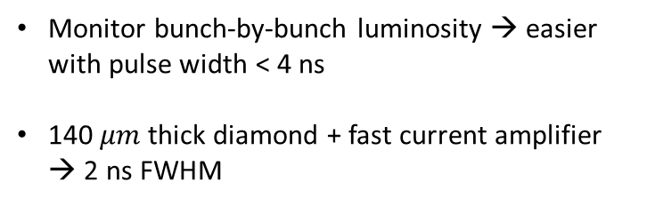
LumiBelle2 diamond sensor signals
High charge carrier mobility
→ fast signal formation
Wide band-gap (5.5 eV)
→ good radiation tolerance
DIAMOND
AMPLIFIER
SuperKEKB nominal collision spacing = 4 ns
Monitor bunch-by-bunch luminosity → easier with pulse width < 4 ns
140 $μm$thick diamond + fast current amplifier → 2 ns FWHM
2 ns
FWHM
Notes:
Radiation length of Tungsten is 0.3504 cm

Slide 14
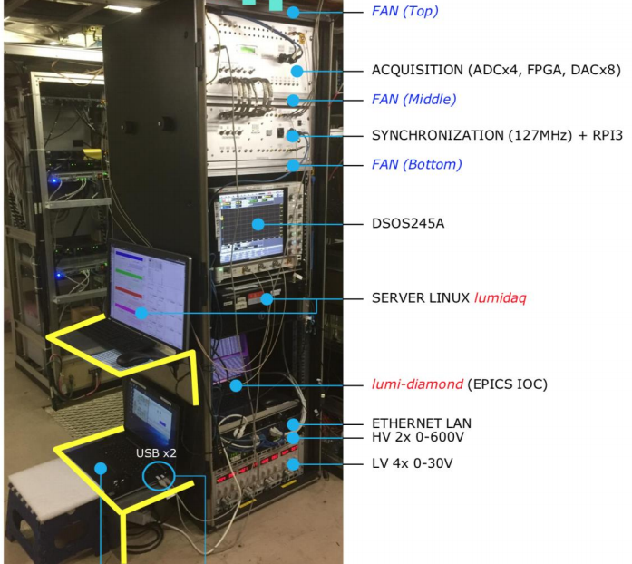
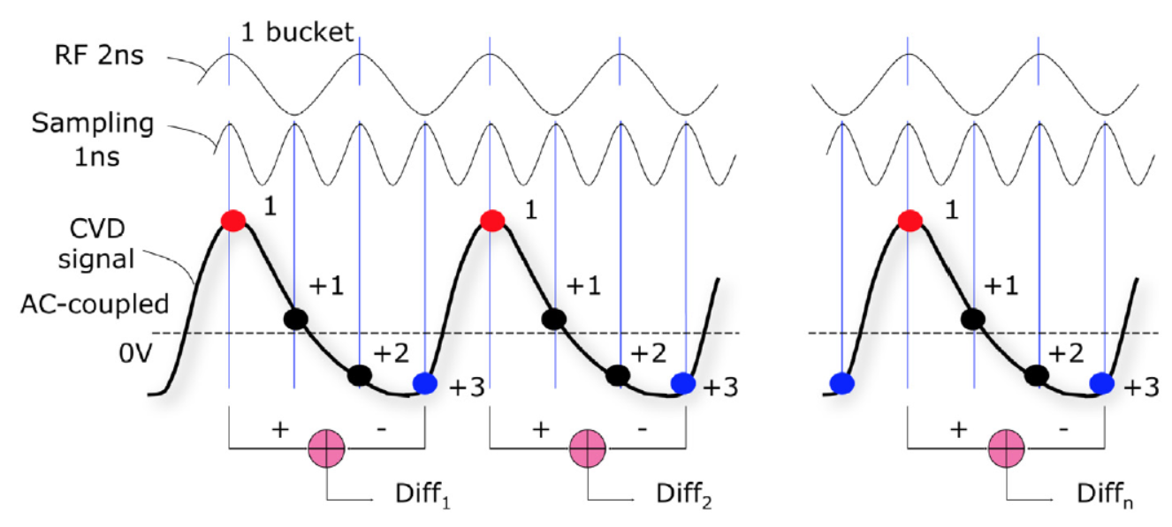
LumiBelle2 signal processing
2 ns FWHM signals are sampled every 1 ns
Synchronization to RF clock → continuous monitoring, averaging at 1 kHz
Luminosity proportional to amplitude of signal peaks
ADC is AC-coupled → record difference between peak and baseline
Raw sum of all sample also ∝ luminosity and recorded

Slide 15


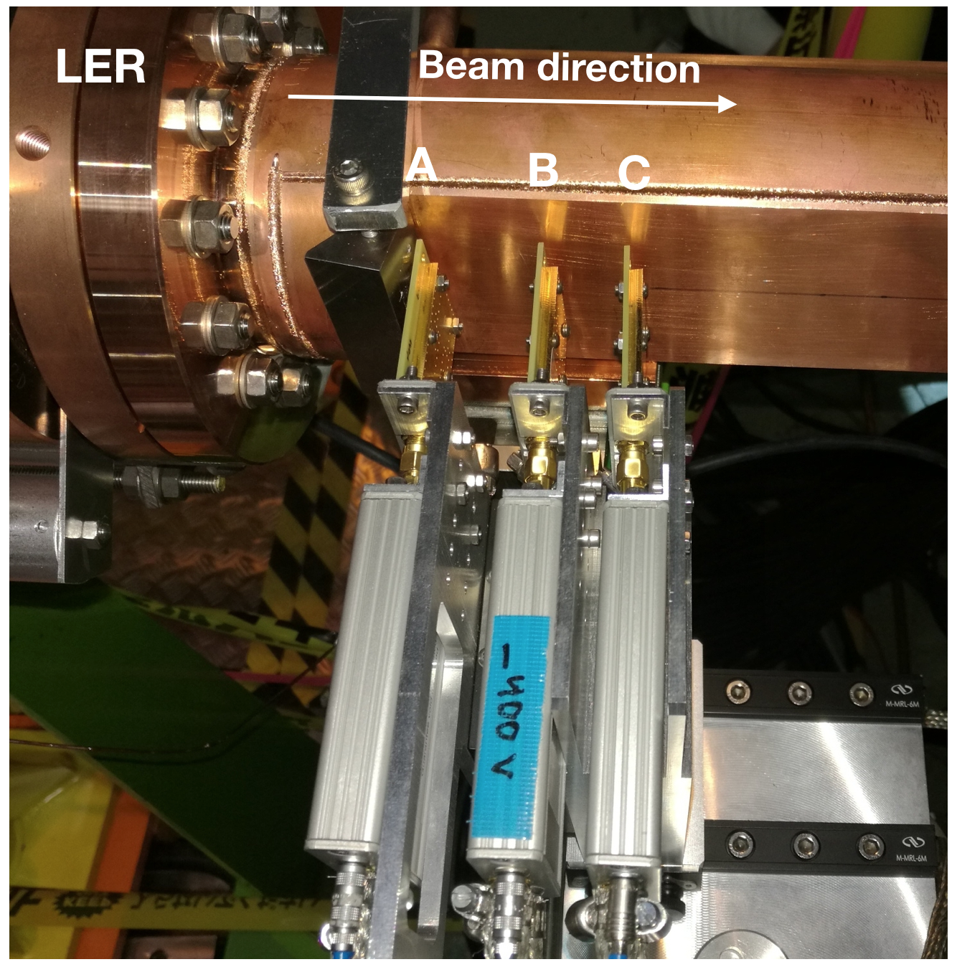
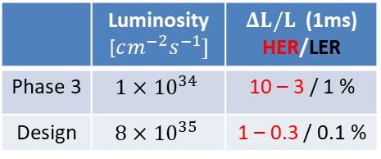
LumiBelle2 current setup
IP
HER
LER
×
horizontally motorized
reduced signal level…
radiation damage ?!?
removed pending calibration
 | Luminosity [$cm^{−2}s^{−1}]$ | $ΔL/L$ (1ms) HER/LER
Phase 3 | $$1×{10}^{34}$$ | 10 – 3 / 1 %
Design | $$8×{10}^{35}$$ | 1 – 0.3 / 0.1 %
CH1
CH2
CH3
CH4
ADC
140um + C2
500um + C6
Simulated stat. precision

Slide 16
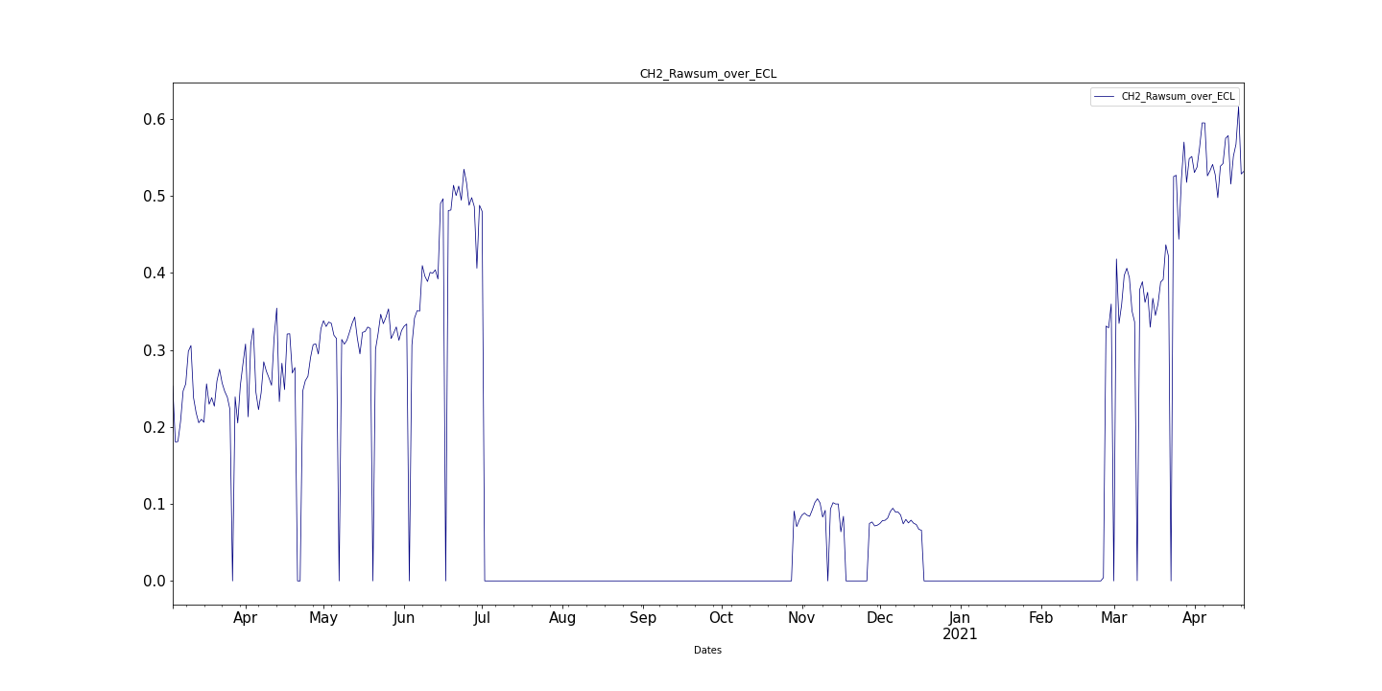
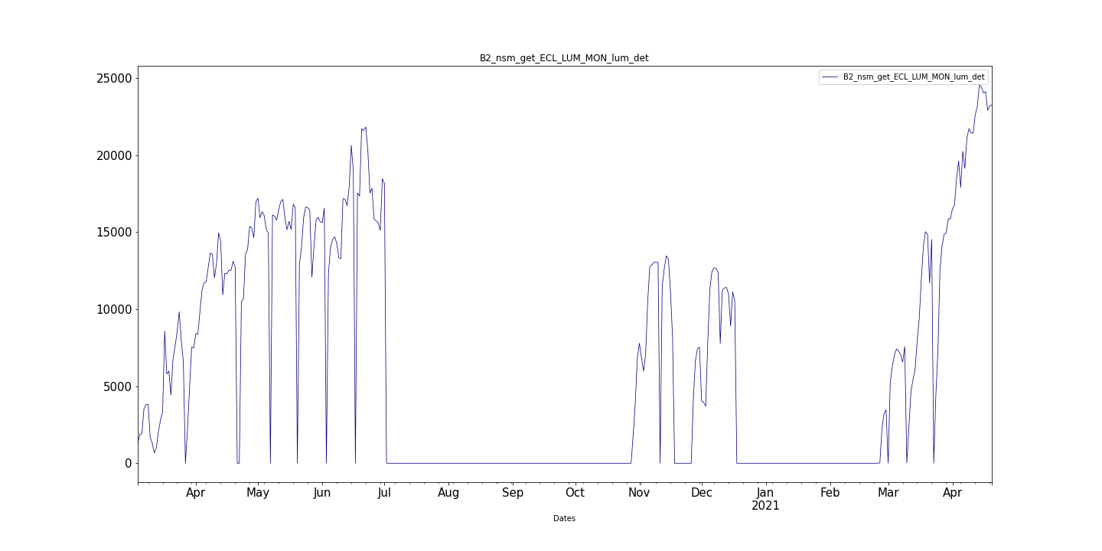
March 2020 – June 2021 remote operation
→ about 150 EPICS variables recorded at 1 Hz
arbitrary units
LumiBelle2 LER Channel 2
10³⁰ cm⁻² s⁻¹
Belle II ECL absolute luminosity

Slide 17
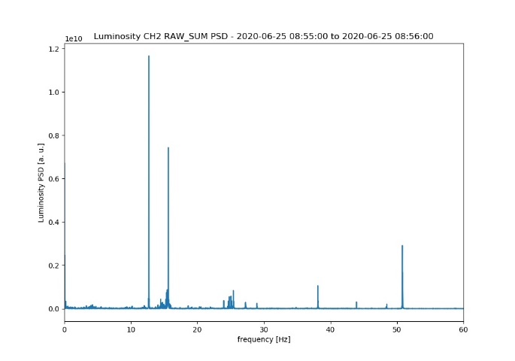
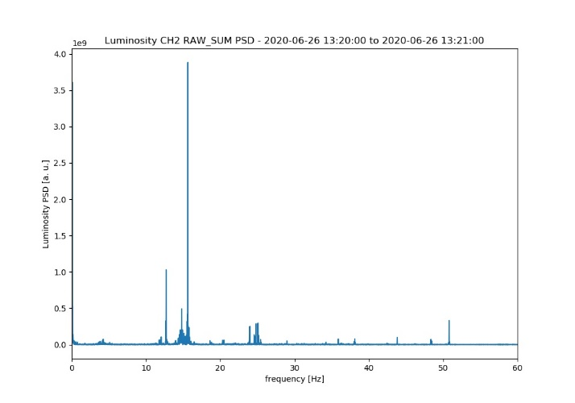
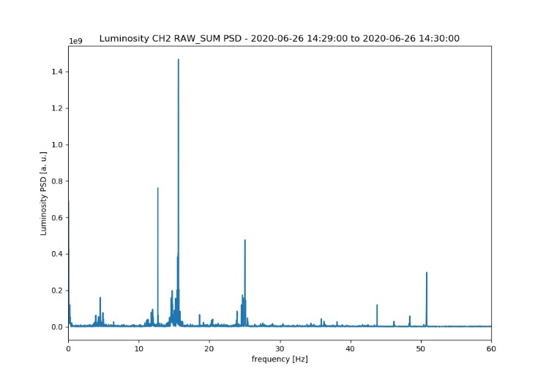
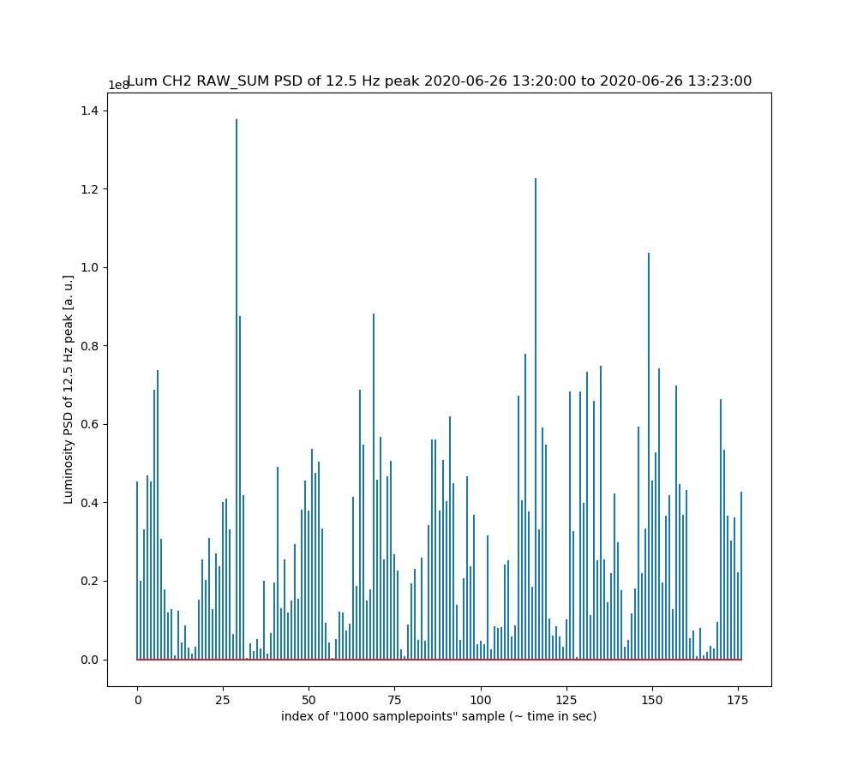
Fast luminosity variations from continuous injection at 12.5 Hz
→ frequency analysis (Power Spectral Density) with 1 kHz LumiBelle2 LER Channel 2 data
before skew quad correction
after 1st skew quad correction
after 2nd skew quad correction
Luminosity power spectrum density [a.u.]
reduced to about 10%
reduced to about 8%
0 10 20 30 40 50 [Hz]
0 10 20 30 40 50 [Hz]
0 10 20 30 40 50 [Hz]
Long term study of 12.5 Hz component
12.5 Hz component reconstructed in 3 minute scans :
→ injections are visible lasting about 10 seconds, typically every 20 seconds !
0 50 100 150 time [sec]

Slide 18
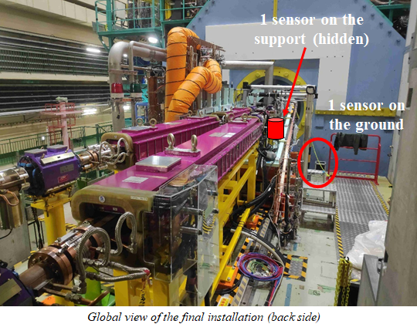
Comparing / correlating vibrations (LAPP) versus luminosity (IJCLab)

Slide 19
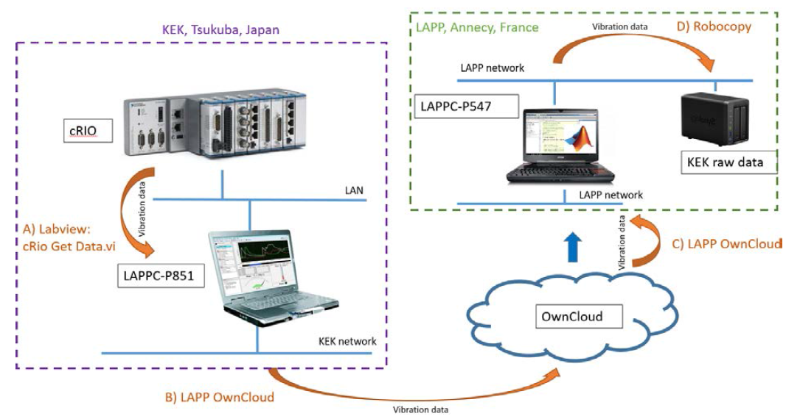
Setup for remote control and data transfer to LAPP
Upload vibration data from cRIO to the LAPP network drive
Vibration data are publicly available: https://lappweb.in2p3.fr/SuperKEKB/
SuperKEKB snapshot history plots: http://www-linac.kek.jp/skekb/snapshot/ring/

Slide 20
Example of comparison in 10-30 Hz frequency band
Clear correlations ! Depend on frequency, coherence, type…
→ ground motion + modeling of mechanical vibrations in cryostat
→ effects on luminosity of periodic variation in IP beam alignment
“Vibration and Luminosity Frequency Analysis of the SuperKEKB Collider”, M. Serluca et al., submitted to NIMA (under review)

Slide 21
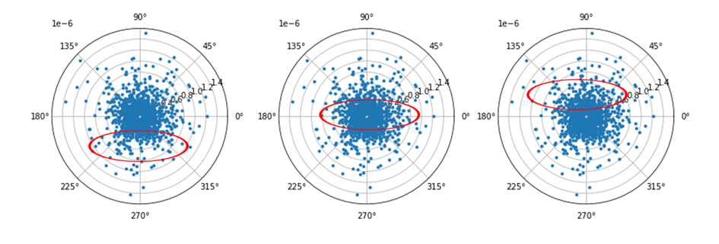
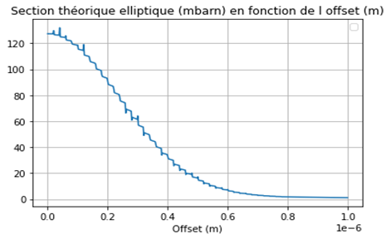
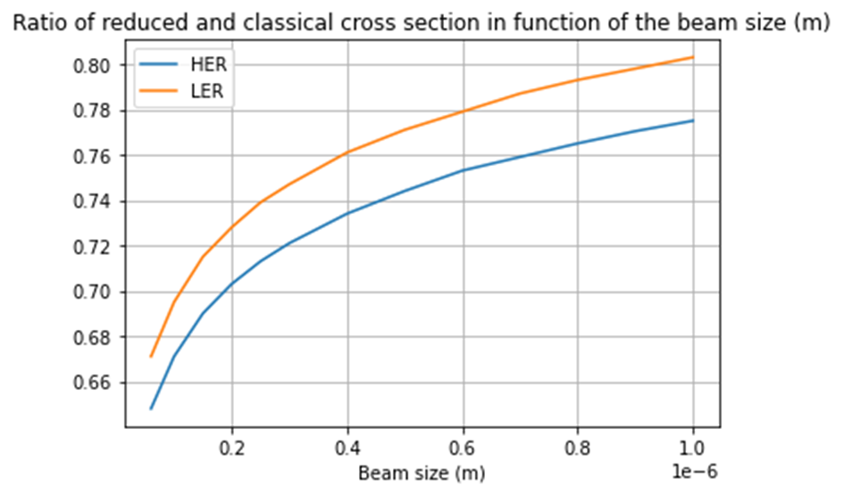
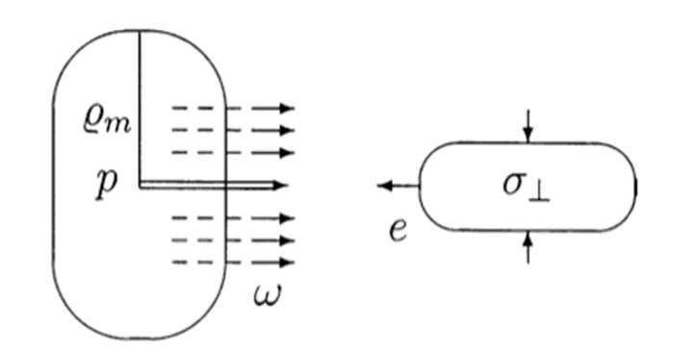
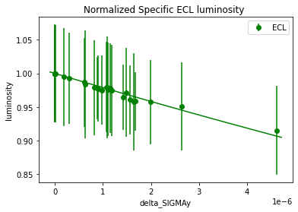
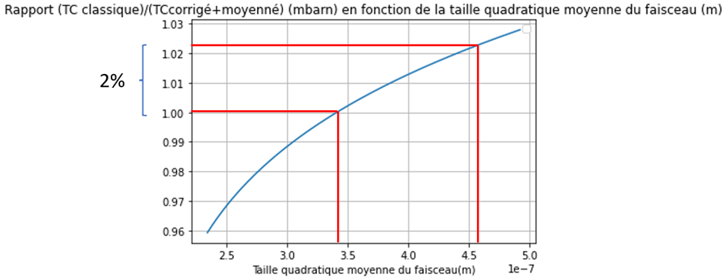
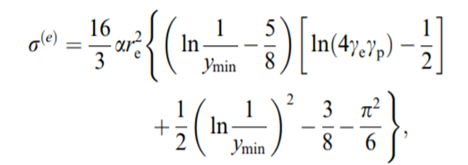
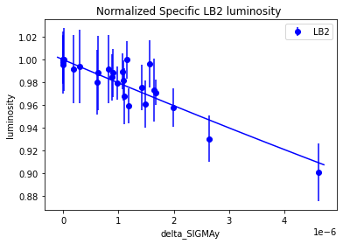
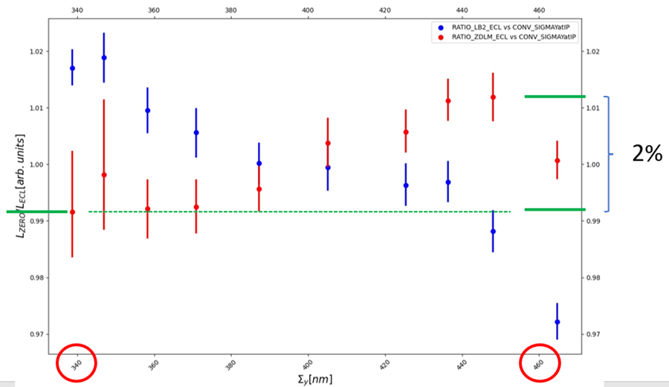
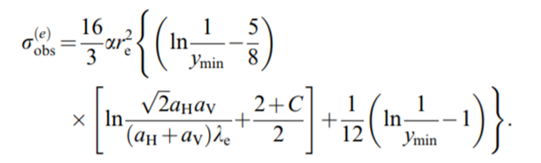
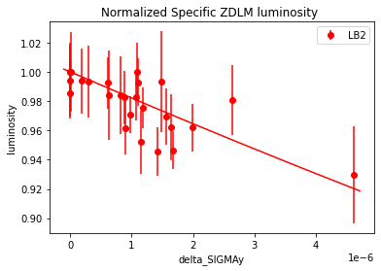
Expect QED cross section reduction for vanishing momentum transfer
Cross section* becomes beam size dependent !
E_{γ} > 1% E_{beam}
θ_{scattering} ≈ 0
[μm]
[μm]
preliminary
* V.N. Baier, V.M. Katkov, G.L. Kotkin, V.G. Serbo et al., Novosibirsk
H. Burkhardt, R. Kleiss, CERN
[μm]
Notes:
LGSO (Lu2-xGdxSiO5)

Slide 22
Summary and prospects
LumiBelle2 has 7 sensors installed, 3 in LER and 4 in HER → 4 are read out in our 4 ADC channels (2 in LER and 2 HER)
1 Hz LER data available via EPICS for IP beam size tuning at very low currents
1 kHz LER data used for tests of “dithering” feedback for horizontal IP beam position
1 Hz bunch-by-bunch luminosity used to detect anomalies along stored bunch train
Many other studies to assist SuperKEKB luminosity optimization, including relating to LAPP remote monitoring of mechanical vibration near Belle II in Tsukuba Experimental Hall…
Fully remote operation in 2020 and 2021 from IJCLab (with some help at KEK…)
Short term:
- main computer for on-line data acquisition must be replaced following HDD failure…
Medium and longer term plans:
- simplify/improve data transfer/archiving software
- improvement of data acquisition software (on-going)
- calibrate all diamond sensors as soon as possible (²⁴¹Am α source at KEK)
- replace some diamonds / amplifiers where needed (LER Channel 2…)
- work with KEK, LAPP and CERN teams on studies (vibration, injection noise, feedback,…)
- no major hardware upgrade
- upgrading/redesigning the DAQ to integrate digital feedback in the LumiBelle2 FPGA
- analyses to support SuperKEKB (luminosity optimization and Belle II (background studies)
- measure zero degree radiative Bhabha cross section beam size dependence

Slide 23
Extra slides

Slide 24
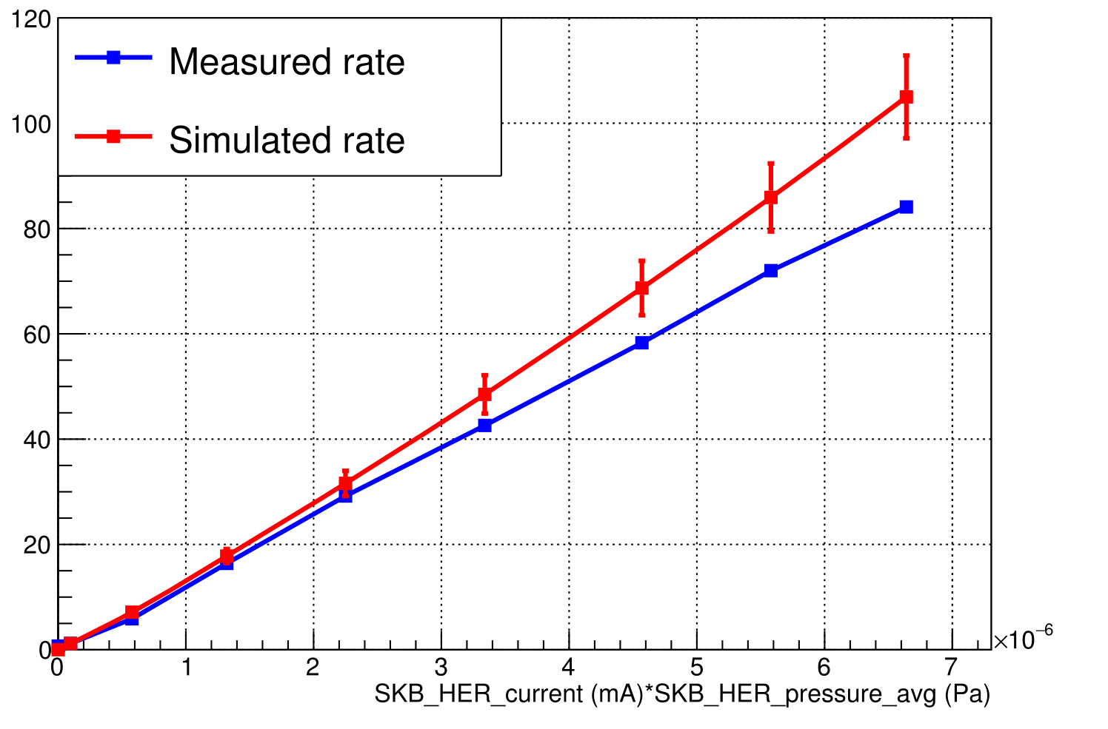
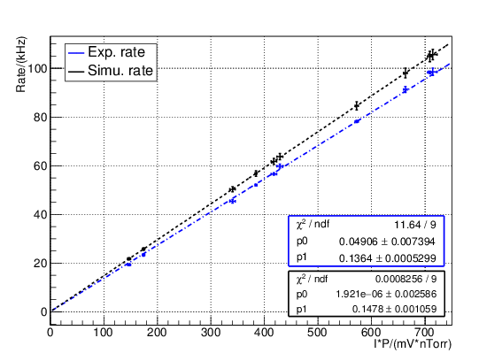
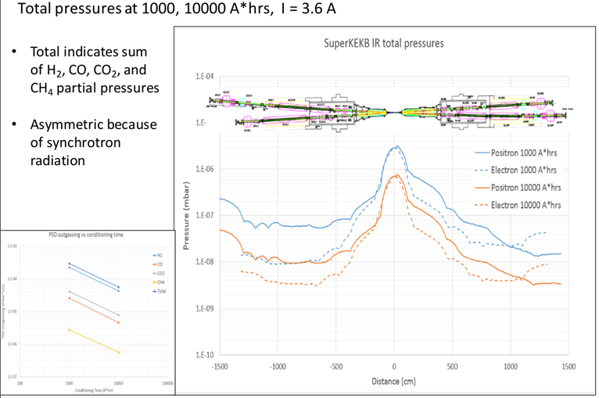
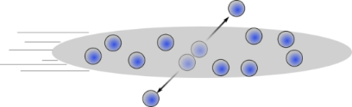
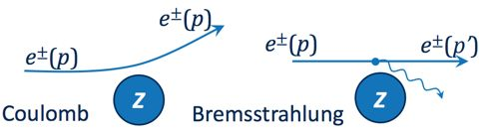


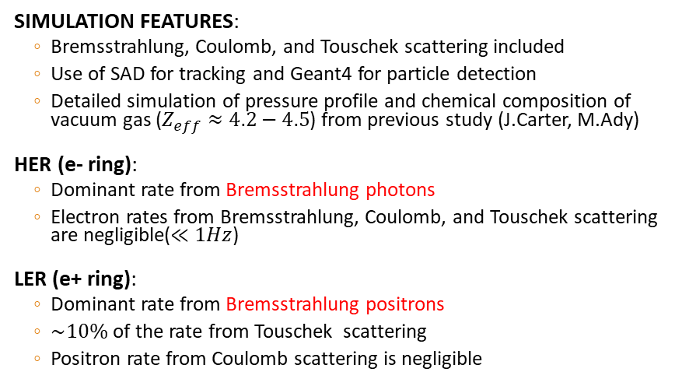


Background study
SIMULATION FEATURES:
Bremsstrahlung, Coulomb, and Touschek scattering included
Use of SAD for tracking and Geant4 for particle detection
Detailed simulation of pressure profile and chemical composition of vacuum gas ($Z_{eff}≈4.2−4.5$) from previous study (J.Carter, M.Ady)
HER (e- ring):
Dominant rate from Bremsstrahlung photons
Electron rates from Bremsstrahlung, Coulomb, and Touschek scattering are negligible($≪1Hz$)
LER (e+ ring):
Dominant rate from Bremsstrahlung positrons
$\sim 10\%$ of the rate from Touschek scattering
Positron rate from Coulomb scattering is negligible
$$Measurement vs Simulation$$
$$Rate(Hz)$$
e- ring
$$Rate(kHz)$$
e+ ring
Scattering position of Bremsstrahlung
particles detected in LumiBelle2 / LER
$$I×P$$
Jason CARTER (ANL) & Marton ADY (CERN)
Touschek
Simulated vacuum profile in IR

Slide 25

First collisions (luminosity): 25 April, 2018
VERTICAL SCAN
PHASE SCAN
VERTICAL SCAN
PHASE SCAN
Vertical and phase (longitudinal) scans were performed to find the optimal position of the beams
The LumiBelle2 and ZDLM channels worked well and were in agreement
Successfully measured and provided the luminosity on-line from the first collision up to this date

Slide 26

LumiBelle2, ZDLM and ECL correlations
C. G. Pang et al.: Nucl.Instrum.Meth. A931 (2019) 225-235

Slide 27

C. G. Pang et al.: Nucl.Instrum.Meth. A931 (2019) 225-235

Slide 28












Beam size estimation with vertical offset scans
S. Di Carlo, 2018
Analytical result integrating Gaussian distributions with vertical offset:
$$\frac{L}{L_{0}}=exp\left(−\frac{Δy^{2}}{2Σ_{y}^{2}}\right)$$
$$Δy$$
e+
e-
$${2Σ}_{y}$$
$$Σ_{y}^{2}={σ_{1,y}^{∗}}^{2} +{σ_{2,y}^{∗}}^{2}≈2{σ_{y}^{∗}}^{2}$$
assumes rigid beams
$$Δy (μm)$$
Benchmark vs ECL
$$L_{σ_{y}^{∗}}=\frac{{fN}_{+}N_{−}}{4πσ_{x,eff}^{∗}σ_{y}^{∗}}$$
$$L(cm^{−2}s^{−1})$$
$$σ_{y}^{∗}(μm)$$
$$L_{σ_{y}^{∗}}/L_{ECL}>1$$
$$Date$$
I⁺ × I⁻ (mA²)
$σ_{y}^{∗}$ estimation biased due to non constant beam-beam blow-up during the scan
beam-beam
simulation
(S. Di Carlo & D. Zhou)
Bias
Blow-up

Slide 29
Sensitive luminosity monitor important to correct optical aberrations in vertical IP beam size very low intensity essential to avoid beam-beam effects: (1) confusion from blow-up, (2) biased beam size estimates
Phase 2
β_{y}*= 4 mm

Slide 30
LumiBelle2 bunch-by-bunch luminosities, folded vertical bunch sizes and relative offsets
C. G. Pang et al.: Nucl.Instrum.Meth. A931 (2019) 225-235
8% spread mainly depends on bunch current differences
Bunch-by-bunch luminosity precision: 1-2% at 1Hz
dominated by spread in bunch-by-bunch currents
8nm RMS spread in bunch-by-bunch vertical offsets (2.3% of average bunch size)
2% RMS spread in bunch-by-bunch vertical beam sizes

Slide 31


LumiBelle2 bunch-by-bunch luminosities at higher current : larger values for 1st bunches → transient beam loading effect may bias bunch-by-bunch current measurement for first bunches (M. Tobiyama)
L = 1.1 × 10³⁴ cm⁻² s⁻¹
1576 bunches
Bunch-by-bunch luminosities
S. Di Carlo, 2nd SuperKEKB Beam Dynamics Mini-Workshop, KEK, 20/9/2019
Specific bunch-by-bunch luminosities

Slide 32
Fast & slow beam position variations at IP require feedback corrections
Beam-beam deflection for fast vertical motion
Luminosity feedback by “dithering” for slower horizontal motion
Δy at IP=
∼ 5nm ∼ 1/10σ_{y}*
BPM
Δy at BPM= ∼ 1.3μm
Vertical vibration ∼ 25-100 Hz
Sampling (BPMs) ∼ 32 kHz
IP
BPM
Cf. WEXBA04 by Yoshihiro Funakoshi, Wednesday, 11:20 am
Horizontal motion ∼ few Hz
Modulation freq. f₀ ∼ 79 Hz
Sampling (lumi. meas.) ∼ 1 kHz
- minimize f₀ output component
- dithering × lumi. signal → phase
↔
2×f₀
Luminosity
↔
f₀
x
Dithering coil x 12
DITHERING
LUMINOSITY

Slide 33





1st dithering feedback test in Phase 2
The e- beam was artificially given an offset, while the e+ beam was dithered
The algorithm tries to minimize the Magnitude [V] of the luminosity FT calculated at the driving frequency $f_{0}$ to bring the beams back to the optimal position (unwanted offset o=0)
These parameters are then sent to the magnet control system via EPICS to create a bump in the e- beam
After first two attempts, optimization of the algorithm parameters, in the third one the feedback was able to smoothly minimize the offset
e+
e-
$$Δx$$
$$Δx=o+d sin⁡(2πf_{0}t)$$
$Δx (μm)$, Magnitude [V] vs Time
Time
Further tests in Phase 2 & 3 have exhibited some coupling effects between X and Y feedback systems → to be solved for operation at design parameters

