Slide 1
Fixed-target physics with LHCb
Patrick Robbe, IJCLab Orsay, 28 Oct 2021

Slide 2
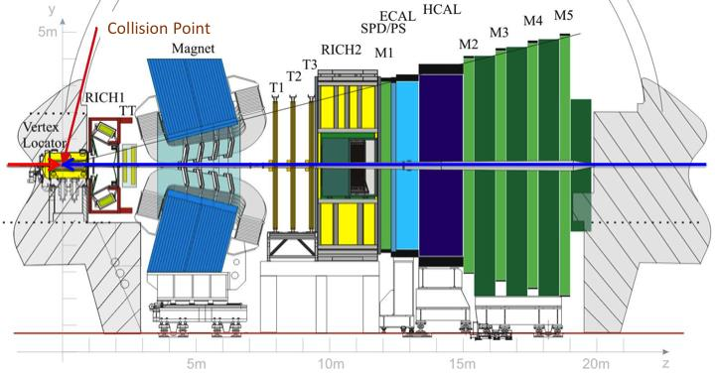
LHCb up to 2018
Physics core program: search for New Physics through heavy flavor decays
  Study CP violation
  Rare B decays
Optimized acceptance: 1.6 < η < 4.9
Good particle ID: e, μ, p, K, π, γ identification up to p=100 GeV
Good vertex and proper-time resolution: Interaction point resolution better than 80 μm
Good mass and low momentum resolution
Efficient trigger for lepton and hadron channels: 1 MHz readout rate up to 2018 – main improvement point for first upgrade.
LHCb became a more general detector in the forward region
JINST 3 (2008) S08005
beam2
beam1

Slide 3
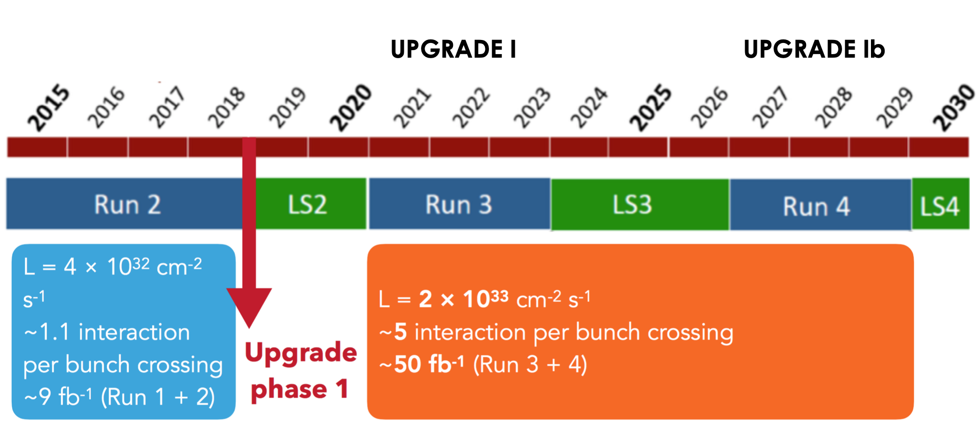
LHCb upgrades
UPGRADE II
NB: Run 3 and following steps shifted by 1 year due to COVID19

Slide 4
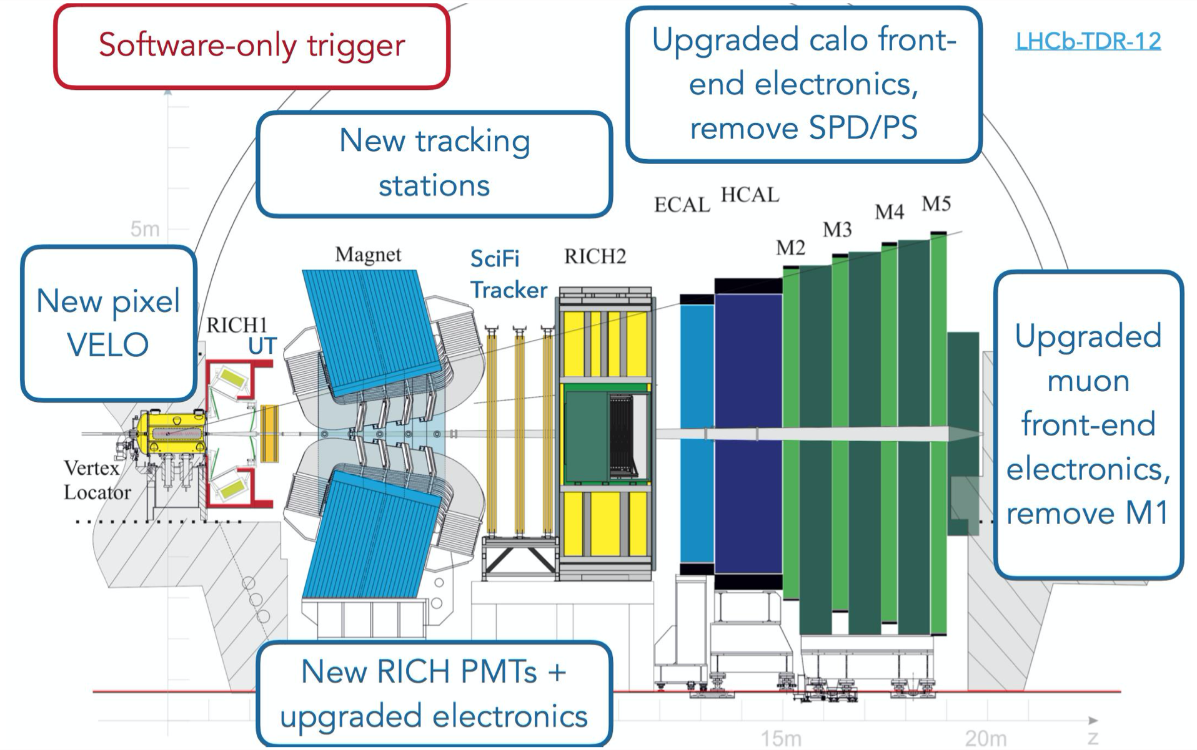
LHCb Upgrade Phase I

Slide 5
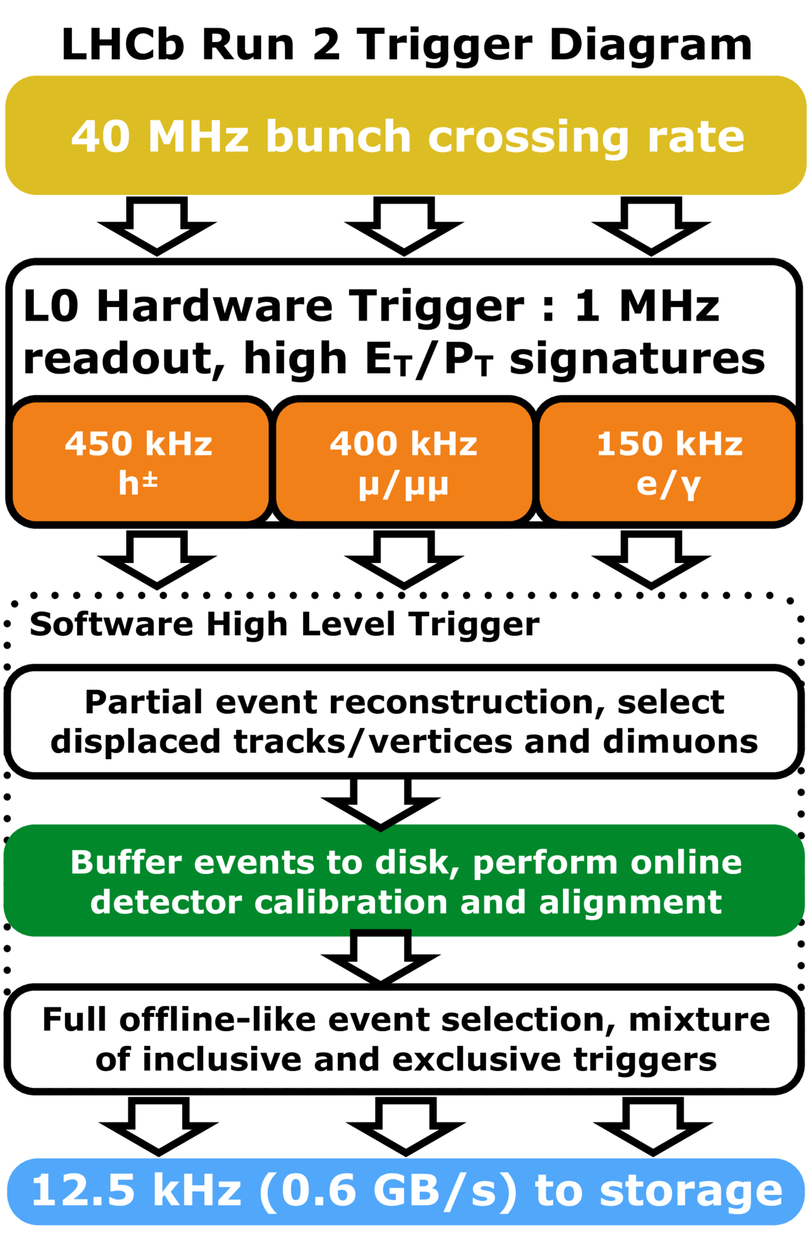
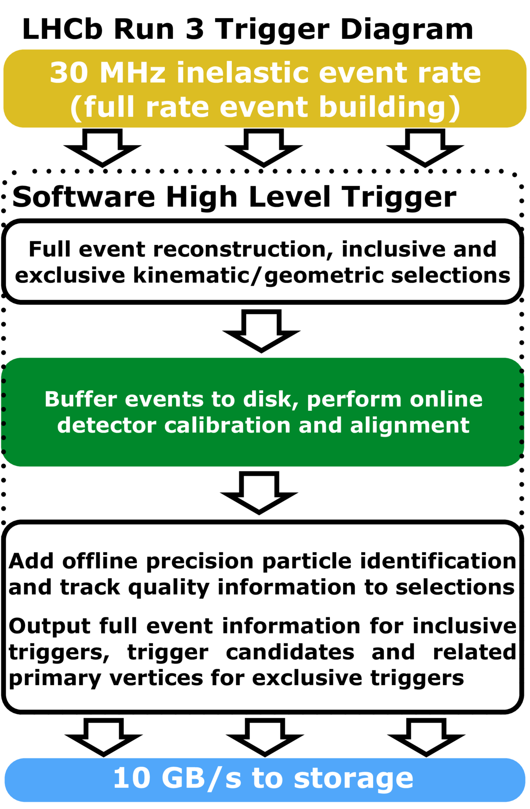
Full Software Trigger

Slide 6
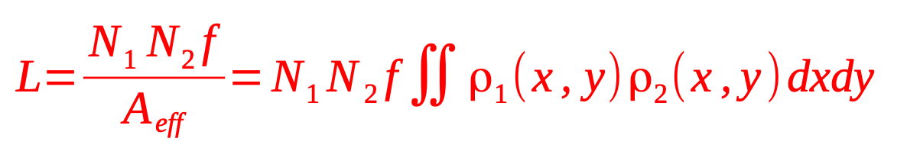
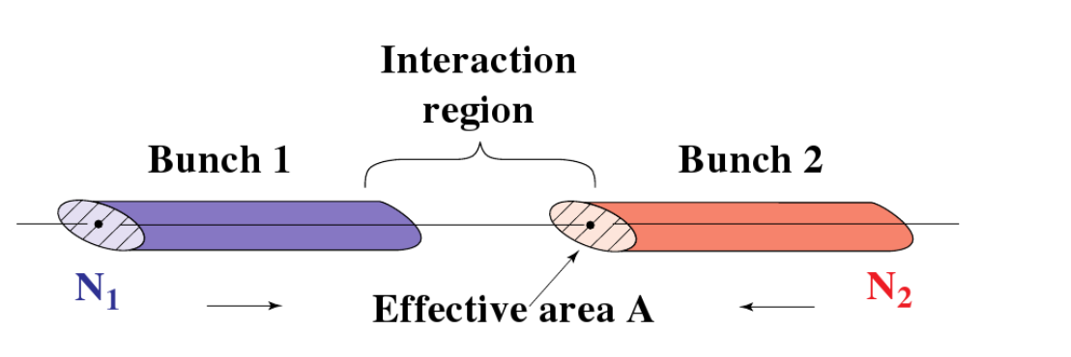
Luminosity measurement at LHCb
[JINST 9 P12005]
Fixed-target physics started with luminosity measurements for LHCb: precise luminosity measurement is an important ingredient for many LHCb publications: cross-sections of J/ψ, Y(1S), charm, beauty, ...
Need to calibrate the luminosity measurements:
  Using well-know processes, like pp ➝ Z⁰(➝μμ) X but this has not good enough precision
  Using dedicated LHC fills to measure directly the luminosity, L (per bunch):
  Where f is the collision frequence, N₁, N₂ are the bunch populations, ρ₁ and ρ₂ the beam profiles

Slide 7

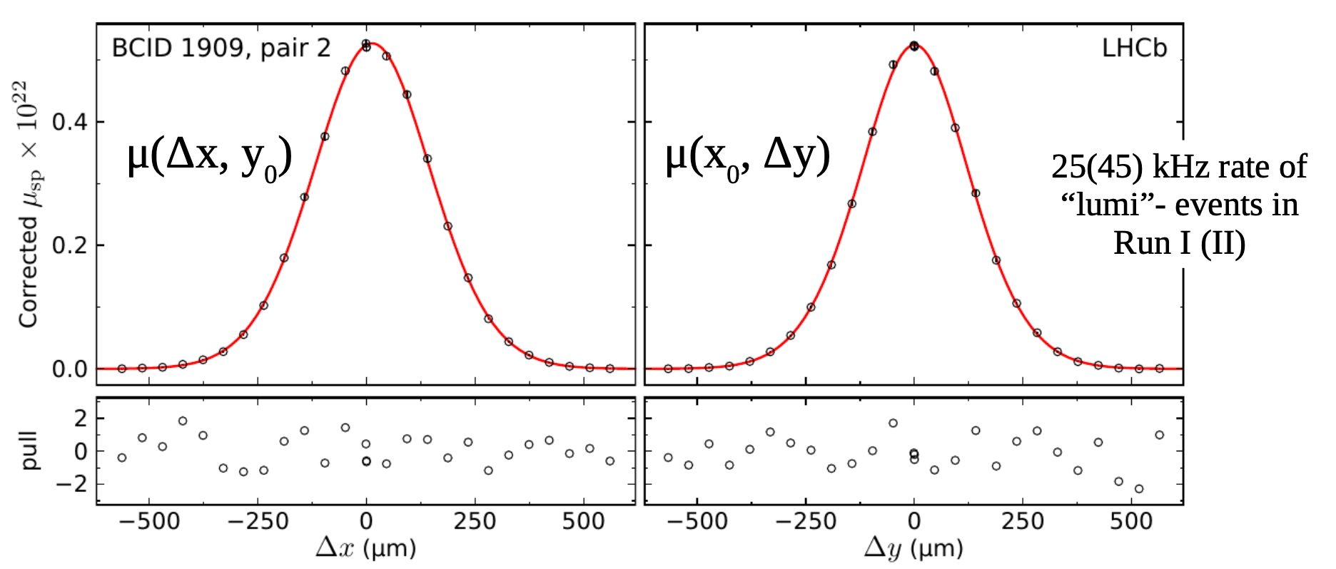
Luminosity measurement at LHCb
[JINST 9 P12005]
N₁ and N₂ are measured by LHC beam monitors (DCCT and FBCT): more on background subtraction later
Two methods to measure
  Traditional van der Meer scan
  Beam gas imaging method with SMOG

Slide 8
Beam Gas Imaging
[JINST 9 P12005]
Only done at LHCb: measure ρ₁ and ρ₂ from beam images reconstructed with beam-gas interactions
First try in 2009, switch off vacuum pumps of the VELO to increase residual gas pressure at the interaction point
From Nov 2011: inject in addition tiny amount of gas to increase statistics using a dedicated injection System to Measure Overlap with Gas (SMOG): x100 more interactions

Slide 9
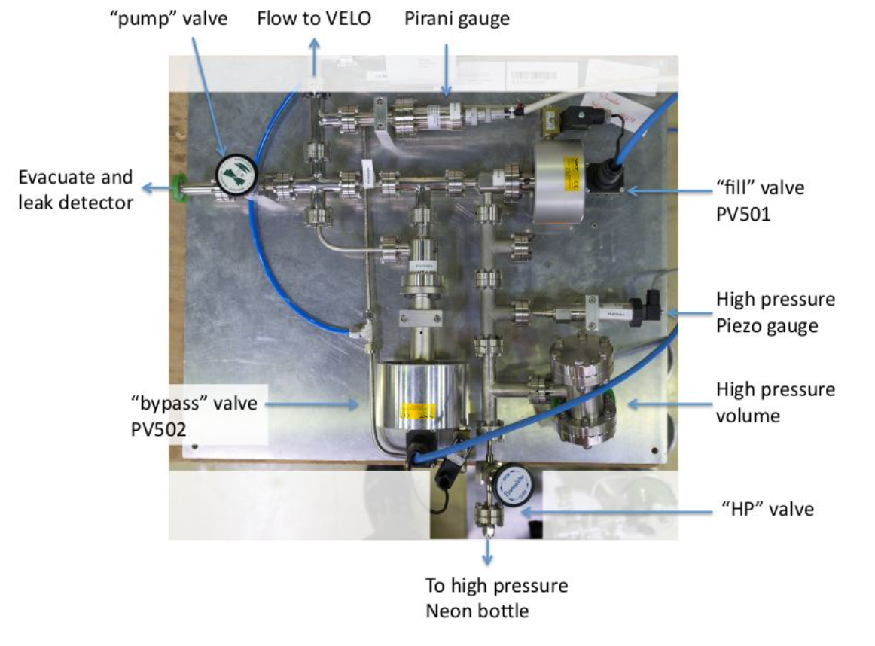
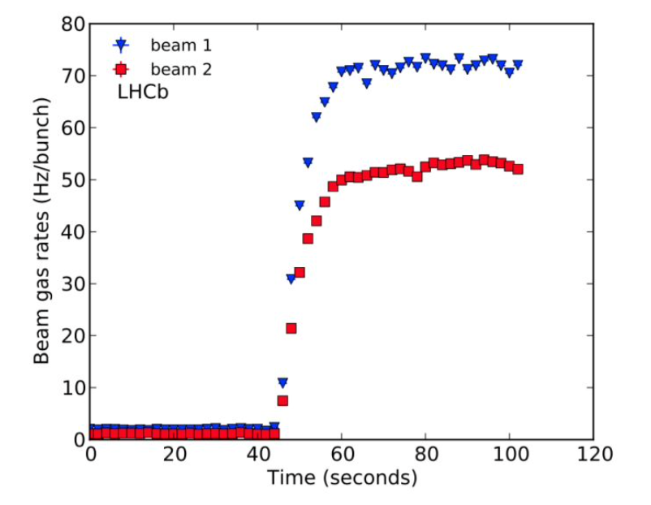
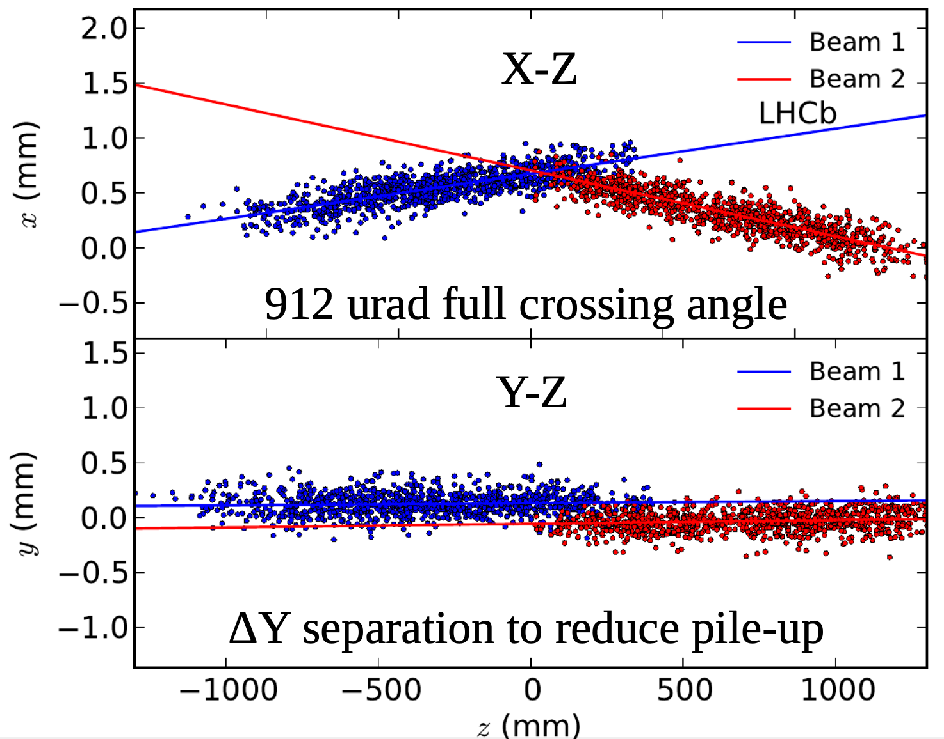
SMOG
[JINST 9 P12005]

Slide 10
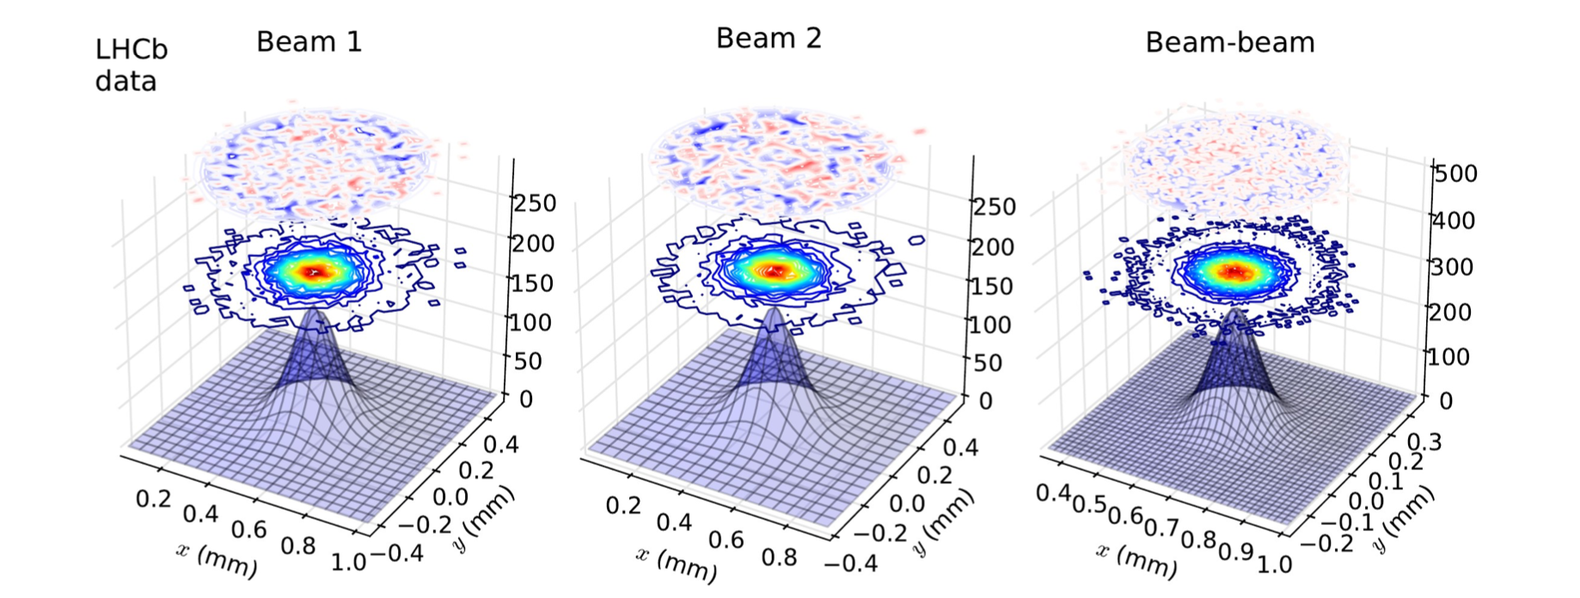
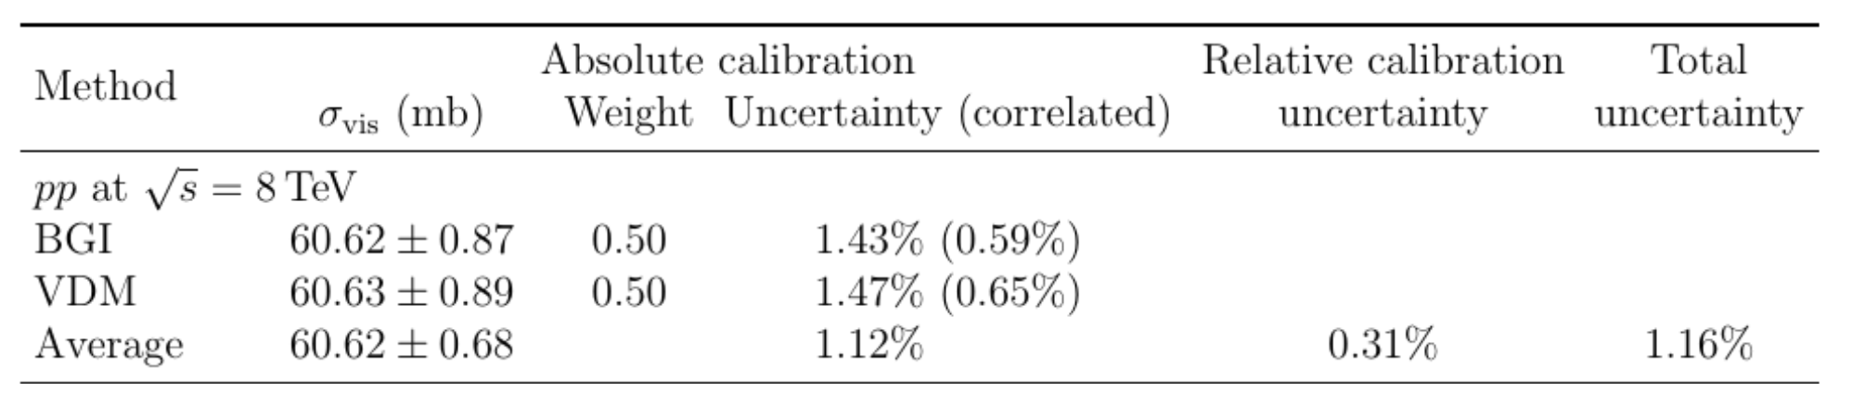
Beam Gas Imaging
[JINST 9 P12005]
Beam profiles are folded with VELO spatial resolution, determined precisely from beam-beam collisions
With 8 TeV pp collisions, reached 1.4% precision on luminosity calibration (J. Instrum. 9 (2014) P12005)

Slide 11
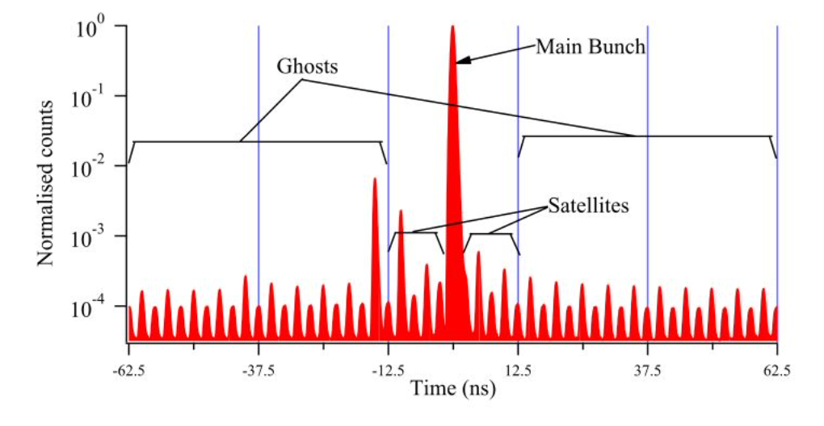
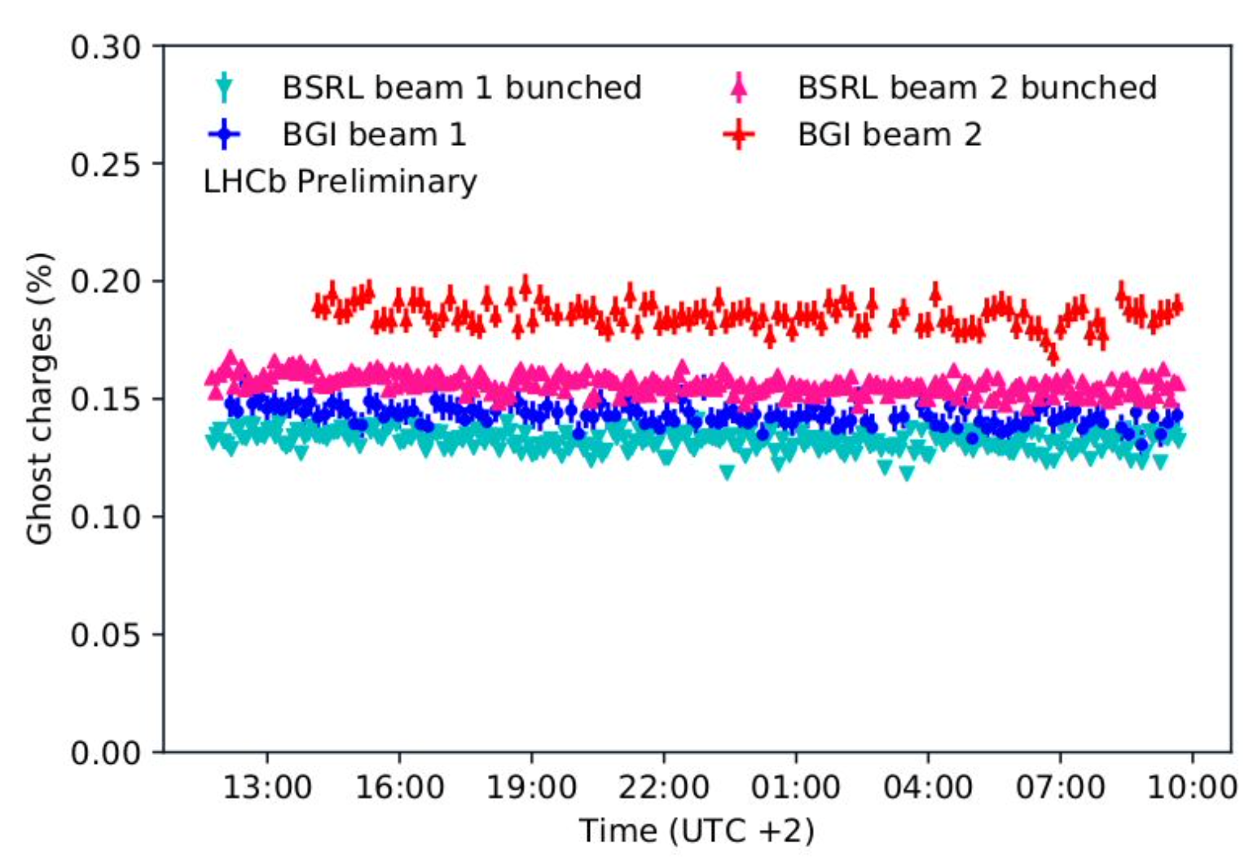
Ghost-charge measurement
[JINST 9 P12005]
Beam Gas Imaging is also used to measure ghost-charges during van der Meer scan sessions:
  the results are used to subtract this background from the LHC beam monitors and used by the other LHC experiments to determine their luminosity precisely (this is one of the largest correction for them)
Ghosts = protons in empty bunches
Satellites: protons in filled bunches but in 2.5ns buckets ouside the main bunch (25 ns bucket)

Slide 12
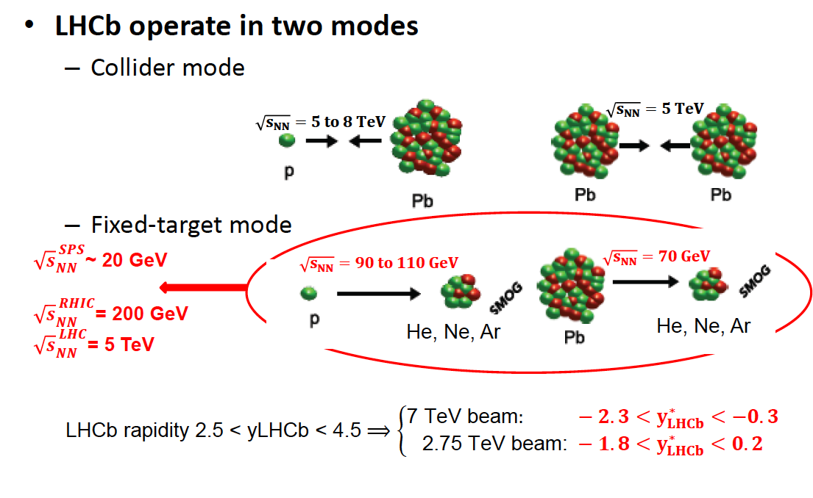
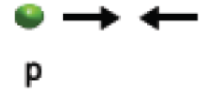

LHCb operation modes
7 to 13 TeV
Unique to LHCb
Unique energies
Noble gases

Slide 13
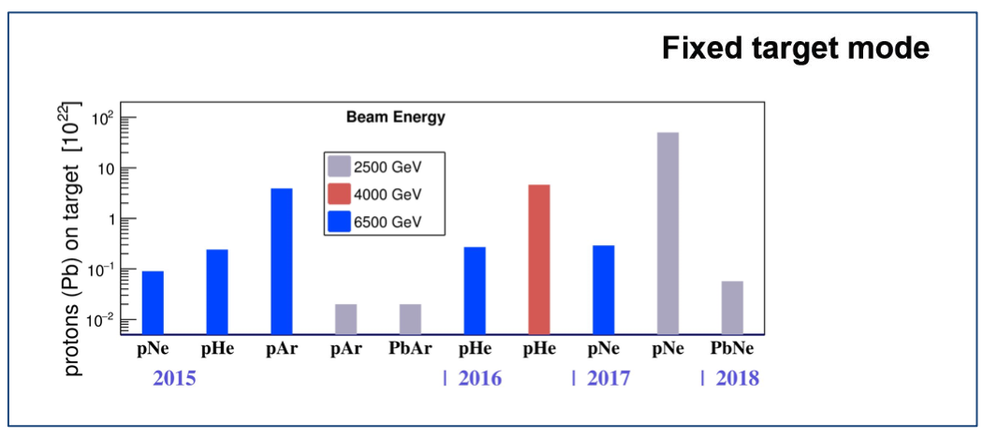
Fixed Target Physics With LHCb
Inject gas between 1 day and 2 weeks.
The pressure is so low that it does not interfere with the running of the LHC and data can be collected also in parallel with pp collisions by LHCb.
Operation in 2015 demonstrated that running with SMOG in completely transparent for the LHC: it is considered now as routine operation.
During Heavy Ion runs, we also took data in parallel collisions/beam-gas.

Slide 14
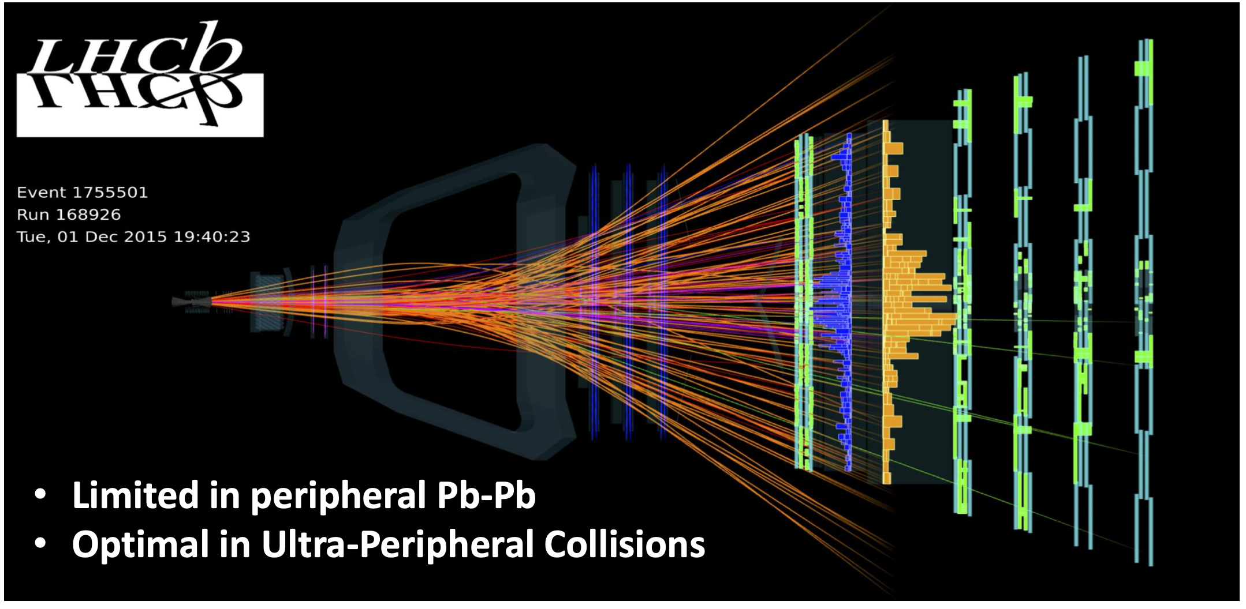
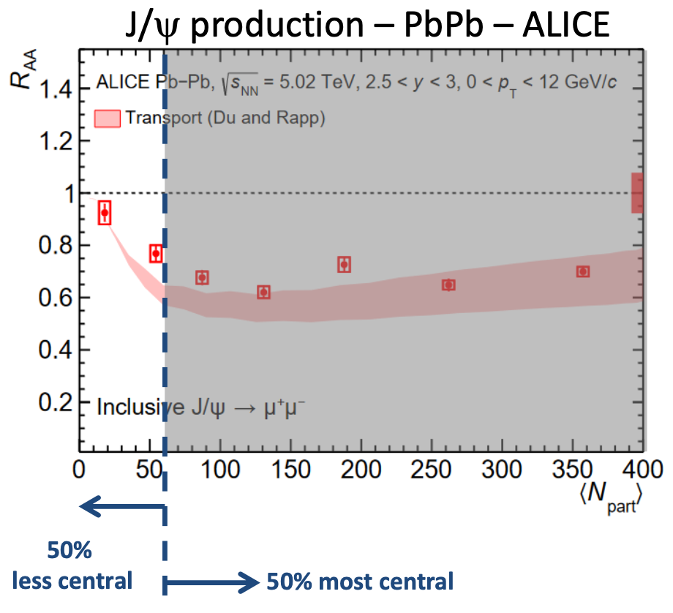
LHCb Heavy Ion Physics Program
The fixed-target is mainly connected to the LHCb QCD/Heavy Ion Physics Program.
So far mostly concentrated on study of heavy-flavor production in pPb collisions: well established performances and large statistics
New areas emerging, that will be consolidated with the future upgrades of the detector:
  Fixed target program (SMOG)
    Limited for the moment by the small statistics available: fixed target data taking required dedicated time limited slots
  PbPb collisions
    Limited by the reach in centrality of the detector

Slide 15
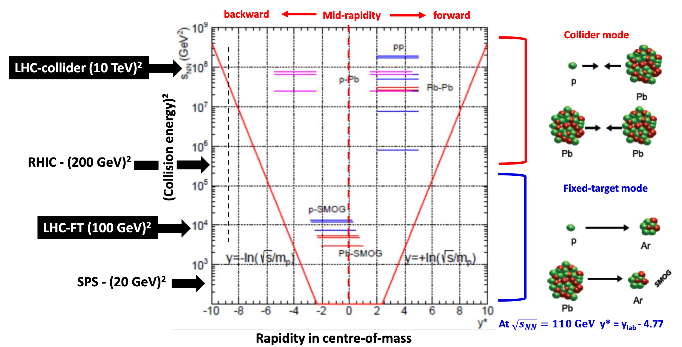
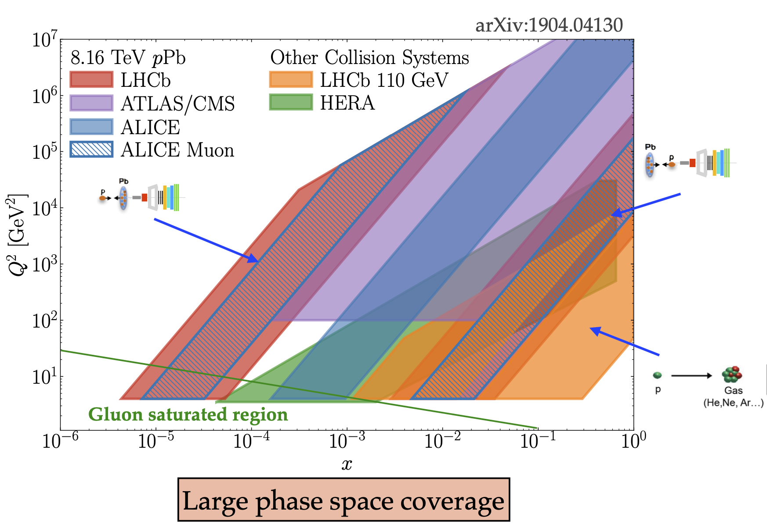
LHCb Heavy Ion Physics Program

Slide 16
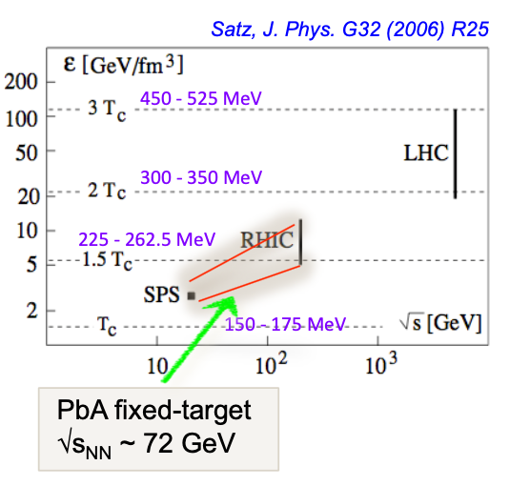
Heavy Ion Physics with LHCb
Proton-nucleus collisions
  Serve as a baseline for nucleus-nucleus collisions
  Nuclear parton distribution function (nPDF), nuclear absorption, saturation, energy loss…
  Unique capabilities with LHCb in the heavy flavor sector to constraint nPDF at very small (pPb collisions – charm and beauty) and large (fixed target - charm) Bjorken-x
Nucleus-nucleus collisions in FT mode
  2.75 TeV Pb beam on fixed target: √s_{NN}~71 GeV (close to the 17 GeV regime reached at SPS)
    Investigate the color screening
    Thanks to unique capabilities, LHCb offers new opportunities in the charm sector: J/ψ, ψ’, χ_{c}, D⁰, D^{+/-}, D*, Λ_{c}… (in the 90’s the NA50/SPS experiment measured only J/ψ and ψ’ in PbPb @ 17 GeV)
  Accessing similar energy density regime than SPS: operate PbAr@71 GeV, lower multiplicity than PbPb collisions, central events should be accessible
Bjorken-x = fraction of the nucleon momentum carried by a parton

Slide 17
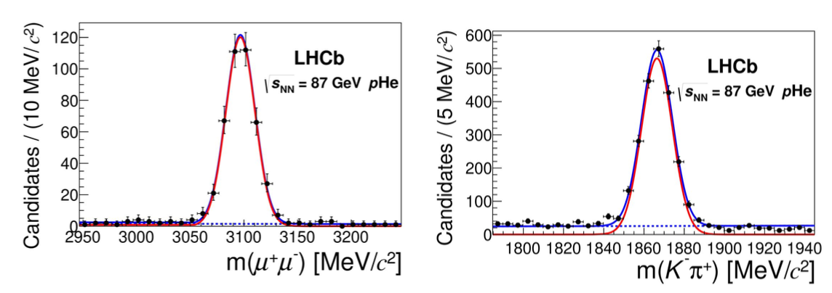
Production of charm in fixed target
[PRL 122 (2019) 132002]
Use two of the data samples: pHe (4 TeV beam, 86 GeV) and pAr (6.5 TeV beam, 110 GeV)
Largest sample is pHe, 7.6 ± 0.5 nb
Measurement of prompt production of J/ψ (➝μ⁺μ⁻) and D⁰(➝Kπ)

Slide 18
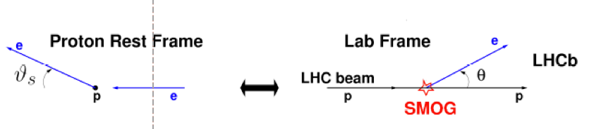
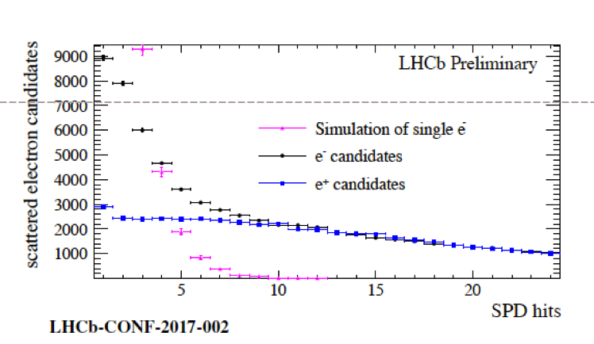
Fixed-target luminosity
Use p-e- elastic scattering (Mott)
Pro:
  Only elastic regime in LHCb acceptance:
    θ>10 mrad ➝ θ_{s}< 29 mrad, Q²<0.01 GeV²
    Cross-section very well-known
  Clear event signature: single low p_{T} electron track and nothing else
  Background comes mainly from conversions: it is charge-symmetric and can be estimated precisely from single positron events
Cons:
  Small cross-section (1000 less than hadronic cross-section)
  Low momentum electrons = low acceptance and reconstruction efficiency

Slide 19
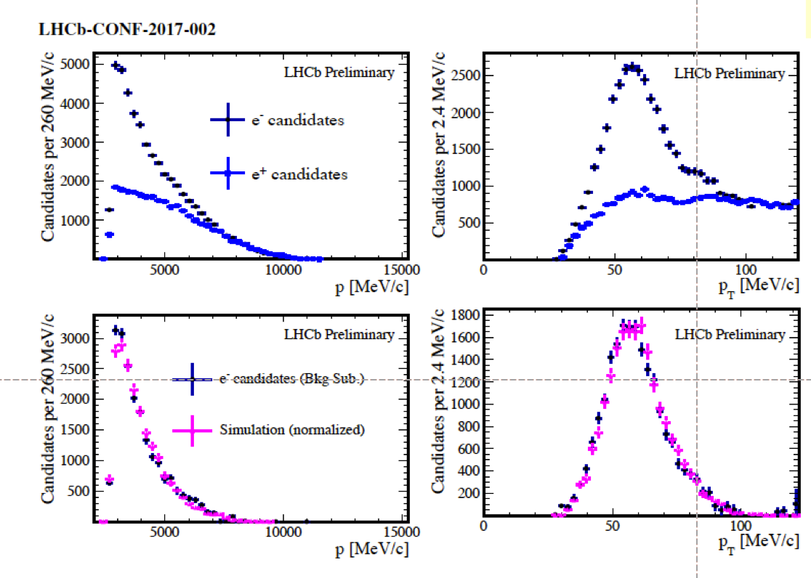

Fixed-target luminosity
Electron spectra in very good agreement with simulation
Data confirm charge symmetry of background
Systematic from variations of selection cuts: largest dependency is on azimuthal angle
Equivalent to gas pressure of 2.4x10⁻⁷ mbar, as expected
(pHe at 110 GeV)

Slide 20
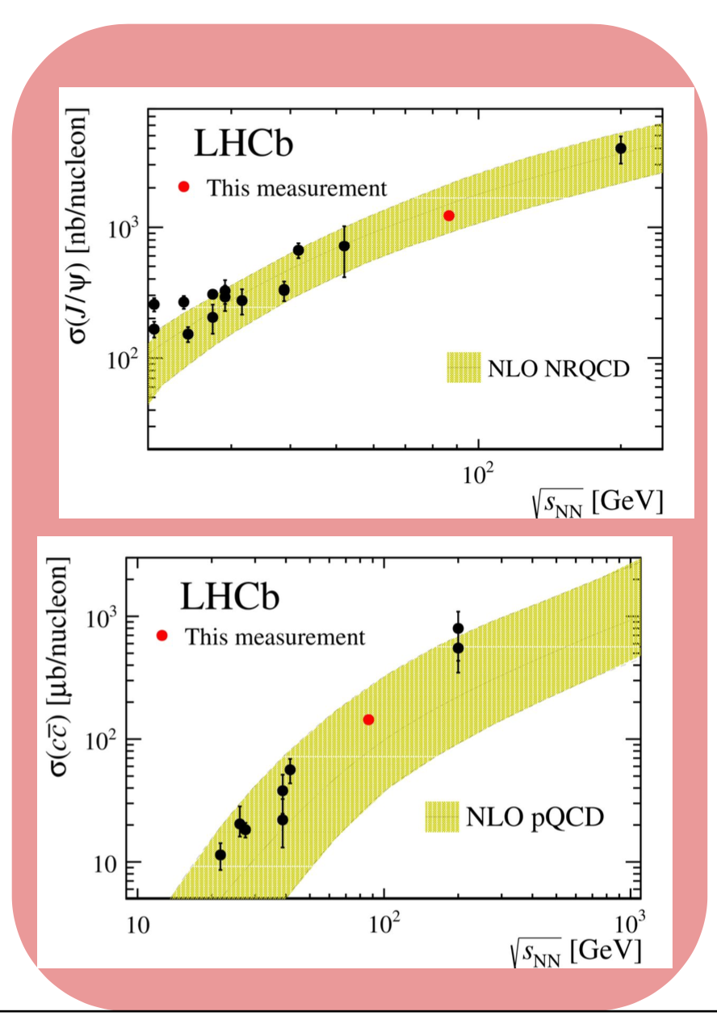
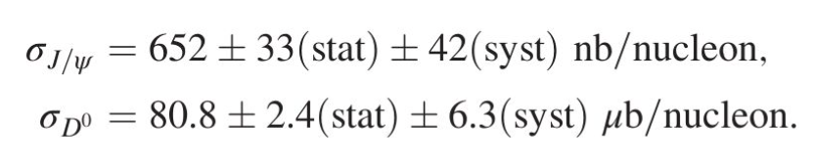
Production of charm in fixed target
[PRL 122 (2019) 132002]
Measured cross-sections are extrapolated to the full phase space (4π) and in the case of the D⁰, to the full cc spectrum (using f(c➝D⁰) from external measurements)
Compared to
  Previous measurements at lower and higher energies
  Predictions from NLO NRQCD for J/ψ [PLB 638 (2006) 202] and NLO pQCD for cc [NPB 373 (1992) 295]

Slide 21
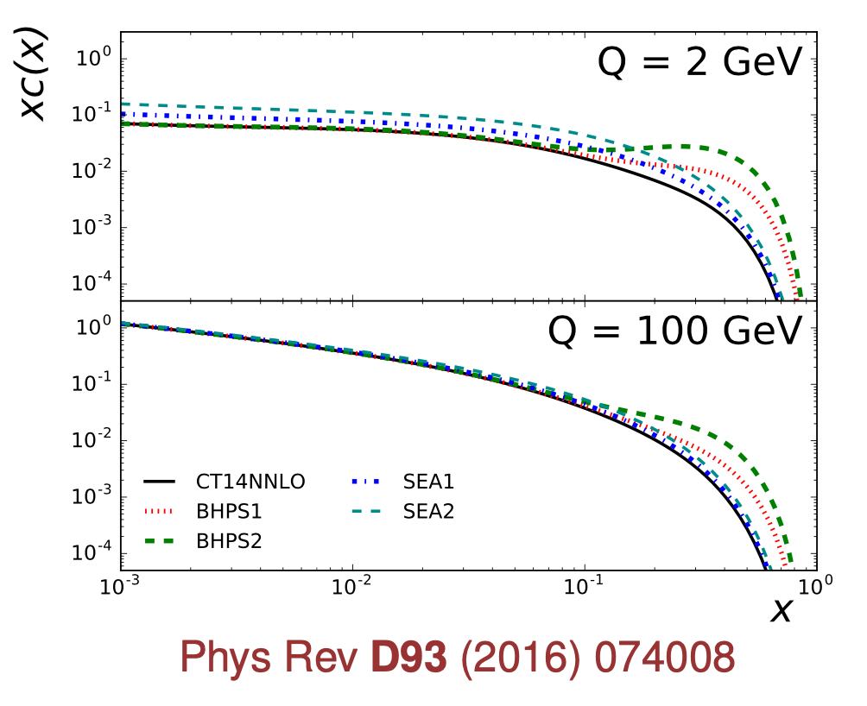
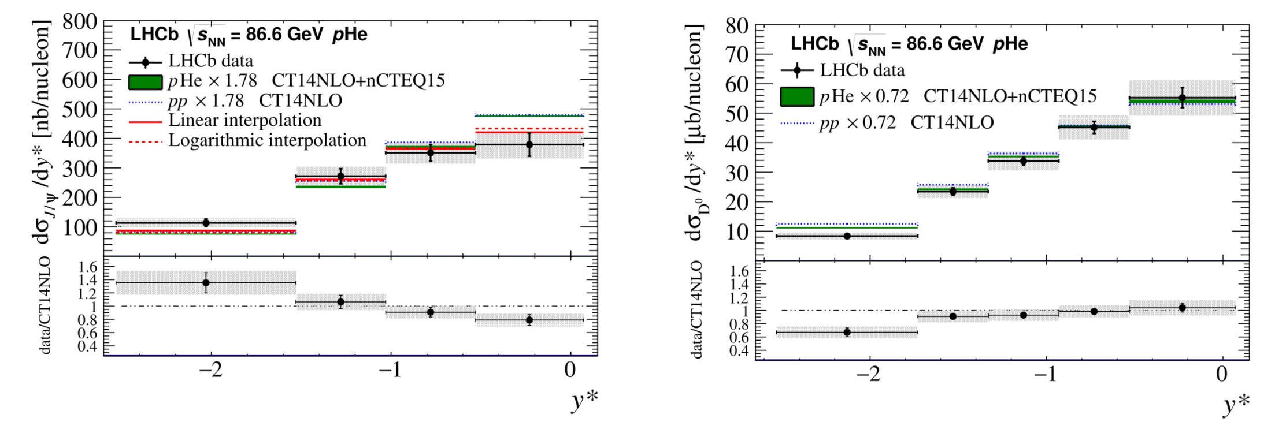
Production of charm in fixed target
Cross-section as a function of rapidity (y*) and p_{T} to test intrinsic charm content of proton (would be seen as increase of cross-section at negative rapidities compared to predictions)
[HELAC-ONIA EPJC 77 (2017) 1]

Slide 22
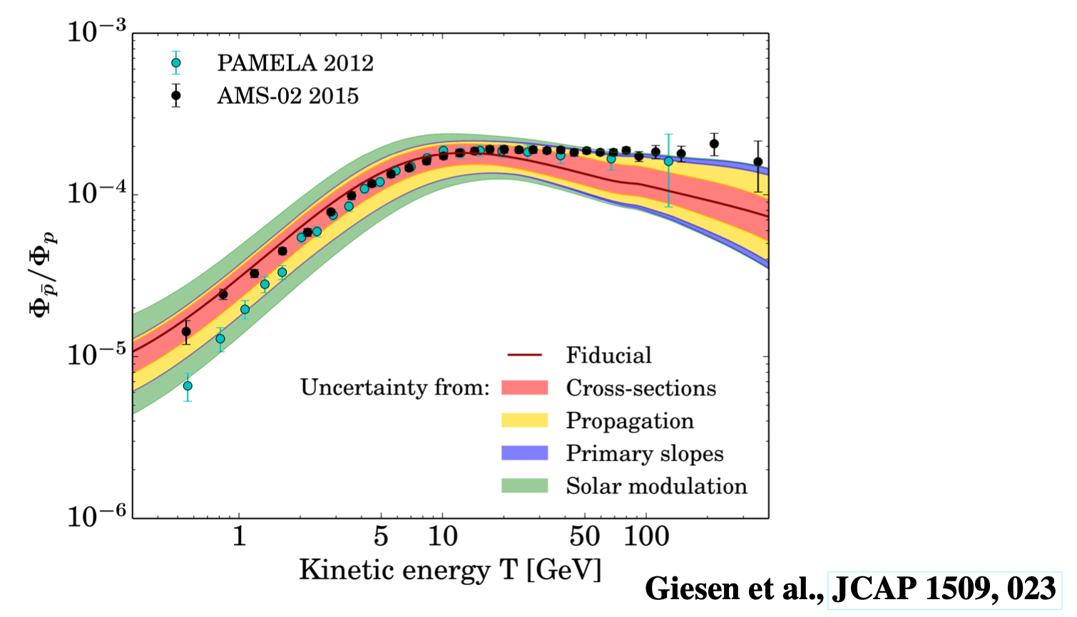
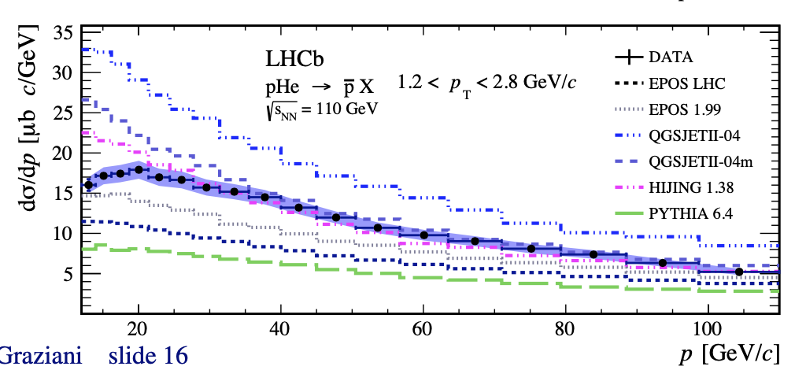
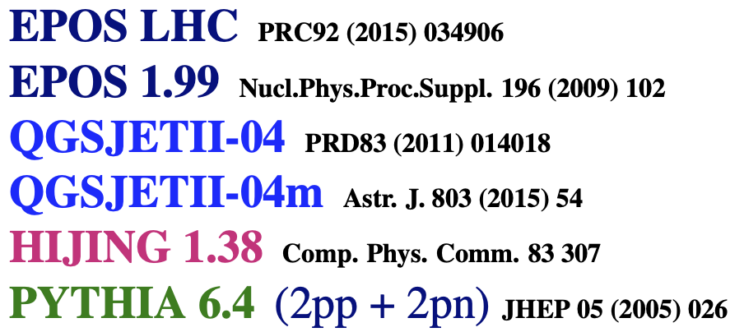
SMOG: anti-protons in pHe collisions at 110 GeV
Interesting to reduce uncertainties on anti-proton production in inter-stellar medium: pHe ➝ pX is ~40% of secondary cosmic anti-proton
Phys. Rev. Lett. 121 (2018) 222001

Slide 23
SMOG2
SMOG proved that a fixed target physics program at LHCb works, but has limitations:
  Fixed target data taking was mostly done during dedicated short runs, at maximum during 1 continous week: low statistics
  The pressure of the injected gas is limited because the gas flow is not contained and goes into the LHC beam pipe
  Changing types of gases is a long operation: requires an acces close to the VELO, i.e. stopping the LHC operation
  The position of the interactions is distributed along a large area: strong variations of the detector efficiency as a function of that position
To address all these difficulties: upgrade of SMOG system = SMOG2

Slide 24
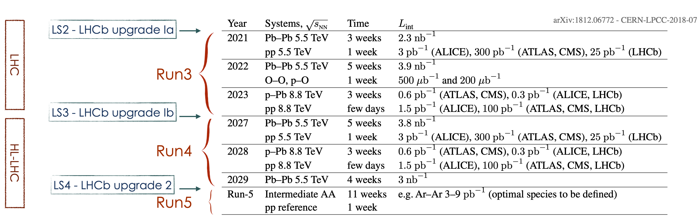
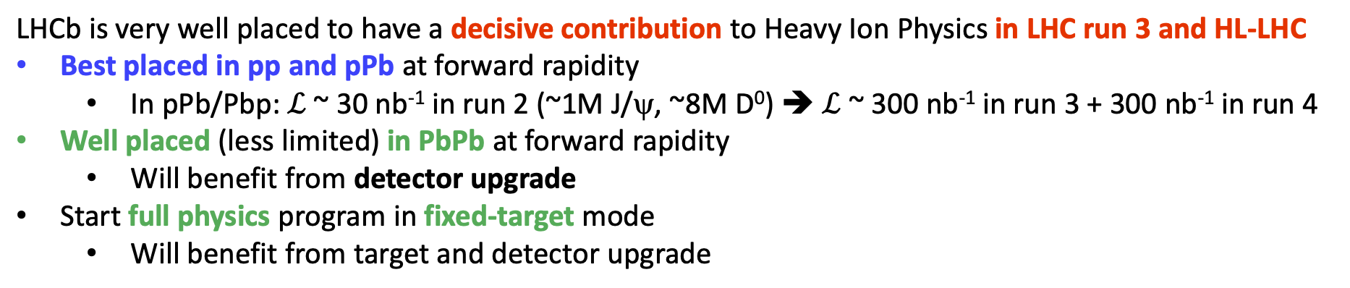
LHC Heavy Ion Schedule

Slide 25

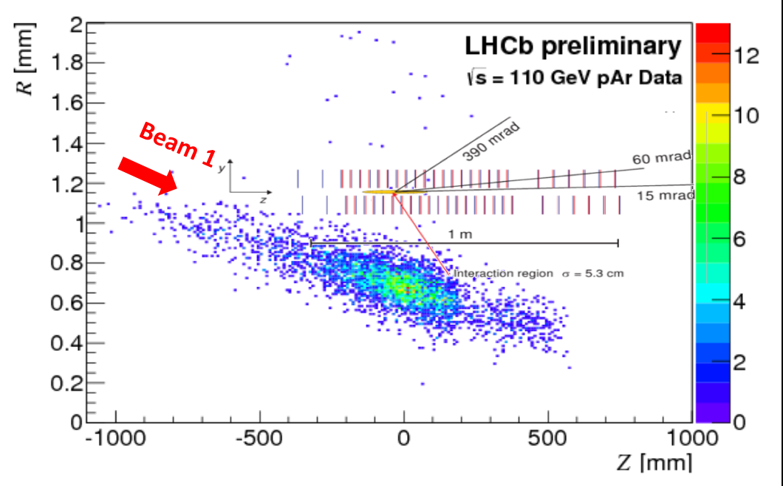
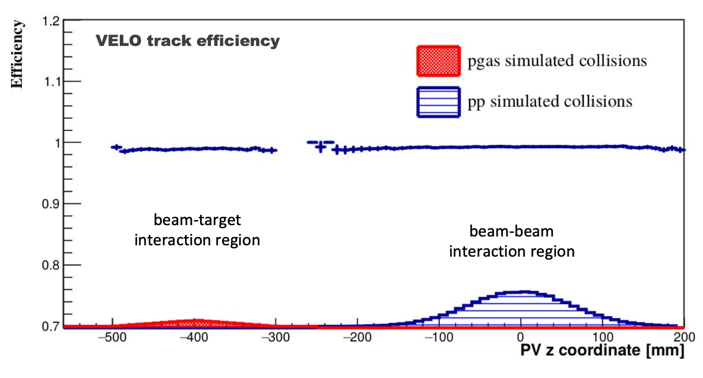
SMOG2
New storage cell installed at LHCb to boost significantly the fixed target program
Increase of the luminosity by up to 2 orders of magnitude using the same gas load as SMOG
Possibility to inject H2, D2, He, N2, O2, Ne, Ar, Kr, Xe with multiple gas lines
New Gas Feed System. Gas density (luminosity) measured with greatly improved precision (few %)
Well defined interaction region upstream the nominal IP: strong background reduction, no mirror charges effect, possibility to use all the bunches. pp and p-Gas simultaneous data taking may be possible thanks to software trigger.
In beam-beam slots:
p-Gas
pp
z
SMOG
SMOG2

Slide 26
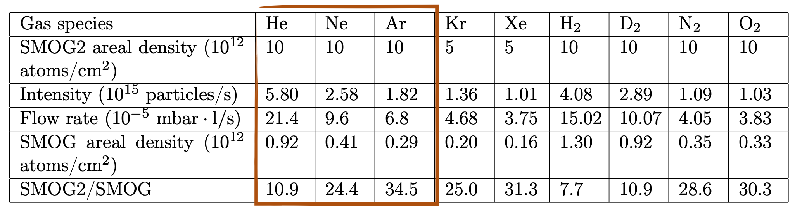
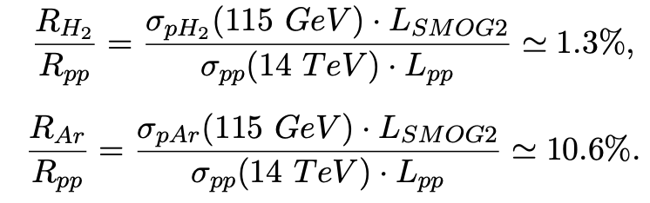
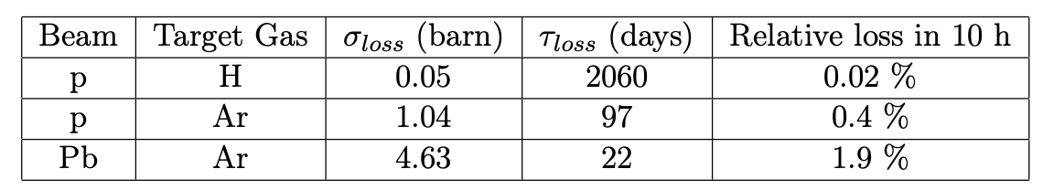
SMOG2
Noble gases He, Ne, Ar were already used with SMOG
Need simulations to assess feasibility from LHC point of view to inject:
  Kr, Xe: risk of accumulation at the warm-cold transitions, and outgasing at injection
  H₂, D₂: degradation of NEG (non-evaporable getter) coating of LHC vacuum chambers
Collision rates expected compared to pp:
Negligible impact on beam lifetime:

Slide 27
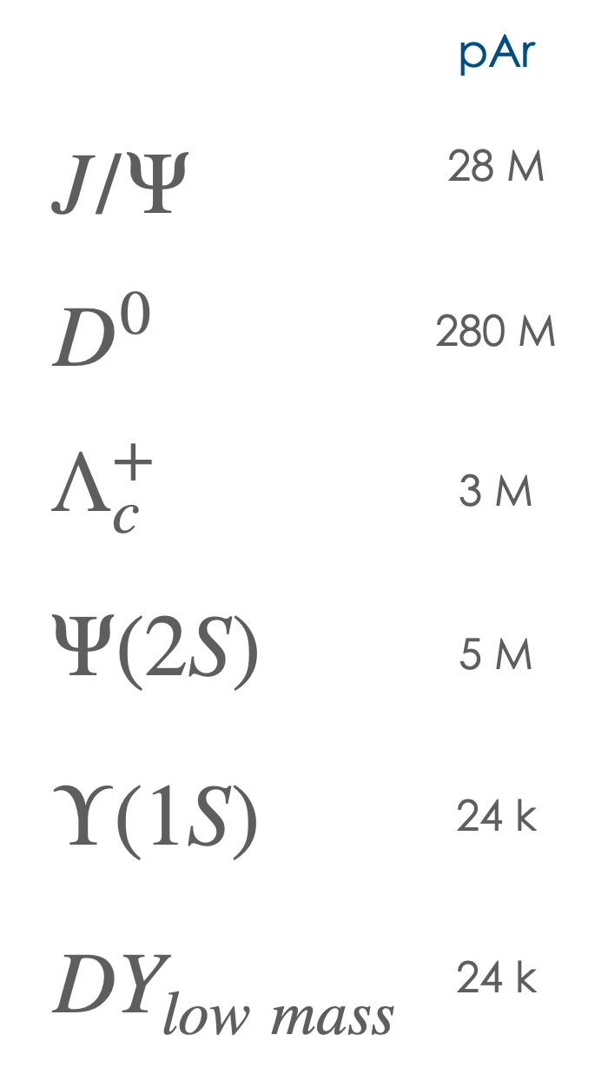
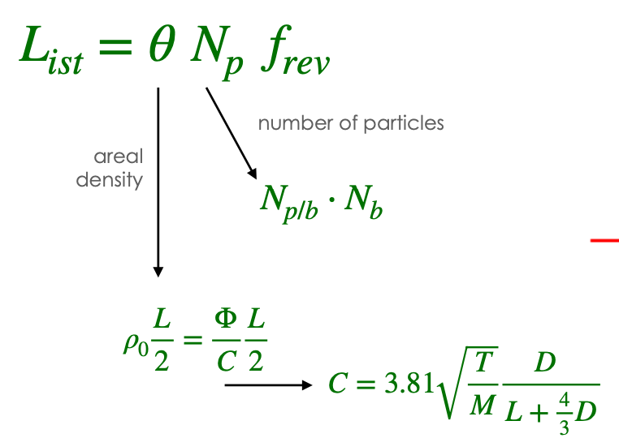
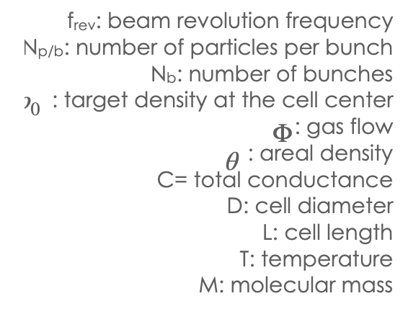
SMOG2 statistics
For 1 year of data taking during Run 3:
Instantaneous luminosity measurement: precision of 2% expected on integrated luminosity

Slide 28
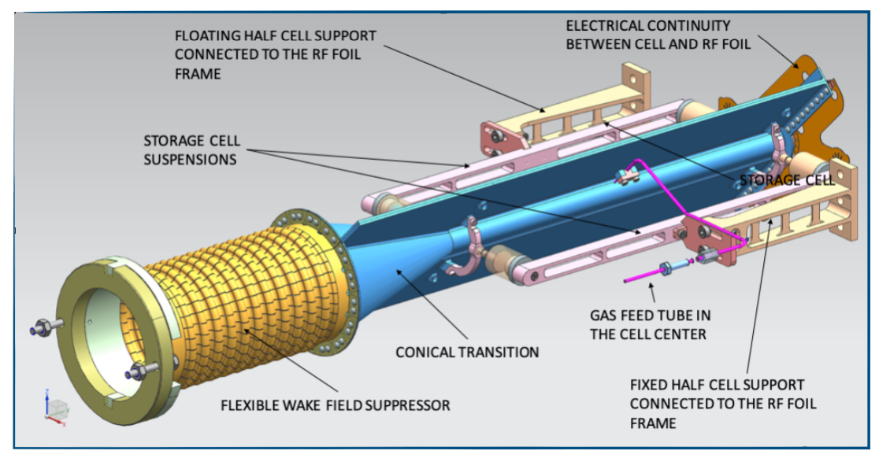
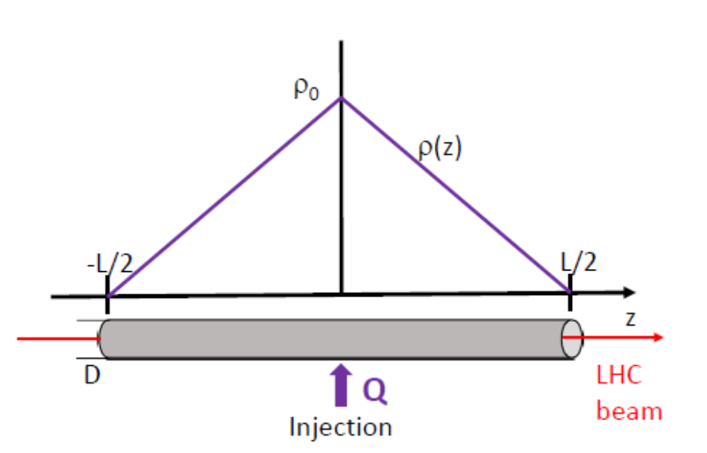
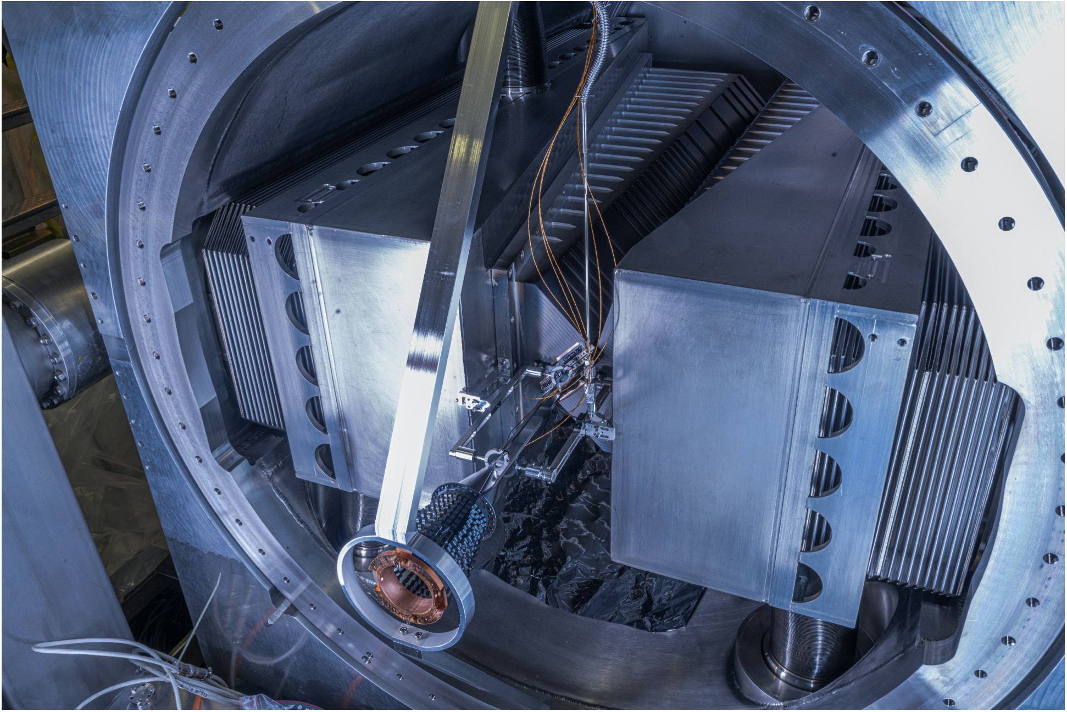
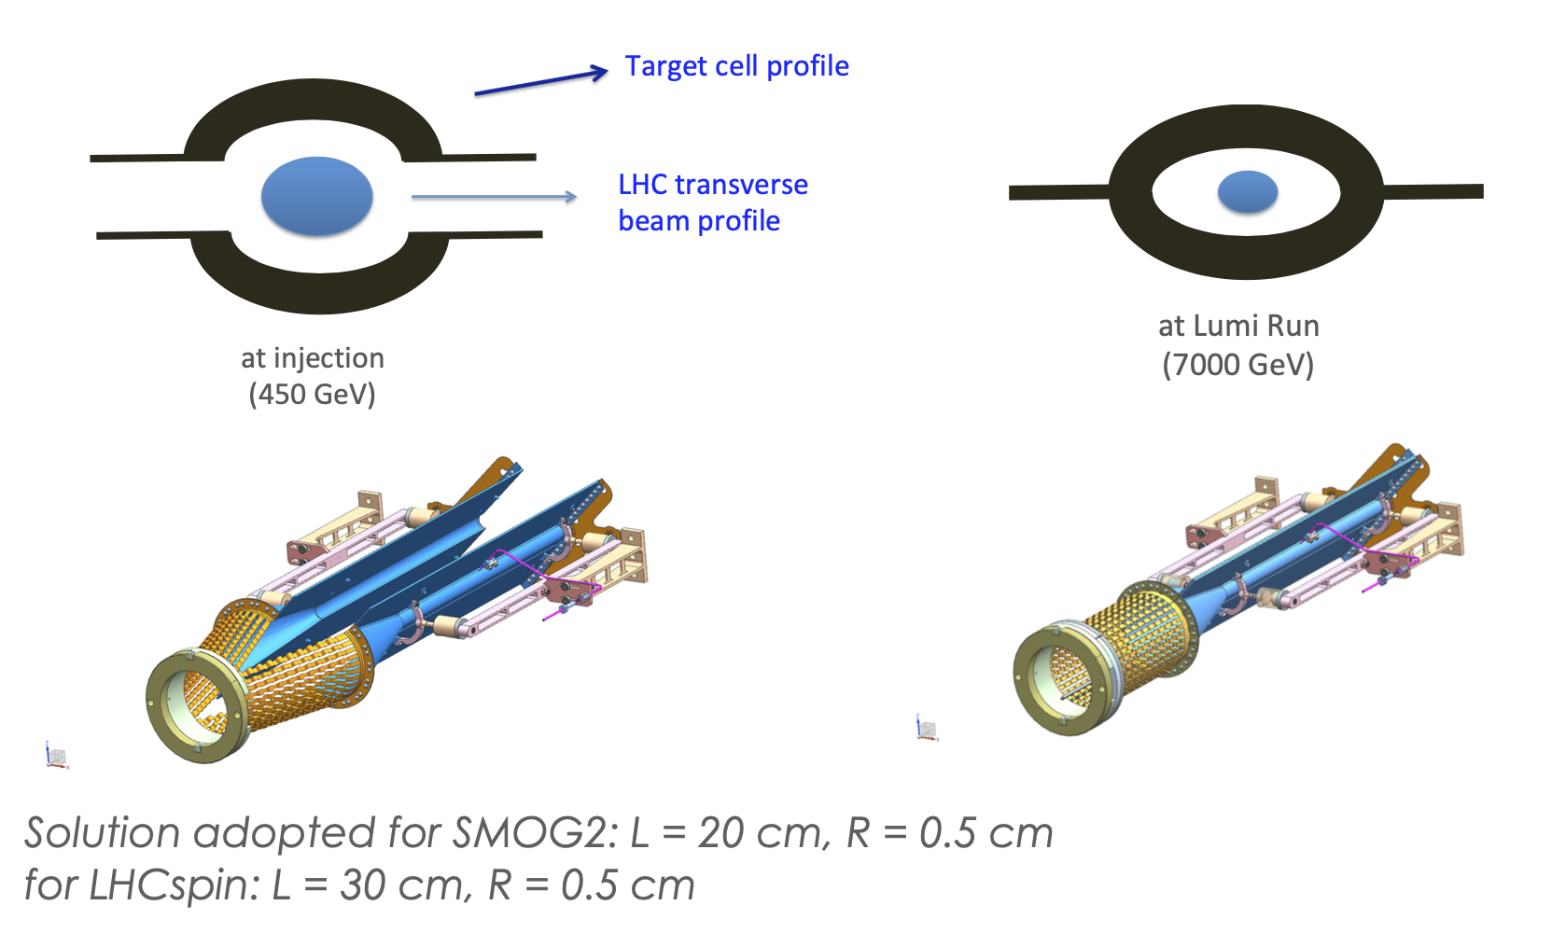
SMOG2 storage cell
The storage cell is a tube (20 cm length, 1 cm diameter) where the gas is injected at the center from a gas-feed system
Similarly to the VELO, the cell must be opened when the beam is not stable (at 3 cm)
Installed in August 2020

Slide 29
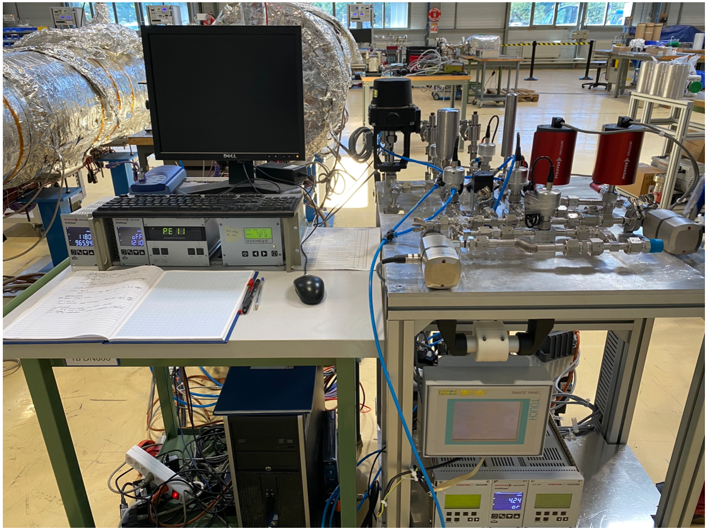
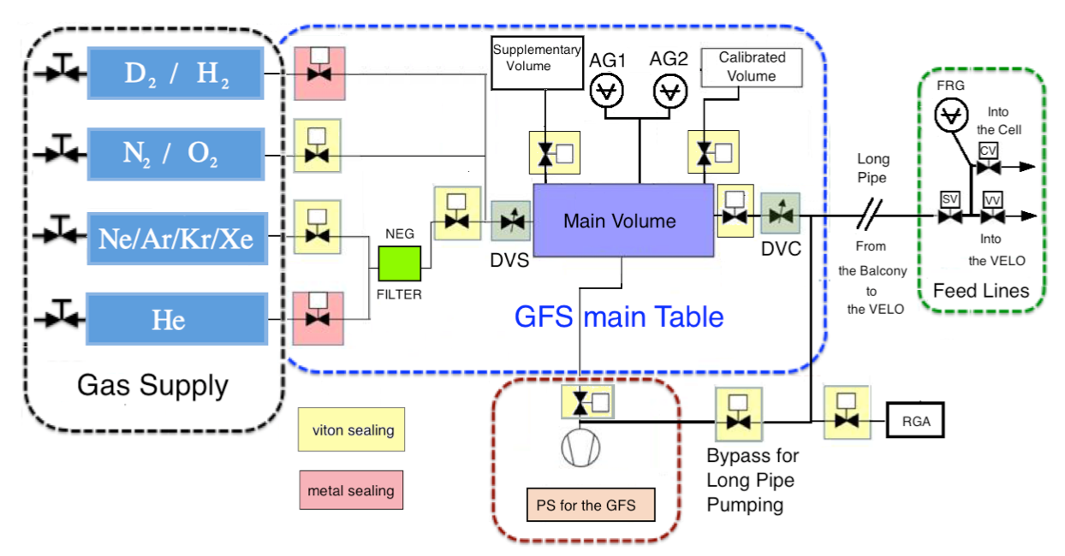
Gas feed system for SMOG2
To be installed in 2022
Will give the possibility to change types of gas dynamically, and to measure the purity

Slide 30

SMOG2: High x physics
Reduction of PDF uncertainties crucial for Beyond Standard Model searches
PDF uncertainties before and after including estimated Drell-Yan production SMOG2 data (Q= 1.3 GeV)
nPDF uncertainties before and after including estimated D⁰, J/ψ, B⁺ and Y(1S) production SMOG2 data

Slide 31

SMOG2: Cosmic rays

Slide 32

SMOG2: Cosmic rays

Slide 33

Upgrade Ib and II
Changes to all parts of the experiments

Slide 34


Polarized Gas Target Topology

Slide 35

Polarized Gas Target: Luminosity
Driven by aperture of the beam which limits the size of the target
R = 0.5 cm, L = 30 cm means target density 1.2x10¹⁴ cm⁻²
At High Luminosity LHC, fixed target luminosity can reach L=8.3x10³² cm⁻².s⁻¹
Impact on the LHC beam lifetime less than 1%

Slide 36


Polarized Gas Target
Space in front of LHCb ~1.5 m

Slide 37

Polarized Gas Target
R&D already started at INFN Frascati, Ferrara, Erlangen, Julich, PNPI
Groups interested in Italy, France (IJCLab, LLR, Saclay), Michigan, Los Alamos, MIT, PSI
Budget: 2 – 4 MEuros
Polarized Gas Target

Slide 38


Physics with polarized gas target
Understand the spin of the proton and its content beyond PDFs
Unpolarized gluon TMD
Polarized gluon TMD
(TMD: transverse momentum distribution)

Slide 39

Target with crystals
[EPJC 77 (2017) 181]
[JHEP 8 (2017) 120]
[EPJC 77 (2017) 828]
Measurement of charm quark MDM and EDM via spin precession of Λ_{c} baryons produced in a fixed target, using crystals

Slide 40

Fixed target in ALICE
Particles from beam halo + solid target inside ALICE:
  Halo particles deflected by bent crystal (70m upstream of ALICE) sent on a solid target
  Particles not interacting with the target need to be absorbed

Slide 41

Fixed target in ALICE
Physics program very similar to LHCb, with a different acceptance, with muon detector covering different acceptance than other parts of the detector

Slide 42
Conclusions
Fixed-target physics at LHCb/LHC feasibility established with SMOG during Run 2 of LHCb: limited by statistics
Success of this first phase encouraged many new projects
Installation of SMOG2 will boost significantly physics output
New projects at LHCb and ALICE under design to explore new directions (polarized target, MDM-EDM, ...)

