Slide 1
POSITRON SOURCES AT LAL-ORSAY:
A LONG STORY
Robert Chehab
IJCLAB

Slide 2
POSITRON SOURCES AT LAL-ORSAY
OUTLINE:
* 1- INTRODUCTION
* 2- METHODS TO OBTAIN POSITRONS
* 3- EXPERIMENTS AT LAL USING POSITRONS
* 4- STUDIES ON POSITRON SOURCES AT LAL
* 5- PARTICIPATION TO INTERNATIONAL PROJECTS
* 6- CONCLUSION
* ACKNOWLEDGEMENTS

Slide 3
POSITRON SOURCES AT LAL-ORSAY
1-INTRODUCTION
Interest on positron sources at LAL-Orsay, appeared, first, for fixed target experiments ➔ possibility to get monochromatic gamma-rays
The interest strengthened with the strong development of colliding beam facilities
➔ high level of energies in CM allowing to reach high energy new particles
In LAL-Orsay, since the beginning of the sixties, development of studies on positron sources and physics experiments using positrons.

Slide 4
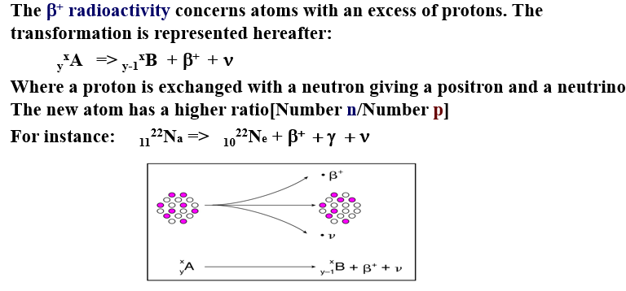
POSITRON SOURCES AT LAL-ORSAY
2-METHODS TO OBTAIN POSITRONS
2-1 β⁺ DECAY

Slide 5
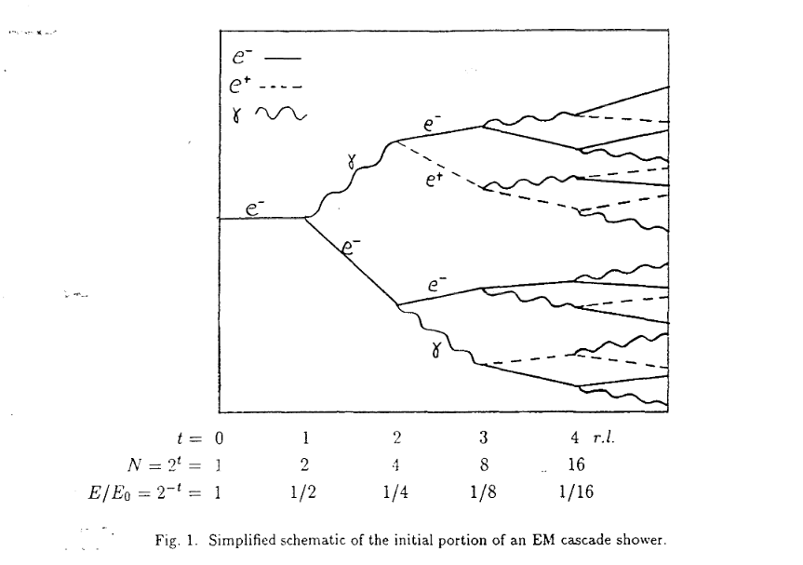
POSITRON SOURCES AT LAL-ORSAY
2-2 ELECTROMAGNETIC SHOWER IN A TARGET
Electrons or photons impinging on a target develop an electromagnetic shower.
2-2-1 ELECTROMAGNETIC SHOWER DRIVEN BY AN ELECTRON BEAM
➔ BREMSSTRAHLUNG RADIATION
+ PAIR CREATION
This is the scheme of the conventional positron source
providing unpolarized positrons. However using incident
longitudinally polarized electrons (AsGa photocathode)
➔ circularly polarized bremsstrahlung photons ➔
longitudinally polarized pairs : see A.P.Potylitsin,
E.Bessonov, A.Mikhailichenko;
Experiments have been done: see E.Voutier et al
➔ Exp. PEPPo at JLAB:

Slide 6
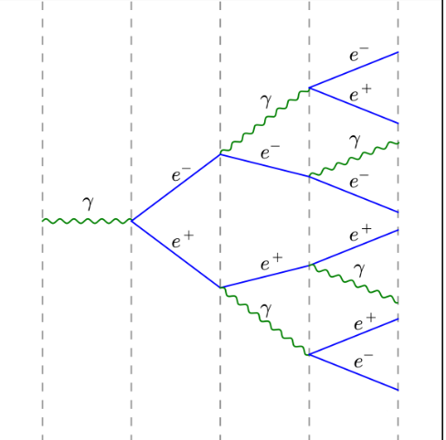
POSITRON SOURCES AT LAL-ORSAY
2-2-2 ELECTROMAGNETIC SHOWER DRIVEN BY A PHOTON BEAM
UNDULATOR
COMPTON
CHANNELING

Slide 7
POSITRON SOURCES AT LAL-ORSAY
Positrons generation through photon beams
* Such methods may provide large positron yields due to the possibility of having large number of photons:
# Undulator: ➔ photon yield proportional to number of periods N
# Compton: ➔ the weak cross section may be compensated by a multi-resonator
system
# Channeling: ➔ high rate of photons compared to bremsstrahlung
As a consequence with a high photon yield : ➔ thinner converter and less energy deposited

Slide 8
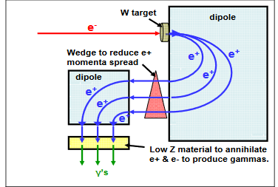
POSITRON SOURCES AT LAL-ORSAY
3- EXPERIMENTS AT LAL USING POSITRONS
3-1 Positrons for fixed targets
# Annihilation of positrons with target electrons
provide quasi monochromatic photons which are
interesting to study some reactions: Compton scattering,…
# The photons created by positron annihilation have different
shape from bremsstrahlung photons. Possibility to collimate
these photons. The rate of produced photons may be high enough,
depending on the number of incident positrons, the kind and
thickness of the target.

Slide 9
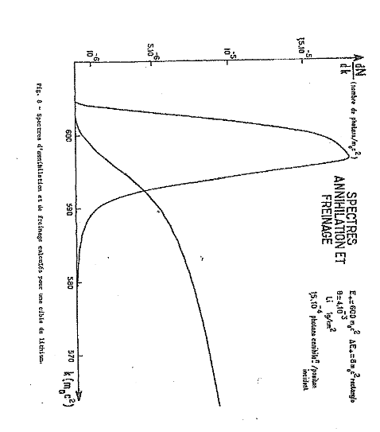
POSITRON SOURCES AT LAL-ORSAY
PHOTONS FROM POSITRON ANNIHILATION:
Energy spectra have different shapes as shown for a Lithium target: annihilation gives quasi-monochromatic photons ( Saclay : Tamas, Schul,..)
At LAL-Orsay, experiments done in 60-70ties by R.Tchapoutian (thesis), B.Bouquet, B.Grossetete,…with Li target :
Studies on Compton scattering,..
Ref: R.Tchapoutian: these: LAL-1230 (1970)
B.Bouquet et al. LAL-1183
D.Blum et al. NIM 115 (1974)553
Experiments also in Saclay: G.Tamas et al: CEA-3628 (1968): see Figure
Annihilation
Bremsstrahlung
Experiment at Saclay (calculation)
Target: Lithium ( 1gcm⁻² thick ~1% Xo)
Xo (Li)➔ 82.8 gcm⁻²

Slide 10
POSITRON SOURCES AT LAL-ORSAY
3-2 POSITRONS AT LAL FOR COLLIDING BEAMS
Positrons have been created to provide storage rings: ADA, ACO, DCI
3-2-1 POSITRONS FOR ADA
The Frascati first colliding facility has been transported
at LAL-Orsay to get enough positrons for the collisions e+e-.
The ring was installed in the experimental hall « 500 MeV »
Electrons beams of 450 MeV were impinging on a
Radiator (0.3 Xo)➔ photons created impinge on
an internal target (0.4 Xo) where e+ and e- are created.
Choosing the right bending field in the ring➔ e+ stored;
The e- coming from the internal target are also stored after
specific motion of the ring. Global yield for the 2 targets: d³n/dEdSdθ = 3.2.10⁻³ cm⁻² MeV⁻¹
Collisions e+e- were observed. Peak Luminosity: 10²⁵ cm⁻²s⁻¹ . Main reference: J.Haissinski thesis: LAL-1122 (1964)
B: ring magnetic field
e+
e-
γ
e-
Radiateur
Cible interne

Slide 11
POSITRON SOURCES AT LAL-ORSAY
3-2-2 POSITRONS FOR ACO
e+ for ACO
e- linac: 750 MeV
e+ linac: 250 MeV
converter
Positrons are created in a W target by 750 MeV e- beam; they are then accelerated to 250 MeV to be injected in ACO. Positron beam was about 10⁷ e+/pulse (1μs) in a ΔE/E of 2.5 %
Capture matching system was made of solenoids. Use, later on, of a QWT improved the e+ intensity by a factor 3.
The electron beam of 250 MeV was generated in a dedicated linac.

Slide 12
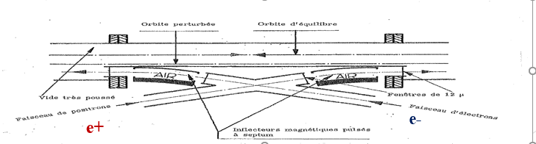
POSITRON SOURCES AT LAL-ORSAY
Physics experiments on ACO:
As an example, researches on vector-mesons ρ, ω, φ have been carried out;
Ref: J.E.Augustin et al. « Comparison of Orsay results on vector mesons with the vector meson dominance model predictions » in Phys.Letters.B Vol.28, N.7 (1969)503-507

Slide 13
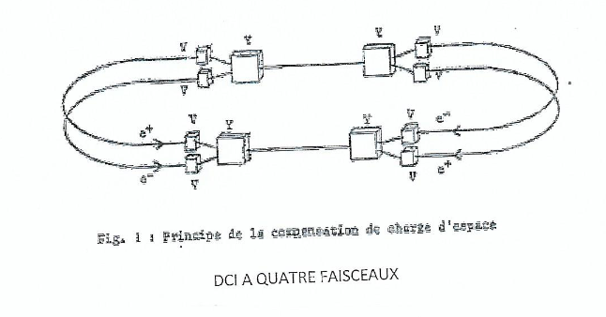
POSITRON SOURCES AT LAL-ORSAY
3-2-3 POSITRONS FOR DCI
Originally DCI was a 2-rings with space charge compensation
The idea was that at a collision point 2 positron and 2
electron bunches could collide simultaneously and the
electric and magnetic forces would cancel mutually.
One of the reasons of the unsuccessful aim was due to
non-linear resonances . Intensity limit appeared
at 15 mA. The nominal luminosity 10³²cm⁻²s⁻¹ could
not be reached
DCI has been, then, working with one ring.
Physics experiments were mainly operated with
DM2 detector on J/Ψ resonance. See: J.E.Augustin et al. DM2, A Magnetic Detector for the Orsay Storage Ring DCI in Physica Scripta Vol. 23 (1981) 623-633

Slide 14
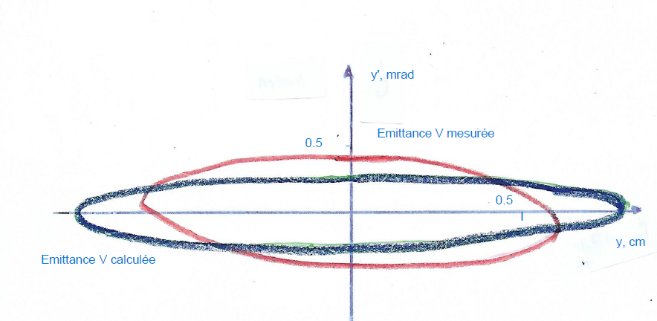
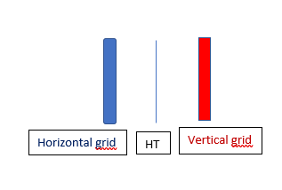
POSITRON SOURCES FOR LAL-ORSAY
POSITRONS FOR DCI
A positron beam of 5.10⁸ e+/pulse of 20ns was available at 1 GeV energy. At that energy the injection was about 1A/h. Increasing the injection energy at 1.2 GeV improved the injection duration.
Of particular interest is the positron beam emittance. Due to the relative weak intensity a special monitor has been used.
The monitor: 2 grids: each plane (H,V) contains 16 layers made of CsI porous dielectric material: these layers are put on aluminium support. Between the 2 plane, a HV plane;
Enhanced secondary emission allowed to measure 10⁷ e+ at least. Emittance➔ 3 gradients method
Vertical emittance: red➔ measurement
blue:➔ calculated
HV
Е_{H} = 4πmm.mrad and E_{V} = 2.7π.mm.mrad

Slide 15
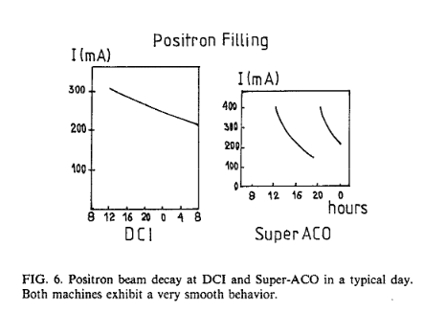
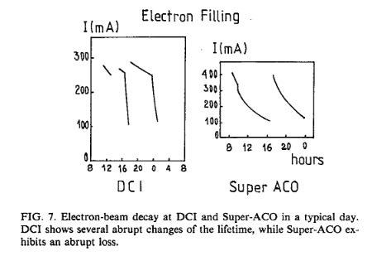
POSITRON SOURCES AT LAL-ORSAY
3-3- POSITRONS FOR SYNCHROTRON RADIATION
Use of positrons instead of electrons allows to avoid the harmful effects of positive ion clouds attracted by electrons and repulsed by positrons ➔ consequences on beam emittance and beam lifetime. Due to the availability of positron beams at LAL, the opportunity to use positron beams made it easier. Such possibility has been used in DCI and SUPERACO rings. The idea was strongly supported by P.Marin.
Beam decays with e- and e+: ➔ measured: they show the advantages of e+ . Nevertheless : cost???
See P.Marin in Rev.Scient.Instrum. 63(1)January 1992, P.327

Slide 16
POSITRON SOURCES AT LAL-ORSAY
4- STUDIES ON POSITRON SOURCES AT LAL-ORSAY
4-1 Measurement of positron yield ( Aggson-Burnod)
A pionner work on positron yield measurement was undertaken at LAL by T.L.Aggson and L.Burnod at the beginning of the sixties. Their work has been described in Production de positrons à l’Accelérateur d’Orsay. Determination de la section efficace à 0˚ sur cibles épaisses. In LAL-27, 1962. They measured the positron yield in function of incident electron energy and the target thickness. They obtained the positron energy spectrum in each case. They derived a practical formula to evaluate the positron yield n for low energy positrons (from about 10 MeV to 0.2-0.3 E where E is the incident electron energy):
n= E .(d²n/EdΩdP) dΩdP
Where d²n/EdΩdP is the measured specific yield at 0˚ , dΩ and dP are the solid angle and the momentum width accepted by the focusing system.
This expression can be written more simply, using e- and e+ intensities, as:
I⁺ = I⁻ .n.πθ².Δv⁺
πθ² , solid angle of acceptance around 0˚ and Δv⁺ accepted energy bandwith
(see Aggson & Burnod report)
;

Slide 17
POSITRON SOURCES AT LAL-ORSAY
4-2 STUDIES ON MAGNETIC CAPTURE SYSTEMS
The most interesting number for physics experiments is the accepted yield. Therefore an essential work consists in designing efficient magnetic lenses to capture the positrons at the target exit. The main capture systems are using axial magnetic field . They are the Quarter Wave Transformer (QWT) and the Adiabatic Matching System (AMD)
4-2-1 THE QUARTER WAVE TRANSFORMER
J.Haissinski studied different focusing devices using solenoids and more in details the QWT which appeared to him as the best solution for the capture system (see J.Haissinski in Nucl;Instrum.Methods 51(2) (1967)181-196. The QWT, with the parameters defined by JH, was installed and improved significantly the accepted positron yield for the storage ring ACO.

Slide 18
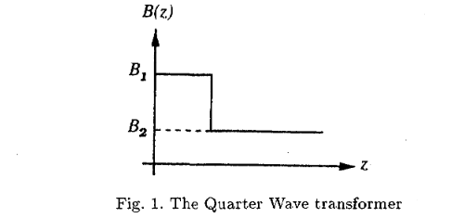
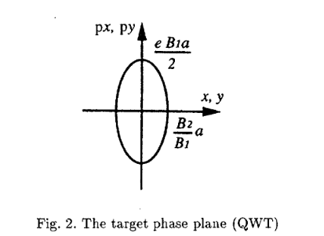
POSITRON SOURCES AT LAL-ORSAY
THE QUARTER WAVE TRANSFORMER
The QWT is using a high magnetic field on a short length
(some cm) followed by a low field on a large length. The
low field is superimposed on the accelerating sections.
The main features: Radial acceptance: r₀ = (B₂ /B₁).a where
a is the radius of the accelerator channel. The maximum
transverse momentum (for a target IN the field) is:
p_{T} = eB₁a(1+ B₂ /B₁ ).
This capture system has a narrow energy band
Usually, some MeV.
In the phase space canonical variables are used

Slide 19
POSITRON SOURCES AT LAL-ORSAY
4-2-2 ADIABATIC MATCHING DEVICE (AMD)
The Adiabatic Matching System was, first, proposed by R.Helm for the SLAC positron source ( see Adiabatic approximation for dynamics of a particle in the field of a tapered solenoid, SLAC-4, 1962 )
It has also been studied and installed at Orsay (see R.Chehab, Positron sources in CERN 94-01, vol.II and R.Chehab et al. An Adiabatic matching Device for the Orsay Linear Positron Accelerator in IEEE transactions on Nuclear Science vol. 30 (4), 1983). The AMD was made of stacked pancakes and solenoids of various radii. The fields values were moderate (maximum field was 1.2 Tesla; the tapering length was 0.75 m)
The AMD took the place of a QWT and has been in operation for two years. The energy bandwith of acceptance has been increased by a factor 2.5 and the positron yield by a factor 2.
The AMD was made of a set of coils constructed and installed by LAL team.

Slide 20

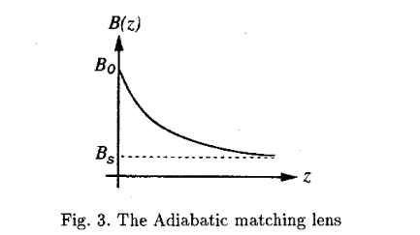
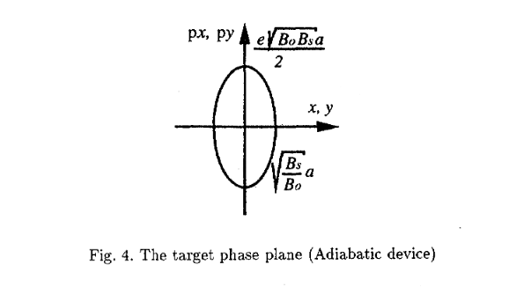
POSITRON SOURCES AT LAL-ORSAY
THE ADIABATIC MATCHING SYSTEM
This system is using a slowly varying magnetic field followed by a long axial magnetic field extending over some accelerating sections. Between the maximum B₀ and the minimum B_{s} the magnetic field tapers adiabatically, that means that the adiabatic invariant:
t
Transverse momentum
is conserved. {p_{i} q_{i} } are canonical variables . That means that the flux of magnetic field through the beam section is conserved .
Maximum Transverse momentum (target IN field)
Maximum geometrical acceptance

Slide 21
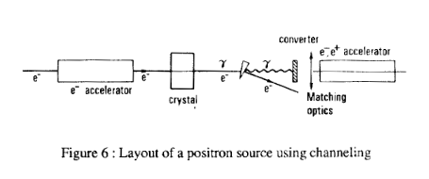
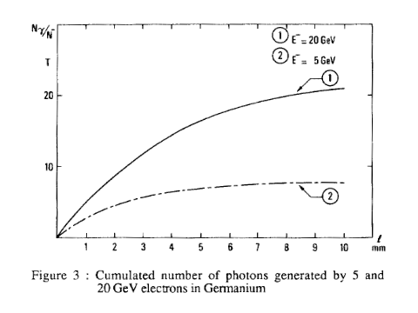
POSITRON SOURCES AT LAL-ORSAY
4-3 NEW KINDS OF POSITRON SOURCES USING CRYSTALS
This idea started at LAL-Orsay in 1988. A group associated to a theoretician , Xavier Artru, from LPT-Orsay thought about the use of an atomic undulator using the strong fields of the atomic rows of a crystal , (instead of the alternating field of a magnetic undulator) to generate the radiations from the electrons propagating at glancing angles from the rows. The wavelengths crystal/magn.undulator are in a ratio ~~10⁻⁴ ➔ the needed e- energies ~~10⁻² ➔ advantage
A preliminary study using Silicon and Germanium crystals in axial orientation to generate the photons and amorphous tungsten targets to create e-e+ pairs was presented at an accelerator conference (R.Chehab et al. in Proceedings of 1989 PAC, Chicago, March 1989)
A positron accepted yield > 1 is obtained with 20 GeV incident beam on 1 cm crystal Ge/Si and 1 Xo for the converter
This configuration is hybrid

Slide 22
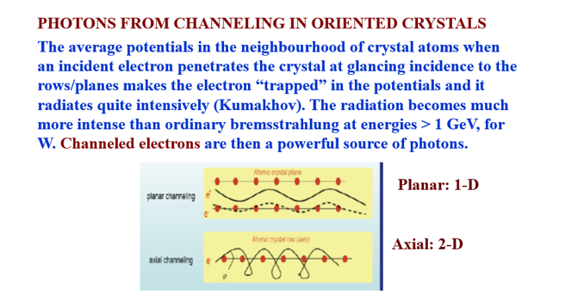
POSITRON SOURCES AT LAL-ORSAY
In order to develop such positron source using crystal effects theoretical and experimental investigations were carried out with different collaborations: IPN-Lyon, BINP-Novosibirsk, IPN-Orsay. Discussions also with KIPT colleagues

Slide 23
POSITRON SOURCES AT LAL-ORSAY
EXPERIMENTAL AND THEORETICAL INVESTIGATIONS
At Orsay a 2 GeV electron linac used as injector for the synchrotron radiation rings DCI and SuperAco was available. It was decided to run a « proof of principle experiment » using a W crystal, oriented on its <111> axis and 1 mm thick. A collaboration with IPN-Orsay for the photon detection has been carried out.
On a parallel way, theoretical studies and simulations involving LAL, IPN-Lyon and BINP-Novosibirsk have been operated.

Slide 24
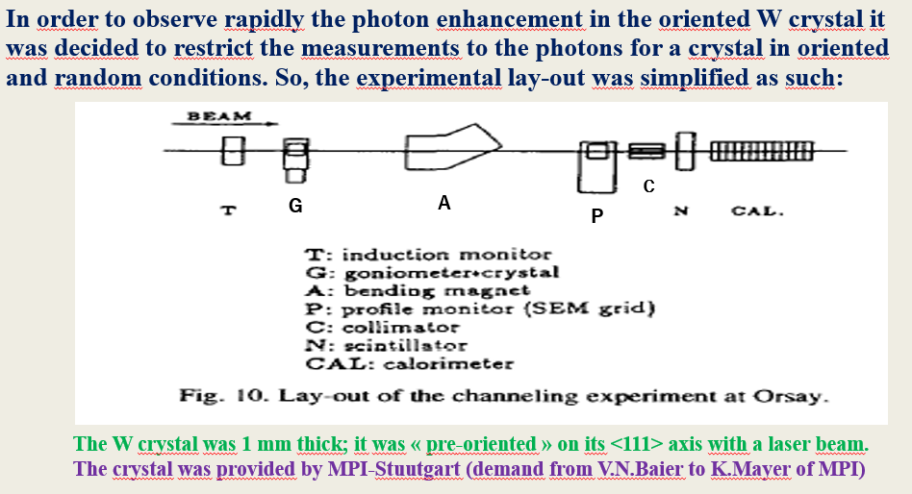
POSITRON SOURCES AT LAL-ORSAY
4-3-1 PROOF OF PRINCIPLE EXPERIMENT AT LAL-ORSAY

Slide 25
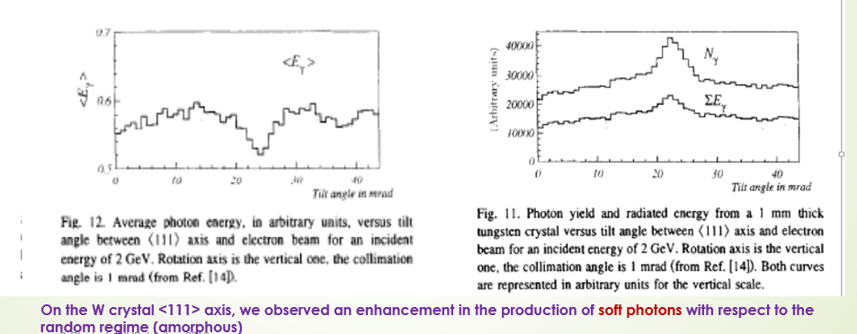
POSITRON SOURCES AT LAL-ORSAY
PROOF OF PRINCIPLE ➔ RESULTS
See X.Artru et al. In Nucl.instrum.Methods B 119(1996)246-252

Slide 26
POSITRON SOURCES AT LAL-ORSAY
4-3-2 THEORETICAL STUDIES AND SIMULATIONS
A collaboration aiming to know better the features of the crystal effects has been undertaken with IPN-Lyon (with Xavier Artru) and the group of V.N. Baier at Novosibirsk. (V.N.Baier, V.Katkov and V.M.Strakhovenko). Simulations based on their works were operated with collaborations from A.Jejcic from College de France. Discussions with theoreticians from KIPT (N.Shul’ga and S.Fomin) were stimulating.
Papers describing these effects with application to positron sources:
* X.Artru, V.N.Baier, R.Chehab, A.Jejcic (Positron sources using channeling in a tungsten crystal) in Nucl.Instrum.Methods A 344 (1994)443-454
* X.Artru, R.Chehab, M.Chevallier, V.M.Strakhovenko (Advantages of axially aligned crystals used in positron production at future linear colliders ) in Phys.Review ST AB, vol.6 (2003)091003

Slide 27
POSITRON SOURCES AT LAL-ORSAY
4-3-3 CRYSTAL RADIATION RESISTANCE: CASE OF TUNGSTEN
The main source of damage is Coulomb scattering of the beam particles on crystal nuclei. When the recoil energy is above certain threshold (~25 eV) the atom is dislodged from its site. Moreover, for higher values, the recoiling nucleus can initiate a cascade of displacements in its neighbouring site.
Tests were initiated with proton beams on Si crystals at BNL and Fermilab: a threshold concerning a fluence of 2-4.10²⁰ proton/cm² was found; above that, losses in crystal performances were met.
The crystal used in positron production might have a long-term resistance. So, it is important to know its performance under a high level of irradiation. The decision was to do a test at SLAC; our colleagues of Stanford greatly helped for that.

Slide 28
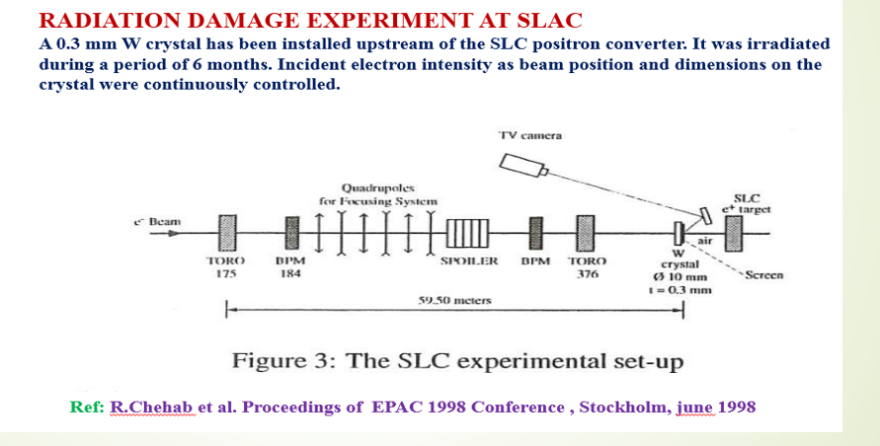
POSITRON SOURCES AT LAL-ORSAY

Slide 29
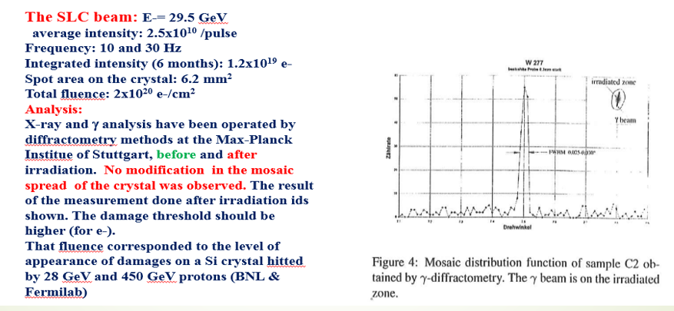
POSITRON SOURCES AT LAL-ORSAY
RESULTS OF THE TEST AT SLAC

Slide 30
POSITRON SOURCES AT LAL-ORSAY
4-3-4 A THICK CRYSTAL AS POSITRON SOURCE: WA 103 EXPERIMENT (CERN)
The aim of this experiment was to investigate the possibilities of a crystal to generate a high positron yield able to satisfy the e+e- colliders requisites ➔ choice of thick crystals, where radiation and pair creation are holding in the same target. Tungsten crystals 4 and 8 mm thick were used. Also 4 and 20 mm thick amorphous targets with the following configurations:
T₁ ➔ 4 mm crystal
T₂➔ 8 mm crystal
T₃ ➔ 4 mm crystal + 4 mm amorphous
T₄ ➔ 20 mm amorphous
The beamline used the secondary electron beam of SPS West Hall (3.2 s pulses with 14.4s period) Each pulse contains 10⁴ electrons. Electron energies were between 5 and 40 GeV.
Measurements: γ ➔ multiplicity with a preshower; radiated energy with a spaghetti calorimeter (Frascati)
e+ ➔ yield: scintillation counters; energy and angle : drift chamber in magnetic field➔ reconstruction
A team LAL-IPNL-BINP-TPU-KIPT participated to the data taking.

Slide 31
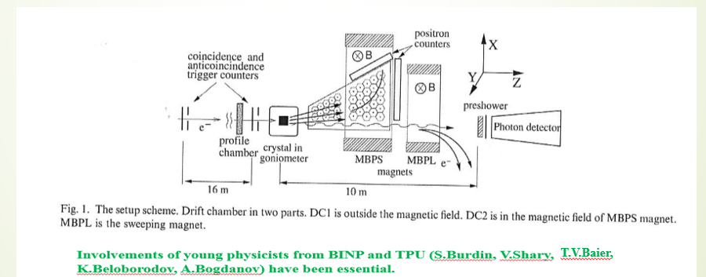
POSITRON SOURCES AT LAL-ORSAY
WA 103: THE LAY-OUT
In this detection system the exit e+ angle is detected in the first part of the Drift chamber and the horizontal momentum in the second part (submitted to bending field)➔ trajectory reconstruction

Slide 32
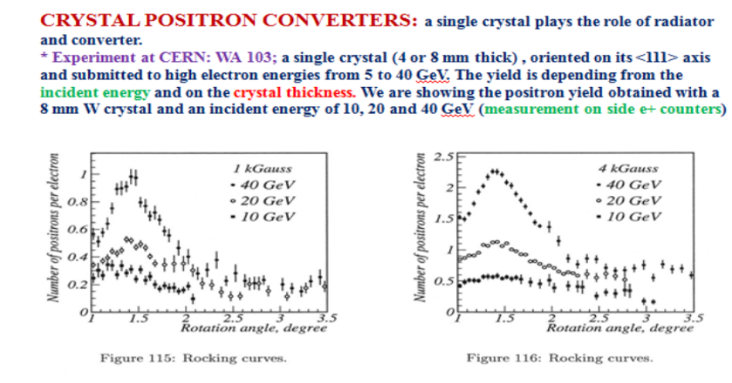
POSITRON SOURCES AT LAL-ORSAY
WA 103: THE RESULTS
INTEREST TO USE HIGH ENERGY INCIDENT ELECTRON BEAMS

Slide 33
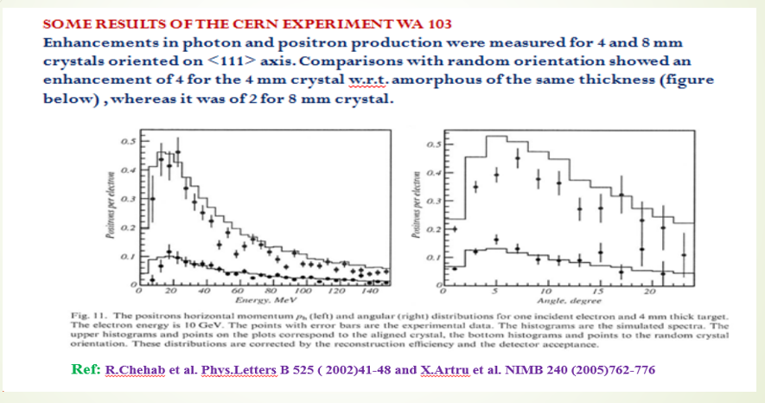
POSITRON SOURCES AT LAL-ORSAY
WA 103: RESULTS
Comparative tests made with 4mm crystal + 4 mm amorphous and 8 mm crystal ➔ same result ➔ no need of very thick crystals

Slide 34
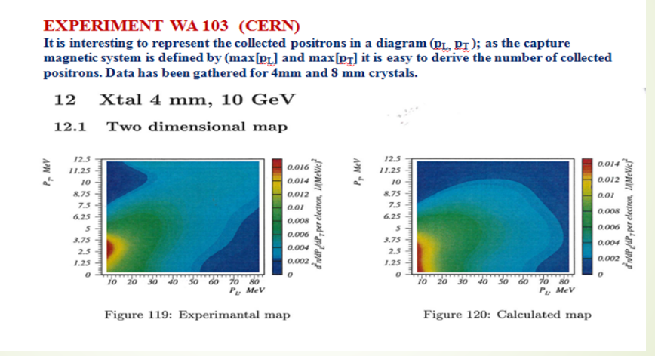
POSITRON SOURCES AT LAL-ORSAY

Slide 35
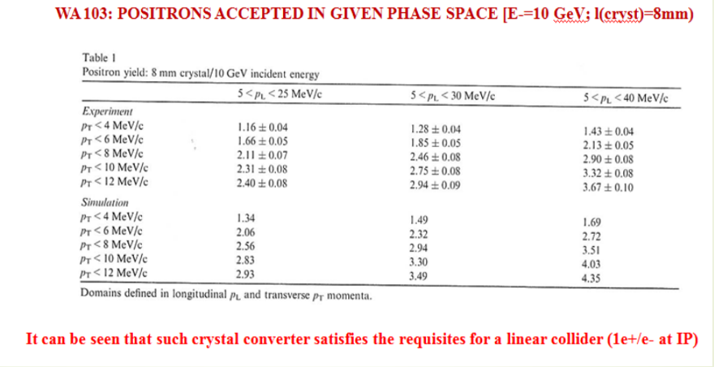
POSITRON SOURCES AT LAL-ORSAY

Slide 36
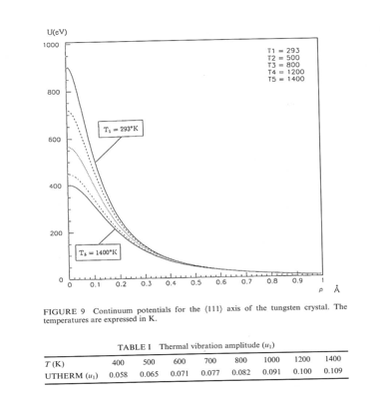
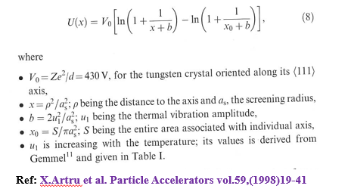
POSITRON SOURCES AT LAL-ORSAY
4-3-5 THE HYBRID POSITRON SOURCE
Using thick crystals to generate photons and positrons in the same target is, from the point of view of the yield, very effective as shown by WA 103 experiment. However using high beam intensities is leading to heat load in the crystal ➔ decrease of the available potentials due to thermal vibrations.
Calculations of the potential in function of the temperature is showing that.
Using Baier formula for the potential:
Contains thermal coefficient
In order to preserve the crystal qualities, radiation and pair creation are separated ➔ hybrid system

Slide 37
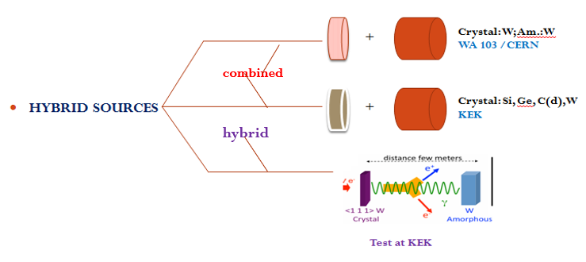
POSITRON SOURCES AT LAL-ORSAY
THE HYBRID POSITRON SOURCE

Slide 38
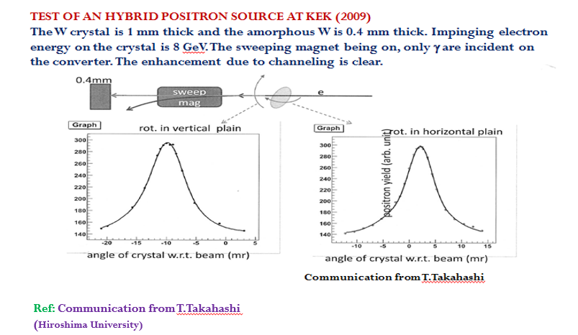
POSITRON SOURCES AT LAL-ORSAY
THE HYBRID POSITRON SOURCE

Slide 39
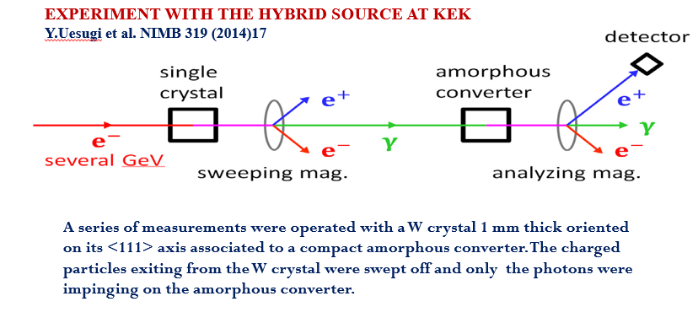
POSITRON SOURCES AT LAL-ORSAY

Slide 40
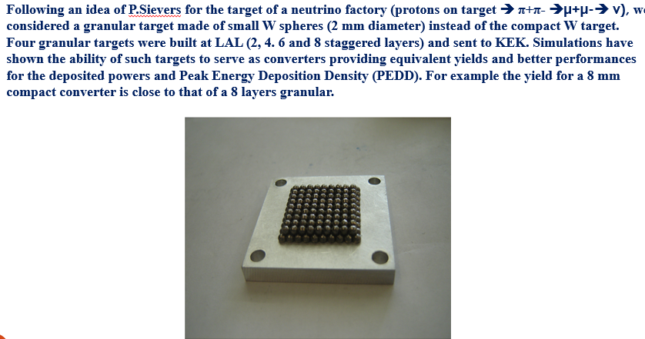
POSITRON SOURCES AT LAL-ORSAY
HYBRID POSITRON SOURCE WITH A GRANULAR CONVERTER

Slide 41
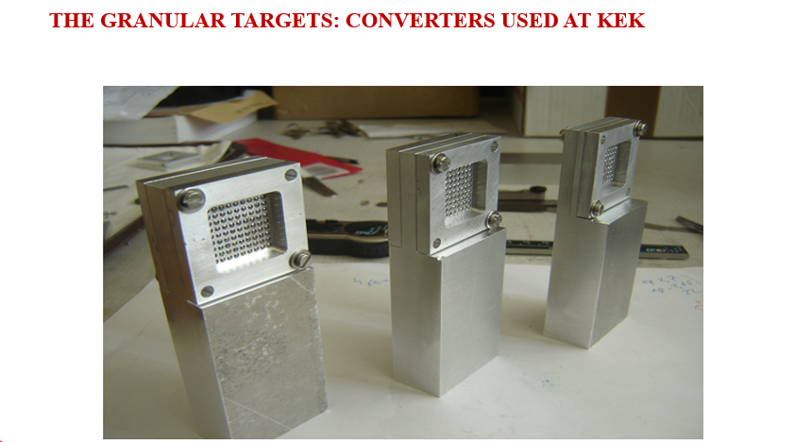
POSITRON SOURCES AT LAL-ORSAY

Slide 42
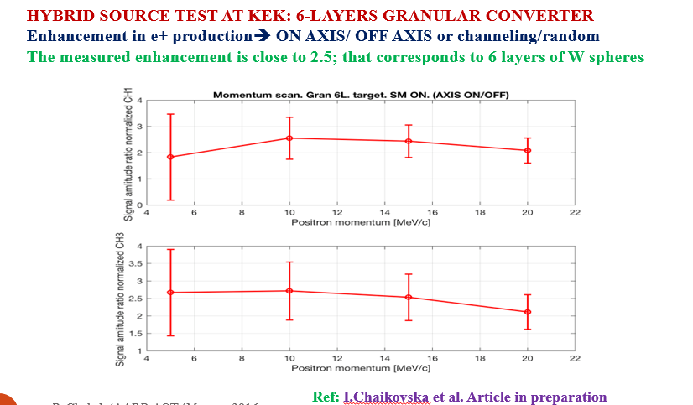
POSITRON SOURCES AT LAL-ORSAY

Slide 43
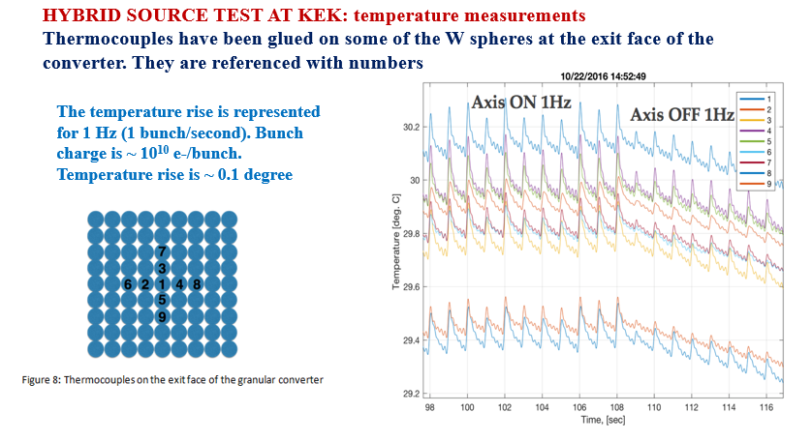
POSITRON SOURCES AT LAL-ORSAY
In the near future: tests at MAMI (Mainz)

Slide 44
POSITRON SOURCES AT LAL-ORSAY
4-4 POLARIZED POSITRONS
The needed longitudinally polarized positrons at the interaction point of a linear collider
are generated by the materialization of circularly polarized photons in amorphous
targets. So the main challenge is to create these circularly polarized photons in an energy
range allowing positron production with an energy of some MeV to tens of MeV able to
be easily captured by known optical matching systems. Various methods can be
considered to generate polarized photons .
Three main ways have been considered in that framework:
# Compton backscattering of circularly polarized laser photons on energetic
electron beams (some GeV, for visible laser photons)
# Radiation of high energy electrons in a helical magnetic undulator.
# Method using polarized bremsstrahlung generated by longitudinally polarized
electrons in amorphous targets.
A theoretical analysis of these methods is in the article of V.M.Strakhovenko et al. in V.Strakhovenko et al.
in Nucl.Instr. and Methods A 547 (2005) 320-333
We shall emphasize on the Compton process, for which works have been done at LAL with a PhD thesis (Iryna Chaikovska) and studies and realization of high finesse F-P cavity (F.Zomer team)

Slide 45
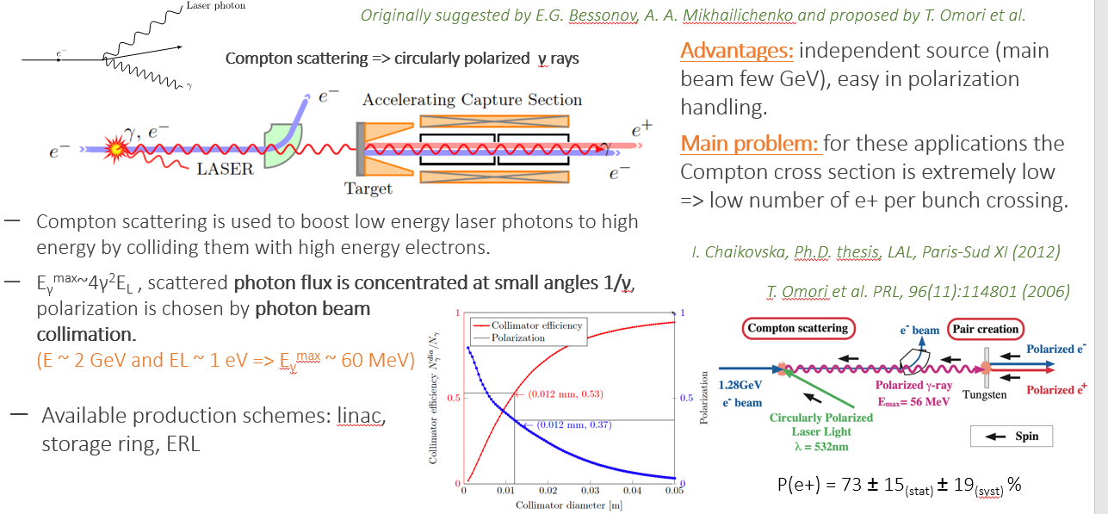
POSITRON SOURCES AT LAL-ORSAY
4-4 POLARIZED POSITRON SOURCES : COMPTON SCATTERING
Courtesy from Iryna Chaikovska
4-4 STUDIES ON POLARIZED POSITRON SOURCES

Slide 46
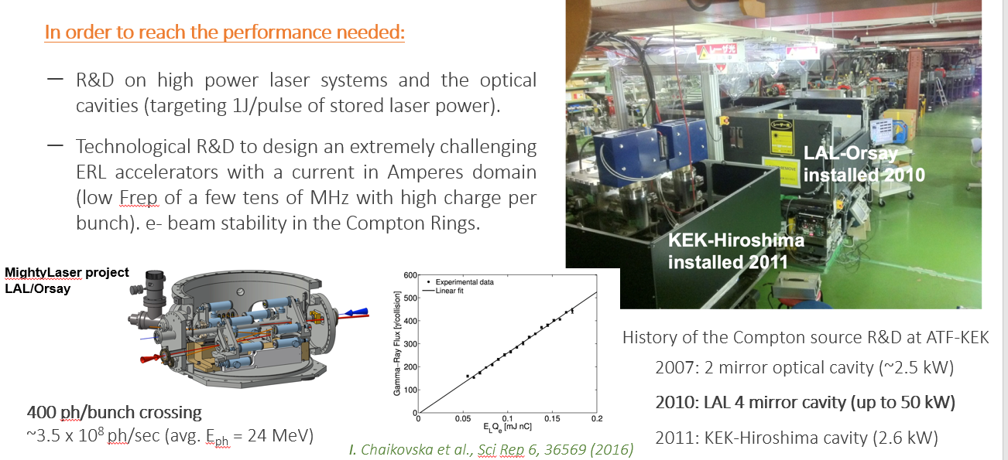
POSITRON SOURCES AT LAL-ORSAY
Courtesy of Iryna Chaikovska

Slide 47
POSITRON SOURCES AT LAL-ORSAY
5- PARTICIPATION TO INTERNATIONAL PROJECTS
LAL team has been involved in studies on positron source and injector for some international projects. In the beginning of the eighties a LAL group associated to CERN colleagues studied and built the positron source of LEP as he studied the LPI (LEP INJECTOR LINAC) for both electrons and positrons.
Linear collider positron sources as for CLIC and ILC have also been investigated at LAL. A particular attention was given to CLIC, for which the solution studied by LAL has been selected as the baseline. Concerning ILC, for which the baseline is associated to the undulator and the back solution to a conventional source, LAL has studied an hybrid positron source filling the requirements of the project.
The LAL, now, IJCLAB team is involved in the FCC-ee project with collaborations with KEK, CERN and PSI.

Slide 48
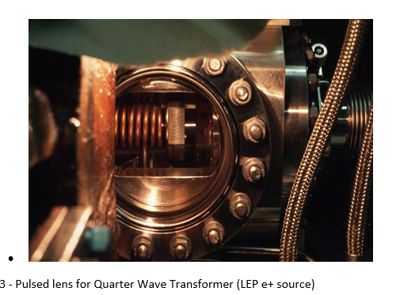
POSITRON SOURCES AT LAL-ORSAY
5- PARTICIPATION TO INTERNATIONAL PROJECTS
5-1 The LEP POSITRON SOURCE
A common group LAL-CERN paricipated to the study and realization of the LEP positron source. This work was done in the more general study of the LPI (LEP Pre-injector), done in common with CERN colleagues.
As an example for this study, a QWT Matching device using a pulsed coil in Vacuum has been studied and built.
The coil has 6 double windings (L=32 mm) .
Internal diameter is 25 mm. Peak field is 1.5 T.
A solenoid (0.3 T) is embedding the accelerating
sections. A tungsten converter 2Xo thick produces
the positrons with a 200 MeV e- beam.

Slide 49
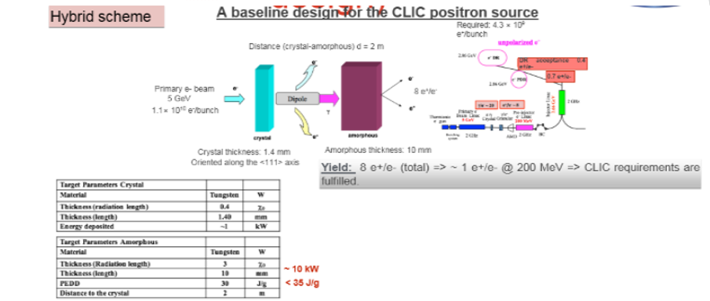
POSITRON SOURCE AT LAL-ORSAY
5-2 AN HYBRID POSITRON SOURCE FOR CLIC

Slide 50
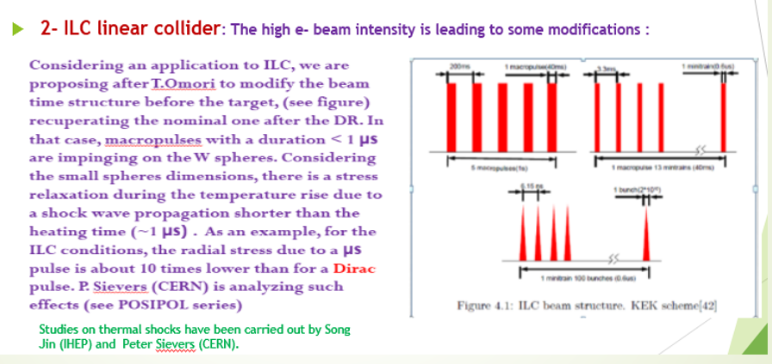
POSITRON SOURCES AT LAL-ORSAY
5-3 STUDY OF AN HYBRID SOURCE FOR ILC

Slide 51
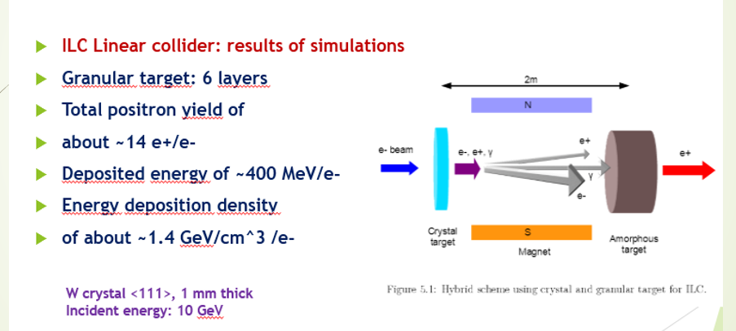
POSITRON SOURCES AT LAL-ORSAY

Slide 52
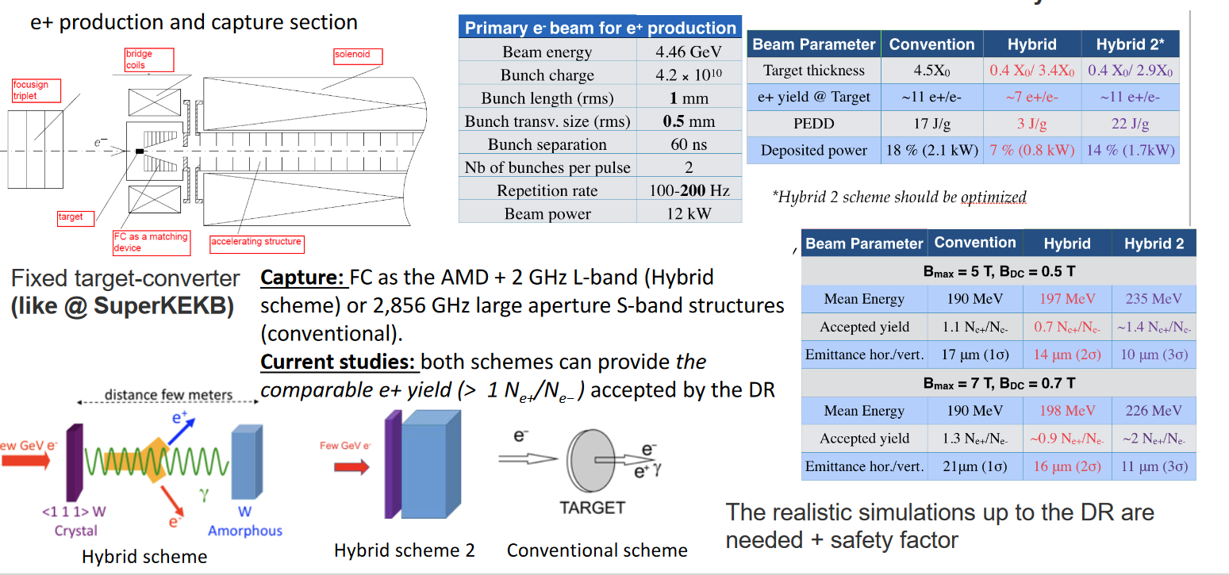
POSITRON SOURCES AT LAL-ORSAY
5-4 POSITRON SOURCE STUDIES FOR FCC-ee

Slide 53
POSITRON SOURCES AT LAL-ORSAY
THE INVOLVEMENT OF LAL/IJCLAB IN FCC-ee PROJECT
The IJCLab group leads the WP3: « Positron source: target and capture system » The tasks associated are concerning:
- The physics design of the target and of the capture system.
# Target: thermo-mechanical studies and area shielding
# Capture system: study & comparison between Flux Concentrator and SC
solenoid ; Solenoid at low field value embedding the accelerating sections.
The group is also involved in the WP6 : « Proof of principle positron source in SwissFEL »
The aim is to build a demonstrator for novel target and capture system at PSI.
Several beam tests at KEK, MAMI and DESY are foreseen ➔ participation of the group is expected.

Slide 54
POSITRON SOURCES AT LAL-ORSAY
SUMMARY AND CONCLUSIONS
Polarized and unpolarized positrons are of great importance for the colliding e+e- facilities. After the realization of the colliding beam rings, LAL activity on positron sources has been essentially directed on dedicated positron sources to e+e- colliders.. That implied the research on high intensity and small emittance positron beams.
Since more than thirty years a special activity in LAL involving theoretical and experimental studies on photon generation using crystal effects has been carried on. The promising results obtained in LAL-Orsay, CERN and KEK confirmed this choice. Such activity has been involving theoretical and experimental physicists, engineers and technicians for the equipment realization. It concerned the collaboration between french (LAL, IPNL) and russian laboratories (BINP, TPU). Discussions with ukrainian institute, KIPT, has been also fruitful.
Participation of LAL team to international projects is of particuliar importance, as shown for LEP. Such participation becomes essential for the development of this activity. The choice for CLIC baseline positron source of our « hybrid source using channeling » has been very encouraging. Presently, the positron source team at IJCLab is strongly involved in the FCC-ee project. Positron studies at IJCLab are continuing with the team led by Iryna Chaikovska. So, you will, probably, hear about positrons for a while.

Slide 55
POSITRON SOURCES AT LAL-ORSAY
ACKNOWLEDGEMENTS
If at the beginning the positron source activity involved few persons, even individuals, this is no more the case. Improvements in the performances (yield, emittance, heat load, resistance to thermo-mechanical stresses) required more means and more persons. In the activity developped at LAL, the involvements concerned more people in the lab and ...more labs. Since 30 years a straight collaboration with IPNL and at certain moment with CdF allowed significant progress in the studies of sources driven by crystal effects. Collaboration with BINP-Novosibirsk boosted the theoretical and experimental activity in the field. At the same time a collaboration with TPU brought interesting results. Discussions with the theoretical group of KIPT were also helpful. The experimental tests at SLAC, CERN and KEK would not have been successful without the decisive implication of our colleagues from Stanford, Geneva and Tsukuba. In a few words, the collaboration is the key.

