Slide 1
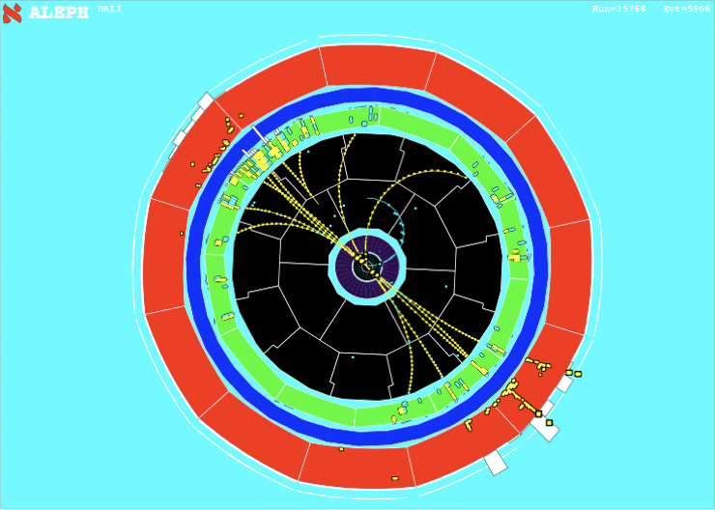

Resummation for collider phenomenology
Andrea
Banfi
Joint workshop
“GDR-QCD/STRONG2020/PARTONS/FTE@LHC/NLOACESS”
4 June 2021

Slide 2
Outline
Resummation: what it is and how you do it
The precision frontier
Spin correlations
Jet substructure

Slide 3
What is resummation?

Slide 4



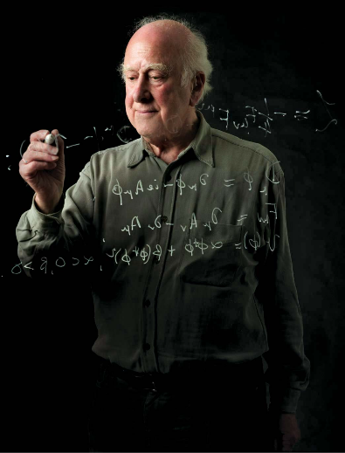

Two-scale problems
Resummation is all about taming two-scale problems, where an object characterised by a “hard scale” is accompanied by softer objects at a scale

Slide 5
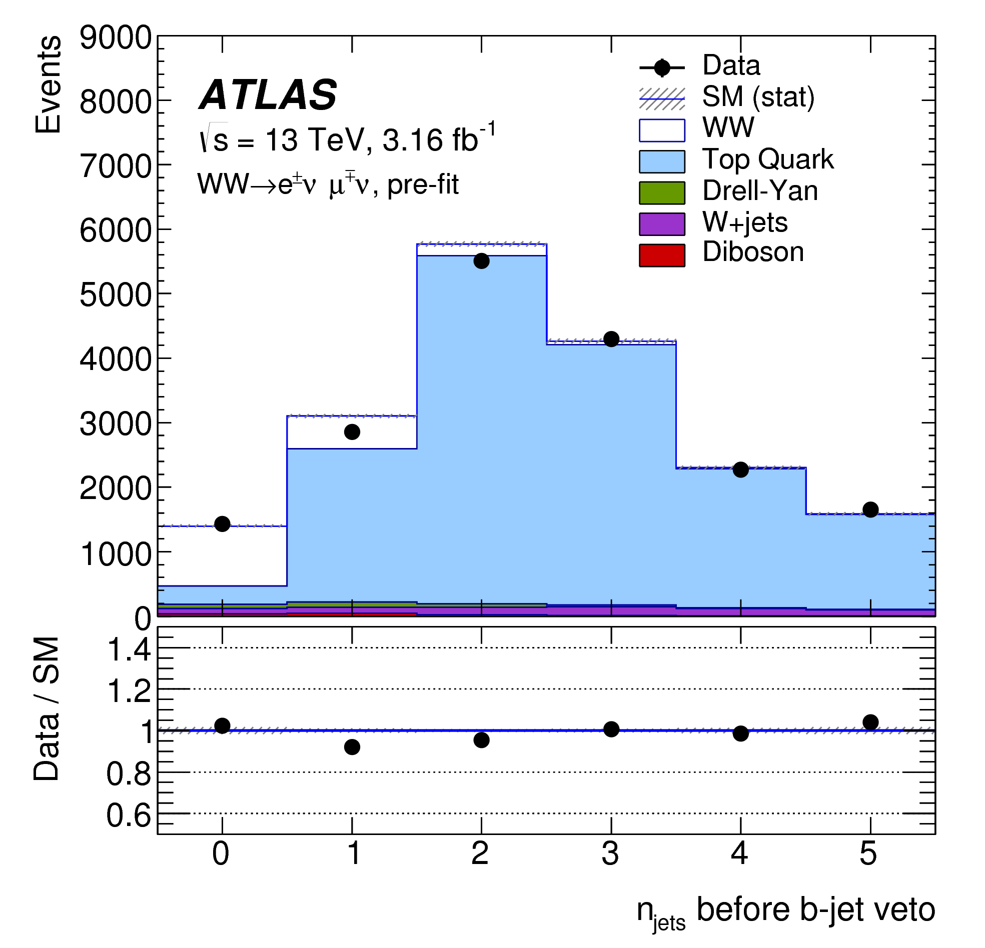
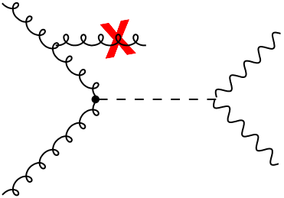

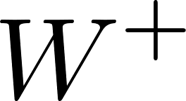

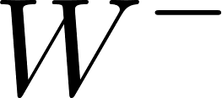
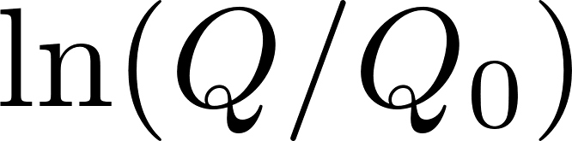
Two-scale problems in QCD
Example: an object with a large invariant mass is produced and the transverse momentum of accompanying jets is below
[1706.01702]
In QCD, large logarithm appear whenever the phase space for the emission of soft and/or collinear gluons is restricted

Slide 6
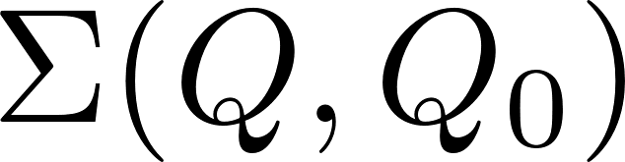

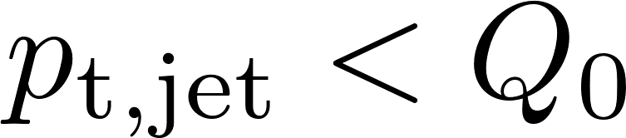
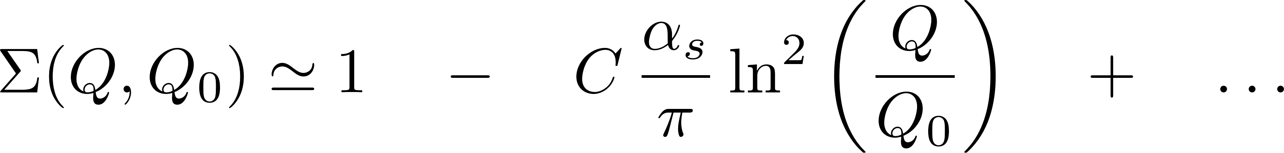

Two-scale observables at FO
Consider the cumulative distribution , the fraction of events such that an observable is below a given resolution (e.g. )
Logarithmic contributions become large whenever
LO
NLO
breakdown of perturbation theory!
large logs

Slide 7

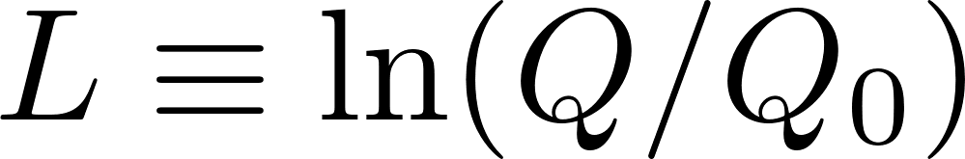
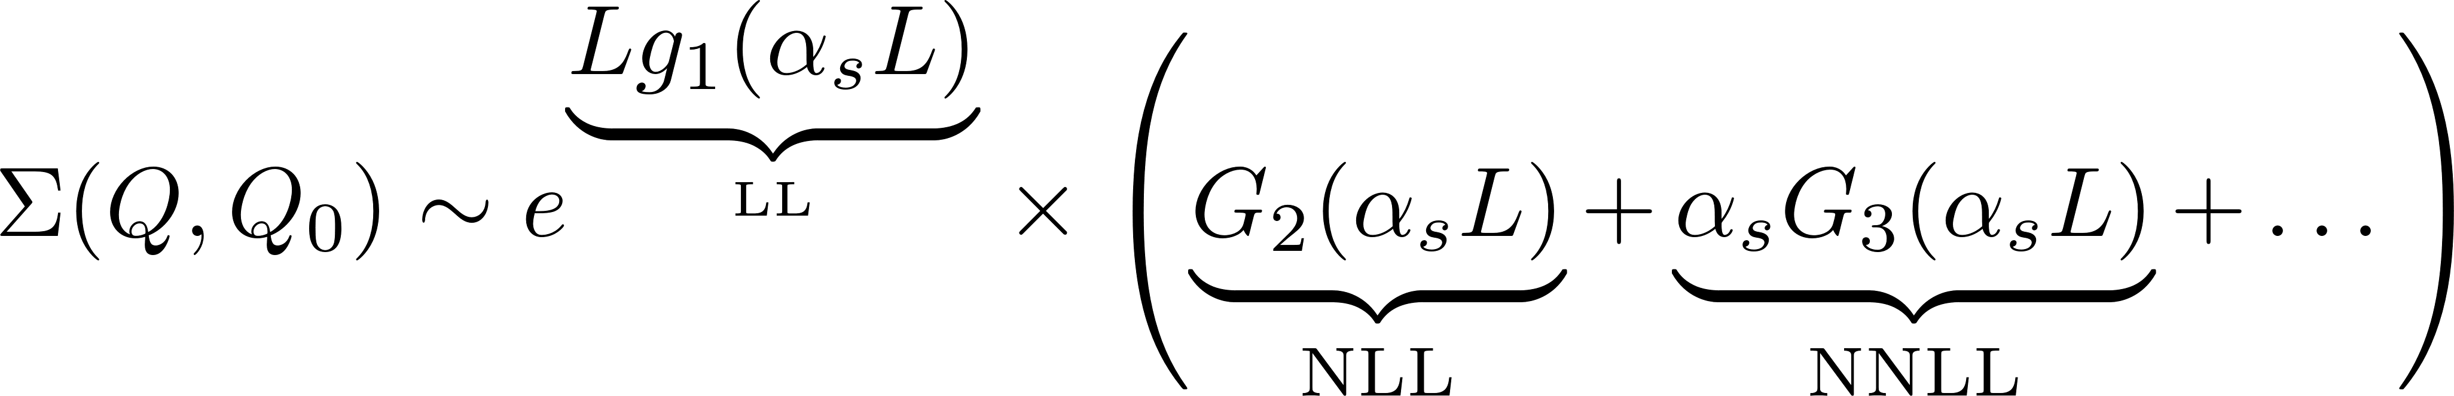
All-order resummation
All-order resummation of large logarithms reorganisation of the perturbative series in the region , with

Slide 8

All-order resummation
All-order resummation of large logarithms reorganisation of the perturbative series in the region , with
The state-of-the art is NNLL for most observables, and for some even N³LL
The above representation holds only when LL factorise. For all other observables, there is no established way to define a resummation accuracy

Slide 9

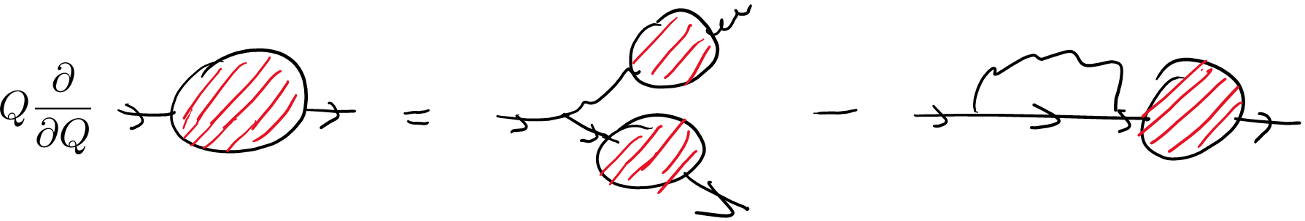
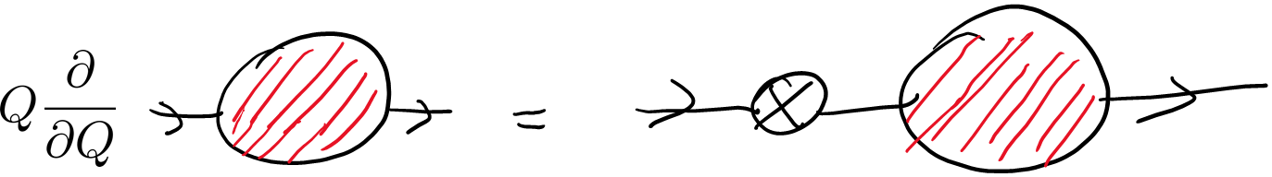
QCD dynamics is non-linear
Main problem of resummation: gluons and quarks radiate in the same fashion QCD dynamics intrinsically non-linear
The key feature of the most precise resummations is the possibility of following only one of the two branches of the splitting
This results in a set of linear renormalisation group equations and resummation is mainly achieved by calculating anomalous dimensions

Slide 10
Factorisation is the key
Resummation would never be possible if we could not separate process-dependent hard matrix elements from universal soft-collinear dynamics
Factorisation is enough to write general resummation formulae for suitable observables in QCD CAESAR (NLL) / ARES (NNLL) approach
Using the technique of strategy of regions, factorisation formulae can include observable constraints Soft-collinear effective theory (SCET)
Strategy of regions is the only way forward so far when no general principles such as gauge invariance can be invoked, e.g. quark-mass logarithms in loop amplitudes
[Collins Soper Sterman hep-ph/0409313]
[AB Salam Zanderighi hep-ph/0407286]
[AB El-Menoufi Monni 1807.11487]
[Bauer Fleming Pirjol Stewart hep-ph/0011336]
[Becher Schwartz 0803.0342]
[Becher Neubert 1007.4005]
[Liu Mecaj Neubert Wang 2009.06779]

Slide 11
The precision frontier

Slide 12
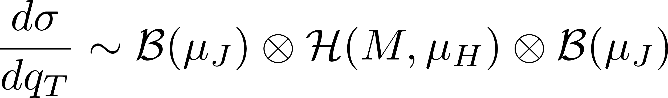
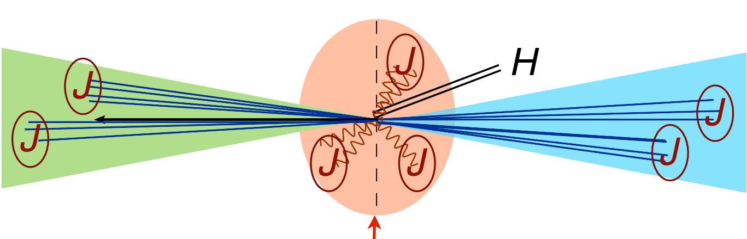
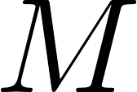
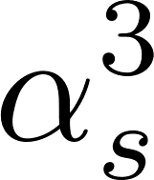
Transverse momentum distributions
The distribution in the transverse momentum of a colour singlet (e.g. Higgs, Z boson) admits an all order factorisation
Calculation of relevant anomalous dimensions makes it possible to achieve a remarkable N³LL accuracy (times a constant at order , a.k.a N³LL’)

Slide 13
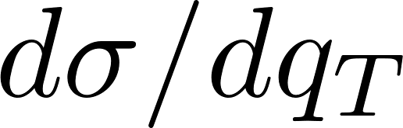
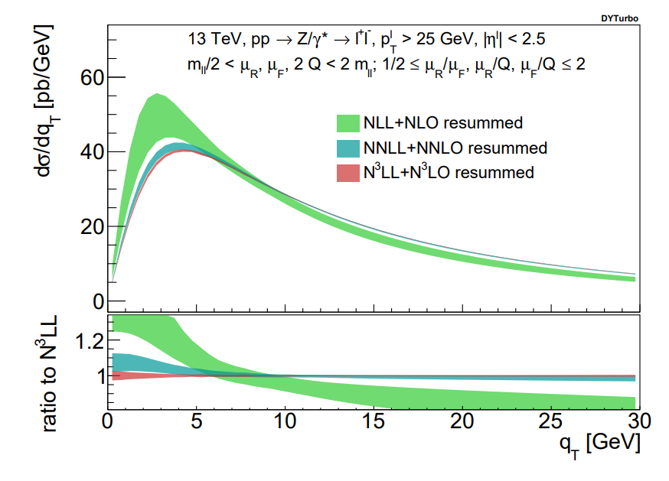
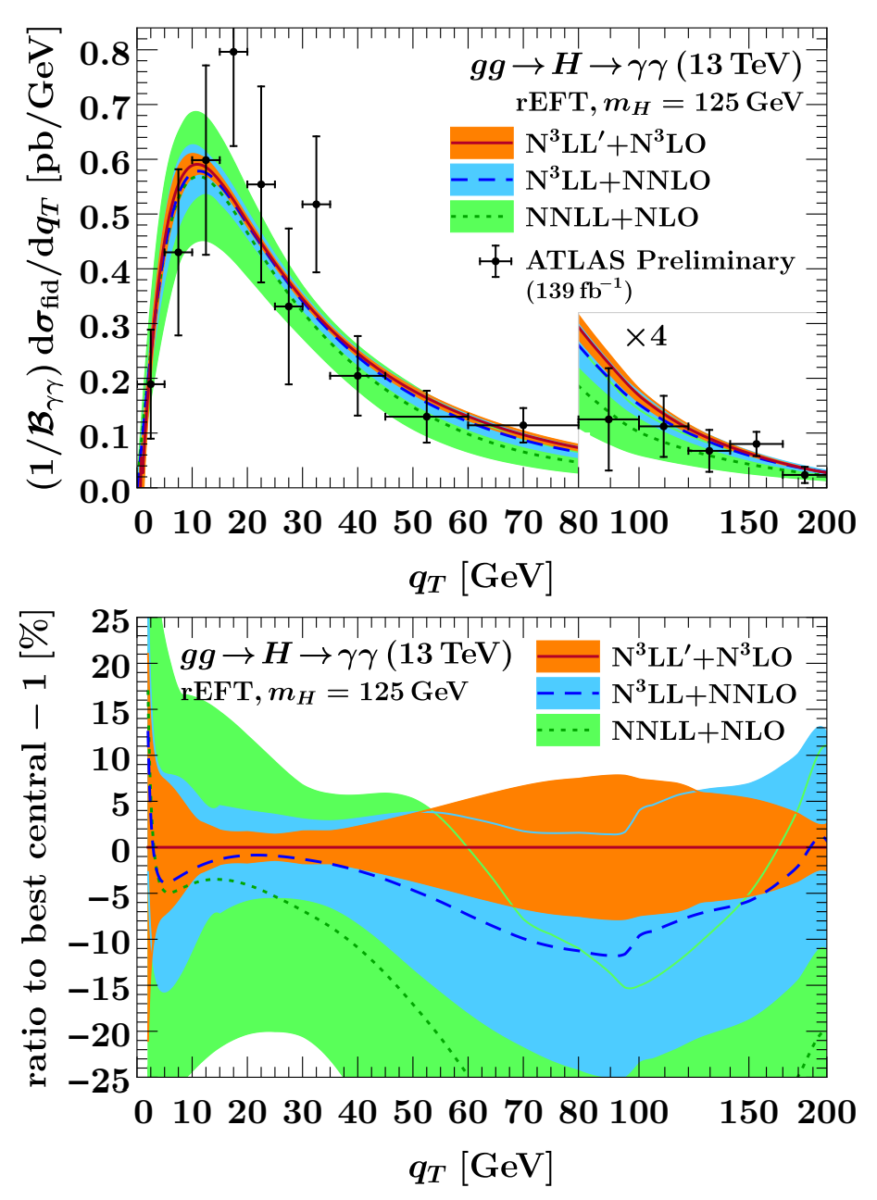
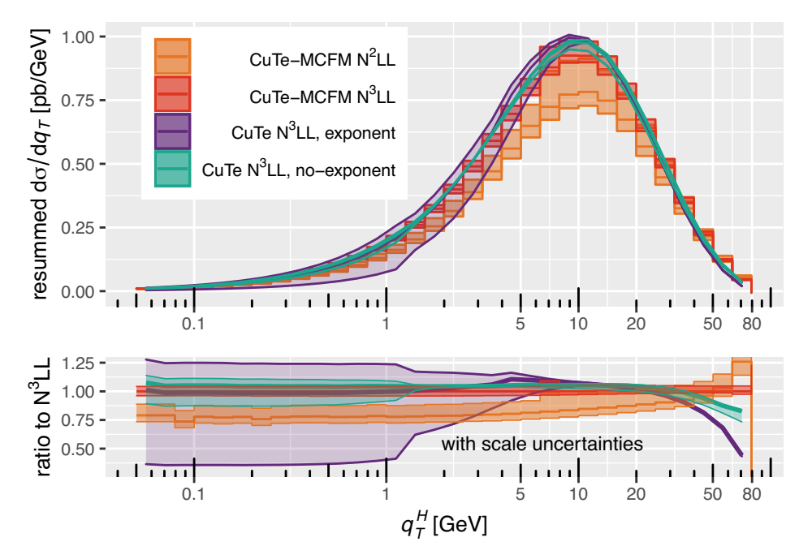
B-space resummation
Three calculations perform the resummation in impact-parameter or b-space, i.e. for the Fourier transform of
[Camarda et al 2103.04974]
[Billis et al 2102.08039]
[Becher Neumann 2009.11437]

Slide 14
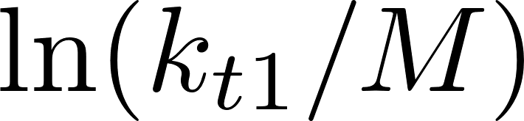
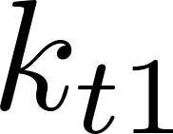
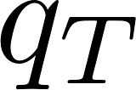
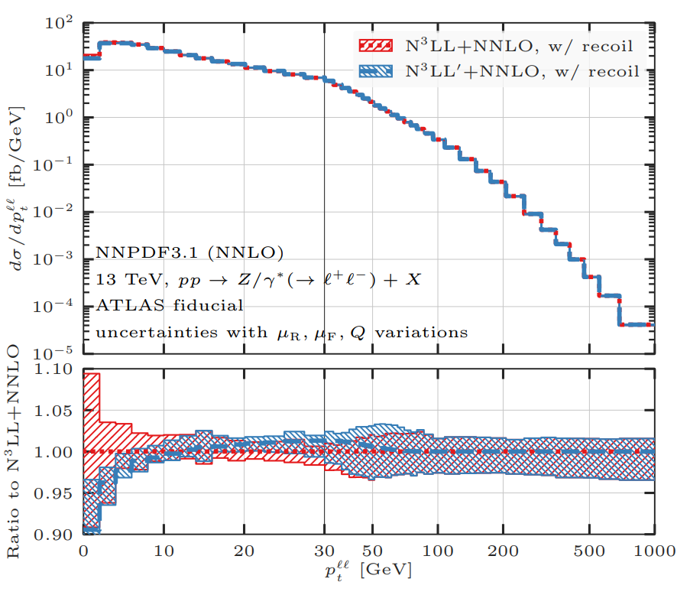
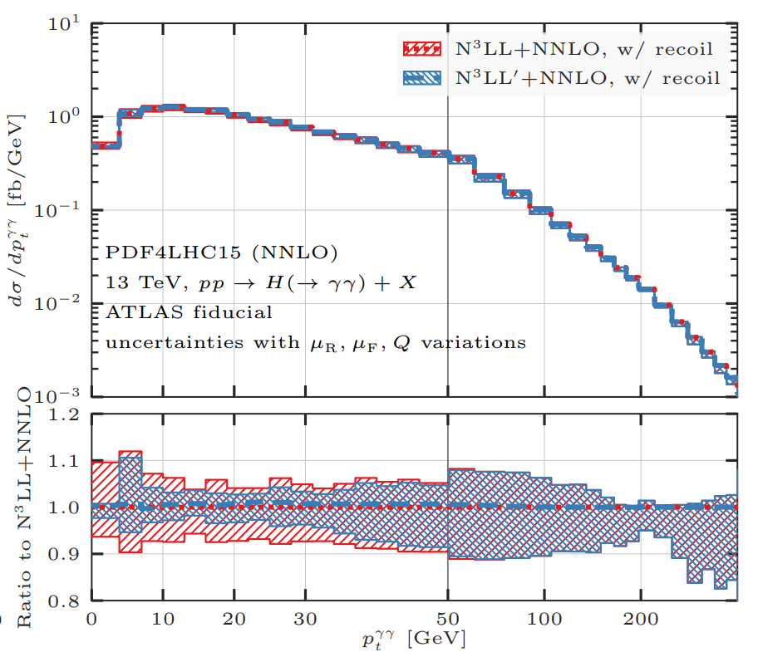
Direct space resummation
In the RadISH formalism, one resums where is the transverse momentum of the leading parton
The resummation in is performed with the ARES philosophy and then the result is then integrated over and binned in
[Monni Re Torrielli 1604.02191]
[Re Rottoli Torrielli 2104.07509]
Uncertainties are reduced if one considers formally power-suppressed terms where the colour singlet acquires non-zero via resummation

Slide 15
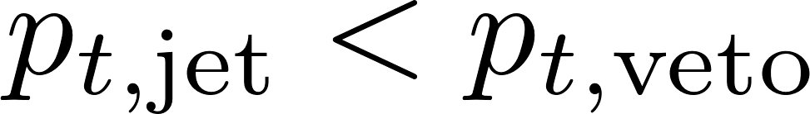
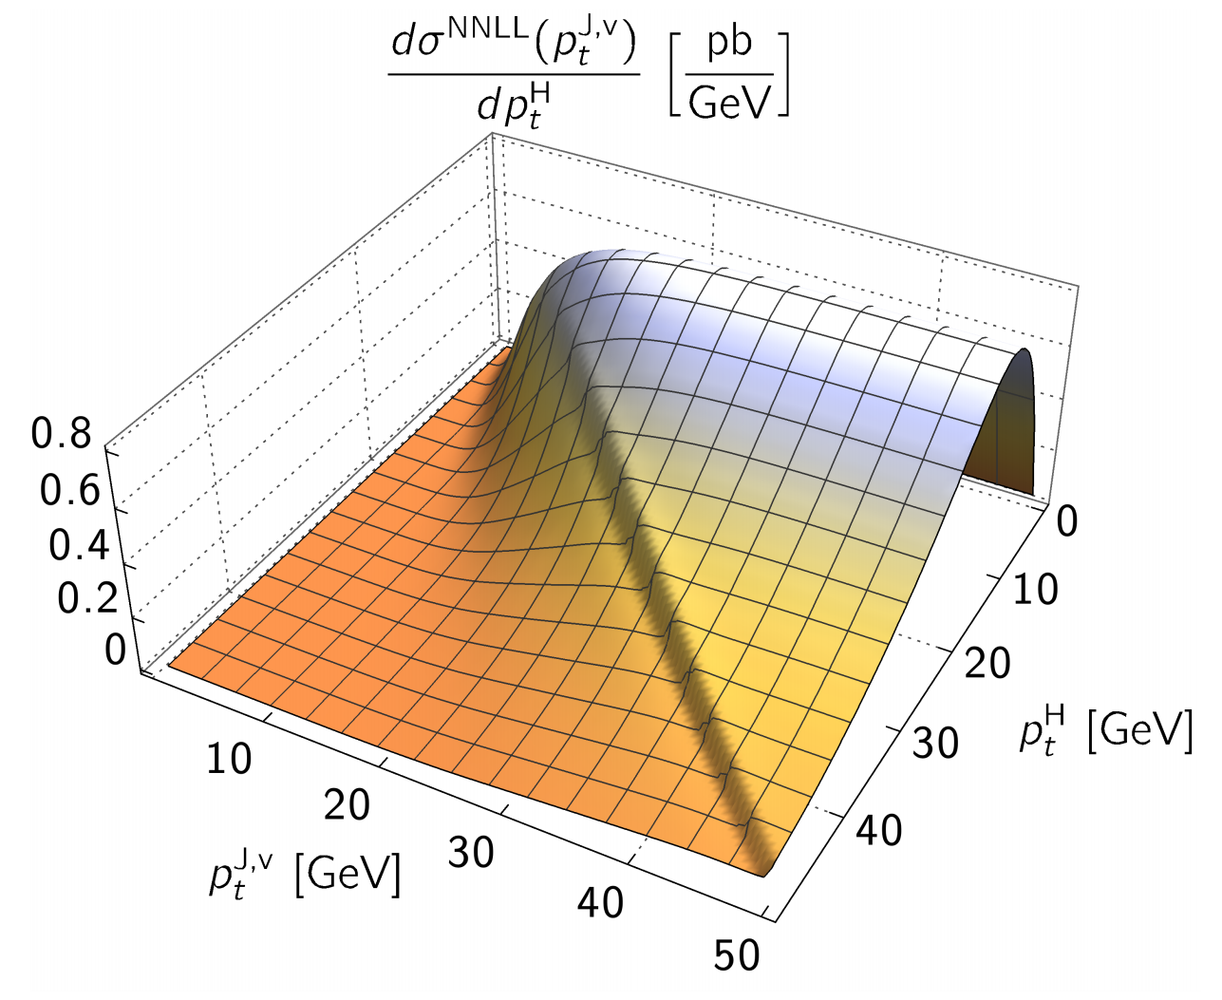
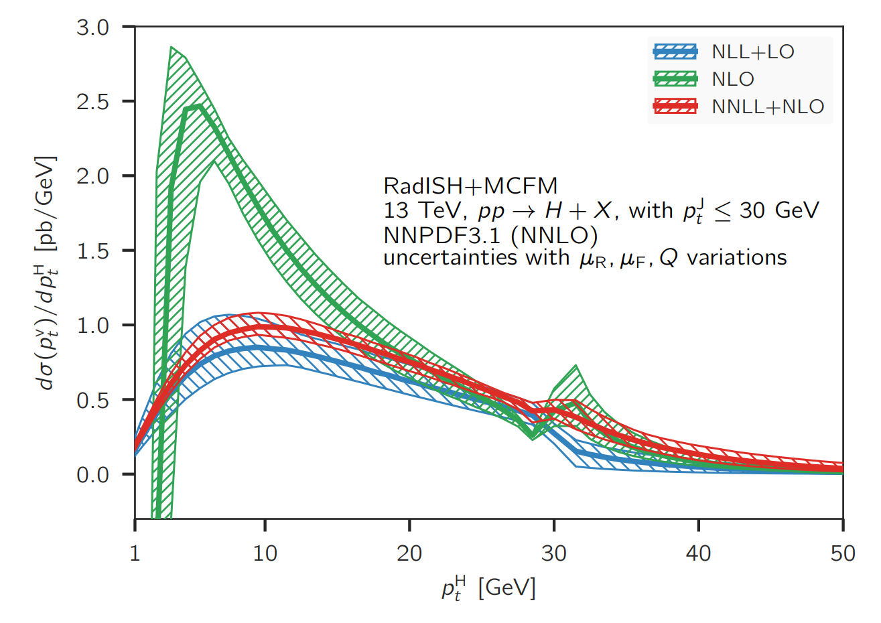
Adding constraints
With the same RadISH formalism used for the distribution, it is possible to add a constraint
[Monni Rottoli Torrielli 1909.04704]
The resummation accuracy here is “limited” to NNLL because of missing calculation of jet-veto effects

Slide 16
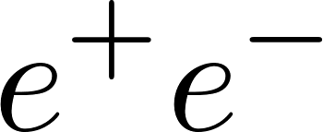
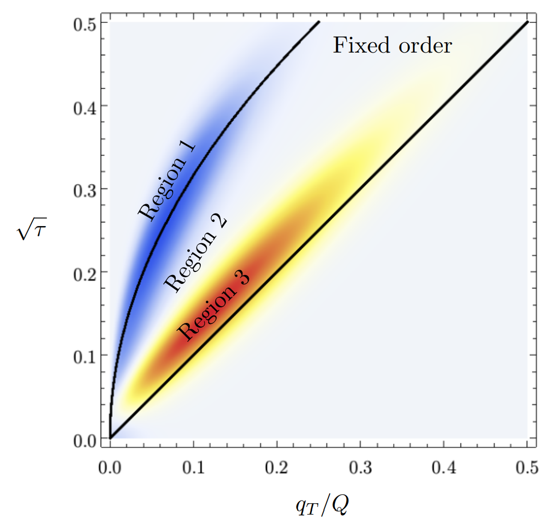
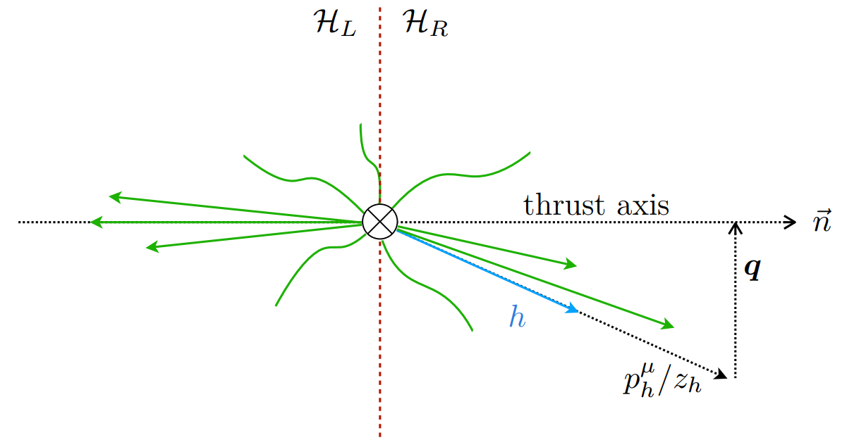
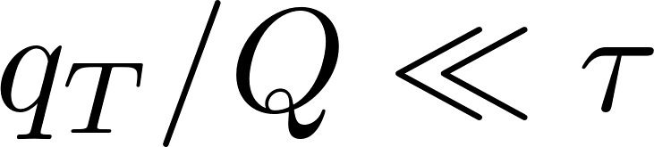
Adding constraints
An observable similar to in is the transverse momentum distribution of hadrons with respect to the thrust axis
Within SCET, a simultaneous resummation of TMD fragmentation function and thrust distribution has been achieved at NNLL accuracy
[Makris Ringer Waalewijn 2009.11871]
For one needs to consider non-global logarithms

Slide 17
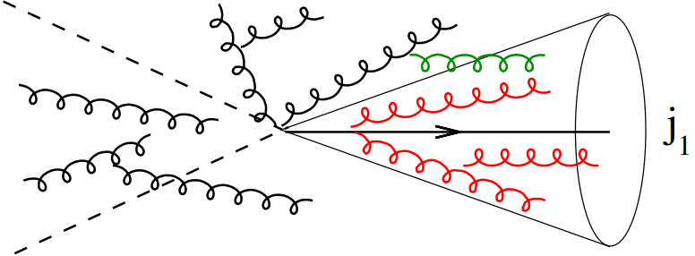
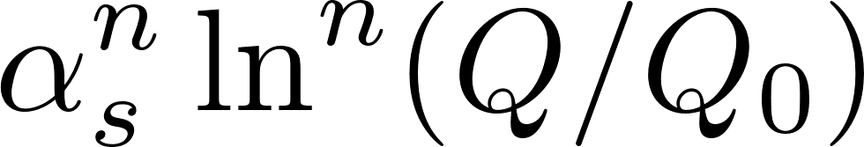
Non-global logarithms
Non-global logarithms (NGLs) arise whenever measurements are restricted to limited regions of phase space, e.g. single-jet mass distribution
They originate when softest emission in a correlated cascade of soft gluons enters the measurement region
[Dasgupta Salam hep-ph/0104277]
Leading NGLs are single logarithms, of the form
Leading NGLs in the limit of a large number of colours (large-N_{c}), they are resummed via the non-linear BMS equation
[AB Marchesini Smye hep-ph/0206076]

Slide 18
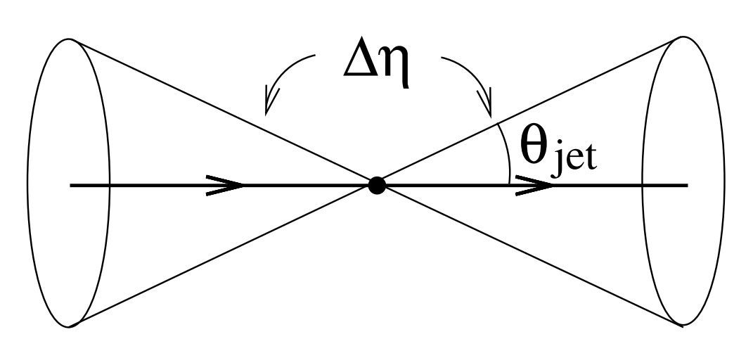
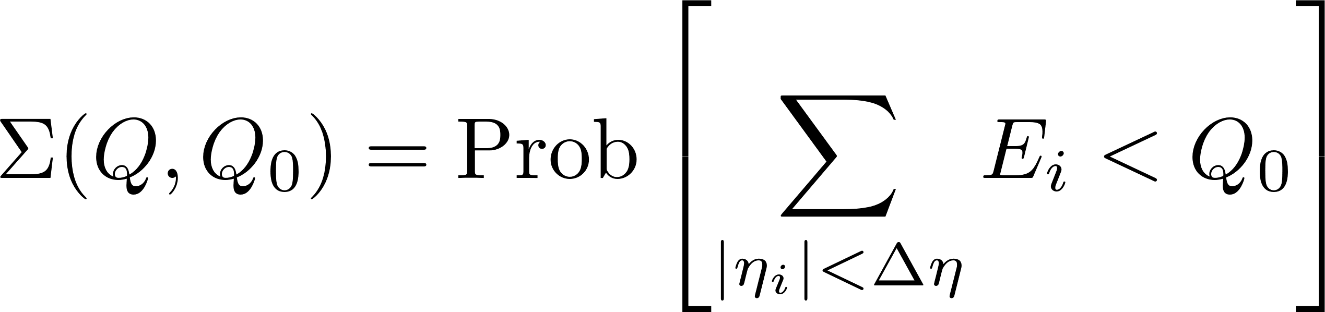
NL non-global logarithms
Case study: veto emissions inside a rapidity slice
All leading logarithms in are resummed by the BMS equation
At LL accuracy, it is also possible to include finite-N_{c} effects
The kernel of BMS equation has been recently improved at NLL accuracy in the large-N_{c} limit
The new NLL resummation is suitable for Monte Carlo implementation
[AB Marchesini Smye hep-ph/0206076]
[Hatta Ueda 1304.6930]
[AB Dreyer Monni 2104.06416]

Slide 19
Spin correlations

Slide 20
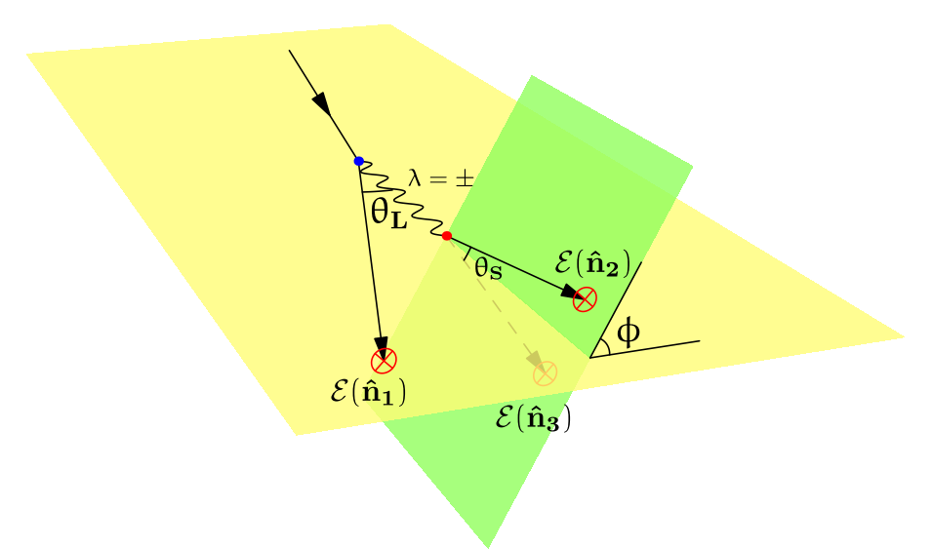
Gluon spin correlations
Since gluons have spin-1, due to spin correlations their splittings depend on the azimuth with respect to a suitably defined plane

Slide 21
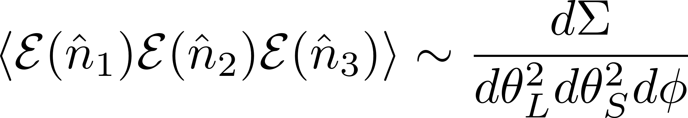
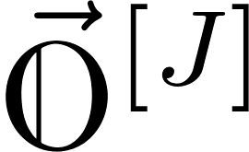
Triple-energy correlations
Such spin correlations can be probed at single-logarithmic accuracy via triple-energy correlations
Resummation of the multi-parton energy correlation is related to CFT light-ray operators of spin J and their anomalous dimensions
[Chen Moult Zhu 2104.00009]

Slide 22
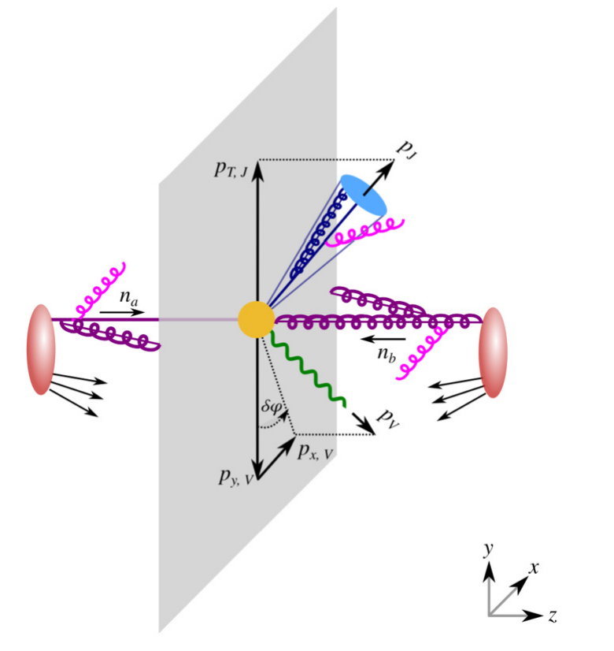
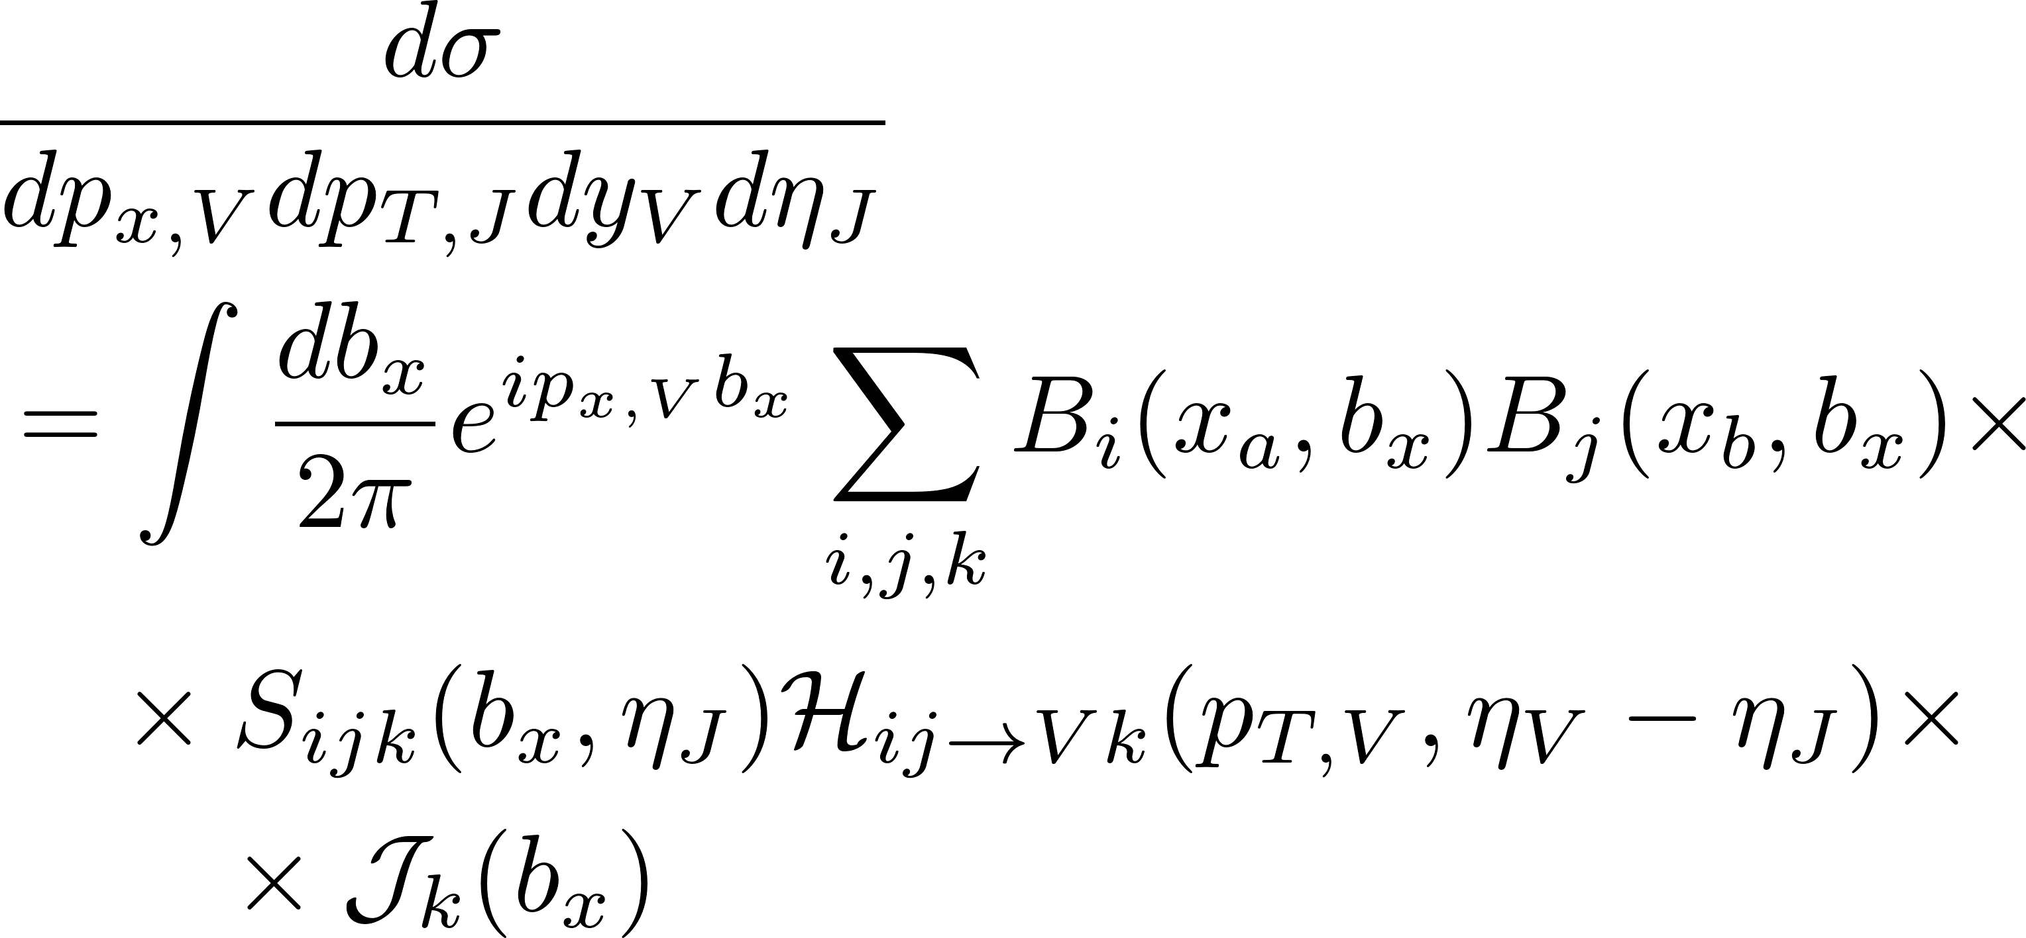
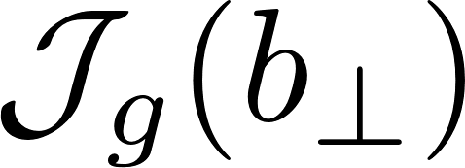
Azimuthal correlations
The plane of the splitting can be fixed by the beam and a hard particle, e.g. a vector boson recoiling against a jet
WTA jet axis no NGLs SCET all-order factorisation formula
[Chien et al 2005.12279]
Spin correlation effects occur at NNLL
When the recoiling jet is a gluon jet, spin correlations give rise to a linearly polarised transverse momentum distribution in the final state

Slide 23
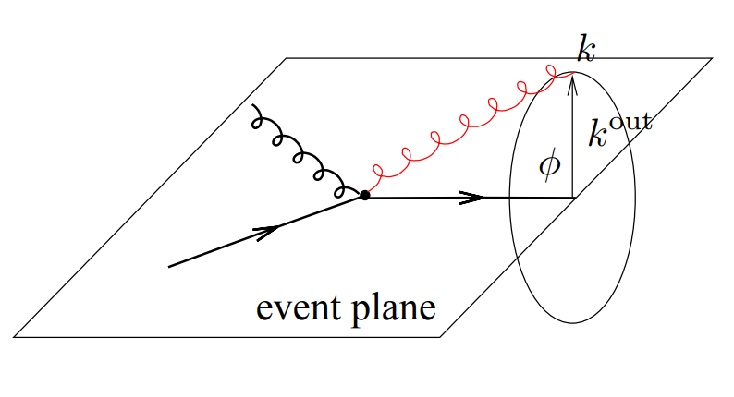
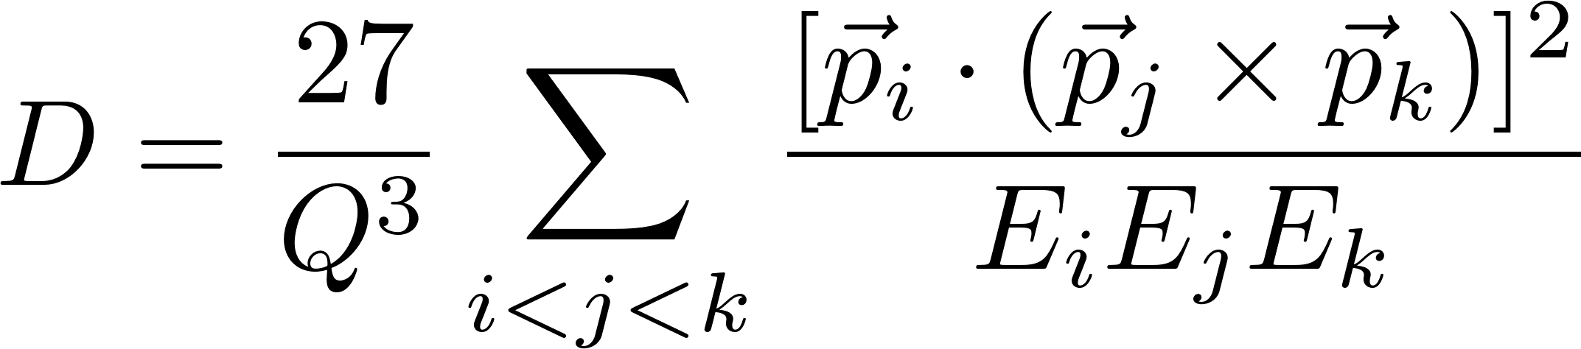
Near-to—planar shapes
Out-of-plane event shapes, e.g. D-parameter, are also sensitive to spin correlations in gluon jets
In the tree-jet region, spin correlations arise at NNLL
In the two-jet region, when the hardest gluon is allowed to be soft and collinear, can spin correlation effects appear at NLL?
[Arpino AB El-Menoufi 1912.09341]
[Larkoski Procita 1810.06563]

Slide 24
Jet substructure

Slide 25
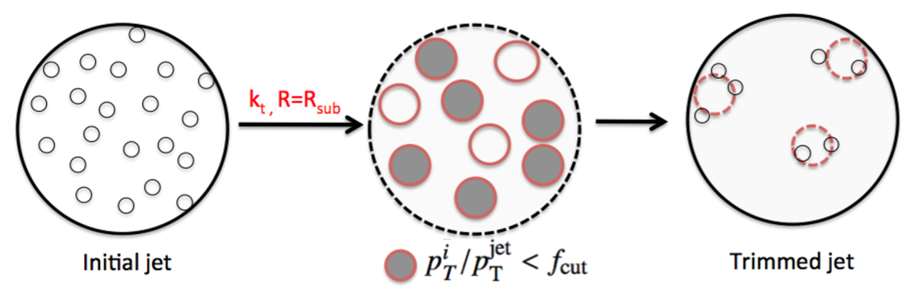
Boosted objects
Both HL-LHC and future colliders will produce boosted heavy objects, whose decay products fall in the same jet (e.g. boosted Higgs or tops)
[Butterworth Davison Rubin Salam 0802.2470]
hadronic top candidate
[ATLAS 1306.4945]
Key feature of boosted object taggers are groomers, procedures that clean jets from soft constituents irrelevant for mass reconstruction

Slide 26

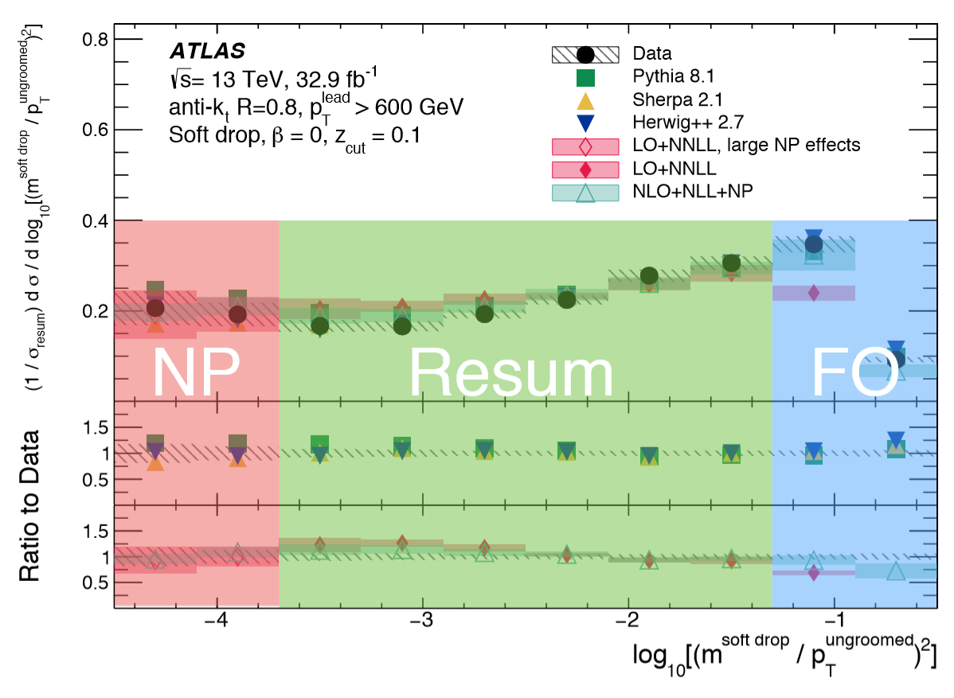
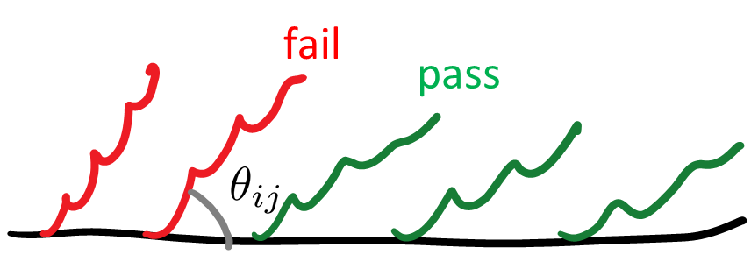
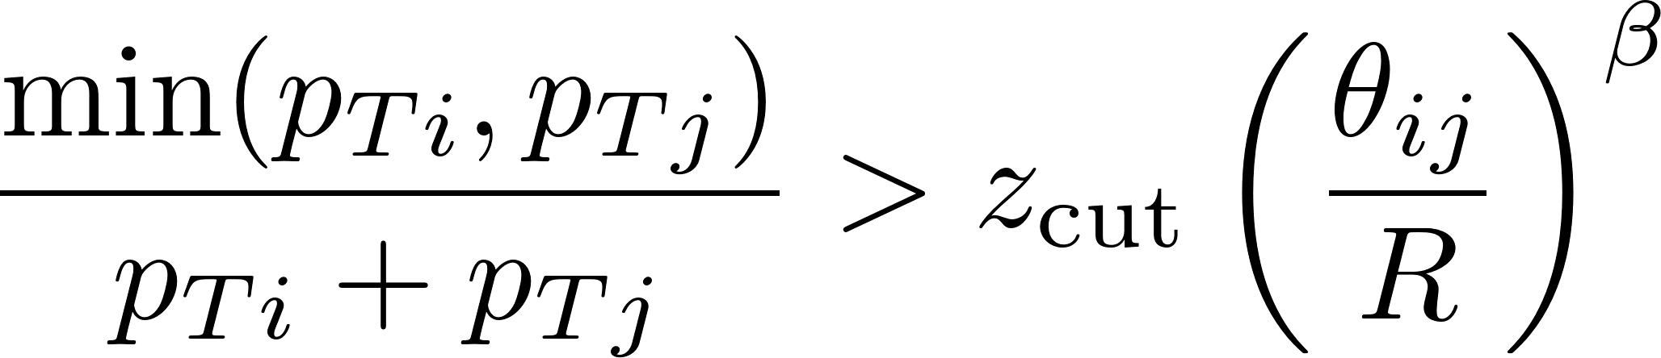

The soft-drop groomer
Groomed jet-mass distributions cumbersome to model in QCD due to the presence of non-global logarithms (NGLs)
New soft-drop groomers are free from NGLs accurate analytical modelling of different taggers now possible
[Larkoski Marzani Soyez Thaler 1402.0007]
: mMDT
[1711.08341]

Slide 27





A new precision era?
The distribution in does obey a factorisation theorem in the region
Anomalous dimensions extracted from fixed-order calculations in annihilation N³LL resummation!
Preliminary studies of extraction of the strong coupling at hadron colliders using jet-substructure observables
[Frye Larkoski Schwartz Yan 1603.09338]
[Kardos Larkoski Trocsanyi 2002.00942, 2002.05730]
[CMS 1808.07340]

Slide 28
Outlook
Resummation is a thriving field, with a plethora of new exciting results
NNLL is the state-of-the-art, achievable both in QCD and with effective-theory methods
Transverse momentum resummations have reached the impressive N³LL accuracy
First NLL resummation of non-global logarithms
Renewed interest in spin-correlation effects
New avenues for the use of jet-substructure observable for precision measurements, i.e. strong coupling

Slide 29
Outlook
Resummation is a thriving field, with a plethora of new exciting results
NNLL is the state-of-the-art, achievable both in QCD and with effective-theory methods
Transverse momentum resummations have reached the impressive N³LL accuracy
First NLL resummation of non-global logarithms
Renewed interest in spin-correlation effects
New avenues for the use of jet-substructure observable for precision measurements, i.e. strong coupling
Thank you for your attention!

