Slide 1




ALD-deposited Multilayer to improve the superconducting performances of RF cavities
Yasmine Kalboussi¹, Sarra Bira², Baptiste Delatte¹, Claire Antoine¹, David Longuevergne², Diana Dragoe³, Jocelyne Leroy⁴, Sandrine Tusseau-Nenez⁵, Aurélie Gentils², Stéphanie Jublot Leclerc², Fréderic Miserque⁷,Gael Sattonnay², Enrico Cenni¹, Mohamed Belhaj⁶, Thomas Proslier¹.
¹IRFU, CEA Saclay, 91191 Gif-sur-Yvette Cedex, France ; ² Université Paris-Saclay, CNRS/IN2P3, IJCLab, 91405 Orsay, France ; ³ Plateforme ICMMO, Rue du doyen Georges Poitou, Bât 410 ,91400 Orsay France ; ⁴ Laboratoire d’Innovation en Chimie des Surfaces et Nanosciences, 91191 Gif sur Yvette, Cedex, France ; ⁵ Plateforme de Diffraction des Rayons X, Ecole Polytechnique, Route de Saclay, 91128 Palaiseau. ⁶ Physics instrumentation environnement space department, coupling of spacecraft and environnement unit, ONERA. ⁷ DEN, Service de la Corrosion et du Comportement des Matériaux dans leur Environnement (SCCME), CEA Saclay, 91191 Gif-sur-Yvette Cedex, France.

Slide 2
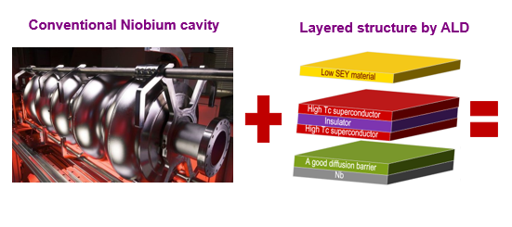
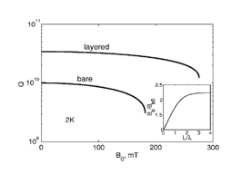
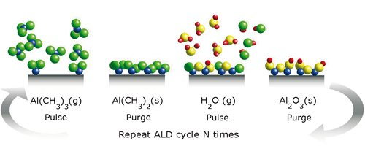
Introduction
An original approach proposed by A. Gurevich [1] to improve RF cavities through depositing a superconducting multilayer capable of screening efficiently the magnetic field.
To optimize this concept, we need as well a thermally stable diffusion barrier as a base and a low SEY material on the outer layer in order to limit multipacting inside the cavities.
The multilayer is a stack of nanometric films of high Tc superconductors and insulators.
To synthesize this structure, we use atomic layer deposition ALD as a deposition technique as it well known to provide high quality Nano-films over large surfaces with complex shapes such as RF cavities.
[1] A.Gurevich,Enhancement of RF breakdown field of SC by multilayer coating.Appl. Phys.Lett, 2006.
| PAGE 1

Slide 3
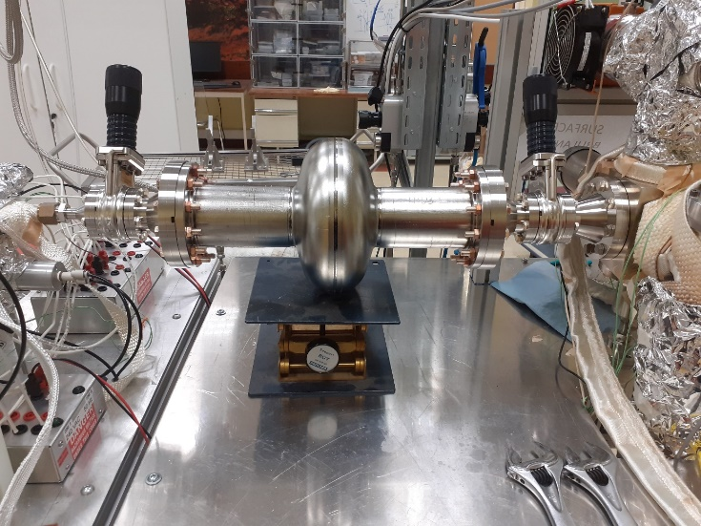
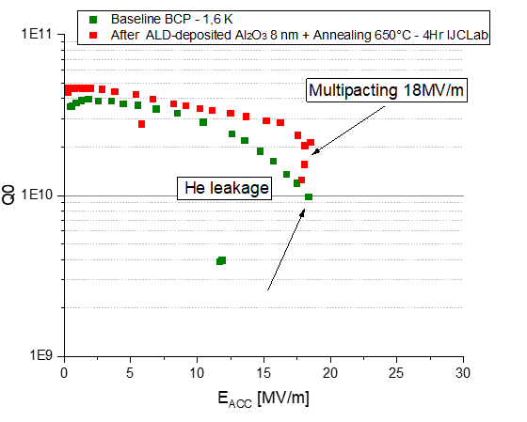
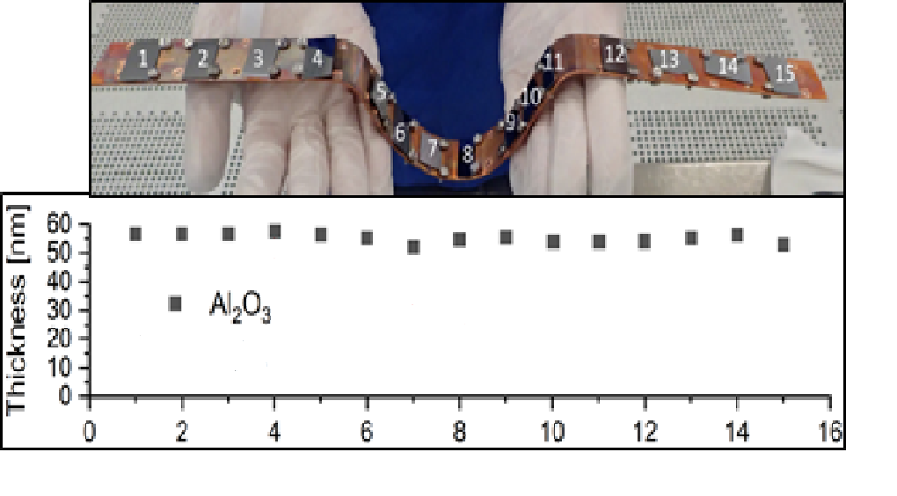
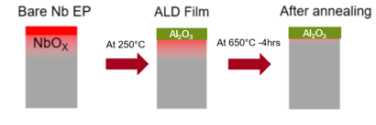
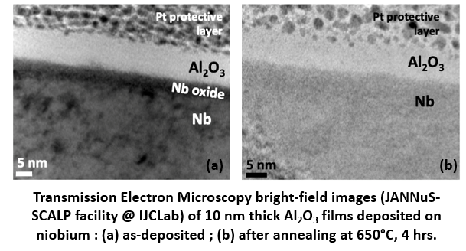
Ald Protective layer
Ald Protective layer
First Step: Reduce Niobium native oxydes which are deleterious for superconductivity and replace it with a thermally stable ALD-deposited diffusion barrier.
RF test of the ALD-coated (Al₂O₃-10nm)cavity
Thickness profile on Si samples inside the Aluminium cavity
Gaz flow direction
  We manage to deposit uniformly a thin film of alumina.
  RF test shows a slight improvement of the Q₀ at low field that increases with the accelerating gradient.
  Strong Multipacting barrier found at 18 MV/m that cannot be processed.
  Why and how to mitigate this effect?
| PAGE 2

Slide 4
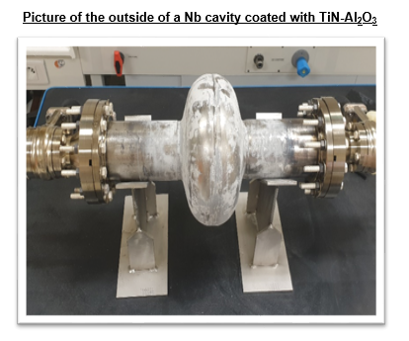
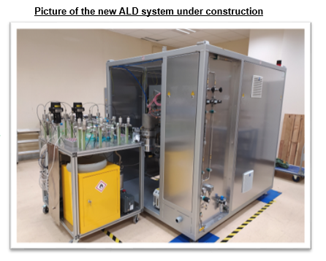
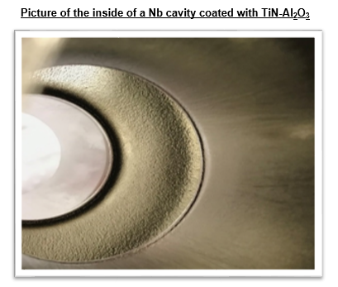
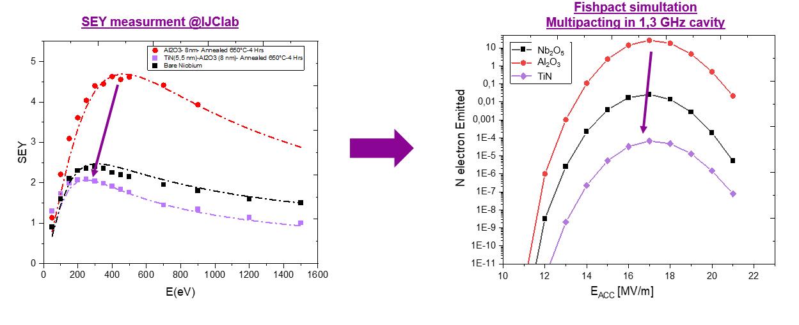
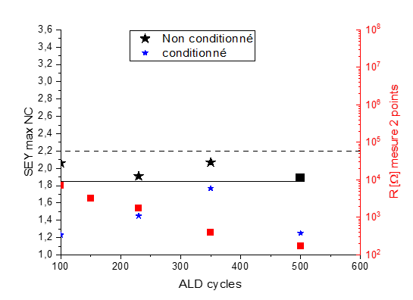
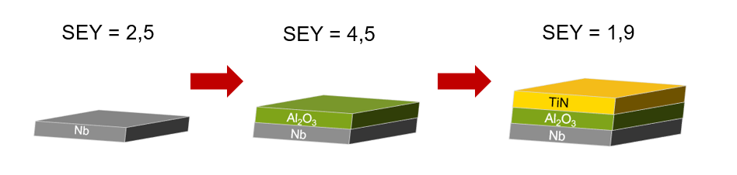
SEY on ALD-deposited Films
Al₂O₃
Yasmine KALBOUSSI
| PAGE 3

Slide 5
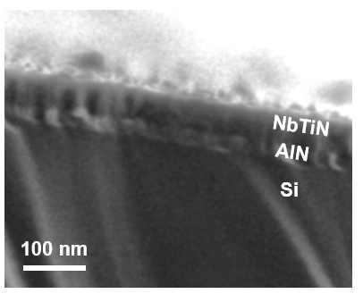
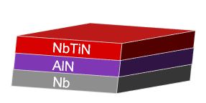
Bilayer AlN-NbTiN
Motivation: NbTiN has good superconducting performance (T_{c} = 17 K).
Chemistry: Combination of NbCl₅/ NH₃ and TiCl₄/NH₃ cycles:
n (TiCl₄ + NH₃) + m (NbCl₅ +NH₃)
NbTiN Chemical composition
Critical temperature
Resistivity
Al₂O₃
Yasmine KALBOUSSI
| PAGE 4
Ti content varies with TiCl₄: NbCl₅ Ratio non linearly.
Highest Tc by ALD without any post-treatment.

Slide 6
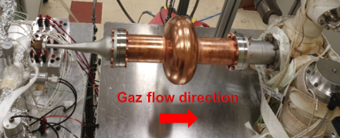
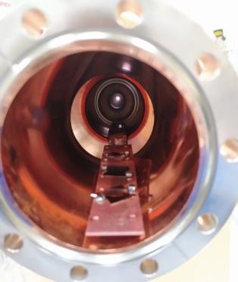
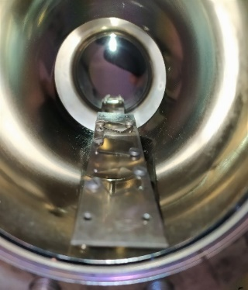
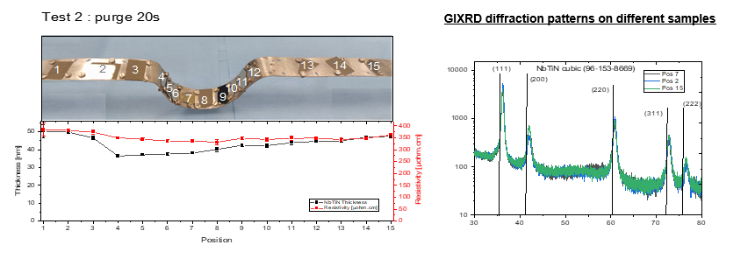
AlN-NbTiN on cOpper 1,3 Ghz cavity
AlN-NbTiN on cOpper 1,3 Ghz cavity
B
Before
After
| PAGE 5
Yasmine KALBOUSSI
| PAGE 5

Slide 7
Conclusion
  We manage to deposit uniformly a thin film of Alumina and reduce drastically niobium native oxides.
  RF test shows a slight improvement of the Q₀ under low and medium Fields.
  TiN film is promising to reduce multipacting inside RF cavities.
  Growth of superconducting NbTiN by ALD with homogeneous composition and thickness control over large surface areas.
  Future Goals will be:
  Optimization of NbTiN process to improve superconducting properties.
  Test the NbTiN-AlN structure on Niobium RF cavities.
Thank you for your attention …
| PAGE 6

