Slide 1
Pulse-gated ultrashort fiber Lasers
The smartest solution for accelerators community?

Slide 2






IRISIOME’s Laser technology features
Many wavelength available in IR around 1 µm and 1,5 µm.
Fine spectral adjustment, SHG & THG available.
0,25 μm
0,5μm
0,75 μm
1 μm
1,5 μm
Adjustable and/or fixed pulsed duration
from 35 ps to few ns. Flat-Top/super-gaussian profile.
Tunable pulse repetition frequency from single-shot
up to 2 GHz, burst capabilities.
Multistage fiber amplifier from > 20 mW to > 20 W.
With good beam quality (M² < 1,3)
Compact, turn-key all-fiber master/slave system with easy synchronization.

Slide 3
MANNY-IR SERIES – Highly flexible IR ps Fiber Laser

Slide 4
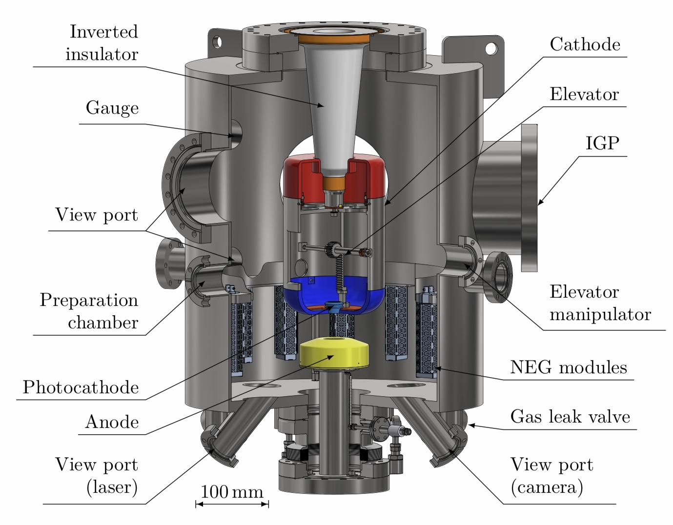
Applications for accelerators
Photocathode excitation:
→ Lasers already on the Field (Brookhaven National Lab)
→ Laser for ELSA accelerator to be delivered
→ Top-Hat pulses, synchronization and different wavelength
available.
IRISIOME Laser for ELSA accelerator (Thanks to V. Le Flanchec)
Metallic Photocathode
1064 nm 50-200 ps Laser
IRISIOME Laser on MESA accelerator, University of MAINZ, Germany (Pr. K. Aulenbacher)
Polarized Electrons ;
Photocathode NEA GaAs (near band gap excitation)
780 nm 150 ps Laser for excitation

Slide 5
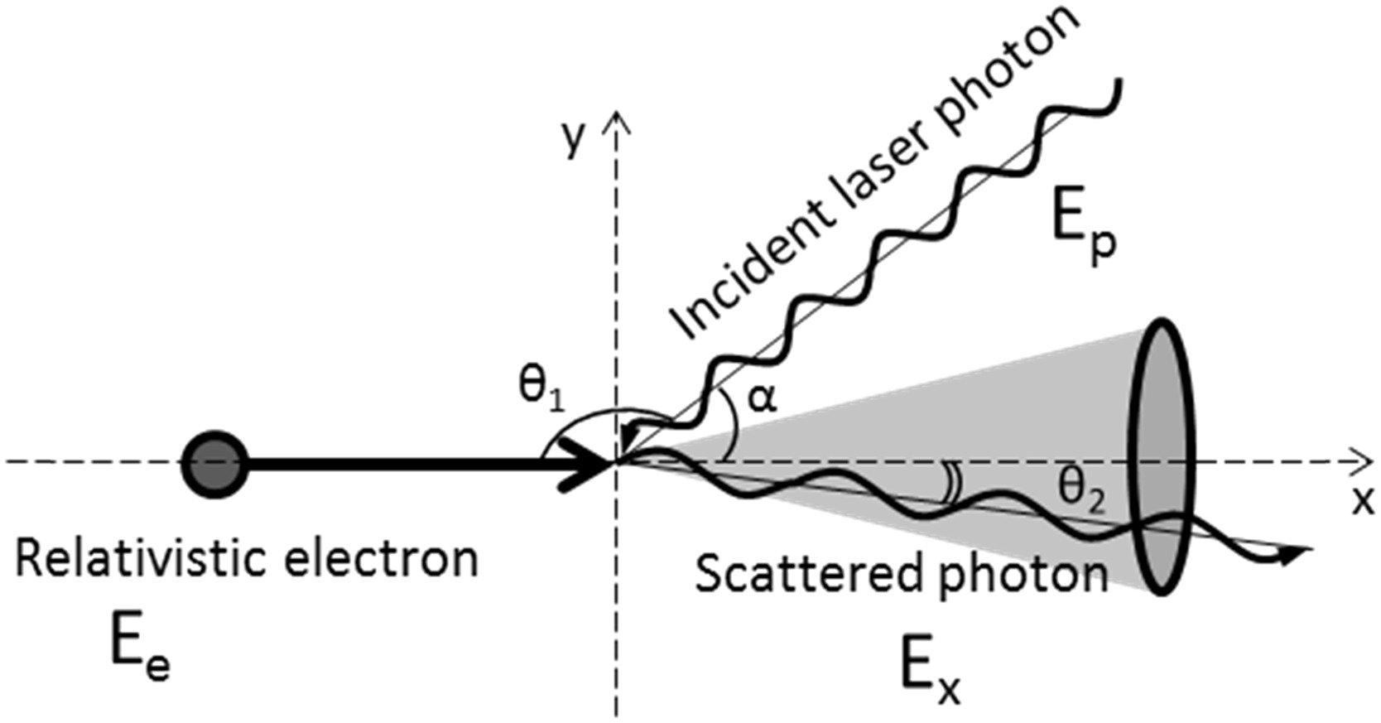
Other potential applications for accelerators?
X-rays production by Compton effect:
→ Use a synchronized pulses to the electron beam
→ Typically ten’s of ps pulses are used? Our Laser can be used a seed Laser
We are looking for your inputs and interesting in potential collaborations
PhD Thesis: Annaïg Chaleil, Développement d’une source de rayonnement X par diffusion Compton inverse sur l'accélérateur ELSA et optimisation à l'aide d'un système d'empilement de Photons.

Slide 6
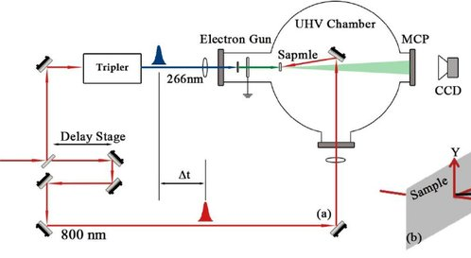
Other potential applications for accelerators?
Ultrafast Electron Diffraction:
→ Pump-probe experiments between an ultrafast Laser (usually fs pulses)
and electron beam for matter analysis
→ Is there any synchronization/delay issues? Is it possible to use ps pulses?
We are looking for your inputs and interesting in potential collaborations

Slide 7
William Renard
renard@irisiome.com
+33 (0)6 47 28 54 73
Stop by our Booth!

Slide 8
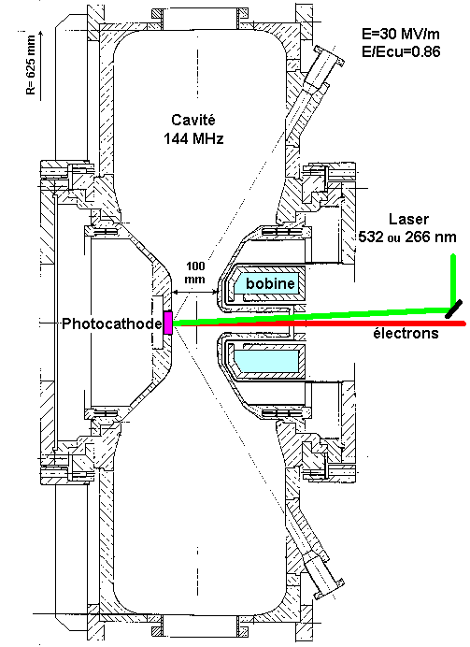
Back up
Laser 1µm
Laser IRISIOME for ELSA accelerator (Thanks to V. Le Flanchec)
Mise en forme train
amplis Nd:YAG
Conversion 2ω
Mise en forme
Photo-injecteur
144 MHz

