Slide 1
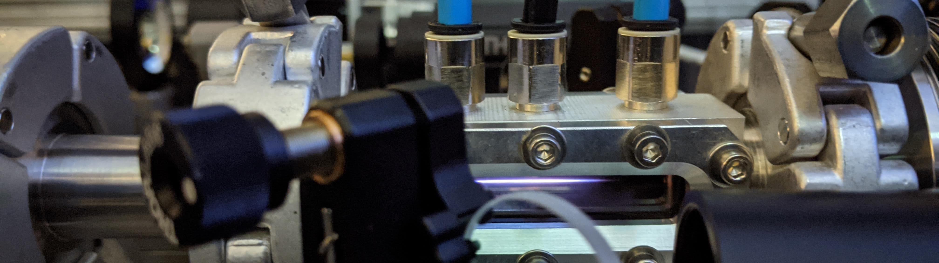

Development of a 150MeV laser-plasma injector
Journées Accélérateurs ROSCOFF 2021
Drobniak Pierre
October 13th 2021

Slide 2

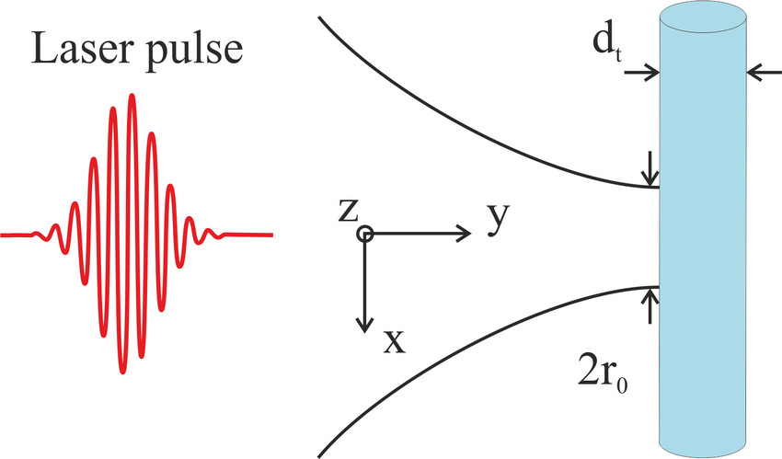
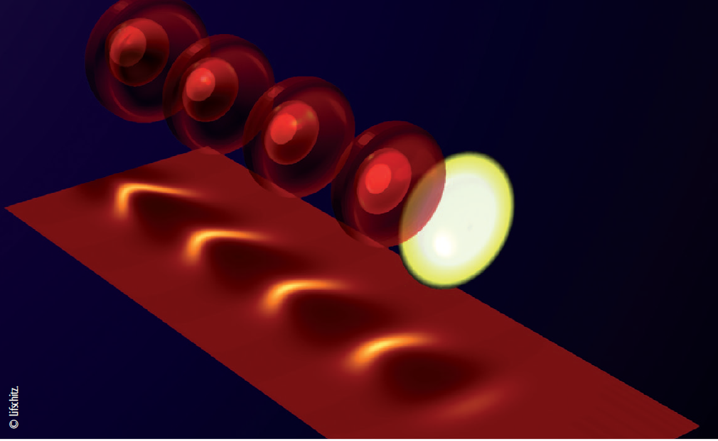

1 –Project
The laboratory project
My PhD
Gas injection
Plasma cell (gas cell in our case)
150-200 MeV
30 pC
10Hz
1 mm.mrad ΔE/E <5%
Stability at 10 Hz
Plasma Cell design
e-
high quality beam
40 fs, 30TW, ~1.2J, 10 Hz
on target (from LaseriX platform)
Beam transport -> multi-stage
Plasma wake
Prototyping Accelerator based on Laser-pLASma technology
Laser pulse
Ionization injection assisted by density modulation
Participation to R&D Technical Design Report in preparatory phase on high-quality laser-plasma injector (LPI) for EUPRAXIA Horizon 2020 European project
e- bunch
Laser Wake Field Acceleration (LWFA) [1]
https://pallas.ijclab.in2p3.fr/
http://www.eupraxia-project.eu/
[1] Malka, V., Thaury, C., Corde, S., Phuoc, K. T., & Rousse, A. (2013). Accélérateurs à plasma laser: principes et applications. Reflets de la physique, (33), 23-26.

Slide 3
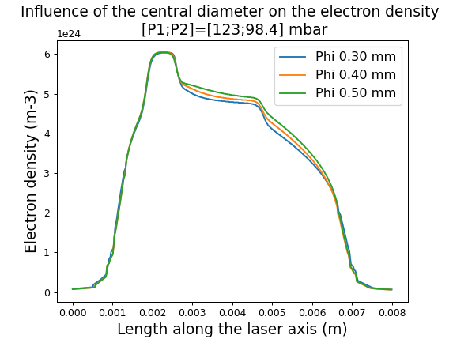
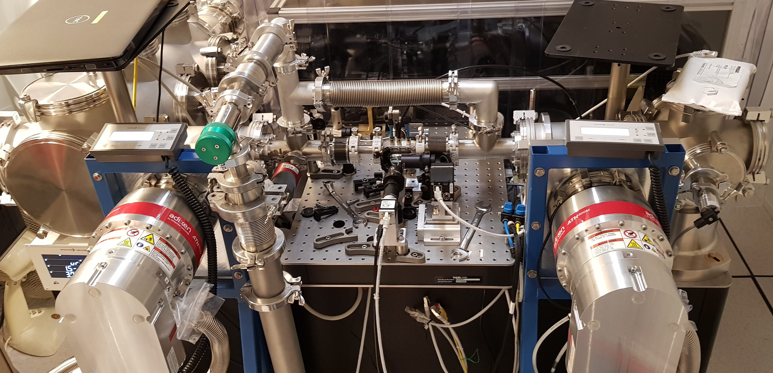
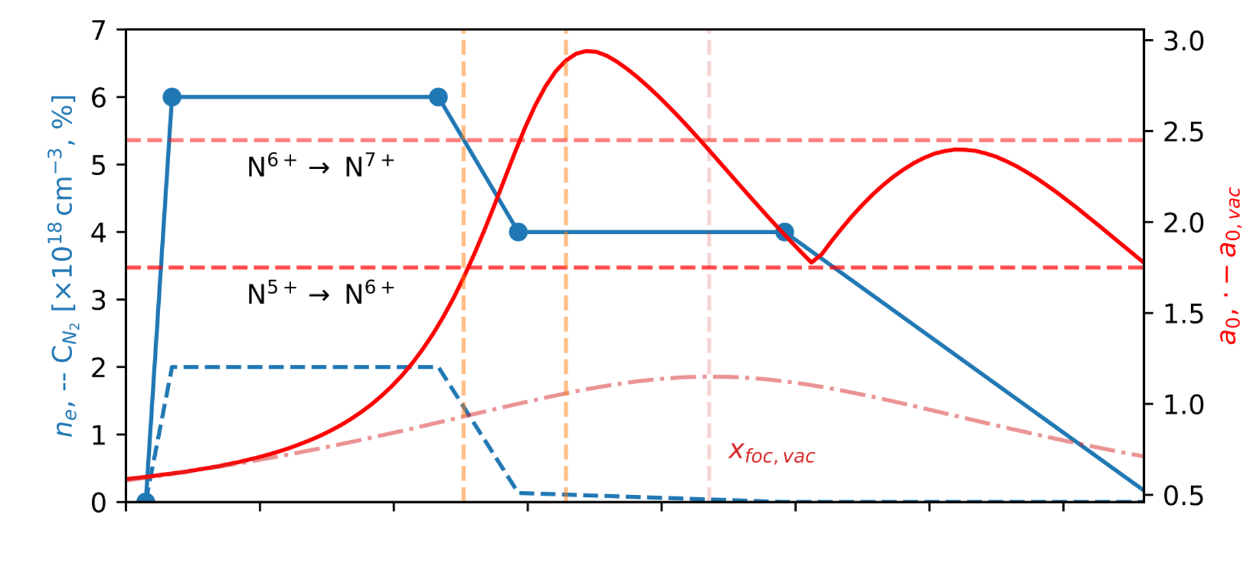

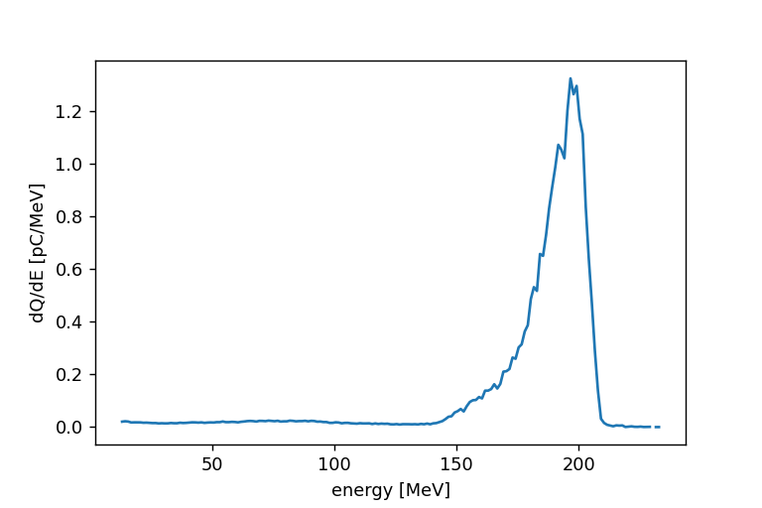
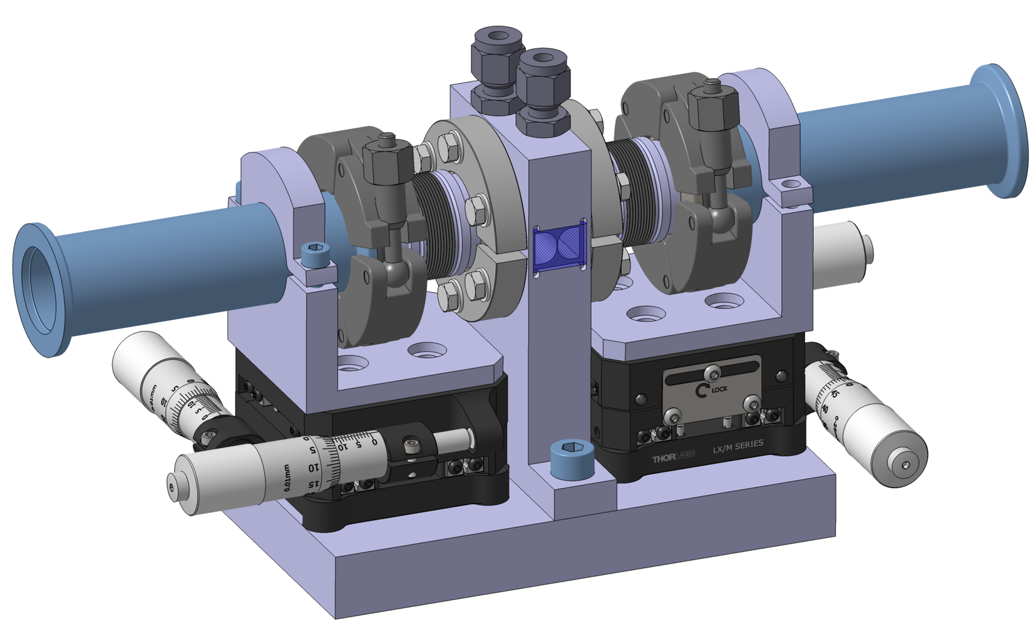

2 – Optimization principle
Experimental qualification on test bench
Theoretical profile and PIC simulated laser variation
n_{e} , -- C_{N2} [x10¹⁸ cm⁻³, %]
a₀ , -- a₀_vac
Longitudinal distance
OpenFOAM-simulated electronic density
Spectrum [pC/MeV]
Energy [MeV]
Cell design
[1] Audet et Al. (2018). Gas cell density characterization for laser wakefield acceleration. Nuclear Instruments and Methods in Physics Research Section A: Accelerators, Spectrometers, Detectors and Associated Equipment, 909, 383-386.
[2] Kononenko, et Al. (2016). 2D hydrodynamic simulations of a variable length gas target for density down-ramp injection of electrons into a laser wakefield accelerator. Nuclear Instruments and Methods in Physics Research Section A: Accelerators, Spectrometers, Detectors and Associated Equipment, 829, 125-129.
[3] Kirchen et Al. (2021). Optimal Beam Loading in a Laser-Plasma Accelerator. Physical review letters, 126(17), 174801. [4] Couperus, J. P., Pausch, R., Köhler, A., Zarini, O., Krämer, J. M., Garten, M., ... & Irman, A. (2017). Demonstration of a beam loaded nanocoulomb-class laser wakefield accelerator. Nature communications, 8(1), 1-7.
[5] Jalas et Al. (2021). Bayesian Optimization of a Laser-Plasma Accelerator. Physical review letters, 126(10), 104801.

Slide 4
3 –Setup of the gas cell test bench
LaseriX input beam, 60mJ, 45fs, 10Hz
Plasma induced phase shift in the diagnostic beam wave front
Diagnostic beam
delay line
Pump beam
Plasma cell
Reconstruction of the absolute phase shift (Abel inversion)
Plasma
Reconstruction of the plasma density
Dichroic mirror for dopant localization
Camera
Wave front sensor
+ spectral filter centred on N2 emission lines
[1]
[1] Plateau, G. R., Matlis, N. H., Geddes, C. G. R., Gonsalves, A. J., Shiraishi, S., Lin, C., ... & Leemans, W. P. (2010). Wavefront-sensor-based electron density measurements for laser-plasma accelerators. Review of Scientific Instruments, 81(3), 033108.

Slide 5
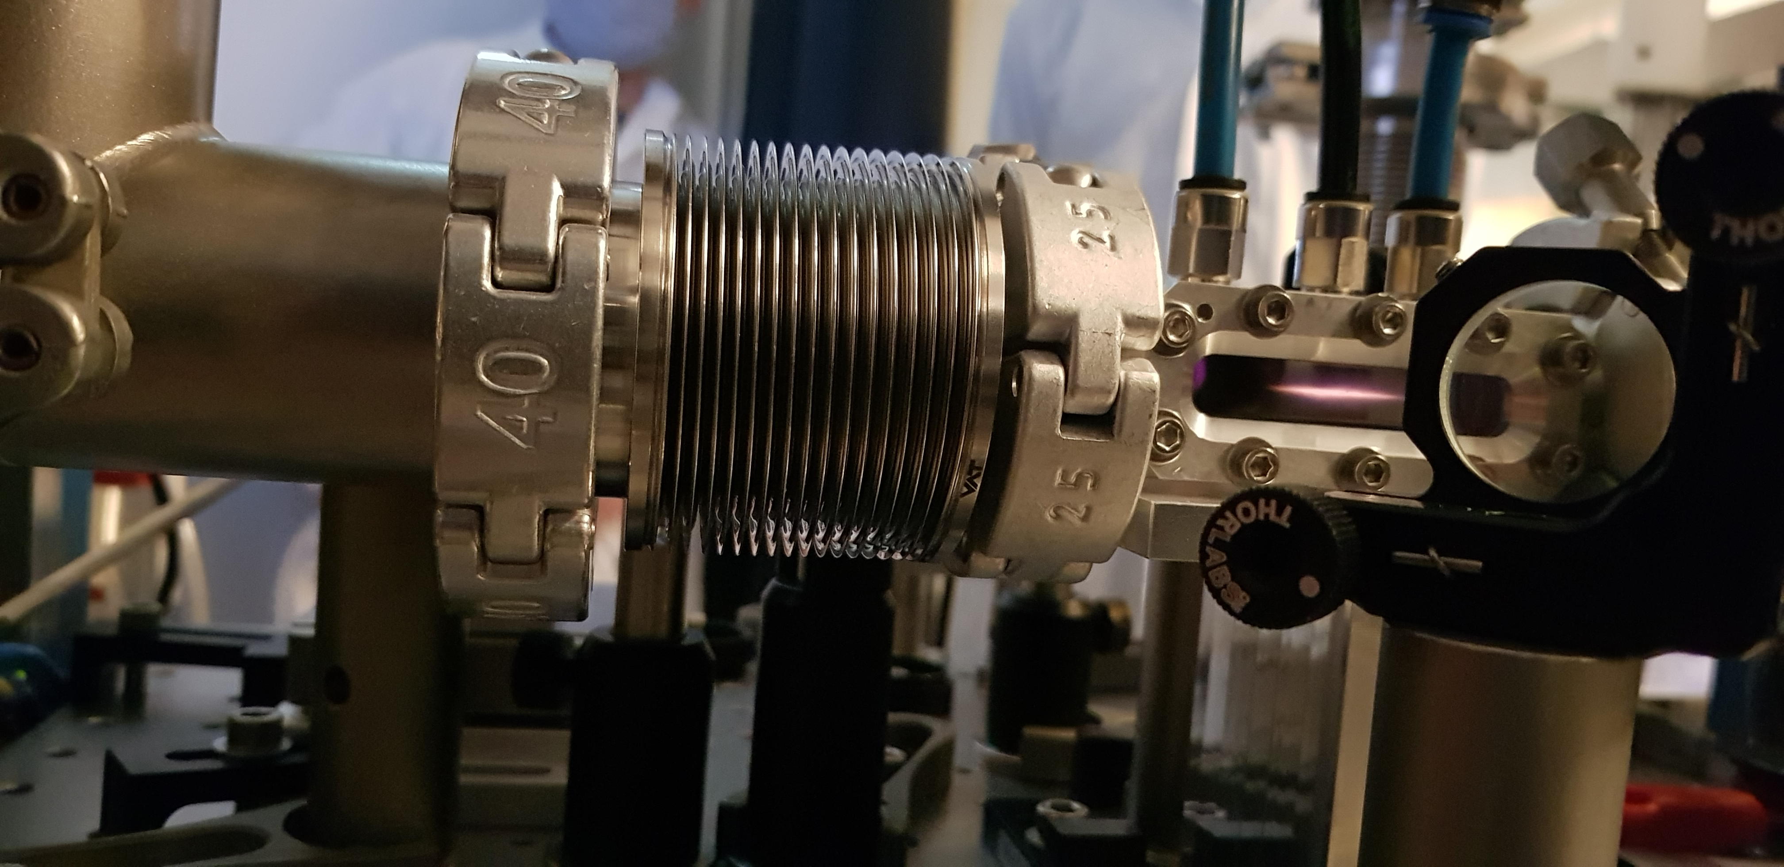
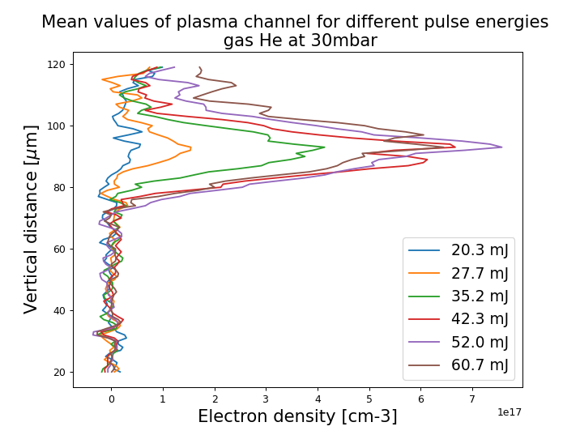
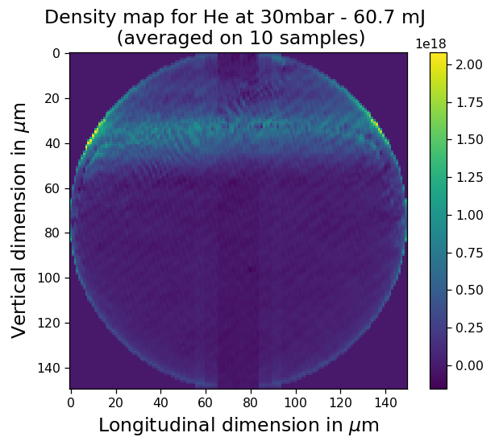
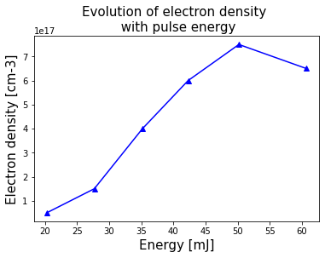
4 – First experimental results
30 µm
Test cell ¹
Sensitivity ~ 10¹⁷cm⁻³
Max. pulse energy
¹ developped in the frame of the ESCULAP project (N. Delerue, K. Wang, J. Jenzer et al. ), used as a test cell [1]
[1] Baynard, E. et al. Status report of the ESCULAP project at Orsay: External injection of low energy electrons in a Plasma. Nuclear Instruments and Methods in Physics Research Section A: Accelerators, Spectrometers, Detectors and Associated Equipment 909, 46–48 (2018).

Slide 6
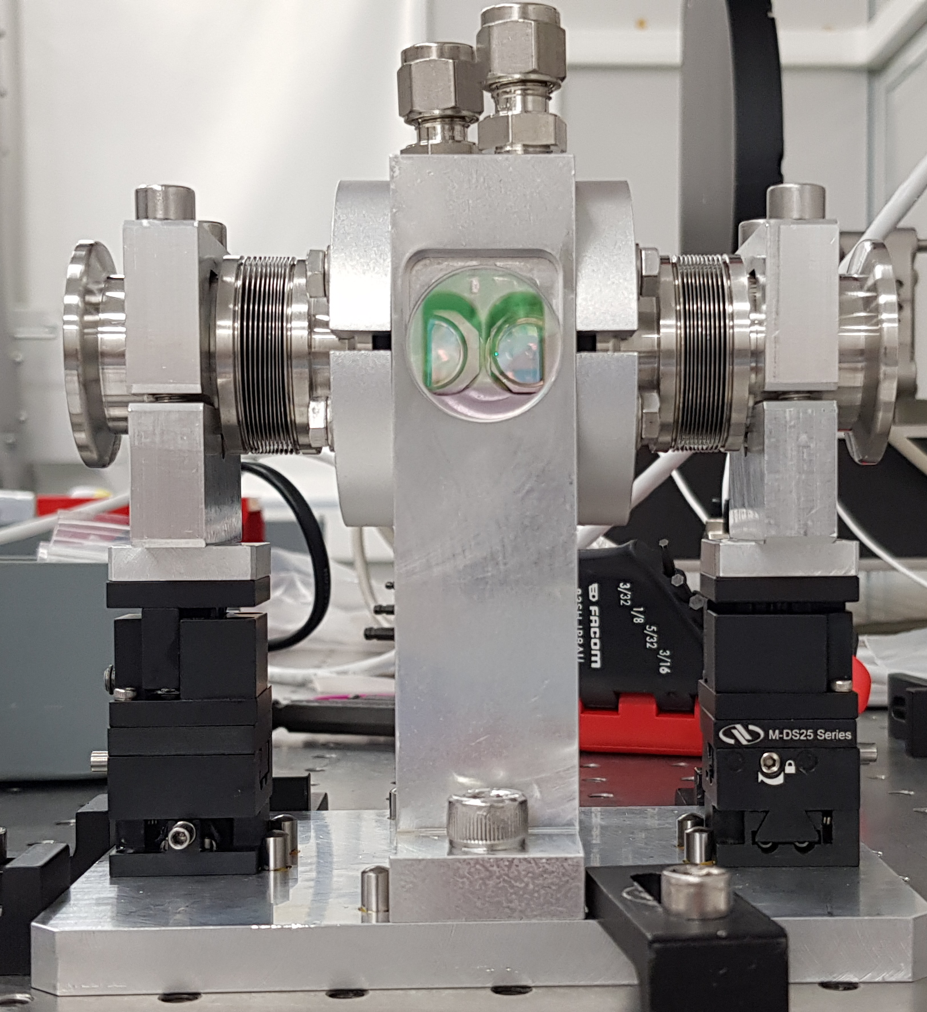
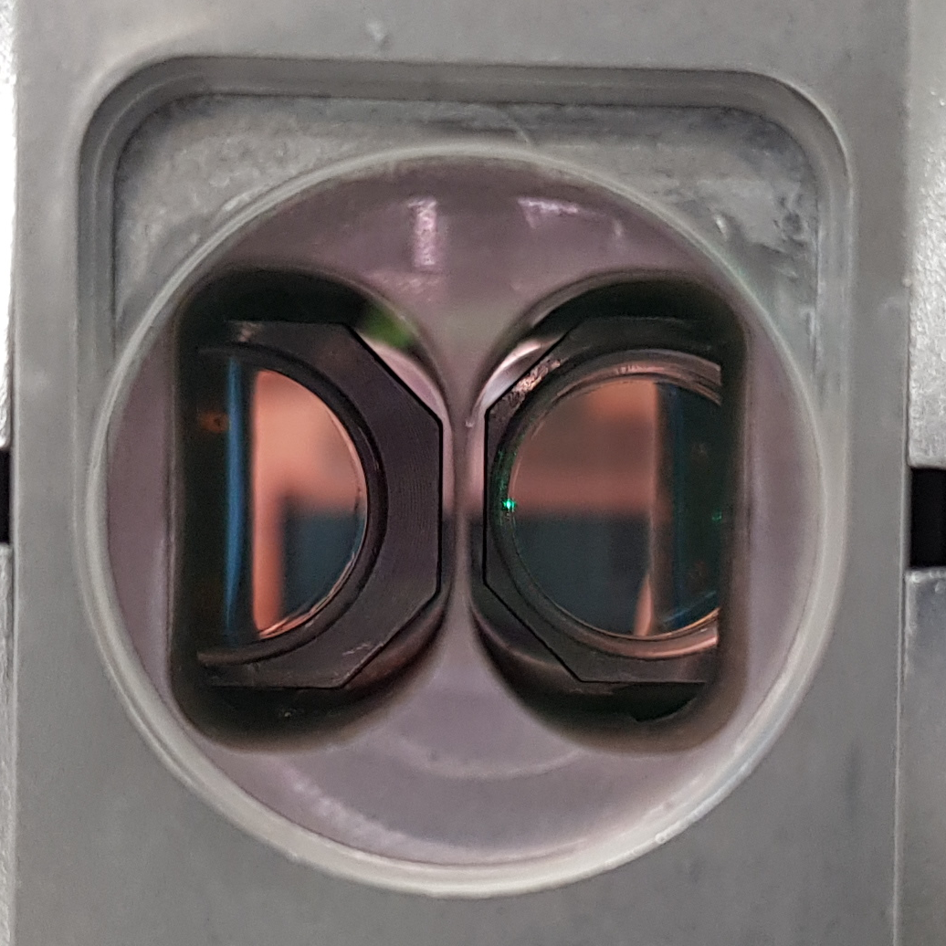
5 – Next steps
SHORT TERM
1 – Implementation first prototype on test bench
2 – Plasma ignition and measurements (using a mixture)
3 – Optimization of gas density (and mixture)
4 – Characterization of dopant migration
LONG TERM
1 – Plasma cell lifetime
2 – Integration of the plasma cell on the beam line (~ late 2022)
-> first electron bunches!
3 – Characterization of the electron bunch
He+N2
He
laser
Zoom inside chamber 1 and chamber 2
First prototype

Slide 7
Thank you
Many thanks to: Kevin CASSOU, Sophie KAZAMIAS, Bruno LUCAS, Viacheslav KUBYTSKYI, Yann PEINAUD, Moana PITTMAN, Elsa BAYNARD, Julien DEMAILLY, Alexandre GONNIN, Stéphane JENZER

