Slide 1








Study of a 5-Cell Elliptical Superconducting Cavity for a Multi-turn Energy Recovery Linac
Carmelo Barbagallo, Patricia Duchesne, Ningyuan Hu,
Guillaume Olry, Walid Kaabi, Fabian Zomer
Laboratoire de Physique des 2 Infinis Irène Joliot-Curie (IJCLab) - Accelerator Physics group – RF section
Université Paris-Saclay, Orsay, France
Journées Accélérateurs 2021 de la SFP, 13 October 2021 – 15 October 2021, Roscoff (France)
Acknowledgments: Dr. Shahnam Gorgi Zadeh, Universität Rostock, Fakultät für Informatik und Elektrotechnik

Slide 2
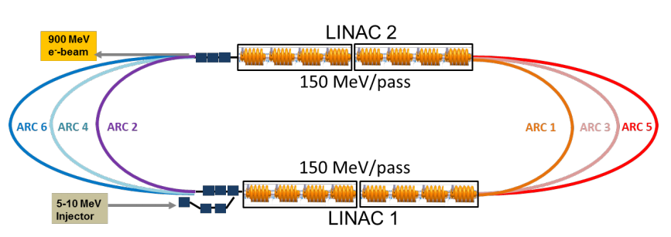




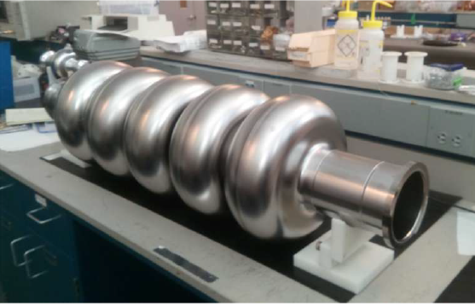
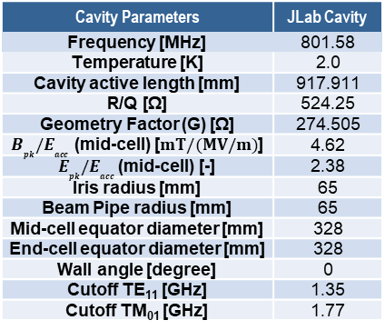
PERLE and 5-cell SRF cavity
  PERLE (Powerful Energy Recovery Linac for Experiments): multi-turn ERL (Energy Recovery Linac) based on Superconducting RF (SRF) technology to be studied and later host at Orsay (France).
487 MeV
e⁻-beam
LINAC 2 (80 MeV)
Target Parameter [2] | Unit | Value
Injection energy | MeV | 7
Electron beam energy | MeV | 500
Normalized Emittance ϒε_{x,y} | mm·mrad | 6
Average beam current | mA | 20
Bunch charge | pC | 500
Bunch length | mm | 3
Bunch spacing | ns | 25
RF frequency | MHz | 801.58
Duty factor | CW (Continuous Wave)
80 MeV
ARC 1 = 87 MeV
ARC 2 = 167 MeV
ARC 3 = 247 MeV
ARC 4 = 327 MeV
ARC 5 = 407 MeV
ARC 6 = 487 MeV
80 MeV
7 MeV
Injector
PERLE CDR, 2018 [1]
LINAC 1 (80 MeV)
Four 5-cell 801.58 MHz elliptical Nb cavities
  The first 801.58 MHz 5-cell elliptical Nb cavity has already been fabricated at JLab on October 2017 [2]
  HOM-damping for ERLs is a challenge due to the presence of many turns (multi-bunch beam instabilities)
  Aim of the numerical study (CST Studio Suite®):
  1) Identification of HOMs, 2) Analysis of the transmission curves of HOM couplers, 3) HOM-damping schemes
Cavity Parameters | JLab Cavity
Frequency [MHz] | 801.58
Temperature [K] | 2.0
Cavity active length [mm] | 917.911
R/Q [Ω] | 524.25
Geometry Factor (G) [Ω] | 274.505
$B_{pk}{/E}_{acc}$ (mid-cell) [$mT/(MV/m)$] | 4.62
$E_{pk}{/E}_{acc}$ (mid-cell) [-] | 2.38
Iris radius [mm] | 65
Beam Pipe radius [mm] | 65
Mid-cell equator diameter [mm] | 328
End-cell equator diameter [mm] | 328
Wall angle [degree] | 0
Cutoff TE₁₁ [GHz] | 1.35
Cutoff TM₀₁ [GHz] | 1.77
The first Nb 801.58 MHz 5-cell elliptical cavity fabricated at JLab [3].

Slide 3
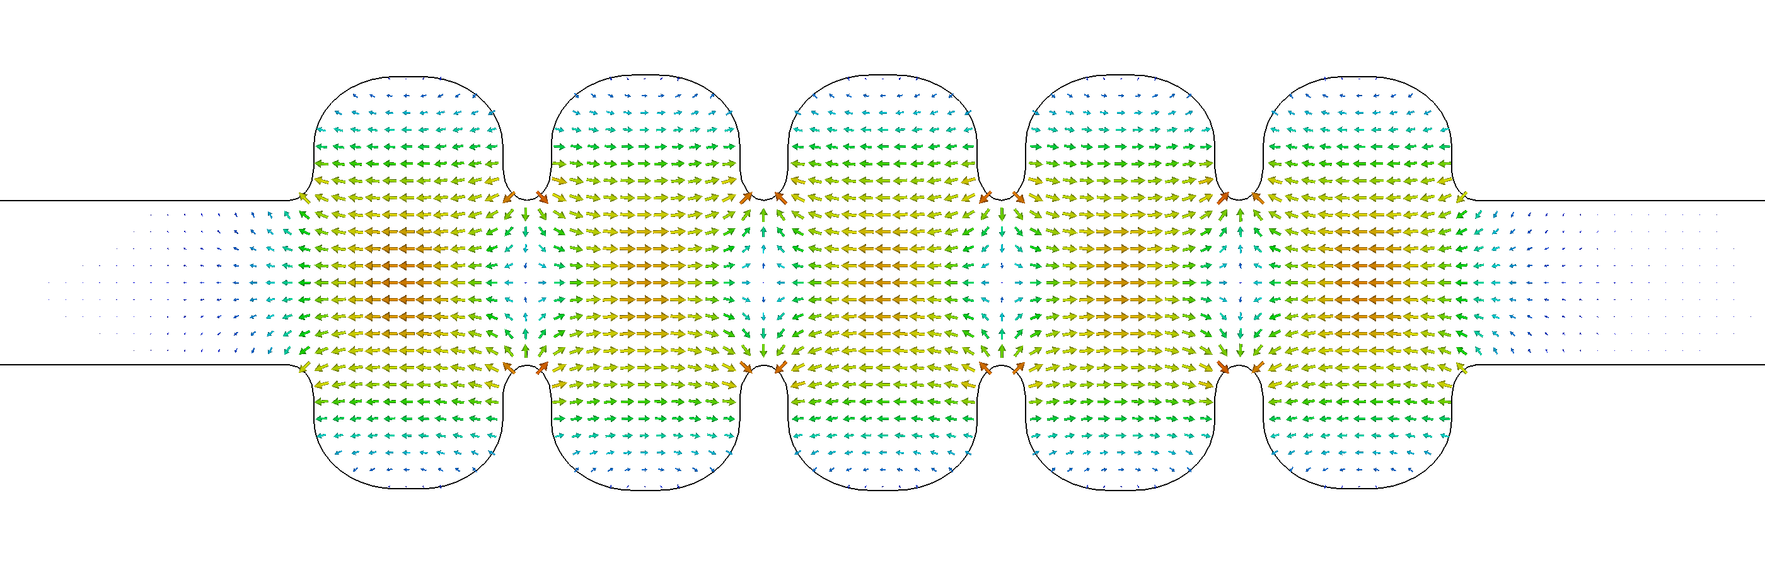
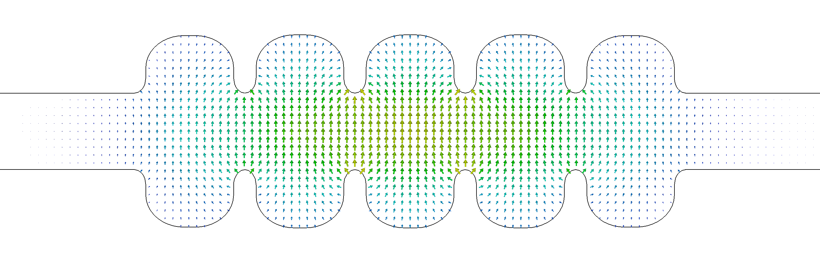
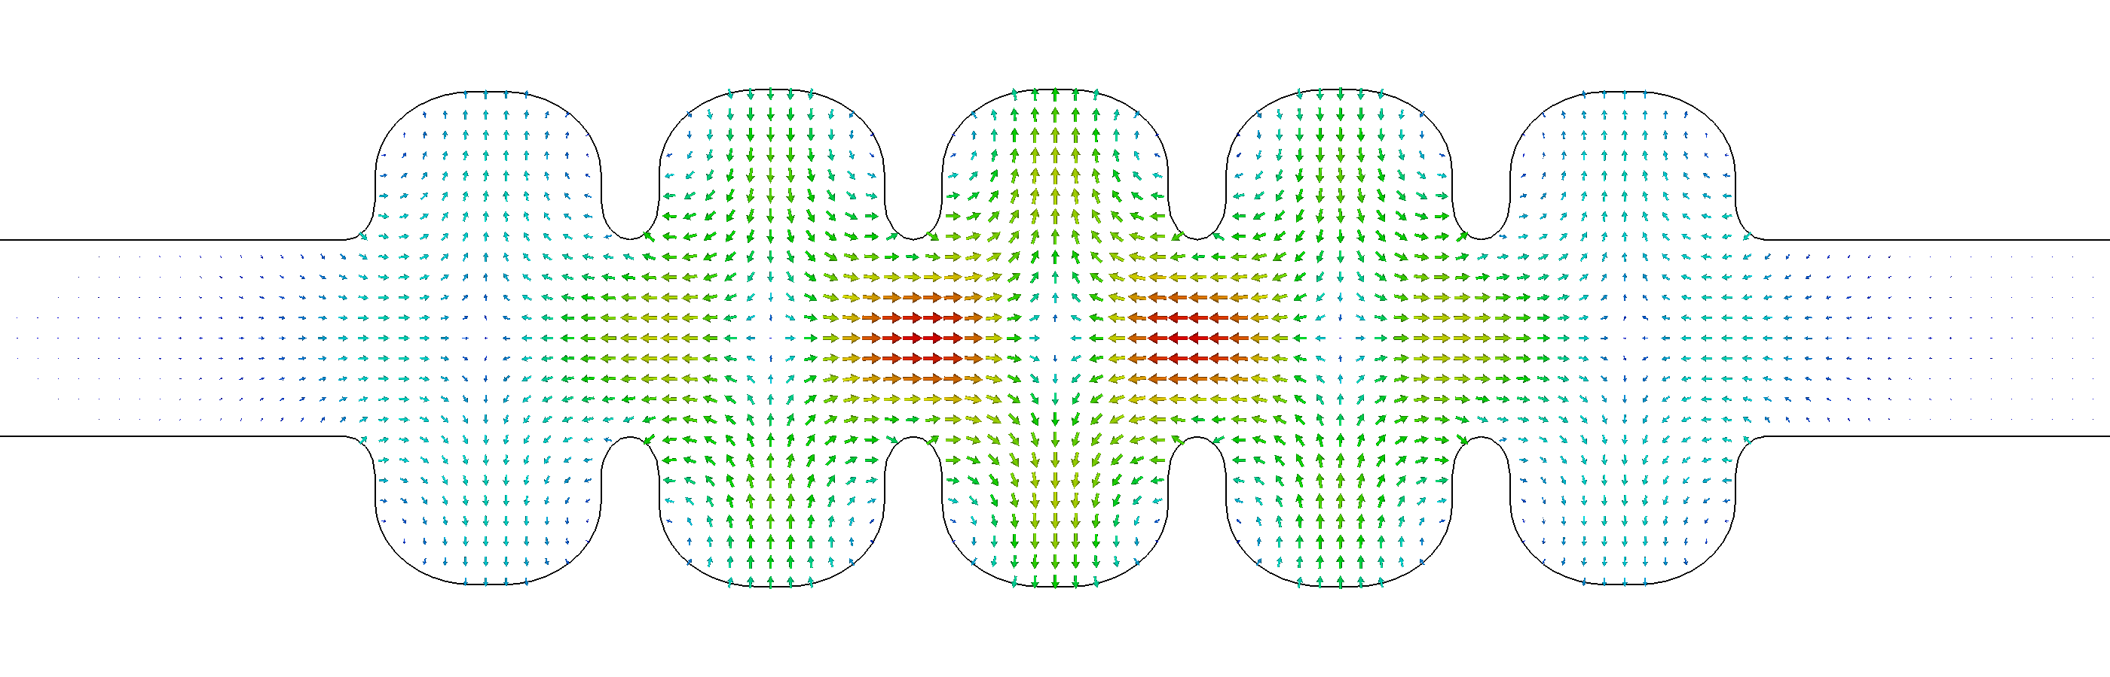
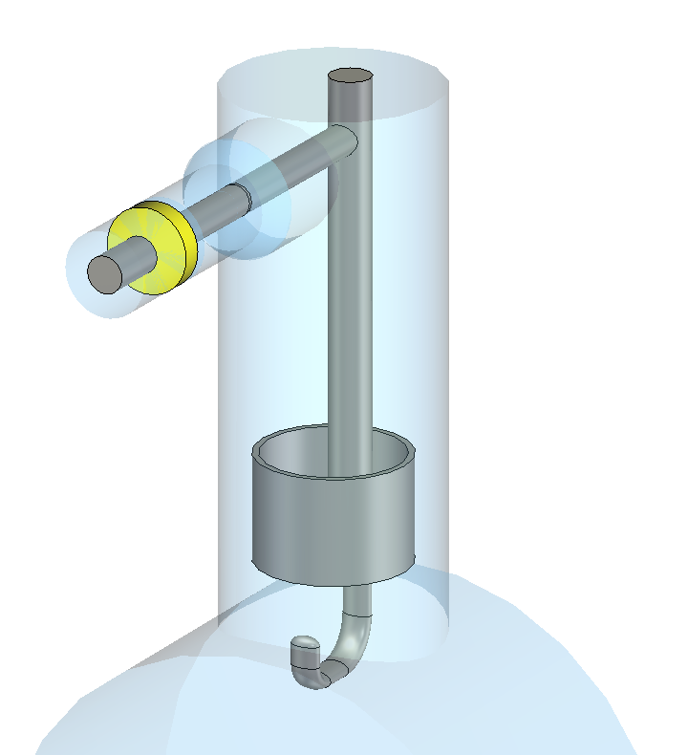
HOMs: consequences and damping mechanisms
  HOMs (Higher Order Modes) are parasitic excited eigenmodes in a resonant accelerating RF cavity, other than and with frequency greater than the operational mode (FM = Fundamental Mode) [4].
TM01-π mode (FM) – f =801.58 MHz
TE111 mode (Dipole HOM) – f =933.53 MHz
TM011 mode (Monopole HOM) – f =1374.73 MHz
  Why are HOMs dangerous for beam dynamics?
  How can we damp HOMs in SRF cavities?
  Monopole HOMs:
    can lead to timing/phase errors and energy spread
    contribute to extra dynamic heat losses in cavity walls
  Dipole HOMs:
    can deflect the beam from its reference orbit: instable beam motion, transverse emittance growth, beam loss
  Coaxial HOM coupler on beam tubes
    Hook-type LHC coupler
    Probe-type LHC coupler
    DQW HOM coupler
  Waveguide dampers on beam tubes
  Absorbers in cavity-interconnecting beam tubes
  Coupling through Fundamental Power Coupler
  DQW HOM Coupler

Slide 4
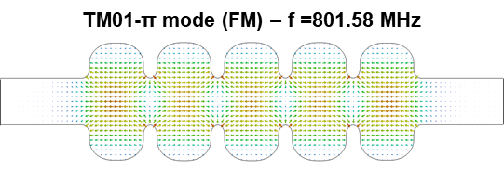
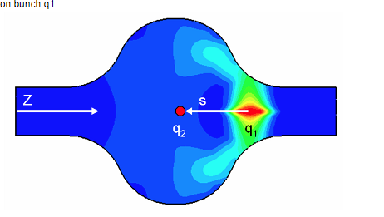

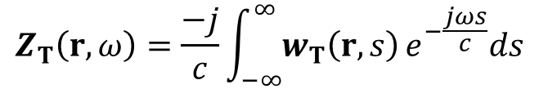


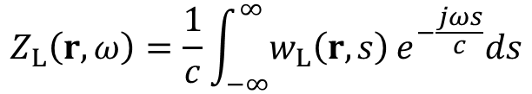

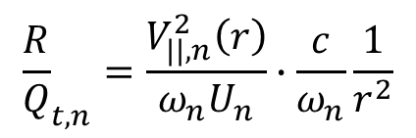



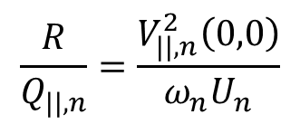


HOM numerical simulations: 3D-Eigenmode and Wakefield
  The eigenmodes of a resonator in a non-excited source-free and lossless medium are computed by solving the Helmholtz equations:
Helmholtz equations
Boundary conditions
$$PEC$$
$$∇^{2}\underline{E}+ω^{2}με\underline{E}=0$$
$$n×\underline{E}=0$$
  and
$$n∙\underline{H}=0$$
  on
$$∂Ω_{PEC}$$
$$∇^{2}\underline{H}+ω^{2}με\underline{H}=0$$
$$n∙\underline{E}=0$$
  and
$$n×\underline{H}=0$$
  on
$$∂Ω_{PMC}$$
Assumption: PEC (Perfect Electric Conductor) on conducting walls (Nb) and interior domain of vacuum
  Cavity-beam interaction: wakefields in time domain or impedances in frequency domain. The long-range wakefield commonly corresponds to the high impedance peaks and can lead to coupled-bunch instability issues [4].
q₁ = excitation bunch
q₂ = test charge
w(r,s) = wake potential = change of momentum
on q₂
Longitudinal shunt impedance [Ω]
Longitudinal impedance [Ω]
$$\frac{R}{Q_{||,n}}=\frac{V_{||,n}^{2}\left(0,0\right)}{ω_{n}U_{n}}$$
$$Z_{L}\left(r,ω\right)=\frac{1}{c}\int_{−∞}^{∞}{w_{L}\left(r,s\right)}e^{−\frac{jωs}{c}}ds$$
Eigenmode simulations
Transverse shunt impedance [Ω/m]
Wakefield simulations
Transverse impedance [Ω/m]
Wakefield in an elliptical cavity [6].
$${\frac{R}{Q}}_{t,n}=\frac{V_{||,n}^{2}\left(r\right)}{ω_{n}U_{n}}∙\frac{c}{ω_{n}}\frac{1}{r^{2}}$$
$$Z_{T}\left(r,ω\right)=\frac{−j}{c}\int_{−∞}^{∞}{w_{T}\left(r,s\right)}e^{−\frac{jωs}{c}}ds$$
The energy left behind q₁ is called wakefield.

Slide 5
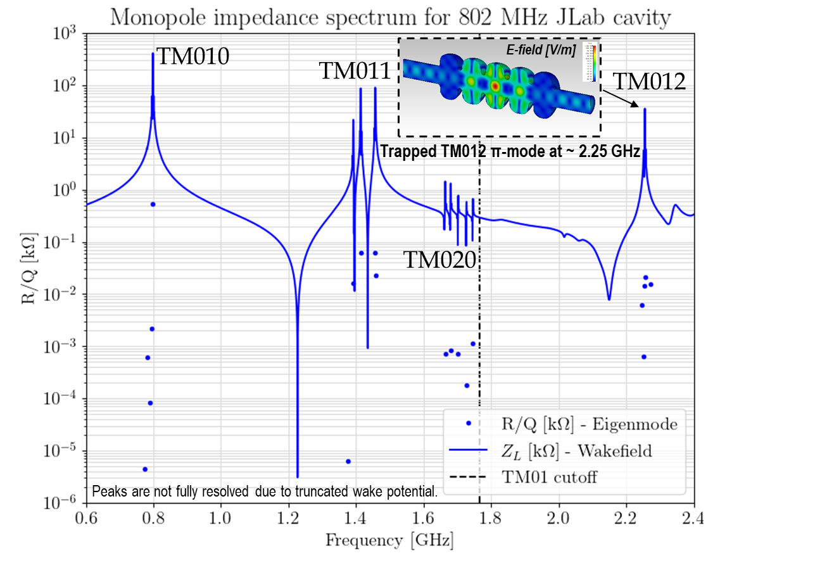
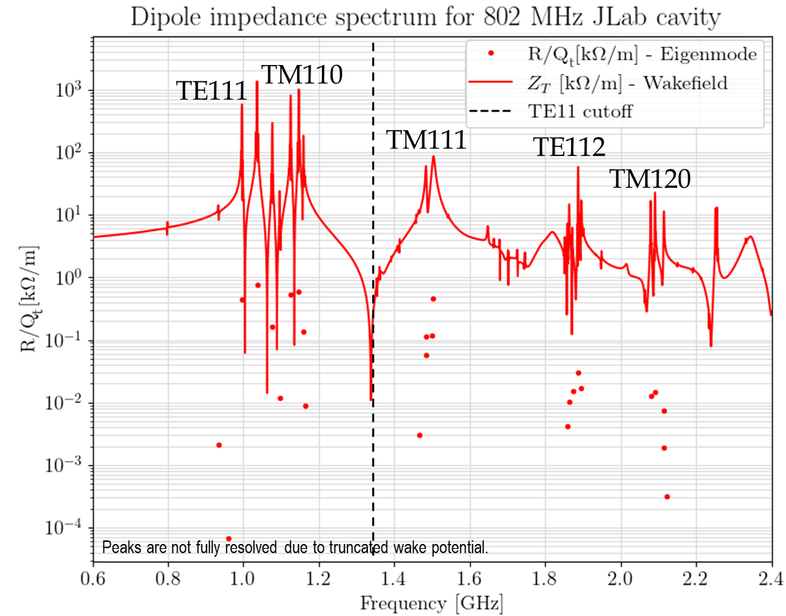
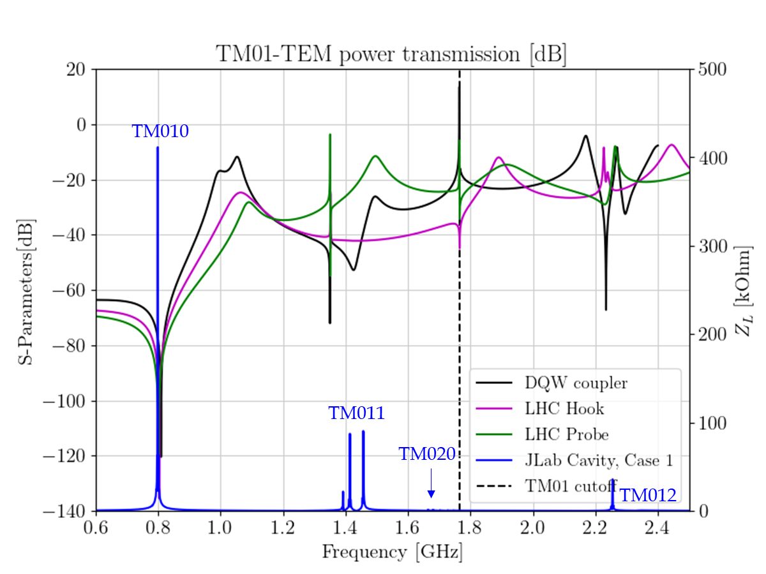
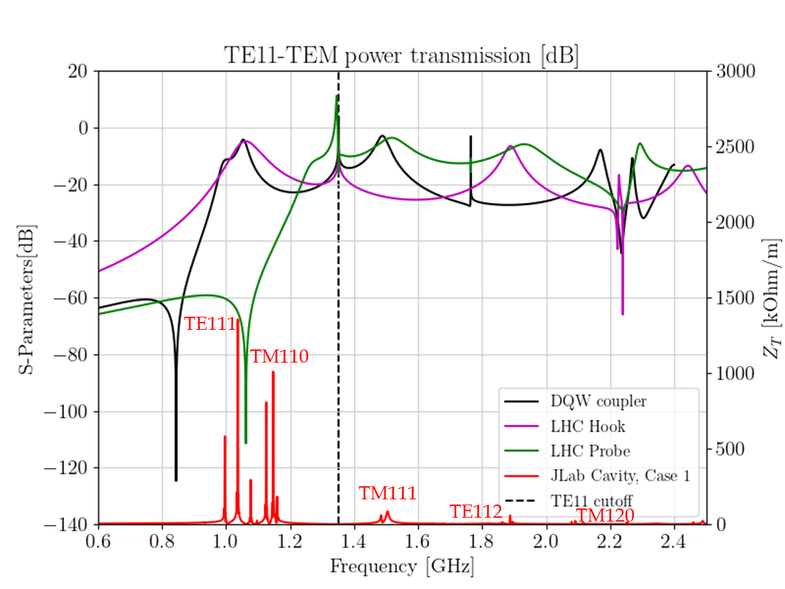
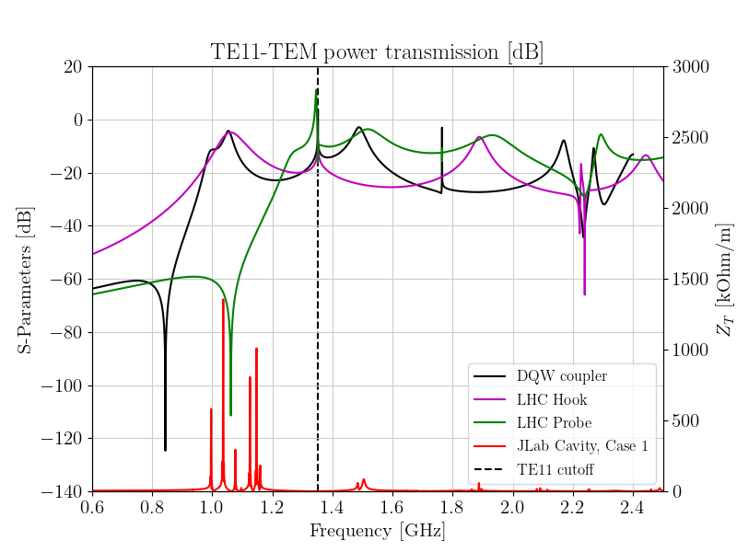
Identification of dangerous HOMs – HOM coupler transmission
  TM monopole modes (like TM010, TM011, TM020, T012)
  E-field component along cavity axis
  Trapped mode can interact with the subsequent bunch
  TM dipole modes (like TM110, TM111, TM120)
  Strong longitudinal E-field component off axis
  Possible deflection and subsequent beam resonant effect
  TE dipole modes (like TE111, TE112)
  Theoretically no longitudinal E-field component on and off axis (possible deflection)
  TM01-TEM transmission
  The notch effect is tuned to 801.58 MHz for monopole coupling.
  Couplers optimization needed to deliver a higher value of transmission.
  TE11-TEM transmission
  Hook coupler: higher transmission than DQW coupler for the TE111-type and TM110-type passband.

Slide 6
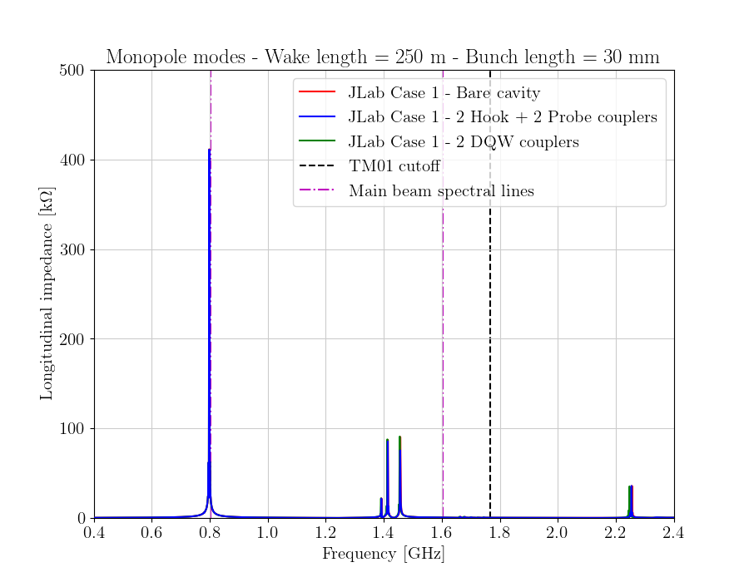
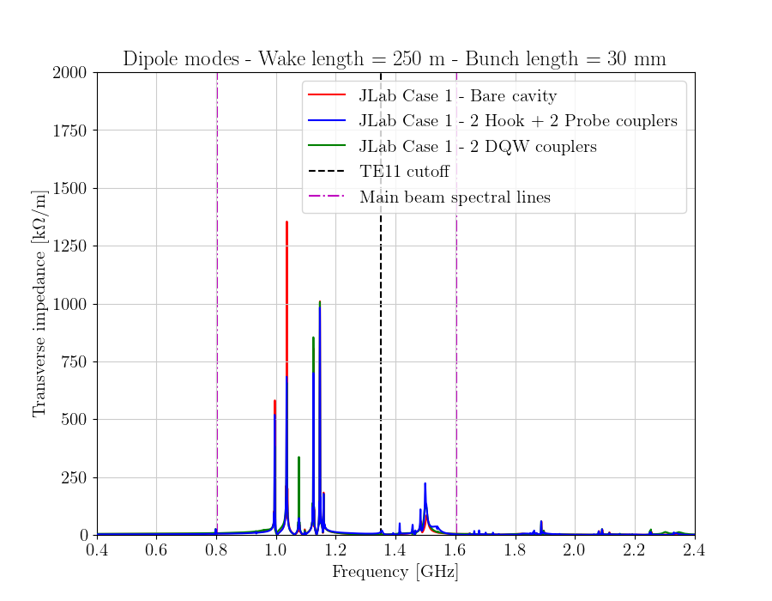
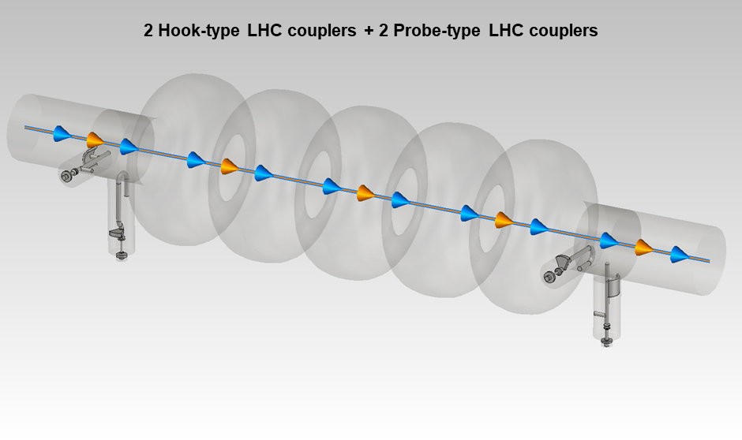
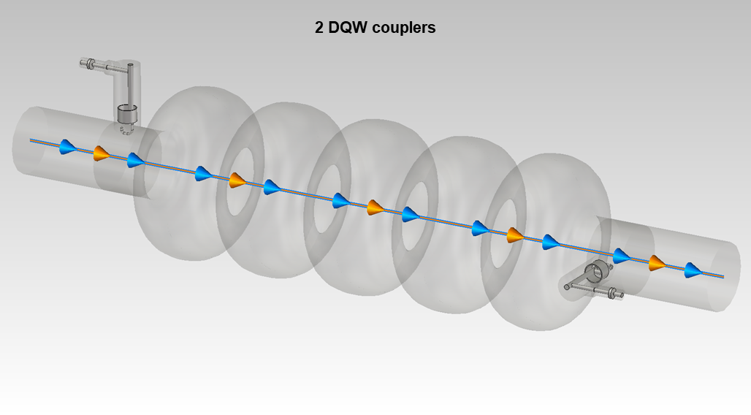
HOM-damping studies
  Objective: extract the energy of the HOMs from the cavity.
HOM-damping schemes
TM010
TE111
TM110
TM011
TM020
TM012
TM111
TE112
TM120
  Preliminary results for the two investigated configurations:
  2 Hook + 2 Probe couplers configuration provides a better damping of both monopole and dipole HOMs than the 2DQW couplers
  However, the trapped TM012 mode was not damped in the two configurations (modification of the end-cells is needed to enhance the coupling to the beam tube)

Slide 7
Conclusions
  Eigenmode and wakefield analyses were carried-out in CST Studio Suite® to investigate on the HOM behavior of PERLE Cavity
  Potentially dangerous monopole and dipole HOMs were identified and classified until 2.4 GHz.
  A trapped monopole HOM was found at ~2.25 GHz
  HOM-damping scheme studies: 2 Hook + 2 Probe couplers configuration gives a better damping of both monopole and dipole HOMs than the 2DQW couplers
  Future perspectives:
  Optimization of the cavity end-cells to improve the coupling of the TM012 π-mode to the beam tubes
  Optimization of HOM couplers, and study of other HOM couplers (JLAB, TESLA)
  Thermal studies for HOM couplers (HOM power and dissipation)

Slide 8
Bibliography
  [1] D. Angal-Kalinin et al., PERLE, Powerful Energy Recovery Linac for Experiments, CDR, Journal of Physics G: Nuclear and Particle Physics, 45(6):065003, 2018.
  [2] W. Kaabi, PERLE: A High-Power Energy Recovery Facility at Orsay, February 2021.
  [3] F. Marhauser, PERLE Cavity Design and Results and First Thoughts on HOM-Couplers, PERLE HOM Coupler Meeting, October 2019, CERN.
  [4] T. Wangler, RF Linear Acceleratos, John Wiley & Sons, 2008.
  [5] CST Studio Suite manual, CST Studio, 2021.

Slide 9
Thank you for your attention!

