Slide 1

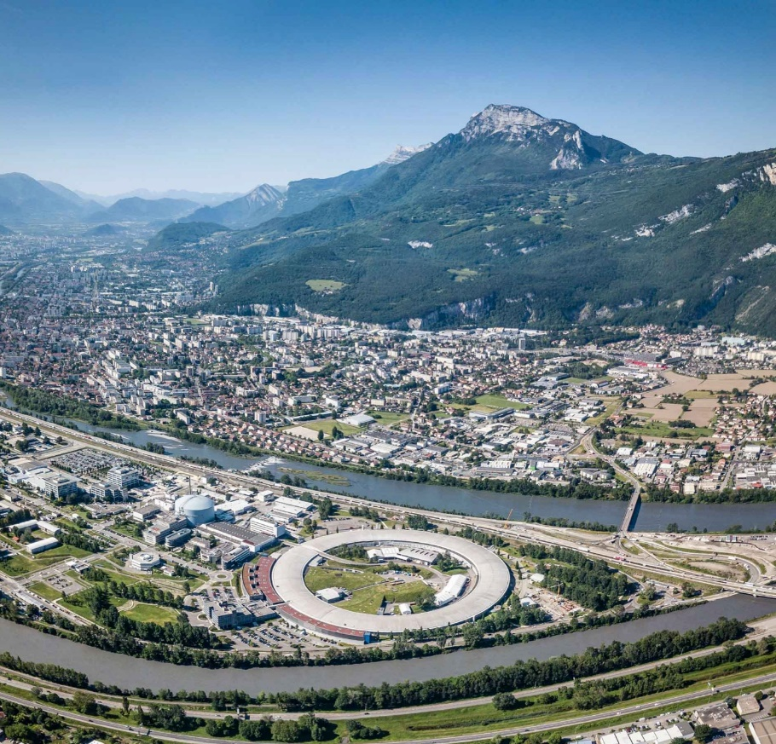
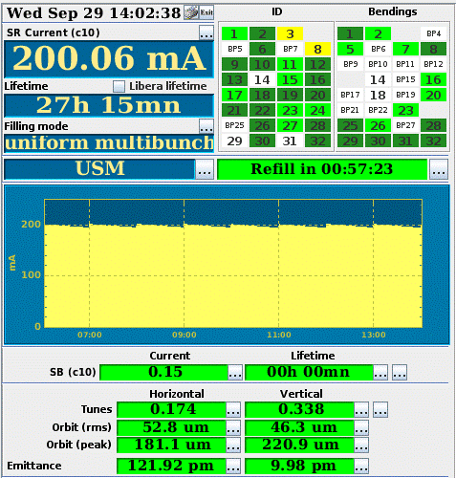























ESRF-EBS : Mise en œuvre et mise en service, performance et redémarrage de l'exploitation utilisateurs
Jean-Luc Revol
On behalf of the ESRF Accelerator and Source Division

Slide 2
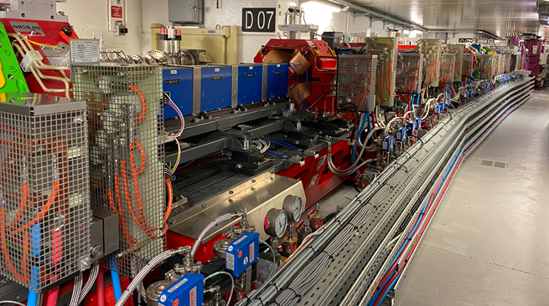
outline
The ESRF-EBS project
Implementation and start-up
Commissioning and restart of user operation
COVID-19 pandemic: impact and lessons learnt

Slide 3
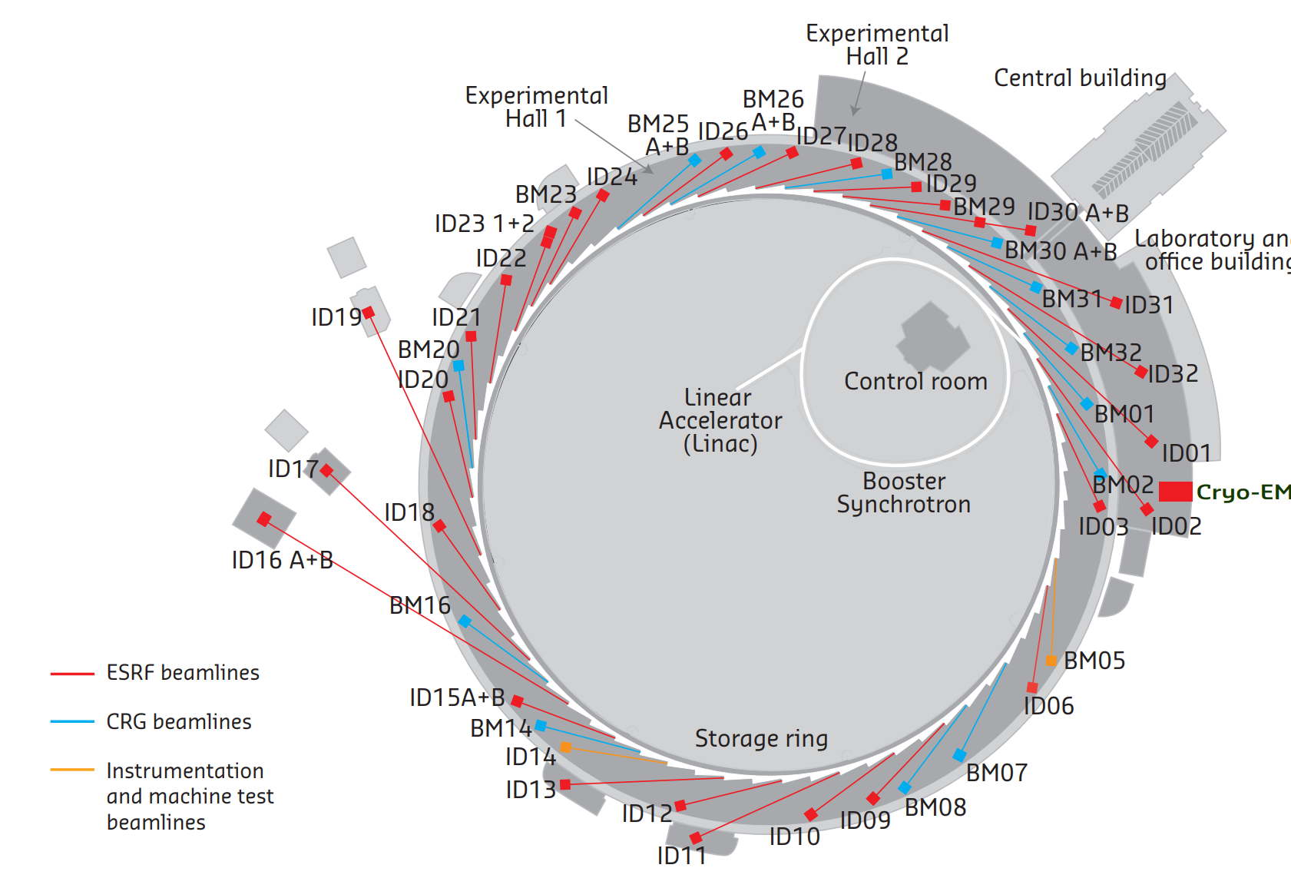
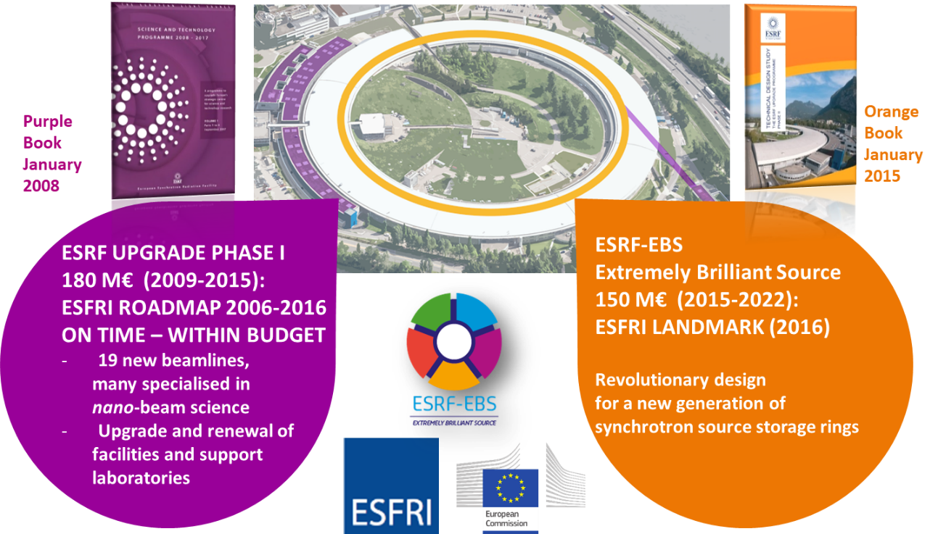
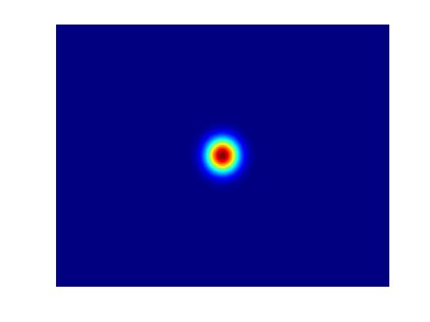
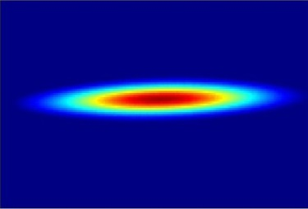
ESRF facts and figures
Light source in operation since 1994
Located in Grenoble, France
22 partner nations
Annual budget: 100 million euros
Staff: 650
E- Linac
200 MeV
Booster synchrotron
300m, 4Hz
Storage Ring
6 GeV
32 cells
The ESRF Extremely Brilliant Source upgrade :
Decrease the horizontal emittance
Increase the source brilliance
Increase the source coherence

Slide 4
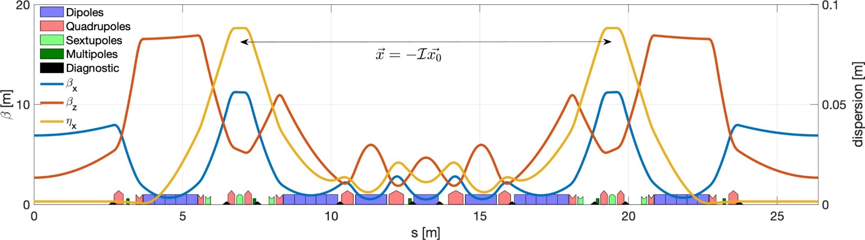
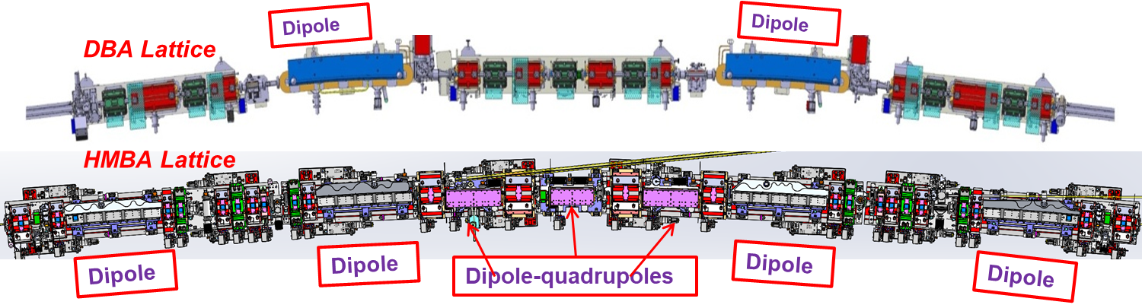
The ESRF-EBS upgrade
 | Units | ESRF | ESRF-EBS
Energy | GeV | 6 | 6
Circumference | m | 844.4 | 844
Lattice |  | DBA | HMBA
Current | mA | 200 | 200
Lifetime | h | 50 | 25
Emittance H | pm.rad | 4000 | 133
Emittance V | pm.rad | 4 | 10*
31 magnets per cell instead of 17

Slide 5
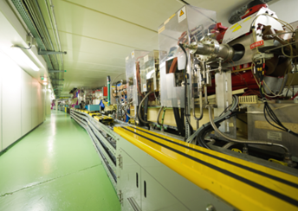
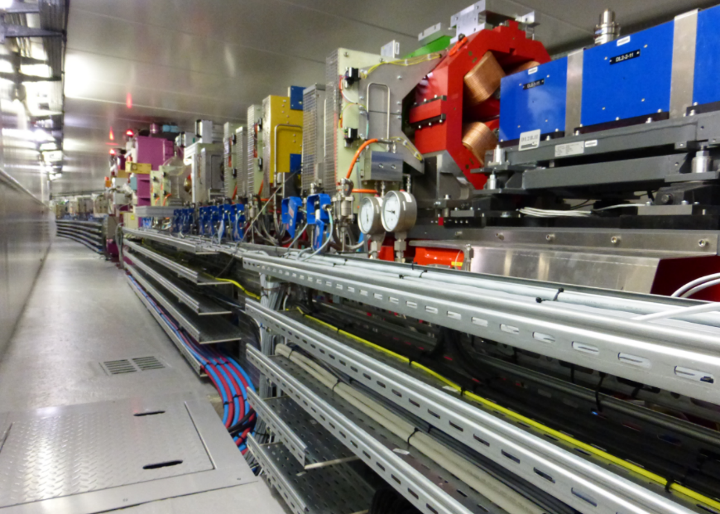
ESRF-EBS project implementation
Mock-up (Summer 2017)
Old ESRF-Storage Ring
ESRF-EBS
October 2017 Start of girder assembly
10 December 2018 End USM, start shutdown
Dismantling
Installation
8 November 2019 Tunnel closed
Tests & Injector restart
28 November 2019 Accelerator commissioning
2 March 2020 Beamline commissioning
25 August 2020 Start User Mode Operation

Slide 6
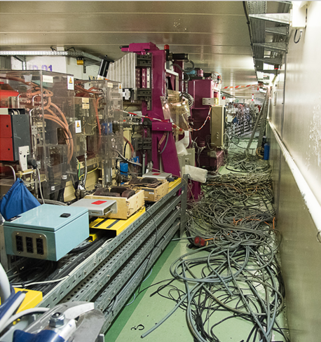
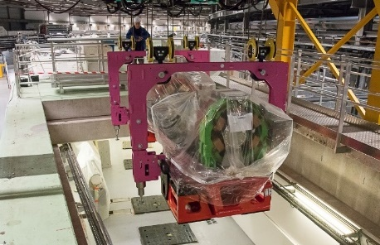
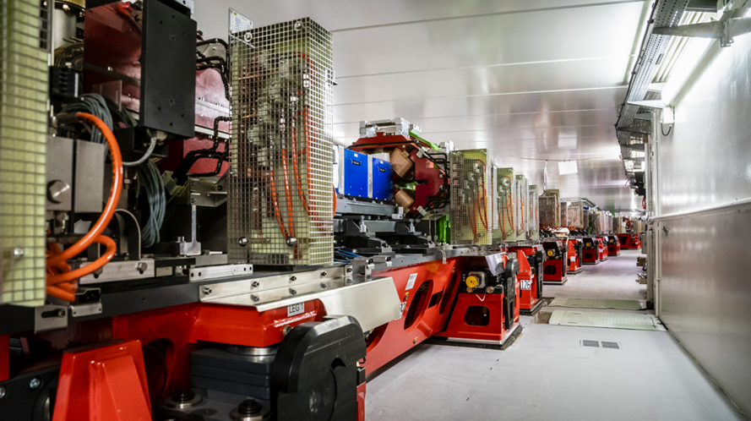
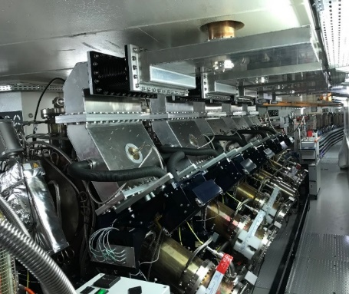
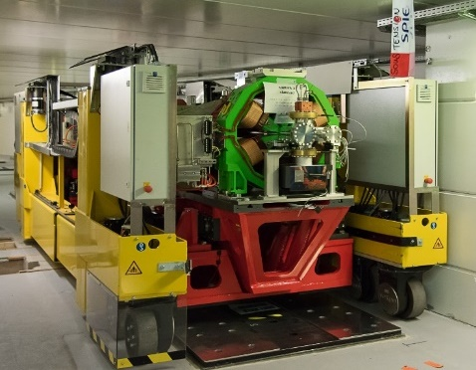
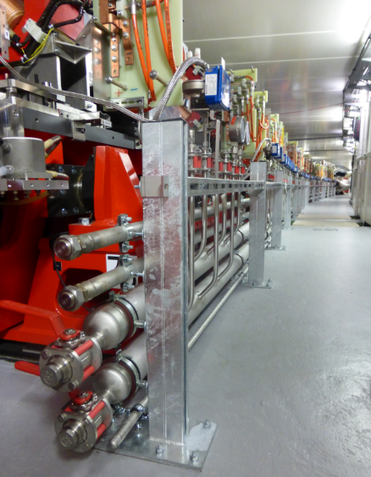
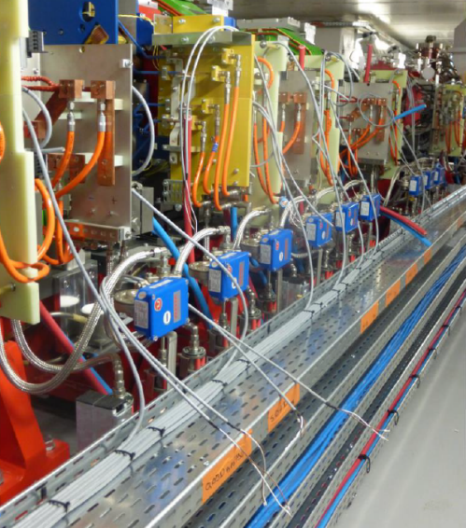
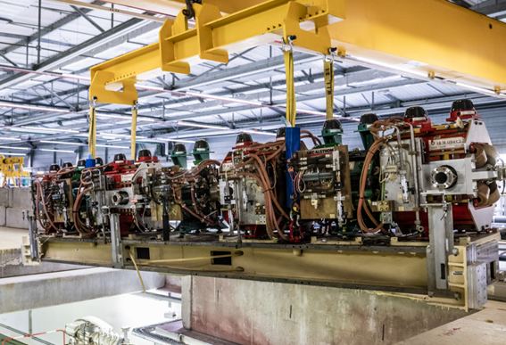
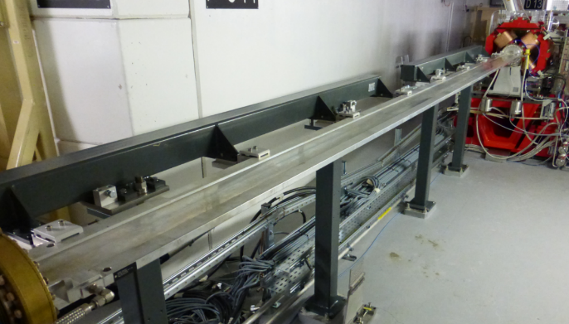
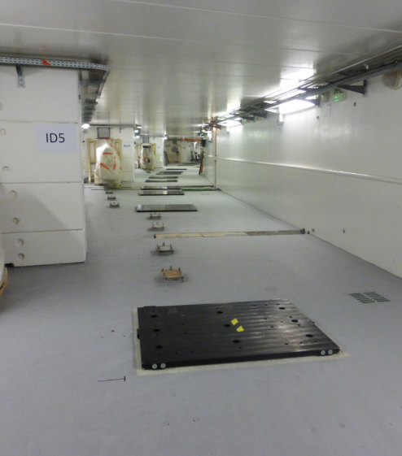
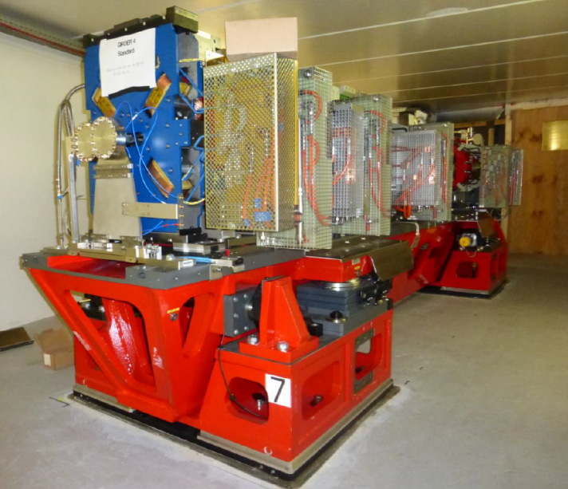
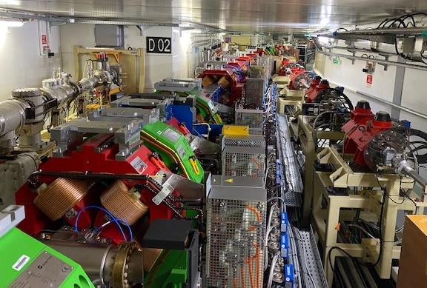
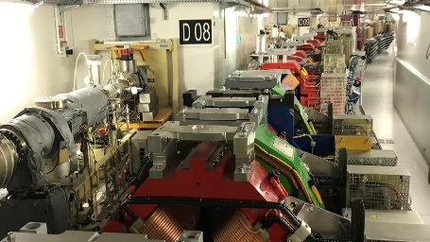
ESRF-EBS: Installation in the tunnel
Interconnection &
alignment
Entering girders
Dismantling
Radiofrequency
Straight section for IDs
Dismantling
ESRF-EBS
Old ESRF-Storage Ring
Moving girders
Piping
Cabling
Front ends
Civil work
Girder in place
Injection zone
December 2018
November 2019

Slide 7
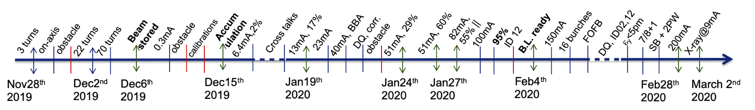
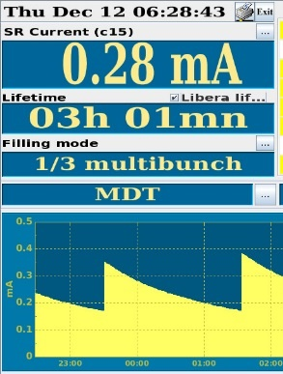
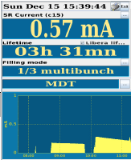
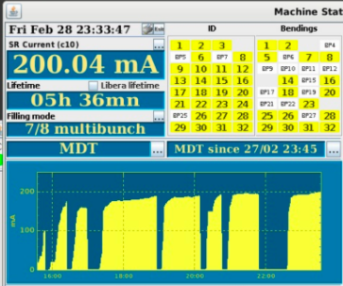
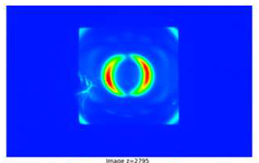
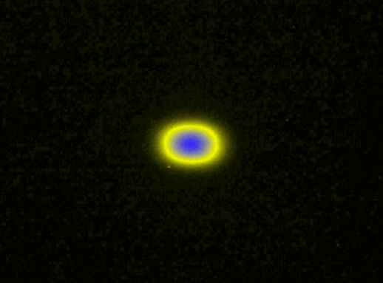
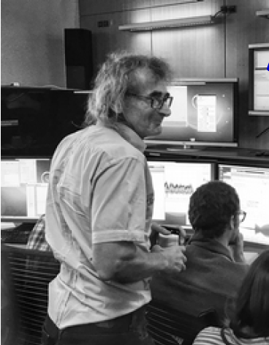
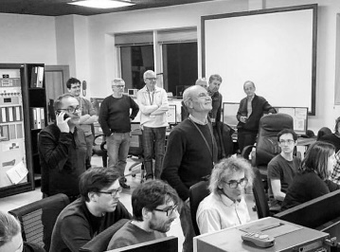
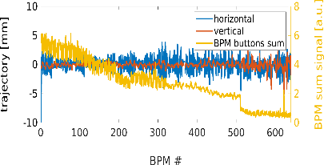
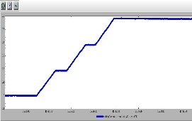
ESRF-EBS: Commissioning
28th November
First turns
6th December Beam stored
15th December Accumulation
30th January First Beam on 26 Beamlines
28th February
200 mA achieved
Courtesy S Liuzzo

Slide 8
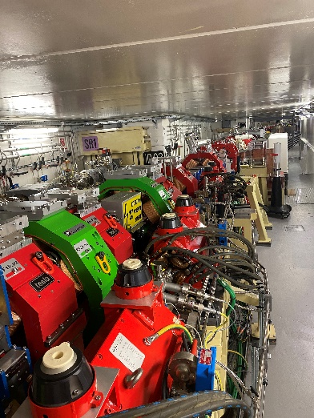
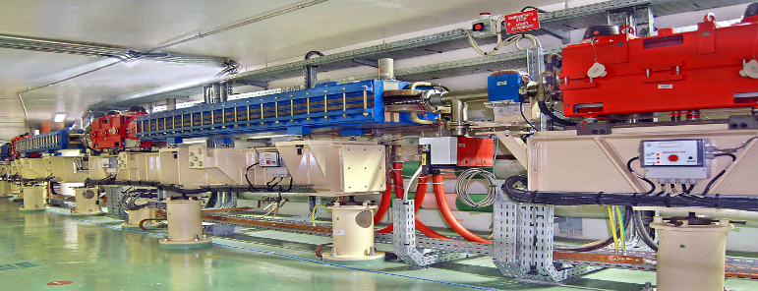
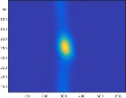
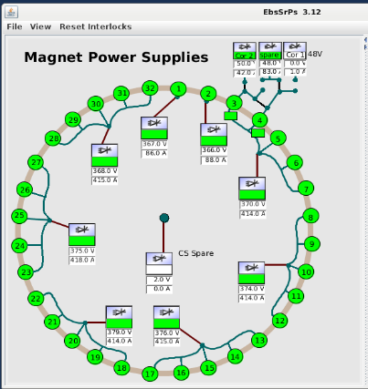
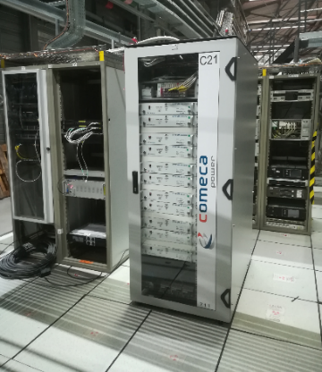
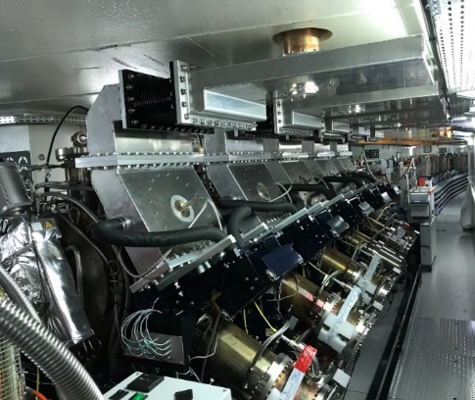
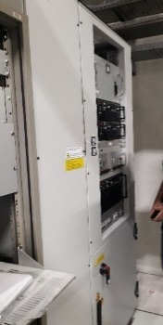
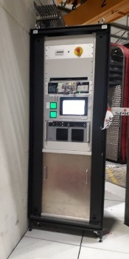
ESRF-EBS: Equipment commissioning
Control software, optics tools, commissioning scripts validated prior and during shutdown
on the Storage Ring simulator
Low and high level control for all equipment (including vacuum):
➔ Started as soon as the cabling is done
Power test of the magnets from August to November with tunnel not accessible
During last weeks of the shutdown with tunnel close (14/10 to 28/11):
  Final alignment & survey
  Validation of the personal safety system
  Global power test of the magnets
  Interlocks
  Injection/extraction elements
  Radio-frequency power commissioning
  Injector commissioning
Injector
Injection elements
Power supplies
Radio frequency

Slide 9
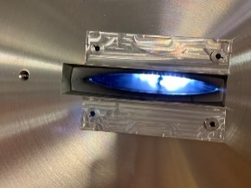
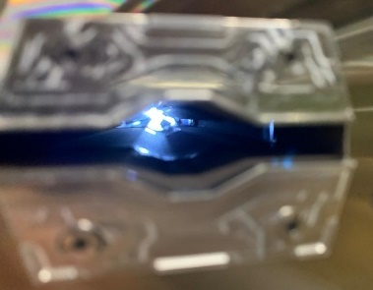
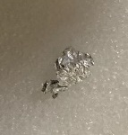
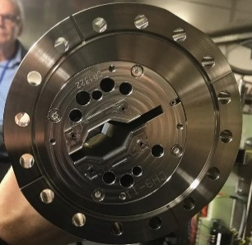
ESRF-EBS: beam Commissioning obstacles
Obstacle in Cell-5 Ch7
AL piece fall during installation of DQ2
3 physical obstacles on the beam path found during commissioning.
Piece of wire accidently into SS-23
ID chamber
Installation error
in cell8
Detected, get around, resolved by:
Very useful beam loss and turn by turn BPM diagnostics
Bumps, non-closed injection bump, off-energy operation, distorted close orbit,,…
Intervention to remove the obstacles one by one
Largely beneficial to injection efficiency, lifetime, optics tuning
Nominal position
Installation mistake Cell8-Bellow 9-11

Slide 10
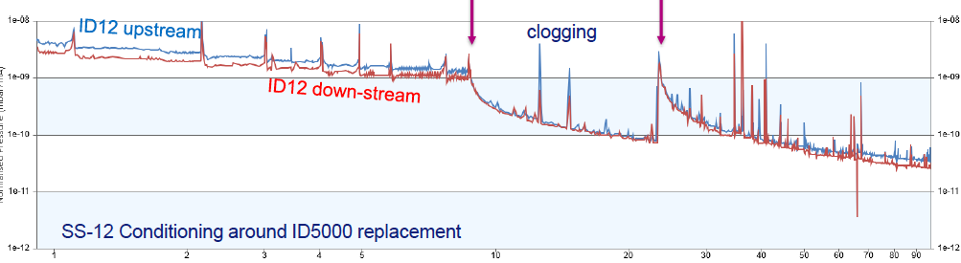
ESRF-EBS: beam Commissioning vacuum issue
A Few ID NEG coated ID chambers with poor vacuum
ID12 was contaminated ➔ poor vacuum ➔replaced
Replacement
Reactivation
Detected, resolved by:
Very useful beam loss diagnostics for detection
Intervention to exchange the chamber
Lifetime increase by a factor 3

Slide 11
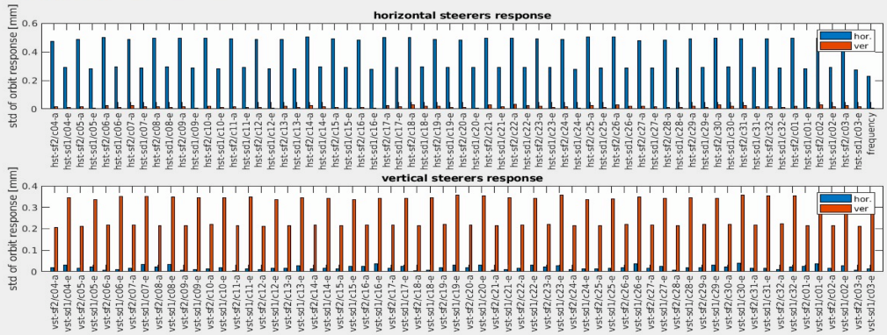
ESRF-EBS: beam Commissioning optics tuning
Optics tuning:
Optics correction (magnet modeling)
Add magnetic cross talk between adjacent magnets
Correct wrong calibration factor
Excellent alignment of components(<50 μm in both plane)
Orbit steering
Beam base alignment (100μm rms both plane)
Eigen vector optimization (from 64 to 162)
Eigen mode analysis (correction of DQs missing angle)
Lattice re-correction after BM sources (SB and 2PW) installation
Coupling correction (ε_{v}< 1pm.rad)
Dynamic aperture and injection efficiency studies
(Still lower than model)
Automatic lifetime/losses optimizer
(sextupoles, octupoles,skew scanning)
Δβ/β > 1.5% H ,
1.5% V,
Δη ∼ 0.7 mm H,
0.7 mm V
IE 80%

Slide 12
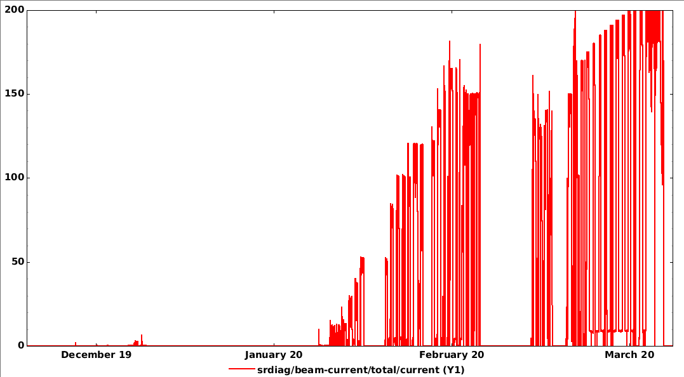
ESRF-EBS: Commissioning from 28/11 to 01/04
200 mA
SR current ramping
Injection efficiency
90 %
75%
Beamline commissioning
55%
30%
20%
0.1%
5%
Winter shutdown
28/11/2019
01/04/2020

Slide 13

Lessons learned from the installation and the commissioning
Large benefit from phase 1 upgrade for the infrastructure and accelerator components
Capitalize on the expertise for installation and start-up gained on the existing facility prior upgrade
(staff, procedures, control…)
Pre-assembly and anticipated tasks executed prior the shutdown
Design, procurement and installation procedures validated on the mockup
Activities concentrated on the storage ring during installation, limited activity for beamlines & infrastructure
Validation of control and tools on a simulator
Equipment test started as soon as possible,
including control system
All systems (RF, diagnostics, power,..) operational and
reliable from start of commissioning
Efficient beam position monitor and beam loss detectors
available from the start of commissioning

Slide 14
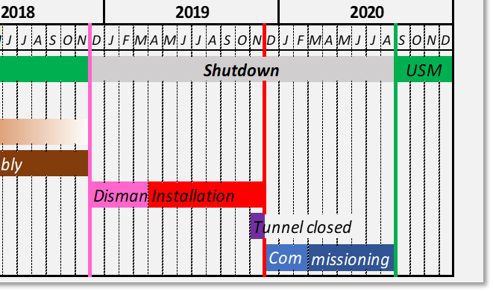




ESRF-EBS Impact of COVID-19 Pandemic
USM
USM
➔ 28 Feb. 2020 plan: Machine ready for beamlines ➔ Achieved
➔ 03 March 2020 plan: Start of beamline commissioning ➔ Achieved
New cases
But: 17-03/20 to 11/05/20: First lockdown in France (declared on 14/03/20)
➔ESRF Closure ➔ Stop operation
➔ 25 August 2020 plan: Start of user operation ➔ Achieved
But: 30/10/20 to 15/12/20: Second lockdown
03/04/21 to 03/05/21: Third lockdown
➔ Adaptation of the operation planning for users
Deaths
COVID-19 impacted the schedule as of 14 March 2020 (only), affecting mostly the beamline and user programme
First
Second
Third

Slide 15


ESRF at the time of the COVID-19 Pandemic
Ensuring safe working conditions on site , strictly following French regulations
Objective: Restarting user service mode (USM) on 25 August 2020 with a maximum number of beamlines open
➔ ESRF KEPT FULLY OPERATIONAL FROM 25-08-2020 TO DATE!
2020
Normal operation of accelerators
RESUME OPERATION
USM OPERATION
CLOSURE
1st WAVE
2nd WAVE
Gradual
Increase of people on site
Less than 10 people on site
Less than 100 people on site
Complete USM preparation
Back to USM
16 March – 11 May
Closure, continuity plan, Teleworking.
Restart of the accelerator with minimum people onsite on 22 April,… but stopped due to a water leak….
12 May – 1 June
2 June – 10 July
13 July – 24 August
From 25 August
Back to USM
Strict COVID-19 sanitary Telework privileged
Resume gradually storage ring & beamline commissioning, COVID-19 research
USM preparation
Telework privileged

Slide 16


Impact of covid-19 for the operation
2020
2021
COVID 19 first lockdown
Third lockdown
Second lockdown
Machine
Commissioning
Beamline Commissioning
August 2020
USM
From the start of the second lockdown to summer 2021,
number of user shifts [blue] reduced (3&4 days /week).
Limited access to the site:
Opportunity to improve tools for remote control
Dedicated chat channels, Confluence, JIRA and Jlogbook have been actively used
Development shifts /interventions were often performed via video-conferencing
➔Very efficient for short and fast support, including activities vith beamlines
Tests with beamlines
MDT & Interventions
Video-conferencing and remote control are new operation tools for the future

Slide 17

Return to Operation: Ongoing remote access experiments
IMPLEMENTING REMOTE ACCESS SOLUTIONS TO KEEP SCIENCE
AT THE FOREFRONT
New protocols for user programme operation, so that a majority of experiments can be conducted or followed up remotely
Implementation new solutions that allows users to interact remotely with beamline control software and tools
Implementation of large-scale sample mail-in solutions for user experiments
Remote data analysis with improved data transfer

Slide 18

User statistics and activities – 25 August 2020 to 31 July 2021
FIRST USM YEAR WITH THE NEW EBS STORAGE RING
A MILESTONE FOR THE X-RAY COMMUNITY
43/44
13 175
1 872
1 262
43 out of 44 beamlines hosted user experiments
13 175 shifts delivered (105 400 hours)
1 872 user experiments
1262 fully remote (68%), 192 only one user (10%), and 418 with users (22%)

Slide 19





Beam delivery from 25/08/2020 to 29/09/2021
Filling patterns
 | 7/8 + 1 | Uniform | 32*12 | 28*12+1 | 62 bunch | 16 bunch | 4 bunch
$I_{max}$ (mA) | 196+4 * (192+8) | 200 | 150 * (200) | 125+3* (200) | 65* | 35* (90) | 20* (40)
Lifetime (hours) | > 22 | > 25 | > 22 | > 23 | ~ 14 | ~ 8 | ~ 5
$ε_{v}$ (pm) * | 10 | 10 | 20 | 20 | 20 | 20 | 20
* Intensity limitation for timing modes due to mechanical weakness of the kicker ceramic chambers
* Vertical emittance artificially increased from 1 to 10 pm rad for an operational lifetime
* All timing modes delivered with a purity of 10⁻⁹ with cleaning process in the booster

Slide 20



Beam delivery since the start of USM
Beam current
25/08/2020
29/09/2021
Some disturbed weeks !!
But also quiet time !
249 hours without a beam loss

Slide 21

Reliability
 | 2017 | 2018 | 2020 | 2021
 |  |  | EBS | EBS
Availability (%) | 98.3 | 98.5 | 96.1 | 98
Mean time between failures (hrs) | 64.3 | 104.3 | 46.0 | 73.4
Mean duration of a failure (hrs) | 1.11 | 1.60 | 1.80 | 1.46
Overall reliability comparable to that of the old source
Magnet power supply system was the most complex hardware to develop and commission
  Hot swap system under commissioning
  Human mistakes due to development
  (mostly at the beginning)
  Infrastructure (mains, cooling, doors)
Operation disturbed by a few long failures from sub-systems not linked to EBS design
  aluminum NEG coated ID vacuum chambers
  RF master source
  20 KV high voltage cable defect
  RF highly reliable
Number of failures 2021

Slide 22


overview: beam current & Lifetime
200 mA
25 h
Beam current [mA]
Lifetime [h]
28/11/2019
25/08/2020
29/09/2021
Commissioning
USM
Average pressure [mbar]

Slide 23

Vertical and horizontal Emittances from 25/08/2020 to 29/09/2021
200 mA
Beam current
130 pm.rad
Horizontal emittance*
20 pm.rad
Vertical emittance
10 pm.rad
25/08/2020
Horizontal emittance diagnostics modified and calibrated during run 2020-06 and run 2021-1
➔ Typical today: 130 ± 20 pm.rad
Vertical emittance artificially blown up using white noise excitation up
from 1 pm.rad to 10 or 20 pm.rad to get an operational lifetime
➔ Typical today: 10 pm ± 1 pm.rad

Slide 24

ESRF-EBS: parameter achieved
 | Design | Realized today
Total current | 200,90,40 mA | 200, 35, 20 mA
MTBF | > 30 h | > 70 h
Up-Time | 98% | 98 %
Injection Efficiency | > 90 % | > 80 %
Lifetime | > 20 h | > 25 h
$ε_{H}$ | < 140 pm rad | < 130±20 pm rad
$$ε_{V}$$ | 10 pm rad | 10 pm rad
Stability | < 0.05 $σ$ | < 0.01 $σ$

Slide 25
conclusion
Results:
Despite the impact of the Covid-19 pandemic, users recovered the beam on the scheduled day and with an adapted operation planning
Main performances achieved (beam current, beam modes, lifetime, emittances, stability)
Excellent reliability of the hardware
Delay in the beamline commissioning and upgrade programme
Additional operating and support tools and methods have emerged
Beamlines are now progressing and upgrading to take full benefit of the source
Users are starting to come back
Objectives for the machine:
Fine tuning of beam parameters
Implementation of the hot-swap system for the power supplies
Reduce injection perturbation and go back to injection from every 1hour to every 20 mn
Nominal beam current in time-structured modes

Slide 26

Many thanks for your attention

