Slide 1
Un programme Européen pour développer la FA sur accélérateur: I.FAST WP10
Fabrication Additive appliquée à la physique des deux infinis
Prof. Toms TORIMS; Dr. Andris RATKUS; Guntis PIKURS / RTU & CERN
Prof. Maurizio VEDANI / PoliMi
Ing. Adriano PEPATO / INFN PD
7 juin 2021
Colloque – IJCLab, Orsay

Slide 2
What is I.FAST ?
Innovation Fostering in Accelerator Science and Technology, an Innovation Pilot Project of Horizon 2020 Framework Programme for Research and Innovation, addressing Research Infrastructure (RI) Advanced Communities.
Goal: demonstrating the role of RI’s in the translation of Open Science into Open Innovation.
How: 48 beneficiaries – 8 large RI operators, 12 national research centres, 12 universities, 16 industrial partners (1/3, including 11 SMEs) - from 15 European Countries, supported by 12 partner organisations and >20 collaborating institutions, jointly developing technologies for the next generation of particle accelerators.
Timeline: 4 years, starting 1 May 2021.
Resources: 10 M€ EC contribution, out of a total project cost of 18.7 M€.
Particle accelerator community entering the age of open innovation:
Sharing of ideas between scientific institutions and companies, to improve high technology products and to find new products and markets.
Creation of an innovation ecosystem:
Keywords: community, trust, openness, creativity

Slide 3
I.FAST: last of a series, first of a kind!
FP6
CARE 01/2004 – 12/2008
5 years, 15.2 M€ EC contribution
Long tradition of EC support to generic accelerator R&D: four successful Integrating Activities have raised 43 M€ EC funding over 16 years (2.7 M€/yr).
EuCARD 04/2009 – 03/2013
4 years, 10.0 M€ EC contribution
FP7
Integrating Activities
Development of cross-boundary subjects, not directly followed by large laboratories, with added value coming from collaboration and sharing of resources
EuCARD-2 05/2013 – 04/2017
4 years, 8.0 M€ EC contribution
ARIES 05/2017 – 04/2021
4 years, 10.0 M€ EC contribution
I.FAST is a new crucial step in our progress.
Integrating Activities disappear from the RI Work Programmes, replaced by other tools.
No more Transnational Access (goes to dedicated projects), accent on common development of instruments in collaboration with industry.
H2020
Innovation Pilot
I.FAST 05/2021 – 04/2025
4 years, 10.0 M€ EU contribution

Slide 4
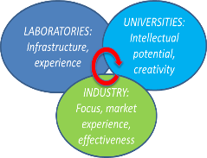
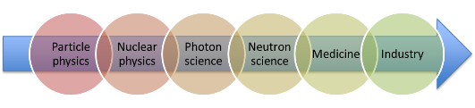
I.FAST Strategic Goals
The «Innovation Pilot» is a completely new instrument to support Particle Accelerator R&D in Europe in 2021-25.
With respect to our old “Integrating Activities” (IA), the core is now made of “co-innovation” R&D activities with industry, at different Technology Readiness Levels (TRL).
We keep the same strategic goals of our IA’s:
Transverse approach based on synergies between accelerators for different users: particle and nuclear physics, photon and neutron science, medicine and industry.
Collaborative schemes involving laboratories, university and industry.
Priority to long-term R&D topics, beyond the specific needs of approved projects and developments.

Slide 5
Task 10.2: AM – Survey of applications and potential developments / M1 – M36
Survey of current Additive Manufacturing (AM) applications in accelerators and identification of needs for future development and research actions
Promote initiatives to identify how AM can address the needs of the accelerator community
Define strategic directions for future AM technologies and foster their impact on accelerator applications (inc. societal), identifying technology barrier and challenges
Task Leader: Prof. Maurizio VEDANI - PoliMi

Slide 6
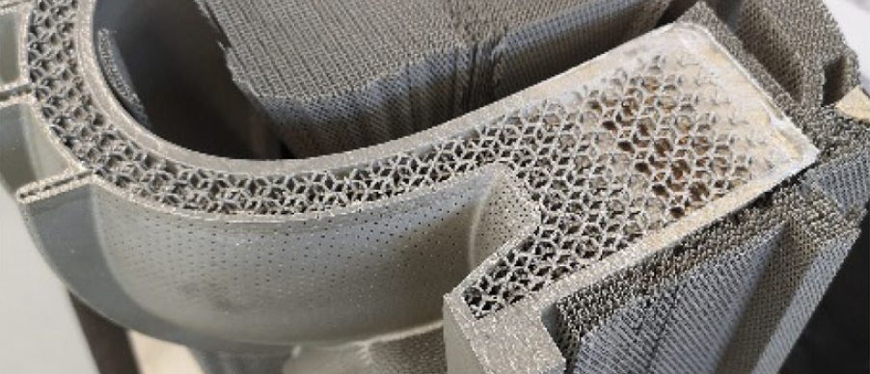
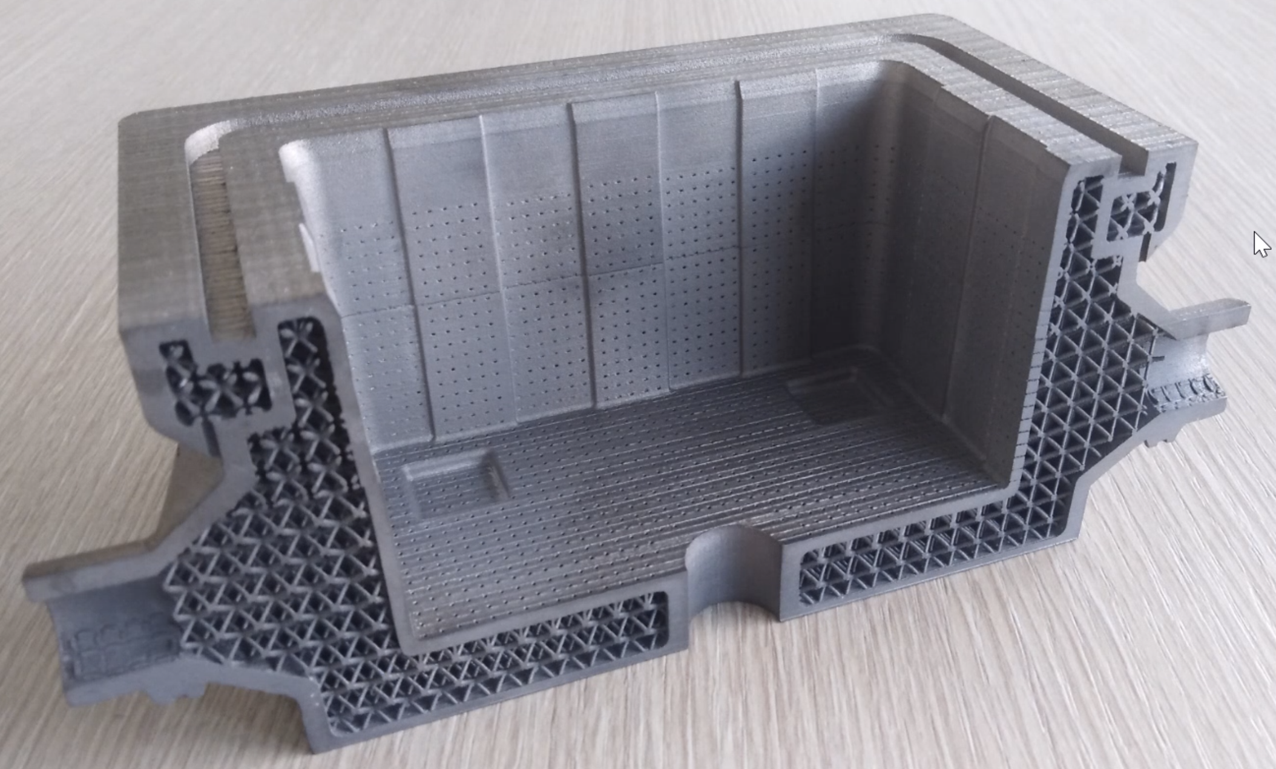
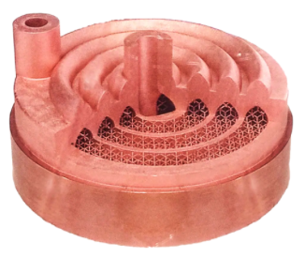
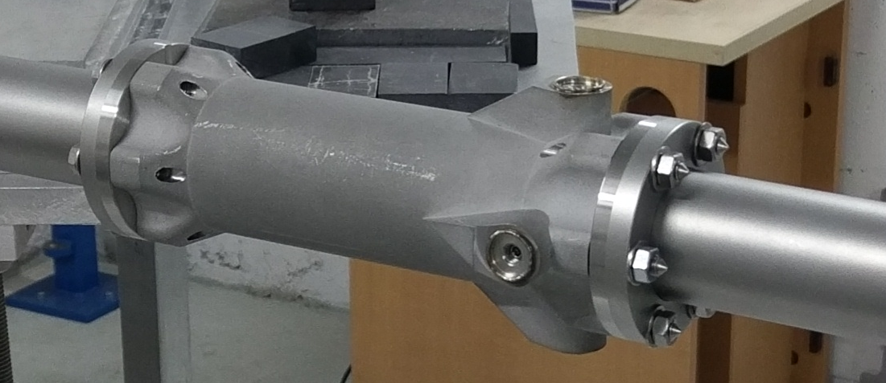
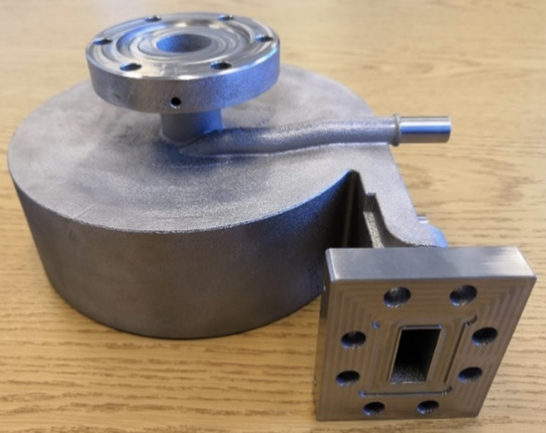
Task 10.2: AM – Survey of applications and potential developments / M1 – M36
Survey of all known AM applications in Accelerator Community
Promote - how AM can address needs of Accelerator Community?
Additive manufacturing opens up new prospects at CERN https://home.cern/news/news/engineering/additive-manufacturing-opens-new-prospects-cern
CNRS and CEA
INFN
Progress in Additive Manufacturing (2021) 6:339–346
https://doi.org/10.1007/s40964-020-00153-3
INFN PD
Courtesy of N.Delerue
Image: CERN

Slide 7
Task 10.3: Refurbishment of accelerator components by AM technologies / M1 – M24
Definition of applications and components for the repair activities in the accelerator components by AM
Identification of AM strategies that can be adopted to repair parts
Study post-processing methods to control surface roughness and surface cleanliness of AM parts
Identification of a sample demonstration prototype of AM repaired unit for an accelerator
Task Leader: Dr. Andris RATKUS - RTU
Your ideas are very welcome!
Specific technological development that could save time and maintenance costs

Slide 8
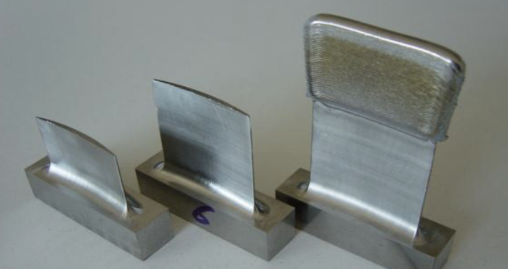
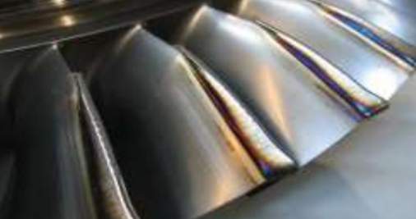
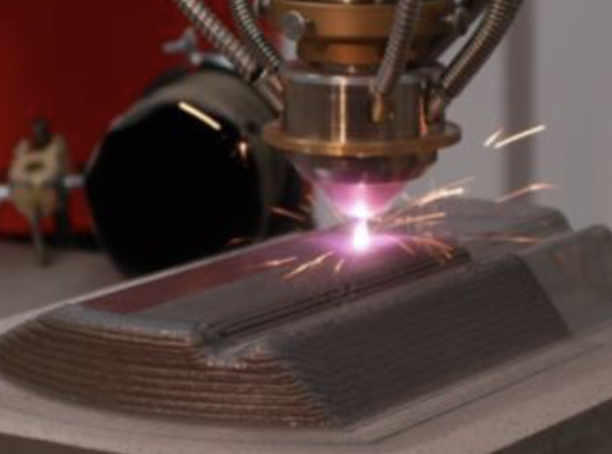
Task 10.3: Refurbishment of accelerator components by AM technologies / M1 – M24
AM for repairs - Q’s to be answered
Potential advantages
What can we repair with AM?
Which types of AM and strategies to use?
If post-processing is required – which methods to use?
What is the best initial demonstration prototype?
In-situ repairs
Can be done in hostile environments (radiation, magnetic field, low O₂, ...)
Wide range of materials, incl. multi-materials
Micro and macro scale repairs
Images: Fraunhofer IWS

Slide 9
Task 10.4: Development of AM-manufactured superconductive RF cavities / M1 – M24
Develop the design approach and test relevant properties of AM-manufactured Niobium RF cavities
Develop the design approach and test relevant properties of AM-manufactured Ultra-Pure Cu-made RF body cavities - coated by a Niobium thin layer at the inner surface
Both to be tested at room and at cryogenic temperature
Task Leader: Ing. Adriano PEPATO - INFN PD

Slide 10
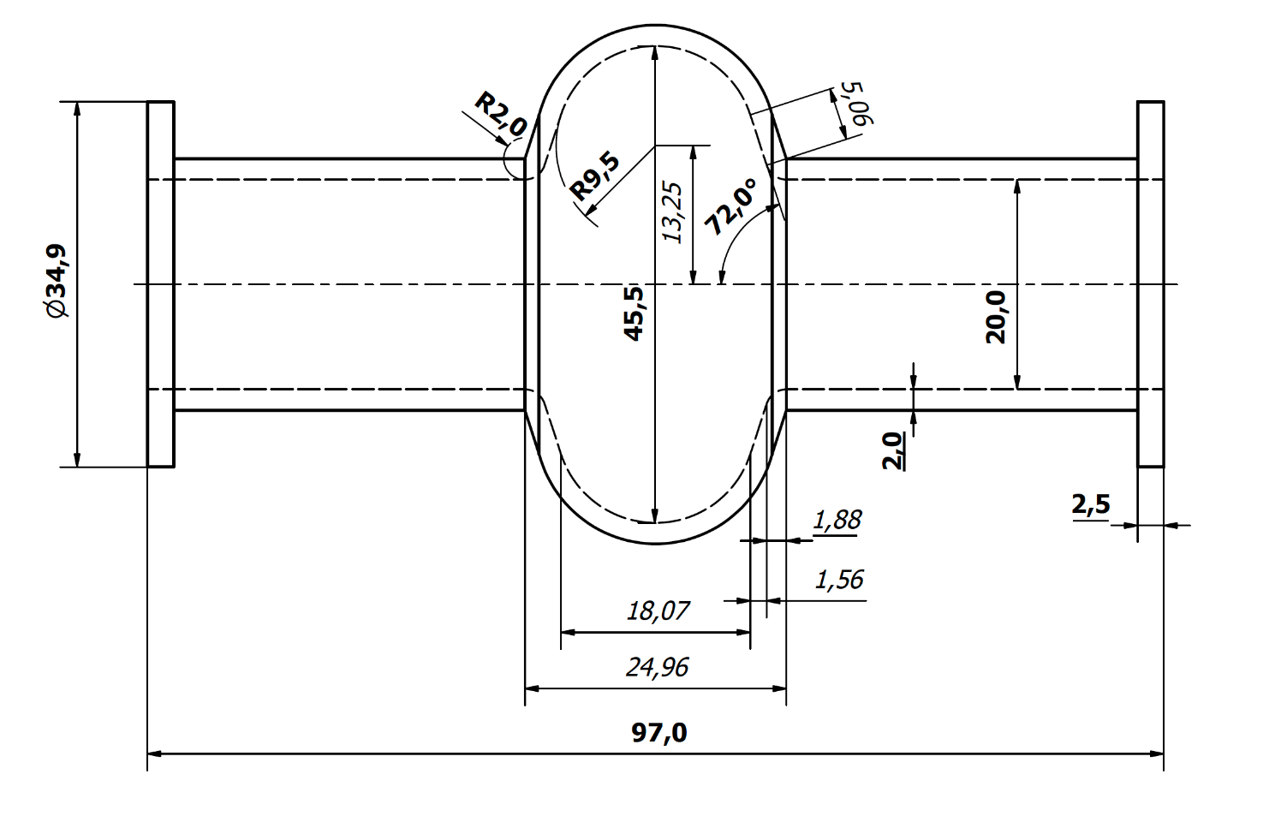
Task 10.4: Development of AM-manufactured superconductive RF cavities / M1 – M24
Novelty – INFN initiative
6 GHz Super conductive Cavity Geometry
The first sample of the 6 GHz cavity will be manufactured with pure Cu
The characterization of Nb will be performed
The challenging issue will be the finishing of the internal skin as well as the respect of the geometrical tolerances of the cavity
Provided by A.Pepato

Slide 11
Big challenges require joint response: Task 10.2; Task 10.3 and Task 10.4
Vacuum, cryo, RF: leak tightness, outgassing rate, porosity, electrical conductivity
Size limitations of machines and available simulation tools
Materials: ultra-clean, chemical purity – still limited avaliability, flow properties
Accuracy: surface roughness, tolerances, geometry precision
Radiation impact and activation
AM technological specificities an optimisation to end requirments (RF, cryo, etc.)
Microstructure uniformity, residual stresses, inclusions, voltage holding
Potential post-processing and eventual hybrid-machining
Yet most importantly: traditionalism, lack of knowledge, and scepticism on AM compliance with the stringent accelerator requirements

Slide 12
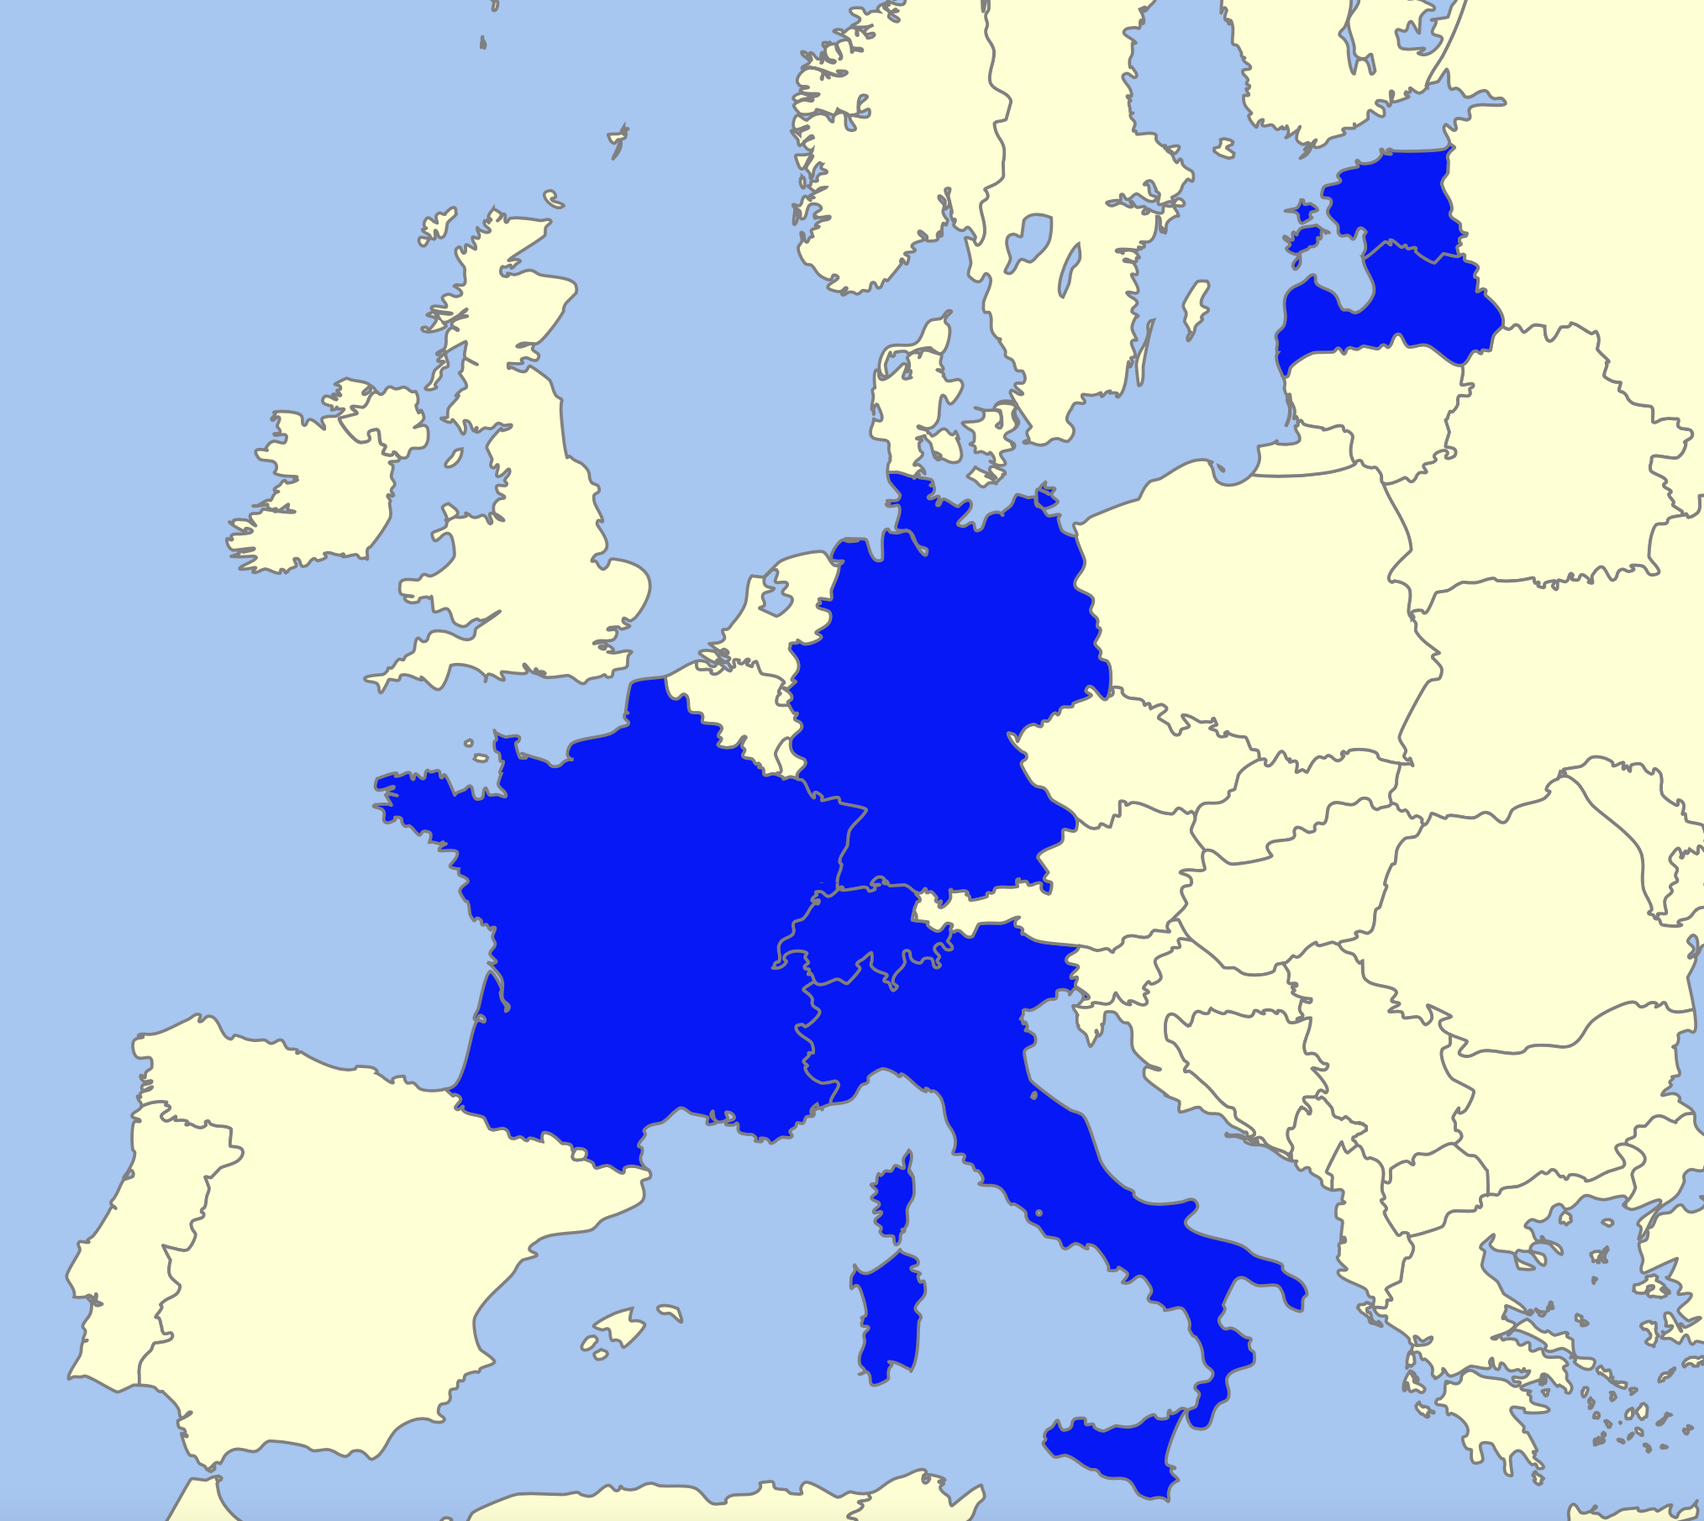
AM Partnership and Collaboration in I.FAST
Extensive previous experience and know-how in AM:
Leading accelerator labs which are doing R&D within AM:
PoliMi – Milano, IT
Fraunhofer IWS – Dresden, DE (new to Accelerator Community)
RTU – Riga, LV
TalTech – Tallin, EE (new)
Rösler Surface Technology Srl - surface finishing solutions of AM parts – IT
H.C. Starck GmbH – AM process developer and supplier of feedstock powders - DE
CERN
CNRS
CEA
INFN – Padova
Partnership is open!
12

Slide 13
Expected outcomes: Task 10.2; Task 10.3 and Task 10.4
Hard Deliverables
Soft results
D10.3: AM Superconductive RF cavities. Production and tests of superconductive RF cavities, made by Nb and/or Cu coated by an Nb thin film – M12
D10.2: Survey of AM applications and strategies for repairing accelerator components by AM. Report listing possible strategies and technologies for repairing of parts – M24
D10.1: Potential AM applications in accelerators. Report on output of the survey on AM applications, further needs for the accelerator community, and perspective developments – M30
WP 10 Strategy group will work on the emerging applications of AM technologies in the accelerator field
Will define further potential applications - in particular, for industrial and medical accelerators
Will explore possibilities of digitalisation in accelerators, evaluating market and economical aspects concerned with AM in the accelerator sector
PhD engagement and scientific mobility/exchange (especially NE Europe)
This all shall result in a “Roadmap of future AM applications for accelerators”

Slide 14
Strategic goals of AM Group within WP10
To proliferate AM R&D in the Accelerator Community at large
To rise the trust to AM by showing real and tangible R&D case studies
To lower overall costs by using AM (e.g. reduced material consumption and repairs) – sustainability
To pull resources and knowledge together + to engage new partners
To promote range of new AM projects and grants within Accelerator Community and beyond
To take a leadership at European level and coordinate efforts with US and China partners
To contribute to Accelerator Community Projects and Collaborations – especially related to societal applications – e.g.NIMMS, SEEIIST, HITRIplus - hadron therapy
To give a visibility to already remarkable achievements
Fully in line with High-priority future initiatives of 2020 Update of the European Strategy for Particle Physics:
The particle physics community should ramp up its R&D effort focused on advanced accelerator technologies …
The European particle physics community must intensify accelerator R&D and sustain it with adequate resources. A roadmap should prioritise the technology, taking into account synergies with international partners and other communities …

Slide 15
Relevant projects conferences and workshops
Upcoming
Previous AM targeted presentations and contributions
Task 10.2 to organise series workshops and meetings
one per country or region during the first year, in at least 5 different regions
open to partners, accelerator experts and other industrial stakeholders
Objective - to identify how AM can address the needs of the Accelerator Community
FCC weeks – 2016; 2017; 2018; 2019
ARIES – Additive Manufacturing: Advanced Technologies for Accelerator Applications – 2019 Budapest
Workshop on AM applied to accelerators and HEP (jointly organised by CNRS and CEA): 1st ed. Dec 2018, Paris
+ today
Accelerator schools, CERN Academic Training Lecture Regular Programme, designated events, etc.

