Slide 1


Workshop GMR du GDR Resanet
Orsay, November 2020
Soft breathing modes in neutron-rich nuclei with the subtracted second random-phase approximation
Marcella Grasso

Slide 2
Outline
Higher-order RPA with the second RPA (SRPA) model (beyond mean field) within the energy-density functional (EDF) framework
Implementation of the SRPA model. Application of a subtraction method (SSRPA) tailored to handle double counting of correlations, instabilities and ultraviolet divergences
Recent Application. Soft compression excitations and links with the compressibility
Conclusions

Slide 3
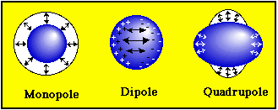
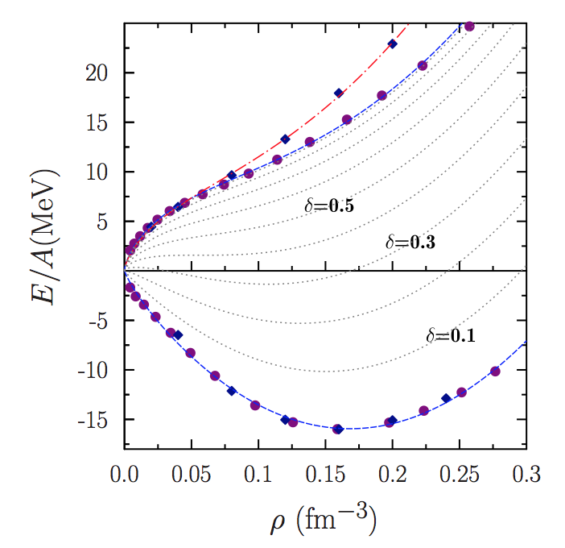
Collective modes and equation of state of infinite matter
Incompressibility (ISGMR, ISGDR)
Effective mass (axial compression modes -> ISGQR)
Symmetry energy and its density dependence (IVGDR, dipole polarizability, pygmy dipole, IVGQR, IAS, Gamow-Teller, spin dipole, anti-analogue GDR)
Grasso, Effective density functionals beyond mean field, Prog. Part. Nucl. Phys. 106, 256 (2019)
Bao-An Li, Bao-Jun Cai, Lie-wen Chen, and Jun Xu, Nucleon effective masses in neutron-rich matter, Prog. Part. Nucl. Phys. 99, 29 (2018)
Roca-Maza and Paar, Nuclear equation of state from ground and collective excited state properties of nuclei, Prog. Part. Nucl. Phys. 101, 96 (2018)
Garg, Colò, The compression-mode giant resonances and nuclear incompressibility,
Prog. Part. Nucl. Phys. 101, 55 (2018)
- Bracco, Lanza, Tamii, Isoscalar and isovector dipole ..., Prog. Part. Nucl. Phys. 106, 360 (2019)

Slide 4
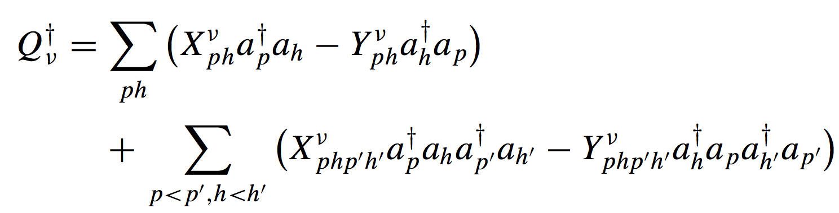
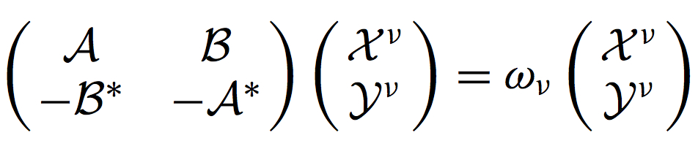
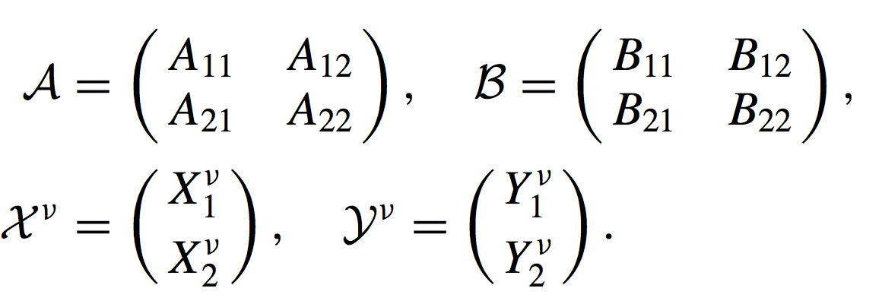
Beyond mean field: SRPA model : formally established in the 60s
Excitation operators: 2p2h configurations are included, together with the RPA 1p1h configurations
Different formal derivations
Variational procedure
Equations of motion method
Small-amplitude limit of the time-dependent density matrix method
- Sawicki, Phys. Rev. 126, 2231 (1962)
- da Providencia, Nucl. Phys. 61, 87 (1965)
- Yannouleas, Phys. Rev. C 35, 1159 (1987)
- Tohyama, Gong, Z. Phys.A 332, 269 (1989)
Same compact form as RPA equations
A₁₁ and B₁₁: standard RPA matrices
A₁₂, A₂₁, B₁₂ , and B₂₁: coupling between 1p1h and 2p2h
A₂₂ and B₂₂: 2p2h sector
1 and 2:
short-hand notation for 1p1h and 2p2h

Slide 5
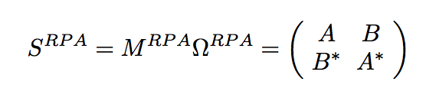
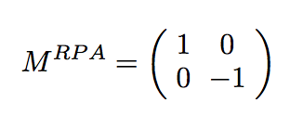
RPA and SRPA stability
- Stability Condition (Thouless 1960)
HF state minimizes the expectation value of the Hamiltonian
-> RPA stability matrix is positive semi-definite
- Tselyaev, PRC 88, 054301 (2013) (subtraction prescription)
- Papakonstantinou, PRC 90, 024305 (2014) (correlated ground state)
IN ADDITION TO STABILITY PROBLEMS
In the EDF scheme for beyond mean field:
- Ultraviolet divergence for zero-range interactions (dependence on the energy cutoff for the 2p2h configurations) - Overcounting of correlations (if parameters of the interactions are adjusted at the mean-field level)
- HF state minimizes the expectation value of the Hamiltonian -> does not guarantee that the SRPA stability matrix is positive semi-definite (instabilities and unphysical strong shifts of the spectrum)

Slide 6
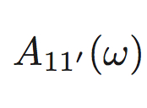
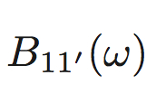


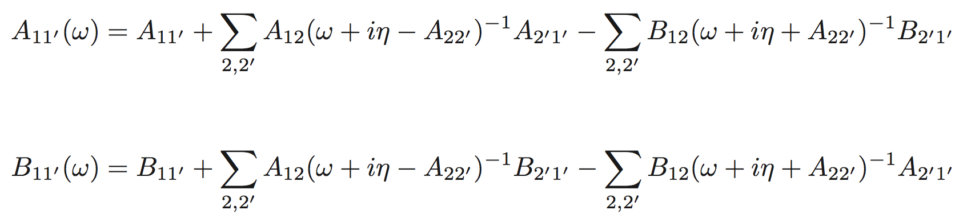
SRPA equations may be written as RPA-type equations with energy dependent RPA matrices
For cases where the interaction is density independent and A₂₂ diagonal the expressions are simplified
SRPA
RPA
Ω
=
Ω
=
*
*
-
*
-
*
-
-
where the energy-dependent matrix elements are
Gambacurta, Grasso, Engel,
PRC 92, 034303 (2015)
Tselyaev : if the static polarizability is the same as in RPA -> the stability matrix is positive semi-definite.
-> subtraction, in the energy-dependent self-energy, of the self-energy calculated at zero
Σ(E) - Σ(0)
Energy-dependent self-energy insertion Σ(ω) -> leads to a beyond mean-field model and provides the description of spreading widths and fragmentation (in addition to the single-particle Landau damping) through de coupling with 2p2h

Slide 7
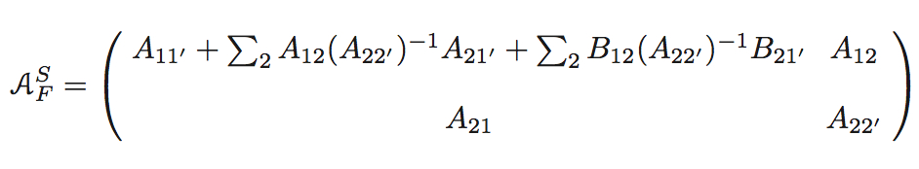
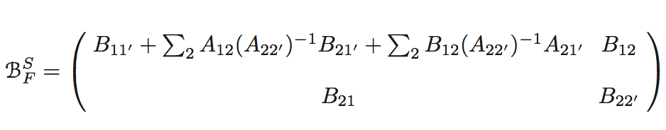
By following Tselyaev 2013 ->
Equations in a non-energy-dependent SRPA form:
S -> subtracted
F -> full scheme (inversion of the matrix A_{22’})
Gambacurta, Grasso, Engel, PRC 92, 034303 (2015)

Slide 8
RECENT APPLICATIONS OF SSRPA
◆ Electric dipole polarizability in ⁴⁸Ca, Gambacurta, Grasso, Vasseur, Phys Lett. B 777, 163 (2018)
◆ Systematic study of axial compression modes, Vasseur, Gambacurta, Grasso, Phys Rev C 98, 044313 (2018)
◆ Beyond-mean-field effects on effective masses, Grasso, Gambacurta, Vasseur, Phys Rev C 98, 051303(R) (2018)
◆ Beyond-mean-field effects on the symmertry energy and its slope from the low-lying dipole response of ⁶⁸Ni, Grasso and Gambacurta, Phys. Rev. C 101, 064314 (2020)
◆ Gamow-Teller strengths in ⁴⁸Ca and ⁷⁸Ni with the charge-exchange subtracted second random-phase approximation, Gambacurta, Grasso, Engel, Phys. Rev. Lett. 125, 212501 (2020)
◆ Soft compression modes and links with the compressibility of asymmetric matter, Gambacurta, Grasso, Sorlin, Phys Rev C 100, 014317 (2019)

Slide 9
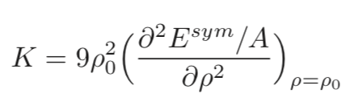
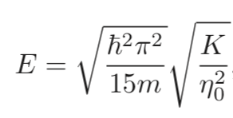


Link between the breathing excitation where neutrons and protons move coherently together (giant resonance) with the compressibility (curvature of the EOS of symmetric matter)
By treating the nucleus as a liquid drop, starting from the hydrodynamics equations, one may write a relation between the centroid energy of the compression mode and the compressibility
For infinite symmetric matter:
Root mean
square radius
K -> compressibility
𝛒₀ -> equilibrium density of symmetric matter (saturation density)

Slide 10
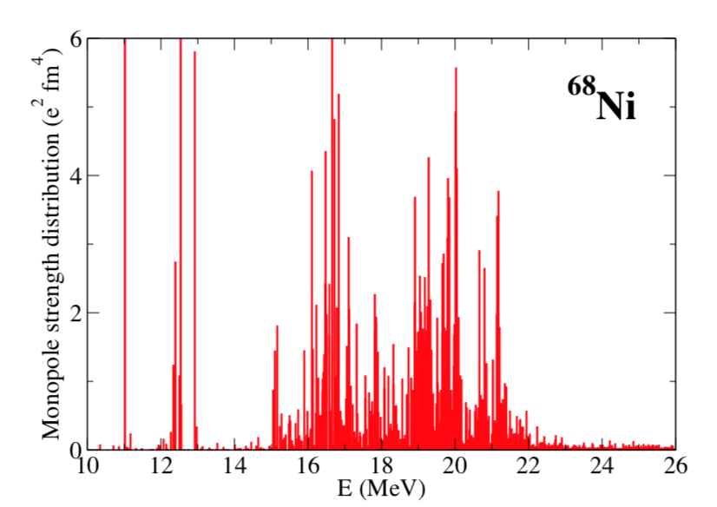
Low-energy compression modes in ⁶⁸Ni -> (N-Z)/A=0.18
Low-energy region,
Soft modes
Attempt for measurement: Vandebrouck et al., PRL 113, 032504 (2014); PRC 92, 024316 (2015).
No clear observation
Monopole breathing mode where neutrons and protons move together coherently
% EWSR up to 14 MeV = 5.37
Mixing of several configurations
Low mixing with 2p2h
Gambacurta, Grasso, Sorlin, PRC 100, 014317 (2019)

Slide 11
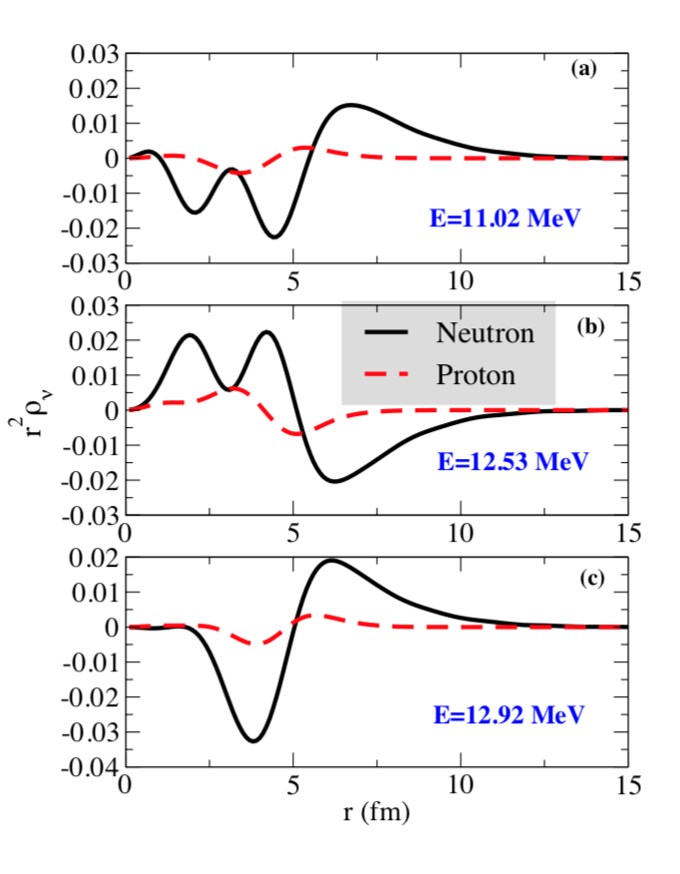
Low-energy compression (monopole) modes. Transition densities
Neutron-driven
excitations
Gambacurta, Grasso, Sorlin, PRC 100, 014317 (2019)

Slide 12
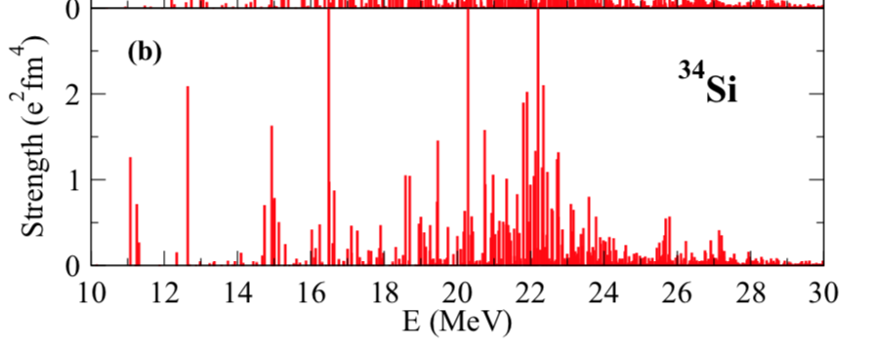
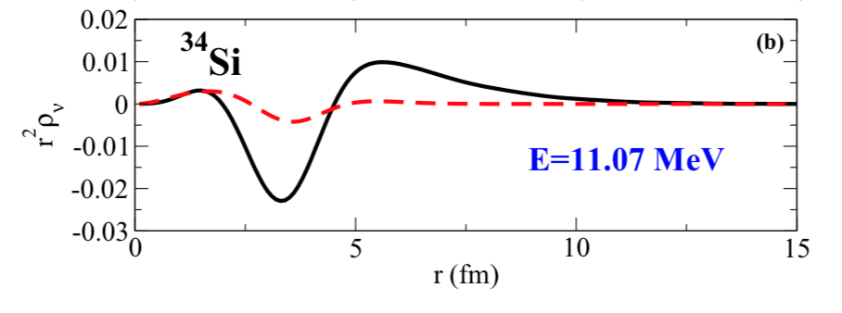
Low-energy compression modes in ³⁴Si -> lighter but similar isospin asymmetry (N-Z)/A=0.18
Neutron-driven
excitation
% EWSR up to 15 MeV = 4.5
Sligthly less collective (but, still, mixing of several configurations)
Mass seems to play a minor role in collectivity
(collectivity is not strongly enhanced in ⁶⁸Ni)
Strong mixing between 1p1h and 2p2h configurations
p
n
Gambacurta, Grasso, Sorlin, PRC 100, 014317 (2019)

Slide 13
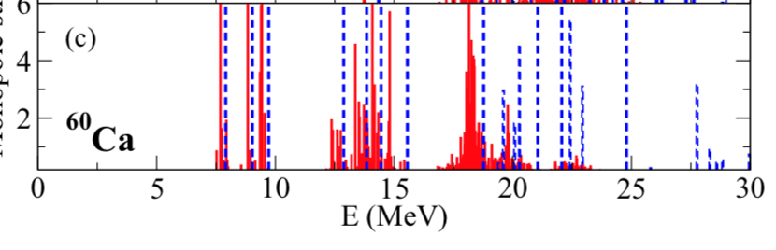
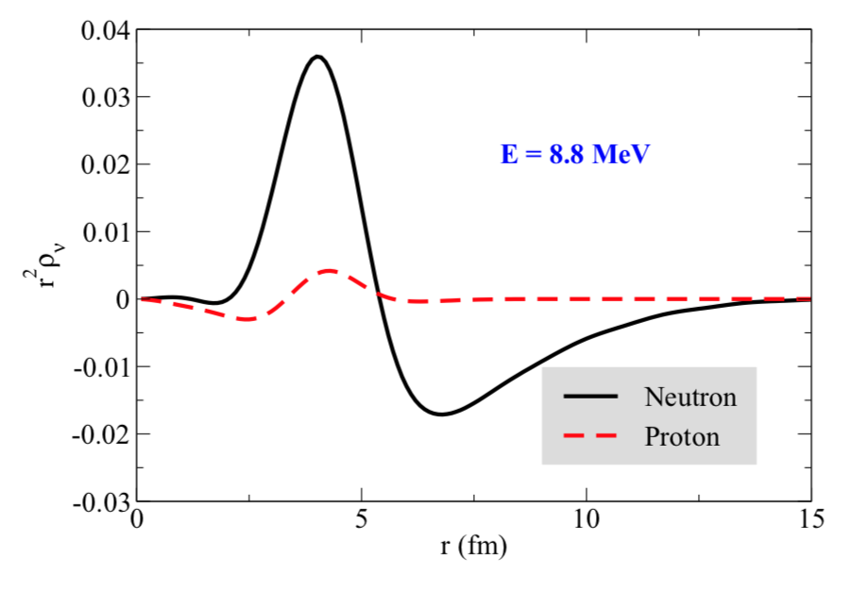
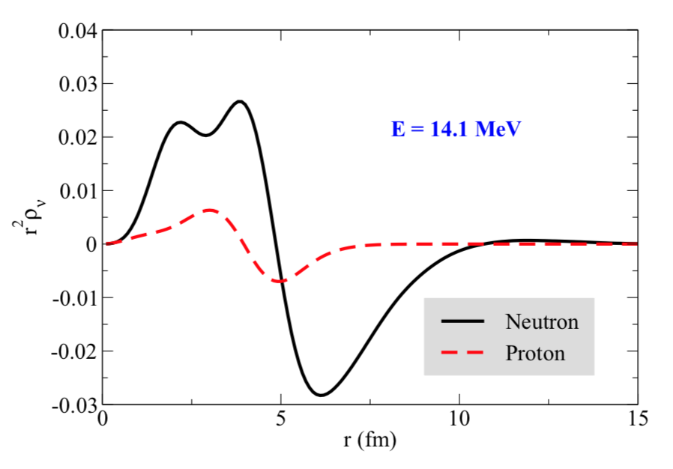
Low-energy compression modes in ⁶⁰Ca -> similar mass as ⁶⁸Ni, but higher isospin asymmetry (N-Z)/A=0.33
Discovered at RIKEN
Tarasov et al., PRL 121, 022501 (2018)
RPA
SSRPA
Strength
% EWSR up to 16 MeV = 26.81
Collective
Neutron excess plays an important role in collectivity
(collectivity is strongly enhanced)
State at 14 MeV: strongly 2p2h configurations
Neutron-driven excitations
Gambacurta, Grasso, Sorlin, PRC 100, 014317 (2019)

Slide 14
Link with compressibility? Soft breathing modes in neutron-rich systems are strongly driven by neutrons
Link with a compressibility defined for asymmetric (neutron-rich) matter ?
X -> isospin asymmetry of asymmetric matter (and of the oscillating system).
(N-Z)/A
Gambacurta, Grasso, Sorlin, PRC 100, 014317 (2019)

Slide 15
Plotting for a given A
Estimating the isospin asymmetry of the oscillating system
Green area: range of isospin asymmmetry for the oscillating system involved in the excitations at 8.8 (⁶⁰Ca), 11.1 (³⁴Si), 11.0 (⁶⁸Ni) MeV.
Magenta arrow: same, for the excitation at 14.1 MeV in ⁶⁰Ca.
Gambacurta, Grasso, Sorlin, PRC 100, 014317 (2019)

Slide 16
Isospin asymmetry of the oscillating system
Using the transition densities computed with SSRPA (estimation with only 1p1h contribution in the transition density)
Gambacurta, Grasso, Sorlin, PRC 100, 014317 (2019)

Slide 17
Summary
Implementation of the SRPA model by a subtraction procedure: double counting of correlations,
stability condition, ultraviolet divergence
A recent application:
►► Low-lying compression modes in neutron-rich nuclei (neutron-driven modes. Link with the compressibility defined for asymmetric infinite matter. Qualitative estimation of the isospin asymmetry of the breathing system)

