Slide 1
Université Européenne EUGLOH European University alliance for GLobal Health
October 21st, 2020

Slide 2
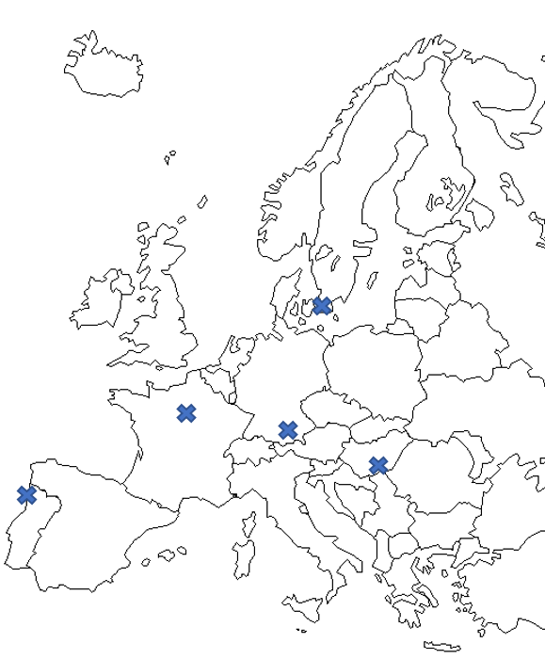






The European University Alliance for Global Health
EUGLOH as a pilot European university able to:
offer a European experience to 50% of its students at all levels
improve the competences and European practices of the teaching and administrative staff
build a European campus with a high level of integration sustained by joint procedures and structures
boost attractiveness and competitiveness of European higher education, research and innovation
be an internationally recognized observatory of best practices and expertise in Global Health
SWEDEN
FRANCE
2
HUNGARY
1
5
3
4
GERMANY
PORTUGAL

Slide 3
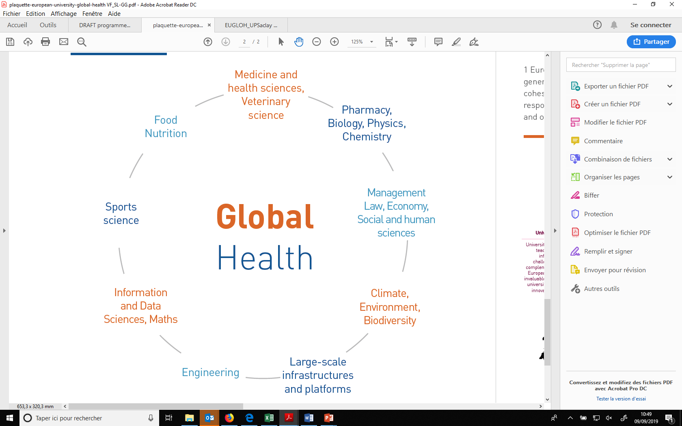
A unifying theme encompassing
various fields and challenges: Global Health

Slide 4
Structural model
Training

Slide 5
Governance and overall organisation
Governing Board
(GB)
Rectors/Presidents)
Responsible for decision-making, endorsement of the missions and budget.
Executive Board
(EB)
Vice-Rector/vice-Presidents, academics, administrative staff and associated partners
In charge of defining the strategy and ensuring the implementation of the WP missions.
Student Board
(SB)
Students of all levels, lifelong learners
Participation in all the missions (programme design, campus life, sharing of best practices)
Advisory Committee
(AC)
External players of all disciplines and all levels of other organisations.
Report and give recommendations on programmes, structures and practices.
Project Management Team
(PMT)
Administrative staff
In charge of the overall management.

Slide 6

TRAINING ACTIVITIES (Feb-June 2020)
Training | Organizers | Target | Month | Number of students | Physical/virtual
Rush Pharmaceutical Game | UPSaclay | Master students | Feb 2020 | 83 | Physical
Voice Training Workshop | LMU | PhD students | May 2020 | 12 | Online
Innovation Days | LMU | PhD students & researchers | May 2020 | 40 | Online
Writing Global Health Workshop | LMU & UPSaclay | Master students | May – June 2020 | 49 | Online
Teaching Skills Workshop | LMU | PhD students | May 2020 | 5 | Online
Online Discussion on Students’ Experience in the COVID 19 pandemic | LMU | PhD students & reasearchers | May 2020 | 19 | Online
COVID

Slide 7

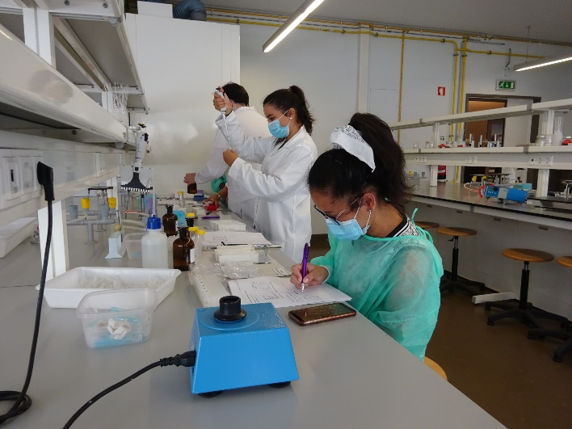
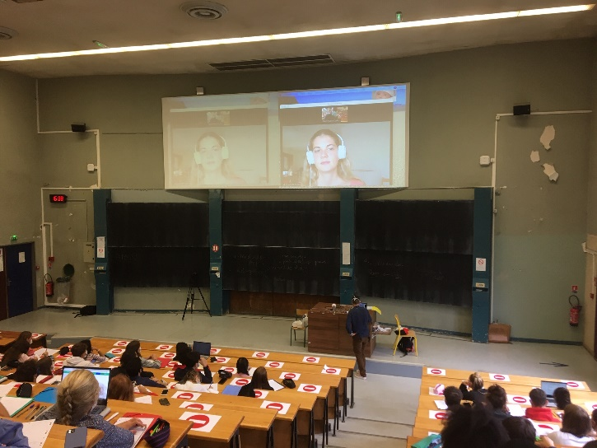
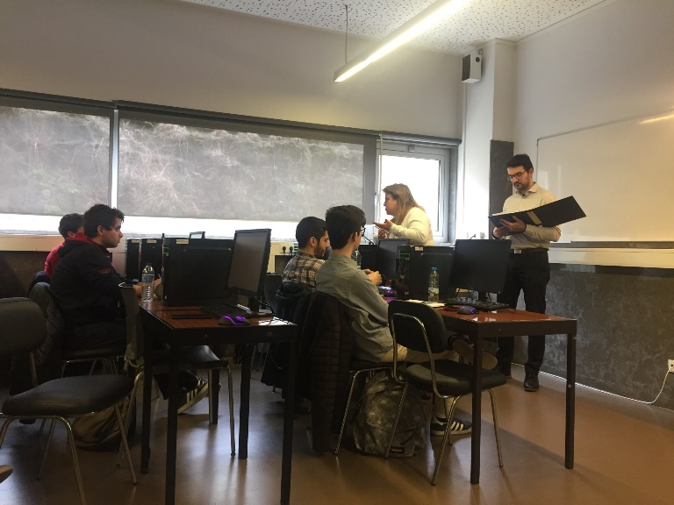
Examples of activities implemented:
Lifelong Learning Programme on
Medicinal Plan
EUGLOH Summer School
First EUGLOH introductory course in astrophysics
Rush Game in Pharmaceutical Marketing course

Slide 8
First EUGLOH introductory course in astrophysics, organised by Professor Hervé Dole in UPSaclay with Dr Charlotte Géhan from the University of Porto:
Link for the video:
https://we.tl/t-xGpChQy3ux

Slide 9


















Chargés de mission et représentants établissements EUGLOH
Sandrine Lacombe
Coordinatrice EUGLOH
sandrine.lacombe@universite-paris-saclay.fr
Slavka Kascakova
Coordination académique et scientifique
slavka.kascakova@universite-paris-saclay.fr
Eric Cassan
VP adjoint Europe
eric.cassan@universite-paris-saclay.fr
Casimiro Vizzini
Secrétaire general
casimiro.vizzini@universite-paris-saclay.fr
Chargés de mission
UFR Pharmacie 1
Eric Morel
eric.morel@universite-paris-saclay.fr
UFR Medicine
Slavka Kascakova
slavka.kascakova@universite-paris-saclay.fr
UFR Sciences
Burkhart Wolff
wolff@lri.fr
STAPS 1
Christopher Hautbois
christopher.hautbois@universite-paris-saclay.fr
UFR Pharmacie 2
Dorine Bonte
dorine.bonte@universite-paris-saclay.fr
UFR de Jean Monnet
Valérie Nicolas-Hémar
valerie.nicolas-hemar@u-psud.fr
STAPS 2
Marie Gernigon
marie.gernigon@universite-paris-saclay.fr
AgroPT 1
Aurélie Baliarda
aurelie.baliarda@agroparistech.fr
AgroPT 2
Sabine D’Andrea
sabine.dandrea@agroparistech.fr
AgroPT 3
Dalila Azzout Marniche
dalila.azzout-marniche@agroparistech.fr
AgroPT 4
Jean-Christophe Bureau
jean-christophe.bureau@inrae.fr
Numérique et EAD
Daniel Pelaez Ruiz
daniel.pelaez-ruiz@universite-paris-saclay.fr
ENS-PS
François Pannequin
francois.pannequin@ens-paris-saclay.fr
UVSQ
Jan Borm
jan.borm@uvsq.fr
UEVE
Nazim Agoulmine
nazim.agoulmine@univ-evry.fr
CS
IOGS
Ecole de 1er cycle
Masters et handicap
Marie Poirier-Quinot
Art, Science, Culture, Société/EUGLOH (formation)
Reconnaissance/Certification des étudiants
Recherche et doctorat (Swafs et Grant 34)
Développement soutenable

