Slide 1
A new institution, a world-class university
September 2020

Slide 2
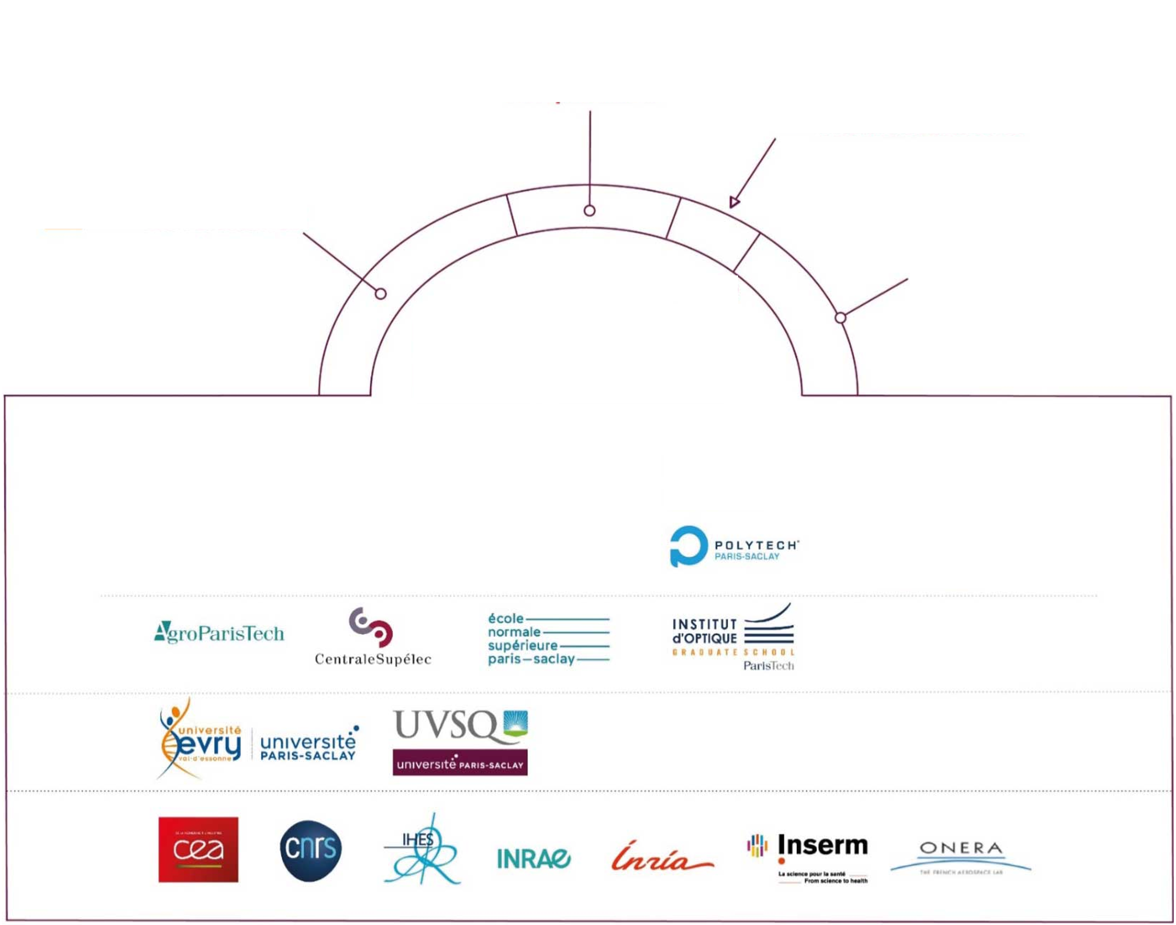





=> Around 30 Erasmus+ Projects
4
Component
institutions
2
Member-associated
universities
10
Academic faculties
7
National
research
bodies
FACULTY OF
MEDICINE
FACULTY OF
PHARMACY
FACULTY OF
SCIENCE
FACULTY OF
SPORTS SCIENCE
JEAN MONNET
FACULTY
CACHAN UIT
SCEAU UIT
ORSAY UIT
OBSERVATORY
OF THE SCIENCES
OF THE UNIVERSE

Slide 3
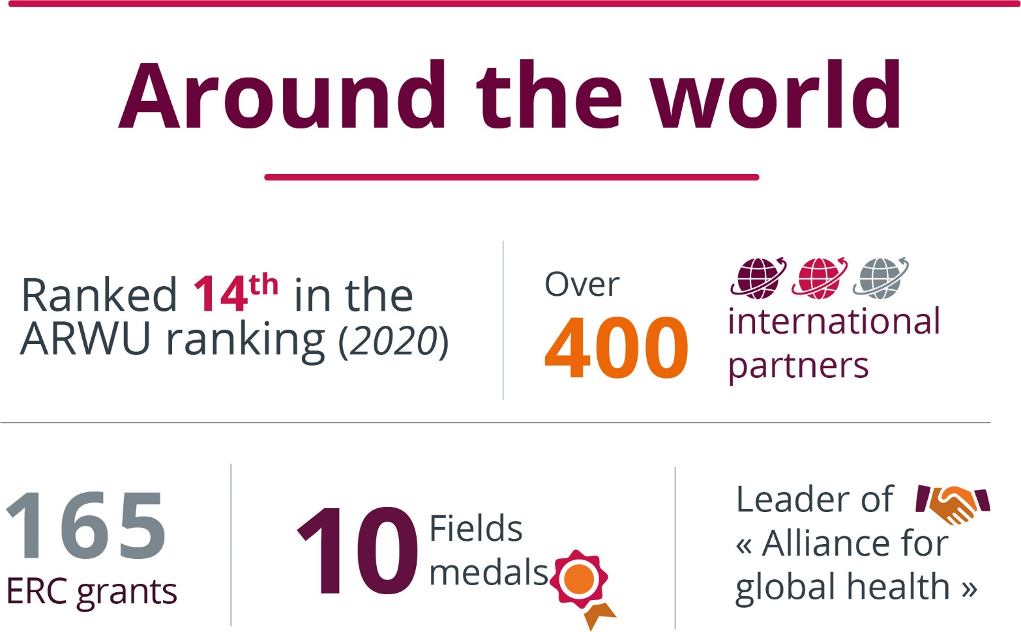
Widely known and recognised on the international stage

Slide 4
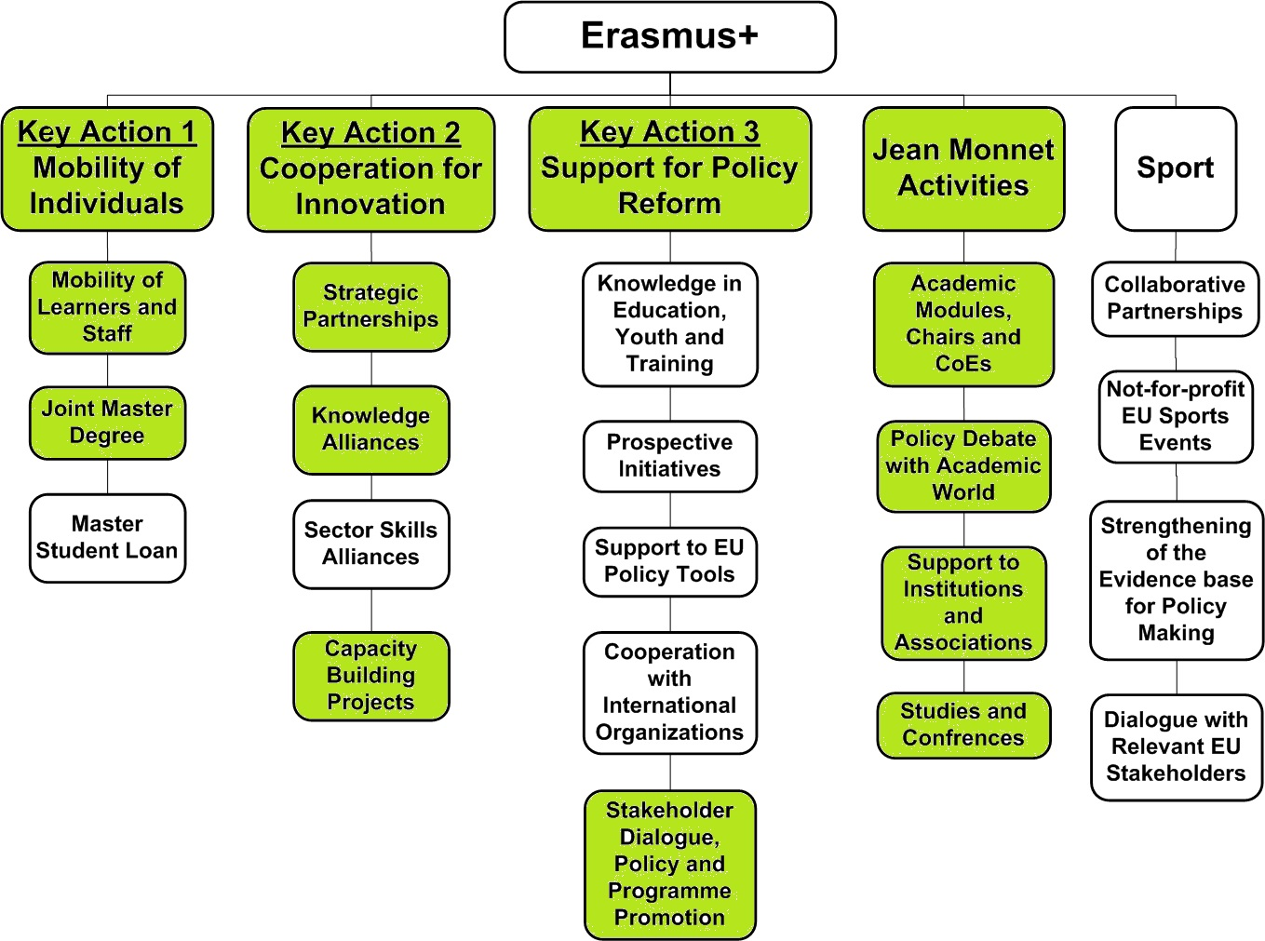

Slide 5
Erasmus Program
2021-2027 Newprogram
=> More inclusive, more sustainable
Students : acquire key skills, support their professional development and deepen their understanding of other cultures. Positive impact on employability.
Staff : acquire new competences, improve language and exchange working methods.
Institutions : increase capacities, gain attractiveness and international dimension

Slide 6
Erasmus Program
ICM : International Credit Mobility
Exchanges between program countries and partner countries
Student mobility for studies
Student mobility for traineeship: can take place in any organization active on the labor market or in the field of education, training and Youth.
Staff mobility for teaching
Satff mobility for training for teaching and non-teaching staff (staff week (2022), job-shadowing, observation periods and training at a partner HEI)
In any subject area or academic discipline

Slide 7
Erasmus Program
Yearly call for proposals for a 24 or 36-month project
Partner country is in charge of the submition of the application on behalf of its partners, signs and manages the grant agreement, and reports to the European Commission at the end of the project.
Participating Partner Country HEIs must be recognised as higher education institutions
=> Before any mobility can happen an inter-institutional agreement must be signed
Notes:
2-3 months preparation for an existing partnership

Slide 8
Erasmus Program
2018 Call : mobility project funded between Université Paris-Saclay and V. N. Karazin Kharkiv National University
15 Internships - 4 study mobility -10 Staff training –
16 teaching mobility
June 2019: 4 partners addition
Taras Shevchenko National University of Kiyv
Kyiv Academic University
Oles Honchar Dnipro National University
Lviv Polytechnic National University
2019 Call : 40 000€
2020 Call : 223 000€

Slide 9
Capacity Buidling Projects
Cooperation between EU and partner cournties in addressing challenges in the management and governance of HEI.
=> improve or create curricula, improve goverance, strengthen relations between higher education systems
16% selection rate
Enables equipment purchase
https://eacea.ec.europa.eu/erasmus-plus/actions/key-action-2-cooperation-for-innovation-and-exchange-good-practices/capacity-0_en
Notes:
The development, testing and adaptation of:
curricula, courses, learning materials and tools, pedagogical approaches,
new forms of practical training schemes, foster university-enterprise cooperation
Quality insurance
modern university services e.g. for financial management, international relations, student counselling and guidance, academic affairs and research
Network effectively in research, scientific and technological innovation
Upgrading of facilities
Staff trainings
1 year preparation

Slide 10

What next ?
Upcoming development:
2022 call for proposals for ICM projects and Capacity Building projects
Inclusion of the Faculty of Medecine medical faculty of Paris-Saclay University
More opportunities for PhDs in the new Erasmus program

Slide 11

FOLLOW US
www.universite-paris-saclay.fr
UParisSaclay
@UnivParisSaclay
Université Paris-Saclay
Université Paris-Saclay
Universite_Paris_Saclay

