Slide 1
Fast luminosity measurements for SuperKEKB
Philip Bambade
IJC Lab
Acknowledgements: S. Wallon (IJCLab), A. Bwembya (Mephi, Moscow), L. Brunetti (LAPP)
S. Di Carlo, D. El Khechen, D. Jehanno, V. Kubytskyi, C.-G. Pang, C. Rimbault (IJCLab)
S. Uehara (Belle II ZDLM), Y. Funakoshi, M. Masuzawa (KEK ACCEL Department)
French-Ukrainian Workshop IJCLab - Orsay 19-23 October 2020

Slide 2
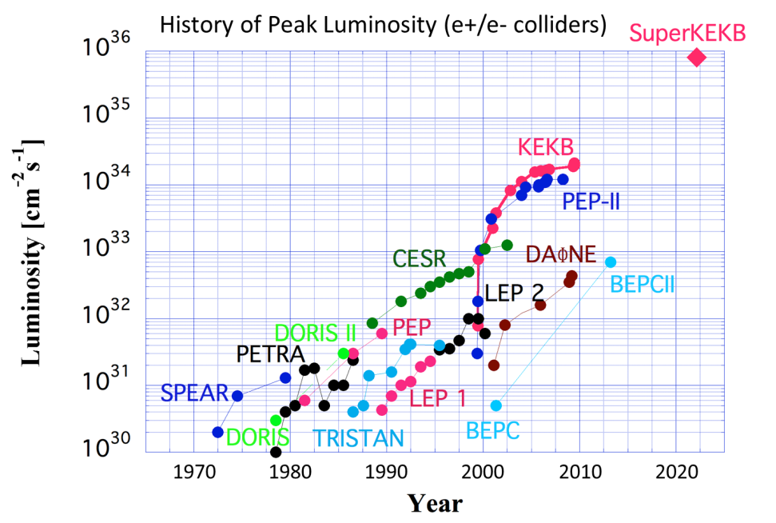
Exploring the luminosity frontier with SuperKEKB
1km diameter
ACO
↓
KEKB
2×10³⁴/cm²/s
SuperKEKB
8×10³⁵/cm²/s
Nanobeam collision scheme (+ crab waist)*
- 1st trials at SuperKEKB
- planned at future e⁺e⁻ circular colliders (FCCee, CEPC)
Maximize luminosity ↔ mitigate beam induced detector & accelerator backgrounds
* P. Raimondi → Daφne + SuperB

Slide 3
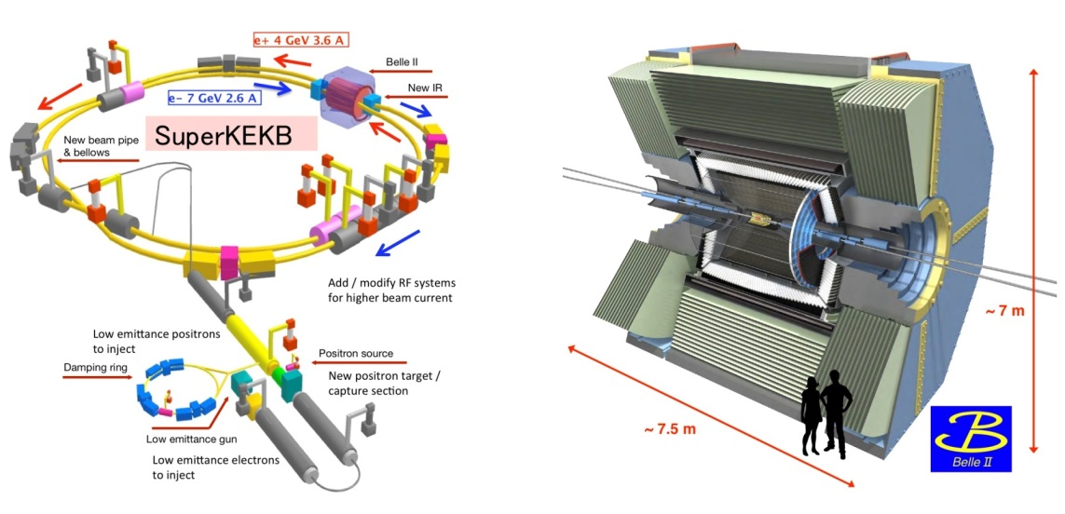
SuperKEKB & Belle-II projects
Schedule
1) Phase 1 : February → June, 2016
- single beam commissioning, vacuum scrubbing
- no luminosity (no final focus), no Belle II
2) Phase 2 : February → July 2018
- colliding beam commissioning, Belle II w/o vertex detector
- first collisions + pilot run (0.5 fb⁻¹)
3) Phase 3 : 2019, 2020,…
- Physics run with full detector ↔ continued machine studies
- Integrated luminosity : 74.1 fb⁻¹
- Operated March-June 2020 → luminosity record 2.4 10⁺³⁴ cm⁻²s⁻¹ !
- Resuming just now in October-December…

Slide 4
Belle-II @ SuperKEKB physics motivation
Discover new physics via precision searches for deviations from SM predictions induced by new particles appearing in higher order quantum corrections
Precision measurements of CKM matrix elements
Rare / forbidden B, D, τ decays
Dark sector searches
….
specification: × 40 peak luminosity of KEKB → 50 ab⁻¹
1st B-B like event during 1st physics run
Luminosity projection
β_{y}* = 1 → 0.3 mm
N_{bunches} 1576 → 2500
RF & QCS upgrades
now
1st Belle II publications:
“Measurement of the integrated luminosity of the Phase 2 data of the Belle II experiment”, Chin.Phys.C 44 (2020) 2, 021001
“Search for an invisibly decaying Z′ boson at Belle II in e+e−→μ+μ−(e±μ∓) plus missing energy final states”, Phys.Rev.Lett. 124 (2020) 14, 141801
“Search for Axion-Like Particles produced in e+e− collisions at Belle II”, Phys.Rev.Lett. 125 (2020) 16, 161806
Talks at this workshop:
The Belle II ARICH detector – Leonid BURMISTROV Wednesday 21 October 11:35
Belle II status and highlights – Karim TRABELSI Friday 23 October 12:30

Slide 5
KEKB ↔ SuperKEKB parameters
× 1/20 β_{y}
σ_{y} ≈ 50-60 nm
(similar as ILC/ATF2)
× 2-3 beam currents
similar beam-beam strength
(tune-shift)
→ × 40 peak luminosity

Slide 6
Nanobeam collision scheme
Opportunities
Very small β_{y} avoids “hour-glass” limitation (effective bunch length ≈ depth of field of the optics)
Collide more charge @ tiny vertical beam size with similar beam-beam tune-shift strength parameter
1. Optical aberrations near IP must be cancelled to achieve / maintain tiny beam spots
2. Control beam-beam tune-shift with more complex IP beam-beam dynamics + optical aberrations
3. Continuously inject intense beams in strongly demagnified IP optics → backgrounds from tails…
Challenges
× 1/20 β_{y}
× 2-3 beam currents
× 1/20 σ_{y}

Slide 7
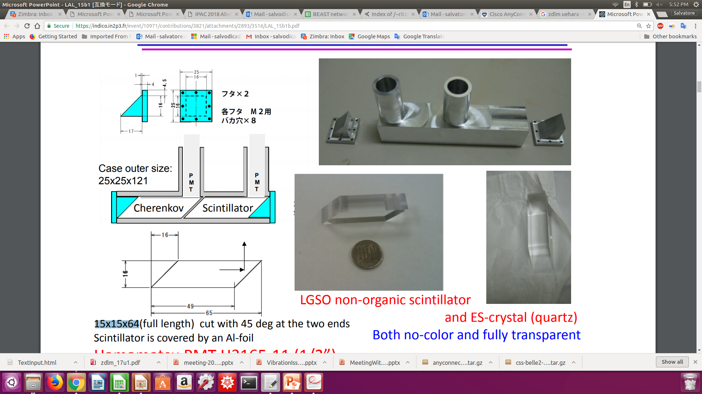

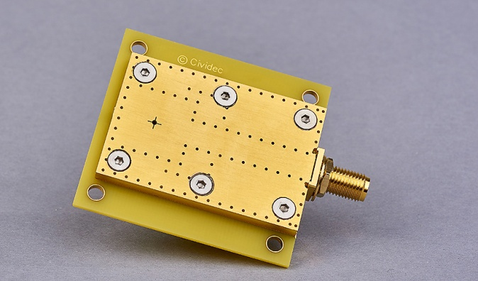
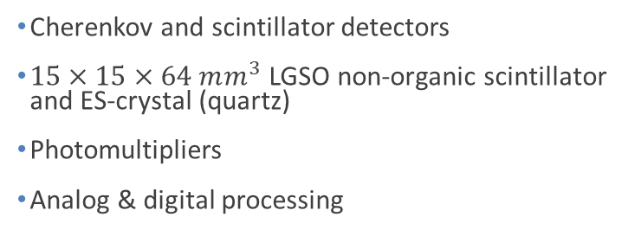

Two complementary techniques for fast luminosity measurements - compare / collaborate / mutually supporting - share simulation, mechanics, some data… - since 2012
LumiBelle2 / IJCLab
ZDLM (Zero Degree Luminosity Monitor) / KEK
single crystal CVD diamond sensors
$4×4×0.5/0.14 mm^{3}$
Fast charge/current amplifiers
Digital electronics and processing
Cherenkov and scintillator detectors
$15×15×64 mm^{3}$ LGSO non-organic scintillator and ES-crystal (quartz)
Photomultipliers
Analog & digital processing
Notes:
LGSO (Lu2-xGdxSiO5)

Slide 8
What for / specs ?
“Dithering” feedback
Correct for few Hz horizontal motion
79 Hz orbit “dithering” + luminosity sampling @ 1 kHz → reconstruct baseline freq. + 2nd harmonic
Efficient separation from other “slow” variations
1% relative precision @ 1 kHz sufficient (cf. C.-G. Pang et al., J.Phys.Conf.Ser. 1067 (2018) no.7, 072023)
Provide analog signal as input to lock-in amplifier
Notes:
LGSO (Lu2-xGdxSiO5)

Slide 9
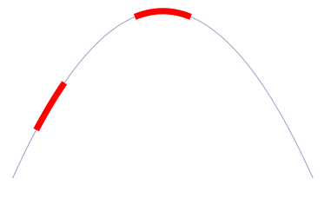
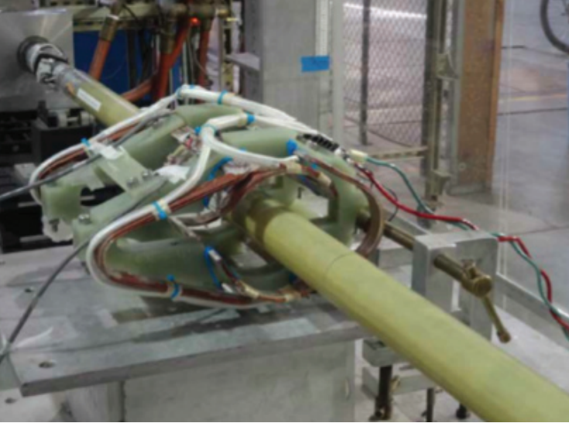
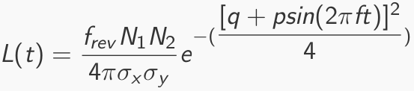
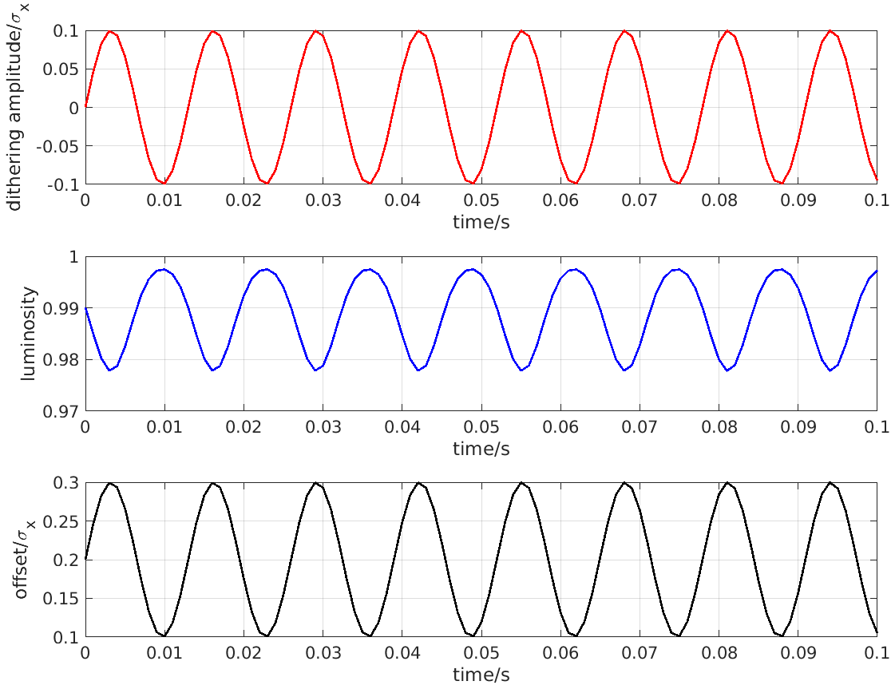
Fast & slow beam position variations at IP require feedback corrections
Beam-beam deflection for fast vertical motion
Luminosity feedback by “dithering” for slower horizontal motion
Δy at IP=
∼ 5nm ∼ 1/10σ_{y}*
BPM
Δy at BPM= ∼ 1.3μm
Vertical vibration ∼ 25-100 Hz
Sampling (BPMs) ∼ 32 kHz
IP
BPM
Cf. WEXBA04 by Yoshihiro Funakoshi, Wednesday, 11:20 am
Horizontal motion ∼ few Hz
Modulation freq. f₀ ∼ 79 Hz
Sampling (lumi. meas.) ∼ 1 kHz
- minimize f₀ output component
- dithering × lumi. signal → phase
↔
2×f₀
Luminosity
↔
f₀
x
Dithering coil x 12
DITHERING
LUMINOSITY

Slide 10
What for / specs ?
“Dithering” feedback
Correct for few Hz horizontal motion
79 Hz orbit “dithering” + luminosity sampling @ 1 kHz → reconstruct baseline freq. + 2nd harmonic
Efficient separation from other “slow” variations
1% relative precision @ 1 kHz sufficient (cf. C.-G. Pang et al., J.Phys.Conf.Ser. 1067 (2018) no.7, 072023)
Provide analog signal as input to lock-in amplifier
Bunch by bunch luminosity diagnostic
Nominally 4 ns bunch separation → need short signal pulses, ideally < 4 ns
1% or better relative precision @ 1 Hz
IP vertical beam size measurement + tuning at very low currents
Single beam orbit + optics corrections in two rings
Vertical e+ and e- beam size optical tuning → suppress local aberrations in nanobeam final focus
Control of beam-beam blowup → find best spot in tune diagram
Can avoid confusion from beam-beam induced blowup if done at very low currents !
Dynamic range L ≈ 10³² → 10³⁶ cm⁻² s⁻¹
Non luminosity scaling contamination < 1% (e.g. beam gas bremsstrahlung and Touschek losses)
Manage radiation damage at highest luminosity
Notes:
LGSO (Lu2-xGdxSiO5)

Slide 11
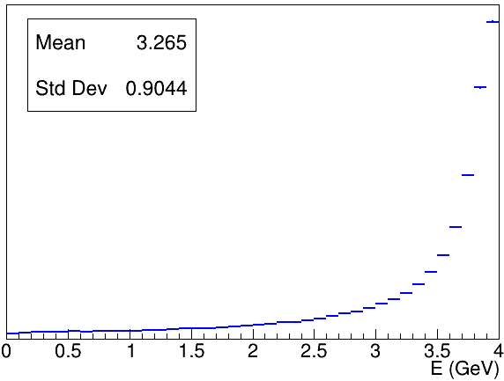
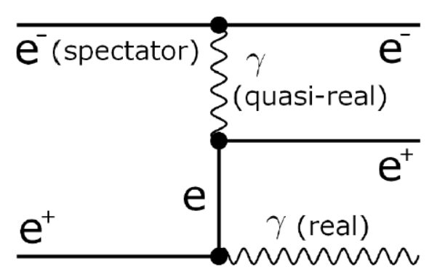
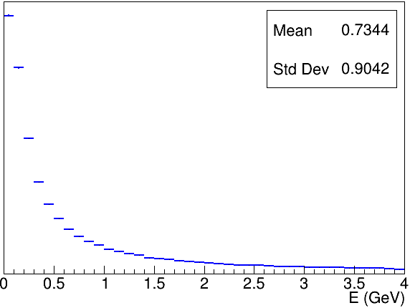
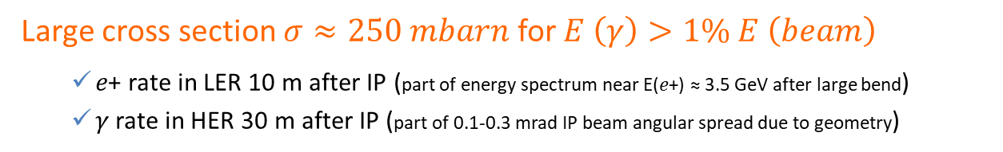






How ?
Bhabha process at vanishing scattering angle
Large cross section $σ≈250 mbarn$ for $E \left(γ\right)>1\% E \left(beam\right)$
𝑒+ rate in LER 10 m after IP (part of energy spectrum near E(𝑒+) ≈ 3.5 GeV after large bend)
𝛾 rate in HER 30 m after IP (part of 0.1-0.3 mrad IP beam angular spread due to geometry)
from GUINEA-PIG++
$$E (e^{−})=7GeV$$
$$E (e^{−})=7GeV$$
𝑒+
$$E (e^{+})$$
$$E (e^{+})=4GeV$$
$$E (γ)$$
$$L∝\frac{dN}{dt}$$
𝛾
Only relative luminosity → with certain conditions…
Acceptance depends on choice of sensor / location
Also some variation with beam parameters…
𝜎_{Bhabha@zero-degree} not precisely known from QED
➔ OK for usage on short enough time-scales
➔ special care for beam parameter dependence
Notes:
LGSO (Lu2-xGdxSiO5)

Slide 12
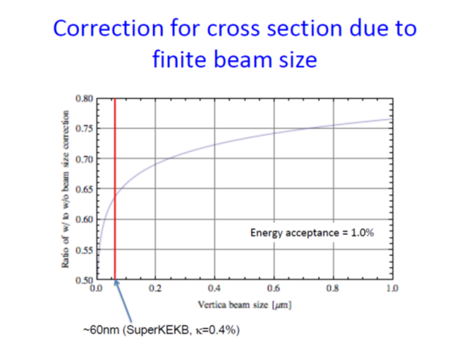
Expect QED suppression for vanishing momentum transfer
Beam size dependent cross section
Models* predict different suppression factors…
Y. Funakoshi (KEK), Feb. 2012
Should already be visible now ?
* V.N. Baier, V.M. Katkov, G.L. Kotkin, V.G. Serbo et al., Novosibirsk
H. Burkhardt, R. Kleiss, CERN
Notes:
LGSO (Lu2-xGdxSiO5)

Slide 13
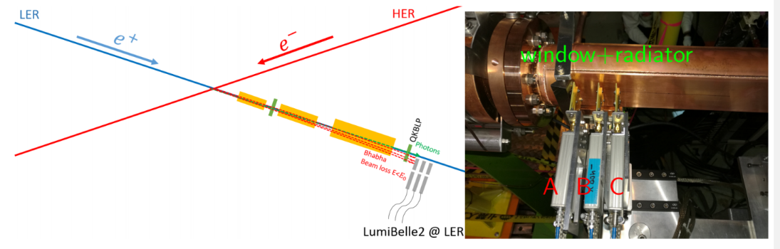
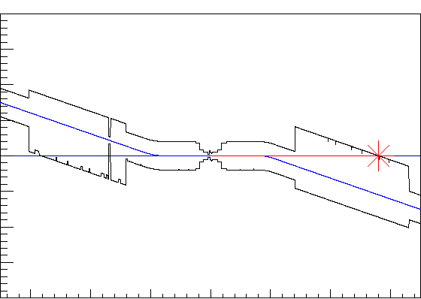
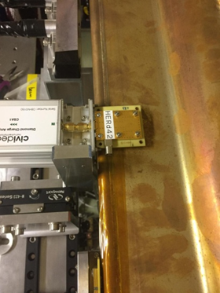
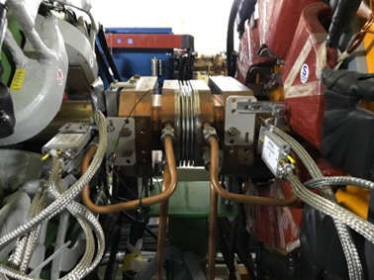
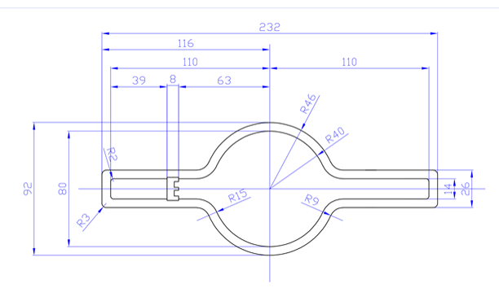

Where ?
POSITRON RING (measure e+)
Optimal position found at 10 m behind IP using SAD
Over-bent Bhabha positrons → vacuum chamber
Special beam pipe with window + Tungsten radiator
Start-to-end simulation (Guinea Pig ++, SAD, GEANT4)
IP
0.4
ELECTRON RING (measure $γ$)
e-
Photon ray-tracing in detailed vacuum chamber geometry + GEANT4
Original position at 30 m (2018)
In 2019, new optimal position found at 28 m with ≈ 10 times higher rate
IP
X(m)
0
0
28
Z(m)
Notes:
Radiation length of Tungsten is 0.3504 cm

Slide 14
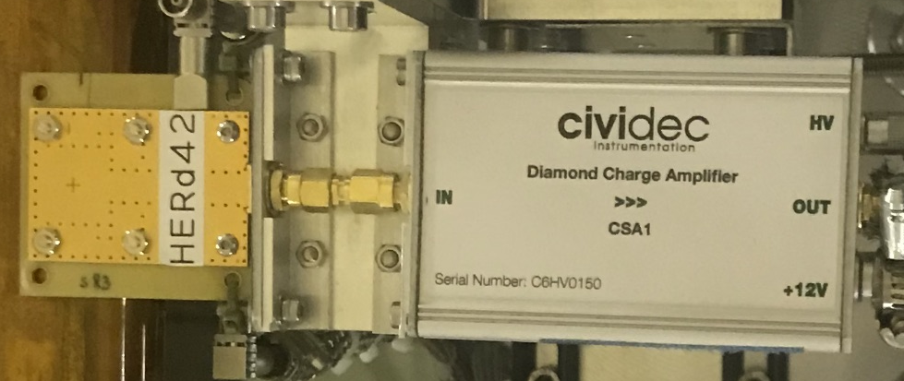
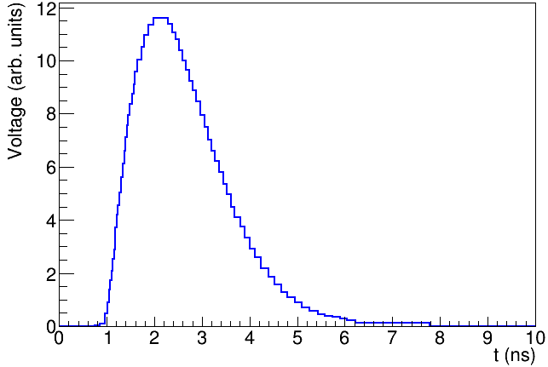
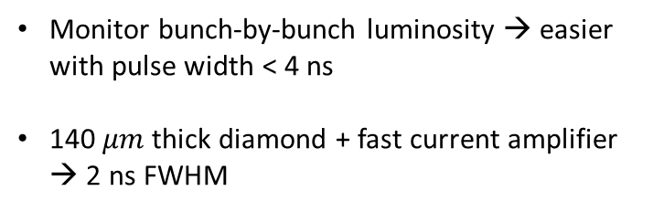
LumiBelle2 diamond sensor signals
High charge carrier mobility
→ fast signal formation
Wide band-gap (5.5 eV)
→ good radiation tolerance
DIAMOND
AMPLIFIER
SuperKEKB nominal collision spacing = 4 ns
Monitor bunch-by-bunch luminosity → easier with pulse width < 4 ns
140 $μm$thick diamond + fast current amplifier → 2 ns FWHM
2 ns
FWHM
Notes:
Radiation length of Tungsten is 0.3504 cm

Slide 15
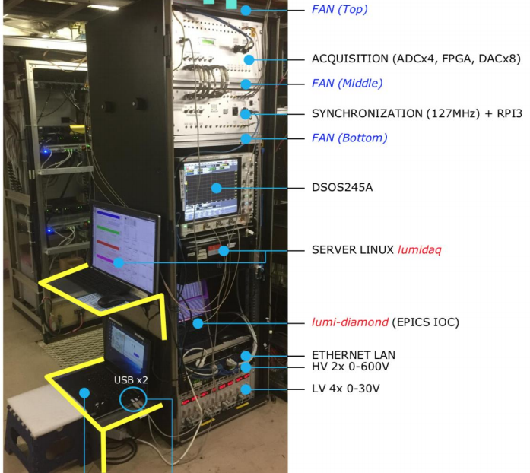
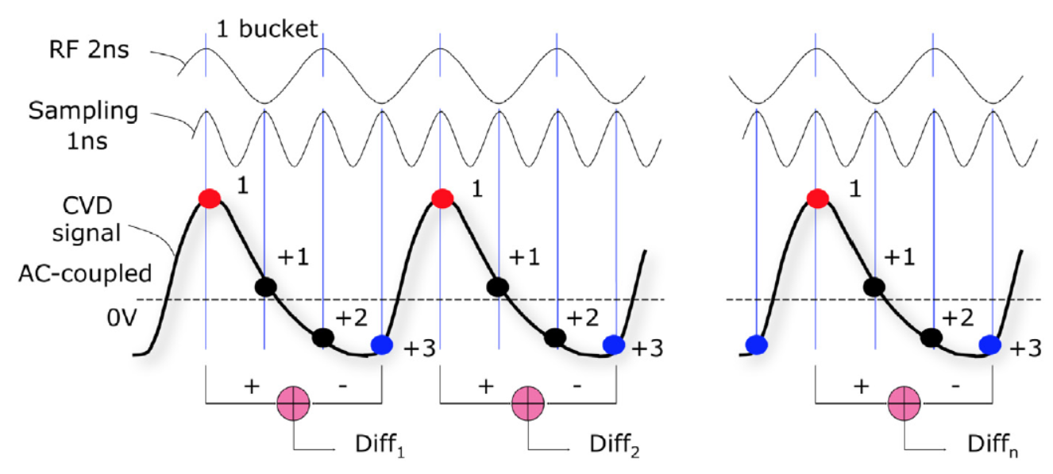
LumiBelle2 signal processing
2 ns FWHM signals are sampled every 1 ns
Synchronization to RF clock → continuous monitoring, averaging at 1 kHz
Luminosity proportional to amplitude of signal peaks
ADC is AC-coupled → record difference between peak and baseline
Raw sum of all sample also ∝ luminosity and recorded

Slide 16
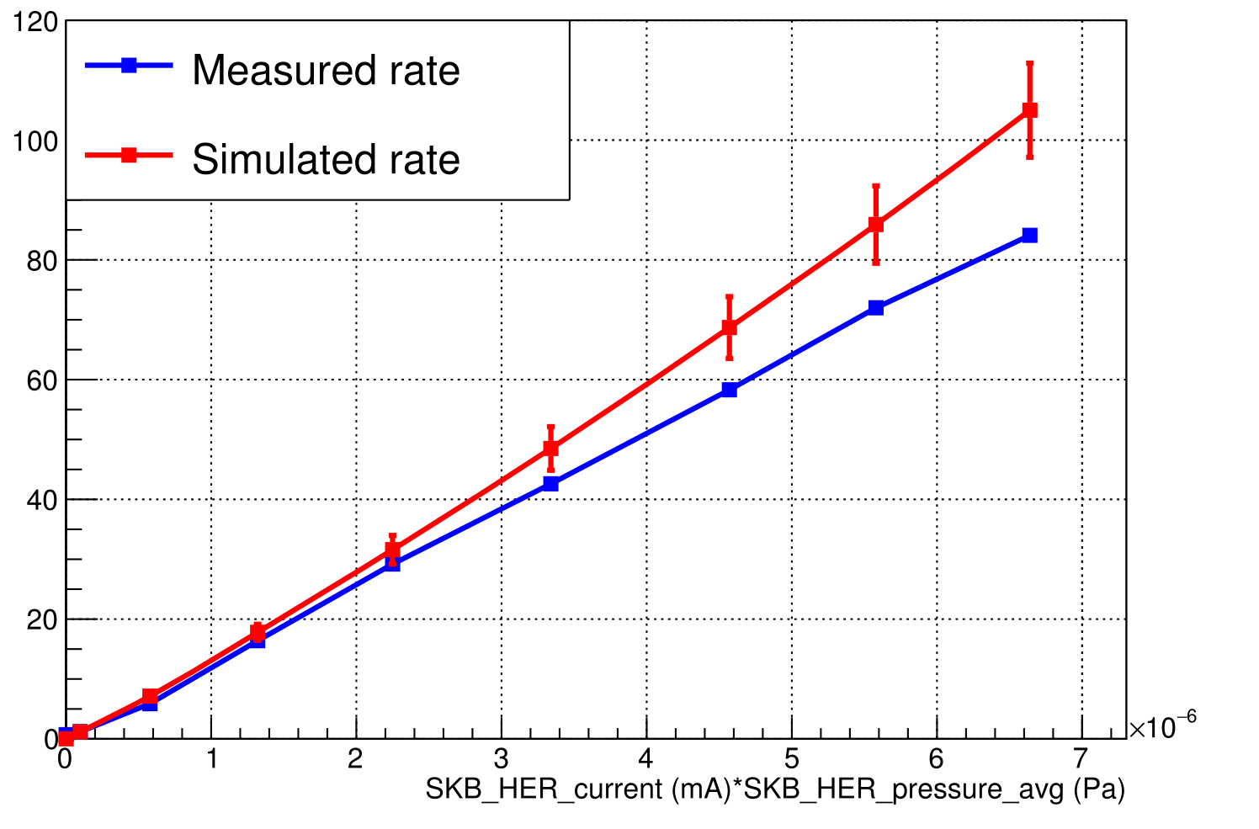
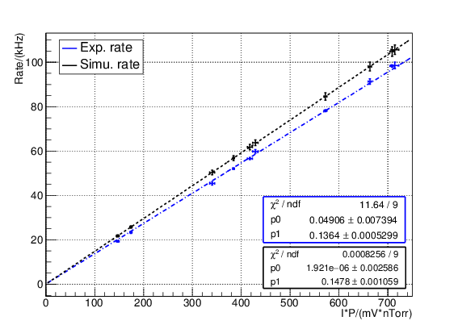
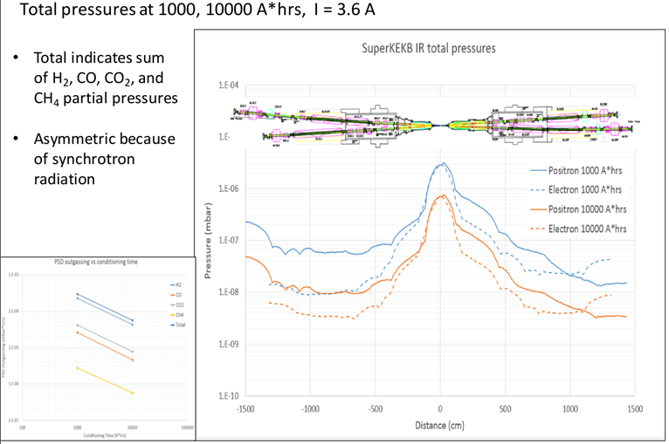
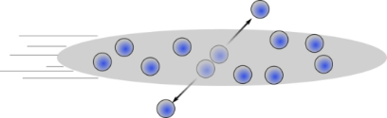
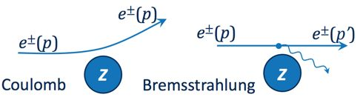


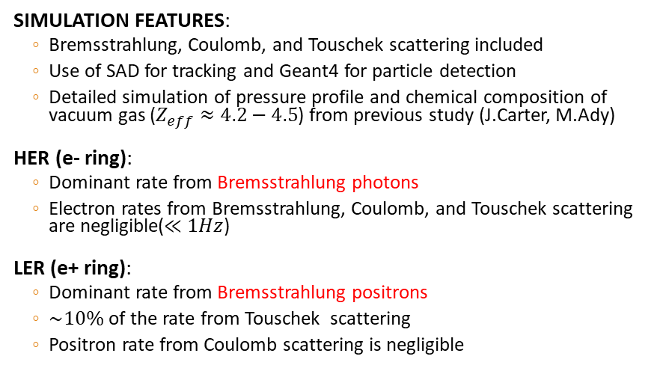


Background study
SIMULATION FEATURES:
Bremsstrahlung, Coulomb, and Touschek scattering included
Use of SAD for tracking and Geant4 for particle detection
Detailed simulation of pressure profile and chemical composition of vacuum gas ($Z_{eff}≈4.2−4.5$) from previous study (J.Carter, M.Ady)
HER (e- ring):
Dominant rate from Bremsstrahlung photons
Electron rates from Bremsstrahlung, Coulomb, and Touschek scattering are negligible($≪1Hz$)
LER (e+ ring):
Dominant rate from Bremsstrahlung positrons
$\sim 10\%$ of the rate from Touschek scattering
Positron rate from Coulomb scattering is negligible
$$Measurement vs Simulation$$
$$Rate(Hz)$$
e- ring
$$Rate(kHz)$$
e+ ring
Scattering position of Bremsstrahlung
particles detected in LumiBelle2 / LER
$$I×P$$
Jason CARTER (ANL) & Marton ADY (CERN)
Touschek
Simulated vacuum profile in IR

Slide 17
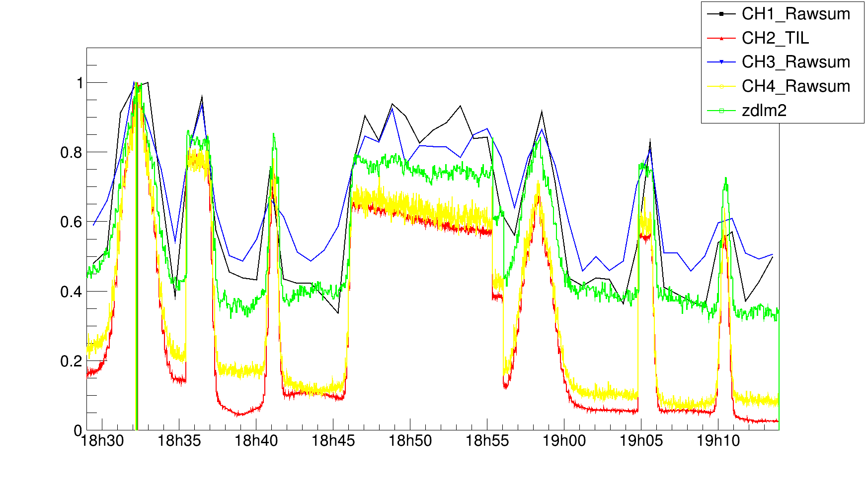
First collisions (luminosity): 25 April, 2018
VERTICAL SCAN
PHASE SCAN
VERTICAL SCAN
PHASE SCAN
Vertical and phase (longitudinal) scans were performed to find the optimal position of the beams
The LumiBelle2 and ZDLM channels worked well and were in agreement
Successfully measured and provided the luminosity on-line from the first collision up to this date

Slide 18
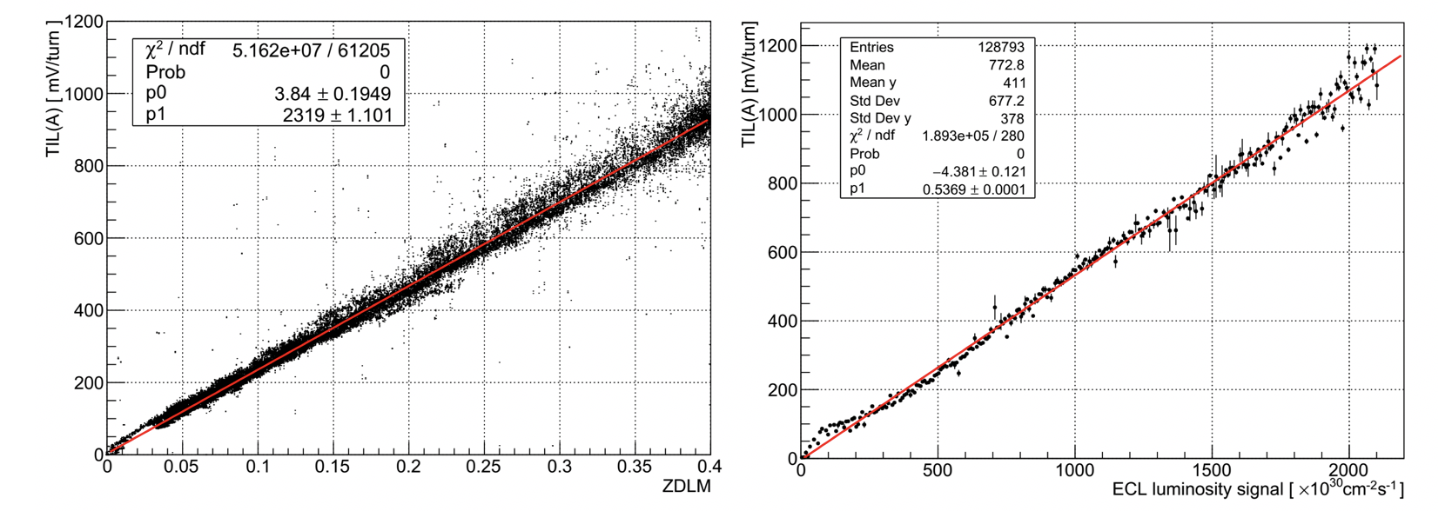
LumiBelle2, ZDLM and ECL correlations
C. G. Pang et al.: Nucl.Instrum.Meth. A931 (2019) 225-235

Slide 19
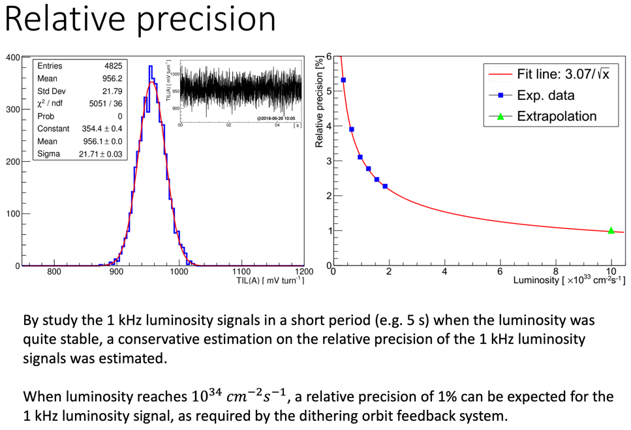
C. G. Pang et al.: Nucl.Instrum.Meth. A931 (2019) 225-235

Slide 20


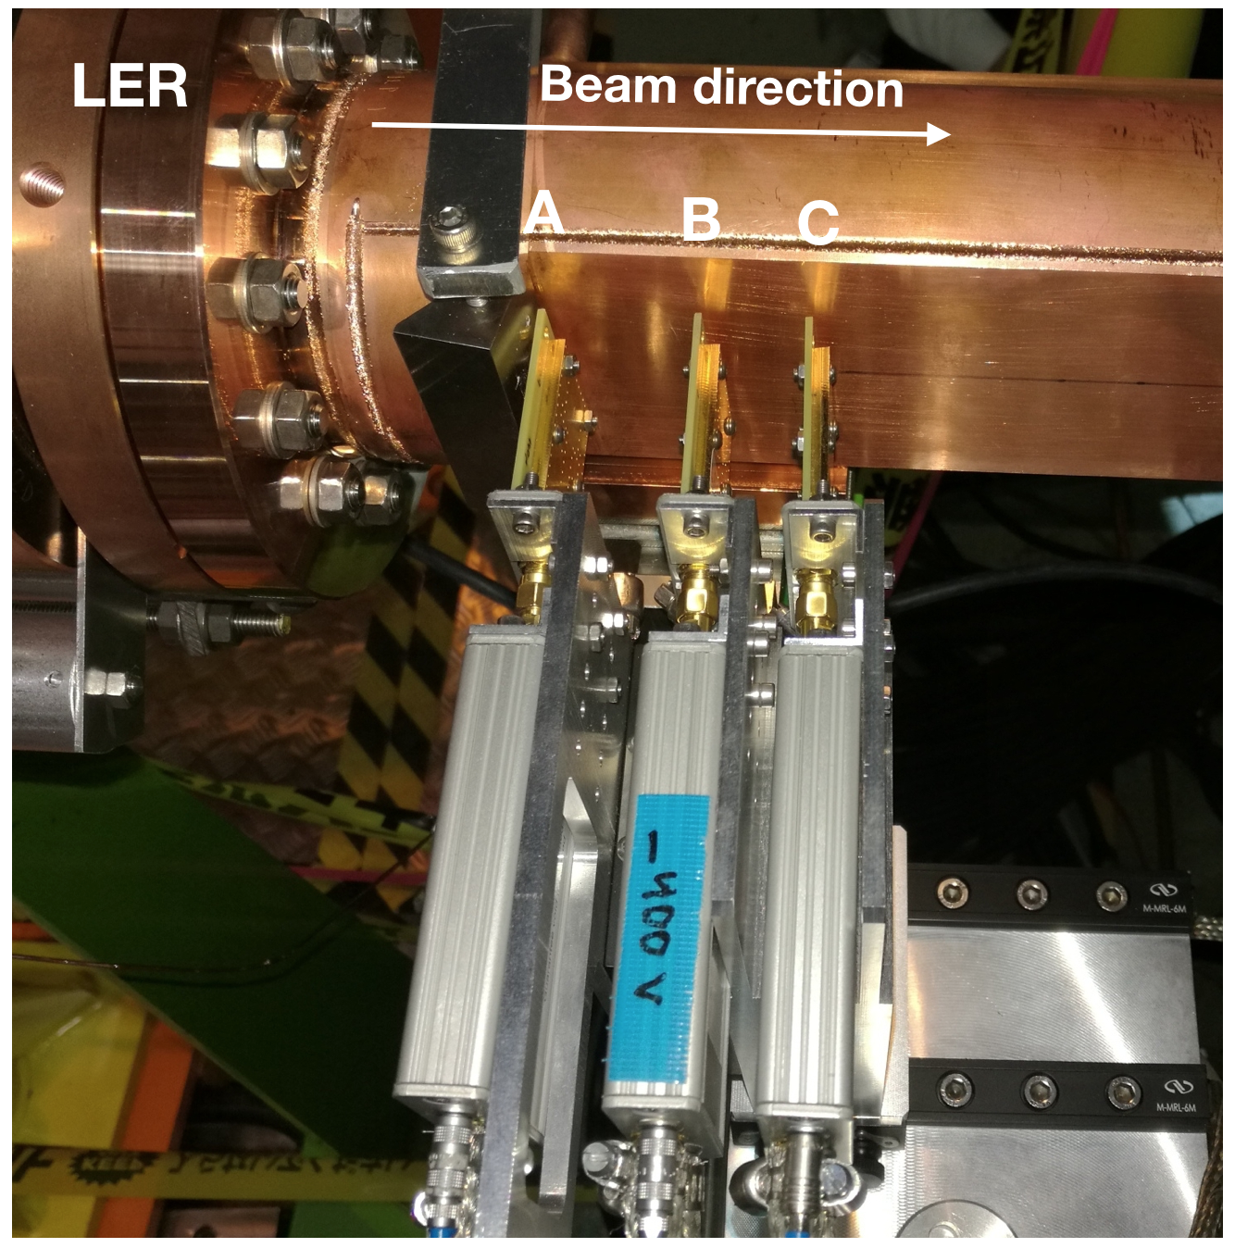
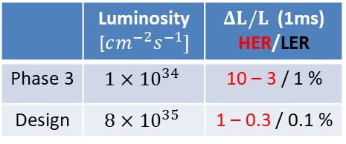
LumiBelle2 current setup
IP
HER
LER
×
horizontally motorized
reduced signal level…
radiation damage ?!?
removed pending calibration
 | Luminosity [$cm^{−2}s^{−1}]$ | $ΔL/L$ (1ms) HER/LER
Phase 3 | $$1×{10}^{34}$$ | 10 – 3 / 1 %
Design | $$8×{10}^{35}$$ | 1 – 0.3 / 0.1 %
CH1
CH2
CH3
CH4
ADC
140um + C2
500um + C6
Simulated stat. precision

Slide 21
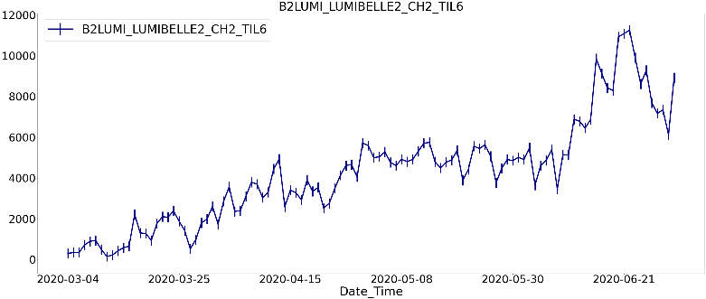
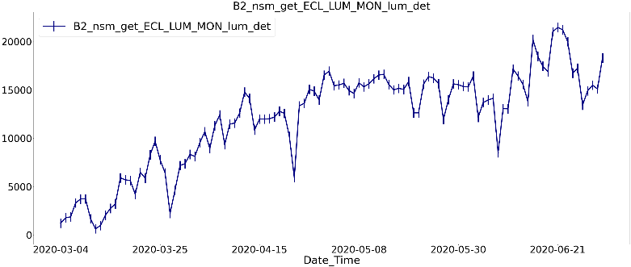
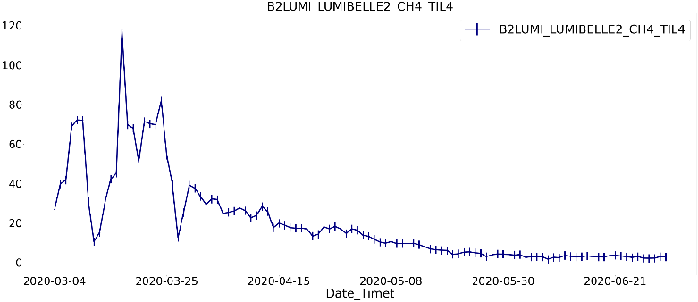
March – June 2020 remote operation
→ about 150 EPICS variables recorded at 1 Hz
arbitrary units
LumiBelle2 LER Channel 4
10³⁰ cm⁻² s⁻¹
Belle II ECL absolute luminosity
arbitrary units
LumiBelle2 LER Channel 2
… has much reduced sensitivity

Slide 22
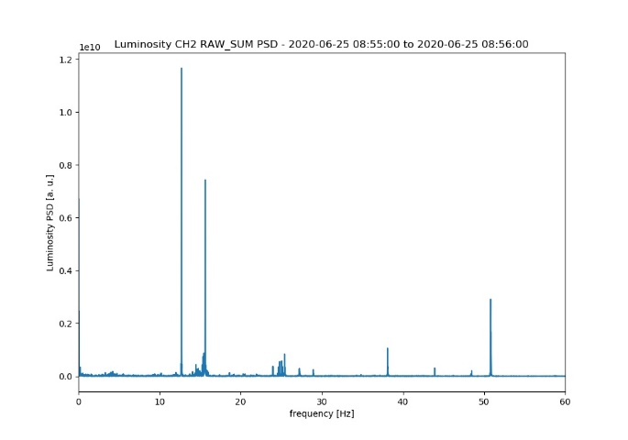
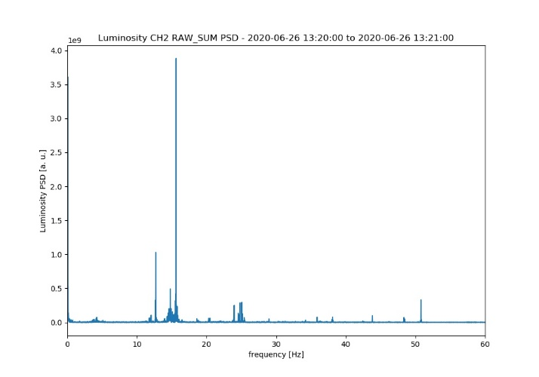
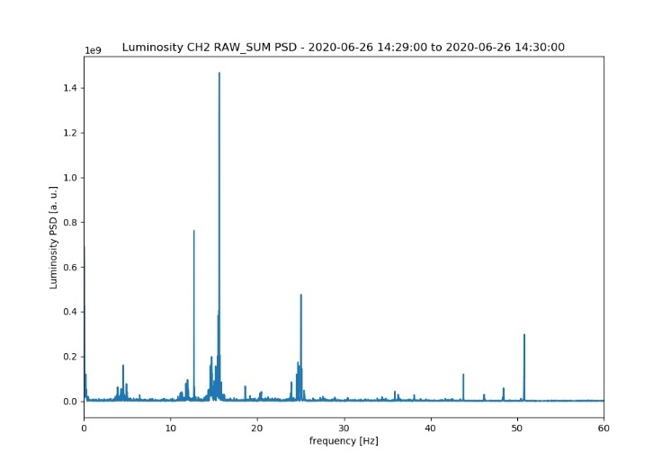
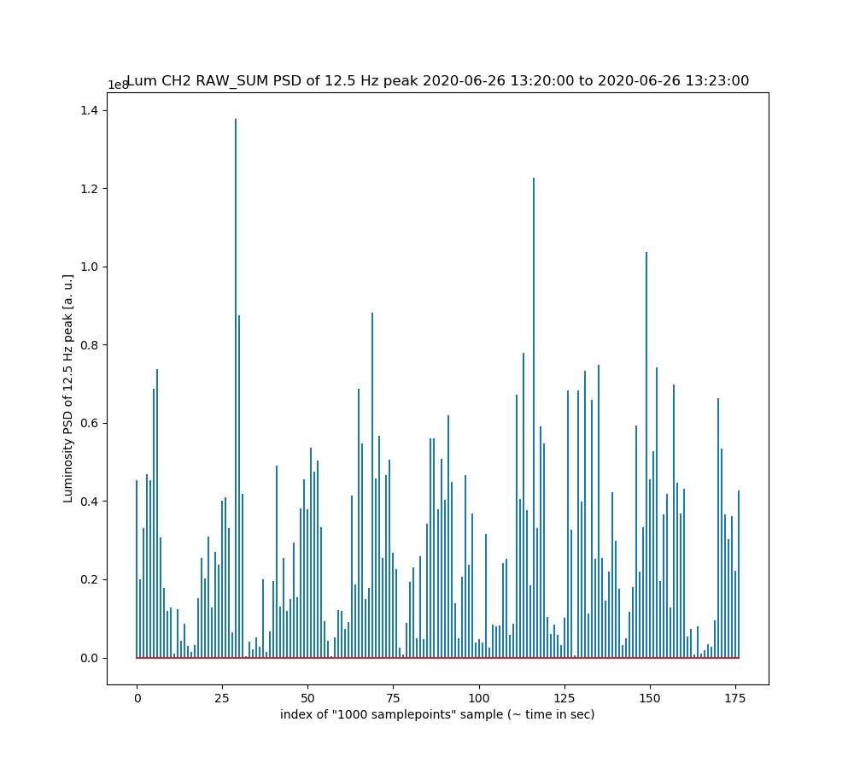
Fast luminosity variations from continuous injection at 12.5 Hz
→ frequency analysis (PSD) using LumiBelle2 LER Channel 2 recorded at 1 kHz
before skew quad correction
after 1st skew quad correction
after 2nd skew quad correction
Luminosity power spectrum density [a.u.]
0 10 20 30 40 50 [Hz]
0 10 20 30 40 50 [Hz]
0 10 20 30 40 50 [Hz]
power spectral density components at 12.5 and 25 Hz
12.5 Hz 1 0.1 0.08
25 Hz 0.08 0.007 0.005
PSD component at 12.5 Hz reconstructed during 3 minute scan :
→ injections are visible lasting 10 seconds every 20 seconds !
0 50 100 150 time [sec]

Slide 23
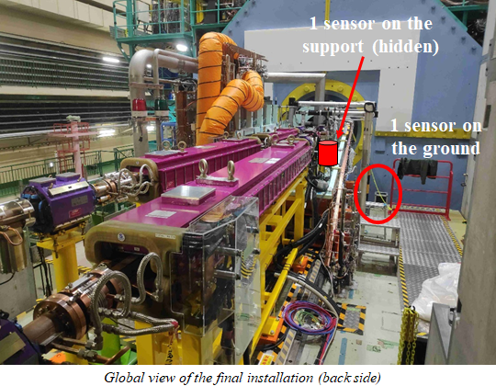
Comparing / correlating vibrations (LAPP) versus luminosity (IJCLab)
04th of December 2019 11h10-20
02th of May 2020 15h35
12th of June 2020 10h35
21th of June 2020 15h35
http://www-linac.kek.jp/skekb/snapshot/ring/

Slide 24
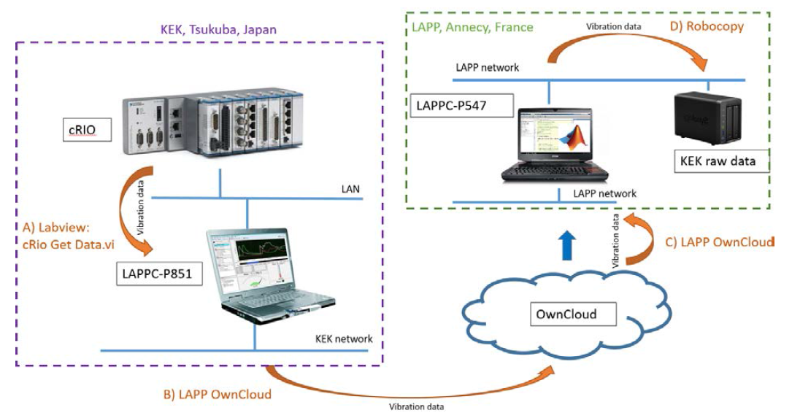
Setup for remote control and data transfer to LAPP
Upload vibration data from cRIO to the LAPP network drive

Slide 25
Overall comparison
Transverse
IJCLab
It seems that there are some correlations depending frequency, coherence, Type…
Analysis is on-going… is attracting some attention at KEK and CERN !

Slide 26
Summary
LumiBelle2 has 7 sensors installed, 3 in LER and 4 in HER → 4 are read out in our 4 ADC channels (2 in LER and 2 HER)
1 Hz LER data available via EPICS for IP beam size tuning at very low currents
1 kHz LER data used for tests of “dithering” feedback for horizontal IP beam position
1 Hz bunch-by-bunch luminosity used to detect anomalies along stored bunch train
Many other studies to assist SuperKEKB luminosity optimization, including relating to LAPP remote monitoring of mechanical vibration near Belle II in Tsukuba Experimental Hall…
Fully remote operation in 2020 (and 2021 ?) from IJCLab (with some help at KEK…)
Medium and longer term plans:
- simplify/improve data transfer/archiving software
- full backup of software system
- calibrate all diamond sensors as soon as possible (²⁴¹Am α source at KEK)
- replace some diamonds / amplifiers where needed (LER Channel 2…)
- work with KEK, LAPP and CERN teams on studies (vibration, injection noise, feedback,…)
- no major hardware upgrade
- upgrading/redesigning the DAQ probably needed to secure long term operation
→ integrate digital feedback in the LumiBelle2 FPGA ?

Slide 27
Extra slides

Slide 28
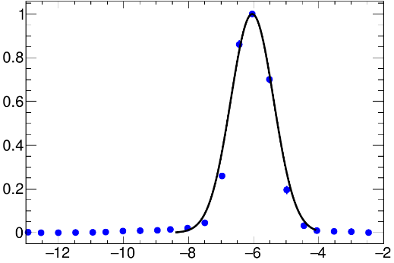
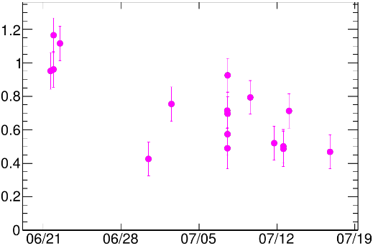










Beam size estimation with vertical offset scans
S. Di Carlo, 2018
Analytical result integrating Gaussian distributions with vertical offset:
$$\frac{L}{L_{0}}=exp\left(−\frac{Δy^{2}}{2Σ_{y}^{2}}\right)$$
$$Δy$$
e+
e-
$${2Σ}_{y}$$
$$Σ_{y}^{2}={σ_{1,y}^{∗}}^{2} +{σ_{2,y}^{∗}}^{2}≈2{σ_{y}^{∗}}^{2}$$
assumes rigid beams
$$Δy (μm)$$
Benchmark vs ECL
$$L_{σ_{y}^{∗}}=\frac{{fN}_{+}N_{−}}{4πσ_{x,eff}^{∗}σ_{y}^{∗}}$$
$$L(cm^{−2}s^{−1})$$
$$σ_{y}^{∗}(μm)$$
$$L_{σ_{y}^{∗}}/L_{ECL}>1$$
$$Date$$
I⁺ × I⁻ (mA²)
$σ_{y}^{∗}$ estimation biased due to non constant beam-beam blow-up during the scan
beam-beam
simulation
(S. Di Carlo & D. Zhou)
Bias
Blow-up

Slide 29
Sensitive luminosity monitor important to correct optical aberrations in vertical IP beam size very low intensity essential to avoid beam-beam effects: (1) confusion from blow-up, (2) biased beam size estimates
Phase 2
β_{y}*= 4 mm

Slide 30
LumiBelle2 bunch-by-bunch luminosities, folded vertical bunch sizes and relative offsets
C. G. Pang et al.: Nucl.Instrum.Meth. A931 (2019) 225-235
8% spread mainly depends on bunch current differences
Bunch-by-bunch luminosity precision: 1-2% at 1Hz
dominated by spread in bunch-by-bunch currents
8nm RMS spread in bunch-by-bunch vertical offsets (2.3% of average bunch size)
2% RMS spread in bunch-by-bunch vertical beam sizes

Slide 31
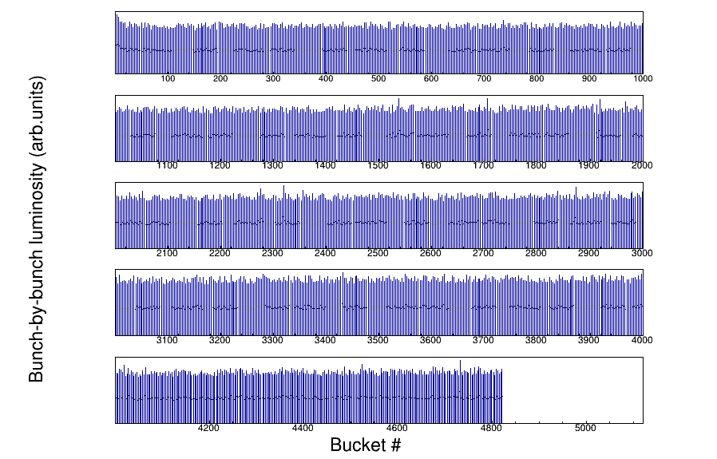
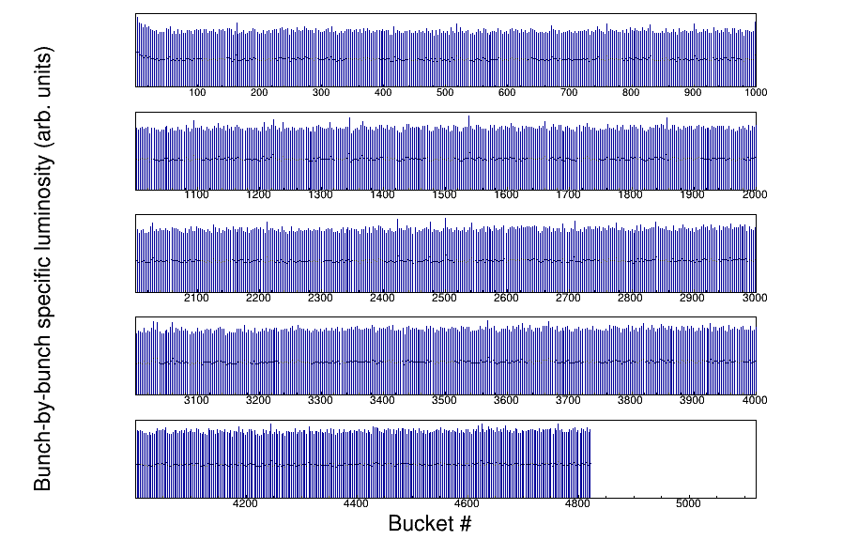
LumiBelle2 bunch-by-bunch luminosities at higher current : larger values for 1st bunches → transient beam loading effect may bias bunch-by-bunch current measurement for first bunches (M. Tobiyama)
L = 1.1 × 10³⁴ cm⁻² s⁻¹
1576 bunches
Bunch-by-bunch luminosities
S. Di Carlo, 2nd SuperKEKB Beam Dynamics Mini-Workshop, KEK, 20/9/2019
Specific bunch-by-bunch luminosities

Slide 32
Fast & slow beam position variations at IP require feedback corrections
Beam-beam deflection for fast vertical motion
Luminosity feedback by “dithering” for slower horizontal motion
Δy at IP=
∼ 5nm ∼ 1/10σ_{y}*
BPM
Δy at BPM= ∼ 1.3μm
Vertical vibration ∼ 25-100 Hz
Sampling (BPMs) ∼ 32 kHz
IP
BPM
Cf. WEXBA04 by Yoshihiro Funakoshi, Wednesday, 11:20 am
Horizontal motion ∼ few Hz
Modulation freq. f₀ ∼ 79 Hz
Sampling (lumi. meas.) ∼ 1 kHz
- minimize f₀ output component
- dithering × lumi. signal → phase
↔
2×f₀
Luminosity
↔
f₀
x
Dithering coil x 12
DITHERING
LUMINOSITY

Slide 33
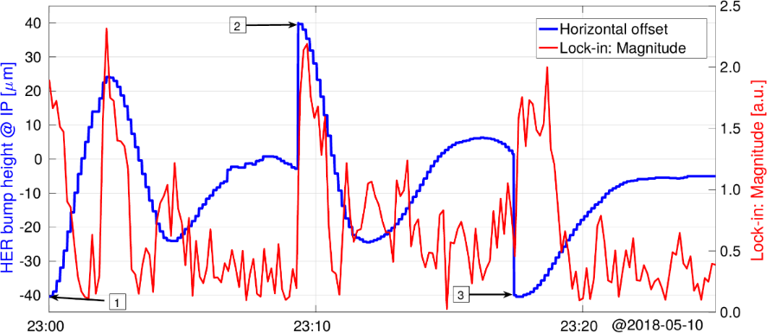




1st dithering feedback test in Phase 2
The e- beam was artificially given an offset, while the e+ beam was dithered
The algorithm tries to minimize the Magnitude [V] of the luminosity FT calculated at the driving frequency $f_{0}$ to bring the beams back to the optimal position (unwanted offset o=0)
These parameters are then sent to the magnet control system via EPICS to create a bump in the e- beam
After first two attempts, optimization of the algorithm parameters, in the third one the feedback was able to smoothly minimize the offset
e+
e-
$$Δx$$
$$Δx=o+d sin⁡(2πf_{0}t)$$
$Δx (μm)$, Magnitude [V] vs Time
Time
Further tests in Phase 2 & 3 have exhibited some coupling effects between X and Y feedback systems → to be solved for operation at design parameters

