Slide 1

Construction the ITK IJC of ATLAS experiment for Phase 2 Upgrade
Abdenour Lounis

Slide 2
Outline
Context of the Tracker Upgrade project
The French Cluster contribution
Infrastructure and equipments for Module production
Calendar and Milestone
Conclusions

Slide 3
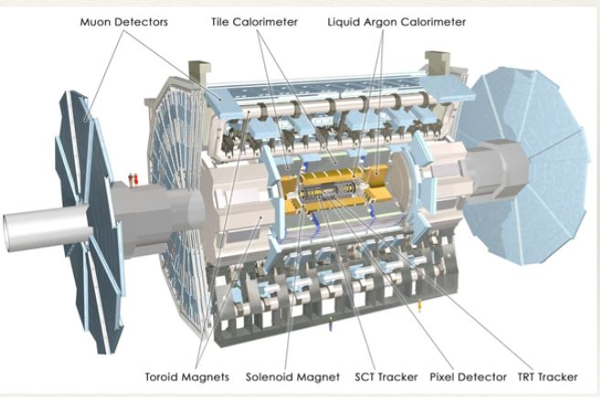
ATLAS Introduction
Atlas Detector
  3 tracking detectors with Large number of channels (Pixels, semi-conductor tracker and Transition Radiation Tracker with particle discrimination capability).
  4 sampling calorimeter covering different regions(EM: Lead/liquid Argon; Tile Hadronic: iron/scintillators, Hadronic End caps : copper /liquid argon, Forward: cooper/tungsten/liquid argon)
  Solenoid and toroid magnetics for charge and momentum measurements
  4 muon detectors with complementary measuring and triggering capabilities
  Forward detectors
Atlas view

Slide 4
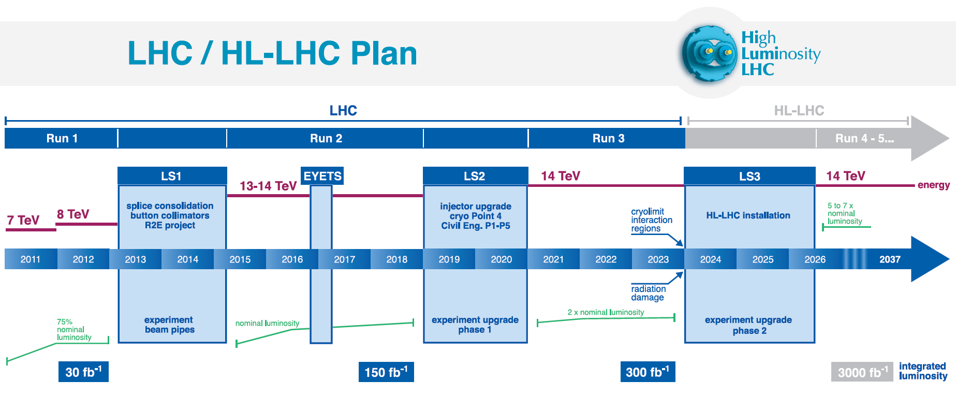
Towards the upgrade
The High Luminosity upgrade of the Large Hadron Collider (LHC) (HL-LHC) is currently expected to begin operations in the second half of 2026, with a nominal levelled instantaneous luminosity of L= 5×10³⁴cm⁻²s⁻¹corresponding to an average μ, of roughly 140 inelastic pp collisions each beam-crossing, and delivering an integrated luminosity of around 250 fb⁻¹per year of operation.
The ATLAS collaboration corresponding Phase-II up-grade of the detector, intended to take full advantage of the accelerator upgrade to achieve an ultimate luminosity of L= 7.5×10³⁴cm⁻²s⁻¹corresponding an average μ=200 inelastic pp collisions per beam-crossing. This programme aims to provide a total integrated luminosity of 3000 fb⁻¹ by 2035.

Slide 5
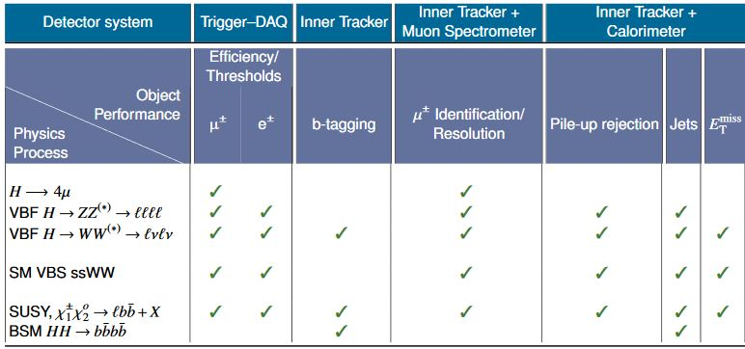
The detector upgrade to achieve physics objectives
LHC energy nominal limit (14 TeV).
Precision measurements of the Higgs Boson properties at HL-LHC will be performed through all accessible production processes
Complexity of the events is even larger : challenge, in particular for the inner detectors (radiation X10) and triggering.
Some detectors won’t survive the particle flu if no upgrade
Experience with present detector helps to define main concerns in upgrade.
Overview of the physics analyses foreseen, and of the associated ATLAS sub-systems whose upgrades may impact the physics object performance

Slide 6
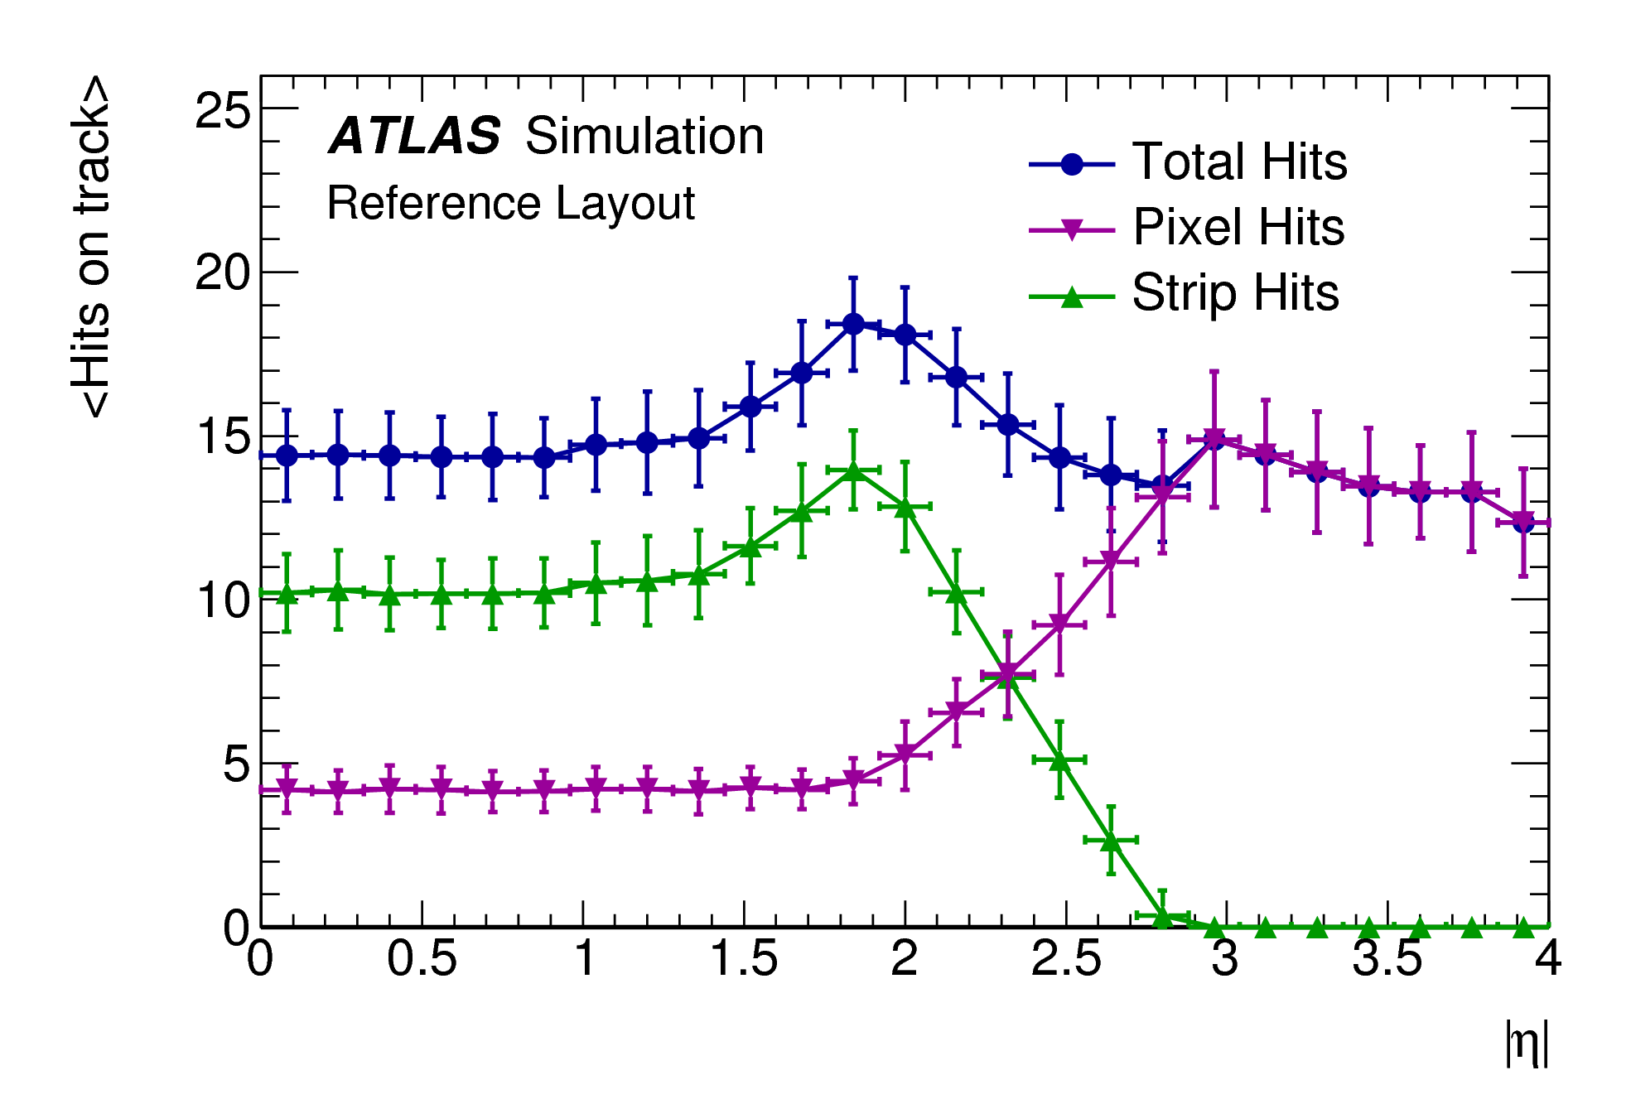
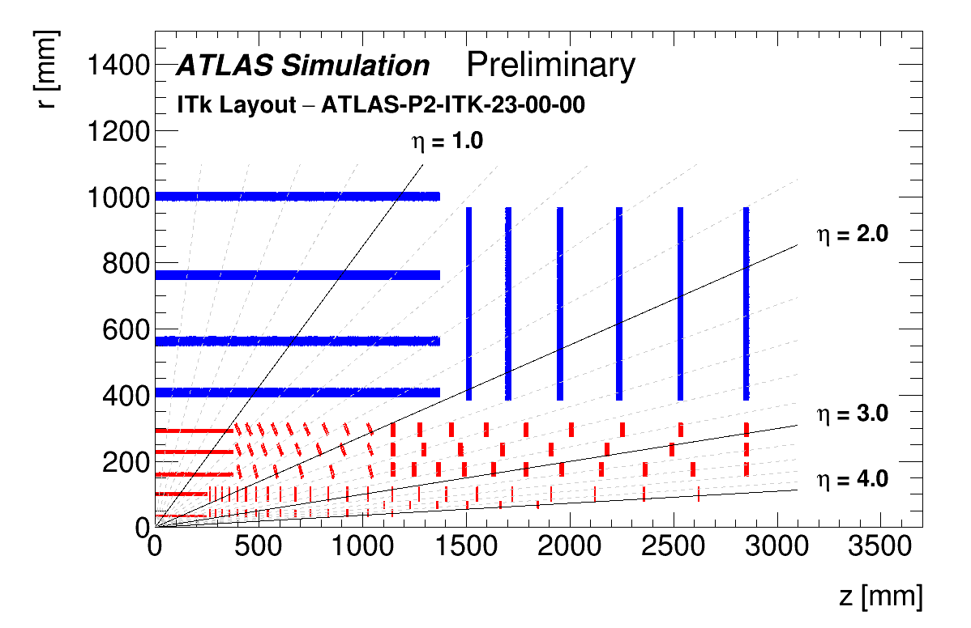
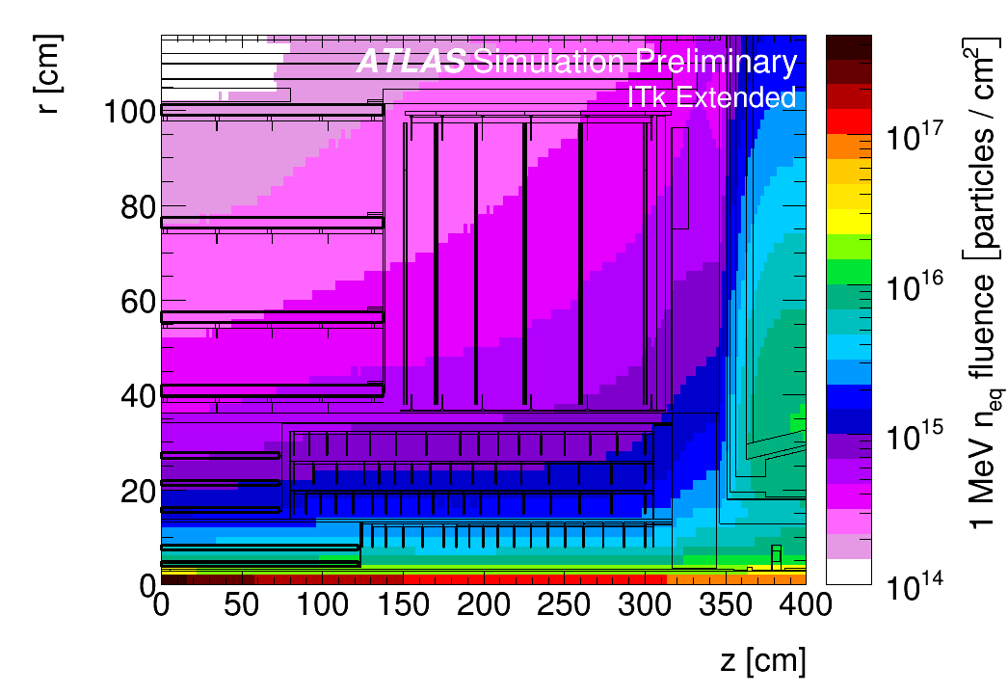
Focus on ITK
Hits in the tracker ~15 Hits
ATLAS Inner Detector will be replaced by Inner Tracker (ITk)
•ITk consists of silicon strip (outside) and pixel sensors (inside)
•One layer of 3D pixel sensors surrounded by layers of planar sensors
•Planar thickness:100μm in layer 1 and 150μm in layers 2-4
•Planar pixel size:50×50μm2 ; (25×100μm2_ Layer 0)
Strips
Pixels
Internal Tracker
Radiation fluences

Slide 7
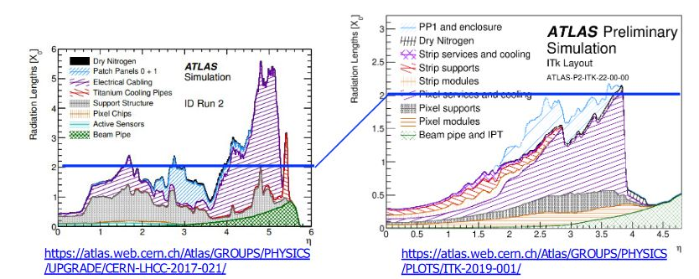
Material Budget optimization

Slide 8
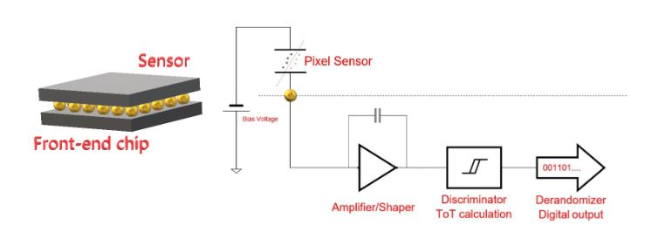
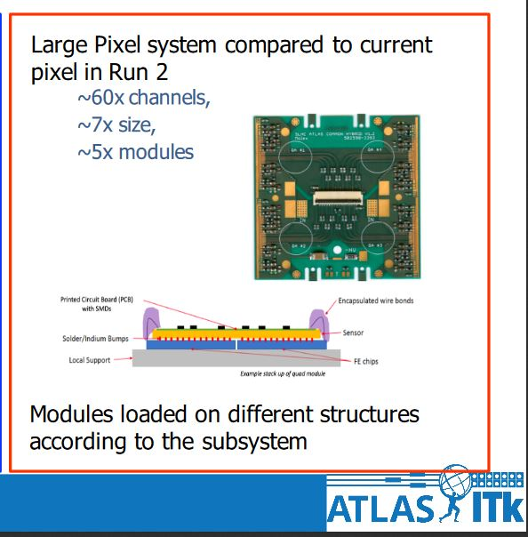
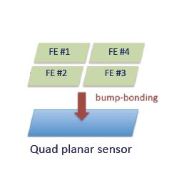
Pixel Modules details (Outer Barrel)
The working principle
Geometry & configuration
150 μm thick Si sensor for the outer barrel of
approximate dimensions 4x4 cm²
• Planar pixel pitch: 50x50 μm²
• ITk pixel readout chip is foreseen to be 20x19.2 mm² relative to a matrix of 400 columns x 384 rows
• Planar sensors will be produced in a size compatible with 4-chip (quad)
Components | Materia Budget X0
Front-end Chip, 150 um thick | 0.19
Sensor, 150 um thick | 0.17
Bumps | 0.03
Module Flex | 0.27
Flex adhesive | 0.01
Total | 0.67

Slide 9
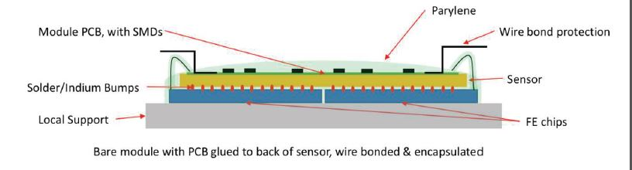
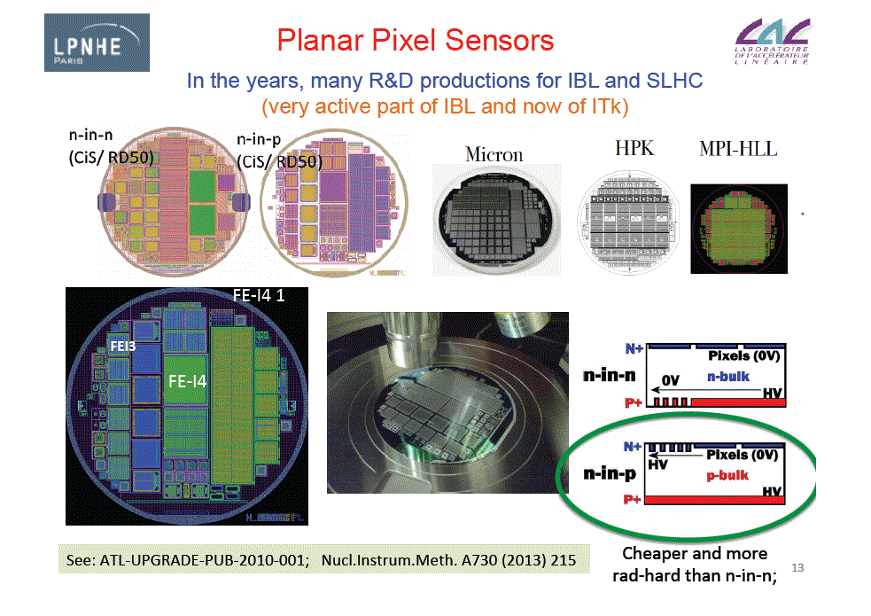
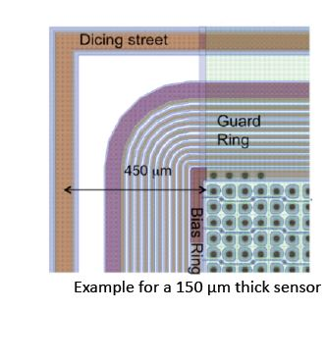
Zoom on module
Present design
Example of wafer production
Future design

Slide 10
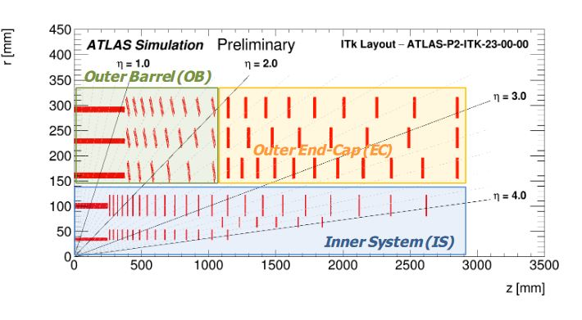
The Cluster Ile de France
Joigned effort of three Laboratories
  LPNHE (Université Pierre et Marie-Curie)
  IJC Lab (Université Paris Saclay)
  CEA-IRFU Saclay
Overall commitment to contribute to 33% of the ITK outer barrel Pixel Construction

Slide 11
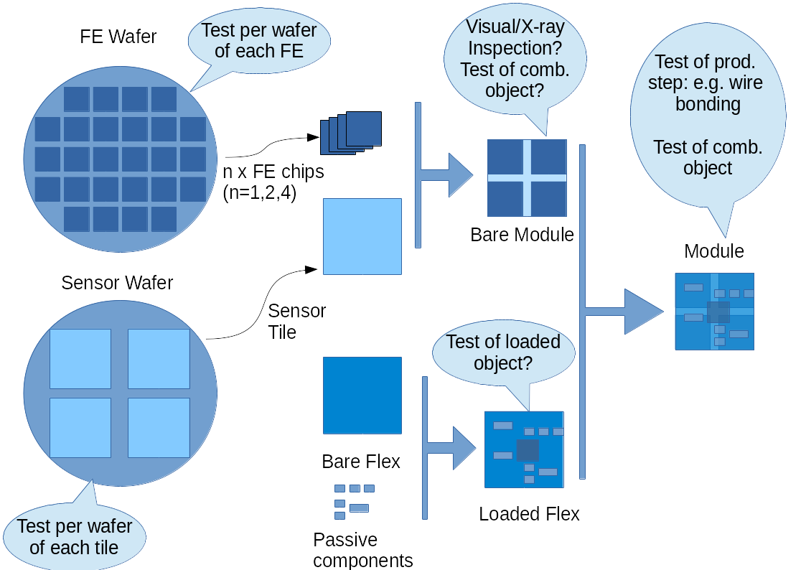
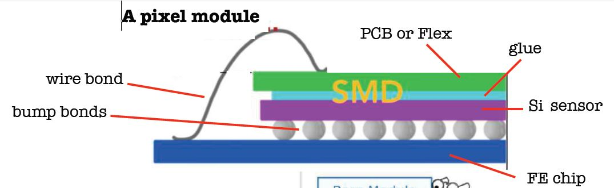
Overall strategy for Module Production
Electronics
Sensor Wafer
Module assembled

Slide 12
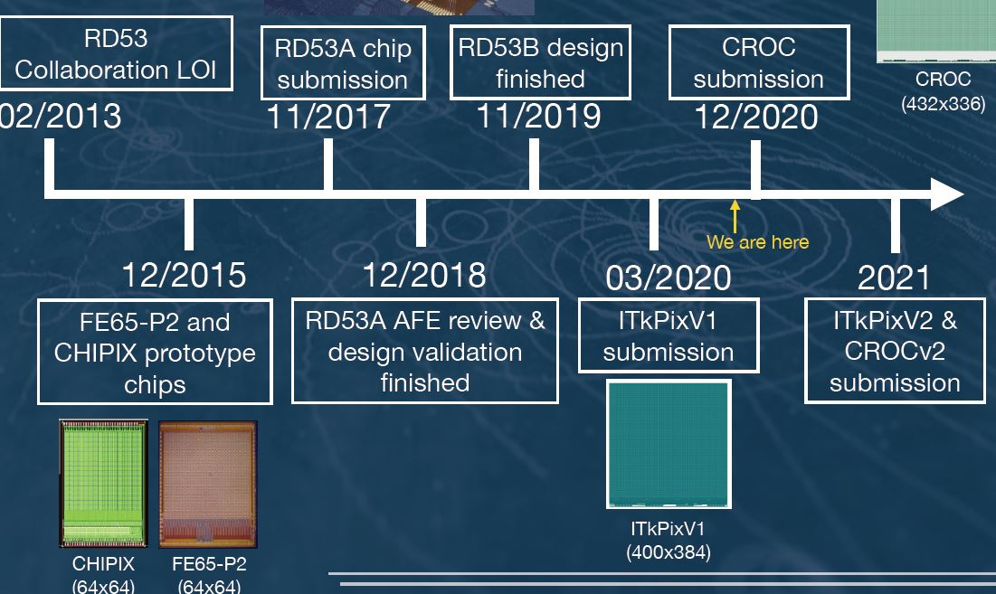
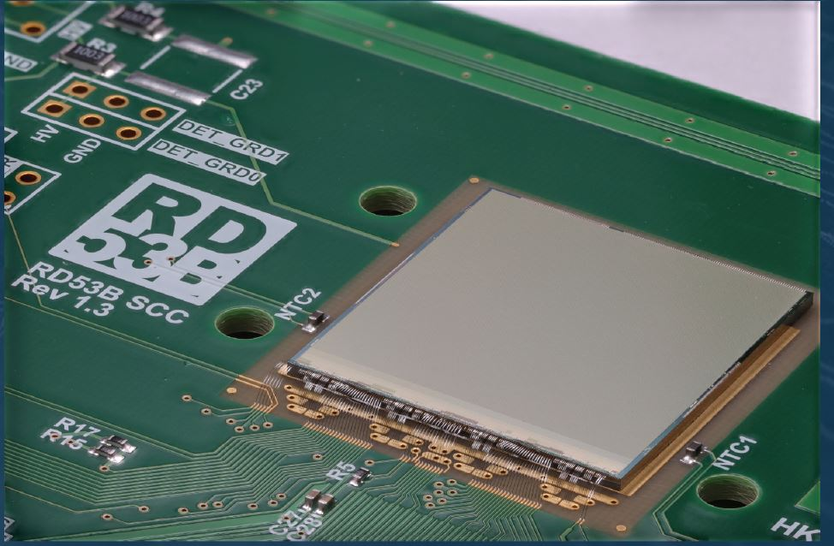
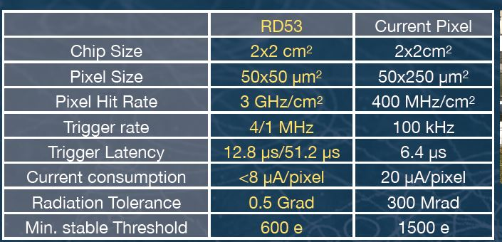
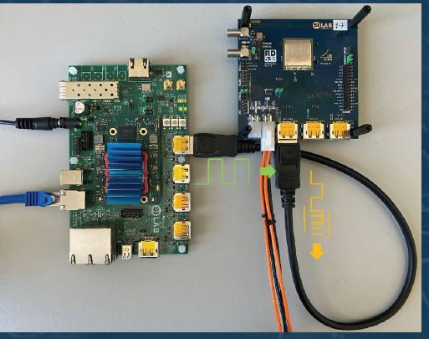
ATLAS Readout Chip developments (LPNHE & IJC are member of RD53 Collaboration)
ITKpixV1 properties

Slide 13
Quality Control & Assurance tasks
QC
QA
QC aims at identifying defects in the finished sensor
Its goal is to identifying and discard faulty sensors
It is a reactive process
Tests are made as much as possible on the final product
QA aims at preventing defects on the production process
Its goal is to assure that the fault does not happen
It’s a proactive process
Tests can be made on other structures

Slide 14
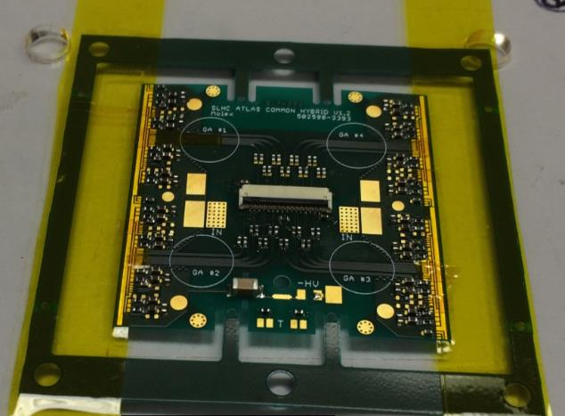
Working operation steps to follow
Planned Quality Control during production
Tests are divided into Quality Control (QC) tests which are applied to all modules or their components and Quality Assurance (QA) tests, i.e. tests which are done on a subset of modules or their components.
Bare module reception tests (QC)
Module flex reception tests (QC)
Quality assurance tests to module flex (QA)
Mass measurements and inspection of the fully assembled modules (QC)
Wire bond pull testing (QC)
Initial module tests (QC)
Long term module tests (QC)
Module tests beyond its operating range and destructive tests (QA)

Slide 15
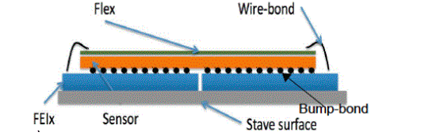
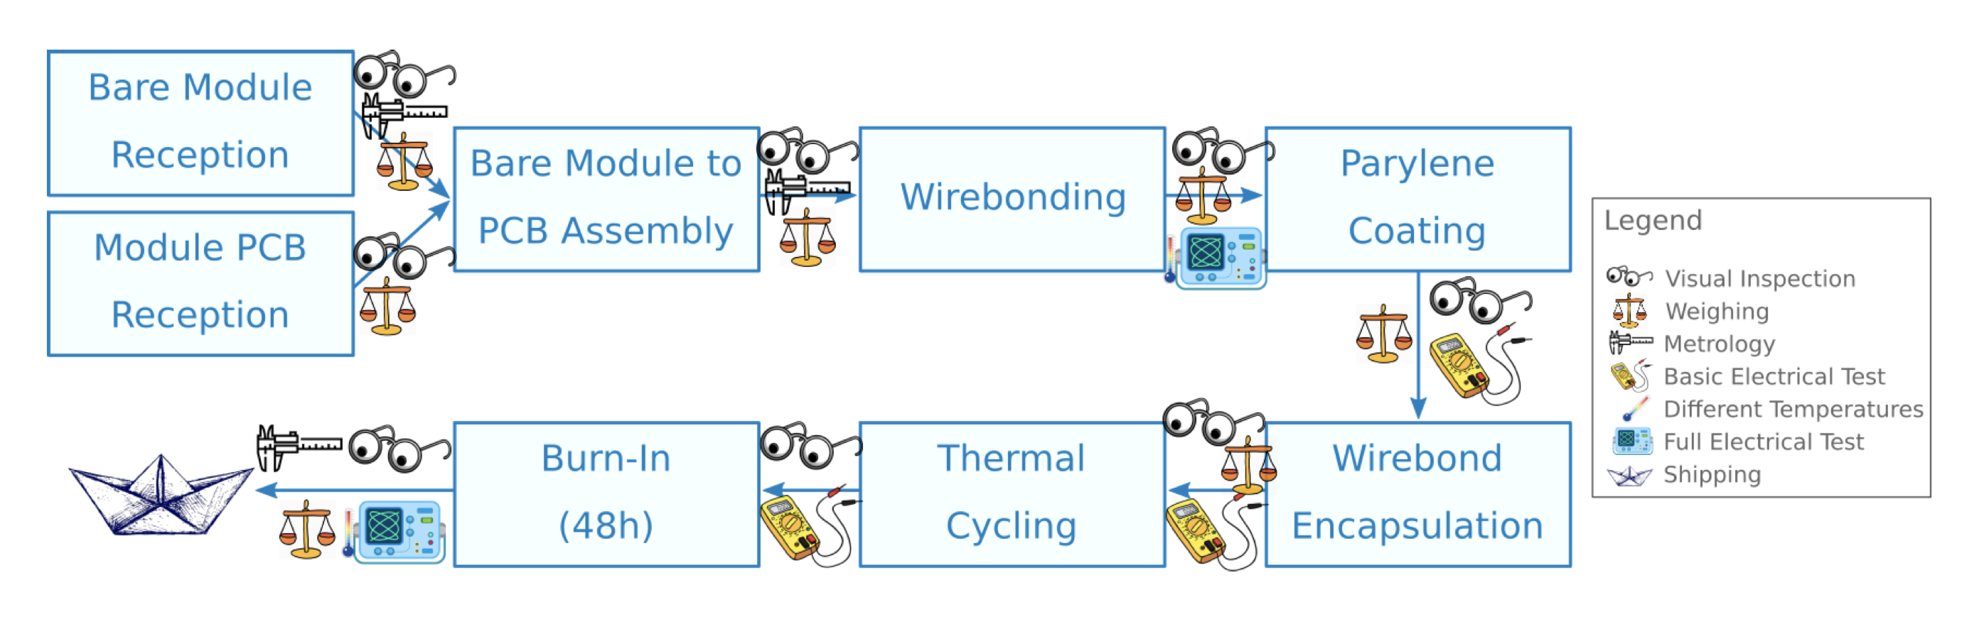
Module Quality Control/Qualitly Assurance- Organization in French Cluster
Sequences for Module QA/QC operations
LPNHE+ CEA+ IJC
LPNHE, CEA
SUBRTREATED
LPNHE+IJC
Testing operations

Slide 16
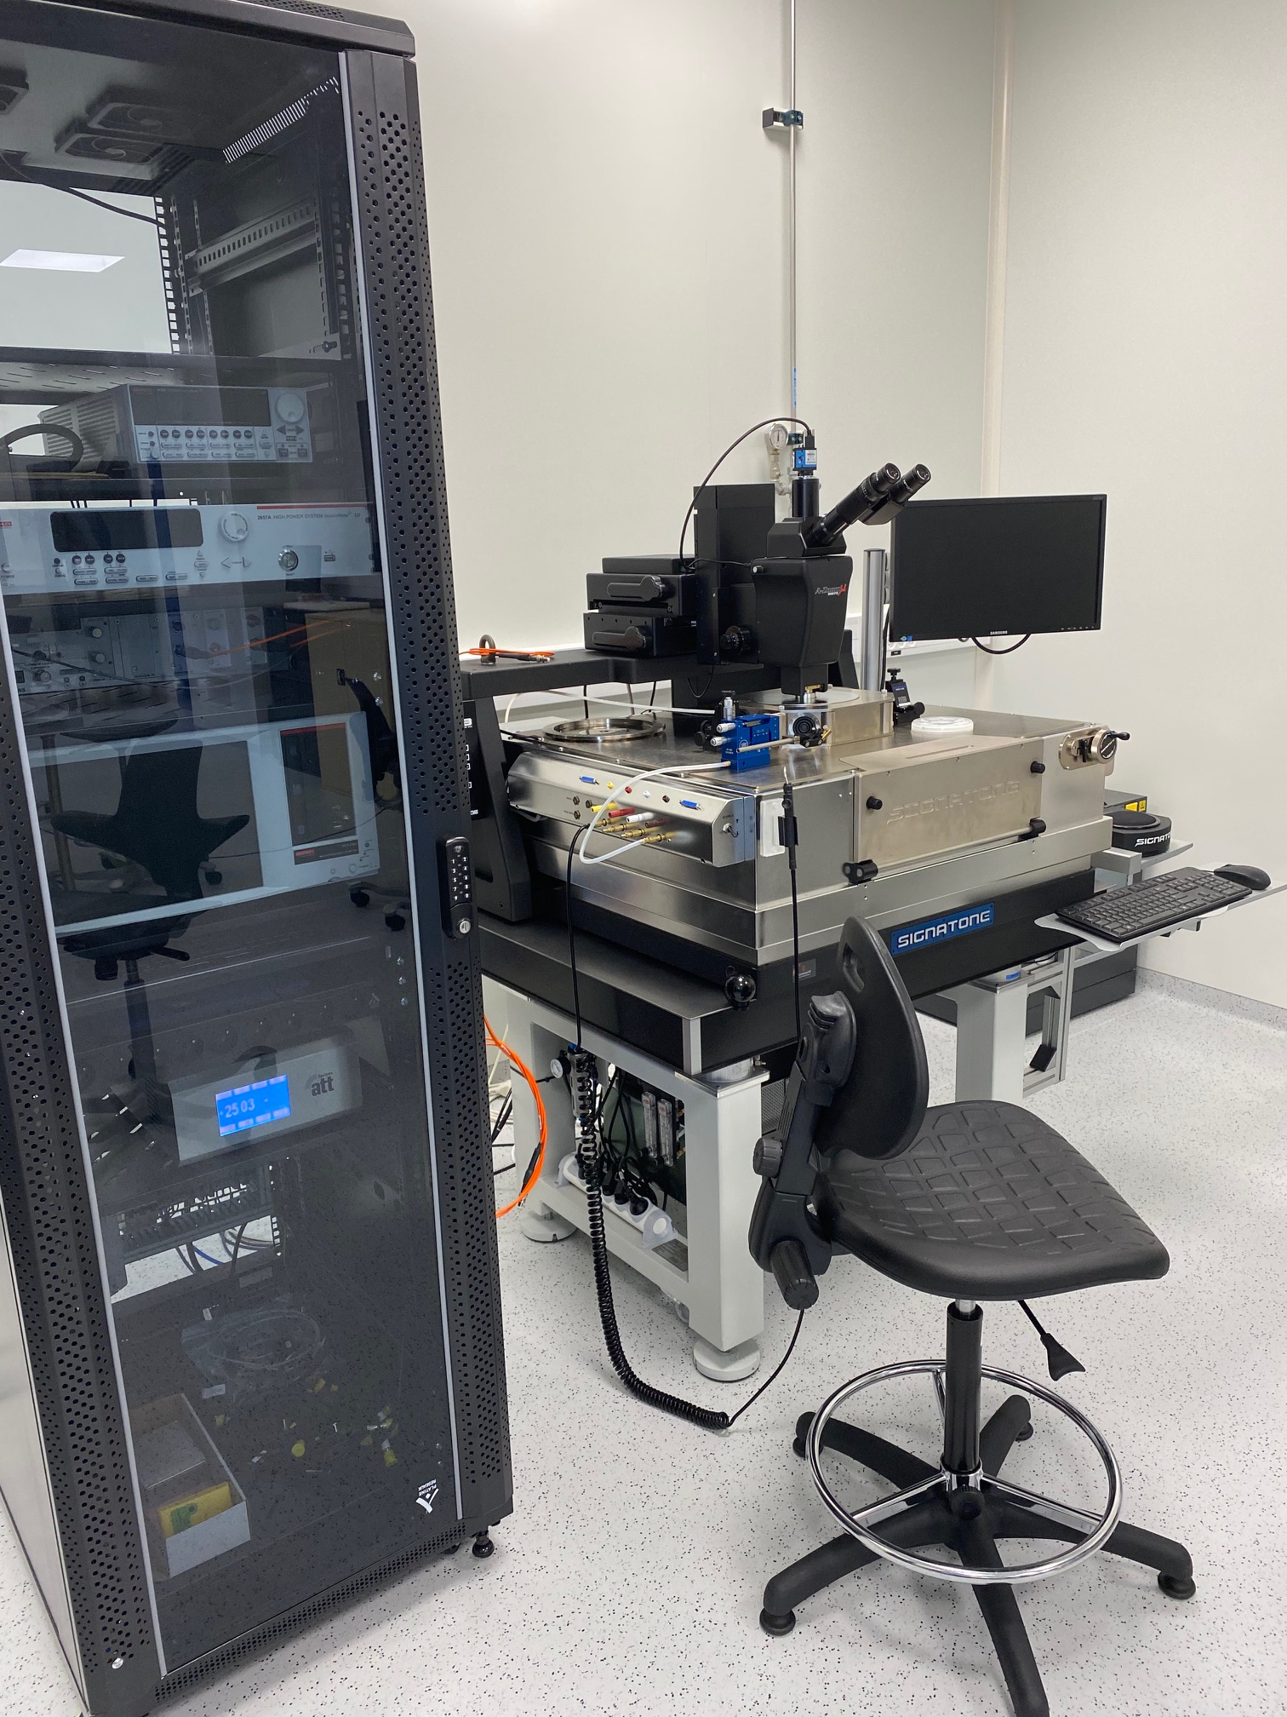
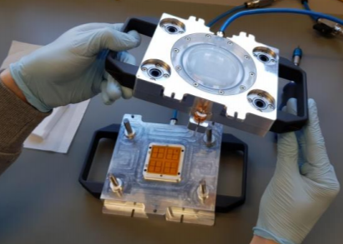
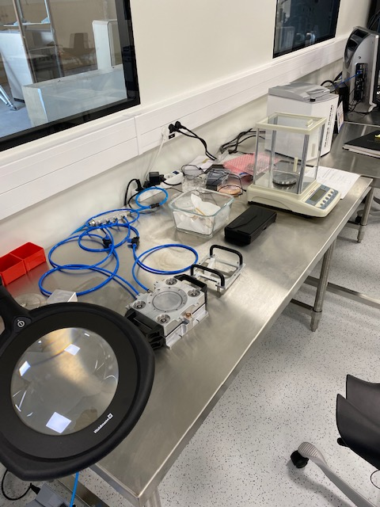
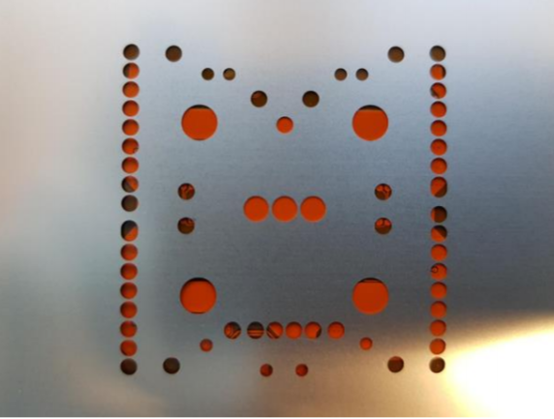
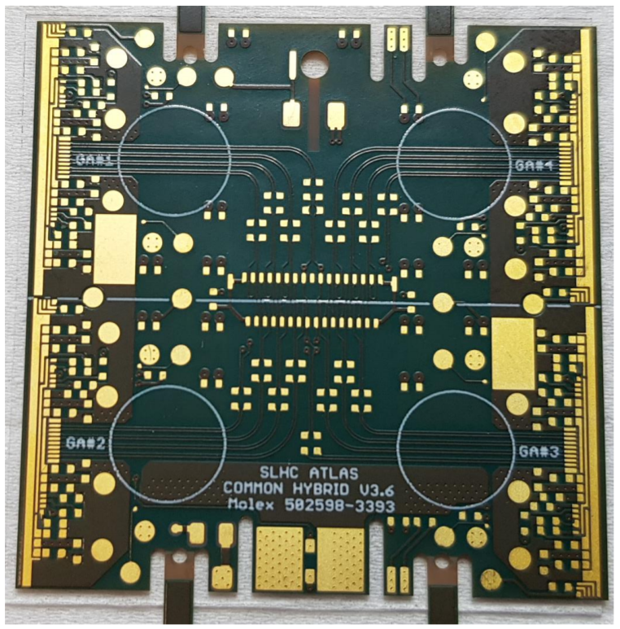
Keithely DAQ
Sensor –wafers and ASIC probing and
testing
Gluing and module assembly Setup

Slide 17
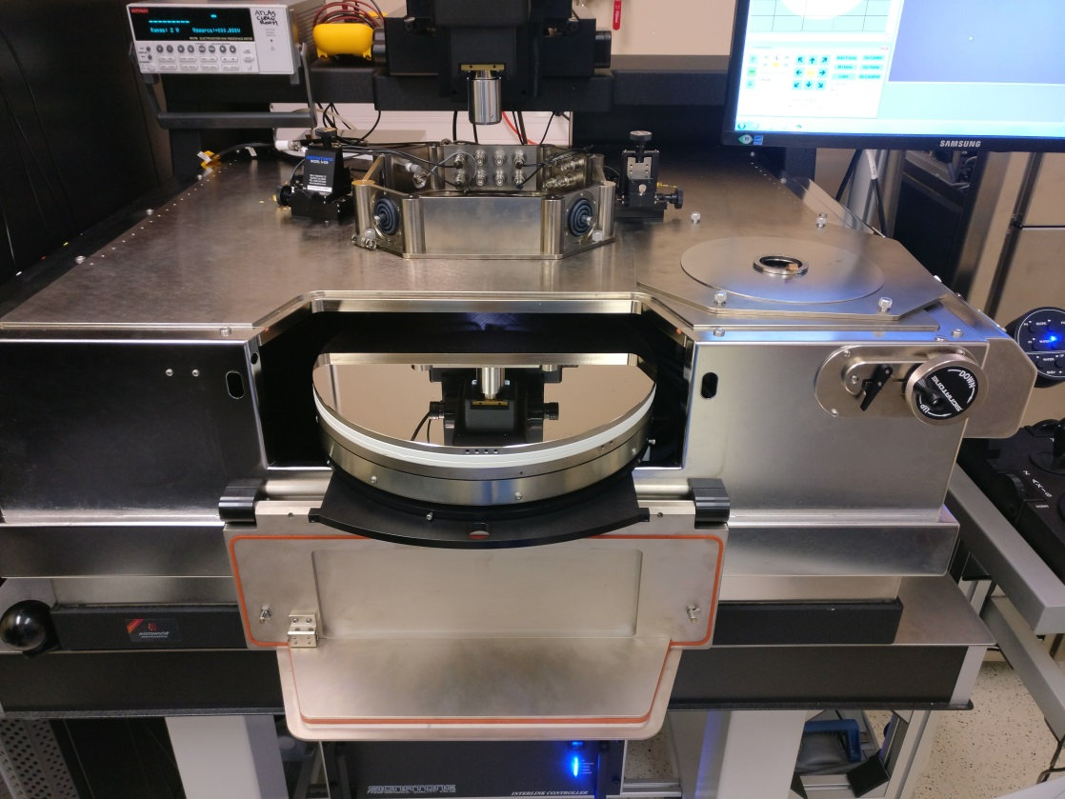
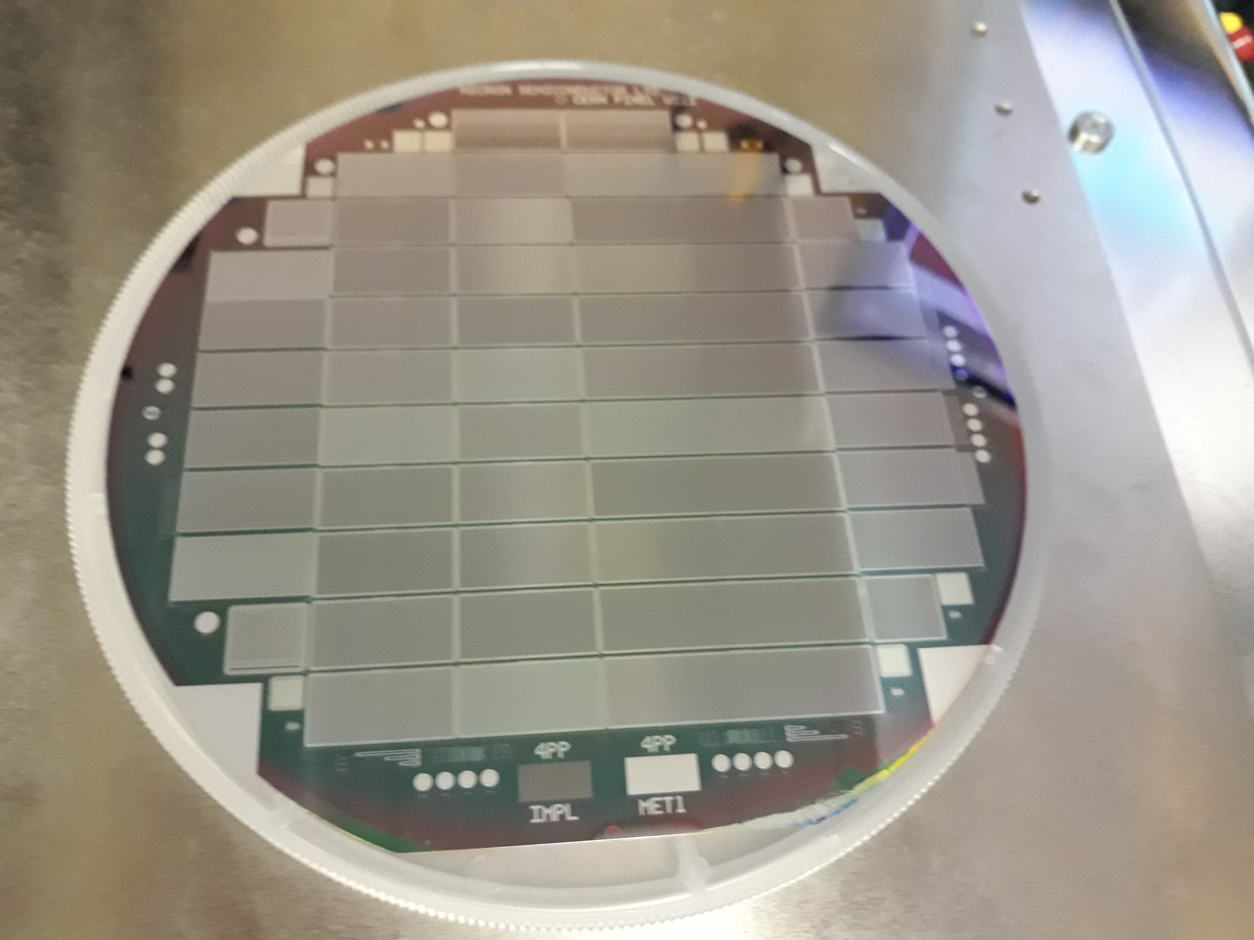
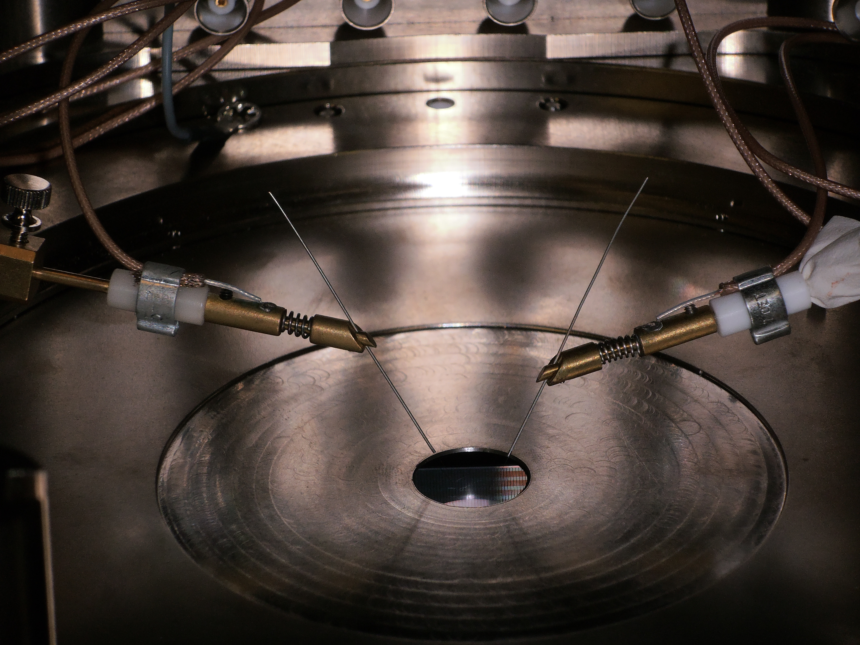
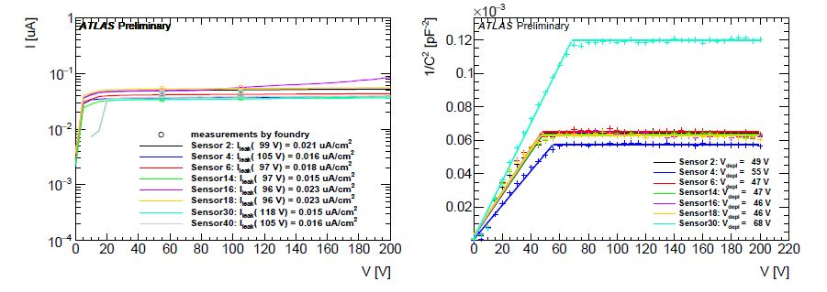
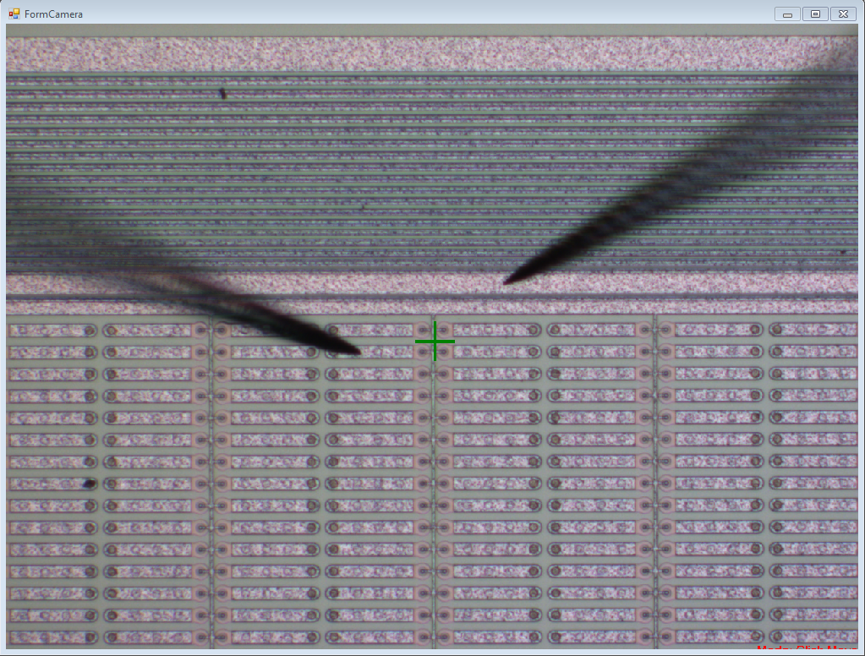
Sensor Probing as an initial step
Powerfull probestations available
(Captinnov Plateform) and LPNHE Clean room
Si wafer
Depletion voltage V_{dep} < 100 V
(for 150 μm sensors) measured at 1 kHz
Leakage current I_{leak} < 0.75 μA/cm² at V_{dep ~} 50 V
Variation of leakage current
ΔI_{leak} ~ 25% measured over 48 h
Breakdown voltage : V_{break} > V_{dep}+70 V
Needle probing
Faraday cage
Data from Pixel Market survey
Sensor & wafer probing

Slide 18
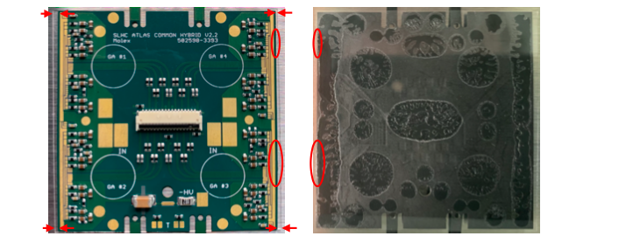
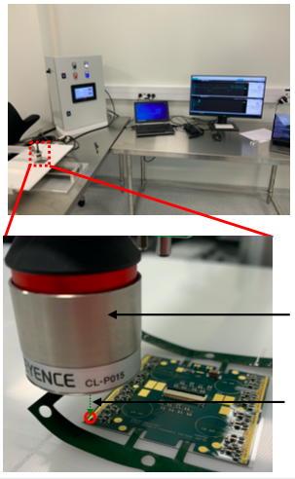
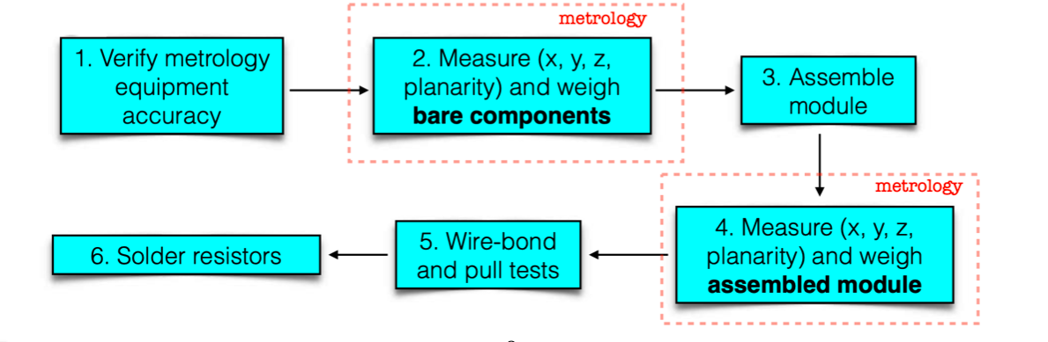
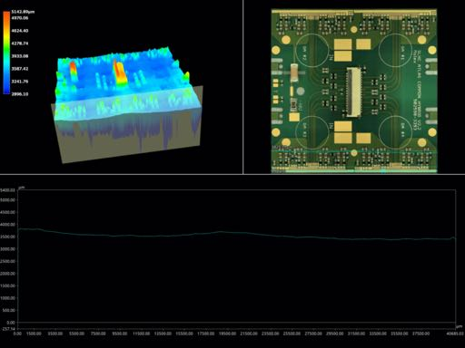
Contribution to module Assembly & QA/QC
Project carried inside the ITK Paris-Cluster (LPNHE-CEA-IRFU, IJCLab)
Profilometer Keyence
laser Head
Operation Carried only in CEA & LPNHE
Laser Beam
Flex

Slide 19
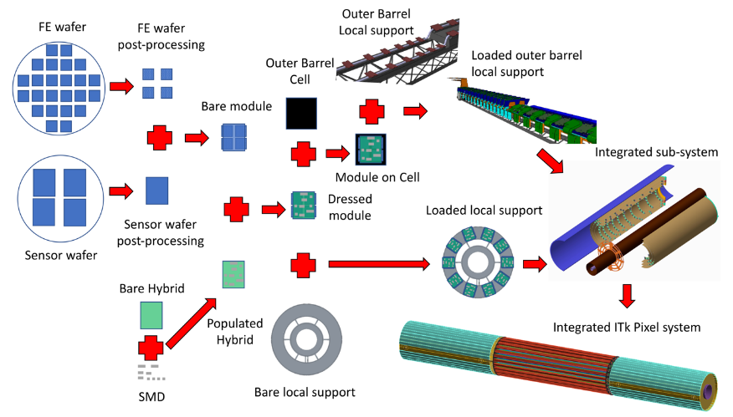
Database needed to share and retreive the full Production
All QC measurements; QC visual inspections, sensor bow, thickness, electrical tests
Module Id - Production testing/step -
Module ID | Production Testing/step | Operator | Data
Date & Time | Cluster Name | Institute name | DB Link
Photographic Documentation for module production:
Modules should be imaged before and after each production testing step
(# 20 pictures/module according to QC recommendations);

Slide 20
Infrastructure and equipment for silicon module developments and production

Slide 21
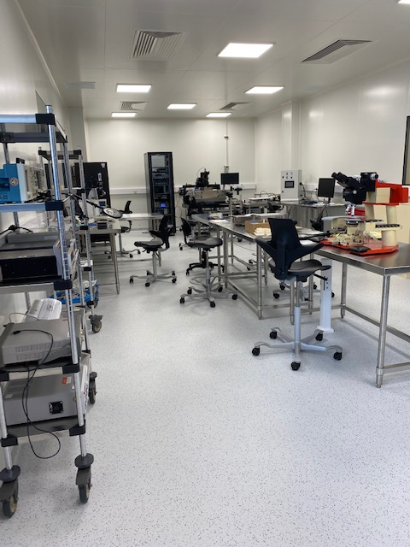
Important Information
In Februray 2020
The ISO7 CAPTINNOV
Clean Room has been delivered
CPER-IJC Lab (Contrat Plan Etat Region)
*2 more clean rooms in LPNHE and CEA-IRFU

Slide 22
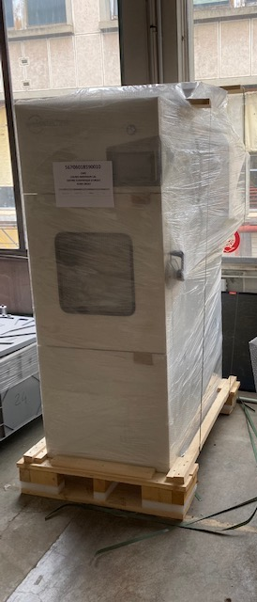
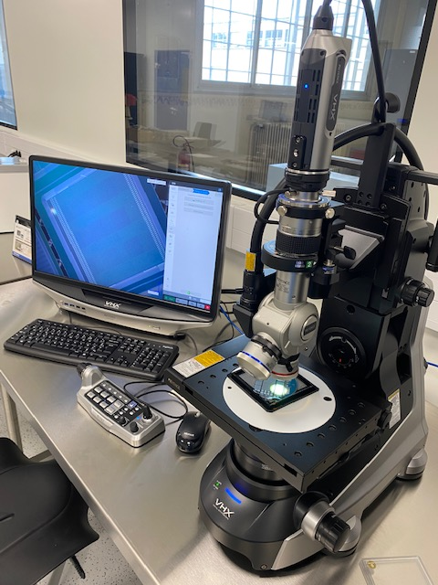
Overview of the actual infrastructure @IJC Lab
Equipments state of the art
Tool for wafer and sensor Testing
Tool for Visual Inspection
Module and Asic temp Cycling
Probe Station
Budget ~ 300 K€
(From Labex P2IO & SESAME
Ile de France)
- HV Chuck*
- Compressor*
Climate Chamber
High resolution Microscope
KEYENCE VHX-7000

Slide 23
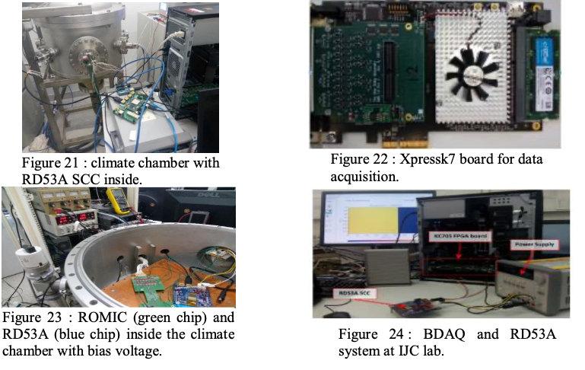
Test benchs for module testing and to radiation monitoring
Electronics :
Test benches for
  Readout Chip ITKpixv1 (RD53) : BDAQ & YARR
  Ring Oscillator & Systems
Ring Oscillator : Chip to monitor the Radiation dose
Embedded in ITKpixV1
Performs mesurement of
frequency Variations as function
of Temperature, Radiation
and charge particle radiation
exposure,
Can Provide a feedback correction loop for ITKpixV1 working voltages
Designer : Maurice Cohen-Solal
SETUP 1
PC-Board
SETUP Open
ATLAS DAQ

Slide 24
Calendar and Milestone

Slide 25
Schedule
Now - end of Nov. 2020: Assemble and test ~10 quad modules
Including , IV/CV/It probing of bare modules will be necessary before the assembly.
• January 2021 - October 2021: Sensors pre-production
Around 200 sensors allocated to Paris cluster. A good fraction of these will have to be
tested using probe stations (LPNHE + IJC)
• October 2021 - May 2022 : Modules pre-production
Paris cluster will have to assembly and qualify/test around 200 modules
• June 2022 - ~2024-2025 : Modules Production
Paris cluster will have to assembly and qualify around 2000 modules
Nov. 2020
OCT 2021
Start Pre-prod
Prod
MS complete

Slide 26
Conclusions
The ATLAS French Cluster is committed in a very challenging detector construction program for HL-LHC program,
High expertise in building complex systems of silicon Tracker will be acquired,
A unique opportunity is given by such program to built in house a state of the art modern technological infrastructure “Si Lab”
A beneficial valuable is gained through the close partnership within IN2P3 Labs and CEA-IRFU (exchange of expertise, open cooperation, sharing the efforts) to win this challenge.

Slide 27
End

Slide 28
