Slide 1


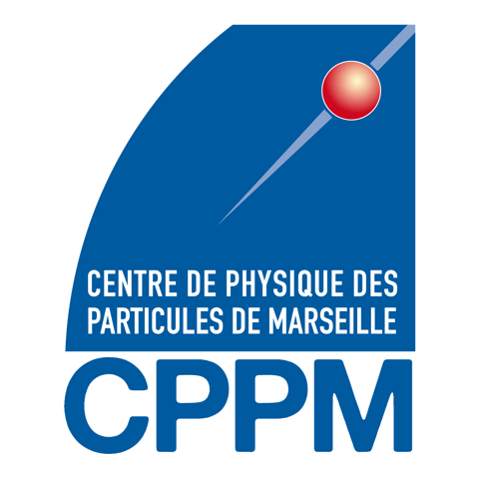



MAPSSIC
An intracerebral CMOS probe for β+ brain imaging
in awake and freely moving rats
philippe.laniece@IJClab.in2p3.fr

Slide 2
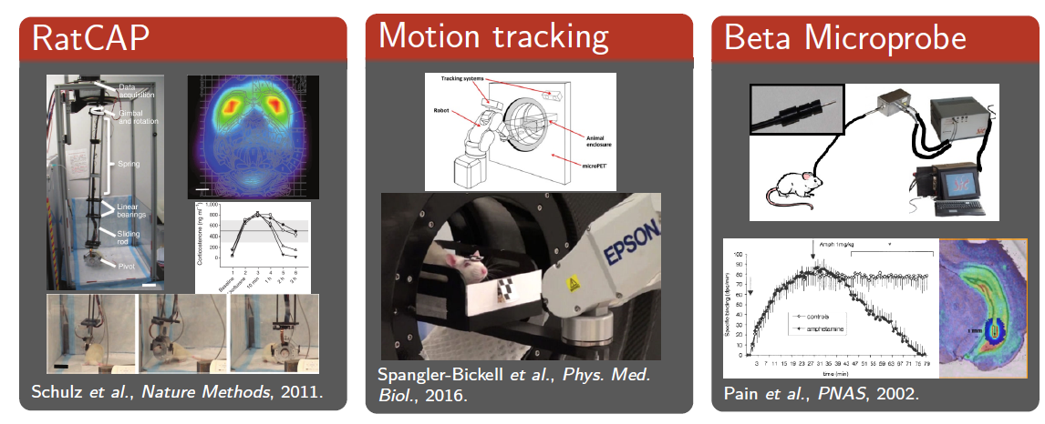
context: brain imaging performed on freely moving small animal
What are anesthesia effects on neuroimaging studies ?
How to perform simultaneous behavior studies and real-time neuroimaging
Time to wake up: Studying neurovascular coupling and brain-wide circuit function in the un-anesthetized animal, NeuroImage 2017

Slide 3
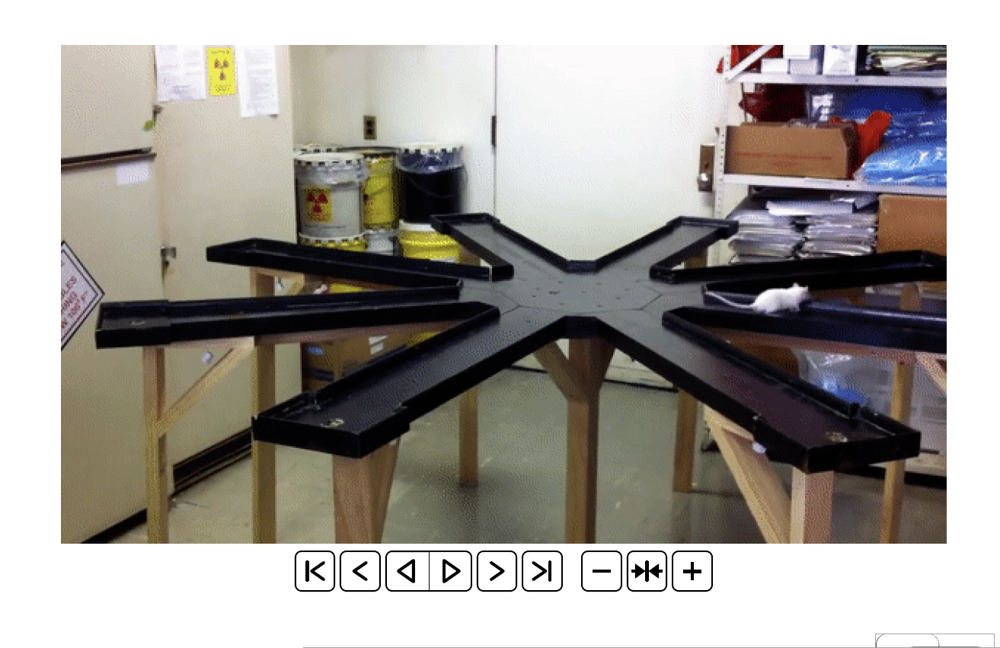
Main goals of the project
To develop a pixelated β+ sensitive imaging device
To give real autonomy to the rat
To limit annihilation rays and visible light sensitivity

Slide 4

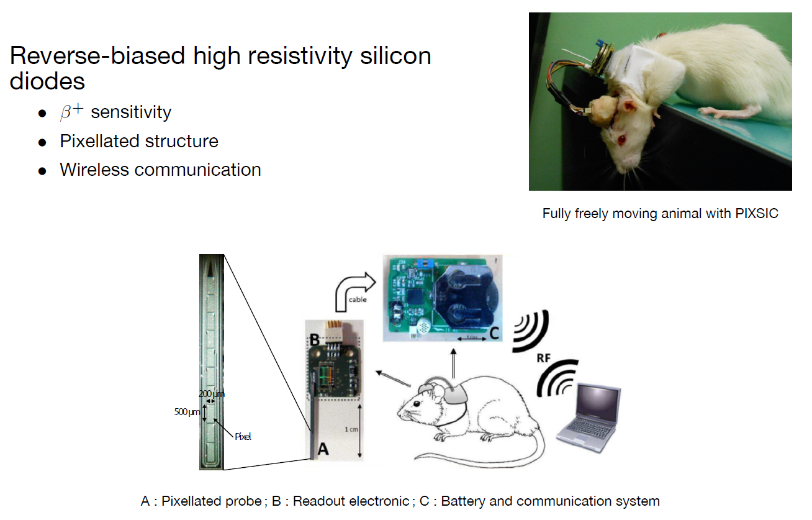
PIXSIC: the first pixelated β+ microprobe

Slide 5
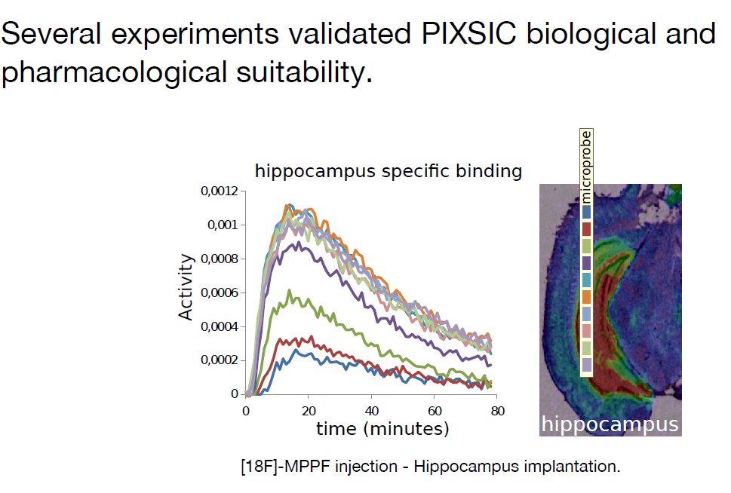
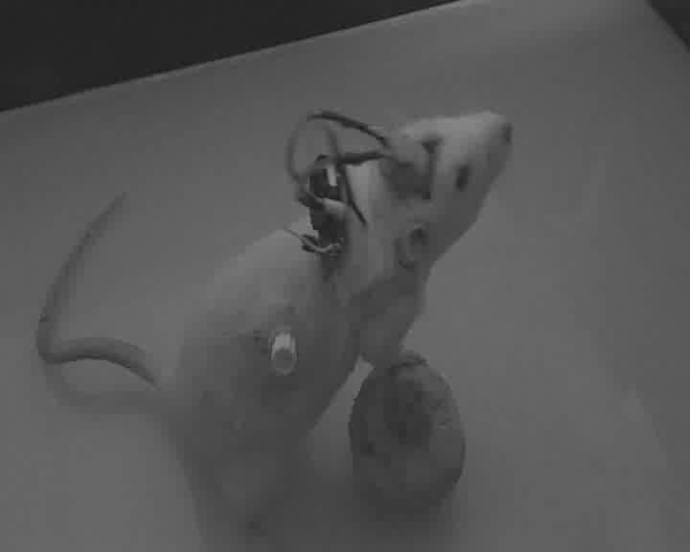
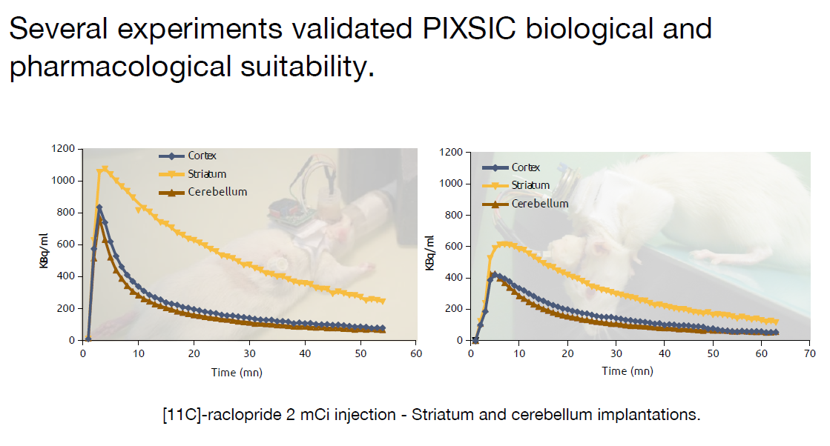
PIXSIC: pharmacological validation
typical recording performed on freely moving rat

Slide 6
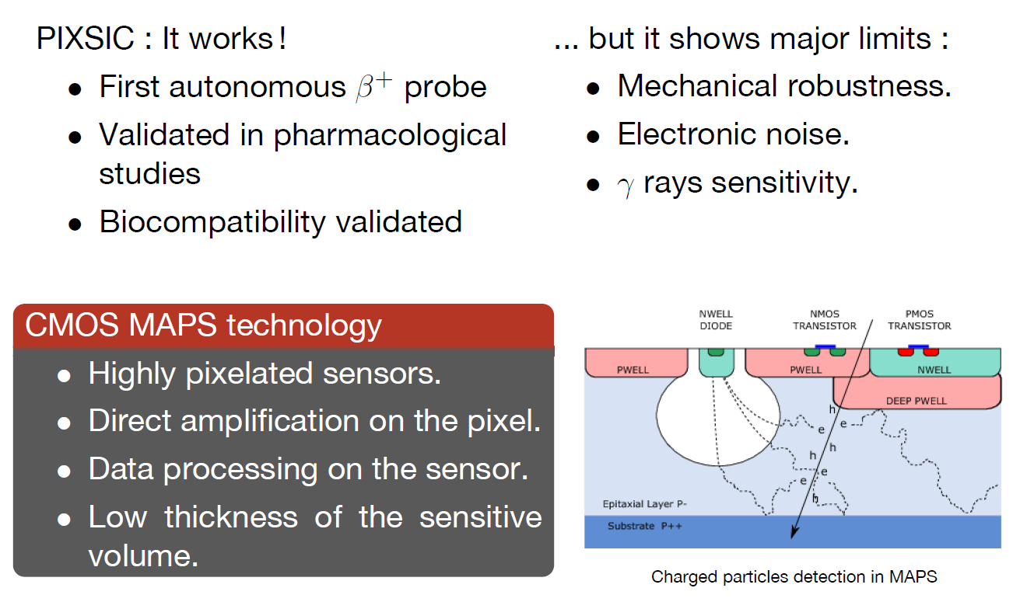
CMOS MAPS : towards an ideal probe

Slide 7
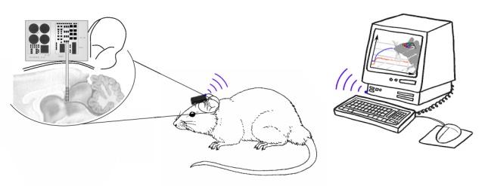
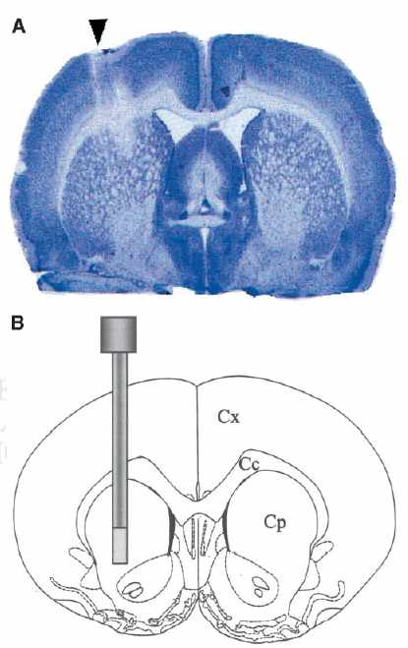
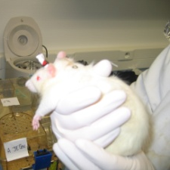
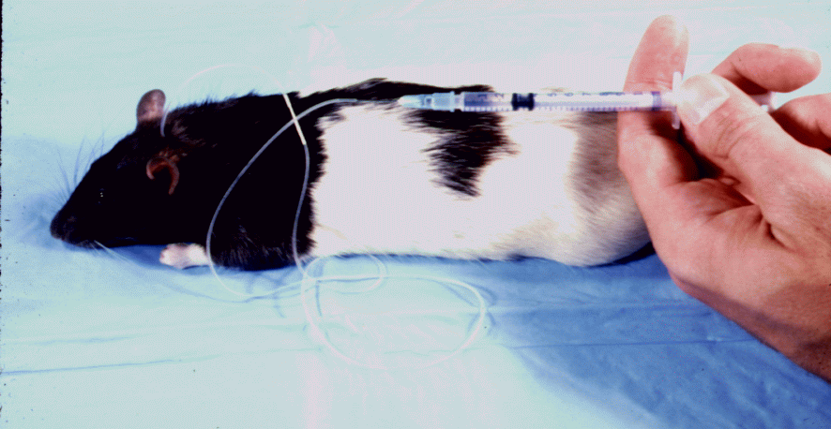
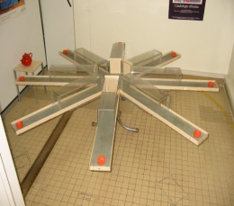

MAPSSIC: project management
Workpackages et tasks
Task 1: Development of a pixelated CMOS preprototype and electronic et physical characterization
Task 2: Design and development of the probe (3D probe, head module and back pack, acquisition)
Task 3: study of the brain injury and recovery resulting from probe implantation and long term consequences on the probe measurement
Task 4: detector modeling in term of biological approach
Task 5: pharmacological validation of the probe and comparison with PIXSIC, microPET et awake and anesthetized
Task 6: physiological and behavioral validation of the probe

Slide 8
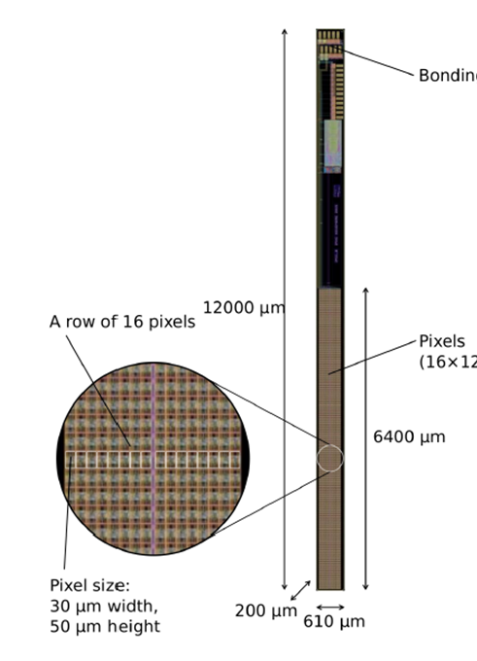
The IMIC* MAPS first prototype
MAPSSIC: new β+ probe
Based on CMOS MAPS technology
Specific front end electronic
Autonomous and wireless
Tissue compatible (size, T°C, …)
Mechanically robust
First prototype
total thickness : 280 µm
Sensitive layer thickness : 18 µm
16 x 128 pixels, 30 x 50 µm²
digital sensor
1 bit memory per frame
Low power consumption (16 µW)
Heymes, Ammour et al., Implantable CMOS Pixel Sensor for Positron Imaging in Rat Brain, 2018, NIMA
Model of the first sensor with monolithic active pixels and compatible with a brain implantation for β+ imaging
* IMIC: Imageur Moléculaire Intra-Cérébral

Slide 9
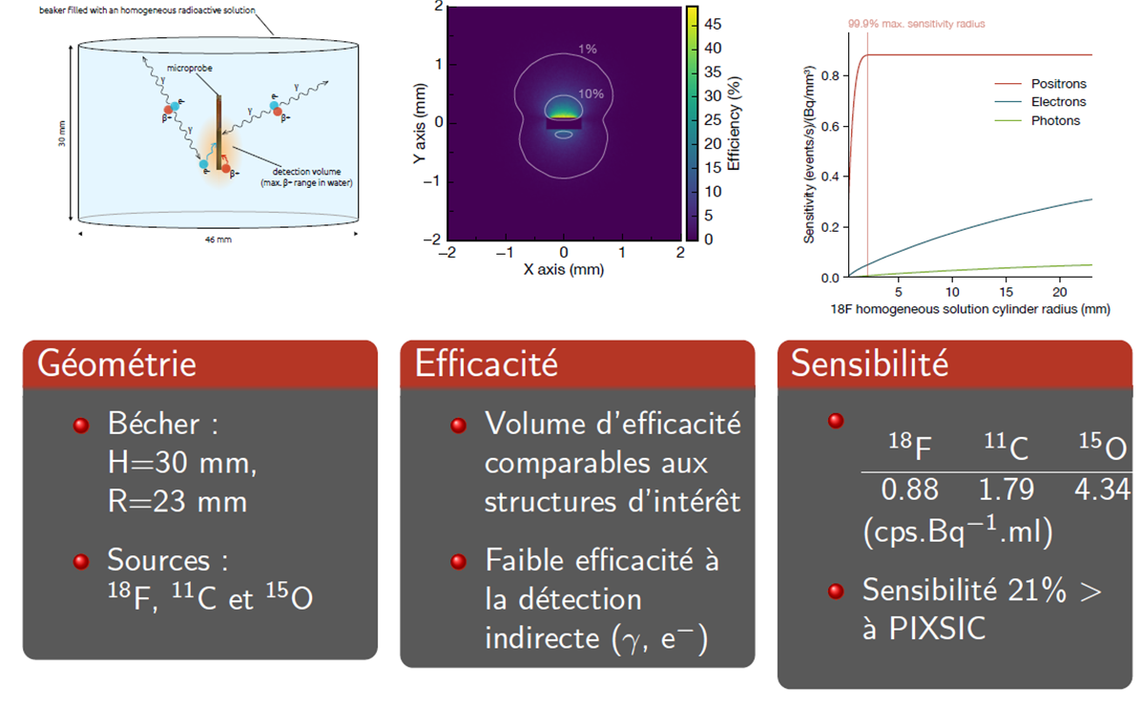
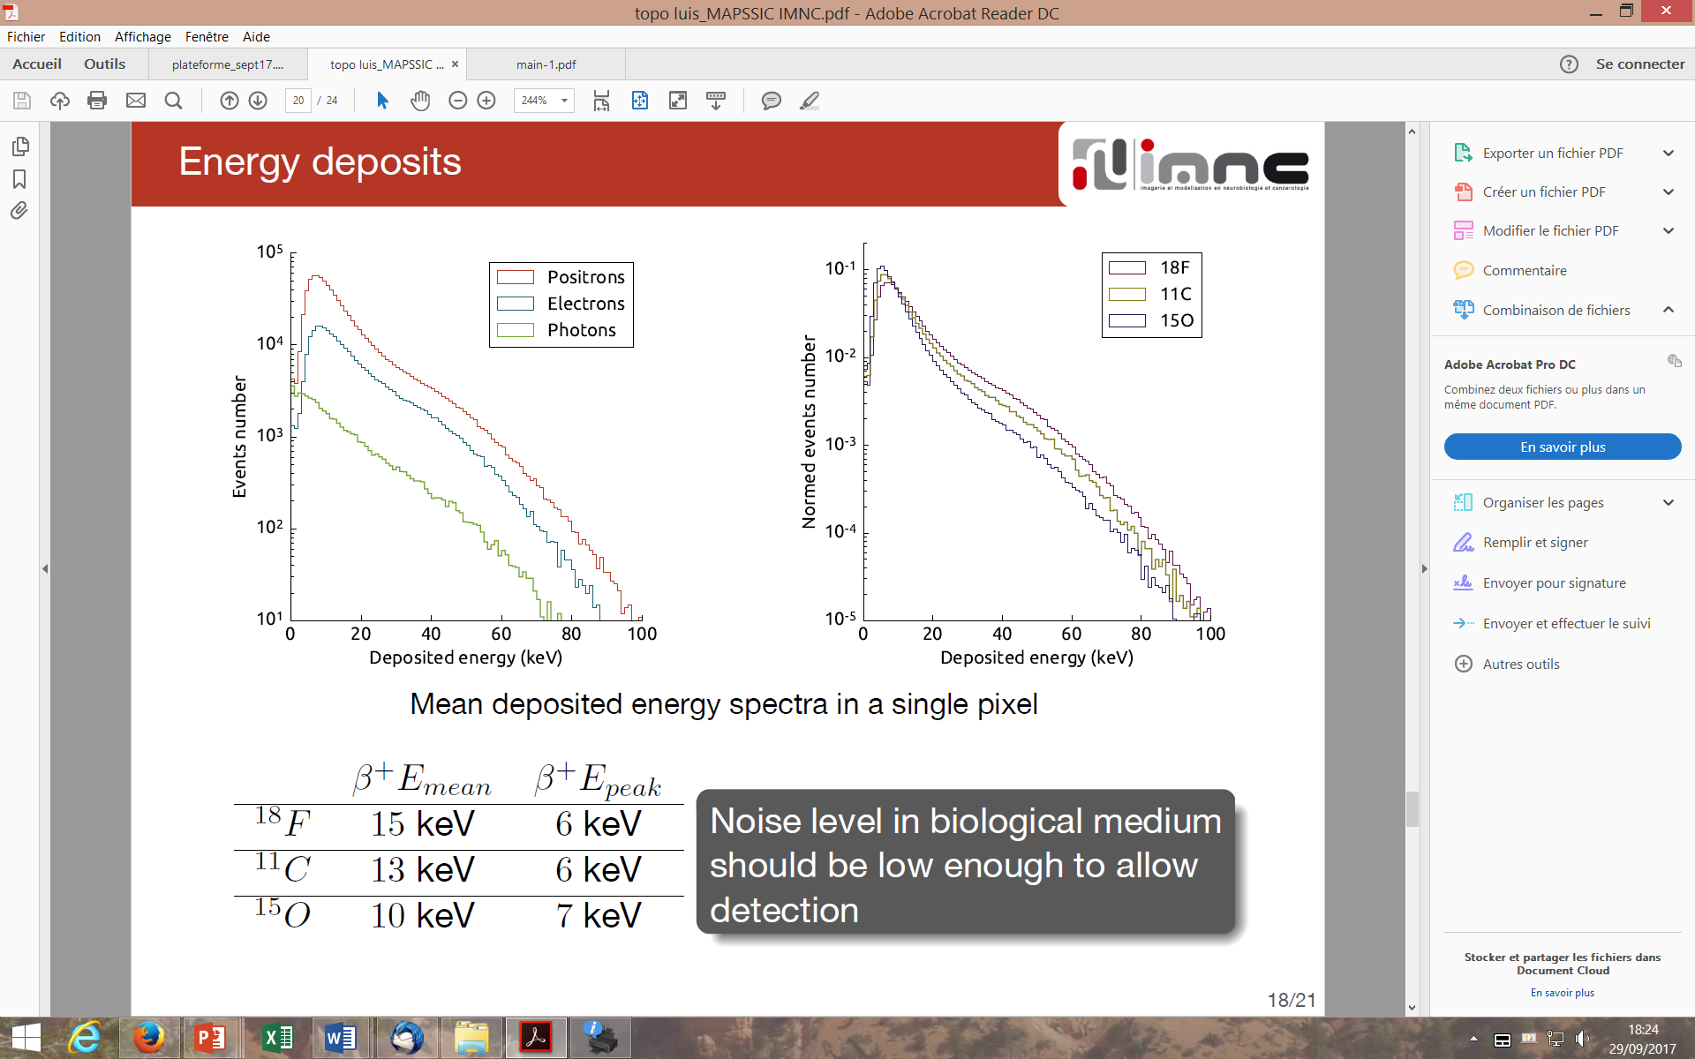
IMIC characterization: MC simulation

Slide 10
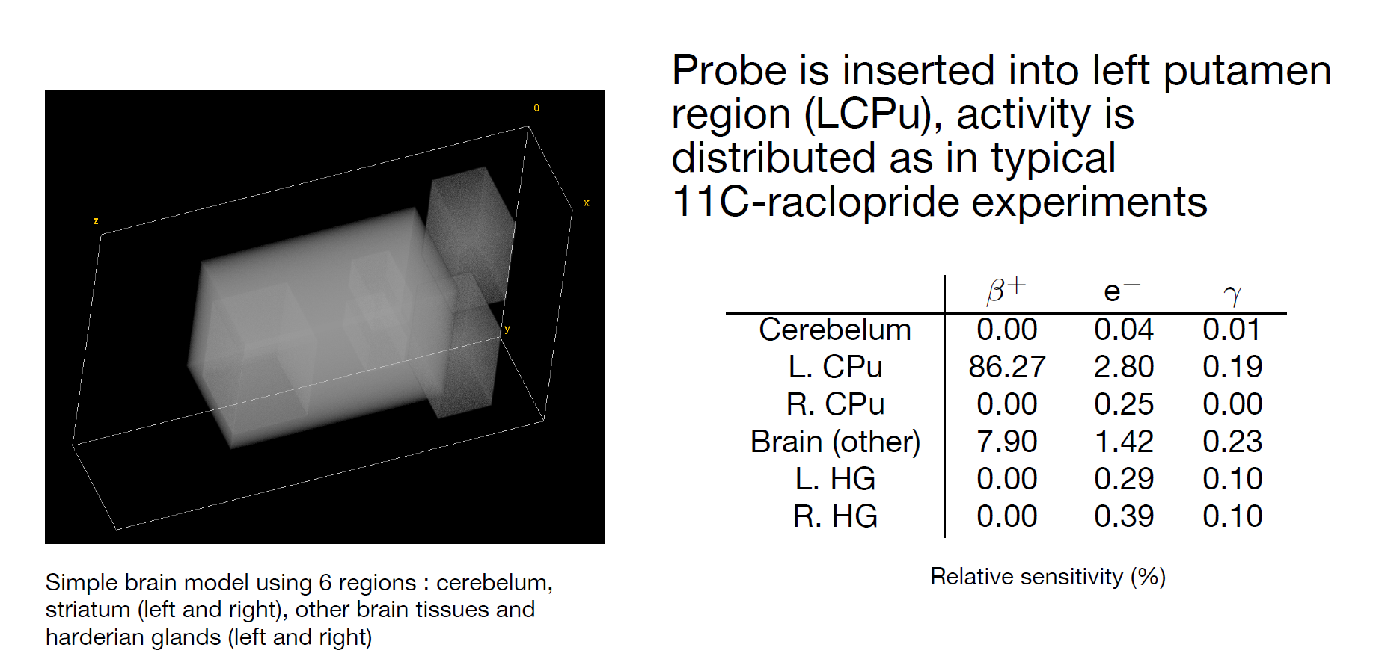
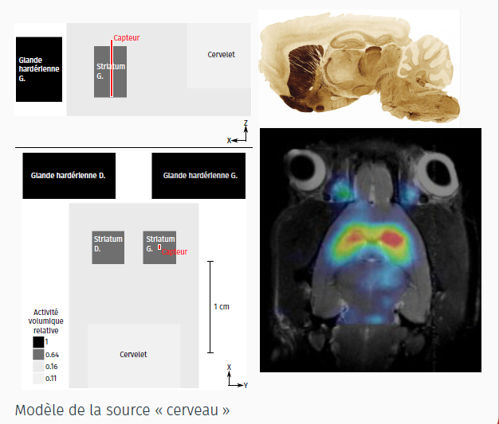
IMIC characterization: Rat brain phantom simulation

Slide 11
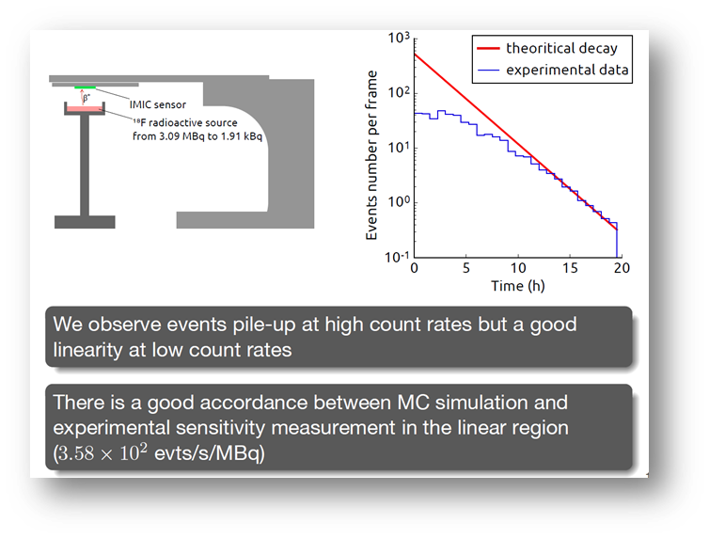
IMIC characterization: experimental results
Machine learning analysis to limit the pile up effect: affinity propagation
Experimental set up:
18F source (FDG or AV-1451) into an ABS container
Single IMIC-B sensor
XBee microcontroller able to acquire 450 ms frames
Micro-computer, connected to the micro-controller by wires

Slide 12
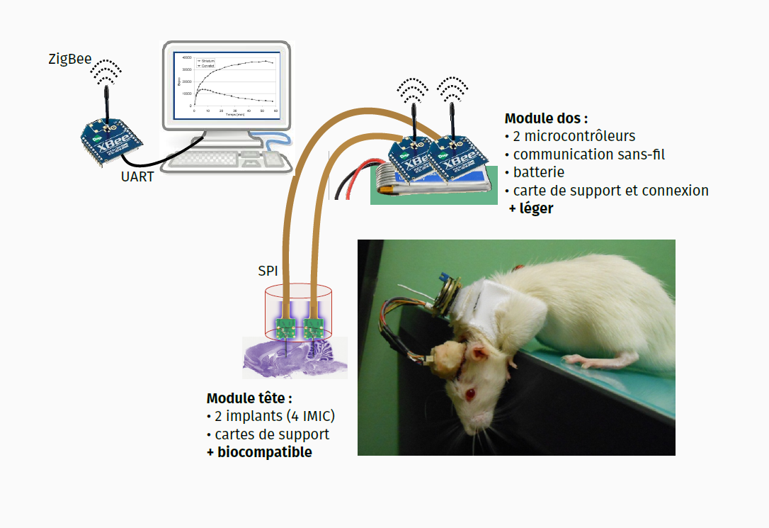
MAPSSIC: general design

Slide 13
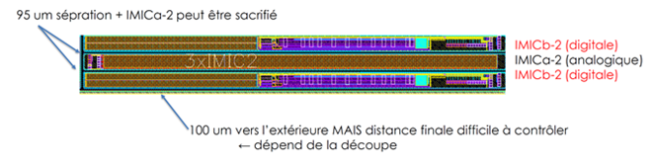
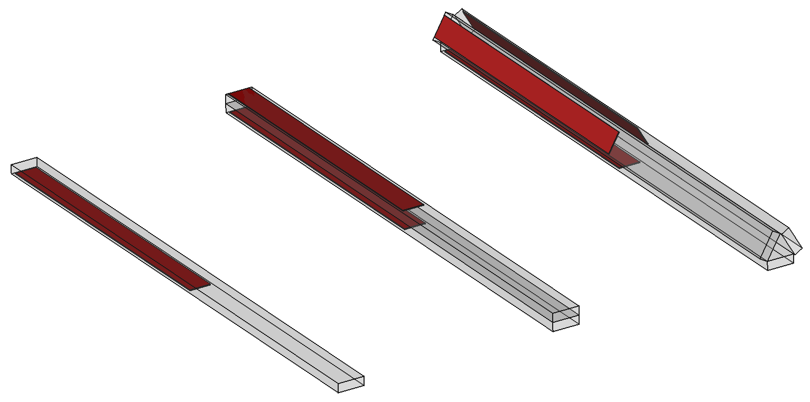
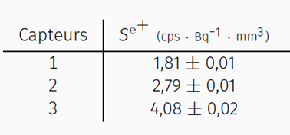
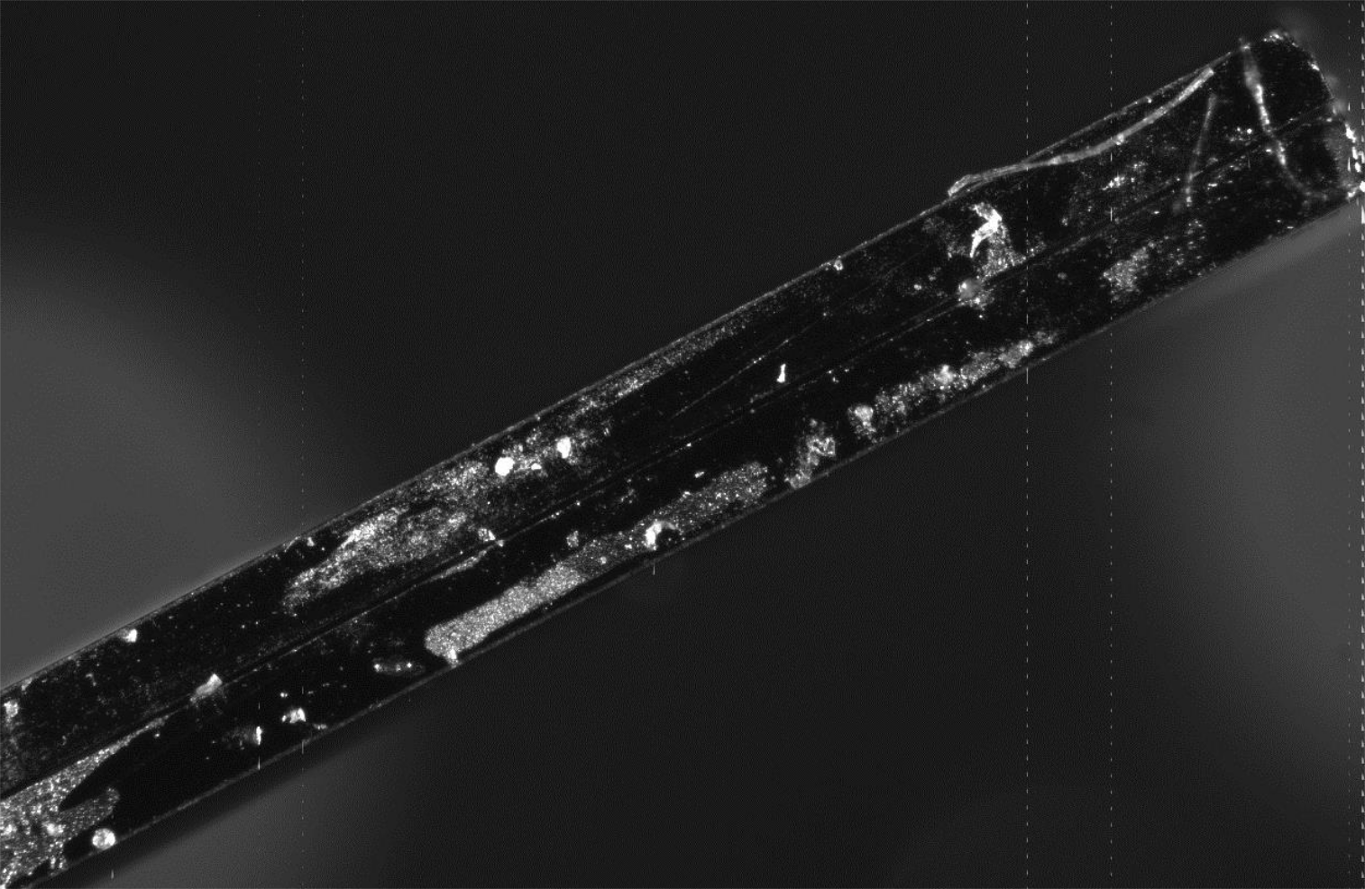
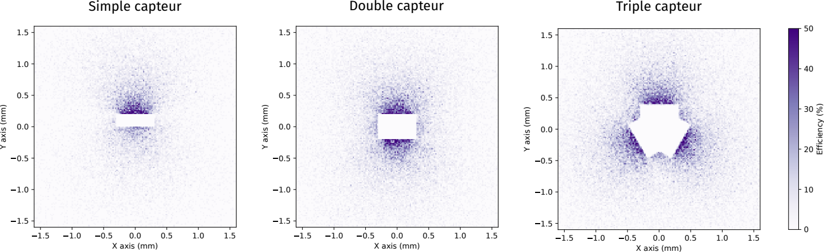
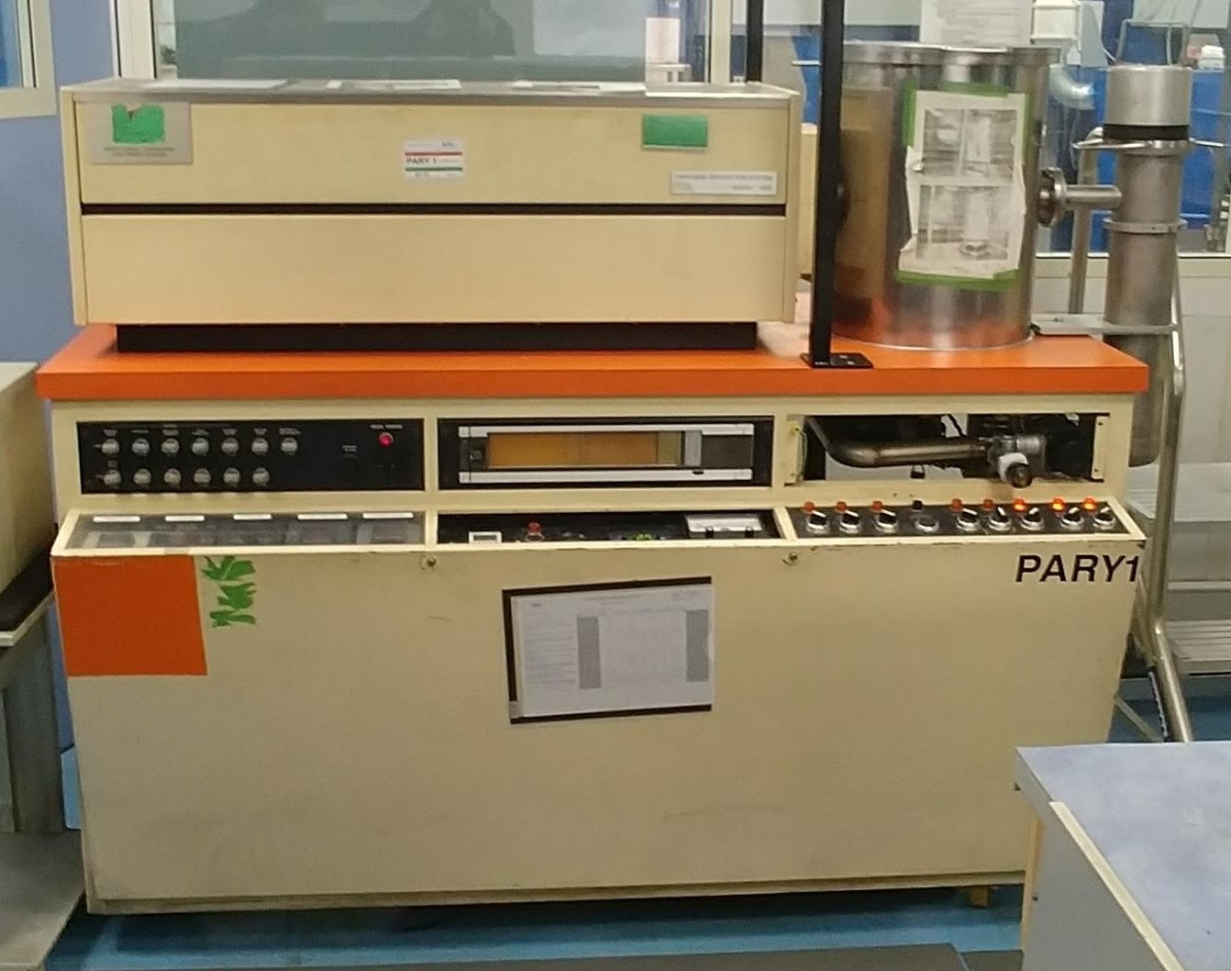
MAPPSIC: from the IMIC prototype to the 3D probe
Aim: on the basis of the IMIC prototype, to develop a 3D probe with a miniaturized electronic
Toward a 3D probe
IMIC Cutting
IMIC gluing back to back
Collaboration Gamberini SA, Grenoble
Parylen thickness: 6 µm
Tissue Protection
Chemical protection
Électrical Isolation
Parylene coating, APS, Marne la Vallée

Slide 14
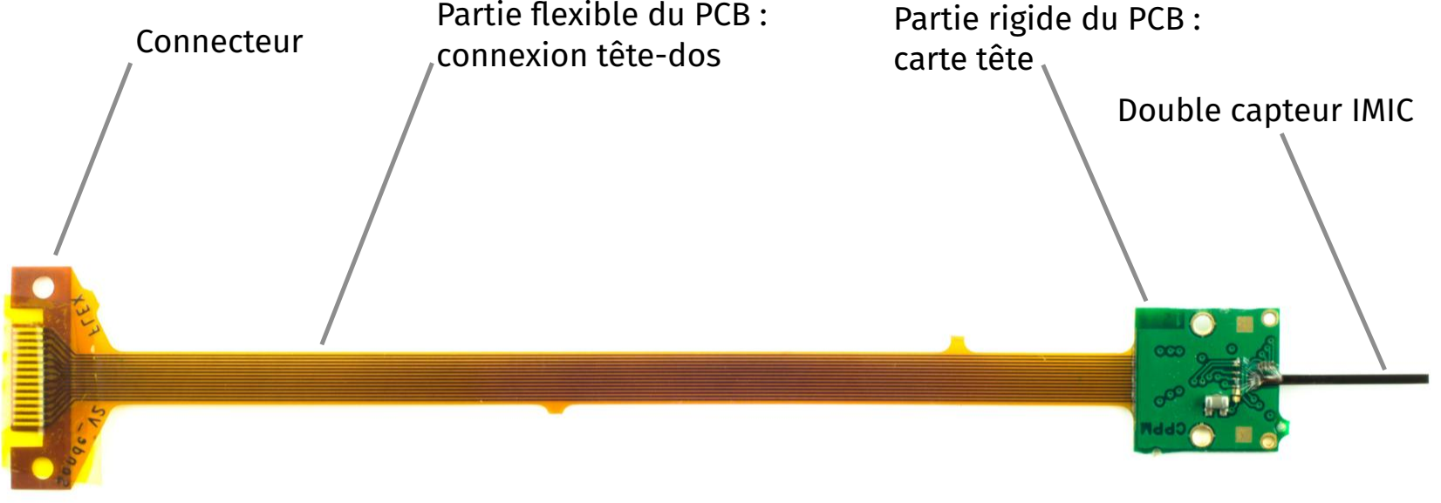
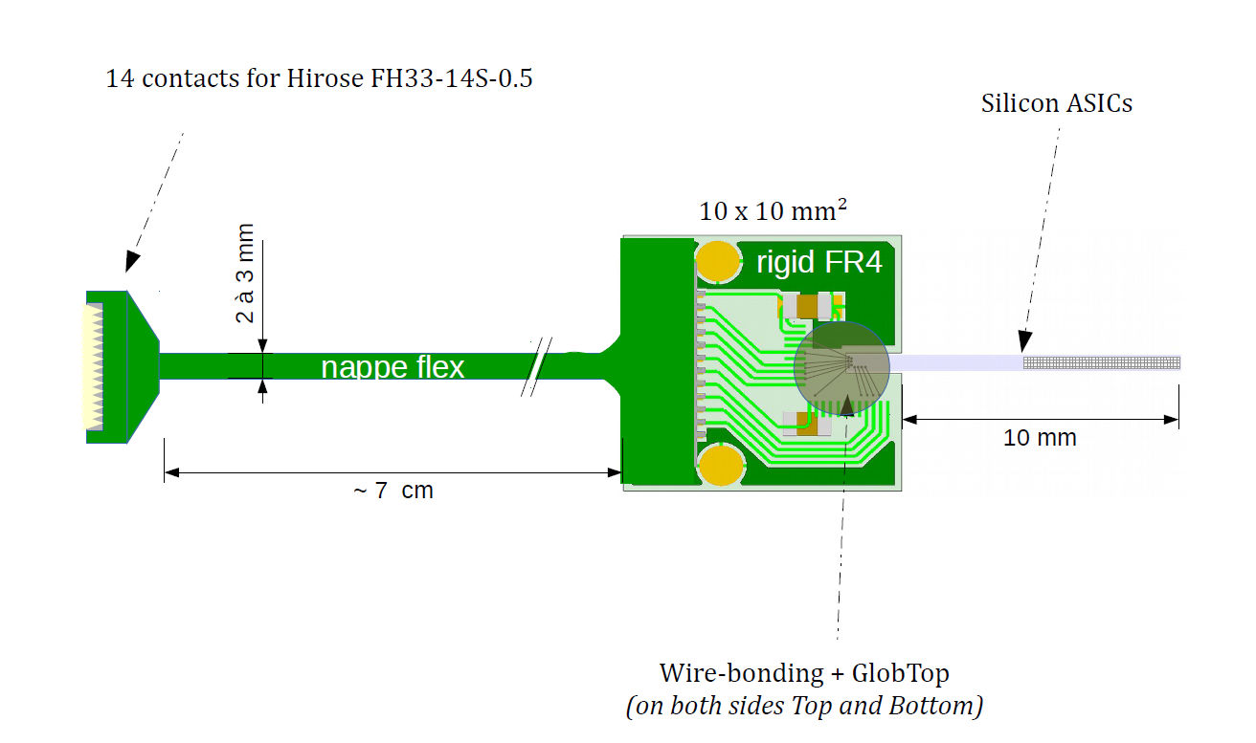
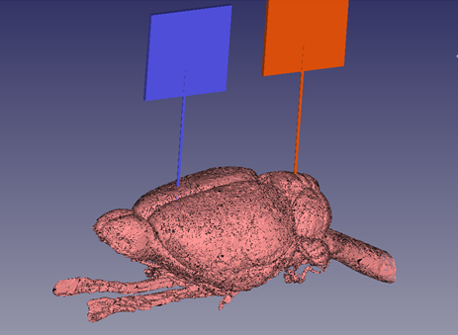
MAPSSIC: head module
Encapsulation process for module protection
Implantation requirement
Transportation requirement

Slide 15
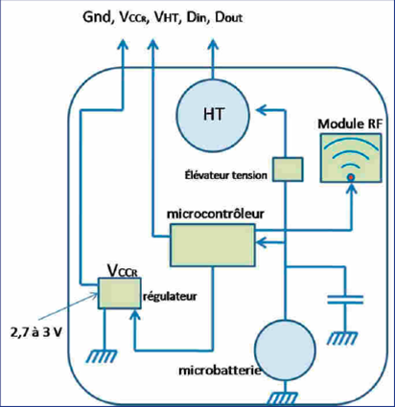
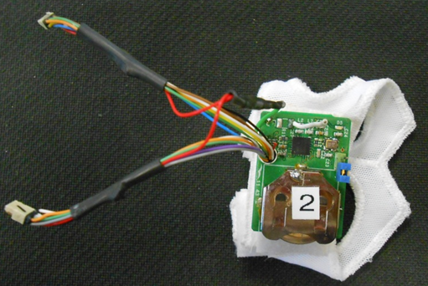
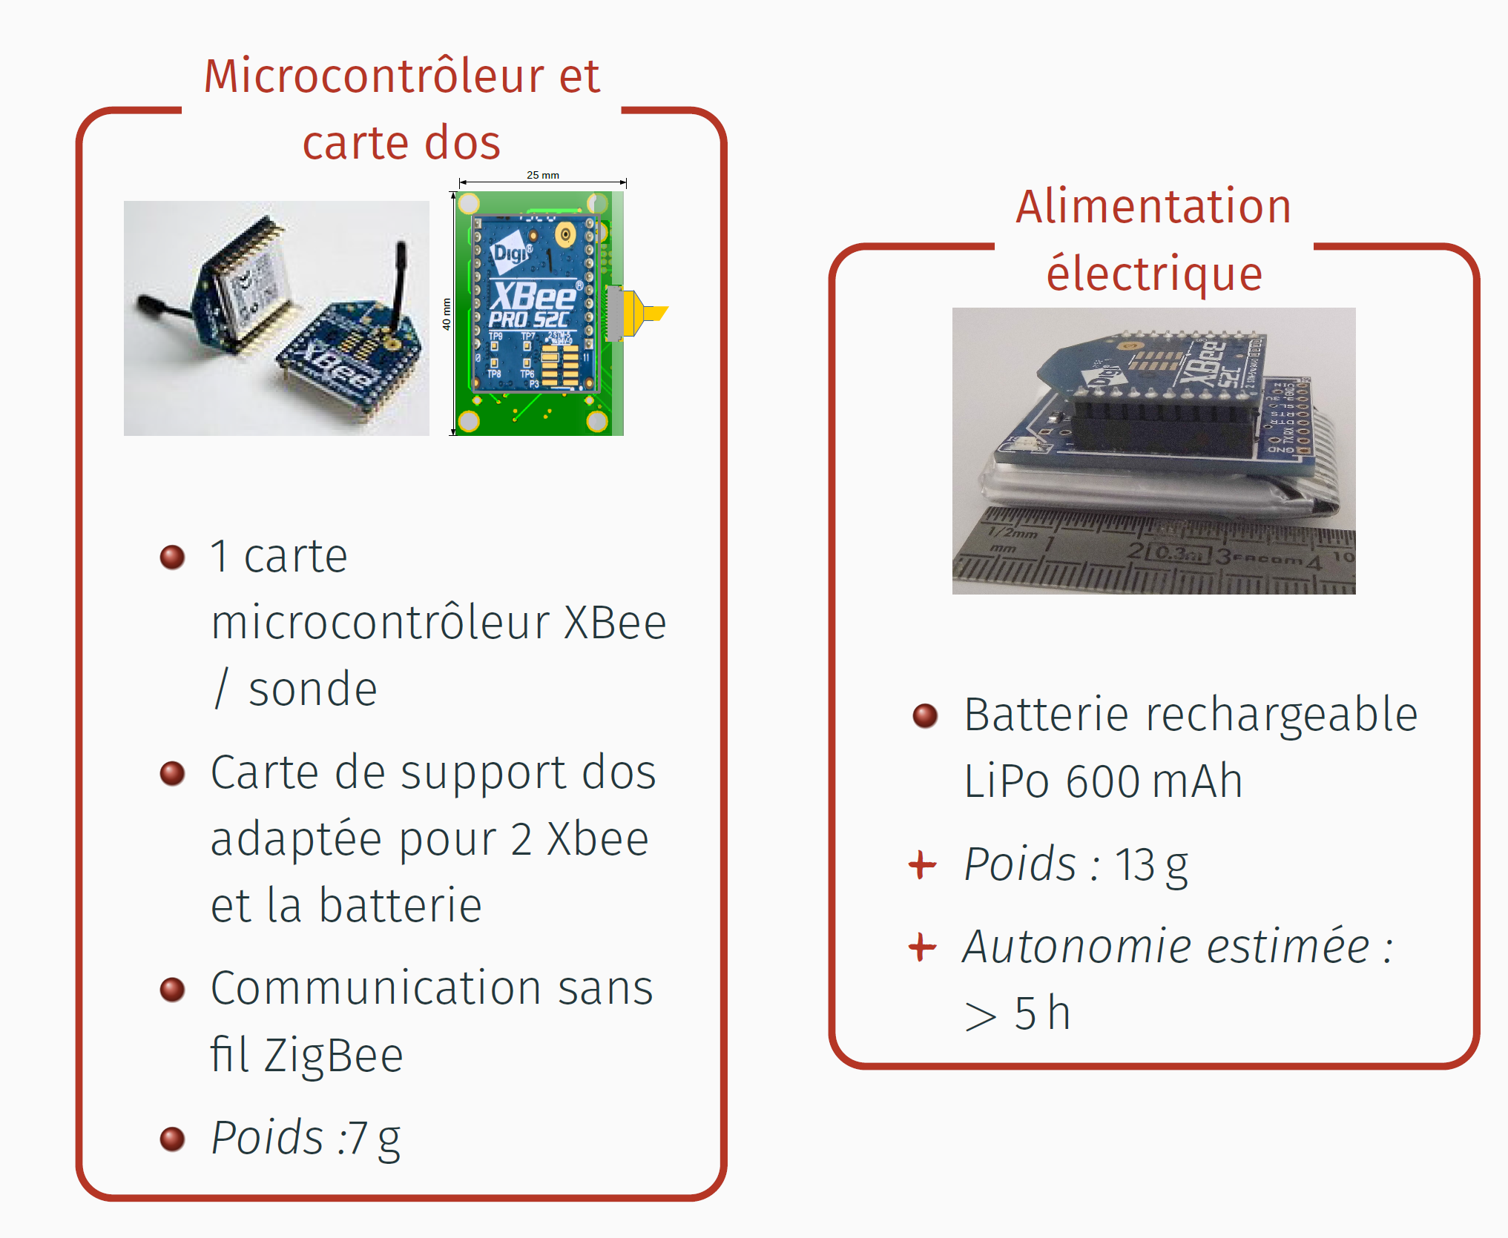
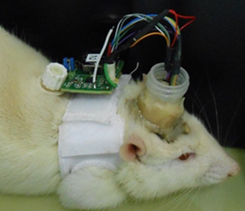
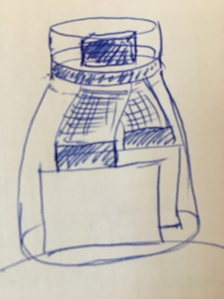
MAPSSIC: back pack and head connector
specifications :
size and weight < 10% rat weight
Power autonomy> 2h → 2 microbatteries
Power supply stability
Wireless → RF module (5m compatibility)
Interfacing with two probes
Connexion robustness (animal motion)
First configuration
Zigbee limited: toward a ESB 32 technology
Low energy consumption
Distance and rate transmission
Communication robustness
Connexion optimization

Slide 16
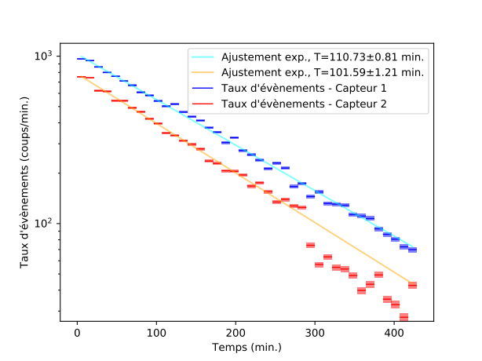
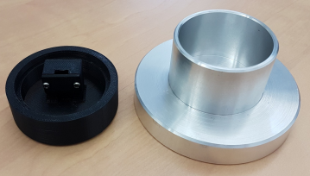
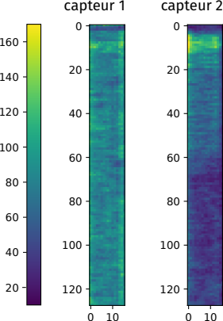
MAPSSIC: results (1)
Physical characterization with a¹⁸F beacker
Linear response
Lower Sensitivity than MC values
Sensors erratic behavior
Development of new sensor version (IMIC 2)
New foundry

Slide 17
MAPSSIC: results (2)
Publications:
J. Heymes et al (2018). Design and First Characterization of a Pixelated Needle Sensor for Molecular Neuroimaging on Awake and Freely Moving Rats, Nuclear Instruments and Methods in Physics Research Section A: Accelerators, Spectrometers, Detectors and Associated Equipment, vol. 911 (2018), p. 19-24.
L. Ammour et al. (2019). MAPSSIC, a Novel CMOS Intracerebral Positrons Probe for Deep Brain Imaging in Awake and Freely-Moving Rats: a Monte Carlo Study. IIEEE Transactions on Radiation and Plasma Medical Sciences, vol. 3, no. 3 (2019) pp. 302-314.
F. Gensolen et al. MAPSSIC, a communicating MAPS-based intracerebral positrons probe for deep brain imaging in awake and freely-moving rats. EPJ Web of Conferences 225 (2020), 09002. https://doi.org/10.1051/epjconf/202022509002.
Extension du brevet n°2 201 405 du 08/10/2008 (2018) Dispositif de détection de la désintegration de radioisotopes dans un tissu biologique (royaume uni, allemagne)
Communications:
IEEE MIC 2016 et 2017
PSD 2017
MI 2016 et 2018
ANNIMA 2019
Thèses soutenues:
Thèse Luis Ammour (2015-2018)
Thèse Julian Heymes (2015-2018)
Projet ingénieur Mathieu Bautista (2015-2018)

Slide 18
MAPSSIC: roadmap
WP3
Protocole implantation
Validation système
Mesures mode ‘aigu’
Mesures mode vigile
Caractérisation pharmacologique eveillé/ anesthésié
portabilité
WP2
Mesure échauffement
Caractérisation invasivité
Optimisation IMIC 2 et nouvelle fonderie
Optimisation sonde 3D back to back
Conception mini-pcb Optimisation encapsulation
Logiciel acquisition
Caractérisation physique sonde 3D optimisée
pcb sac à dos-IMIC-v2 avec dérivation sonde
Logiciel acquisition (suite)
Validation connecteur et portabilité
Optimisation des méthodes d’analyse de données
Production et contrôle qualité
Logiciel acquisition (multimodale)
WP1
… Collaboration bio
… Valorisation
2021
2022
2023

Slide 19
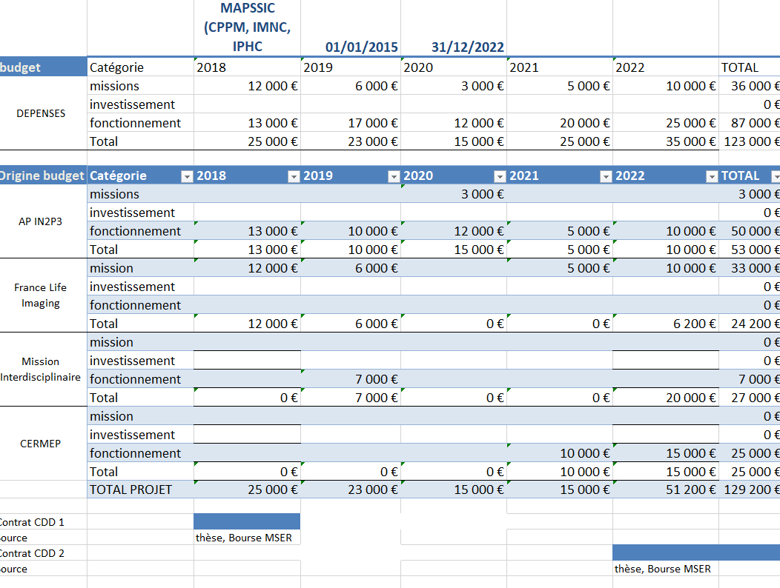
MAPSSIC: financial support

Slide 20
Behavioral neuroimaging: what’s up
Open-field PET: simultaneous brain functional imaging and behavioural response measurements in freely moving small animals. Neuroimage 188 (2019). University of Sydney
18F-FDG PET imaging of memantine-induced brain activation and test-retest in freely running mice. JNM (2019). University of Antwerp
Rapid 18F-FDG uptake in brain of awake, behaving rat and anesthetized chicken has implications for behavioral PET studies in species with high metabolisms. Frontier in behavioral Neuroscience 12 (2018). Brookhaven National Laboratory
Optical imaging: Method of the Imaging in freely behaving animals. Nature methods 16 (2019)
Circuit interrogation in freely moving animals
Imaging whole nervous systems: insights into behavior from worms to fish
A tiny macroscope to look into complex behavior
Ultrasound imaging
Real-time imaging of brain activity in freely moving rats using functional ultrasound. Nature methods 12 (2015)
Transcranial functional ultrasound imaging in freely moving awake mice and anesthetized young rats without constrat agent. Ultrasound in medicine and biology 43 (2017)

Slide 21
MAPSSIC: perspectives
Neuroscience:
  BNL protocol : cocaine awareness and place preference protocol (coll. NeuroPSI)
  Comparative analysis of dedicated systems (awake/anesthetized studies)
  Behavioral neurobiology, addiction, depression (coll. Ext)
Instrumentation:
  Biomedical CMOS diffusion for telemetric application (per op, dosimétrie)
  Multimodality: combining an optical/radiosensitive probe
Valorisation
  Positioning according to neuroscience results

Slide 22
The MAPSSIC collaboration
S. El Ketara (doc)
P. Lanièce (DR)
L. Pinot (IR)
M.-A. Verdier (MCF)
J. Baudot (Pr)
M. Kachel (IR)
M. Dupont (IR)
F. Gensolen (IR)
C. Morel (Pr)
P. Pangaud (IR)
L. Zimmer (Pr)
S. Bouvard (IE)
P. Gisquet (DR)
22/24

