Slide 1

Report from the Advisory Group 9 October 2019 Paris-Saclay
Andrew Hutton

Slide 2
Role of the Advisory Group
The role of the Advisory Group is to assist the AMICI Steering Committee, including the coordinator and the work package leaders, to produce their promised deliverables, and particularly those involving a strong industrial participation

Slide 3
Organization of the Advisory Group
“An Advisory Group will be appointed and steered by the Steering Committee
The Advisory Group shall give advice and recommendations on strategic matters to the Steering Committee and report them to the General Assembly
“The chair of the Advisory Group will be designated by the Steering Committee and shall be allowed to participate in General Assembly meetings upon invitation but has not any voting rights”

Slide 4
Group Members
Members who presented at the AMICI 2nd Industry Forum
*** Talk by Serge Sierra, Thales
***
*** Talk by Imran Tahir
***
***
***
***
Name | First name | Company
BETHUYS | Stéphane | Thales
GRESELE | Ambra | Zanon
DZIWOKI | Adam | Prevac
GEHRING | Michael | Babcock Noell GmbH
HOWLAND | Patricia | e2v
HUTTON | Andrew | Jefferson Laboratory
LANCELOT | Jean-Luc | SigmaPhi
LINDHOLM | Mikael | Scandinova
MCGINNIS | David | ESS
MELHEM | Ziad | Oxford Instruments
PEINIGER | Michael | Research Instruments GmbH
PELLECCHIA | Antonio | AS-G
TROXLER | Josef | Ampegon
YAMAMOTO | Akira | KEK

Slide 5
Name | First name | Company
BETHUYS | Stéphane | Thales
GRESELE | Ambra | Zanon
DZIWOKI | Adam | Prevac
GEHRING | Michael | Babcock Noell GmbH
HOWLAND | Patricia | e2v
HUTTON | Andrew | Jefferson Laboratory
LANCELOT | Jean-Luc | SigmaPhi
LINDHOLM | Mikael | Scandinova
MCGINNIS | David | ESS
MELHEM | Ziad | Oxford Instruments
PEINIGER | Michael | Research Instruments GmbH
PELLECCHIA | Antonio | AS-G
TROXLER | Josef | Ampegon
YAMAMOTO | Akira | KEK

Slide 6
Meetings
The Advisory Group has met four times during the Kick-off and Annual meetings
Kick-off Meeting 18/1/2017, FIAP Jean Monnet, Paris
1st Annual Meeting 21/2/2018 Uppsala
2nd Annual Meeting 22-24/2/2019 Salerno
3rd Annual Meeting 22-24th January 2019, Paris Saclay
In addition, members of the Advisory Group attended, and participated in, the industrial meetings
Industry Days, 18–19/4/2017, Padova
2nd Industry Forum, 17–18/9/2019, Brussels

Slide 7
WP1: Management
Overall management of the project in order to ensure the achievement of the project objectives and the coordination of the work done in the different Work Packages
Relations with European Commission including progress and financial reporting
Exchange of information between the partners and with industry
External dissemination of the project results
Communication and outreach activities.
Defining how industry, from large enterprises to SMEs, will be associated to the project and their role in the different Work Packages

Slide 8
WP1: Relations with Industry
Can we, and should we, extend the Spanish ‘Ineustar’ model to European Science Industry?
“Ineustar” is a successful model in Spain that represents Spanish Industries to help make contacts with Research Institutes and other business opportunities
The Advisory Group was unanimous that the members did not want an over-arching organization
Most members are well established and already have contacts
It was felt that the members would be better served by direct interaction with the AMICI project

Slide 9
WP1: Industry Interaction with AMICI
Should Industry partners interact with AMICI as an Association of private companies foreseen via an “associated industry partnership?“
An informal group of associated industry partners elects a representative (1 person) for the AMICI Collaboration Board
To receive information about developments with Technical Facilities
To influence future developments of Technical Facilities
The Advisory Group recommends that each company participates directly in AMICI, not as part of a consortium

Slide 10
WP2: Strategy
Key Elements
Identification of the Key Accelerators Technological Areas which are essential for the sustainability and long term development of the Technological Infrastructures
Background strategic aspects: the existing scientific roadmap of Research Infrastructures in Europe (ESFRI) and worldwide, and their specific agendas; the approaches to Innovation in the EC and in the other regions
Study how to support and develop the Technological Infrastructures in future

Slide 11
WP2: Key Technology Areas
The Advisory Group was asked to comment on the list of key technology areas
Particle sources
‘High precision’ magnets
High field SC magnets
Normal Conducting RF cavities
SRF structures
Radio Frequency power sources
Cryogenics
Beam instrumentation
The eight areas were accepted, but cryostats should be added to the SRF category and modulators should be added to RF power sources

Slide 12
WP2: System Integration
System integration is not part of the WP2 charge and the Advisory Board would like it to be included
The Advisory Group recommends developing a statement as to how systems can be included in AMICI goals similar to the list of Key Technologies Areas
The Advisory Group would like a recommendation as to when an industry is asked to “build-to-print,” when to build to performance and when industry should participate in design
Industry is very keen to be involved from the design phase though production
Industry is concerned about protecting IP created during prototyping and how that applies to series production

Slide 13
WP3: Cooperation
Define the conditions of the coordination of Technological Infrastructures in the area of accelerators and superconducting magnets in order to harmonize their operation and increase their efficiency . . .and establish a co-innovation platform with industry
Eligibility criteria for the participation and networking of Technological Infrastructures will be investigated in detail, in order to finally propose an appropriate coordination model
This targeted network can support temporary exchange of highly qualified personnel; as innovative expert teams should have access to dedicated Technical Infrastructures for education and training purposes
The elaboration of a consortium agreement reflecting the goals of the overall Cooperation programme will be sought.

Slide 14
WP3: Proposed Eligibility Criteria
Capacity and willingness of the new Member to integrate itself in an organization of Technological Facilities that coordinate their efforts and their development towards the construction of future research infrastructures, and that are willing to provide access to their technical platforms to other partners and to industries
Capability of the new Member to reinforce the technical spread and the expertise of the existing Technology Infrastructure and hence contribute to more efficient sharing of efforts at the European level
The Advisory Board did not have time to evaluate the criteria

Slide 15
WP3: Goals of the Collaboration
Found a joint European Technology Infrastructure dedicated to the development, testing and production of accelerator components and superconducting (SC) magnets
Sustain the infrastructure considered part of the AMICI Collaboration
Define the contents of the infrastructure of the AMICI partners and the necessary alignment for a common (across all Parties) Infrastructure
Setup project and working groups of common interest
Seek financing for the implementation of the roadmap
Ensure availability of the AMICI infrastructure within the AMICI Collaboration and its access by external partners
Ensure the availability of highly trained personnel to operate the AMICI Technological Facilities
Ensure long term support, maintenance and development of the AMICI Infrastructures

Slide 16
WP3: Goals of the Collaboration
Promote the availability of the AMICI Infrastructure to external partners in particular to industrial partners
Setup a common compensation scheme for industrial use of AMICI Infrastructure
Propose training for external users, in particular industry, in the know-how, techniques and quality standards of the Technical Facilities
Setup, maintain and provide access to a database allowing preservation and dissemination of common knowledge and know-how within the members and to the benefit of external users
The Industrial members would like to understand the advantages of being a member of AMICI compared to not being a member
Exchange of staff for training is interesting, but only if series production is expected near term (<3 years)

Slide 17
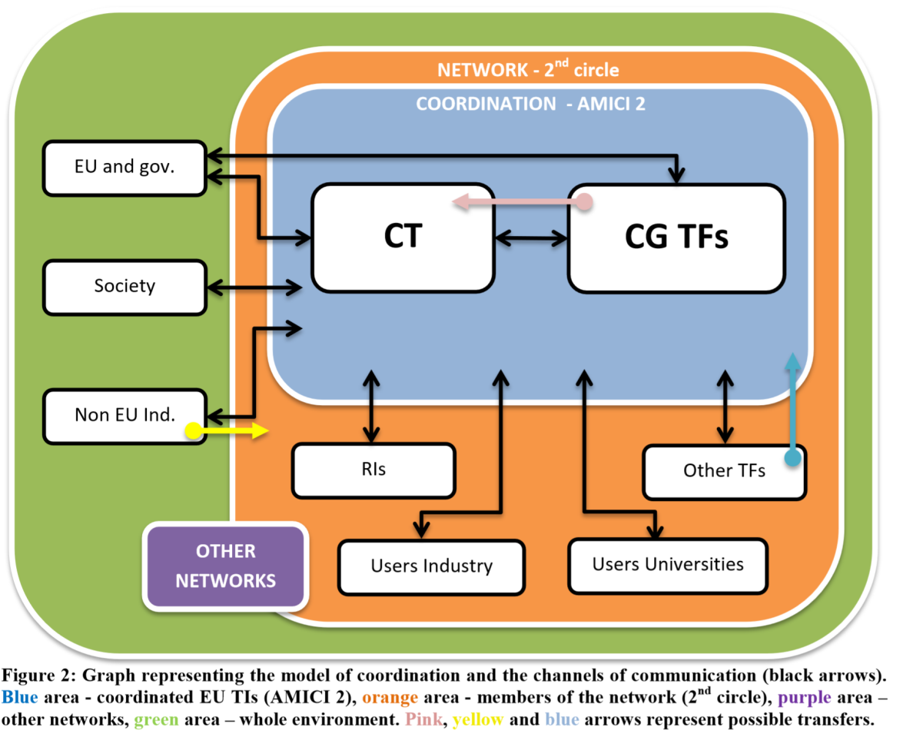
WP3: Network and Collaboration Model
The networking and collaboration model proposed by WG3 was evaluated by the Advisory Board
The Advisory Group accepted this vision but wanted more detail e.g. who is in the Coordination Team
The present version of the AMICI Collaboration is consistent with the proposal
The Board would still like to see a definition of the Coordination Team

Slide 18
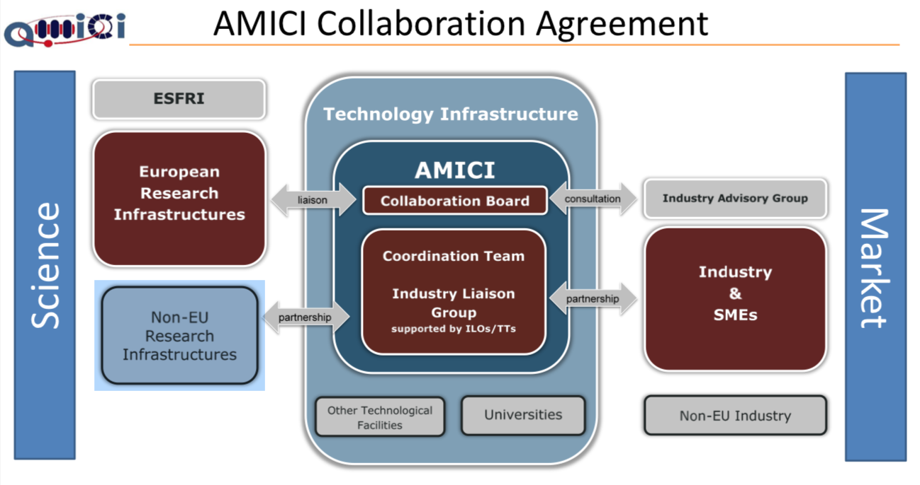

Slide 19
WP4: Innovation
Promote the potential applications of mature Accelerator and Magnet technologies to European businesses, with a particular focus on innovative SMEs, which have the potential to apply their expertise to applications for societal needs
Identify a European network of commercial organizations, consisting of both large companies and SMEs, that has the potential to innovate in the field of mature Accelerator and Magnet technologies
Identify domains of societal applications and potential markets beyond Research Infrastructures that can be developed by these innovative commercial organizations
Identify ways to optimize effective engagement between Industry and the Technological Infrastructures to support the development of societal applications by industry

Slide 20
Comments on Innovation
Technical demands are often at the limits of physics
Requires prototyping and limitation of risks (avoid penalties)
Requires close cooperation between research labs and SME industries
Technology Transfer between Research Labs and Industries
This is key for SME companies – synergies to other industrial projects
Beneficial for both: Research Labs and Industries (IP; licensing)
Flexibility for superior technical solutions
SME companies are capable to offer innovative solutions
Take benefit from Industrial know-how
Take benefit from standardization and synergies between Contracts
Continuous overall cost improvements (competition works well)
Courtesy of Josef Troxler (OCEM)

Slide 21
WP5: Industrialization
Sensitize and train the industrial companies in the needs, the know-hows, the techniques, the methods and the quality standards of laboratories developing accelerator and superconducting magnet technologies in their Technological Infrastructures
Industrialization of technologies involved in accelerator related activities will foster innovation and place European Industries in a position to take a major part in the construction of new Research Infrastructures in Europe and worldwide
Activities aiming to understand how to standardize basic knowledges and general safety procedures will be performed

Slide 22
WP5: Industrialization
Members of the Advisory Board were concerned that they were not involved in the industrialization process early enough
If industry is to gain the know-how, they must be involved in design and prototyping, not just build-to-print
Here are the preferred model and commercial issues:

Slide 23
Cooperation Model Industries - Research Labs
Early involvement of industry during design phase
Conceptual work
Layout and space requirements, time scale
Preparation of preliminary technical specifications
Design (R&D) Contracts for complex parts
Tender procedures for Prototype
Reducing technical risks for supplier as well as for the laboratory
Prototype testing during preparation of tendering process
Qualification for next tendering step
Tender process for Series production
Specifications based on experience with prototype
Accelerated process for fast production release
Built-to print requests are not the preferred solution
Courtesy of Josef Troxler (OCEM)

Slide 24
Commercial Issues
Contractual Conditions in tenders with Research Labs
It should be considered that specialized Industries are SME companies
Positive cash flow is always of high importance:
Advance payments
Progress payments against milestones
Performance and Warranty Bonds are often linked to cash flow
Liabilities can not be unlimited, indirect liabilities to be excluded
Warranty conditions should be reasonable
Component constraints
Fast evolution of Controls (software)
Service and Support Agreements
Business continuity, permanent improvements and maintenance
Optimized operational performance
Courtesy of Josef Troxler (OCEM)

Slide 25
Conclusions
There should be time left in the schedule between the Advisory Board meetings and the presentation of the conclusions to the Steering Committee to enable the recommendations to be structured and therefore be more useful
The Advisory Board should consist of industrial representatives
The Chairperson of the Advisory Board has to do actual work
Industrial representatives do not see this work as helping their business
The Chairperson needs to be well connected to the Research Infrastructures but not be too closely linked to any one Infrastructure

