Slide 1

On the significant role played by the AMICI European Technology Infrastructure for the development and build-up of the Large Research Infrastructures
Report by the Members of the AMICI Task 2.3 on “Sustainability”
Tord Ekelof, Pierre Vedrine, Hans Weise and Maurizio Vretenar
Presented at the AMICI Third Annual Meeting in Paris 9 October 2019

Slide 2
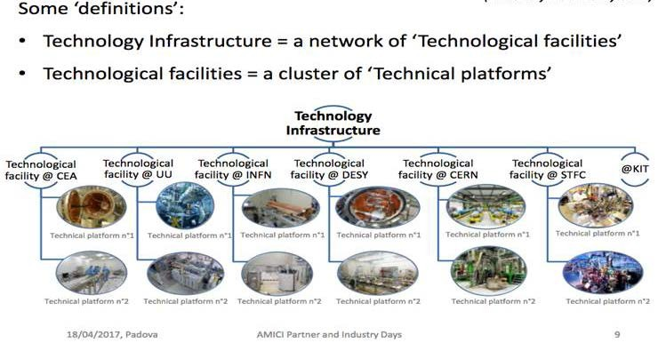
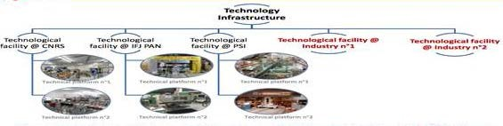
The AMICI European Technology Infrastructure

Slide 3
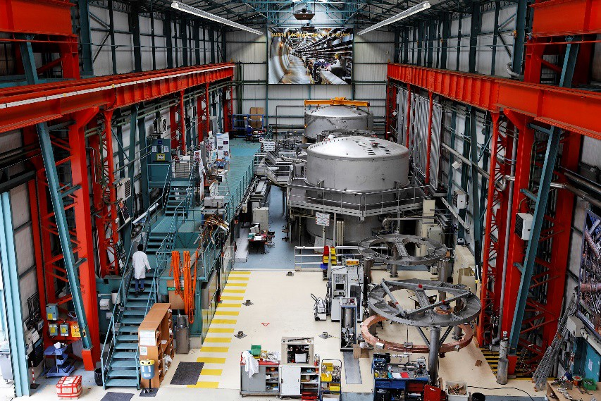
The Technological Facilities (TF) and the Research Infrastructures (RI)
The AMICI TFs CEA, CERN, CNRS, DESY, FREIA, IFJ PAN, INFN, KIT, PSI and STFC used to be also RIs – now only CERN and DESY are RIs
These few and very large RIs are in absolute need of the co-operation of the Technical Platforms of the TFs for their build-up and development
Test stations for sc magnets and large
cryogenic components at CEA Saclay

Slide 4
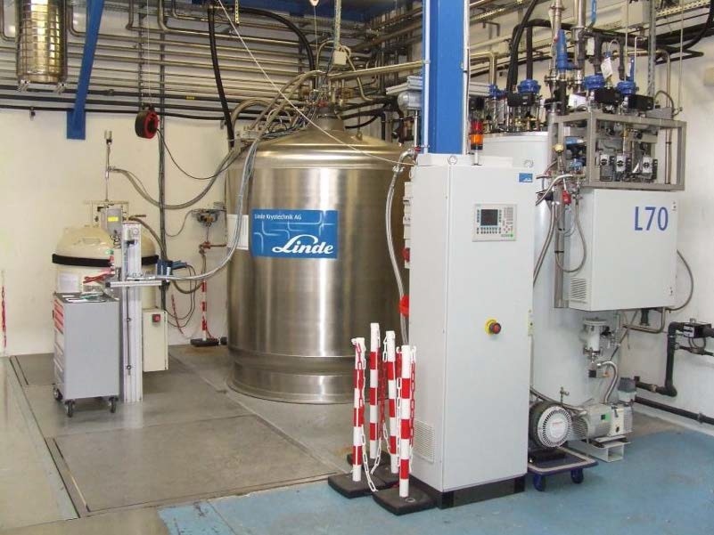
The ESS example
Almost all components for the build-up of the ESS are being developed and tested by the TFs, which also place the production orders in industry.
If technical personnel would have been employed, equipment acquired and lab buildings built on-site to an extent sufficient to develop and build ESS without support from the TFs, this would have required 7 additional years and 77 MEUR in additional investment capital.
Liquid helium is produced at CNRS IPN Orsay using a commercial helium liquefier

Slide 5
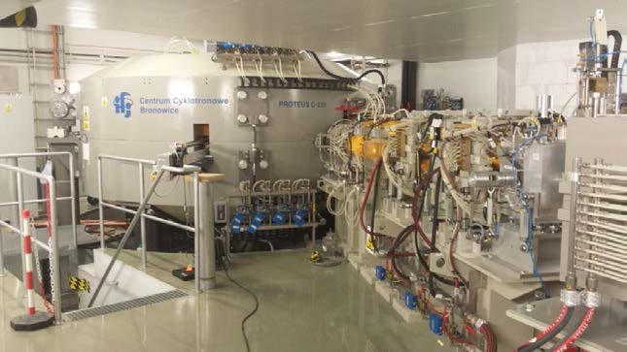
Three categories of Technological Facilities
1. Single laboratory with a large accelerator facility with a large use community, also having TPs: CERN, DESY, PSI, INFN Frascati and STFC RAL
2. National cluster of smaller labs with smaller accelerator for tests and TPs: some of the national laboratories of INFN, STFC and CNRS-IN2P3
3. Single laboratories with no accelerator but with TPs: some of the national laboratories of INFN, STFC and CNRS-IN2P3, in particular CEA-Saclay, FREIA and IFJ PAN
These categories have ifferent sustainability conditions – a user community provides important support
Test beam facility at IFJ PAN

Slide 6
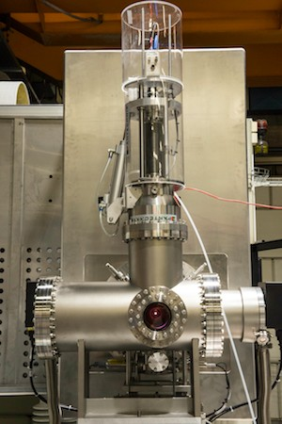
The conditions for the TF-RI co-operation
The TF will in general demand the RI to cover the full costs for all purchased equipment components, industrial orders and consumables and in some cases also the personnel costs.
The RI will in general not be asked to pay for TF operational costs like costs for rental of premises, for overhead and for depreciation of existing equipment at the TF.
The TF-RI co-operation has more a character of a collaboration of mutual interest and benefit rather than that of a commercial relation.
This is natural as the TFs are basically public service institutions and not commercial companies.
Ion source from INFN Catania being
installed at ESS

Slide 7
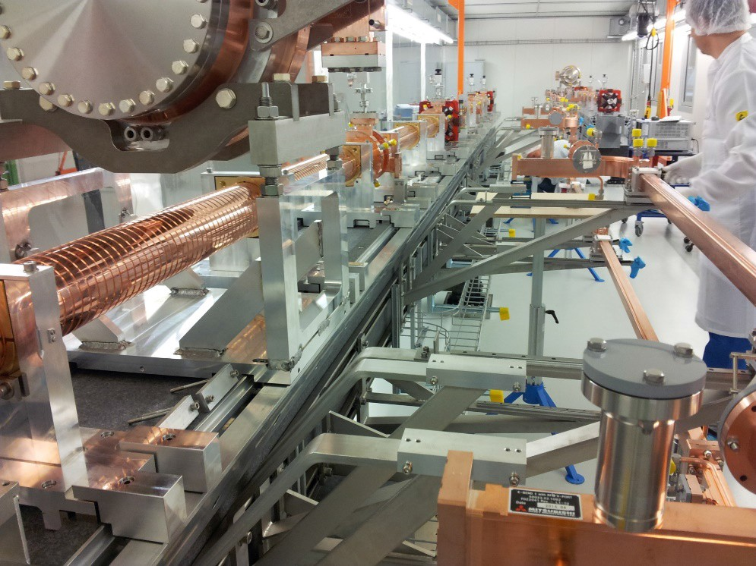
The TF-RI co-operation is not publicly recognized
The general public as well as the funding authorities usually have the understanding that the CERN LHC and its upgrade, the DESY's XFEL and ESS's neutron spallation source are build by CERN, XFEL and ESS, respectively, and that is all.
The extensive and intensive interplay existing between the RIs and all the European TFs in collaboration with European High-Tech Industry is to a varying degree unknown.
It is essential for the sustainability of the TFs that this important TF-RI interrelation and its conditions be generally known and recognized.
C-band accelerating structures test stand at PSI

Slide 8
What needs to be made generally recognized
Experimental fundamental science, which has since the Renaissance been the long-term driver of the Western World’s technological and economic leadership in the World, nowadays requires RIs that have become so large and complex that they need the support of all European TFs and High-Tech Industry.
This is made particularly important by the fact that Europe’s technological and economic leadership is currently seriously challenged by other upcoming major regions in the world like China and India.
Winding of a CCT orbit corrector
dipole prototype for HL-LHC at
the Scanditronix AB company

Slide 9
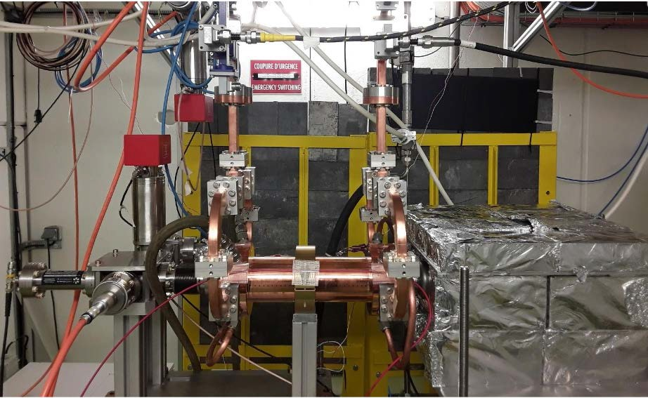
The different roles of the ILOs and the TFs
Industrial Liaison Officers organize product overviews and regular information meetings with Industry, like the Big Science Business Forums, in order to facilitate contacts and identify companies that can deliver already commercialized technical products required by the Ris.
The development of the new technologies required for the RIs most often implies too high risks to be financed on purely commercial grounds. The tight technical collaboration between the TIs and high-tech industrial companies constitutes a necessary condition for the development of new RIs.
Test stand for X-band accelerating
structures for CLIC at CERN

Slide 10
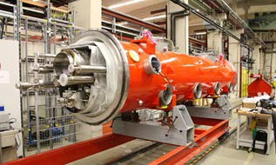
The co-operation TF - Industry I
The involvement of Industry in the development and construction of an RI requires that there are scientists and engineers that have experience of working with the development of the specific type of RI in question, having at their disposal adequately equipped TFs for their collaboration with the RIs and the SMEs as partners.
The TFs need to have most of their basic salary, premises and overhead costs covered by public funding – if it were to have to ask the SME to cover also these costs for the services offered in the co-operation, this will normally represent too big a risk for the SME and make this kind of co-operation impossible.
An almost finished European XFEL
3.9 GHz module after assembly at DESY

Slide 11
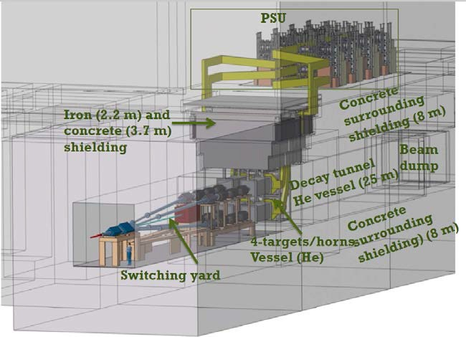
The co-operation TF-Industry II
An important function of the TFs is to make their test benches and other TPs available on-site for use by industry. In general industry is paying for such access, illustrating the industrial and societal relevance of the TFs.
Such income can to some extent help the sustainability of the TF but cannot be a dominant source for covering the basic operation costs of the TFs.
Layout of the 4 magnetic Hardon
Collector Horns with their
350 ‘000 A pulsed current
sources for ESSnuSB

Slide 12
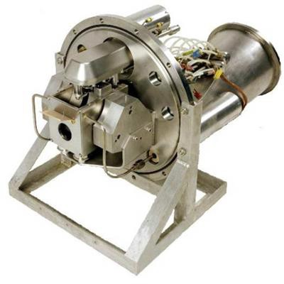
Concluding remarks I
The TFs are needed to enable development and construction of the new large RIs and thereby maintain Europe’s leading position in science, technology, innovation and economy.
The significance of the TF-RI co-operation needs to be explained to the general public and governments in order for the TFs to be sustained.
The TFs need to engage in partnership with their respective national governments and funding authorities on the national level.
The European Regional Development Funds is a source of support that shoul be explored.
Multi-purpose test stand for high power
proton accelerator front end
technologies at STFC

Slide 13
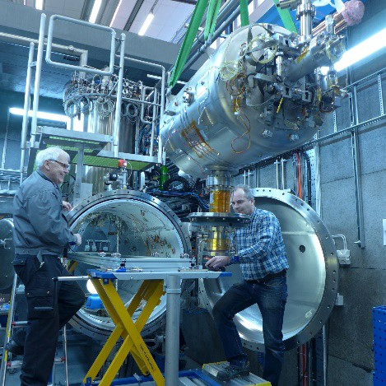
Concluding remarks II
The EC constitutes through its Research and Innovation Directorate a common platform for these national research and innovation agencies and can play an important role by developing and supporting a long-term common European plan.
The European TFs should coordinate their efforts, avoiding unnecessary duplication, and organize their co-operation with industry in a coherent way, in particular regarding IP and technology transfer.
AMICI has as purpose to facilitate the development in this direction by acting as a forceful coordinating and supporting common platform for the European Technological Facilities.
Insertion of the ESS spoke cavity protoype
for tests in the FREIA horizontal cryostat

