Slide 1









AMICI Third Annual Meeting Work Package 2:
Walid KAABI- LAL/IN2P3/CNRS
Paris-Saclay Campus, October 9th 2019

Slide 2
Goals of Strategy Working Group:
Provide the European industries with a clear view of the strategic science and technology roadmaps for the future accelerator and SC magnet based Research Infrastructures worldwide.
Identify the Key Technology Areas (KTAs) that need special support and important technical development to meet the future projects challenging requirements.
Identify the European Technological Infrastructures (TIs) where technical development on KTAs could be performed, identify the needs on new TIs → Set up a TI roadmap.
Identify the elements necessary for a successful implementation of a sustainable cluster of TIs in partnership with industry.

Slide 3








Organization of WP2:
The WP2 will be subdivided in 3 sub-tasks:
WP2.1: Key Technological Area (CNRS, IFJ PAN, CEA, STFC)
WP2.2: Global Landscape (CEA, CERN, INFN, CNRS)
WP2.3: Accelerator and SC Magnet Technology Infrastructures Sustainability (UU, DESY, CEA, CNRS, CERN)
WP2: Strategy W. Kaabi
WP2.1: Key Technological Area | WP2.2: Global Landscape | WP2.3: Technology Infrastructures Sustainability
W. Kaabi - CNRS | O. Napoly - CEA | T. Ekelöf – Uppsala Univ.

Slide 4
WP2 Milestones and deliverables:
Milestones:
M2.1: Updating of the Key Technological Areas (M9).
M2.2: Collection of the scientific Roadmaps (M12).
M2.3: Intermediate report on sustainability (M18).
Deliverables:
D2.1: Report on Key Technological Areas (KTA) and prospective outlook (M27→ M30).
D2.2: Report on the Technological Roadmaps for the different KTA (M29→ M30).
D2.3: Report on propositions to guarantee the long term sustainability of TIs (M30).

Slide 5
How to proceed?
Collect and analyse the scientific roadmaps and the agendas of the future Research Infrastructures in Europe and worldwide (WP 2.2),
Regarding the future project needs and the technical development effort made by accelerator and SC magnet communities, identify the KTAs in which the most performances progress are expected (WP 2.1),
Collect and analyse information about the available European TIs (funding, manpower, link to an RI, link to local facility, operation and sustainability model…), via AMICI partners census (WP 2.3).
→ The cross-reference of these analysis will allow to define the technological roadmap for the different identified KTAs, showing thereby the opportunities and needs that could orient and sustain the activity of the TI.
5

Slide 6
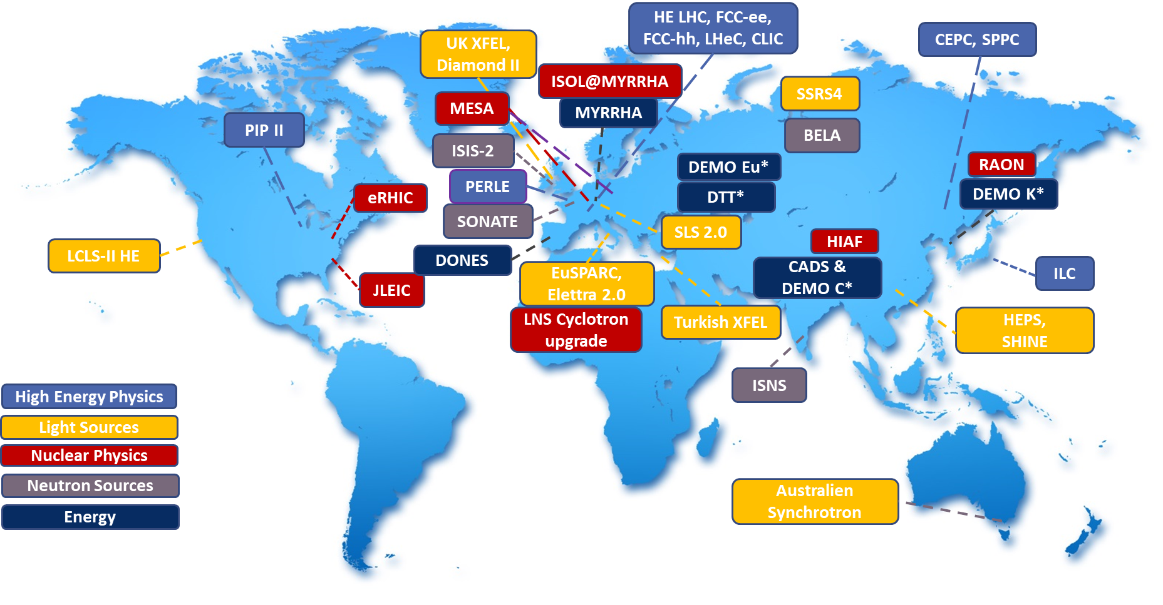
Global Landscape of Future Accelerator Project:
Research Infrastructures based on Accelerators and large Superconducting Magnets are enabling scientific instruments to advance and push the limits of pure human knowledge and of societal welfare.
Motivated by the successful operation of the existing Research Infrastructures and building on engineering progress, more powerful facilities are under study. The map illustrates the rich Global Landscape of the proposed future Research Infrastructures worldwide serving a wide range of applications from science to technology, spanning fundamental, applied and technological research.

Slide 7
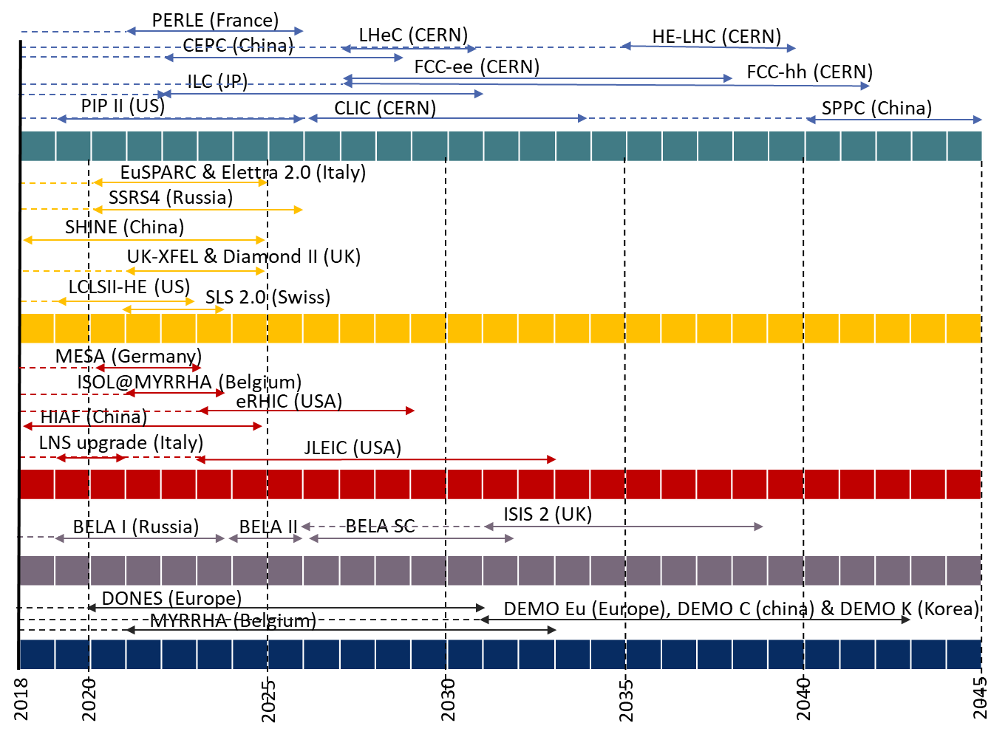
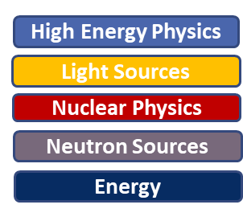
Future Accelerator Project Timelines:
This timeline of the proposed future Research Infrastructures highlights the planning strategy distinction between:
multi-billion Euro international projects like the large high-energy colliders and the nuclear fusion demonstrators: at such high costs, these projects are planned over several decades by collaborations representing one science community, and must undergo a down-selection until at most one facility is built to serve a common research goal.
Billion-range regional projects like the synchrotron or FEL light sources, generally planned by one country over a decade: these projects serve several science-user communities organized in small collaborations running experiments in parallel and during a limited time. Competition between the facilities built at several places worldwide leads to innovation and improved modes of operation, and thus to increasing steadily the scientific reach of these facilities.

Slide 8
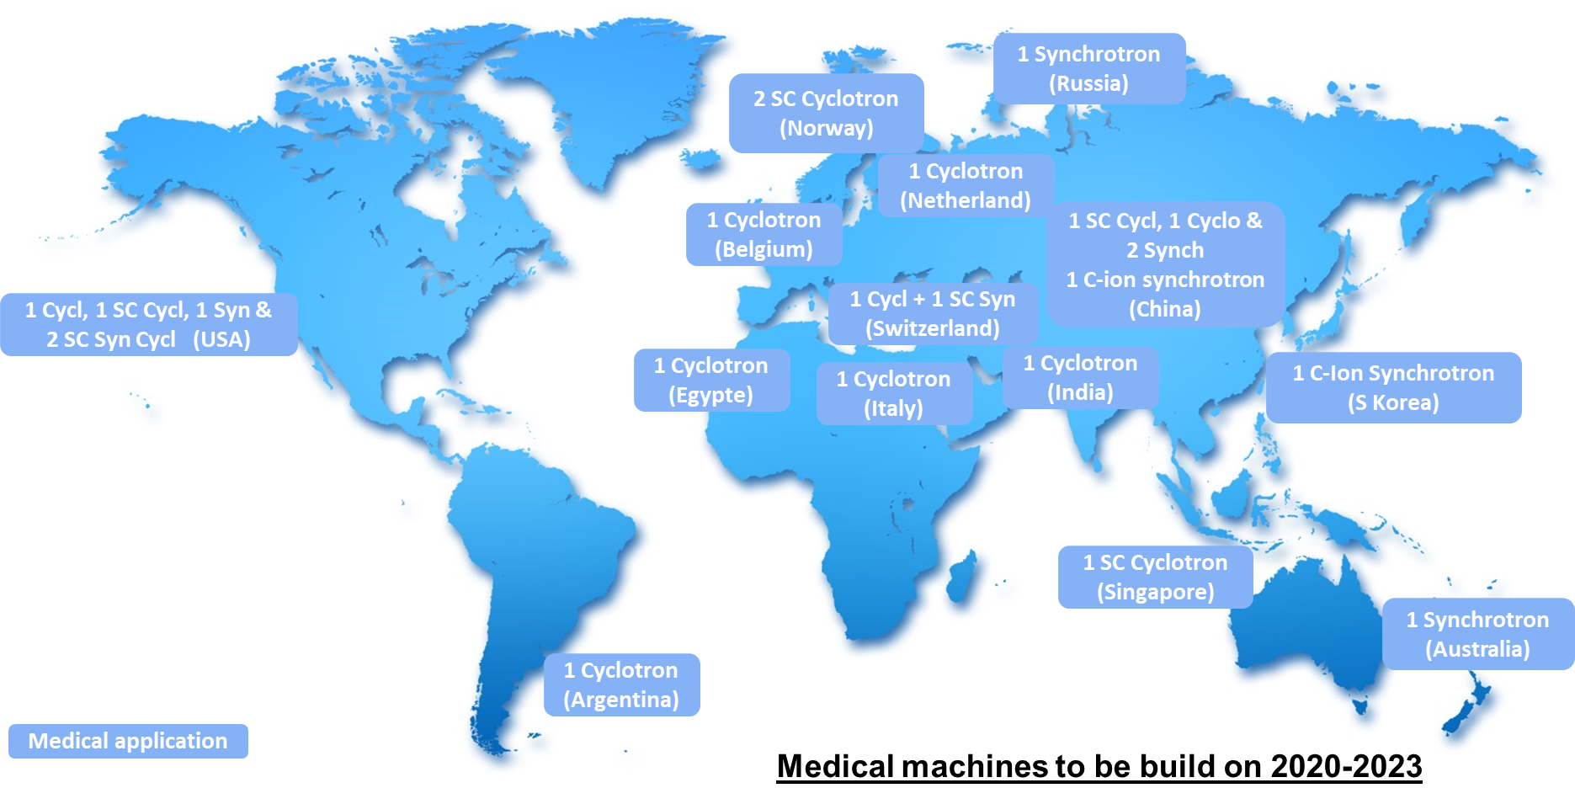
Global Landscape of Future Medical Accelerator
(Proton-therapy):
Radio-medecine uses particles like photons (X-rays and gamma-rays), electrons, protons, neutrons, various atomic nuclei to penetrate living tissue, for non-invasive imaging of internal organs, or at higher energies selectively destroy malignant tissue. This map illustrates the worldwide landscape of proton-therapy medical accelerators, based on state-of-the-art cyclotrons or synchrotrons whose construction is scheduled in 2020-2023, mostly at oncology centers.
Besides radio-medicine, health applications of superconducting magnets encompass mainly the magnetic resonance imaging (MRI) scanners when coupled to radio-frequency antennas, and compact gantry systems around hadron-therapy facilities. Health application of accelerators encompasses also the production of radio-nuclides used for disease diagnostics and treatment

Slide 9
Future accelerator projects & main technical areas :
Leptons Accelerators
Hadrons Accelerators
Particle source
Cavity shape
Pulsed machines
CW machines
RF source efficiency
Cryoplant efficiency
Normal conducting technology
Cavity materials & performances
Superconducting technology
High precision Magnet
SC Magnet
Linear accelerators
Circular Accelerators
Beam diagnostics
Small machines
Large machines
Wide range of beam parameters

Slide 10
Cutting-edge technology of high interest for accelerator or SC magnet communities
Critically dependent on single/very few vendor(s)
Widely needed for the future projects
KTAs choice criteria
High technical development potential to reduce construction & operation costs
High technical development potential to meet future machine requirements

Slide 11
Key Technological Areas (KTA) being developed
for future major projects
This table shows which KTAs are being further developed for the major Research Infrastructures of the global landscape, based on the following criteria:
1. being widely needed for the future projects
2. presenting a high development potential allowing to meet the needs of future challenging machines
3. presenting a high development potential allowing to reduce the construction and/or operation

Slide 12
Developments needed in Key Technology Areas :
Key Technology Areas Needed Developments
Particle sources High intensity heavy ions, positron sources, polarized beams
Magnets and vacuum systems Permanent magnets, Small chambers evacuation
High field SC magnets High-Tc conductors, Cost reduction
Normal Conducting RF structures High precision fabrication and tuning, RF breakdown
Superconducting RF cavities Surface treatments, Robotics, Cost reduction
Radio Frequency power sources CW sources, Solid State Amplifiers, High efficiency
Cryogenics High efficiency, Cryo-coolers, Cryo-safety
Beam instrumentation Optical and RF diagnostics, Fast electronics and feedback

Slide 13
Guidelines for Key Technology Areas report preparation:
For each KTA, we have to go through the following items:
Justification of the choice of the KTA according to the criteria (one or many).
State of the art in each KTA.
Targeted performances beyond state of the art regarding future project needs.
Technical development paths to improve the performances (or reduce cost) and meet future project needs.

Slide 14
1- Particle Sources
The research potential of the accelerator or post-accelerator facilities could be determined by its particle sources:
- Proton accelerators (e.g. LHC, SNS, ESS, etc…) are using high intensity H⁺ or H⁻ ion sources,
- Heavy ions accelerator are based on the widest range of stable ions from helium to heavy stable ions (e.g. lead or uranium).
- Radioactive ions beams are using secondary sources including a target.
- Fusion reactors are using MeV-energy intense ion sources (e.g. D-) for neutral injection as a plasma heating mechanism.
- For spatial (e.g. ion thruster) & industry (e.g. ion beam lithography) applications, compactness & reliability are crucial properties of the ion sources.
- Strong interest in material science for ion traps producing highly charged ions at rest.
- For Electron sources, the new generation of CW FELs calls for high current high repetition rate (10 kHz-1 MHz) RF photo-injectors (SRF gun, DC gun)
- Pushing the intensity of positron sources is mandatory for colliders, together with polarization.
- Creating low-emittance energetic muon beams would open the way for a new generation of lepton colliders.
Advances: High intensity heavy ions, positron sources, polarized beams
Electron Cyclotron Resonance (ECR) ion source breakthroughs in intensity can be expected by increasing the RF frequency (up to 45 GHz) and using superconducting coils (up to 11 T with Nb3Sn or HTSC) to match the resonance condition. On the other hand, the standard ECR sources (0.8 T, 2.45 GHz) can increase their power efficiency, ease of operation and compactness by using permanent magnets for spatial and industry applications.
Electron Beam ion sources (EBIS) are more efficient for highly charged heavy ion sources. A large range of studies are in progress to improve their reliability and ease of operation.
The creation of electron-positron pairs in matter is the basic mechanism for the positron sources; hence thermal effects on the solid target limit the beam intensity. New schemes are proposed using intense photon radiation from laser collision or undulators, preferably superconducting, or atomic crystals, followed by photon conversion on thin targets. Some schemes are amenable to producing polarized positron beams, others are considered to produce muon pairs.

Slide 15
2- Magnets and vacuum systems
Warm magnet technology is indeed basic for guiding particle beams along accelerators, with a widespread group of laboratories and industries capable of producing and testing conventional magnets in large series. However, new promising beam transport techniques have recently been discovered or implemented successfully (e.g. ultimate-brilliance synchrotron-radiation storage rings (DLSR), fixed-field alternating gradient accelerators (FFAG), beam channels for plasma acceleration) that extend the design and manufacturability needs for warm magnets, be they resistive magnets or permanent magnets, beyond their current state of the art. In many cases, small gap vacuum chambers with high pumping speed and low desorption are required to implement these techniques.
Advances: Special Function Magnets, Permanent Magnets, Small Vacuum Chambers
Manufacturing of combined function magnets with complex magnetic polar pieces
Permanent magnets introducing high permeability material like Neodymium or Praseodymium
Coating of small aperture vacuum chambers using the Non-Evaporable-Getter (NEG) technology
Surface treatment of vacuum chamber to reduce secondary electron emission yield.

Slide 16
3- High Field Superconducting Magnets
Large and powerful high-field superconducting magnets are routinely used in science, research and technological development (RTD) and in medical diagnostics, using Magnetic Resonance Imaging (MRI), the latter representing the biggest current market for superconductivity. In addition, superconductors bring potentially large energy savings in power applications, with demonstrations of power cables, transformers, motors or current limiters already have been made.
There is a strong drive on new superconductor developments to increase the power of hadron colliders and MRI for scientific research, and for tokamaks for the next demonstrators by raising the magnetic field strength in large volumes using new innovative superconducting materials, such as Nb₃Sn or High Temperature Superconductors (HTS), and developing cable and coil innovative cooling technologies.
Advances: Nb3Sn and High-Tc conductors, Cryo-cooling, Cost reduction
Development and use of ultimate performance Nb₃Sn conductors, the most mature option so far, to overcome cost and coil fabrication issues.
Development and use of HTS conductors still needing R&D on material science to electromechanical engineering.
Innovative conductor and cold mass cooling methods to increase the operating temperature margin.
Reinforcement of the conductor mechanical strength to take on much higher internal magnetic forces.

Slide 17
4- Normal Conducting RF Stuctures
Radio Frequency acceleration technology (normal conducting) was introduced 90 years ago (e.g. drift tube linacs) and is still the standard reference for acceleration, used in the majority of particle accelerators worldwide. There are irreplaceable in the front-end injection systems of proton and ion linear accelerators (e.g, Radio-Frequency-Quadrupole). Normal-conducting RF cavities are characterised by a large variety of designs (single cell, multi-cell, TE-mode, TM-mode, RFQ, etc.), operating frequencies (from the kHz to the multi-GHz range), operating modes (CW or pulsed, tunable or fixed frequency, coupled or stand-alone, etc.), and of fabrication technologies (Cu-plated or full copper, bolted, welded or brazed). The availability of simple designs using conventional fabrication techniques makes normal-conducting RF accessible to small universities and laboratories without the need for specialised infrastructure. Conversely, sophisticated designs reaching challenging parameters and/or large-scale productions require specific technological infrastructure for the manufacturing and for the processing of the cavities.
Advances: High precision fabrication and tuning, RF breakdown
The main ongoing developments for accelerating RF cavities are related to increasing the accelerating gradient to reduce the length the accelerator, and to increase the power efficiency. This latter challenge leads to increasing the operating frequency reducing at the same time the cavity dimensions, thus imposing additional challenges on the manufacturing in terms of precision machining and surface quality.
Given the pressing need of proton or ion high intensity injectors, the fabrication of RFQs in industry requires sophisticated machining, thermal treatment and firing of ultra-pure copper, with some commonalities with the fabrication of high power RF input couplers and CW RF guns. Consolidating these techniques over time and regions would benefit to the lead time and cost of their fabrication

Slide 18
5 - Superconducting RF cavities
The past two decades have seen the advent of superconducting RF cavities in most of the accelerators recently built or under construction, resulting from the dramatic breakthroughs in the accelerating field (from 5 MV/m to 30 MV/m) and cryogenic consumption at roughly constant fabrication cost and unsurpassed operation efficiency. After LEP200 operational success, the usage of niobium based SRF technology became widespread and almost unavoidable for circular and linear accelerator projects using electron, proton and heavy ion beams in pulsed or CW mode operation. It also opened up new operation modes included beam recirculation and beam energy recovery, and new applications like SRF electron guns and transverse deflection. Furthermore, some advances are still the result of recent R&D demonstrating that higher performances are to be expected in the medium term future.
Advances: Surface treatments, New Materials, Particle-free Assembly and Robotics, Cost reduction
High Q₀ / high gradient SRF structures, requesting special furnaces, and other demanding infrastructure
Surface preparation of SRF cavities requesting innovative sophisticated surface modification methods like Nitrogen doping or infusion
New fabrication techniques using large grain bulk niobium or coated cavities with higher Tc material
SRF electron sources of high demand for future CW FEL operation
Optimized cryostat design for particle-free assembly and robotics, and cost reduction.

Slide 19
6 - Radio-Frequency Power Sources
The electrical power consumption of future accelerators will be driven to a large part by their RF systems. A significant part of the initial investment and running cost of the large scale machines will be determined by the purchasing cost and the efficiency of their RF sources. Increasing the efficiency of existing RF systems to higher levels means several millions euros saved per year on the electricity bill. The upcoming large scale accelerators are expected to require RF power in the range of 10 to 100 MW (for comparison, the Large Hadron Collider (LHC) has a total RF drive of 5 MW). This is particularly true for electrons colliders, circular (e.g. FCC-ee or CEPC) or linear (e.g. ILC or CLIC), High power hadron Linacs (e.g. PIP2) and Accelerator Driven Systems (e.g. MYRRHA).
Advances: High Efficiency for Klystrons and Modulators, Solid State Amplifiers
Modulators: today’s modulator are already operating with very high efficiency (85-92%) almost independent of their output power (kW-MW), Voltage (1-100kV), and pulse length. For short pulses (<500 μs), the modulator rise time becomes an important factor in the system efficiency and this is where further developments, such as the Stacked Multi-Level (SML) design, are expected to make a significant difference.
Klystrons: Current State of the art Klystrons can deliver a maximum efficiency of approximatively 65%. The limiting factor is the electron bunch profile as it approaches the output cavity of klystrons, as well as the velocity of the lowest electron leaving the output gap. With the advance of modern beam dynamics tools, number of novel electron bunching mechanisms such as the Core Oscillation Method (COM), the Bunching, Alignment and Collecting (BAC) method and the Core Stabilisation Method (CSM), have shown an improve on the efficiency through numerical investigations.
Solid State Amplifiers (SSA): SSAs promise cost efficient RF power generation and the advantages of modular systems. This imply an effective combination of the single units (of 1 kW) to reach high power values (> 100kW). A promising solution is to use combiner cavities that combine all the output of single units in one stage. The difficulty still to match hundreds of input antennas and minimise the reflected power due to manufacturing tolerances of the electronics or to failed units.

Slide 20
7 - Cryogenics
Cryogenics is a base technology for the numerous worldwide research facilities that utilize large superconducting (SC) magnets or SC particle accelerators, be it with superconductive radio-frequency cavities or high-field magnets. The rarity and potential shortage of helium gas, as the most used cooling liquid for the large facilities, call for critical advances in reducing the overall helium consumption and raising efficiency, as well as alternative cryo-cooling technologies.
Industry, especially European firms, and research laboratories are leading these developments. European PED certification is not fully adapted to the peculiar risk and technical solutions of the Helium cryostats used in accelerators.
Advances: High efficiency, Cryo-coolers, Cryo-safety
higher efficiency cryo-plants through improved performance sub-system components such as heat exchangers, turbines, instrumentation and process control optimisation,
cryo-coolers: adopting development technologies employed from space industry applications and possibly new cryogenic fluid mixtures,
safety specifically for accelerator equipment, by developing dynamic models for improving mitigation of cryogenic incidents and new European standards to certify cryostat design and fabrication.

Slide 21
8 - Beam Instrumentation
Beam instrumentation is the accelerator artificial intelligence: it keeps particle beams running under control and brings it to its required performance level. As an analogy, beams stored during one day on powerful circular accelerators travel the same distance as the orbit of Pluto (about 30 billion kilometers), while keeping their sub-millimeter orbit and size characteristics. Beam instrumentation includes
beam diagnostics, i.e. instruments that sense the electro/optical signals of charged particles and monitor their evolution
front-end systems, i.e. ultra-fast electronics systems that process these signals and dynamically generate corrective actions
control systems, i.e. specialized software suites that command and regulate the operation of the many technical individual constituents and systems cooperating collectively to stabilize the accelerator operation, from the beam source to beam delivery.
Advances: Optical and RF diagnostics, Digital and Fast electronics, Feedback Algorithms
Non-invasive diagnostics based on RF or optical signals, particularly for high intensity beams.
Longitudinal diagnostics for ultra-short bunches based in RF structures, electro-optics or Terahertz detectors.
Digital conversion of electric or light signals with high resolution and large bandwidth.
Ultra-fast electronics based on parallel developments in computer industry and high-speed communications
Innovative feedback algorithms in control systems, e.g. software development to handle normal operation and fault detection, hardware for personnel and machine protection, machine learning methods capable of detecting patterns in data and using them to achieve desired automation tasks.

Slide 22
WP2.2: Guidelines for KTAs technical roadmap
report preparation
Once all the KTAs defined, we have to identify:
Where KTA technical development/testing is (or could be) made in the AMICI technological Infrastructures (TIs) or European companies.
The needs on new TIs or the upgrade of existing ones.

Slide 23
The Role of AMICI Technological Facilities for the
Development of Key Technology Areas
This table shows the matching of KTAs with the Technological Facilities that constitute the current AMICI Technology Infrastructure: for the checked entries, scientists at TFs recognize pursuing cutting-edge technical developments aimed at breakthroughs in performance, cost or reliability of the given KTA.

Slide 24
Examples of upgrade needs for AMICI TIs
KTA - Cryogenics:
CEA needs to upgraded the existent cryoplant to a higher capacity (250 l/h cold box with a 35 K helium distribution) to ease parallel operation on SC cavities for different projects and to adapt to mass production, and to simultaneously to continue SC magnet test program (e.g. FCC) with much higher electrical efficiency.
KTA - Superconducting RF cavities:
Upgrade of the SRF equipment at STFC by a horizontal cryostat allowing integrated cavity, coupler and tuner tests of production cavities. Such an upgrade would significantly enhance SRF testing validation capability prior to cryomodule integration.
refurbishing of the SC cavities test facility at INFN-LNL (especially He and N distribution system) before giving them reliably to labs or industries.
KTA - Normal Conducting RF structures:
INFN stressed the importance of promoting/creating new copper coating facilities for large structures because of the very limited number of facilities Europe-wide with the appropriate skills and equipment.
KTA- Magnets and vacuum systems:
Upgrade of the material deposition facilities @ STFC:
To allow long structures treatment (NEG deposition) to enhance pumping capability in long insertion devices with ultra-narrow apertures.
Being able to treat large and complex SRF cavity geometries with high Tc and/or multi-layer thin films, in order to demonstrate high performance capability, following smaller scale validation
KTA- Radio Frequency power sources:
To develop a new solid-state power station (400 kW peak power at 352 MHz) at FREIA, In order to maximise the efficiency while delivering variable power levels to the superconductive cavities.

Slide 25
Conclusions:
The evolution of Global Landscape needs continuous effort from the AMICI project.
• The descriptions of Key Technology Areas and their needed/promising advances are developed in 1-2 page per KTA, in a document which, together with the description of the Global Landscape, is to be delivered to the EC.
• All AMICI deliverable reports are public and will be available in October 2019 on the AMICI web page.
http://eu-amici.eu/about/documents
• The AMICI Technology Infrastructure is, to first order, well equipped and staffed to host the KTAs further developments.
• This overall statement shoud be refined at the level of the individual technical platforms, taking into account platform availability and needed upgrades.
• We are ready to dialog with our industrial partners to see how we can bring them in the picture, on a case-by-case basis.

Slide 26

Thanks to all for the attention

