Slide 2
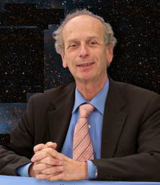
L’enseignement de Michel Spiro à L’École Polytechnique

Slide 3
Charged dark matter Nuclear Physics B March 1990
de Rújula, A.; Glashow, S. L.; Sarid, Uri
CHAMP's, charged massive particles that survive annihilation in the early Universe. We show that the window of allowed champ mass extends from 20 to 1000 TeV. Champs of charge + 1 should now appear as super-heavy isotopes of hydrogen.

Slide 4
Charged dark matter Nuclear Physics B March 1990
de Rújula, A.; Glashow, S. L.; Sarid, Uri
CHAMP's, charged massive particles that survive annihilation in the early Universe. We show that the window of allowed champ mass extends from 20 to 1000 TeV. Champs of charge + 1 should now appear as super-heavy isotopes of hydrogen.
Is there room for changed dark matter? Physics Letters B,
11 January 1990
J.L.Basdevant, R.Mochkovitch, J.Rich, M.Spiro, A.Vidal-Madjar,
Z ! Misprints charged <=> changed

Slide 5
Charged dark matter Nuclear Physics B March 1990
de Rújula, A.; Glashow, S. L.; Sarid, Uri
CHAMP's, charged massive particles that survive annihilation in the early Universe. We show that the window of allowed champ mass extends from 20 to 1000 TeV. Champs of charge + 1 should now appear as super-heavy isotopes of hydrogen.
Is there room for changed dark matter? Physics Letters B,
11 January 1990
J.L.Basdevant, R.Mochkovitch, J.Rich, M.Spiro, A.Vidal-Madjar,
Z ! Misprints charged <=> changed
Search for Superheavy Hydrogen in sea water
M. Spiro, B. Pichard, J. Rich, J.P. Soirat, S. Zylberajch, G. Grynberg, F. Trehin,
P. Verkerk, Pierre Fayet, M.E. Goldberg). 1990. Published in In *Les Arcs 1990, Proceedings, New and exotic phenomena '90* 489-498

Slide 6
Maths 1 | Informatique | Maths 2 | ENSEIGNTS
Maths Appliquées | Mécanique 1 | Mécanique 2 | DE
Physique (MQ) | Physique (MS) | Chimie | SYNTHÈSE
HSS/Langues | HSS/Langues | HSS/Langues | SPORT

Slide 7
Chenyang Jin, Arnaud Vanneste
La situation énergétique de la Chine
Energie, environnement et économie
Energie et Environnement
Centrale à gaz naturel, Kårstø, Norvège
Harris Utne
Aurore Landry, Energie, environnement
Combien coûterait l’envoi des déchets dans le soleil ?
GénéK 2003, Energie, environnement
La Pile à Combustible
Principe, Fabrication, Applications

Slide 8
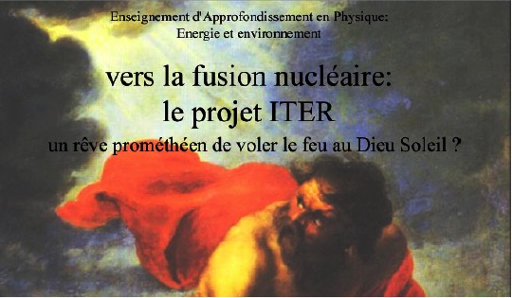


Slide 9
J-L. Basdevant, M. Spiro et J. Rich :
« Énergie Nucléaire » Ecole Polytechnique, 2003,
« Fundamentals of Nuclear Physics ; from Nuclear Structure to Cosmology » Springer Verlag, 2004.
Z ! Misprints nuclear <=> unclear
James A. Rich :
« Principes de la Cosmologie » Ecole Polytechnique, 2002.
« Fundamentals of Cosmology » Springer-Verlag, 2009,
« Cosmologie » De Boeck, 2010.

Slide 10


07/11/2019
(Anniversaire de la révolution d’octobre)

Slide 11
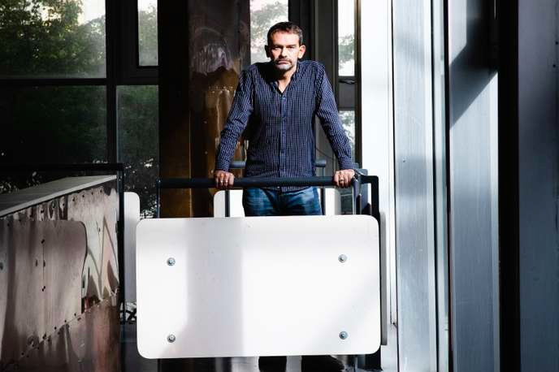
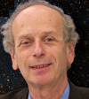

Slide 12

Merci
Michel
Et Bravo !

Slide 14
07/11/2019
(Anniversaire de la révolution d’octobre)

