Slide 1






PERLE : A High Power Energy Recovery Facility at Orsay
Les Journées Accélérateurs de la SFP
Roscoff, 2-4 octobre 2019
Walid Kaabi-LAL/CNRS

Slide 2
Introduction- Energy recovery in RF fields
λ_{Rf}
E_{Out} = E_{Inj}
E = E_{inj} +ΔE
E = E_{inj} +2 ΔE
E_{Inj}
E = E_{inj} +ΔE
E = E_{inj} +ΔE
(β ~ 1)
L = n · λ + λ / 2
L = n · λ
Energy supply → acceleration
Deceleration = “loss free” energy storage (in the beam) → Energy recovery

Slide 3
Introduction- ERL concept
ERL concept was proposed first in 1965 by Maury Tigner ^{[1]}
[1] M. Tigner: “A Possible Apparatus for Electron Clashing-Beam Experiments”, Il Nuovo Cimento Series 10, Vol. 37, issue 3, pp 1228-1231,1 Giugno 1965
First test was done at SCA@ Stanford in 1986 (interesting concept for FELs, Compton light sources and high current electron cooler)
Concept become only viable with recent advances in SRF technology.

Slide 4
Introduction to PERLE:
PERLE: A proposed 3 pass ERL based on SRF technology, to serve as testbed for studying, testing and validating a broad range of accelerator phenomena & technical choices for future projects.
Particularly, design challenges and beam parameters are chosen to enable PERLE as the hub for technology development (especially on SRF) for the Large Hadron Electron Collider (LHeC)^{[2]}:
Target Parameter | Unit | Value
Injection energy | MeV | 7
Electron beam energy | MeV | 500
Normalised Emittance γε_{x,y} | mm mrad | 6
Average beam current | mA | 20
Bunch charge | pC | 500
Bunch length | mm | 3
Bunch spacing | ns | 25
RF frequency | MHz | 801.58
Duty factor |  | CW
[2] J.L. Abelleira Fernandez et al, “ A Large Hadron Electron Collider at CERN: Report on the Physics and Design Concepts for Machine and Detector “, J.Phys. G39 (2012) 075001, arXiv:1206.2913

Slide 5
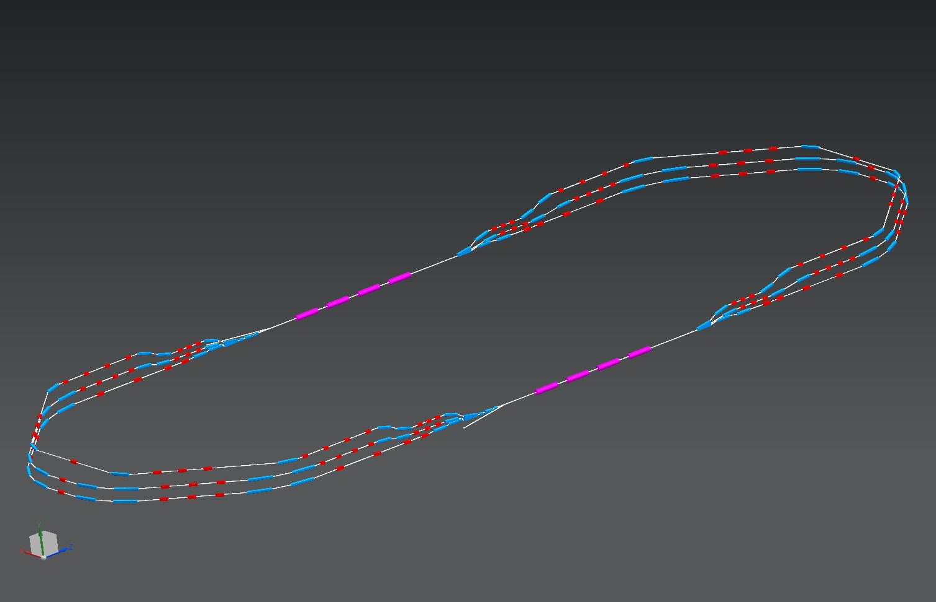
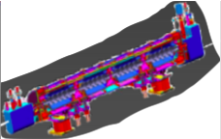
PERLE configuration:
2 Linacs (Four 5-Cell 801.58 MHz SC cavities)
3 turns (160 MeV/turn)
Max. beam energy 500 MeV
1 : 3 : 5
DE = 80 MeV
injector
7 MeV
DE = 80 MeV
2 : 4 : 6
7 MeV
dump
DC = l_{RF}/2
Footprint: 24 x 5.5 x 0.8 m³

Slide 6
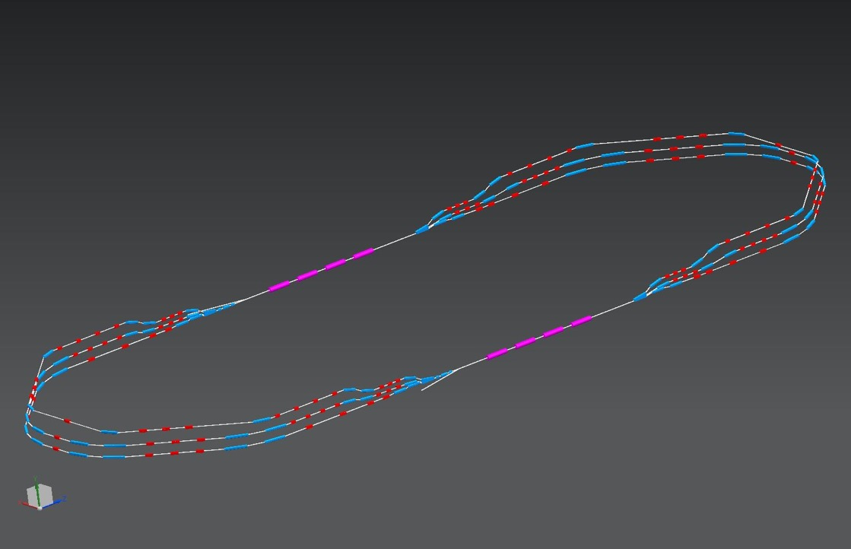
PERLE configuration:
Three passes ‘up’ to reach the maximum energy
1 : 3 : 5
ΔE = 80 MeV
injector
7 MeV
ΔE = 80 MeV
2 : 4 : 6
7 MeV
dump
ΔC in arc 6 = λ_{RF}/2

Slide 7
PERLE configuration:
Three passes ‘down’ for energy recovery
1 : 3 : 5
ΔE = 80 MeV
injector
7 MeV
ΔE = 80 MeV
2 : 4 : 6
7 MeV
dump

Slide 8
PERLE in the global landscape:
legacy, decommissioned
Operating (SC, NC)
planned
potential future machine
PERLE
cERL-KEK

Slide 9
Motivations to study, then host an ERL at Orsay:
Why an ERL:
A clever concept and accelerator R&D at it’s best.
Saving energy is a key word for future machine construction.
Compact accelerator with high performances, smaller infrastructures (site area, cryogenic plant…)
Why @ Orsay:
Involvement of local accelerator experts with complementary expertise around an ambitious and federating project.
Develop and acquire expertise in design and operation of ERL.
Opportunity to host the first superconductive R&D test facility at Paris-Saclay Campus and contributing to the visibility of the future lab worldwide.

Slide 10
Motivations to study, then host an ERL at Orsay:
Why PERLE:
The opportunity to work within an international collaboration with expert in ERL design and operation.
Technical challenges imposed by the machine design:
Multi-pass energy recovery,
High power operation,
SR cavities test with beam,
beam stability (intensity, position and size) in acceleration and deceleration phases,
Injector versatility.
To prepare technology for the future machine.
Compact but powerful machine that could allow many applications for accelerator science (Beam diagnostics development, injector studies, test facility for cryomodules), and also for Particle Physics (elastic electron-proton scattering with polarised beam), Nuclear Physics (exploration of proton densities in exotic nuclei by electron scattering) and Photo-Nuclear Physics (production of gamma ray between 0.2 and 5 MeV allowing wide application in photonuclear physics).

Slide 11
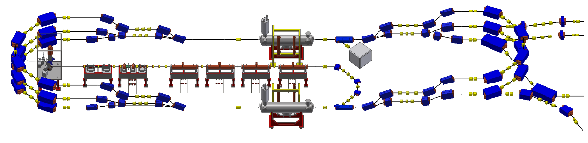
PERLE transport optics:
Appropriate recirculation optics are of fundamental concern in a multi-pass machine to preserve beam quality. The design comprises different regions:
The Spreader optics: The beams need to be directed into the appropriate energy dependent arc. Spreaders separate vertically beams and match optics functions to arcs.
The Arc optics: Disturbing effects on beam space charge such as cumulative emittance and momentum growth have to be counteracted through a pertinent choice of the basic optics cell
The Re-combiner optics: Re-combiners and spreader are mirror symmetric.

Slide 12
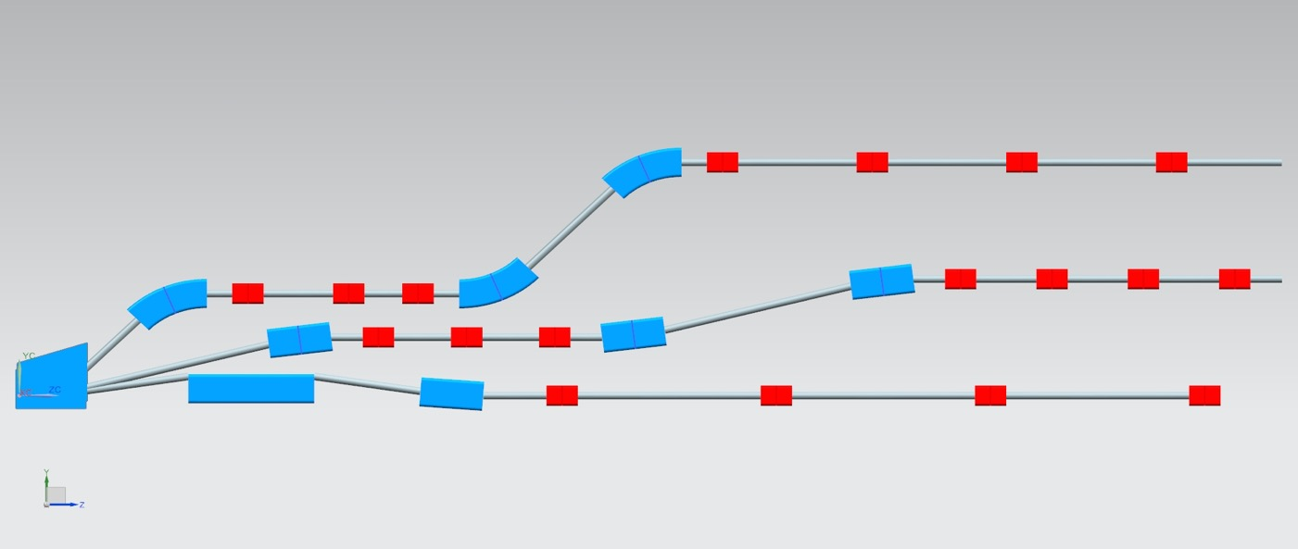
Switchyard- Vertical Separation of Arcs (1, 3, 5):
LAL/IPNo – JLAB Collaboration
Energies1 : 3 : 5
87 MeV
40 cm
247 MeV
35 cm
20 cm
40 cm
407 MeV
Dipoles: (20 and 40 cm long), B = 0.8 Tesla

Slide 13
Arc optics, Arc 1 (87 MeV) as example:
LAL/IPNo – JLAB Collaboration
20
Isochronous Arc
2
BETA_X&Y[m]
pathlength: 42 × λ_{RF}
DISP_X&Y[m]
0
-3
0
BETA_X
BETA_Y
DISP_X
DISP_Y
15.71
2-step vert. Spreader
180⁰ Arc
2-step vert. Recombiner
Spr. dipoles:
4× 45⁰ bends
L = 20 cm
B = 9.5 kGauss
Arc dipoles :
4×45⁰ bends
L = 45.6 cm
B = 4.5 kGauss
Rec. dipoles:
4× 45⁰ bends
L = 20 cm
B = 9.5 kGauss
quads: L = 10 cm G ≤ 1 kGauss/cm

Slide 14
1 pass up + 1 pass down optics:
LAL/IPNo – JLAB Collaboration
Pass-1 ‘up’
20
2
BETA_X&Y[m]
DISP_X&Y[m]
0
0
BETA_X
BETA_Y
DISP_X
DISP_Y
50.8316
-2
7 MeV
87 MeV
167 MeV
Pass-1 ‘down’
20
2
BETA_X&Y[m]
DISP_X&Y[m]
0
0
BETA_X
BETA_Y
DISP_X
DISP_Y
50.8316
-2
167 MeV
87 MeV
7 MeV

Slide 15
Bunch recombination pattern:
LAL/IPNo – JLAB Collaboration
Basic RF structure, without recirculation: Bunches are injected every 25 ns
When recirculation occurs → bunches at different turns in the linacs:
→ Ovoid bunches in the same bucket
→ Recombination pattern adjusted by tuning returned arcs length of the required integer of λ
Maximize the distance between the lowest energy bunches ( & ): ovoid reducing the BBU threshold current due to the influence of HOMs kicks
Achieve a nearly constant bunch spacing: minimize collective effects
1
6

Slide 16
PERLE magnets design: Magnet inventory
LAL/IPNo – CERN - BINP Collaboration
Courtesy to Cynthia Vallerand
6 recirculation arcs, for different beam energies: 87, 167, 247, 327, 407 and 487 MeV.
Each arc contains 4 dipoles, powered in series within the arc .
114 quadrupoles, powered individually
Number of sextupoles, correctors included and octupoles to be defined
46 dipoles in the spreader/combiner, powered individually

Slide 17
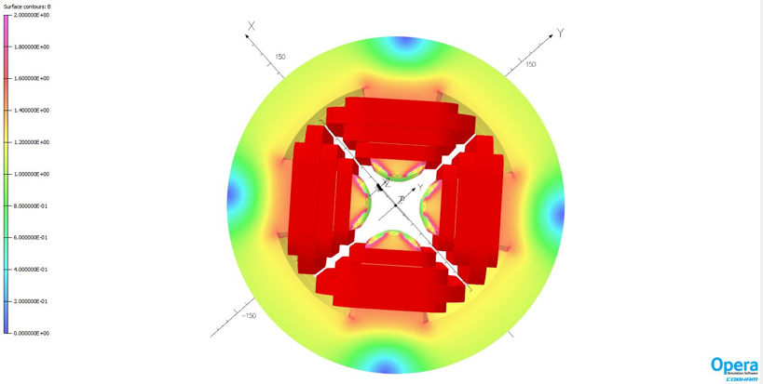
PERLE magnets design: Quadrupoles
LAL/IPNo – CERN - BINP Collaboration
Features of quadrupoles magnets
Quantity | 114 + 1 (pre-serie)
Magnetic length | 100 - 200 mm
Main gradient G₀ | 30T/m
Gap | 40 mm
Good field region | +/- 20mm
Beam energy | From 50 to 400 MeV
Diameter increase to 250 mm (220 mm initially)
Chamfer optimization: 2.46 mm depth
 | Harmonic @ 13 mm
B6/b2 | 0.63 10⁻⁴
B10/b2 | -0.45 10⁻⁴
B14/b2 | -0.05 10⁻⁴
B18/b2 | -0.003 10⁻⁴

Slide 18
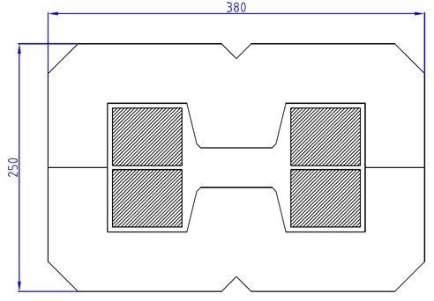
PERLE magnets design: Arc bending magnets
Iron-dominated resistive magnets preferred for improving tunability
Engineering current density of 7-8 A/mm²
H design to reduce the height of magnet for stacking
Homogeneous field as low as possible due to the use of one power supply by arc
Cost optimization by coupling the design of arc magnets to studies of power converters, vacuum system and cooling as well as using one magnet per bend with a 45° deflection
LAL/IPNo – CERN - BINP Collaboration
Features of arc bending magnets
Quantity | 12 + 1 (pre-serie) | 12 + 1 (pre-serie)
Rotation angle | 45° | 45°
Radius of curvature | 1192 mm | 596 mm
Main field B₀ | 1.25 - 1.3 T | 1.25 - 1.3 T
Gap | 40 mm | 40 mm
Good field region | +/- 20mm | +/- 20mm
Mechanical length | 936 mm | 468 mm
Current max. | Not defined | Not defined
Beam energy | 305 to 455 MeV | 80 MeV to 230 MeV
Challenge to highlight : Very compact bending magnet while keeping a reasonable current density for 6 arcs and using the same structure for Arc 1 up to 3 and for Arc 4 up to 6.

Slide 19
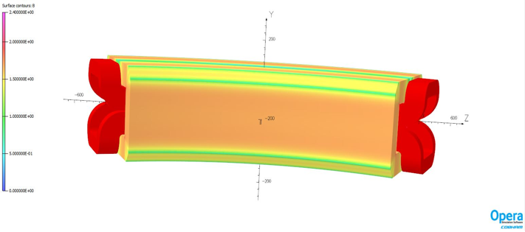
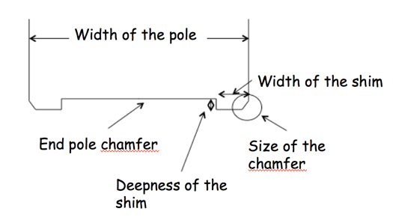
PERLE magnets design: Arc bending magnets
LAL/IPNo – CERN - BINP Collaboration
Parameters for dipole design optimization:
Depth shim (mm) | Homogeneity (*10⁻⁴) with a pole width 90 mm |  |  | Homogeneity (*10⁻⁴) with a Pole width 105 mm |  |  | Homogeneity(*10⁻⁴) with a pole width 120 mm
 | 305 MeV | 380 MeV | 455 Mev | 305 MeV | 380 MeV | 455 Mev | 305 MeV | 380 MeV | 455 Mev
1 | 9.2 | 6.5 | -2.5 | 3.5 | 2.5 | -8 | 1.4 | 1 | 0
2 | 45 | 40.5 | 26 | 15 | 13 | 9 | 5 | 4.4 | 3
3 | 86 | 78 | 53 | 28 | 26 | 18 | 9 | 8 | 6
Shim is optimized for 3 energies to get a field homogeneity lower than 5. 10⁻⁴
Magnetic design is finished for the arc bending magnet R1192 mm

Slide 20
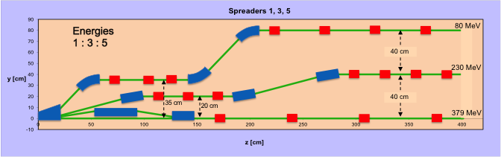
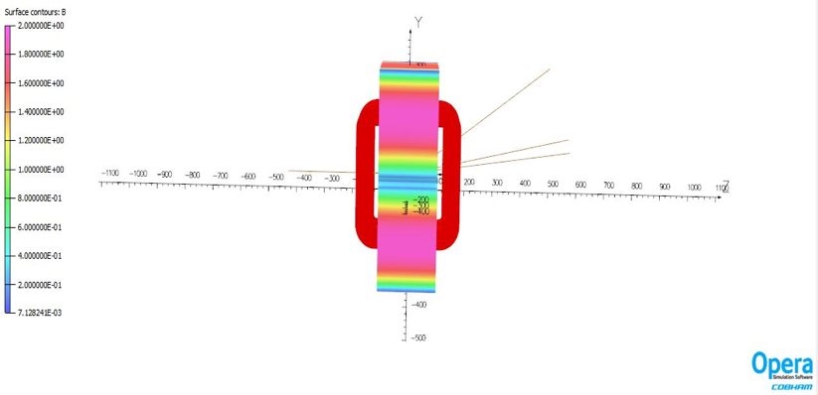
PERLE magnets design : Spreader/Recombiner dipoles
LAL/IPNo – CERN - BINP Collaboration
Preliminary results for Spreader dipole:
H-magnet design was chosen for the dipoles in order to minimize stray fields given the close proximity of the beamlines.
Maximum field restricted to 6 kG, to limit flux leakage out of central pole iron.
Trajectories at 80 MeV, 230 MeV and 380 MeV are correct.
Feasibility is done but iron saturated.
Need to check if mechanical length can be increased.
=> Need to adjust magnetic length with mechanical length.

Slide 21
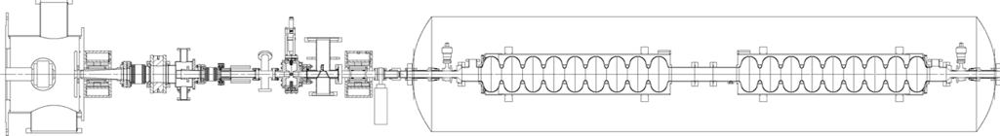
Electron source and injector:
LAL/IPNo – STFC Daresbury- Univ. Liverpool Collaboration
The PERLE injector consists of:
A DC photoemission electron gun (The ALICE DC gun to be upgraded).
A bunching and focusing section: 401 MHz normal conducting buncher cavity placed between two solenoid.
A superconducting booster with five 802 MHz cavities individually feeded and controlled on amplitudes and phases.
Merger to transport the beam into the main LINAC,
Beam diagnostics to be placed between components.
Spin manipulator for the polarised electrons option.
Courtesy to Ben Hounsell
Photocathode gun
Buncher
SRF booster
Light box
Focusing solenoids
Photocathodes choice:
Sb-based photocathodes (unpolarized electrons) operated at 350 kV
GaAs photocathodes (polarized electrons) operated at 220 kV
Photocathode laser choice:
Nd:YAG laser (532 nm) or Ti:Sapphire laser (400 nm).

Slide 22
Electron source and injector:
LAL/IPNo – STFC Daresbury- Univ. Liverpool Collaboration
Studies on ALICE gun upgrade to operate at up to 500 pc (B. Hounsell PhD thesis):
Optimisation of the electrode geometry, the laser pulse spatial and temporal profile and the field in the first solenoid to preserve the emittance in the gun and first solenoid section and to reduce transverse beam size in the focusing and bunching section.
The electrode geometry optimisation was also performed so that the same electrode shape must be used for both voltages (350 and 220 kV) → Use of a mlti-objective optimisation algorithm NSGAIII.
Optimisation of the buncher frequency (401 MHz or 802 MHz) in order to minimise emittance growth.
Hounsell et al. «Re-optimisation of the ALICE gun upgrade design for the 500 pC bunch charge requirements of PERLE», IPAC 19, Melbourne-Australia

Slide 23
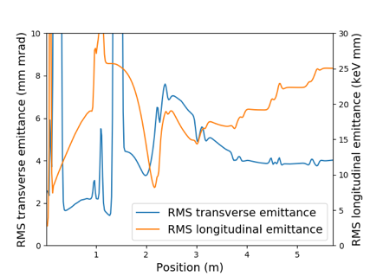
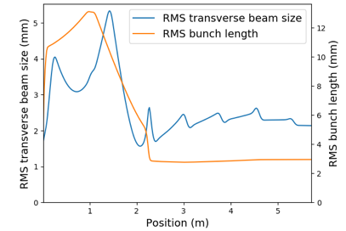
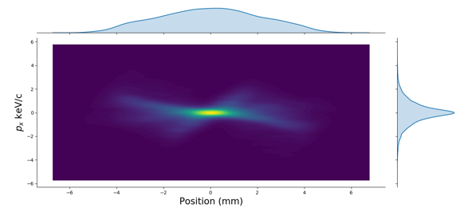
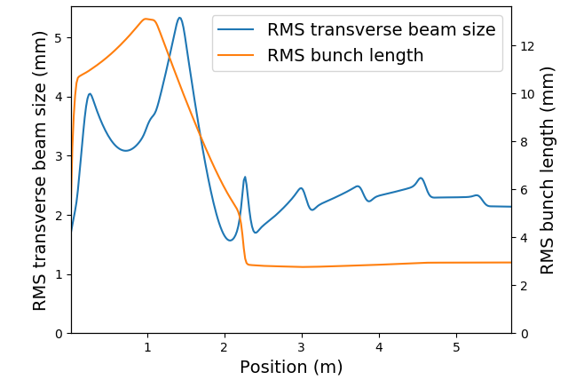

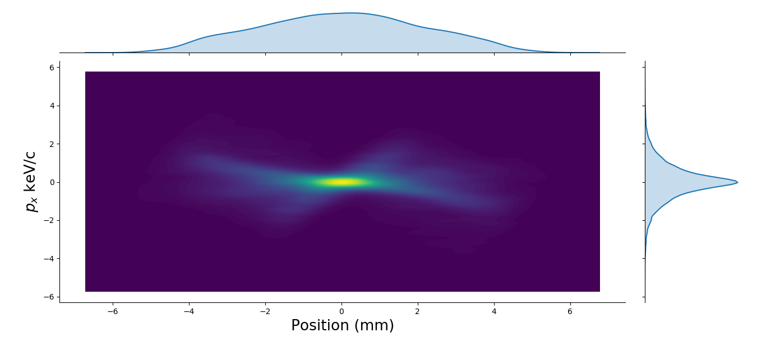
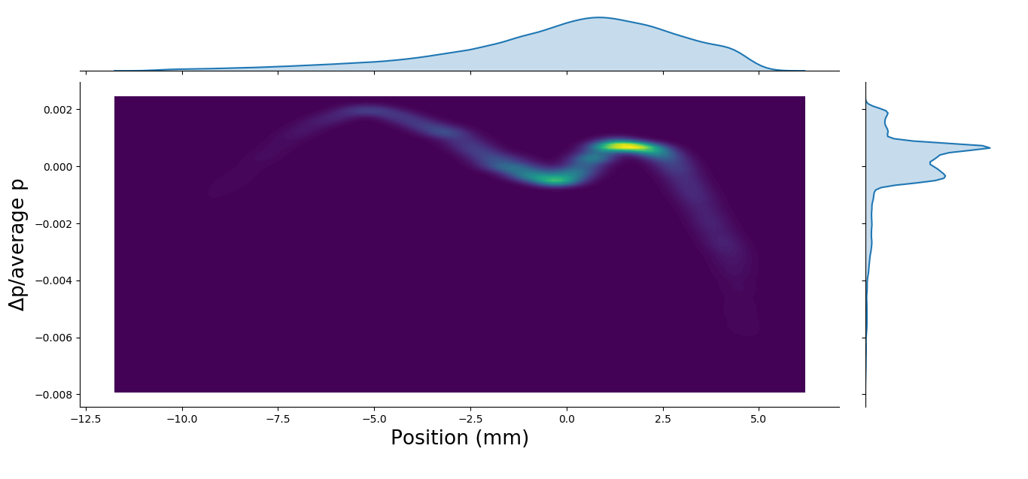
Electron source and injector:
LAL/IPNo – STFC Daresbury- Univ. Liverpool Collaboration
PERLE injector (up to the booster exit) was optimised using NSGAIII: a many objective optimisation algorithm
Variables: laser parameters, solenoid settings, buncher amplitude and phase, distances between elements and the booster cavity amplitudes and phases.
Constrains: injection energy of 7 MeV & final bunch length of 3 mm
The objectives were all minimised at the point of the booster exit. They were rms transverse emittance, rms longitudinal emittance, rms energy spread, x halo parameter and z halo parameter.
The solution was not only selected for its transverse emittance but also the shape of the bunch distributions:
For more: See the poster B. Hounsell « Status of the PERLE injector optimisation » @ERL 2019
Achieved bunch parameters
Transverse emittance/ mm mrad | 4.0
Longitudinal emittance/ keV mm | 25.1
Bunch length/ mm | 3.0
Energy/ MeV | 7.0
=> The PERLE injector is capable of achieving the specification at the booster exit. The possibility of improving the bunch distributions and longitudinal phase space will be investigated (linearizing the longitudinal phase space)

Slide 24
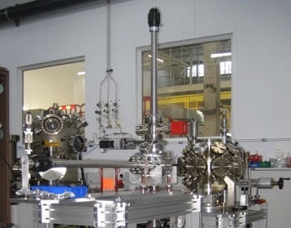
Electron source and injector:
LAL/IPNo – STFC Daresbury- Univ. Liverpool Collaboration
Still to be done:
The final step towards a complete injector design is the merger=> Work is ongoing.
A 'first ‘ start-to-end simulation: Tracking initial particle distribution, as defined by the injector and using magnet error tolerances would validate beam transport through the entire ERL complex.
Studies on the tolerances required for the injector.
The possible options for a polarised beam injection will be considered.
Relatively short lifetimes of the photocathode impose their frequent replacement (on a daily basis for GaAs and weekly for Alkali antimonides) → Need of preparation and transfer chambers for each photocathode material. For GaAs photocathodes an existing design of photocathode preparation facility produced for ALICE could be easily implemented.

Slide 25
Electron source and injector:
LAL/IPNo – STFC Daresbury- Univ. Liverpool Collaboration
ALICE DC-Gun and equipment transferred from Daresbury to LAL on May 9 & 10, 2019

Slide 26
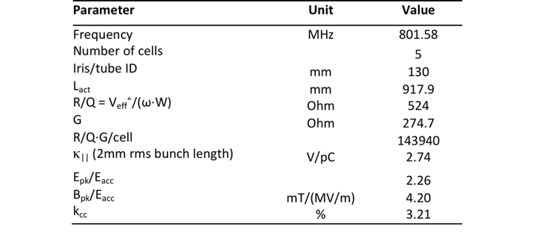
Cavity fabrication and test:
LAL/IPNo – CERN - JLAB Collaboration
Courtesy to Frank Marhauser
The first Nb 802 MHz 5-Cell cavity fabricated October 2017 at JLAB

Slide 27
Cavity fabrication and test:
LAL/IPNo – CERN - JLAB Collaboration
5-cell cavity successfully electropolished with new flange adapters

Slide 28
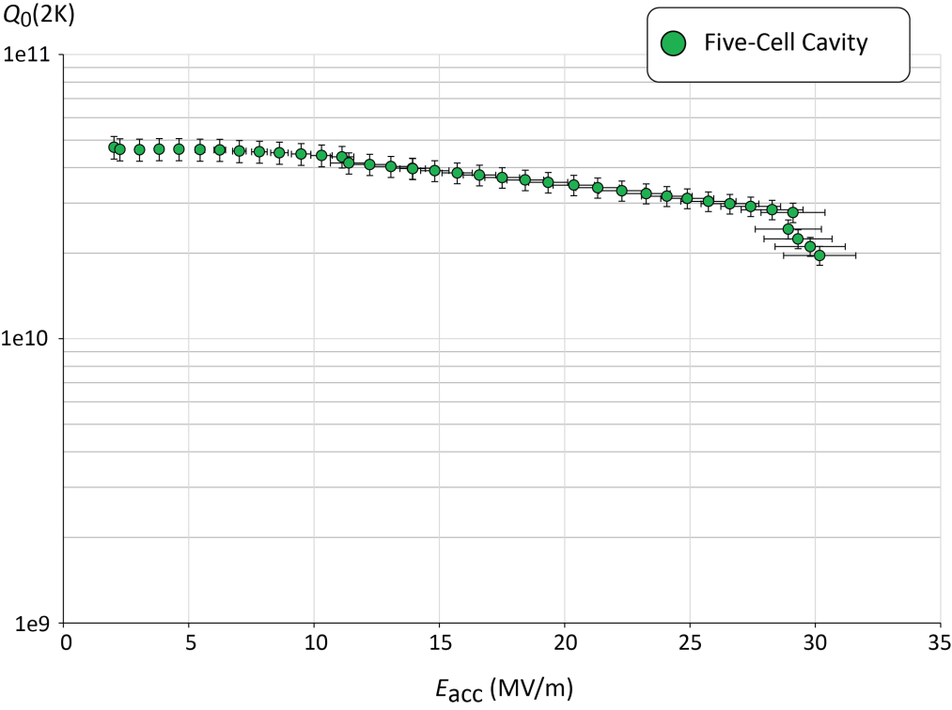
Cavity fabrication and test:
LAL/IPNo – CERN - JLAB Collaboration
Q₀ (2k) = 3 e10 @ ~27 MV/m
Parameter | Unit | CRN5
E_{acc} at quench | MV/m | 30.1
E_{pk} at quench | MV/m | 68.1
B_{pk} at quench | mT | 126.3
FE onset field | MV/m | ~25
FE-induced radiation(max) | mR/hr. | 0.06
Max. Q₀-value | /1e10 | 4.72
Q₀-value at 25 MV/m | /1e10 | 3.12
Lorentz Force Detuning | Hz/(MV/m)² | -1.5
Quench @ E_{acc} ~ 30 MV/m
PERLE requirements
For more details: F. Marhauser’s talk in the FCC Week, April 2018, Amsterdam, Netherland

Slide 29
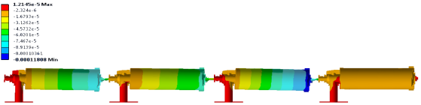
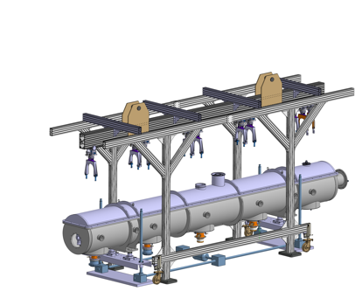
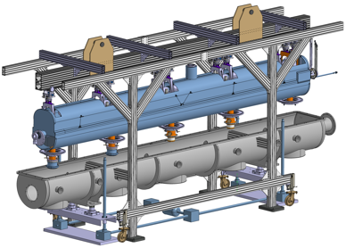
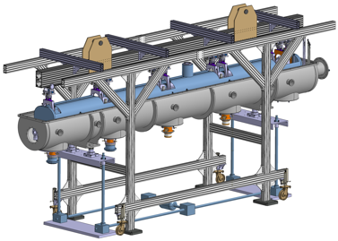
Cryomodule design study:
LAL/IPNo – CERN Collaboration
IPN-Orsay & CERN are studying the SPL cryomodule adaptation for PERLE.
Courtesy to Gilles Olivier
Déformée du train de cavités (poids propre seul)
Max: 0.12 mm
Displacement of the cavity string alone (weight only)
SPL cryomodule: designed to integrate 4 elliptical 5-cells 704 MHz cavities
Cavity string equipped with magnetic shield, CTS, cryogenic lines and thermal shield
Insertion of the complete assembly inside the vacuum vessel
Closing of the top lid and of the beam ports

Slide 30
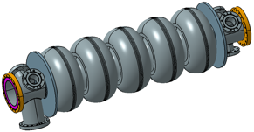
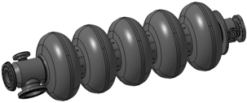
Cryomodule design study:
LAL/IPNo – CERN Collaboration
Main Issue: the HOM extraction
How many extraction ports (interferences with CTS)?
Which power (W, tens of W, more)?
What kind of damper (waveguide, loop coupling)?
Active helium cooling or thermalization by copper braids.
What kind of RF line to the external load (cable sufficient, which kind of connector)?
Intermediate thermalization of the cables
External cooled RF loads
CHARACTERISTICS | SPL (704MHz) | PERLE / JLAB (802MHz)
Coupler to coupler length (mm) | 1490,5 | -
Length flange to flange (mm) | 1397,3 | 1292,5
Coupler to flange dimension (mm) | 116,4 | 96,7
Cells external diameter (mm) | 386,5 | 335
Beam port internal diameter (mm) | 129,8 / 139,8 (coupler side) | 130
Flanges internal diameter (mm) | 79,7 (CF100) | 130 (CF160)
Vacuum valve diameter | CF63 | tbd
Coupler internal diameter (mm) | 100 | 100
Coupler flange | CF100 | CF100
Beam axis to ext. coupler flange | 403 | tbd
=> The two cavities present similar features

Slide 31
Cryomodule design study:
LAL/IPNo – CERN Collaboration
First results:
Thermal and magnetic shielding are well sized for PERLE operation parameters. Their design could be modified if needed.
Vacuum vessel could be reused without refurbishing
Input coupler designed for SPL cavity could be easily adapted to meet PERLE requirement
Further studies will define if Cryogenic lines have to be adapted
Space liberated due to cavity frequency difference give a little margin for auxiliaries integration.
Pending issues:
HOM study to define the design and the number of HOM couplers to be used for PERLE cavities.
→ Risk of interference between CTS and HOM dampers
→ Big impact on the decision to adapt the SPL cryomodule for PERLE or not.

Slide 32
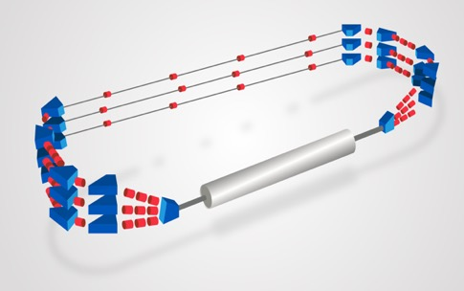
Project staging strategy:
The PERLE configuration entails the possibility to construct PERLE in stages. We propose in the following two main phases to attend the final configuration.
Phase 1: Installation of a single cryomodule in the first straight and three beam lines in the second (consideration motivated by the SPL cryomodule availability)
To allow a rather rapid realisation of a 250 MeV machine.
To test with beam the various SRF components.
To prove the multi-turn ERL operation.
to gain essential operation experience.
PERLE Phase 1 layout
Phase 2: Realisation of PERLE at its design parameters as a 10MW machine:
Upgrade of the e- gun
Installation of the 2nd Spreader and recombinar
Installation of the second cryomodule in the second straight.
PERLE Phase 2 layout

Slide 33
Project staging strategy:
Phase 1 is divided in two sub-stages:
Studies and prototyping stage: Mainly for design completion of the main sub-systems, the beam dynamics studies and the prototyping of the main components (cavity, power coupler, HOM, dipoles…). All the outcomes will be included in the PERLE Technical Design Report.
Assembly, test and installation stage: of all the subsystems according to their final design (injection line most likely without the upgrade of the DC gun, the SPL cryomodule, the 6 arcs, a spreader & a recombiner), leading to PERLE-Phase 1 configuration.
It is foreseen that phase 1 includes also the realisation of infrastructure work and the installation of equipment sized as for their final use (beam dump, cryogenics, cooling circuit, shielding, electrical power, etc.).

Slide 34
Project staging strategy:
Milestones, Timeline & Collaborator Involvement
Phase 1
Phase 2

Slide 35
Thank you for your attention

Slide 36
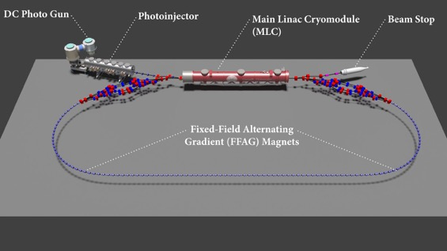
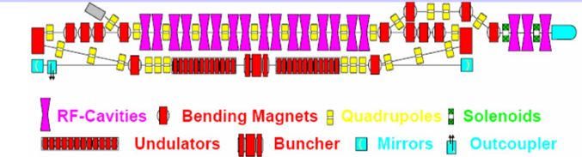
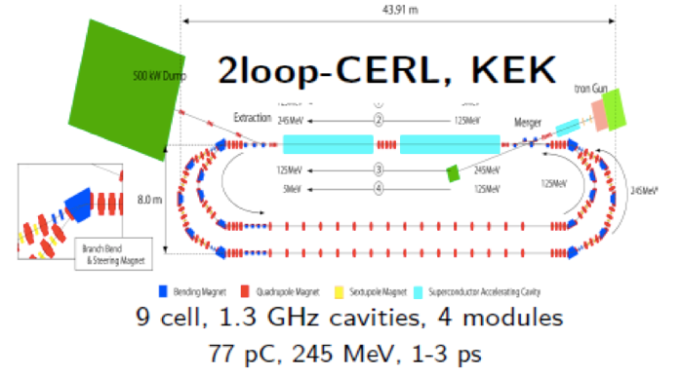
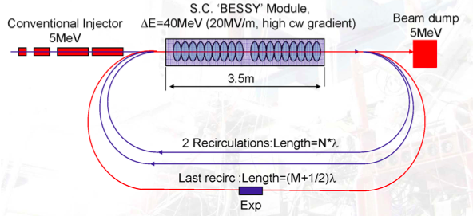
ERLs around the world:
Normal Conducting 180 MHz + DC Gun
30 mA, 11 MeV, 70-100 ps
BINP, Novosibirsk
- 3-4 turn ERL
- Normal conducting RF
CBETA- Cornell (commisionning starts now: March 2019)
1.3 GHz, 4 turns, 40 mA, E_{max}= 150 MeV
10mA
1.3GHz
5-125 MeV
MESA
- At the moment only single loop operation
- Severe limitations in beam current due to injector

Slide 37
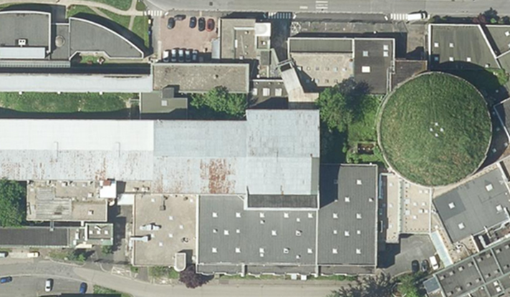
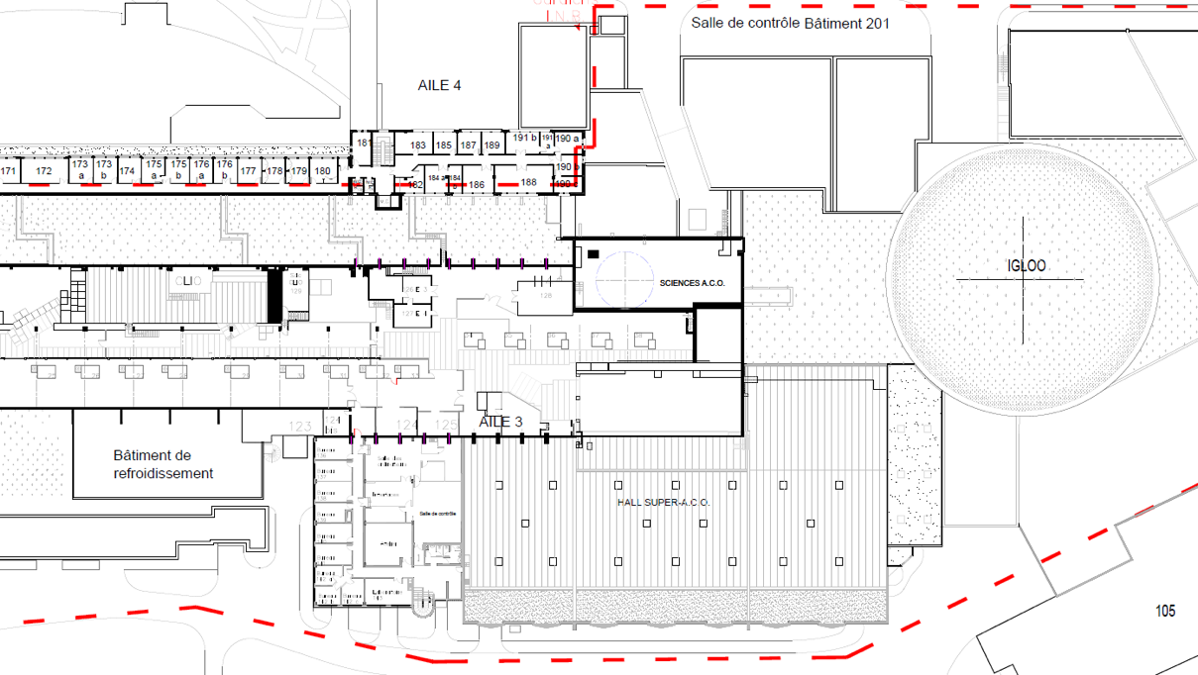
The site:
PERLE footprint: 24 x 5.5 x 0.8 m³
IGLEX: Thomx + Andromede
Possible location for PERLE
Hall Super ACO
(1850 m²)

Slide 38
Administrative classification of PERLE:
According to French safety regulation (Code de l’environnement L593-2, Décret n°2007-830 du 11 mai 2007), an electron accelerator is considered as Basis Nuclear Installation (INB) when these two criteria are reached simultaneously:
Beam energy > 50 MeV
Beam power > 1 kW
In case of PERLE:
Parameters | Values
Bunch charge | 500 pC
Bunch spacing | 25 ns
Average current | 20 mA
Beam energy | 7 to 500 MeV
Beam power | 140 kW to 10 MW
Conclusion: PERLE could not be considered as INB
The « INB » administrative regime would not be applicable to PERLE if it is proven that beam losses of power > 1 kW could not be maintained for relatively long time (>1s) in all cases (exploitation or accidental beam loss scenario).

