Slide 1


Equality and Diversity - and Physics?
Tomas Brage
Professor in Physics
Lund university, Sweden
and
Member of stearing group for LERU TG-EDI

Slide 2

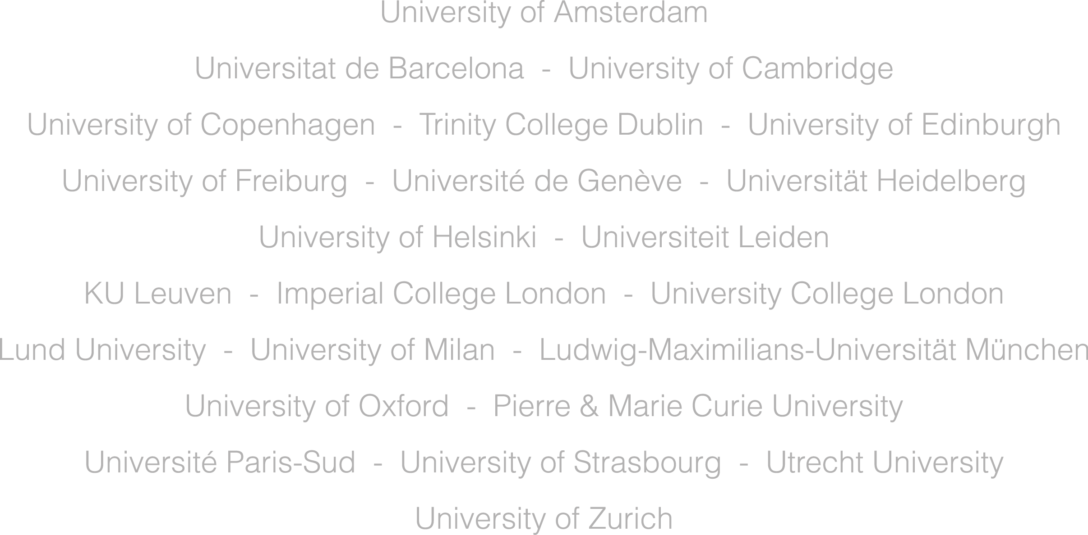
League of European Research Universities

Slide 3

Position paper
https://www.leru.org/publications/equality-diversity-and-inclusion-at-universities
Welcome to workshop in Lund, December 2, 2019
www.lu.se/leru-seminar

Slide 4
WHY diversity? Opportunities for universities
Be in tune with society
Include the greatest talents
Realize the potential of staff and students
Enhance performance and wellbeing
Increase validity and quality
Remaining relevant

Slide 5
Be in tune with society
and its challenges
Critical partner
Fairness and efficiency
Help with social mobility
Productive and enriched learning
Role models

Slide 6
Include the greatest talents
by redefining excellence
Is our metric working?
More diverse definition of merits needed.
Counteract bias
Avoid ”trick-based” systems
Work for true meritocracy

Slide 7
Realize the potential
of staff and students
Diverse teams, better outcome
Reduce stereotypical threats and prejudice
Increase status of teaching
Future employers demand diversity!

Slide 8
Enhance performance
and wellbeing
leaking pipelines to multiple pipelines
Fairness is benefitting everybody
Empower people to become whistle-blowers!

Slide 9
Increase validity and quality
of teaching and research
Dialogue and critique
Gendered research, innovation and teaching
Different perspectives, better quality

Slide 10
Remaining relevant
for training and research
Inequalities creates underperformance
Improvements for diversity benefits all (care leave, stress management, ...)

Slide 11
HOW? Manifesto for inclusive Universities
Mind the gap
all discrimination grounds,
staff and students
Use the evidence
Stereotypical threats and bias
Micro-aggressions
Awareness training and observers
Leadership and lead by example!

Slide 12

Do you need proof?
Diversity as quality/excellence!
R. B. Freeman and W. Huang, Nature News 513, 305 (2014):
Collaboration: Strength in diversity
M. W. Nielsen et al., Nature, human behaviour 2 726 (2018)
Making gender diversity work for scientific discovery and innovation
K. Powell, Nature 558, 19 (2018):
These labs are remarkably diverse – here´s why they’re winning in science.
Being inclusive gives research groups a competitive edge. It also happens to be the right thing to do

Slide 13

.. and even more proof?
Diversity as quality/excellence!
M. W. Nielsen et al., PNAS 114, 1740 (2017)
Opinion: Gender diversity leads to better science

Slide 14

Specific for Physics
We are not a culture without culture
We are affected by bias and stereotypes
We are fascinated by excellence
Leads to a bigger threat to meritocracy
Traweek 1998,
Beamtimes and Lifetimes

Slide 15

Specific for Physics
We have to question the Herculian ideal
Teams not individuals are diverse
and more ”excellent”
Hasse &Trentemöller 2008,
Break the pattern!

Slide 16
WHY?
Be in tune with society
Include the greatest talents
Realize the potential of staff and students
Enhance performance and wellbeing
Increase validity and quality
Remaining relevant
HOW?
Mind the gap
Use the evidence
Leadership and lead by example!

Slide 17
Thank you for your attention!

Slide 18
References
Banaji et al, Project implicit, https://implicit.harvard.edu
Brage and Lövkrona 2016, Core values work in academia – with experiences from lund univeristy, Lund University
Conell 2014, Gender, Springer Fachmedien, Wiesbaden
de Vries, Jennifer 2011, Mentoring for change. Melbourne, Victoria: Universities Australia Executive Women & the LH Martin Institute for Higher Education, Ledership and Management.
de Vries, Jennifer 2012, ”The bifocal approach: (Re)positioning women´s programs”. In Strid, Sofia, Husu, L, Gunnarsson, L. (eds.), GEXcel. Work in progress report, volume X: Proceedings from GEXcel Theme 11-12: Gender paradoxes in academic & scientific organisations. Örebro University, Sweden.
Etzkowitz and Ranga 2011, gender Dynamics in Science and Technology: From the leaking pipe-line to the vanish box, Brussels Economic Review 54
Freeman & Huang 2014, Collaboration: Strength in diversity, Nature News 513 305
Harvard project on diverse pipelines: https://hr.fas.harvard.edu/development-diverse-pipelines
Hasse and Trentemöller 2008, Break the Pattern!, UPGEM-project report, Tartu University Press
LERU advice papers on Gender: https://www.leru.org/publications?q=gender
Lundborg and Schönning 2006, investigation of PhD-students situation at the Physics Department, Uppsala 2006
MacNell et al 2014, What’s in a Name: Exposing Gender Bias in Student Ratings of Teaching, Innov High Educ, Springer Verlag.
Notes:
18

Slide 19
Nielsen 2015, Nature 525 427
Nielsen Wullum, Mathias, Bloch Carter, Walter & Schiebinger, Londa (2018), Making gender diversity work for scientific discovery and innovation. Nature, human behaviour. 2 726-734
Nielsen et al. 2017, Opinion: Gender diversity leads to better science, PNRAS 114 1740
Ong, Maria 2017, Counterspaces for women of color in STEM higher education: …, J. Res. Science Teaching.
Rosser 1995, Teaching the Majority, Teacher’s college press
Rosser 2012, Breaking into the Lab, New York University Press
Schiebinger 2003, Has Feminism Changed Science, Harvard University Press
Schiebinger (ed) 2008, Gendered Innovations in Science and Engieering, Stanford University Press
Schiebinger et al: https://genderedinnovations.stanford.edu/
Spears et al. 2008, Seeing gender: Tools for change, Manhattan, KS: Midwest Equity Assistance Center. (CD-ROM).
Spears (2008). Seeing Gender (Invited Editorial). The Physics Teacher, 46(3), 136-137
Traweek 1998, Beamtimes and Lifetimes, ..., Harvard United Press
Wennerås and Vold 1997, Nepotism and sexism in peer review, Nature 387 341
VR 2017: Gender equality observations in the Swedish Research council’s evaluation panels, https://www.vr.se/english/just-now/news/news-archive/news/2018-11-23-gender-equality-observations-in-the-swedish-research-councils-review-panels.html

