Slide 1
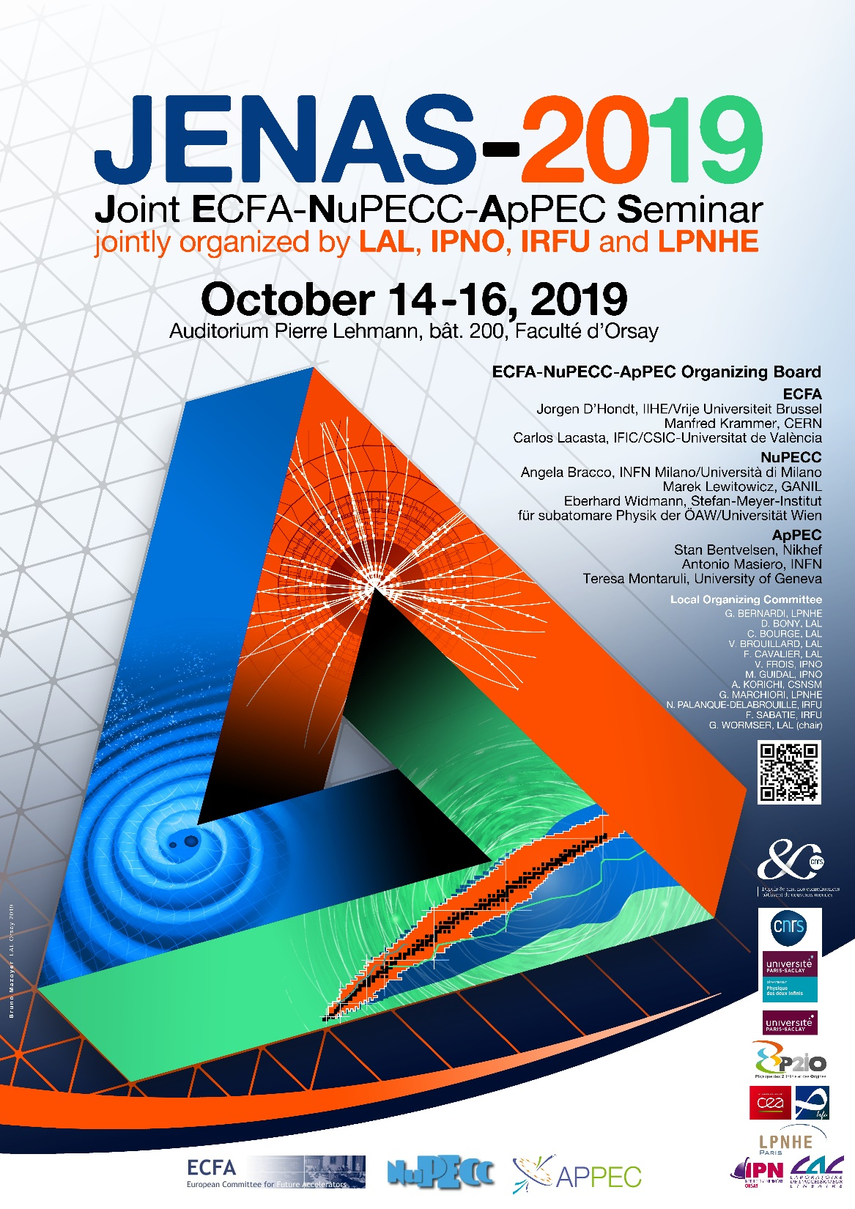
HAPPY TO WELCOMING YOU FOR THE
This first Joint ECFA-NuPECC-ApPEC Seminar (JENAS)
jointly organized by CSNSM, LAL, IPNO, IRFU and LPNHE
Achille Stocchi

Slide 2
HAPPY TO WELCOMING YOU FOR THE
This first Joint ECFA-NuPECC-ApPEC Seminar (JENAS)
jointly organized by LAL, IPNO, IRFU and LPNHE
FLUO

Slide 3




The new Laboratory in the Orsay Campus
FLUO
Future Laboratory Unified in Orsay
Fondamental Laws of Universe in Orsay
It is created from the merger of CSNSM, IMNC, IPNO, LAL, LPT
will be in operation on 1th January 2020

Slide 4
Merging of CSNSM, IMNC, IPNO, LAL, LPT → FLUO: ~3,5 years of history at a glance
First ideas for the merging of CSNSM, IMNC, IPNO, LAL, LPT, meetings,
discussions… mid 2016
Different preliminary phases (Conseil Inter Laboratoire),
working groups (science, technics, supports), dedicated workshops… Sept 2016 – June 2018
Consultation of all the personnel. June 2018
Project phase Sept 2018 – June 2019
Implementation phase NOW
Starting of FLUO 1st January 2020

Slide 5
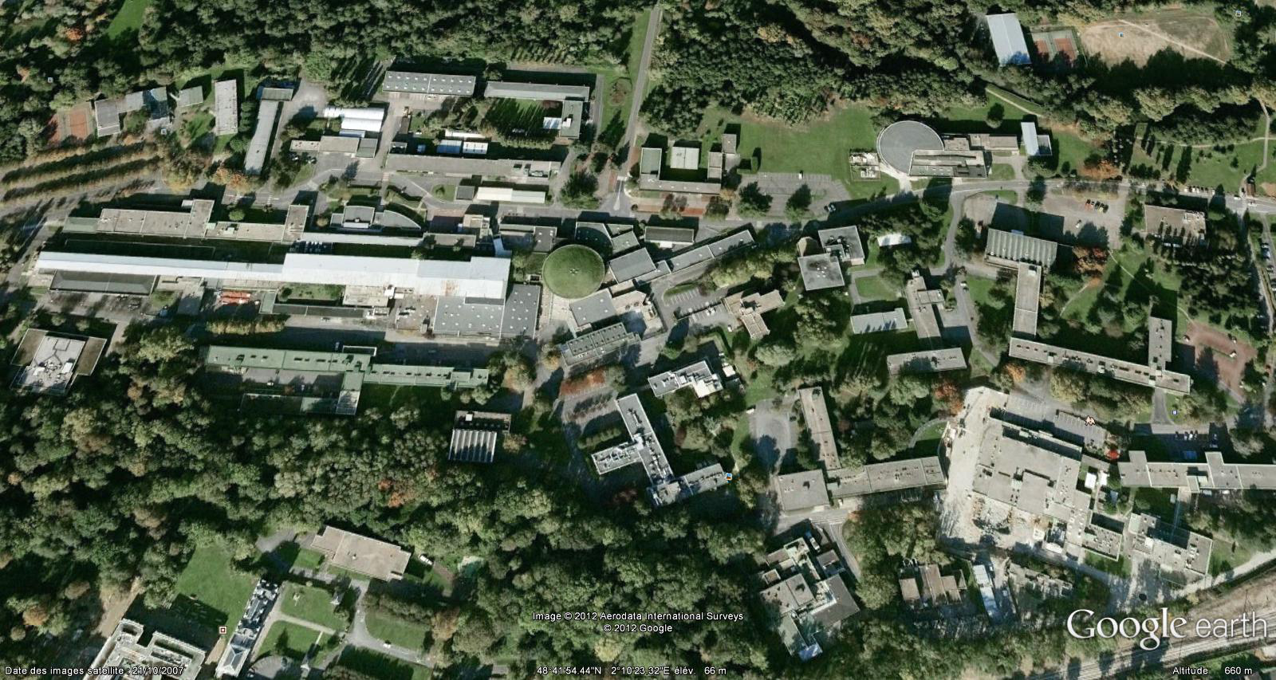
A lot of building working on going !
Renovation and Restructuring for hosting new scientific equipments
~750
208
ALTO
205
Virtual DATA
Mechanical
Workshop
109
You are here
209
Mechanical
Workshop
200
Vacuum/Surface
Worskshop
Science
ACO
PHIL/LaseriX
IGLEX
SCALP
PRAE
108
100
210
150 m
104
102
Health
Supra Tech
103
RER B Bures
106
RER B Orsay
On going / soon starting Operations
150 m

Slide 6
7 RESEARCH POLES
The ensemble of all the themes of “the physics of the two infinities” with the presence
of strong historical/existing poles, of emerging poles and of activities at the interfaces
NUCLEAR PHYSICS
~40
HIGH ENERGY PHYSICS
~50
ASTROPARTICLES & COSMOLOGY
~40
~50 postdoc
~100 PHD
ACCELERATOR PHYSICS
~30
ENERGY & ENVIRONNEMENT
~20
THEORETICAL PHYSICS
~40
HEALTH PHYSICS
~15

Slide 7
4 TECHNICAL DEPARTEMENTS
Strong pole of competences, essential pillars for the laboratory
to conceive, design and build the instruments.
ELECTRONICS
~60
INFORMATICS
~55
MECANICS
~55
Instrumentation
Detectors
~25
~30 non permanents

Slide 8
8 SUPPORT DIVISIONS/SERVICES
Indispensable in strongly and vitally supporting all the scientific and technical activities
Risk Prevention and Radioprotection
~10
ADMINISTRATION
~50
Events and Communication
~10
Infrastructure and Logistic
~10
Library and IST
Partnership
and Valorisation
Quality
Education and Knowledge Transfer
~10

Slide 9


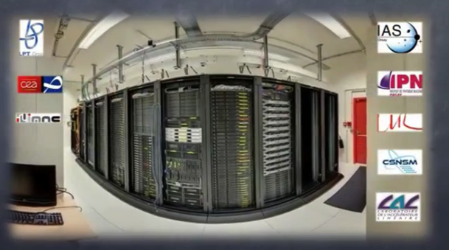




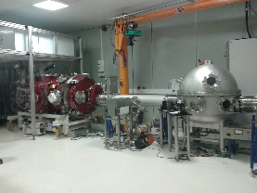
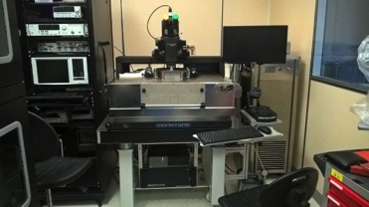
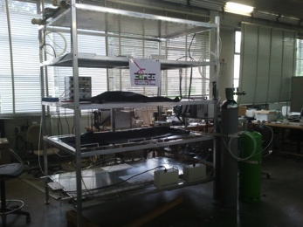
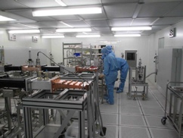
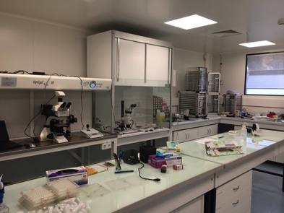


~50
The Platforms
Richness of FLUO for the sciences and for supporting the construction of detectors and accelerators
Ion Beam facilities
Xrays/electrons beams facilities
Intense compact X-ray source based on Compton effect
Technological demonstrator
Test bench for Detector characterization
Cavities for the Lock of
Advanced Virgo
interaction solid target – laser IR ⇒ plasma synchronous IR and XUV light beams
ultra short pluse (500 ps → 40 fs)
CALVA
Captinov
CORTO
Virtual Data
. shared hosting place with common infrastructure
Accelerator
Physics & Technology
micrometeorite
Preparation/analysis
Myrtho
SUPRATech
Power coupler station
γ detectors
development / characterization
spectroscopy / scanning
Labelized “in vivo imaging platform”
by FLI (France Life Infrastructure)
cryogenic infrastructure
cavities and modules preparation
non linear optical biphotonique imaging
(spatial, temporal, spectral)
to integrate “vide & surfaces”

Slide 10
HAVE a nice fruitful meeting.
It is a strategical moment for all our disciplines.
It is extremely important to meet, to debate
and to converge worldwide together !
All these discussions and future decisions will have a strong impact for FLUO

