Slide 1
Outreach
A united ApPEC-ECFA-NuPECC story to tell ?
Steven Goldfarb, IPPOG Chair
JENAS 2019, FLUO Orsay, 15 Oct 2019

Slide 2
Outreach
A united ApPEC-ECFA-NuPECC story to tell !
Steven Goldfarb, IPPOG Chair
JENAS 2019, FLUO Orsay, 15 Oct 2019

Slide 3

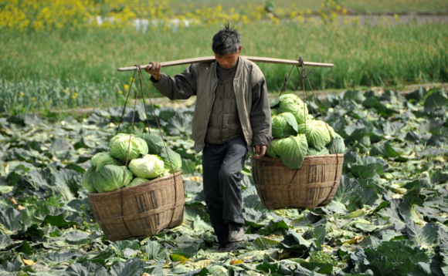

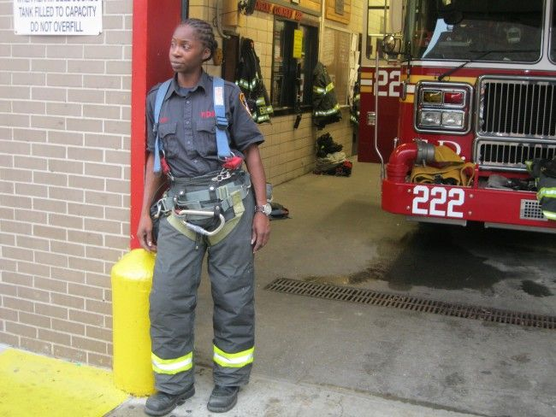
Why?

Slide 4
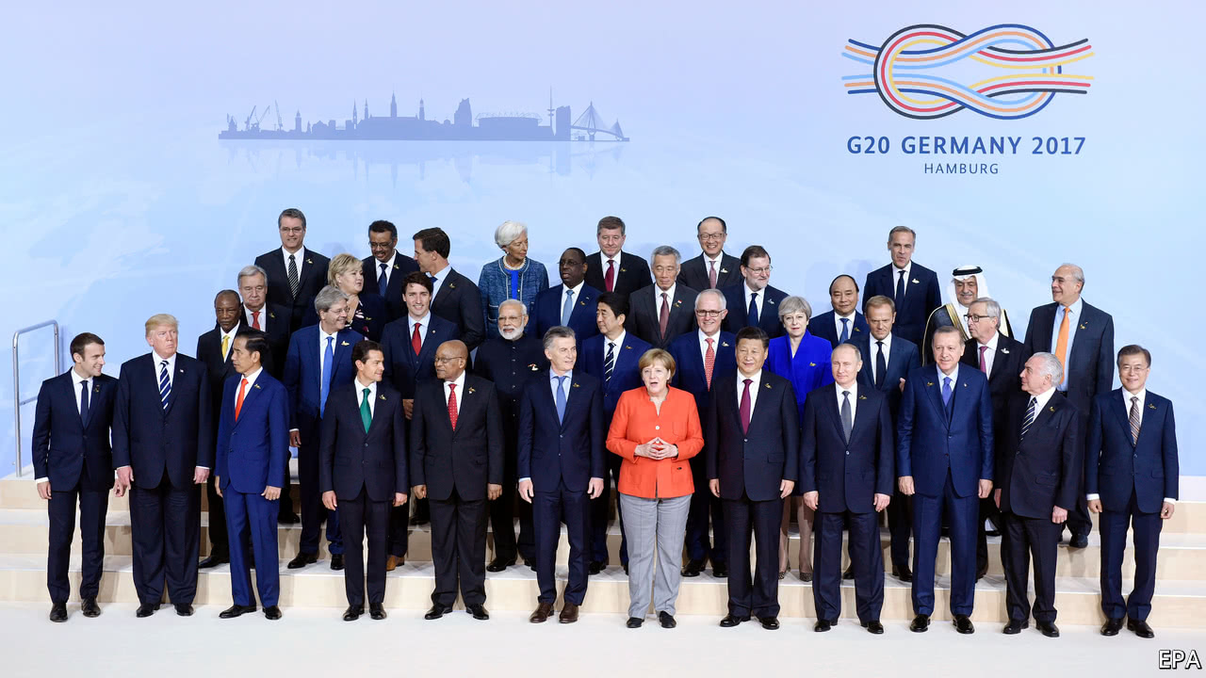
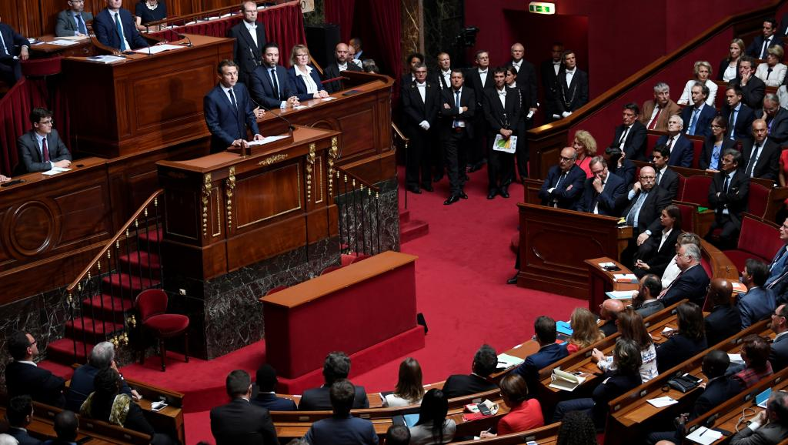
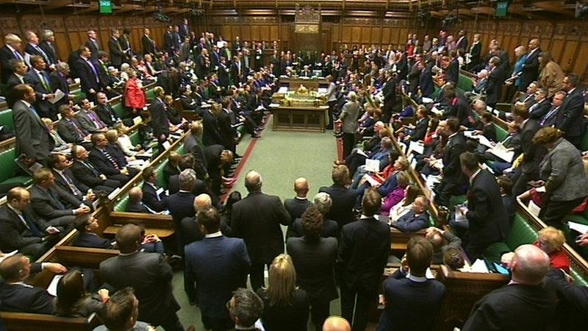
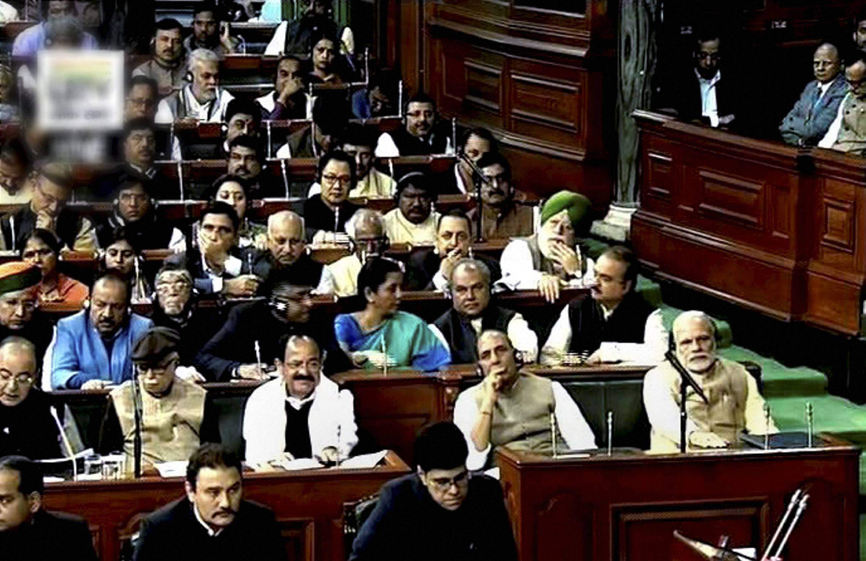
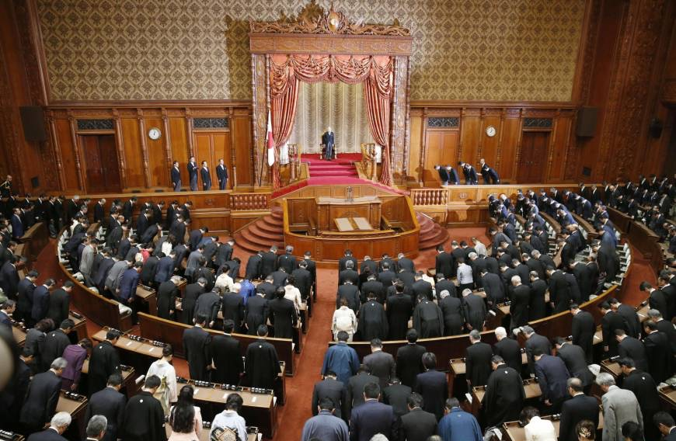
How much?

Slide 5

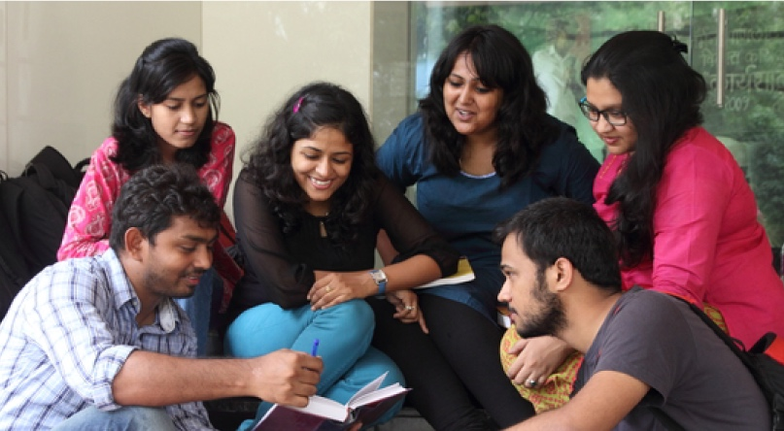

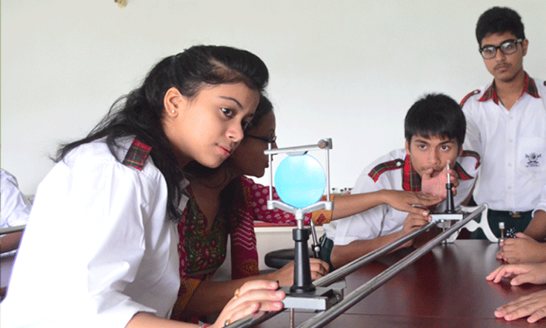
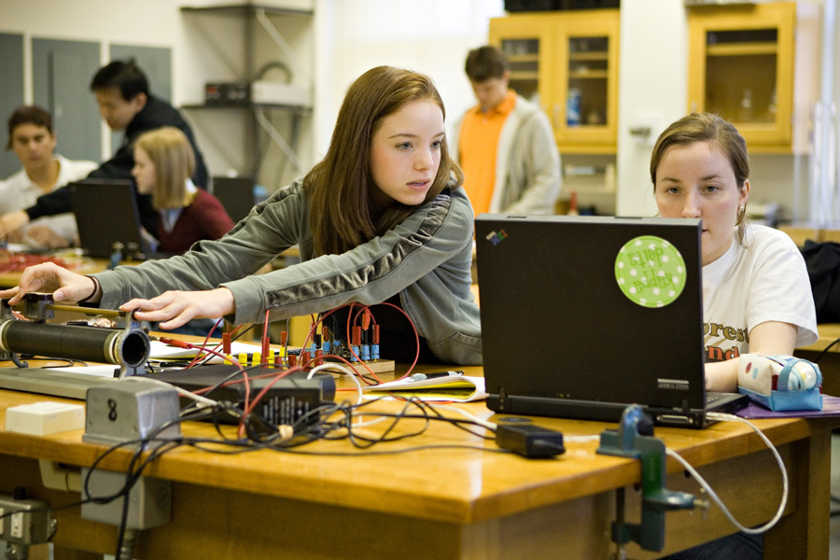
Who to believe?
What to do?

Slide 6

What are the answers they see?

Slide 7
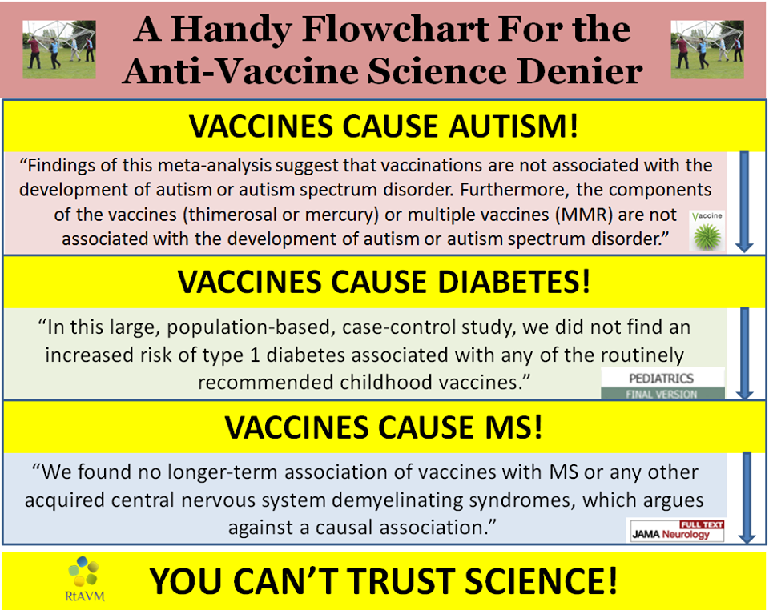
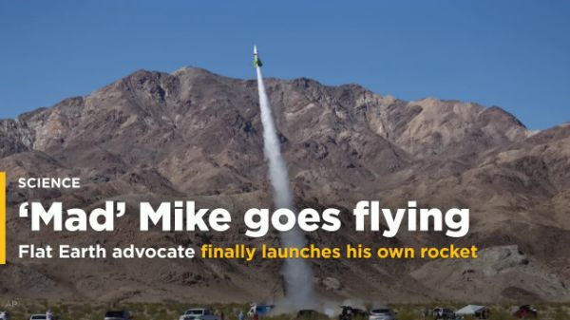
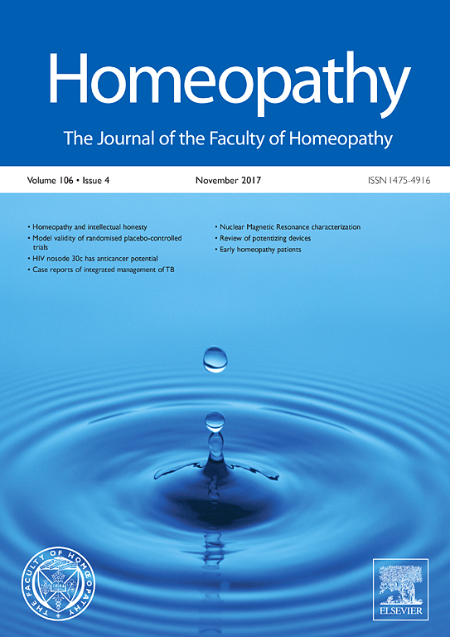
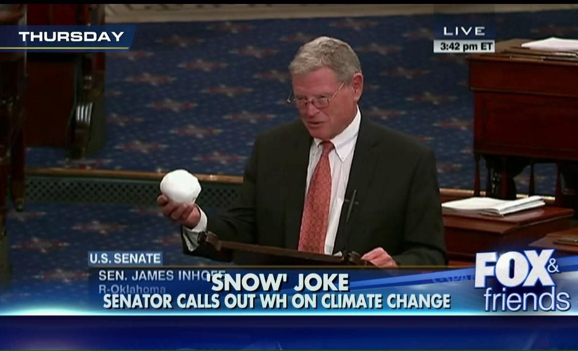
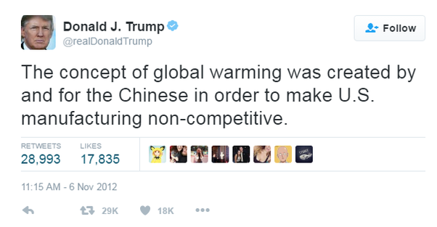

Slide 8
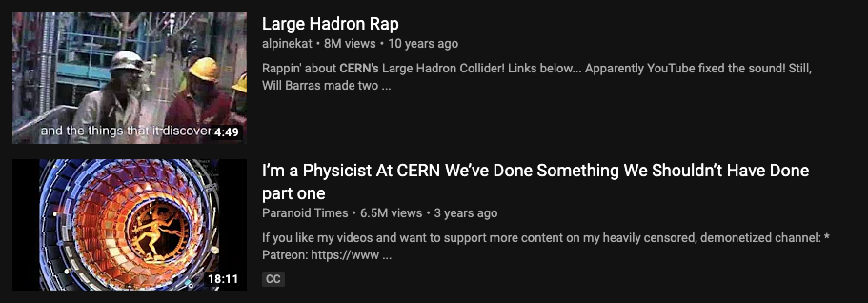
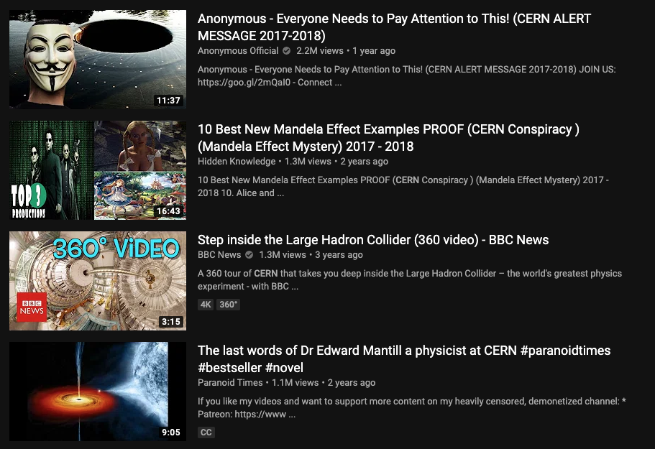
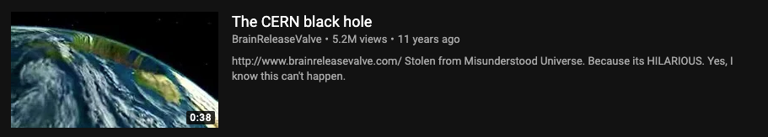
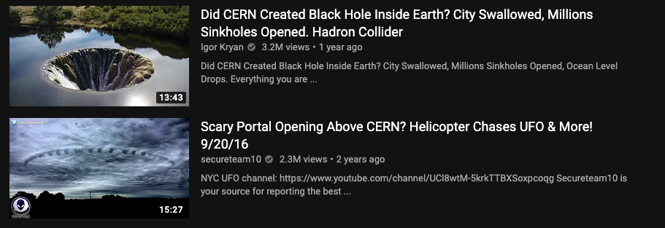
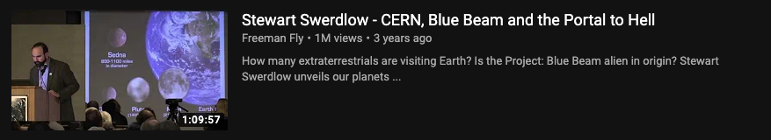

Slide 9
Yet, in this environment,
we have big plans…

Slide 10
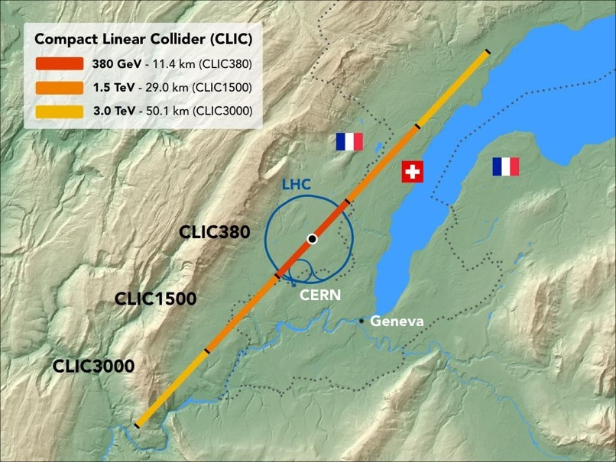
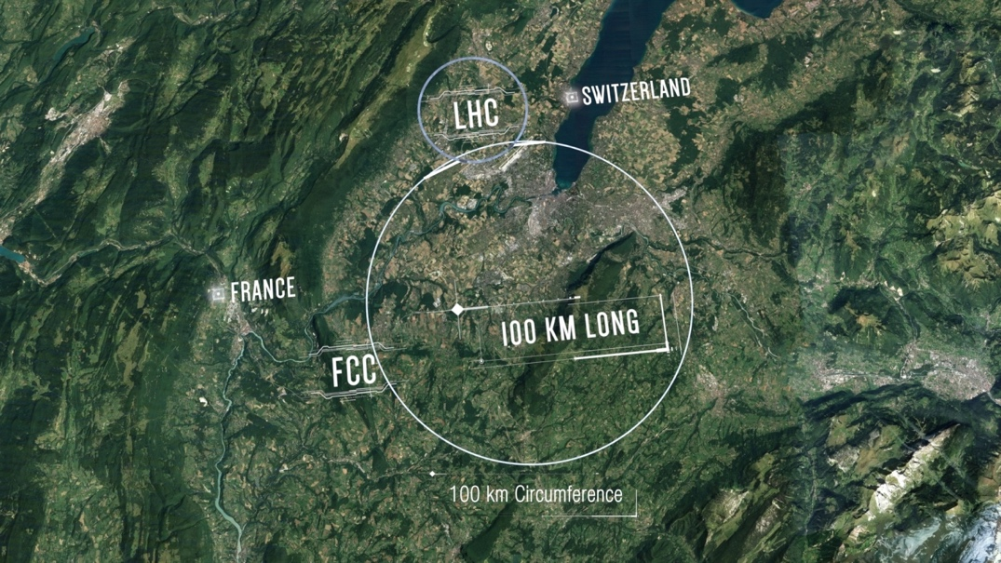
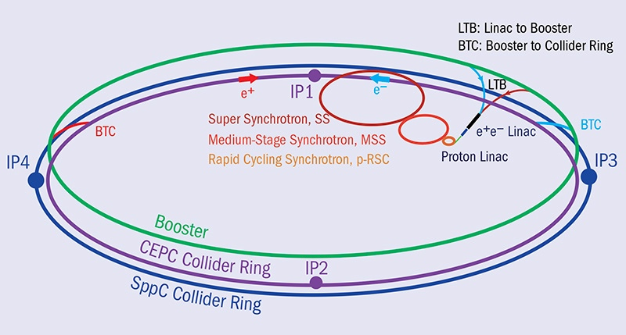
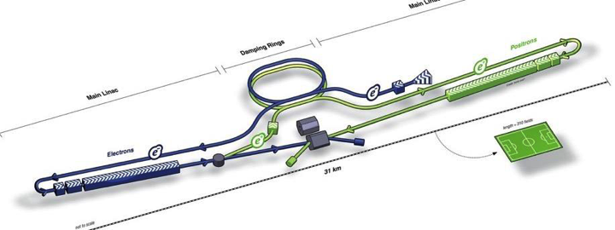
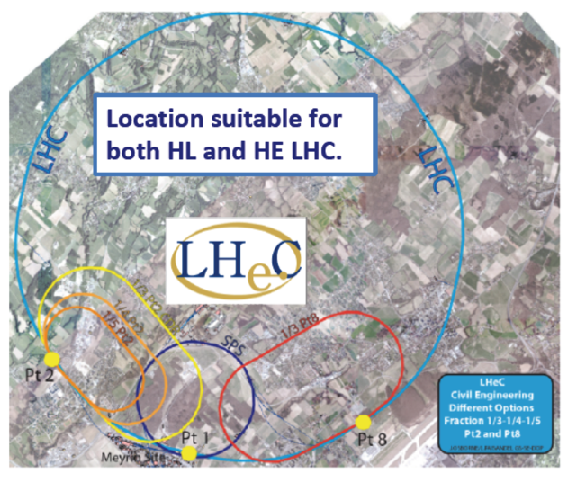
Future Plans for Particle Physics
Landscape of proposed large-scale infrastructures
CLIC
FCC_{ee/eh/hh}
CEPC / SppC
LHeC
ILC

Slide 11
Future Plans for Particle Physics
Time scales

Slide 12
How do we prepare for this?

Slide 13
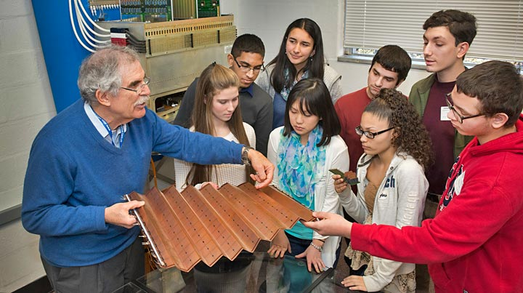
Education, Outreach & Communication
Communication
  Report Goals and Results to the public
  Extend Reach through methods & networks
Education & Outreach
  Establish Understanding of scientific process
  Instil Appreciation of fundamental research
  Build Trust with communities
  Train Next Generation of scientists
Education, Outreach and Communication are Strategic Pillars of Research
They are what we have to do before we build, not just after!

Slide 14
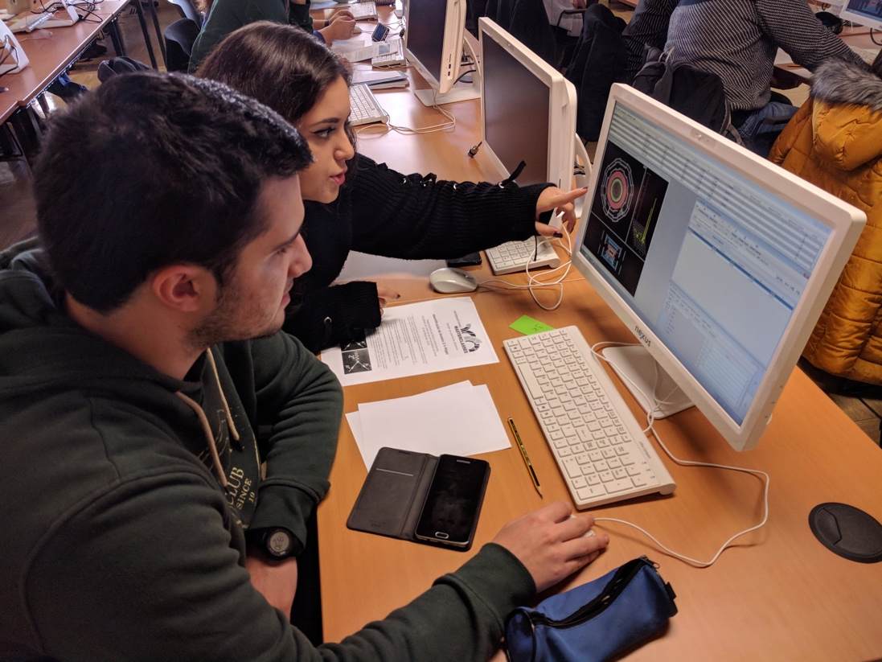
IPPOG
International Scientific Collaboration
  Active Researchers with Experience in Education & Outreach
  Experts in Communication & Education
Global Network
  25 Countries, 5 Experiments, 1 International Lab (CERN)
  Linked with national networks
Organise Global Activities
  International Particle Physics Masterclasses
  World Wide Data Day, Global Cosmics, etc.
Support Local Activities
  Sharing of expertise, best practices, material database
  Resources to support events, kick-start activities

Slide 15
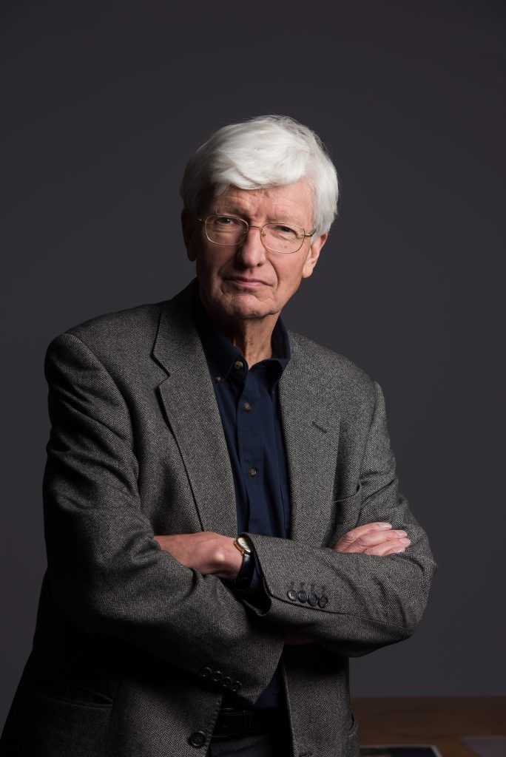
IPPOG Origins
1997 Birth of European Particle Physics Outreach Group (EPPOG)
  formed under the joint auspices of ECFA and EPS-HEPP
“…the particle physics community has a moral obligation to inform the public on its activities. To do this well, experiences must be shared among countries in view of the need to optimize the use of resources.”
- Chris Llewellyn-Smith, CERN DG
2011 Global Expansion to IPPOG
  Israel, Australia, USA (now South Africa, Brazil,…)
2016 Formal Scientific Collaboration
  Memorandum of Understanding

Slide 16
IPPOG Goals
Sustainable Development of Particle Physics Outreach
  Discussion forums for scientists active in Outreach and Informal Education
  Information exchange between individuals, institutions and laboratories
  Active working groups addressing specific challenges of global Outreach
Improving Outreach Standards Worldwide
  Development of Strategies based on current best practices and experience
  Long-Term links between scientists and education specialists
  Continual development & improvement of explanatory material
Extending Global Reach
  Expansion to Countries and Peoples underrepresented in Particle Physics
  Usage of new methods, activities and topics to reach broader audiences
  Active online communication platforms

Slide 17
IPPOG Membership
25 Countries, 5 Collaborations, 1 International Lab

Slide 18
MoU Commitments
Experiments
  Recognition of outreach as key component of research programme
  Recognition of efforts of collaboration members who do outreach
  In-Kind contributions (data, tools, educational material, in-kind support)
Countries
  Representative, access to national research programme & education networks
  Modest monetary support for IPPOG activities & infrastructure
Laboratories
  CERN contributes 5 kEUR + Masterclass Coordinator + Scientific Secretary + Infrastructure for Web, Finance, Legal Support

Slide 19
Organisation
Chairs
  Hans Peter Beck (Universität Bern) 2013-2019 (completing 2nd term)
  Steven Goldfarb (University of Melbourne) 2017-2019 (completing 1st term)
Core Team
  Strategic Development: Barbora Gulejova (Universität Bern)
  Community Lead: Claudia Marcelloni (CERN)
Coordination
  Masterclasses: Uta Bilow (Dresden University), Ken Cecire (University of Notre Dame)
  Global Cosmics: Sabine Hemmer (INFN), Carolin Schwerdt (DESY)
Organisational Bodies
  Advisory Boards & Committees: Finance, Speakers & Publications
  Steering Groups: Masterclasses, Global Cosmics, Web Development
  Working Groups: Bringing Masterclasses to New Countries, Explaining Particle Physics Hot Topics, Exhibits & Exhibitions

Slide 20
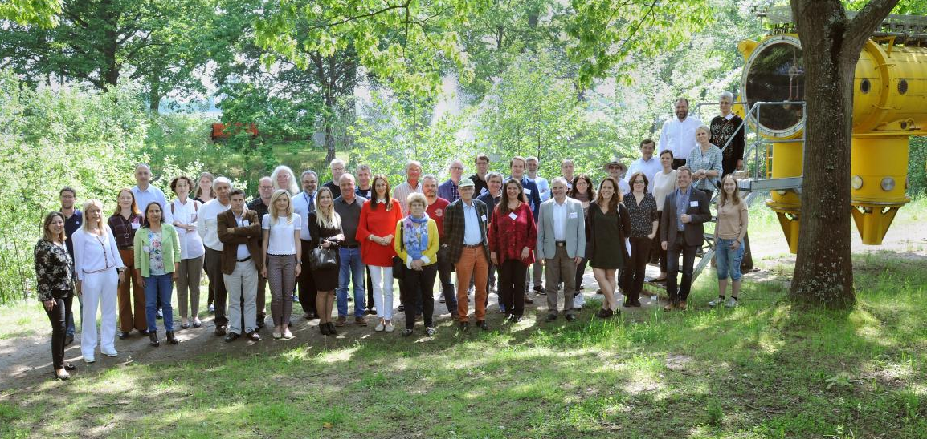
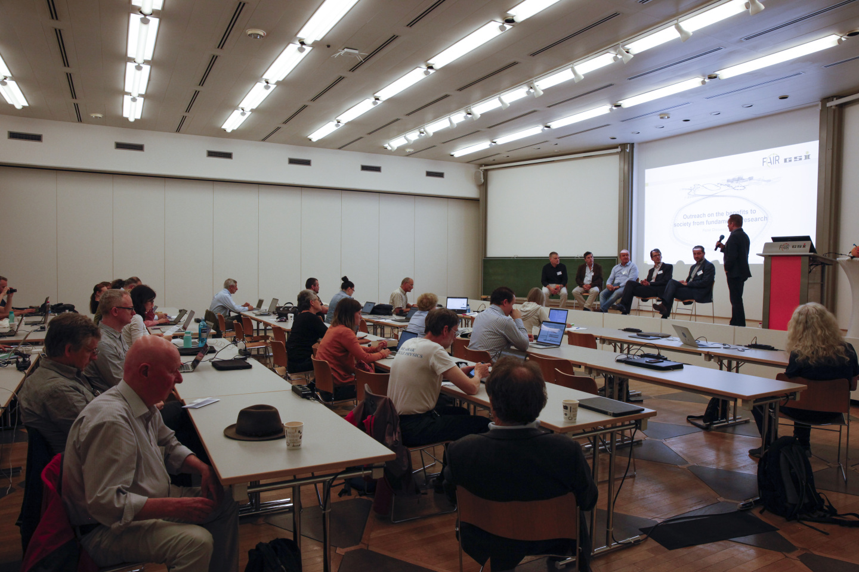
Sharing Ideas
17th IPPOG Meeting
  GSI-FAIR, Darmstadt, Germany, May, 2019
  Steering Group Meetings & Reports:
    Global Cosmics, Masterclasses
  Working Group Meetings & Reports:
    Exhibits & Exhibitions
    Explaining Particle Physics to a Lay Audience
    Expanding Masterclasses to New Countries
    Outreach of Applications for Society
  Panel Discussion:
    Outreach on the benefits to society from fundamental research
18th IPPOG Meeting
  CERN, 28-30 Nov 2019
Intensive 2.5-Day Meetings

Slide 21
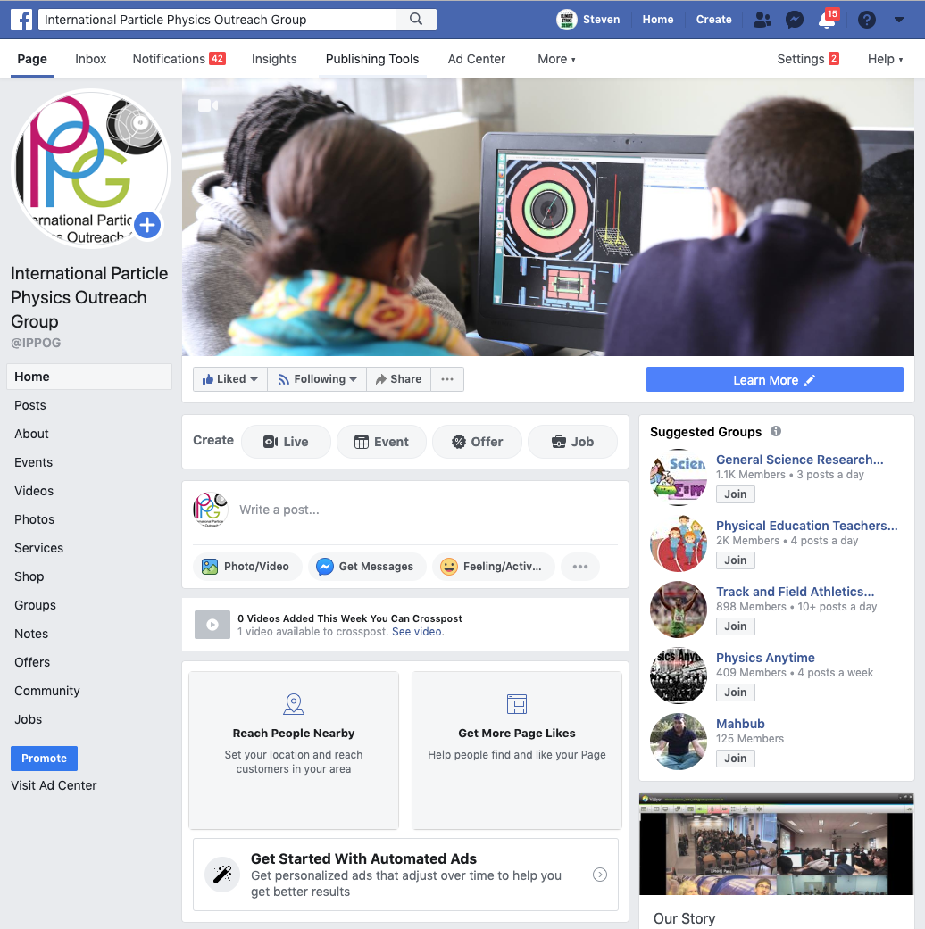
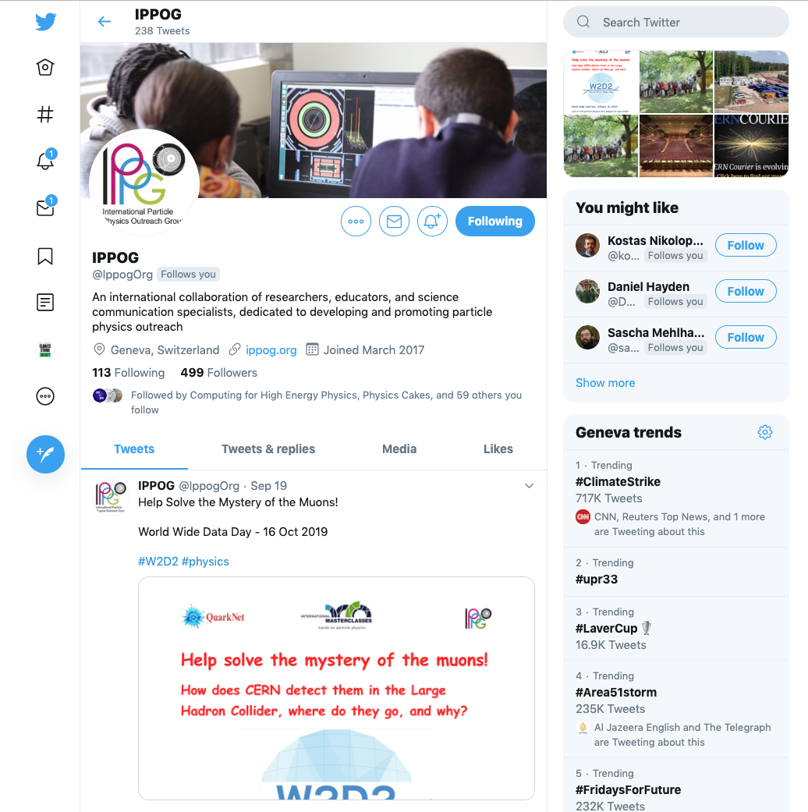
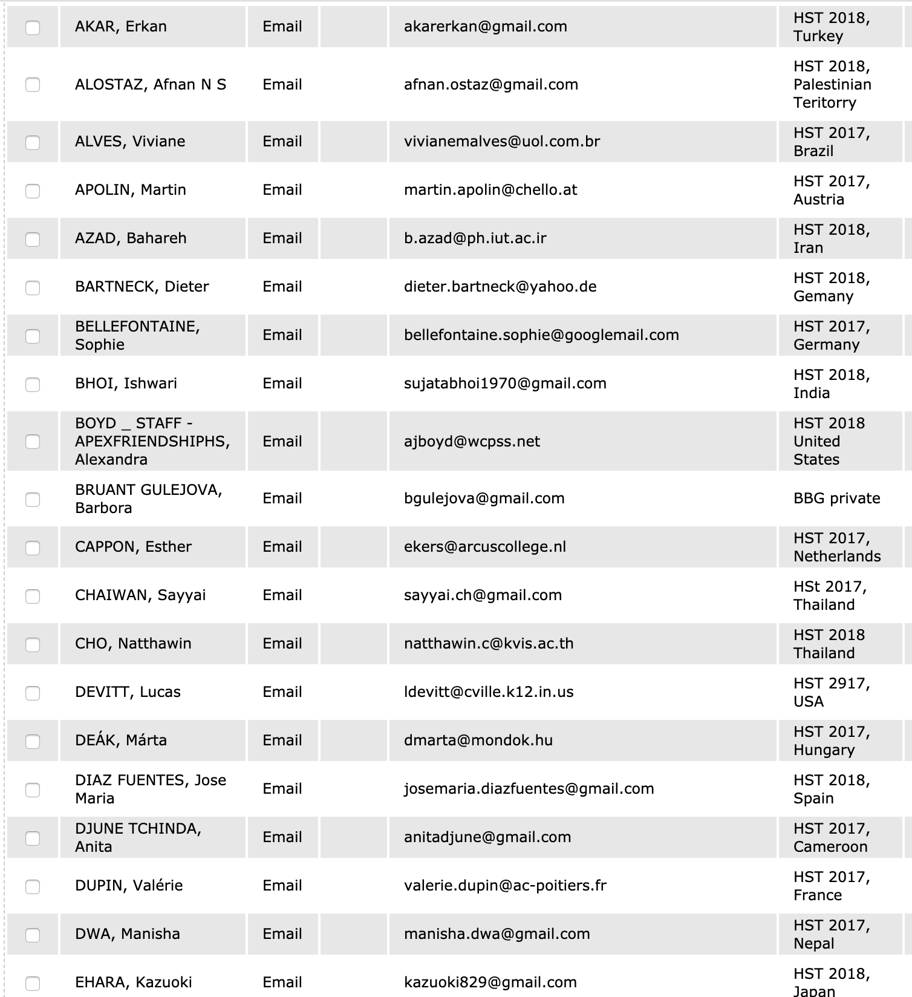
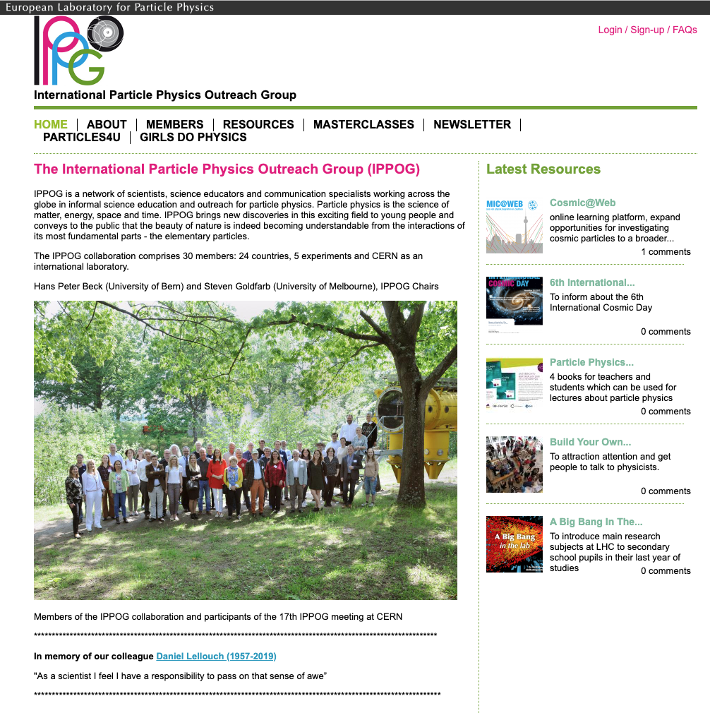
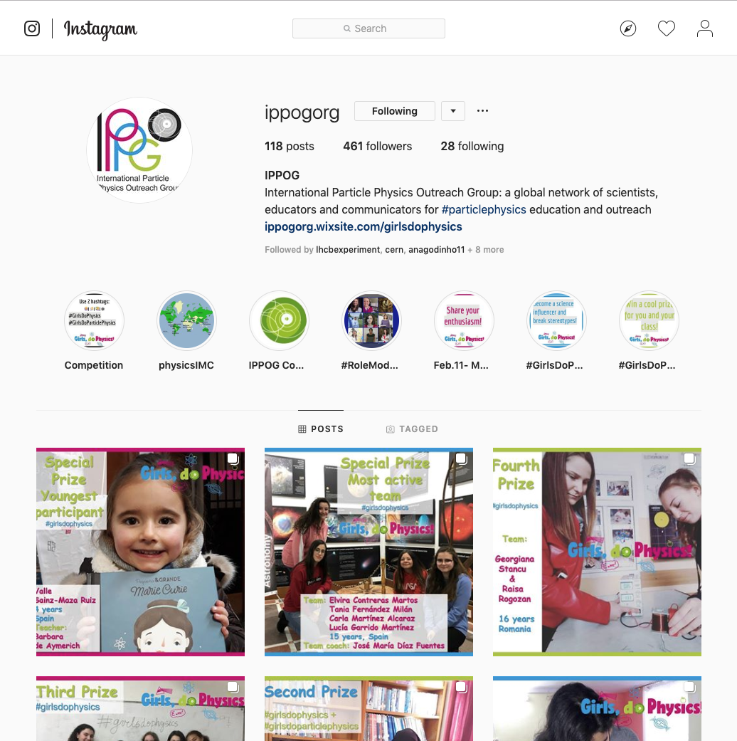
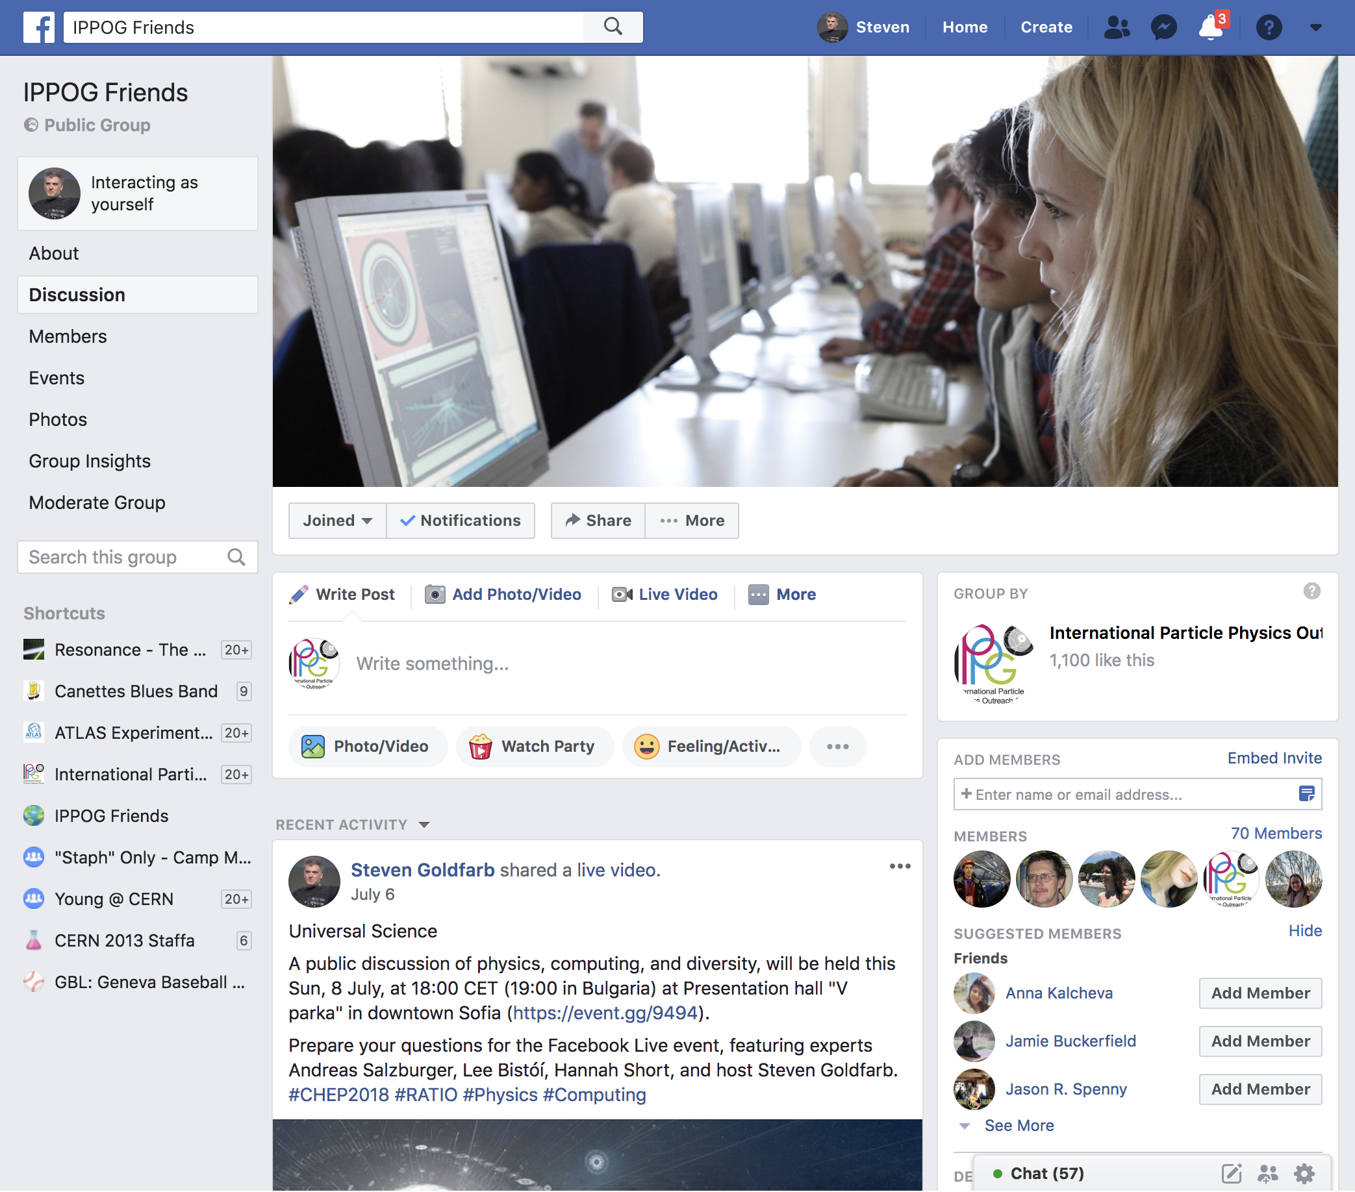
Communication Platforms
International Particle Physics Outreach Group
http://ippog.org
http://facebook.com/ippog
http://facebook.com/groups/friends.ippog
http://twitter.com/ippogOrg
http://instagram.com/ippogOrg
ippog-friends@cern.ch

Slide 22
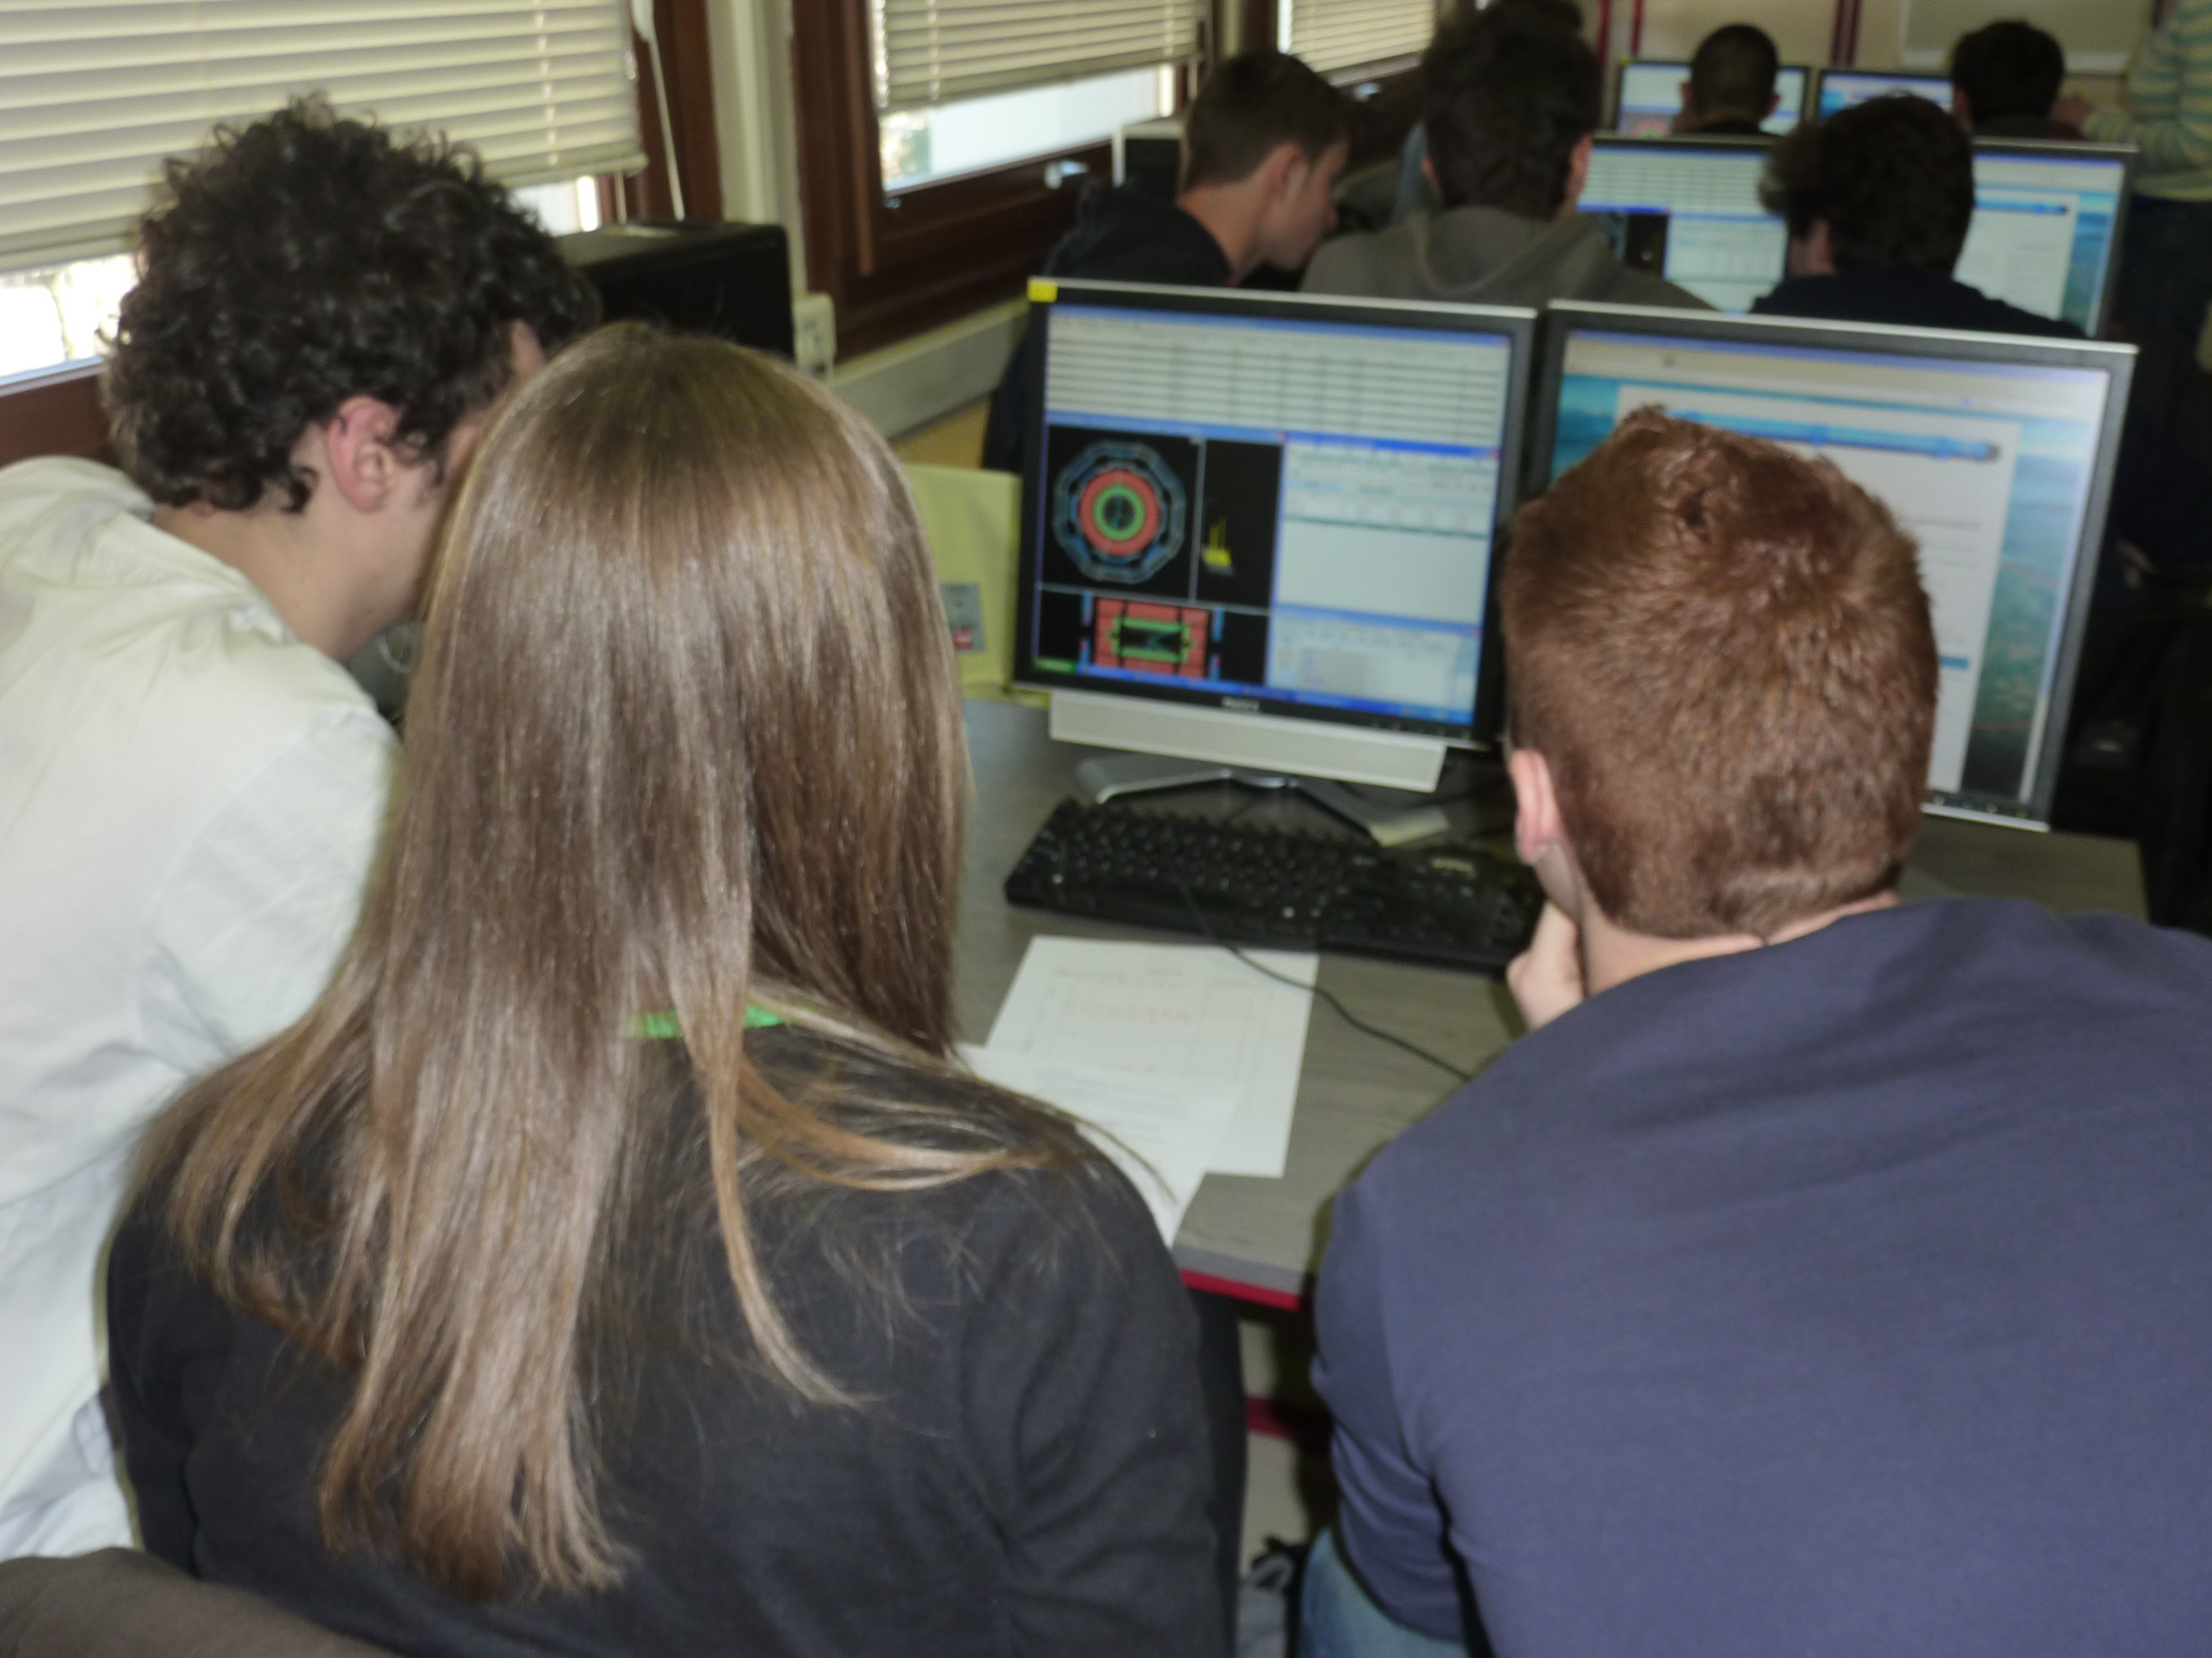
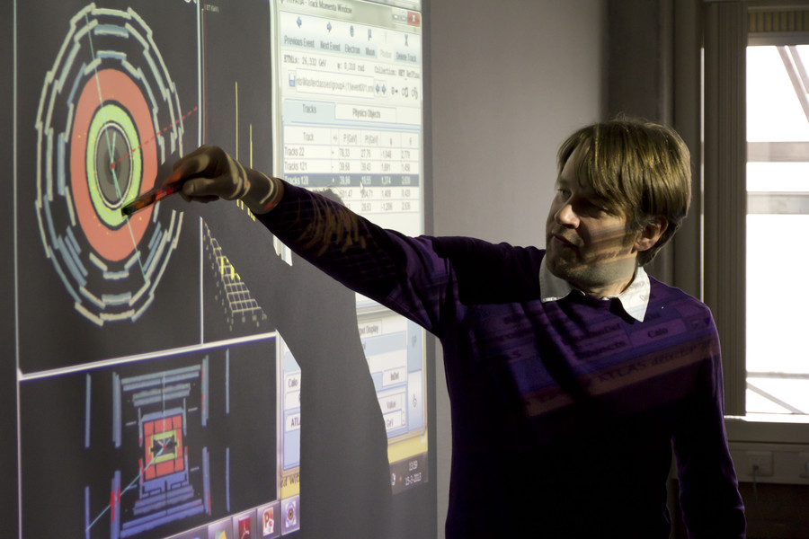
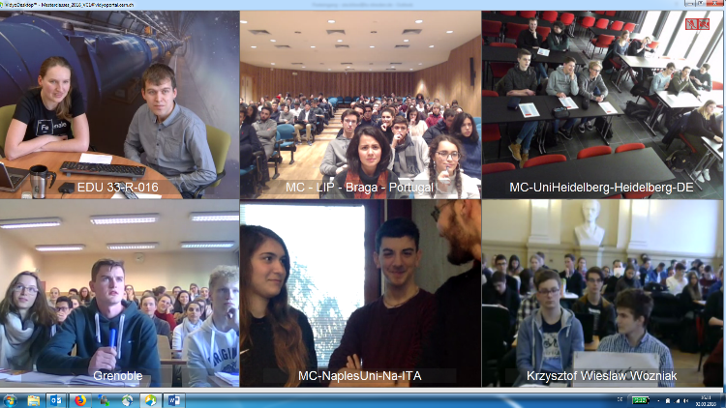
International Particle Physics Masterclasses
The Flagship of IPPOG
  Students become “Researchers for a Day”
  Invited to research institute or university
  Given introductory lectures on particle physics research
  Taught to use analysis tools to examine real data
  Spend 2 hours on research
  Discuss results via videoconference with other students around the world
In 2020
  26 Feb – 8 Apr

Slide 23
International Particle Physics Masterclasses
The Measurements
  ATLAS W-Path (Study Ratio W⁺ / W⁻, extra credit for H→ WW)
  ATLAS Z-Path (Measure Z Mass, extra credit for Z’ bosons, H →𝛾𝛾)
  CMS (Identify W, Z, H Decays)
  ALICE Strange Particles
  ALICE R_{AA} Measurement
  LHCb D⁰ → K𝜋
  MINER𝜈A
New Masterclasses being explored
  IceCube, Auger, BELLE II
  Particle Therapy (GSI/FAIR)
Tools & Data Continually Renewed

Slide 24
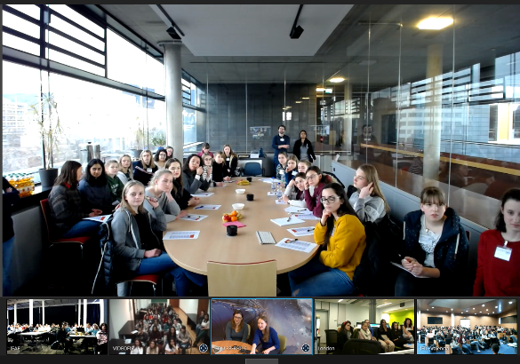
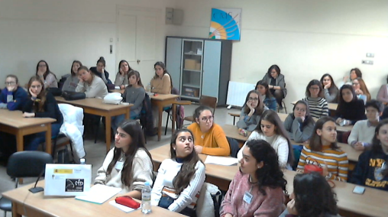
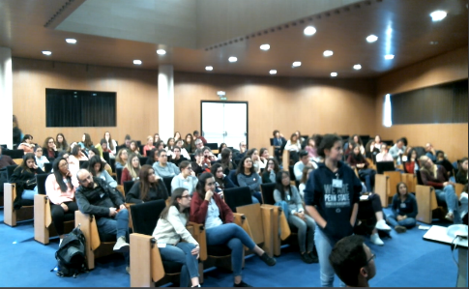
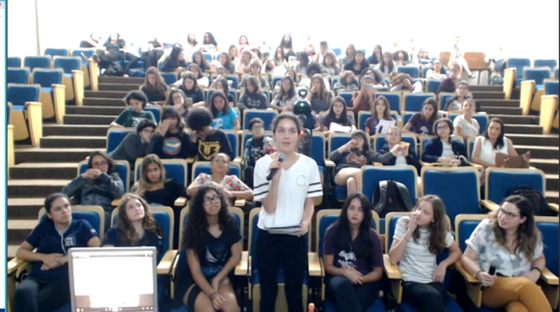
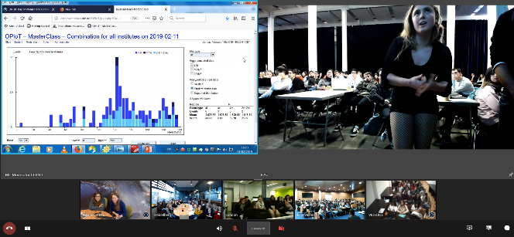
International Particle Physics Masterclasses
International Day of Women and Girls in Science 2016-2019

Slide 25
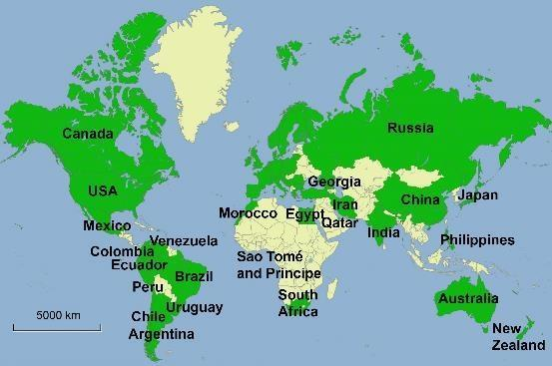
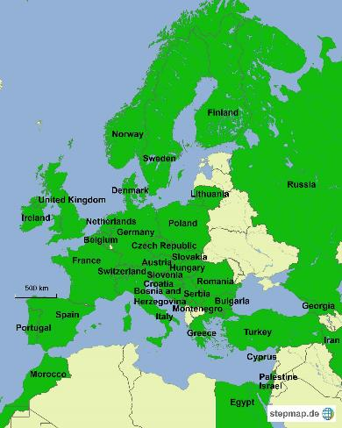
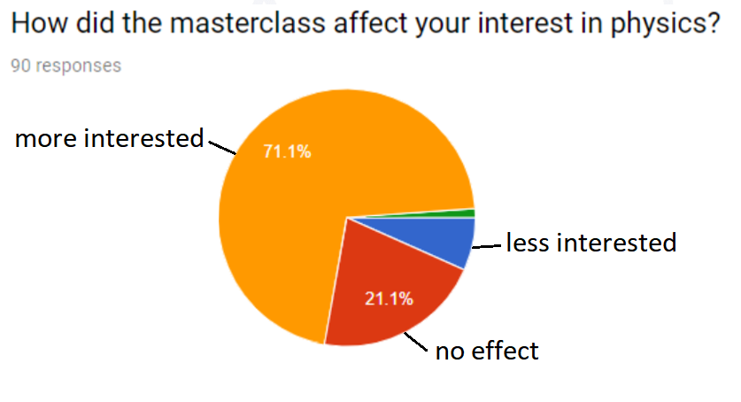
International Particle Physics Masterclasses
2019 Programme
  7 Mar – 16 Apr 2019
  54 Countries
  added Spanish Videoconfs
QuarkNet
51 Institutes
54 LHC Masterclasses
  32 CMS
  22 ATLAS
12 MINERvA Masterclasses
TU Dresden
188 Institutes
266 LHC Masterclasses
  30 ATLAS W
  101 ATLAS Z
  64 CMS
  41 LHCb
  27 ALICE SP
  3 ALICE R_AA

Slide 26
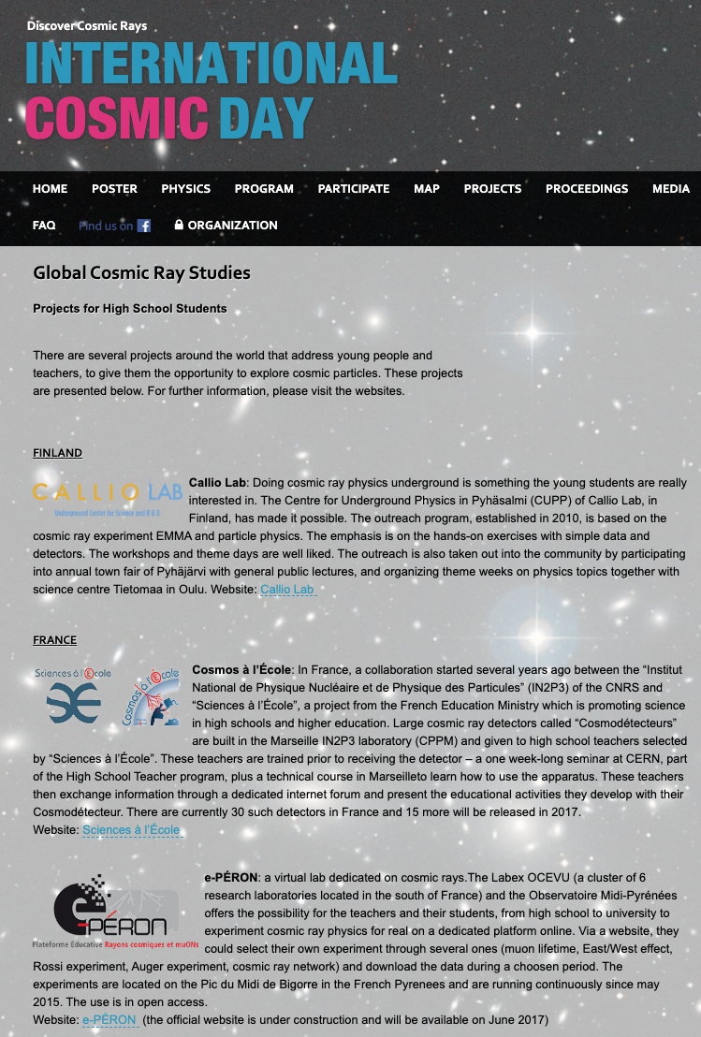
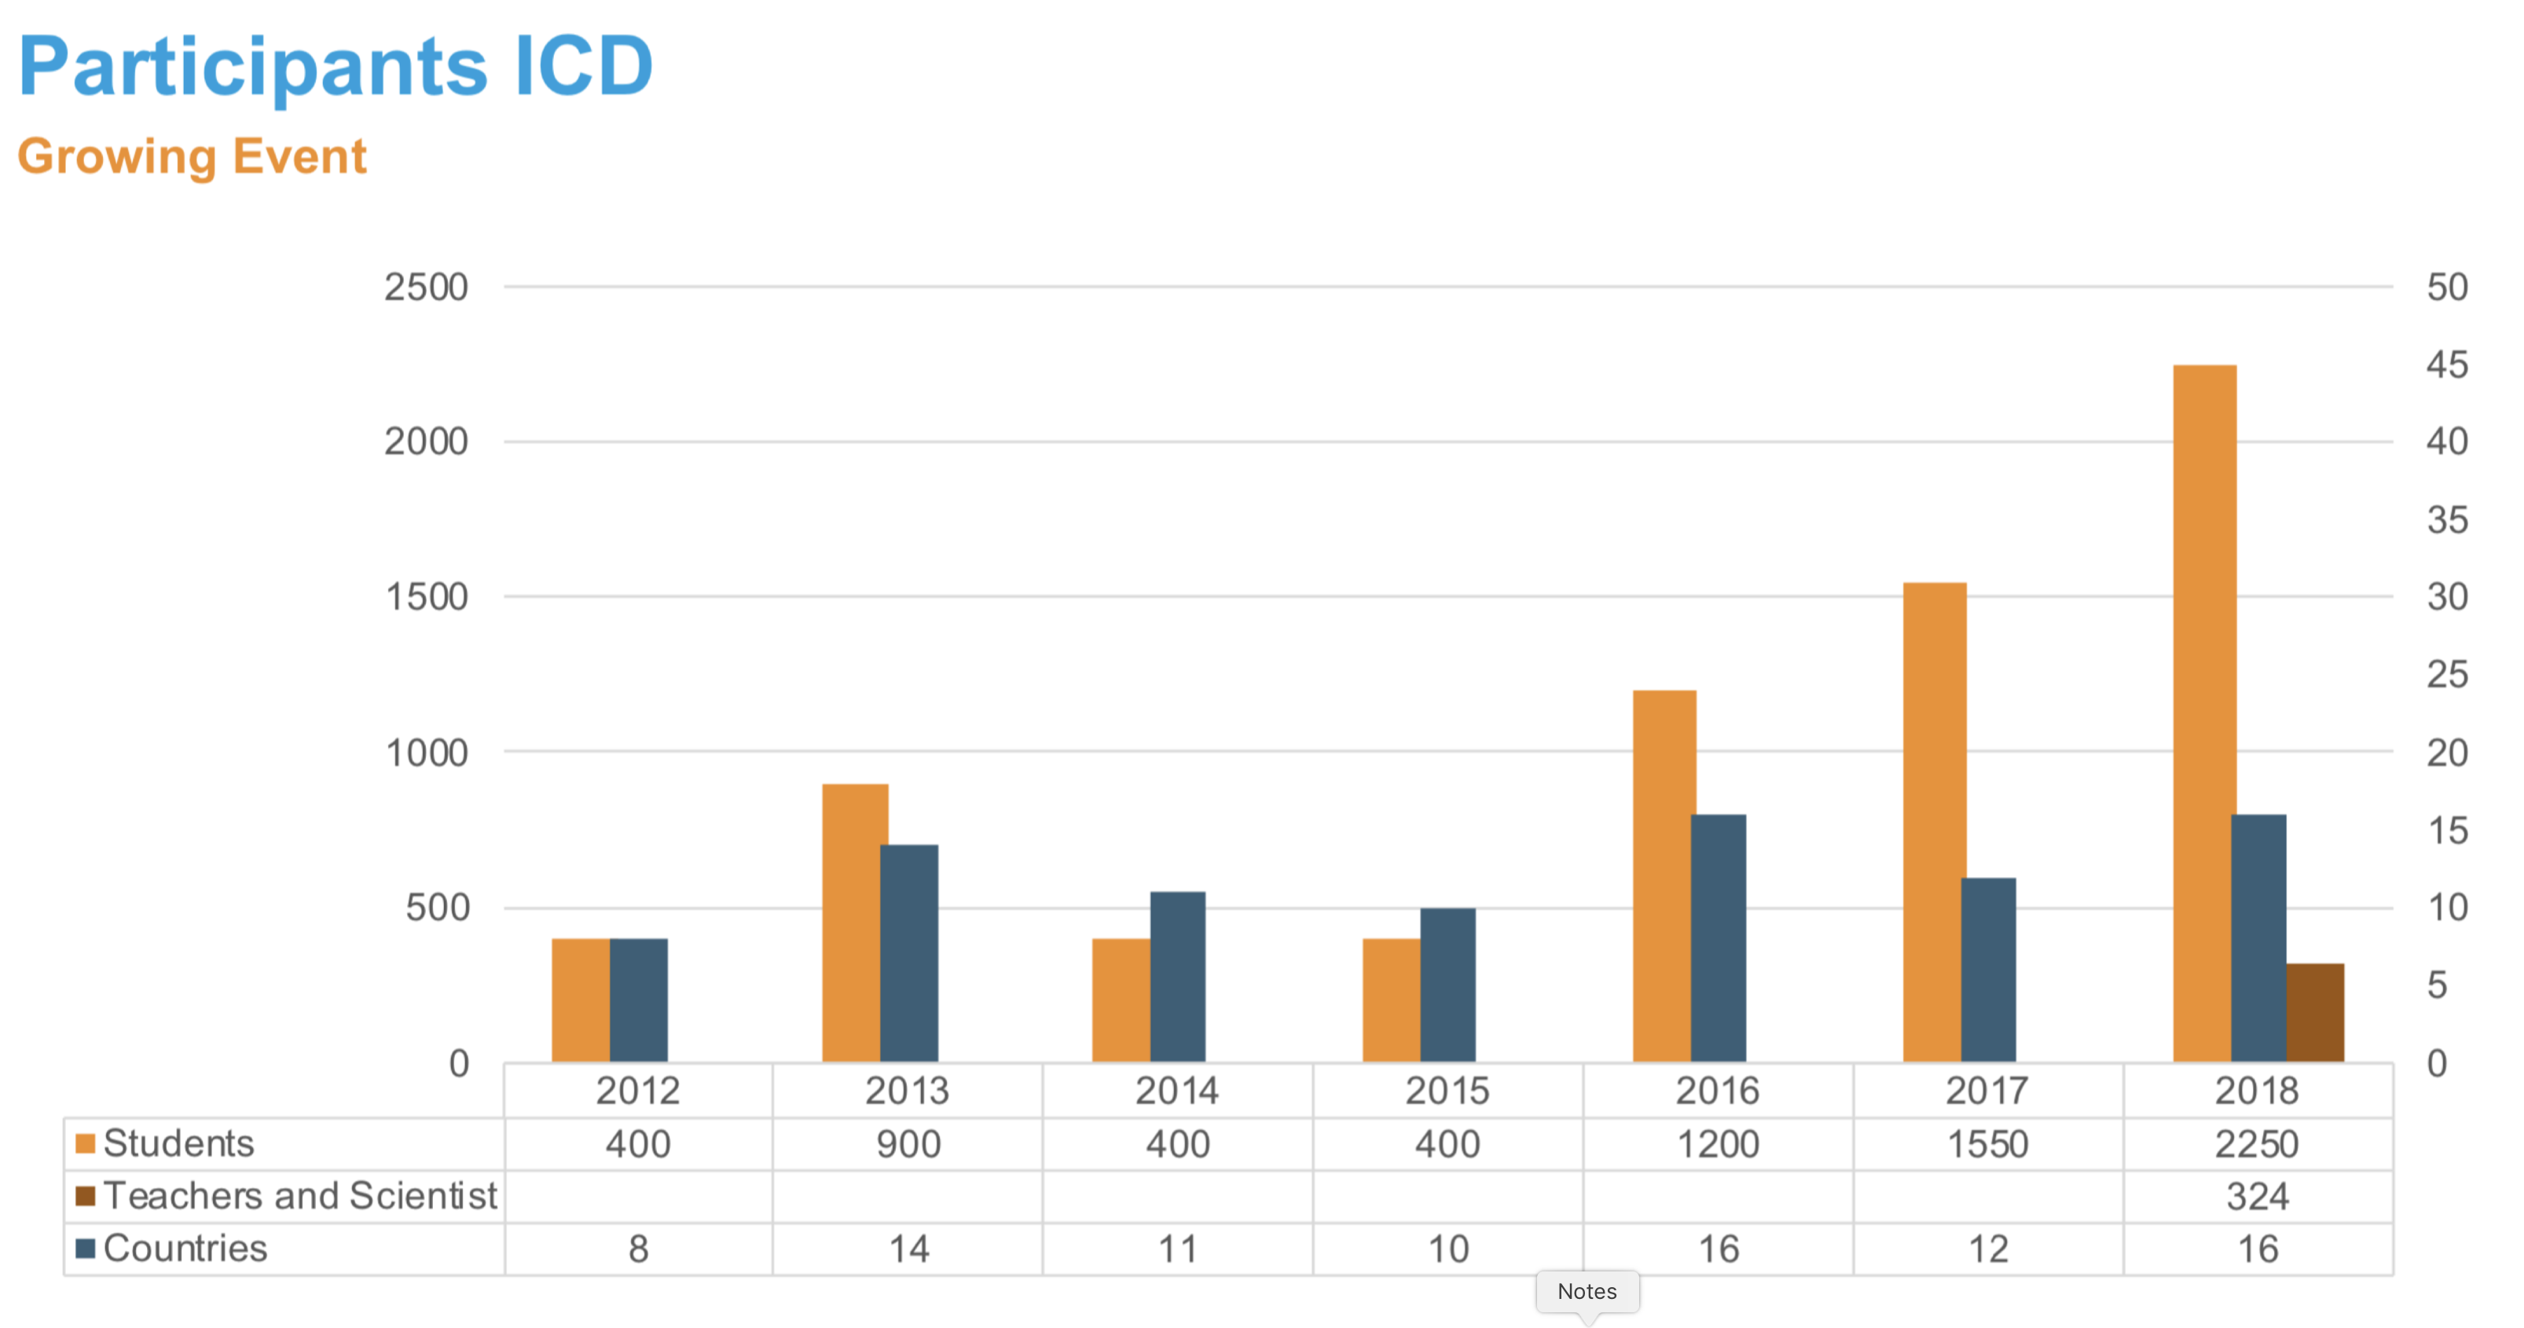
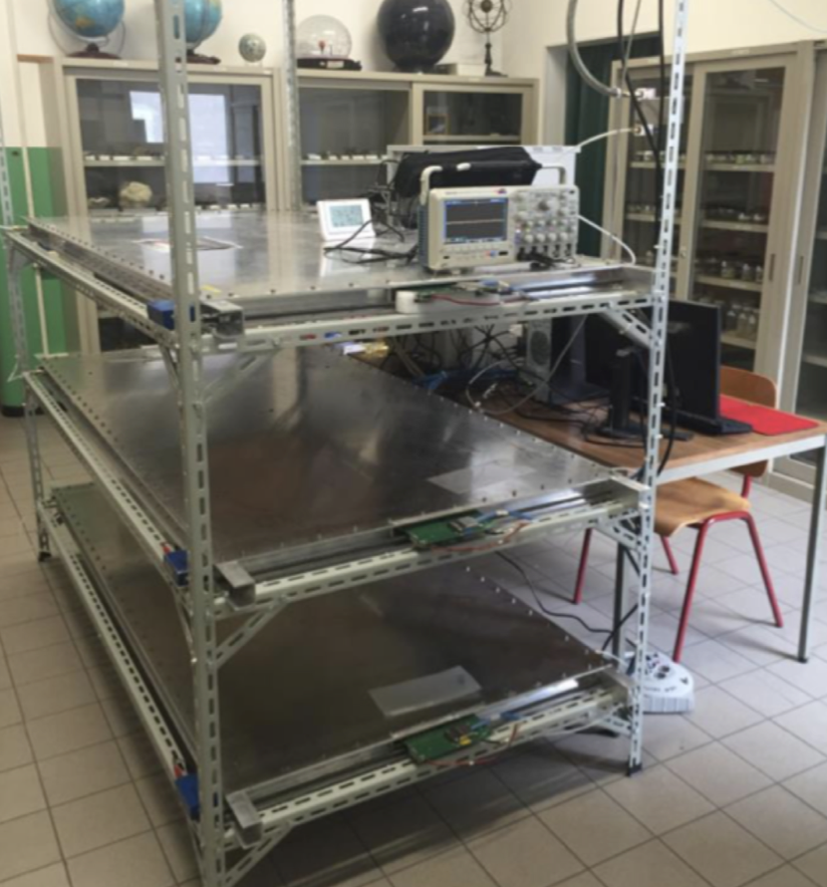

Global Cosmics
High School Initiatives Exploring Cosmic Rays
  Sabine Hemmer (INFN), Carolin Schwerdt (DESY)
  International Muon Week (1-5 Apr 2019)
    54 sites participated
    World-wide project: measure average speed of muons
  International Cosmic Day (6 Nov 2019)
    What are cosmic particles? Where do they come from? How can they be measured?
http://globalcosmics.org

Slide 27



World-Wide Data Day (W2D2)
15 Nov 2018 (24h)
  Participating groups: 66
  Students: 1064
  Moderators: 24
Measurement
  Students measure theta and phi for dimuon events
  Data analysis at school, physics discussion in VC
  Measurement used in Chile, Mexico, Namibia workshops in 2018
  Great growth in Mexico: 9 groups
  Measurement stable
http://tiny.cc/w2d2-18

Slide 28

CERN’s Beamline 4 Schools
IPPOG Participation
  Local Contacts to Schools
  Help Remove Language Barrier
  Give Guidance for Physics, Feasibility
http://beamlineforschools.cern

Slide 29





Public Events & Festivals
Colours of Ostrava
Czech Rep, 2019
Universal Science, CHEP
Sofia, Bulgaria, 2018
Pohoda Festival
Slovakia, 2019

Slide 30








In The Media
Italy, 17 Nov 2018
Bulgaria, 23 Jan 2019
Italy, 5 Feb 2019
Brazil, 26 Mar 2019
Slovakia, 5 Apr 2019
Serbia, 18 Mar 2019
Czech Rep, 26 Feb 2019
Montenegro, 14 May 2019

Slide 31

In Conferences
APS April 2019 – Denver, CO, USA
  International Masterclasses: Particle Physics for High School Students and Teachers, Ken Cecire, IPPOG Masterclass Coordinator
LHCP 2019 – Puebla, Mexico
  Particle Physics Outreach as a Strategic Pillar for Society: A report from IPPOG, Sascha Mehlhase, ATLAS IPPOG Rep
EPS HEPP 2019, Ghent Belgium
  Future Challenges in Particle Physics Education and Outreach, Hans Peter Beck, IPPOG Chair
  Developments in International Masterclasses, Uta Bilow, IPPOG Masterclass Coordinator
ICNFP 2019 – Kolymbari, Crete, Greece
  The International Particle Physics Outreach Group, Despina Hatzifotiadou, ALICE IPPOG Rep
CHEP 2019 – Adelaide, Australia
  International Particle Physics Masterclasses - Current development to expand scope and global reach, Farid Ould-Saada, Norway IPPOG Rep
  The International Particle Physics Outreach Group - Reaching Across the Globe with Science, Steven Goldfarb, IPPOG Chair
  The IPPOG Resource Database – Making Particle Physics Outreach & Education Available Worldwide, Marzena Lapka, CMS IPPOG Rep
Proceedings to LHCP 2019

Slide 32
What about NuPECC & ApPEC?

Slide 33

NuPECC Outreach
Outreach Board (PANS = Public Awareness of Nuclear Science)
  Sissy Körner (Scientific Secretary)
  Rodi Herzberg (NuPECC)
  Stephan Pomp (EPS/NPB)
Existing Content
  Booklets for the public based on NuPECC Reports
  NUPEX Educational Database
    continuously being updated and translated
  Book "Nucleus - a Trip into the Heart of Matter”
Ongoing Activities
  Nuclear Physics News
    (http://nupecc.org/?display=npn/issues)
  PANS Web Site
    pool of information on ongoing outreach activities (http://nupecc.org/pans/)

Slide 34


NuPECC Outreach
http://nupecc.org/pans
http://nupecc.org
http://nupex.eu

Slide 35


NuPECC Outreach
http://nupecc.org/?display=npn/issues
https://jhupbooks.press.jhu.edu/title/nucleus
Special Edition

Slide 36



ApPEC Outreach
Outreach Team
  Katrin Link, KIT
Communication Efforts
  Website www.appec.org
  Newsletter
  Twitter @astroparticle

Slide 37


Astroparticle Physics Outreach
Outreach done by many Astroparticle Physics experiments and several national and international groups
  Masterclasses (IceCube, Auger)
  International Cosmic Day (https://icd.desy.de)
  Dark Matter Day (https://www.darkmatterday.com)
  International Muon Week
  Cosmic@web (http://cosmicatweb.desy.de)
  National activities, e.g. Netzwerk Teilchenwelt in Germany (www.teilchenwelt.de)
    Already cooperation of Astroparticle, Particle and Nuclear Physics
→ ApPEC has begun a survey on outreach activities in Astroparticle Physics to get a better overview and to connect with different groups.

Slide 38


Astroparticle Physics Strategy

Slide 39
ApPEC-ECFA-NuPECC Commonalities
Common Goals
  Developing Best Practices in Informal Education & Outreach
  Enabling National & International Outreach Efforts
  Establishing Communication Channels & Networks
Common Activities & Partnerships
  Masterclass Development
    ALICE R_{AA}, GSI/FAIR Particle Therapy
    MINER𝜈A, Ice Cube, Auger, HAWC?
  Global Cosmics
    International Cosmic Day
    International Muon Week
  What about Gravitational Waves?
    Outreach meeting following GR22 / Amaldi13 in Valencia, July 2019
    IPPOG attended and presented
    Proposal of “International Gravitation Outreach Group”

Slide 40
A Few Concluding Thoughts
In Outreach there has always been overlap of our fields
  The public wants to learn about the universe (they don’t care about which field)
  We are all learning how to give each other’s Masterclasses
    And that is awesome, by the way…
Outreach messages are the same
  To the public: Science is essential – support it, do it (it makes us better citizens)
  To our colleagues: Outreach is strategic – support it, do it (it makes us better scientists)
IPPOG
  Is happy to welcome our NuPECC and ApPEC colleagues
  We would like to broaden our scope, both in geography and in physics content
  We already provide a platform to share ideas and content
  And we are not afraid to change our acronym

Slide 41


Slide 42

or something like that…

