Slide 1




« Big Data » Challenges for Science
Françoise Genova
Observatoire Astronomique de Strasbourg RDA-France
Many thanks to Maurizio Pierini and Giovanni Lamanna
Présenté par

Slide 2
Big Data requires data
Storage/network and computing/software needs and challenges often much better understood than data
Data availability and quality are key for Big Data
N. Vayatis, Introduction to AI, Forum ORAP Nov. 2018

Slide 3
The FAIR principles and their implementation
The FAIR Principles
Findable, Accessible, Interoperable, Reusable
http://www.nature.com/articles/sdata201618
Report and Action Plan of the EC FAIR Expert Group (2018)
Concepts
Research culture
Technical ecosystem
Skills
Metrics
Sustainable and strategic funding
Recommandations et actions

Slide 4
Open Science is high on the political agenda but is not only a political question!
It changes the way research is performed!
Discover data, access them, reuse them, combine them
All disciplines are concerned, but they are at different readiness levels
First changes the way disciplinary research is performed
Enables interdisciplinary research, in particular for societal challenges
Strong disciplinary pillars are necessary to enable interdisciplinary research

Slide 5
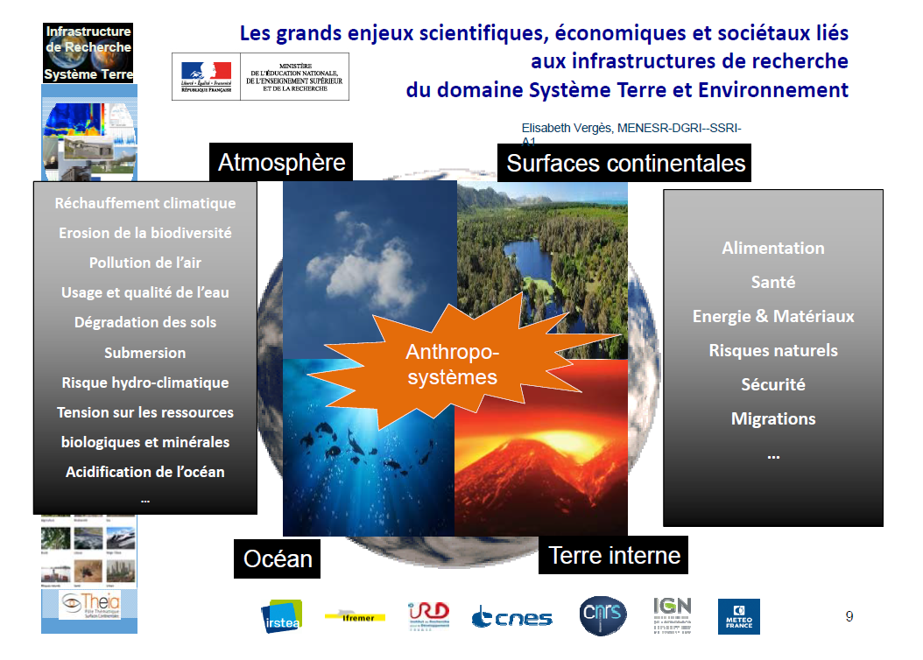
National Data Terra Research Infrastructure
Thanks to F. Huynh

Slide 6
There are many kinds of pillars and of bridges!
Inspired from J. Bicaregui, 2012

Slide 7
Disciplinary Interoperability Frameworks
Astronomie/Earth sciences/Humanities/Linguistics/Material sciences/Cristallography
Common points
Driven by science needs
Define the disciplinary part of interoperability standards is difficult but mandatory
Sharing data and tools
Incentives
Sociological aspects are more difficult than technical ones
Disciplines can share many methods and techniques
The governance system is more diverse, it depends on the discipline, its culture, history and organisation – each disciplines has its own practices and needs
Panel at the International Data Week, Denver 2016
Genova et al. Data Science Journal 2017

Slide 8
How to make it happen?
Work is necessary at the disciplinary level
It should involve people who know that data and the user needs
International collaboration mandatory to define disciplinary standards (formats, semantics, …)

Slide 9

The Research Data Alliance
A neutral forum to tackle all aspects of science data sharing, technological and sociological, and to work on recommendations
Funded by EC, The Australian Goverment and NSF in 2013
More than 9000 members from 137 countries
Very diverse membership of « data practitioners », including funders
Bottom-up: Activities proposed by the members
Currently 87 Working Groups and Interest Groups
Plenary meeting next week in Helsinki, then Melbourne 18-20 March 2020

Slide 10
Data sharing in astronomy: accessibility AND reusability
International collaboration on standards
Format including data and metadata (FITS) 1979 > Reusability
The astronomical Virtual Observatory (VO): Interoperability of data and tools
Standards and tools to Find, Access and Intereoperate data
Standards defined by the IVOA (since 2002)
Open and inclusive framework, distributed with no central point – anyone can « publish » a data resource in the VO, anyone can develop a VO-enabled tool to access data
More than 100 « authorities » provide a resource in the VO, including most of the large data providers
Significant impact on RI impact: data is reused!

Slide 11
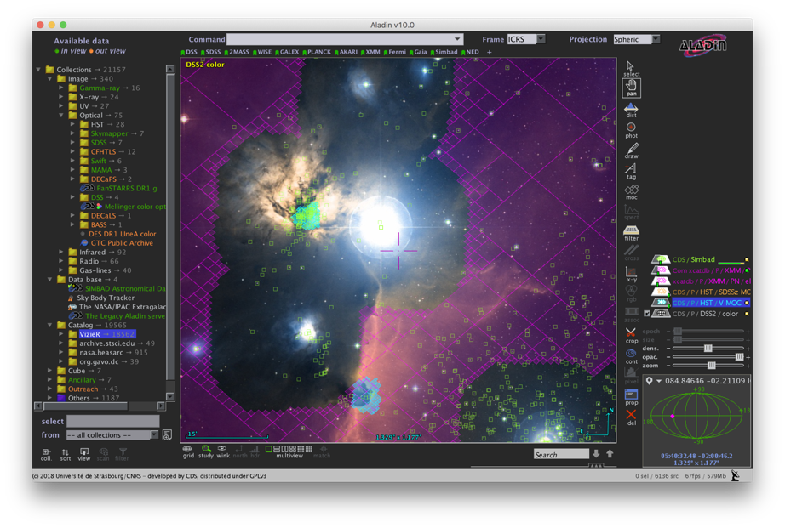
One view of the VO from an application:
Largest catalogues: PanSTARRS, Gaia etc.
1000s All-Sky data sets
Built from VO Registry
Complex ADQL queries
Multi-resolution techniques for Big Data
Data from many observatories and missions
Interoperability of data
Interoperability between applications

Slide 12
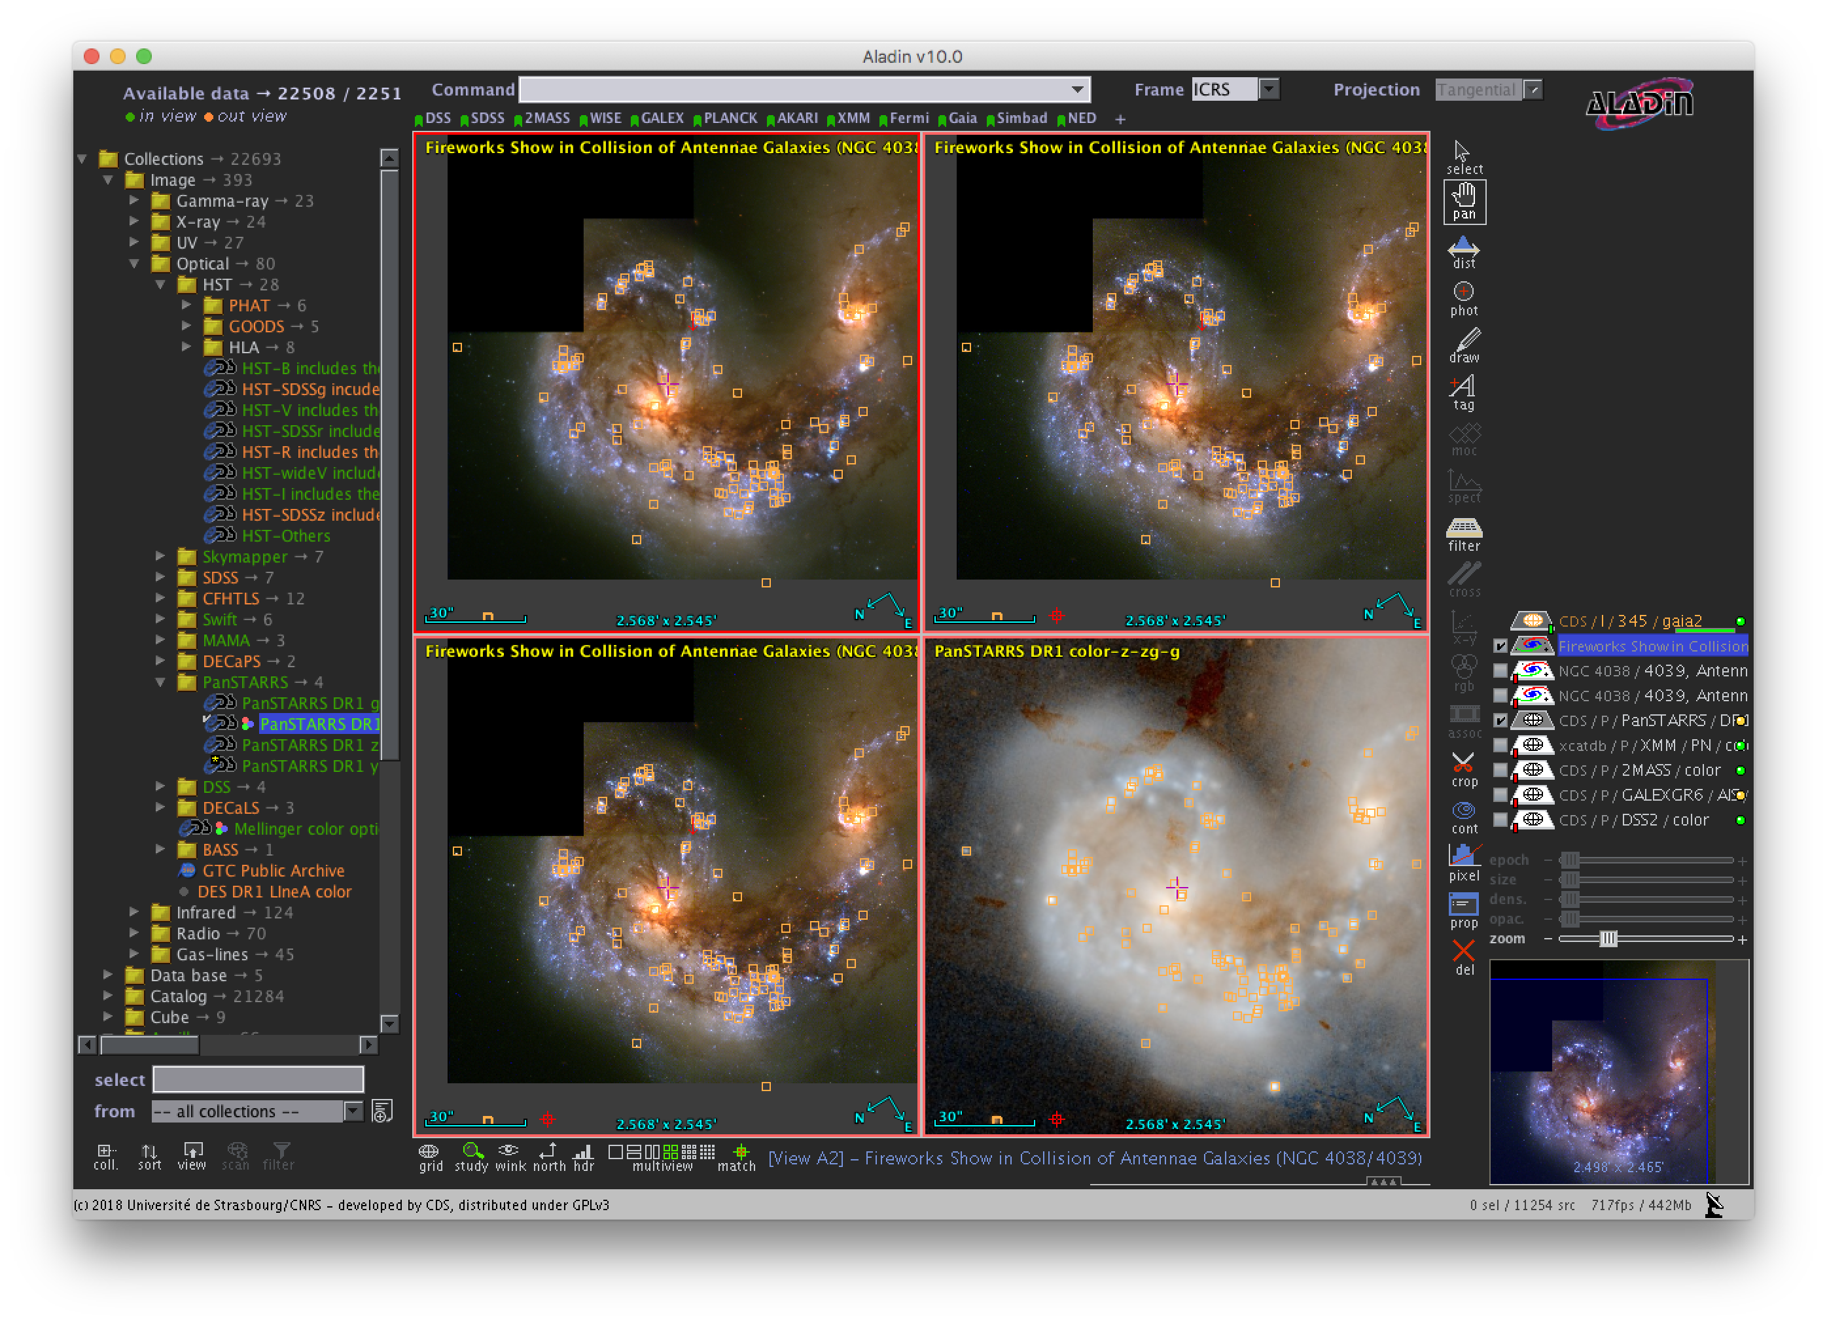
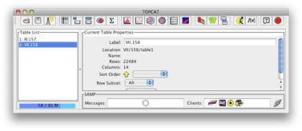
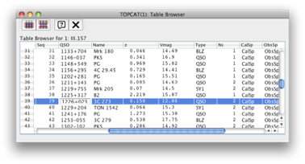
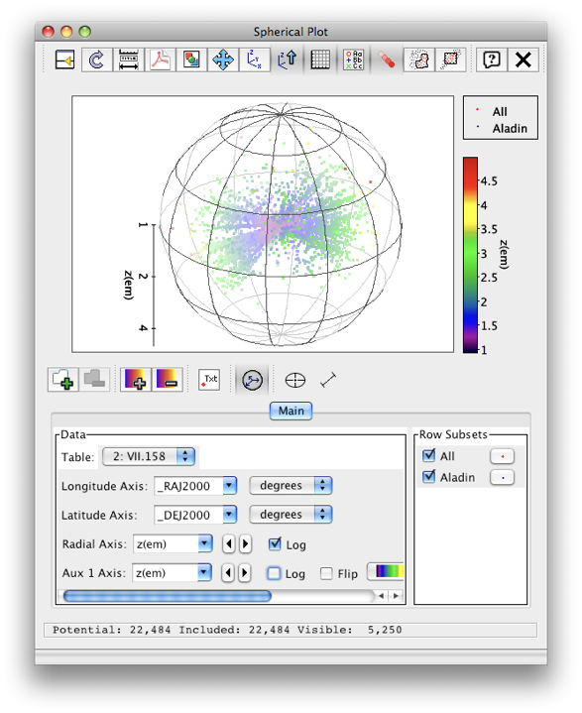


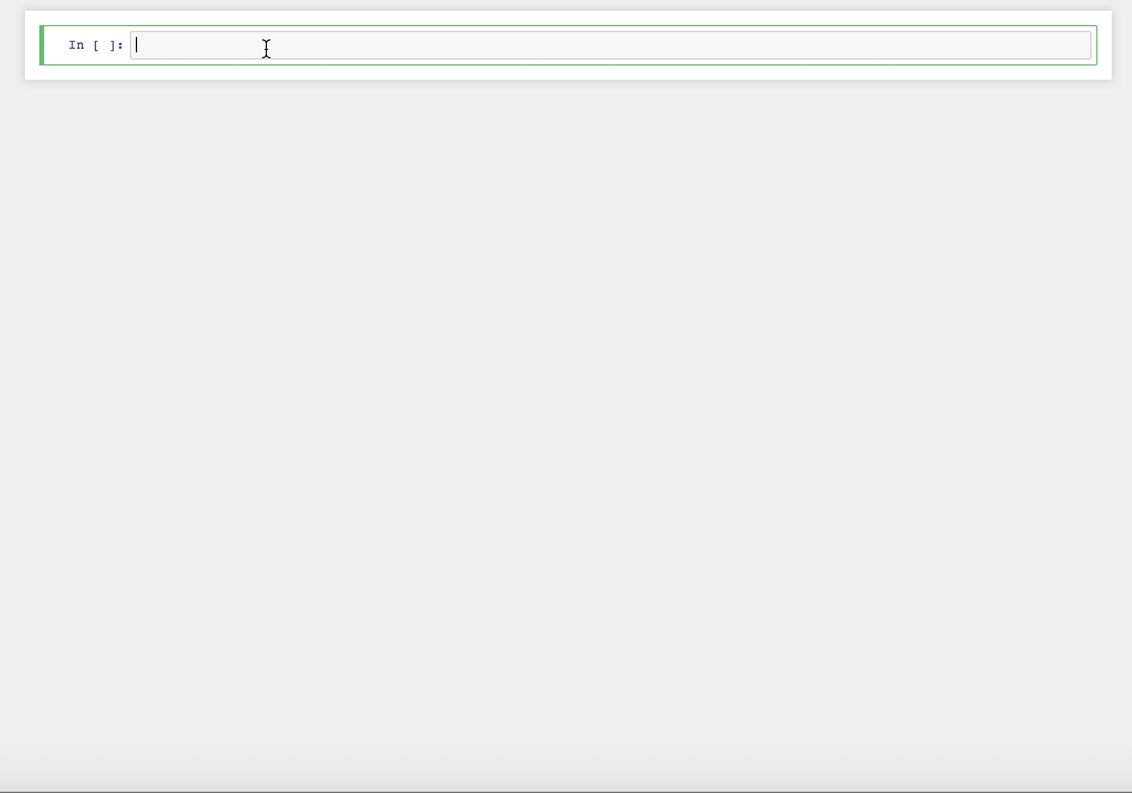
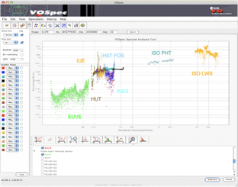

Interoperable applications and services
Aladin
Your apps
& programs
Notebooks
TOPCAT
Spectral tools

Slide 13
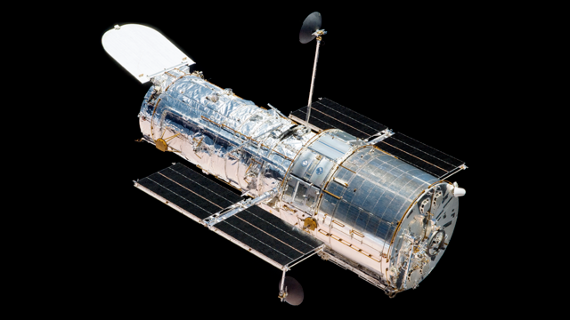
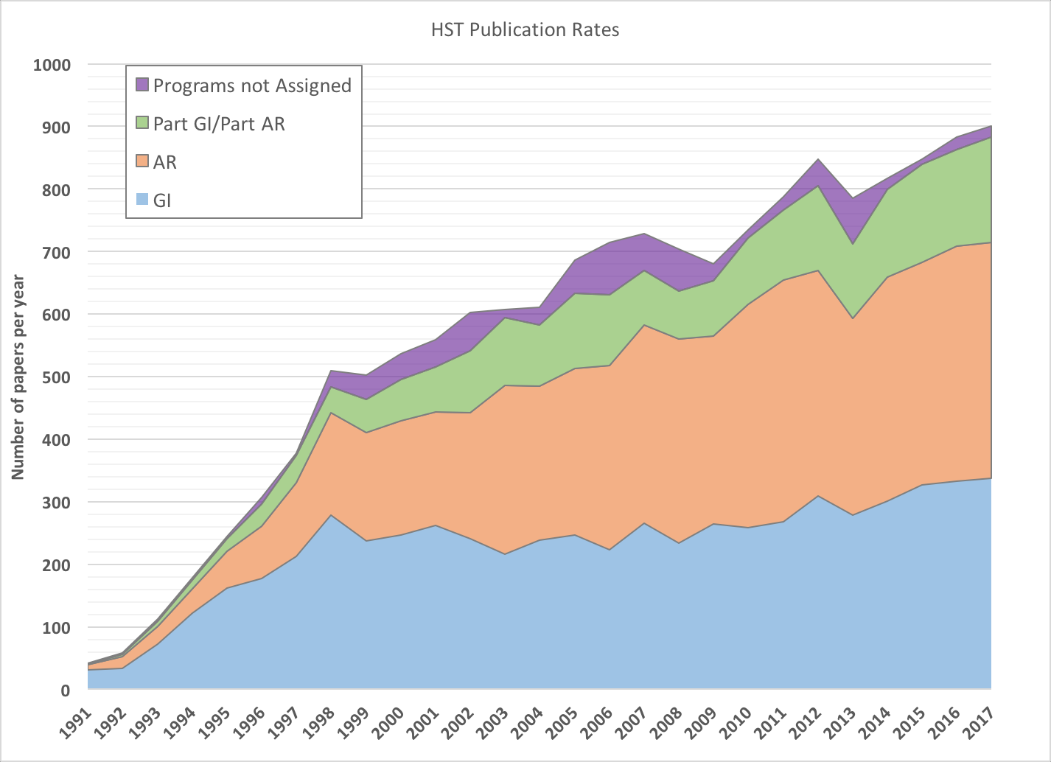
Impact for Research Infrastructures: Publications using HST data
Both
Archive
Guest
Observers

Slide 14
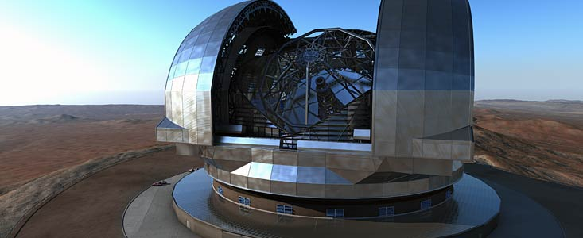
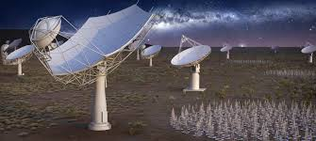
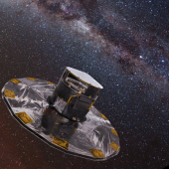

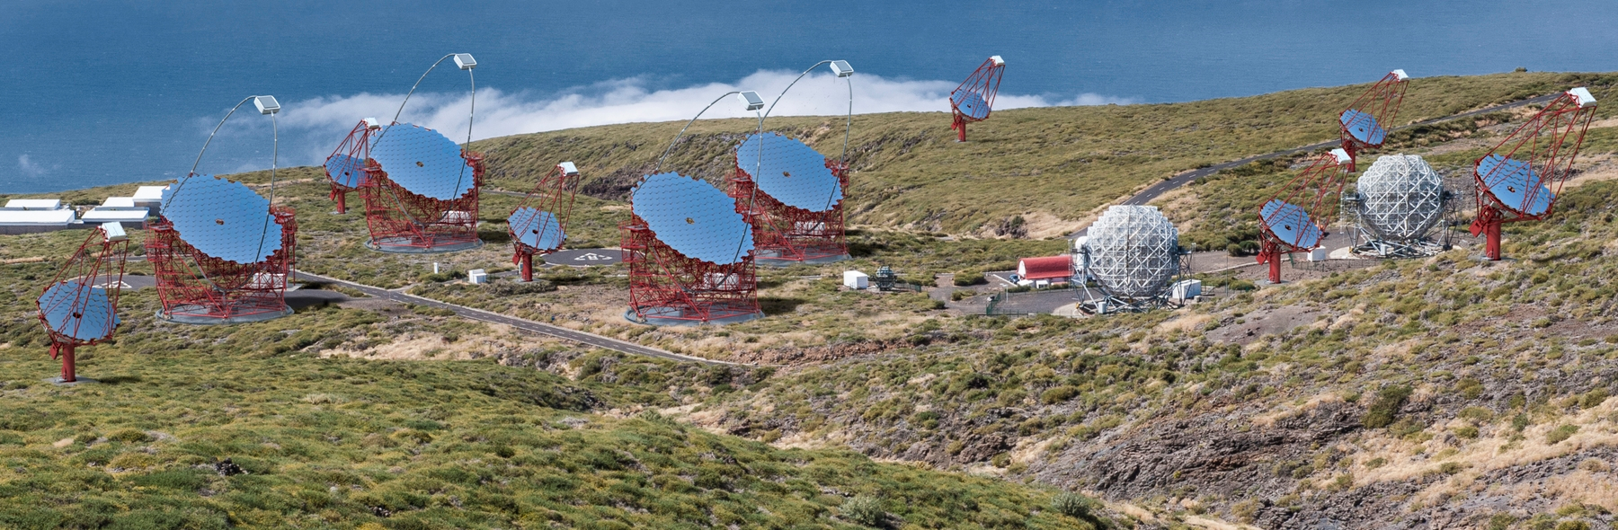
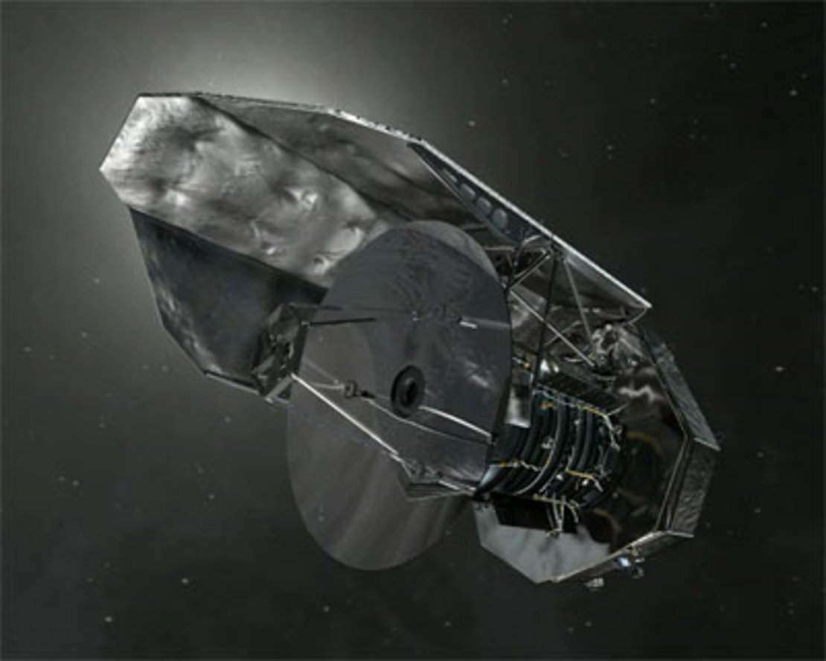
Research Infrastructures in astronomy/astroparticle physics
ELT
SKA
Gaia
CTA
Planck
+ DATA
Herschel

Slide 15
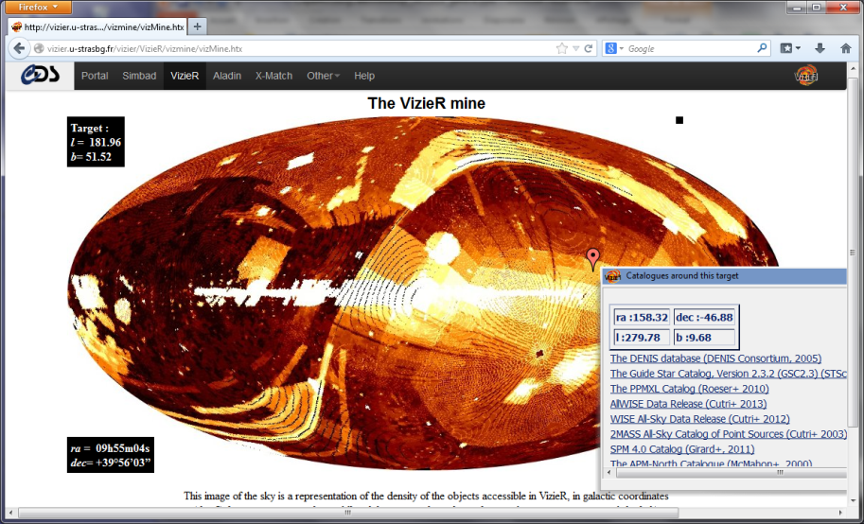
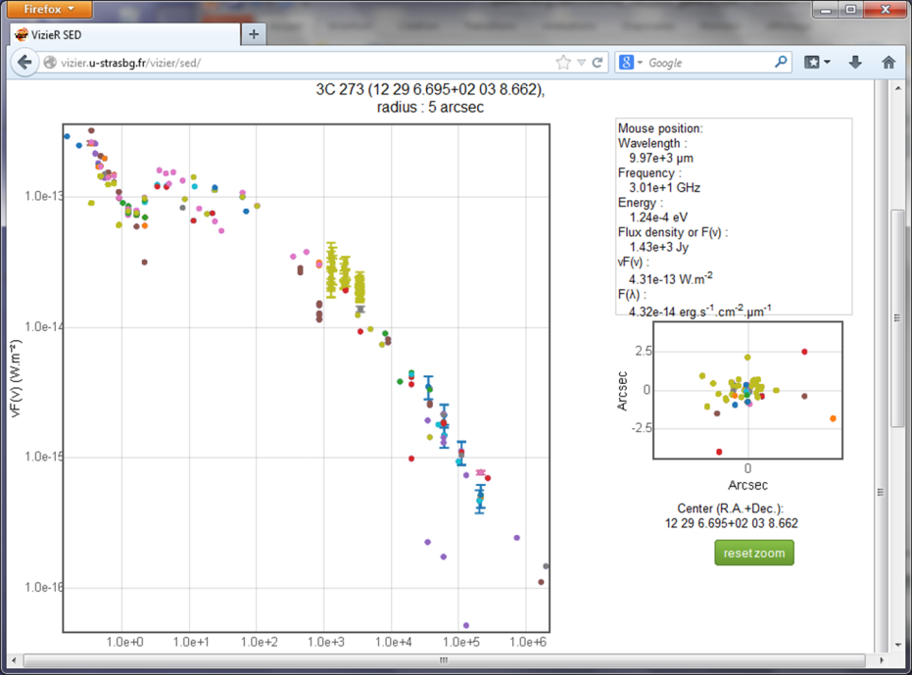
Small and Big data -
Including the « Long Tail » data: CDS/VizieR
Data validated by a publication
Homogeneous metadata describing
heterogeneous content – Variety!
Fully discoverable and usable
together with the very large surveys
“Photometry viewer”:
Spectral points
extracted from the
collection

Slide 16
Extension to other disciplines
ASTERICS Data Access, Discovery and Interoperability WP: Astroparticle physics (CTA, Km3NeT, EGO/VIRGO/ET)
From « Experiments » to « Observatories »
EUROPLANET VESPA: Solar system data
ESCAPE: Solar data
Atomic and Molecular data: VAMDC
Materials physics customized the IVOA Registry of Resources in an RDA Working Group

Slide 17
Servillat, Second DADI ESFRI Forum, 2017
CTA
Data
management
system

Slide 18

Graf, Second DADI Data Provider Forum 2018

Slide 19
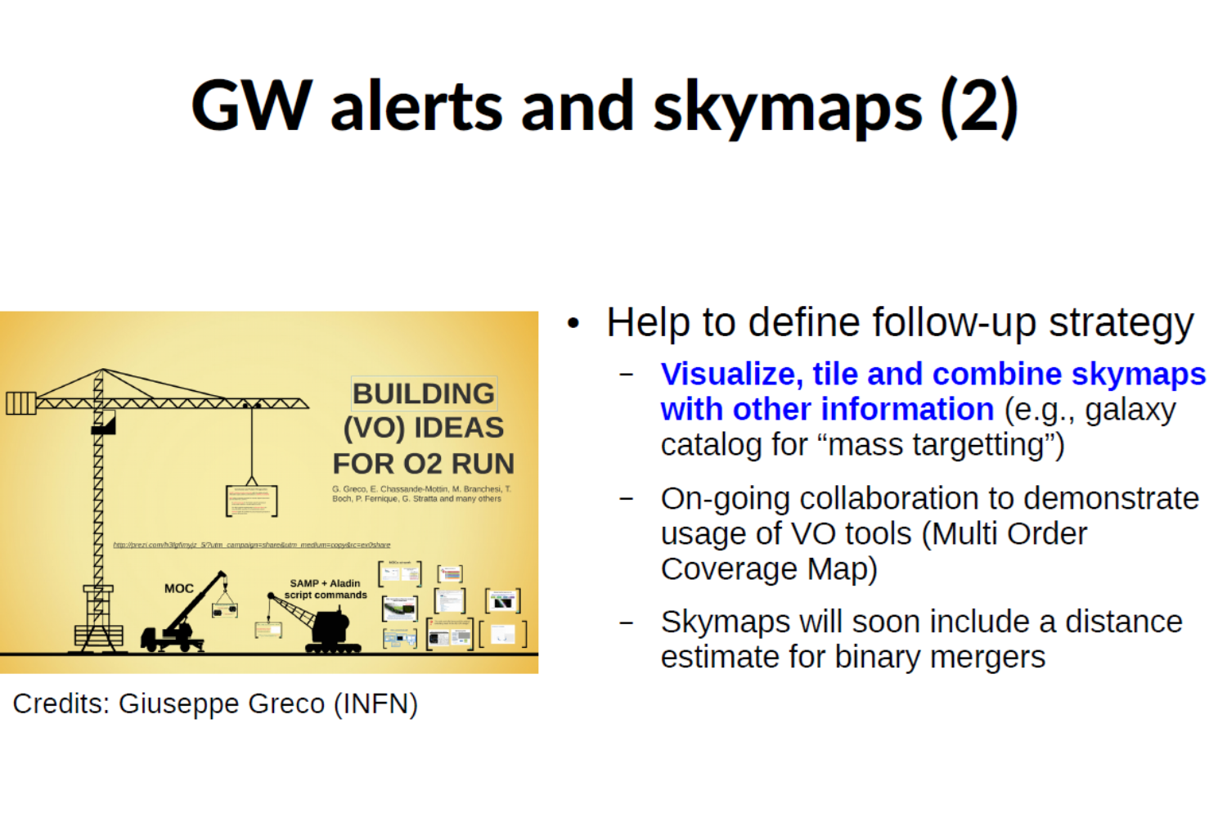

Slide 20
Greco et al, DADI ESFRI Forum Trieste 2017

Slide 21
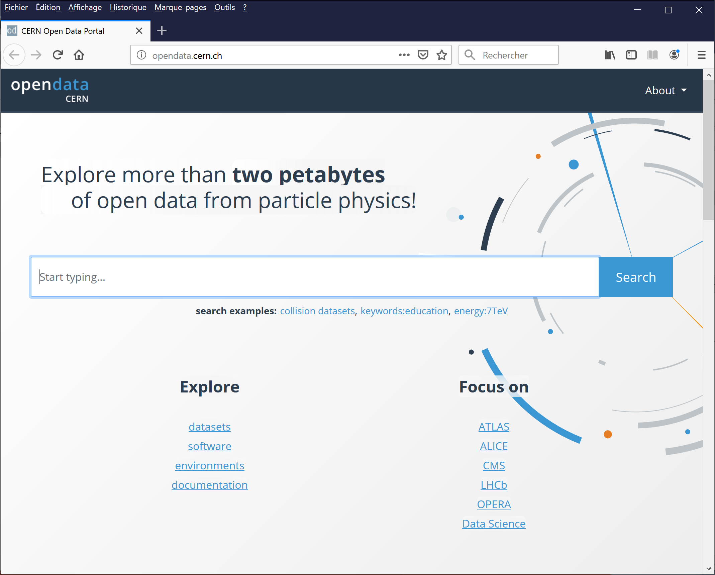
Open data at CERN

Slide 22
The impact of Big Data for astronomy
ISSI Forum « The Impact of Big Data in Astronomy » 4-5 July 2019 – Report available soon
Gaia, Euclid, LSST, SKA require new tools and methodologies
Complexity increases (e.g. objects blended at 27th mag), analysis of large fraction of large data set to derive results
Big Data developments and services should be driven by user needs – provide data and tools using the new technologies
Assess usage of AI technologies to automate data curation/preservation
Investements and improvements in e-infrastructure, in particular networks and storage – connect large data silos
Become more efficient and have less duplicated systems for simulation and processing – long term maintenance of software
Career paths and training
Many teams have begun to care about big data
E.g., ESO is exploring machine learning and analytics for adding value to its archive in ESCAPE WP4 Connecting ESFRI projects to EOSC through VO framework

Slide 23
Usage of Big Data should be science driven
All disciplines have to build their own point of view
Bridging activities
E.g. AI at CERN and SKA 17-18 September 2018, London
“This two-day workshop, to be held in central London at the Alan Turing Institute, will bring together the community of the Alan Turing Institute (ATI), AI researchers from industry, and scientists working with CERN or SKA surrounding the application of Artificial Intelligence (AI) for scientific discovery. The aim is to gain an understanding of what has been achieved in High Energy Physics (HEP) using data from CERN, and in astrophysics leveraging data obtained through radio astronomy. Areas of interest include processing of the raw instrument data, use of science data products for research and applicable technology. In discussions, possible new areas of collaboration and research will be explored.”

Slide 24
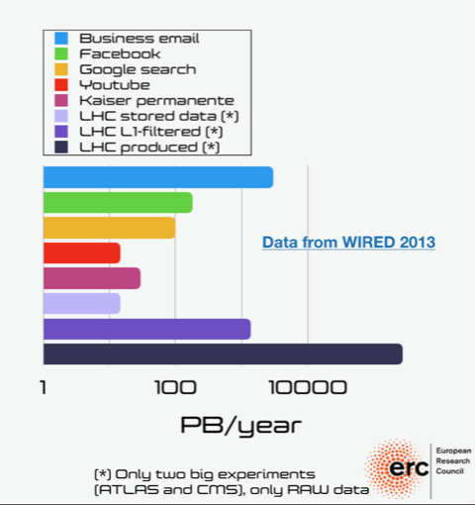
LHC Point of View on Big Data
From Deep learning for the future of the LHC, M. Pierini, AI at CERN and SKA
“The High-Luminosity LHC phase, scheduled for 2025, will challenge the commonly accepted solutions for tasks such as event reconstruction, real-time processing, large dataset simulation, etc. Deep Learning is considered as a strong candidate to solve this issue, by speeding up the task executions with potentially no performance loss.”
M. Pierini, using data from
https://www.wired.com/2013/04/bigdata/

Slide 25
From M. Pierini, op. cit.

Slide 26
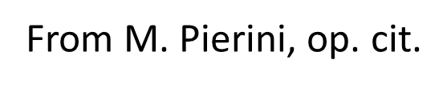
Paths to explore for LHC, and why
“Too many data, too large data -> need to filter online
Filters based on theoretical bias: we might be loosing good events “
“The solution to the HL-LHC problem: modern Machine Learning to be faster and better in what we do today, freeing resources for new ideas
This ML deployment need to happen in between collisions and data analysis (trigger, reconstruction, …), where freeing resources will make a difference” – First steps in real time analysis: LHCb, CMS, more has to come
Faster particle reconstruction with computer vision
HEP and Language Processing networks
Fast decision taking

Slide 27
Conclusions
Among the essential elements:
User trust in data and algorithms
Relevance to research needs: Developments should be science driven
Take the best advantage of technological capabilities but not driven by these technological capabilities
Provide tools near data
Many methods and techniques can be shared

