Slide 1
A Leading University at the Heart of a large-scale Ecosystem of Research, Training and Innovation
Pr. Sylvie Retailleau
President

Slide 2
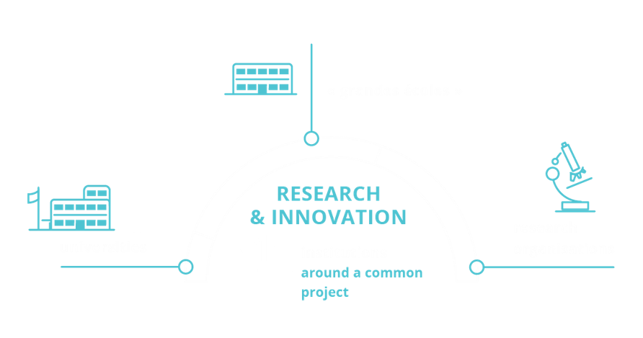

14 founding members for 1 research university
Notes:
Université Paris-Saclay is a collective project which benefitted from the PIA (Programme d’investissements d’avenir – Investments for the Future programme), decided by the French government in 2010 to establish top-class sites and centers for education, research and innovation. UPSaclay has won the IDEX (Initiative d’excellence) funding and label along with few other major French sites, but it is specific and remarkable in several ways which make it unique in France (shown a bit later) – the 1st being the physical relocation of several institutions in the Saclay core campus (ENS-Paris Saclay, CentraleSupelec, AgroParisTech, …)
This 30 M€/year fund has been invested since 2012 in the Paris-Saclay ecosystem. In addition, other IDEX programmes were set up for top-notch equipment (Equipex) and laboratories of excellence (Labex).
A major characteristic is to create a comprehensive university with a broad range of disciplines such as life and health sciences, natural sciences and all concerned humanities and social sciences, while fostering major interdisciplinary research projects and pedagogical innovation.
Another aim is to reinforce the international visibility and attractiveness of the ecosystem with a rich range of institutions, education tracks, research platforms.
And also obviously to increase the links between education, research, companies and innovation in the south of Paris area

Slide 3
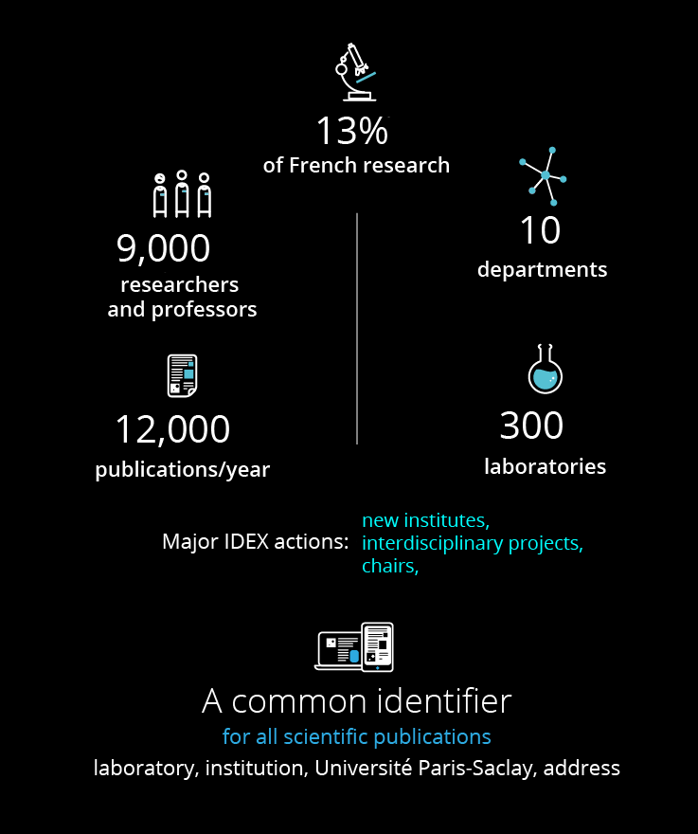

Intensive Research
9,000
researchers
and professors
17
Graduate Schools
275
publications / year
laboratories
Notes:
research EXCELLENCE: more than 300 laboratories and 9,000 professors and researchers
With a production of over 12,000 publications per year, the vitality of research and teaching at Université Paris-Saclay is already well established.
Research teams, coordinated within ten disciplinary departments have an international standing in fields such as mathematics, laser and particle physics, astrophysics, neuroscience, nanoscience, material sciences, chemistry, neuroscience, plant sciences, engineering, economics and business, law, political and social sciences …
Creative research is reinforced by interdisciplinary institutes and excellence laboratories (LABEX) bringing together different scientific communities around major themes: health, agriculture and food, HPC and numerical simulation, climate, energy and sustainability, mobility and transport, science and society … Experimental or technological platforms and very large facilities serving all disciplines (Synchrotron SOLEIL, NeuroSpin, Simulation Centre …) complete the research infrastructure.

Slide 4
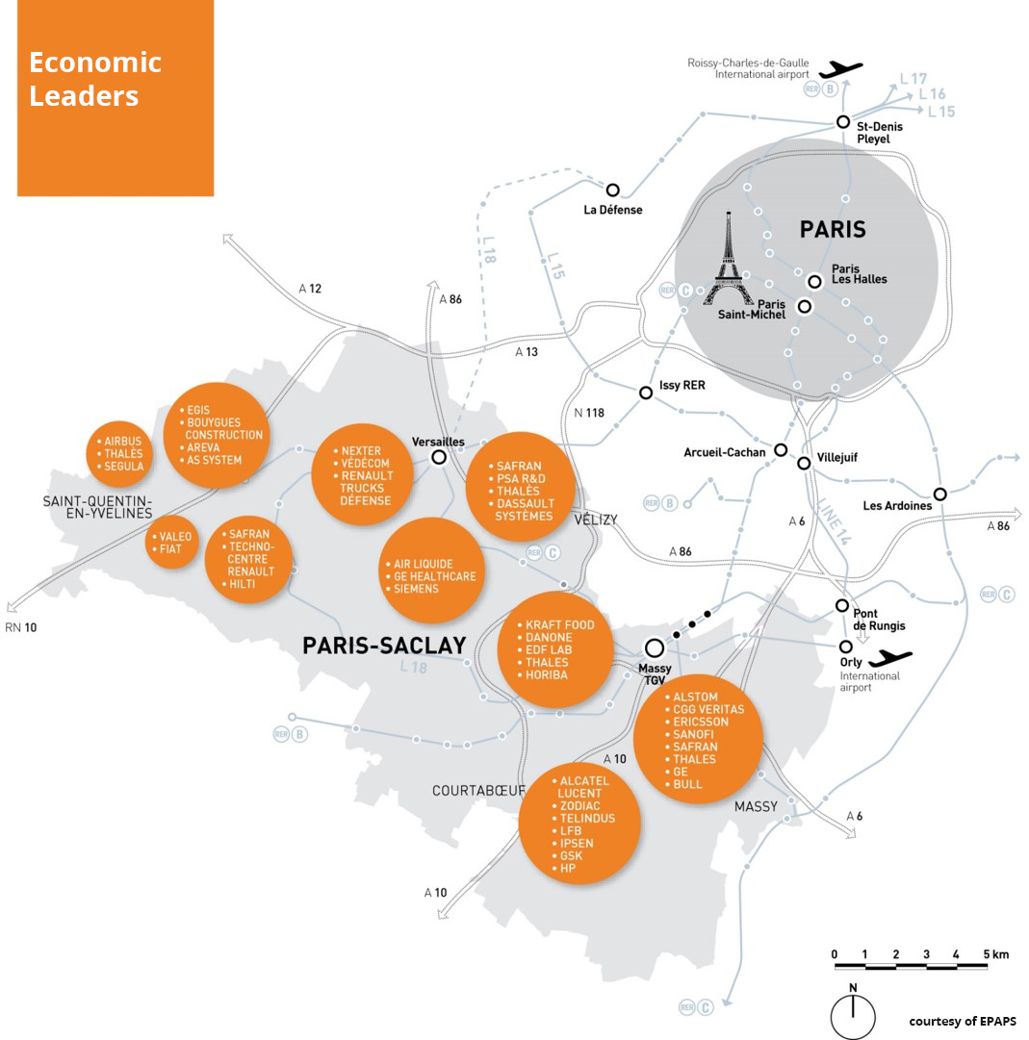
13% of French R&D 169 ERC projects (FP7&H2020) 152 ERC grantees 1st in France Top 5 in Europe 2 Nobel Prizes 10 Fields Medallists Projected Shanghai Ranking: 20th HiCiR (Clarivate Analytics) 34 at UPSaclay
Notes:
The Paris-Saclay ecosystem is already the largest French site in terms of research potential both in fundamental research and applied research. It already includes more than 15% of France's potential in R&D, and ranks third in France for executive employment (behind Paris and Lyon). Thousands of researchers in private R&D labs are already active on site. And the academic potential is demonstrated through 167 ERC projects (UPSaclay is the 1st university in France and in the top 5 in Europe in the number of ERC grants awarded), 2 nobel prizes and 10 Fields Medallists with Psud et IHES (institute des Hautes Études Scientifiques).

Slide 5
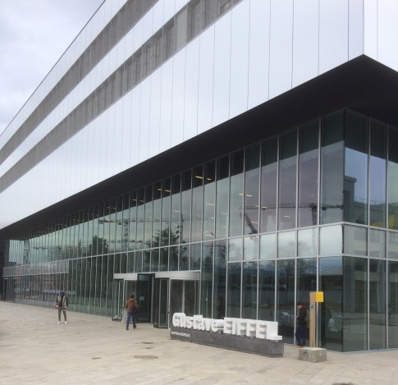
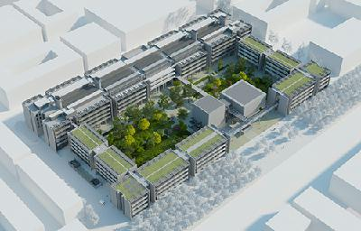
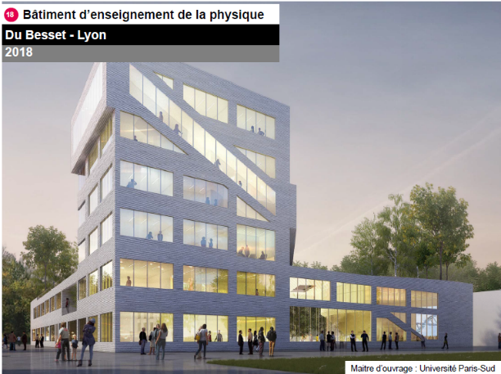
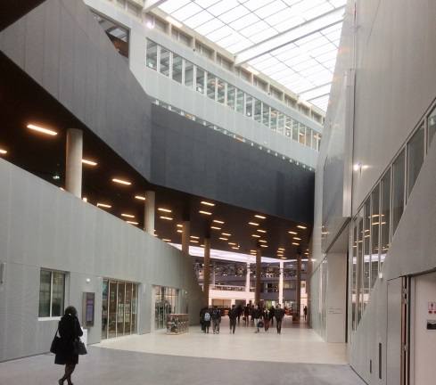
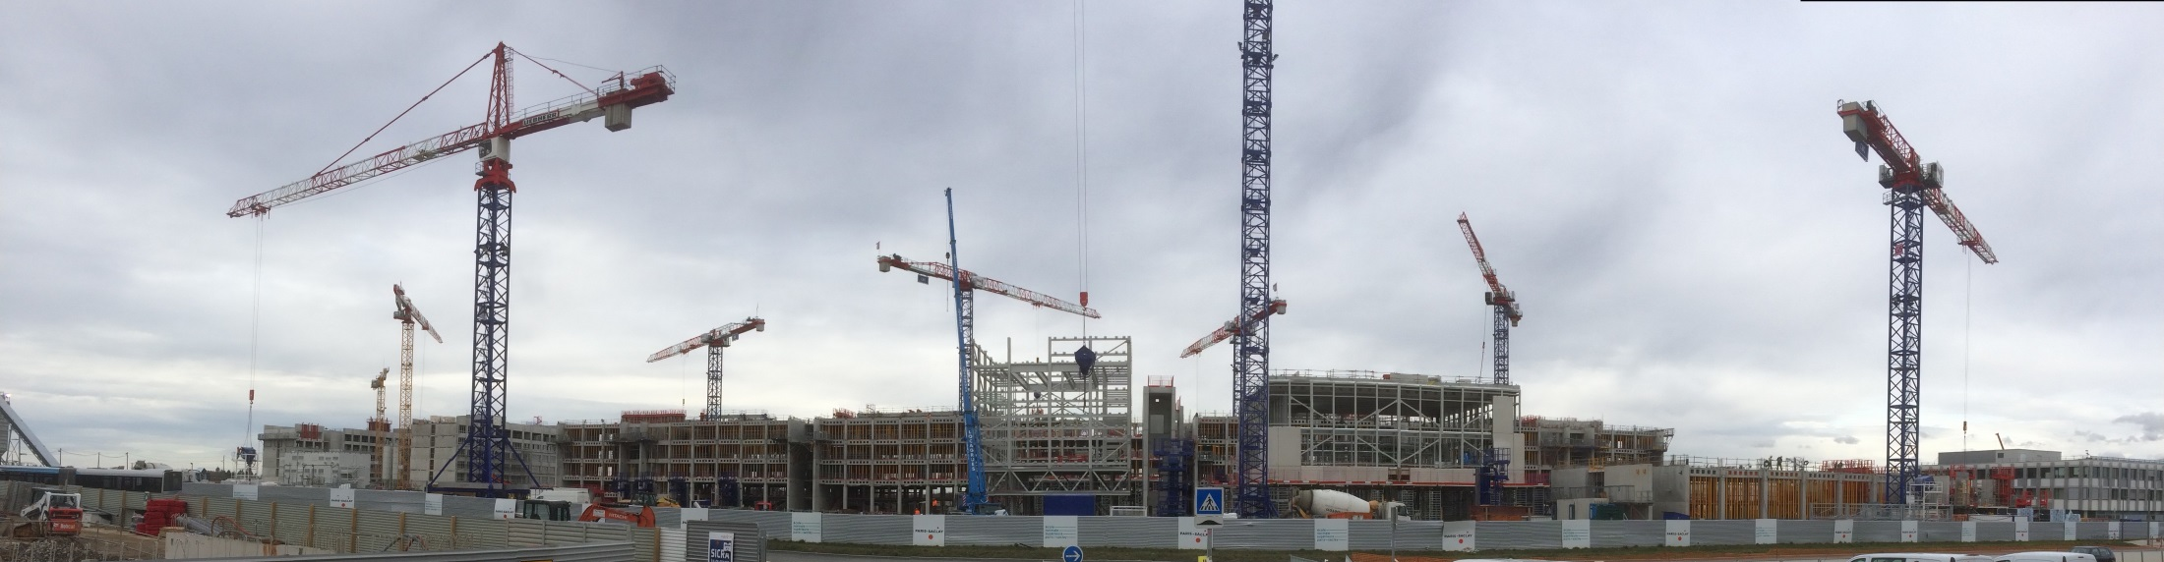
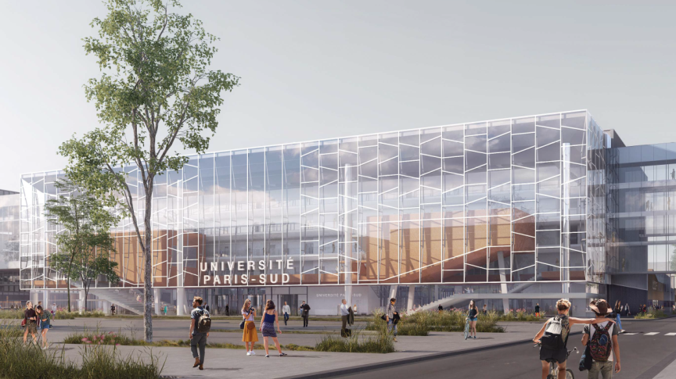
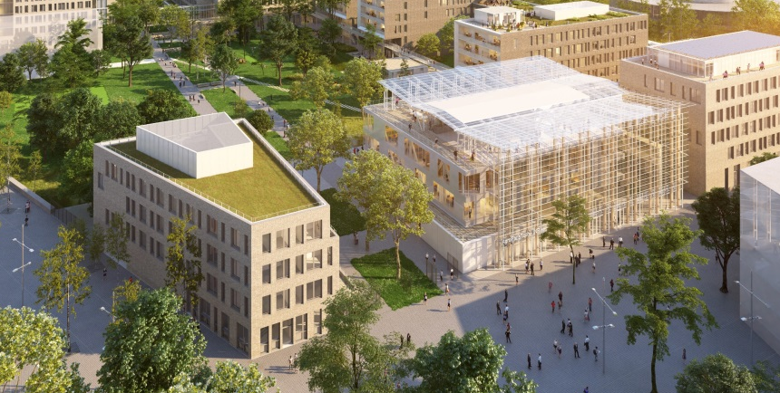
New buildings, higher education
and research facilities
Physics building –
Université Paris-Sud 2018
CentraleSupélec - 2017
ENS Paris-Saclay - 2019
Biology-Pharmacy-Chemistry - 2022
AgroParisTech - 2021

Slide 6
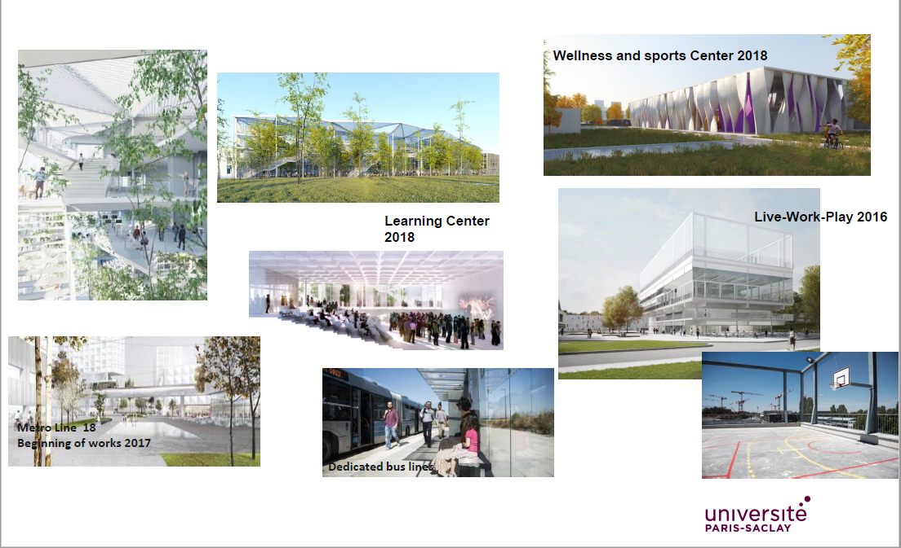
Enhancement of campus life
Sports and wellness centre
2018
Learning Center 2018
Live-work-play building 2016
Metro line 18
Beginning of works in 2017
Dedicated bus lanes

Slide 7
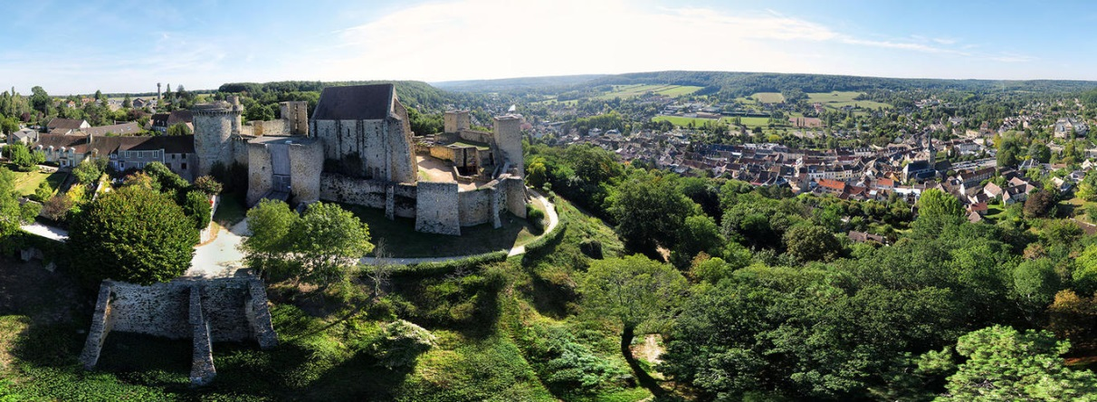
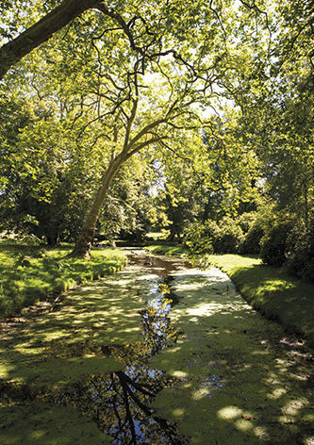
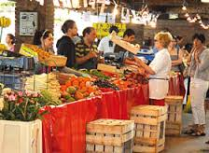
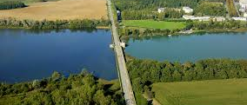
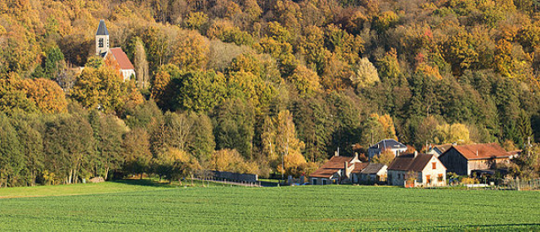

A green Campus close to Paris with outstanding natural reserves
Notes:
Soft and green mobility, electric vehicles and shuttles, …

Slide 8

17 Graduate Schools and Institute
Biodiversity, Agriculture and Food, Society, Environment
Public Health
Engineering and System Sciences
Mathematics
Law
Humanities - Heritage Science
Health and Medicine
Life science and Health
Physics
Computer Sciences
Economics - Management
Sports, Movement and Human Factors
Chemistry
Geoscience, Climate, Environment and Planets
Sociology and Political Science
Higher Education and Research Jobs
Education, Training, Teaching
Light Sciences Institute
16

Slide 9






Master’s programmes
65,000
students
5
ENS & eng. degrees
EDUCATION
DEVELOPING PEDAGOGICAL INNOVATION
Health and Life Sciences
Sciences and Engineering
Social Sciences & Humanities
9,000
Master’s students
67
67
Master’s tracks
Notes:
The university Paris-Saclay already offers a rich, quality range of Master’s programs, with 67 master programs with 550 tracks among which 15% in english, and 9,000 students enrolled. In three years, the number of applicants has increased from 44,000 to 90,000. 37 percent of these are newly arrived foreign students, proof of a rise in international visibility. Almost a third of these are taught totally or partially in English.
In 2020 university paris-Saclay will represent 60,000 students awarding Bachelor, Master and Doctorate

Slide 10
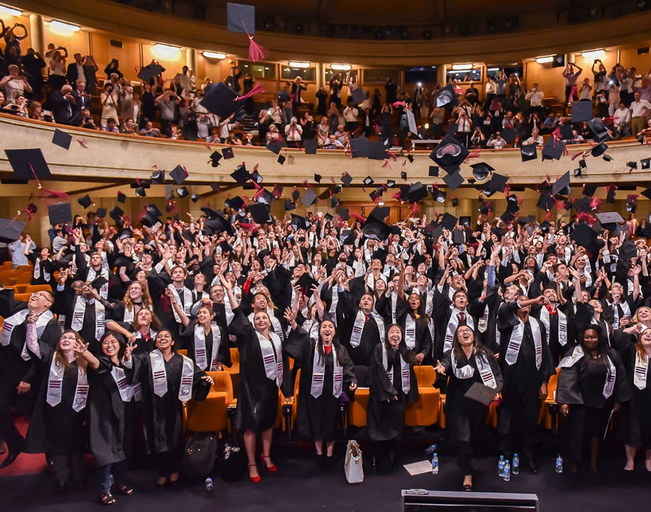
Le Doctorat
Doctoral education
4,500 PhD students
4,700 faculty members qualified to supervise PhD students
20 doctoral schools
1,200 PhD degrees delivered / year
45% International PhD students
42% women, 58% men
Notes:
In the same line, the university Paris-Saclay is also responsible for the accreditation of 20 doctoral schools with a total of more than 5400 PhD students. Nearly 45 percent of these graduate students are from outside France, making Paris-Saclay the leading site in France in terms of the number of PhD students.

Slide 11
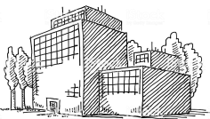







Research Ecosystem
275
cutting-edge laboratories
Health and Healthcare
Open science
17 Graduate Schools and institutes
Energy, climate, sustainable development
Societal challenges
Biodiversity, agriculture and food
Digital transformation and AI
Sustainable growth
Cross- Disciplinary Initiatives
Quantum
Mobility
AI
Aeronautics and Space
Art, culture and science for and with society
Therapeutic innovation
Industrial Renewal
Undergraduate
cycle

Slide 12
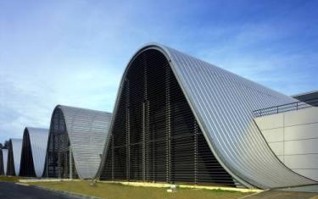
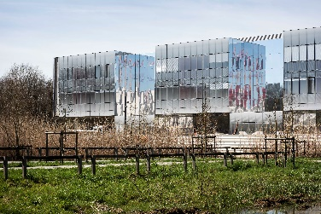
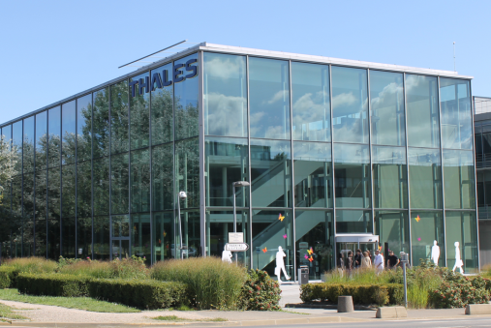
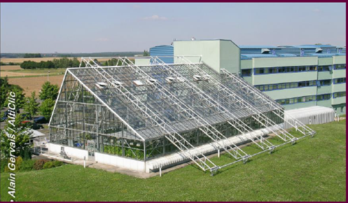
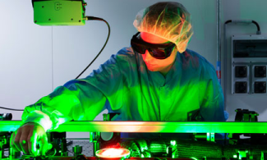
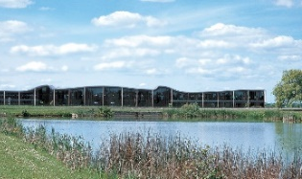
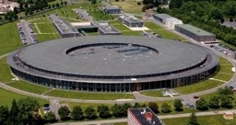
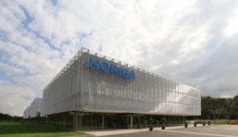
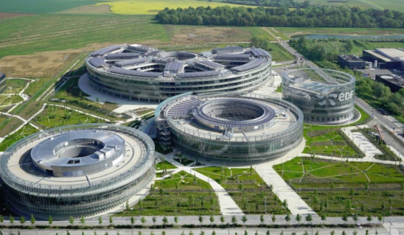
Université Paris-Saclay in the Top 8 World Innovation Clusters*
A key location for innovation and R&D in Europe
Neurospin-CEA
Centre for Nanoscience & Nanotechnology – C2N
2018
Thales R&D Centre
Institute of Plant Sciences
Safran Campus
Apollon Laser
SOLEIL Synchrotron
Horiba R&D Centre
EDF R&D and Training Centre
Large-scale research infrastructures
Joint research centres
Key European R&D Centres
* MIT Technology Review, July 2013
Notes:
Research platforms (a few examples)
NeuroSaclay Centre - most powerful MRI (magnetic resonance imaging) magnet (Iseult) in the world for research on humans - 11.7 tesla MRI scanner
C2N – Centre for Nanoscience & Technology – 410 people, 18,000 sq.m, one 2,800 sq.m clean room (1st in France, among top 3 in Europe)
SOLEIL synchrotron - Electromagnetic radiation source covering a wide range of energies (from the infrared to x-rays)
Apollon – for the time being, most powerful laser facility in the world (5 PW ; can go up to 10 PW))
R&D centres – some examples
Danone (2002) - French multinational food-products corporation based in Paris, 1 of 2 biggest R&D centres in the world
Thalès - 18,000 sq. m. – 5,000 sq.m of labs, 3,200 sq. m of clean rooms - Provides services for the aerospace, defense, transportation and security markets. CNRS, UPSud & Thalès researchers
Nobel Prize winner in Physics: Albert Fert, one of the discoverers of giant magnetoresistance which brought about a breakthrough in gigabyte hard disks.
Horiba (2012 – 7,500 sq.m) – European headquarters of the Japanese group
EDF (2016 – 12 hectares) - Research on zero carbon electricity generation, electric systems of the future. Biggest industrial research and training centre in Europe. 8 of 14 EDF labs

Slide 13

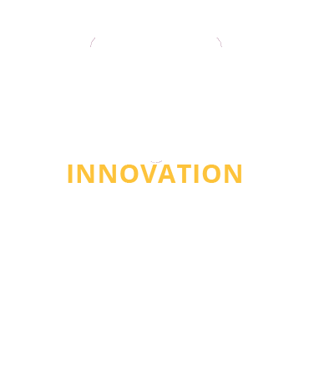



















Close ties with businesses
35,000
R&D jobs
Technology Transfer Office
SATT Paris-Saclay
100
Start-ups
350 patents per year
INNOVATION
ACCELERATING OUR VALORIZATION POTENTIAL
Student entrepreneurship hub - PEIPS
Fablab network
Incubators
Notes:
développer un cluster scientifique et technologique de rang mondial sur ce territoire où se concentrent des centres scientifiques, des activités de recherche et développement, la force industrielle de pôles d’activités majeurs de l’Essonne et des Yvelines, un tissus de PME innovantes.
Un comptage récent montre que l’Université Paris-Saclay dépose de l’ordre de 350 brevets et créé 100 start-ups chaque année. L’objectif du travail effectué conjointement entre le tissu scientifique local et le tissu économique local et national n’est pas simplement d’accroitre ces chiffres, mais bien d’optimiser les partenariats en recherche et aussi formation, les transferts technologique, les voies de collaborations … pour mieux valoriser les connaissances produites dans les laboratoires, les brevets et licences, et mettre les start-ups et PME dans les meilleures conditions pour lever des fonds et se développer
• In the area of innovation, UPSaclay has established an iterative process to foster technology transfer for scientists and students, in 5 steps: Awareness – Proof of Concept – Maturation – Incubation and Design – Seed Fund with more or less 100 new start-ups supported every year.

Slide 14







Thank you !
www.universite-paris-saclay.fr/en
https://www.universite-paris-saclay.fr/en/e-international-welcome-office
@UnivParisSaclay
UParisSaclay
Université Paris-Saclay
Universite_Paris_Saclay

