Slide 1
High Level applications development status
H. Guler for the ThomX commissioning group

Slide 2
Motivations/Goals
General machine startup strategy
General machine control strategy
Provide tools for Linac commissioning (TL-LE)
On top of Tango Tools
Give an alternative to basic Atkpanels
Combined information
Modified information (fitting, calculations, etc )
Strategy for measurements types
Strategy for data taking
Strategy for publications on eLog (visible from outside LAL)
Interlock management
General pane (+ Tango tools)

Slide 3
Some basic rules
Knowledge / basic understanding of TANGO (Training at control room)
Interfaces to be implemented by using MATLAB (MML) and / or directly using Python (Taurus, …)
High level interfaces design should be done by machine experts and could evolve
Periods of training and development is necessary
Easy installation, versioning, and user manuals are needed
General single common scripts for raw signal analysis :
Beam charge extraction (from Wavecatcher)
YAG : Spot analysis tool (extract size, position, … )
BPMs …
Physical variables (Calibrations, Twiss parameters, …) coming from calculation should be included in Tango DS
No differences for same variable should appear in different IHM
Single programing language is not mandatory (MATLAB, Python)
Matlab : Tango-binding
Python : PyTango

Slide 4
Hardware 1
Hardware 2
Hardware 3
Hardware 4
Hardware 5
Hardware 6
________________TANGO _______________
Data : access data, contrôle timouts, save data etc :
PyTango / MatLab-Tango binding
Interfaces : IHM (contrôle equipment, show data, …)
Python (Taurus, PyQt, ..) – MatLab (MML) – Labview - Java
Saved data
Write to eLog
Manage machine alarms

Slide 5
From simulation to first tests
Linux platform (tango-util2) deployed with TANGO9 and simulation Ds
Python software could generate sim-Ds from Ds
Magnets + Cycling Ds
Libera, RedPytaya
During commissioning : Development could be done on sim-Ds
Simulator-DS functionality still to be understood
Repository process will be used
Git / GitLab
Keep development history : nothing lost / improve efficiency
Cross check : each modification should be approved by other developer
Notes:
Utills pour les tests

Slide 6
Linac commisioning needs
IHM to startup all the Linac sub-systems
General startup IHM
IHM to monitor the machine status
Simple general status manager
Quickly see equipment with problems (Green vs Red color in IHM)
tools to control the beam and to tune the machine
Algorithms which combines diagnostics and accelerator parameters
data saving strategy
All data from different measurements
Quick analysis tools / environment → improve decision quality during shifts
Offline analysis → easily retrieve and analyze data
easy reporting
Elog : tools to automatically (or not) save needed data

Slide 7
Linac commissioning : basic objects
Tasks | Details | Device Server | Measured quantity | Data
Magnets cycling |  | Magnet and Cycling
Energy steerer
Beam size and position | Screen + barycenter + size | Lima |  | Image Sx,Sy,X,Y
Bunch charge screen | Screen calibration in charge | Lima | Calibration coefficient in DS | Image
Bunch charge ICT |  | Wavecatcher | Waveform | Integral(WF)
Laser E, size Virtual Cathod | UV Camera | Lima |  | E, Sx,Sy,X,Y
Laser pulse length | Streak |  |  | Image
Faraday Cup |  | Wavecatcher | Waveform
BPM |  | Libera

Slide 8
Linac commissioning : machine tuning
Use of scans / measurements :
Algorithms to be called inside IHMs
Examples :
Charge vs Phase
Charge vs solenoid current
Dedicated IHM for Diagnostics should contain :
Measurement selection
Which includes list of variables that should be saved
Includes measurement parameters to be set to the algorithm
Button to send analysis to eLog → Template to be prepared
Prepare tango-device with list of variables to be saved (calibrations, …)

Slide 9
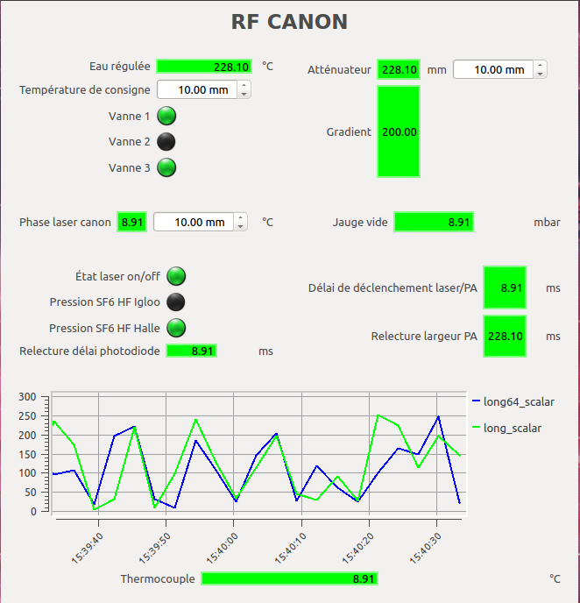
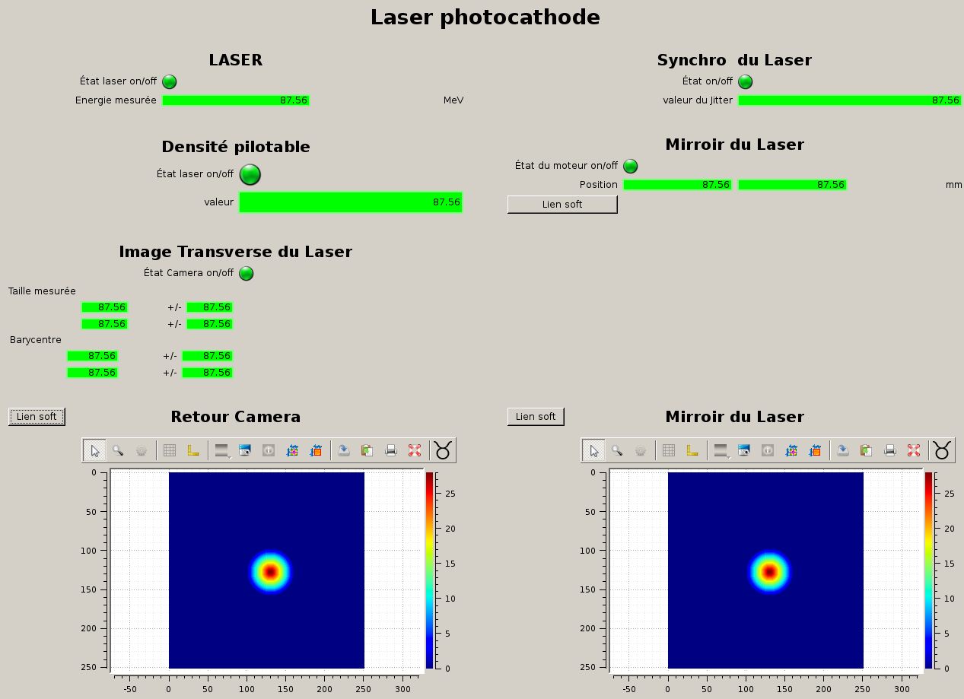
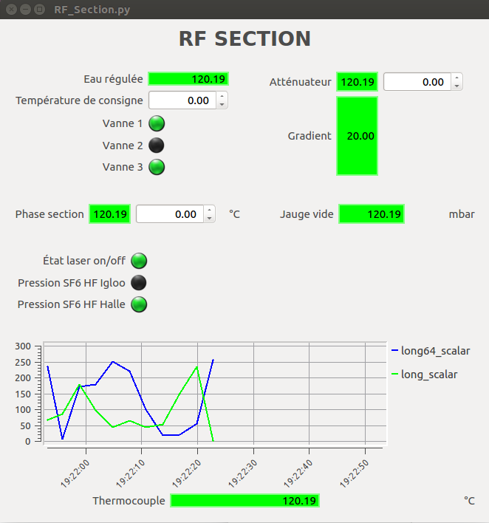
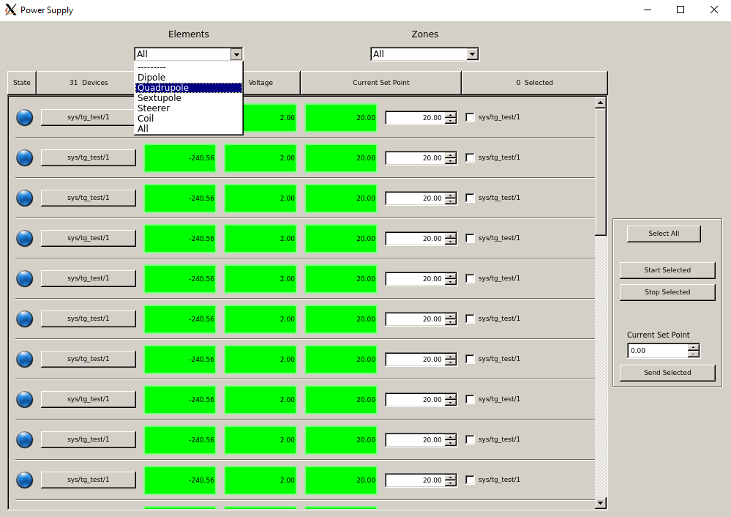
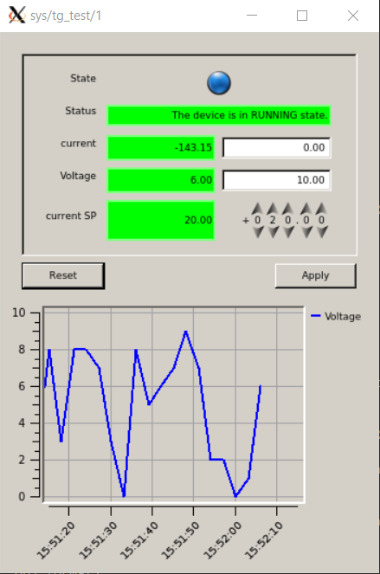
Linac commissioning : Equipment interfaces
IHM | Language | Status
Linac Laser | Python (Taurus) | 90%
Modulator | Java | 90%
RF GUN | Python (Taurus) | 90%
RF Section | Python (Taurus) | 90%
Vacuum | LabView | 90%
PowerSupply | Python (Taurus) | 90%
Icepap supervision | LabView | 90%
RF-GUN
LASER
Magnets
powersupply
RF-Section

Slide 10
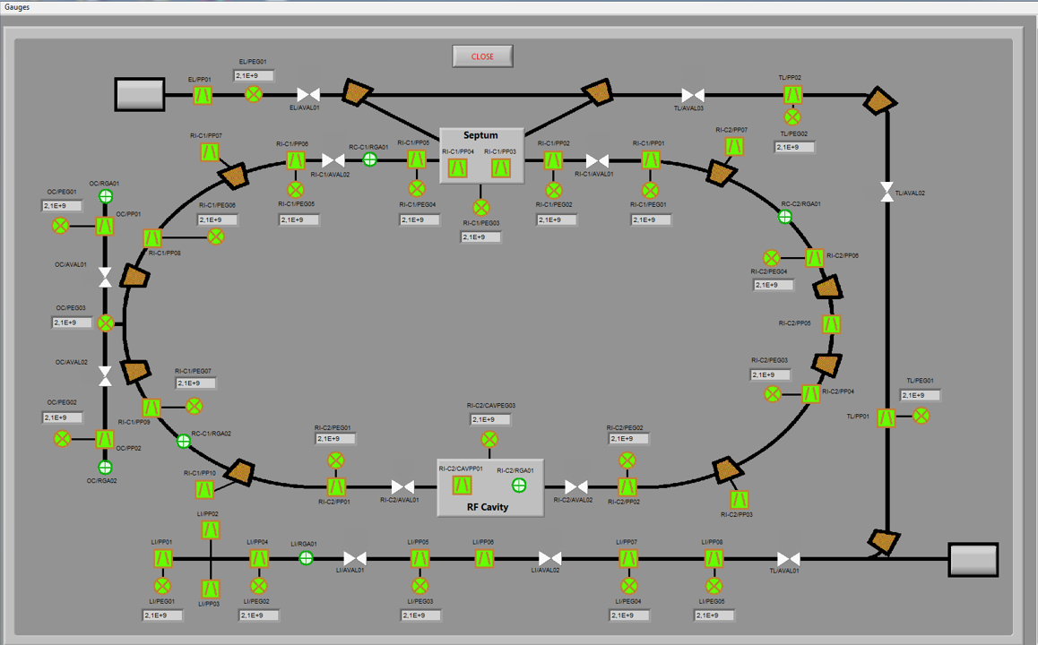
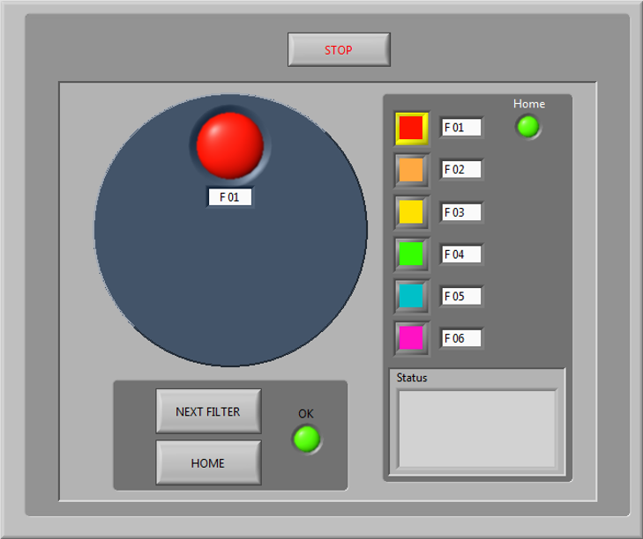
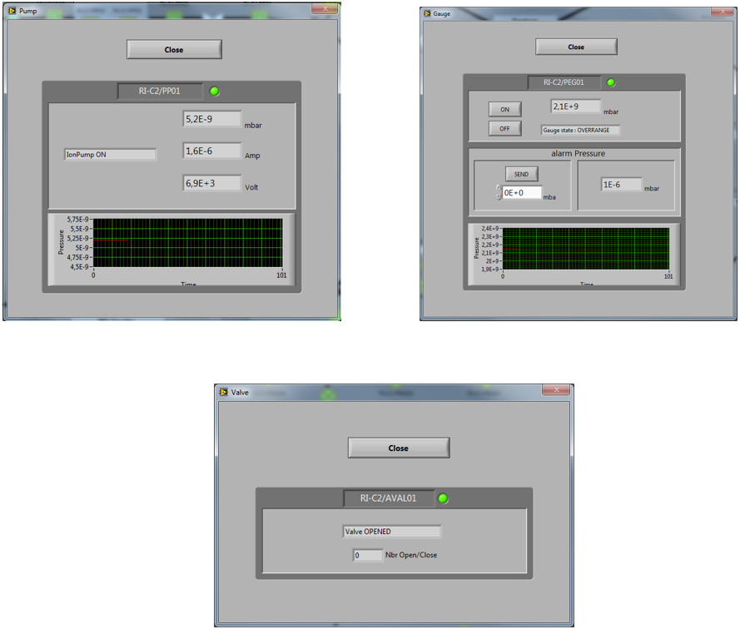
Linac commissioning : Equipment interfaces
IHM | Language | Status
Linac Laser | Python (Taurus) | 90%
Modulator | Java | 90%
RF GUN | Python (Taurus) | 90%
RF Section | Python (Taurus) | 90%
Vacuum | LabView | 90%
PowerSupply | Python (Taurus) | 90%
Icepap supervision | LabView | 90%
ICEPAP Wheel
supervision
Vacuum IHM

Slide 11
Linac commissioning : Equipment interfaces
IHM | Language | Status | Remark
Synchronizations | Python (Taurus) | On going
Diagnostics |  | On going | To be done with commissioning group
General startup | Python (Taurus) | On going | To be done with commissioning group
General Status | Python (Taurus) | On going | To be done with commissioning group
Alarm status |  | On going | To be done with Interlock group
Machine synoptic |  | On going | To be done with commissioning group

Slide 12
Need for trend plots : easy to compute and very useful

Slide 13
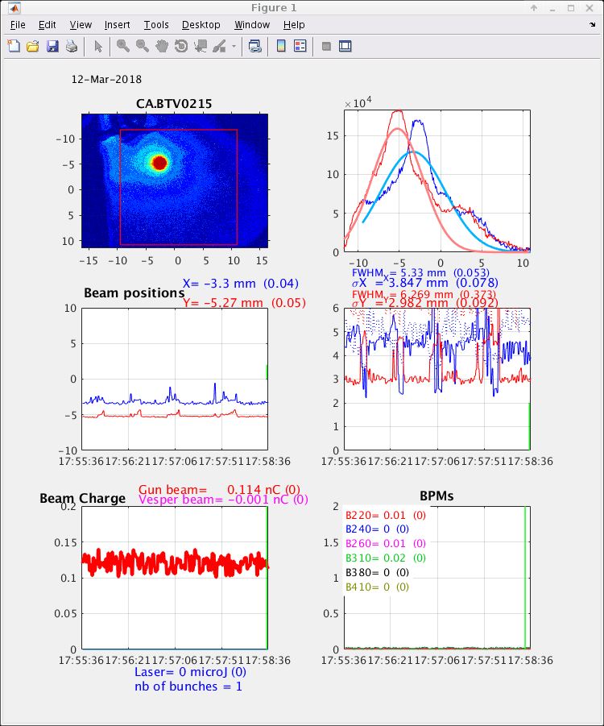
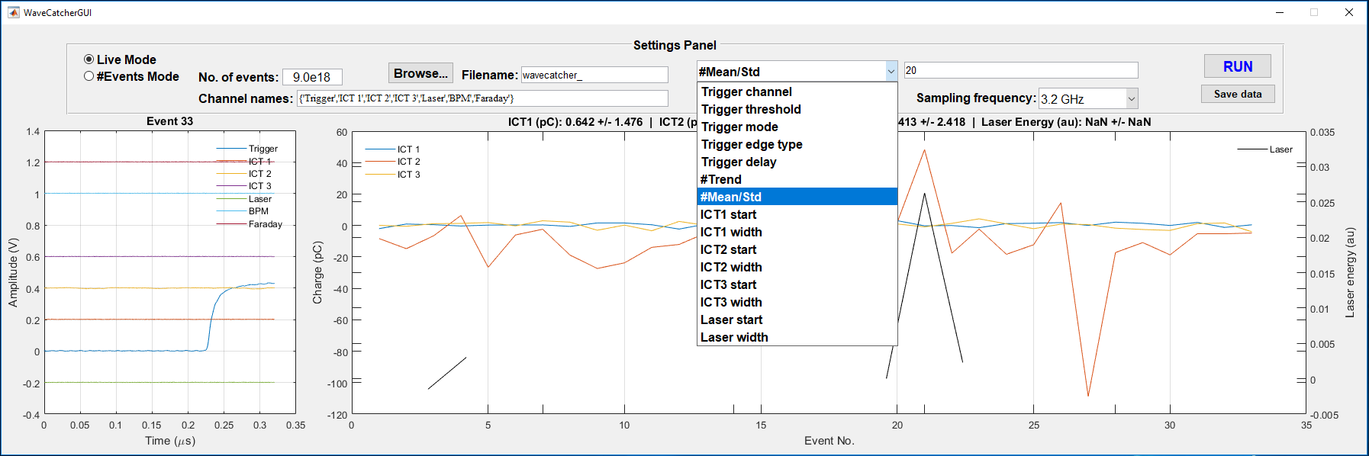
Interfaces needed for beam tuning for single pass (Linac-TL-EL)
Example of interface @CLEAR
Choose screen
Measure beam spot size, position
Plots trends
Get beam charge / position at different locations
Plot trends
During the Linac + TL + EL commissioning
To help the beam tuning
Useful for beam alignment
Follow trends for ICT, BPMs
For example Trend of the beam charge / position
Example of interface used at PHIL
Taurus provide Taurustrend, taurusplot, taurusform …

Slide 14
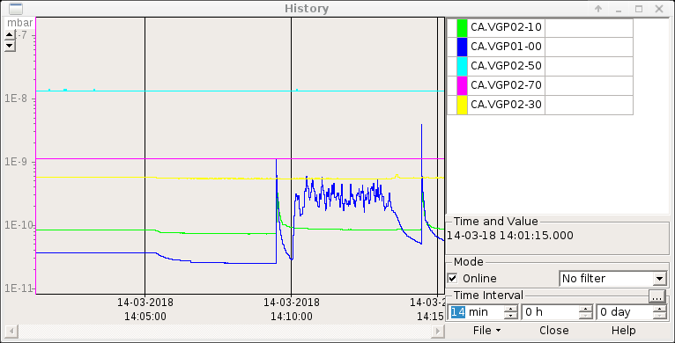
Trend plots for vacuum
During RF conditioning for RF-Gun or Linac Section.
Very useful for conditioning

Slide 15
Scan measurements : To be adapted for ThomX

Slide 16
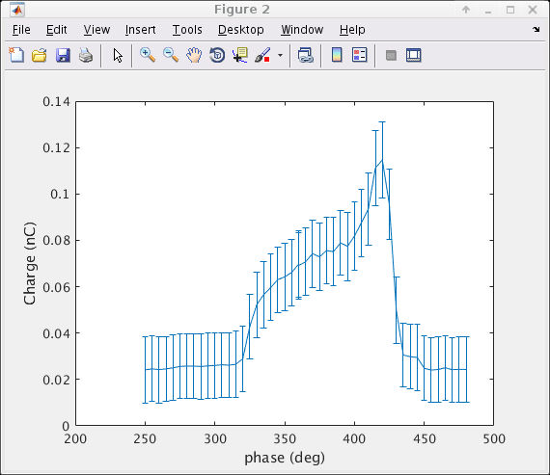
Example of Scan interfaces to be included in MML Charge phase scan (from CLEAR)
Script to adapt for ThomX (could be done in MML or Taurus )

Slide 17
Example scan for energie steerer

Slide 18
Example of solenoide scan

Slide 19
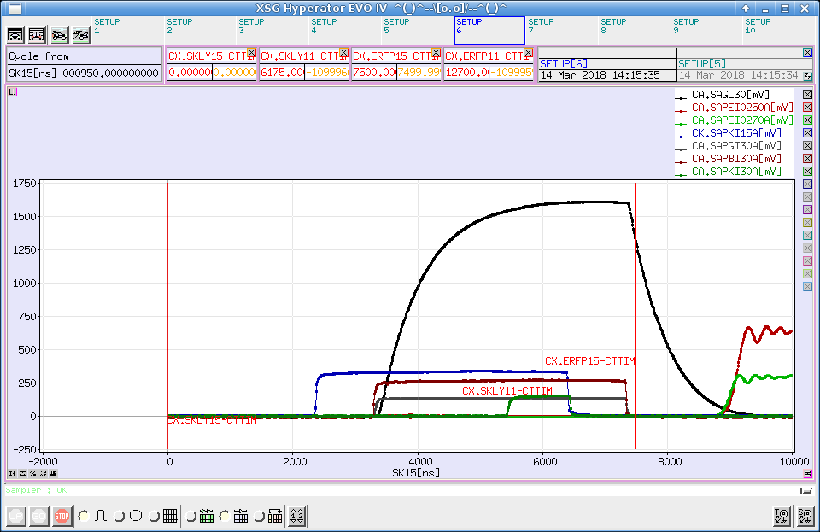
Interface with RF-Signals
Could be very useful to understand the Timing status
Need to keep the possibility to access the analog signals (scope)

Slide 20
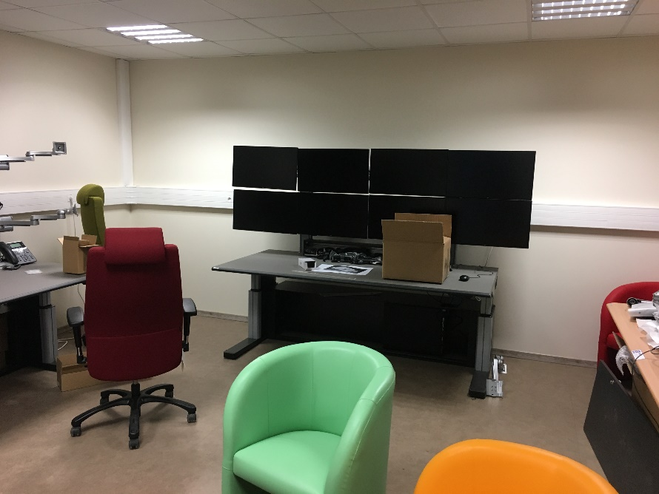
Interfaces roadmap : commisioning
Interface for Linac commissioning are essential for commissioning
Equipment startup
Monitor equipment
Tune the machine :
Strategy for the data
Set of Algorithms and use of dedicated tango variable
Collaborative future development in the ThomX control room
By training and working together IHM would change, adapt to our usage

