Slide 1
Dynamique faisceau dans l’anneau de stockage :
Régime de micro-paquet transitoire
Alexis Gamelin^{1,2}, Christelle Bruni¹, Iryna Chaikovska¹, Sophie Chancé¹, Nicolas Delerue¹, Mohamed El Khaldi¹, Ezgi Ergenlik¹ Hayg Guler¹, Jacques Haissinski ¹, Pierre Lepercq¹, Alexandre Loulergue², Hugues Monard¹, Cynthia Vallerand¹
¹Laboratoire de l’Accélérateur Linéaire (LAL)
²Synchrotron SOLEIL
Alexis Gamelin

Slide 2
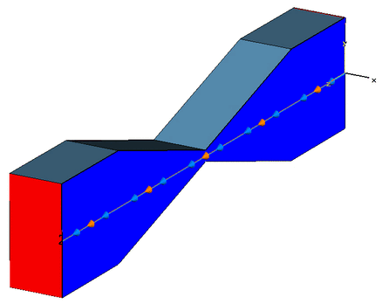







An introduction to collective effects
The term “collective effects” refers to the interactions of beam particles with each others and with the environment.
Perfectly conducting wall
Perfectly conducting wall
-$q$
- -
$$\vec{E}$$
$$\vec{E}$$
$$q$$
+ +
$$v=c$$
$$v=c$$
The change in cross section of the beam pipe leading to a radiation of the image charges is called geometric wakefield.
The same type of perturbation produced by the beam pipe finite resistivity is the resistive wakefield.
-$q$
- -
Alexis Gamelin
GIF image from CST.com

Slide 3




An introduction to collective effects
The term “collective effects” refers to the interactions of beam particles with each others and with the environment.
$$λ$$
Incoherent synchrotron radiation: $σ_{s}>λ$
The radiation produced by the beam in curved section, synchrotron radiation, is emitted in phase when a bunch is short enough, in that case it is called coherent synchrotron radiation (CSR).
$$λ$$
Coherent synchrotron radiation: $σ_{s}<λ$
Alexis Gamelin
Figure modified from G. Wüstefeld

Slide 4
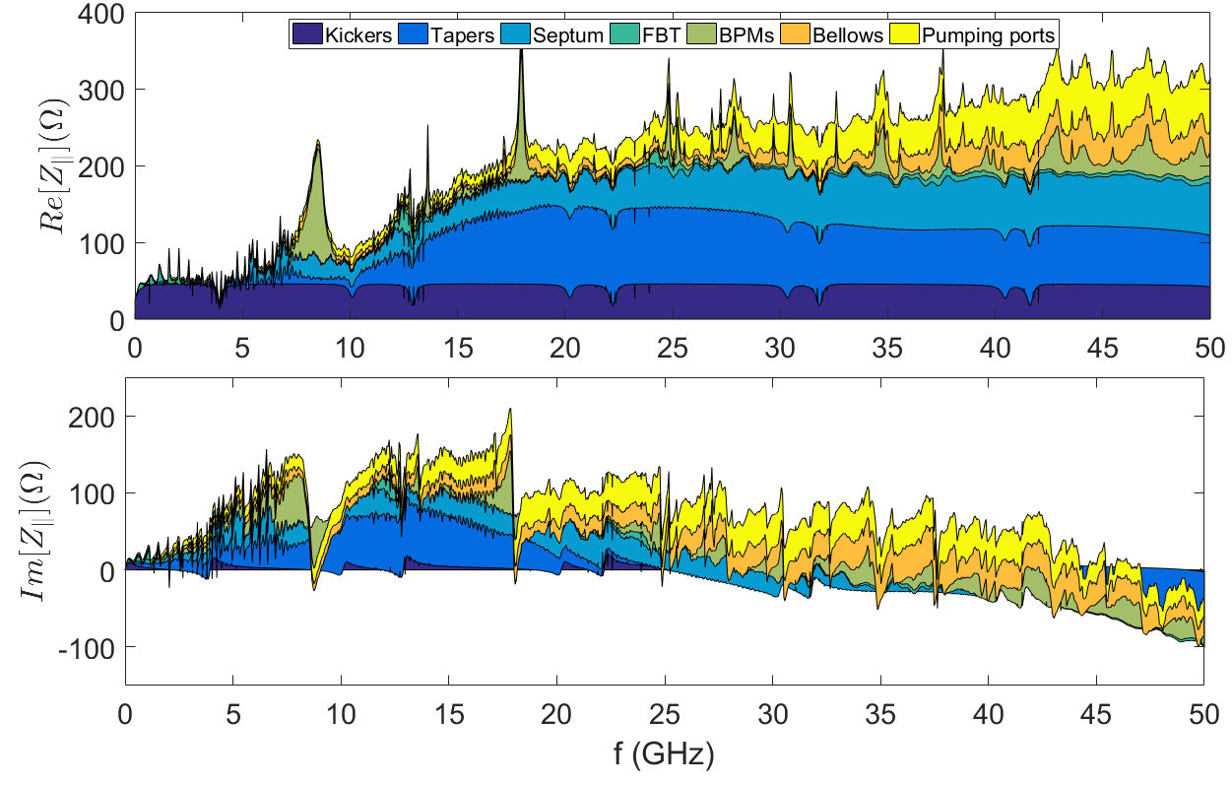
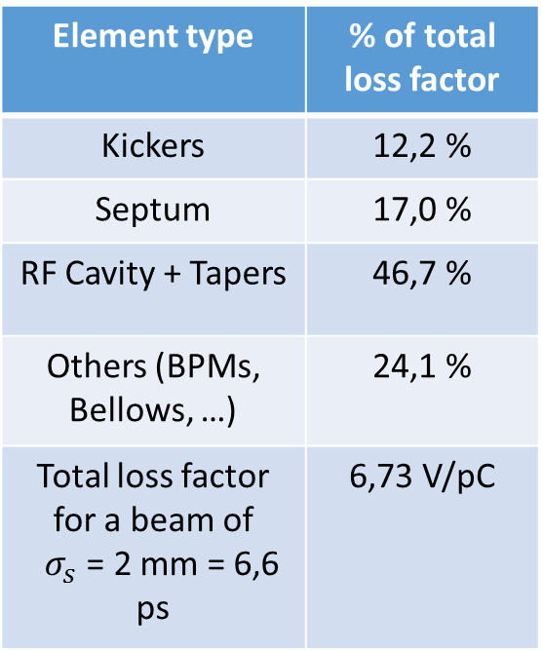
Total impedance (Geometric and RW) model
Element type | % of total loss factor
Kickers | 12,2 %
Septum | 17,0 %
RF Cavity + Tapers | 46,7 %
Others (BPMs, Bellows, …) | 24,1 %
Total loss factor for a beam of $σ_{s}$ = 2 mm = 6,6 ps | 6,73 V/pC
Alexis Gamelin

Slide 5
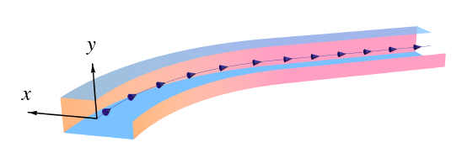
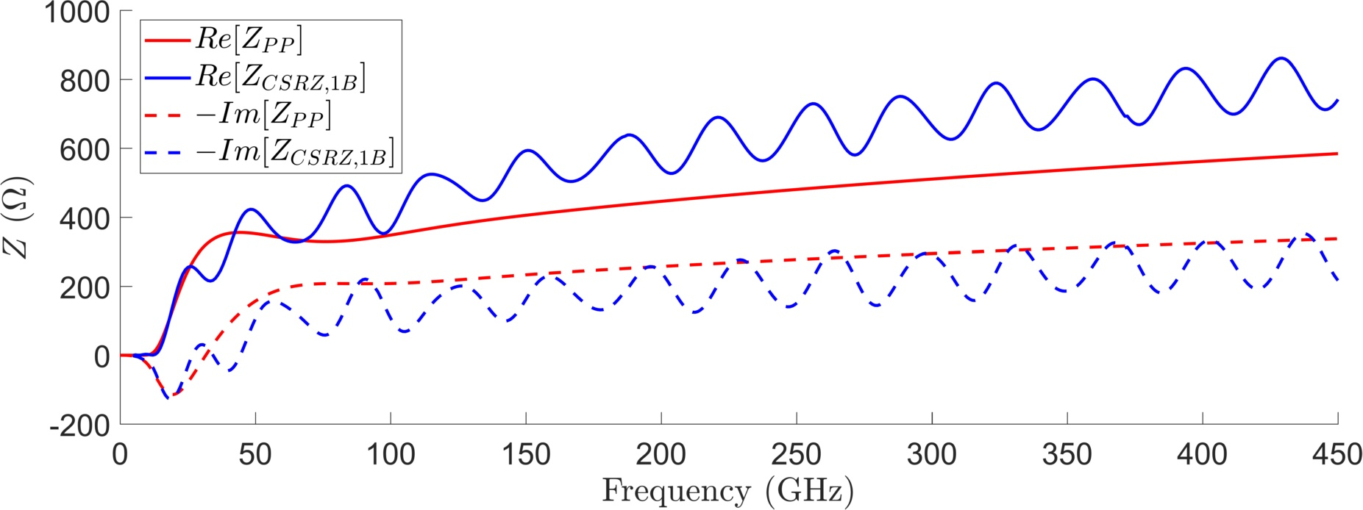
CSR impedance
CSRZ computes the CSR impedance by numerical integration of Maxwell equations in the paraxial approximation
Resonant behavior
Transient effects
Alexis Gamelin

Slide 6
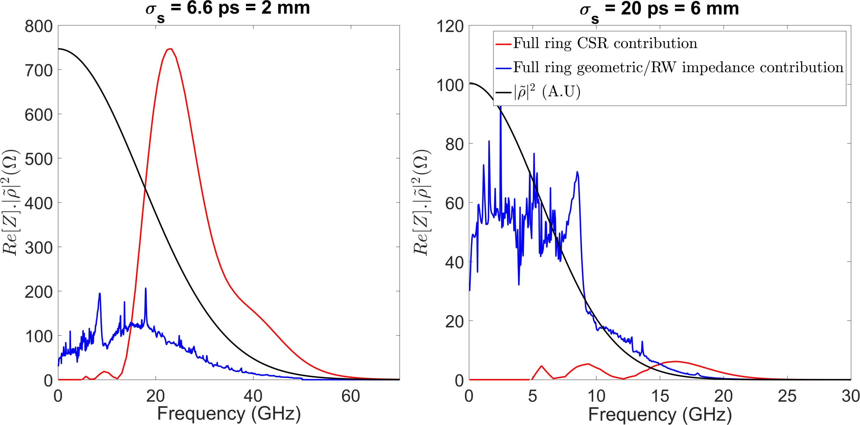
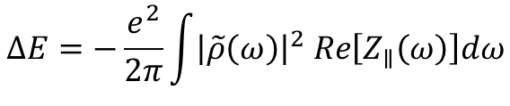
Why should we care: impact on beam dynamics
$$ΔE=−\frac{e^{2}}{2π}\int{{\left|\tilde{ρ}\left(ω\right)\right|}^{2} Re\left[Z_{∥}\left(ω\right)\right]dω}$$
Total energy loss per bunch
Alexis Gamelin

Slide 7


The micro-bunching instability
If the initial density modulation characteristic length is shorter than the shielding threshold, the micro-bunching instability mechanism is the following:
CSR
Longitudinal position s
Relative energy $δ$
due to path length dependence on energy in dipoles
$$\frac{ΔL}{L}=α_{c}δ+α_{2}δ^{2}+…$$
Longitudinal position s
Alexis Gamelin

Slide 8
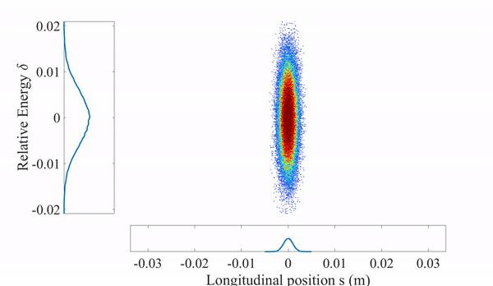

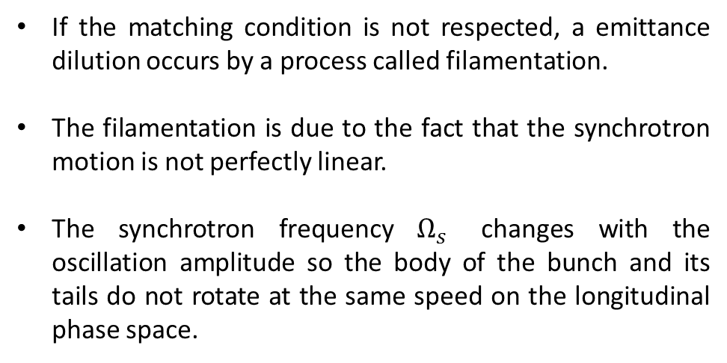
ThomX, injection without longitudinal matching
When transferring a beam from one accelerator to another, some conditions, referred as matching, are needed to adapt the injected bunch. The longitudinal matching condition is given by:
$$σ_{δ}= \frac{Ω_{s}}{\left|η_{c}\right|}σ_{s}$$
Synchrotron angular frequency
Energy spread (rms)
Momentum compaction
Bunch length (rms)
If the matching condition is not respected, a emittance dilution occurs by a process called filamentation.
The filamentation is due to the fact that the synchrotron motion is not perfectly linear.
The synchrotron frequency $Ω_{s}$ changes with the oscillation amplitude so the body of the bunch and its tails do not rotate at the same speed on the longitudinal phase space.
Alexis Gamelin

Slide 9
ThomX, the transient microbunching regime
In ThomX, the bunch is injected with a longitudinal mismatch to save up the cost and space of the harmonic cavity that would be needed to match the beam.
So at injection the bunch undergoes filamentation for about 1 ms until the bunch has filled the RF bucket.
But the filamentation process is strongly affected by collective effects, in particular the CSR, which seeds a microbunching instability during the filamentation.
Alexis Gamelin

Slide 10
ThomX, the transient microbunching regime
In ThomX, the bunch is injected with a longitudinal mismatch to save up the cost and space of the harmonic cavity that would be needed to match the beam.
So at injection the bunch undergoes filamentation for about 1 ms until the bunch has filled the RF bucket.
But the filamentation process is strongly affected by collective effects, in particular the CSR, which seeds a microbunching instability during the filamentation.
The resulting dynamics is transient microbunching regime which determines the shape of the beam for the rest of the storage time.
As there is no damping within the storage time, it is crucial to manage the transient regime in order to keep both a high charge and low beam emittances to deliver the expected X-ray flux.
Alexis Gamelin

Slide 11
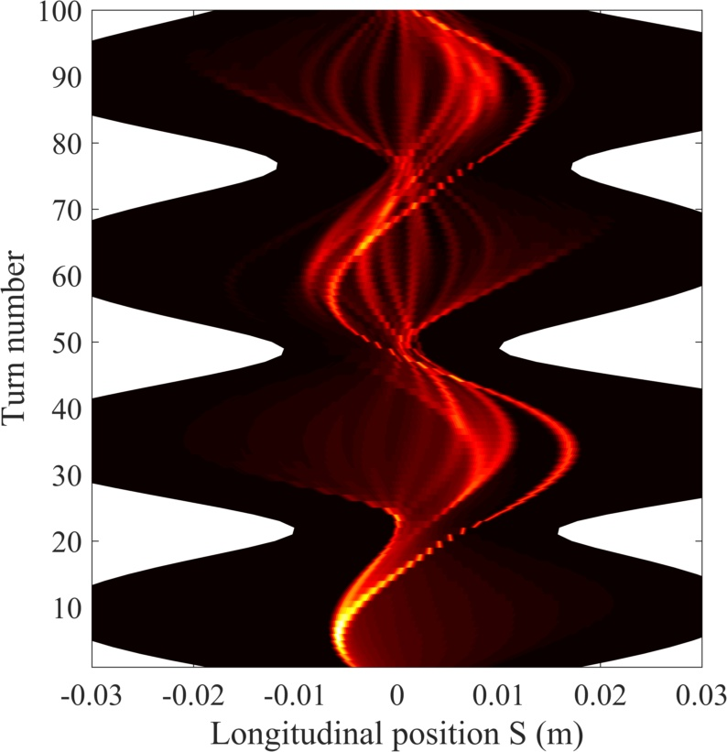
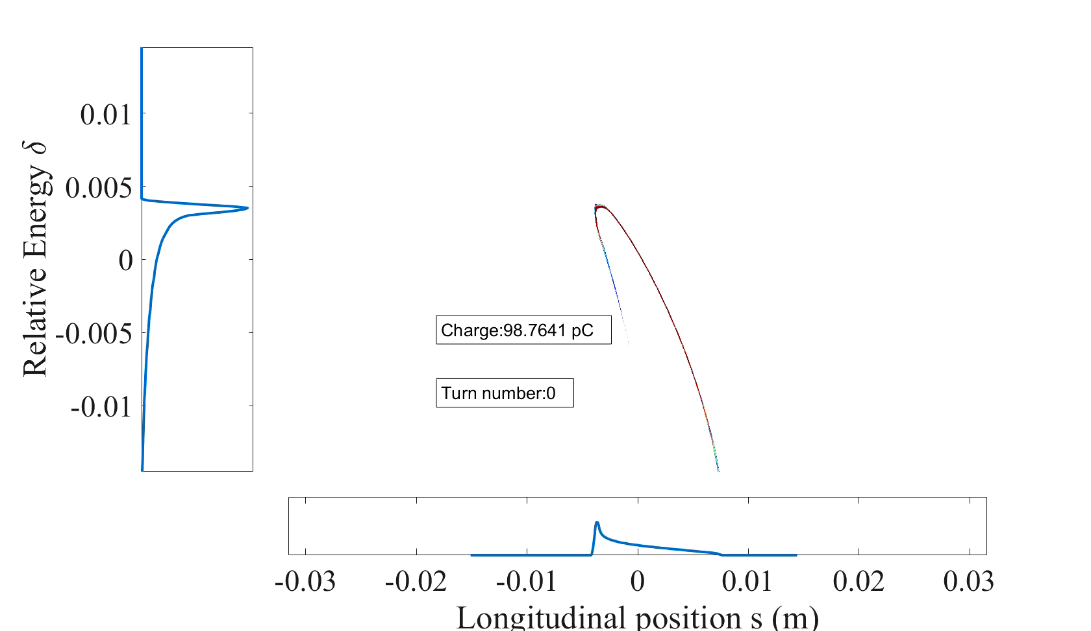
Transient microbunching regime at low charge (100pC)
6D non linear tracking element by element along the lattice.
Injected bunch from linac + transfer line simulations with collective effects.
Injected bunch with a coherent core and long tails.
Alexis Gamelin

Slide 12
Transient microbunching regime at low charge (100pC)
The filamentation starts to bend the bunch tails.
The effect of the CSR is visible on the bunch core, which is pushed toward negative $δ$.
Due to the CSR, the core begins to separate from the rest of the beam and forms a micro-structure.
Alexis Gamelin

Slide 13
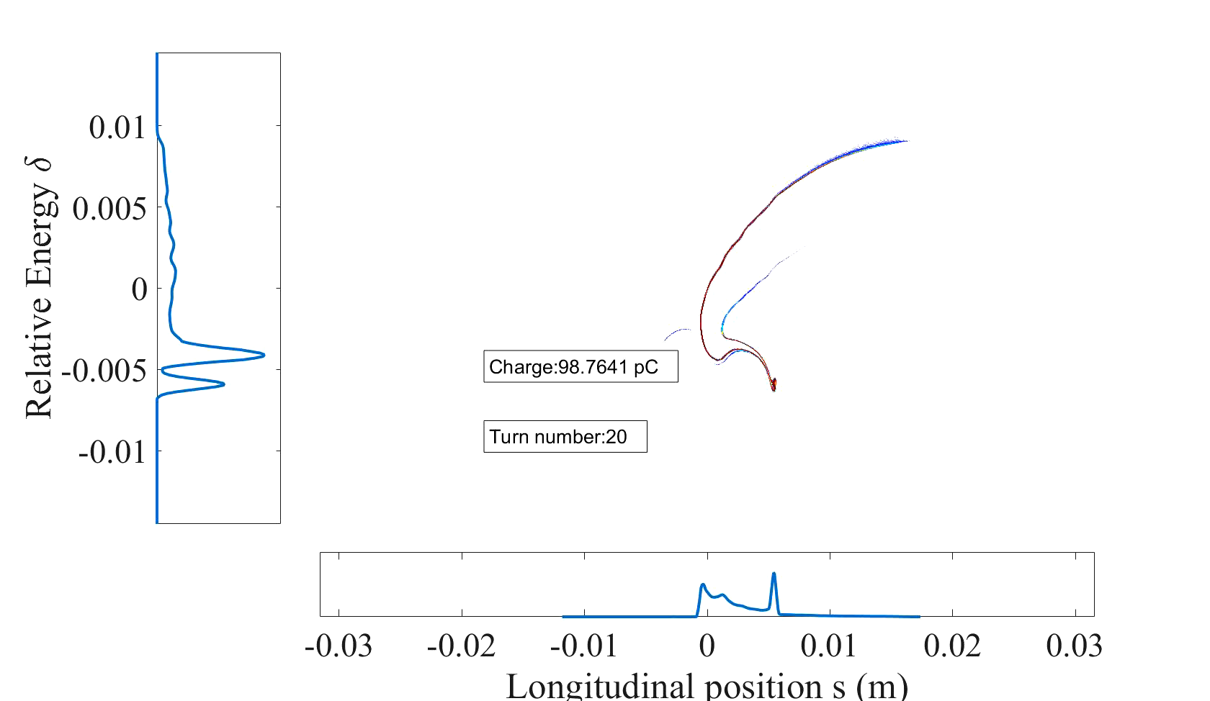
Transient microbunching regime at low charge (100pC)
Twice per synchrotron period, the arms forms a coherent peak producing a strong CSR splitting further the bunch.
The combined effect of the CSR and of the filamentation bring the formation of loops in the phase space.
Alexis Gamelin

Slide 14
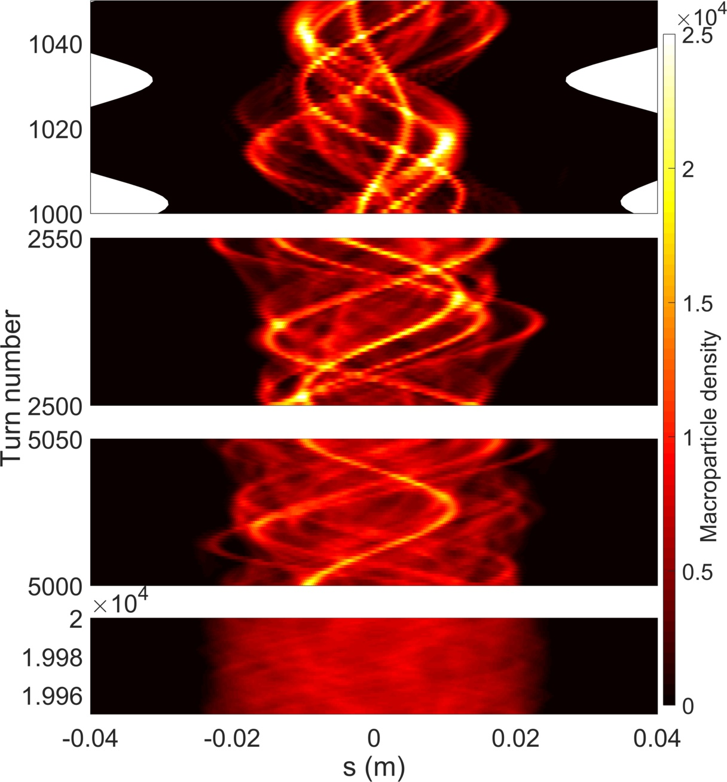
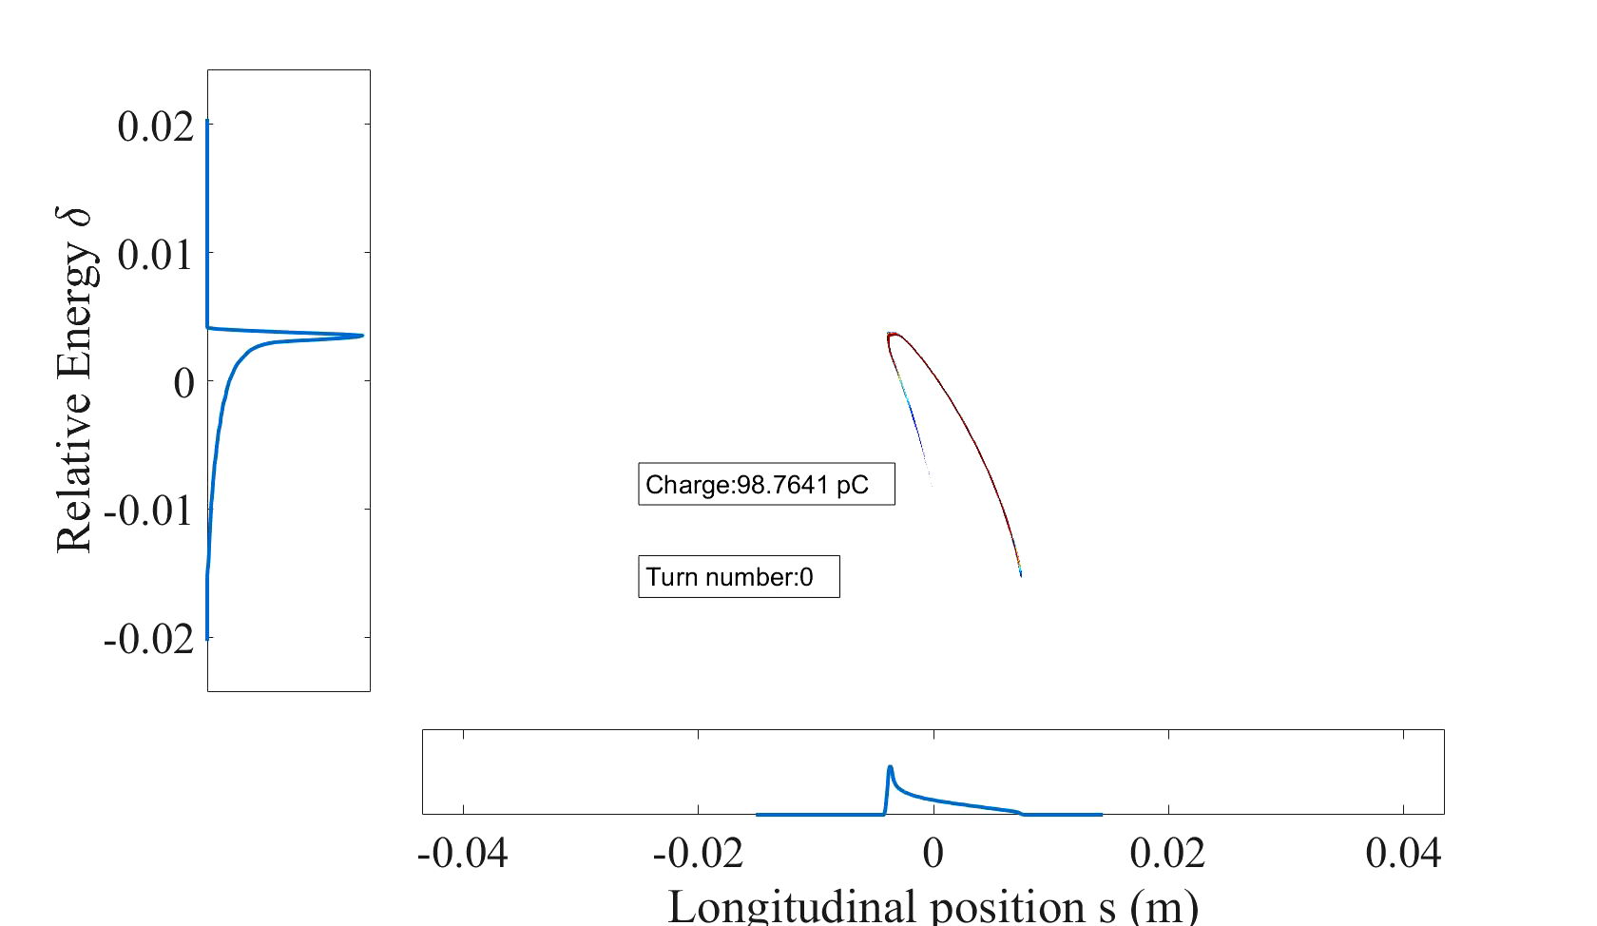
Transient microbunching regime at low charge (100pC)
After 1000 turns, many microbunches are visible in the phase space.
Contrary to the first turns, their synchrotron oscillations do not have the same frequency nor the same phase.
Alexis Gamelin

Slide 15
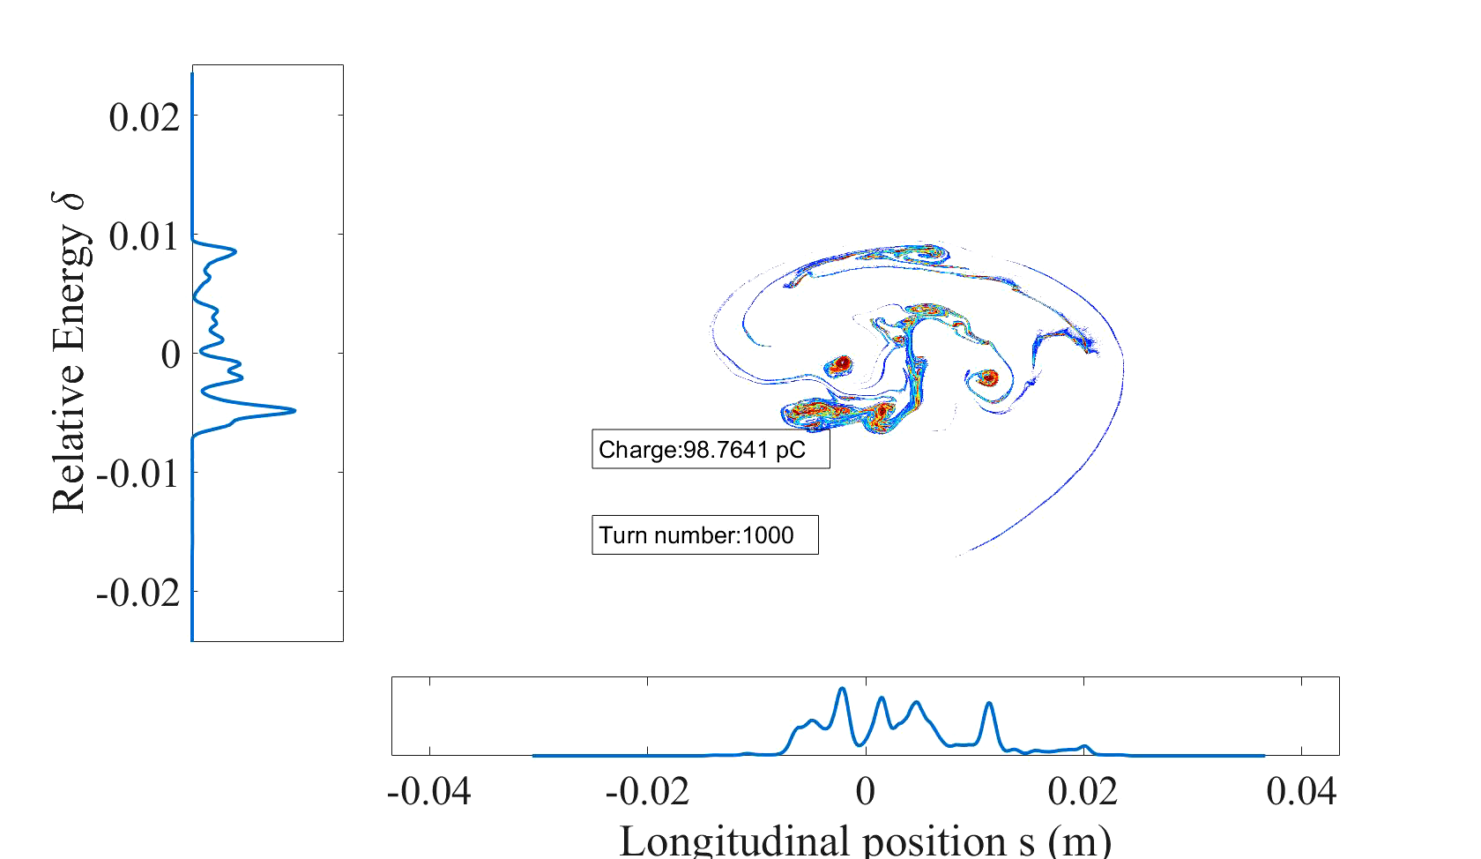
Transient microbunching regime at low charge (100pC)
After 2500 turns, the micro-structures seem to be less dense as each microbunch has begun to fill the phase space due to filamentation.
Alexis Gamelin

Slide 16
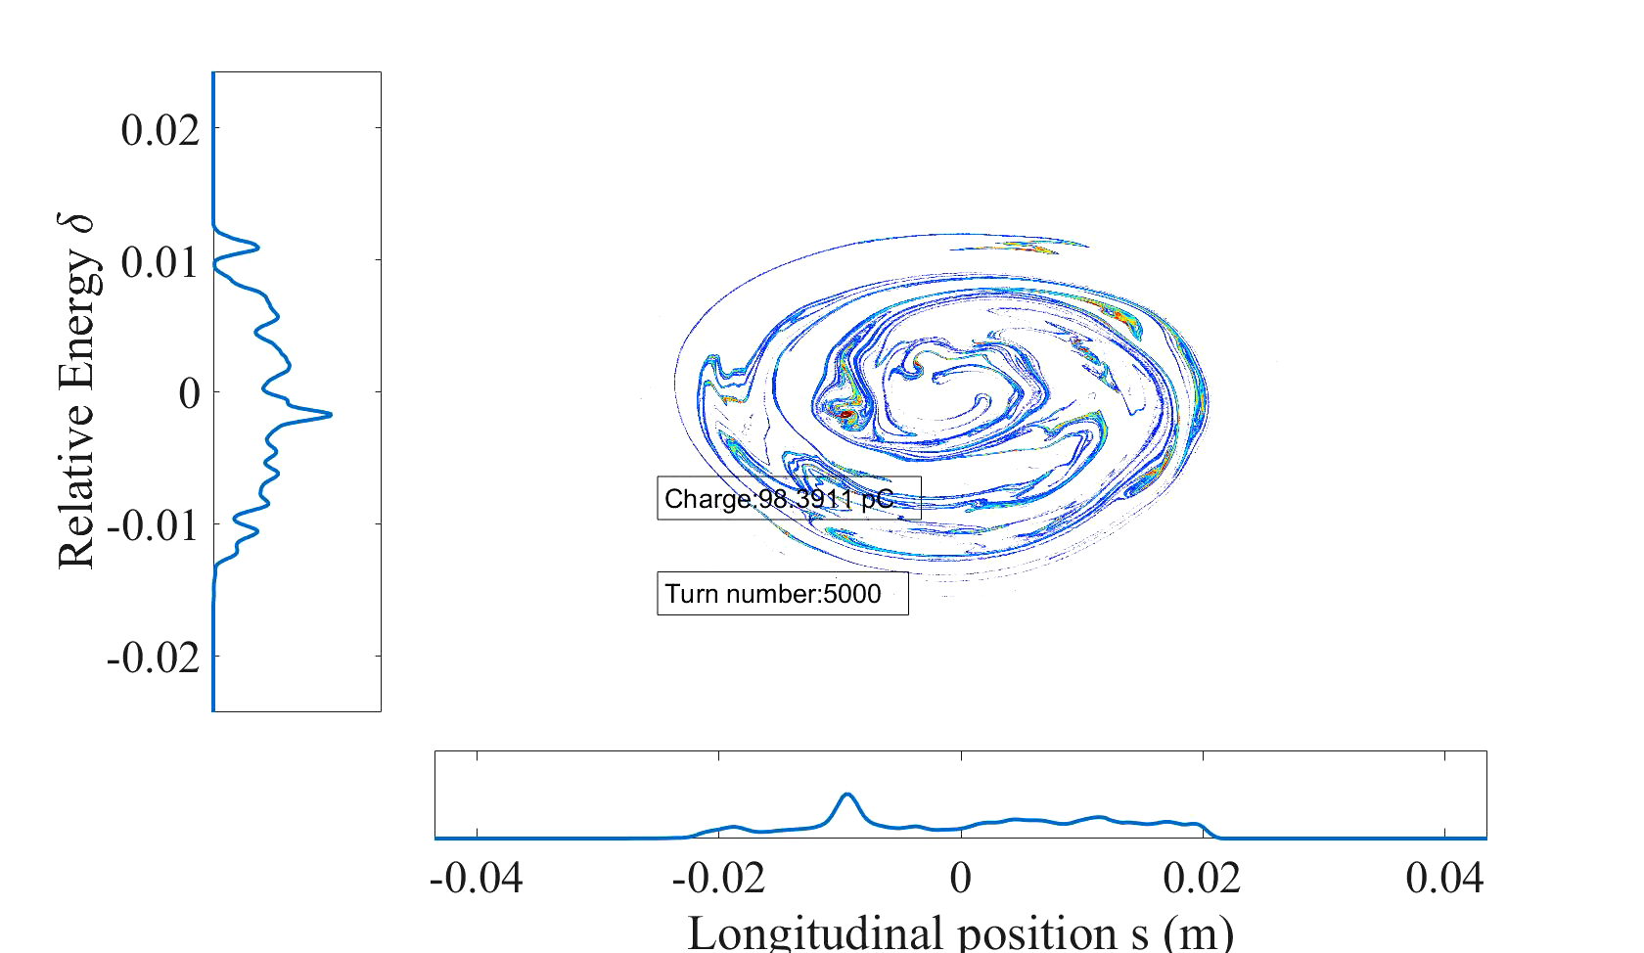
Transient microbunching regime at low charge (100pC)
Most of the microbunches have been diluted in the phase space as the RF bucket begins to be filled.
Alexis Gamelin

Slide 17
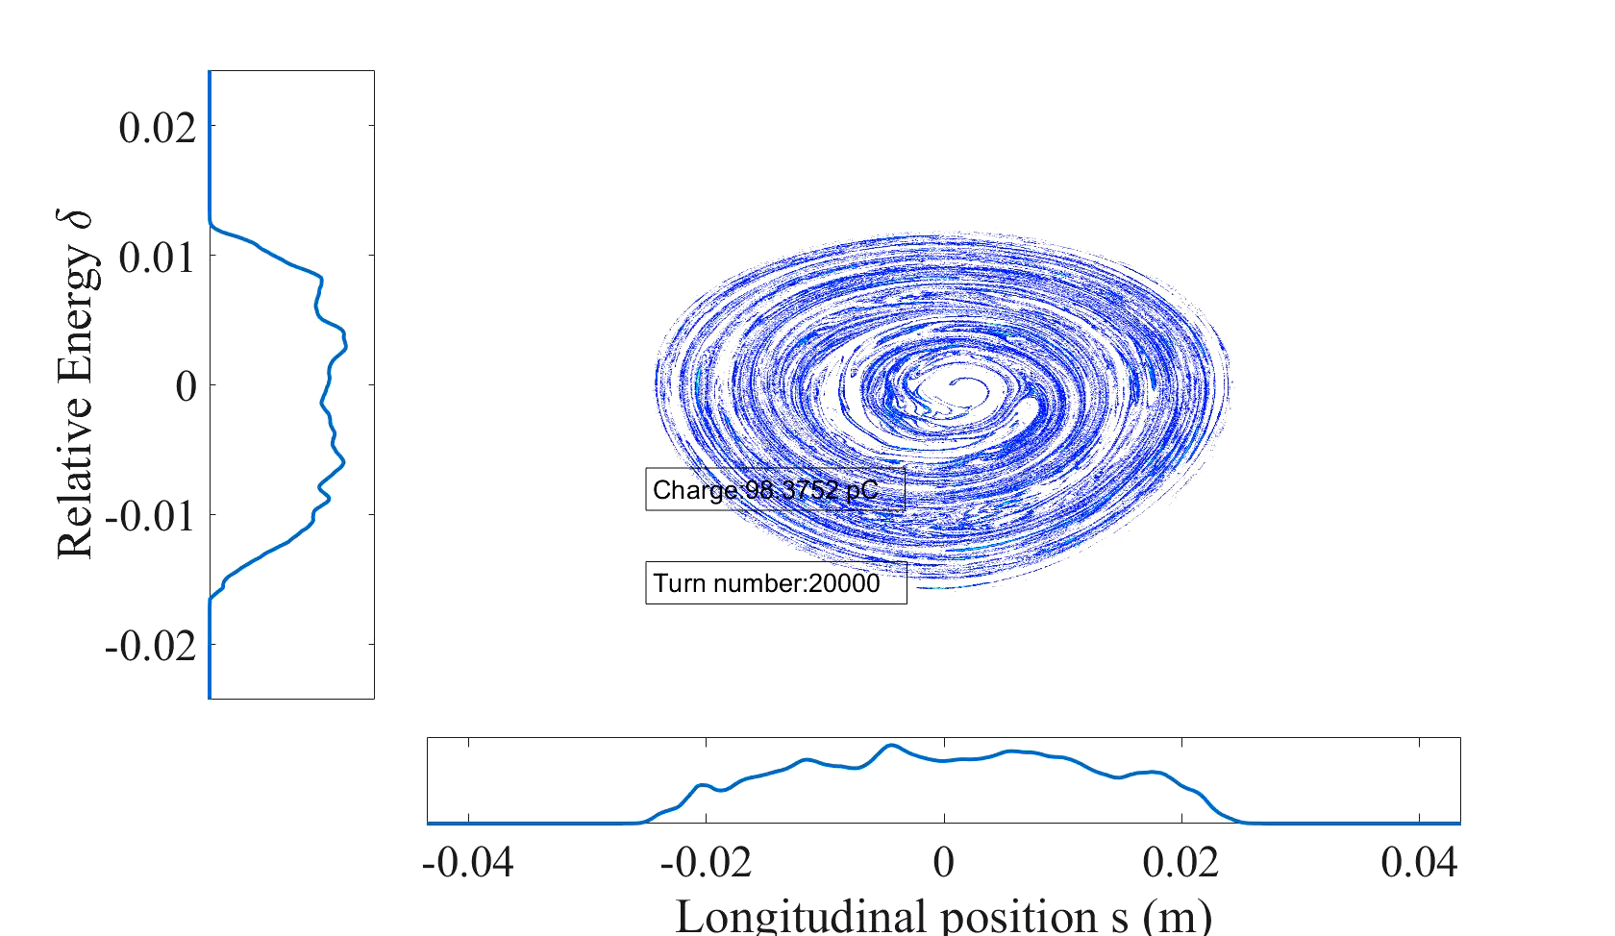
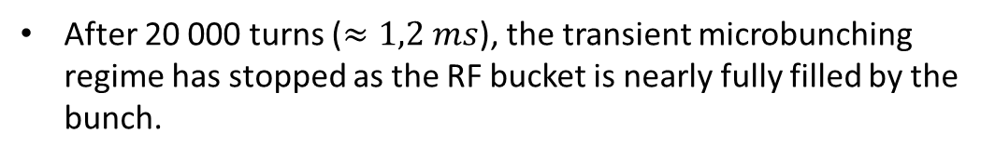

Transient microbunching regime at low charge (100pC)
After 20 000 turns ($≈1,2 ms$), the transient microbunching regime has stopped as the RF bucket is nearly fully filled by the bunch.
$$σ_{s}≈40 ps$$
$$σ_{δ}≈0,67 \%$$
$$ε_{x}≈2,8 mm.mrad$$
$$ε_{y}≈2,3 mm.mrad$$
Alexis Gamelin

Slide 18
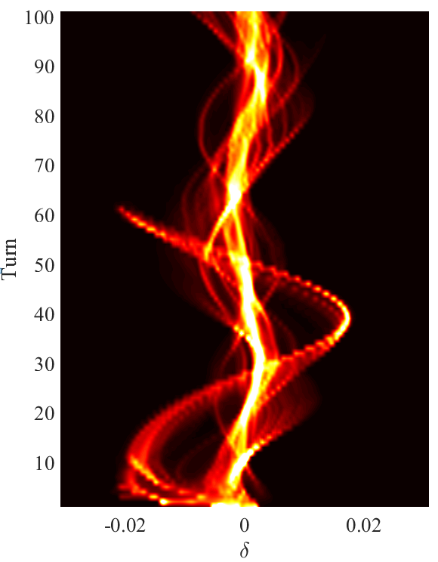
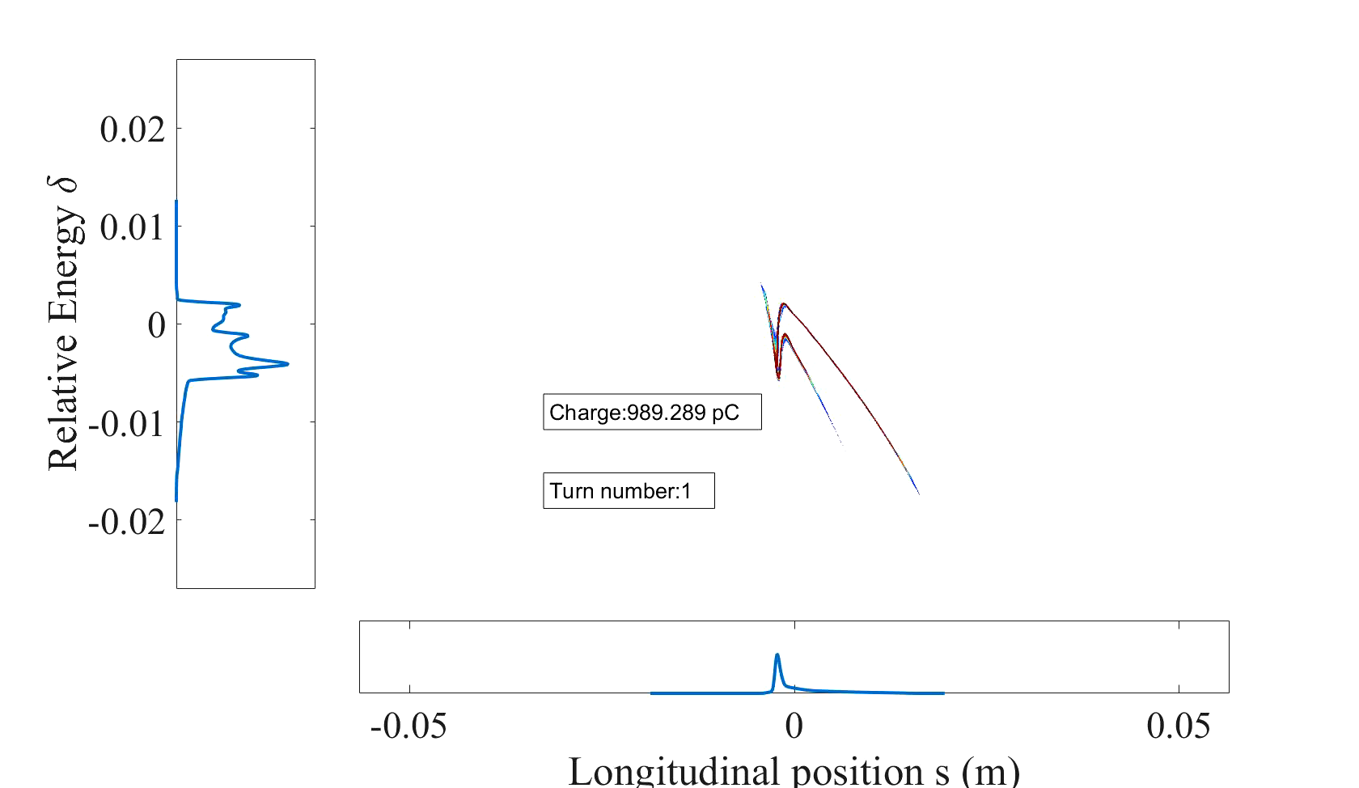
Transient microbunching regime at high charge (1nC)
At high charge, the bunch core folds on itself due to the strong CSR, which reinforces the very peaked, and thus coherent, longitudinal distribution.
Alexis Gamelin

Slide 19
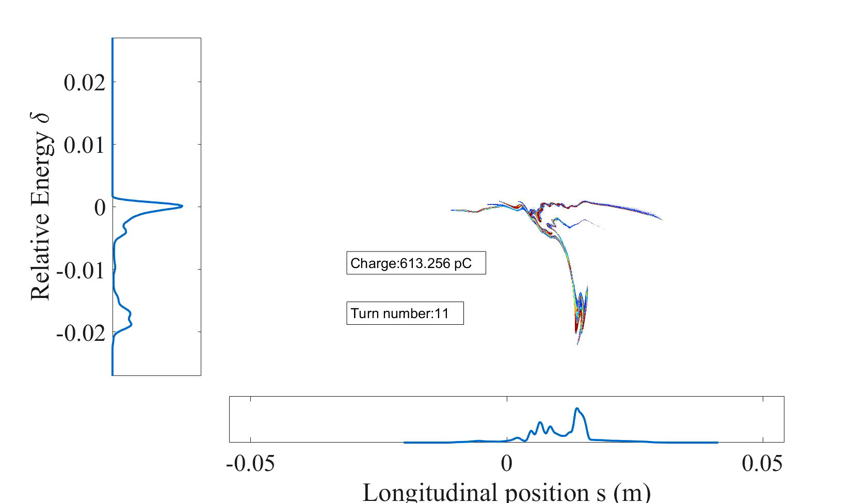
Transient microbunching regime at high charge (1nC)
After 100 turns, only 430 pC are left.
Alexis Gamelin

Slide 20
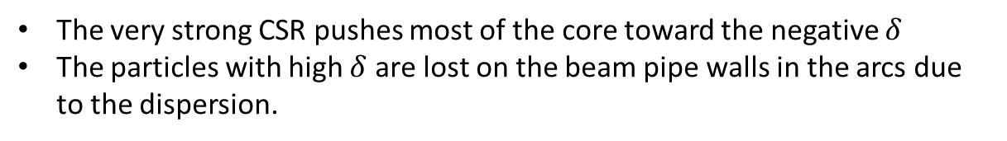
Transient microbunching regime at high charge (1nC)
The very strong CSR pushes most of the core toward the negative $δ$
The particles with high $δ$ are lost on the beam pipe walls in the arcs due to the dispersion.
Alexis Gamelin

Slide 21






First turns at 1nC
Possible mitigations:
Optimise Linac + TL to inject a « better » beam
Decrease the dispersion $η_{x}$ in the arcs to allow for more important $δ$
Increase $Ω_{s}$ (phase space rotation speed) so that the particles do not feel the same wake for too long
Increase $σ_{s}$ at injection (in fact decrease the longitudinal coherence, RMS is not very relevant)
but the off momentum DA limit $≈ ±1,5 \%$
Increase $V_{RF}∝\sqrt{Ω_{s}}$
$$\frac{ΔL}{L}=α_{c}δ+α_{2}δ^{2}$$
$$∝{\sqrt{Ω}}_{s}$$
$∝$ filamentation
Tweak the lattice
Alexis Gamelin

Slide 22
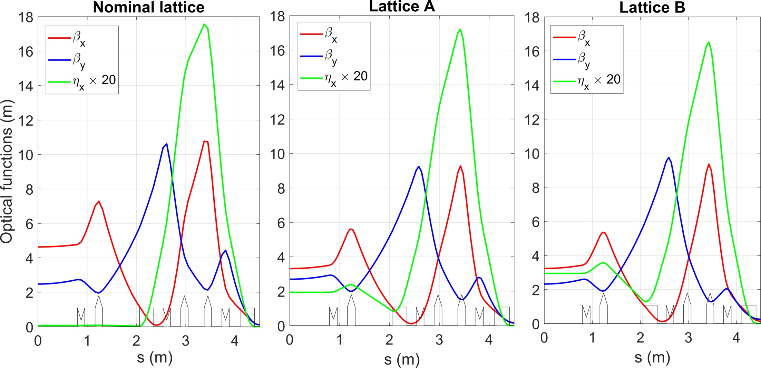


Alternative optics
$T_{s}=$synchrotron period$= \frac{2π}{Ω_{s}}$
$T_{0}=$revolution period$=$ 60 ns
Alexis Gamelin

Slide 23

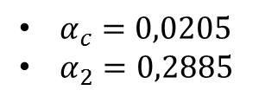
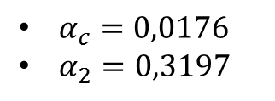

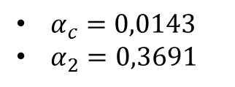


Alternative optics
$T_{s}=$synchrotron period$= \frac{2π}{Ω_{s}}$
$T_{0}=$revolution period$=$ 60 ns
$$T_{s}\left(V_{RF}=300kV\right)=49 T_{0}$$
$$T_{s}\left(V_{RF}=500kV\right)=38 T_{0}$$
$$T_{s}\left(V_{RF}=500kV\right)=34 T_{0}$$
$$T_{s}\left(V_{RF}=500kV\right)=31 T_{0}$$
$α_{c}=0,0143$
$α_{2}=0,3691$
$α_{c}=0,0176$
$α_{2}=0,3197$
$α_{c}=0,0205$
$α_{2}=0,2885$
Alexis Gamelin

Slide 24
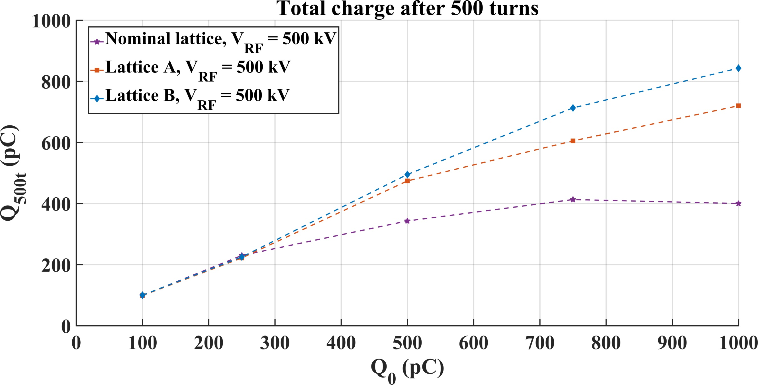
Alexis Gamelin

Slide 25
Conclusion on the impedance models and on the beam dynamics in the transient microbunching regime
From the simulations/measurements of the geometric/resistive impedance, no important problems are expected from longitudinal wakefields
The CSR is the dominant effect during the transient regime
The mismatch at injection seeds a microbunching instability which can induce beam losses during the transient regime
To be validated by further wire measurements (kickers, septum) and beam studies
The CSR can lead to a misalignment of the bunch slices leading to an increase of the transverse emittance at high charge
No beam losses expected at low charge (up to 250 pC)
At higher charge, the beam losses can be reduced by increasing $V_{RF}$ and $α_{c}$
Alexis Gamelin

Slide 26
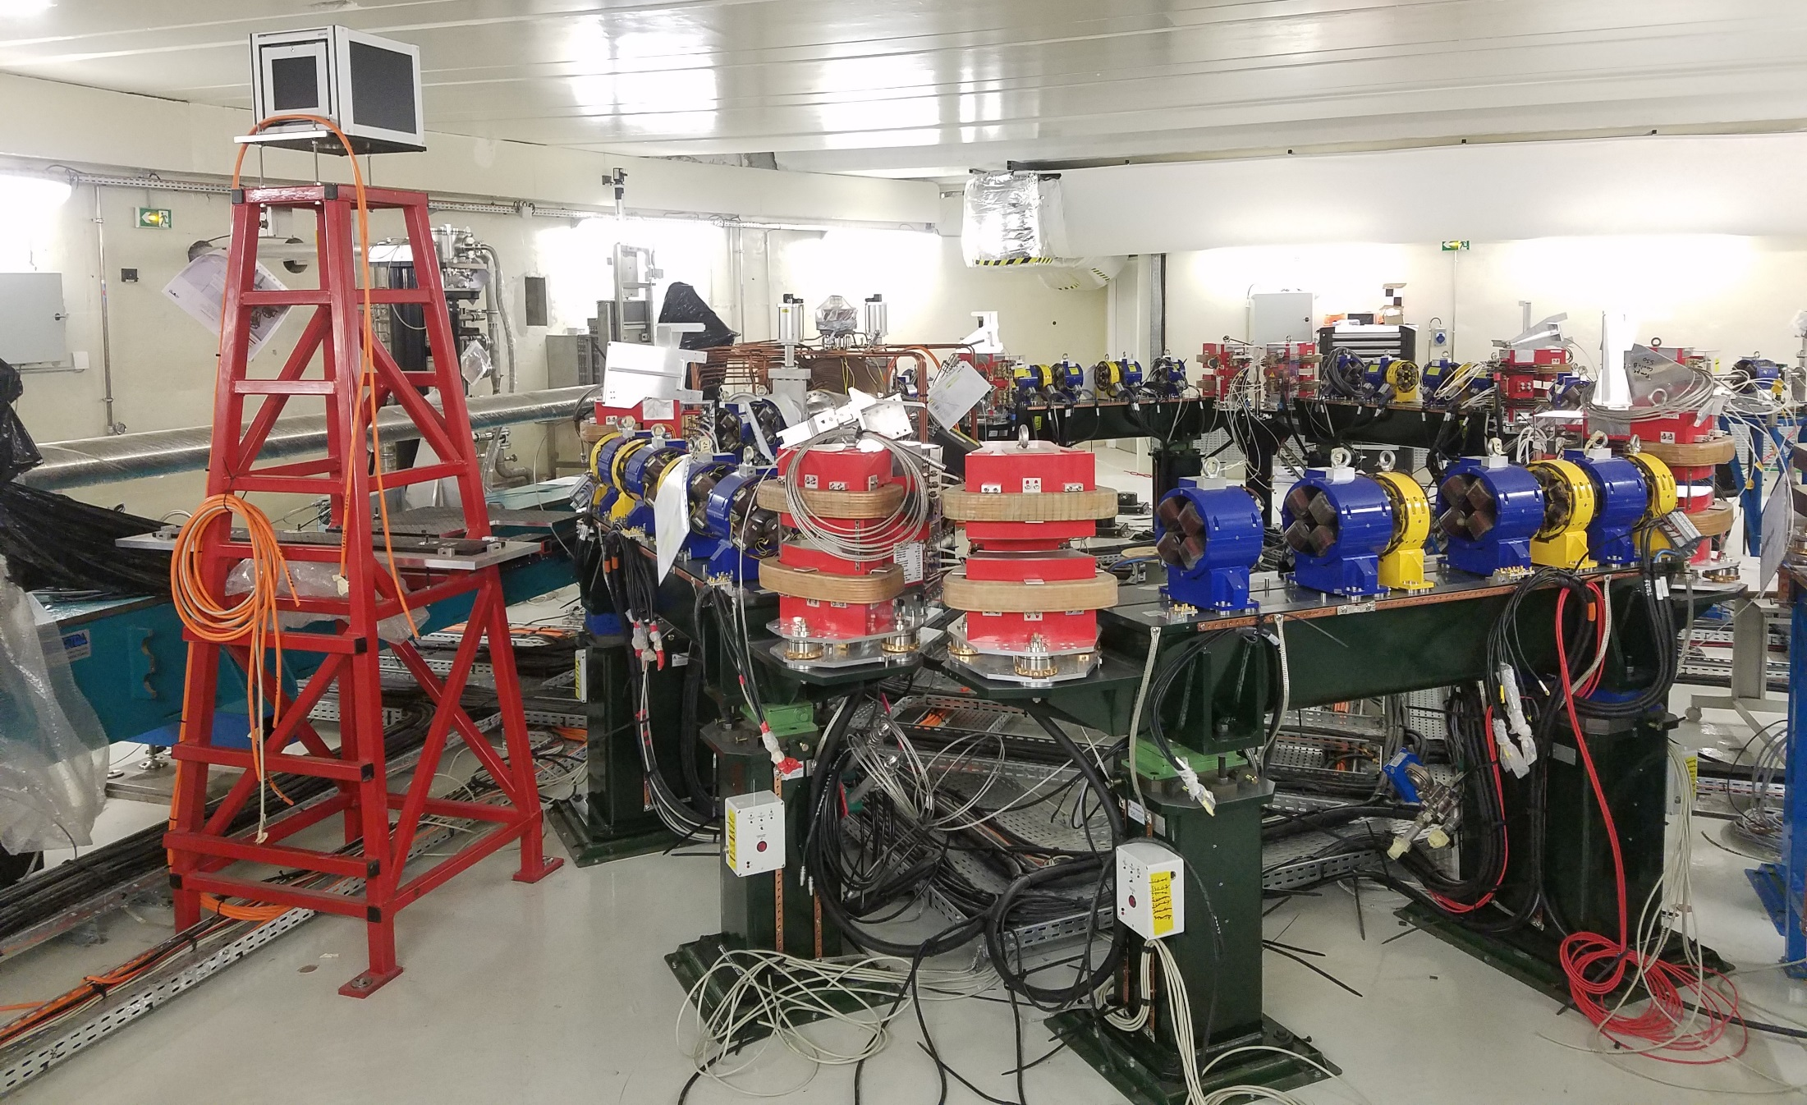
Merci !
Alexis Gamelin

Slide 27
Backups
Alexis Gamelin

Slide 28
Perspectives: ThomX commissioning
Start at low charge to avoid troubles linked to collective effects
Try to slowly increase the charge
Plan for shifts dedicated to beam studies for each possible axis of improvement
Shot to shot mode (or big gap) to avoid ions
Study the effect of the mismatch using streak plots
Characterise the beam after the transient regime
Compare with the measurements at low charge and locate the beam losses to identify causes
Try to test optics which minimise transverse emittance growth due to CSR
Try to lower the bunch coherence at injection
Optimise the longitudinal feedback to minimise beam loss
Increase $Ω_{s}$ via $V_{RF}$ and $α_{c}$
Alexis Gamelin

