Slide 1












PRAE Dechirper for ProRad exp.
Projet Emblématique
Programme SESAME
With the support of
Sandry Wallon
2018.11.28 – réunion du groupe diagnostiques

Slide 2
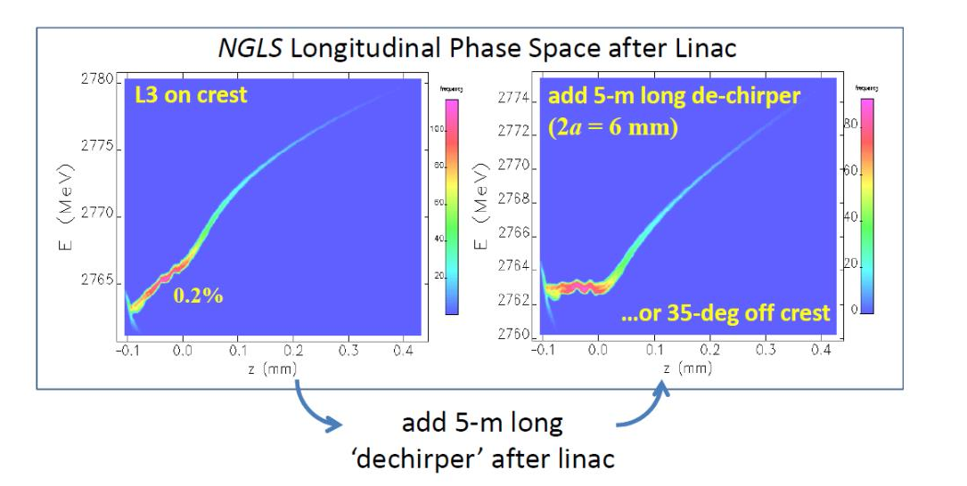
Outline 1/3
Dechirper and its applications – 23 May 2014
Heung-Sik Kang
Pohang Accelerator maboratory
Dechirper for PRAE used to correct the beam longitudinal phase space portrait.
  Longitudinal wake field to be generated.
  Avoid (minimized) transverse wake field (dipole and quadrupole effects).
  σE/E < 5x10⁻⁴ required by final user (ProRad exp.)

Slide 3
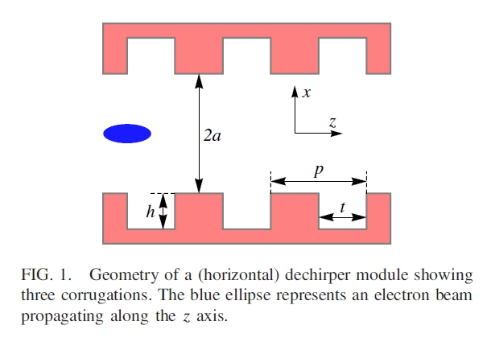
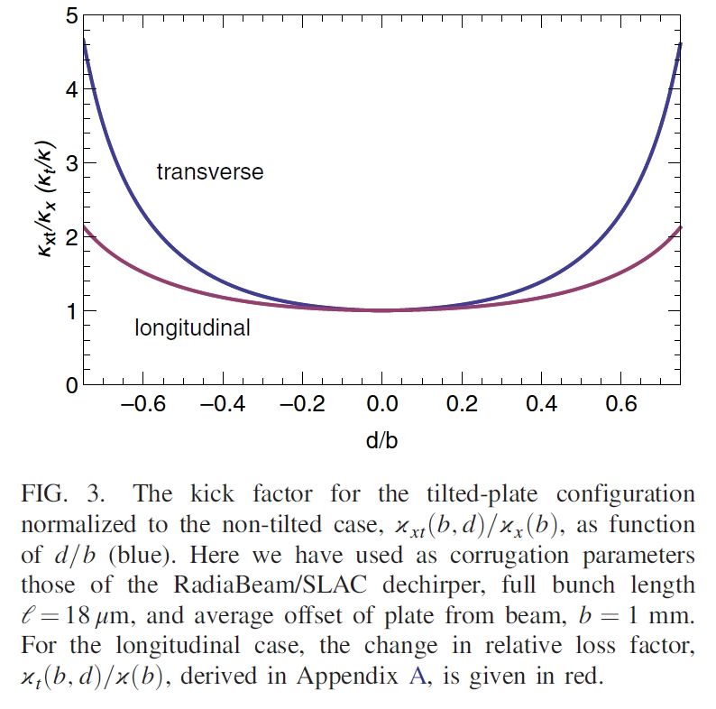
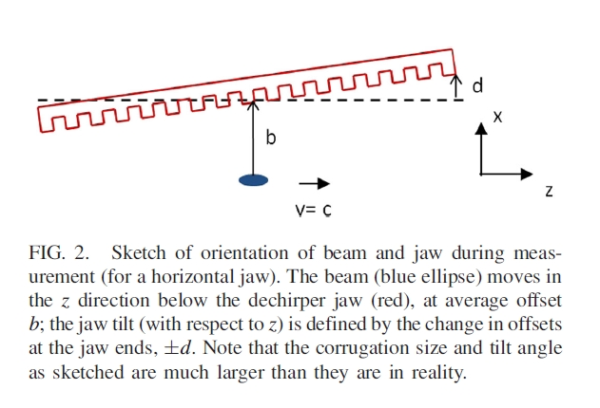
Outline 2/3
  Corrugated structure used to generate wake fields
jaw1
Wake measurements of a dechirper jaw with nonzero tilt angle - 29 May 2018
Karl Bane, Marc Guetg, Alberto Lutman, SLAC
jaw2
To minimize transverse wake field, jaws need no tilt w.r. to the beam
Side talk : “Obviously”, the beam must see two corrugated surfaces symmetrical together (one of the wake field component then equals to zero) → consideration to be taken into account for the manufacture of the 2 jaws (e.g. machining during the same operation)

Slide 4
Outline 3/3
Existing dechirpers / sources of inspiration :
  LCLS project at SLAC : 1 hori. + 1 vert. dechirpers (hori. model showed a 25 μm backlash issue ; vert. model intended to have no tilt issue thanks an unusual design [See May 2018 paper quoted previous
  page]).
  LAL collimator project at ATF2 (not a dechirper, but some affinities ; showed linear disp. statistical error within +/- 3 μm)
Jaws’ specifications :
  Not known yet (required wake depends on beam dynamics)
  First mechanical design done w/ 1 m long jaws (LCLS used 2 m long jaws… and 2 “crossed” dechirpers. Only one dechirper for PRAE.

Slide 5
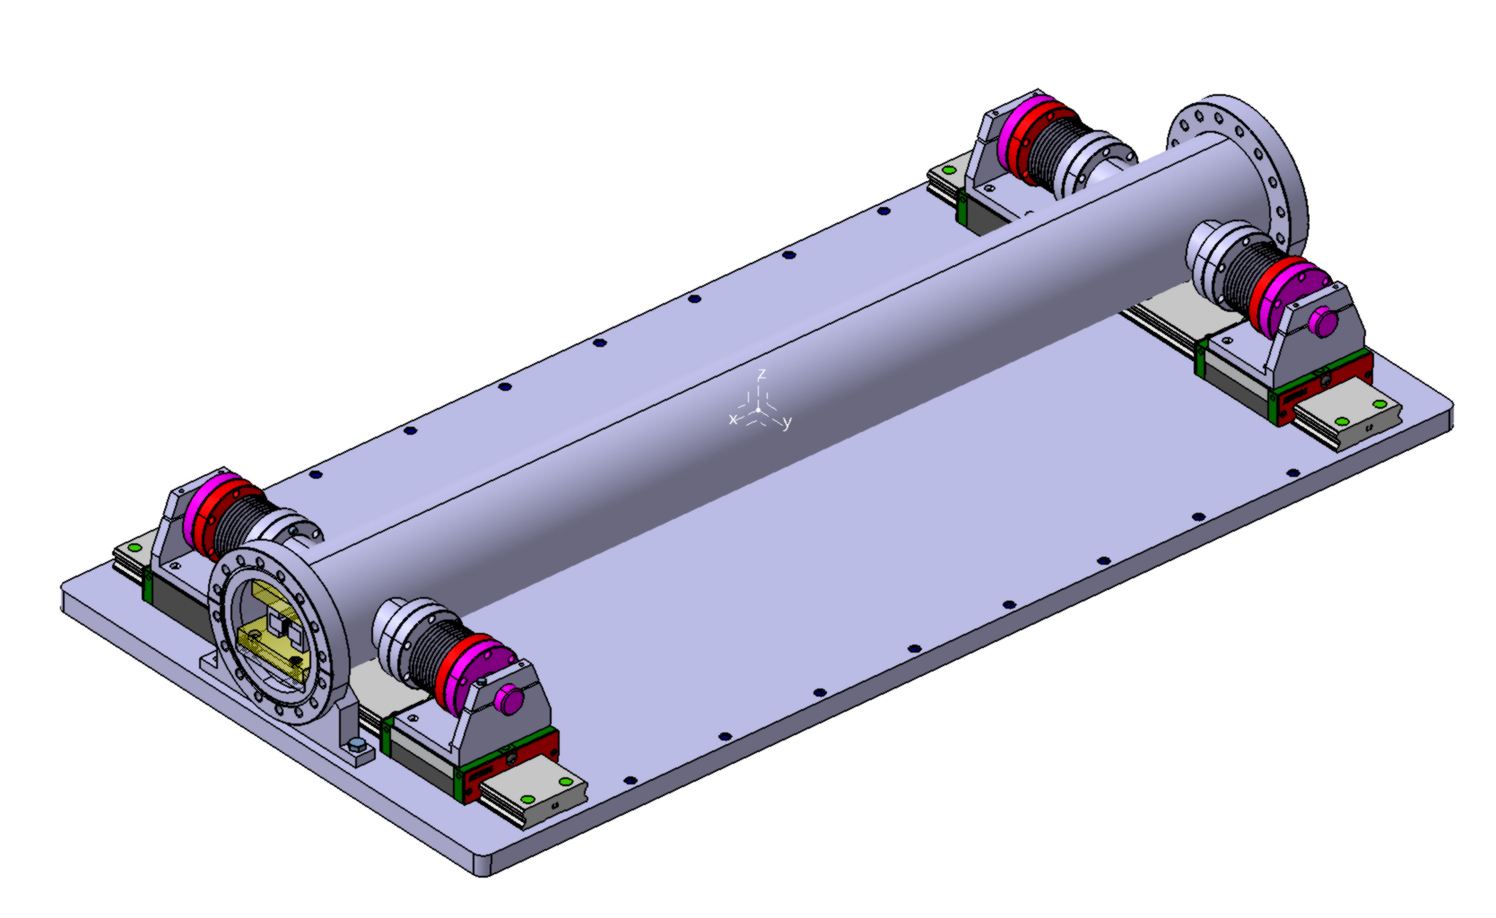
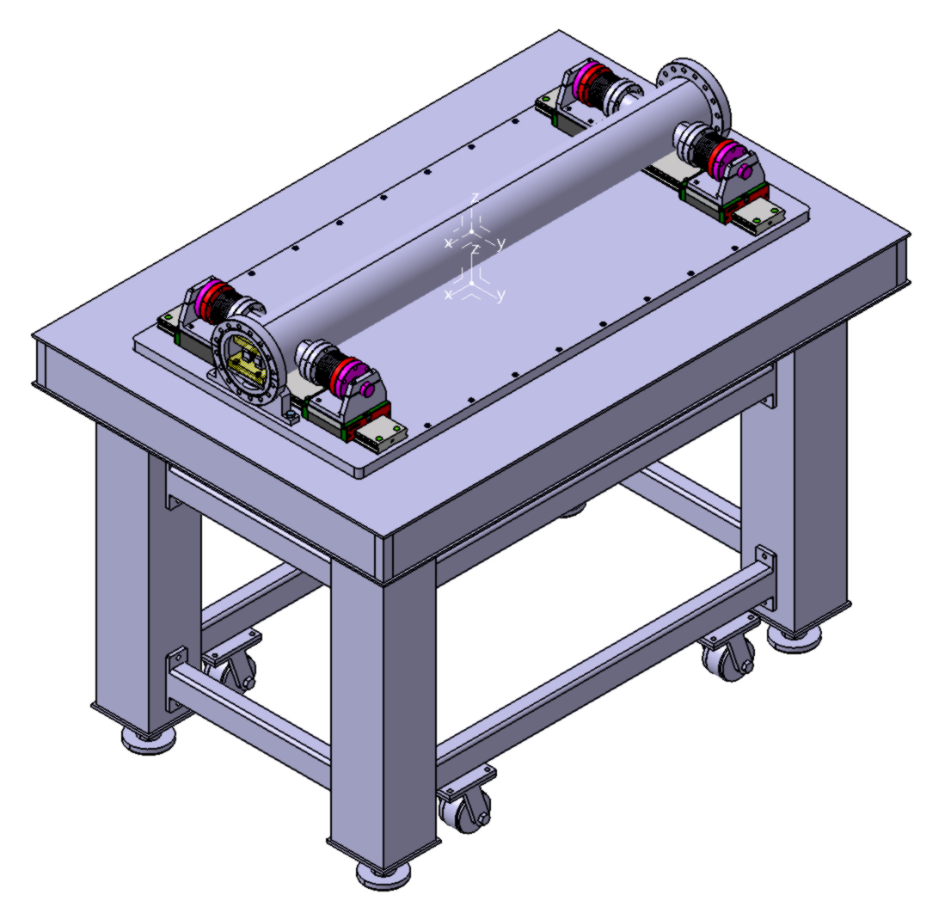
Dechirper model (1/2)
(main subsystem)
Dechirper main subsystem (right pic)
Features :
Follows the KISS principle (i.e. make it simple);
Different kind of actuators can be used (step motor, piezo element stack);
Compatible with different kinematics (regular style, or latest used at LCLS)
NB. Dechirper’s jaws could move in a horizontal plane or a vertical one : it does not change the longitudinal wakefield, but change the direction of transverse one.
Shown CAD model is done for a horizontal dechirper, the simplest type.
Dechirper main subsystem
mounted on an optical table

Slide 6
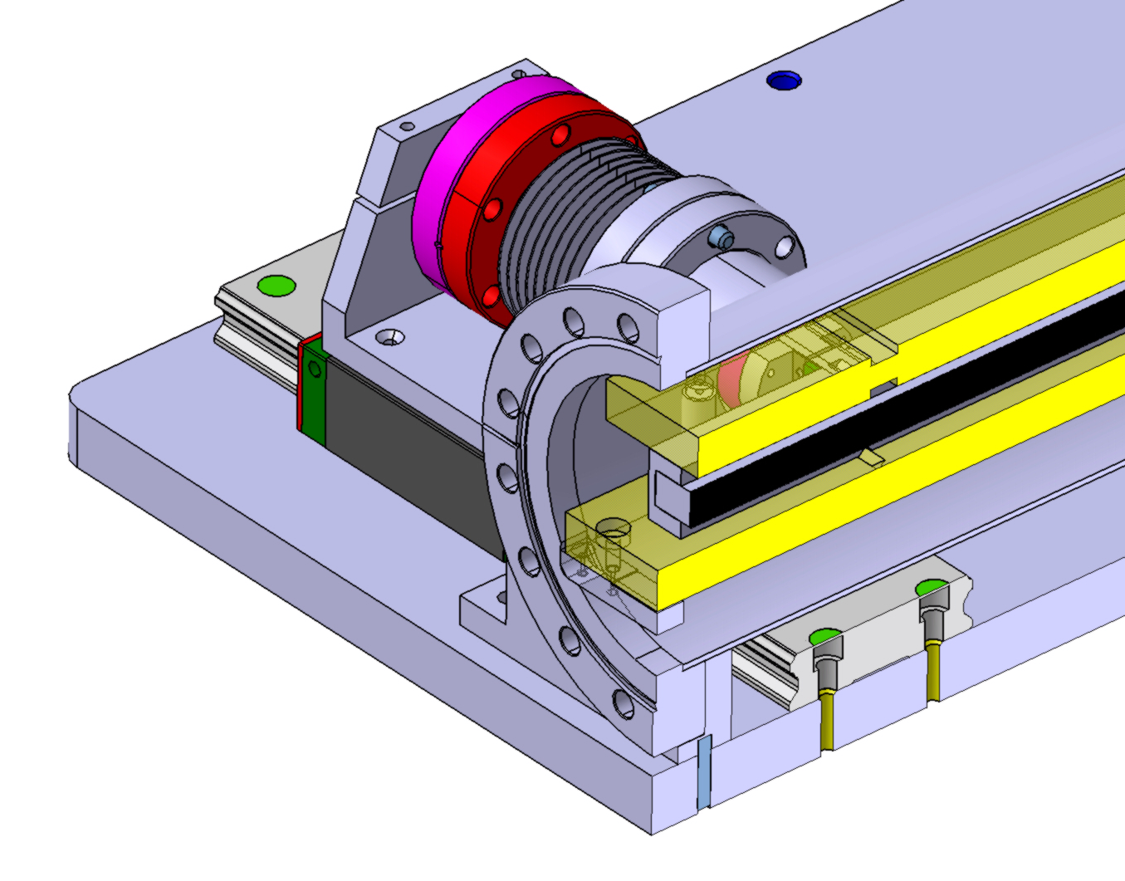
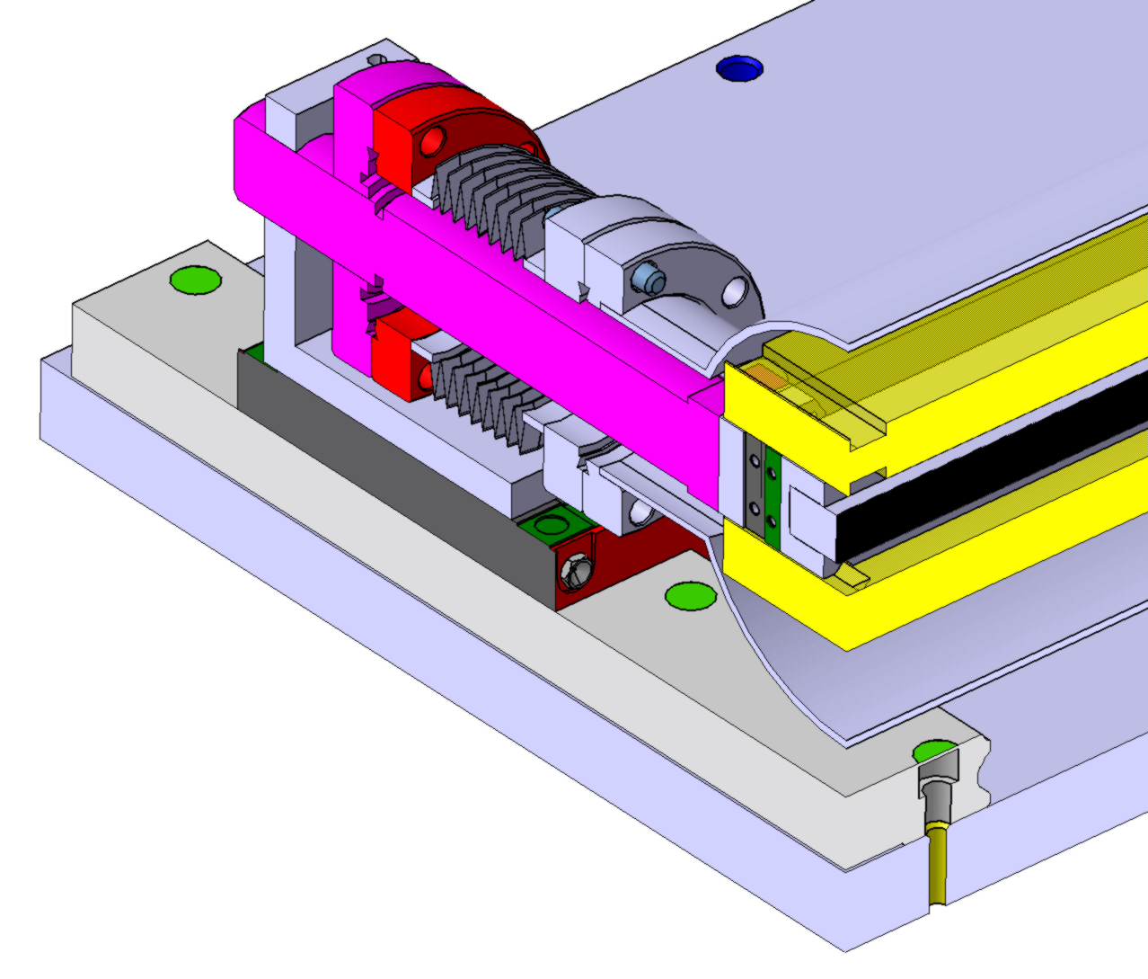
Dechirper model (2/2)
(main subsystem)
Dechirper main subsystem can be mounted on an optical table, giving high flexibility to installed equipment (actuators, manual positioning stages, linear position encoders)
Mechanical interfaces : DN100CF flanges non-rotatable (used also as references for alignment)
One of the two jaw enables to move in a horizontal plane
(slots – i.e. corrugated pattern – are vertical)

Slide 7
Status, budget & WBS (1/3)
Budget done (next page);
WBS done (but not a planning) (next page);
Main subsystem designed ; drawings done, but update needed (jaw and actuators specs);
Jaw need to be specified → wakefield calculations to be done be Y. Han or by B. Bowen ?
ProRad’s ANR un-successfull → project postponed for the mechancial part.

Slide 8
Status, budget & WBS (2/2)

Slide 9
Status, budget & WBS (2/3)
Dechirper budget & "non fine tuned" WBS
Sandry Wallon - édition 2018.11.27
Pos. | Task | Field | Item / work | Material only (if fab.at LAL) | Min price | Max price | Qty | Tot. Price (min) € | Tot. Price (max) € | Brand / supplier / Human R. | LAL's HR - estimated work time required (wk) | Rem.
1 | 1.1 | Mec. design | Derchirper main subsystem |  |  |  | 1 |  |  | LAL | not estimated | Raphael Vilar (Trainee) - DONE
2 | 1.3 | Mec. drawing |  |  |  |  | 1 |  |  |  |  | Raphael Vilar (Trainee) - DONE
3 | 2.1 | Mec. design | Derchirper - linear actuators integration |  |  |  | 1 |  |  |  |  | Sandry Wallon, trainee
4 | 2.2 | Mec. drawing |  |  |  |  | 1 |  |  |  |  | Trainee
5 | 3.1 | Mec. design | Adjustable interface between derchirper support (table) and ground |  |  |  | 1 |  |  |  |  | See LAL's mec. Dpt : proposed interface shown at 2018 PRAE workshop (hoof style) - (final table leg specs to provide to Mec. Dpt)
6 | 3.2 | Mec. drawing |  |  |  |  | 1
9 | 4 | Mec. drawing | General layout drawing |  |  |  | 1 |  |  |  |  | Trainee
10 | 5 | Manufacture (machining, welding) | Chamber (flanges quoted below) | Y | 100 | 600 | 1 | 100 | 600
11 |  |  | Stems w/ flange to be welded | Y | 10 | 20 | 4 | 40 | 80
12 |  |  | Misc. Parts | Y | 300 | 400 | 1 | 300 | 400
13 |  |  | Jaw (1 m long) |  | 1500 | 4000 | 1 | 1500 | 4000 | KG industrie or other |  | Specs unknown on Nov. 2018
14 | 6 | General supplies | Metal bellow w/ 2 DN40CF flanges |  | 350 | 350 | 4 | 1400 | 1400 | Mewasa
15 |  |  | Optical table w/ legs (bench) |  | 2418 | 6000 |  | 0 | 0 | Micro Controi Instrument Ltd or Thorlabs |  | Solid Vibration Isolation vs pneumatic Vibration Isolation
16 |  |  | Solid aluminum breadboard probably to be machined from Al board (at LAL) or standard breadboard | Y or N | 200 | 1300 |  | 0 | 0 | LAL or Thorlabs
17 |  |  | Block for linear slide |  | 88 | 120 | 4 | 352 | 480 | Hiwin or other
18 |  |  | Rail for linear slide |  | 221 | 300 | 2 | 442 | 600

Slide 10
Status, budget & WBS (3/3)
19 |  |  | DN40CF non-rotatable flange |  | 28 | 28 | 8 | 224 | 224 | NEYCO
20 |  |  | DN100CF non-rotatable flange |  | 154 | 154 | 2 | 308 | 308 | NEYCO
21 |  |  | Special screws and washers (vented, molycoated) |  | 200 | 200 | 1 | 200 | 200 | MDC
22 |  |  | Regular screws, washers and nuts |  | 50 | 50 | 1 | 50 | 50 | LAL's warehouse
23 |  | Sensitive supplies | Linear actuator w/ electonics (e.g. linear stage based on step motor w/ brake, EGSK-26-100-2P like) |  | 1800 | 1800 | 4 | 7200 | 7200 | FESTO or other |  | Check thrust needed ; Tx and Rz coupled -> 4 same actuators ; if Tx and Rz uncoupled -> 2 types of actuators
24 |  |  | Linear position encoder (LVDT - linear variable disp. tranducer) |  | 200 | 500 | 4 | 800 | 2000 | Misc. |  | likely requested "accuracy" : 1 um ; Warning : "While most LVDTs are magnetically shielded, it is recommended that ferrous metals should not be located closer than 1/4 inch from the open end of the LVDT body."
25 | 7 | Checks | Linear actuators and linear encoder to be checked and assess the performance |  |  |  |  |  |  | LAL |  | "volunteer?" ; devices could be checked w/ LAL's interferometer -> Statistical and systematic errors to assess
26 | 8 | Checks | Parts dimensions and specs to be checked w/ CMM |  |  |  |  |  |  |  |  | Bruno Leluan
27 | 9 | Cleaning | Cleaning for vaccum app |  |  |  | 1 |  |  |  |  | LAL's vacuum group
28 | 10 | Mechanical assembly | Assembly |  |  |  | 1 |  |  |  |  | Filip Rudnyckyj (proposal)
29 | 11 | Checks | He leak test |  |  |  | 1 |  |  |  |  | LAL's vacuum group
30 | 12 | Electrical supply | Box for 2 controllers and 1 power supply |  | 106 | 150 | 2 | 212 | 300 |  |  | See Patrick Cornebise
31 |  |  | Misc. Parts for controller box |  | 101.5 | 150 | 2 | 203 | 300
32 |  |  | (set) Basic cables (PC to controler : RJ45 ; 24/48VDC power supply to controler) |  | 0 | 100 | 4 | 0 | 400
33 |  |  | (set) Encoder and motor cables (if longer than 8 m) |  | 0 | 100 | 4 | 0 | 400
34 |  | Design & drawing | Controler box - wiring diagramm and boxe machining drawing |  |  |  | 1 |  |  |  |  | Patrick Cornebise (proposal)
35 |  | Electrical assembly | Controler box w/ power supply and controler |  |  |  | 2 |  |  |  |  | Patrick Cornebise (proposal)
36 | 13 | Checks | Test of assembly with its "power supply" (test with power on) - Adjust jaws position w/ respect of external references - final test under vacuum condition and w/ power on |  |  |  | 1 |  |  |  |  | Bruno Leluan + "volunteer?"
37 | 14 | Installation | Installation |  |  |  | 1 |  |  |  |  | Sandry Wallon + Filip Rudnyckyj (proposal)
 |  |  |  |  |  |  | Total (€) | 13331 | 18942

