Slide 1
DeLLight
(Deflection of Light by Light)
with LASERIX
Modification of the vacuum refractive index
in intense electromagnetic fields
F. Couchot, X. Sarazin, M. Urban + LASERIX dream team + A. Djannati-Ataï (APC)
S. Robertson (post-doc theory)
Xavier Sarazin (LAL) Séminaire LAL 9 octobre 2018

Slide 2
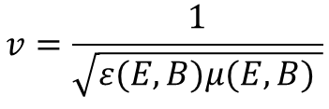
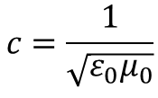
Is the vacuum optical index constant ?
Maxwell’s equations are « linear » in vacuum
D = ε₀E
B = μ₀H
ε₀ and μ₀ are CONSTANT
Optical index (n=1) is constant
Do not depend on external fields
$$c=\frac{1}{\sqrt{ε_{0}μ_{0}}}$$
Maxwell’s equations are not linear in medium
D = ε₀E + P(E,B) = ε (E,B).E
B = μ₀H + μ₀M(E,B) = μ (E,B).H
$$v=\frac{1}{\sqrt{ε(E,B)μ(E,B) }}$$
Optical index is not constant but depends on external fields E,B ⇒ n(E,B)
There is a non linear interaction between the electromagnetic fields, through the medium
n(B) : Birefringence induced by an external magnetic field, first measured by Faraday (1845)
n(E) : Refractive index increased by an electric field, first measured by Kerr (1875)

Slide 3
Is the vacuum optical index constant ?
Is the vacuum a non linear optical medium as other material mediums ?
Can the vacuum optical index be modified by an external field ?
This question has been studied for the first time in 1911 in the case of gravitaion…

Slide 4
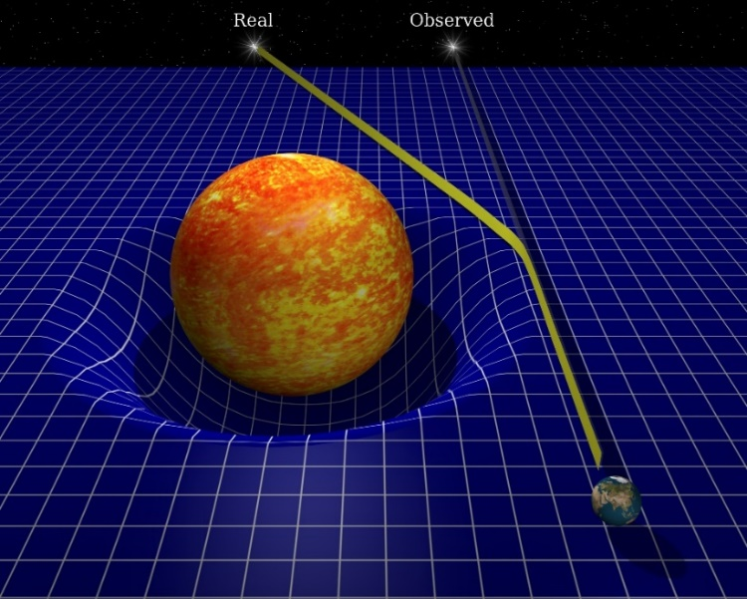
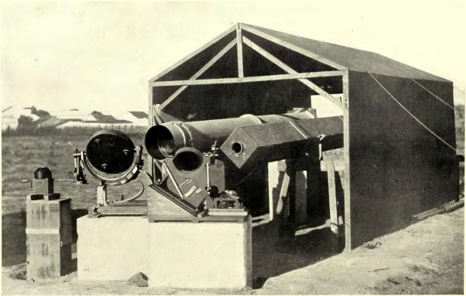
Is the vacuum optical index modified by gravitation ?
Einstein is the first one to note that n and c are affected by the gravitation:
Einstein, A. ‘Über den Einfluss der Schwerkraft auf die Ausbreitung des Lichtes’, Annalen der Physik 35, 898-908 (1911)
“The constancy of the velocity of light can be maintained only insofar as one restricts oneself to spatio-temporal regions of constant gravitational potential” (Einstein A., Ann. Physik 38 (1912) 1059)
Einstein generalized the « $c=\text{constante}$ » relativity principle thanks to the introduction of a curved spacetime metric
The General Relativity is a « geo-metric » theory
Vacuum has no physical role anymore
Deflection of light first observed by Eddington in 1919

Slide 5


Is the vacuum optical index modified by gravitation ?
Another empirical approach initially proposed by Wilson (1921) and Dicke (1957)
Euclidean flat metric
Spatial change of ε₀ and μ₀ by the gravitational potential
Modification of the vacuum optical index and inertial test mass
Wilson, Phys. Rev. 17, 54 (1921)
Dicke, Rev. Mod. Phys. 29, 363 (1957)
$n(r)$ formally identical to $g_{00}$ in General Relativity
⇒ See Landau & Lifshitz (1975) : “A static gravitational field plays the role of a medium with electric and magnetic permeabilities $ε_{0}=μ_{0}=1/\sqrt{g_{00}}$”
(Wilson-Dicke Analogy)
Exemple : Static spherical gravitational field
$$n\left(r\right)=1+\frac{2GM}{rc_{∞}^{2}}$$
$$m\left(r\right)=m_{∞}×n^{3/2}(r)$$
(to preserve the equivalence principle)

Slide 6
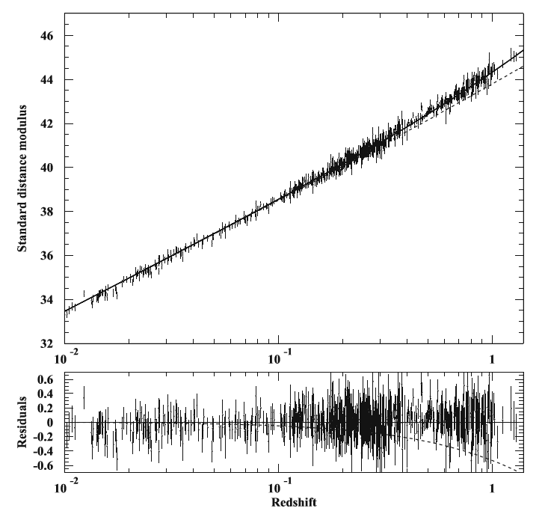
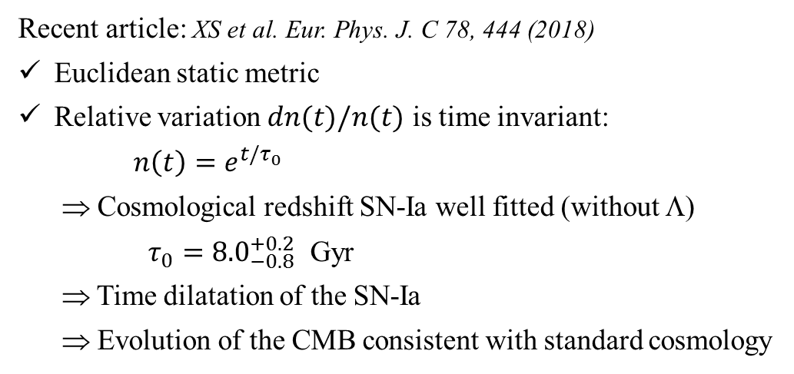
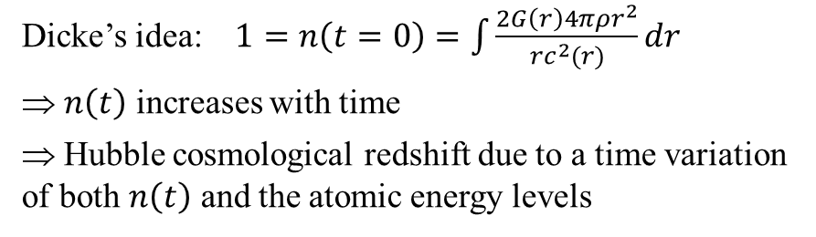
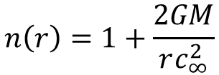
Cosmology with a vacuum index increasing with time
$$n\left(r\right)=1+\frac{2GM}{rc_{∞}^{2}}$$
?
Dicke’s idea: $1=n\left(t=0\right)=\int{\frac{2G\left(r\right)4πρr^{2}}{{rc}^{2}(r)}dr}$
⇒ $n\left(t\right)$ increases with time
⇒ Hubble cosmological redshift due to a time variation of both $n\left(t\right)$ and the atomic energy levels
Recent article: XS et al. Eur. Phys. J. C 78, 444 (2018)
Euclidean static metric
Relative variation $dn(t)/n(t)$ is time invariant:
$n\left(t\right)=e^{t/τ_{0}}$
⇒ Cosmological redshift SN-Ia well fitted (without Λ)
$τ_{0}={8.0}_{−0.8}^{+0.2}$ Gyr
⇒ Time dilatation of the SN-Ia
⇒ Evolution of the CMB consistent with standard cosmology

Slide 7
Is the vacuum optical index
modified by electromagnetic fields ?

Slide 8

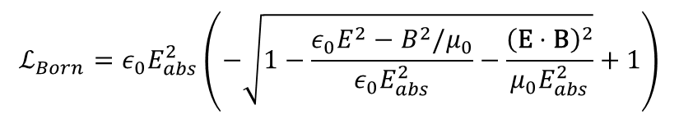
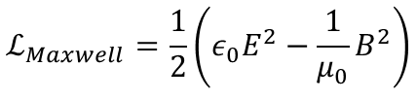

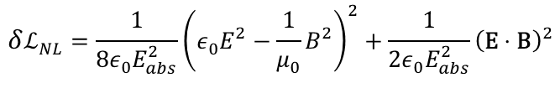
« Born-Infeld » non linear electrodynamics
A crucial problem in physics:
Electromagnetic mass of the electron = self-energy of a point charge… which is infinite !
(By the way, this problem is still unsolved in quantum field theory !…)
How to regularize an electromagnetic field ?
Born and Infeld, in 1934, proposed to introduce non linear interactions between electromagnetic fields
by assuming an absolute field $E_{abs}$
$$ℒ_{Born}=ε_{0}E_{abs}^{2}\left(−\sqrt{1−\frac{ε_{0}E^{2}−B^{2}/μ_{0}}{ε_{0}E_{abs}^{2}}−\frac{{\left(\text{E}⋅\text{B}\right)}^{2}}{μ_{0}E_{abs}^{2}}}+1\right)$$
Born and Infeld, Proc. R. Soc. A 144, 425 (1934)
Fouché et al., Phys. Rev. D 93, 093020 (2016)
$$ℒ_{Maxwell}=\frac{1}{2}\left(ε_{0}E^{2}−\frac{1}{μ_{0}}B^{2}\right)$$
$$ℒ_{Born}≅ℒ_{Maxwell}+δℒ_{NL}$$
$$δℒ_{NL}=\frac{1}{8ε_{0}E_{abs}^{2}}{\left(ε_{0}E^{2}−\frac{1}{μ_{0}}B^{2}\right)}^{2}+\frac{1}{2ε_{0}E_{abs}^{2}}{\left(\text{E}⋅\text{B}\right)}^{2}$$
$E_{abs}$ is a free parameter of the Born-Infeld theory
Born-Infeld theory predicts no birefringence

Slide 9
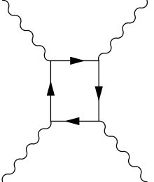




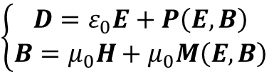
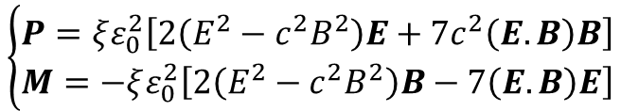
« Euler-Heisenberg Lagrangian » & non linear QED
Euler-Heisenberg (1935) : nonlinearity induced by the coupling of the field with the e⁺/e⁻ virtual pairs in vacuum
Heisenberg and Euler, Z. Phys. 98, 714 (1936)
$$\left\{\begin{aligned}D=ε_{0}E+P\left(E,B\right) \\ B=μ_{0}H+μ_{0}M\left(E,B\right)\end{aligned}\right.$$
$$\left\{\begin{aligned}P=ξε_{0}^{2}\left[2\left(E^{2}−c^{2}B^{2}\right)E+7c^{2}\left(E.B\right)B\right] \\ M=−ξε_{0}^{2}\left[2\left(E^{2}−c^{2}B^{2}\right)B−7\left(E.B\right)E\right]\end{aligned}\right.$$
$$ξ^{−1}=\frac{45m_{e}^{4}c^{5}}{4α^{2}ℏ^{3}}≈3 {10}^{29} \text{J}\text{/}{\text{m}}^{\text{3}}$$
⇒ Modification of the Maxwell’s equations in vacuum ⇒ Vacuum is a non linear medium
The vacuum refractive index is not an absolute constant
It can be modified on large scale (low energy) when it is stressed by intense e.m. fields
$$n≠1$$
This result has been derived later by Schwinger with the QED frame
J. Schwinger, Phys. Rev. 82, 664 (1951)
Schwinger critical field :
$$E_{cr}=\frac{m_{e}^{2}c^{3}}{eℏ}=1.3×{10}^{18} \text{V}\text{/}\text{m}$$
$${B_{cr}=E}_{cr}/c=4.4×{10}^{9} \text{T}$$

Slide 10
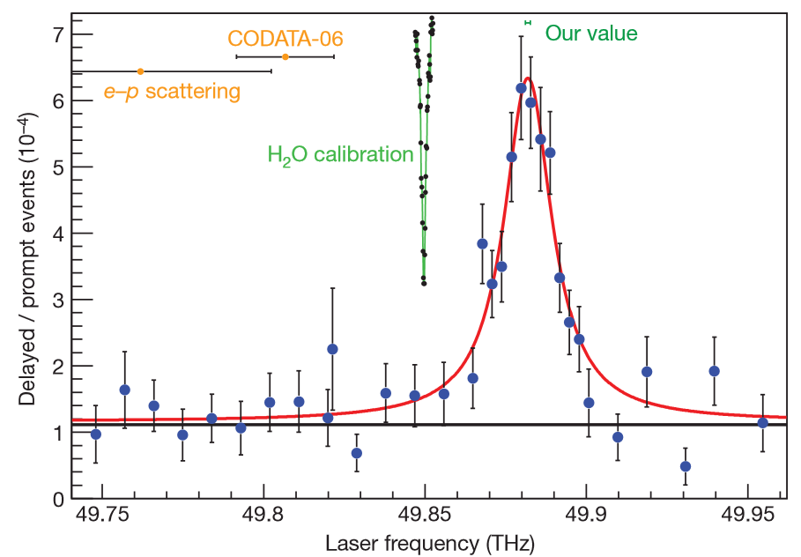
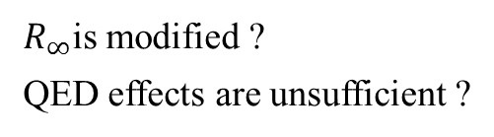





Two-photons scattering v.s. Intense fields
High occupancy number
Coherence @ mesoscopic scale
Field intensity
$$∆E/E≈2×{10}^{−3}$$
$$E_{cr}=1.3×{10}^{18} \text{V}\text{/}\text{m}$$
$R_{∞}$is modified ?
QED effects are unsufficient ?
μ−hydrogen
spectrocopy
$$E_{H−μ}≈4×{10}^{15} \text{V}\text{/}\text{m}$$
Pohl et al. Nature 2010
Antognini et al. Science 2013
$$E_{LASERIX}≈{3×10}^{13} \text{V}\text{/}\text{m}$$
DeLLight
e−hydrogen
spectrocopy
$$E_{H−e}≈{10}^{11} \text{V}\text{/}\text{m}$$
γ (29 GeV) + N photons (laser 527nm) → e⁺ e⁻
Pb+Pb(γγ)
→ Pb^{(*)}+Pb^{(*)} γγ
Two-photons
scattering
(SLAC-1997)
Atlas@LHC
Energy

Slide 11
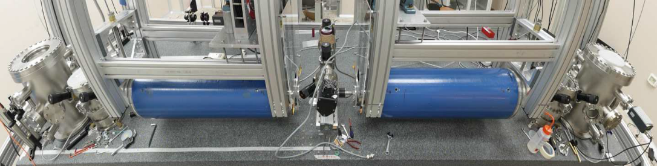
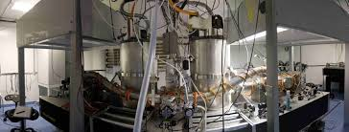
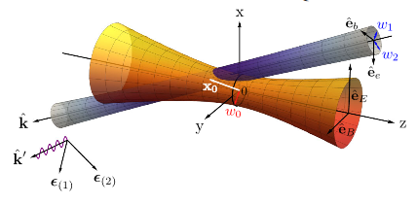

Current experimental tests
Search for birefringence with the PVLAS + BMV experiments
$$∆n_{\text{QED}}=4×{10}^{−24} { \text{T}}^{−2}$$
Fabry-Perrot laser cavity with an external B field
PVLAS: Rotating field B=2.5 T
Eur. Phys. J. C (2016) 76:2
BMV: Pulsed field B=6.5 T
Eur. Phys. J. D (2014) 68: 16
0.1 σ sensitivity after ~100 days of measurement
Project @ XFEL using x-ray free electron and intense PW laser Phys. Rev. D 94,013004 (2016)
Laser Pump
X-ray Probe
Birefringence null with Born-Infeld nonlinear formalism

Slide 12
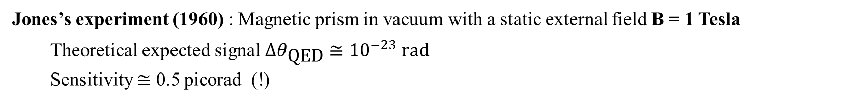

Jone’s experiment in 1960…
Variation of the vacuum refractive index, independentely of the polarization, has been tested only once, by R.V. Jones in … 1960 !
Jones’s experiment (1960) : Magnetic prism in vacuum with a static external field B = 1 Tesla
Theoretical expected signal $∆θ_{\text{QED}}≅{10}^{−23} \text{rad}$
Sensitivity $≅$ 0.5 picorad (!)
θ ?
⊗
B₀
$$∆θ_{\text{QED}}∝B^{2}$$
DeLLight with intense laser field produced by LASERIX
2.5 J, 30 fs, w₀=5μm ⇒ ~ ${3×10}^{20}$ W/cm² ⇒ $E\sim {3×10}^{13}V/m$, $B\sim {10}^{5} T$

Slide 13
The DeLLight experiment

Slide 14














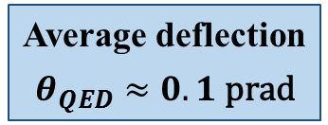
Pump-Probe interaction
Recent calculations done by Scott Robertson, post-doc LAL & LPT (R. Parentani)
$$y$$
$$e$$
Probe pulse
~ 1 mJ
$$y$$
$$b$$
Pump pulses
2.5 J
E₀
$$x$$
$$x$$
B₀
k₁
$$z$$
k₂
$$ξ^{−1}=\frac{45m_{e}^{4}c^{5}}{4α^{2}ℏ^{3}}≈3 {10}^{29} \text{J}\text{/}{\text{m}}^{\text{3}}$$
${δn}_{QED}$ depends on the polarisation
$$δn(x,y,z,t)=k×ξ4ε_{0}E_{0}^{2}$$
$k=7/4$ when $e_{y}=0$
$k=1$ when $e_{x}=0$
$δn$_{Born-Infeld} independent of the polarisation
Average deflection
$$θ_{QED}≈0.1 \text{prad}$$
$$θ$$

Slide 15
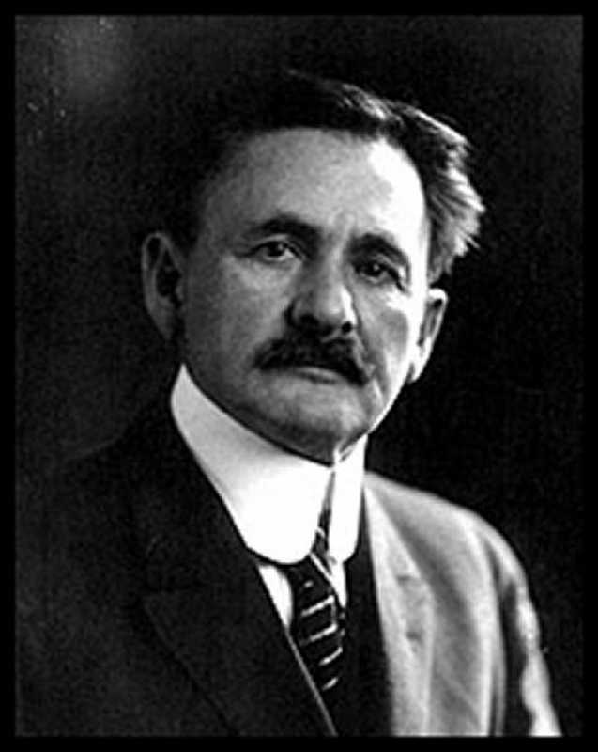

Refraction measured with a Sagnac Interferometer
Signal
Extinction independent of beam pointing fluctuations
CCD
Pump
pulse
AOP
Georges Sagnac
(1869 – 1928)
Dark Port
BS-2
Interaction
Area
M3
Probe-2
λ/2
Probe-1
Delay Stage
Timing coinc.
M1
M2
Probe Pulse
~ 1 mJ
BS-1
Low energy
30 fs
Amplification
2.5 J, 30 fs

Slide 16

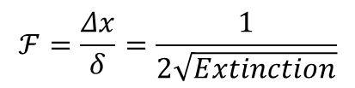
Refraction measured with a Sagnac Interferometer
Refraction of the probe pulse ⇒ Transversal shift $Δx$ of the interference intensity profile
θ
x
E(x+δ)
I(x+Δx)
δ
Δx
E(x)
Interference ⇒ Amplification factor $𝓕$compared to standard pointing method (with transversal shift δ)
$$ℱ=\frac{Δx}{δ}=\frac{1}{2\sqrt{Extinction}}$$
where $Extinction=\frac{I_{out}}{I_{in}}=4ε^{2}$
and $ϵ=$asymetry in intensity of the beam splitter)
$ε= {10}^{−3}$ ⇒ $Extinction=0.4 {10}^{−5}$ ⇒ $𝓕$ = 250

Slide 17
Refraction measured with a Sagnac Interferometer
Signal
The beam pointing fluctuations are measured and suppressed thanks to the back-reflexions on the beam splitter
CCD
Ref-1
CCD
CCD
Ref-2
Pump
pulse
AOP
BS-2
Dark Port
Interaction
Area
M3
Probe-2
λ/2
Probe-1
Delay Stage
Timing coinc.
M1
M2
Probe Pulse
~ 1 mJ
BS-1
Low energy
30 fs
Amplification
2.5 J, 30 fs

Slide 18
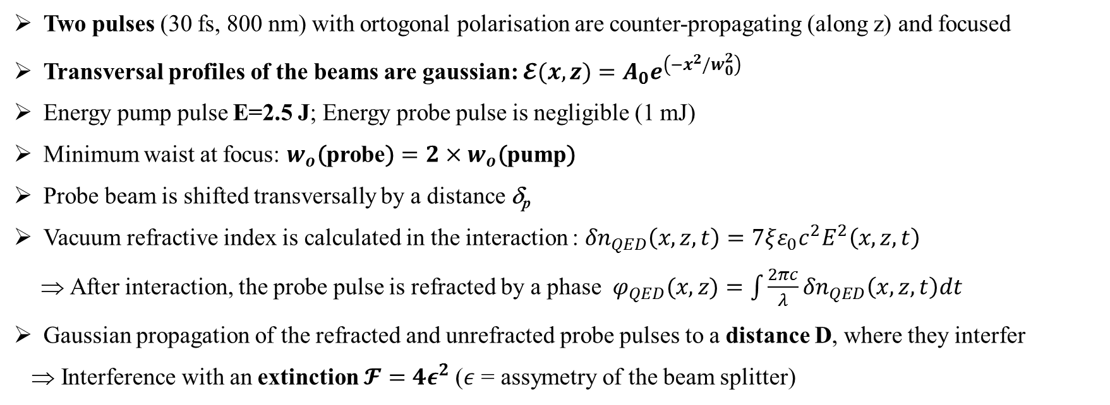
Numerical Simulations
Preliminary 2-d (x,z) numerical simulation:
Two pulses (30 fs, 800 nm) with ortogonal polarisation are counter-propagating (along z) and focused
Transversal profiles of the beams are gaussian: $𝓔(x,z)=A_{0}e^{\left(−x^{2}/w_{0}^{2}\right)}$
Energy pump pulse E=2.5 J; Energy probe pulse is negligible (1 mJ)
Minimum waist at focus: $w_{o}\text{(}\text{probe}\text{)}=2×w_{o}\text{(}\text{p}\text{ump}\text{)}$
Probe beam is shifted transversally by a distance δ_{p}
Vacuum refractive index is calculated in the interaction : ${δn}_{QED}\left(x,z,t\right)=7ξε_{0}c^{2}E^{2}\left(x,z,t\right)$
⇒ After interaction, the probe pulse is refracted by a phase $φ_{QED}(x,z)=\int{\frac{2πc}{λ}{δn}_{QED}\left(x,z,t\right)dt}$
Gaussian propagation of the refracted and unrefracted probe pulses to a distance D, where they interfer
Interference with an extinction $𝓕=4ε^{2}$($ε$ = assymetry of the beam splitter)

Slide 19
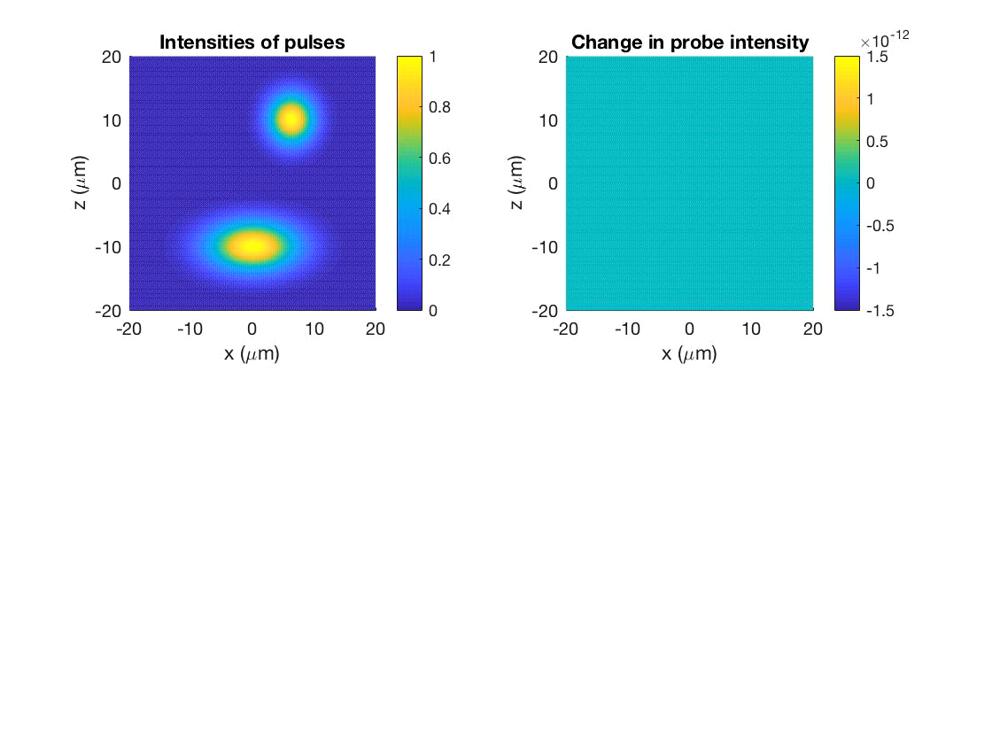
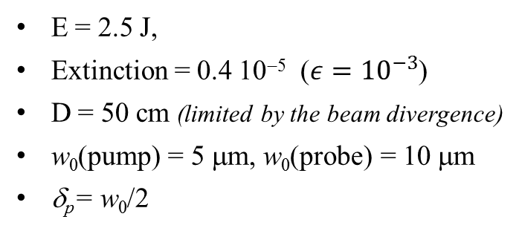
Numerical Simulations
E = 2.5 J,
Extinction = 0.4 10⁻⁵ ($ε={10}^{−3}$)
D = 50 cm (limited by the beam divergence)
w₀(pump) = 5 μm, w₀(probe) = 10 μm
δ_{p}= w₀/2

Slide 20
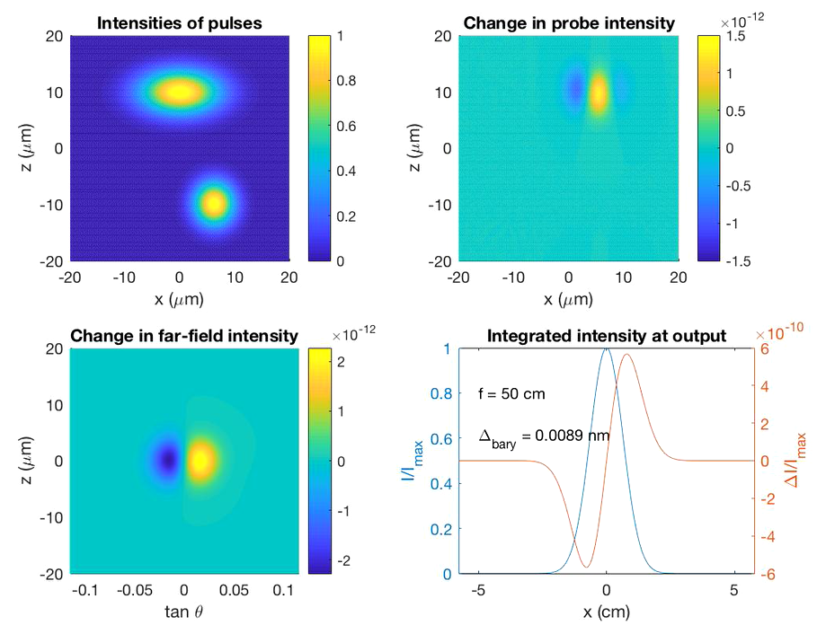
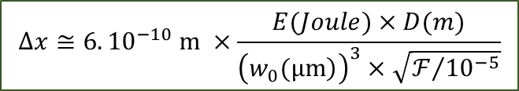

Numerical Simulations
E = 2.5 J,
Extinction = 0.4 10⁻⁵ ($ε={10}^{−3}$)
D = 50 cm (limited by the beam divergence)
w₀(pump) = 5 μm, w₀(probe) = 10 μm
δ_{p}= w₀/2
$$Δx≈0.01 nm$$
Signal $Δx$reduced by ~20% if jitter pump ±2.5μm
$$Δx≅{6. 10}^{−10} m ×\frac{E(Joule)×D(m)}{{\left(\left.w_{0}(μm\right)\right)}^{3}×\sqrt{ℱ/{{10}^{−5}}}}$$

Slide 21
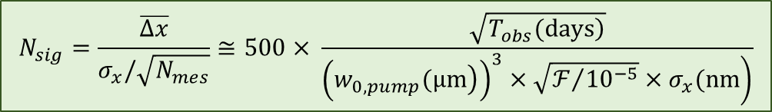

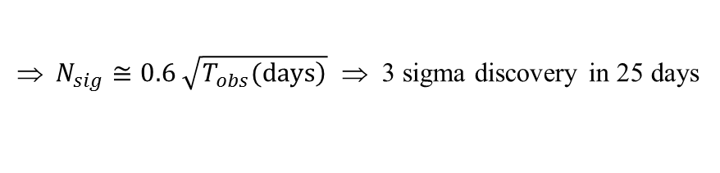
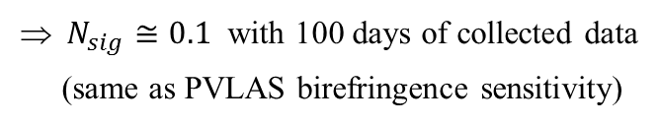
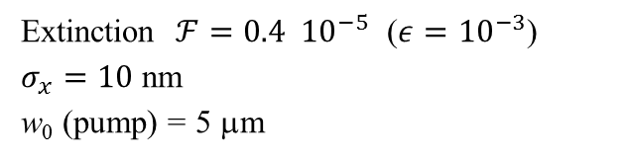
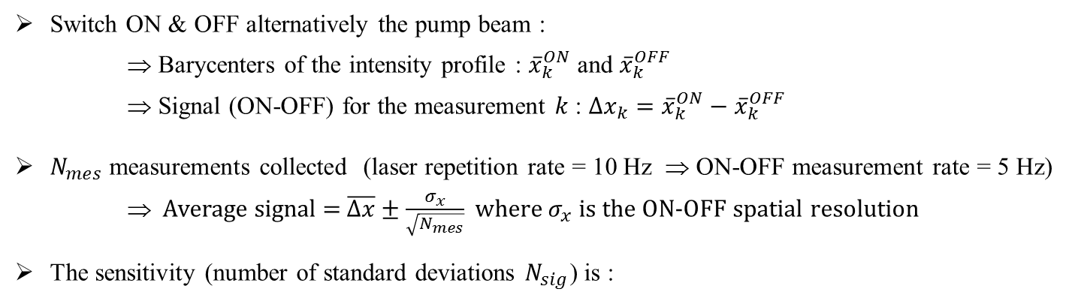

Expected sensitivity
Switch ON & OFF alternatively the pump beam :
⇒ Barycenters of the intensity profile : ${\overline{x}}_{k}^{ON}$ and ${\overline{x}}_{k}^{OFF}$
⇒ Signal (ON-OFF) for the measurement $k$ : ${Δx}_{k}={\overline{x}}_{k}^{ON}−{\overline{x}}_{k}^{OFF}$
$N_{mes}$ measurements collected (laser repetition rate = 10 Hz ⇒ ON-OFF measurement rate = 5 Hz)
⇒ Average signal = $\overline{Δx}±\frac{σ_{x}}{\sqrt{N_{mes}}}$ where $σ_{x}$ is the ON-OFF spatial resolution
The sensitivity (number of standard deviations $N_{sig}$) is :
$$N_{sig}=\frac{\overline{Δx}}{σ_{x}/\sqrt{N_{mes}}}≅500× \frac{\sqrt{\left.T_{obs}(days\right)}}{\left.{\left(\left.w_{0,pump}(μm\right)\right)}^{3}×\sqrt{ℱ/{{10}^{−5}}}×σ_{x}(nm\right)}$$
Extinction $ℱ=0.4 {10}^{−5}$ ($ε={10}^{−3}$)
$σ_{x}=10$ nm
w₀ (pump) = 5 μm
$N_{sig}≅0.6 \sqrt{\left.T_{obs}(days\right)}$ ⇒ 3 sigma discovery in 25 days
$$T_{obs}∝w_{0,pump}^{6}$$
With w₀ (pump) = 20 μm
$N_{sig}≅0.1$ with 100 days of collected data
(same as PVLAS birefringence sensitivity)
$$T_{obs}∝σ_{x}^{2}$$

Slide 22
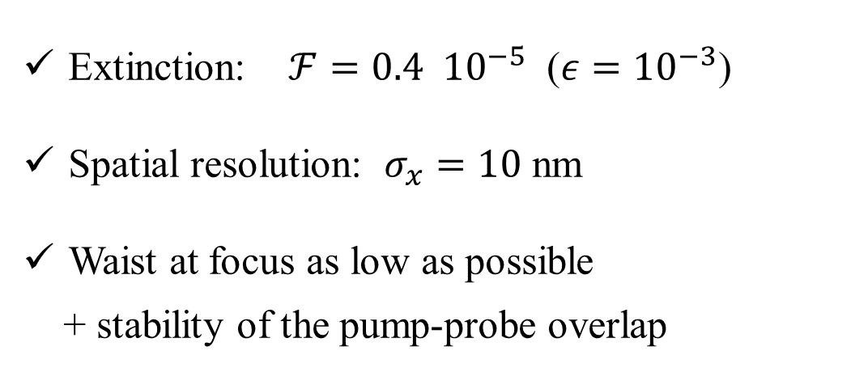
Experimental challenges
Extinction: $ℱ=0.4 {10}^{−5}$ ($ε={10}^{−3}$)
Spatial resolution: $σ_{x}=10$ nm
Waist at focus as low as possible
+ stability of the pump-probe overlap
DeLLight-0 prototype

Slide 23


DeLLight-0 prototype
CCD
Filter $λ_{0}±∆λ$
$$∆λ=3nm$$
Measurement of the extinction factor
Measurement of the spatial resolution
Neutral density
Dark Port
Probe-1
M3
BS-2
50/50
Polarisation (λ/2)
Probe-2
Probe Pulse
~ 10 μJ
Φ ~ 800 μm
M4
100 μJ
100 fs
BS-1

Slide 24
DeLLight-0 prototype
CCD
Filter $λ_{0}±∆λ$
$$∆λ=3nm$$
Measurement of the extinction factor
Measurement of the spatial resolution
Measurement of the index gradient
induced by Kerr effet in silica window and in gas
⇒ Validation of the methode
Neutral density
Probe-1
M3
BS-2
50/50
Polarisation (λ/2)
Probe-2
Silica
window
Delay stage
(time synchro)
Pump pulse
100 nJ - 10 μJ
Φ ~ 400 μm @ interaction
Probe Pulse
~ 10 μJ
Φ ~ 800 μm
M4
100 μJ
100 fs
BS-1

Slide 25
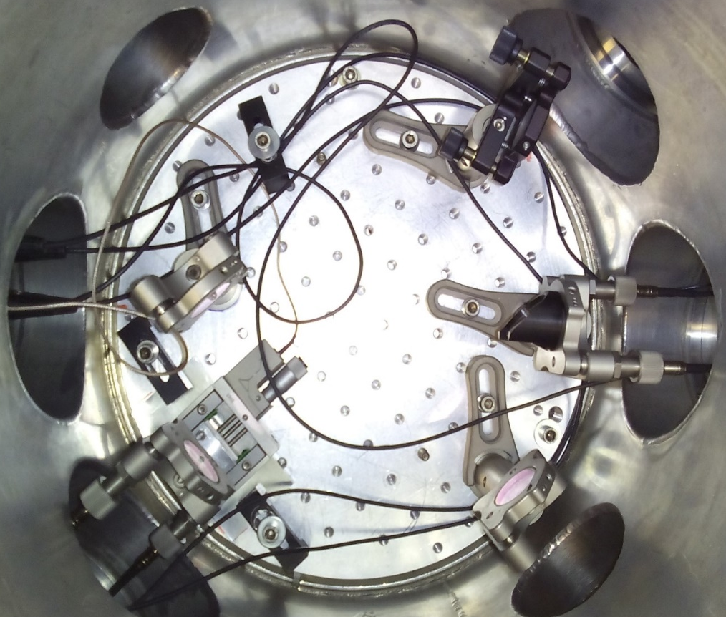
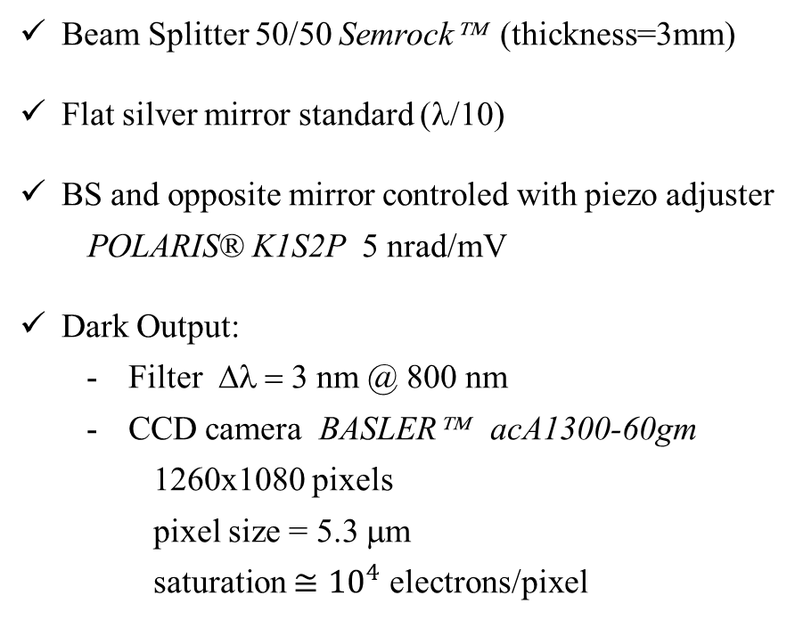
DeLLight-0 demonstrator
Beam Splitter 50/50 Semrock™ (thickness=3mm)
Flat silver mirror standard (λ/10)
BS and opposite mirror controled with piezo adjuster
POLARIS® K1S2P 5 nrad/mV
Dark Output:
Filter Δλ = 3 nm @ 800 nm
CCD camera BASLER™ acA1300-60gm
1260x1080 pixels
pixel size = 5.3 μm
saturation $≅{10}^{4}$ electrons/pixel
20 cm

Slide 26
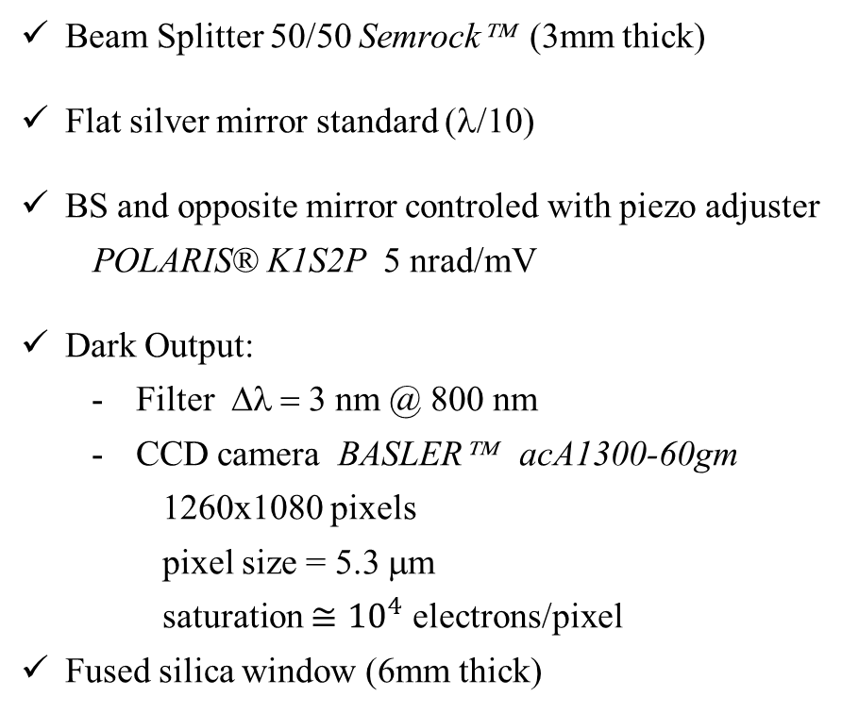
DeLLight-0 demonstrator
Beam Splitter 50/50 Semrock™ (3mm thick)
Flat silver mirror standard (λ/10)
BS and opposite mirror controled with piezo adjuster
POLARIS® K1S2P 5 nrad/mV
Dark Output:
Filter Δλ = 3 nm @ 800 nm
CCD camera BASLER™ acA1300-60gm
1260x1080 pixels
pixel size = 5.3 μm
saturation $≅{10}^{4}$ electrons/pixel
Fused silica window (6mm thick)
20 cm

Slide 27

Experimental challenges
Extinction: $ℱ=4ε^{2}$ ($ε={10}^{−3}$)
Spatial resolution: $σ_{x}$
Waist at focus as low as possible
+ stability of the pump-probe overlap

Slide 28
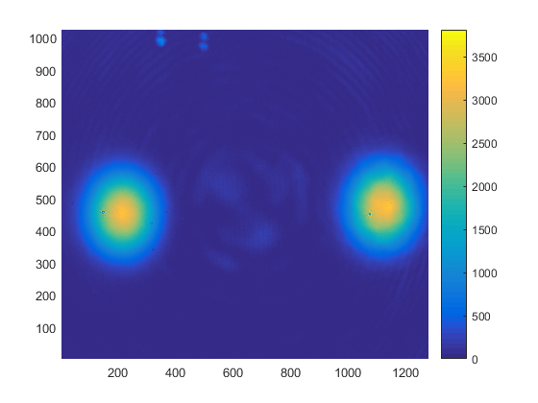
Extinction of the interferometer
Signal : Extinction ~ 10⁻⁵
Interference of the residual tail of transverse profile
+ Surface defects
Back reflection (~ 10⁻³)

Slide 29
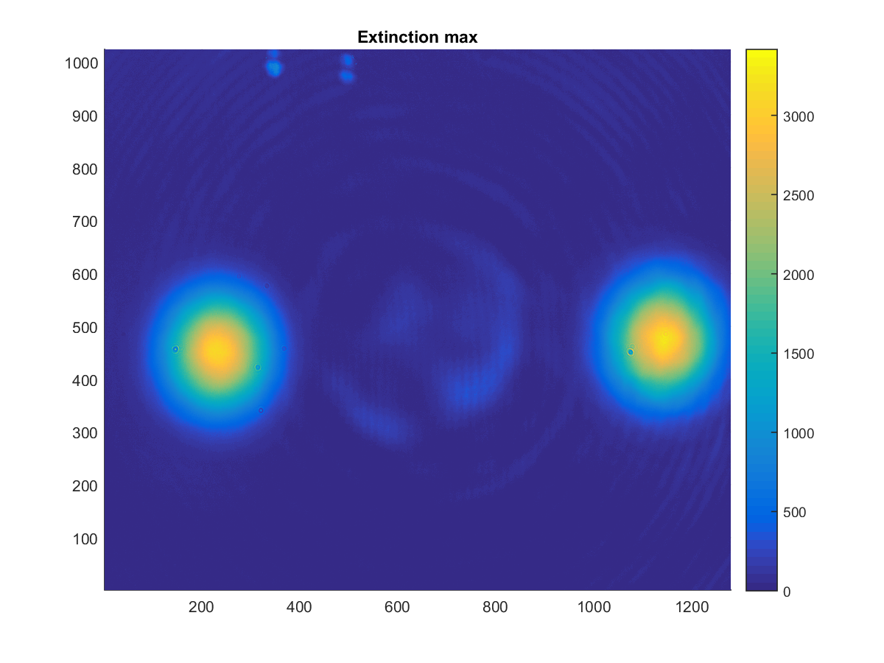
Extinction of the interferometer
Similar extinction has been measured with a beam focalized before entering inside the Sagnac interferometer
waist ~ 50μm
10 cm
30 cm

Slide 30
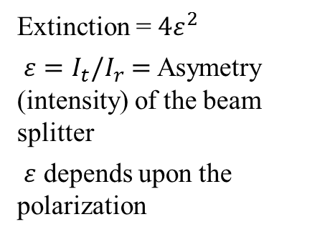
Extinction of the interferometer
Polarization of the probe beam
Extinction = $4ε^{2}$
$ε=I_{t}/I_{r}$ $=$ Asymetry (intensity) of the beam splitter
$ε$ depends upon the polarization

Slide 31
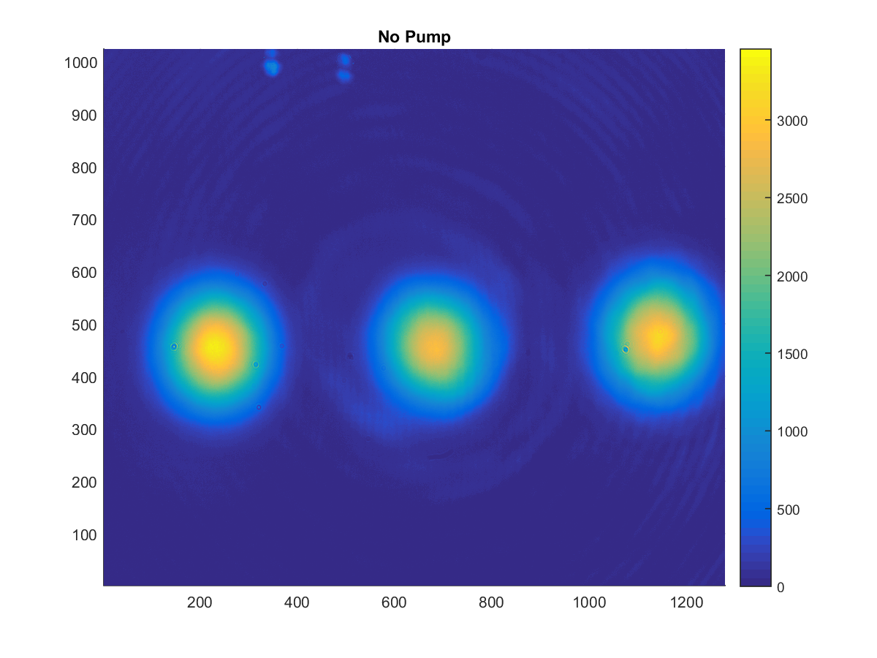
Extinction of the interferometer
Rotation of the polarization ⇒ Extinction ~ 10⁻³
Extinction = $4ε^{2}$
$ε=I_{t}/I_{r}$ $=$ Asymetry (intensity) of the beam splitter
$ε$ depends upon the polarization

Slide 32
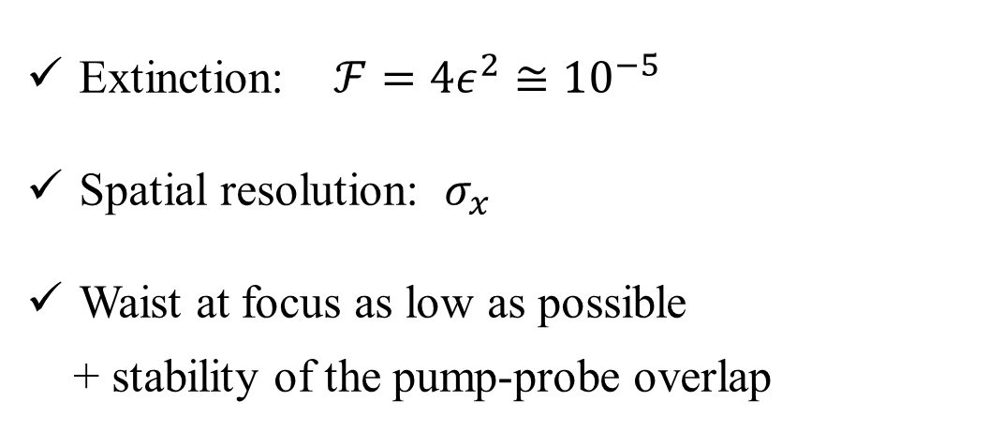
Experimental challenges
Extinction: $ℱ=4ε^{2}≅{10}^{−5}$
Spatial resolution: $σ_{x}$
Waist at focus as low as possible
+ stability of the pump-probe overlap

Slide 33
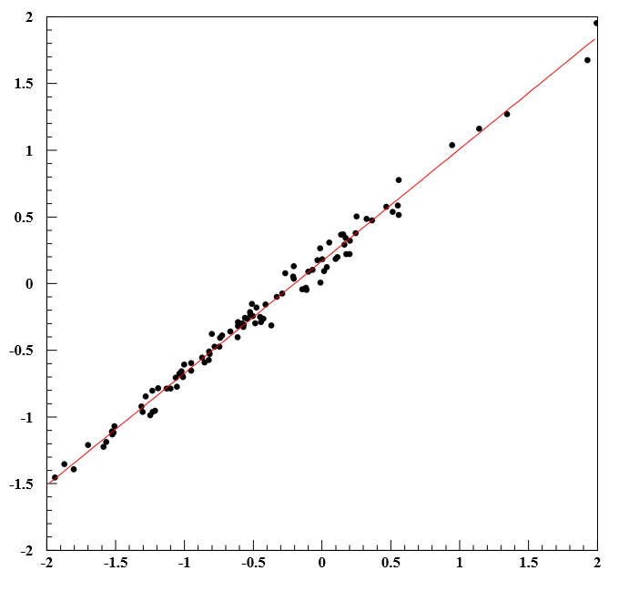
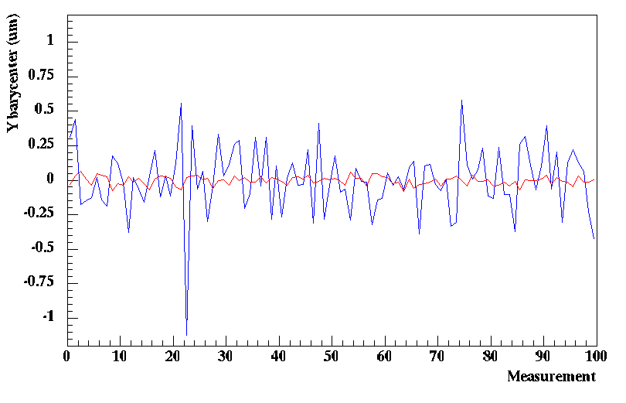




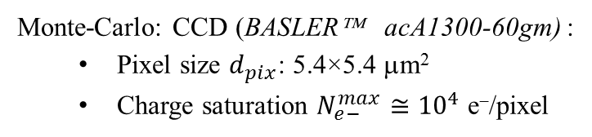




Spatial resolution
Preliminary analysis based on a barycenter calculation in a simple square analysis window (RoI)
Beam pointing fluctuations are well measured by the back-reflections on BS
Without correction
After pointing correction
$σ_{x}≅35$ nm
${\overline{y}}_{raw}^{signal}$ (μm)
${\overline{y}}_{cor}^{signal}(ON−OFF)$ (μm)
RoI $=1.5×σ_{beam}$
${\overline{y}}_{raw}^{ref1}$ (μm)
$$y$$
Monte-Carlo: CCD (BASLER™ acA1300-60gm) :
Pixel size $d_{pix}$: 5.4×5.4 μm²
Charge saturation $N_{e−}^{max}≅{10}^{4}$ e⁻/pixel
⇒ ${\text{Photon} \text{statistic}\text{ :} σ}_{x}≅33 \text{nm}∝\frac{d_{pix}}{\sqrt{N_{e−}^{max}}}$
Ref
Signal
$$x$$

Slide 34
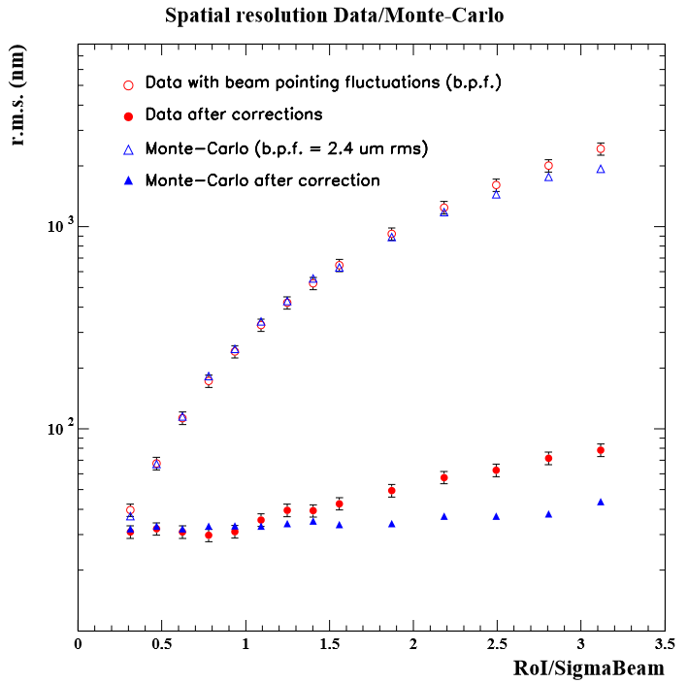


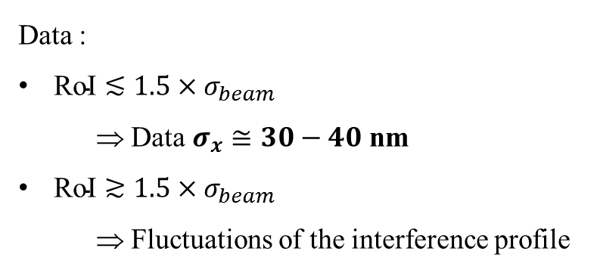

Spatial resolution
Data vs Monte-Carlo
Data :
$\text{RoI}≲1.5×σ_{beam}$
⇒ Data $σ_{x}≅30−40$ nm
$\text{RoI}≳1.5×σ_{beam}$
⇒ Fluctuations of the interference profile
$σ_{y}^{ON−OFF}$ (nm)
$$\frac{1}{30}$$
$$(Window Size) /σ_{beam}$$

Slide 35
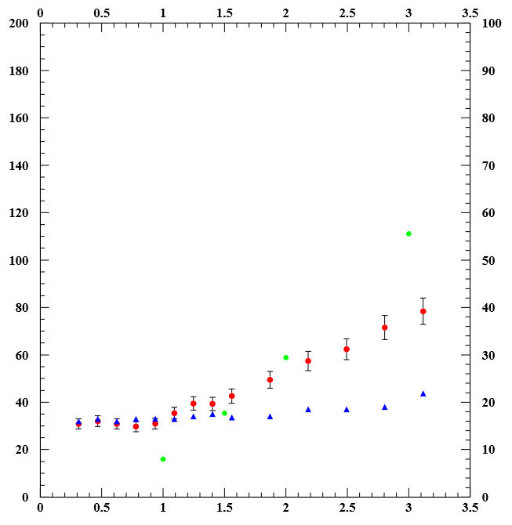




Spatial resolution
1.0
Data :
$\text{RoI}≲1.5×σ_{beam}$
⇒ Data $σ_{x}≅30−40$ nm
$\text{RoI}≳1.5×σ_{beam}$
⇒ Fluctuations of the interference profile
0.9
0.8
0.7
0.6
$σ_{y}^{ON−OFF}$ (nm)
Attenuation Factor on Signal $∆x$
0.5
Signal $∆x/5$ if RoI $=1.5×σ_{beam}$
0.4
Fluctuation in the tails must be reduced
0.3
Next steps :
Background substraction
Fit of the profiles
Surface quality of the optics
CCD uniformity
Etc…
0.2
0.1
$$(Window Size) /σ_{beam}$$

Slide 36

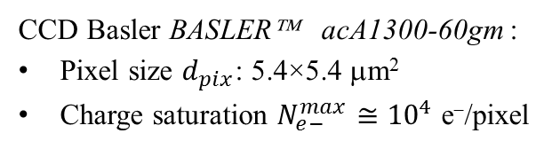



Spatial resolution
Spatial resolution limited by the photon statistic
⇒ $σ_{x}∝\frac{d_{pix}}{\sqrt{N_{e−}^{max}}}$
CCD Basler BASLER™ acA1300-60gm :
Pixel size $d_{pix}$: 5.4×5.4 μm²
Charge saturation $N_{e−}^{max}≅{10}^{4}$ e⁻/pixel
CCD Basler BASLER™ :
Pixel size $d_{pix}$: 1.8×1.8 μm²
Charge saturation $N_{e−}^{max}≅{10}^{4}$ e⁻/pixel
$$σ_{x}≅30 \text{nm}$$
$σ_{x}≅10$ nm ?
Work in progress…

Slide 37

Experimental challenges
Extinction: $ℱ=4ε^{2}≅{10}^{−5}$
Spatial resolution: $σ_{x}$
Demonstration of the method by observing the non linear Kerr effect

Slide 38



Is the vacuum optical index constant ?
The Kerr non linear effect with intense laser field
$$n\left(I\right)=n_{0}+n_{2}×I\left(\text{W}/{\text{cm}}^{2}\right)$$
In silica: $n_{2}≈3×{10}^{−16} {\text{cm}}^{2}$/W
In air : $n_{2}≈3×{10}^{−19} {\text{cm}}^{2}$/W

Slide 39

Observation of the non linear Kerr effect
Data taken in June & July 2018
Φ(probe) $≅$ 800 μm (fwhm)
Φ(pump) $≅$ 400 μm (fwhm)
Duration of the pulses Δt ~ 50 – 100 fs
Energy Pump varies from ~12 μJ down to ~350 nJ
20 cm

Slide 40


Observation of the non linear Kerr effect
Intensity profiles of the Pump & Probe in the interaction area
$Φ$(probe) $≅$ 800 μm
$Φ$(pump) $≅$ 400 μm
20 cm

Slide 41

Observation of the non linear Kerr effect
Intensity profiles of the Pump & Probe in the interaction area
$Φ$(probe) $≅$ 800 μm
$Φ$(pump) $≅$ 400 μm
20 cm

Slide 42
Measurement of the Kerr signal in SiO₂
Maximal extinction
Without pump
Intensity profiles in the dark output of the Sagnac interferometer

Slide 43

Measurement of the Kerr signal in SiO₂
Maximal extinction
With pump
I ~ 10¹¹ W/cm²
Energy pump ~ 20 μJ
Intensity profiles in the dark output of the Sagnac interferometer

Slide 44
Polarization rotated
Without pump

Slide 45
Polarization rotated
With pump
Energy pump ~ 100 μJ

Slide 46









Measurement of the Kerr signal in SiO₂
Energy pump ~ 300 nJ
${\overline{y}}_{raw}^{signal}$ (μm)
OFF
${\overline{y}}_{raw}^{signal}$ (μm)
ON
Δt ~ 50 – 100 fs
Φ(pump) ~ 400 μm
I ~ 10⁹ W/cm²
$$∆n/n≈5×{10}^{−7}$$
${\overline{y}}_{raw}^{ref1}$ (μm)
${\overline{y}}_{raw}^{ref1}$ (μm)
ON − OFF
ON − OFF
$$Δy=117.0±4.5 \text{nm}$$
${\overline{y}}_{}^{ON−OFF}$ (μm)
${\overline{y}}_{cor}^{ON−OFF}$ (μm)
(200 meas. ON-OFF; 40 sec.)
Measurement
Measurement

Slide 47




Measurement of the Kerr signal in SiO₂
Signal ${\overline{∆y}}_{ON−OFF}$ is proportional to the energy of the pump, as expected for the Kerr effect
Preliminary results, work in progress...
Next steps:
Simulations of the Kerr effect in medium
Measurement of the Kerr effect in gas with focussed beams
Preliminary Results
$${\overline{∆y}}_{ON−OFF}=k×E_{pump}$$
${\overline{∆y}}_{ON−OFF}$ (μm)
Energy Pump (μJ)

Slide 48

DeLLight for the next 3 years
Funded by ANR Oct. 2018 – Oct. 2021
Partners: LAL, LPGP, LUMAT, APC
Program:
DeLLight-0 (2018-2019):
Kerr effect inside Silica window $⇒δn≈{10}^{−7}−{10}^{−8}$
Kerr effect inside low pressure gas $⇒δn≈{10}^{−10}$
DeLLight Phase 1 (2019-2020): Measure in vacuum with 2 Joules & focus w₀ = 20μm
DeLLight Phase 2 (2020-2021): Measure in vacuum with focus w₀ = 5μm $⇒δn≈{10}^{−12}$

Slide 49

DeLLight and other intense laser facilities
LASERIX (LAL, Orsay):
running with 2J, 30fs ⇒ ~70 TW @ 10 Hz
BELLA laser (Berkeley LBNL):
running with 40J, 30fs ⇒ ~1 PW @ 1 Hz
APOLLON laser (Saclay):
2019: 30 J, 30 fs ⇒ ~1 PW @ 0.1 Hz
Target: 100 J, 20 fs ⇒ ~5 PW @ 0.1 Hz
HAPLS laser (developed by LLNL and running @ ELI Beamlines Research Center, Czech Republic)
diode-pumped petawatt laser in order to reach 10 Hz repetition rate
June 2018: 16 joules, 28 femtosecond pulse duration (0.5 PW) @ 3.3Hz
Target: ~200 Joules, 30 fs ⇒ ~6 PW @ 10 Hz
$Δx_{LASERIX}≈0.01 \text{nm}$ ⇒ $Δx_{HAPLS}≈1\text{nm}$

Slide 50

Conclusions
In May 29, 1919 Eddington measured the deflection of light by a gravitational field
In 20XX, DeLLight–LASERIX will measure the deflection of light by an electromagnetic field ?

Slide 51
Backup

Slide 52

Pressure in the interaction area
Phase-1 ($w_{0}≅10−15$μm) P=10⁻⁶ mbar
⇒ ~ 10 molecules in the volume $V=w_{0}^{2}×∆t×c$ ($∆t×c=10μs$)
Phase-2 ($w_{0}≅5$μm) P=10⁻⁹ mbar
⇒ ~ 1 molecule in the volume $V={\left(20 μm\right)}^{2}×10×∆t×c$

Slide 53

Numerical Simulations
Systematics due to pump-probe jitter

Slide 54






Amplification with a Sagnac Interferometer
$${I\left(x\right)=I}_{0}{\left(\left(\frac{1}{2}+ε\right)E\left(x+δ\right)−\left(\frac{1}{2}−ε\right)E\left(x\right)\right)}^{2}≅2δε\frac{∂E}{∂x}+4ε^{2}E^{2}\left(x\right) \left(δ≪1\right)$$
$$E\left(x\right)=exp\left(−\frac{x^{2}}{2σ^{2}}\right)$$
$$I\left(x\right)= \left(\frac{2εδ}{σ^{2}}x+4ε^{2}\right)exp\left(−\frac{x^{2}}{σ^{2}}\right)$$
$$Δx=\frac{\int_{−∞}^{+∞}{xI\left(x\right)dx}}{\int_{−∞}^{+∞}{I\left(x\right)dx}}=\frac{δ}{4ε}$$
Extinction factor : $ℱ=\frac{I_{out}}{I_{in}}=4ε^{2}$
Amplification $=\frac{Δx}{δ}=\frac{1}{2\sqrt{ℱ}}$
θ
x
E(x)
δ
E(x+δ)
I(x+Δx)

Slide 55


Slide 56



Expected sensitivity
Sensitivity depends strongly on the waist of the pump at focus
$$T_{obs}∝w_{0}^{6}$$
Extinction $ℱ=0.4 {10}^{−5}$ ($ε={10}^{−3}$)
$σ_{x}=10$ nm
3 sigma
1 sigma
0.1 sigma
5

