Slide 1
ThomX Diagnostics :
beam charge measurements

Slide 2
Sommaire
Présentation générale du sous-système et de son fonctionnement
Etat d'avancement:
  Transfert des responsabilités LAL => SOLEIL (si applicable)
  Équipements manquants
  Équipements pas encore testés
  Équipements pas encore testé avec le CC (si applicable)
  Progrès de l'assemblage des composants (si applicable), intervention entreprise extérieure nécessaire (si applicable)
  Planning d'installation dans l'igloo (identification des étapes pour l'installation, durée, et date d'installation si celle-ci est définie, dépendance avec d'autres sous-systèmes)
  Liste des tests de validation sur site.
  Liste des tests de validation sur site avec le CC (si applicable).

Slide 3
ThomX Diagnostics :
beam parameters
The standard ThomX charge is 1nC
Linac pulse length 4ps
Ring pulse length: 4ps @ injection time 20ps @ extraction Time
Requirements: Charge measurement from few pC to 2nC
Resolution +-1pC

Slide 4
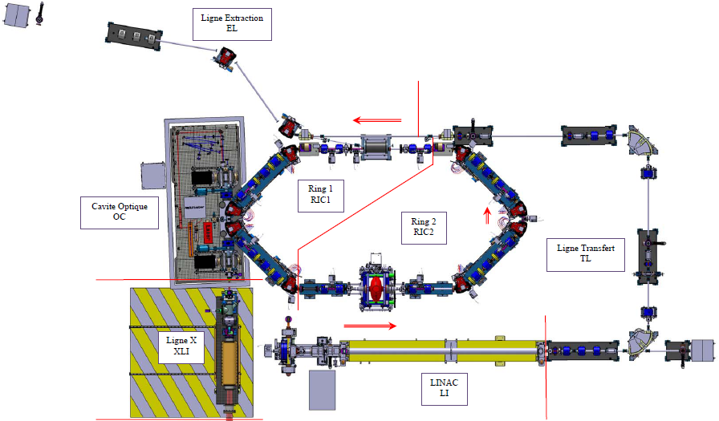
Faraday Cups and Integrated Current Transformers
Two Faraday Cups
Three ICTs

Slide 5
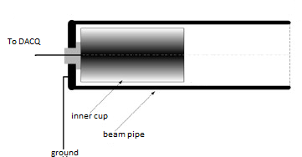
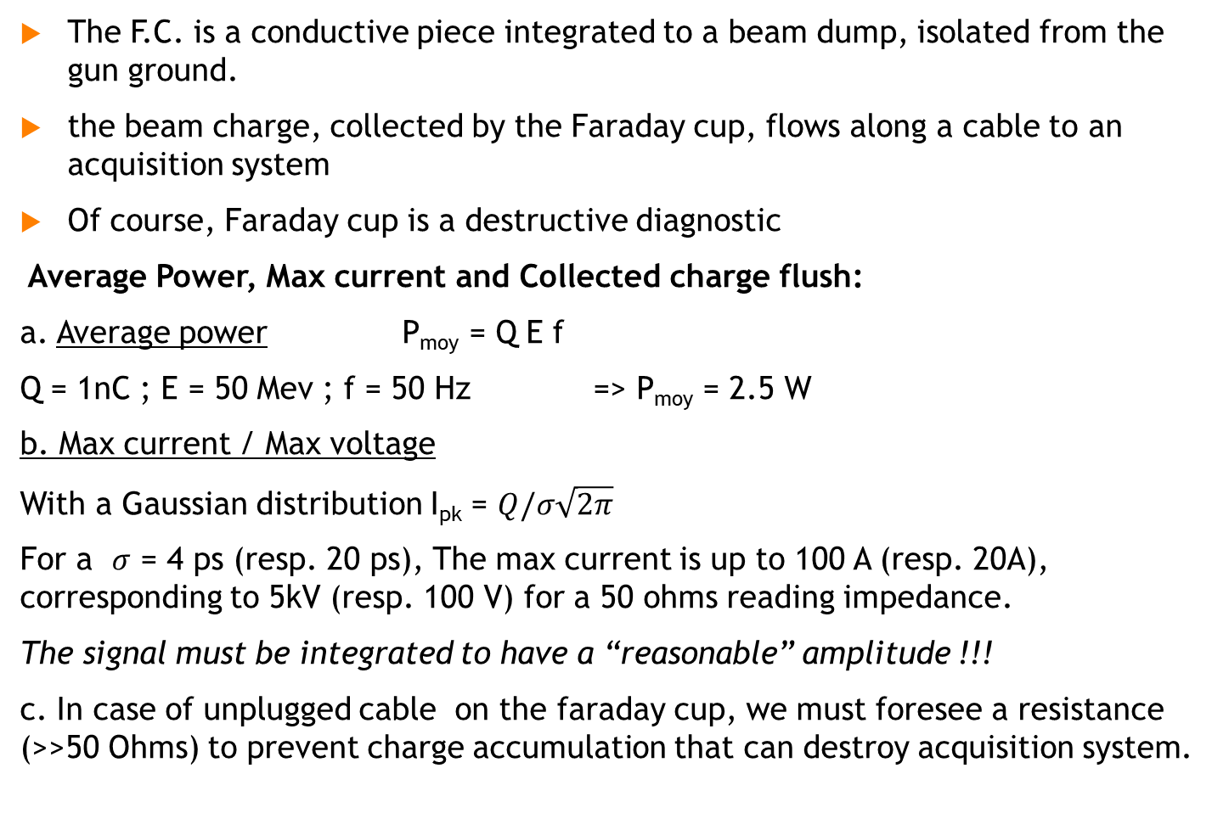
Faraday Cups (F.C.)-1
The F.C. is a conductive piece integrated to a beam dump, isolated from the gun ground.
the beam charge, collected by the Faraday cup, flows along a cable to an acquisition system
Of course, Faraday cup is a destructive diagnostic
Average Power, Max current and Collected charge flush:
a. Average power P_{moy} = Q E f
Q = 1nC ; E = 50 Mev ; f = 50 Hz => P_{moy} = 2.5 W
b. Max current / Max voltage
With a Gaussian distribution I_{pk} = $Q/σ\sqrt{2π}$
For a $σ$ = 4 ps (resp. 20 ps), The max current is up to 100 A (resp. 20A), corresponding to 5kV (resp. 100 V) for a 50 ohms reading impedance.
The signal must be integrated to have a “reasonable” amplitude !!!
c. In case of unplugged cable on the faraday cup, we must foresee a resistance (>>50 Ohms) to prevent charge accumulation that can destroy acquisition system.

Slide 6
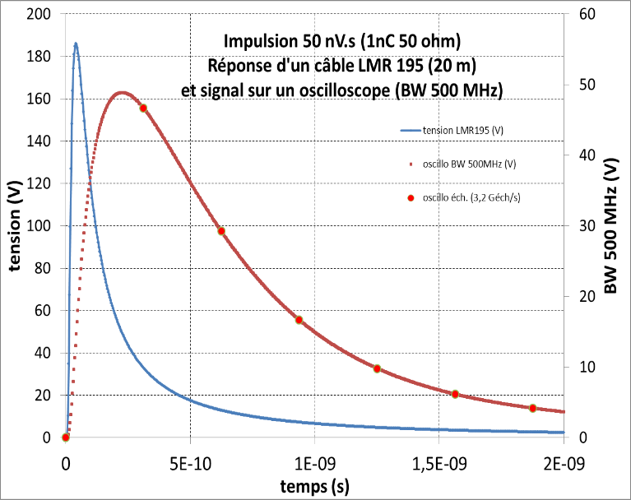
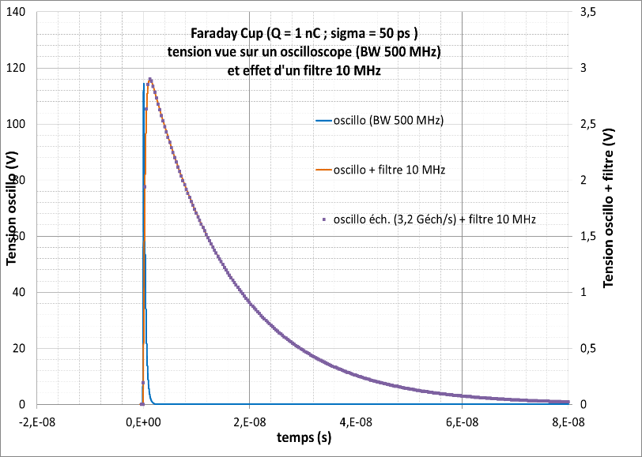
Faraday Cups -2
Analog signal integration:
To fit the DAQ input capability (Wavecatcher, 2,5V max 128ns memory depth, 3,2GS/s),
The FC output signal (5KV 4ps) must be integrated:
The first integration step is done by the length of the cable (LMR 200, 20m) from the FC to the Wavecatcher.
The second step is done by a 10MHz band pass filter @ the end of the cable.
Step 1: cable integration
Step 2: 10MHz pand pass filter

Slide 7
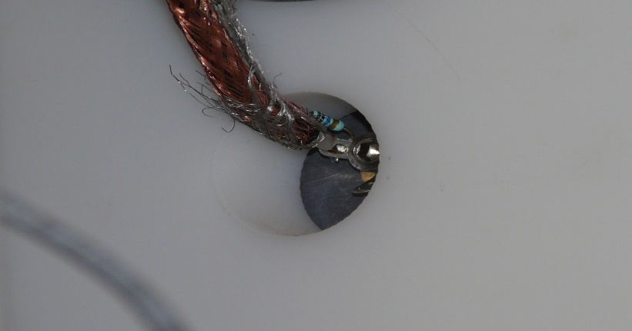
Faraday cups -3
Possible deffects:
1- wrong solder at the Faraday side
2- unplugged cable at Wavecatcher side
Status:
1- Faraday Cups installed but not yet connected to cable
2- Band pass filters on command
3- Wavecatcher Man Machine Interface not yet ready
Cable connection @ the back of a Faraday Cup

Slide 8
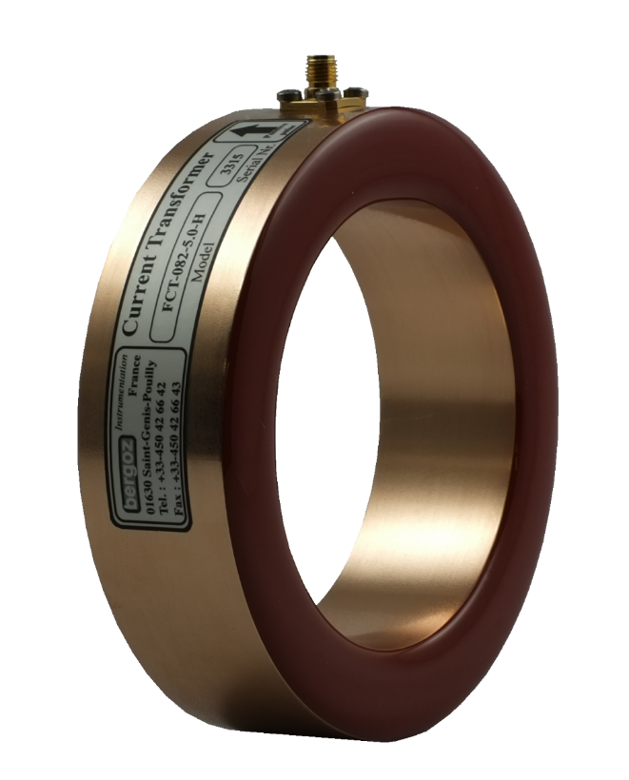
ICT-1 (integrated current transformer) (from Bergoz company)
The ICT is a coil isolated from the beam pipe with a ceramic that cut the ground continuity.
A current is induced in the coil by the electron beam.
The ICT is NOT a destructive diagnostic.
Ceramic
Beam pipe
e⁻ beam
Ground continuity

Slide 9
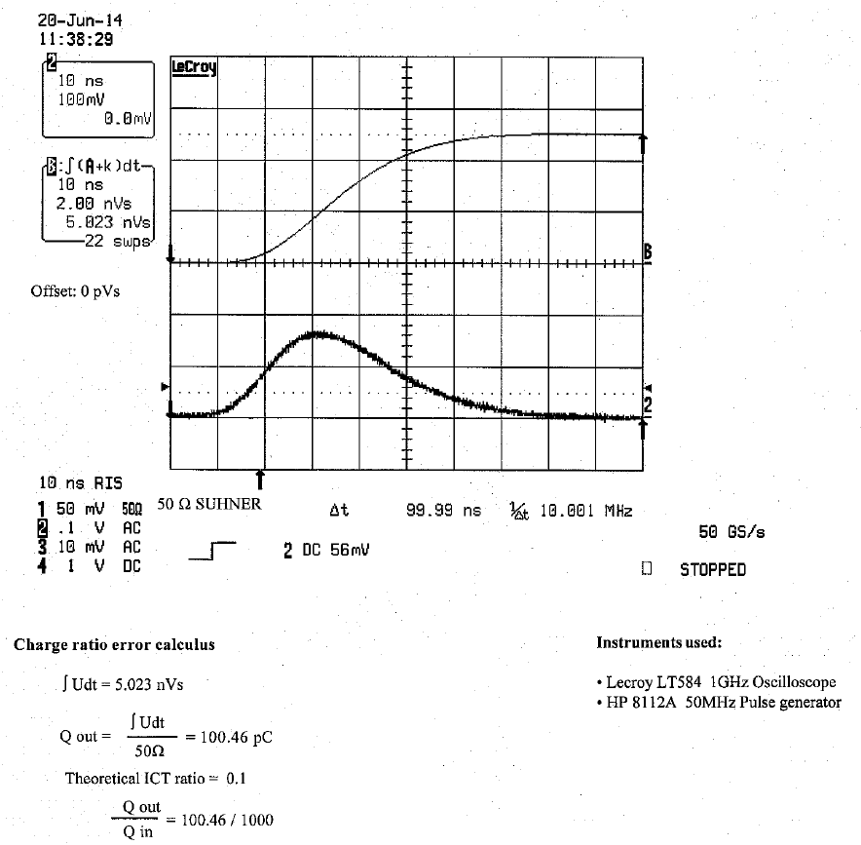
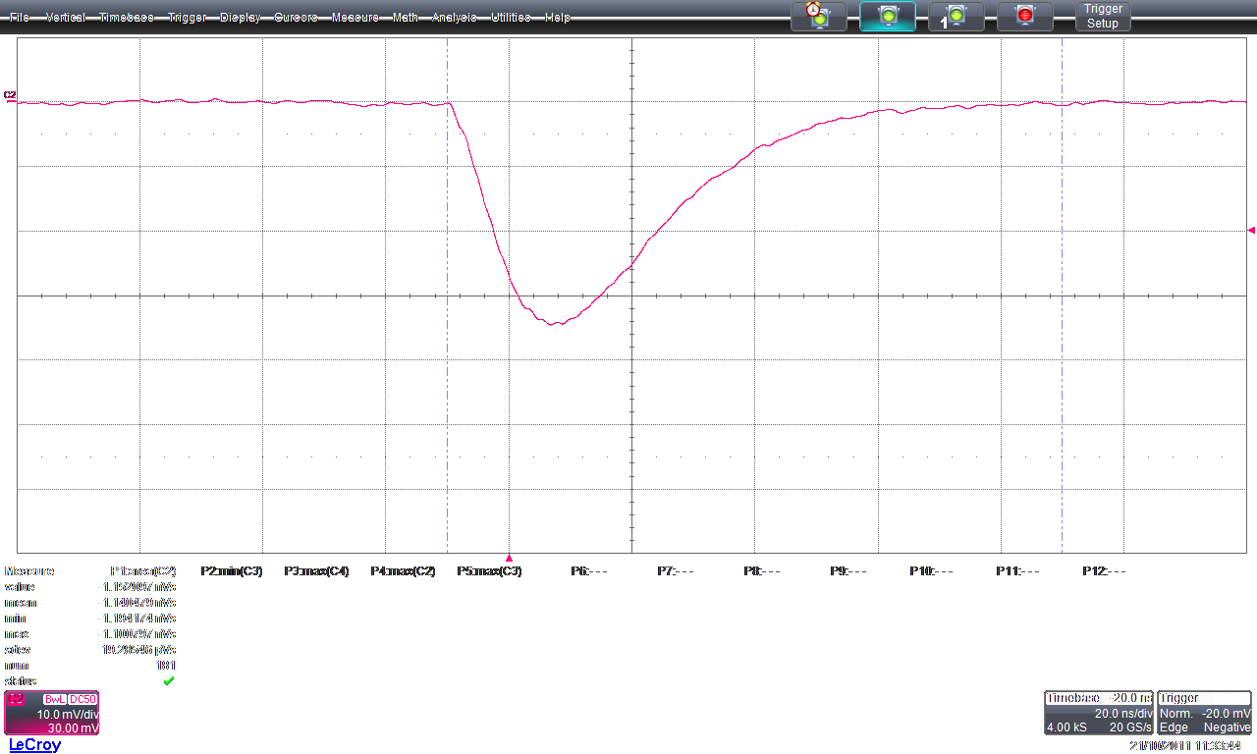

ICT-2
The ICT models on ThomX: ICT-CF6”—60,4-UHV-070-5.0
Standard response : 1nC beam => 5nVs charge output (ie 100pC on 50 Ohms)
Signal en sortie d’ICT : (scope 20GS/s) 20ns/div 10mV/div
(Mesure effectuée sur PHIL avec une charge de 220pC)
ICT calibration by Bergoz : Error to standar response: below 0,5%
Triangle approximation
for resolution calculation
Vmax
Vmean
Q
70ns

Slide 10
ICT-3
Analog signal acquisition:
The mean amplitude (over 70ns) of the output signal of the ICT for a 1nC charge is around 70mV
The Wavecatcher is a 12 bits ADC @ a 3,2GB/s rate ( bit weight 0,6mV)
That give a 9pC resolution for 1 acquisition dot.
For a 70ns acquisition signal the Wavecatcher make a 225 dots acquisition, increasing the resolution to 0,6pC.
For the maximum beam charge (2nC) The ICT output give a 300mV max amplitude signal far below the Wavecatcher limitation (2,5V)

Slide 11
ICT-4
Possible deffects:
1- unplugged cable at Wavecatcher or ICT side
Status:
1- ICTs installed but not yet connected to cable
2- Wavecatcher Man Machine Interface not yet ready

Slide 12
Requirements
ThomX Diagnostics :
beam charge measurements
Transfer from Soleil to LAL done
No major component missing
M.M.I. for Wavecatcher has to be developed.
Cable connection from measurer to DAQ has to be test
Final tests:
- One day per device (as soon as the beam reach the measurer)

