Slide 1
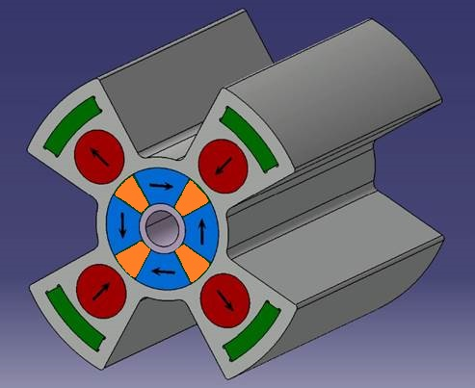
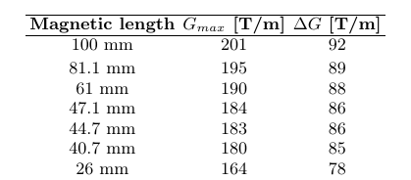
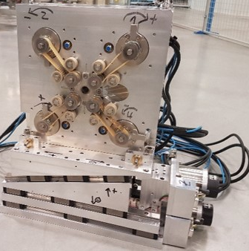
Concept was patented (QUAPEVA program-Triangle de la Physique, SOLEIL/Sigmaphi collaboration)
7 systems :
First triplet to focus a 180 MeV beam
Second triplet to focus a 400 MeV beam
A prototype
Magnetic center excursion in both planes (x, z) is about ± 10 µm

