Slide 1
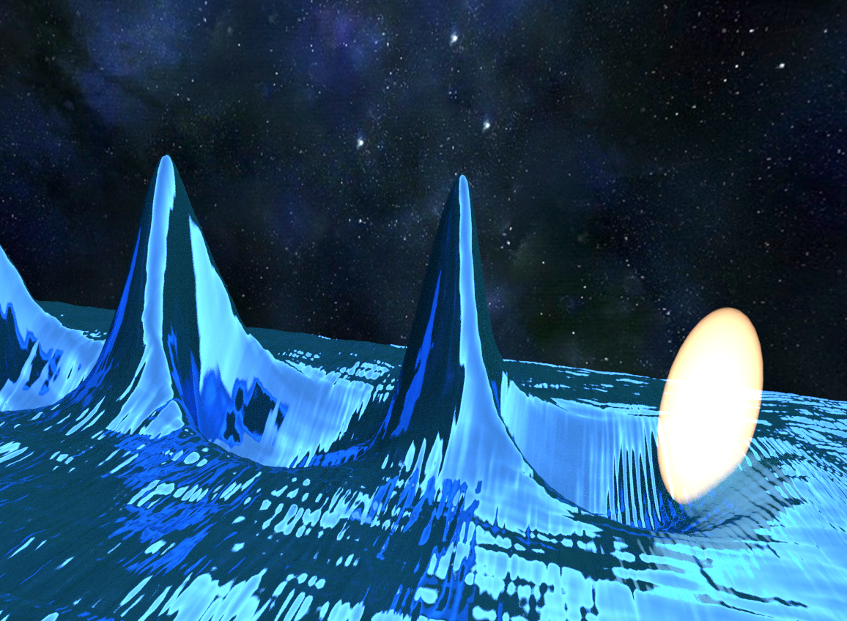




Codes et techniques pour la modélisation numérique dans le project EuPRAXIA
Francesco Massimo¹, A.F. Lifschitz¹, V. Malka^{1,2}
1Laboratoire d’Optique Appliquée, ENSTA ParisTech - CNRS UMR7639 -
Ecole Polytechnique, Université Paris-Saclay
2Department of Physics of Complex Systems, Weizmann Institute of Science
francesco.massimo@ensta-paristech.fr
Journées Accélérateurs, Roscoff 2017

Slide 2
Outline
Modeling and Simulation for EuPRAXIA Project
Basics of PIC simulations
Basic PIC loop, Parallelization
How can I speed up my simulations?
QSA, Boosted frame, Azimuthal decomposition, Hybrid codes
Summary

Slide 3
Outline
Modeling and Simulation for EuPRAXIA Project
Basics of PIC simulations
Basic PIC loop, Parallelization
How can I speed up my simulations?
QSA, Boosted frame, Azimuthal decomposition, Hybrid codes
Summary

Slide 4
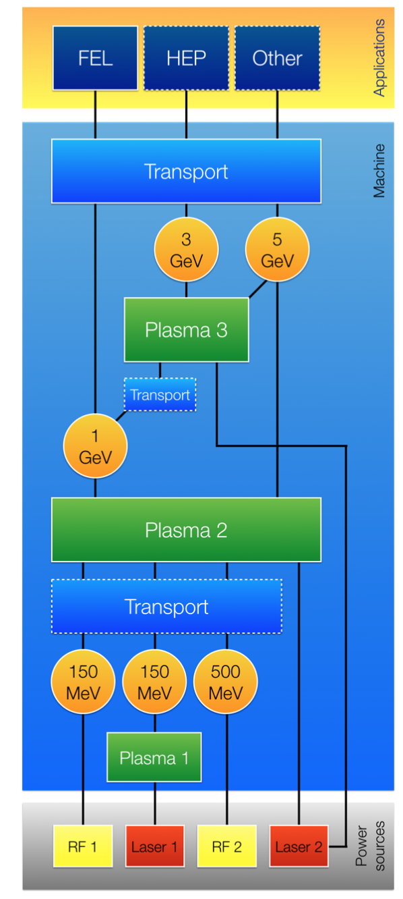
EuPRAXIA Project
European Plasma Research Accelerator
with eXcellence In Applications
http://www.eupraxia-project.eu
P. A. Walker et al.,
Horizon 2020 EuPRAXIA design study,
J. Phys.: Conf. Ser. 874 (2017) 012029

Slide 5
Outline
Modeling and Simulation for EuPRAXIA Project
Basics of PIC simulations
Basic PIC loop, Parallelization
How can I speed up my simulations?
QSA, Boosted frame, Azimuthal decomposition, Hybrid codes
Summary

Slide 6
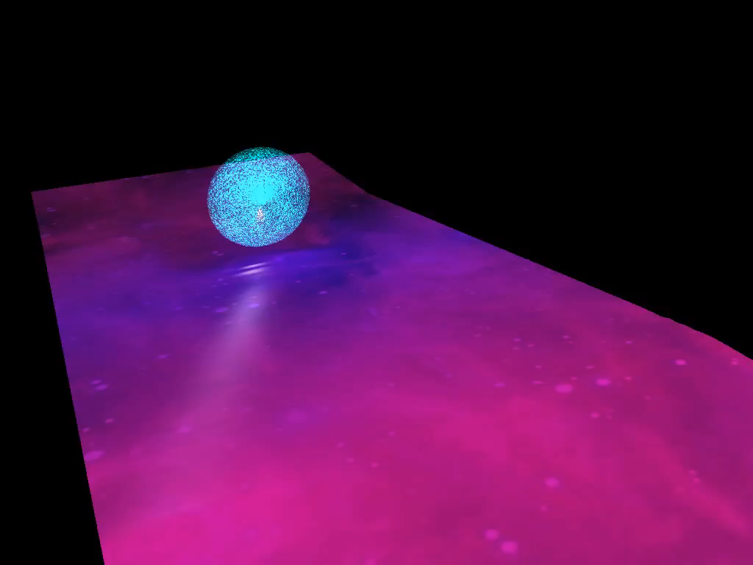
Laser wakefield excitation

Slide 7
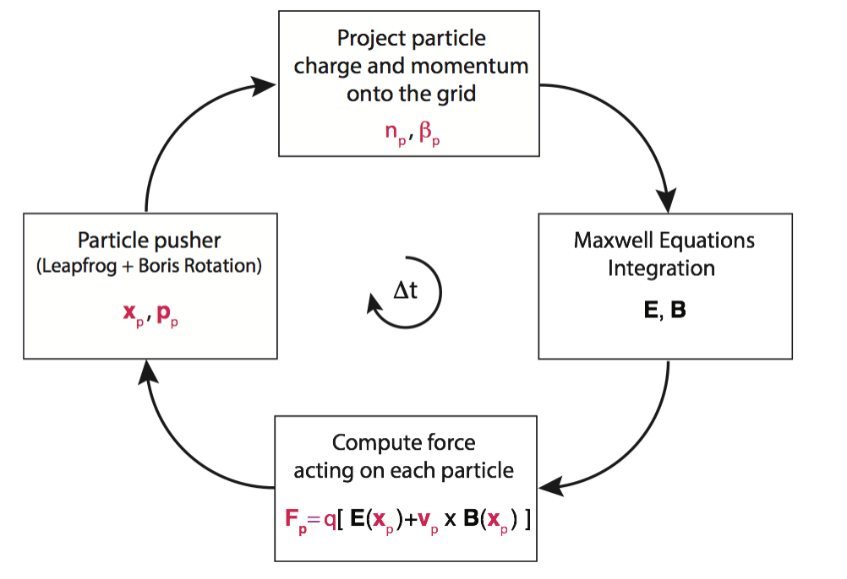
Basic Particle in Cell (PIC) Loop
Plasma = computational macroparticles moved by E. M. fields they induce on a grid
C. K. Birdsall, A. B. Langdon, Plasma Physics Via Computer Simulation
download a Python 1D PIC code by A. Marocchino: http://gaps.ing2.uniroma1.it/alberto/alberto/PIC.html

Slide 8
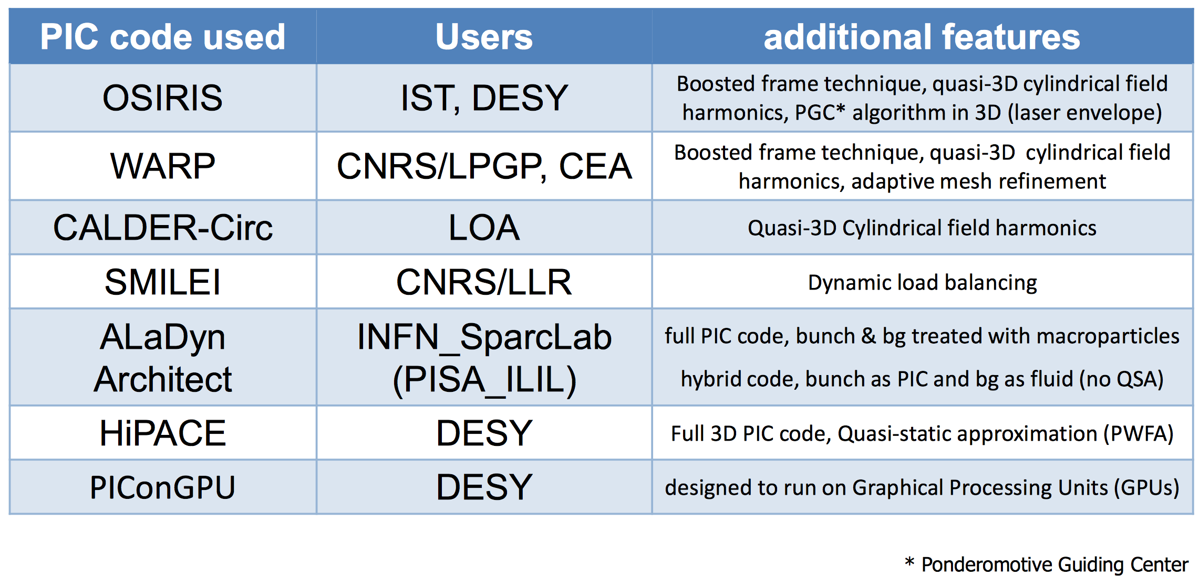
List of PIC codes in EuPRAXIA

Slide 9
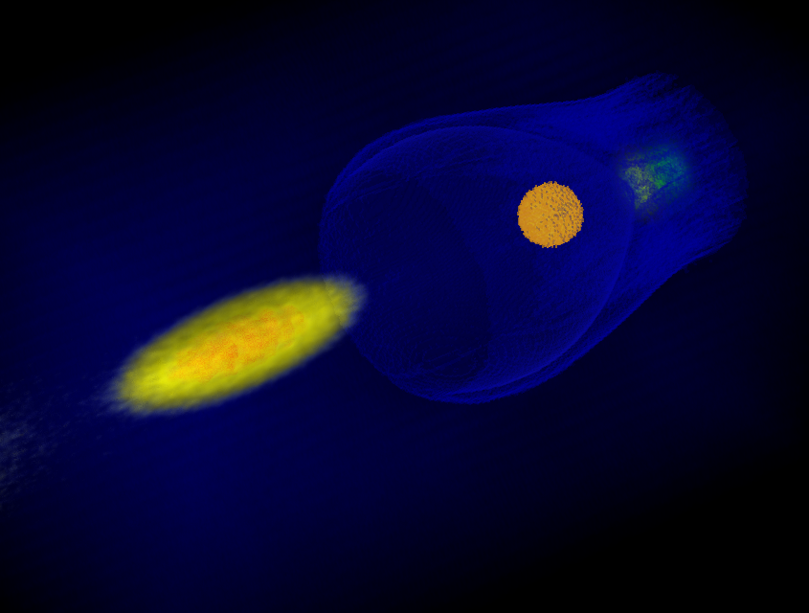
PIC codes must be parallelized
3D simulations are HEAVY
With no parallelisation
and infinite memory:
PWFA simulations
106 Mcells,
8 particles per cell = 850 Mparticles
4 kh-cores run time = 170 days
LWFA sims are even longer
need to sample the laser
wavelength
centuries of simulation time
3D simulation of PWFA with ALaDyn code

Slide 10
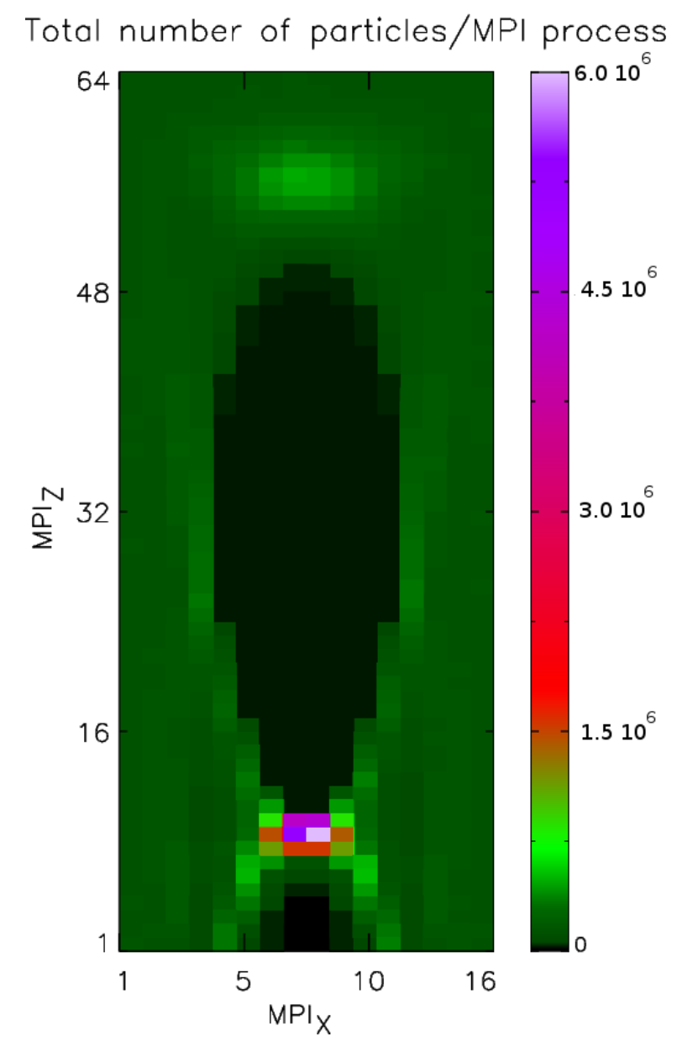
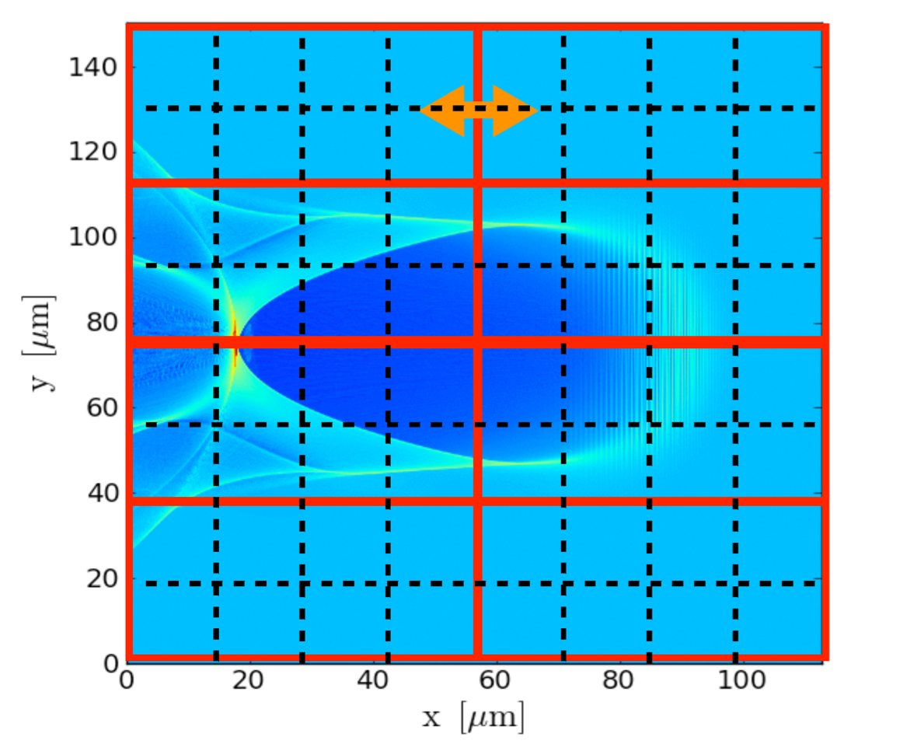
Basic PIC is not well balanced
Load Imbalance of 40!
Simplest domain decomposition
Example of Laser Wakefield Electron Acceleration
full 3D, Photon-Plasma, Niels Bohr Institute

Slide 11
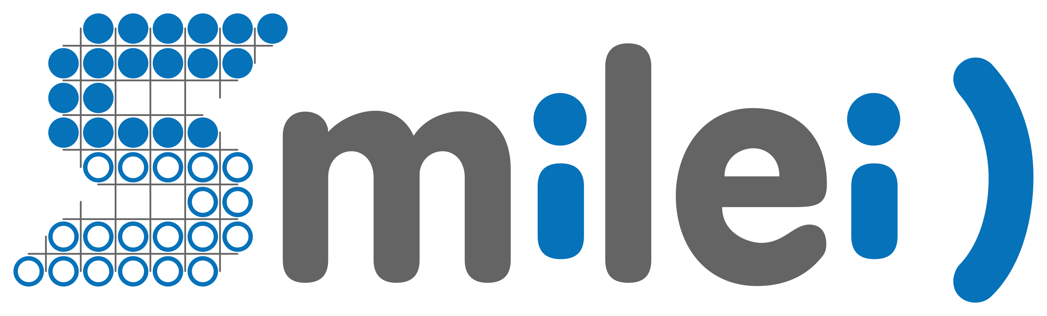
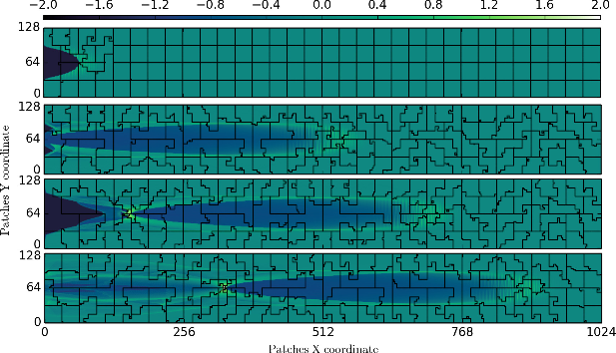
Dynamic evolution of MPI domains
in SMILEI PIC code
Software for Matter Interacting with Laser at Extreme Intensities
http://www.maisondelasimulation.fr/smilei/

Slide 12
Outline
Modeling and Simulation for EuPRAXIA Project
Basics of PIC simulations
Basic PIC loop, Parallelization
How can I speed up my simulations?
QSA, Boosted frame, Azimuthal decomposition, Hybrid codes
Summary

Slide 13
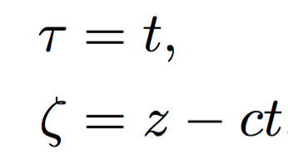
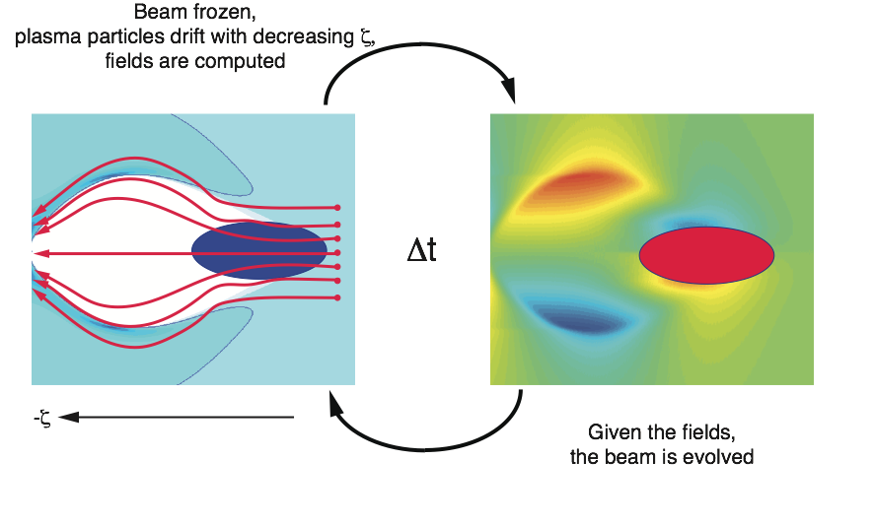
Quasi-Static Codes: how they work
Assumption: driver evolution much slower than background plasma evolution,
i.e. driver can be considered frozen while plasma electrons pass it
(Laser diffraction time or betatron period ωβ⁻¹ >> Plasma period ωp⁻¹)
QSA = neglect τ derivatives for background plasma
(Comoving variable)
Quasi-Static Loop

Slide 14
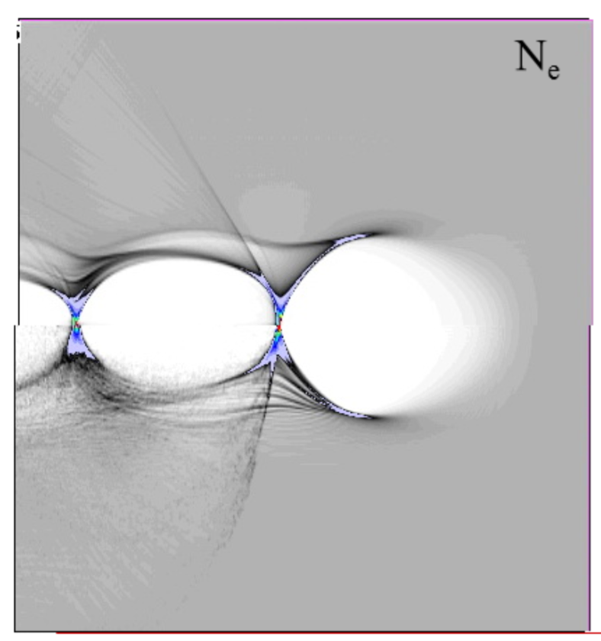
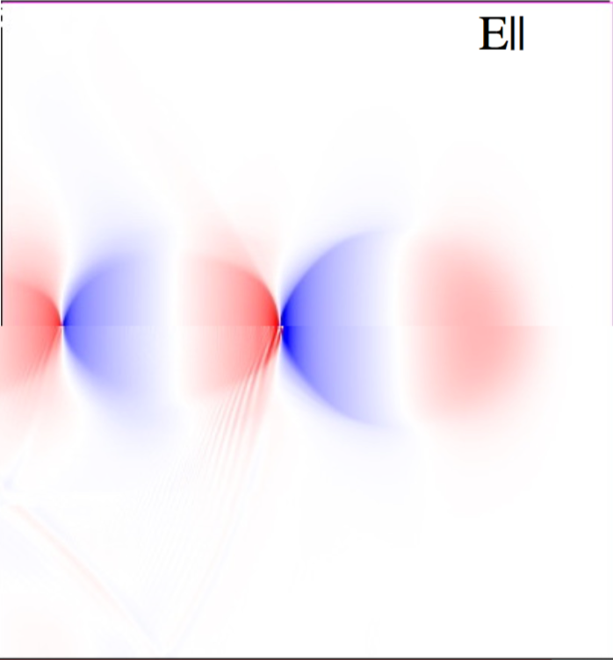
Quasi-Static Approximation (QSA):
comparisons with time - explicit PIC code (VLPL)
Quasi-static VLPL
Time explicit VLPL
Adapted from A. Pukhov, in Proceedings of the CAS–CERN Accelerator School: Plasma Wake Acceleration, Geneva, Switzerland, 23–29 November 2014, edited by B. Holzer, CERN-2016-001 (CERN, Geneva, 2016), http://dx.doi.org/10.5170/CERN-2016-001. [pp. 181-206]

Slide 15
Quasi-Static Approximation (QSA): Performances
Speed-up
Disadvantages
Radiation is not included (only envelope model for laser)
Injection, trapping, wave breaking are not reproduced
Sharp longitudinal variations in initial
plasma density violate QSA assumptions
( τ derivatives are no more negligible)
~(2γdriver)^{1/2} for PWFA
~(λp/λ0)² for LWFA
Codes with QSA in EuPRAXIA:
WAKE
P. Mora and T. M. Antonsen, Phys. Rev. E 53 R2068 (1996)
P. Mora and T. M. Antonsen, Phys. Plasmas 4 217 (1997)
HiPACE
T. Mehrling et al,Plasma Phys. Control. Fusion 56 (2014) 084012

Slide 16
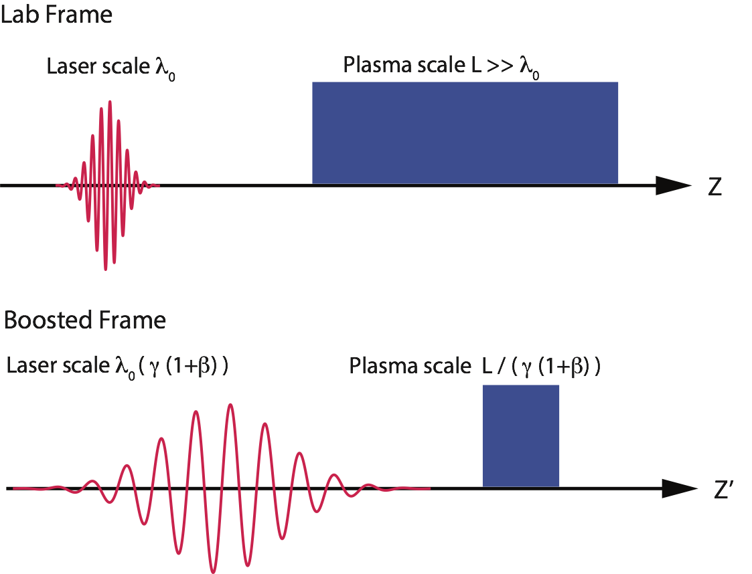
Speedup with Lorentz Boosted Frame simulations
In a boosted frame moving with relativistic factor γboost
the driver is stretched by γboost (coarser grid cell size possible)
the plasma channel is compressed by factor γboost (smaller distance to travel)
J.-L. Vay, Phys. Rev. Lett. 98 (2007) 130405
Total theoretical speedup ~ γ²boost
Code with Boosted frame in EuPRAXIA: WARP

Slide 17
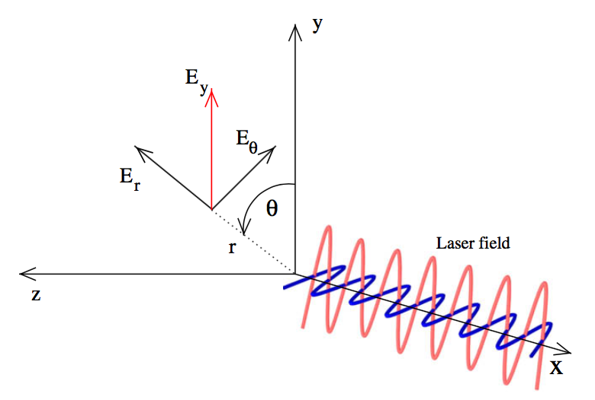


Speedup through Azimuthal Fourier decomposition
Cylindrical coordinates are used for the fields:
Fourier decomposition is used
in the azimuthal coordinate
Often for LWFA only few azimuthal modes are needed
Neglecting all but the first N modes, cost is approximately equal to N 2D simulations
First code implementing Azimuthal Fourier decomposition:
CALDER-CIRC
X. Davoine et al. “New Algorithms for Cylindrical PIC code” (1st EAAC - 2013)
A. Lifschitz et al, Journal of Computational Physics 228 (2009)

Slide 18
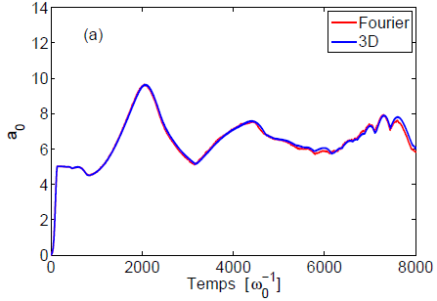
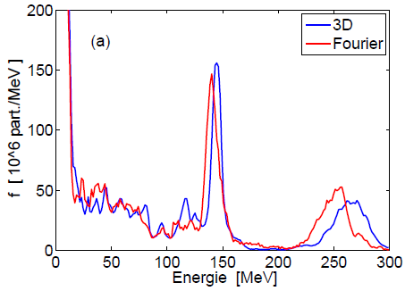
Azimuthal Fourier decomposition:
much faster than full 3D code
Laser and plasma parameters
λ0 = 0.8 μm
τ0 = 30 fs
w0 = 9 μm
a0 = 5
ne = 0.007 nc
CALDER-CIRC:
12h on 6 processors for 1 mm
50x faster
Images from X. Davoine et al. “New Algorithms for Cylindrical PIC code”
(1st EAAC - 2013)
A. Lifschitz et al, Journal of Computational Physics 228 (2009)

Slide 19
Speedup through Hybrid kinetic - fluid codes
Most cumbersome PIC routines:
Particle Push,
Particle Charge deposition, Computation of Forces on Particles from grid
Hybrid code = Beam Particles / Laser + Fluid Plasma Electron Background
Background advance reduces to solve fluid equations on grid (dramatic speedup)
Disadvantages: kinetic effects, highly nonlinear regimes cannot be simulated
Hybrid code in EuPRAXIA:
Architect (time explicit, electron PWFA)
Marocchino et al., Nucl. Instr. and Meth. A 829 (2016) 386–391
F. Massimo et al., Journal of Computational Physics 327 (2016) 841–850
A.Marocchino, F. Massimo, http://dx.doi.org/10.5281/zenodo.49572, (2016)

Slide 20
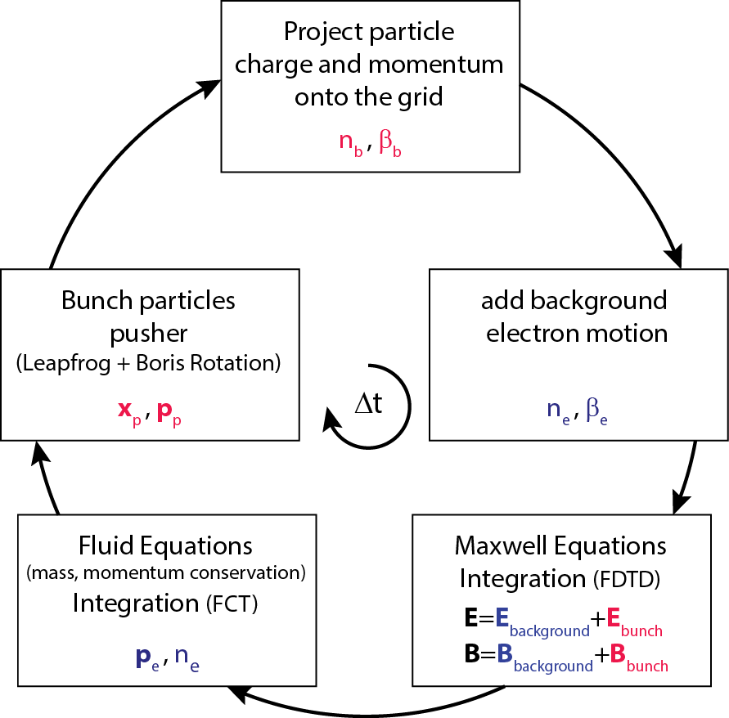
Example of hybrid code: Architect Loop
Beam Particles + Fluid Plasma Electron Background
code download: http://dx.doi.org/10.5281/zenodo.49572

Slide 21
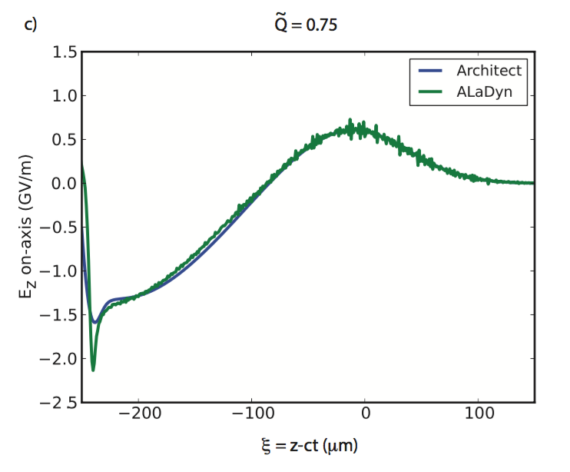
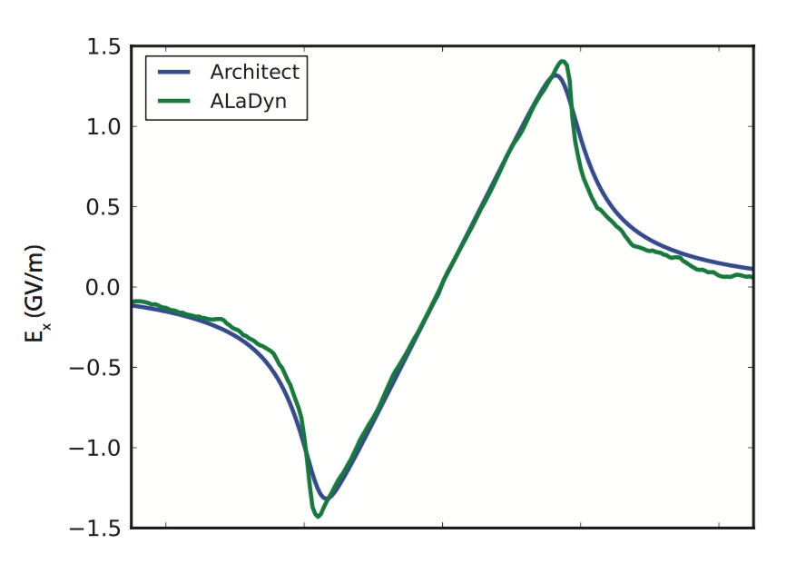

Architect: Comparison against 3D PIC code ALaDyn
Comparison after 1 mm of propagation in the plasma
3D ALaDyn simulation
4 kh-cores run time
2D Architect simulation
1 hour run time (1 cpu)
ALaDyn v1.0.0-beta, S. Sinigardi, A. Marocchino, P. Londrillo, A. Sgattoni,
http://dx.doi.org/10.5281/ zenodo.49553 (2016).
F. Massimo et al., Journal of Computational Physics 327 (2016) 841–850

Slide 22
Summary
PIC codes are essential tools to investigate various regimes of plasma acceleration
Huge amounts of operations in PIC codes slow down the simulation
Various “tricks” and reduced models can be used to speed up simulations, as QSA, Boosted Frame, Azimuthal decomposition, Hybrid kinetic-fluid codes
Advantages of the various solutions must be weighted with the physics they lose
Various codes used in EuPRAXIA to address different needs

Slide 23
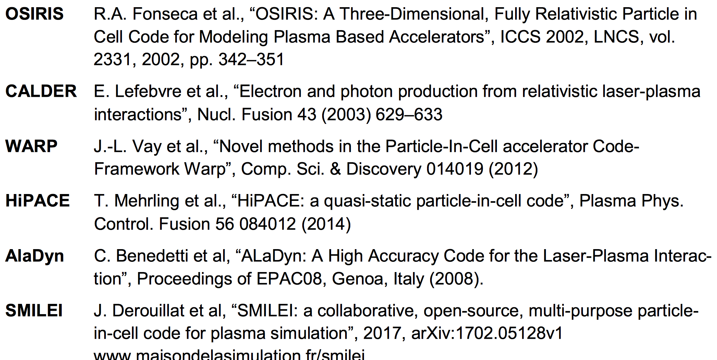
References
EuPRAXIA MILESTONE: M2.3 - Simulation Tools

Slide 24
Acknowledgements
Work funded by by the European Union’s Horizon 2020 research and innovation programme under grant agreement EuPRAXIA No. 653782 and X- Five ERC project, contract No. 339128
Special thanks to A. Marocchino (SPARC_LAB), A. Beck (LLR), A. Mosnier (CEA, Irfu)
Journées Accélérateurs, Roscoff 2017

Slide 25
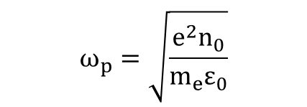

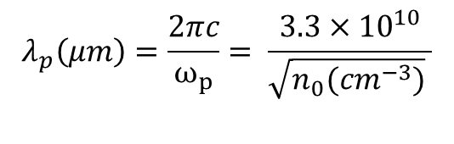
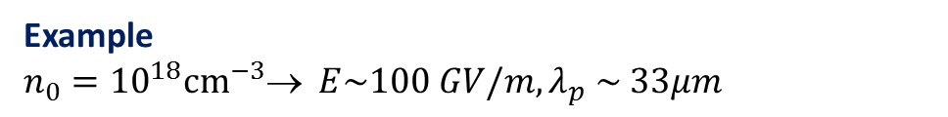
Various Characteristic Scales in Plasma Acceleration
For small perturbations of the electron equilibrium density n0, the electron plasma wave frequency is:
Accelerating field:
Plasma wavelength:
Typical accelerating lengths: mm, few cm

Slide 26
Basic parallelisation is not well balanced
Example of Laser Wakefield Electron Acceleration in full 3D, Photon-Plasma, Niels Bohr Institute.
2048 BG/Q nodes.
16X16X64 MPI processes.
8 openMP threads.
Standard domain decomposition.
Imbalance of 40.

Slide 27
Speedup with Quasi-Static Approximation (QSA)
Assumption: driver evolution much slower than background plasma evolution,
i.e. driver can be considered frozen while plasma electrons pass it
(Laser diffraction time or betatron period ωβ⁻¹ >> Plasma period ωp⁻¹)
Introducing new variables:
QSA: neglect τ derivatives
with respect to ζ derivatives
for background plasma
(Comoving variable)
In QSA the τ dependance in the fields and plasma quantities disappears
Plasma quantities at each iteration depend only on the distance from the driver ζ

Slide 28
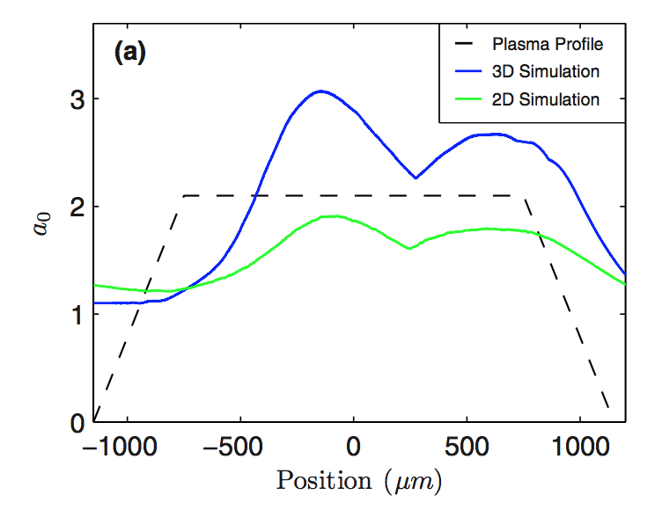
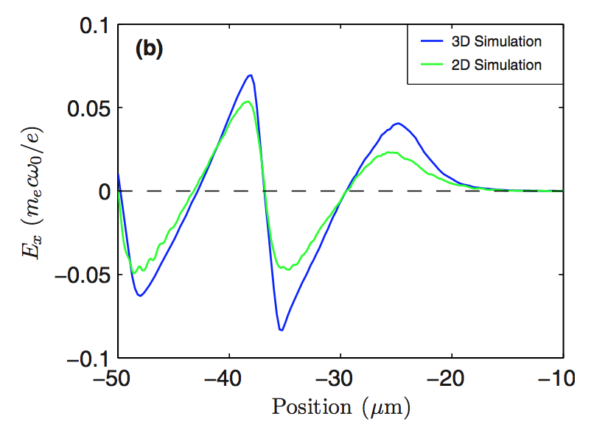
LWFA: intrinsically 3D problem
Image from:
X. Davoine et al., Physics of Plasmas 15, 113102 (2008)

Slide 29
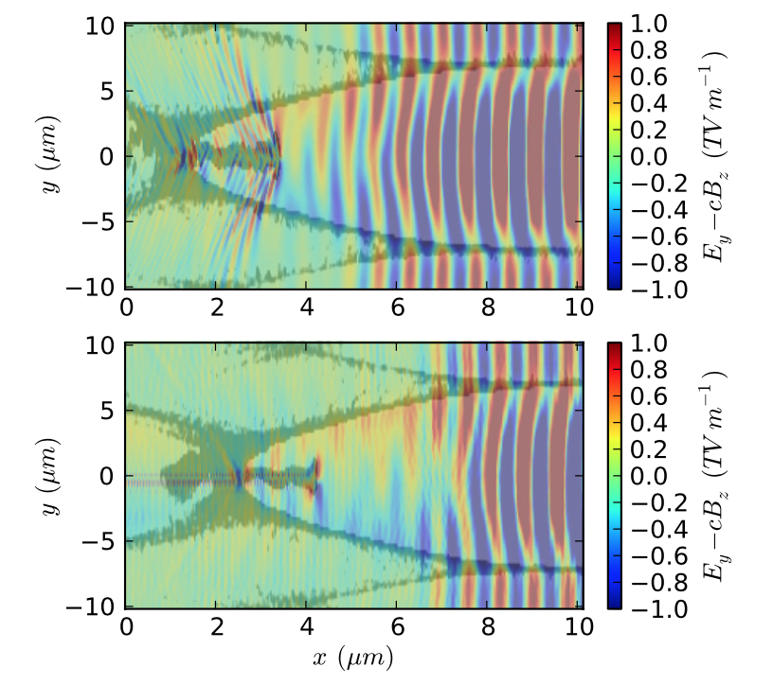
Anti-Cherenkov scheme
Numerical dispersion in standard PIC codes (e.g. FDTD scheme) slows down radiation,
radiation deflects particles, generated current induces more radiation
R. Lehe et al., “Numerical growth of emittance in simulations of laser-wakefield acceleration”, PRSTAB 16, 021301 (2013)
Anticherenkov off
Anticherenkov on

Slide 30
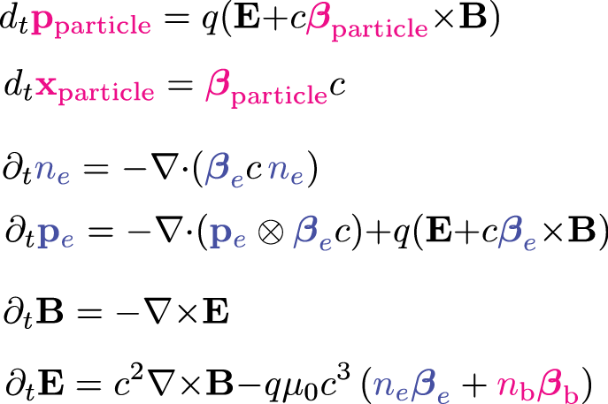
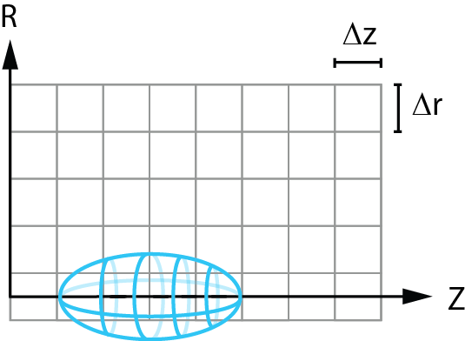
Example of hybrid code: Architect
Beam Particles + Fluid Plasma Electron Background
X
Dz
Dx
Beam particles move in 3D-3V space
EM fields and fluid integration in moving window, no quasi-static approximation
cylindrical symmetry assumed for fluid and electromagnetic fields (Z, X, X>0)
Only X>0 domain is considered in the fluid and electromagnetic field equations
No need for parallelization for typical SPARC_LAB simulations
Architect: first release, A. Marocchino, F. Massimo, http://dx.doi.org/10.5281/zenodo.49572 (2016).

Slide 31
Architect: Comparison against 3D PIC code ALaDyn
Q = 180 pC
s_{x} = 9 mm, s_{z} = 50 mm
E₀ = 100 MeV
e_{x} = 1 mm-mrad
Dg/g = 0.1%
n₀ = 10¹⁶ cm⁻³
3D ALaDyn simulation
4 kh-cores run time
106 Mcells
850 Mparticles
Dt = 0.23 fs
Dx = 0.4 mm
Dz = 1 mm
2D Architect simulation
1 hour run time (1 cpu)
250 cells
15 kparticles
Dt = 0.2 fs
Dr = 0.4 mm
Dz = 1 mm
Comparison after 1 mm of propagation in the plasma
ALaDyn v1.0.0-beta, S. Sinigardi, A. Marocchino, P. Londrillo, A. Sgattoni, http://dx.doi.org/10.5281/ zenodo.49553 (2016).
Architect: first release, A. Marocchino, F. Massimo, http://dx.doi.org/10.5281/zenodo.49572 (2016).

Slide 32
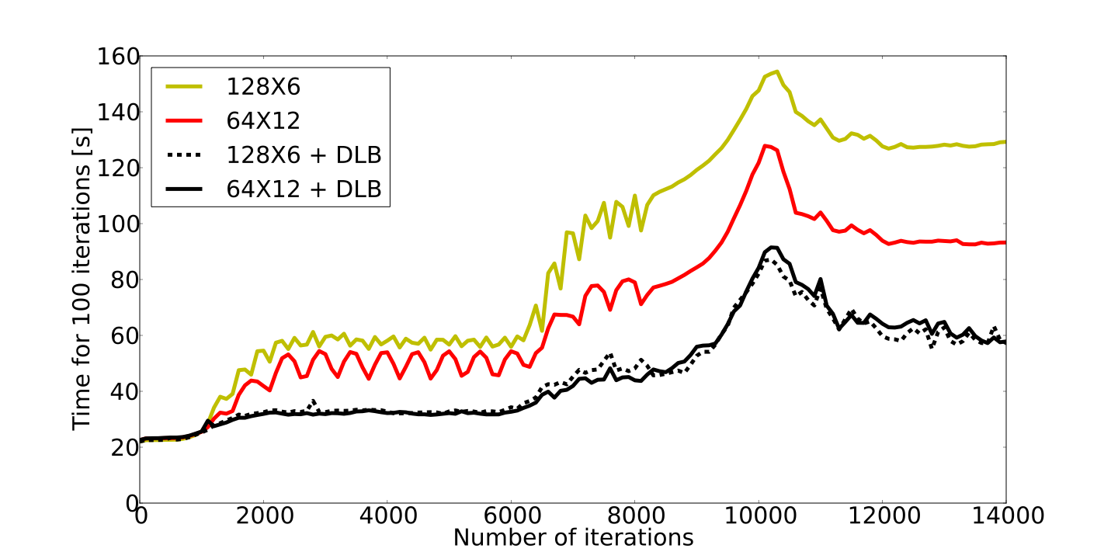
SMILEI Speedup
Software for Matter Interacting with Laser at Extreme Intensities
MPI × OpenMP

