Slide 1
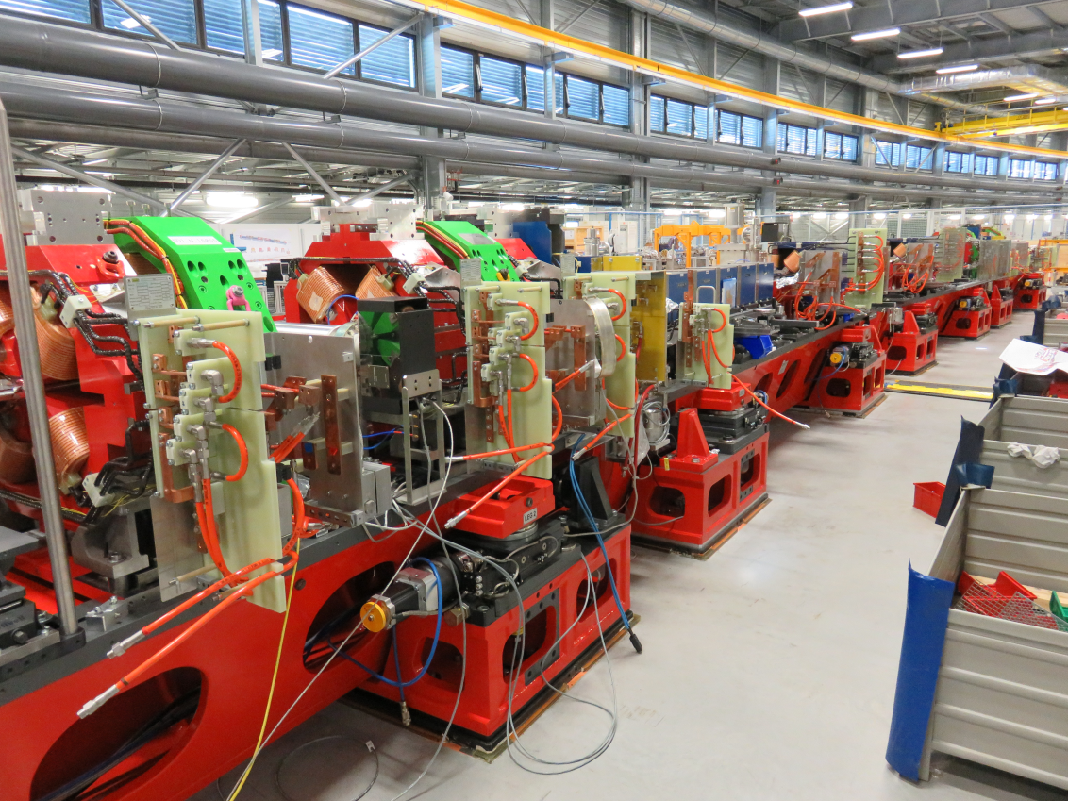


The Extremely Brilliant Source project
Project Overview
P Raimondi
On behalf of the EBS Accelerator Project Team

Slide 2
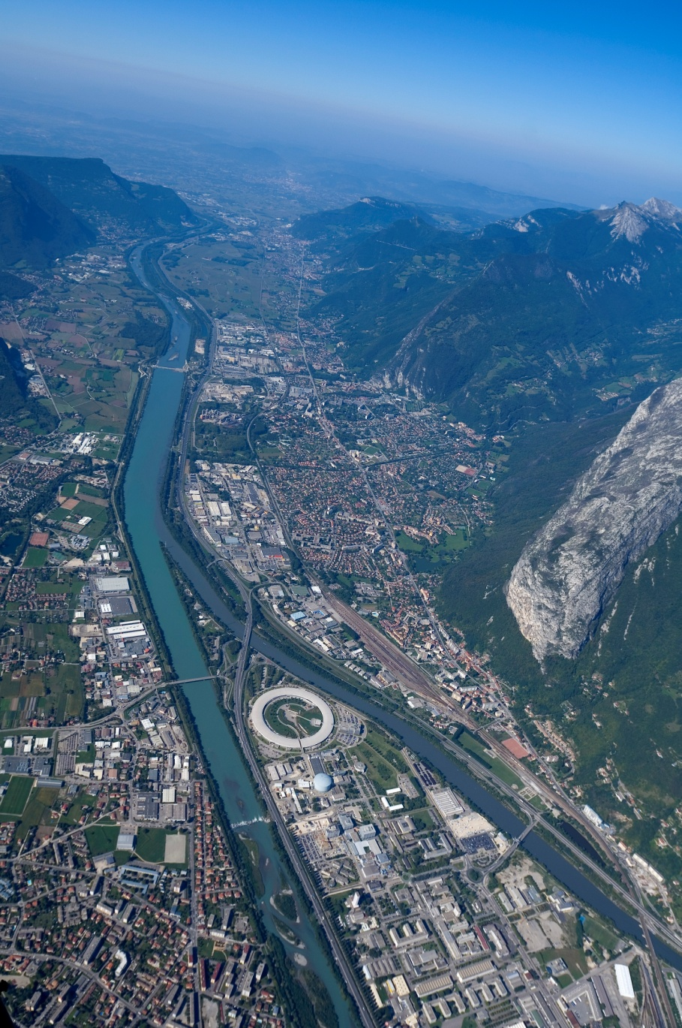
Outline
ESRF-EBS Project
Storage Ring characteristics
Project management
Main EBS accelerator components
Girders, magnets, vacuum chambers, absorbers, FE
From Assembly to Installation
Conclusion
Notes:
Simplify, complete

Slide 3
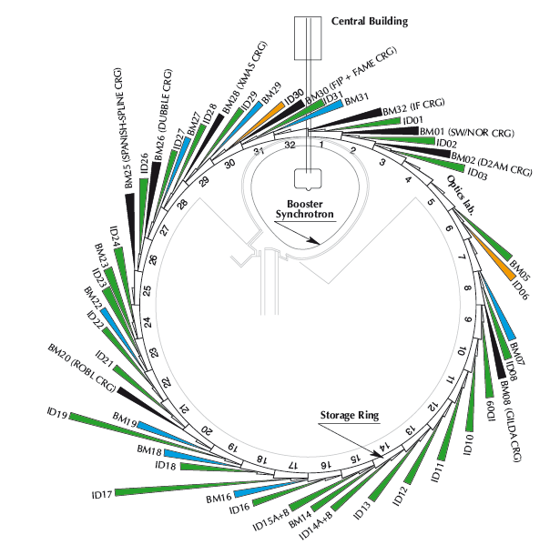
Accelerator and source division (ASD) mission
ESRF Today
Storage ring
6GeV, 844 m
Energy | GeV | 6.04
Multibunch Current | mA | 200
Horizontal emittance | nm | 4
Vertical emittance | pm | 3.5
Booster synchrotron
200 MeV ➔ 6 GeV
300m, 10 Hz
32 straight sections
DBA lattice
42 Beamlines
12 on dipoles
30 on insertion devices
72 insertion devices: 55 in-air undulators, 6 wigglers, 11 in-vacuum undulators, including 2 cryogenic
E- Linac
200 MeV

Slide 4
The EBS Storage Ring characteristics
The Extremely Brilliant Source Project aims to:
Substantially decrease the store ring equilibrium horizontal emittance
Increase the source brilliance
Increase coherent fraction of the beam
(reduce electricity consumption)
e⁻ beam properties
 | Now | EBS
Energy (GeV) | 6.04 | 6
Multibunch current (mA) | 200 | 200
Circumference (m) | 844.39 | 843.98
Horizontal emittance (nm.rad) | 4 | 0.13
Vertical emittance (pm.rad) | 4 | 5
reduced by
a factor of 30

Slide 5

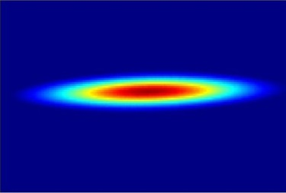
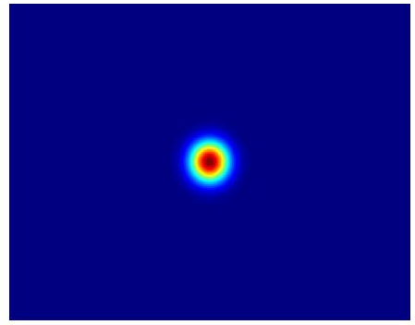

EBS – Reduction of the horizontal emittance
Reduction of the horizontal emittance from 4nm.rad to 0.14nm.rad
Experiments can benefit from : an increase in brilliance
an increase of coherence
(the coherent fraction of the light in the horizontal plane)

Slide 6
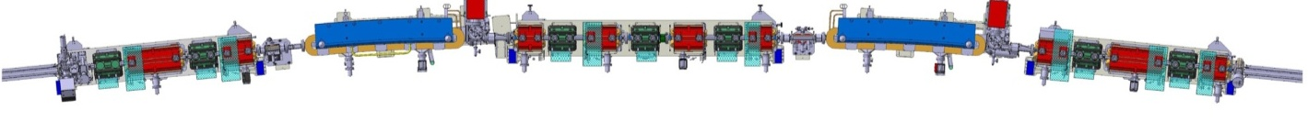
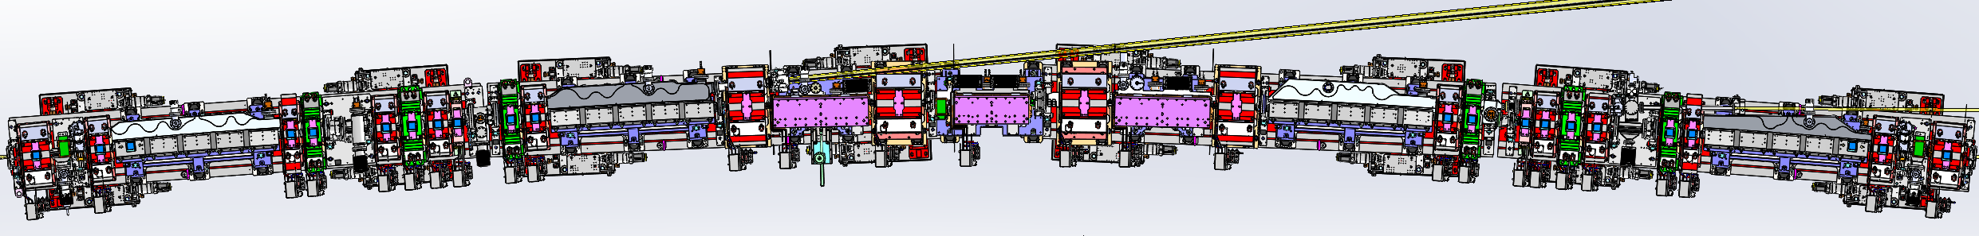
New lattice vs present ESRF lattice
Present ESRF lattice Double Bend Achromat = (2 dipoles + 15 quad. sext.) per cell ID length = 5 m (standard) / 6m / 7m
Future EBS lattice Hybrid 7 Bend Achromat = (4 dipoles + 3 dipole-quad + 24 quad., sext., oct.) per cell ID length = 5 m
present
Dipole
Dipole
future
Dipole
Dipole
Dipole-quadrupoles
Dipole
Dipole
31 magnets per cell instead of currently 17!

Slide 7
EBS lattice – engineering challenges and constraints
EBS
Dipole
Dipole
Dipoles-quadrupoles
Dipole
Dipole
Main engineering challenges:
Fit in the same tunnel. Same circumference.
Insertion devices at the same locations: keep beamlines where they are!
Little space between magnets, i.e. 3.4 m/cell instead of 8 m/cell today!!
Re-use injector complex
High precision & high stability positioning requirements
Little time for the project and in parallel to the normal operation of the facility

Slide 8
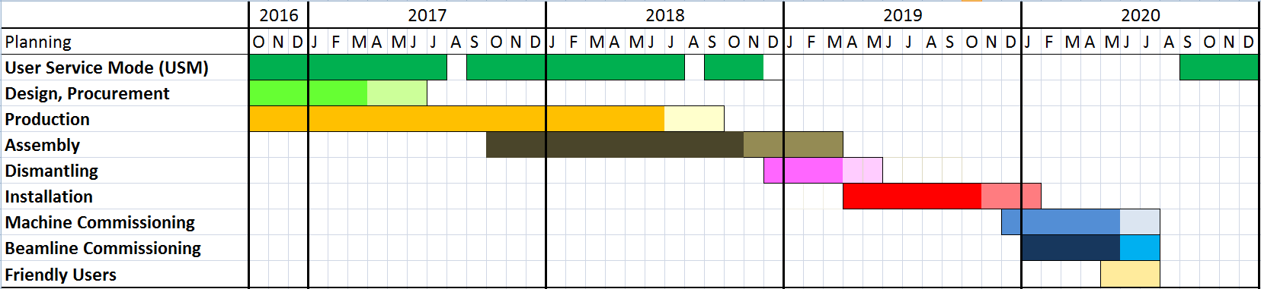
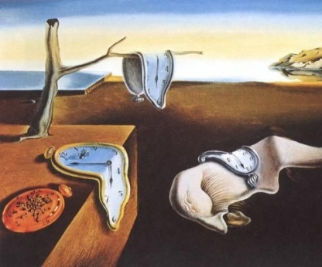
EBS time line (2016-2020)
January 2017-June 2018 – Delivery of components
10/12/2018 – Start of shutdown
Milestone: Decision on shutdown date
11/11/2019 – Start of machine commissioning
May-July 2020 – Friendly Users
25/08/2020 – Start of USM
2018 is a normal year for Operation, except for shorter summer and October shutdowns
10 December 2018 Potential start of the long shutdown, dismantling starts
11 November 2019 Commissioning starts
02 March 2020 Beamline commissioning starts
25 August 2020 Back to USM
Notes:
Update

Slide 9
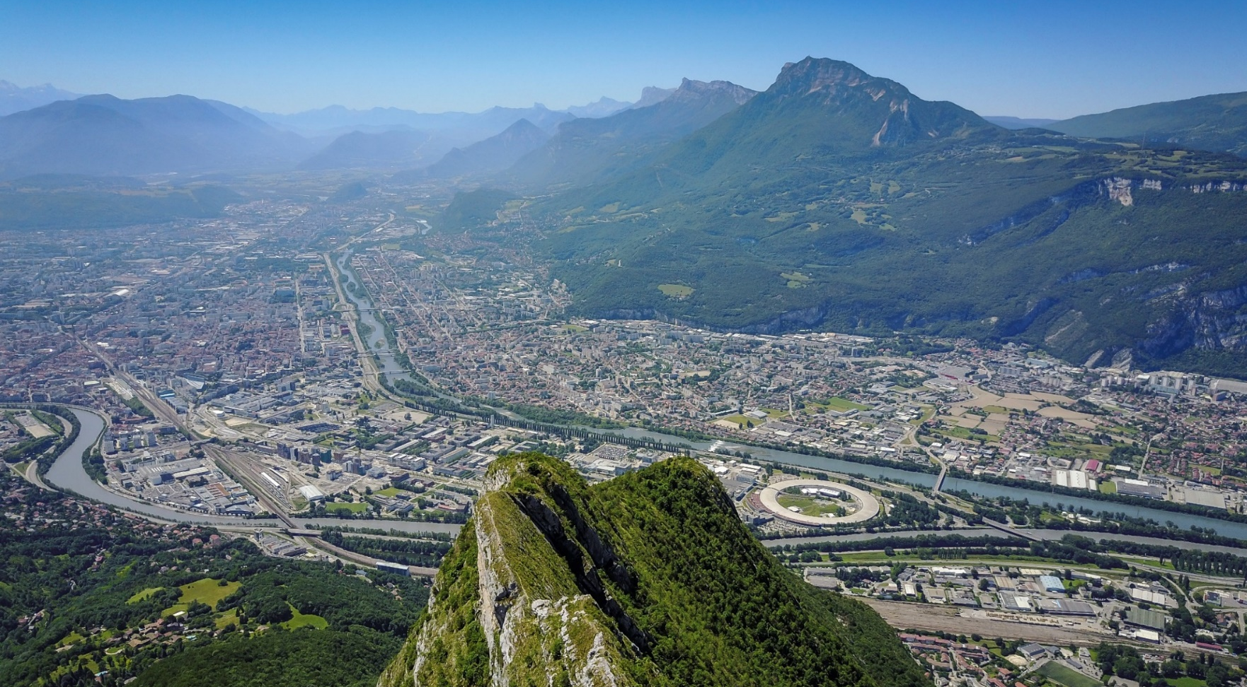
Main EBS accelerator components

Slide 10
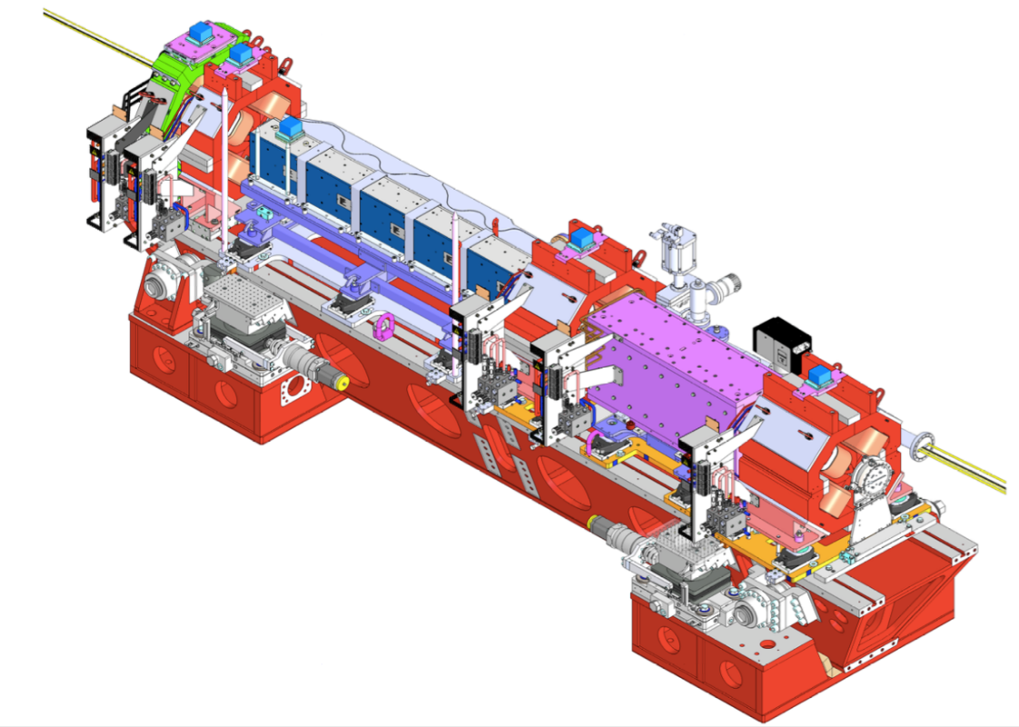
Girders
Four girders per cell to install:
Magnet supports
Magnets
Vacuum equipment
Diagnostics
Bare girder weight: ~6t
Fully equipped girder: ~12-13t
129 girders in total
5100mm

Slide 11
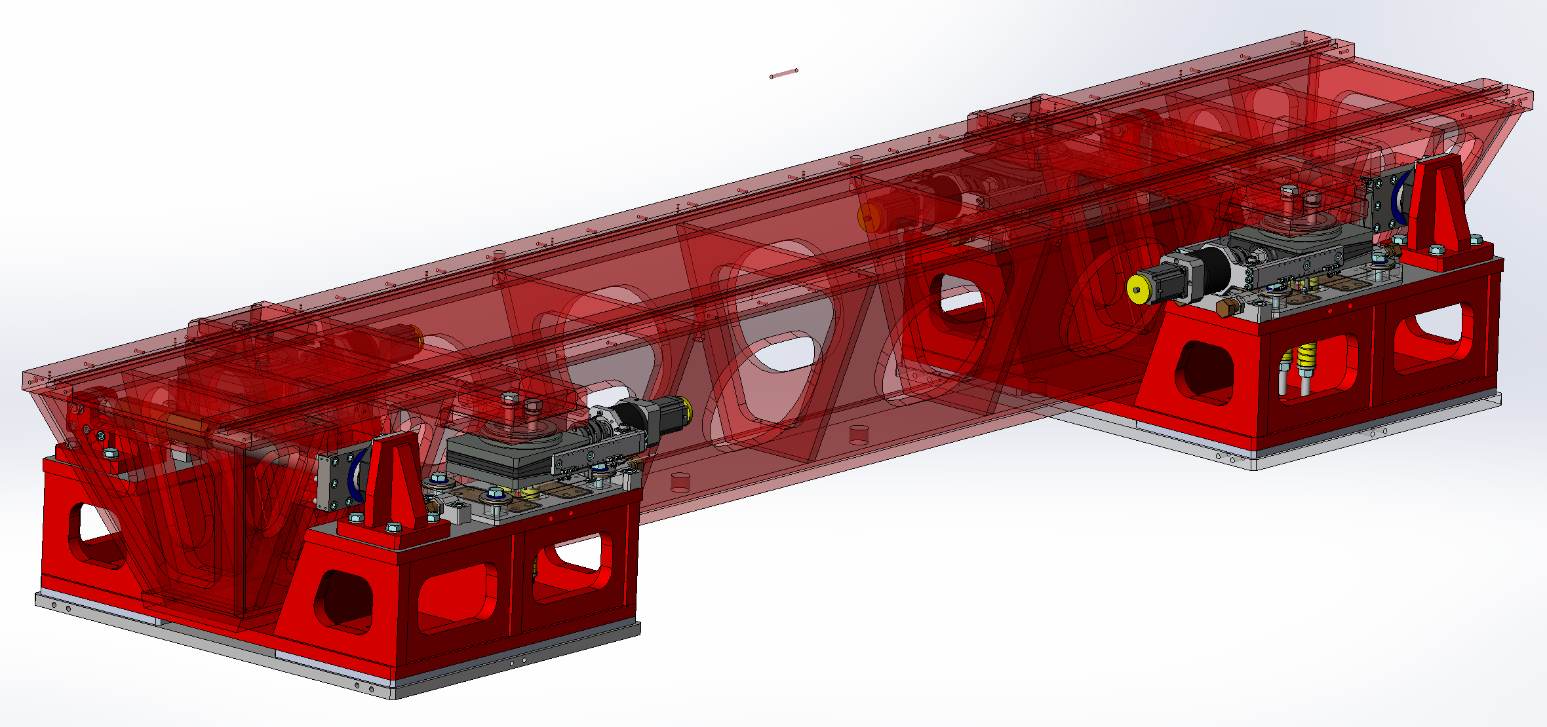
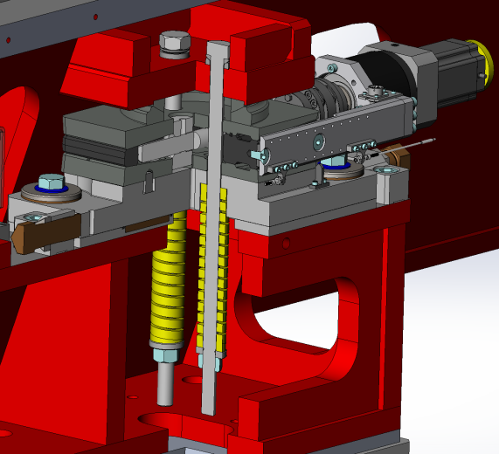
Girder design
Girder supported by 4 adjustable Z feet made of motorised wedges
Y adjustment by 2 manual jacks pushing the girder
Motorized Z adjustment resolution 5μm
Manual Y adjustment resolution 5μm
1st natural Eigen frequency:
- 50 Hz (design goal)
- 49 Hz measured
Z feet optimised for maximum stiffness
Z
Y
X
There is 1 degree of hyperstaticity in the vertical direction managed by the girder “flexibility” for small displacements.
Courtesy: Filippo Cianciosi

Slide 12
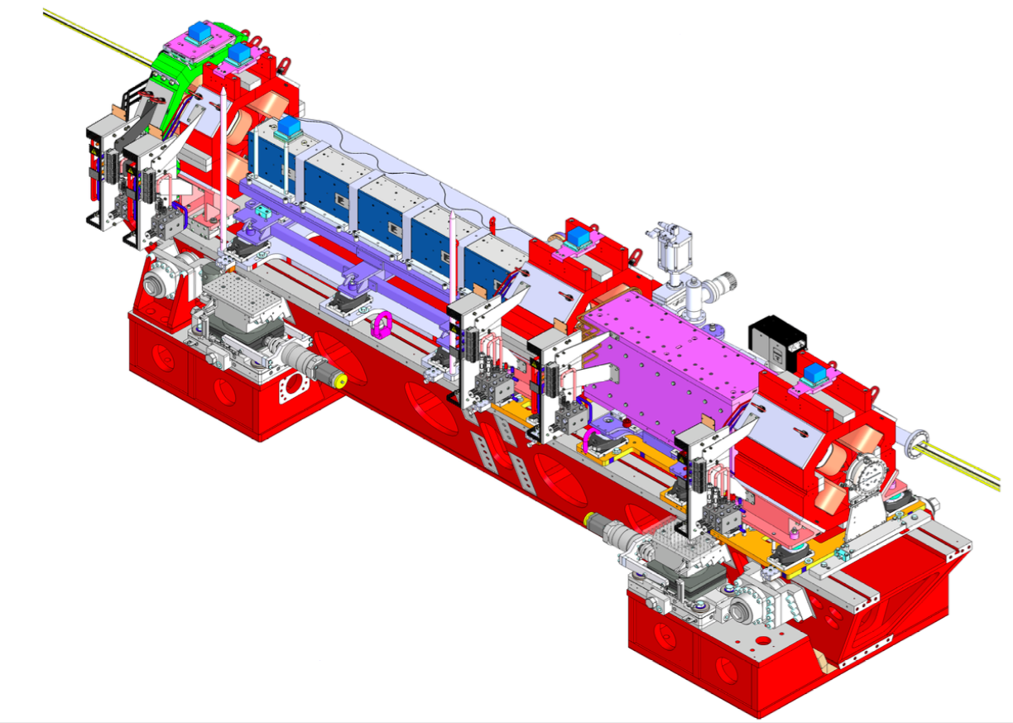
Supports
Moderate gradient magnets
Longitudinal gradient Dipoles
Vacuum chamber supports
Vertical shims
Support & Adjustable wedges for
Dipoles Quadrupoles & Quadrupoles

Slide 13
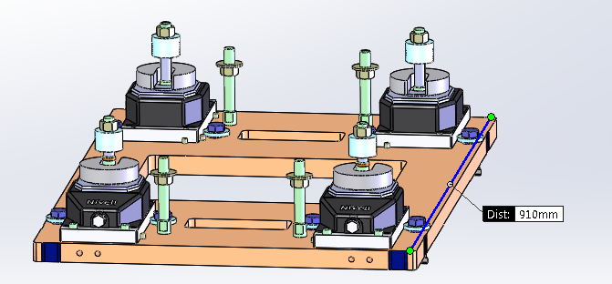
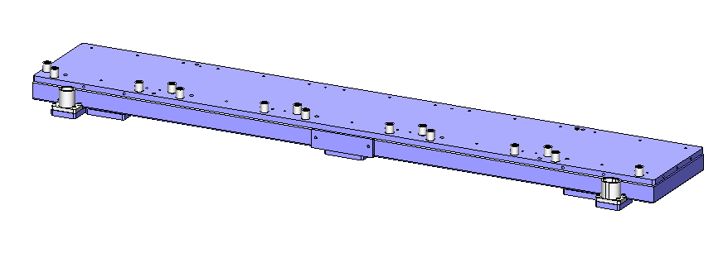
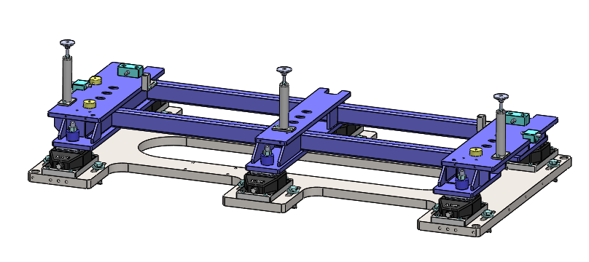
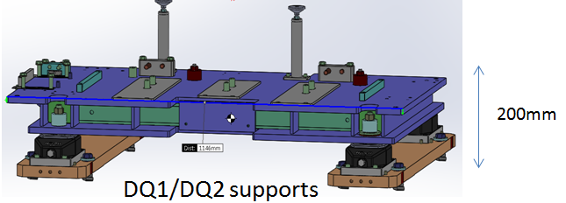
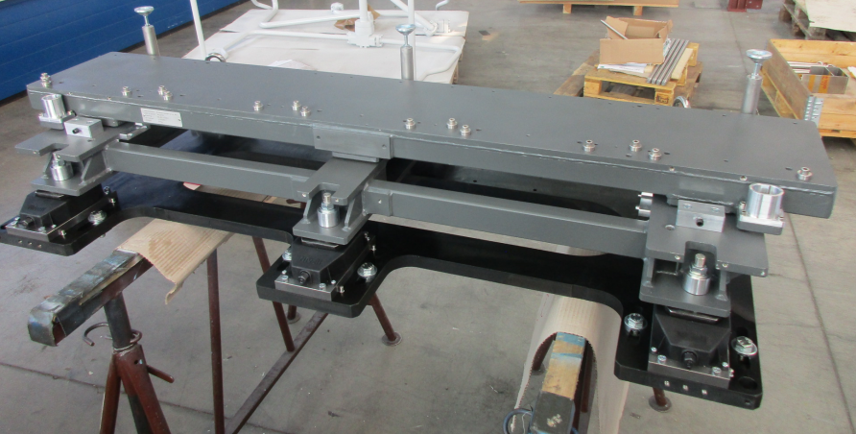
QF6/QF8- DQ supports – DL supports
Dipole support assembly
Top Frame
QF6/QF8 supports
Base
support
Courtesy: L Eybert

Slide 14
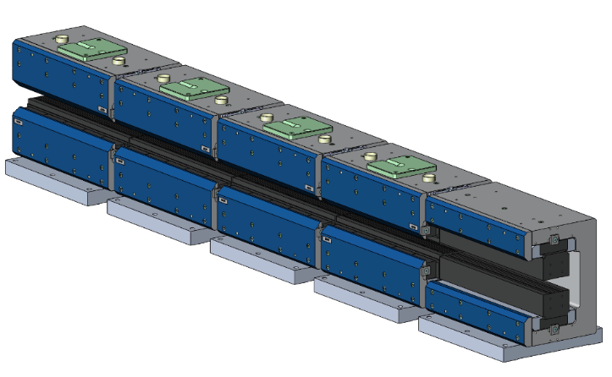
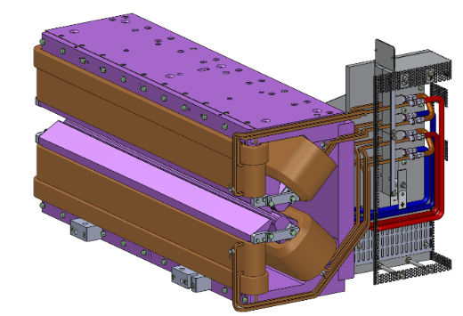
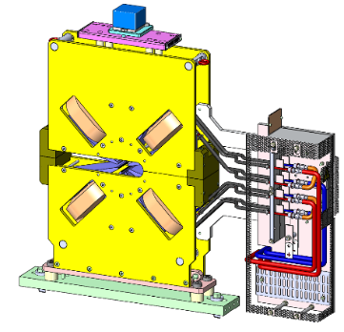
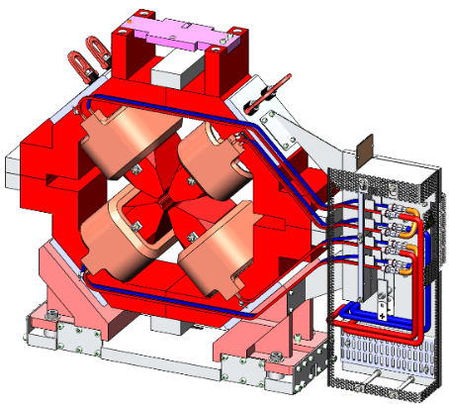
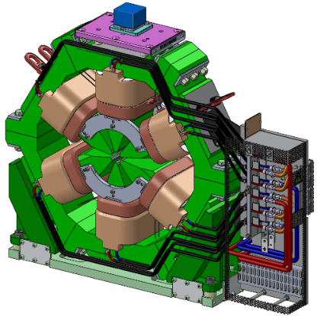
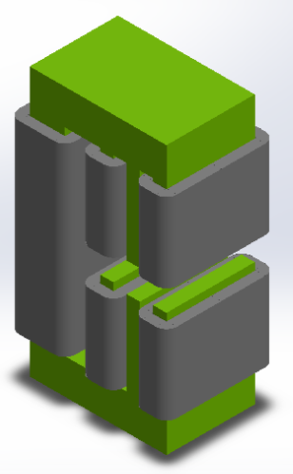
Magnets
132 Dipoles
100 Dipole-quadrupoles
66 Octupoles
More than 1000 Magnets to be produced
524 Quadrupoles
(132 HG, 392 MG)
196 Sextupoles
98 Correctors

Slide 15
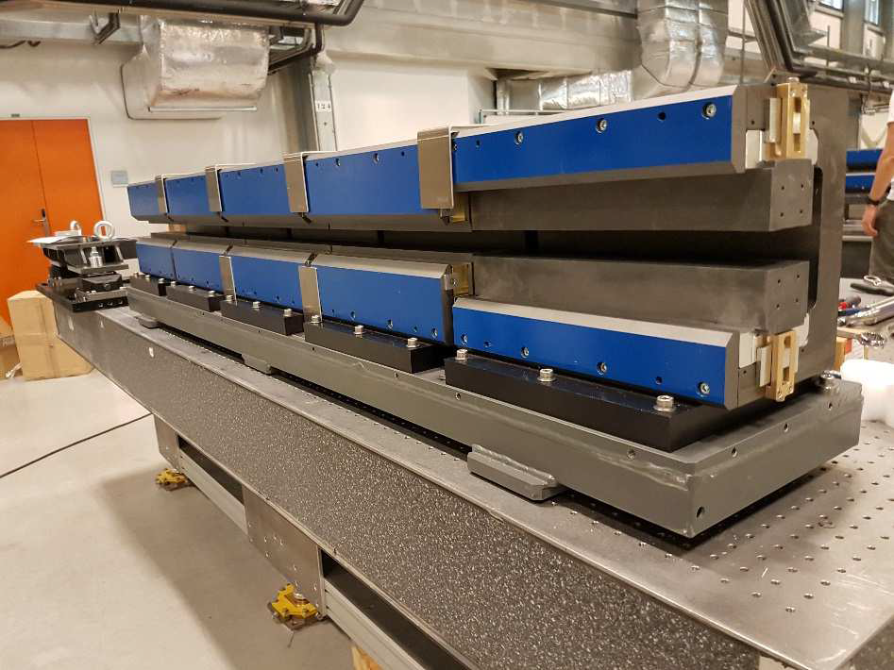
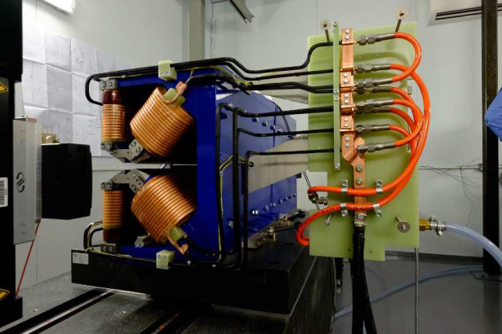
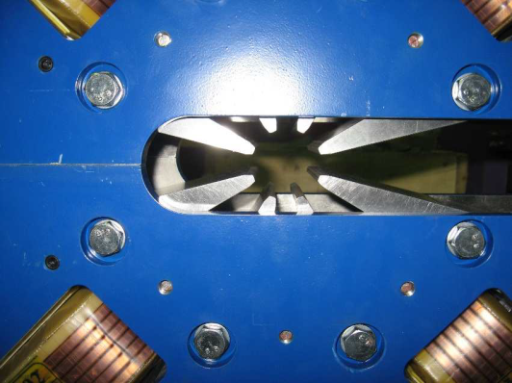
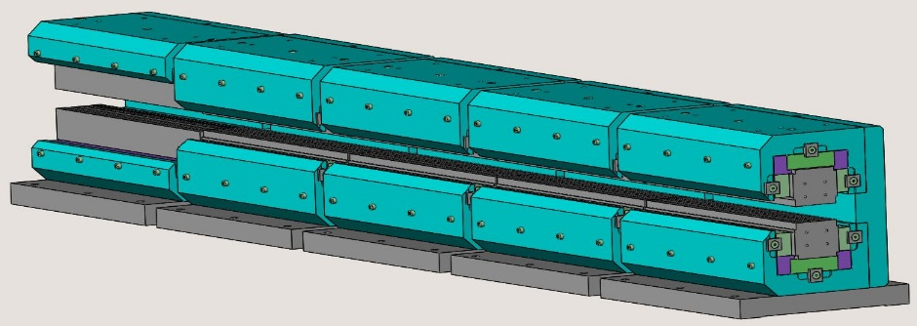
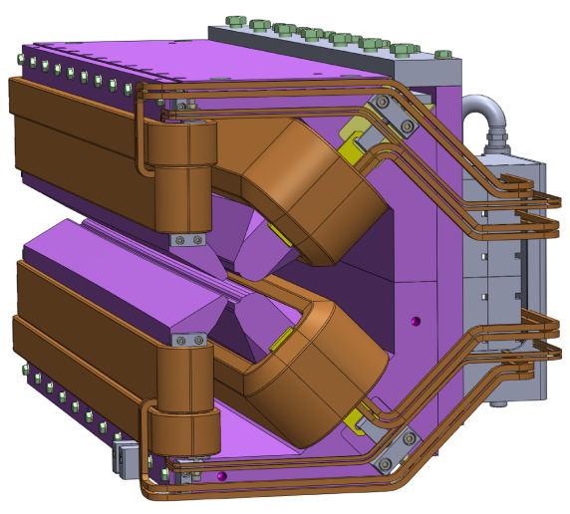
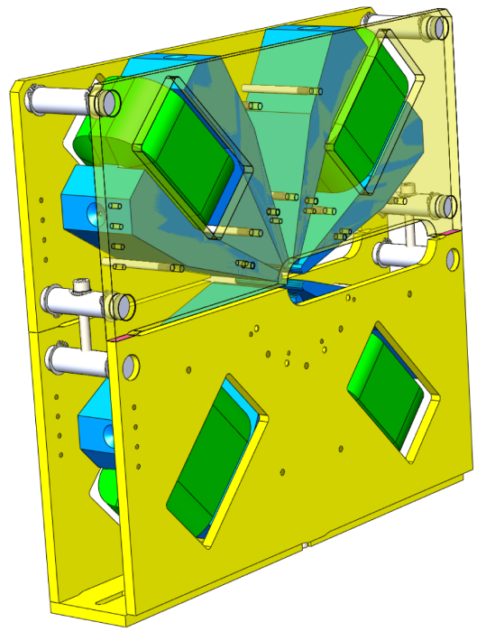
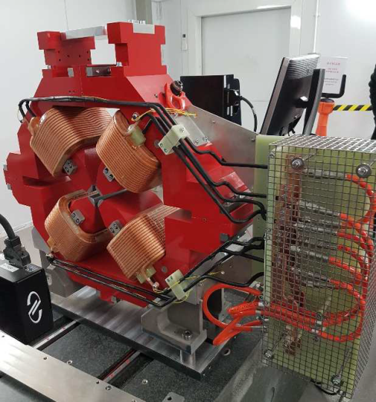
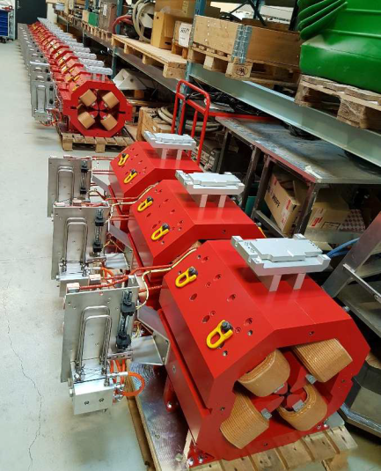
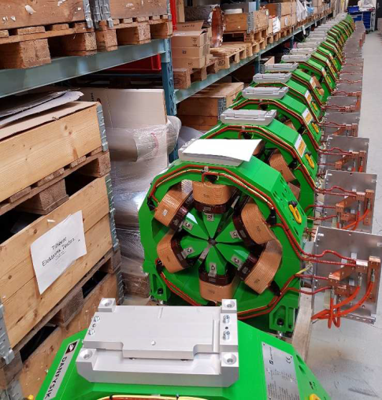
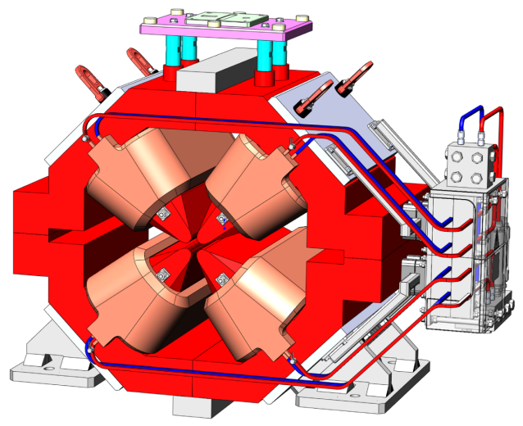
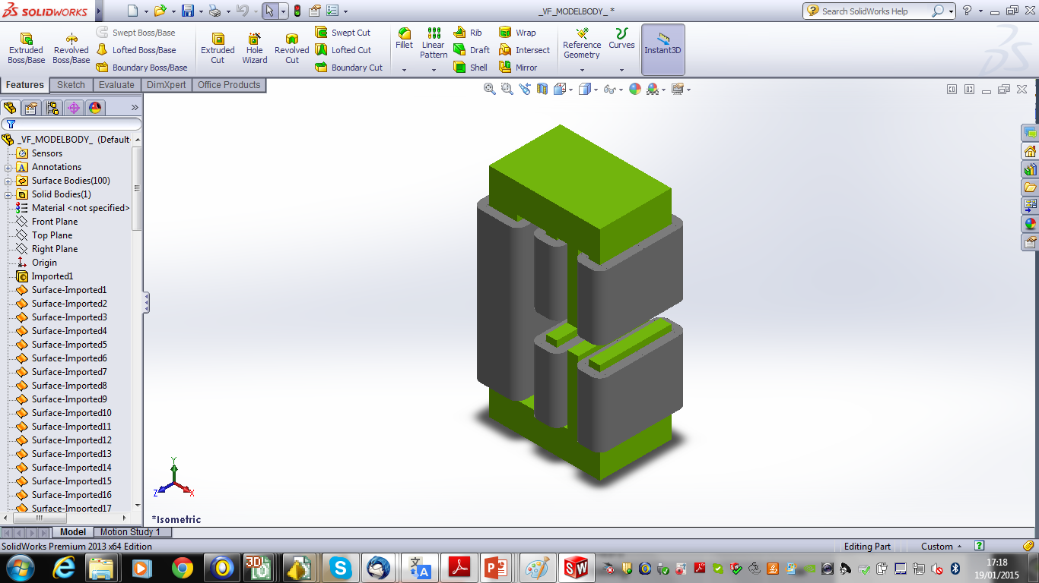
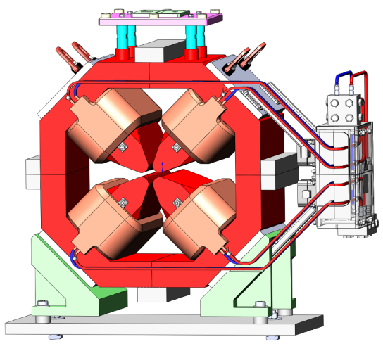
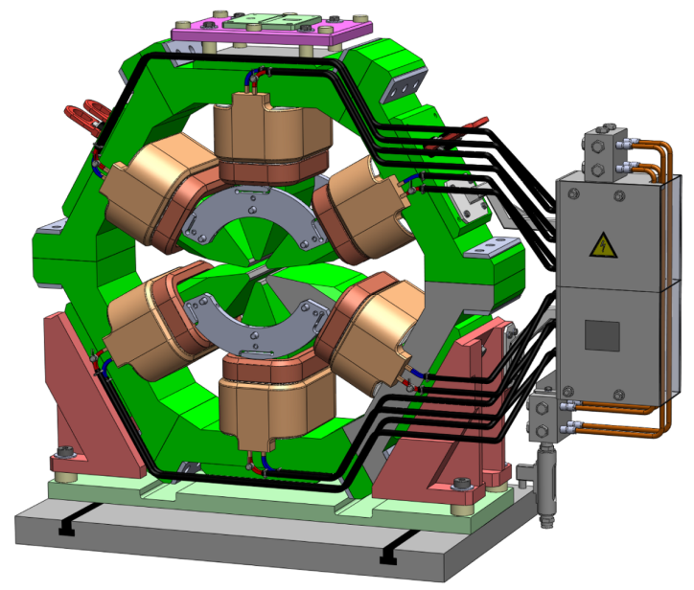
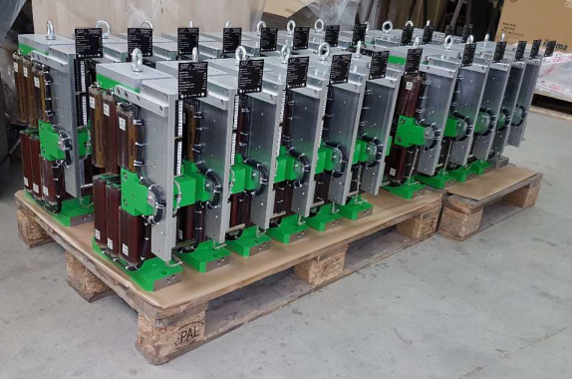
ESRF EBS (2015-2022): magnets procurement
All contracts in place, magnets in fabrication
All preseries successful, first batches of serial productions already at ESRF
More than 1000 Magnets to be procured by the end of 2018
132 dipoles
99 dipole-quadrupoles
66 octupoles
398 moderate gradient quadrupoles
130 high gradient quadrupoles
196 sextupoles
100 correctors

Slide 16
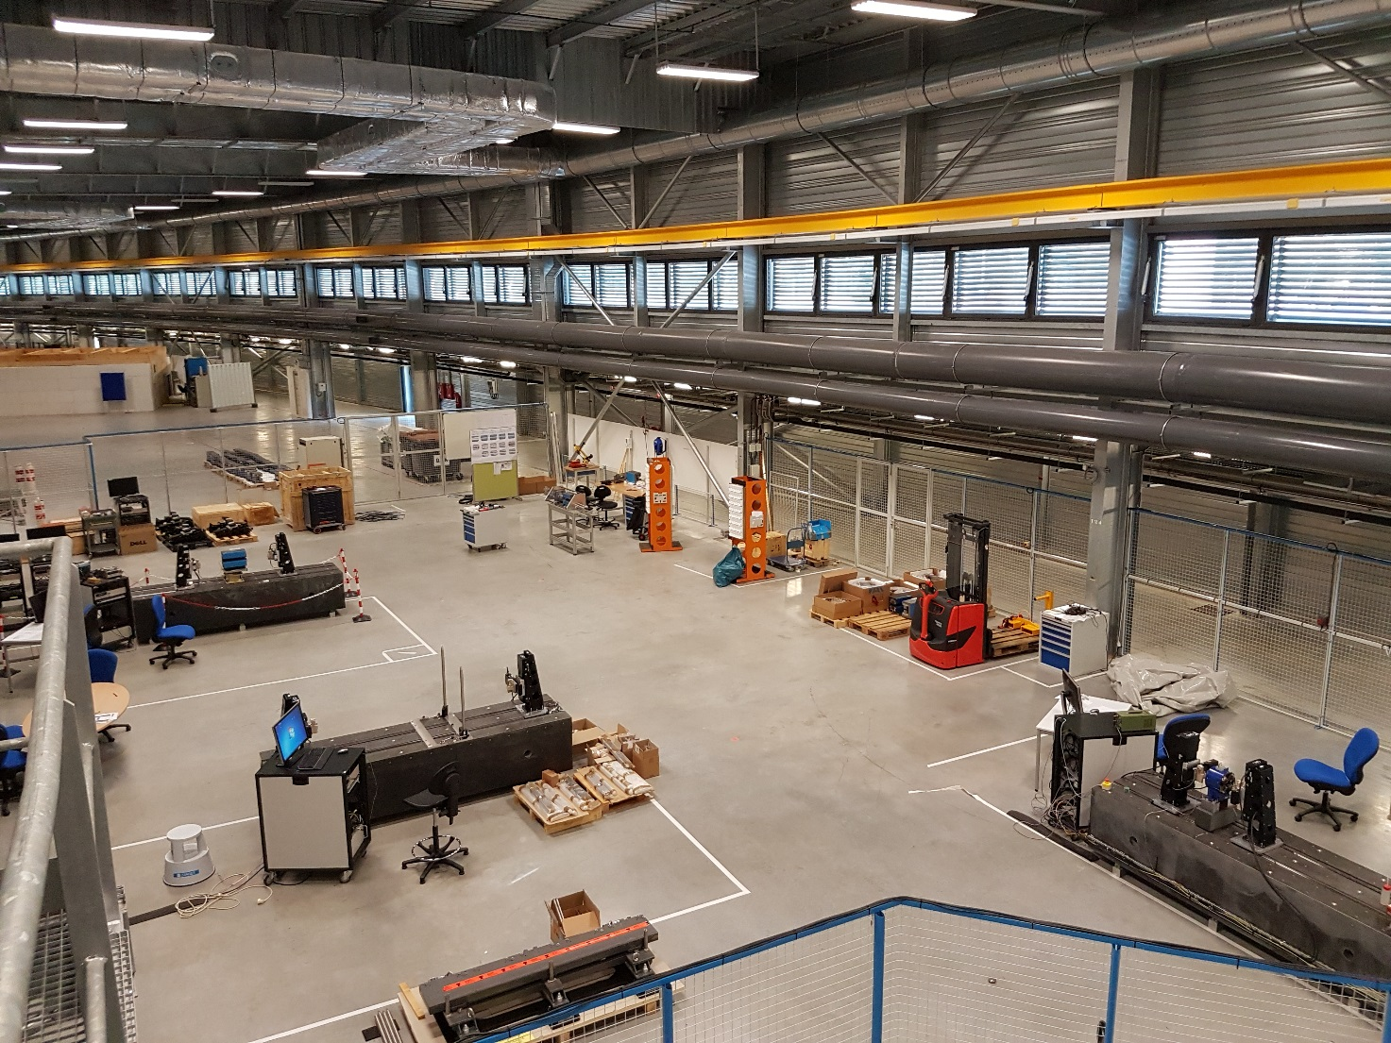
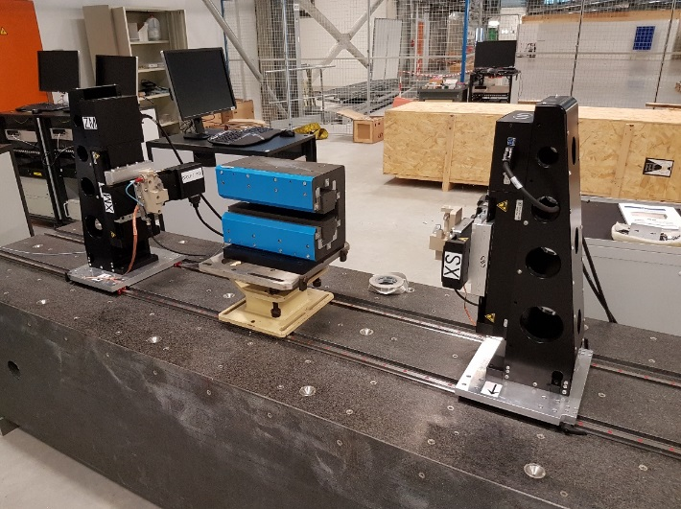
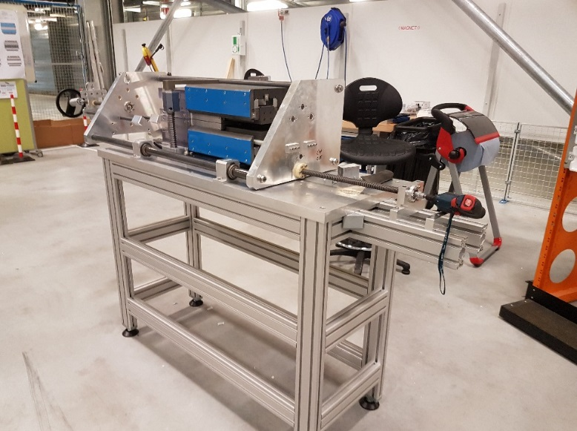
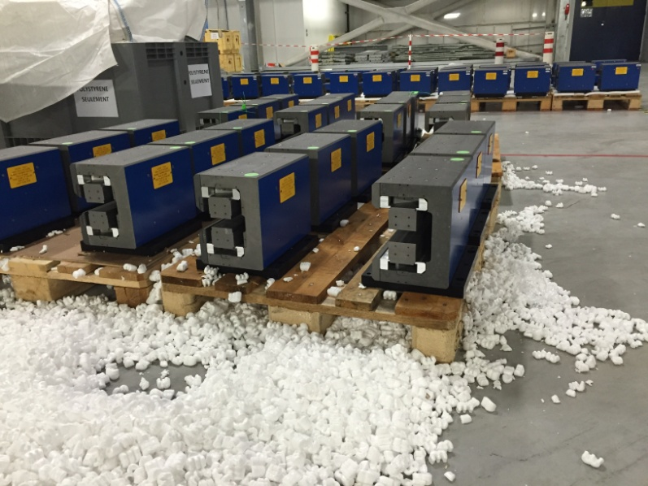
Implementation in Chartreuse Hall
PM Dipoles have been assembled by ESRF staff
More than 650 Magnets Modules for a total of about 128+4 5-Module dipoles
All Dipoles have been already completed
PM assembly tool
Dipole assembly area

Slide 17
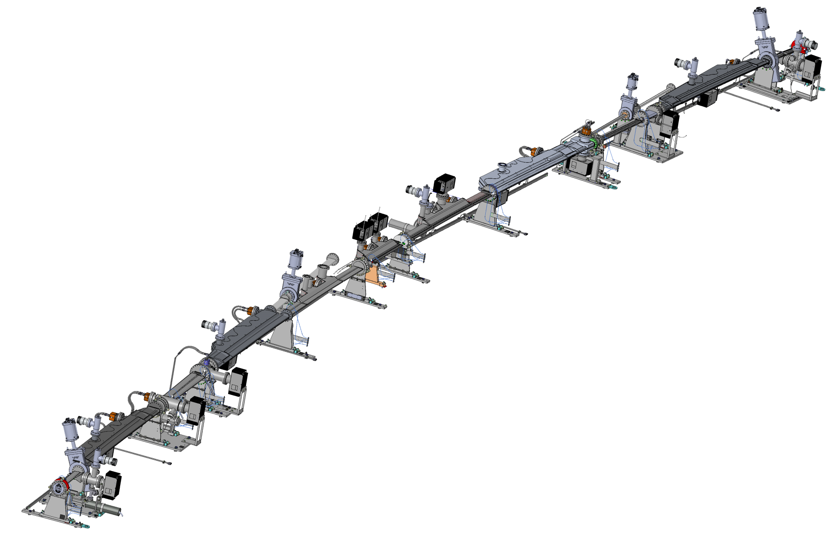
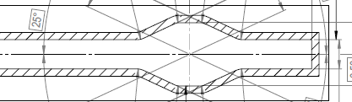
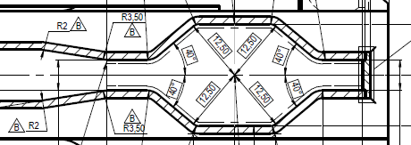
Vacuum chambers
Three main families of chambers:
High profile aluminium chambers (dipole magnets + other)
High profile stainless steel chambers
(quadrupoles, sextupoles, octupoles)
Low profile stainless steel chambers
(inside combined dipole-quadrupoles
& HG quadrupoles)
Diagnostic chambers
Possible location
Low profile cross section
In situ bake-out
13mm
High profile cross section
20mm

Slide 18
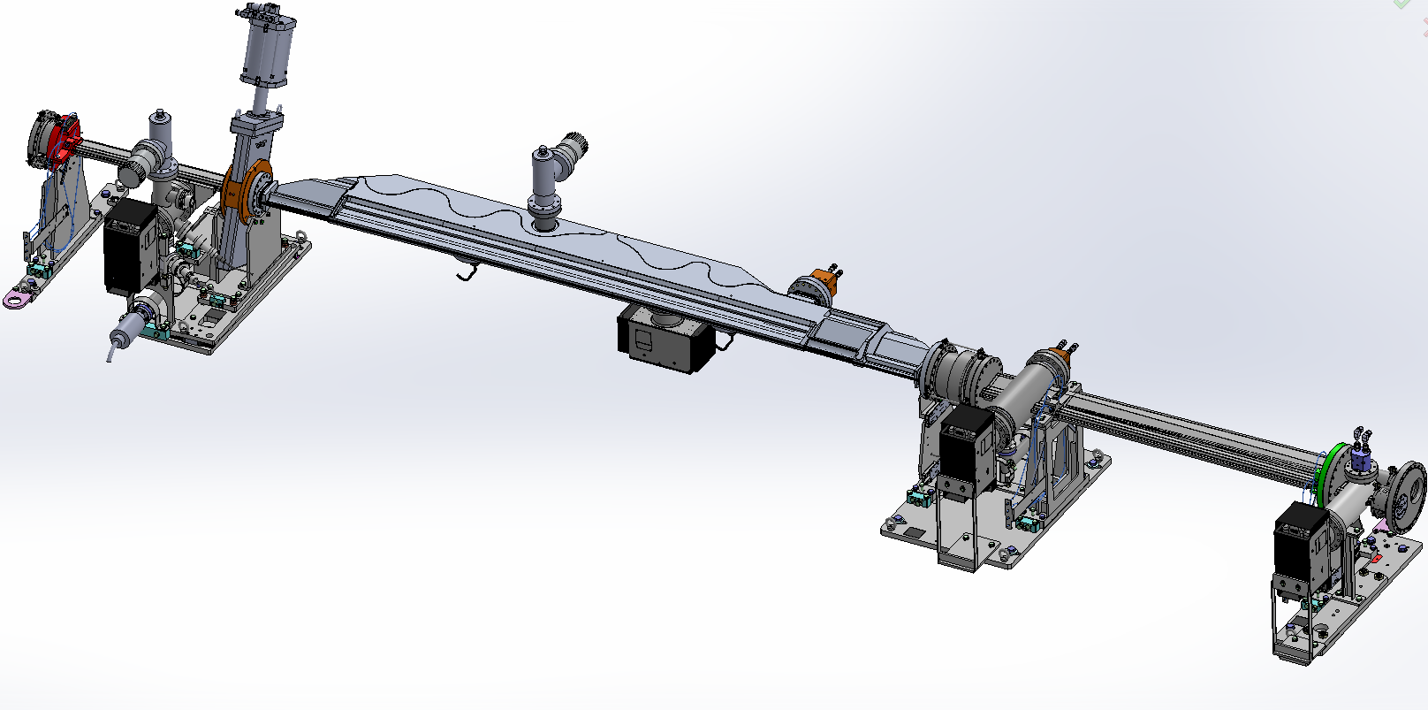
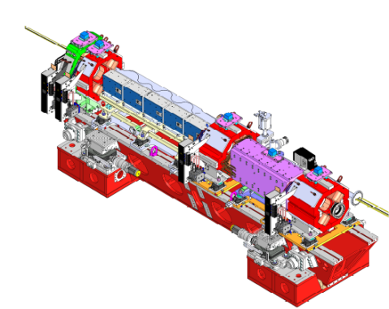
Girder 1: detailed vacuum chamber & supports
(Dipole Chambers intermediate
basic support not represented)
Bellow
Sector valve
sliding support
Chamber flexible support
BPM1 (fixed) support
CH3- crotch 1
BPM2 (fixed) support
CH4 BPM3 (movable) support
Courtesy: L Eybert

Slide 19
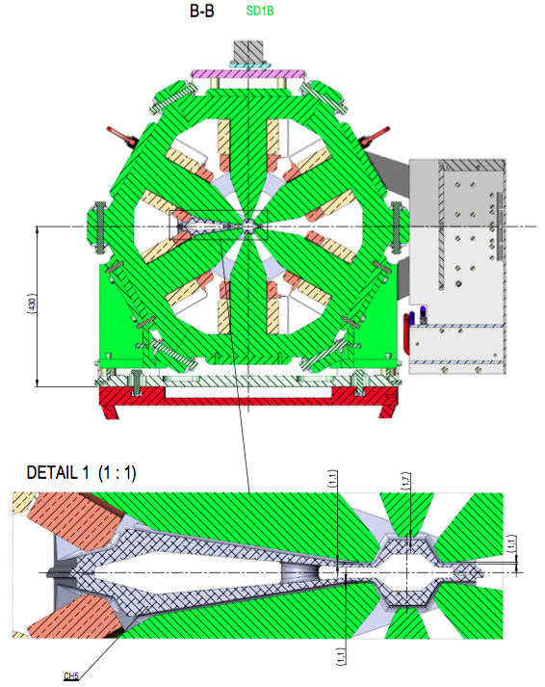
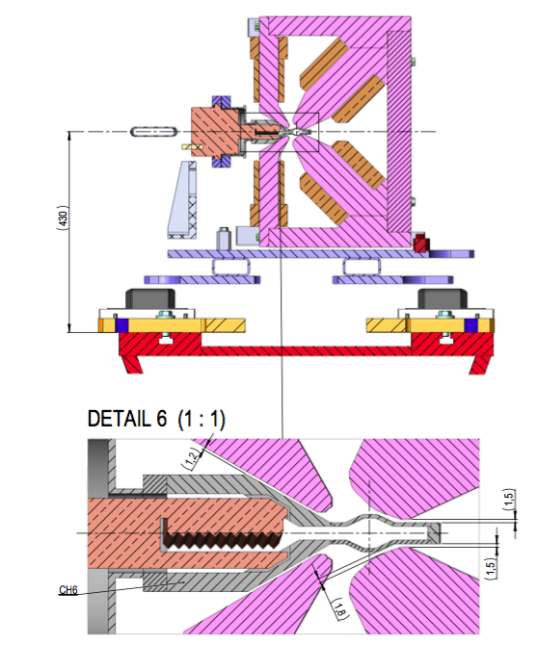
Vacuum chambers integration with Magnets
Limited space between
Magnets and chambers
Minimum thickness required
Deflection (vacuum)
Material stresses
CH5 Dipole
Aluminium chamber
(section inside sextupole)
CH6
316LN chamber
(section inside DQ1C)

Slide 20

Vacuum pumps
IP & NEG Pumps |  | CH1 | CH2 | CH3 | CH4 | CH5 | CH6 | CH7 | CH 8 | CH9 | CH11 | CH12 | CH13 | CH14
IP | 55 l/s |  |  |  |  |  |  | 2 |  |  |  | 1
 | 75 l/s | 1 | 1 | 1 | 1 | 1 | 1 |  | 1 | 2 |  | 1 | 1
NEG | GP100 |  |  |  |  |  | 1
 | GP200 |  | 2 |  |  | 5 |  |  | 1 | 2 |  |  | 2

Slide 21



RF fingers
8 different bellows = 8 different RF Fingers
Close collaboration with the vacuum chamber designer
FEA model
Prototype tested, additional tests in progress
Design completed
Patent pending
P Brumund,T Brochard, L Goirand, J Pasquaud

Slide 22






Vacuum chambers – Diagnostics
H stripline
V stripline
Shaker
Beam losses collimator
Current transformer
Procurement in progress
1
5
2
3
5
4
J Borrel

Slide 23


EBS photon absorbers
~391 absorbers
Total power to be absorbed: 504.5 kW (30 x 15.795 kW + 2x 15.314) kW
Power density: 10 to 110 W/mm²
→ moderate power parameters compared to current ESRF
Photon Absorbers
Synchrotron radiation
E Beam
Absorber flange mounted on the ante-chamber
Tight space constraints
D. Coulon, Y. Dabin, Th. Ducoing, E. Gagliardini, Ph. Marion, F. Thomas

Slide 24









Absorber design: two families
Toothed (up to 110 W/mm²)
Frontal (up to 50 W/mm²)
ABS CH5-1-1
Crotch 1
ABS CH13-1-13
ABS CH9-1-29
ABS CH4-1-1
D. Coulon, Y. Dabin, Th. Ducoing,
E. Gagliardini, Ph. Marion, F. Thomas
No welding, no brazing

Slide 25




Straight sections
Straight sections
5m AL chamber [1]
2 In-vacuum undulators [2]
Invac & Al chamber [3]
RF cavities [4]
[1]
[2]
[3]
[4]
B Ogier, P Ponthenier

Slide 26

Front-ends
Bending Magnets FE
42 Front-Ends
28 ID FE’s
14 BM FE’s
Insertion Devices FE
Front-end design completed for:
SR junction chambers
BM FE photon shutter unit
Courtesy of J Pasquaud

Slide 27

Mock-up: Magnets overview
Courtesy: L. Eybert

Slide 28

Mock-up: vacuum system overview
Courtesy: L. Eybert

Slide 29






Mock-up – transfer of vacuum string
Vacuum assembly table
Girder
Courtesy: L. Eybert

Slide 30

Mock-up: Girder 1 fully assembled
Courtesy:
L. Eybert

Slide 31

From Assembly to Installation

Slide 32

Assembly Phase (November 2017 – October 2018)
Jean-Claude Biasci will oversee the Assembly phase
Note: The Assembly phase takes place during the Operation of the facility!
Main ESRF staff involved:
TID Vacuum group
TID ALGE group
External assembly staff (BINP)
External handling staff (ECTRA)
Aim of the Assembly Phase:
Produce 129 fully equipped girders, ready to be installed in the SRTU

Slide 33

EBS buildings

Slide 34

ESRF01 – Assembly Building

Slide 35
Assembly Planning – ESRF01 layout
Assembly line C
Assembly line B
Assembly line A
Position girders
Install magnets & align
Open magnets
Install pre-assembled chambers
Align BPM’s & chambers
Close magnets
Final alignment check
ESRF1-Assembly building

Slide 36

ESRF01 – Assembly lines

Slide 37



ESRF02a/b – Storage Buildings
ESRF02b
ESRF02a

Slide 38


Logistics areas
ID24 - BM24
Entrance for girders
Chartreuse
DL assembly
^{Girder storage}
ID14
Storage and entrance for girders
BM7:Entrance for girders
ID08: RF storage and preparation area
4TH MAC MEETING – 22-23 September 2016 - T Marchial - WP11

Slide 39



Girder transport module
The first girder transport module has been delivered to ESRF
There will be four girder transport modules in total
The girder transport modules will be used inside our buildings
Page 53

Slide 40



Tractor and trolley between buildings

Slide 41

Dismantling the good old existing Storage Ring

Slide 42



Storage buildings for the dismantled machine – architect view
ESRF13
ESRF12
ESRF11

Slide 43

Dismantling + Installation Planning

Slide 44
Dismantling + Installation Planning
Dismantling
Civil works
Girder entry
Piping
Cabling
FE+Bakeout
PSS test
Equipment test
Alignment

Slide 45

Storage ring commissioning

Slide 46

Draft operation schedule 2018

Slide 47
Conclusions
The main engineering challenges are:
Extreme compactness/lack of space which required multiple design iterations and complex vacuum chambers
System integration
Vacuum chambers tolerances
Schedule & installation in existing tunnel
The first cell (out of 32) called “MockUp” has been built
Production of the ESRF-EBS components is in full swing
Serial components contracts will be exhausted over the next 12 months
Assembly will start in November and last about 1 year
Dismantling/Installation planning and organisation charts are finalised
The project is well under way!

Slide 48

Many thanks for your attention

